Slide 1
Solar power generation and solar chemistry
Energy focus
Department of Physics

Slide 2
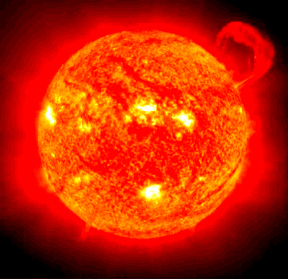
Power output: 3.8 x 10¹⁴ Terrawatts = 3.8 x 10²⁶ W

Slide 3
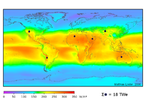
Some numbers
Solar constant (terrestrial orbit) ~ 1.4 kW/m²
Ground level constant ~ 1.0 kW/m²
Correction for UK latitude ~ 600 W/m²
Average over one day ~ 200 W/m²
Correction for UK weather ~ 100W/m²
Near equator in desert (Sahara) ~ 300W/m²
Total electricity supply in the UK at present: ~40 GW
Projected energy supply in the future: ~140 GW
Today’s electricity supply from solar sources requires
At 100 % efficiency within the UK: ~ 400 km²
At 10% efficiency (present level): ~ 4.000 km²
At 100% in desert ~ 134 km²
Projected energy supply in the future requires
At 100 % efficiency within the UK: ~ 1.400 km²
At 100% in Sahara ~ 467 km²
0 50 100 150 200 250 300 350 W/m² ..

Slide 4
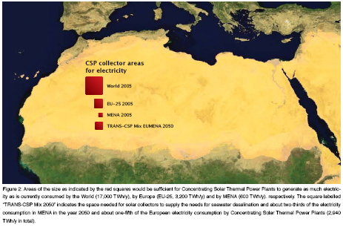
Sa
Source: desertec.org
Problems:
Efficient energy conversion solar energy/energy carrier
Efficient energy transport potentially over large distances
Economy based on energy cycle of renewable carriers

Slide 5
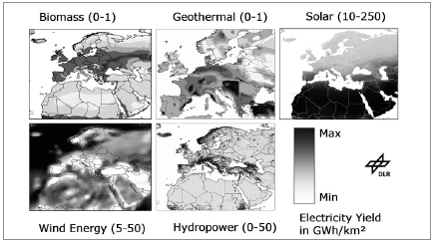
Potential sources of renewable energy
Solar energy by fare the most abundant energy source
Source: German Space Agency DLR

Slide 6
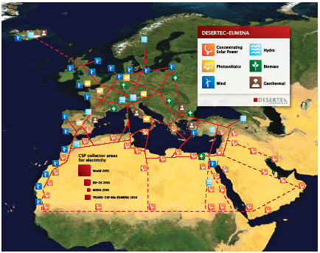
European Energy Network

Slide 7
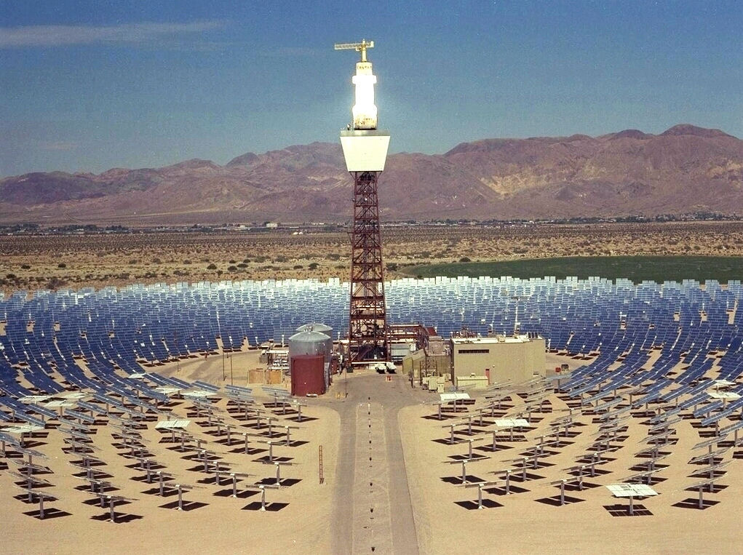
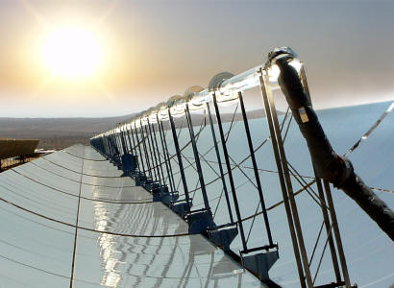
Methods of energy conversion
Concentrating solar power (known as CSP):
Power generation of CSP: about 100 MW/km²

Slide 8
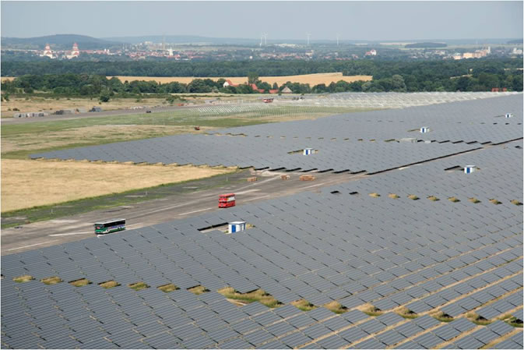
Solid state solar cells
Direct conversion of sunlight into electric power via semiconductor thin films
Image: Photovoltaic power station with a capacity of 40MW in eastern Germany

Slide 9
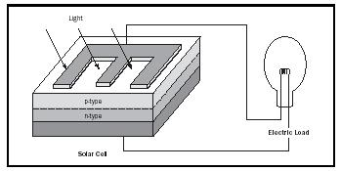
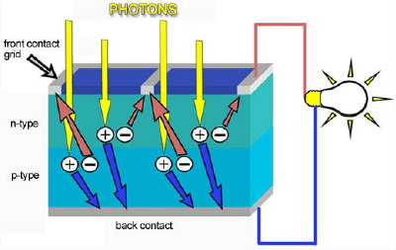
Photovoltaics: the principle (pn junction)
The pn-junction provides an inbuilt potential of about 0.6 – 0.7V, the
excitation of electrons into the conduction band provides the current
Efficiency of semiconductor (Si, CdTe, GaAs) cells: ~ 20%
Notes:
P-doping: with Boron; one bond ansaturated corresponds to a hole
N-doping: with Phosphorus or Arsenic; one electron free as carrier

Slide 10
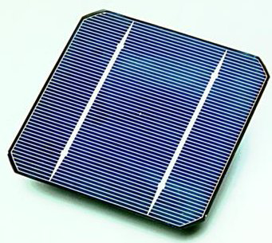
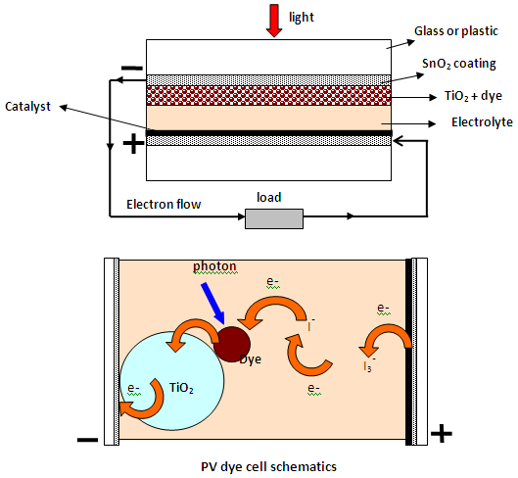
Industrial applications
Polycrystalline semiconductor cells
Dye-sensitized TiO₂ cells
Nature 414, 338 (2001)

Slide 11
Problems of solar cells
Semiconductor solar cells:
Energy balance of production
Cost of production material
Frequency dependence of light adsorption
Dye sensitized cells
Lifetime of dye compounds
Efficiency of cells
Frequency dependence of light adsorption
Bottom line: photovoltaics will not be the
exclusive solution to our energy problems

Slide 12
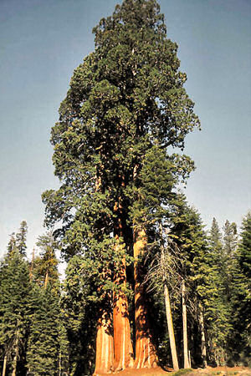
Photosynthesis
Oldest and most ubiquitous method of energy conversion:
Efficiency higher than 50%

Slide 13
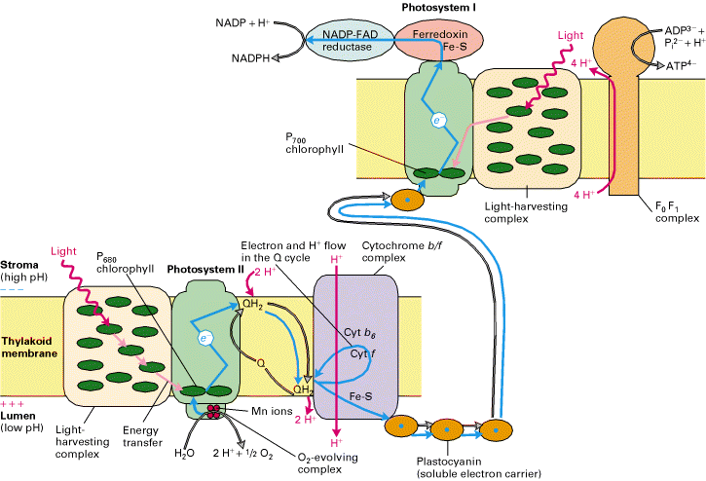
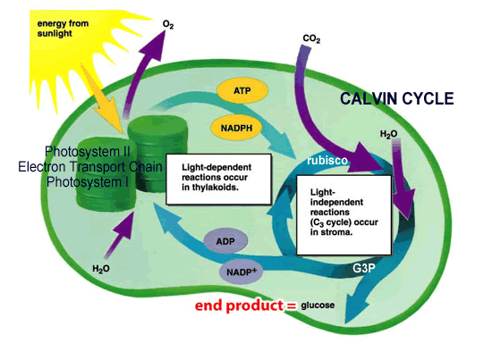
Photosynthesis: the principle
Main ingredients: electron separation and transport
oxidation/reduction of organic compounds
from wikipedia
Notes:
Redox reactions:
Oxidant + e- -> Product
(Gain of electrons) is a reduction (Oxidation number decreases)
Reductant -> Product + e-
(Loss of electrons) is an oxidation (Oxidation number increases)
ATP = Adenosinetriphosphate is the high energy compound with three phosphate groups
ADP = Adenosindiphosphate is the low energy compound with only two phosphate groups

Slide 14
Accelerator Sources of Terahertz Radiation
100
Power of laboratory instruments
At 1 THz ~ 100 μ watts
Courtesy: J. Allen. M. Chamberlain
10
Impatt
III-V's
1
QC Laser
HG
100m
Gunn
Short electron bunches
When bunch length < wavelength
Coherent emission ---> massive output power
Daresbury ERLP/ALICE
Output Power ( Watts )
10m
1m
SLED
100µ
RTD
Lead salts
10µ
RTD array
1µ
.01
.1
1
10
100
1000
Frequency (Terahertz )
Average power ~ 24 mW
Peak power ~ 70 kW

Slide 15
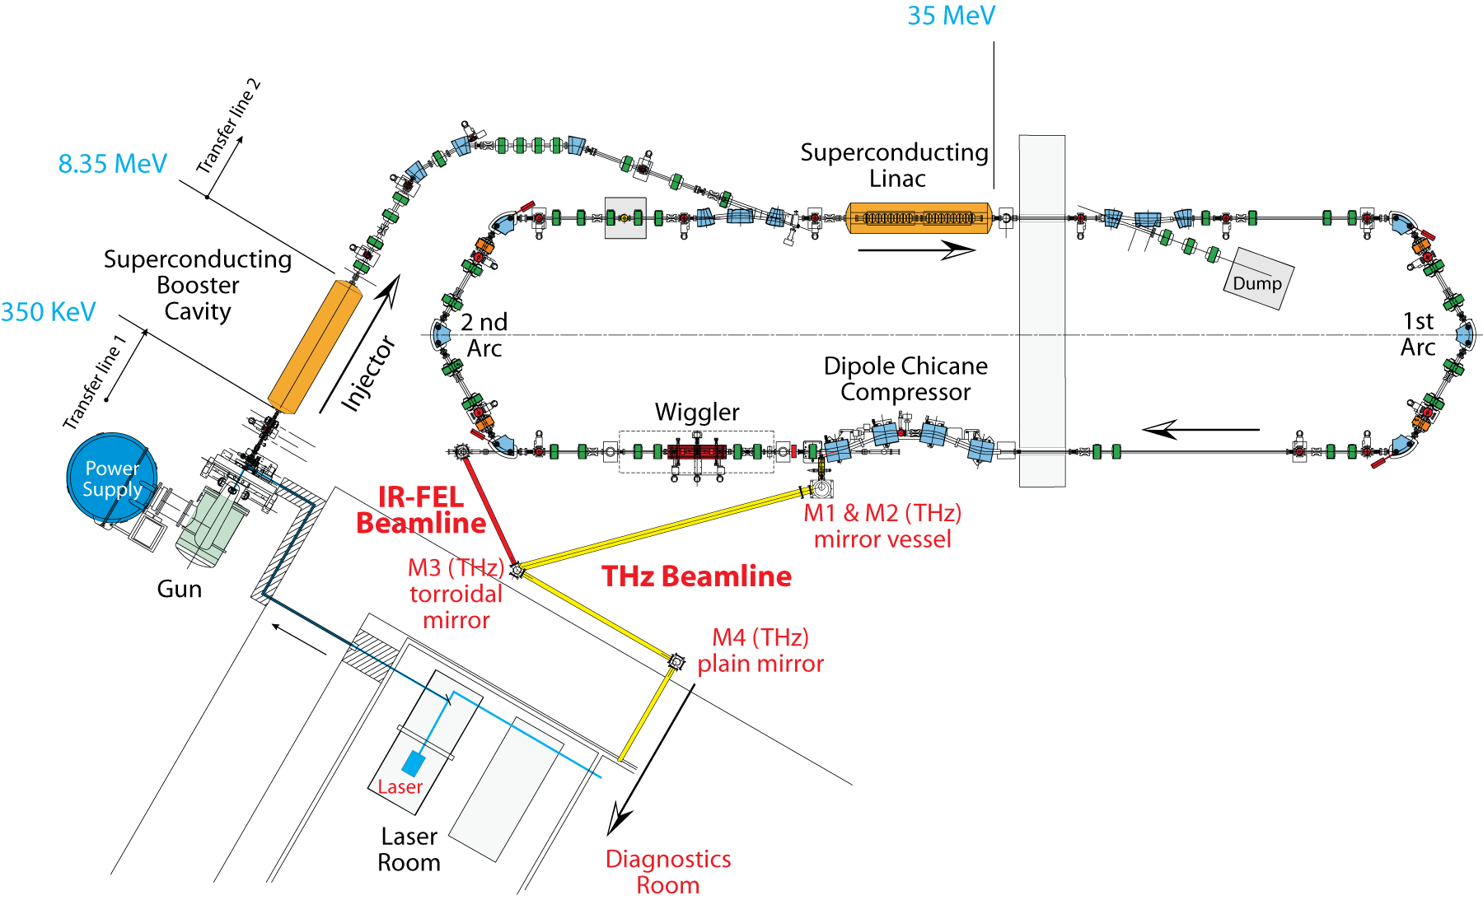
Energy Recovery Linear Accelerator / ALICE
Daresbury
Liverpool
THz beamline
NW Science Fund: Liverpool
The most intense broad band source of THz in Europe and only the 3rd in the world.
5 years under construction now commissioning
Notes:
Describe key elements.
Injection line illustrates the collaborative effort that underpins this challenge: fundamental accelerator physics, RF, laser, magnets, vacuum, controls, electrical, diagnostics, engineering, health and safety,
This is not a simple easy thing to do. World class challenge in its own right.

Slide 16
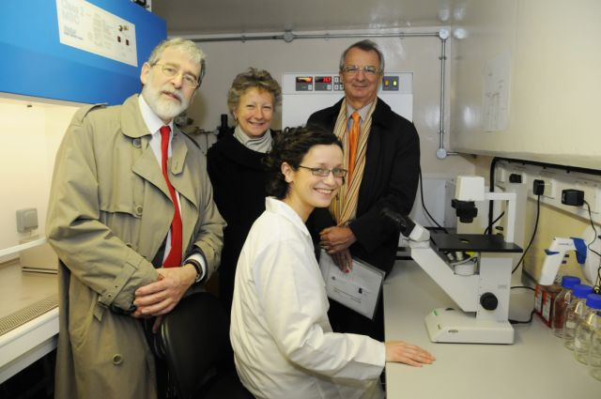
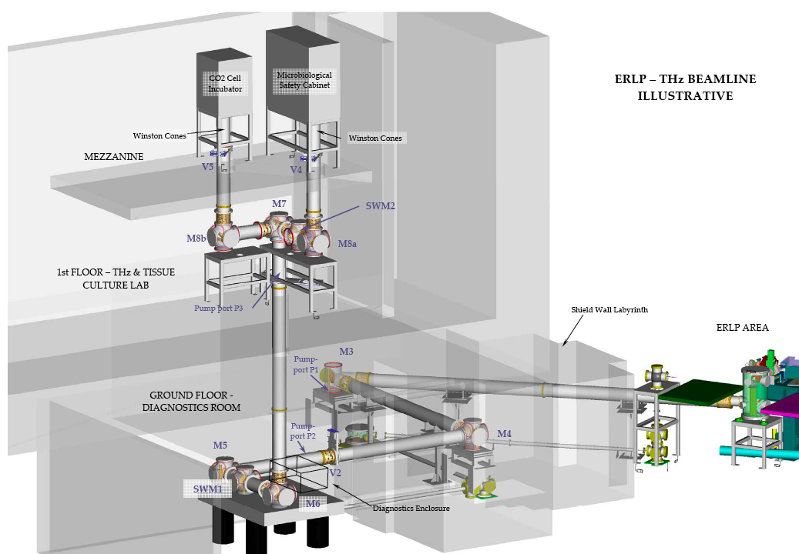
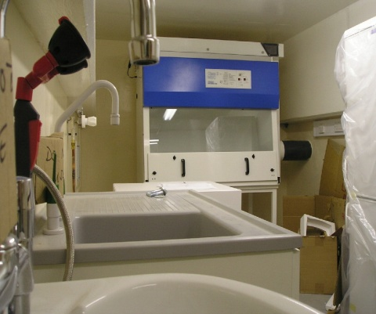
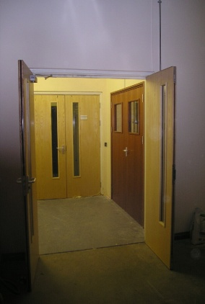
.
.
Liverpool THz Beamline
1st Floor Tissue Culture Facility
Lower level hutch for THz
energy experiments
Beamline funded and
built by physics dept.

Slide 17
Artificial Photosynthesis
Key elements:
A photo receptor, often a metal complex
Function: adsorb photons and release excited electrons
A transducer, often organic ligands
Function: transport electrons from the photo receptor to the catalytic reactor
A catalytic reactor, also often a metal complex
Function: reduce CO₂ to CO, split H₂ from H₂O, or convert CO₂ and H₂O to formic acid HCOOH
The goal is to use sunlight to create high-energy molecules which can then be recombined with other molecules to release the stored chemical energy. The principle is applied in living organisms (bacteria, plants). Harnessing it for technological applications has the potential to create cycles of energy production and consumption, which have no negative impact on the environment.
So why hasn’t this been done already?
Short answer: it turns out to be rather difficult.
But the good news is: we know that it works.

Slide 18
Scheme of a cell for artificial photosynthesis
Antenna
hν
½ H₂O
e-
e-
e-
e-
H⁺
C_{OX}
A
C
D
C_{RED}
C chromophore
A electron acceptor
D electron donor
H⁺ +½ O₂
½ H₂
H⁺
½ H₂O
Surface
H⁺ + ½ CO₂
½ H₂O
Surface
C_{RED}
C_{RED}
Surface
Surface
C_{RED}
C_{OX}
C_{RED}
C_{OX}
½ H₂
H⁺ +½ O₂
½ HCOOH
H⁺ + ¼ O₂
Photoelectrochemical Synthesis Cell (PES Cell)
Photoelectrochemical Synthesis Cell (PES Cell)
Notes:
The diagram illustrates the essential elements in the assembly for artificial photosynthesis and the sequence of events after light is adsorbed. The antenna harvests light or photons which are converted into excited electrons in the conduction band in the chromophore C. The electron is then transferred to the electron transfer donor D, which donates it to the reduction catalyst Cred. At this catalyst the electron is used to convert hydrogen ions to neutral hydrogen. At the oxidation catalyst hydrogen donates an electron to the catalyst which is transferred via the electron transfer acceptor A to the chromophore which is thus again in its groundstate and can excite another electron into the conduction band by photon adsorption.
The principal difficulty in the application of the scheme is the efficiency of converting light to excited electrons, the efficiency of the reduction and oxidation processes, and the necessary cross-linking of reduction and oxidation catalysts for a transfer of H+.
The last difficulty can be partly amended by using a photoelectrochemical synthesis cell, as shown in the two diagrams.
(from J. H. Alstrum-Acevedo et al., Inorganic Chemistry 44, 6802 (2005)

Slide 19
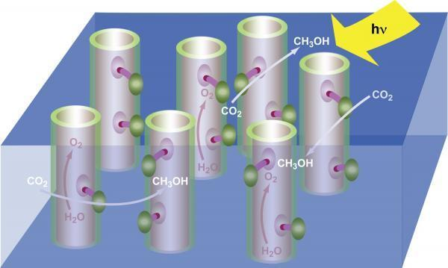
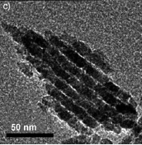
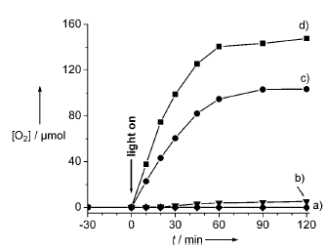
Recent advances
TEM image of the clusters
Oxygen formation
Scheme: nanostructured materials
(here, nanotubes) are used to convert
CO₂ in solution into methanol
First steps: photo-oxidation of water in
Cobalt oxide nanoclusters
F. Jiao and H. Frei, Angewandte Chemie Intl. Ed. 48, 1841 (2009)

Slide 20
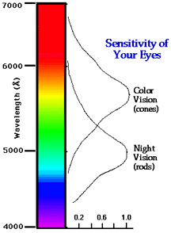
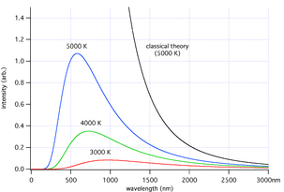
Solar spectrum and material properties
E ~ 1.8 eV
E ~ 3.1 eV
Needed: a semiconductor with a bandgap of less than
1.8 eV and fast carrier transport for charge separation:
metal oxides and/or metal organic compounds

Slide 21
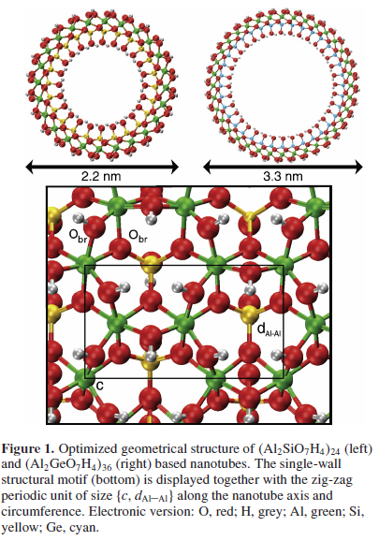
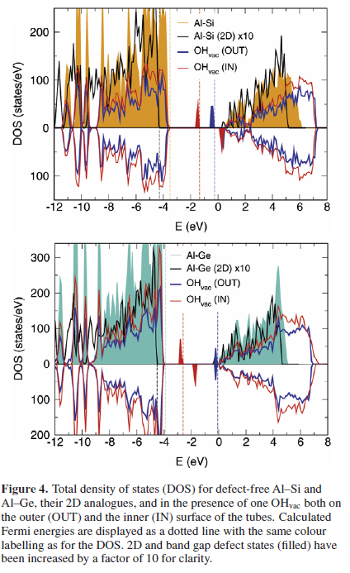
Metal oxide nanotubes: preliminary results
JPCM 21, 195301 (2009)

Slide 22
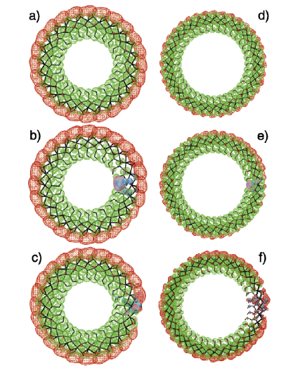
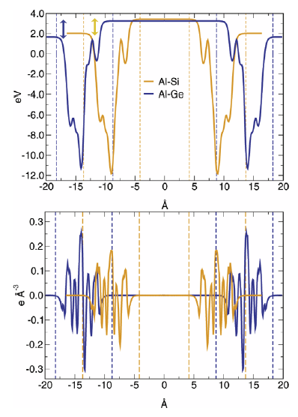
Charge polarization and membrane
Charge separation: green valence band
red conduction band
Electrostatic potential and
Charge density: radial dipole field

Slide 23
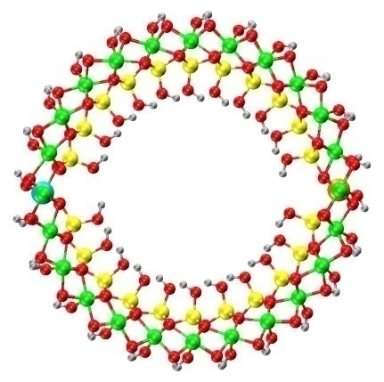
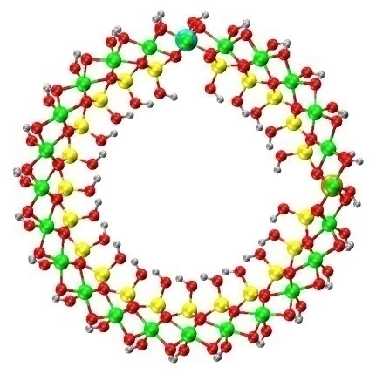
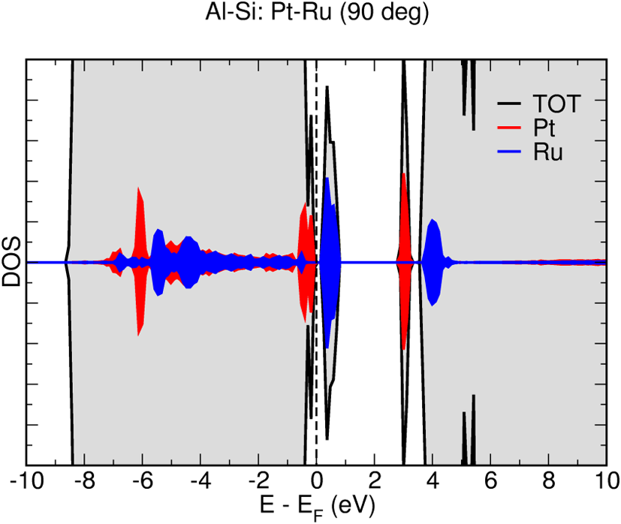
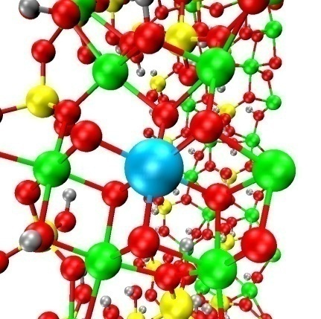
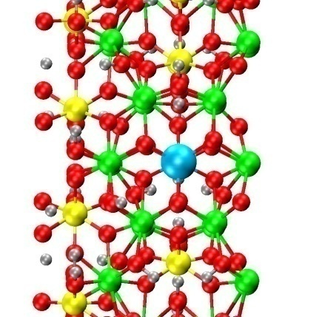
Metallic adsorption and reaction centres
Bandgap for Ru -> Pt less than 2 eV
Dopants: Ru, Pt
Fundamentally new material for photosynthesis applications

