Slide 1
Laplace’s equation in spherical polar coordinates
In this lecture we will:
See how Legendre polynomials arise in the solution of Laplace’s equation in spherical polar coordinates.
Introduce spherical harmonics.
See how spherical harmonics are used in the quantum mechanical description of atoms.
A comprehension question for this lecture:
Prove that the function is a solution of the equation
1

Slide 2
Laplace’s equation in spherical polar coordinates
In spherical polar coordinates, the gradient is:
The divergence is:
Putting them together, we get the Laplacian in spherical polar coordinates:
Setting this expression equal to zero gives us Laplace’s equation in spherical polar coordinates:
Lots of physical potentials are described by this equation and many of them depend on r and θ, but not on φ.
Look for solutions to Laplace’s equation that are independent of φ.
Also assume we can solve by separating variables, i.e. that
2

Slide 3
Solving Laplace’s equation by separating variables
We can then rewrite the equation as:
The only way that a function of r and a function of θ can be equal for all values of r and θ is if they are both equal to the same constant.
Write that constant as (We will see later why this form is chosen!)
We then have:
Two solutions of this equation are:
Prove that is a solution of
3

Slide 4
Solving Laplace’s equation by separating variables
Also: Change variables by setting
This gives:
We then have:
Rearranging:
Differentiating w.r.t. w gives:
This is Legendre’s equation (with l instead of n)!
The solutions of this equation are the Legendre polynomials
The solutions of the Laplace equation (without φ dependence) are therefore:
4

Slide 5
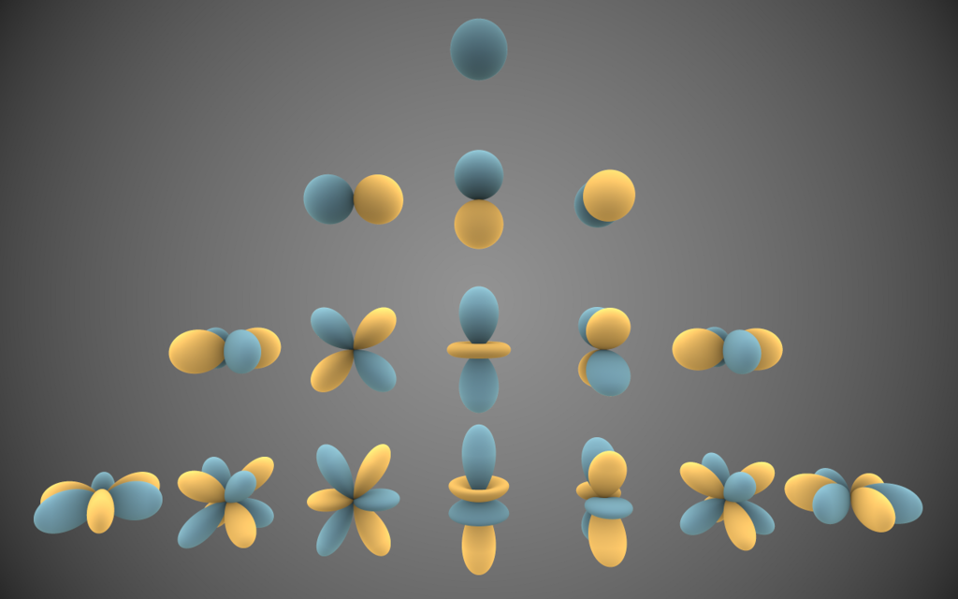
Spherical harmonics
If we allow φ dependence, the Laplace equation can still be solved by separating variables; the angular part of the solution is given by the spherical harmonics:
The picture shows the first few real spherical harmonics
The distance from the origin shows the value of direction, with blue being positive and yellow negative.
Wikimedia
5

Slide 6
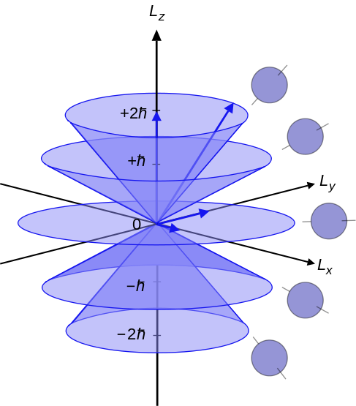
Schrödinger’s equation for an H-like atom
Schrödinger’s equation describing an electron moving around a nucleus is:
The solutions are of the form:
The energy , i.e. it can only take on discrete values.
The value of l is limited by
The magnitude of the orbital angular momentum of the electron is given by
The z component of the orbital angular momentum is given by
The magnetic quantum number m is restricted to the range
Wikimedia
6

Slide 7
Schrödinger’s equation for an H-like atom
The value of n, is called the principal quantum number.
If an electron shifts from an orbit with to one with , it emits (or absorbs) an energy:
As , this means energy is emitted from atoms at particular frequencies/wavelengths.
As the nuclear charge of (and the number of electrons in) an atom influence the energy levels, this gives rise to distinctive spectra which allow atoms to be identified.
Note that, in this solution, the energy is independent of l and m.
The independence of the energy on the magnitude of the angular momentum vanishes when relativistic effects are considered.
These effects introduce fine structure to the spectra.
A further l dependence is also introduced if the atom is placed in a magnetic field, the Zeeman effect.
This latter effect is used in nuclear magnetic resonance spectroscopy (NMR) and magnetic resonance imaging (MRI).
7

