Slide 1
Convolution and convolution theorem
In this lecture we will:
Motivate introduction of convolution by looking at the effect of an RC circuit on a signal.
Look at another example of convolution.
Introduce the (Fourier) convolution theorem.
A comprehension question for this lecture:
Calculate the convolution of the functions:
1

Slide 2
Effect of RC circuit on signal
Consider low pass filter consisting of resistance R and capacitance C.
Current through resistor
Current through capacitor
These must be same, so:
Rewriting:
Solve using integrating factor:
Multiplying through by the IF:
V_{in}
V_{out}
R
C
2

Slide 3
Effect of RC circuit on signal – convolution
Introducing a dummy variable and limits for the integration:
The result of sending a signal V_{in}(t) through the filter with response function is given by the convolution of V_{in} and r:
You will also see this written:
Determine output if
We will set to simplify things!
Integrate by parts once…
3

Slide 4
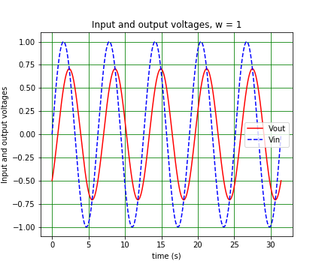
Effect of RC circuit on signal – convolution
Integrate by parts again:
Hence:
4

Slide 5
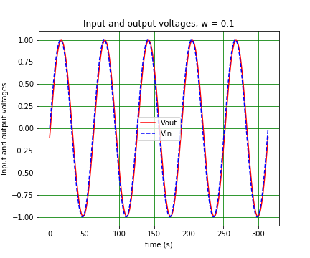
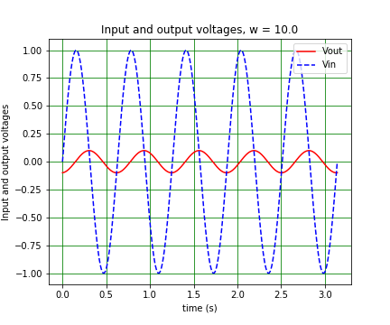
Effect of RC circuit on signal – convolution
Look at response of circuit at low and high frequencies:
See amplitude change, but also in V_{in} and V_{out} in phase for ω << 1, V_{out} lags behind V_{in} by π/4 for ω = 1 and by π/2 for ω >> 1.
5

Slide 6
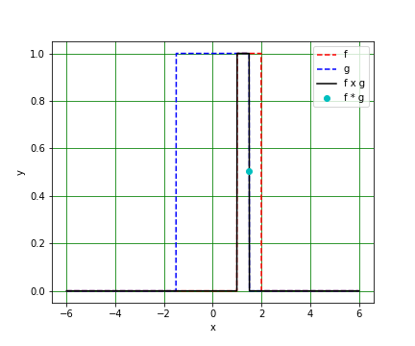
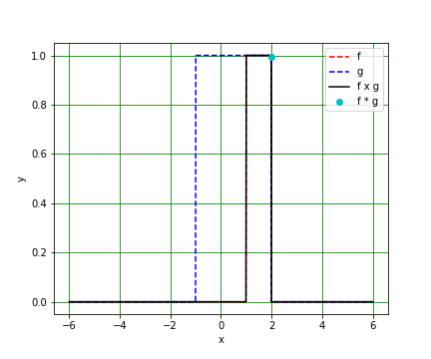
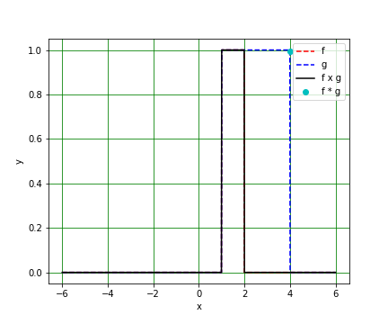
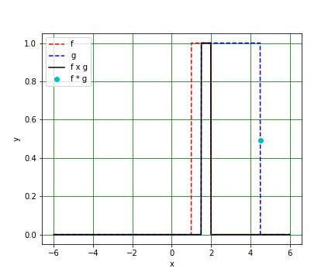
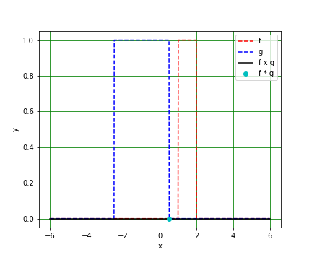
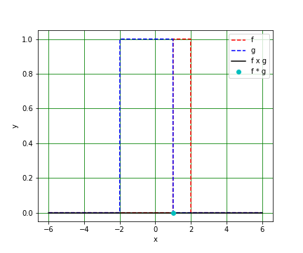
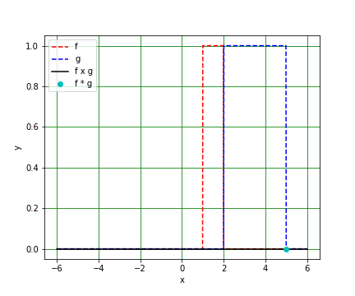
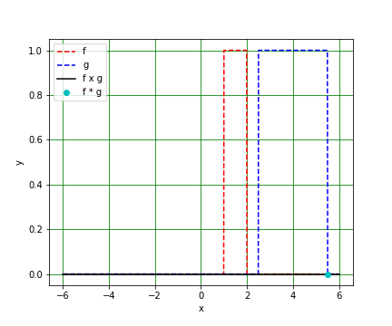
Convolution example
Look at functions:
And their convolution:
For x = 0.5, 1, 1.5, 2, 4, 4.5, 5, 5.5, we have (L to R, top to bottom):
6

Slide 7
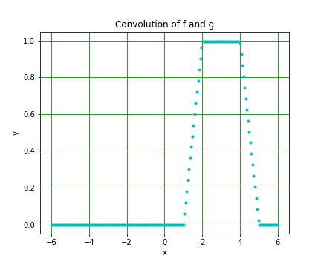
Convolution example
Convolution theorem
The value of at a given x is the overlapping area of f and g
Putting the graphs on the previous slide together, is:
If is the Fourier Transform of f and that of g, then:
Using the inverse Fourier Transform, we can write:
7

