Slide 1
Fourier transforms
In this lecture we will:
See how Fourier series can be written in exponential form.
Introduce Fourier transforms.
Look at some examples to try and gain a little insight into the Fourier transform.
A comprehension question for this lecture:
Show that the Fourier transform of the function: is
1

Slide 2
Fourier series using exponentials
The “standard” formulae for finding Fourier coefficients are:
Now
…so could re-write the formulae as:
These contain the same information as the standard formulation:
2

Slide 3
Fourier series using exponentials
Using this formulation, the Fourier series representation of the function becomes:
This gives us the required result because:
We can go one step further…
3

Slide 4
Fourier series using exponentials
Allow negative values of n.
We then see that, because cosine is even and sine odd, we get coefficients such that:
We can then write our function as:
The factor of ½ is needed as all terms appear twice (once with negative and once with positive n), except for the case where n = 0.
This also allows us to use the same formula to determine w₀ as all the other coefficients, so:
Note that
(We may have to fix the w₀ calc. by hand if n appears in the denominator, as in the case of the square wave.)
This will make it easier to see the relationship between the Fourier series and the Fourier transform.
First, check it all works for the square wave (with “fix” for w₀!).
4

Slide 5
Fourier series using exponentials
Square wave, top using exponential, bottom using standard Fourier series (both with 20 terms).
Plot the coeffs w_{n} as a function of n.
The real part (a_{n}) is shown as blue dots and the imaginary part (b_{n}) as red stars:
The b_{n} are all zero, as correspond to sine (odd) terms and function is even.
5

Slide 6
Fourier series and transforms
Fourier series can describe periodic functions (e.g. square wave).
If need to describe single pulse (e.g. “top hat”), need to move from using cosines and sines with frequencies 0, f, 2f, 3f… to using full frequency spectrum.
Make f continuous, so (schematically):
Square wave:
Top hat:
6

Slide 7
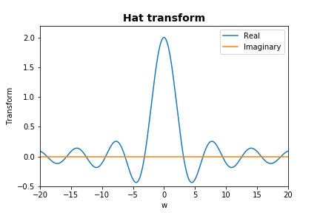
Fourier series and transforms
Conventional notation, is that Fourier transform of a function f(x) is written:
And the original function can be represented using:
Look at an example, the top hat.
This can be simplified:
7

Slide 8
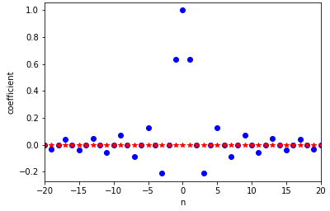
Fourier series and transforms
Now use the transform to represent the original function:
Representation not perfect, because integration range reduced, equivalent to taking only first terms in the Fourier series.
Fourier coefficients for square wave:
Fourier transform for top hat:
a_{n}
b_{n}
8

Slide 9
Using Fourier transforms
Similar example as for Fourier series.
How does an electronic pulse respond to passage through a high- or low-pass filter?
Describe the pulse using a Fourier transform.
Apply the frequency dependent function (filter) and evaluate the inverse Fourier transform.
E.g. for low-pass filters, reduce range of integration
Input:
Output:
9

Slide 10
Using Fourier transforms
For high-pass filter, omit central region of integration:
For other filters, multiply transform by function that represents required effect.
Input:
Output:
10

