Slide 1
Filters and forced oscillations – Fourier series in physics
In this lecture we will:
See a practical use of Fourier series in analysing electronic circuits.
See again how 2nd order differential equations can arise in physical situations such as the motion of masses on springs.
Examine the case of periodic (but not sinusoidal) “forcing terms” and see how to deal with them using Fourier series.
Do an example.
A comprehension question for this lecture:
Deduce as much as you can about the coefficients in the Fourier series for the following function:
Compare your guesses with the true values.
1

Slide 2
Fourier series in practical physics
Suppose we have two electronic circuits that only let through signals in certain frequency ranges:
f < f_{top} (a “low-pass” filter).
f > f_{bot} (a “high-pass” filter).
What will we see if we send a square wave signal through these circuits?
Input:
Represent as a Fourier series.
Have shown that:
First few terms:
2

Slide 3
Why use Fourier Series?
If add up first 20 terms get reasonable representation of input:
What do we get if we pass this signal through our low- and high-pass filters?
Find out by applying effect of circuit to sine and cosine terms that make up input, then adding them up again.
Low-pass (cut off terms above tenth):
High-pass (remove terms below fourth):
3

Slide 4
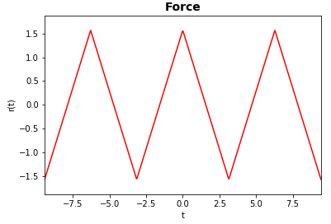
Forced oscillations
Consider a mass m attached to a spring with spring constant k.
The force on the mass, at distance y from equilibrium, is
Newton’s second law relates the force to the acceleration,
Hence
Now assume that an external force r(t) is also applied to the mass.
Then:
We have seen how to solve this if r(t) is something like
What if r(t) is a more complicated periodic function?
Can solve by representing r(t) as a Fourier series.
An example:
4

Slide 5
Forced oscillations
First compute the Fourier series for r(t).
Only cosine terms (even function), a₀ is zero (average of r(t)) and
Hence:
Now is 2 if n is odd and zero if n is even, so:
The term in cos nt in the series for r(t) is:
5

Slide 6
Forced oscillations
Look at the original equation for this cos nt term:
The particular integral is of the form:
Equating coefficients gives:
Since the complete force term is the sum of the full particular integral y_{p} will be the sum of terms y₁, y₃, y₅…
That is:
The solution of the homogeneous equation is:
The full solution is :
6

Slide 7
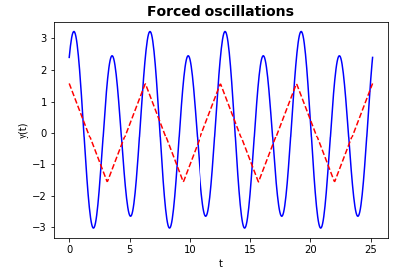
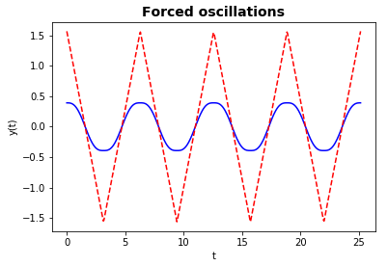
Forced oscillations
We see the force term excites a spectrum of oscillations with amplitudes that decrease with frequency.
There is no friction; initial conditions influence the oscillations for all t.
If motion due to force only:
Motion including component due to a particular initial position and velocity.
Friction would cause component due to initial motion to die out, leaving only that due to the force.
7

Slide 8
Resonance
What happens if we change the spring constant?
If the chosen value means that the natural frequency of the system is the same as one of the frequencies in the force term, resonance occurs.
E.g. pick
Then
In the particular integral, we now have to change to as y_{c} already contains cos 5t and sin 5t terms.
We can see this frequency component (“mode”) has an amplitude that grows with time, there is a “resonance”.
If there is no (or only little) friction, the resonant mode can become very large: the results can be quite interesting!
Tacoma narrows bridge collapse.
8

