Slide 1
Fourier series
In this lecture we will:
See how to represent general periodic functions using Fourier series.
Look some more at odd and even functions.
Do some more examples.
A comprehension question for this lecture:
Work out the Fourier series that describes the function:
1

Slide 2
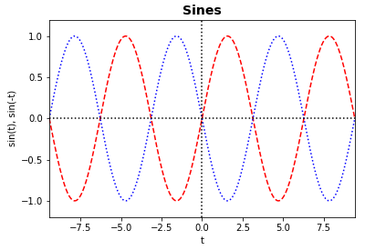
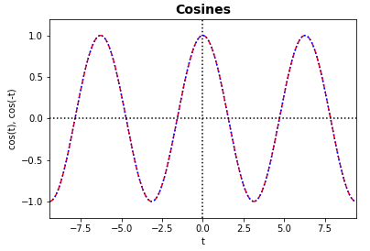
Functions with general period
Odd and even functions
To represent a function with period T, we must scale the result derived for functions with period 2π.
The coefficients are found using:
Odd function, e.g. sine:
Even function, e.g. cosine:
2

Slide 3
Odd and even functions
The integral of an odd function over a symmetric range [– T/2, T/2] is zero.
“Obvious” from graph, but prove it!
Put in first integral.
Hence:
If an even function, f(t), is multiplied by an odd function, sine, the result is an odd function.
Hence:
Similarly, for an odd function g(t):
3

Slide 4
Odd and even functions
Sawtooth function
The integrals used to determine the Fourier coefficients can be simplified if the integrand is even, e.g. for an even function f(t):
Even functions can be written:
And odd functions:
The sawtooth function is:
Here,
Calculate the Fourier coefficients.
f(t) is odd, so a₀ and all a_{n} are zero.
Must calculate b_{n}, but can use fact that integrand is even (product of two odd functions):
4

Slide 5
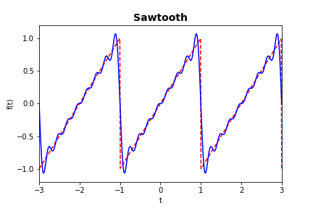
Sawtooth function
So:
5

