Slide 1
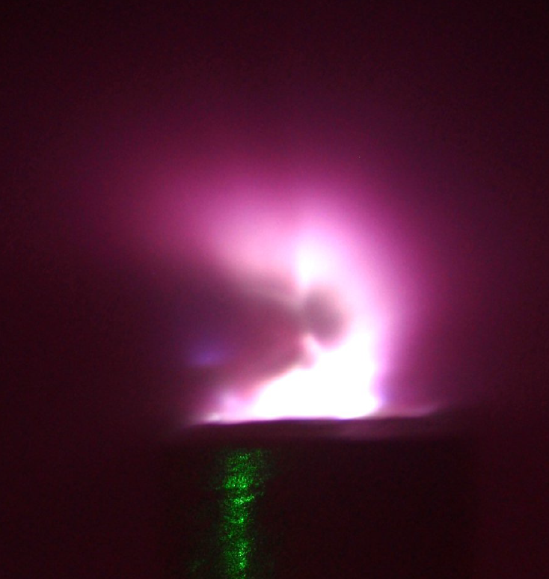
Laser-hybrid accelerator for radiobiology (LhARA)
Cancer and radiotherapy
Comparison of X-ray and ion therapy
Ion therapy challenges
  Radiobiology
  Accelerator
LhARA stage 1
  Laser source
  Capture and focussing of beam
  End station experiments
LhARA stage 2
  FFAGs
Summary

Slide 2
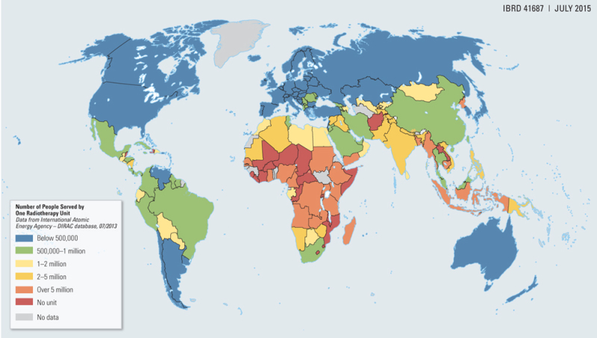
Cancer and radiotherapy
Globally, one in 5 men and one in 6 women develop cancer during their lifetime (WHO – 2018).
Radiotherapy indicated in about 50% of cases.
One in 8 men and one in 11 women die from the disease.
Provision of treatment on the necessary scale requires
development of new
techniques…
….And will generate substantial economic impact.
Number of people served by one radiotherapy unit:
2

Slide 3

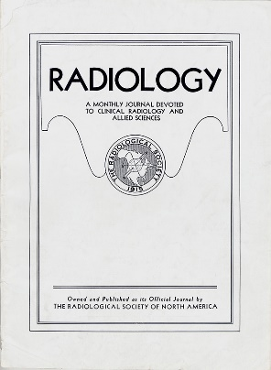
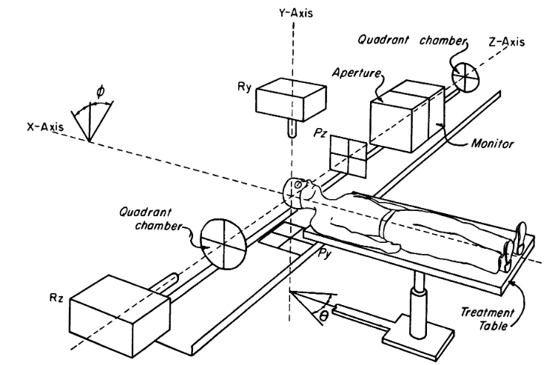
Proton and ion therapy
Proton therapy first proposed in “Radiological Use of Fast Protons”, R.R. Wilson, Radiology 47:487-491, 1946.
Robert Wilson was involved in the Manhattan Project, was a sculptor, architect and the first director of Fermilab.
First patients1954 at LBNL.
“Pituitary irradiation with high-energy proton beams: a preliminary report.” C. A. Tobias et al. Cancer Res. 18(2):121-34, 1958.
3

Slide 4
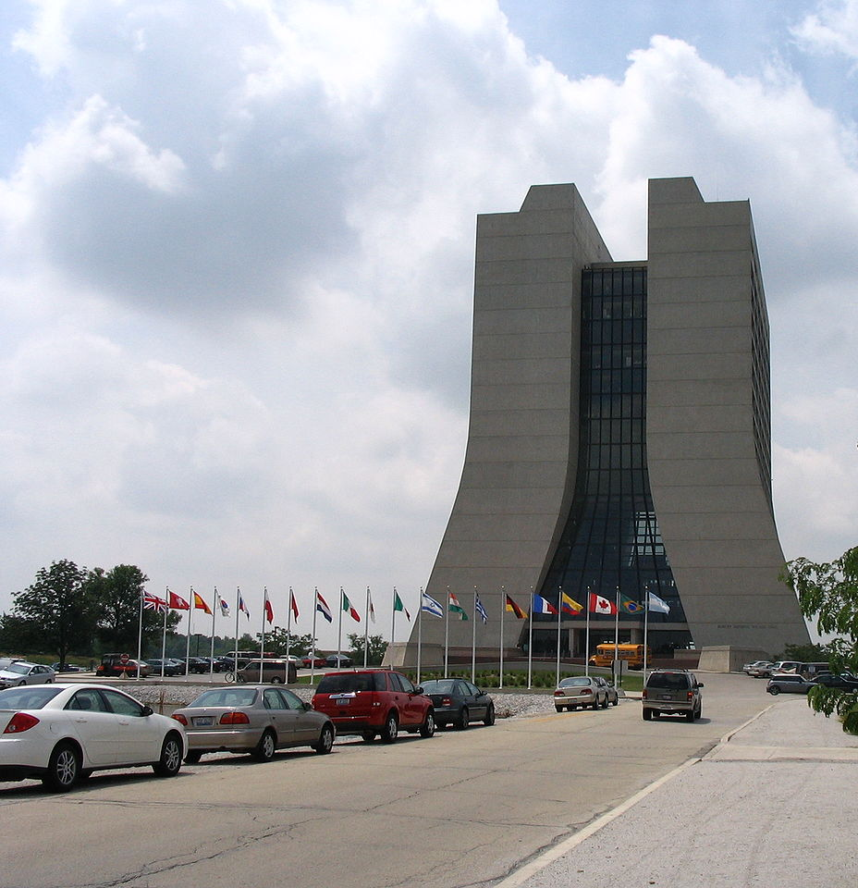
An aside
When called to justify the cost of Fermilab to a congressional committee, Wilson said:
“It only has to do with the respect with which we regard one another, the dignity of men, our love of culture... It has to do with: Are we good painters, good sculptors, great poets? I mean all the things that we really venerate and honor in our country and are patriotic about. In that sense, this new knowledge has all to do with honor and country but it has nothing to do directly with defending our country except to help make it worth defending.”
4

Slide 5
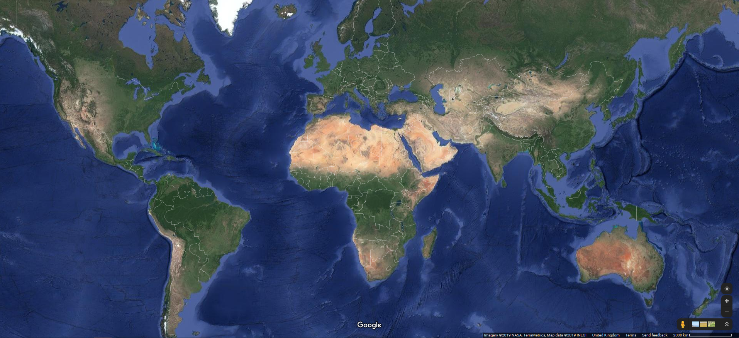
Proton and ion therapy
Existing proton and carbon beam treatment facilities:
In contrast, well over 10 000 linacs used for X-ray therapy.
Compact, (relatively) cheap, can be installed in most hospitals.
1
1
4
1
3
3
6
2
1
1
3
1
1
1
33
3
1
6
2
3
2
14
1
1
Proton beam facility(83 total)
1
Carbon ion facility(13 total)
5

Slide 6
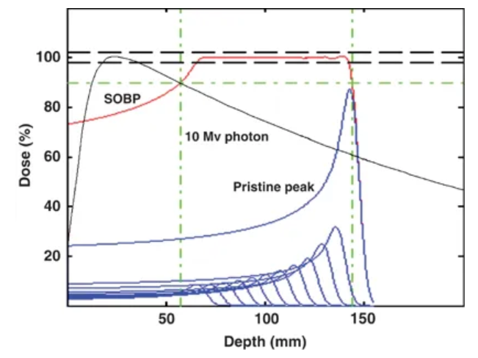
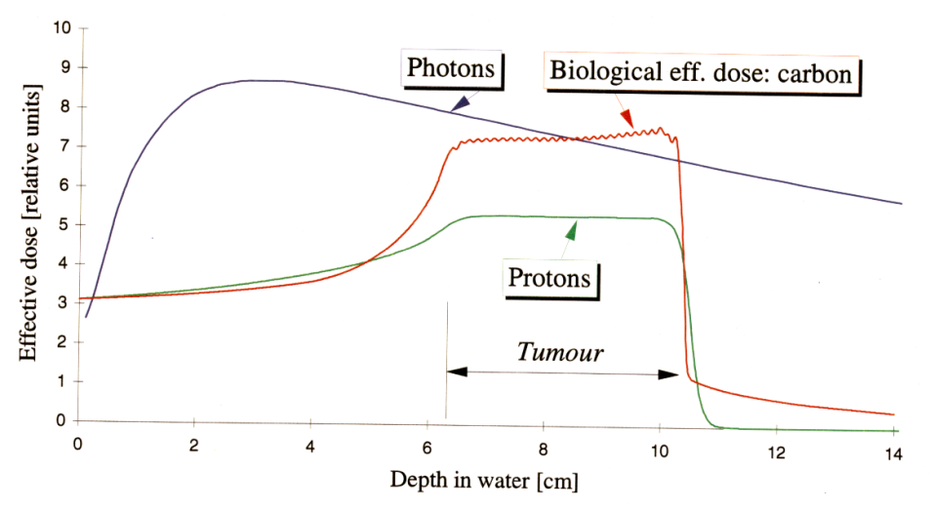
X-ray and ion therapy
Ion therapy has advantages over X-rays due to energy loss mechanisms for photons and ions in material.
Get exponential dose depth profile for photons, “Bragg peak” for ions:
Clinical treatments use a Spread Out Bragg Peak (SOBP) to conform dose over the length of the tumour.
Carbon ions have a better dose profile in front of the tumour than protons, though fragmentation creates a distal tail.
Levin et al. “Proton beam therapy” British Journal of Cancer volume 93, pages 849–854 (2005).
6

Slide 7
X-ray and ion therapy
Volumetric Modulated Arc Therapy (VMAT) therapy delivers X-ray dose conformal to tumour by modulating beam while rotating around patient.
Here for prostate cancer patient:
Minimises dose to surrounding tissues.
Compare with dose distribution from four-beam intensity modulated treatment plan using protons:
Allows reduced dose to critical tissues, here, bowel and spine.
7

Slide 8

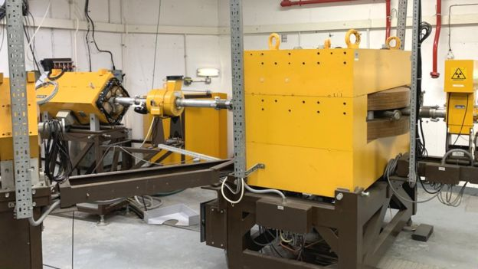
Proton therapy in the UK
Douglas Cyclotron at Clatterbridge produces 60 MeV protons.
Originally designed to provide fast neutron therapy for trials of radio-resistant tumour treatment.
Total of 384 patients treated with neutrons until 1995.
Now used solely for proton therapy of eye tumours.
About 450 diagnosed in the UK each year, 40% of patients referred for proton-beam radiotherapy.
Age of eye patients from 9 to 92 years, average about 50 years.
Some beam time for research.
8

Slide 9
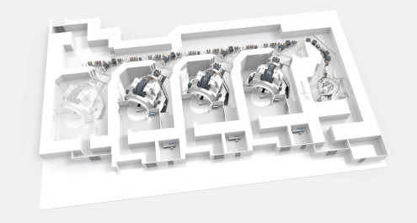
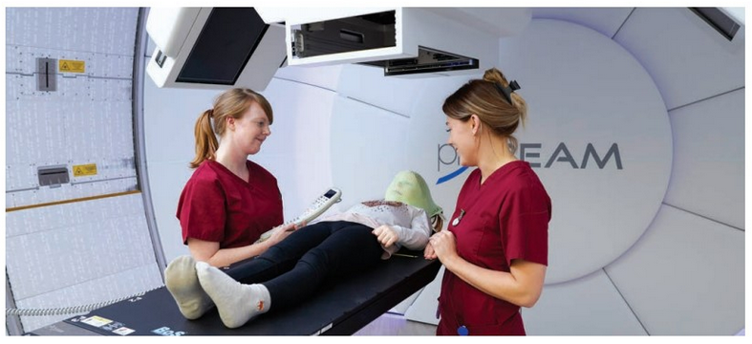
Proton therapy in the UK
Two new NHS centres, each to treat about 750 patients per annum.
Use cyclotrons, producing 230 MeV proton beam (range 33 cm in water).
Carbon absorbers can reduce energy to 70 MeV.
One centre, Christie NHS Foundation Trust (Manchester), opened in 2018:
Second centre, University College London Hospital NHS Foundation Trust, due to open in 2020:
Also Rutherford Cancer Centre machines in Newport, Bedlington and Reading, and one under construction in Liverpool.
All 230 MeV cyclotrons.
9

Slide 10
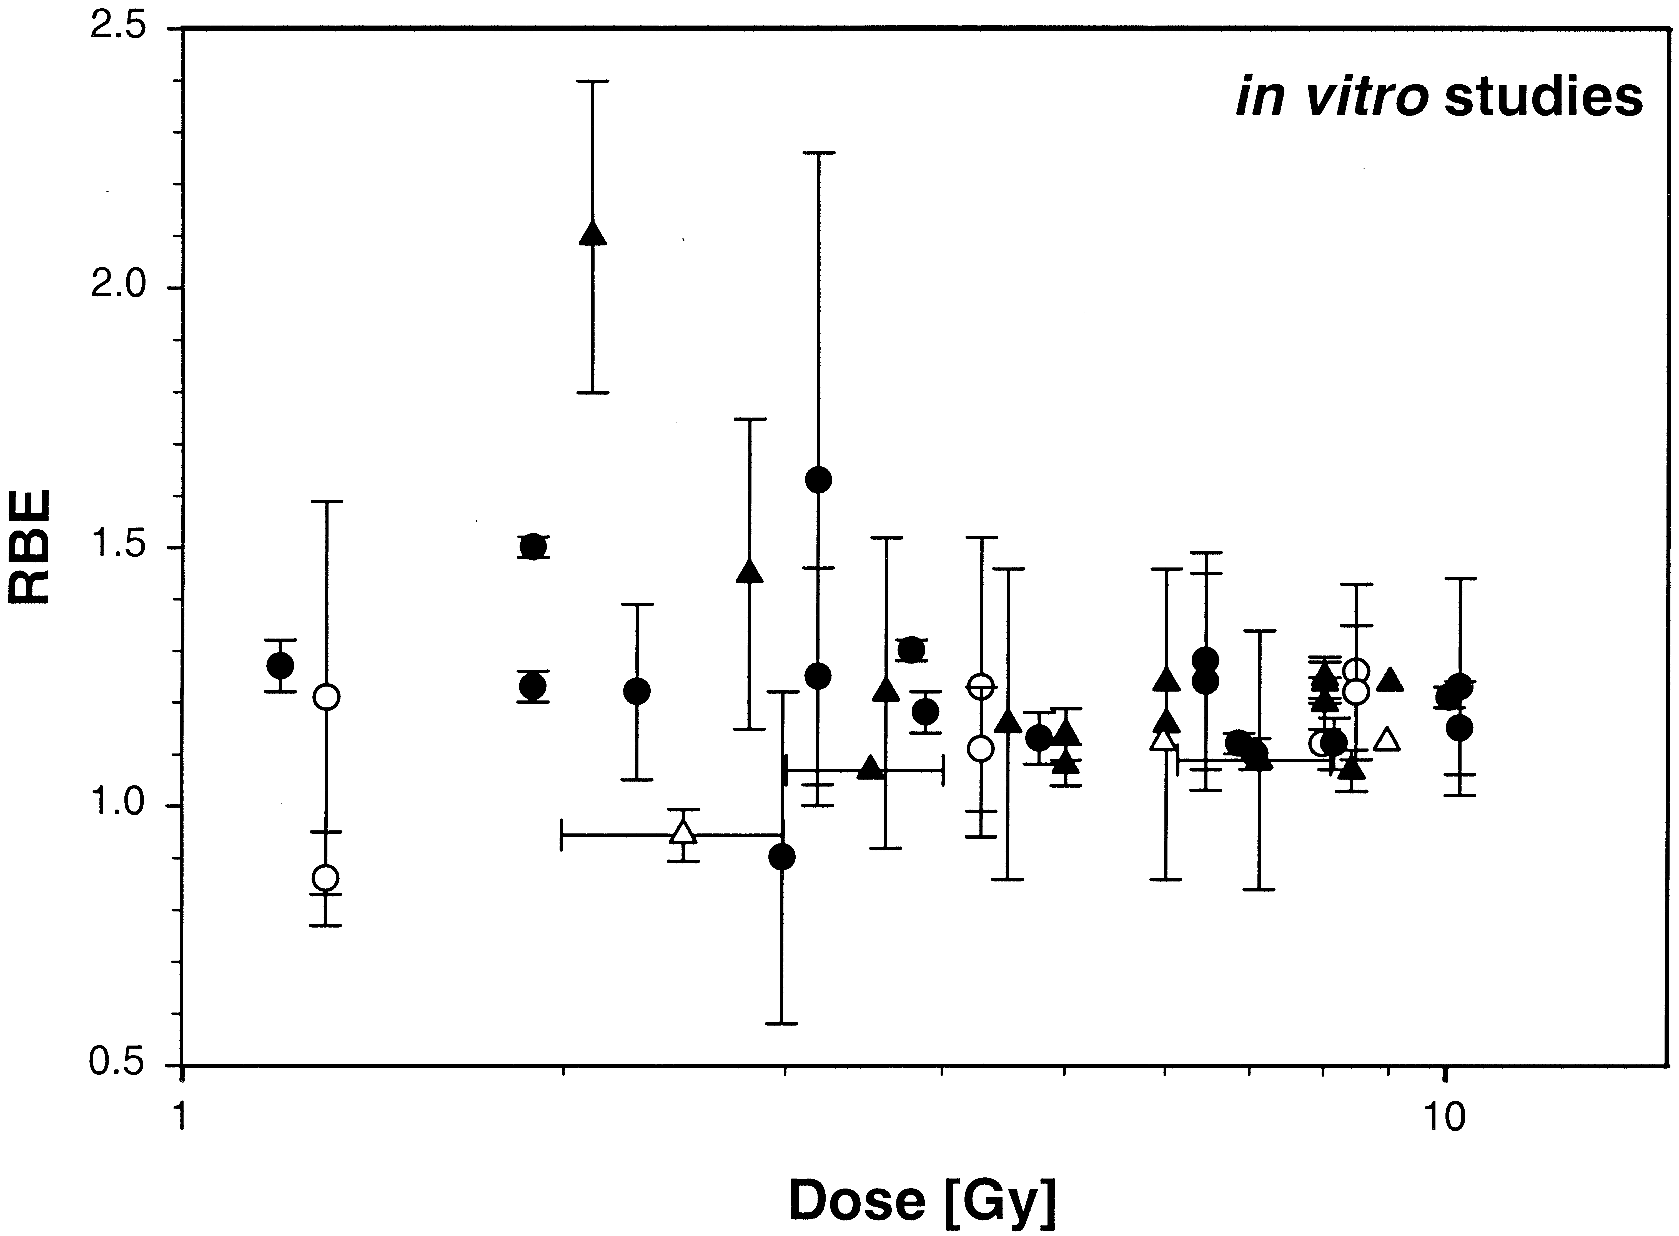
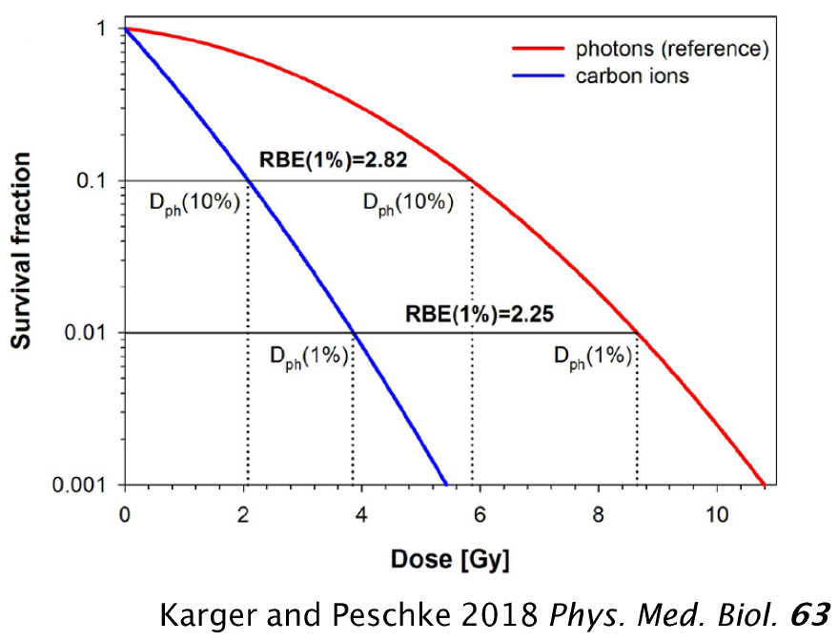
Ion therapy challenges – radiobiology
Biological effects of a given dose of radiation (energy deposited per kg, units Gy) depend on the type of radiation (and other factors).
Radiobiological effectiveness (RBE) is ratio of effectiveness w.r.t. photons.
Typically, constant RBE = 1.1 used for planning proton therapy.
For carbon ions, RBE typically above about 2.25.
Systematic studies needed to improve data and understanding of underlying radiation damage mechanisms.
Important for planning of proton and ion treatments.
Experimental proton RBE values relative to ⁶⁰Co.
Paganetti H et al. 2002 Relative biological effectiveness (RBE) values for proton beam therapy Int. J. Radiat. Oncol. Biol. Phys. 53 407–21
10

Slide 11
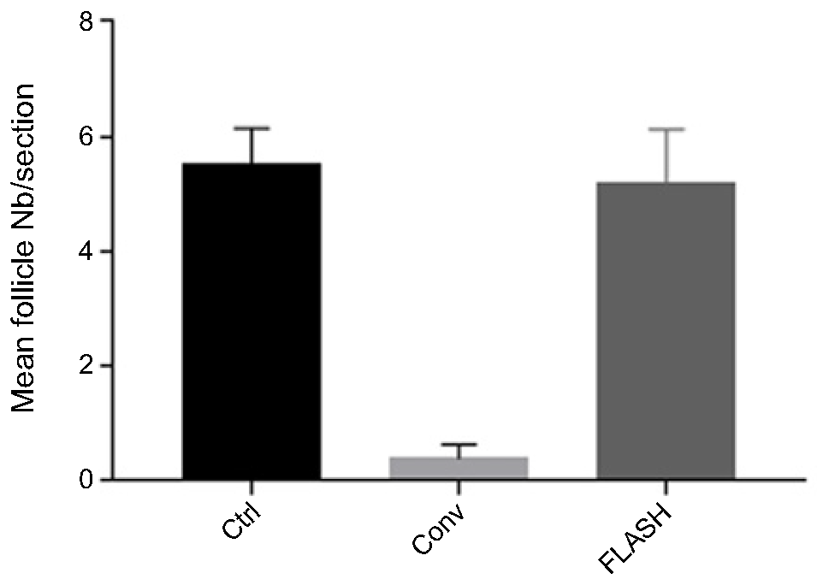
Ion therapy challenges – radiobiology
Need for better understanding illustrated by efficacy of Ultrahigh Dose-rate (FLASH) radiotherapy.
Conventional treatment, dose rate typically a few Gy/min.
Flash treatments, dose rates above 100 Gy/s.
Efficacy higher for a given dose.
Evidence that normal tissue sparing is also improved, e.g. “The Advantage of FLASH Radiotherapy Confirmed in Mini-pig and Cat-cancer Patients.” Vozenin et al. Clin. Cancer Res. 2019 Jan 1;25(1):35-42.
Microbeam radiation therapy showing similarly interesting results.
Thirty-six weeks postradiotherapy, quantification of hair follicles per tissue section performed on sections cut from
6-mm punch biopsies taken from nonirradiated, Conv-RT, and FLASH-RT patches (data are presented as number of hair follicles per tissue section).
11

Slide 12
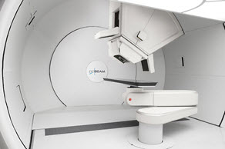
Ion therapy challenges – accelerator
Cyclotrons deliver beams at final, single energy.
Degraders used to decrease beam energy, cause scattering, produce radiation.
Low energy injection of cyclotrons limits beam current due to space charge.
Cyclotrons one ion species.
Synchrotrons can accelerate multiple ion species but larger and more costly.
Gantries, significant cost of the accelerator facility.
MedAustron p and C synchrotron:
Varian proton gantry:
12

Slide 13
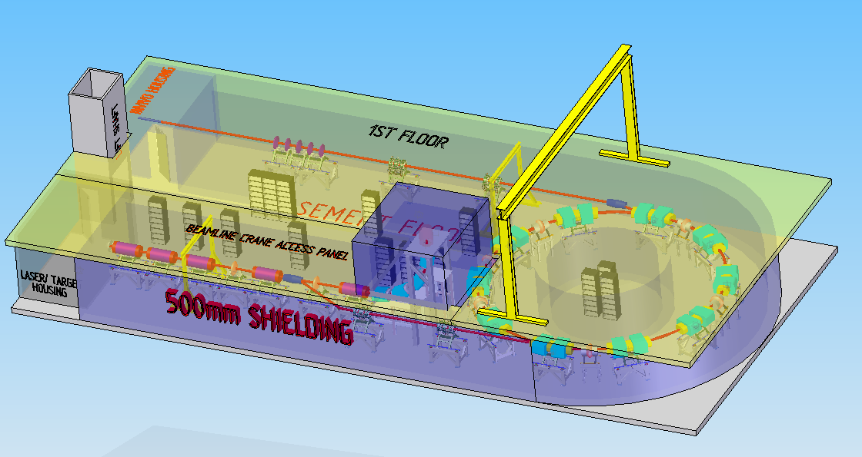
LhARA
Radiobiology research facility.
Initial acceleration laser driven.
Gives large flux of protons and ions in very short bunches.
Compact capture system.
Injection at 15 MeV overcomes space charge limitations.
Allows large instantaneous doses.
Implementation in two stages.
  In vitro studies, 15 MeV protons.
  In vivo studies, 127 MeV protons, in vitro studies with 33 MeV/u carbon 6+ ions.
Groups involved:
13

Slide 14
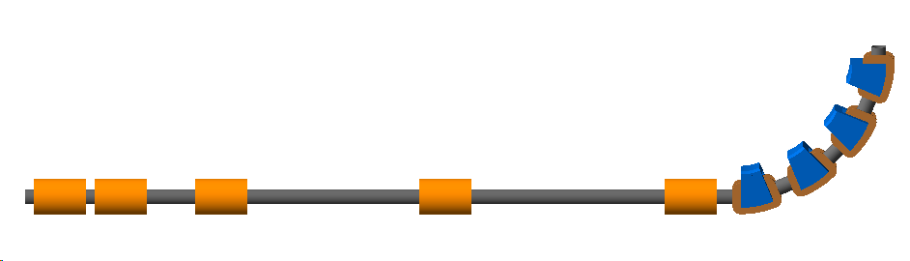


LhARA stage 1
Facility for irradiating cell samples.
END STATION
Where the cells are irradiated. The beam is delivered vertically from below the cell culture plate.
LASER TARGET
Laser used to generate intense beams of different types of ions, e.g. protons and carbon ions.
beam
ENERGY SELECTION
A Gabor lens and a collimator are used to select particle energy.
y
z
2.55 m
45$°$
laser
11.58 m
CAPTURE SECTION
Gabor lenses used for compact focussing to capture the large divergence and energy spread of the laser-driven ion beam.
MATCHING
Further Gabor lenses are used to adjust the beam size and divergence in the end station.
90$°$ VERTICAL BEND
Combined function magnets deliver the beam vertically to the end station.
14

Slide 15
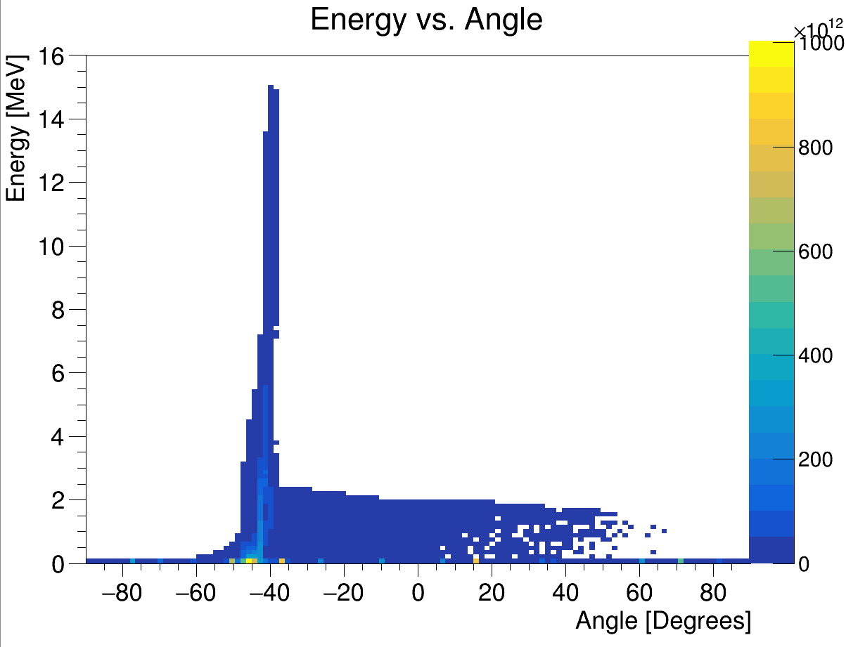
Laser source
Target normal sheath acceleration mechanism.
Protons from (hydrocarbon) contamination on foil surface.
Produces large flux of ions in pulse of ~ 30 fs duration.
Kinetic energy up to 15 MeV.
Energy vs angle with respect to laser beam direction
Laser driven ion beam simulation using EPOCH.
15

Slide 16
Capture and focussing of beam from source
Initial beam has small size, large divergence, large energy spread.
Capture and focussing difficult.
Approaches include magnetic systems based around:
  Quadrupole magnets.
  SC solenoidal magnet.
  Pulsed solenoidal magnet.
Here, propose to use Gabor lenses.
Principle of Gabor lens:
Electron cloud confined axially by anode (red) and grounded electrodes (black).
Radial confinement produced by magnetic field.
Space charge due to electron cloud focusses protons.
R_{A} ~ 20 mm, R_{C} ~ 10 mm, L ~ 0.5 m.
V_{A} ~ 600 kV, B_{Z} ~ 0.3 T.
16

Slide 17
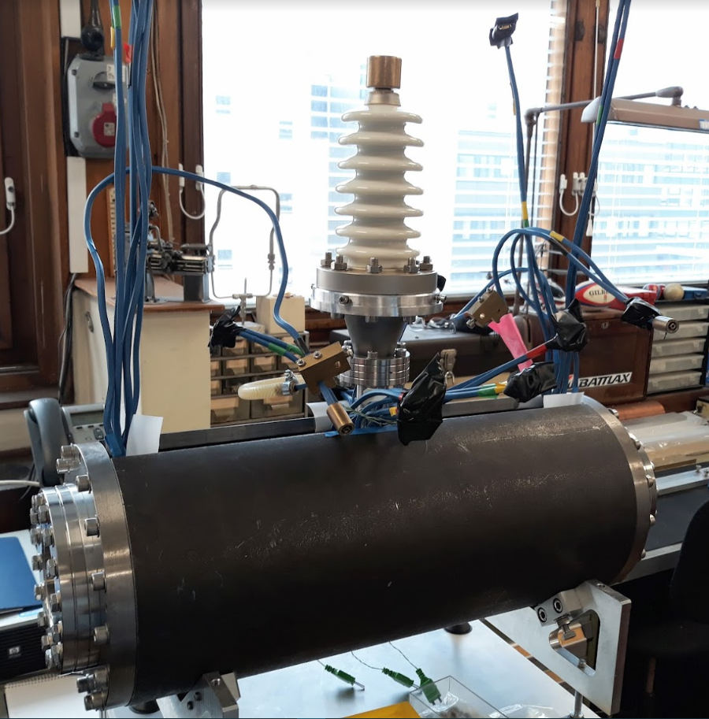
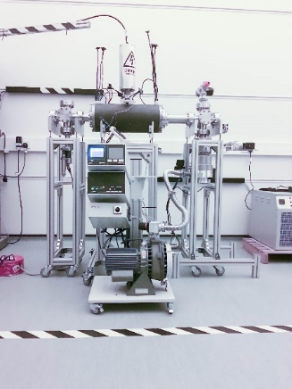
Capture and focussing of beam from source
Prototype Gabor lens constructed at Imperial College:
Initial measurements with prototype using 1 MeV proton beam at Surrey Ion Beam Centre.
Gabor lens
design
being
updated at
Imperial.
Next steps:
Vacuum
tests.
Tests with
radioactive
source.
Tests with the laser driven ion beam.
17

Slide 18
Capture and focussing of beam from source
Example of section of Gabor lens lattice:
Lens 1: Capture large fraction of particles, reduce divergence angle.
Lens 2: Focus beam into aperture for energy separation.
Lens 3: Deliver beam to lenses and magnets of end-station section.
18

Slide 19
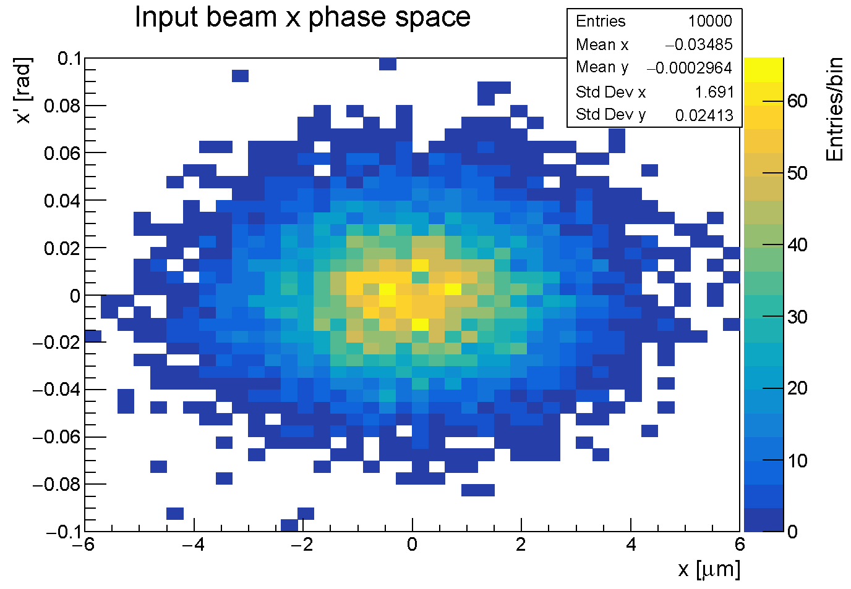
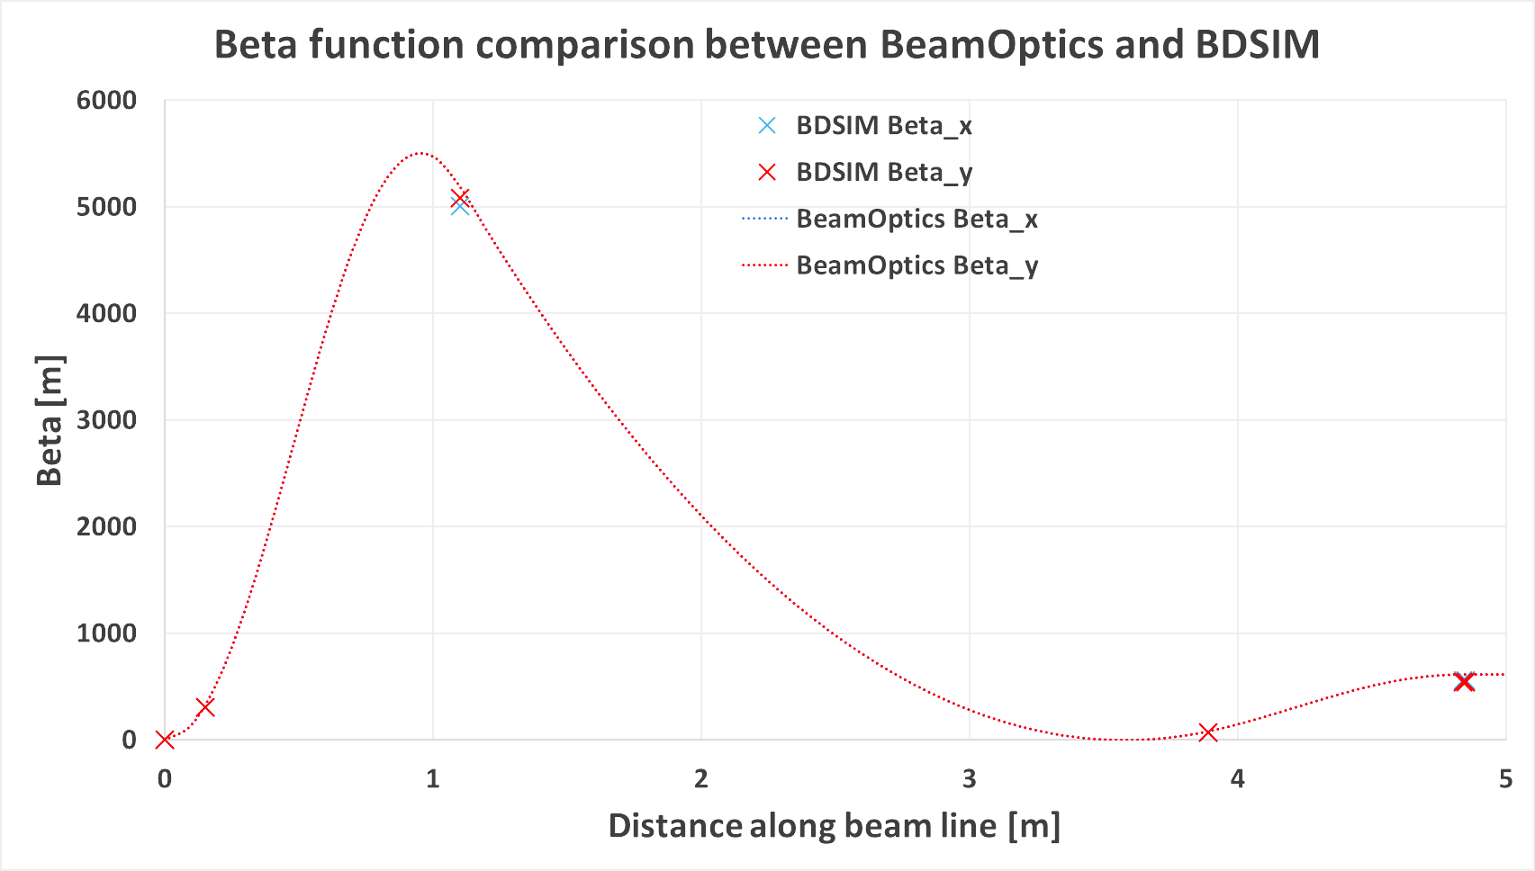
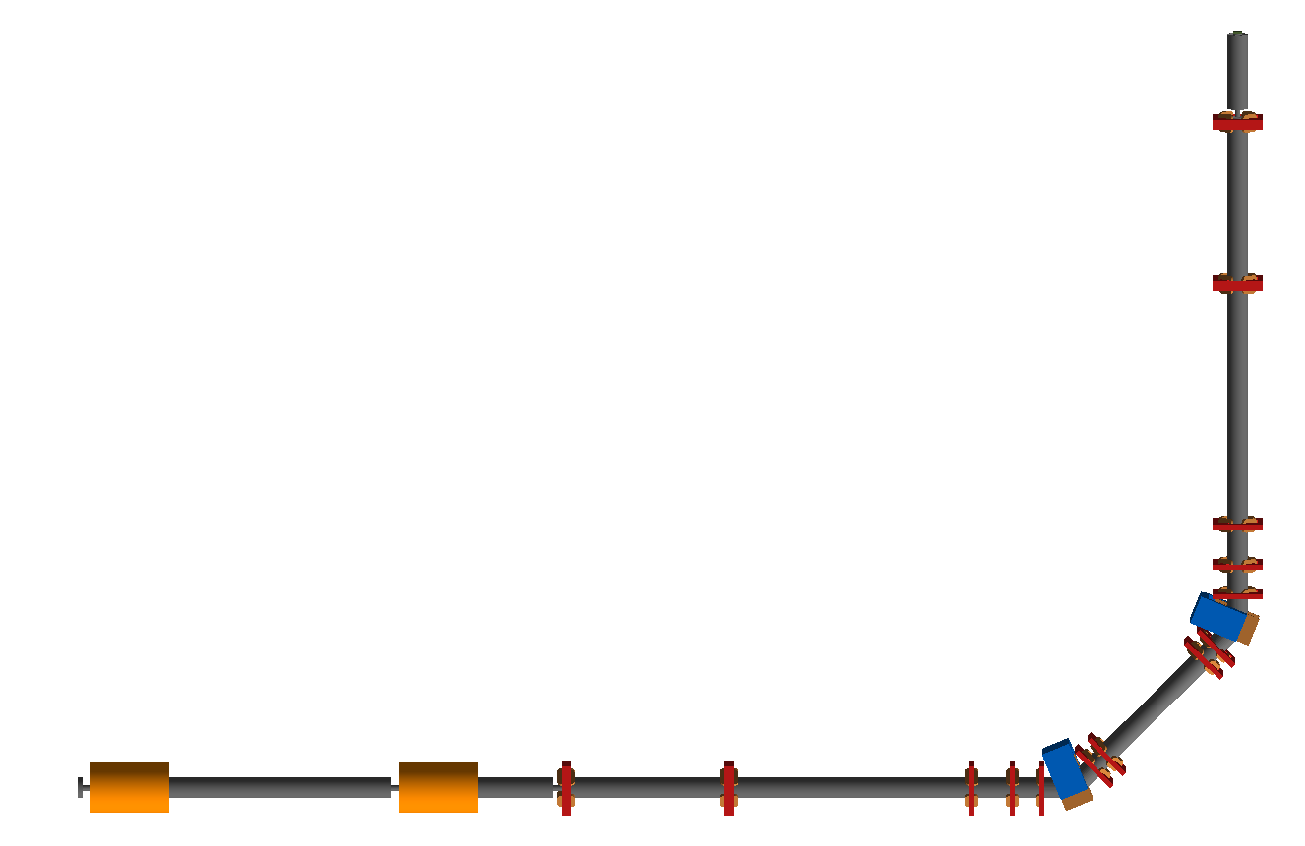
Beam transport
Simulate beam transport from source through to target station using BDSIM (Beam Delivery Simulation), based on Geant4.
  Model beam line elements.
  Track through 3D EM fields.
  Simulate material interactions.
  Extract beam optics parameters and energy deposition.
While design evolving, Gabor lenses modelled as equivalent focal length solenoidal magnets.
Shift to EM simulation of lenses at later stage.
Initial beam
generated by
BDSIM.
Tracked
through
LhARA:
19

Slide 20
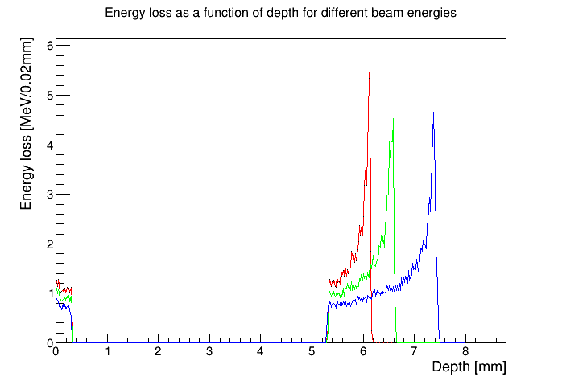
End station
Beam energy chosen to ensure Bragg peak can be scanned through cell layer.
Detailed simulation of delivery of beam to sample.
Energy loss as function of depth
10 MeV
12 MeV
15 MeV
beam
0.075 mm window
0.25 mm scint. fibre layer
5 mm air gap
1.15 mm base
0.03 mm cells
15 mm cell nutrients
20

Slide 21
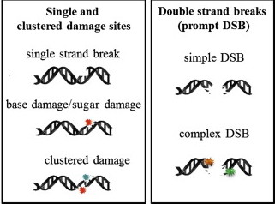
Example of end-station experiments
Understand damage caused to DNA by proton irradiation.
Single strand breaks rapidly repaired.
Repair of double strand breaks more difficult.
Study number of single and double strand breaks as a function of dose, dose rate…
Determine damage e.g. using Comet analysis:
  Irradiate cells and embed in agarose gel.
  Forms mesh through which fluids can permeate, but traps cells.
  Perform lysis to break down cell membrane and membrane surrounding nucleus.
  Leaves DNA in holes originally occupied by cells.
21

Slide 22
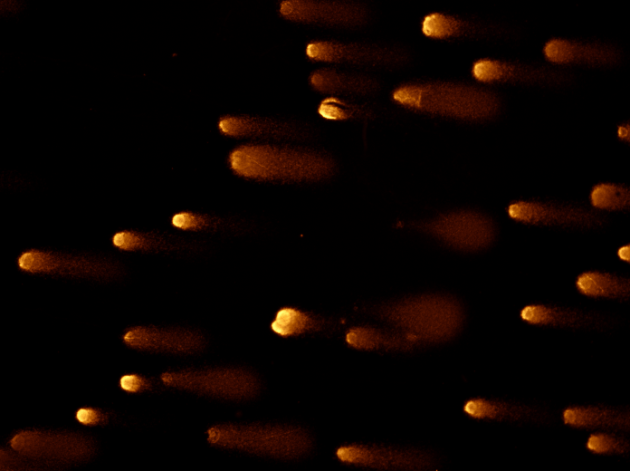
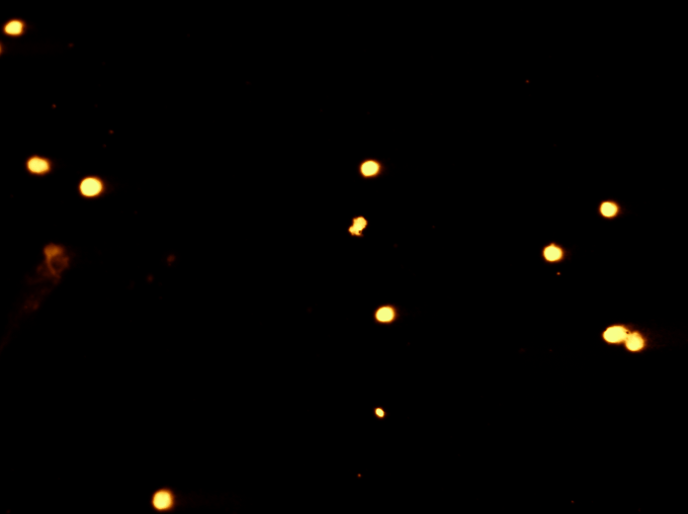
Example of end-station experiments
Comet analysis cont.
  Electrophoresis causes charged DNA to migrate through mesh.
  Speed of migration depends on length of DNA strands.
  Stain and image the “comets”.
Comet analysis cont.
  Amount of light from tail contains information about number of DNA strand breaks.
  Compare with image of similarly processed, unirradiated cells:
Jason Parsons, Liverool Univ.
22

Slide 23
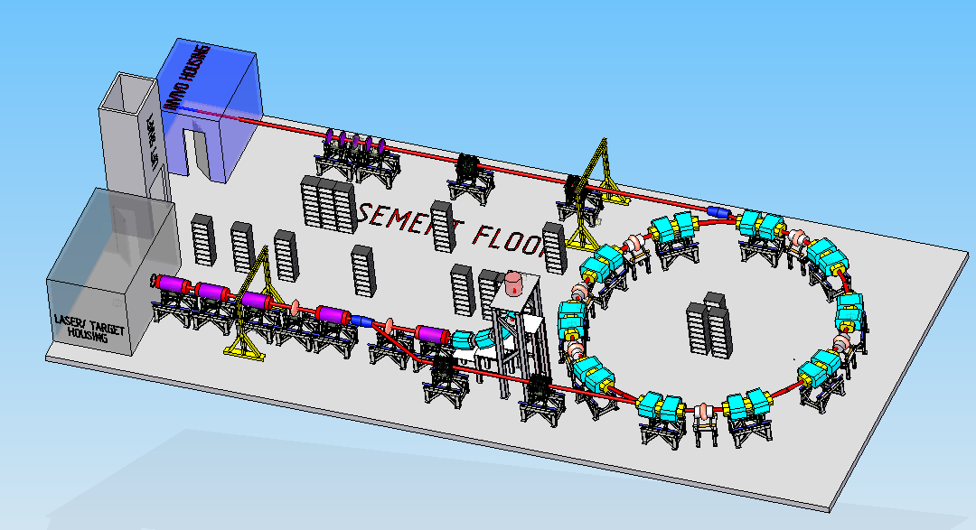
LhARA – stage 2
Goal – irradiate animal models.
Need post-acceleration to increase energy of the beam driven by the laser.
Current solution is based on a fixed field alternating gradient accelerator.
Can achieve factor 3 or more increase in momentum.
  Accelerate 15 MeV protons to 127 MeV.
  3.8 MeV/u carbon 6+ ions to
  33 MeV/u.
23

Slide 24
Fixed field alternating gradient accelerators
FFAGs are accelerators in which magnetic fields do not vary in time but are a strong function of radius.
Orbit changes with momentum are relatively small.
Radius of orbit given by
Scaling FFAG, orbit shape independent of momentum.
Non-scaling FFAG, shape of orbit is function of momentum.
Scaling FFAG, k ~3.
Non-scaling FFAG, k can be as large as 80.
F
High energy
D
D
Low energy
Beam dynamics (and orbits) more complex than in cyclotron.
High energy
D
F
D
Low energy
24

Slide 25
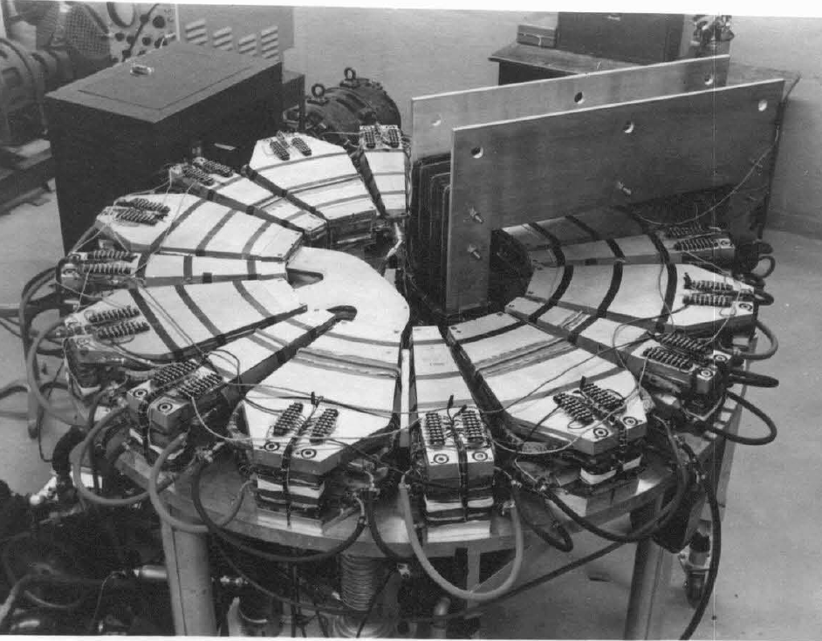
FFAGs
Proposed for use as muon accelerators, in accelerator driven sub-critical reactors, and for medical applications.
Advantages over conventional medical cyclotrons.
  Variable energy operation without energy degraders.
  Operation with different ions.
  Multiple extraction ports.
FFAG concept developed independently in 1950s in Japan by Tihiro Ohkawa, in the US by Keith Symon, and in Russia by Andrei Kolomensky.
Initial designs all scaling FFAGs.
First 500 keV e‒ prototype operated in Michigan 1956.
25

Slide 26
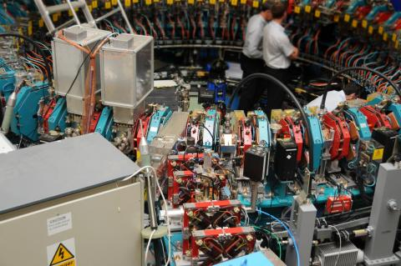
FFAGs
First 500 keV p FFAG, KEK in 2000.
FFAG for ADSR, Kyoto University
First non-scaling FFAG, EMMA, at Daresbury.
Acceleration of electrons from 10 to 20 MeV reported in Nature in January 2012.
26

Slide 27
LhARA FFAG
LhARA ring:
LhARA ring parameters:
Number of sectors 10
k 5.19
R_{min} 2.92 m
R_{max} 3.49 m
B_{max} 1.4 T
Max p injection E 15 MeV
Max p extraction E 127 MeV
RF freq 2.89…6.48 MHz
Bunch intensity 10⁸ protons
27

Slide 28
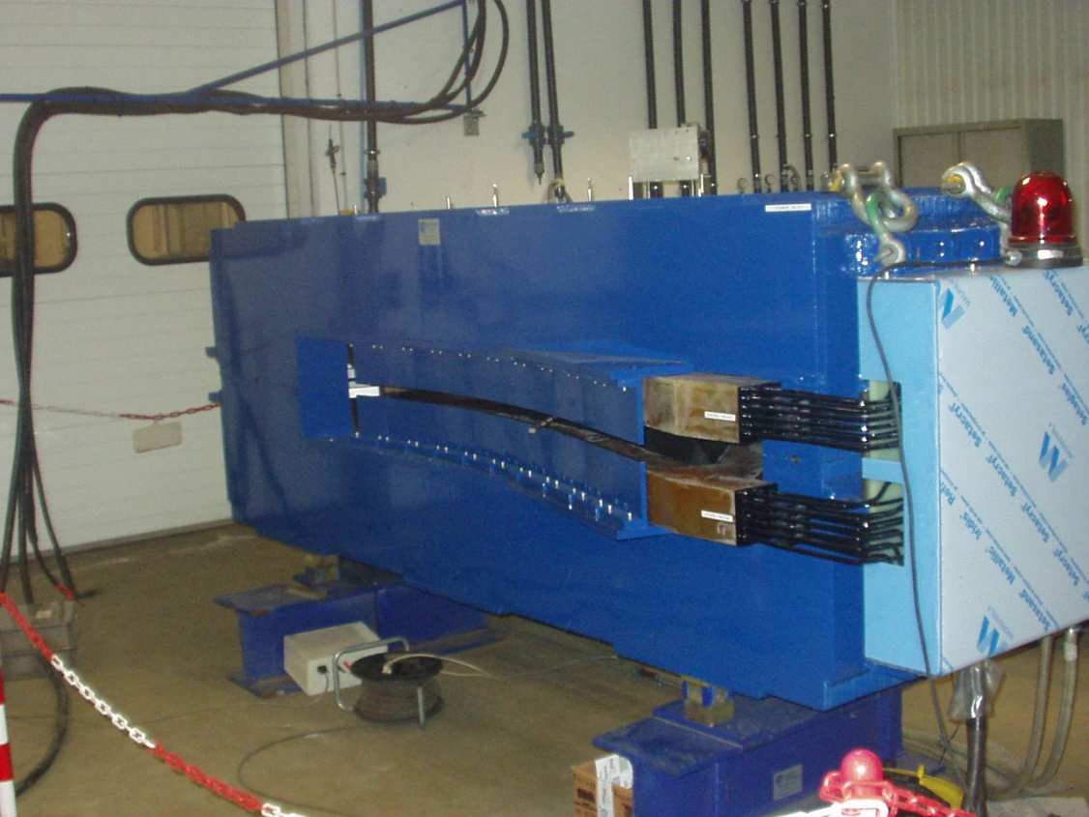
LhARA magnets and RF
Spiral FFA magnet
Built by
SigmaPhi
for the
RACCAM
project.
Need cavities capable of low frequency and large frequency variation.
Can use
magnetic
alloy (MA)
cavities,
similar to
those used
at J-PARC.
28

Slide 29
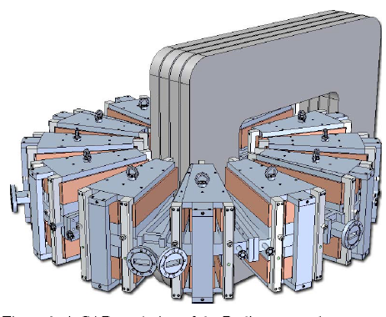
Induction acceleration for FFAGs
Circumvent difficulties of synchronising RF in an FFAG by using “betatron” acceleration mechanism?
Faraday’s law:
Varying magnetic flux through centre of FFAG generates EMF which accelerates particles.
Design of an electron FFAG for industrial applications was studied in the USA by RadiaBeam Technologies.
Radiatron:
Reported in Proc.s of PAC07 (Albuquerque) and of EPAC08 (Genoa)…but then development stopped.
29

Slide 30
Induction acceleration for LhARA
Look at possibility of using induction acceleration for LhARA.
Set up LCR circuit by adding C to L of accelerating magnets.
Choose C to get appropriate resonant frequency.
Resulting acceleration of proton beam injected at 15 MeV:
May be worth looking at a little more seriously.
Energy (eV)
Energy spread
Flux (W)
EMF (V)
t (s)
t (s)
30

Slide 31
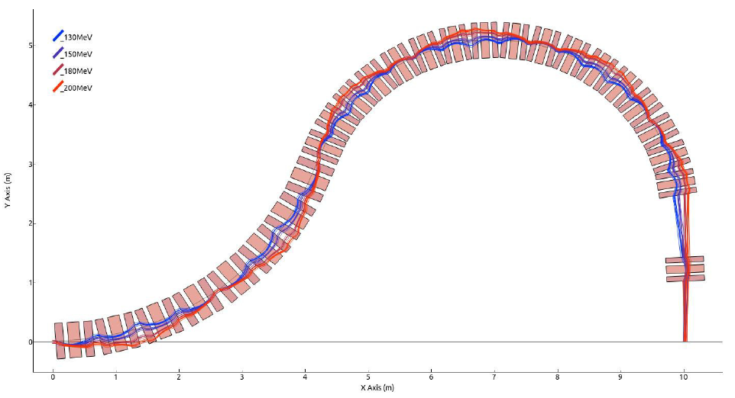
FFAG gantry
Reduce gantry cost and mass by using FFAG.
E.g. of design for PAMELA.
Produces zero dispersion condition at end of first bending section and at end of gantry.
31

Slide 32
Summary
Cancer is a major threat to health.
Radiotherapy is a valuable treatment method in about 50% of cancer cases.
Proton/ion therapy offers significant advantages over X-rays.
Potential large benefits through FLASH treatment.
But further radiobiology studies needed.
Wider provision of ion therapy requires significant cost reductions.
LhARA is attempt to couple development of technologies for proton/ion therapy with radiobiology experiments.
Ultimate goal (2050?), thorough understanding, optimisation of radiobiology of proton/ion therapy.
Low cost proton/ion therapy system based on laser acceleration and Gabor lenses for beamline/gantry.
32

