Slide 1
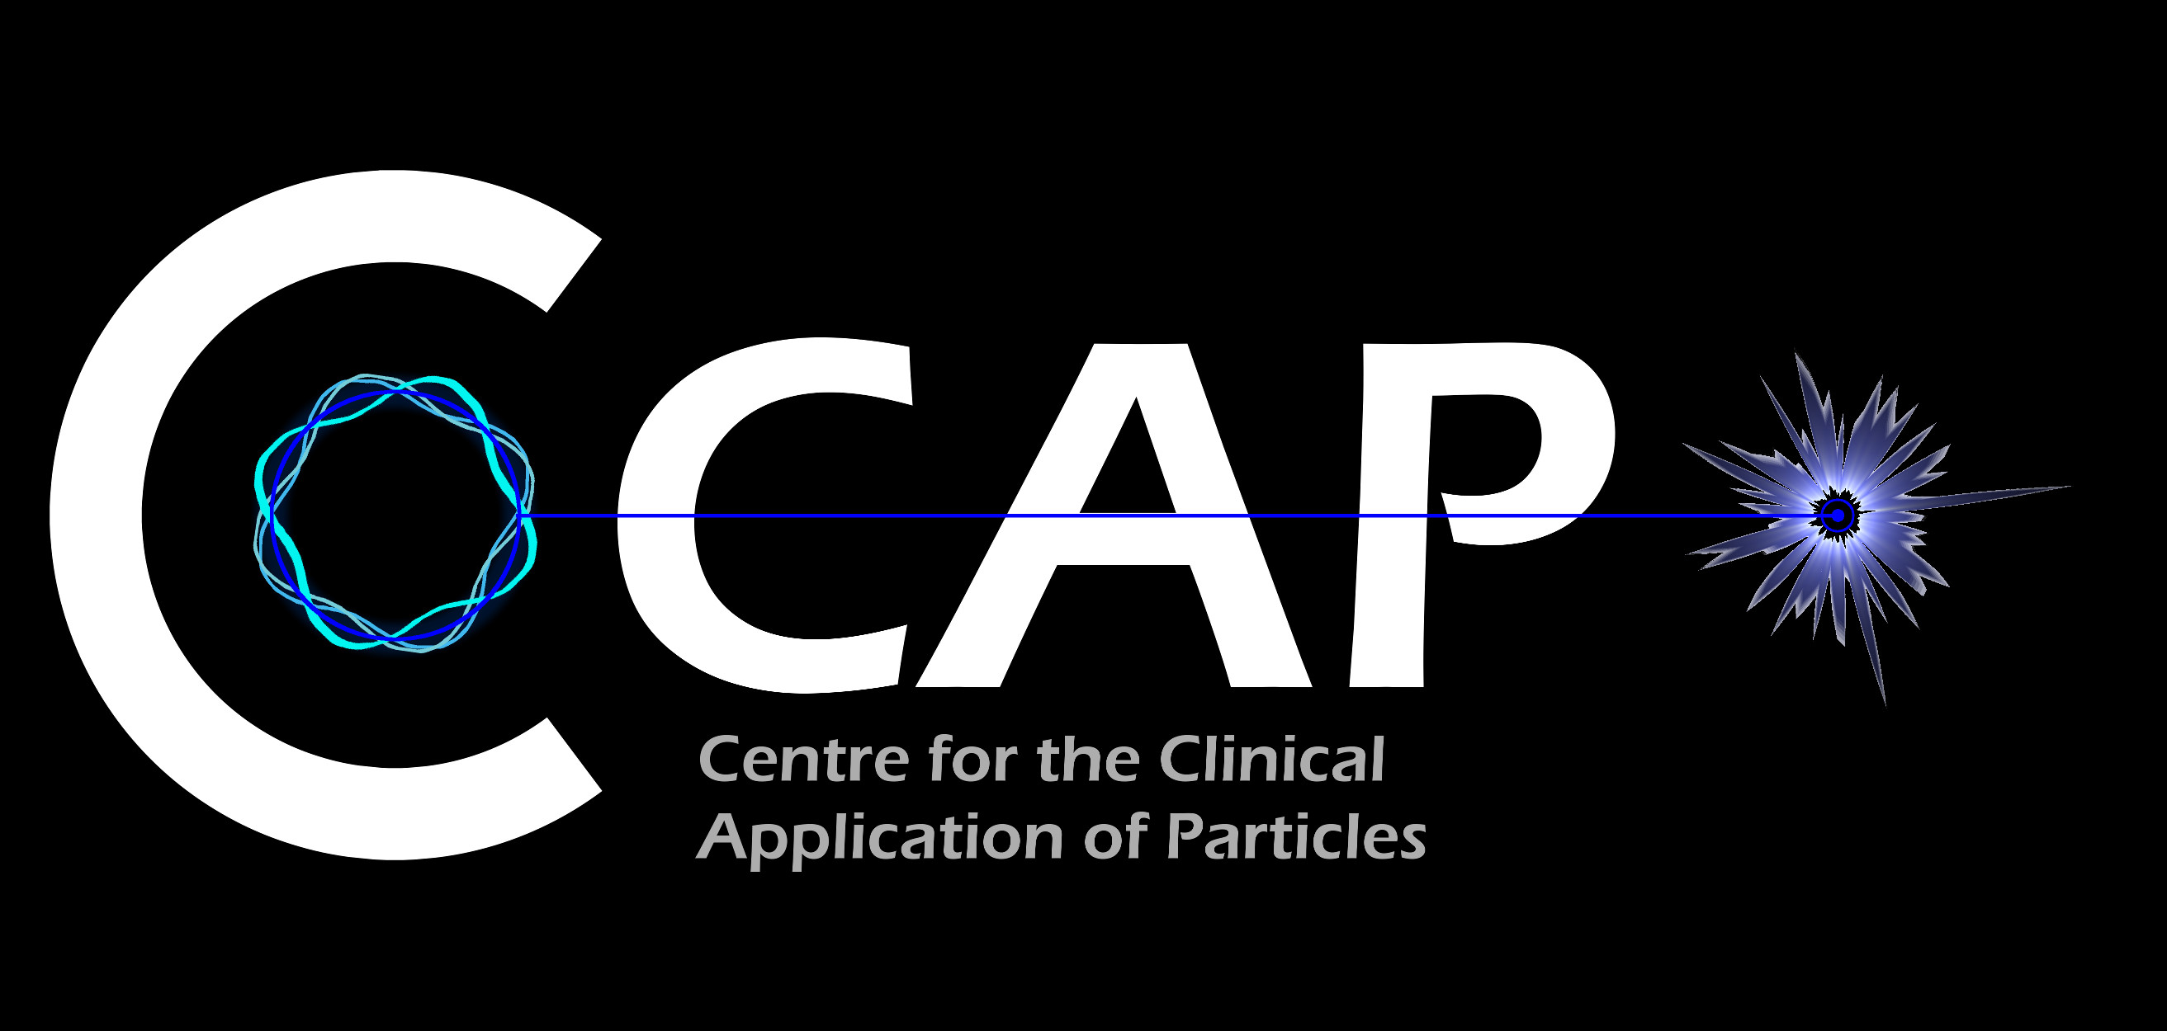

LhARA the Laser-hybrid Accelerator for Radiobiological Applications
for the LhARA collaboration
Serving the
Ion Therapy Research Facility
with

Slide 2
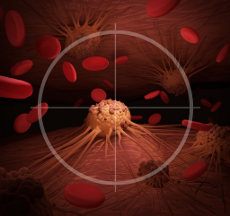
LhARA collaboration’s mission
Create a uniquely-flexible, novel system that will:
  Deliver a systematic and definitive
  radiobiology programme
  Prove the feasibility of the
  laser-hybrid approach
  Lay the foundations for
  transformative ion-beam therapy
    Highly automated,
    patient-specific
      Implies triggerable source,
      online imaging, integrated
      fast feedback and control

Slide 3
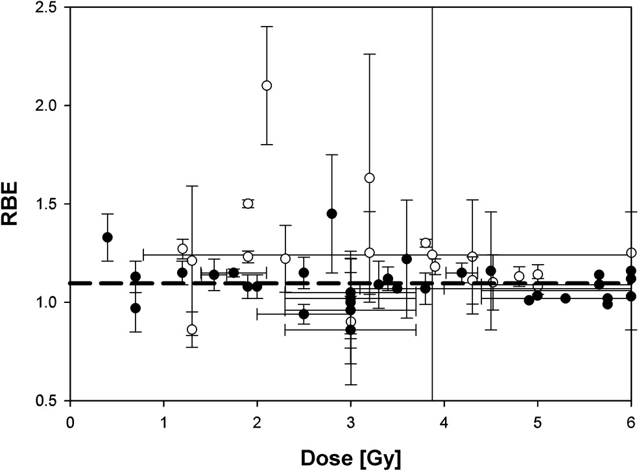
The case for fundamental radiobiology
Relative biological effectiveness:
  Defined relative to reference X-ray beam
  Known to depend on:
    Energy
    Ion species
    Dose
    Dose spatial distribution
    Dose rate
    Tissue type
    Biological endpoint
Yet:
  All p-treatment planning uses RBE = 1.1
  Effective values are used for C⁶⁺
Maximise the efficacy of PBT now & in future:
  Systematic programme needed to develop
  full understanding of radiobiology
Paganetti,
van Luijk
(2013)
SemRadOncol

Slide 4
Radiobiology in new regimens
Time
domain
Space
domain
The ideal
beam facility
can deliver it all
⇒ opportunity
for step-change
in understanding
Ion
species
Energy
In combination with:
Chemotheray
Immunotherapy

Slide 5
The case for transformative ion-beam therapy
Cancer: second most common cause of death globally
  Radiotherapy indicated in half of all cancer patients
Significant growth in global demand anticipated:
  14.1 million new cases in 2012 ⇢ 24.6 million by 2030
  8.2 million cancer deaths in 2012 ⇢ 13.0 million by 2030
Scale-up in provision essential:
  Projections above based on reported cases (i.e. high-income countries)
  Opportunity: save 26.9 million lives in low/middle income countries by 2035
Provision on this scale requires:
  Development of new and novel techniques…integrated in a
  Cost-effective system to allow a distributed network of RT facilities
Atun, Lancet Oncol. 2015 Sep;16(10):1153-86

Slide 6
The LhARA laser-hybrid approach is disruptive
The LhARA initiative will:
Create the capability to deliver particle-beam therapy in completely new regimens
  Flexibility!
    Combine a variety of ion species in a single treatment facility, exploiting ultra-high dose rates in novel spatial- and spectral-fractionation schemes
Make "best in class" treatments available to the many
  Automated, triggerable system → reduce requirement for large gantry:
    Incorporate dose-deposition imaging in fast feedback-and-control system; track movement, deliver dose at optimum tissue alignment

Slide 7
Laser-hybrid Accelerator for Radiobiological Applications
A novel, hybrid, approach:
Laser-driven, high-flux proton/ion source
  Overcome instantaneous dose-rate limitation
    Capture at >10 MeV
  Deliver protons or ions in very short pulses
    Bunches as short as 10—40 ns
  Triggerable; arbitrary pulse structure
Novel “electron-plasma-lens” capture & focusing
  Strong focusing (short focal length) without use of high-field solenoid
Fast, flexible, fixed-field post acceleration
  Variable energy
    Protons: 15—127 MeV
    Ions: 5—34 MeV/u
Front. Phys., 29 September 2020; DOI: 10.3389/fphy.2020.567738

Slide 8
Collaboration and STFC labs now developing “Preliminary Phase” programme
WP1: Project management
Project management
Stakeholder engagement & PPI
LhARA collaboration open to
new collaborators:
Fantastic ambitions!
Outstanding opportunities!

Slide 9

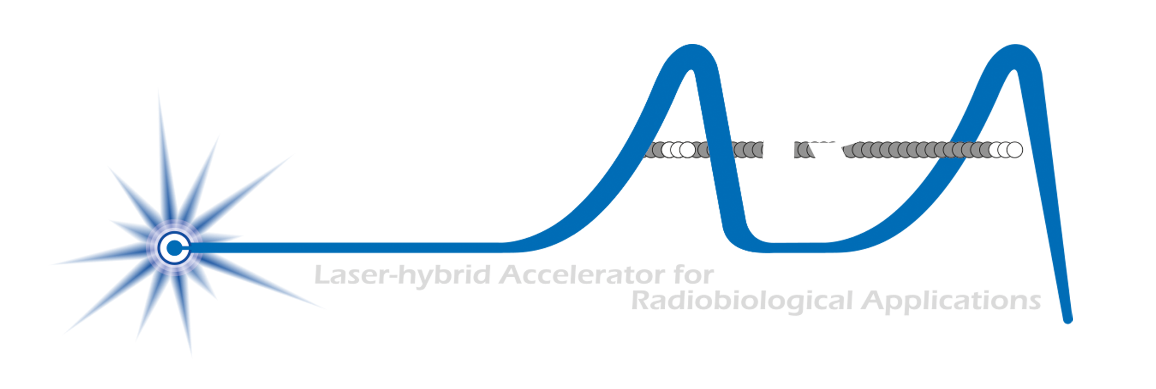

Conclusions
Laser-driven source is a disruptive technology
  Has the potential to drive a step-change in clinical capability
Laser-hybrid approach can:
  Overcome dose-rate limitations of present proton and ion beam therapy sources
  Deliver a uniquely flexible facility:
    Range of ion species, energy, dose, dose-rate and time and spatial distribution
  Be used in automated, triggerable system → reduce requirement for large gantry
    Transformative approach to proton and ion-beam therapy for 2040
By serving the ITRF the LhARA collaboration now seeks to:
  Prove the novel laser-hybrid system in operation
  Provide facility capable of delivering broad & definitive radiation biology programme
  Create the novel capabilities required to transform proton and ion beam therapy

