Slide 1
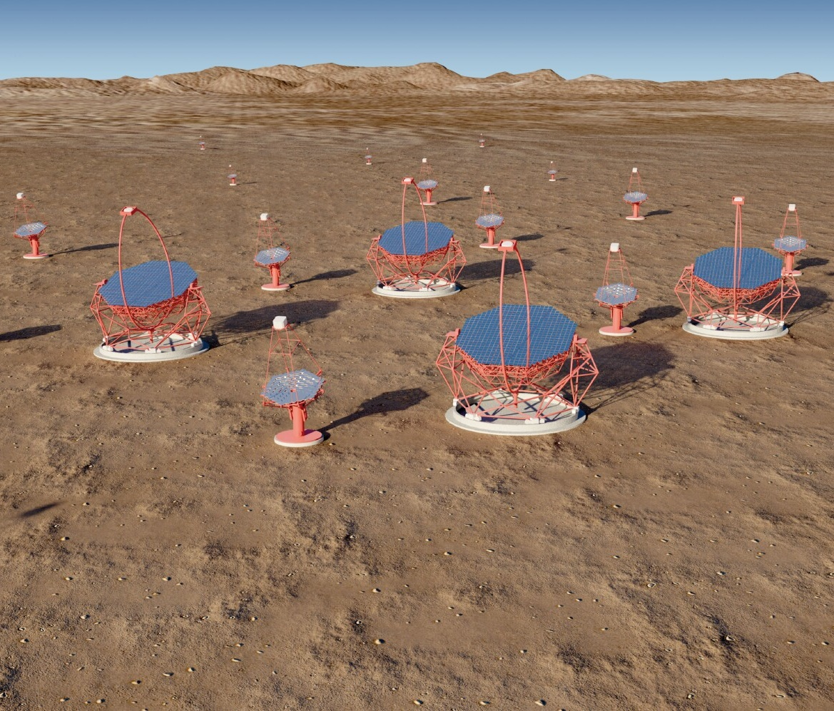
GCT: progress since Liverpool meeting
Introduction
Installation of CHEC-M on prototype telescope
GCT First Light
Inauguration of GCT
Progress with structure
CHEC-M studies
CHEC-S mechanical design
Electronics for CHEC-S
Pre-production GCTs
Summary
Tim Greenshaw, Liverpool University, for GCT group
Notes:
The Cherenkov Telescope Array (CTA) is the next generation observatory for ground-based gamma-ray astronomy. Current instruments (HESS, MAGIC and VERITAS) have made huge progress in the observation of cosmic sources of photons in the ~ 50 GeV to ~ 50 TeV energy range using Imaging Atmospheric Cherenkov Telescopes (IACTs). CTA will extend the range of these observations at both low and high energies, will improve their sensitivity by a factor of about 10 and will increase the precision of photon energy and direction measurements. This talk presents briefly the designs of the 23 m, 12 m and 4 m diameter IACTs that CTA will use to achieve this performance, before discussing the impact the array will have on studies of Fundamental and Astroparticle Physics. Topics covered include: searches for Dark Matter (DM) and axion-like particles (ALPs); studies of possible violation of Lorentz invariance; and studies of the sources and acceleration mechanisms of high energy cosmic rays.
Remember the Ellis/White paper.
Include EBL studies.

Slide 2
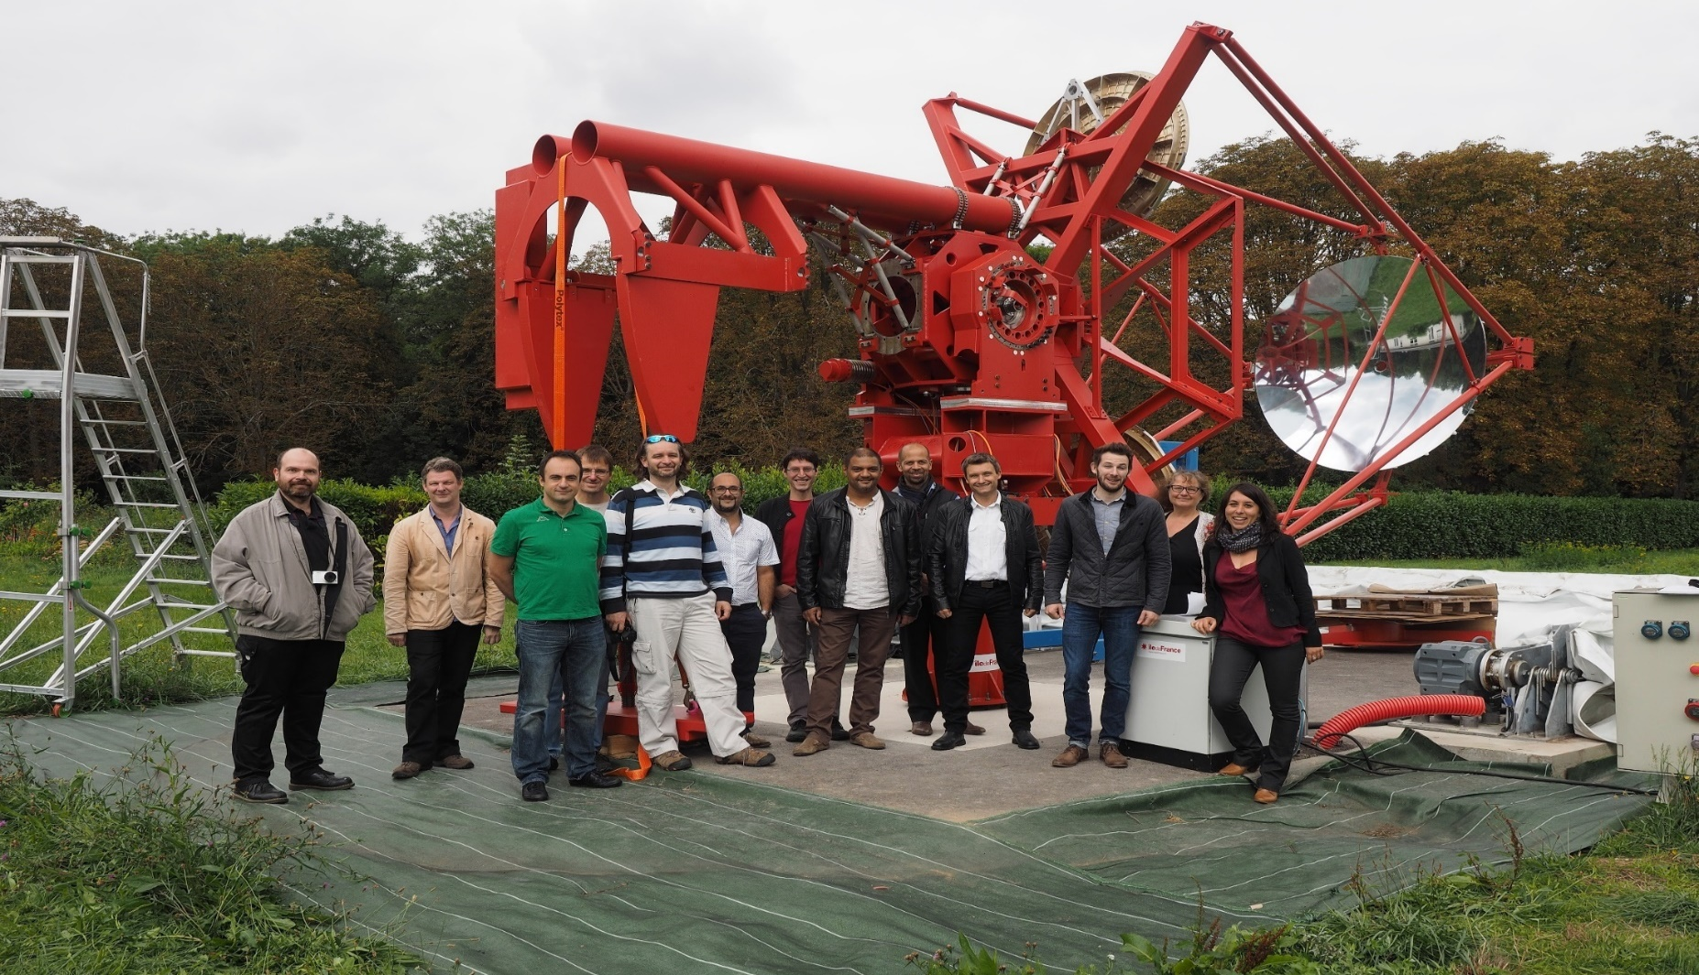
Introduction – recent history
Eight months ago, we had a nearly complete telescope structure in Meudon (here on the occasion of the ESO visit)…
2

Slide 3
Recent history
…and a multi-anode photomultiplier based camera, CHEC-M, in Leicester (here after installation of the Backplane, allowing self triggered operation).
3

Slide 4
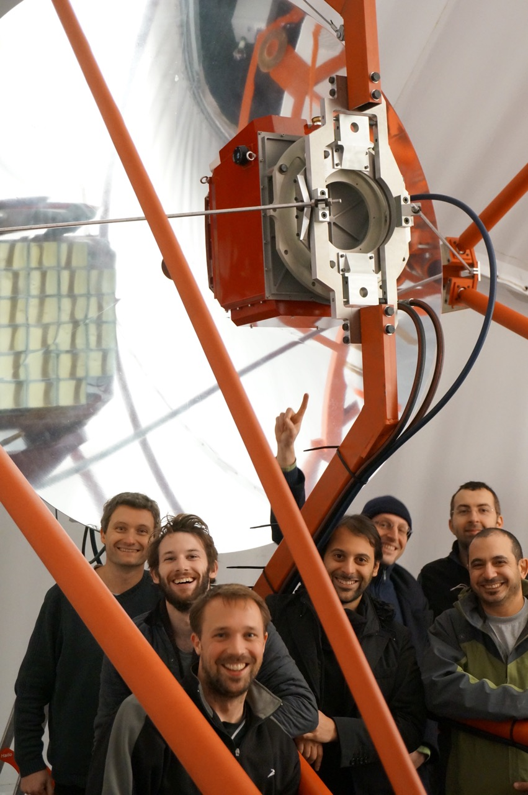
Building the GCT
These were put together in two and a half weeks of intensive work in November by a team of 17 people from the GCT camera and telescope groups.
Telescope structure:
  Cabling completed.
  Camera power supply installed.
  Camera cooling system added.
  Fibre for camera readout installed.
Camera:
  Function checked following transport.
  Installed on telescope.

Slide 5
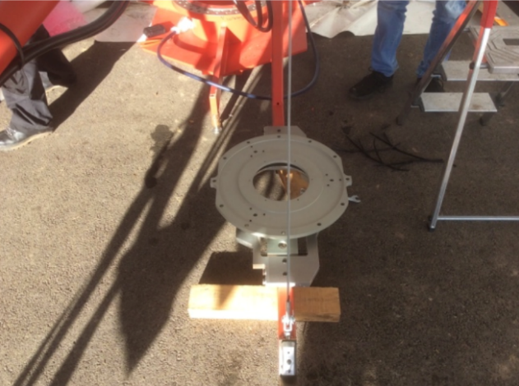
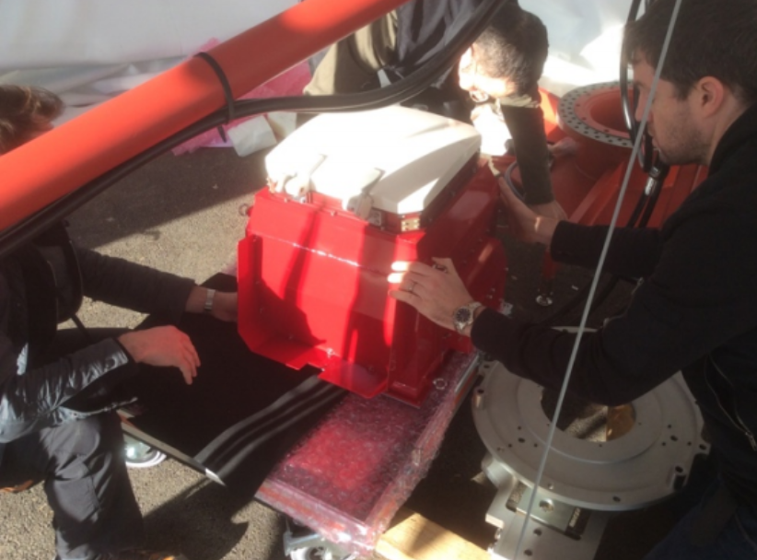
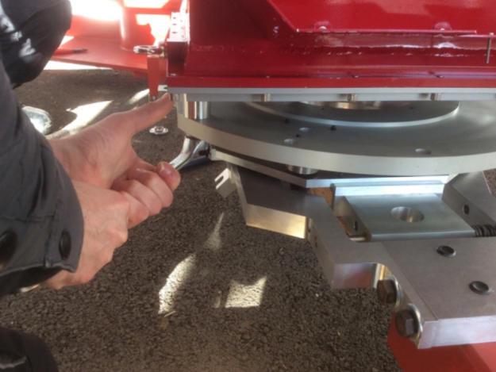
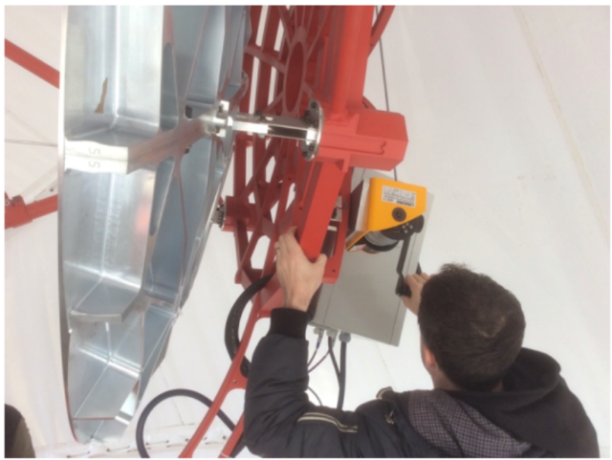
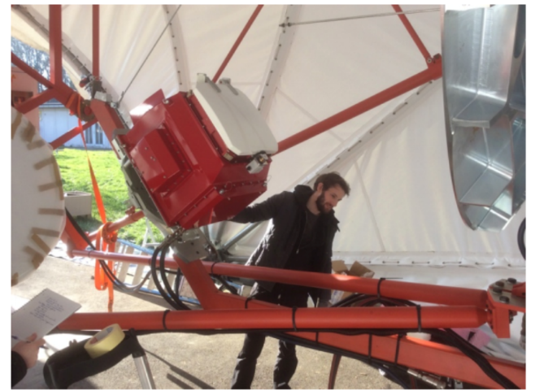
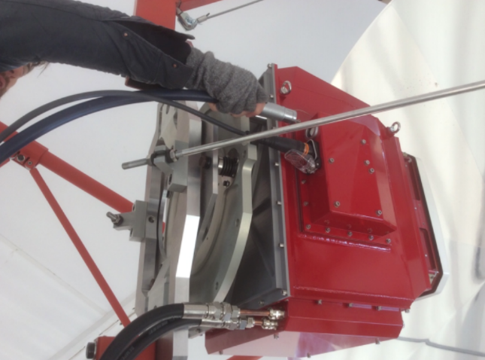
Installation of CHEC-M on telescope
Richard White
Camera was mounted on telescope on 20th November.
Can now be done by 3 people in 15 mins (though it took a little longer the first time).
Arm lowered
Camera moved into position
Camera secured
Camera raised
Horizontal rods and cables attached
5

Slide 6
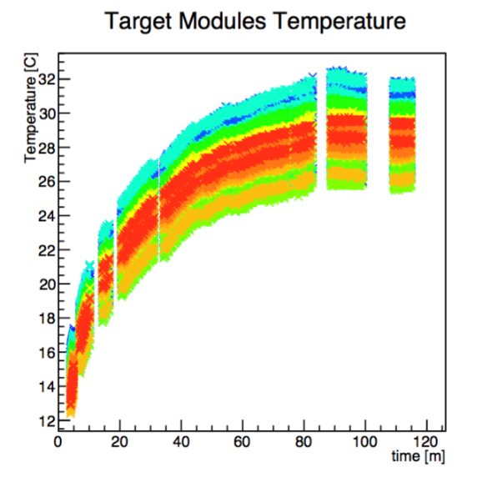
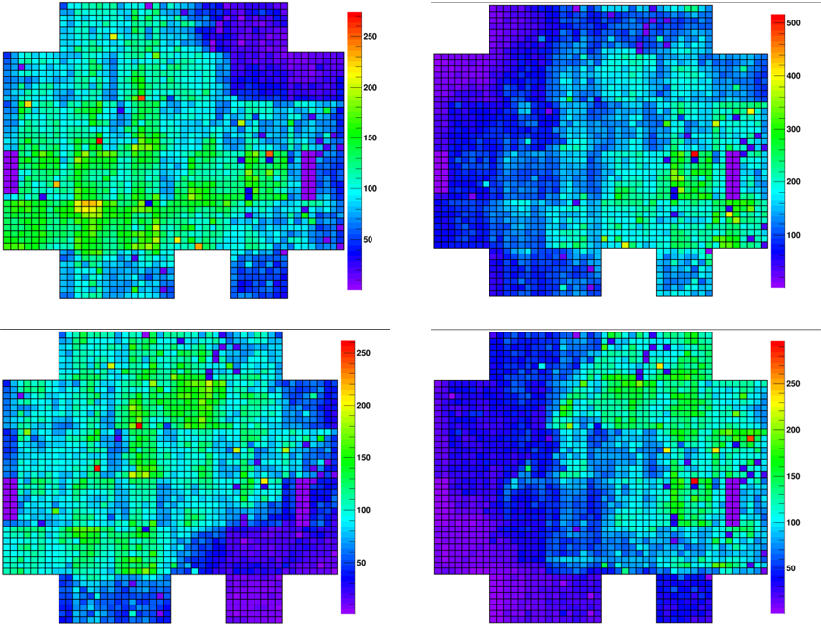
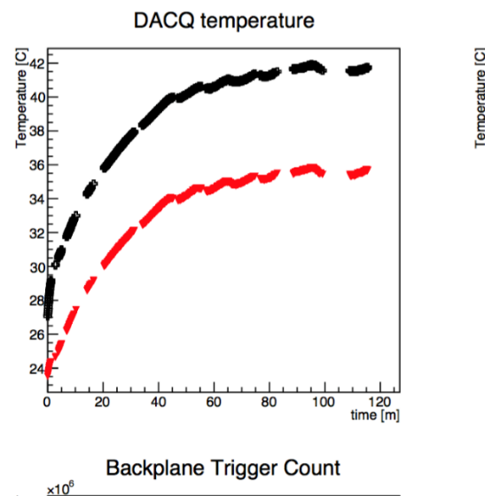
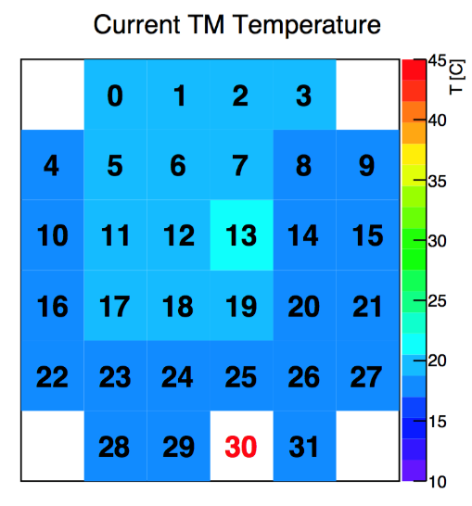
Camera function tests
  Camera tested
  on telescope
  (under shelter).
E.g. real time
monitoring
of TARGET
module…
…and DACQ board temperatures.
LED flasher tests:
6

Slide 7
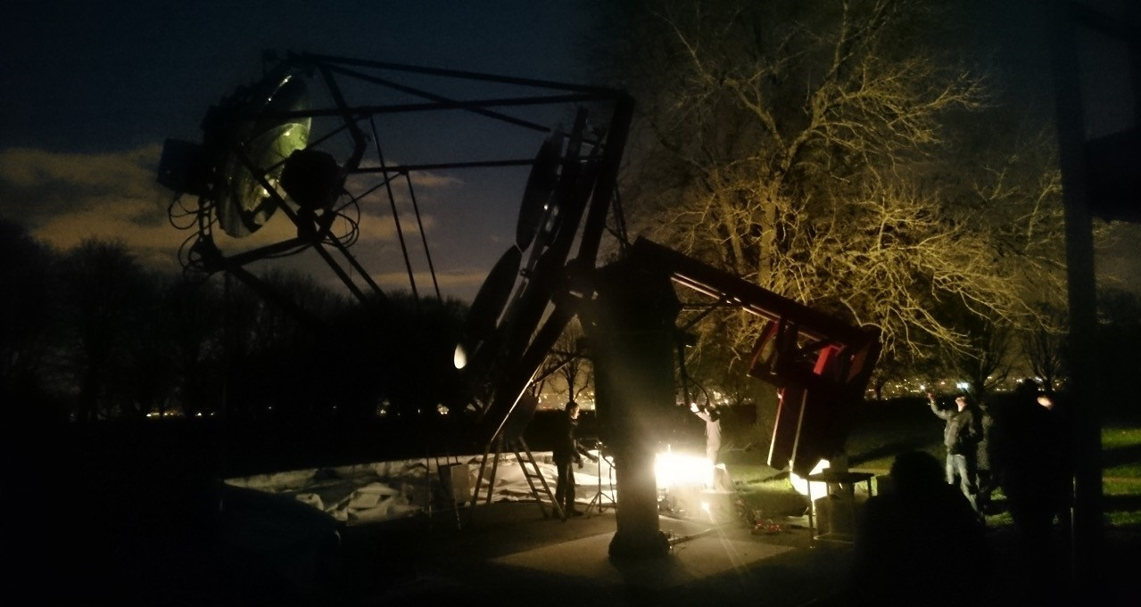
First tests of the GCT prototype on sky
Thursday 26th Nov, night sky background 20 to 100 times higher than CTA site…

Slide 8
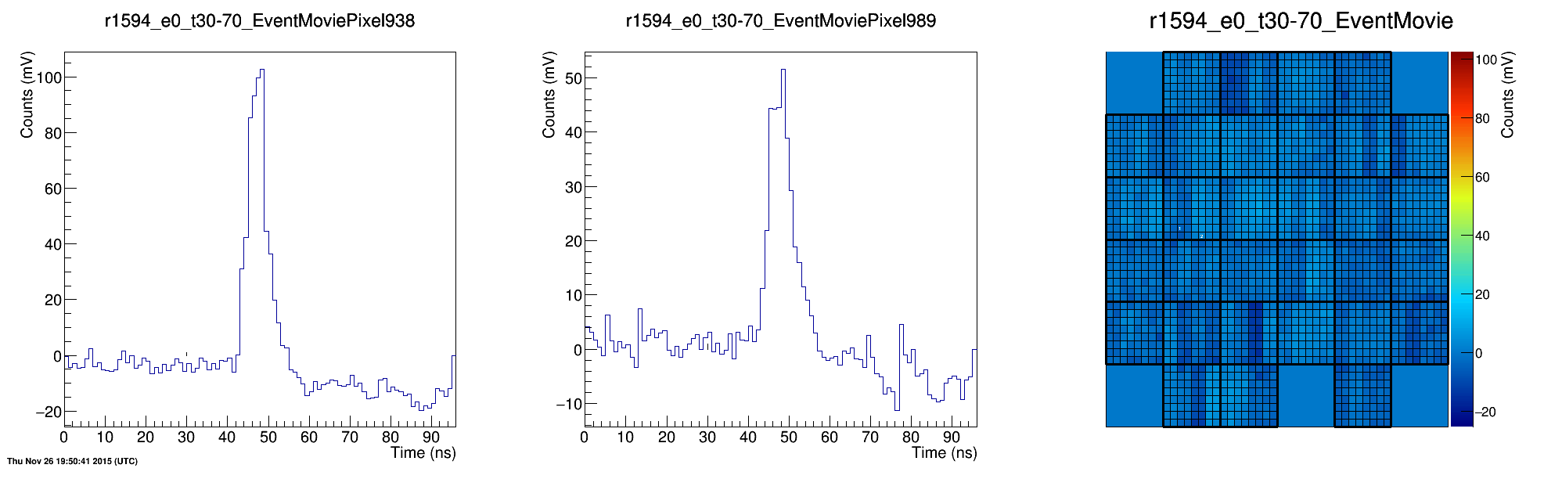
First tests of the GCT prototype on sky
…but despite this successfully observed Cherenkov light from ~ 50 TeV showers, including this first event:
Note, high NSB required that MAPMs be operated ~ 200 V below voltage at which laboratory tests carried out – low gain, high threshold, no gain equalisation.
8

Slide 9
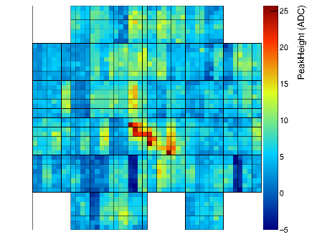
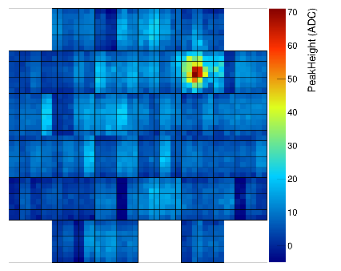
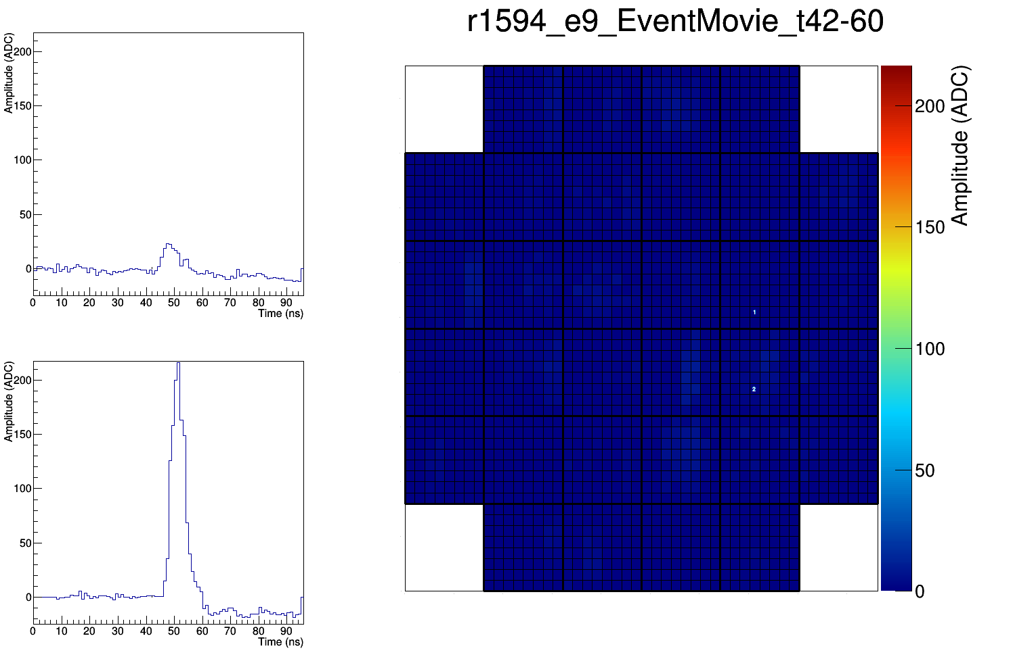
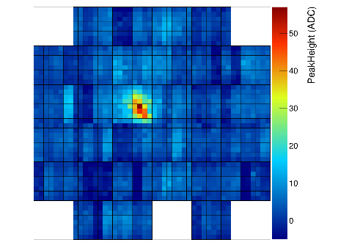
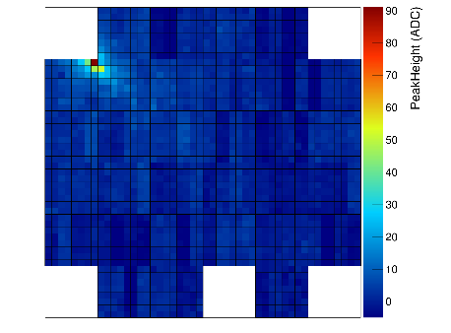
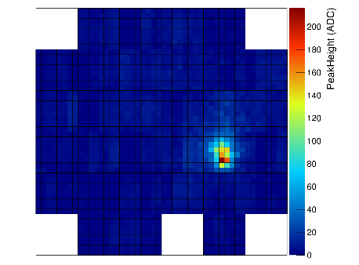
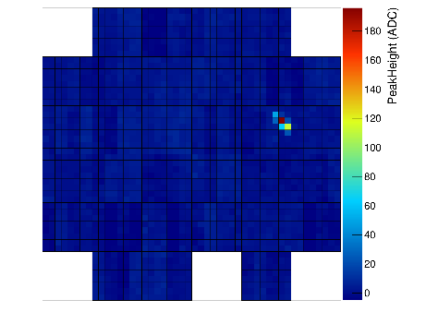
First tests of the GCT prototype on sky
More events:
The cleanest event:
9

Slide 10
CTA science meeting and inauguration of GCT

Slide 11
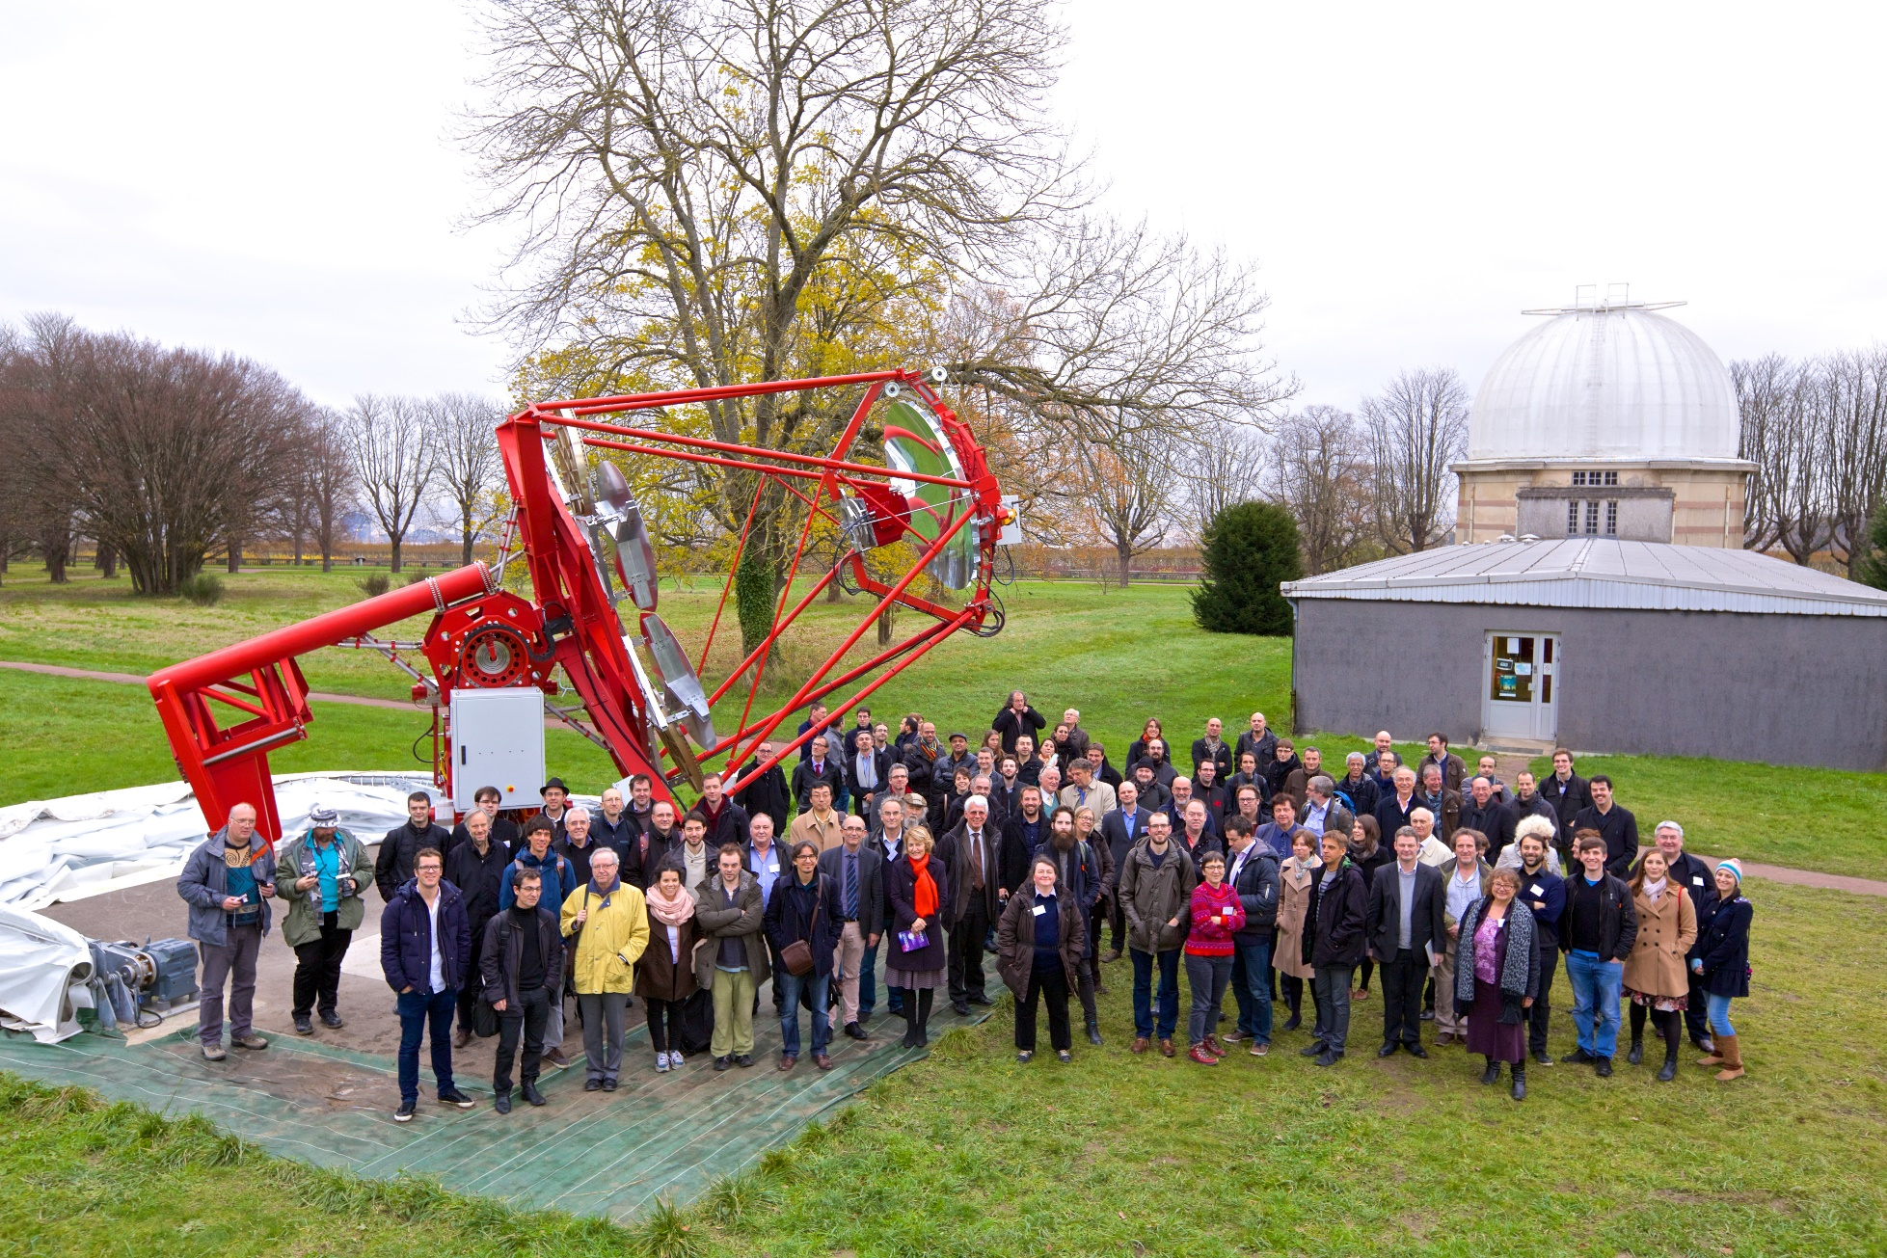
Inauguration of the telescope
Helene Sol
Party on 1st Dec. 2015.
Photo Akira Okumura

Slide 12
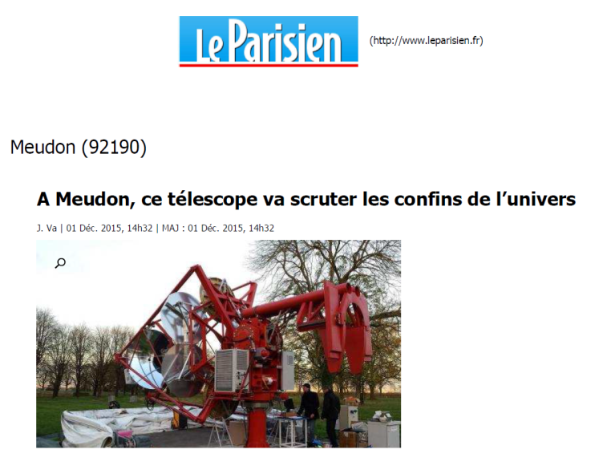
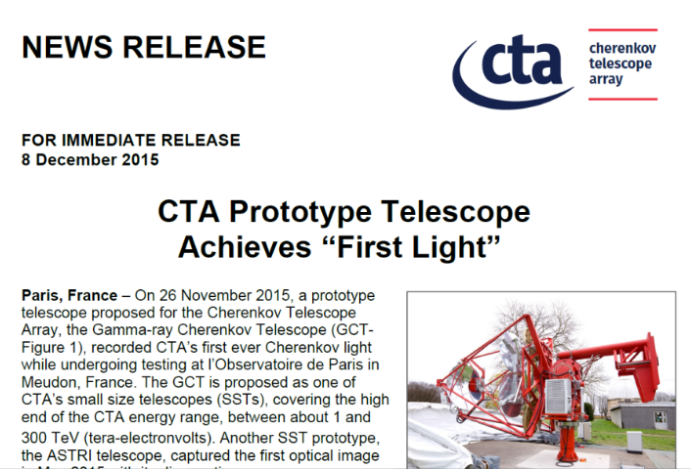
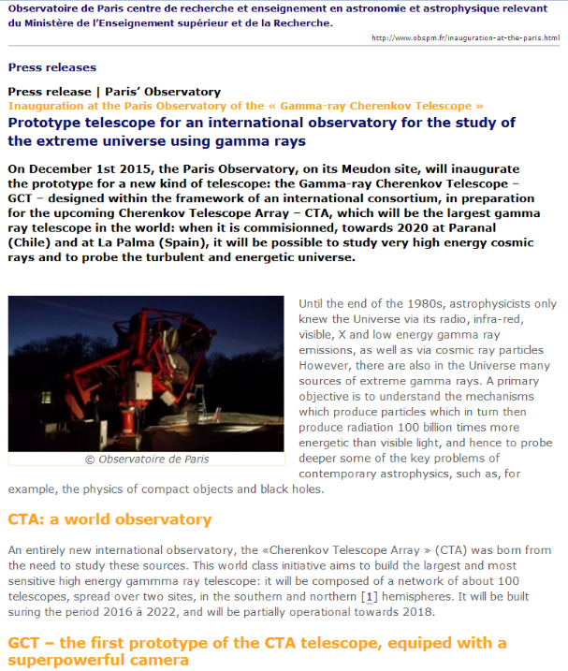
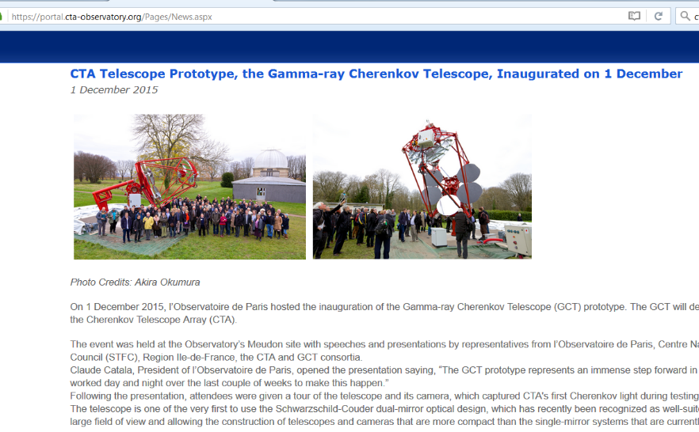
Outreach
First light and inauguration were the subject of CTA, Observatoire de Paris and STFC press releases.
And the inauguration was reported in at least one newspaper…
…who liked the colour we’ve chosen for the GCT:
« Un nouveau télescope flambant rouge a été inauguré ce mardi sur le site de l'observatoire de Paris à Meudon. »
12

Slide 13

Progress with structure
Jean-Laurent Dournaux
At inauguration, telescope was moved by hand.
Damaged encoder caused control software to believe telescope was always “out of range”.
Hence drives locked by safety system.
Encoder now fixed.
Drive systems operating.
Can be controlled either remotely, or using switch box on telescope foundation.
Moving the GCT:
13

Slide 14
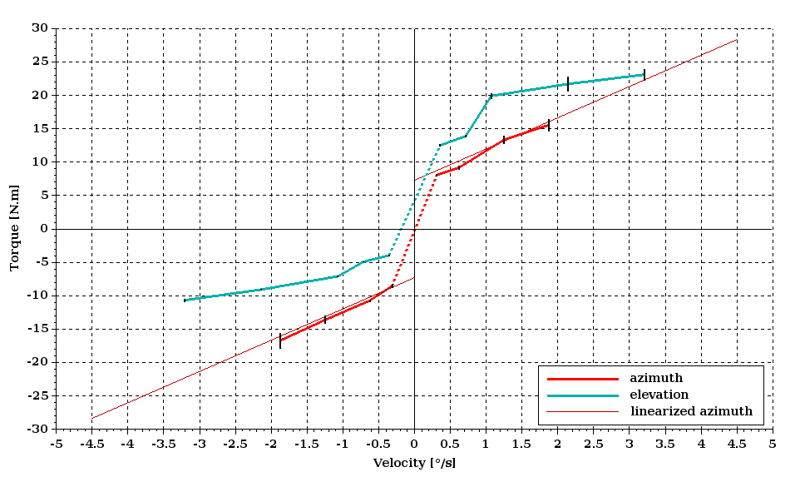
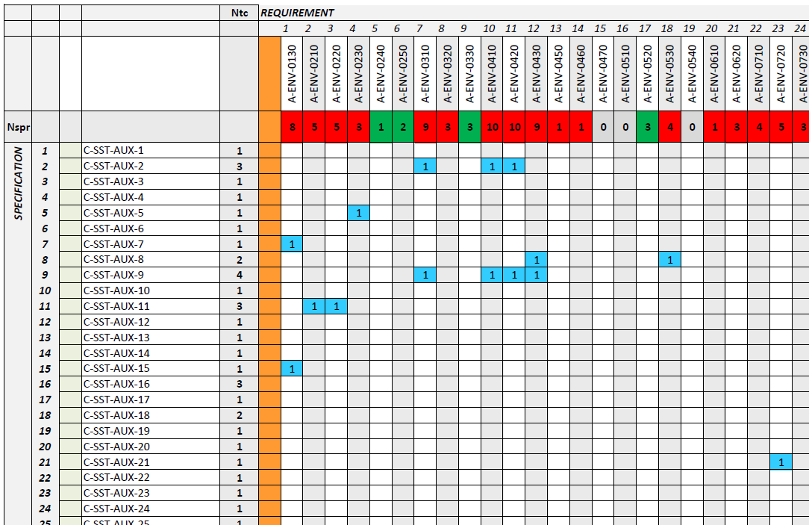
Progress with structure
A programme of 330 tests has been devised to check the structure meets all specifications and requirements.
About 25% of tests started, some finished; goal is completion by end of summer.
Torque required for motion:
Telescope easily achieves required angular speeds.
Maximum power needed ~100 W per axis.
14

Slide 15
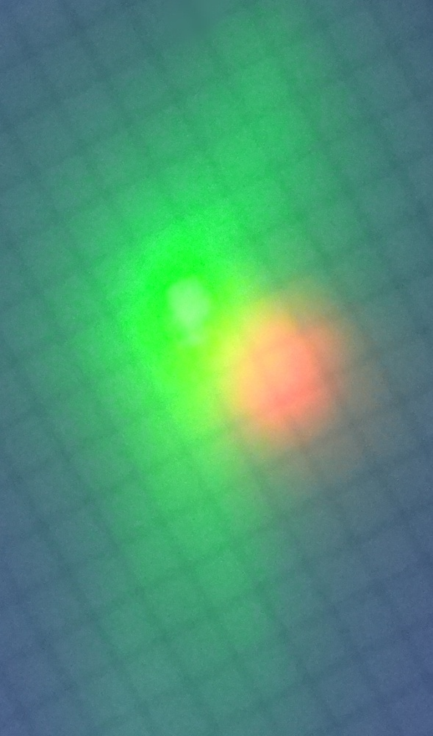
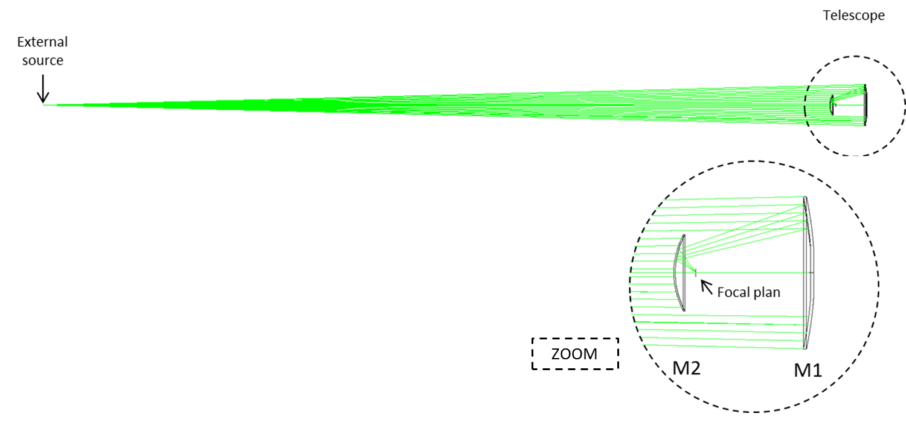
Progress with structure
Check of optical/mechanical axis and mirror alignment.
Illuminate primary with green laser at 75 m distance.
Record image with CCD, with green filter to attenuate laser and reduce background due to stray light.
Red laser along mechanical axis.
Axes coincident and mirrors aligned within tolerances, without adjustment.
Squares of
side 5 mm
15

Slide 16
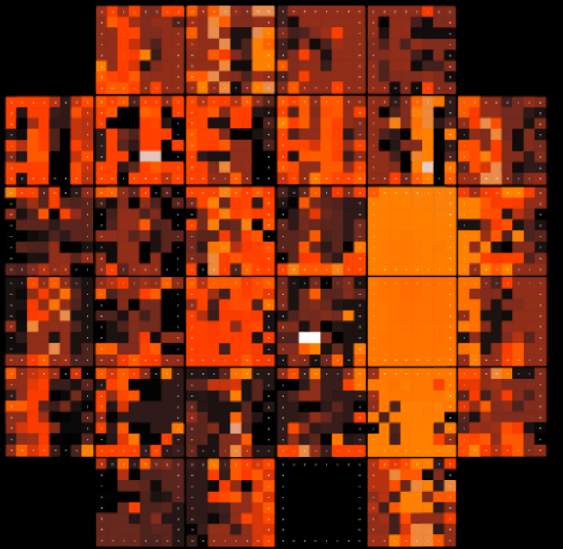
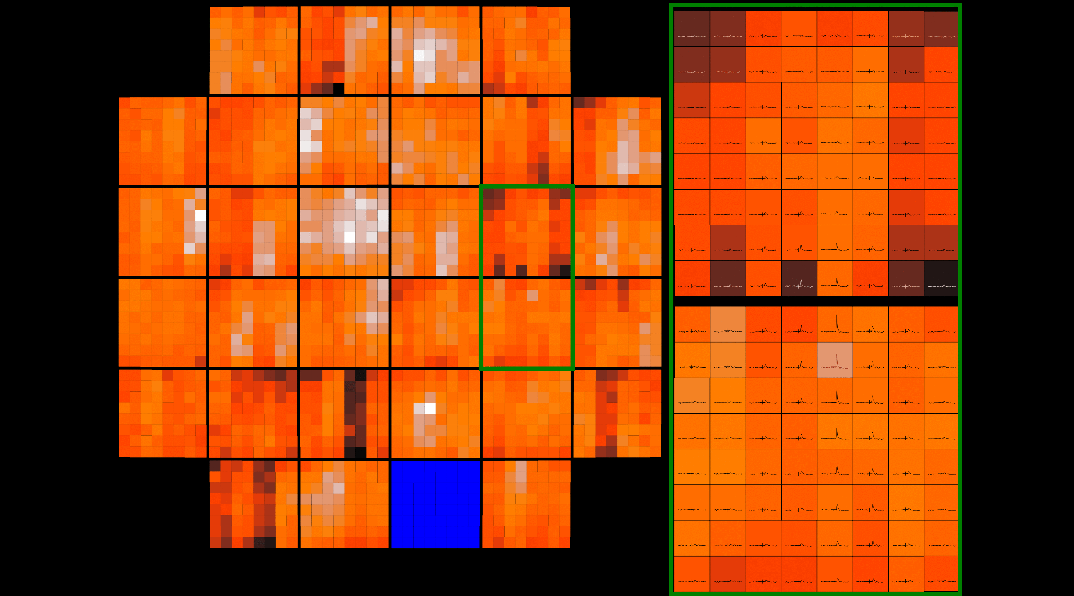
CHEC-M studies
Richard White
Analysis of Paris data ongoing.
Here, graphical display of signal amplitude, with pulse traces in zoomed module view (MESS):
Times of pulse maxima.
BG signal maxima at varying times, peak signal for Cherenkov photons strongly correlated in time.
16

Slide 17
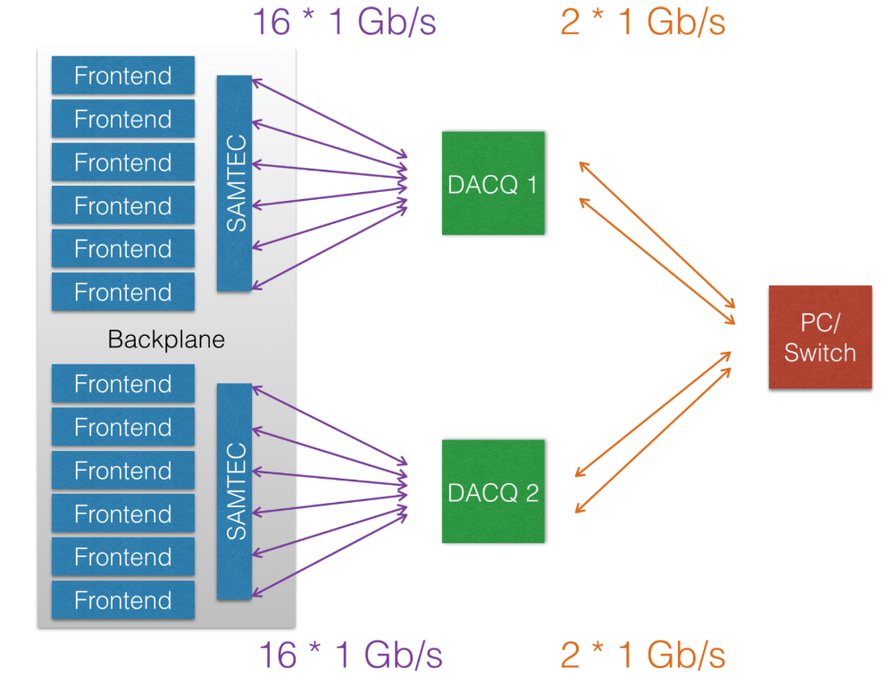
CHEC-M studies
CHEC-M now in MPI-K dark room.
Current tests focussed on data rate and integrity.
Less than 1 corrupt packet in 100M.
Occasional event building problems (0.1% of events) under investigation.
No packet loss with “CW” load at 85% of maximum link bandwidth.
Data through 1 DACQ board (15 TMs → 120 packets per event)
Approximate limit for 15 TMs assuming 100% use of 2 x 1 Gbps on the DACQ (1050 Hz)
17

Slide 18
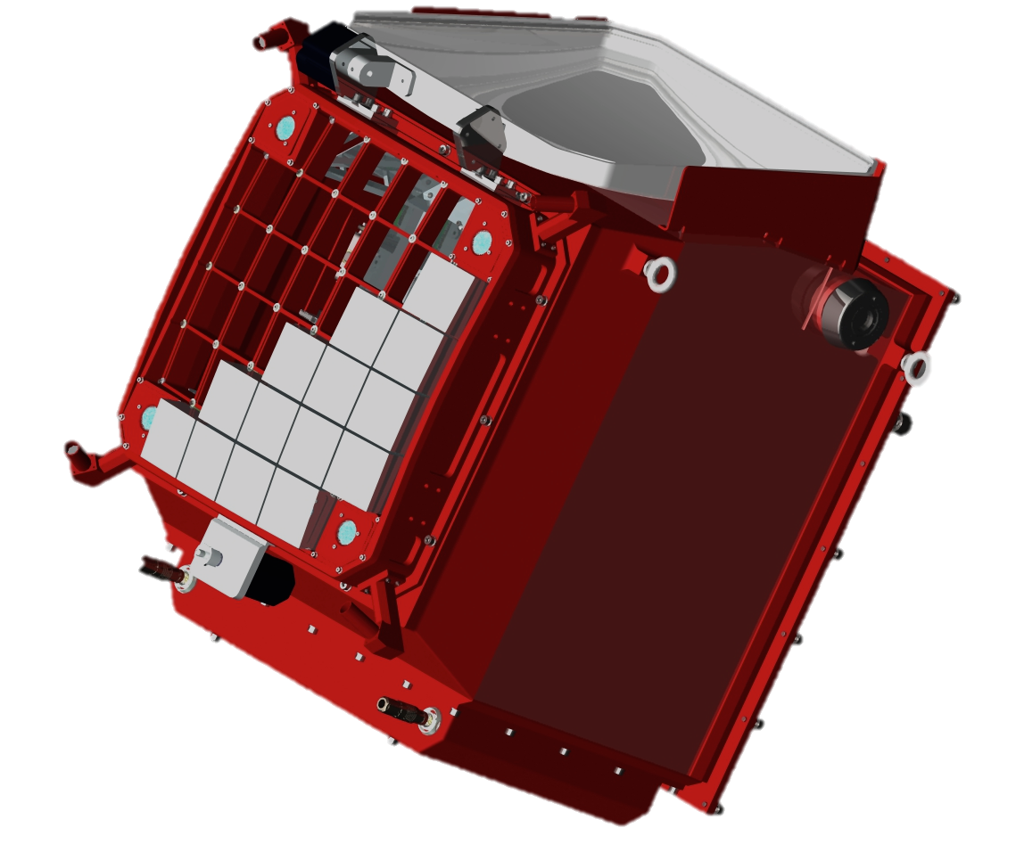
CHEC-M next steps
Increase DAQ speed; read out all TARGET modules through one DAQ board with a 10 Gb/s link.
Allows CHEC to cope with goal data rates, with random spacing.
Shift to improved safety and control system (some safety critical boards not directly steerable, power to some boards not individually switchable).
Shift to new software release.
(Initiative to cooperate on camera software launched – Akira Okumura.)
Tests on telescope in September.
Planning CHEC-M tests on ASTRI.
18

Slide 19
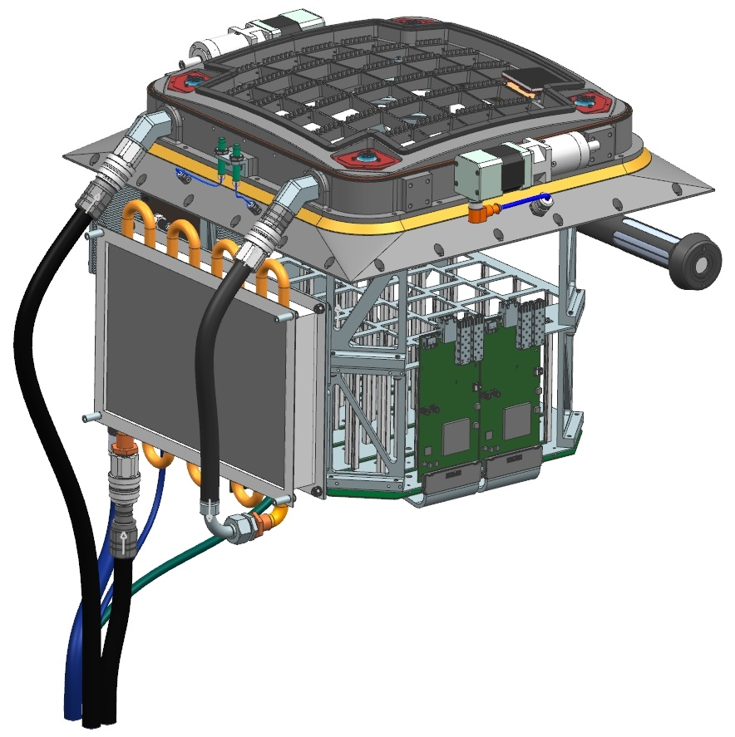
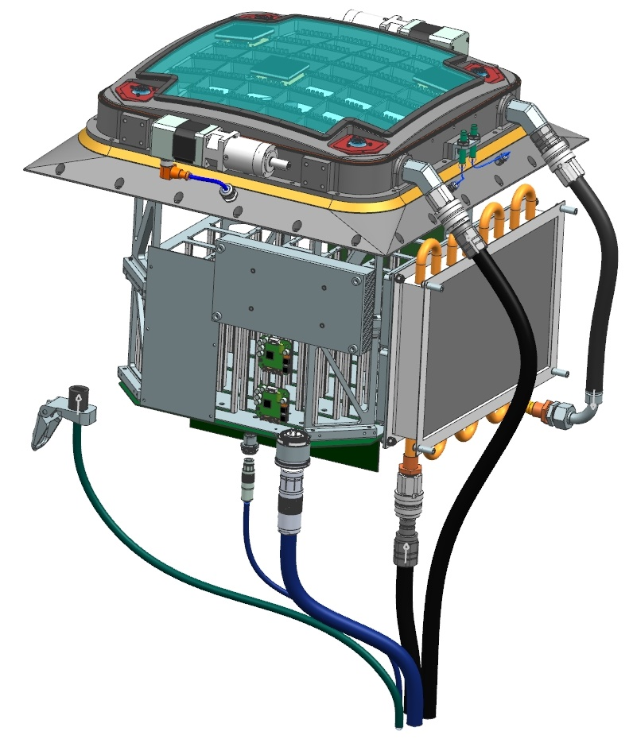
CHEC-S
Jon Lapington
Cooled focal plane
Improved door seal
2 motors for dual door
Thermal break
SiPM window
O-ring seals
Quickfit cooling
connections
Power relay
New heat exchanger
19

Slide 20
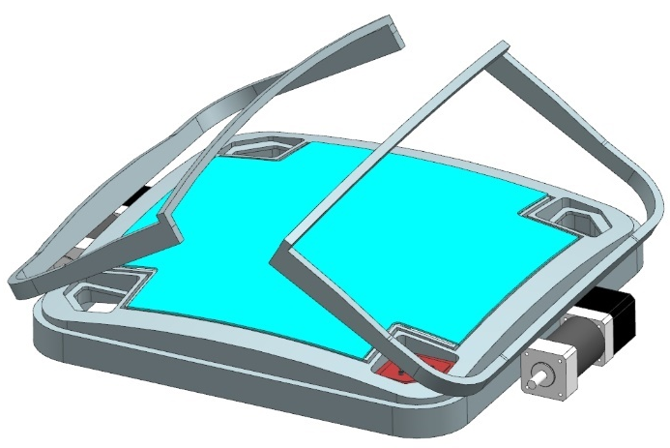
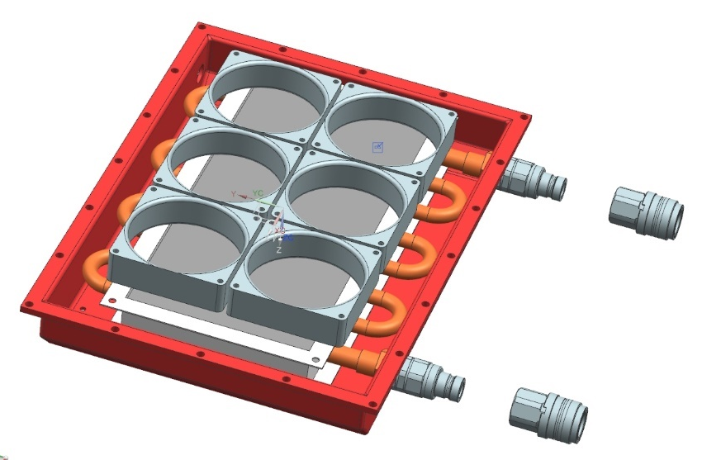
Mechanical design of CHEC-S
Larger enclosure (+3 cm/side), improved airflow.
Changes to body to simplify rack insertion.
O-rings for sealing, no flat gaskets.
Reposition DAQ boards.
Add further internal desiccator unit.
Improve heat exchanger.
Dual-panel
door.
Further options under consideration:
  Revise telescope interface plate – thicker, more mounting holes.
  Add removable handles for lifting.
  Add a dry-nitrogen purging system.
Powder coat enclosure, passivate unpainted external areas.
20

Slide 21
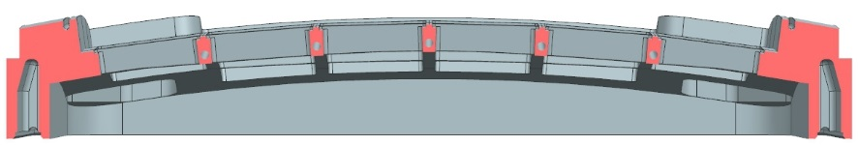
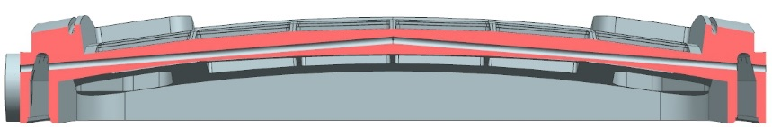
Mechanical design of CHEC-S
Major change in mechanical design: cooling of focal plane plate.
Thermal model showed SiPMs reach > 32 C in centre of camera.
Channel added around edge of plate.
“Gun drilling” provides path for cooling water through ribs.
Drilled channels for water cooling
Axial misalignment on 2 holes drilled for opposing
directions = +/- 0.5mm (acceptable error/restriction)
21

Slide 22
Mechanical design of CHEC-S
Paula Chadwick
Studying window manufacture using hot slumping of ~ 2 mm thick glass.
Coat to improve UV transmittance and cut out NSB
Difficult, due to large range of angles of incidence on window (20° < θ < 60°).
Alternatives, micro-lenses or Polycasa XT UV window.
Transmittance of coated window as function of wavelength and angle of incidence:
22

Slide 23
Front end electronics for CHEC-S
Stefan Funk
Recall T5 had low trigger threshold when no digitisation running, but poor dynamic range.
T7 improved dynamic range, but trigger problems worsened.
Noise in trigger caused by “substrate bounce”: digitisation influences analogue section of chip.
Split TARGET ASIC into two parts:
  Trigger (T5TEA) based on T5.
  Digitisation (TC) based on T7.
First studies show this combination satisfies our requirements.
Decide to use T5TEA and TC for CHEC-S, not T7.
T5TEA:
C.f. T5 with digitisation running:
Threshold 25 mV
Noise 5 mV
23

Slide 24
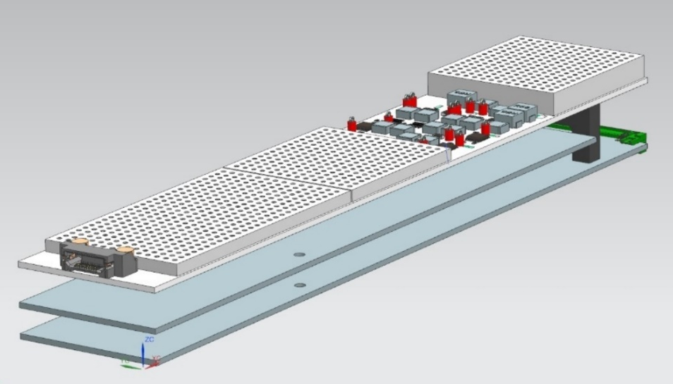
Front end electronics for CHEC-S
Improve design of TARGET modules to further reduce noise.
Previous two boards become:
  Top Power Board.
  Central Auxiliary Board – shapers and trigger.
  Bottom Primary Board – digitisation.
Power Board under test.
Auxiliary Board schematics nearly ready.
Primary Board, layout ongoing.
Further mechanical and electronic improvement through using micro-coax cables to connect SiPMs + pre-amps to TARGET modules.
Ensure that module length allows CHEC-S to be compatible with ASTRI – drawings being re-checked.
24

Slide 25
Back end electronics developments
Arnim Balzer
Backplane firmware re-written:
Preparing for shift of Backplane construction to Amsterdam.
The prototype GCT camera timing board (shrunk version of the ZEN board from Seven Solutions)…
…will serve as a test-bed for the CTA universal timing card reference design.
plain code at lowest levels
25

Slide 26
Pre-production GCT
Richard White/Jean-Laurent Dournaux
Downside of improvements to CHEC-S is that production is delayed – CHEC-S ready early 2017.
Upside is that expect only minor tweaks to CHEC-S to produce pre-production camera designs.
Some modifications to structure for pre-production:
  Accommodate common SST foundation.
  Cast some elements of structure.
  Cable housings will be plastic.
2015
2016
2017
2018
2019
2020
2021
2022
Prototyping
Pre-Prod design complete
(June 2017)
1st Prod camera on-telescope and verified (March 2019)
CHEC-M
On telescope (Nov 2015)
CHEC-S built
(Jan 17)
Last Prod camera on-telescope and verified (Nov 2021)
CHEC-S lab evaluation
(March 2017)
Pre-Prod cameras on telescopes (July 2018)
Pre-Prod Photosensor Choice (Oct 2016)
Pre-Production
Prod Photosensor choice (March 2018)
Overlap where procurement begins
Production
26

Slide 27
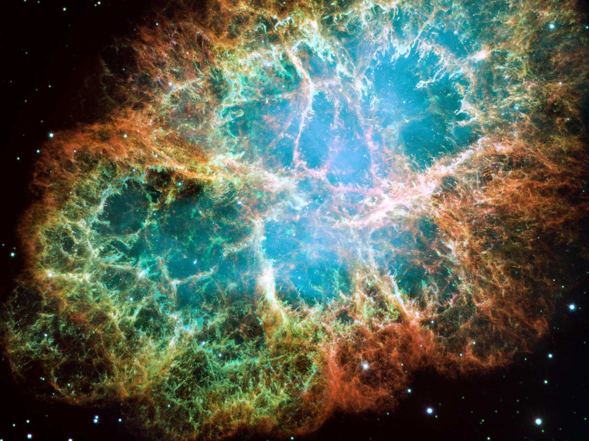
Summary
Tests of CHEC-M on the GCT prototype in Meudon have proven the GCT concept.
Good progress made with completion/testing of structure.
Noise problems in TARGET-based readout of camera solved.
CHEC-S design nearing completion: CHEC-S will be late, but will essentially be GCT pre-production camera.
Ambitious schedule sees 1st GCT on site in 2017, pre-prod (3 GCTs) completed mid-2018, prod (+ 32 = 35 GCTs) completed late 2021.
Cyril Trichard – can the GCT prototype see the Crab?
27

