Slide 1
CTA Highlights 2019
From three possible Small Size Telescopes and cameras, CTA selected the ASTRI structure (Italy) and the CHEC camera (UK + collaborators).
Tested in Sicily this year:
Selection of recorded events, showing Cherenkov light generated in EM showers in atmosphere by cosmic rays and photons.
Sampling frequency 1 GHz.

Slide 2
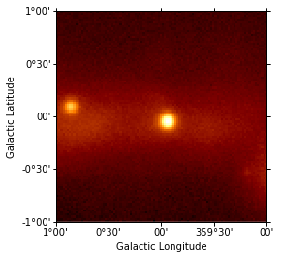
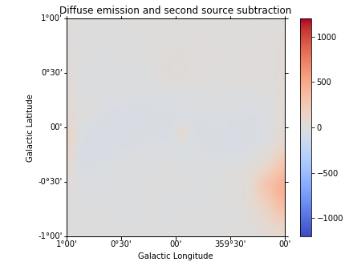
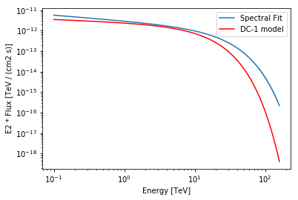
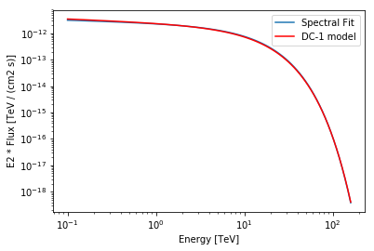
CTA Highlights 2019
As part of preparation of data analysis pipeline and Monte Carlo, Data Challenge 1 released.
Example, raw gamma ray image of Galactic Centre:
Analysis using GammaPy…
…successfully reconstructs input gamma ray spectrum:

