Slide 1
Design of Flexible Printed Circuit Prototype towards RD53 IC
Ilya Tsurin
Liverpool University
on behalf of ATLAS UK WP1/WP2

Slide 2
Full System Test for Pixel TDR:
Design Objectives
Re-design of the FE-I4B Quad hybrid (with the RD53 chip
in mind) for the new version of the Pixel EndCap bus tape
Mechanical concepts, connectivity, power distribution, cooling, readout, sensor performance, characterization of stresses and lifetime etc.
Drafting solutions for the RD53 IC Quad hybrid
Power density, readout speed, material budget, radiation tolerance etc.
Elaborating Module Production Schedule
Testing QC/QA procedures, infrastructure development

Slide 3
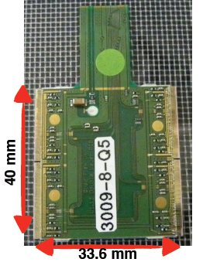
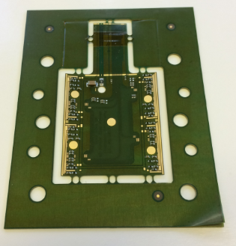
Revisions
V1 (Working Horse)
V2 (First experience with ZOT)
Single-sided
150um track/gap
100um FR4
18um copper clad
Individually cut PCB
Unpopulated
50um DuPont Pyralux
18um copper thinned to 9um :-(
Supplied on a frame for gluing
Fully assembled

Slide 4
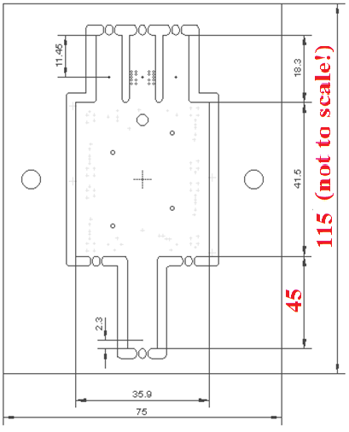
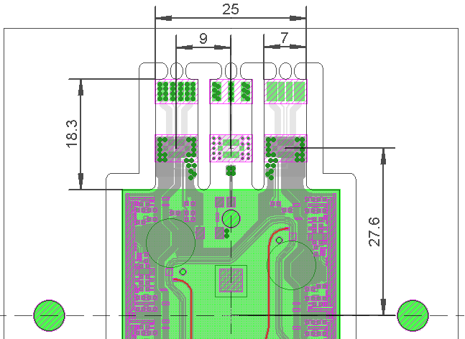
Quad Hybrid V3
Outline
Frame size is different from V1
(6 hybrids should fit on the standard
8inch x 12inch panel)
Dowel pins for module assembly are
10mm further apart compared to V2
4 tabs: LV, HV, Clock/Data

Slide 5
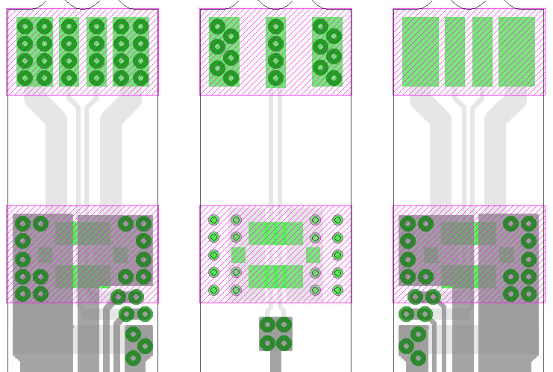
V3 Tab Features
Power Tabs
Hot bar solder pads
with optional through
hole plated vias
Openings in solder
stop mask for hot bar soldering and gluing
rigid plates
Through hole vias for
stronger bond with
connector stiffener
Connector footprint
on the backside
3x BM25-4P-V51 connectors with 10A current rating

Slide 6
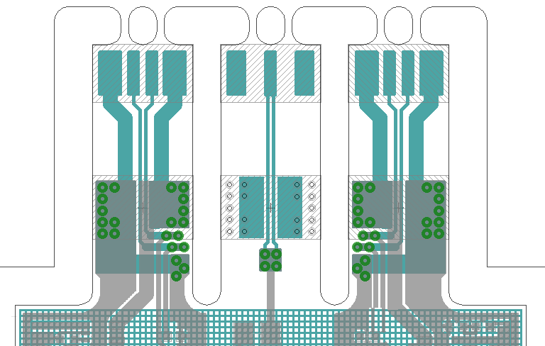
V3 Power Connector Pinout
Shield
HV return
NTC+
NTC-
GND
VIN
HV
VIN
GND
- “HV return” referred to GND via RC high pass filter
- “Shield” referred to GND via capacitor

Slide 7
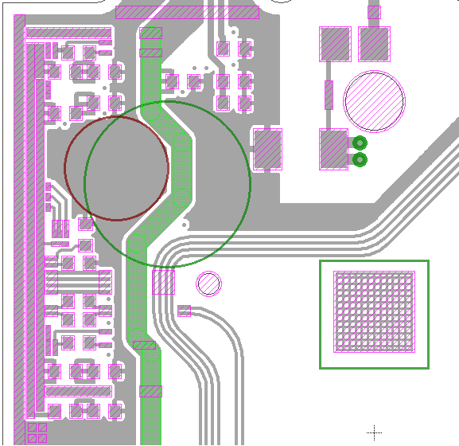
V3 Components (1 ASIC)
Canopy for
HV creepage
RC filter for
sensor bias
D=5mm pad
for pick and
place tool
D=8mm pad
for pick and
place tool
Hole to access
sensor backplane
Ground and
power rails
Area for RF ID
(up to 18mm range)
or QR code 5x5mm
Centre (0,0)

Slide 8
V3 Components (1 ASIC)
“Beefy” Serial
Power IN
(selectively plated
together with vias)
Wire bond pads
for connector-less
integration
Clock and command
GA jumpers
Opening for
laser alignment
of silicon sensor
Alignment mark
and bond-off pad
Data Out
(AC-coupled)
Centre (0,0)

Slide 9
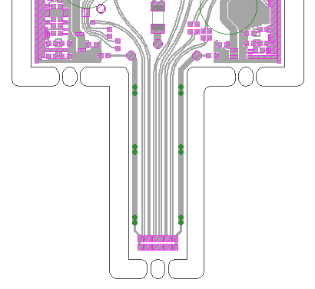
V3 Components (common)
Clock and command
terminating resistors
AC-coupling of clock
and command
AC-coupling of copper
plane (at Low Voltage)
under microstrips
Clock and command
Data out
AC-coupling of copper
plane (at High Voltage)
under microstrips
BM14 Hirose 24+4 way
connector 0.4mm pitch
for 10 Gbps data rate

Slide 10
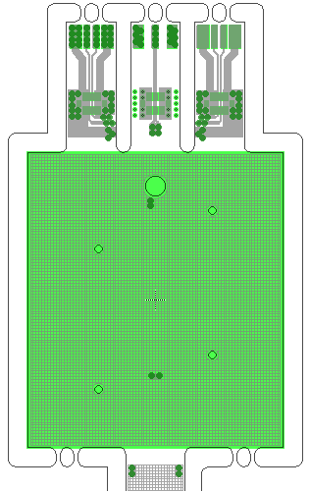
V3 Backside
Copper mesh:
125um track,
400um step
(47% transparent)
Mesh improves
peel strength of
FPC glued to
silicon sensor
Copper plane (at High
Voltage) for impedance control
Copper plane (at Low
Voltage) for impedance control
Sensor area is free
of solder resist for
better adhesion

Slide 11
V3 Ground Scheme
Flex V1 and V2: aluminium-coated sensor’s backplane (under HV)
serves as a reference plane for microstrip transmission lines – poor
impedance control due to thickness and Er variations of the laminate
Flex V3: bottom copper (fine mesh) as RF reference plane
ROC ground rail (top copper)
RF reference plane
(bottom copper)
RF reference plane (bottom copper)

Slide 12
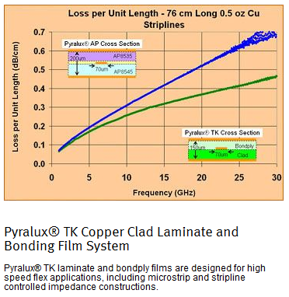
V3 Laminate Selection
Material:
Dupont Pyralux AP: all polyimide (no adhesive)
Designed for plate through hole reliability (good
resistance to thermal stresses)
Laminate thickness 4 mil (~100 um)
Copper clad 0.5 oz (~18um) Trace width 6 mil (~150 um)
Trace separation 6 mil (~150 um)
Relative dielectric
constant for Pyralux AP 3.4
Zo = 32 Ohm, Zd = 103 Ohm

Slide 13
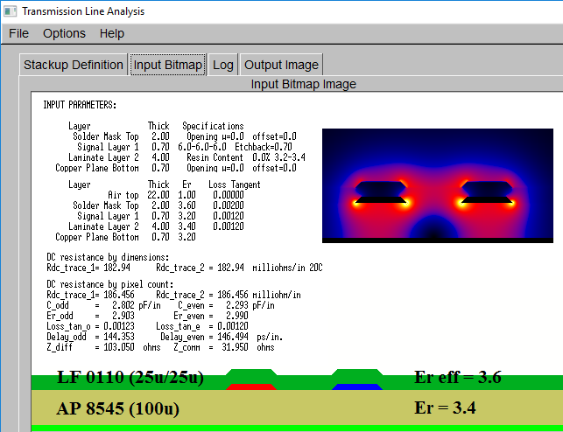
V3 Impedance Estimate

Slide 14
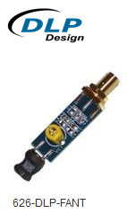
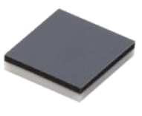
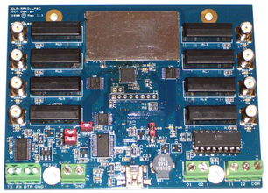
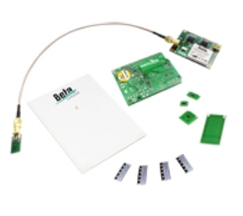
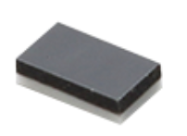
Murata RF ID devices
LXMS33HCNG-134
HF band, 15mm range
No PCB layout needed
Dimensions 3.2x3.2mm
HF RFID
Write-Read Kit
Available from Mouser
for approx. GBP 200
LXMS21NCNH-147
UHF band, 7mm range
No PCB layout needed
Dimensions 2x1.2mm
UHF RFID
Write-Read Kit
Supplied by Beta
Layout for EUR 280
ICs are Available
from multiple vendors

Slide 15
80 hybrids submitted with ZOT Plans to submit 10 hybrids with Stevenage to compare vendors for Pixel TDR Quad silicon packages (4xFE-I4B bump-bonded to “n-in-p” sensors ) are coming soon Reminder to organise UK/international Face-to-Face meeting for the module assembly (gluing FPC on silicon)
Summary

Slide 16
Backup Slide 1
FPC specs:
Double clad DuPont Pyralux AP8545 (18u copper, 100u laminate),
150u track and gap, 0.3mm minimum drill diameter, ENIG finish
Top and bottom HXC1215 coverlay (12u polyimide film, 15u epoxy adhesive)
silkscreen print, individually cut, cleaned and packaged.
Questions to FPC suppliers:
1. Stock availability / lead time of AP8545 / HXC1215
2. ENIG finish: total copper coverage / exposed contacts only
(influence of ferromagnetic Nickel on properties of microstrips)
3. Selective via plating capabilities
4. Impedance control capabilities.
5. Etch control: dummy pattern in copper-free areas (radiation length)

Slide 17
Backup Slide 2
FPC population
1. Compensating solder paste mask (provided) for kapton stretching
2. Ensure the right component grade (sulphur-free resistors, tolerance etc.)
3. Leaded solder assembly (to avoid tin whiskers and tin pest)
4. Positioning accuracy of in-line connectors
5. Making use of RF ID chip
Quality control
1. Visual inspection: solder escape to wire bond pads and misalignment
of coverlay are unacceptable
2. Electrical test (flying leads): integrity of traces - discontinuities and
shorts are unacceptable
3. Optical / tactile (CMM) inspection of ENIG finish for wire bonding,
too rough (grainy) is unacceptable (probably an artefact of copper thinning)
4. Impedance measurements of microstrip transmission lines
(PCB itself or test coupons).

Slide 18
Backup Slide 2
FPC cleaning
Application specific evaluations should be performed for the chosen solder
paste to identify if any remaining residue still needs to be removed from the
boards in final production. Plasma cleaning is recommended as a final step.
Packaging, shipping
Cleanroom materials should be used for packaging individual circuits.
The use of foil laminated mylar bags sealed in inert environment is
recommended. Measures should be taken to prevent circuits from bending
during their shipment.

