Slide 1
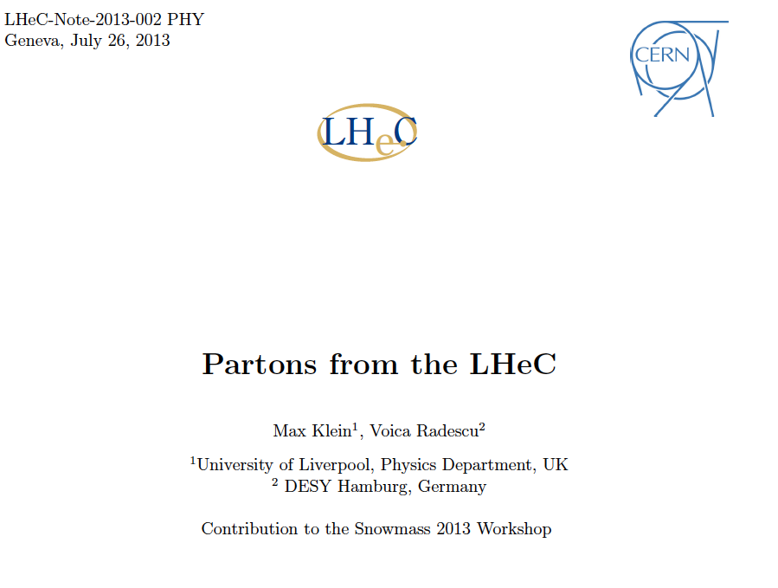
Introduction and Updates (work in progress)
LHeC Workshop, Chavannes-de-Bogis, January 20th, 2014

Slide 2
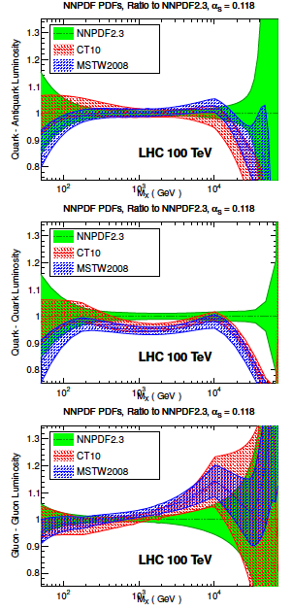
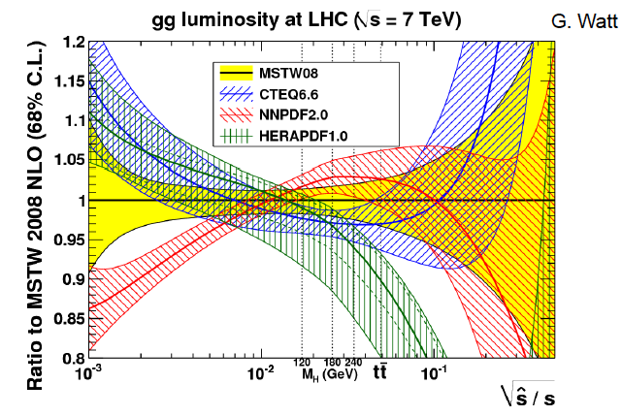
Parton Distributions
Need to know the PDFs much better than
so far, for nucleon structure, q-g dynamics,
Higgs, searches, future colliders, and
for the development of QCD.
Snowmass13 QCD WG report

Slide 3
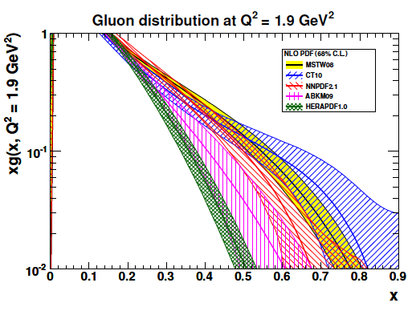
(Un)certainty on PDFs
Light Quarks:
valence x < 0.01, u_{v} x > 0.8, d_{v} x>0.6
light sea (related to strange) -8% ATLAS/F₂,
light sea quark asymmetry, d/u=?
Isospin relations (en!) ??
Strange: unknown, =dbar? strange valence?
Charm: need high precision to % for α_{s}
(recent HERA 5%)
Beauty: HERA 10-20%, bb → A?
Top: tPDF at high Q² >M_{t}² - unknown
Gluon: low x, saturation?, high x - unknown
medium x: preciser for Higgs!
Recent review: cf E.Perez, E.Rizvi 1208.1178, in RPP
..unintegrated, diffractive, generalised,
polarised, photonic, nuclear PDFs ???

Slide 4
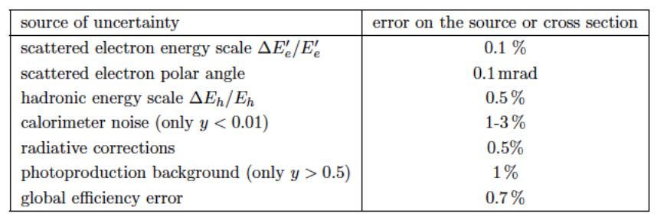
Simulated LHeC Data (Note=CDR=OLD)
Scenario “B”: (Lumi e^{+/-}p = 50 fb⁻¹) Ep=7 TeV, Ee=50 GeV, Pol=±0.4
  Kinematic region: 2 < Q² < 500 000 GeV² and 0.000002 < x < 0.8
Scenario “H”: (Lumi e⁻p = 1 fb⁻¹) Ep=1TeV, Ee=50 GeV, Pol=0
  Kinematic region: 2 < Q² < 100 000 GeV² and 0.000002 < x < 0.8
Typical uncertainties:
Full simulation of NC and CC inclusive cross section measurements including statistics, uncorrelated and correlated uncertainties – based on typical best values achieved by H1
  Statistical it ranges from 0.1% (low Q²) to ~10% for x=0.7 in CC
  Uncorrelated systematic: 0.7 %
  Correlated systematic: typically 1-3% (for CC high x up to 9% )
This set is available on LHAPDF

Slide 5
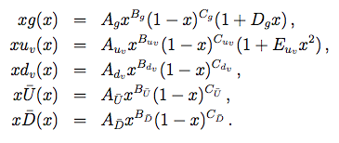
Settings for the PDF determination
[HERAFitter framework]
  Data:
    LHeC simulated data:
      NC e⁺p, NC, e⁻p, CC e⁺p, CC e⁻p postive and negative polarisations P=±0.4
    Published HERA I (NC, CC e±p data, P=0)
      Kinematics of HERA data: 0.65>x>10⁻⁴, 30 000 >Q²>3.5 GeV²
    Full experimental Uncertainties
  Initial Theory settings:
    NLO DGLAP [QCDNUM package], RT scheme
    Fitted PDFs:
      uval, dval, g, Ubar=ubar+cbar, Dbar=dbar+sbar
        Sea=Ubar+Dbar
        sbar=s=fsDbar=dbar fs/(1-fs)
        with fs=0.31 at starting scale
    Impose the fermion and momentum sum rules
    One B parameter for sea and one for valence

Slide 6
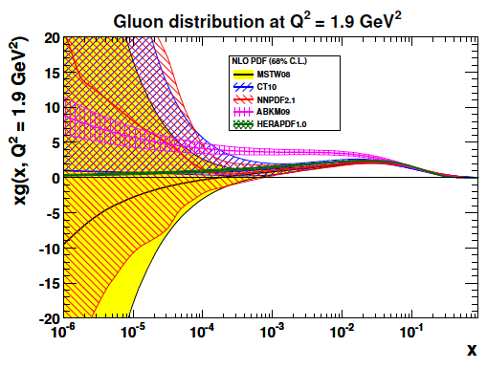
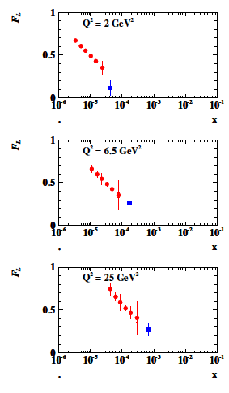
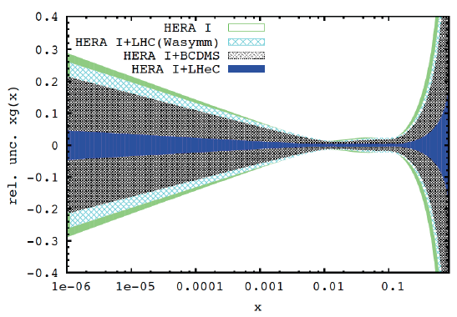
Gluon Saturation at Low x?
LHeC
H1
→ HERA sensitivity
Gluon measurement down to x=10⁻⁵, Saturation or no saturation (F₂ and precise F_{L})
Non-linear evolution equations? Relations to string theory, and SUSY at ~10 TeV?
cf H.Kowalski, L.Lipatov, D.Ross, arXiv:1205.6713

Slide 7
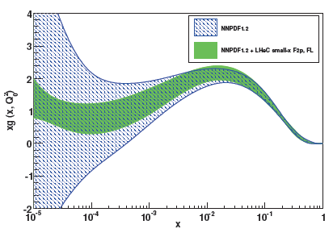
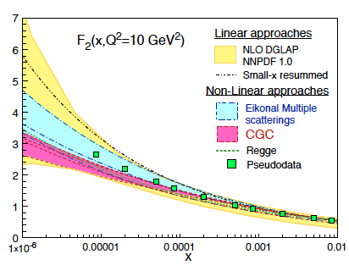
Partons at low x
Studies within NNPDF (CDR 8/12)
High precision F₂ and F_{L} pin down
low x phenomenology and determine
the gluon distribution down to x~10⁻⁵

Slide 8
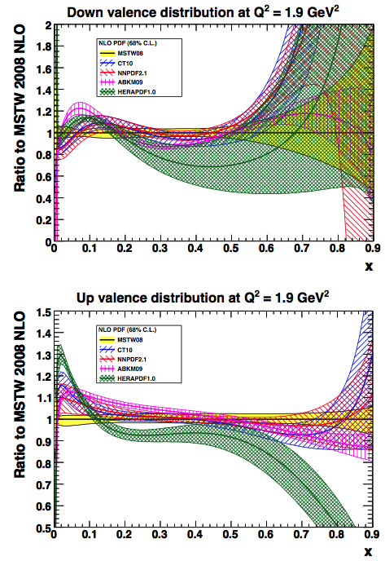
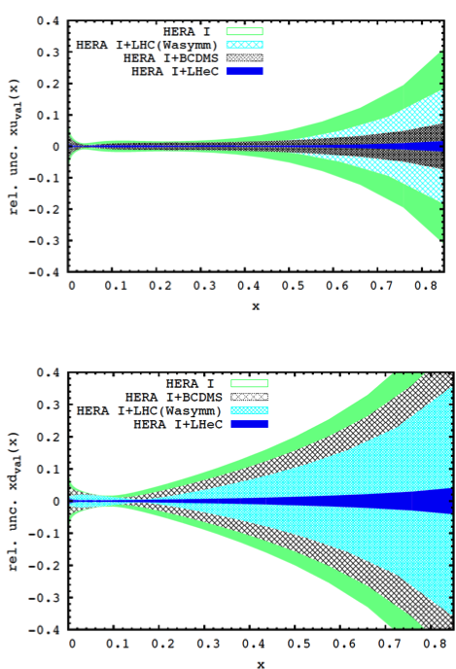
Valence quark distributions
Now…
…Then
Current knowledge is limited at high x:
  Lumi barrier
  challenging systematic
  nuclear effects
  Effects of higher
  twists
LHeC could improve the knowledge of the valence at high x to a precision of:
  2% (uval) x=0.8
  4% (dval) x=0.8
  Important for d/u limit clarification
dval
uval
uval
dval

Slide 9
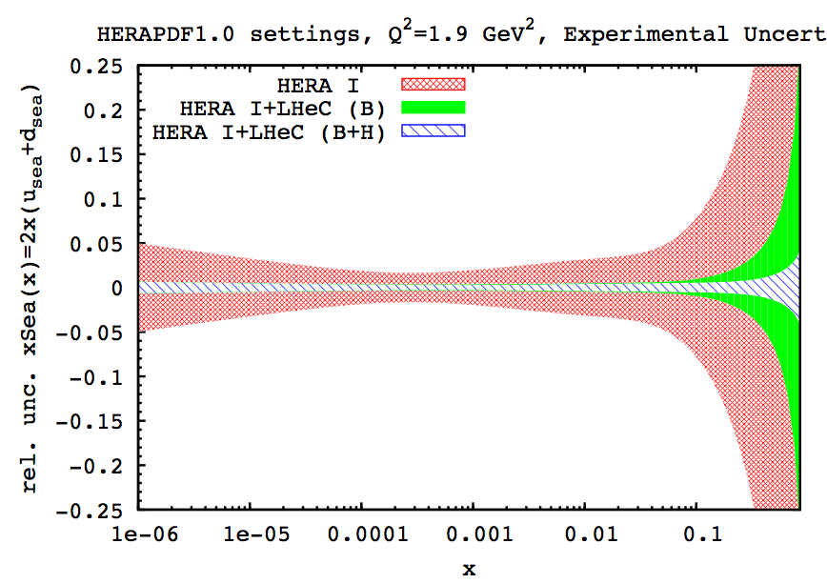
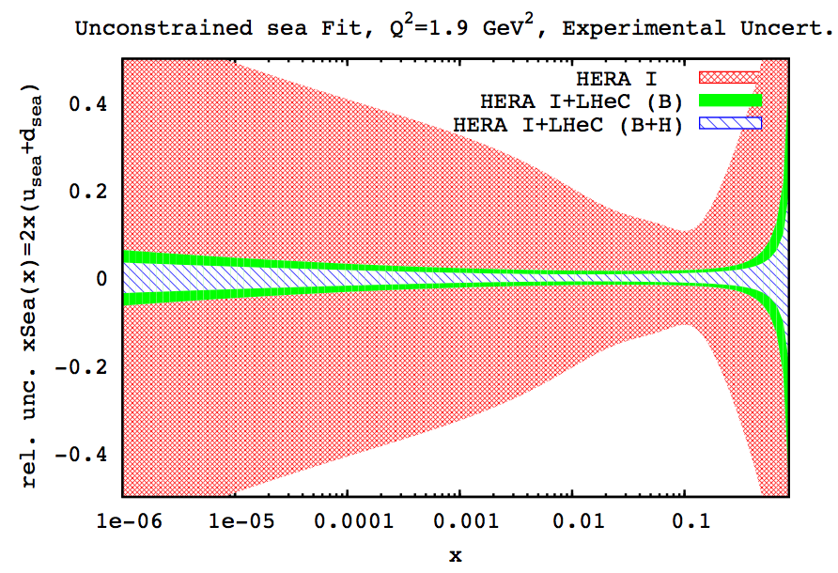
Unconstrained setting at low x
Usual assumptions for light quark decomposition at low x may not necessary hold.
Relaxing the assumption at low x that u=d , we observe that uncertainties escalate:
constrained (u=d)
unconstrained
  One can see that for HERA data, if we relax the low x constraint on u and d,the errors are increased tremendously!
  However, when adding the LHeC simulated data, we observe that uncertainties are visibly improved even without this assumption.
  Further important cross check comes from the deuteron measurements, with tagged spectator and controlling shadowing with diffraction [see tomorrow LHeC talks]

Slide 10
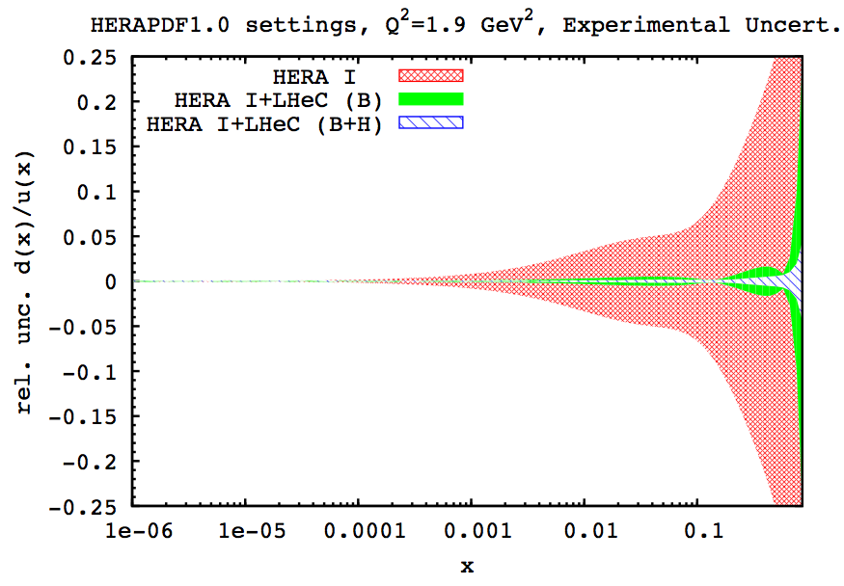
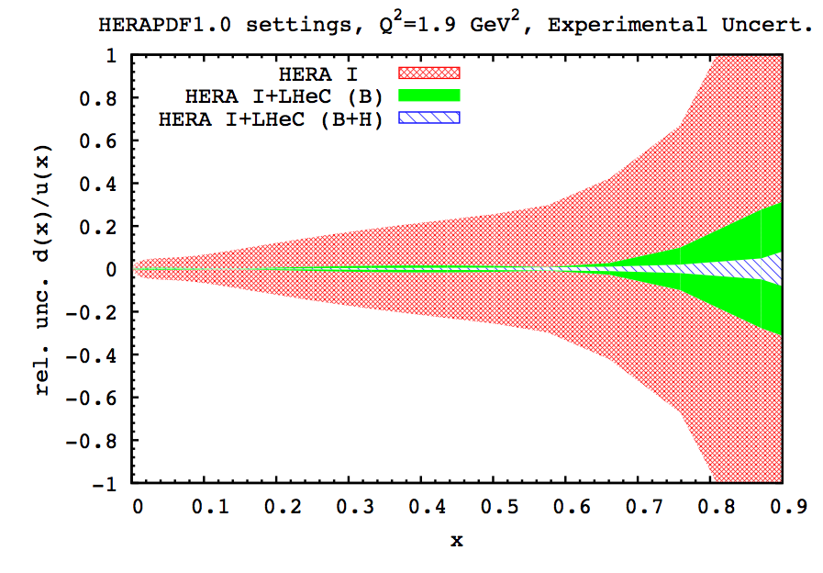
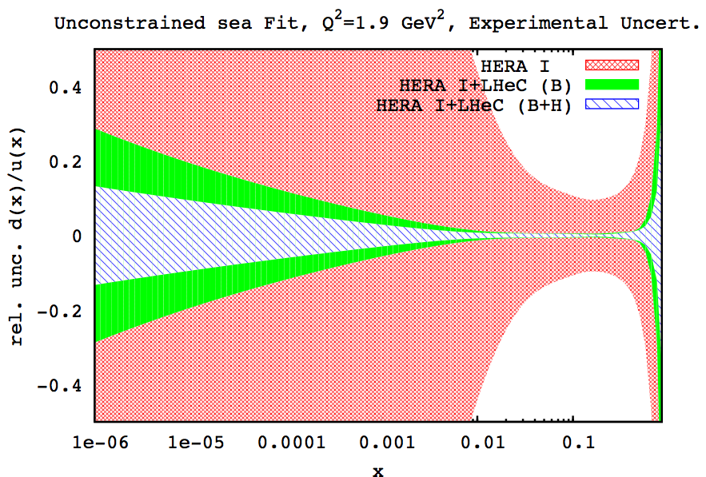
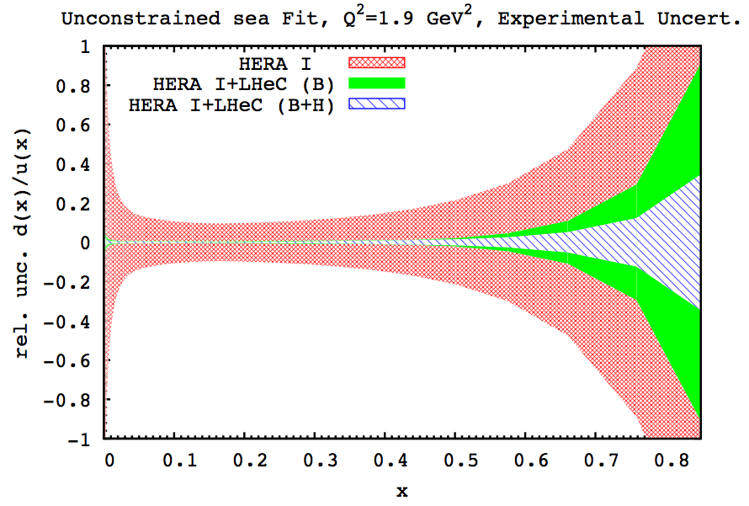
Impact on d/u ratios
Constrained decomposition:
Unconstrained sea decomposition:

Slide 11
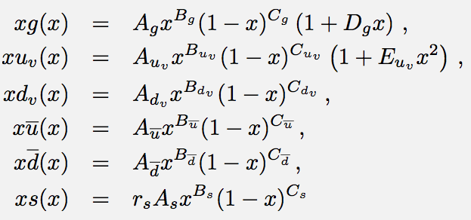
Releasing further PDF constraints
Releasing further the assumptions:
  Removing the correlation that ubar=dbar at low x
  Free parameters for the strange quark are introduced
  This study was driven by the recent ATLAS results on strange determination, hence we have repeated the impact of LHeC study under the new conditions.

Slide 12
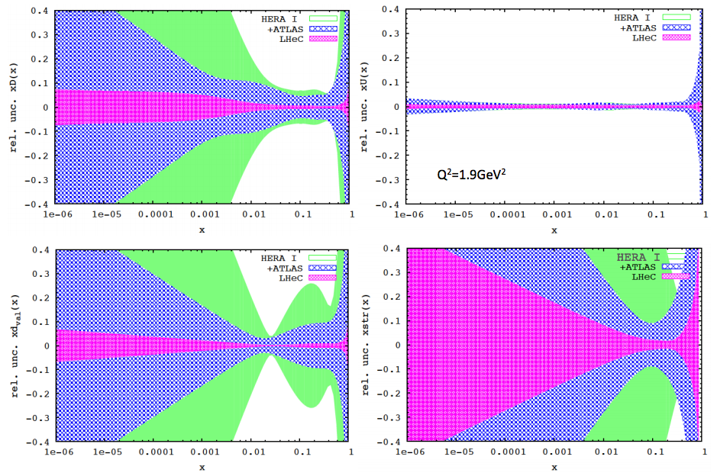
Releasing assumptions
QCD fit with free
u,d,s, HERA plus ultimate ATLAS and
full systematic error simulation on LHeC
Dbar
Ubar
dval
strange
  Inclusive LHeC data leads to very precise determination of all PDFs even after removing large bulk of assumptions:
  LHeC ep data constrain better U than D distributions, however deuteron data would symmetrise our understanding.
  Determination of the strange can complement the strange determination from the charm data

Slide 13
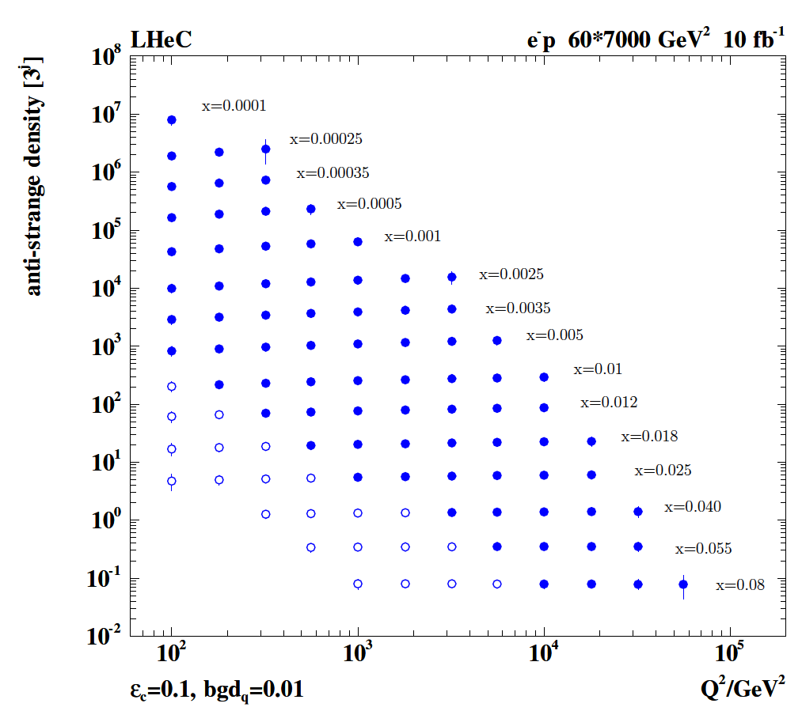

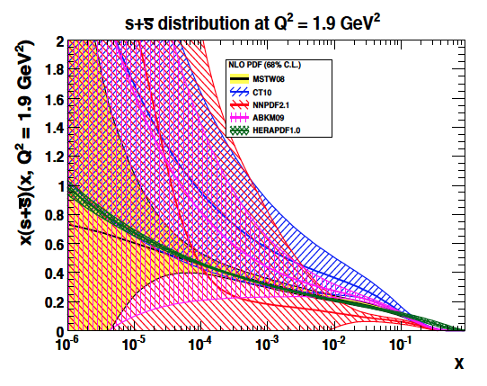
Strange Quark Distribution
High luminosity
High Q²
Small beam spot
Modern Silicon
NO pile-up..
First (x,Q²)
measurement of
the (anti-)strange
density, HQ valence?
x = 10⁻⁴ .. 0.05
Q² = 100 – 10⁵ GeV²
JPhysG 39(2012)7
Initial study (CDR): Charm tagging efficiency of 10% and 1% light quark background in impact parameter

Slide 14
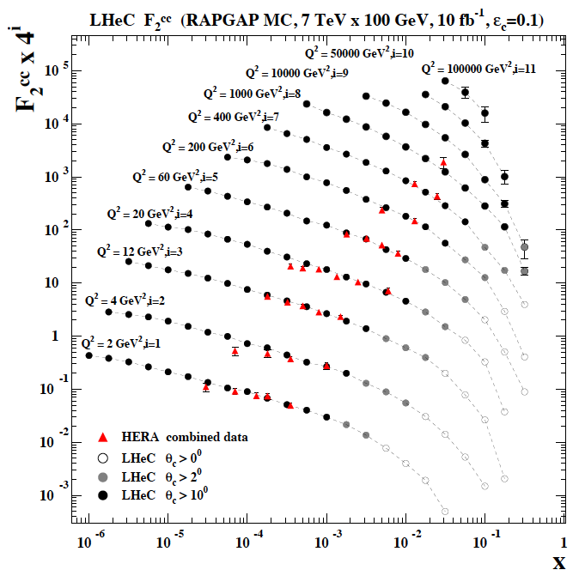
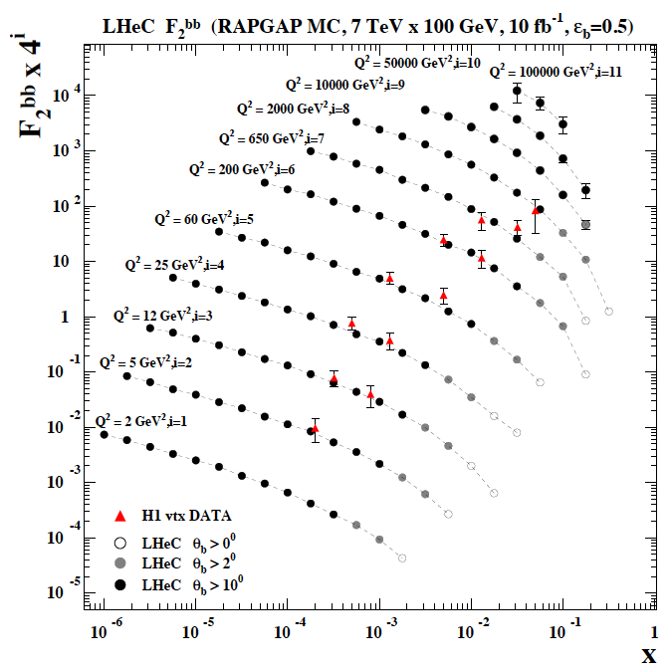
F₂^{charm} and F₂^{beauty} from LHeC
Hugely extended range and much improved precision (δM_{c}=60 HERA → 3 MeV)
will pin down heavy quark behaviour at and far away from thresholds, crucial for precision t,H..
In MSSM, Higgs is produced dominantly via bb → H , but where is the MSSM..

Slide 15
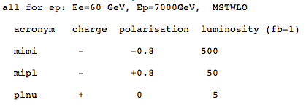
Further studies (“New”)
The ERL configuration does not provide polarised positrons at comparable L
The interest in the Higgs prefers electrons with negative, high polarisation:
Not (yet) included low E_{p} data (important for high x) nor low E_{e} (F_{L})

Slide 16
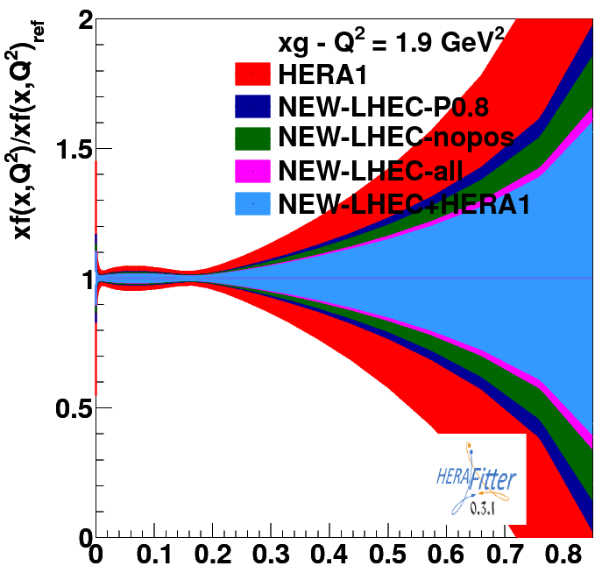
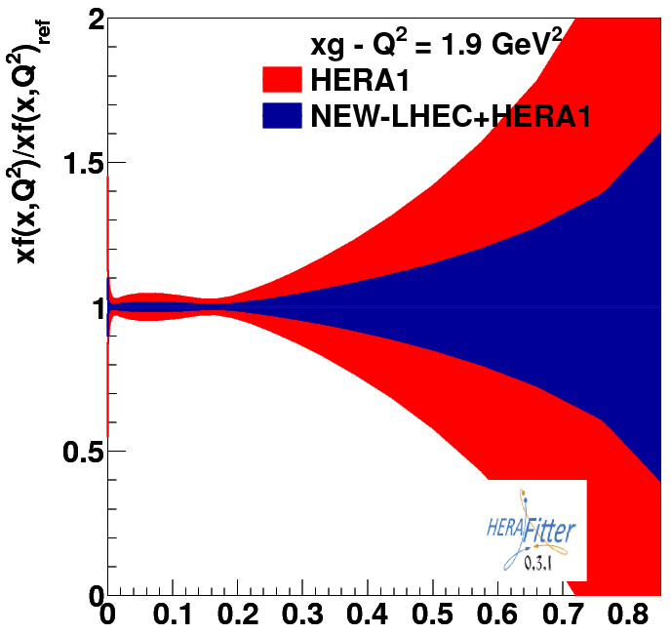
PDF Uncertainties high x - Gluon
All new files:

Slide 17
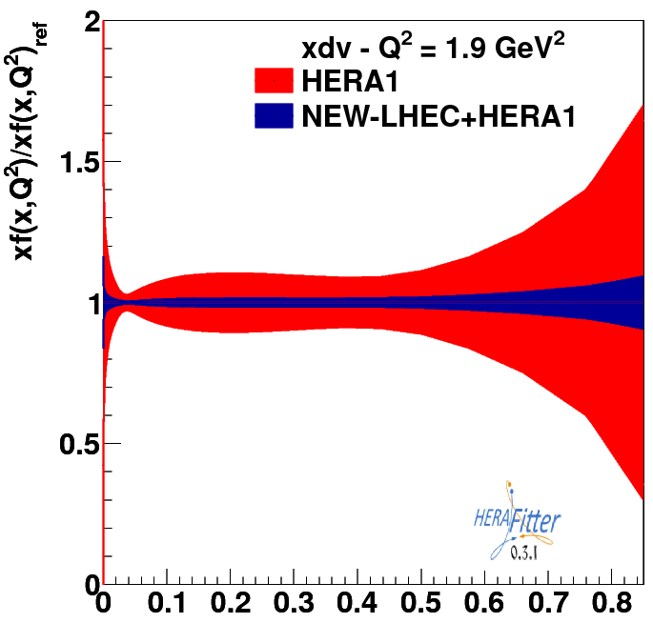
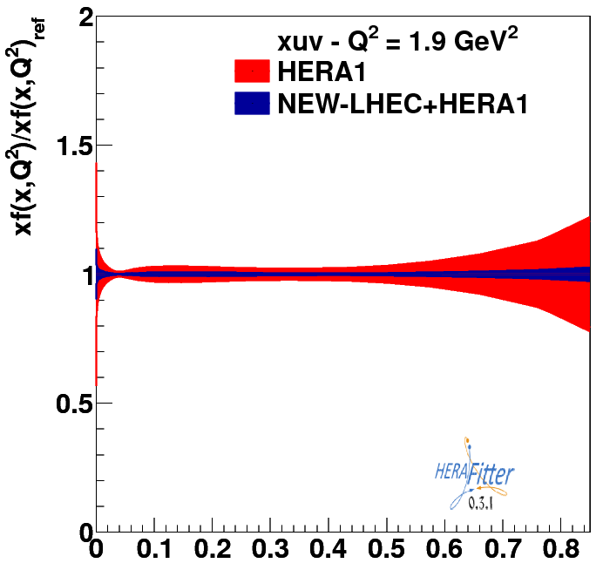
PDF Uncertainties high x - Valence
All new files:

Slide 18
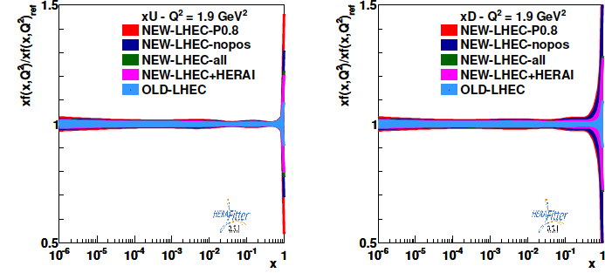
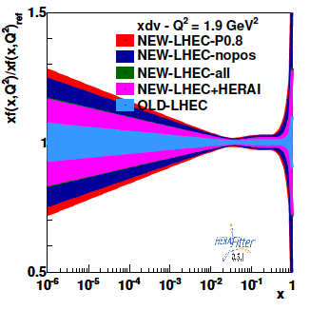
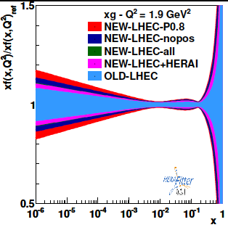
Further initial results
Next steps:
include low Ep
also consider FL
and eD + ep

Slide 19
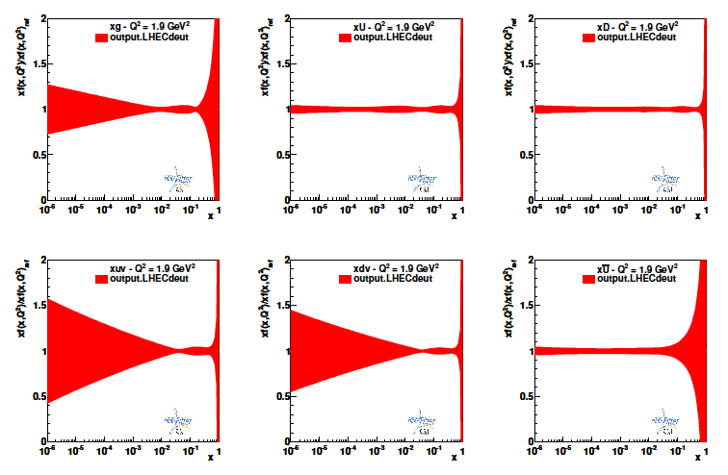
First, standalone eD data fits
3.5 TeV x 60 GeV, e-, P=-0.8, 1fb-1 Neutral and Charged Current, exp uncertainties
Future fit of jointly ep and eD data will lead to precise unfolding of u-d

Slide 20
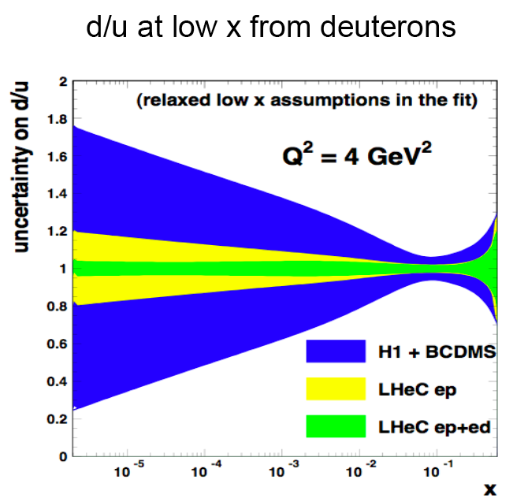
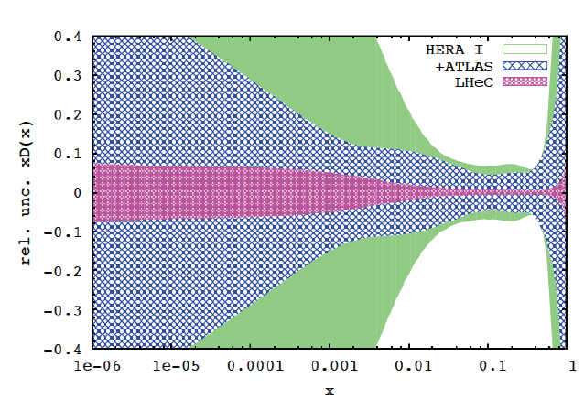

Deuterons and Light Sea Quark Asymmetry
D=“total down” from LHeC (ep) fit
with FREE d-u difference, including
simulated high precision LHC W,Z
CDR
From 2007 LHeC paper: E.Perez et al.
Deuterons: Crucial for
NS-S decomposition
Neutron structure
Flavour separation
Nice: Gribov relation and spectator tagging to get rid off shadowing and Fermi motion!!

Slide 21
Summary
With the LHeC the determination of the PDFs, quarks and gluons,
will be put on a completely new base:
Determination of all quark PDFs, including d/u, s, c, b
Mapping of the gluon distribution from nearly 10⁻⁵ to x=1
Determination of the strong coupling to permille level (CDR)
This puts severe requirements to detector design, precision of
tracking and calorimetry in large acceptance and to QCD.
Besides the classic PDFs, the LHeC provides much further insight
to photon, neutron, nuclear, Pomeron structure and to the
extension of the collinear approximation to generalised PDs.
Further studies are envisaged (data optimisation, role of e+, d..)

Slide 22
backup

Slide 23
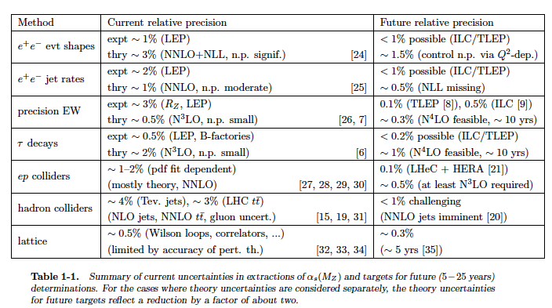
The strong coupling “constant”
Snowmass QCD WG report 9/2013
Prospects to measure α_{s}(M_{Z}²) to per mille precision with future ep and ee colliders
Important for gauge unification, precision Higgs at LHC, and to overcome the past..

Slide 24
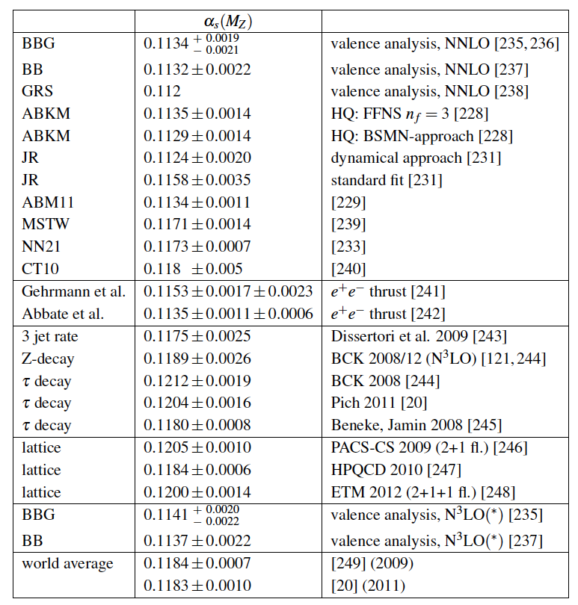
The strong coupling constant
α_{s} is the worst measured
fundamental coupling constant.
Is there grand unification?
In DIS, values (NNLO) range from
0.113 to 0.118.
τ leads to about 0.120
Lattice predictions seem to
determine the world average.
The LHeC has the potential to
measure αs to permille accuracy
(0.0002) from a consistent
data set. This leads to high
precision understanding of all
related effects (low x, δM_{c}=3MeV)
and pQCD at N³LO
J.Bluemlein, Why Precision, arXiv:1205.4991

