Slide 1
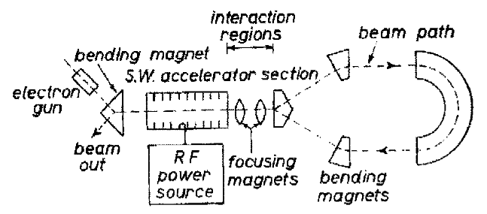
incomplete
Status Report for TIARA
…
with a remark on PERLE
Performance of a 55 year old idea with
the technology of today and tomorrow:
M Tigner A Possible Apparatus for Electron
Clashing-Beam Experiments, N.Cim 10(1965)1228
Max Klein (U.Liv) & Andrew Hutton (Jlab)
for the ERL Roadmap Panel
TIARA Meeting, June 29, 2021

Slide 2
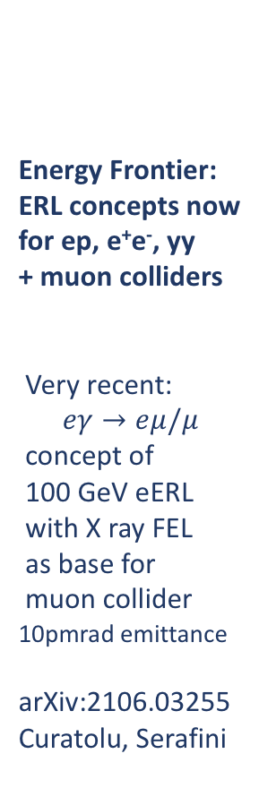
erl
A long
Write-up
on ERLs
for
Publication
Science base
for input to
Roadmap.
Status:
Write-up
drafted
ERL Symposium
Next:
PP Symposium
EPS Conference
Roadmap
Today:
Observations
Energy Frontier:
ERL concepts now
for ep, e⁺e⁻, yy
+ muon colliders
Very recent:
$$eγ→eμ/μ$$
concept of
100 GeV eERL
with X ray FEL
as base for
muon collider
10pmrad emittance
arXiv:2106.03255
Curatolu, Serafini
[from report to LDG]

Slide 3
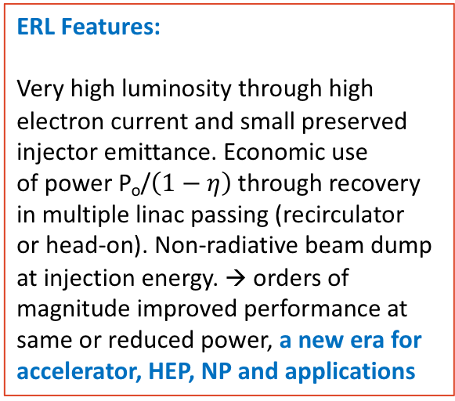
A selection of past, present and proposed ERL facilities: Power = E_{e} I_{e}
ERL Features:
Very high luminosity through high
electron current and small preserved
injector emittance. Economic use
of power P_{o}/$\left(1−η\right)$through recovery
in multiple linac passing (recirculator
or head-on). Non-radiative beam dump
at injection energy. → orders of
magnitude improved performance at
same or reduced power, a new era for
accelerator, HEP, NP and applications
“The ERL concept is well proven
and the technology is well
developed. Many demonstrator
facilities exist worldwide with
increasing sophistication. It
needs a facility comprising
all essential features
simultaneously: high-current,
multi-pass, optimised cavities
and cryo-modules and a
physics quality beam eventually
for experiments”. (Bob Rimmer
at ERL Symposium, June 4, 2021 )

Slide 4
ERL Facilities DRAFT 19.3.21
New Facilities in the Twenties
CEBAF (Jlab): high energy, 5-turn
MESA (Mainz): polarisation
Cooler (BNL): high current
PERLE (Orsay): high power, 3-turn
Chapter 4
Key Challenges – a Concerted Effort
Studies:
DICE Darmstadt, DIANA Daresbury
Derived from PERLE; also IHEP Beijing
MK+AH - LDG Meeting 19.3.21

Slide 5
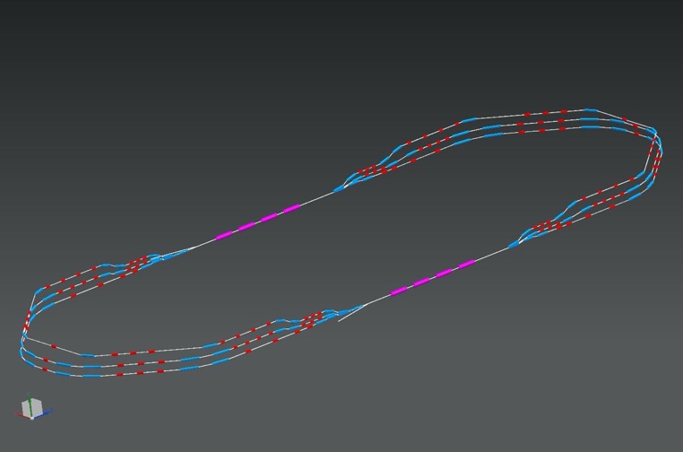
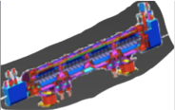
PERLE * (ERL R&D → Physics [NP, PP])
ALICE DC Photocathode, JLEIC Booster and SPL Cryomodule – in kind
LHeC Design
Update
2007.14491
J.PhysG, 21
1 : 3 : 5
injector
7 MeV
2 : 4 : 6
DE = 80 MeV
7 MeV
dump
DC = l_{RF}/2
24 x 5.5 x 0.8 m³
CERN, Cornell, Daresbury, Jefferson Lab, Liverpool, Novosibirsk,
IJCLab Orsay (Host) Collaboration, growing: Grenoble, GANIL +
PERLE
* PERLE. Powerful energy recovery linac for experiments. Conceptual design report
Published in: J.Phys.G 45 (2018) 6, 065003 e-Print: 1705.08783 [physics.acc-ph]

Slide 6
DRAFT timeline of PERLE: Design, Injector, SRF, Magnets, Infrastructure, Experiments, Safety/Integration
Principally endorsed by PERLE CB, June 2021
Walid Kaabi et al, 28.6.2021

Slide 7
[from report to LDG]

Slide 8
Evaluation of ERL concepts for FCC-ee [CERC] and the ILC [ERLC]
Vladimir Litvinenko+ https://doi.org/10.1016/j.physletb.2020.135394 ;
Valery Telnov, https://arxiv.org/abs/2105.11015
The Sub-Panel should evaluate the technical and financial implications of the two novel concepts compared to the FCC-ee and ILC projects:
What are the technical advances, specifically in luminosity?
What are the technical solutions + obstacles requiring R&D?
How much time would that additionally require?
What is the rough cost implication (to about 10%)
Sub-Panel members
Chris Adolphsen (SLAC) Reinhard Brinkmann (DESY)
Oliver Brüning (CERN) Andrew Hutton (JLab) – Chair
Sergei Nagaitsev (Fermilab) Max Klein (Liverpool)
Peter Williams (STFC) Akira Yamamoto (KEK)
Kaoru Yokoya (KEK) Frank Zimmermann (CERN)
The e⁺e⁻ ERL Sub-Panel
Dates for the sub-Panel
Kick-off meeting held June 9, 2021
Completion by September 3, 2021
Deliverable:
A short report (~20 pages) detailing the conclusions of the evaluation, which should be agreed and supported by the entire sub-Panel and published as Appendix B to the full Panel report.
Methodology: Sessions with proponents to begin with. Sessions open to other ERL panel members
Procedure agreed with the proponents
Valeri Telnov and Vladimir Litvinenko, Tomas Roser

Slide 9
The symposium was an important event
for information, consultation and formation
of a more coherent R&D ERL effort.
→

Slide 10
Current Summary: ERLs - a Progressing, Revolutionary Technology
Based on decades of SRF, FEL, ERL, Facility..
developments*) :
The debate now is about the conditions for ERLs to reach their productivity plateau and the demands implied on R&D, financial, intellectual and technical support.
ERL
An initial observation (not only) by the panel:
ERLs are more than an appealing technology:
They (cor)respond to A NEW ERA in
particle and several other fields of physics,
industry, accelerators .. in a world that cannot
proceed without renewed care for our planet.
ERLs, as came out at the Symposium, are technologies with far reaching impacts on science + society.
Next: Working towards the ERL Roadmap
Olga Tanaka (KEK)
*) e.g. Ilan Ben-Zvi 2016 Supercond. Sci. Technol. 29 103002
Chris Tennant, ERLs, in “Challenges and Goals for Accelerators
in the XXI Century”, O Bruening, S Myers, World Scientific, 2019

