Slide 1
W,Z, pdf’s and the strange quark distribution
Max Klein, Uta Klein, Jan Kretzschmar
QCD Fit assumptions and pdf’s
Measurement Quantities
Effects from a strange strange
Effects from ū/đ asymmetries
A case study (using numerical and MC calculations) to investigate the sensitivity of W,Z to pdf’s
in discussions with DESY, HH, Mainz, Oxford → note on W,Z studies in preparation.
WZ Meeting, CERN 23.10.2009

Slide 2
QCD Fit Assumptions on pdf’s
Require ū=đ at low x (only constraint is HERA F₂^{p} =2x[4ū+đ+..]) At larger x ~ 0.1 they differ (Exxx)
Testing the low x symmetry assumption would have required deuteron scattering at HERA.
Charm is generated dynamically. Usually Q₀² >m_{c}². Some 5-10% constraints from F₂^{cc} at H1/ZEUS
Beauty is generated dynamically above threshold and ~20% constraints from F₂^{bb} at H1/ZEUS
The high x region is not too well constrained (low HERA luminosity, nuclear corrections),
which results in larger pdf uncertainties at high x (large |rapidity|).
A stranger is the strange quark distribution. Some hints for s ≠ sbar. Some constraints from K, Φ.
Usual assumption
Recent H1pdf2009 and HERApdf1.0 [D=d+s]
HERAPDF1.0 release imminent

Slide 3
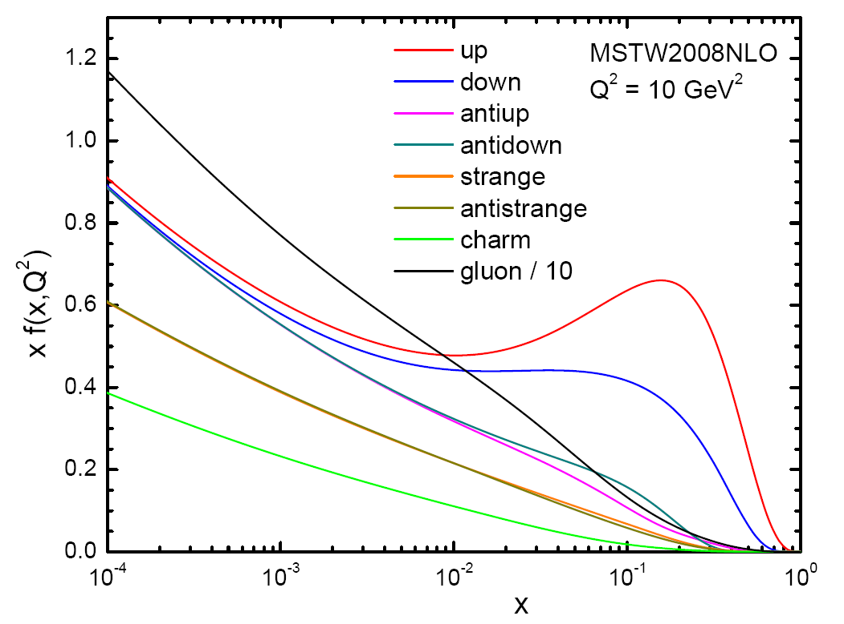
W.Stirling seminar at CERN, 8/09

Slide 4
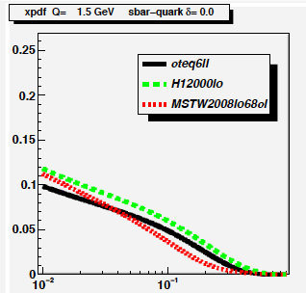
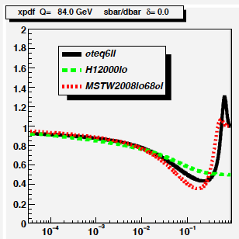
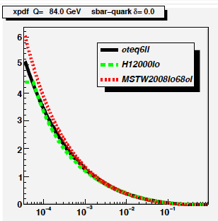
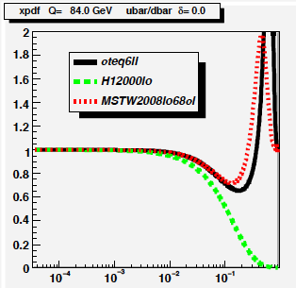
pdf’s

Slide 5
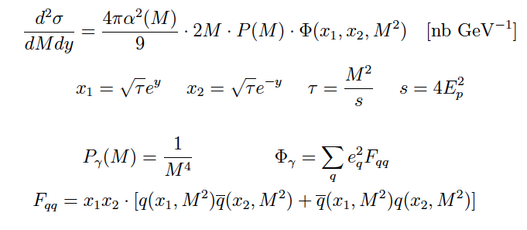
Cross Sections – Drell-Yan (photon exchange)
ALL cross sections are for the lepton decays Z → ee or W→eν
Note that τ=x₁x₂ and often one gets confused as the
quark distribution term is often written without x₁x₂
but the LHAPDF delivers xq which we term pdf .
With NLO corrections the cross section depends on the gluon distribution too.

Slide 6
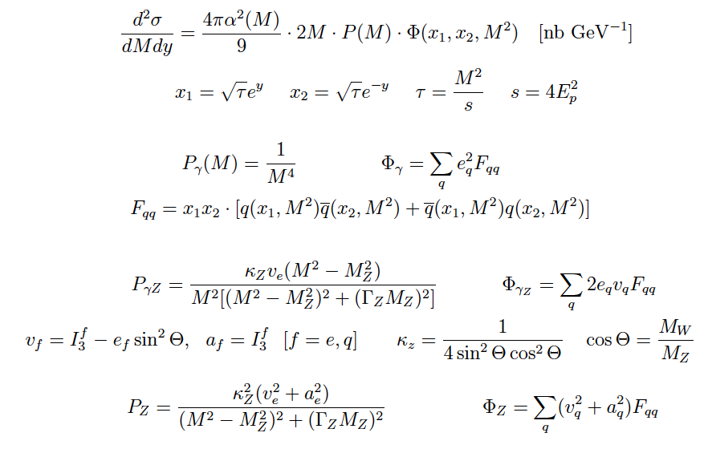
Cross Sections – γ and Z exchange and interference
Interference must change sign at M_{Z} and is in itself small as v_{e}=-1/2 + 2 sin² Θ ≈0

Slide 7
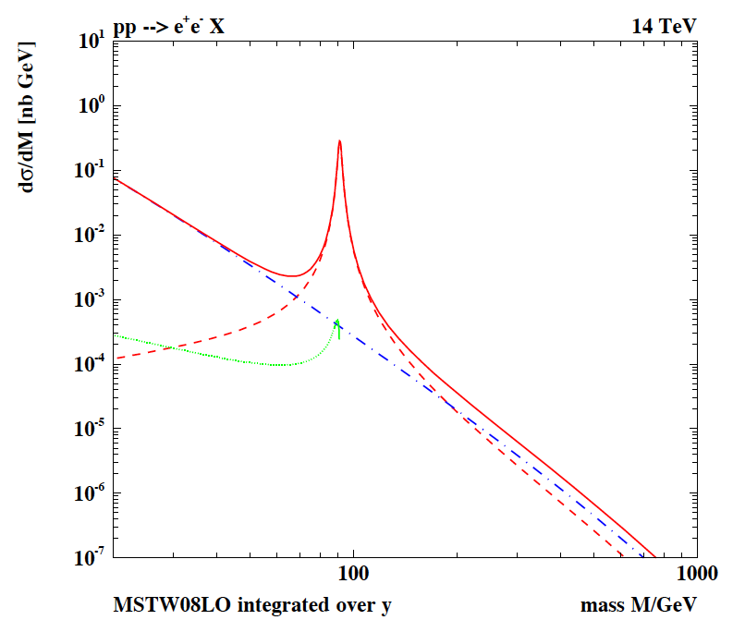
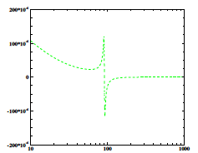
Z Mass Distribution
LO - integrated
Cross section [nb]:
M=60-120 GeV
all y (|y|<2.5)
Z 1.75 (1.14)
yZ 0.003 (0.002)
y 0.057 (0.033)
Drell Yan 20-60 GeV:
1.3 (0.60) nb →
O(1000) events/pb⁻¹
Low/hi mass DY is sizeable
Interference is negligible

Slide 8
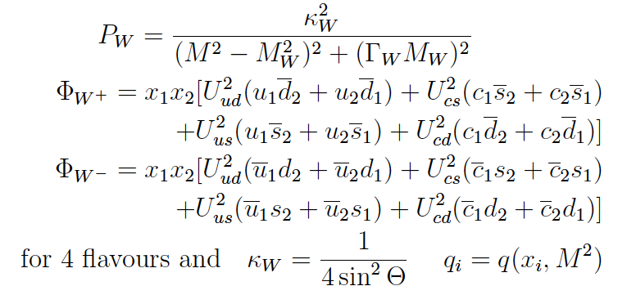
Cross Sections - W^{+/-}
U_{ud}²=U_{cs}²=0.94, U_{us}²=U_{cd}²=0.05

Slide 9
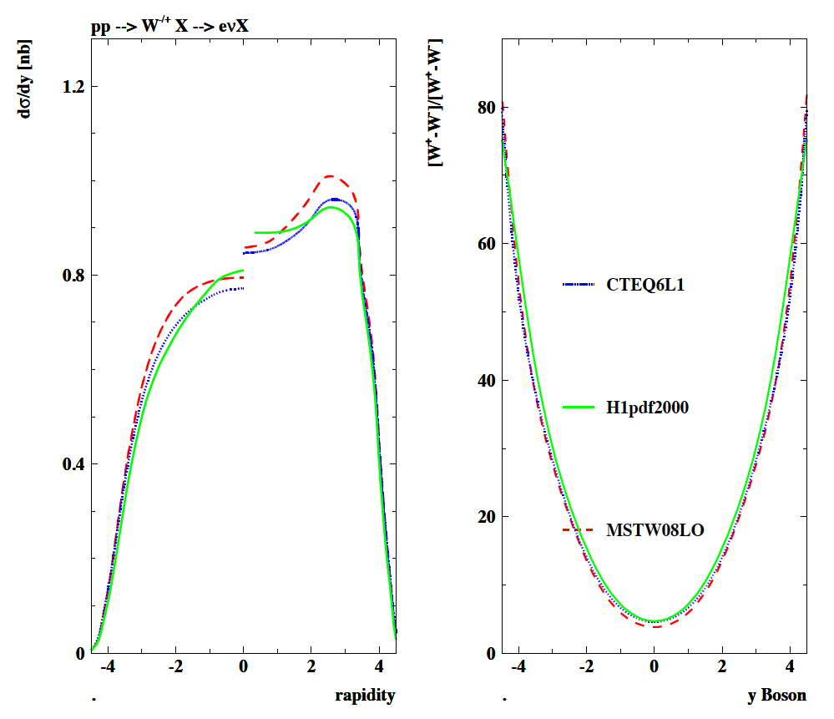
y Distributions and Asymmetries W^{+/-}
10 TeV
LO
MSTW08
CTEQ6
H1pdf2000
broad agreement
Differences in
plateau of
O(5-10)%

Slide 10
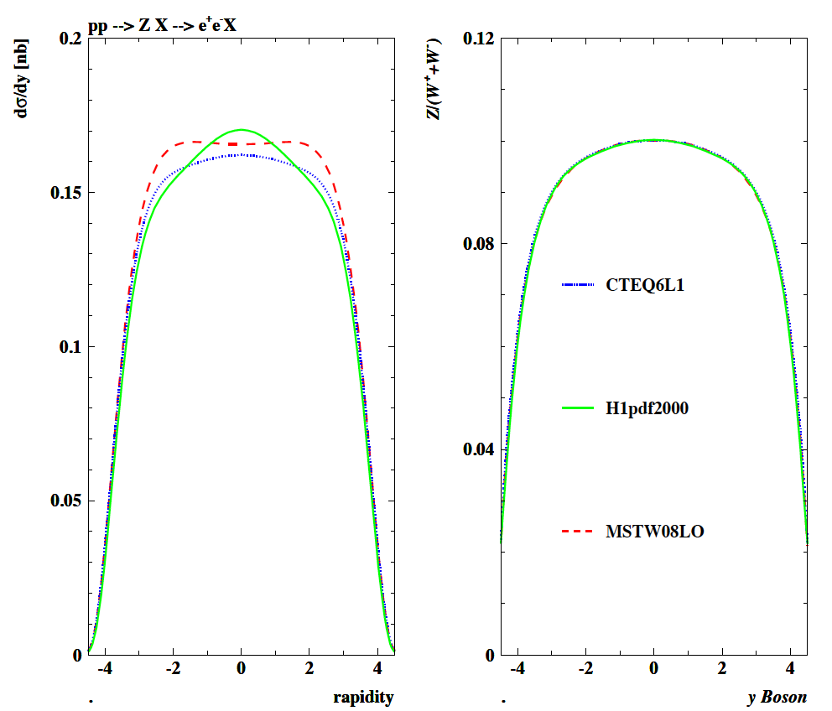
y Distribution of Z and Universal Z/(W⁺ + W⁻)
Large cancellation in if u=ubar=d=dbar
10 TeV
LO
MSTW08
CTEQ6
H1pdf2000
broad agreement
Differences in
plateau of
O(5)%

Slide 11
HERMES
Different x dependence than ubar+dbar and possibly 2 times higher than assumed so far at low x.
Klaus Rith EPS09 Cracow

Slide 12
What constrains F₂?
IF s was very different at lowish x, yet F₂ is to be kept constant (just now measured
to 1% accuracy in relevant x range). Thus then d or u .. have to compensate this
Deuteron data, as from BCDMS, provide some information on u-d
Further constraints exist from DY and dimuon data, Gottfried
sum rule… The HERMES result will have to be confronted
with world data on pdf’s. Here study only W,Z and keep F₂ fixed
as we are interested in lower x.

Slide 13
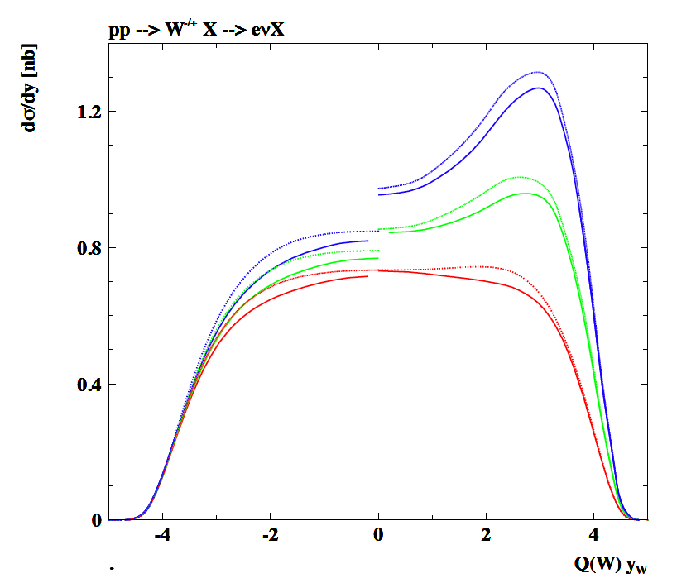
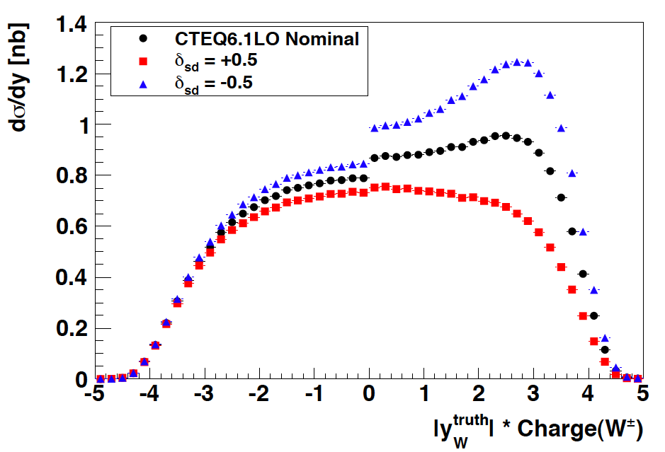
W± Rapidity Cross Section
MSTW08
CTEQ6L
Numeric. (MSTW08LO and CTEQ6L)
MC reweighted (CTEQ)
Possibly significant strange-down effects in W⁺ some in W⁻

Slide 14
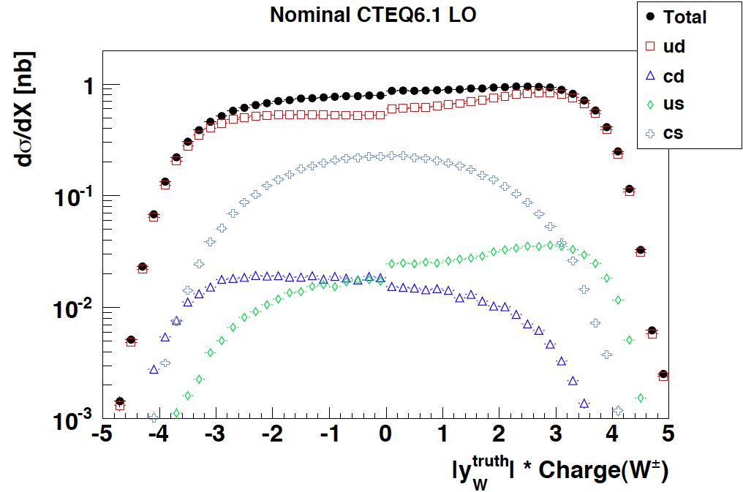
title
Different sensitivity of W⁺ vs W⁻ can be traced back to flavour contributions

Slide 15
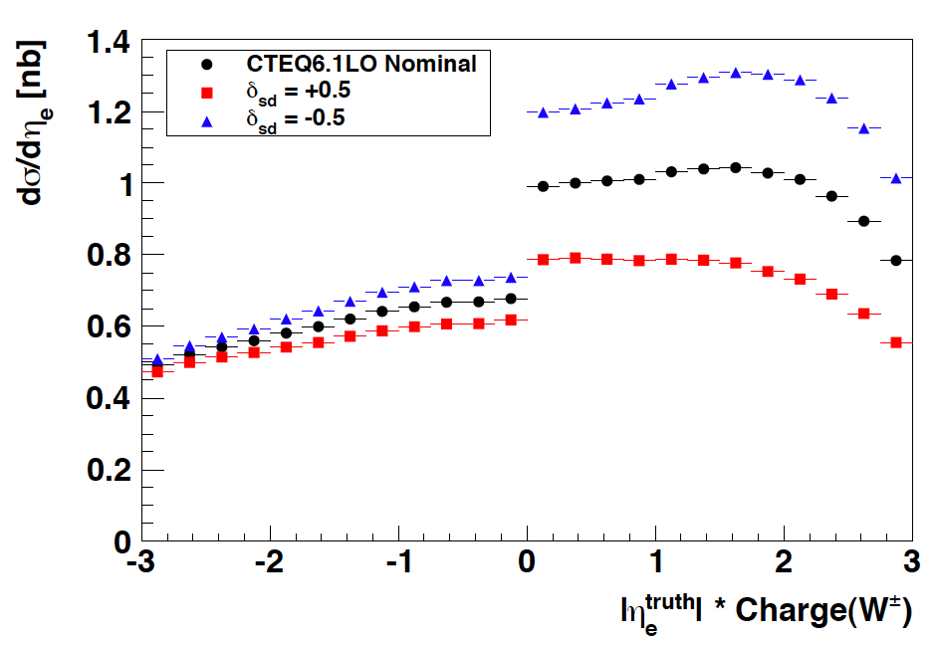
W± Cross Section in η_{e}
Similar observation would be made in pseudo-rapidity distribution

Slide 16
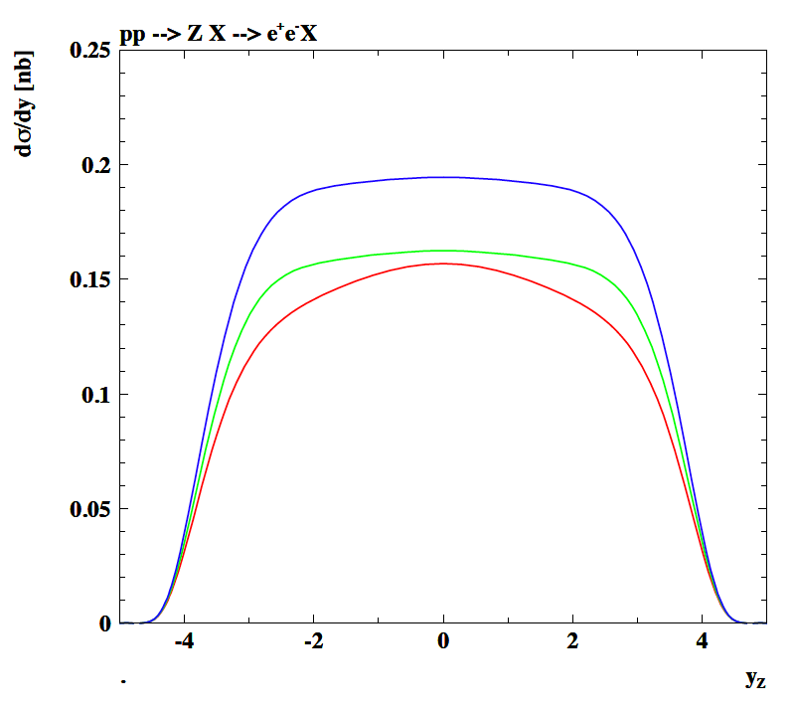
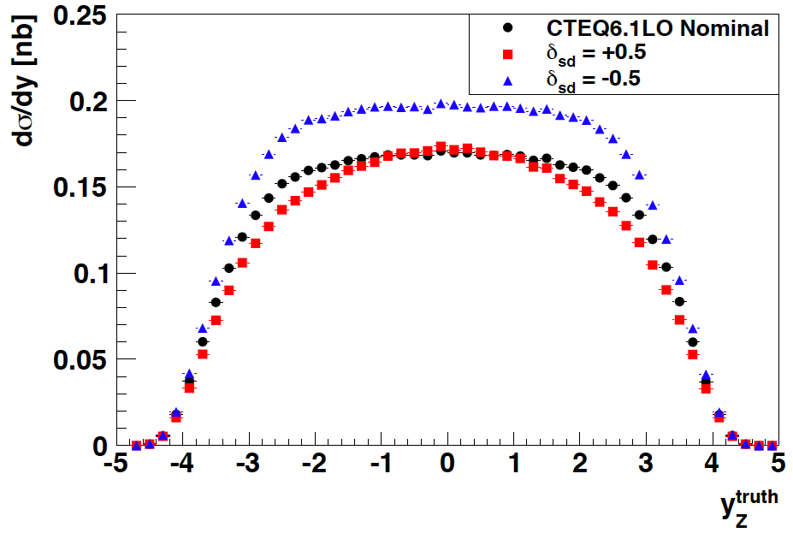
Z Rapidity Cross Section
A reduced strange density and enlarged down sea would enhance the Z cross section
[50% reduced s would enlarge cross section by 20%, enlarged s would be rather hidden]
[Z cross sections and ratios still being checked with MC calculation]

Slide 17
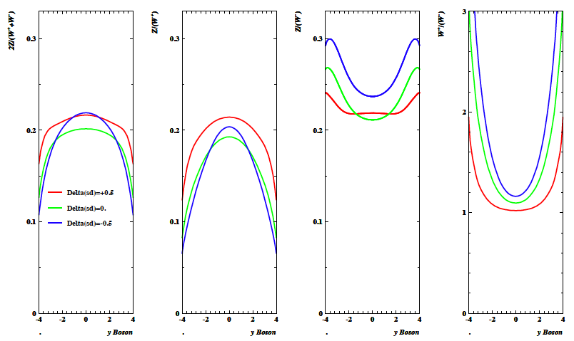
Cross Section Ratios [sd]
CTEQ6L
The cross section ratios may come out different than predicted, due to pdf variations.
A change of s would increase the 2Z/(W⁺+W⁻) ratio, but the sign may be deduced from W⁺/W⁻.

Slide 18
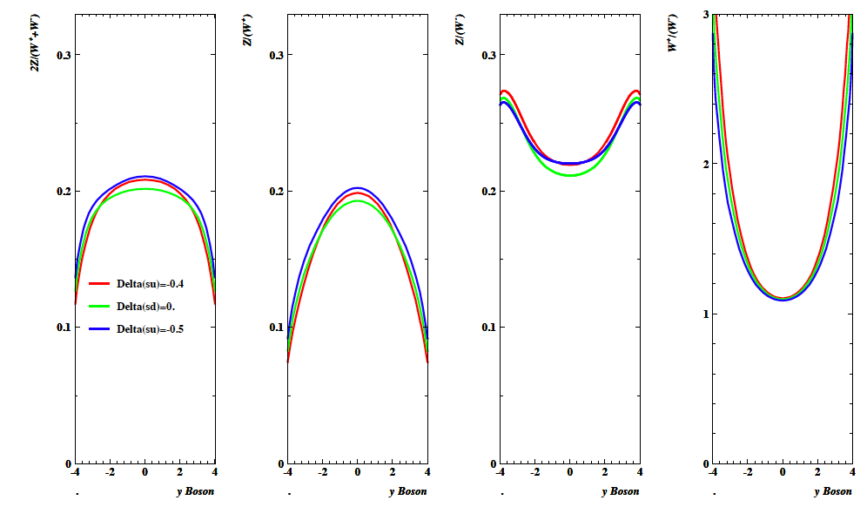
Cross Section Ratios [su]
A change in s which would modify ū would be difficult to monitor. A conventional result
on W/Z would thus not imply necessarily that the strange was conventional too..

Slide 19
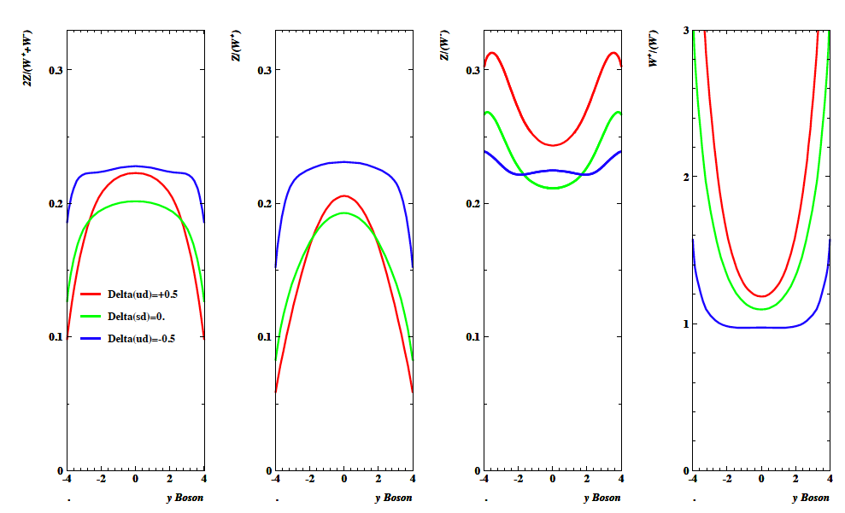
Cross Section Ratios [ud]
Significant effects would occur if đ ≠ ū to a large extent [50% gives 10% in W⁺/W⁻]

Slide 20
Direct Effects on pdfs
+0.5
Nominal
-0.5

Slide 21
Summary
The current pdf measurements have some freedom, which leads to simplifying QCD fit assumptions.
The W and Z cross sections and their ratios may provide further constraints on this.
If indeed the strange quark distribution was much larger than hitherto assumed, and if that was balanced
by an reduced down sea, for example, then the Z/(W⁺+W⁻) and the W⁺/W⁻ ratios would allow tagging
such an effect (50% change of s roughly corresponding to 5-10% asymmetry effects).
The rapidity (x) dependence is of interest, and the η_{e} dependence leads to similar effects as y.
The variations as studied are to set a scale, not to indicate that so large variations are to be considered.
Some checks are still being done and an NLO study may be of interest.
It is possible, that the W, Z cross sections and their ratios as functions of the rapidity may deviate from the
canonical predictions as most of these use common assumptions in the Bjorken x range of interest.
In particular, the famous W/Z ratio may turn out to look different and this may not hint to an ATLAS problem..
A differential, accurate measurement of W⁺, W⁻ and Z cross sections and their ratios is important.

Slide 22
backup

Slide 23
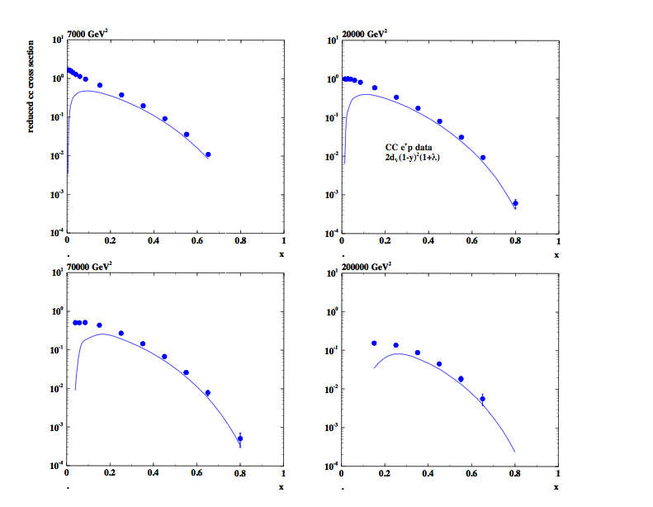
Charged currents (e⁺)
LHeC

Slide 24
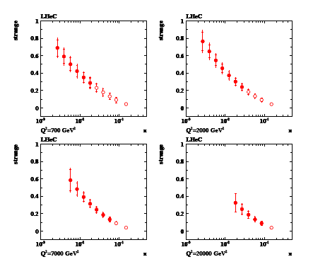
Strange quark distribution

Slide 25
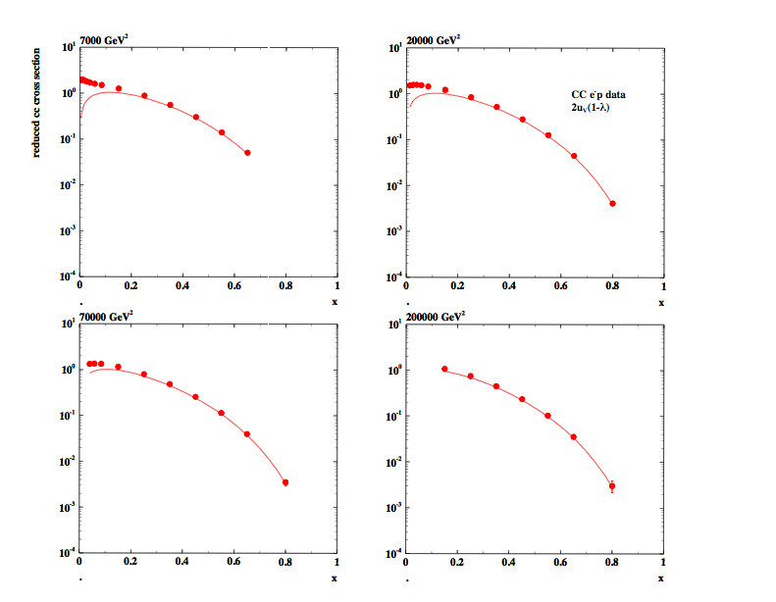
Charged currents (e⁻)

Slide 26
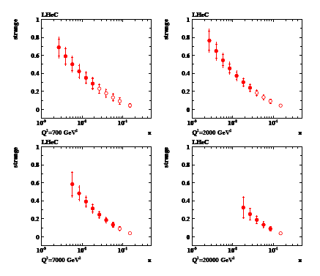
Anti-Strange quark distribution

