Slide 1

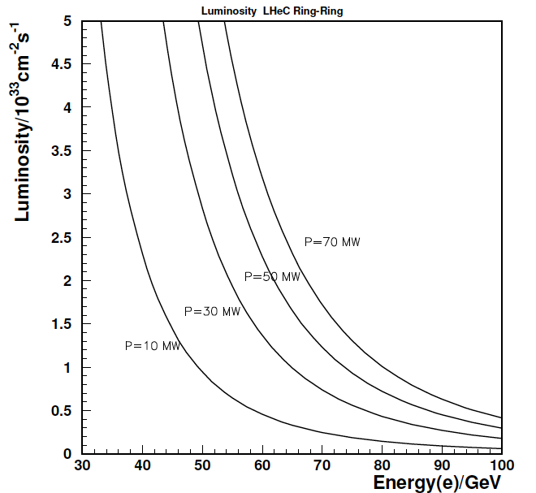
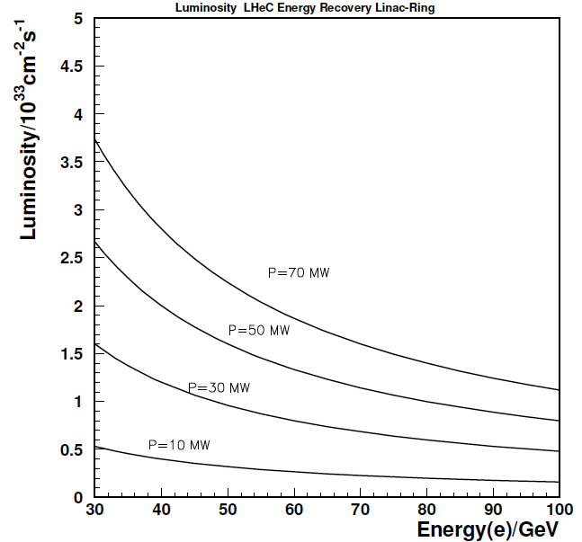
Design Considerations
LHC hadron beams: E_{p}=7 TeV E_{A}=E_{e}•Z/A
Luminosity O (10³³) cm⁻²s⁻¹ with Beam Power 100 MW (wall plug)
Integrated e±p : O(100) fb⁻¹ ≈ 100 * L(HERA) → synchronous ep and pp operation
Two solutions
e Ring in the LHC tunnel (Ring-Ring - RR) Superconducting ERL (Linac-Ring -LR)

Slide 2
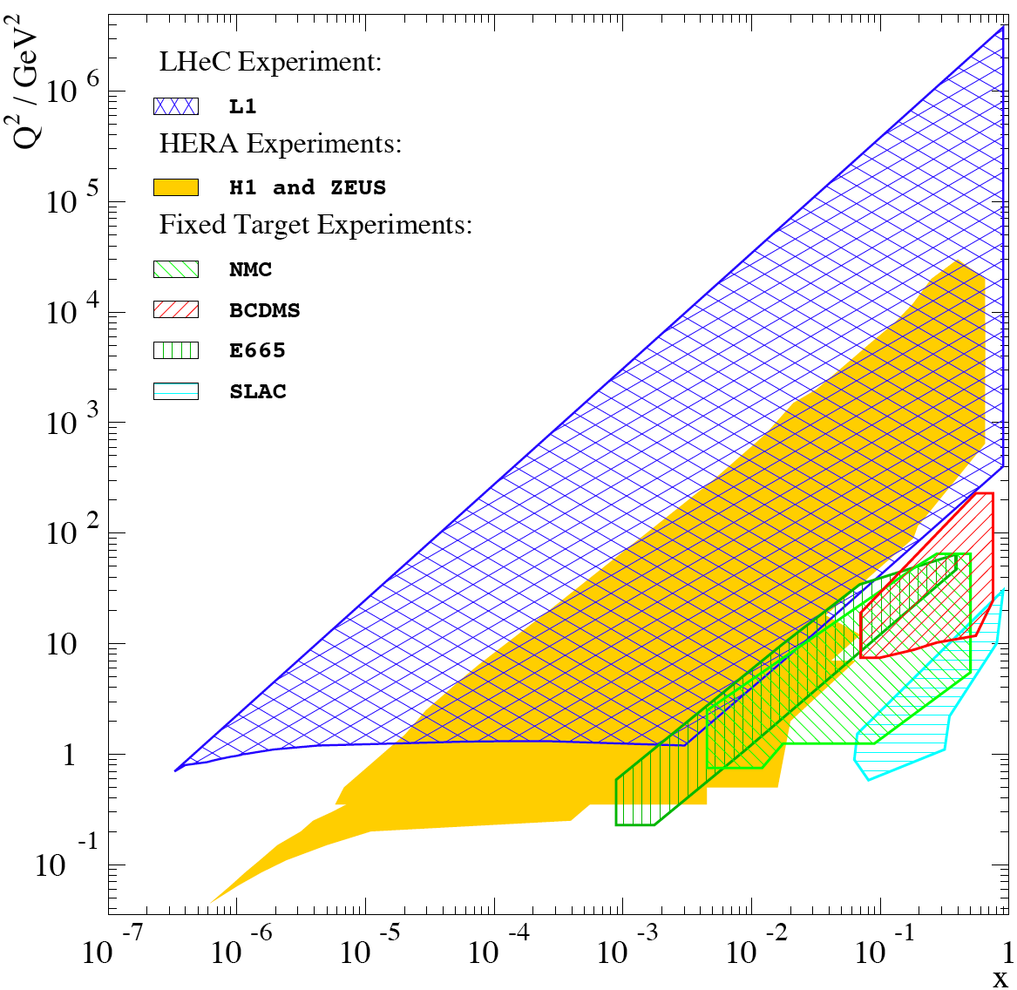
Physics and Range
New Physics
Physics
eQ states
GUT (δα_{s}=0.1%)
Excited fermions
Hot/cold spots
Single top
Higgs
PDFs
Multi-Jets
DVCS
Unintegrated
partons
Saturation
Vector Mesons
IP - graviton
Odderons
NC couplings
sin²Θ
Beauty
Charm
Partons in nuclei
Shadowing
….
Large x
High precision
partons in plateau
of the LHC
Nuclear
Structure
& dynamics
High Density Matter
Q² = 4momentum transfer² x = Bjorken x: fraction of p’s momentum

Slide 3



















LHeC - Participating Institutes
TOBB ETU
KEK

Slide 4
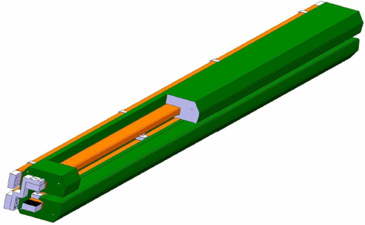
Accelerator: Ring - Ring
Workpackages as formulated in 2008, now in the draft CDR
Baseline Parameters and Installation Scenarios
Lattice Design [Optics, Magnets, Bypasses]
IR for high Luminosity and large Acceptance
rf Design [Installation in bypasses, Crabs?]
Injector Complex [Sources, Injector]
Injection and Dump
Cryogenics – work in progress
Beam-beam effects
Impedance and Collective Effects
Vacuum and Beam Pipe
Integration into LHC
e Beam Polarization
Deuteron and Ion Beams
LHeC Ring Dipole Magnet
.12-.8T
1.3kA
0.8MW
5.3m long
(35 cm)²
slim + light(er)
3080 magnets
Prototypes:
BINP-CERN

Slide 5
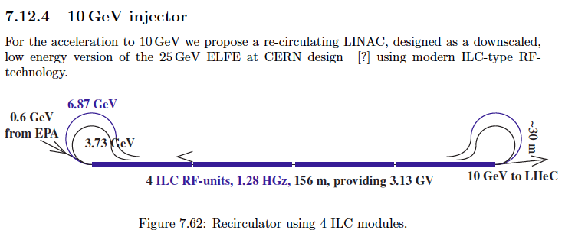
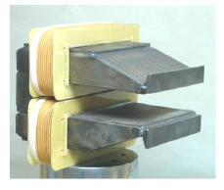
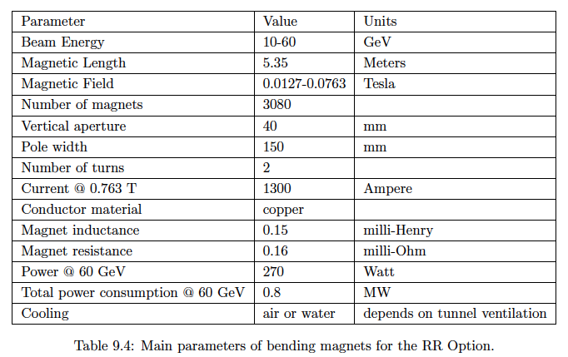
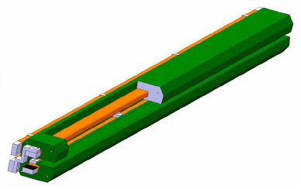
Magnets
Injector to Ring – similar to Linac design [R+D]
Novosibirsk dipole prototype
measured field reproducible
to the required 2 10⁻⁴
CERN prototype under test
3080 dipoles
336+148 F+D

Slide 6
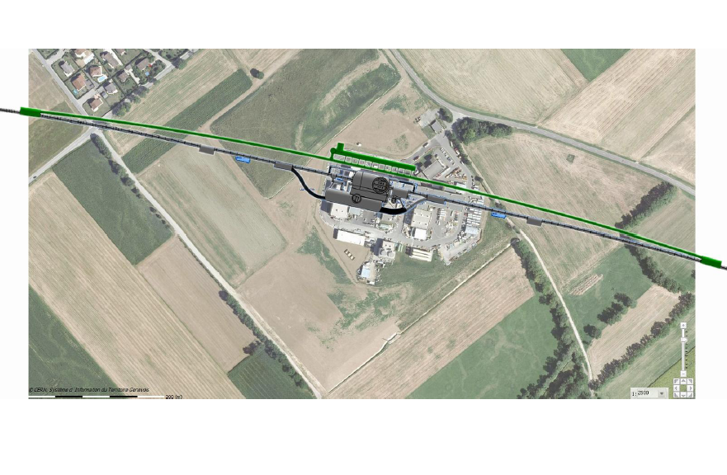
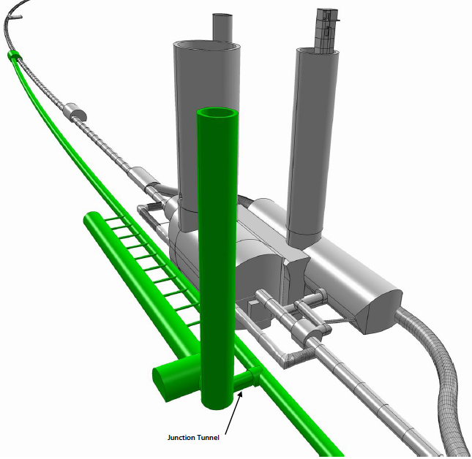
Bypassing CMS
RF

Slide 7
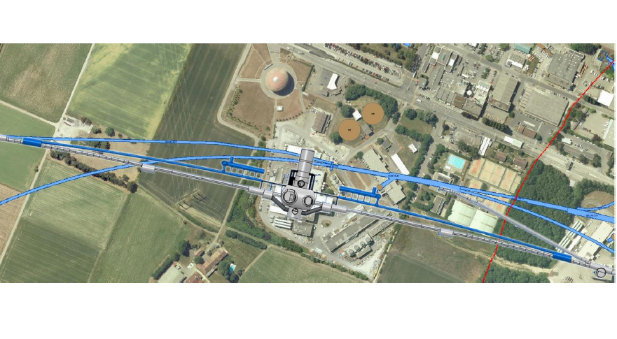
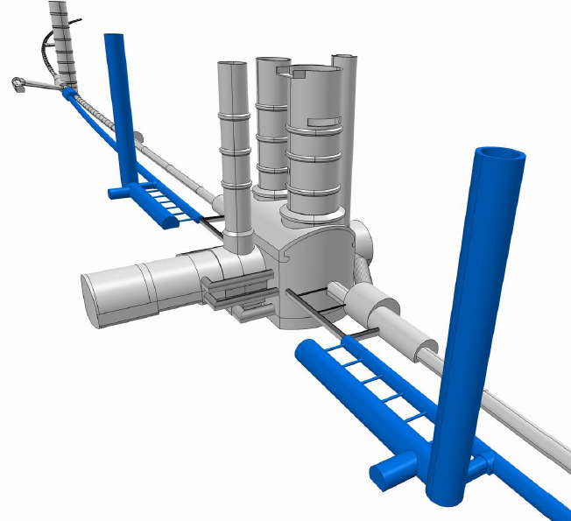
Bypassing ATLAS
For the CDR the bypass concepts
were decided to be confined to
ATLAS and CMS

Slide 8
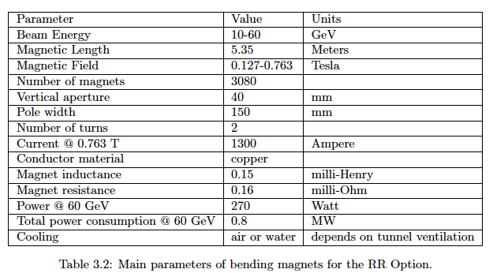
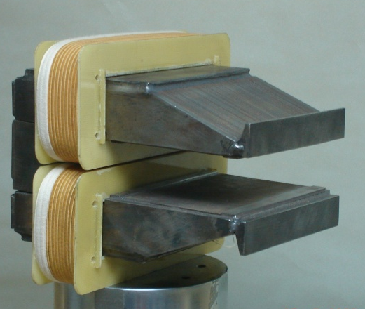
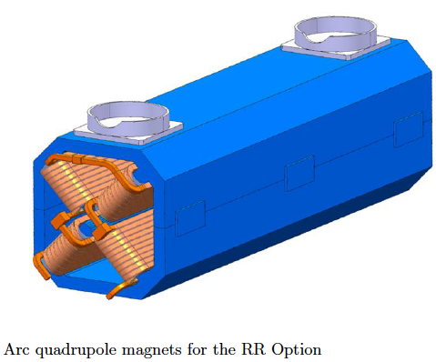
Ring: Dipole + Quadrupole Magnets
BINP &
CERN
prototypes
5m long
(35 cm)²
slim + light
for installation
736 magnets
1.2 m long

Slide 9
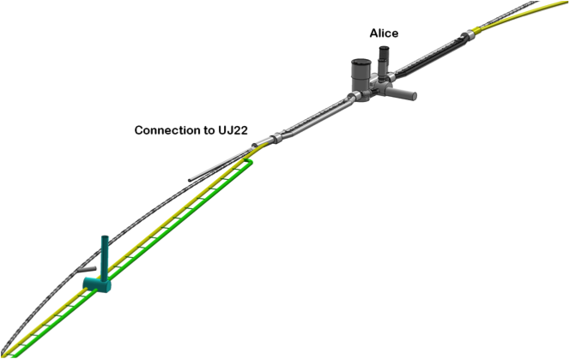
LINAC - Ring
Workpackages as formulated in 2008, now in the draft CDR
Baseline Parameters [Designs, Real photon option, ERL]
Sources [Positrons, Polarisation]
Rf Design
Injection and Dump
Beam-beam effects
Lattice/Optics and Impedance
Vacuum, Beam Pipe
Integration and Layout
Interaction Region
Magnets
Cryogenics
IP2
1056 cavities
66 cryo modules per linac
721 MHz, 19 MV/m CW
Similar to SPL, ESS, XFEL, ILC, eRHIC, Jlab
21 MW rf
Cryo 29 MW for 37W/m heat load
Magnets in the 2 * 3 arcs:
600 - 4m long dipoles per arc
240 - 1.2m long quadrupoles per arc
Linac (racetrack)
inside the LHC for
access at CERN
Territory
U=U(LHC)/3=9km

Slide 10

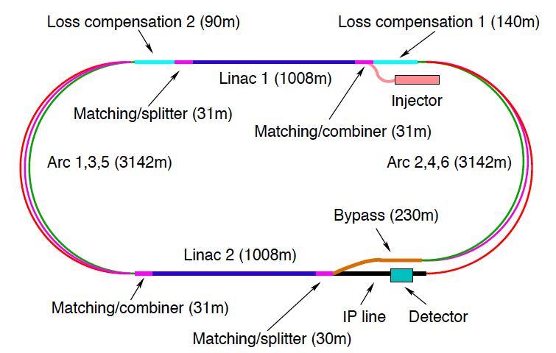
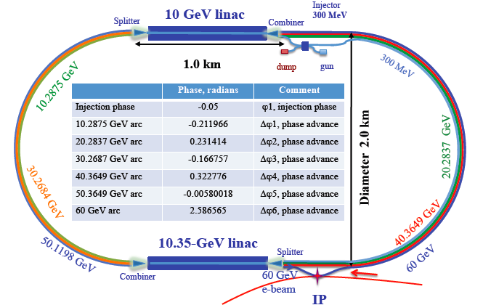
60 GeV Energy Recovery Linac
CERN 1
CERN 2
Jlab
BNL
Two 10 GeV energy recovery Linacs, 3 returns, 720 MHz cavities

Slide 11
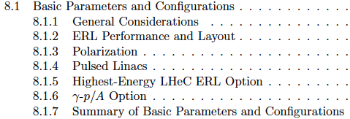
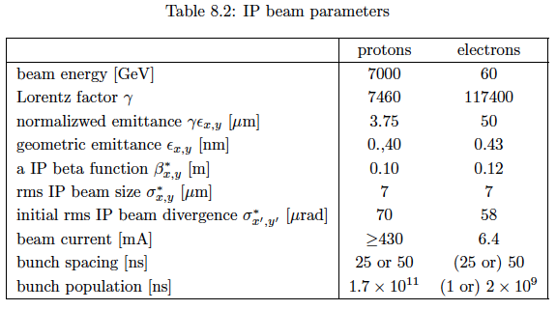
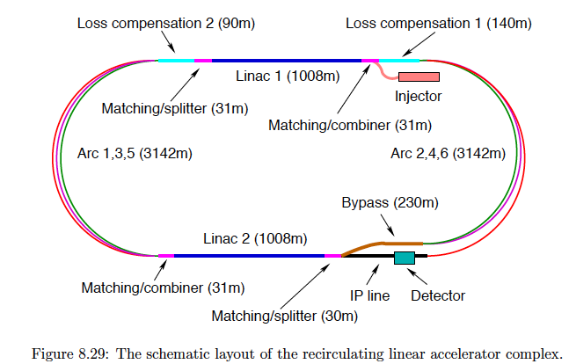
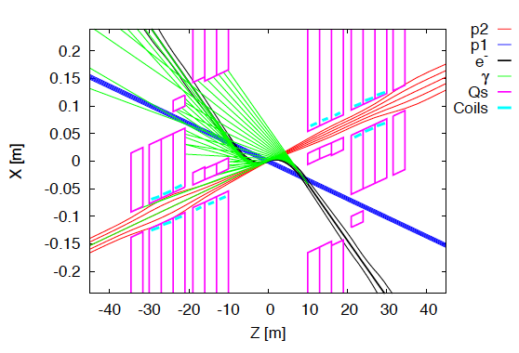

CDR draft
LINAC 60 GeV ERL

Slide 12
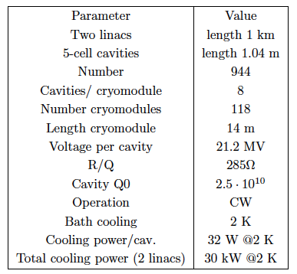
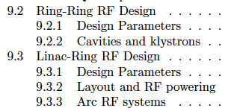

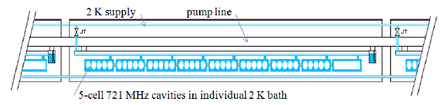

CDR draft

Slide 13
Design Parameters
electron beam | RR | LR | LR^{*)}
e- energy at IP[GeV] | 60 | 60 | 140
luminosity [10³² cm⁻²s⁻¹] | 13 | 10 | 0.4
polarization [%] | 40 | 90 | 90
bunch population [10⁹] | 20 | 1.0 | 1.5
e- bunch length [mm] | 10 | 0.3 | 0.3
bunch interval [ns] | 25 | 25 | 50
transv. emit. γε_{x,y} [mm] | 0.58, 0.29 | 0.05 | 0.1
rms IP beam size σ_{x,y} [μm] | 30, 16 | 7 | 7
e- IP beta funct. β*_{x,y} [m] | 0.18, 0.10 | 0.12 | 0.14
full crossing angle [mrad] | 1 | 0 | 0
geometric reduction H_{hg} | 0.75 | 0.91 | 0.94
repetition rate [Hz] | - | - | 10
beam pulse length [ms] | - | - | 5
ER efficiency | - | 94% | -
average current [mA] | 131 | 6.4 | 0.27
tot. wall plug power[MW] | 100 | 100 | 100
proton beam | RR | LR
bunch pop. [10¹¹] | 1.7^{*)} | 1.7
tr.emit.γε_{x,y} [μm] | 3.75 | 3.75
spot size σ_{x,y} [μm] | 30, 16 | 7
β*_{x,y} [m] | 1.8,0.5 | 0.1
bunch spacing [ns] | 25 | 25
LHC “ultimate” p beam used
*) : 1.7 probably conservative
Design also for
D and A (L_{eN} = 10³¹ cm⁻²s⁻¹)
RR= Ring – Ring
LR =Linac –Ring
Parameters from Draft CDR
Ring: with 1º as baseline : L/2
Linac: clearing gap: L*2/3
*) pulsed, but high energy ERL not impossible

Slide 14
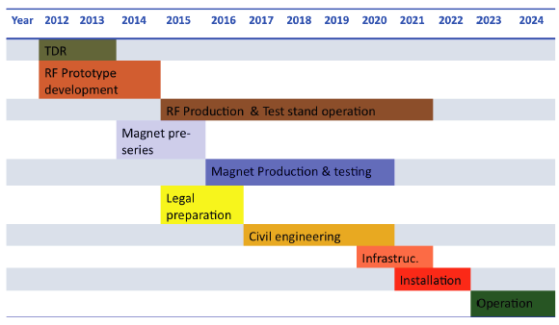
LHeC Tentative Time Schedule
LS3 --- HL LHC

Slide 15
title

