Slide 1
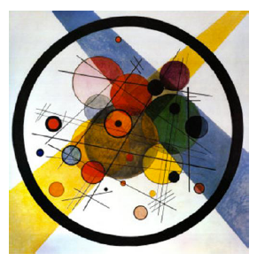
Steps Towards the LHeC
Where do we stand
What We Have
& 10 More Steps
and the 8 fold way
Wassilij Kandinski. Circles in a Circle. 1923. Philadelphia Museum of Arts : Symbol for gg saturation (2008)
Max Klein
U Liverpool
For the LHeC Coordination Group and Physics Convenors
Contribution to PERLE Collaboration Meeting, Daresbury, UK, 16.1.2018

Slide 2
title

Slide 3
title
CDR: Default configuration, 60 GeV, 3 passes, 720 MHz, synchronous ep+pp, L_{ep}=10³³

Slide 4
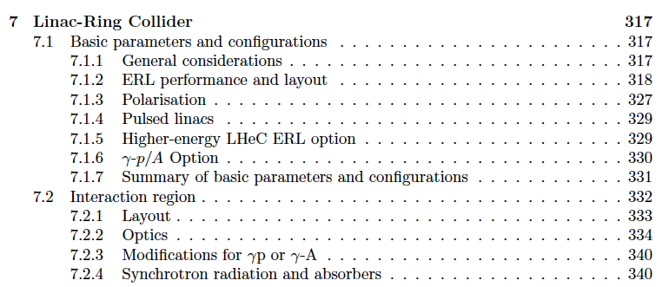
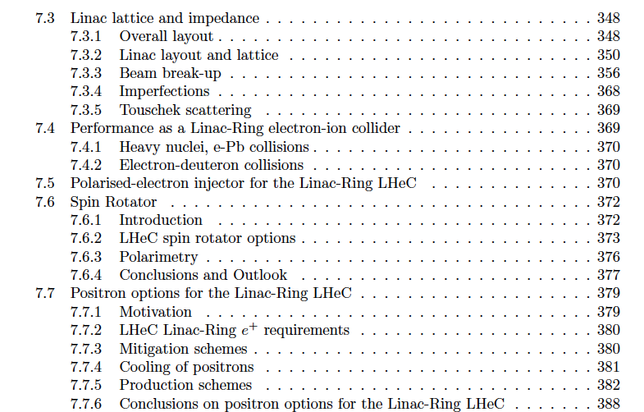

Slide 5
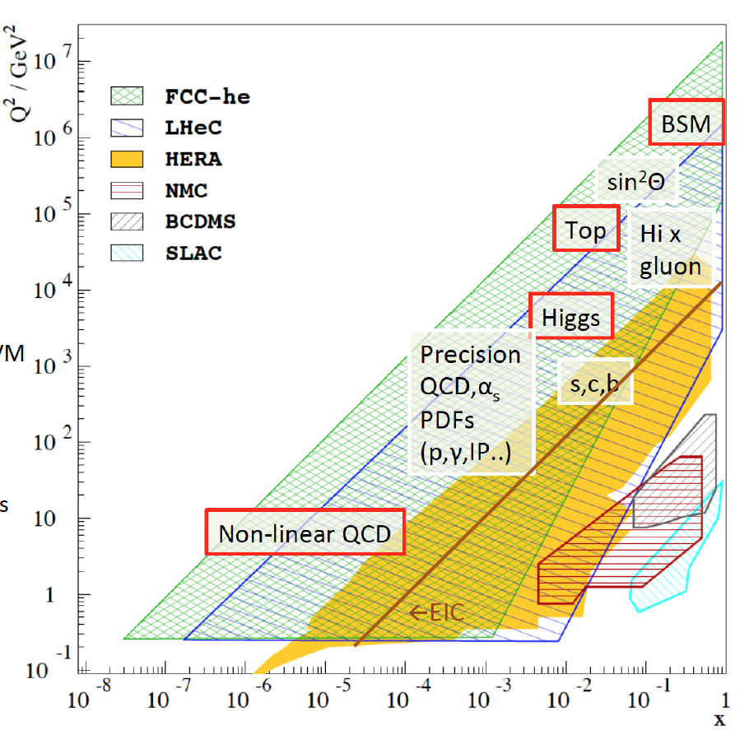
Pursue New Physics of Deep Inelastic Scattering

Slide 6
LHC Physics
Superb LHC performance, reliable detectors and great experimental art
French artist’s view on LHC physics – pileup at HL LHC 140-200
2000 LHC papers published (ATLAS 100/year). No BSM Physics observed
Discovery of the Higgs Boson (Mass to W,Z,fermions + portal to BSM??)
Surprisingly high precision (e.g. ATLAS Wmass to 19 MeV → 0.02%)
The LHC exploits the large majority of HEP physicists, ATLAS: 1200 PhD’s

Slide 7
Motivation
Mandate (ECFA, NuPECC, CERN, PP Community)
HERA’s success which is DESY’s legacy to a major extent
Technology (ERL – green, high tech accelerator technology, SCRF)
An affordable accelerator for CERN to build, not only design.
Detector (a high tech detector challenge following the lumi upgrade)
New Physics in QCD + BSM, BLHC and ultra high precision (for ep AND pp)
The cleanest high resolution microscope the world can build!
Exploitation of our largest particle physics infrastructure
It can be done (think of 2m SLAC Linac 50 years ago and XFEL at DESY)
… in one word
develop energy frontier collider physics and technology comme il faut

Slide 8
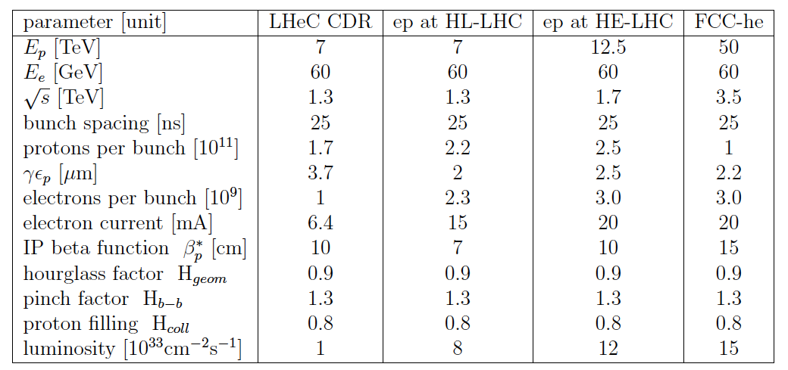
Luminosity for LHeC, HE-LHeC and FCC-ep
10³⁴ in ep, simulated
6 10³² in eA for LHeC

Slide 9
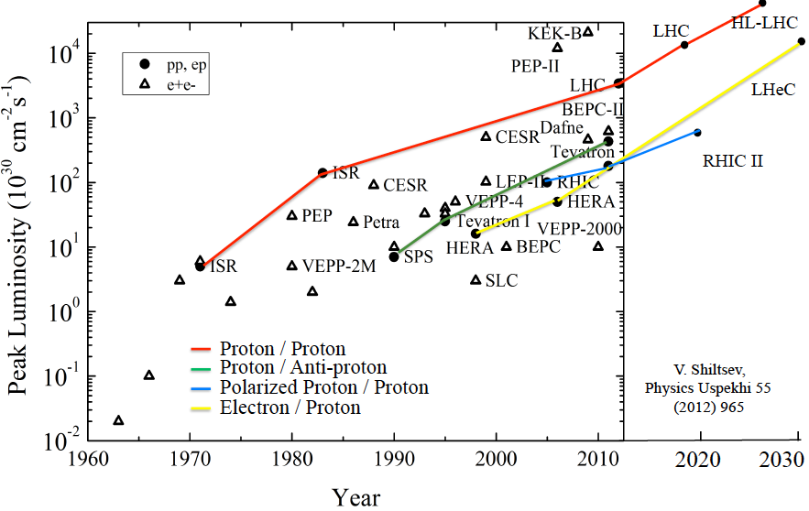
Collider Luminosities vs Year (pp and ep)
O. Bruening 2/17

Slide 10
Framework of the Development
Following the CDR in 2012: Mandate issued by CERN:2014 (RH), confirmed in 2016 (FG)
Mandate to the International Advisory Committee
Advice to the LHeC Coordination Group and the CERN directorate by following the
development of options of an ep/eA collider at the LHC and at FCC, especially with:
Provision of scientific and technical direction for the physics potential of the ep/eA
collider, both at LHC and at FCC, as a function of the machine parameters and of a
realistic detector design, as well as for the design and possible approval of an ERL
test facility at CERN.
Assistance in building the international case for the accelerator and detector
developments as well as guidance to the resource, infrastructure and science
policy aspects of the ep/eA collider.
Chair: Herwig Schopper, em. DG of CERN. IAC+CERN have invited four of its members to follow the study with special attention (Stefano Forte, Andrew Hutton, Leandro Nisati and Lenny Rifkin). Collaboration also with the FCC Review Committee chaired by Guenther Dissertori.
LHeC has been a development for and initiated by CERN, ECFA and NuPECC, so far, it’s formal status is that of a community study, not a proposal, which holds for the FCC also, of which ‘eh’ is a part.

Slide 11
Organisation^{*)}
Working Groups
International Advisory Committee
“..Direction for ep/A both at LHC+FCC”
PDFs, QCD
Fred Olness,
Claire Gwenlan
Higgs
Uta Klein,
Masahiro Kuze
BSM
Georges Azuelos,
Monica D’Onofrio
Top
Olaf Behnke,
Christian Schwanenberger
eA Physics
Nestor Armesto
Small x
Paul Newman,
Anna Stasto
Detector
Alessandro Polini
Peter Kostka
Coordination Group
Accelerator+Detector+Physics
Sergio Bertolucci (CERN/Bologna)
Nichola Bianchi (Frascati)
Frederick Bordry (CERN)
Stan Brodsky (SLAC)
Hesheng Chen (IHEP Beijing)
Eckhard Elsen (CERN)
Stefano Forte (Milano)
Andrew Hutton (Jefferson Lab)
Young-Kee Kim (Chicago)
Victor A Matveev (JINR Dubna)
Shin-Ichi Kurokawa (Tsukuba)
Leandro Nisati (Rome)
Leonid Rivkin (Lausanne)
Herwig Schopper (CERN) – Chair
Jurgen Schukraft (CERN)
Achille Stocchi (LAL Orsay)
John Womersley (ESS)
Nestor Armesto
Oliver Brüning – Co-Chair
Andrea Gaddi
Erk Jensen
Walid Kaabi
Max Klein – Co-Chair
Peter Kostka
Bruce Mellado
Paul Newman
Daniel Schulte
Frank Zimmermann
5(11) are members of the
FCC coordination team
OB+MK: FCC-eh responsibles
MDO: physics co-convenor
We miss Guido Altarelli.
*)September 2017

Slide 12
1. New Timeline

Slide 13
Projected Timelines for Future ep/eA Colliders
HL-LHC
HE-LHC
FCC
LHeC
LHeC
something yy? in between?
RHIC
Jlab12 GeV
EIC
2025
2035
2045
HERA: Proposal 1984, Data 1992-2007, Publications 1993-2018
VHEep: Plasma e – LHC. Chinese ep/A projects: Lanzhou (low E) and CEPC/SPPC
Dislaimer: For discussion and illustration at DIS17 only
MK+RY, April 7th, 2017, DIS at Birmingham

Slide 14
2. Cost-Energy-Physics-Configuration Update
We need maximum E_{e} and 10³⁴ and time for the Higgs and BSM programmes

Slide 15
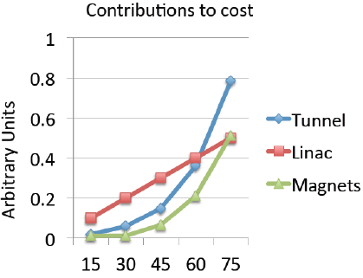
Considerations on the Choice of E_{e}
Chosen 60 GeV and U(LHeC)=U(LHC)/3 as a supposedly realistic first choice.
MK, F Zimmermann
Initial, tentative, rough scaling estimate of basic cost (tunnel, linac (XFEL), magnets
On energy vs physics see MK at September workshop

Slide 16
3. Civil Engineering
New cost estimate under way. Previously Amberg: fully documented. 4 years

Slide 17
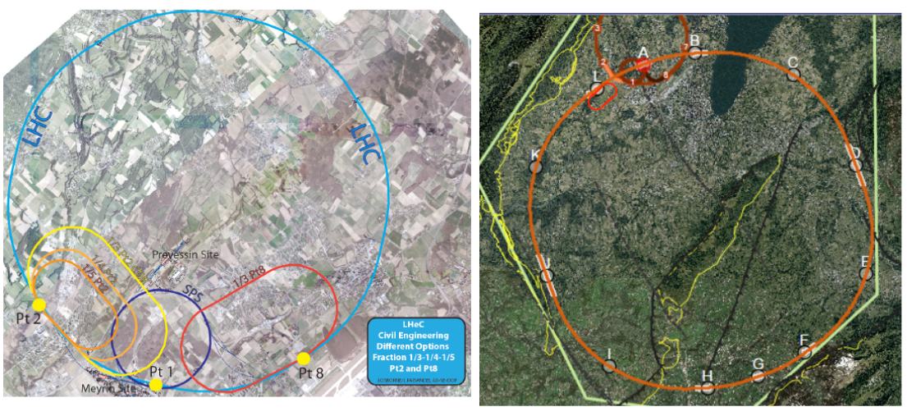
Location + Footprint of the electron ERL
LHC (HL and HE)
FCC
A 9km ERL is a small add-on for the FCC
Doubling the energy to 120 GeV hugely
increases cost and effort.
Energy – Cost – Physics – Footprint
are being reinvestigated

Slide 18
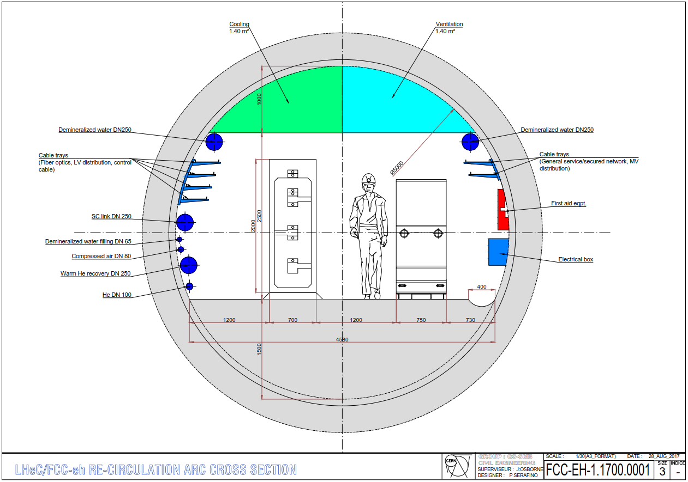
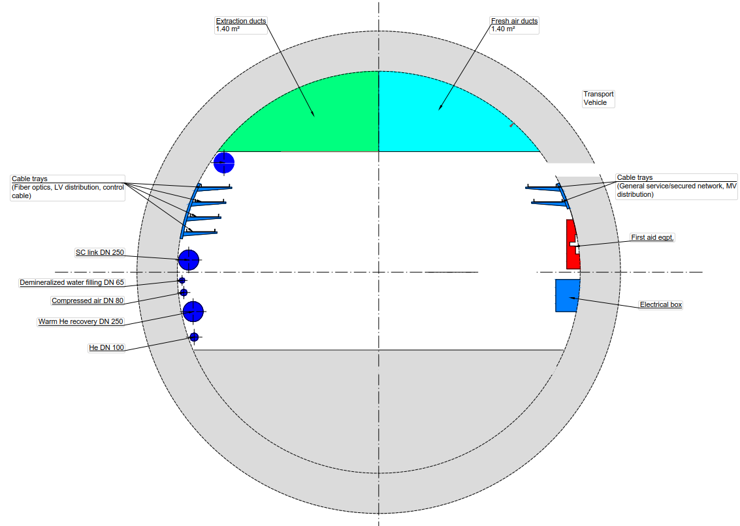
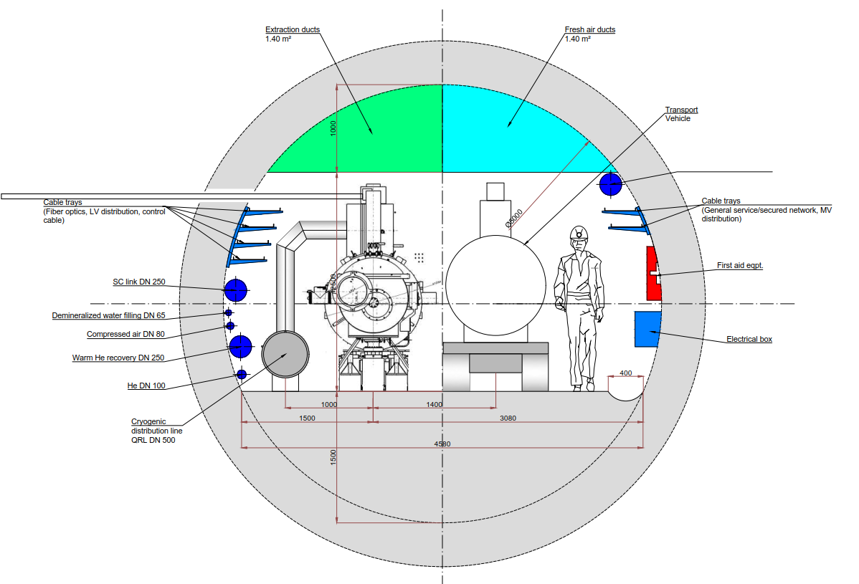
Tunnels: Triple Arc and LINACs
Arc
DRAFTs
cf Matt Stewart et al. 12.9.
RF Gallery
LINAC

Slide 19
4. Detector Decisions + Flexibility
An invitation to the world community to build a modern collider detector in the 20ties
Installation and ALICE replacement in 2 years, studied (cf A Gaddi)

Slide 20
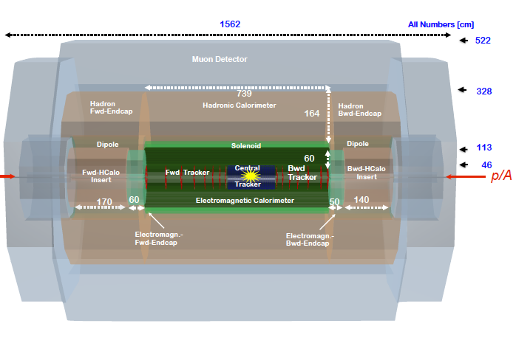
title
LHeC Detector for the HE LHC
e
P.Kostka et al
Length x Diameter: LHeC (13.3 x 9 m²) HE-LHC (15.6 x 10.4) FCCeh (19 x 12)
ATLAS (45 x 25) CMS (21 x 15): [LHeC < CMS, FCC-eh ~ CMS size]
If CERN decides that the HE LHC comes, the LHeC detector should anticipate that

Slide 21
5. Update of the Interaction Region Design

Slide 22
title
Brett Parker at September 2017 LHeC Workshop. Replace Q1 of CDR by another design

Slide 23
6. Integration of ep into pp physics (and ions)
Many studies ongoing. Forum: HL-HE Workshop and FCC CDR. Many new papers

Slide 24
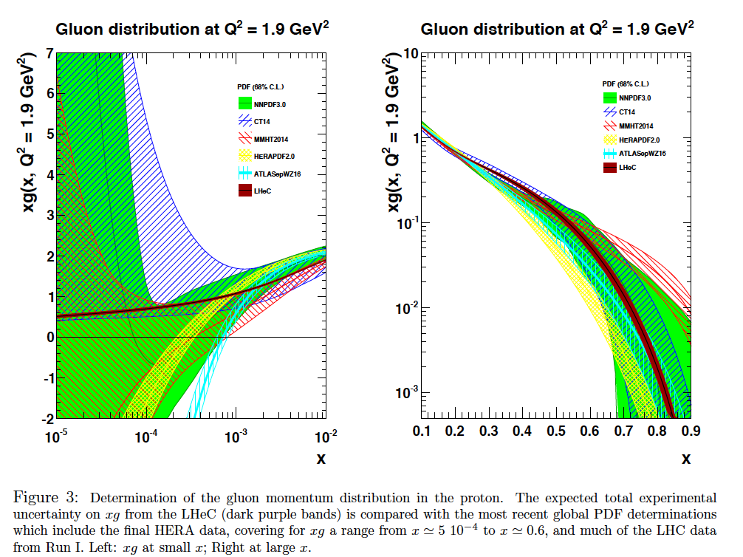

Slide 25
Higgs SM Coupling Prospects
δκ/κ [%]
Charged Current ep →νHX
Neutral Current ep → eHX
preliminary
HL LHC: ATLAS-PUB-2014-016 14 TeV 3ab⁻¹ – LHC has no gg, no cc, and poor bb, but rare channels as γγ
LHeC: 1ab⁻¹, 60 GeV x 7 TeV - Work in progress. ep also provides precise: xg, α_{s} and PDFs to N³LO..
LHC (ep+pp): HL LHC with reduced theory uncertainty combined with LHeC
FCCeh: 2ab⁻¹, 60 GeV x 50 TeV - Work in progress. ep also provides precise: xg, α_{s} and PDFs to N³LO..
Improvements: ATLAS 2014 conservative, no CMS. ep (LHeC/FCCeh) are overconstrained:
CC+NC, ratios, sum(br)=1.. → joint coupling determination: especially WW and ZZ should improve
U+M Klein, Contribution to FCC Workshop, 16.1.2018, preliminary

Slide 26
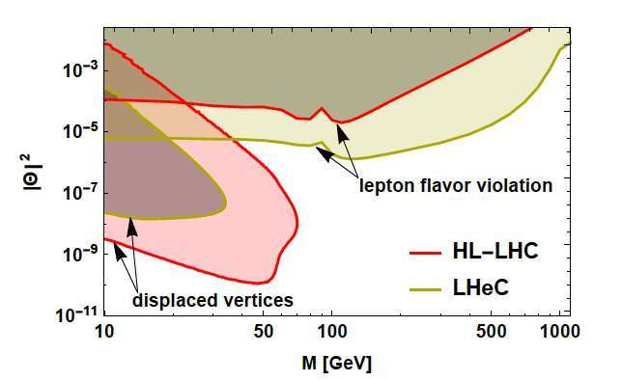
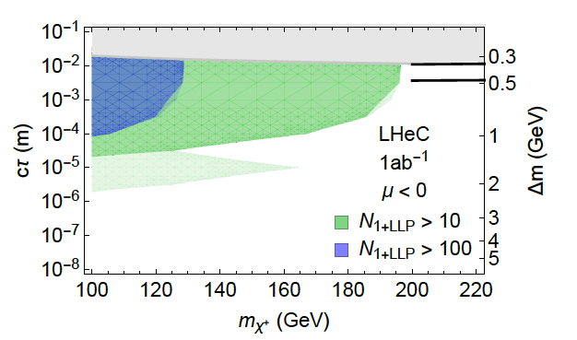
Lots of exciting new papers on BSM in ep
Sterile (heavy) Neutrinos in ep → NX
Search for Higgsino at LHeC
arXiv:1712.07135

Slide 27
7. PERLE

Slide 28
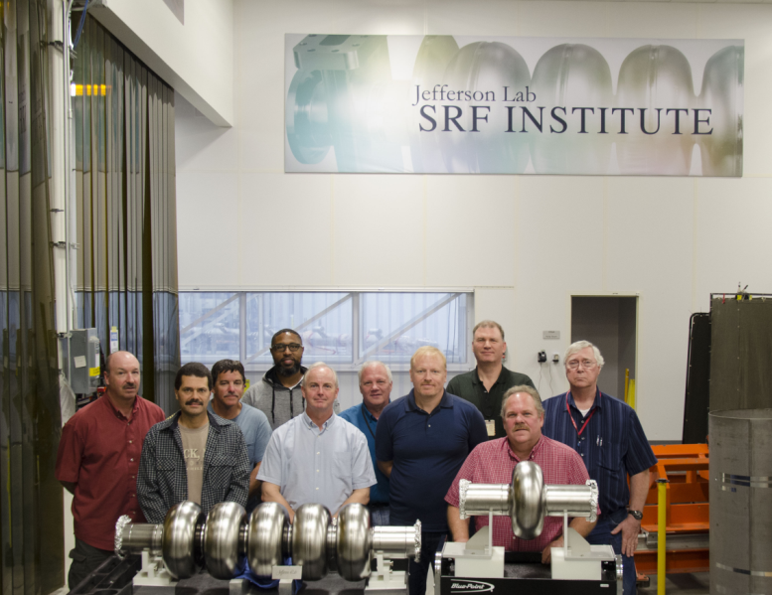
Keep them and many others busy for PERLE
Thank you and many congratulations
TDR by mid 2019 (town meeting of the European PP community)
Technical developments accompanying ERL development (e.g. Jlab’s 7 GeV ERL synrad test)
PERLE operational in the early twenties - in time for LHeC in LS4 (2030)

Slide 29
8. Reaching out
Larger and lasting LHeC/FCCeh/PERLE Workshop in Orsay 27-29.6.18
10 pages for EU Strategy Secretariat by fall 2018
Papers=publications on ALL areas we cover: theory, studies, detector, accelerator, PERLE
Contributions to Yellow Report on HL-HE LHC Workshop (12/2018)
Contributions to the FCC CDR Books (eh is part of hh, rightly so)
Update of the LHeC CDR
- …
Crucial for 2018: Involve and attract new collaborators in support of the LHeC submission
Reach public attention, beyond scientists: funding agencies, interested stable geniuses

Slide 30
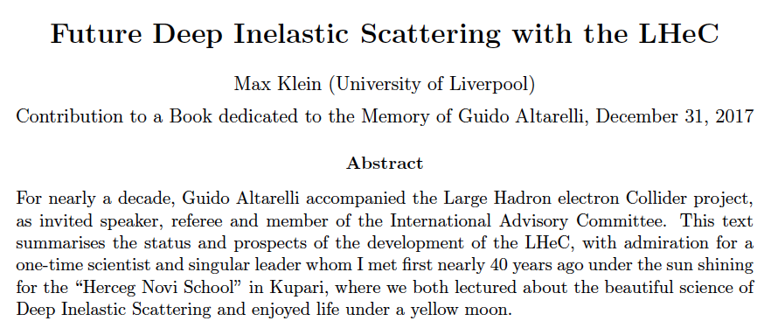
Summary of Physics and Project Status, to be released to arXiv asap.

Slide 31
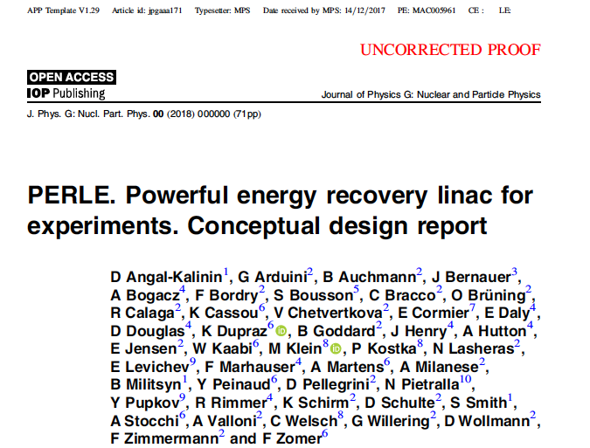
backup

Slide 32
Expectations
Physics
Strategy
Community

Slide 33
Five Major Themes of Electron-Hadron Physics at the energy frontier
Cleanest High Resolution Microscope
Joint ep and pp Physics at LHC and FCC
High Precision Higgs Exploration
Discovery Beyond the Standard Model
A Unique Nuclear Physics Facility
CERN has the obligation to utilize its potential fully: the HL LHC programme can and should not
“fade away”, new discoveries have to be correctly interpreted, and the world’s Collider
future is with CERN. DIS has to be part of it, as Guido Altarelli and Lev Lipatov had taught us.

Slide 34
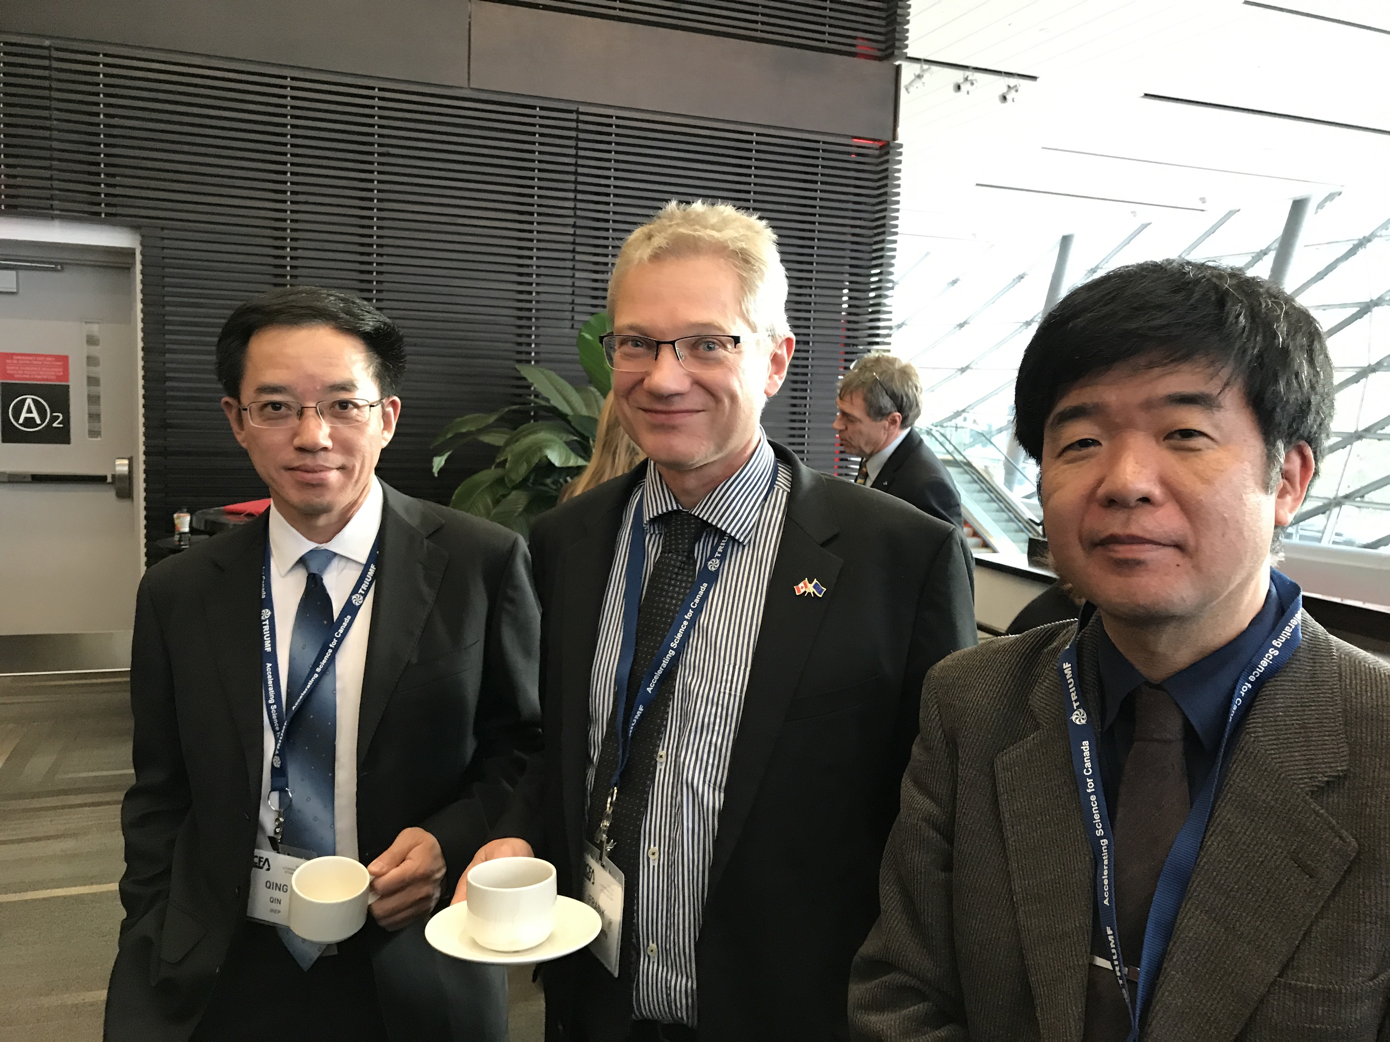
on “the strategy”
MK remarks made in the LHeC Coordination June 2017
At ICFA Seminar in Canada 11/17
Quin Qin, Frank Zimmermann
and Shinichiro Michizono

Slide 35
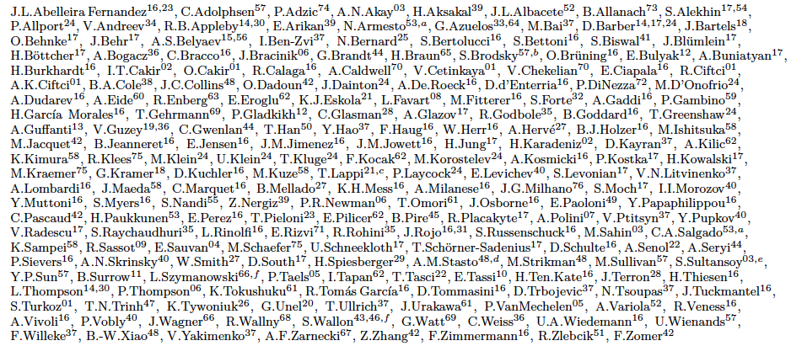
http://lhec.web.cern.ch
LHeC Study group and CDR authors
And further, that we “never walk alone”

Slide 36
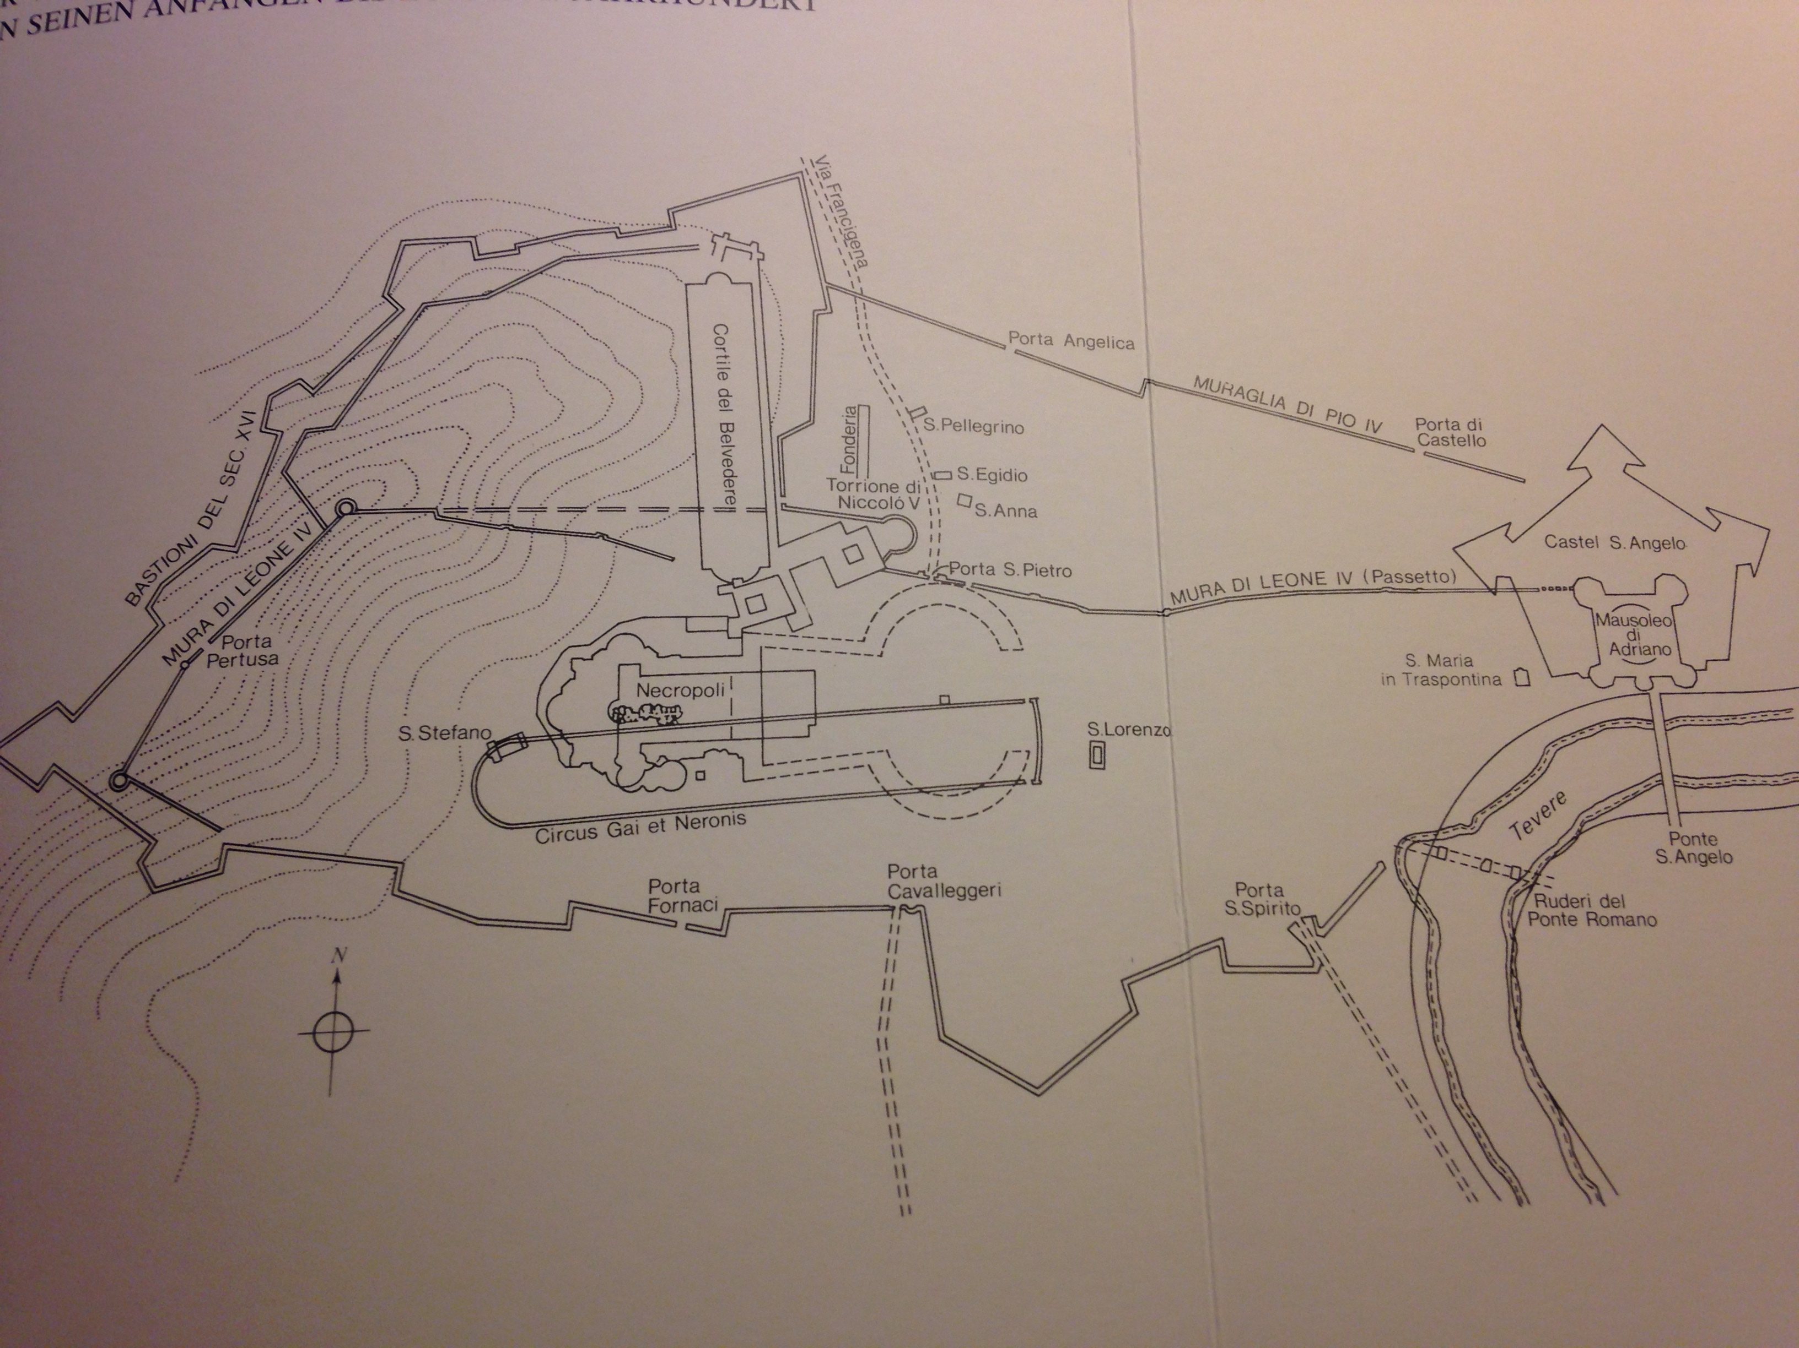
The LHeC is not the first racetrack of the world.
It can be built and will lead to fundamental
progress in particle physics and technology
in our lifetimes, the elder ones included..
An early racetrack embedded in the Vatican (XV century)

Slide 37
backup

Slide 38
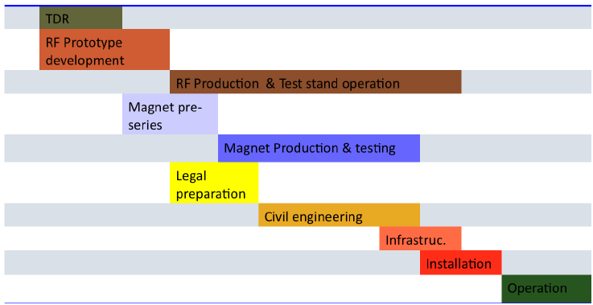
CDR Timeline
2012
Needs update
2022

Slide 39
title

