Slide 1
The LHeC Conceptual Design
Max Klein - University of Liverpool
A status report on behalf of the LHeC Study Group
2007 CERN SPC and [r]ECFA
2008 Divonne I, ICFA,ECFA
2009 Divonne II, NuPECC, ECFA
2010 Divonne III (28.-30.10.), ECFA
→ Conceptual Design Report
CERN Science Policy Committee 14.6.2010
http://cern.ch/lhec

Slide 2
Organisation for the CDR
Working Group Convenors
Scientific Advisory Committee
Accelerator Design [RR and LR]
Oliver Bruening (CERN),
John Dainton (CI/Liverpool)
Interaction Region and Fwd/Bwd
Bernhard Holzer (DESY),
Uwe Schneeekloth (DESY),
Pierre van Mechelen (Antwerpen)
Detector Design
Peter Kostka (DESY),
Rainer Wallny (UCLA),
Alessandro Polini (Bologna)
New Physics at Large Scales
George Azuelos (Montreal)
Emmanuelle Perez (CERN),
Georg Weiglein (Durham)
Precision QCD and Electroweak
Olaf Behnke (DESY),
Paolo Gambino (Torino),
Thomas Gehrmann (Zuerich)
Claire Gwenlan (Oxford)
Physics at High Parton Densities
Nestor Armesto (Santiago),
Brian Cole (Columbia),
Paul Newman (Birmingham),
Anna Stasto (MSU)
Guido Altarelli (Rome)
Sergio Bertolucci (CERN)
Stan Brodsky (SLAC)
Allen Caldwell -chair (MPI Munich)
Swapan Chattopadhyay (Cockcroft)
John Dainton (Liverpool)
John Ellis (CERN)
Jos Engelen (CERN)
Joel Feltesse (Saclay)
Lev Lipatov (St.Petersburg)
Roland Garoby (CERN)
Roland Horisberger (PSI)
Young-Kee Kim (Fermilab)
Aharon Levy (Tel Aviv)
Karlheinz Meier (Heidelberg)
Richard Milner (Bates)
Joachim Mnich (DESY)
Steven Myers, (CERN)
Tatsuya Nakada (Lausanne, ECFA)
Guenther Rosner (Glasgow, NuPECC)
Alexander Skrinsky (Novosibirsk)
Anthony Thomas (Jlab)
Steven Vigdor (BNL)
Frank Wilczek (MIT)
Ferdinand Willeke (BNL)
Steering Committee
Oliver Bruening (CERN)
John Dainton (Cockcroft)
Albert DeRoeck (CERN)
Stefano Forte (Milano)
Max Klein - chair (Liverpool)
Paul Laycock (secretary) (L’pool)
Paul Newman (Birmingham)
Emmanuelle Perez (CERN)
Wesley Smith (Wisconsin)
Bernd Surrow (MIT)
Katsuo Tokushuku (KEK)
Urs Wiedemann (CERN))
Frank Zimmermann (CERN)
http://cern.ch/lhec

Slide 3
LEP*LHC (1984, 1990) - Lausanne, Aachen
E.Keil LHC project report 93 (1997)
Thera (2001),
QCD explorer (2003)
J.Dainton et al, 2006 JINST 1 10001
LHeC at DIS conferences since Madison 2005

Slide 4
Outline
Basic Project Considerations
Precision QCD and Electroweak Physics
New Physics with the LHeC and the LHC
High Density Matter (Low x and eA)
Detector Design
Accelerator: Ring-Ring
Accelerator: LINAC-Ring
Concluding Remarks
Please note: ALL plots and results are preliminary and being (re)done for the CDR

Slide 5
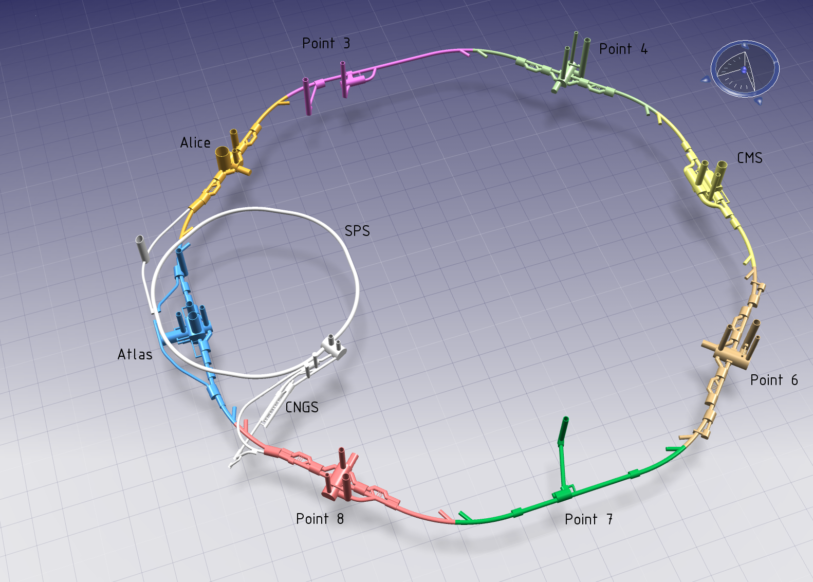
Ring – Ring
Dedicated
injector
10 GeV
2 10¹⁰e
(LEP: 4 10¹¹)
~10 min filling time
100 times HERA luminosity, 50-100 times Q² and 1/x

Slide 6
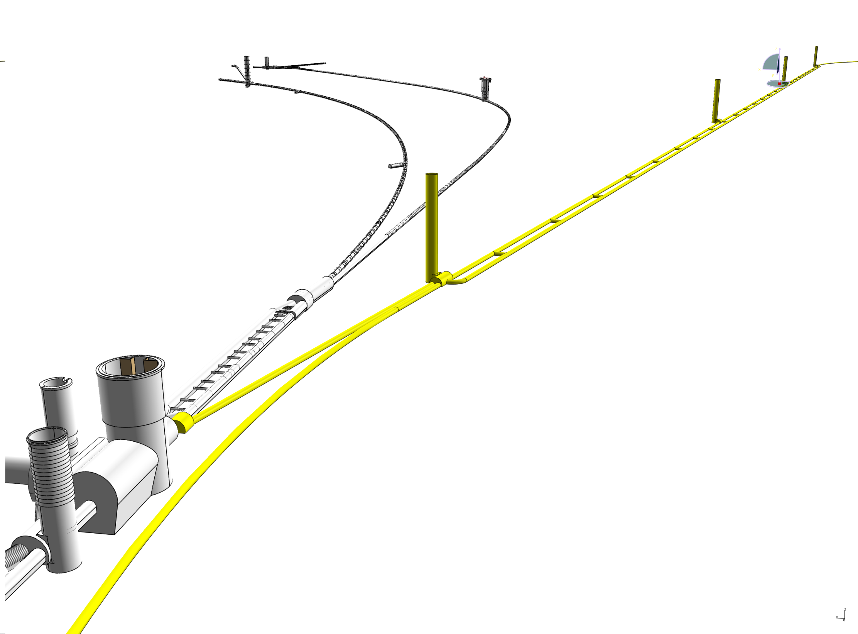
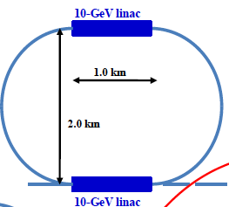
LINAC - Ring
Also presented in CDR:
60 GeV pulsed 10³²cm⁻²s⁻¹
140 GeV pulsed 5 10³¹
Note: CLIC x LHC ~10³⁰
due to different time
structure (0.5 vs 50ns)
Also P_{max}=100 MW
Energy recovery (94%), β*=10cm

Slide 7
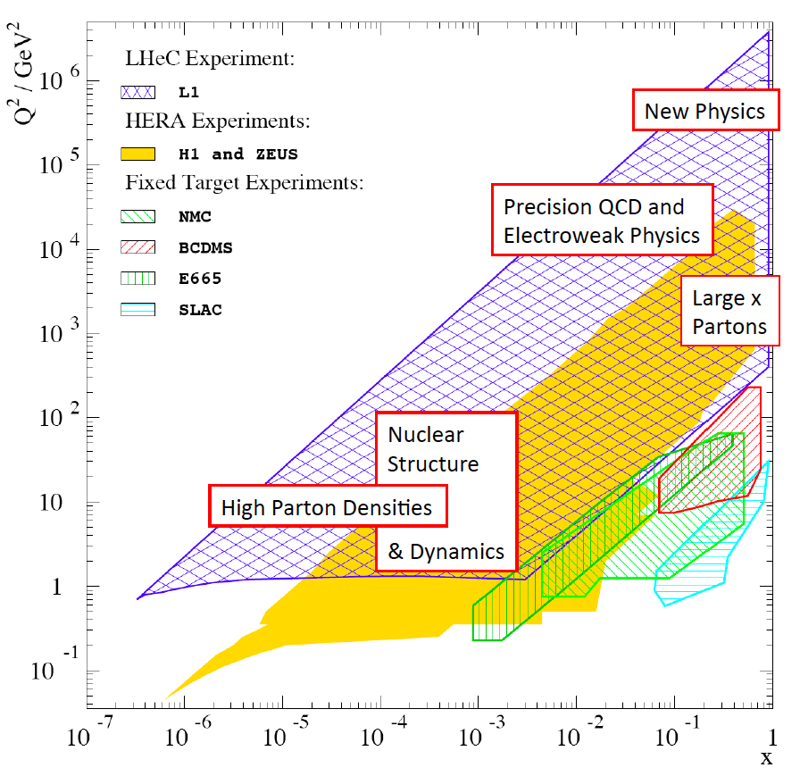

Slide 8
HERA - an unfinished programme
Low x: DGLAP seems to hold though ln1/x is large
Gluon Saturation not proven
High x: would have required much higher luminosity
[u/d ?, xg ?]
Neutron structure not explored
Nuclear structure not explored
New concepts introduced, investigation just started:
-parton amplitudes (GPD’s, proton hologram)
-diffractive partons
-unintegrated partons
Instantons not observed
Odderons not found
…
Fermions still pointlike
Lepton-quark states (as in RPV SUSY) not observed
*) For an experimental review see:
M.Klein, R.Yoshida, “Collider Physics at HERA’’
arXiv 0805.3334, Prog.Part.Nucl.Phys.61,343(2008)
HERA II analysis still ongoing

Slide 9
Precision QCD and Electroweak Physics
Based on weak = electromagnetic cross sections, p, d, e±,P_{e} and high precision and full acceptance
Structure functions [F₂,F_{L},xF₃^{gZ},F₂^{gZ}; F₂^{cc},F₂^{bb},F₂^{ss}] in p/d and A
Quark distributions from direct measurements and QCD fits
Strong coupling constant α_{s} to per mille accuracy
Gluon distribution in full x range to unprecedented precision
Standard Model Higgs
Single top and anti-top quark production at high rate (5pb)
Electroweak couplings (light and heavy quarks and mixing angle)
Heavy quark fragmentation functions
Charm and beauty below and way beyond threshold at per cent accuracy
Heavy quarks in real photon-proton collisions [LR option]
Jets and QCD in photoproduction and DIS
Gluon structure of the photon
….

Slide 10
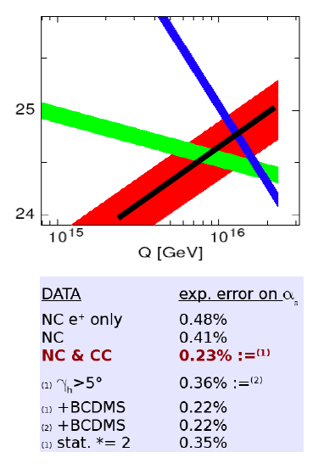
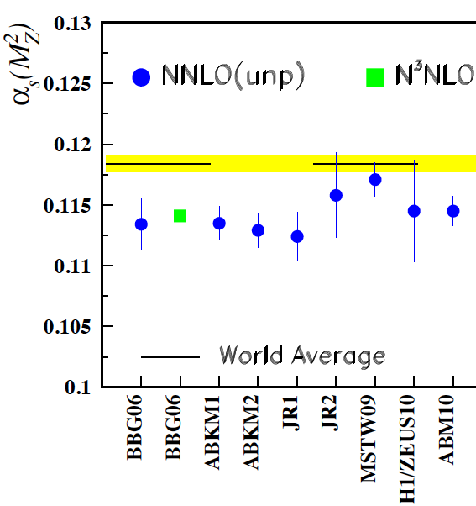
Strong Coupling Constant
Simulation of α_{s} measurement at LHeC
α_{s} least known of coupling constants
Grand Unification predictions suffer from δα_{s}
DIS tends to be lower than world average
LHeC: per mille accuracy indep. of BCDMS.
Challenge to experiment and to h.o. QCD
1/α
fine structure
weak
strong
MSSM - B.Allnach et al, hep-ex/0403133
?
+pol
J.Bluemlein and H. Boettcher, arXiv 1005.3013 (2010)

Slide 11
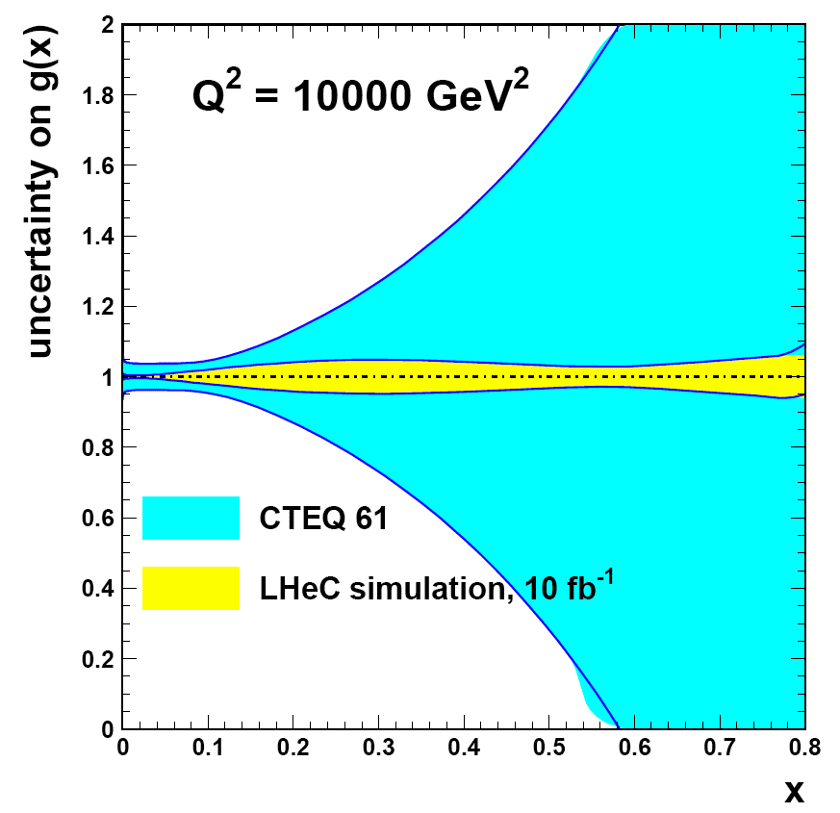
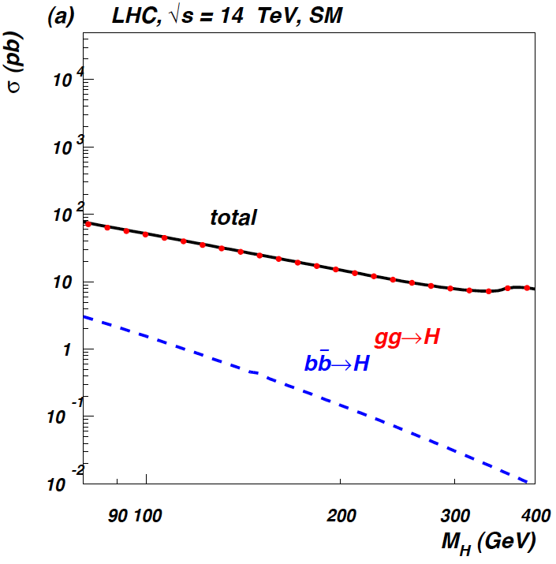
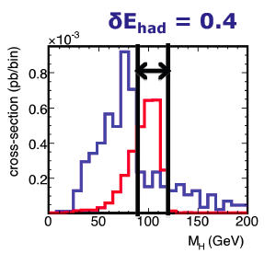
Gluon - SM Higgs
CTEQ Belyayev et al. JHEP 0601:069,2006
H→bb
QCD3j
In SM Higgs production is gluon dominated
LHeC: huge x,Q² range for xg determination
WW to Higgs fusion has sizeable ep xsection

Slide 12
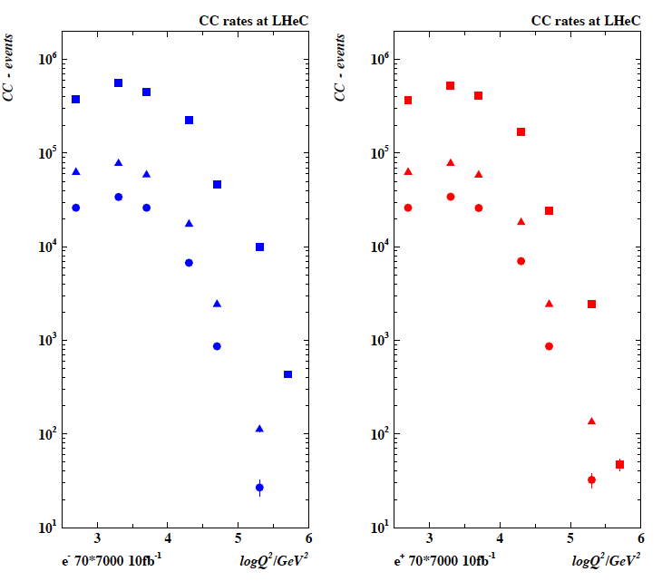
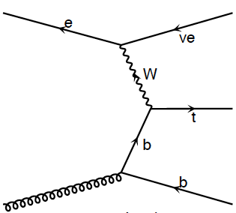
Single top and anti-top Production in charged currents
LHeC is a single top and
single tbar quark `factory’
CC t cross section O(5)pb
CC events for 10 fb⁻¹

Slide 13
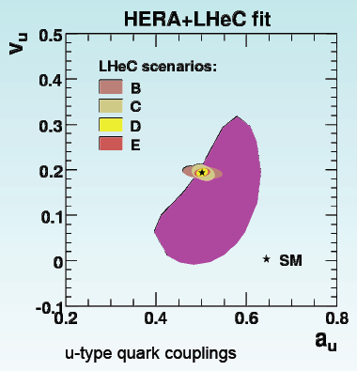
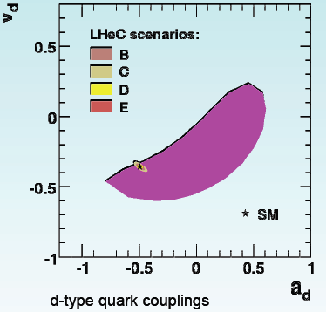
Electroweak Couplings
ZEUS
For H1, CDF, LEP cf Z.Zhang DIS10

Slide 14
Physics Beyond the Standard Model
Based on high energy, luminosity, e±,P_{e} and high precision and full acceptance
Lepto-Quarks [E6, bound states of technifermions, squarks decaying by RP violation..]
Contact Interactions [new physics at multiTev scale]
Excited Fermions
Higgs in SM and MSSM (in SM chapter)
Heavy Leptons
4th generation quarks
Z’
SUSY
…

Slide 15
Questions on a TeV ep Collider
Divonne 08
G. Altarelli
J.Bartels: Theory on low x

Slide 16
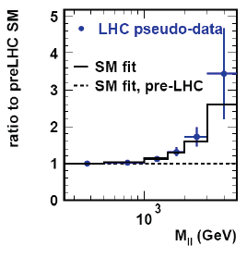
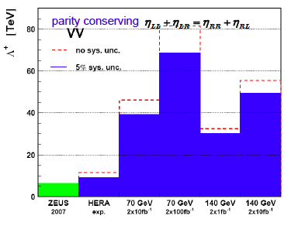
Contact Interactions
CI study:
LHeC freezes the pdfs which
allows new
physics to be revealed.
HERA+BCDMS reshuffle the sea…
High luminosity vs high energy

Slide 17
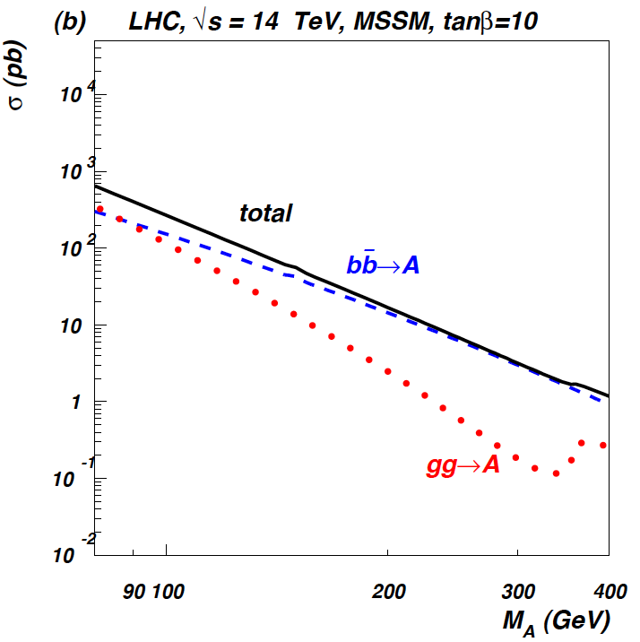
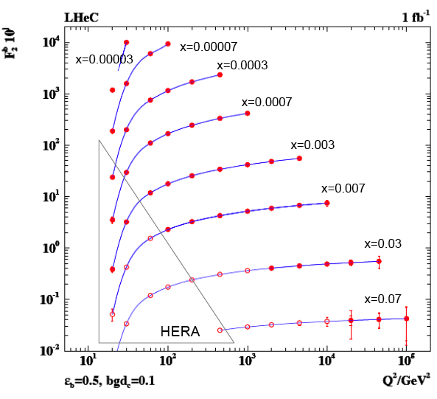
Beauty - MSSM Higgs
CTEQ Belyayev et al. JHEP 0601:069,2006
In MSSM Higgs production is b dominated
First measurements of b at HERA can be
turned to precision measurement of b-df.
LHeC: higher fraction of b, larger range,
smaller beam spot, better Si detectors

Slide 18
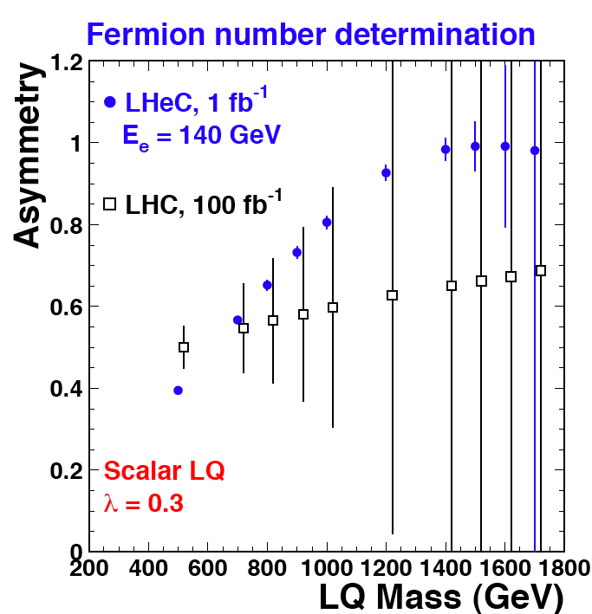
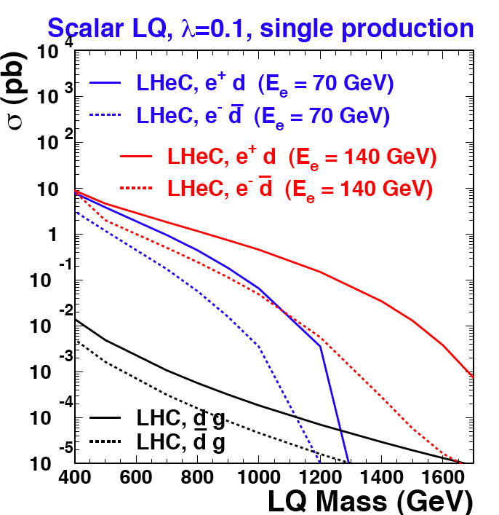
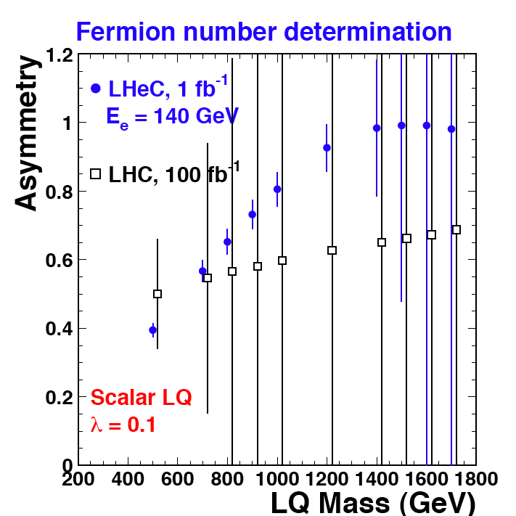
LQ Quantum Numbers
Charge asymmetry much cleaner in ep [in] than in pp [out].
Similar for simultaneous determination of coupling
and quark flavour. Polarisation for spectroscopy
JINST 1 2006 P10001

Slide 19
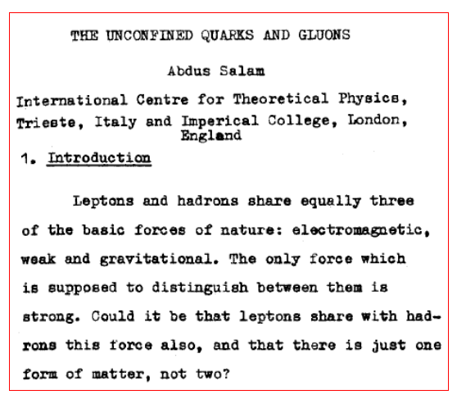
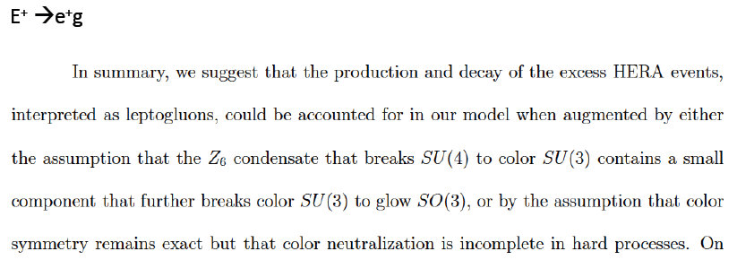
Surprises and Theory
Things may evolve differently
than we think, but we may
rely on the ingenuity of our
theory colleagues to deal with
the unexpected.
Design a maximum energy, high
luminosity, affordable collider
Tbilissi 76
S.Adler, arXiv:hep-th/9610104

Slide 20
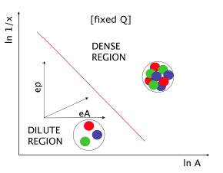
Low x Physics: non-linear parton evolution (ep/eA)
Based on p/A [e±,P_{e}] and high precision and full acceptance in forward and backward region
Unitarity and QCD
Expectations from LHC
DIS on nuclei
New physics at low x
Diffraction
Vector Mesons
Deeply Virtual Compton Scattering
Jets and Parton Dynamics
Forward jets and parton emission
Initial QGP [AA-eA]
UHE Neutrino Scattering and LHeC

Slide 21
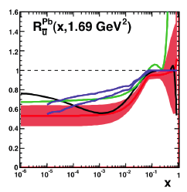
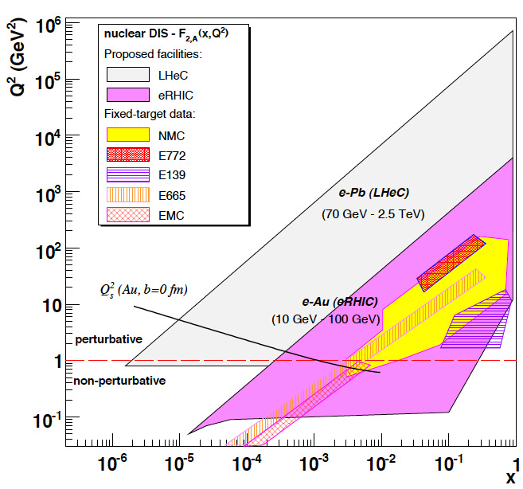
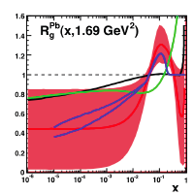
eA → eX
Extension of kinematic range by 3-4 orders of
magnitude into saturation region (with p and A)
Like LHeC ep without HERA.. (e.g. heavy quarks in A)

Slide 22
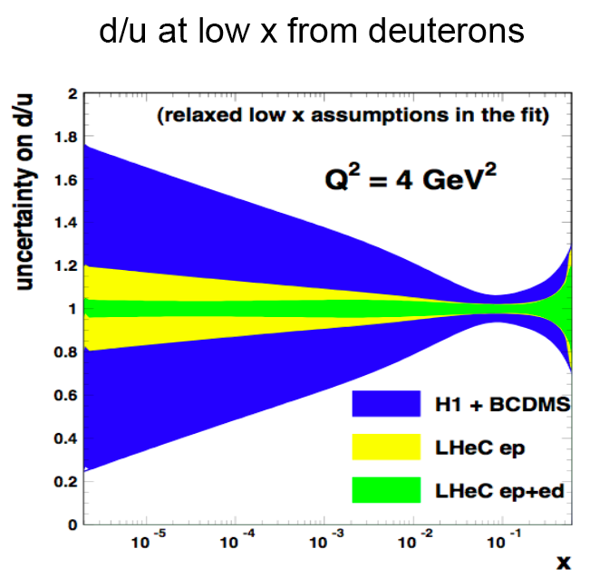
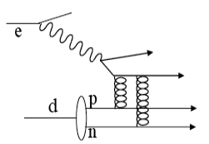
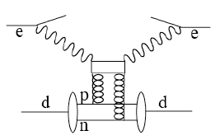
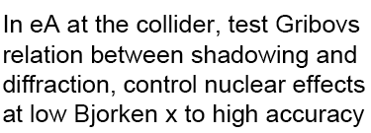
Rich Neutron Physics from eD
Neutron structure unknown in HERA range and below, yet crucial to resolve its partonic structure and to predict scattering on nucleons. Stabilizes
QCD evolution (singlet – non singlet parts!)
Collider eD: low x: diffraction-shadowing,
high : tag p spectator to en interaction
Brodsky

Slide 23
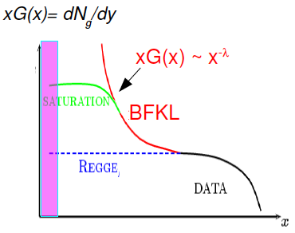
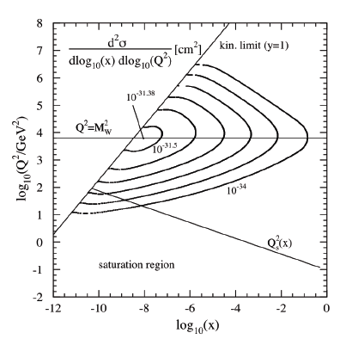
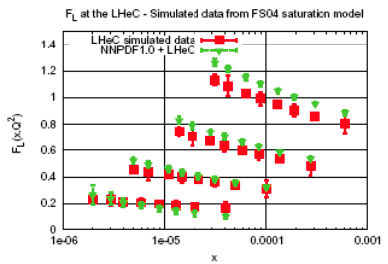
Saturation of Gluon Density
MUST show up as LHeC measures in
unitarity limited region. Can be uniquely
identified (inclusive F₂/F_{L}, diffraction, J/ψ).
With eA reach effectively x of 10⁻⁸ (UHEν)

Slide 24
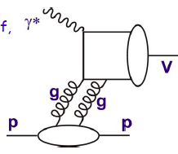
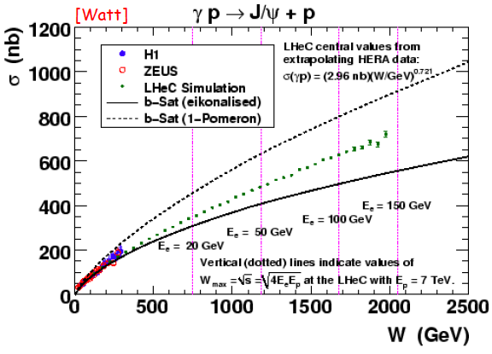
J/ψ – golden channel
cf also:
A.Caldwell, H.Kowalski
PR C81:025203,2010
Investigation of nuclear
matter with J/Psi

Slide 25
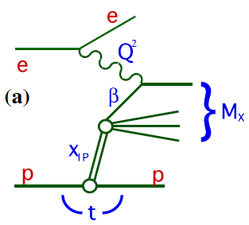
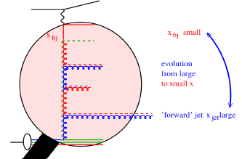
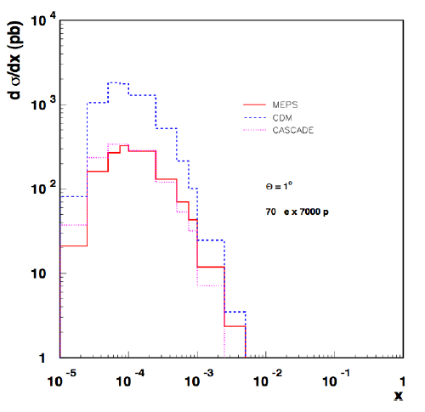
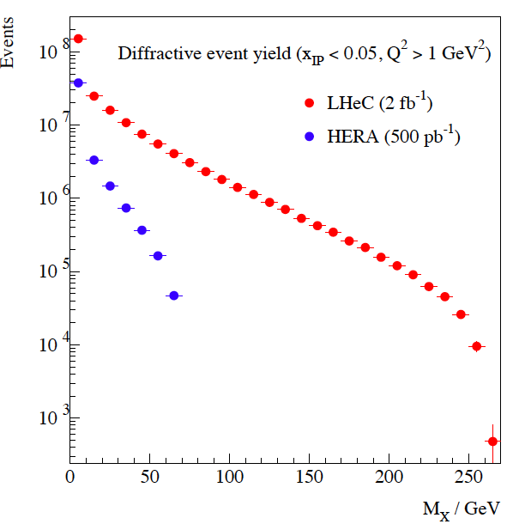
Quark-Gluon Dynamics - Diffraction and HFS (fwd jets)
Understand multi-jet emission (unintegr. pdf’s), tune MC’s
Production of high mass 1⁻ states
At HERA resolved γ effects mimic non-kt ordered emission

Slide 26
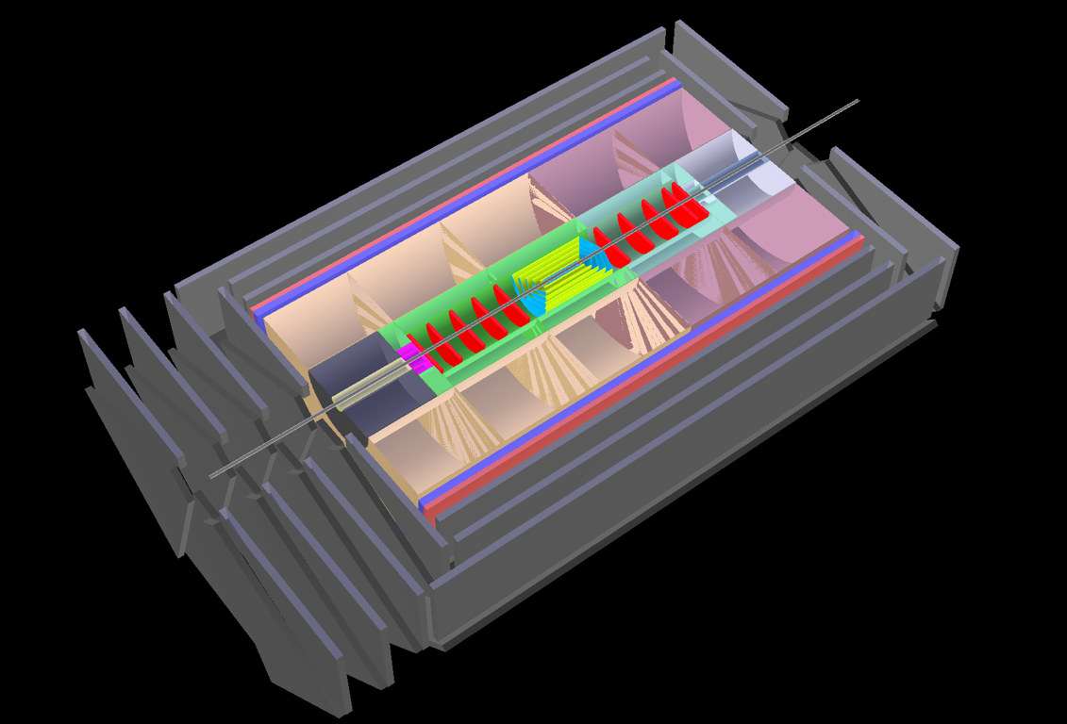
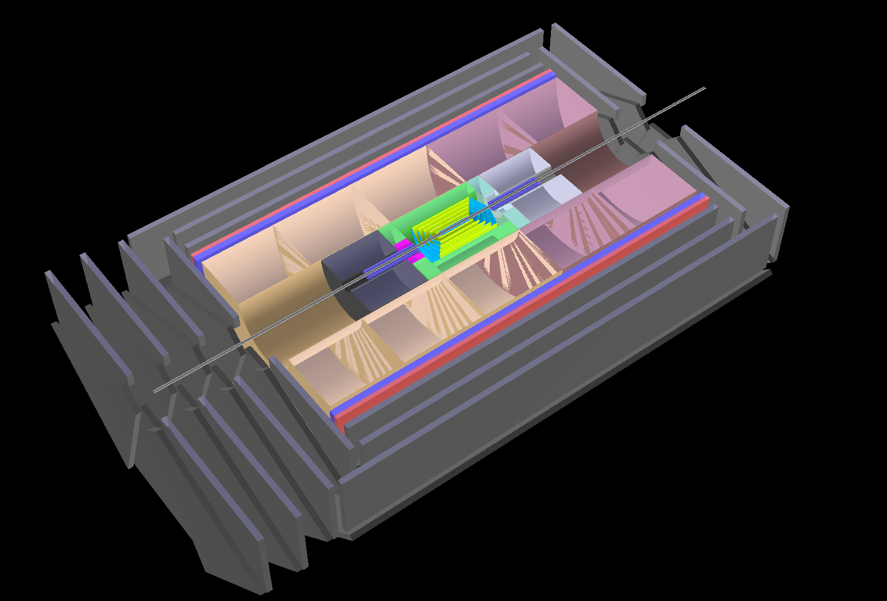
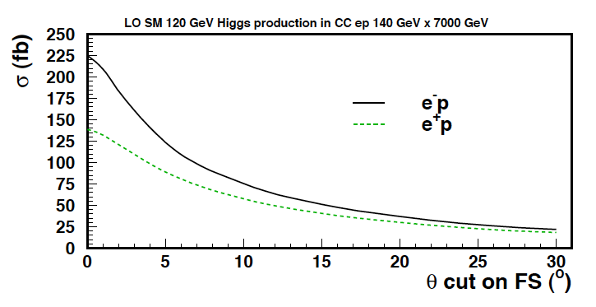
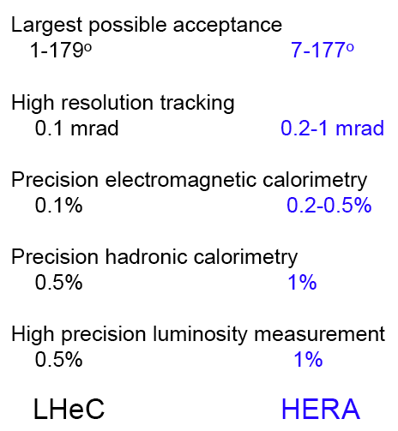
Detector Design
Based on HERA, LHC, ILC R&D
Large fwd acceptance and high luminosity
High precision tracking and calorimetry
Forward tagging of p,n,d
Backward tagging of e,γ
Tagging of c and b in max. angular range
High resolution final state (Higgs to bbar)
?

Slide 27
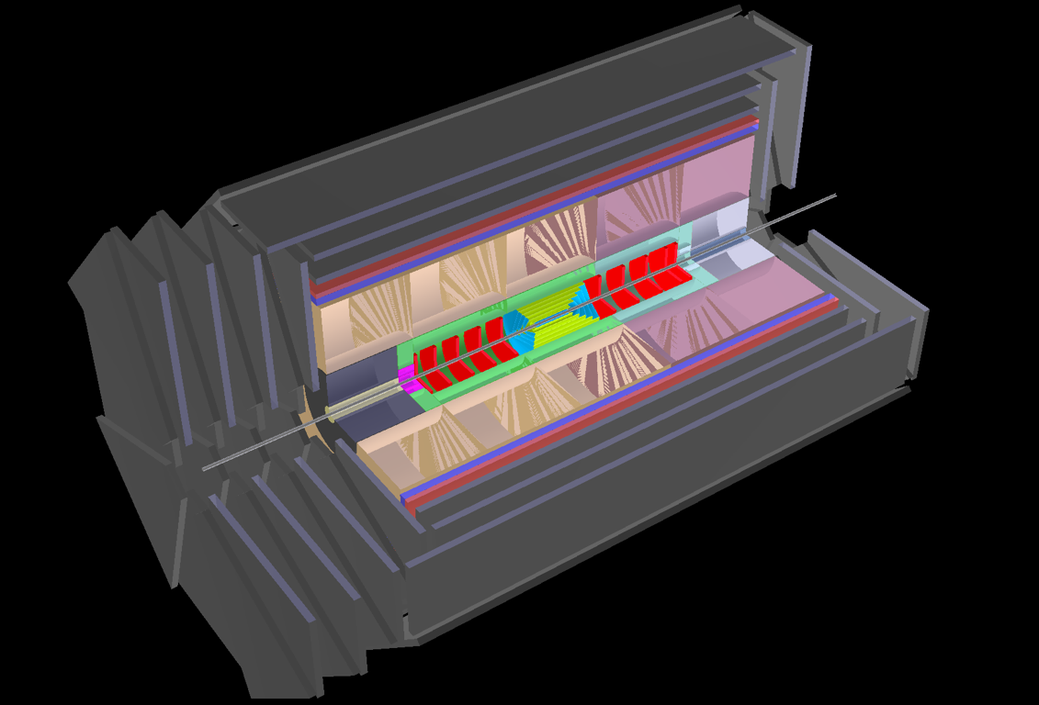
LHeC Detector: version for low x
Muon chambers
(fwd,bwd,central)
Coil (r=3m l=11.8m, 3.5T)
[Return Fe not drawn]
Central Detector
Pixels
Elliptic beam pipe
Silicon (fwd/bwd+central)
[Strip or/and Gas on Slimmed Si Pixels]
[0.6m radius for 0.03% * pt in 3.5T field]
El.magn. Calo (Pb,Scint. 30X0)
Hadronic Calo (Fe/LAr; Cu/Brass-Scint. 9-12λ)
Fwd Detectors
(down to 1º)
Silicon Tracker
[Pix/Strip/Strixel/Pad Silicon or/and Gas on Slimmed Si Pixels]
Calice (W/Si); dual ReadOut - Elm Calo
FwdHadrCalo:
Cu/Brass-Scintillator
Bwd Detectors
(down to 179º)
Silicon Tracker
[Pix/Strip/Strixel/Pad Silicon or/and Gas on Slimmed Si Pixels]
Cu/Brass-Scintillator,
Pb-Scintillator (SpaCal - hadr, elm)
Dimensions defined by beam pipe (Nomex/Be sandwich?) – work in progress.

Slide 28
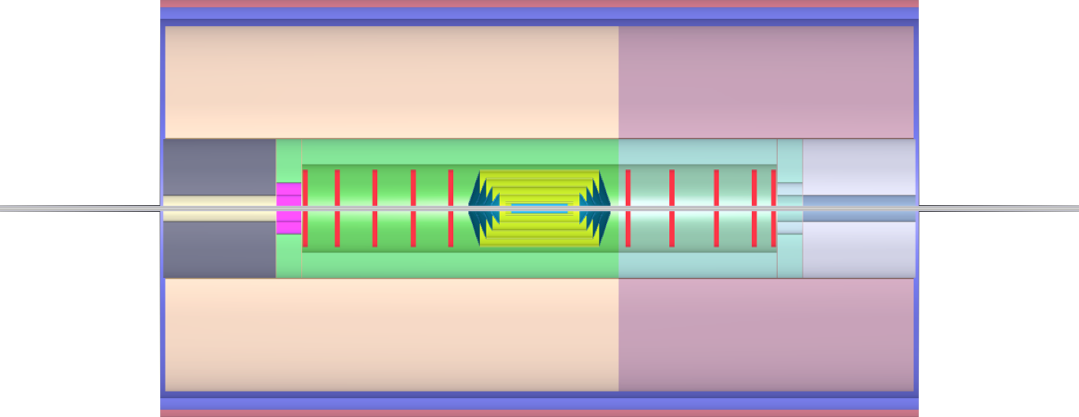
The Detector - Low Q² Setup
217
250
250
250
217
[cm]
HaC-Barrel-fwd
HaC-Barrel-bwd
40
EmC-Endcap-bwd
Fwd Tracking
Bwd Tracking
EmC-insert-½-bwd
177
EmC-fwd
EmC-Barrel
EmC-bwd
10⁰ and 170⁰
177
5⁰ and 175⁰
4⁰ and 176⁰
3⁰ and 177⁰
2⁰ and 178⁰
1⁰ and 179⁰
20
20
40
Central Tracking
40
HaC-insert-½-fwd
HaC-insert-½-bwd
60
60
112
112
EmC-insert-½-fwd
40
EmC-Endcap-fwd
289
289
Solenoid+Dipole
Fwd/Bwd asymmetry in energy deposited and thus in technology [W/Si vs Pb/Sc..]
Present dimensions: LxD =17x10m² [CMS 21 x 15m² , ATLAS 25 x 45 m²]

Slide 29
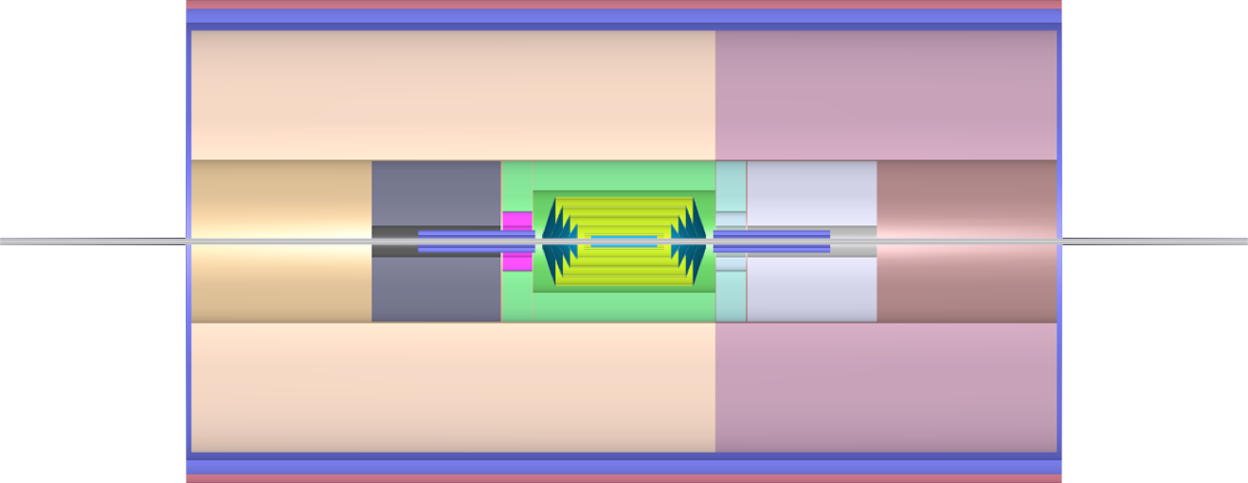
The Detector - High Q² Setup
217
250
250
250
217
[cm]
HaC-Barrel-fwd
HaC-Barrel-bwd
40
EmC-Endcap-bwd
EmC-insert-½-bwd
177
EmC-Barrel
177
10⁰ and 170⁰
5⁰ and 175⁰
4⁰ and 176⁰
3⁰ and 177⁰
2⁰ and 178⁰
1⁰ and 179⁰
20
20
40
Central Tracking
40
HaC-insert-½-fwd
HaC-insert-½-bwd
60
60
112
112
EmC-insert-½-fwd
40
EmC-Endcap-fwd
Low Beta Magnet
Low Beta Magnet
+ MagCal
+ MagCal
289
289
Solenoid+Dipole
Aim of current evaluations: avoid detector split in two phases: time and effort

Slide 30
Accelerator: Ring - Ring
Based on HERA, LEP and LHC Experience
Workpackages for CDR
Baseline Parameters and Installation Scenarios
Lattice Design [Optics, Magnets, Bypasses, IR for high L and 1º]
Rf Design [Installation in bypasses, Crabs]
Injector Complex [Sources, Injector]
Injection and Dump
Beam-beam effects
Impedance and Collective Effects
Vacuum and Beam Pipe
Integration and Machine Protection
Powering Issues
e Beam Polarization
Deuteron and Ion Beams
BINP Novosibirsk
BNL
CERN
Cockcroft
Cornell
DESY
EPFL Lausanne
KEK
Liverpool U
SLAC
TAC Turkey

Slide 31
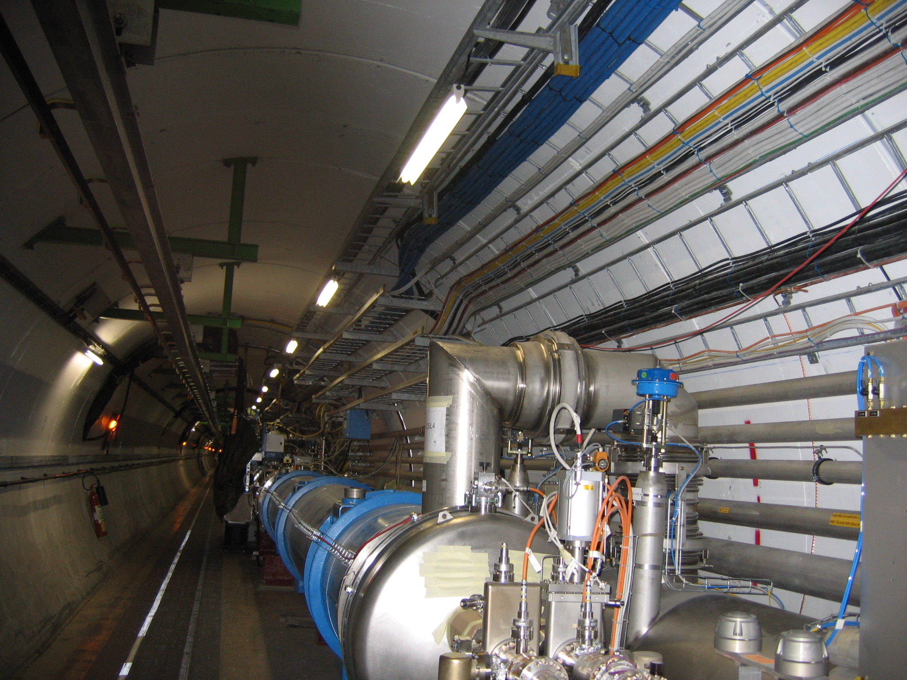
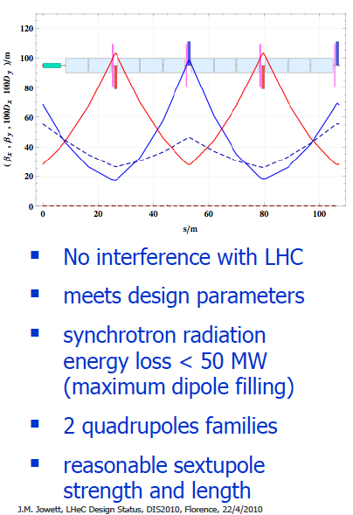
Arc Cell Design – Double FODO
Cryo jumpers
accounted for in
FODO design.
Further interferences
mapped and being studied.

Slide 32
Dipole Magnets
CERN: 40cm model design
Accelerator | LEP | LHeC
Cross Section/ cm² | 50 x 50 | 20 x 10
Magnetic field/ T | 0.02-0.11 | 0.01-0.10
Energy Range/GeV | 20-100 | 10-80
Good Field Area/cm² | 5.9 x 5.9 | 6 x 3.8
FODO length/m | 76 | 107 [double]
Magnet length/m | 11.5 | 5.5
segmentation | 8x31x6 | 8x23x15
Number of magnets | 1488+192 [DS] | 3080+320
Weight / kg/m | 800 | 200
Novosibirsk: Hysteresis loop measurements
Fe based magnet prototypes [BINP-CERN] → CDR
challenges:
compact design for installation
good reproducibility at injection: 0.01T to 10^{-3..-4}

Slide 33
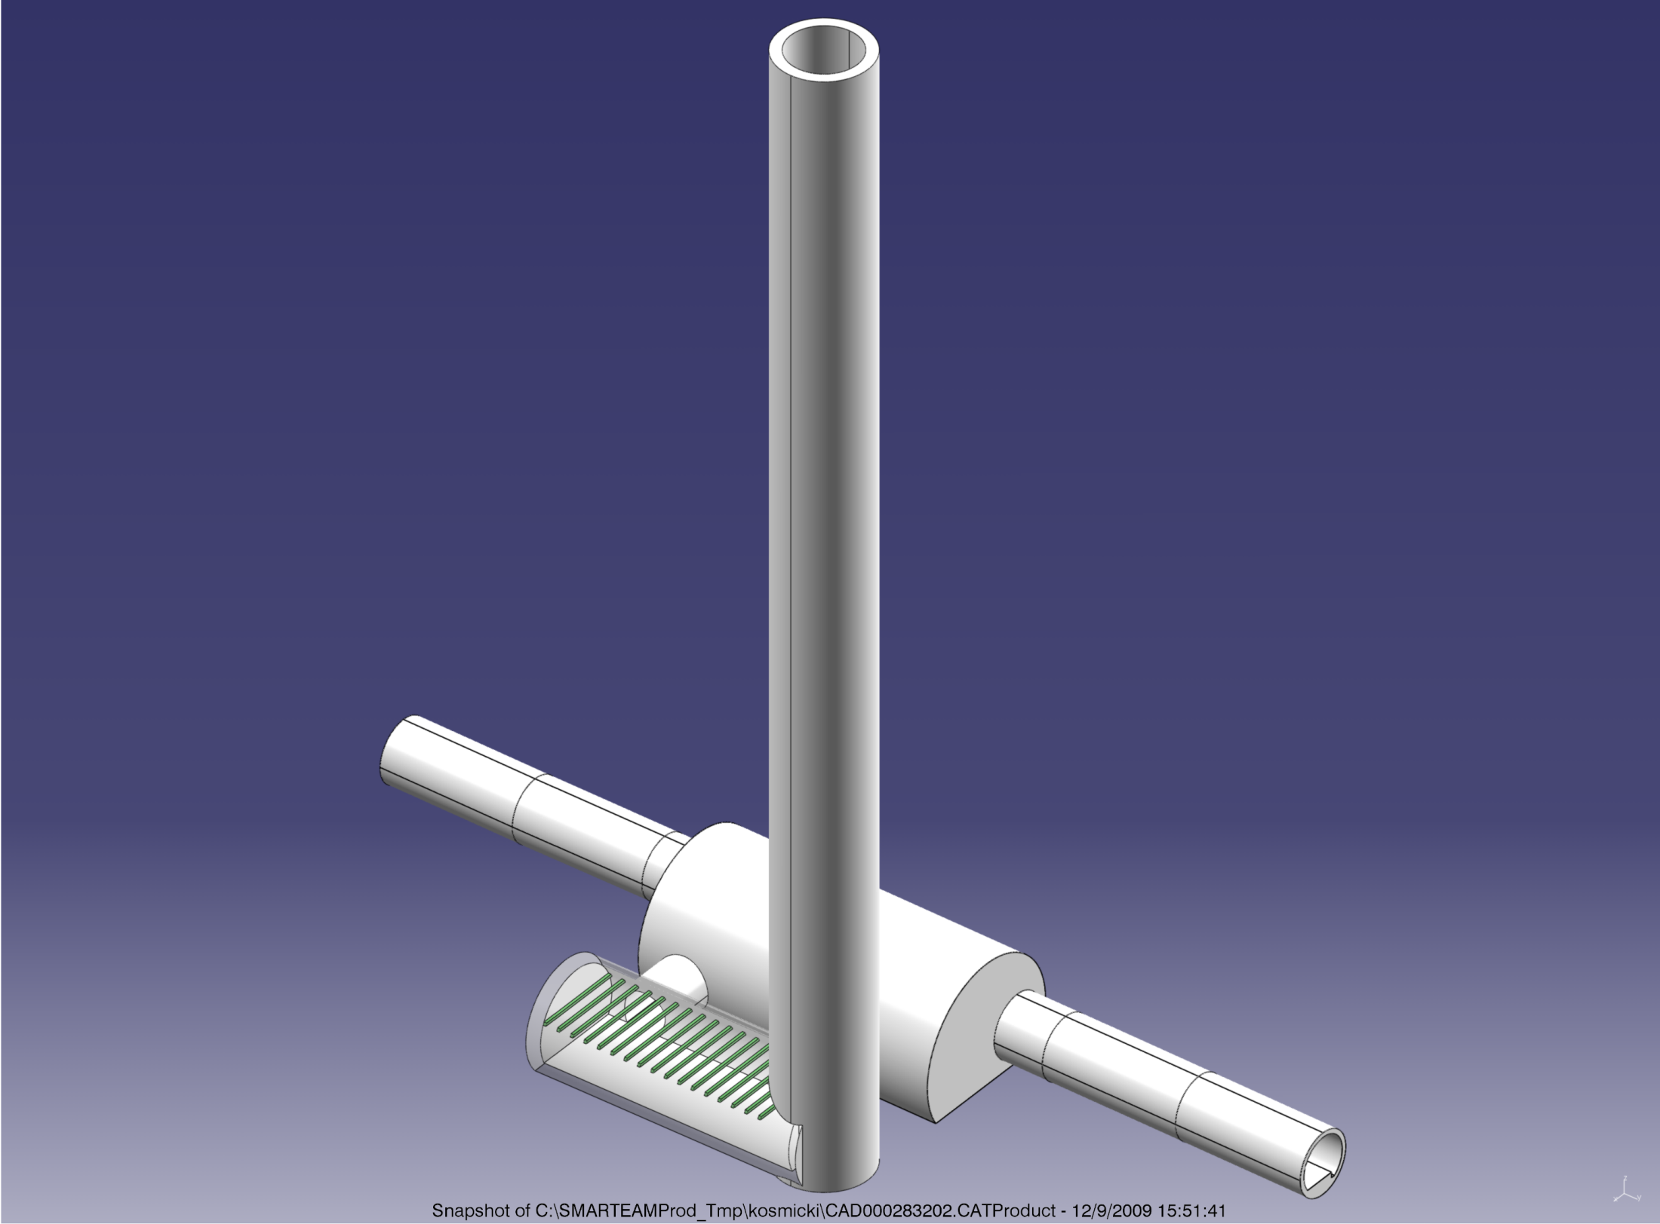
Bypasses
Bypasses
Alternative He supplies
and SEE relocation. Seed
for P1,5 service
galeries
S. Waisz (Chamonix 10)
J.Osborne GS-SEM
Away from galeries
Double tunnel: use to install rf
[typically 0.5-1km]
Aim to keep U_{e}=U_{p}
Tunnel connection (CGNS, DESY)
Possibly in line with P1,5 redesigns

Slide 34
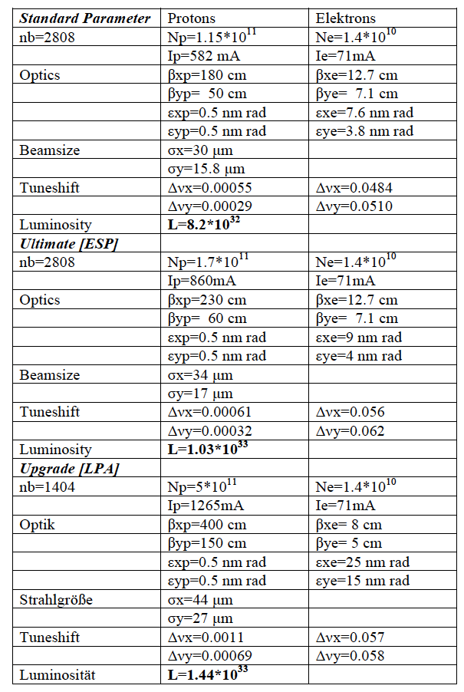
Ring-Ring Parameters
Luminosity safely 10³³cm⁻²s⁻¹
HERA was 1-5 10³¹
Table values are for 14 MW sync.rad
loss (beam power) and 70 GeV
on 7000 GeV.
LHC upgrade: N_{p} increased.
Need to keep e tune shift low:
by increasing β_{p}, decreasing β_{e}
but enlarging e emittance,
to keep e and p matched.
Ring LHeC profits from LHC upgrade
but not proportional to N_{p}
Crucial for LINAC

Slide 35
Accelerator: LINAC - Ring
Based on ILC, SLC and LHC Experience
Workpackages for CDR
Baseline Parameters [Designs, Real photon option, ERL]
Sources [Positrons, Polarisation]
Rf Design
Injection and Dump
Beam-beam effects
Lattice/Optics and Impedance
Vacuum and Beam Pipe
Integration and Layout
Interaction Region
Powering Issues
Magnets
Cryogenics
BINP Novosibirsk
BNL
CERN
Cockcroft
Cornell
DESY
EPFL Lausanne
KEK
Liverpool U
SLAC
TAC Turkey

Slide 36
Pulsed
ERL
LHC p
10-GeV linac
1.67 km
0.34 km
1.0 km
30-GeV linac
60 GeV
circumference = 4.4 km
2.0 km
LHC p
Pulsed 140
10-GeV linac
circumference = 8.3 km
2.0 km
LHC p
3.9 km
70-GeV linac
circumference = 14.1 km

Slide 37
LHC proton interaction-region optics for β*_{x,y}=0.1 m, scaled from the nominal IR optics (left) [5],
and a new IR optics with β*_{x,y}=0.1 m for protons [l*=10 m] (top right) and electrons [l*=20 m] (bottom right) [4]

Slide 38
LINAC-Ring Parameters
For ERL version:
2 x 560, 1m long cavities
25 MW cryo power
Cf recent papers to IPAC10 at Kyoto (from LHeC web page)

Slide 39
Project + Concluding Remarks

Slide 40
Proposal as endorsed by ECFA (30.11.2007)
As an add-on to the LHC, the LHeC delivers in excess of 1 TeV to the electron-quark cms system. It accesses high parton densities ‘beyond’ what is expected to be the unitarity limit. Its physics is thus fundamental and deserves to be further worked out, also with respect to the findings at the LHC and the final results of the Tevatron and of HERA.
First considerations of a ring-ring and a linac-ring accelerator layout lead to an unprecedented combination of energy and luminosity in lepton-hadron physics, exploiting the latest developments in accelerator and detector technology.
It is thus proposed to hold two workshops (2008 and 2009), under the auspices of ECFA and CERN, with the goal of having a Conceptual Design Report on the accelerator, the experiment and the physics. A Technical Design report will then follow if appropriate.
Unanimously supported by rECFA and ECFA plenary in November 2007
NuPECC: Long Range Plan being finalised: LHeC listed there (Madrid 5/10)

Slide 41
Schedule+Remarks
If the LHeC is to be realised it has to start operation by 2020/22 [programme, effort]
this is possible:
HERA: Proposal 1984 – Operation 1992. LEP: Proposal 1983 – Operation 1989
The major technologies for the accelerator and the detector exist. It can be built.
Steps: CDR 2010/11 [15.9. – Divonne III 28.10.-30.10. – ECFA – Referees/SAC - Printed Spring 2011]
Evaluation. When positive: set up professional project structure for
TDR by end of 2013 for either Ring or LINAC [charge, pol, L, cost, IR, Det, LHC interference ..]
Crucial for CDR: Concluding the work (IR→ Detector, writing the chapters -70 authors)
A detailed installation plan is being worked out for the Accelerator and the Detector
in order to understand the interference with the LHC developments.
The high luminosity ingredients for the LINAC would require to strongly couple R&D
with ongoing developments (Nb₃ Sn, positron sources, ERL, crab cavities).
In the long term perspective a 140 GeV electron beam coupled with a 16 TeV
LHC’ beam would mean that this field can be brought to 3 TeV cms and x ~10⁻⁷

Slide 42
The TeV Scale [2010-2035..]
pp
W,Z,top
Higgs??
New Particles??
New Symmetries?
LHC
ep
e⁺e⁻
New Physics
ttbar
Higgs??
Spectroscopy??
High Precision QCD
High Density Matter
Substructure??
eq-Spectroscopy??
ILC/CLIC
LHeC
CKM - superB

Slide 43
Deep Inelastic Scattering
SLAC 69: 2m LINAC: a “bold extrapolation
of existing technology” to “collect
data which may be of future use…”
CERN – Mecca of pp [SppS] and DIS [μ,ν]
50 000 times Q² possibly with
10 times the accelerator length
when comparing with SLAC69!
http://cern.ch/lhec

Slide 44
G. Altarelli
Divonne 08
Many thanks to too many people to be named here..

Slide 45
backup

Slide 46
The Fermi Scale [1985-2010]
pp
b quark
top quark
M_{W}, H?
Tevatron
ep
e⁺e⁻
The Standard
Model Triumph
M_{Z} , sin² Θ
3 neutrinos
h.o. el.weak (t,H?)
gluon
h.o. strong
c,b distributions
high parton densities
LEP/SLC
HERA
CKM - B factories

Slide 47
Physics Programme of the LHeC
+ Unfolding completely the parton structure of the proton (neutron and photon)
and search for sub-substructure down to ten times below HERA’s limit
+ Sensitive exploration of new symmetries and the grand unification of particle
interactions with electroweak and strong interaction measurements of
unprecedented precision.
+ Search for and exploration of new, Terascale physics, in particular for singly
produced new states (RPV SUSY, LQ, excited fermions) complementary to the LHC
+ Exploration of high density matter [low x physics beyond the expected unitarity
limit for the growth of the gluon density]
+ Unfolding the substructure and parton dynamics inside nuclei and the study of
quark-gluon plasma matter by an extension of the kinematic range by four
orders of magnitude.
G. Altarelli
Divonne 08

Slide 48
Charged Lepton Proton Scattering Experiments

Slide 49
rates

Slide 50
Tunnel CLIC

Slide 51
LHeC – HERA - Kinematics
Low x,Q² requires small angle acceptance
for both e and hadronic final state.
Large x requires small angle acceptance
for hadronic final state. TeV energies in
forward p direction

Slide 52
Light Quark Distributions
d and u at high x: a longstanding puzzle
NC/CC: free of HT, nuclear corrections.
Essential for predictions at high x
LHeC is an electroweak machine.
e.g.: Charge asymmetry in NC measures
valence quarks down to x ~10⁻³ at high Q²
E.Perez

Slide 53
Electron-Boson Resonances : excited electrons
coupling
~ f / Λ
Single e*
production
x-section
in ep is
high.
LHeC prelim. analysis, looking at e* → eγ
Pair production at LHC
If LHC discovers (pair prod) an e*:
LHeC would be sensitive to much
smaller f/Λ couplings
L assumed 10 (1) fb⁻¹ with 20/70 (140) GeV

Slide 54
Anti-Strange Quark Distribution
s not measured with H1,ZEUS
HERMES (N_{K}); much larger
dimuon data: s.ne.sbar?
HERMES, K.Rith EPS09
LHeC: measure both
strange and anti-s
with high precision
for the first time

Slide 55
ep and pp experiments

Slide 56
Supersymmetry (R-parity conserved)
~
e
Pair production via t-channel exchange of a neutralino.
Cross-section sizeable when ΣM below ~ 1 TeV.
Such scenarios are “reasonable”.
E.g. global SUSY fit to EW & B-physics observables
plus cosmological constraints (O. Buchmueller et al, 2008),
within two SUSY models (CMSSM & NUHM) leads to masses
of ~ (700, 150) GeV.
SUSY cross-section at LHeC:
about 15 fb for these scenarios.
e
χ⁰
~
q
q
Added value w.r.t. LHC to be studied :
- could extend the LHC slepton sensitivity
- precise mass measurements
- relevant information on χ⁰ sector

Slide 57
In-medium Hadronisation
The study of particle production in eA (fragmentation functions and hadrochemistry)
allows the study of the space-time picture of hadronisation (the final phase of QGP).
Low energy (ν): need of
hadronization inside.
Parton propagation: pt broadening
Hadron formation: attenuation
High energy (ν): partonic
evolution altered in the
nuclear medium.
W.Brooks, Divonne09
LHeC :
+ study the transition from small to high energies in much extended range wrt. HERMES, Jlab
+ testing the energy loss mechanism crucial for understanding of the medium produced in HIC
+ detailed study of heavy quark hadronisation …
Notes:
57

Slide 58
Nuclear Physics with the LHeC
Nuclear Parton Distribution Functions
Saturation (low x, nonlinear QCD)
Quark Gluon Plasma, its initial and final states
Gluon emission from saturated nuclei Glasma? QGP Reconfinement

Slide 59
Quark Gluon Plasma
Landau 1953. RHIC: QGP strongly coupled plasma with liquid behaviour
instead of weakly interacting gas of partons
Related to cold atoms and to
superstring theory [AdS/CFT]
M.Tannenbaum, Rept.Prog.Phys 65 (2006) 2005
Collective flow in non-central collisions anisotropic
Anisotropy proportional to 1/viscosity of fireball,
dominantly elliptic (“v₂” coefficient)
QGP most perfect liquid – smallest shear viscosity/entropy
Conclusions depend on initial fireball eccentricity
eA to measure the initial conditions of QGP.
Hirano et al, Phys.Lett.B636(2006)299
U.Heinz arXiv:0907.4256 (nucl.th)

Slide 60
Colour Glass Condensate - Saturation
Perturbatively calculable via non-linear evolution equations
HERA: Quark and gluon densities
in p rise towards low Bjorken x.
Gluon dominant but no clear
proof of nonlinear effects.
Expect saturation of rise at Q²_{s} ≈ xg α_{s} ≈ c x^{-λ}A^{1/3}
Qualitative change of scattering behaviour:
Saturation of cross sections amplified with A^{1/3} (A wider than p)
Rise of diffraction to 50% of cross section
hot spots of gluons or BDL?
The LHeC is bound to discover saturation in DIS
both in ep and in eA in a region where α_{s} is small

Slide 61
Nuclear Parton Distributions
Study using eA LHeC pseudodata
Quantitative improvement, but
based on DIS `DATA’ for the 1st time
Fermi motion ← p tagging
p, D, Ca, Pb
LHeC will have immense
impact on the partonic
structure of nuclei
→ A complete determination of nPDFs in grossly extended range, into nonlinear regime
K.Eskola, H.Paukkunen, C.Salgado, Divonne09

Slide 63
Optics: β*~ 0.1 m by combination of 3 ingredients:
A shorter free length to the interaction point, l* of 10 m, instead of 23 m for the LHC pp collisions, eases the requirements on the magnet aperture (~l*) and reduces the chromaticity (~l*/β*).
The triplet aperture must accommodate only one squeezed proton beam, instead of two for pp collisions, which increases the aperture available for the single main beam by some 50%. By itself this would allow decreasing β* by more than a factor of 2 aperture-wise.
(3) Changing the superconductor material from Nb-Ti to Nb₃Sn may increase the maximum field and/or aperture by up to a factor of 2 [11]. Since (1) and (2) together can already achieve β*~ 0.1 m,the new superconductor is not strictly necessary for reaching β*=0.1 m, but it provides additional safety margin, e.g. for a thicker beam screen and cold bore or for spurious dispersion.

Slide 64
CDR

Slide 65
assumptions: σ*_{p} =σ*_{e}
LHC design emittance and bunch length.
proton IP beta function β*=0.1 m
disruption angle θ₀ : conservative upper bound for largest deflection angle in collision [6]. Its numerical value for electrons ~ times the rms divergence of a non-colliding beam. → 10 σ beam minimum stay clear to extract e- beam from IP

Slide 66
NuPECC – Roadmap 5/2010: New Large-Scale Facilities
 |  |  | 2010 |  |  |  |  | 2015 |  |  |  |  | 2020 |  |  |  |  | 2025
FAIR | PANDA | R&D Construction Commissioning |  |  |  |  |  |  |  |  | Exploitation
 | CBM | R&D Construction Commissioning |  |  |  |  |  |  |  |  | Exploitation |  |  | SIS300
 | NuSTAR | R&D Construction Commissioning |  |  |  |  |  |  |  |  | Exploit. |  | NESR FLAIR
 | PAX/ENC | Design Study R&D Tests Construction/Commissioning |  |  |  |  |  |  |  |  |  |  |  |  |  | Collider
SPIRAL2 |  | R&D Constr./Commission. |  |  |  |  | Exploitation |  |  |  |  |  |  | 150 MeV/u Post-accelerator
HIE-ISOLDE |  |  | Constr./Commission. |  |  |  | Exploitation |  |  |  |  |  |  |  | Injector Upgrade
SPES |  |  |  | Constr./Commission. |  |  |  | Exploitation
EURISOL |  | Design Study R&D Preparatory Phase / Site Decision Engineering Study Construction
LHeC |  | Design Study R&D Engineering Study Construction/Commissioning
G. Rosner, NuPECC Chair, Madrid 5/10 - DRAFT

