Slide 1
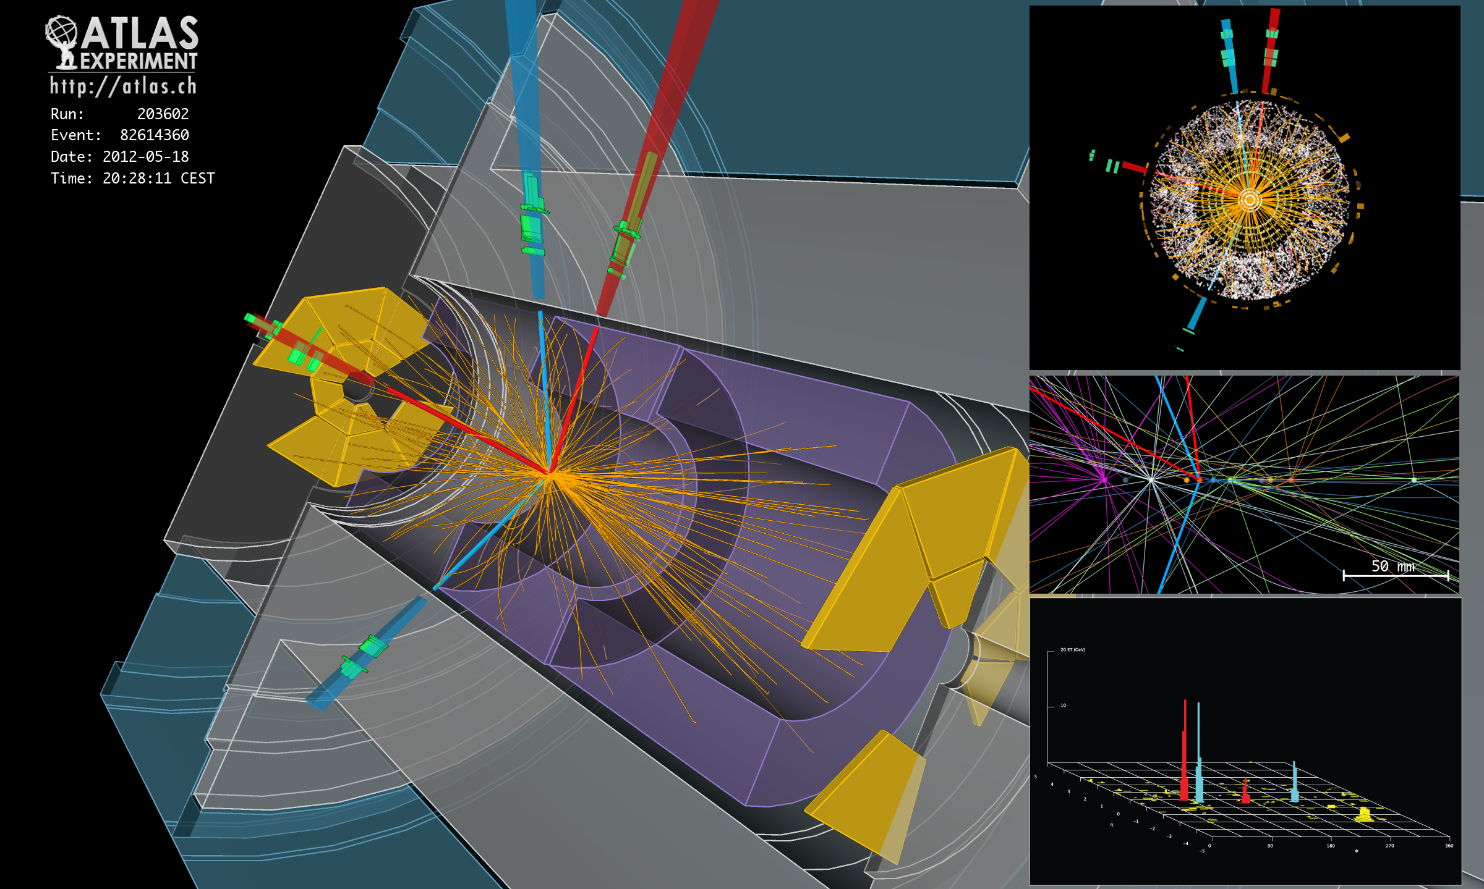
R
LHC
Higgs
SUSY
W,Z
Publications + Talks
Software
Detector
Upgrade
Max Klein – for the Liverpool ATLAS Group
H → 4e candidate (m_{4e} ~ 124 GeV)
2nd of July, 2013
Ronan McGrath, Jo Arthur, Jason Ralph – welcome at CERN. Max Klein for ATLAS L’pool.

Slide 2
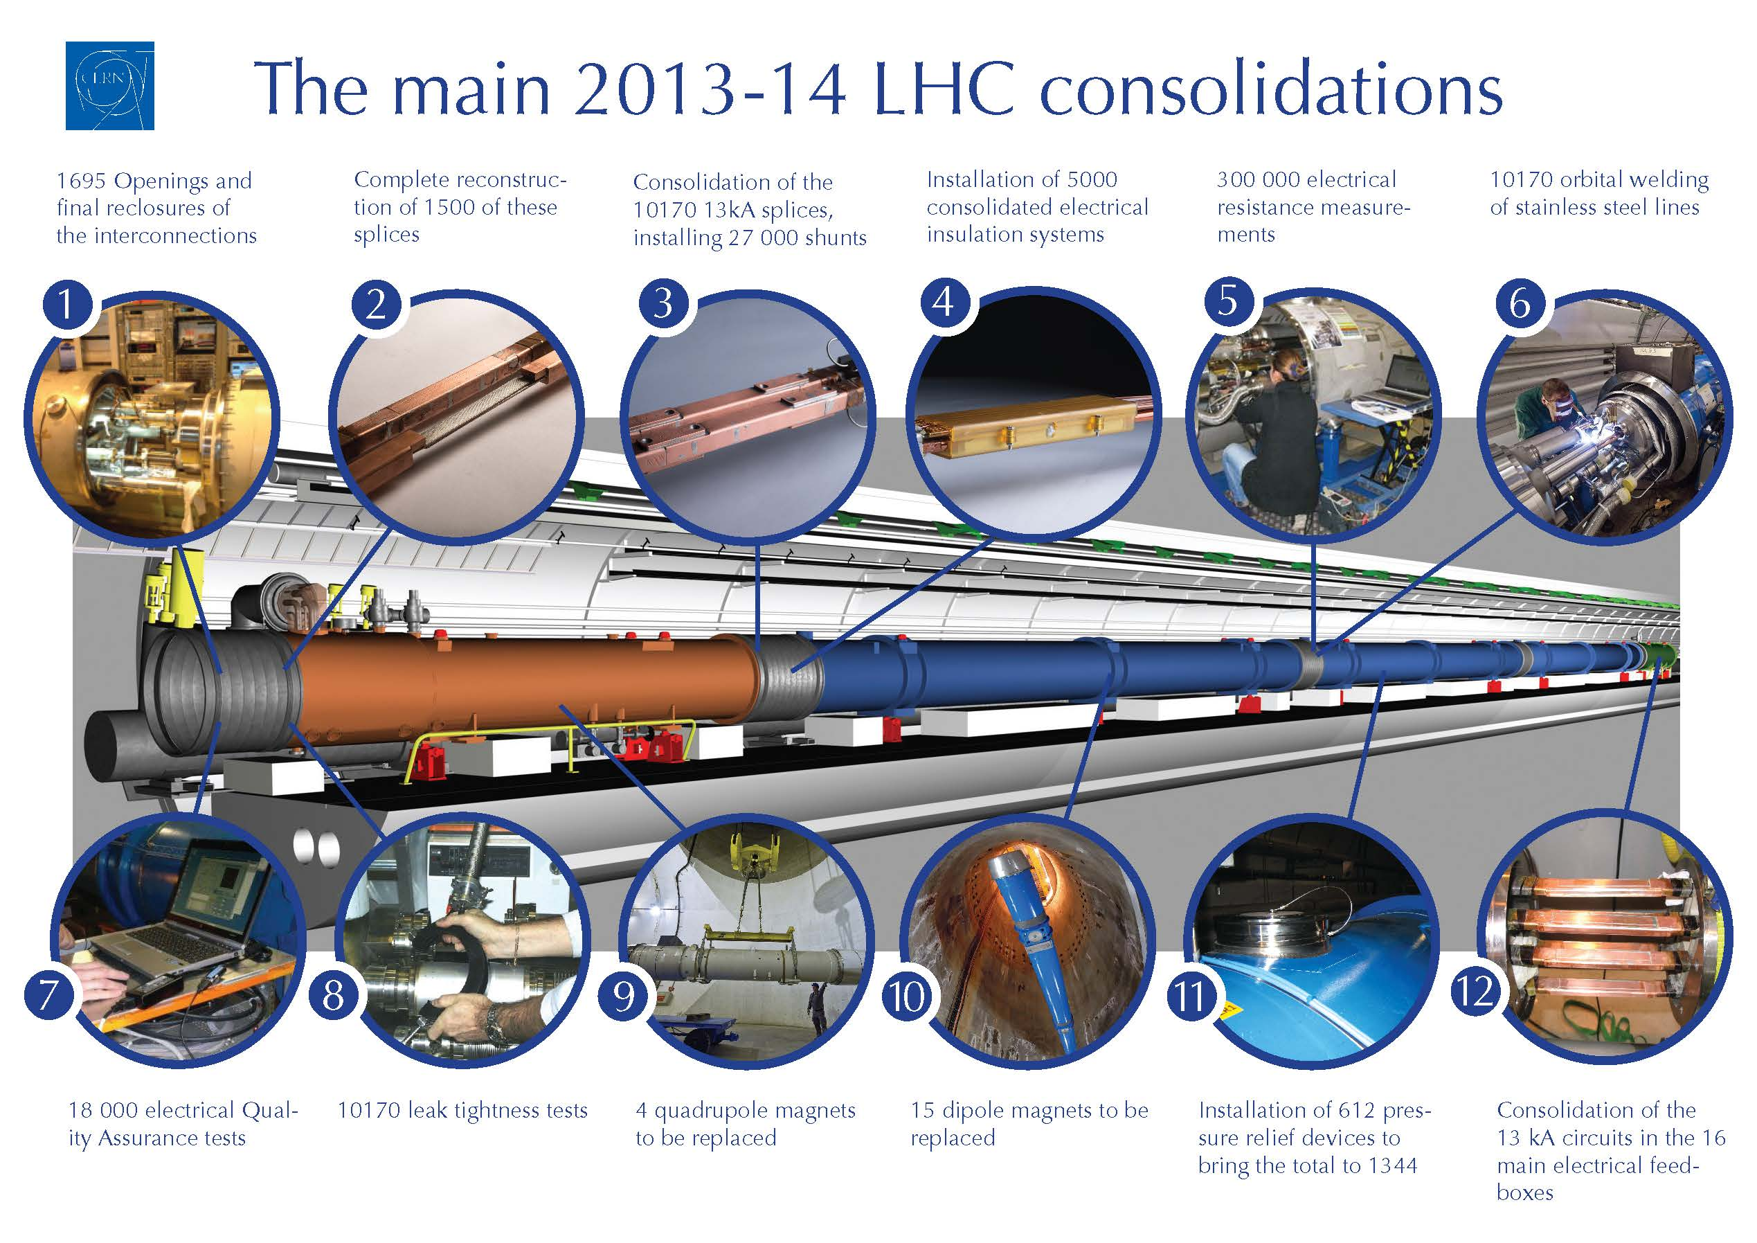
SMACC project

Slide 3
LS1 - Accelerator complex
2013
2014
2015
F
M
A
M
J
J
A
S
O
N
D
J
F
M
A
M
J
J
A
S
O
N
D
J
F
M
A
LHC
SPS
PS
PS Booster
beam to beam
available for works
Physics
Beam commissioning
Shutdown
Powering tests

Slide 4
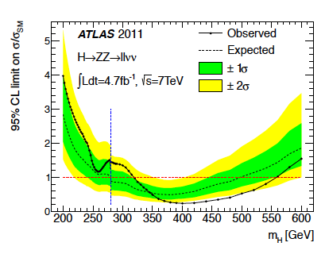
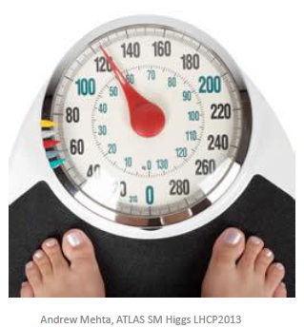
Higgs
Early beginning (2 ? Years ago)
Phys.Lett.B 717 (2012) 70
llνν
Also H →llqq, VH → V bbar
Discovery – now ~10 σ
Spin
CP
VBF Production
Rarer Decays
BSM
Structure?
More H
Mass regularisation … → center of World HEP attention – LHC, ILC, LHeC, γγ, μμ

Slide 5
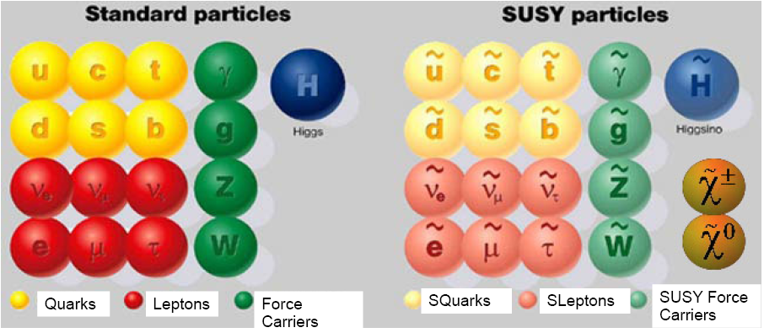
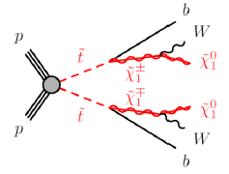
SUSY..
J=1/2 J=1 J=0 J=0 J=1/2 J=1/2
stop?
..is not (yet?) found
complex final states
many parameters
many scenarios
hopes & excuses ☺

Slide 7
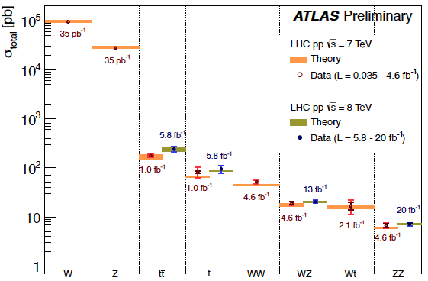
Standard Model – Quark-Gluon Dynamics
The not suppressed strange
+10% change of u+d+s
as 4u+d is fixed by HERA
High precision test of QCD and electroweak theory
(NNLO, scales, y induced corrections, y FSR,
PDFs, electroweak schemes, computing, theorists..)
Extend W,Z to low/high masses and searches for new bosons. e/y paper:5th best cited

Slide 8
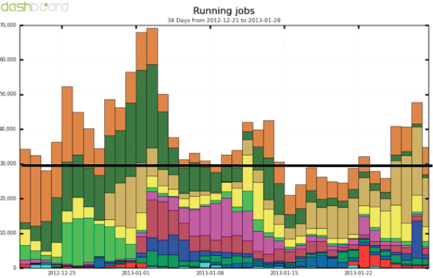
Computing
ATLAS is a huge
computing
enterprise with
enormous time
constraints
30000/day →
Liverpool group:
Data monitoring
Calibration data base
Performance monitors
New software formats
Beam spot monitoring
MC + Detector Simulations
Theoretical calculations
Upgrade studies
Liverpool Farm, UK Grid, ATLAS Grid, Dirac (Cambridge), CERN, … J.Bland + R.Fry !
Xmas12

Slide 9
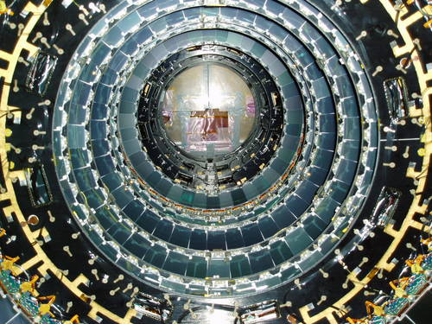
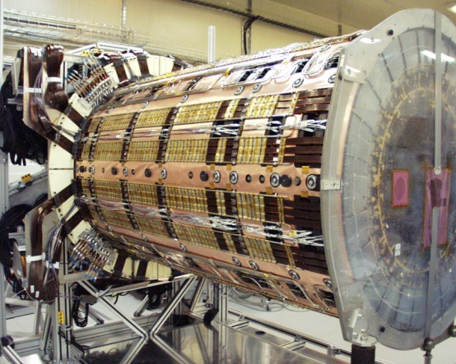
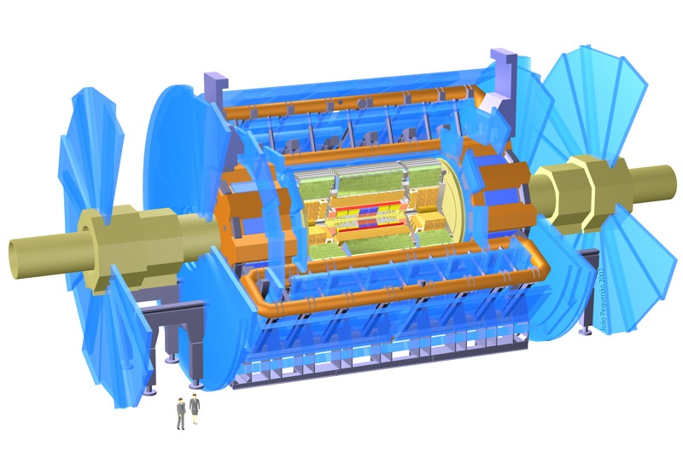
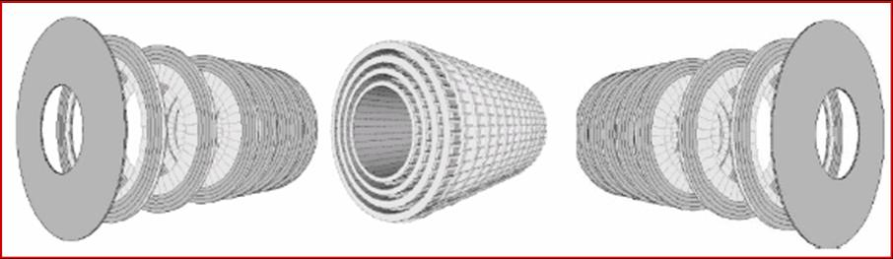
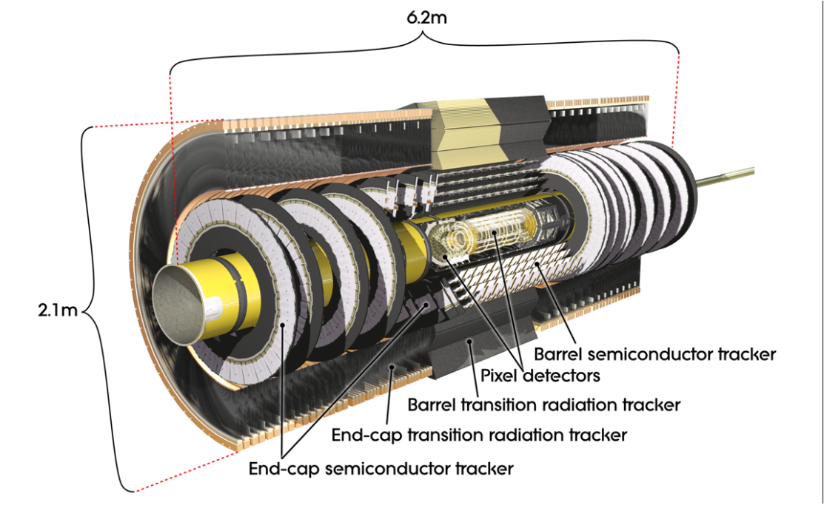
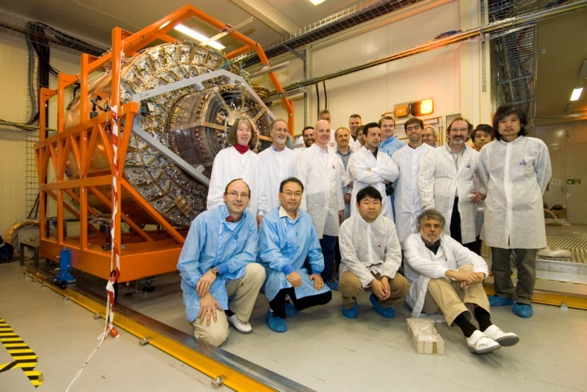
High Speed, High Precision Silicon Detectors
Designed to take a picture of each collision at 40 million collisions per second.
Measure where particles go with 0.01mm precision (15 million strips).
Has to withstand radiation 100,000 times that deadly to people.
610,000 cm² of silicon micro-strip sensors
~20,000 6×6 cm silicon detectors
Built at Liverpool
Built at Liverpool
ATLAS

Slide 10
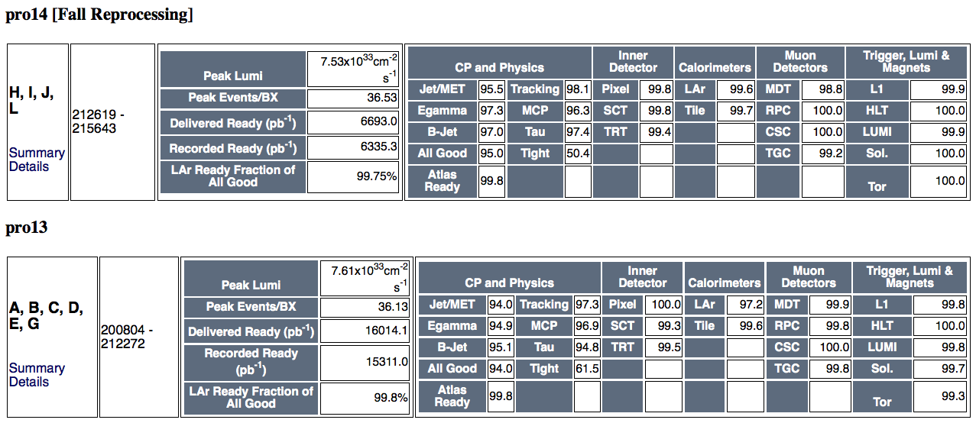
High Data Quality - SCT 99%
Note: about 1.5% data is affected by SCT+pixel issues occuring together impacting on DQ.

Slide 11


ATLAS Upgrade Planning
LHC to reach 100 times more L at twice the beam energy by early 30ies
11

Slide 12
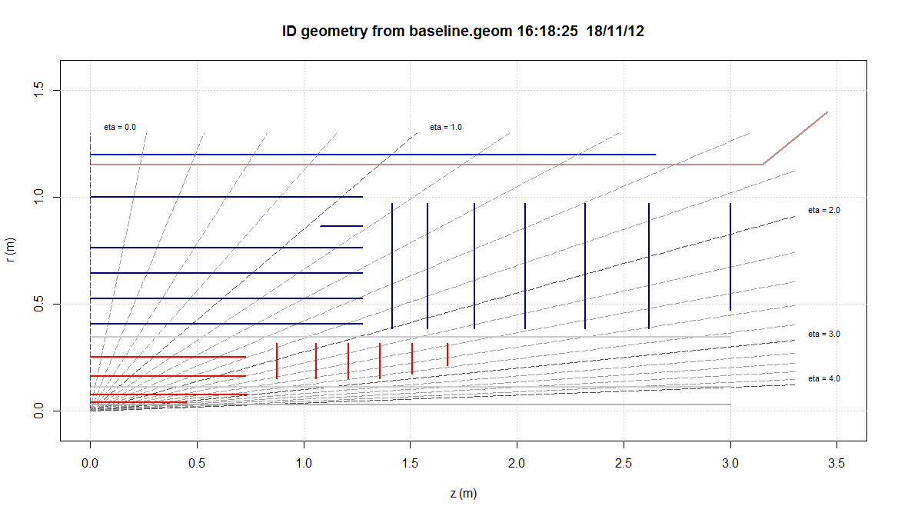
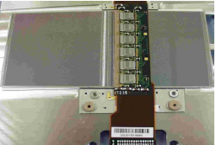
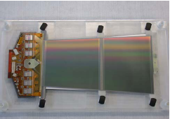
Tracker Upgrade for the Twenties
Central sensors
Forward modules
Present plan for complete new Silicon tracker (only) with pixel and strips, 4x the area of now

Slide 13


A world laboratory at CERN, not just an experiment
Argentina
Armenia
Australia
Austria
Azerbaijan
Belarus
Brazil
Canada
Chile
China
Colombia
Czech Republic
Denmark
France
Georgia
Germany
Greece
Israel
Italy
Japan
Morocco
Netherland
Norway
Poland
Portugal
Romania
Russai
Serbia
Slovakia
Slovenia
South Africa
Spain
Sweden
Switzerland
Taiwan
Turkey
UK
USA
CERN
JINR
~ 3000 scientists
Institutions from
38 Countries
250 papers in journals, 500 preliminary papers (CONF), 475 MSF Core detector cost, 3000 authors..
ATLAS has 2-3 times more collaborators than CERN has employees
ATLAS is the biggest apparatus ever built in HEP and a new environment
ATLAS is one of the greatest values particle physics now owes and deserves appropriate support

Slide 14
Remarks on the ATLAS Liverpool Group
Major element of HEP group
Strong support in computing and ground floor – crucial to success
Involved in most exciting physics parts (not all)
Extremely capable and motivated
Large but only 1% of ATLAS – tough to compete
Too few albeit very good students (4 → 1)
No postdoc’s
Carl, Helen, Paul on RG positions with major contributions
Presently two leading ATLAS roles: SUSY (Monica), Upgrade (Phil)
MANY other tasks (teaching, old and coming projects)
… for discussion

