Slide 1


Approaching QCD with FCC a few observations on
QCD
ee pp ep
Jets
Coupling
PDFs
Low x
In memory of Willy van Neerven, Wu-Ki Tung, Guido Altarelli and Lev Lipatov
Max Klein
University of Liverpool, H1 and ATLAS
Talk at the FCC Week 2018, Amsterdam, 11.4.18
Many thanks to Davide D’Enterria, Alain Blondel, Michelangelo Mangano, Voica Radescu + the eh QCD team.

Slide 2
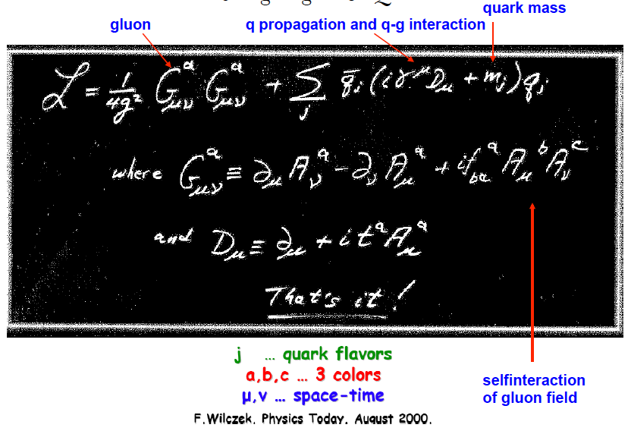
QCD
QCD

Slide 3
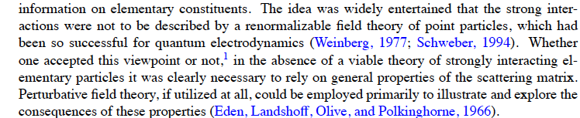
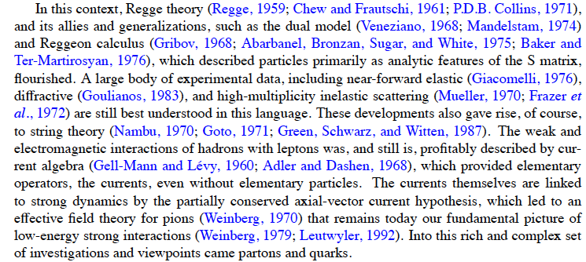
QCD evolved from a Lagrangian with the property of asymptotic freedom to a sophisticated tool for the calculation of high energy processes. R.K. Ellis Nuovo Cimento 39C(2016)355

Slide 4
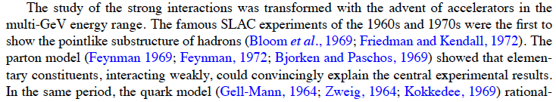
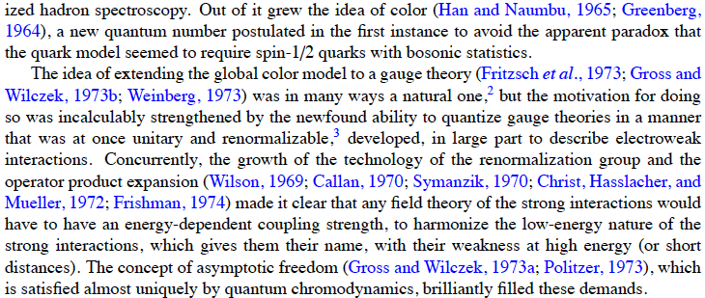
That may not be it..
H
Handbook of perturbative QCD, CTEQ

Slide 5
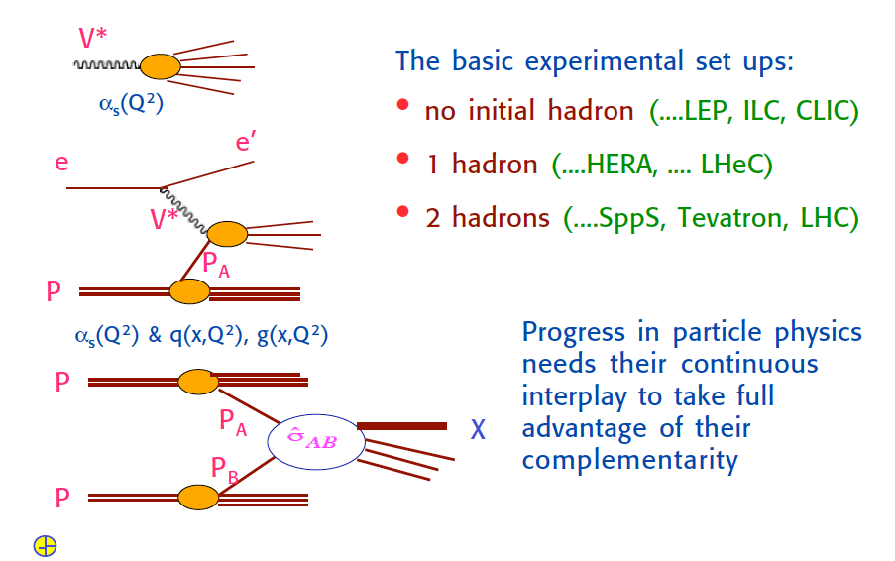
Guido Altarelli DIS2009, Madrid

Slide 6
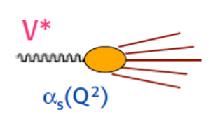
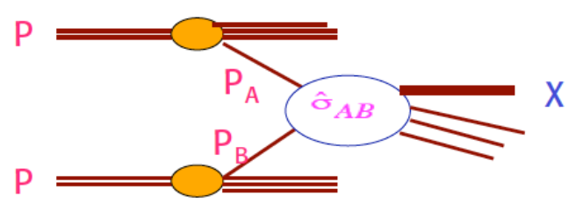
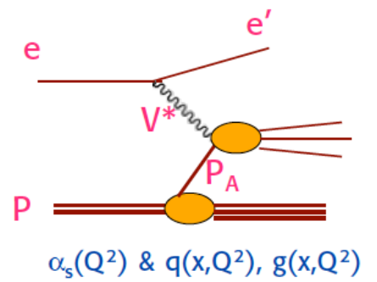
QCD with ee pp ep
Final state arises completely from short distance interaction
of virtual boson with quarks: NO PDFs, but jets, α_{s}
Njets +0, energy, angles. Unique association of q,g with jets
Observation of 3-jet events at PETRA to discover the gluon
√s=2E_{e} ≈ [G_{F}√2]^{-1/2} =246 GeV
S Ellis and D Soper, hep-ph/9306280
Successive combination jet algorithm for hadron collisions
Many initial partons but only two interact.
“rest” is the underlying event of soft i.a.’s
Dynamical coupling of all components. MPIs
N jets at large pT +X, pseudorapidity + azimuth
Ledermann-Drell-Yan scattering, jets
Scattering depends on parton distributions
The “Altarelli cocktail” to save the SM (1984, Bern)
√s = 2E_{p} = 14, 27, 100 TeV
“Route royale” to the structure and dynamics
of parton interactions inside the proton (nucleon)
Universal partons evolving with resolution scale
x BJ fixed through electron kinematics. PDFs + α_{s}
Redundant e and h final state reconstruction.
Discovery of partons and the QPM … DGLAP
√s = 2√E_{e}E_{p} = 1.3, 1.8, 3.5 TeV
ep - “option” which ought to be a real part. Seguil tuo corso, e lascia dir el genti (Dante, KM)

Slide 7

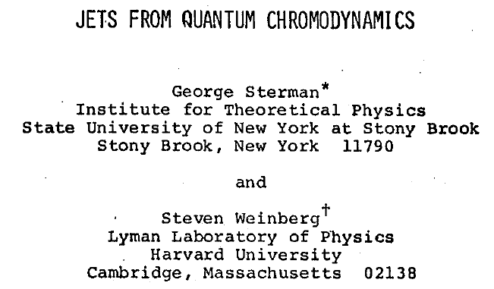

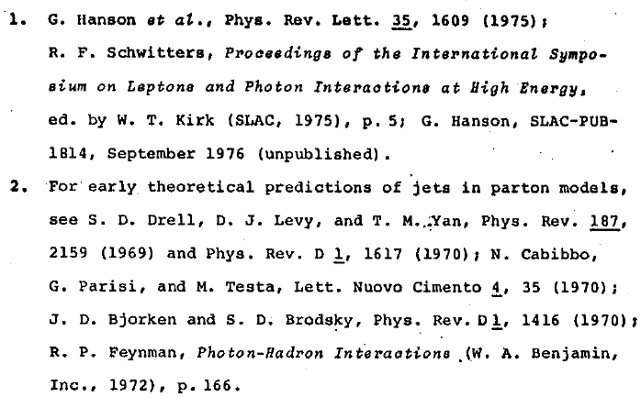
Jets
=
Jets in e⁺e⁻ at > 5 GeV at SPEAR at Stanford

Slide 8
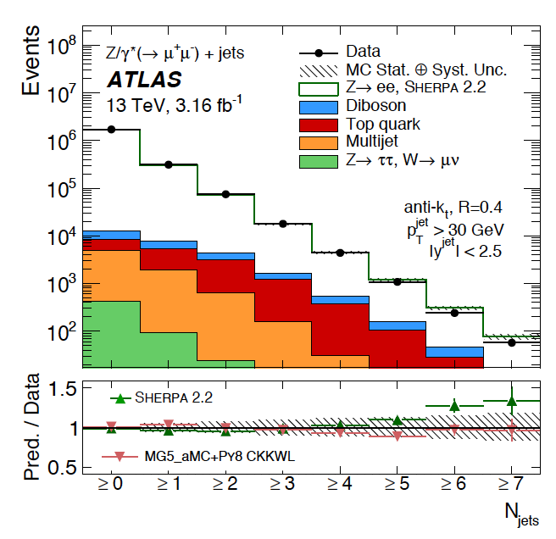
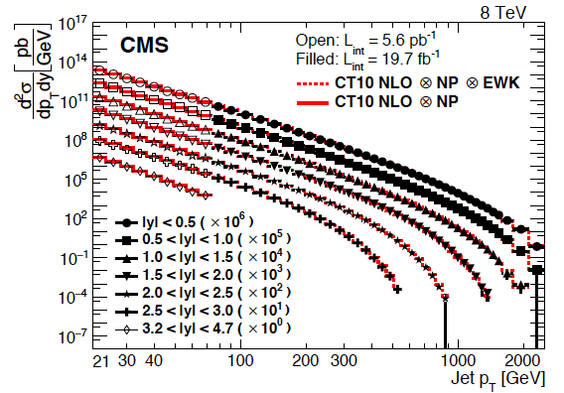
QCD at work at the LHC
1702.05725 Z + n jets ATLAS 3fb⁻¹ 13 TeV
1609.05331 inclusive jets, 26fb⁻¹ 8 TeV
100 events with ≥ 7 jets
10 orders of magnitude in cross section
LHC is the trick to attract a few 1000 physicists to work on QCD: T Sjoestrand, 2007, after we saw ATLAS

Slide 9
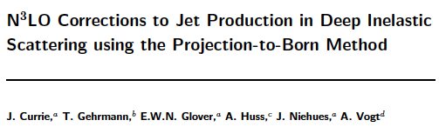
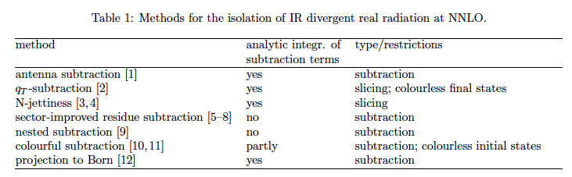
pQCD Theory
Substantial and remarkable theoretical progress in pQCD calculations to N^{k}LO, e.g.
1803.09973, 2 weeks ago
G Heinrich 1710.04998

Slide 10
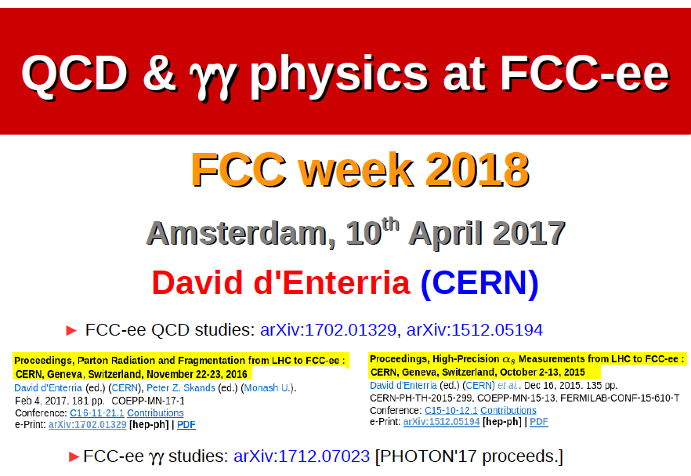
QCD

Slide 11
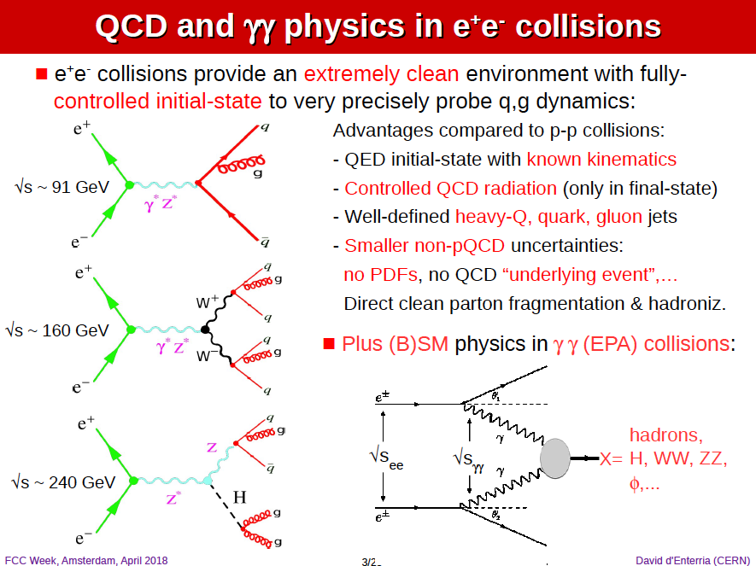
QCD

Slide 12
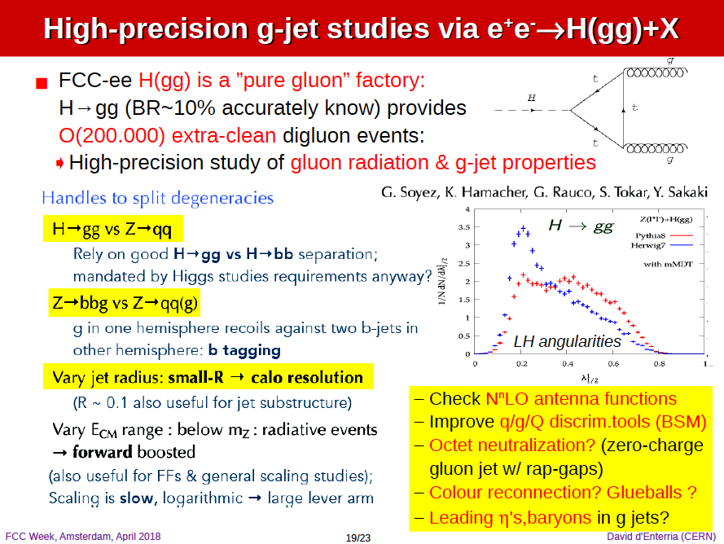
QCD

Slide 13
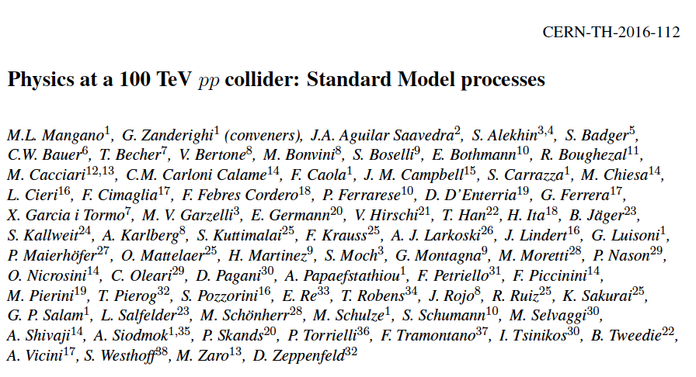
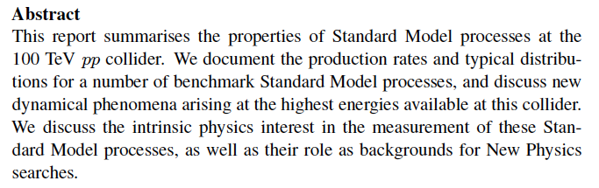
1607.01831, 250 pages

Slide 14
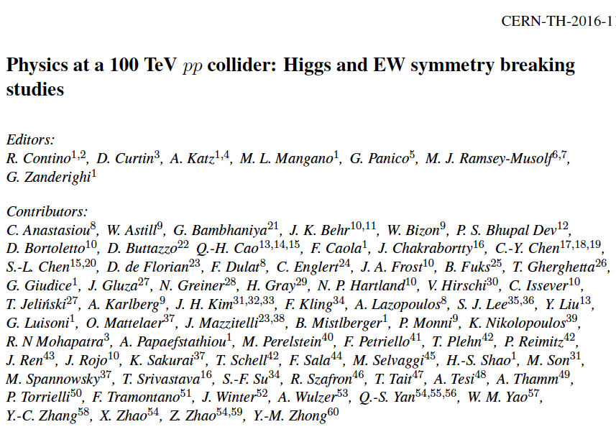
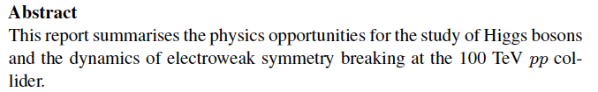
1606.09408, 190 pages

Slide 15
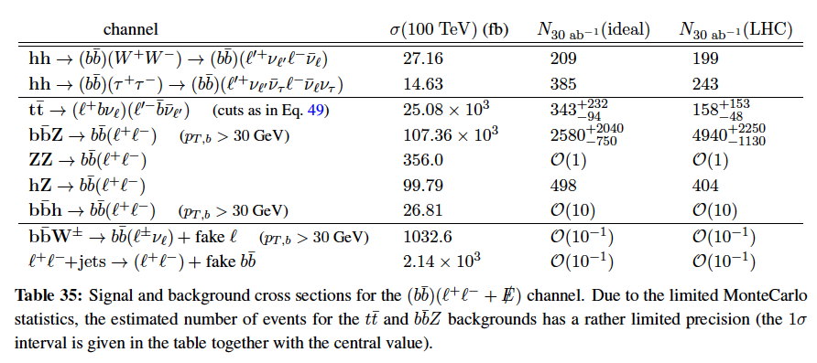
Double-Higgs Production at FCCpp
arXiv:1606.09408, p76
Foregrounds: tt, bbZ and HZ: QCD and electroweak theory in new range crucial to control.
Note: central rapidity for inclusive H production is at x=M/2Ep … low x Bj.

Slide 16
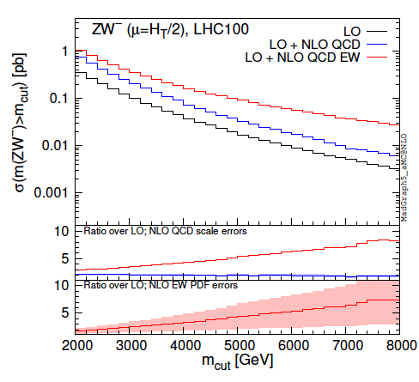
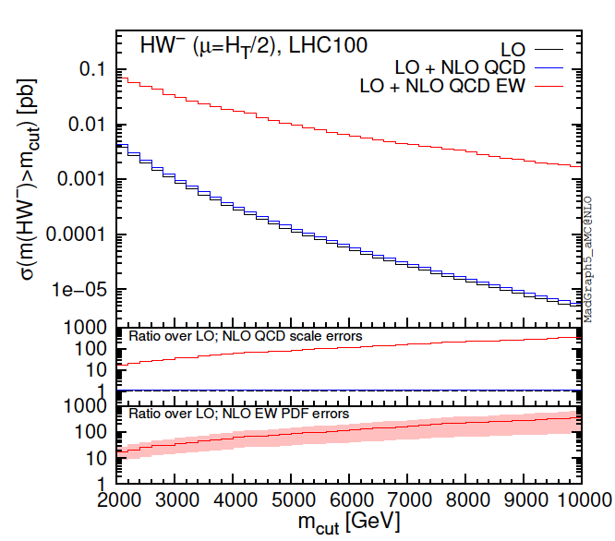
SM and Higgs at FCCpp
pp → Z/H W + X, an example
F. Piccinini in arXiv:1607.01831, FCC-pp
Large higher order corrections, sensitive to photon induced processes, large y,p PDF errors
At FCC (LHC), the QCD of the Higgs boson will become an important area of SM research.
High precision requires precise calculations of combined strong+eweak corrections + PDFs

Slide 17
Strong Coupling Constant
β(α_{s}) = - (11 –n_{s}/3 -2N_{f} /3) α_{s}²/2π

Slide 18
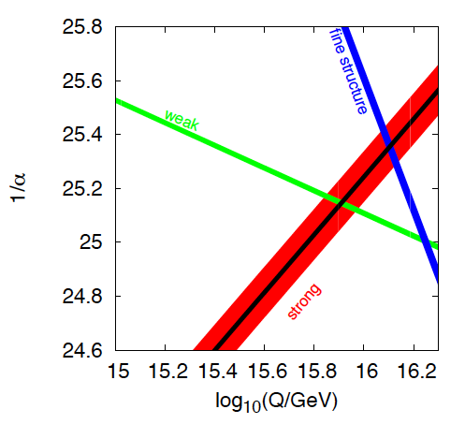
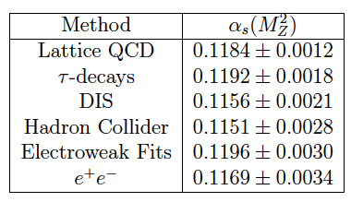

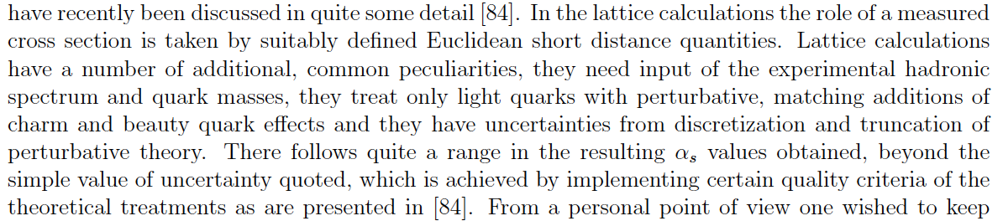
α_{s}(μ)
Grand unification??
PDG 2016
Recent Articles see: G Dissertori 1506.05407
A Deur, S Brodsky, G de Teramond 1604.08082
w/o lattice
1.5% error
1211.5102 – on the relation of ep+pp
1802.04317 MK

Slide 19
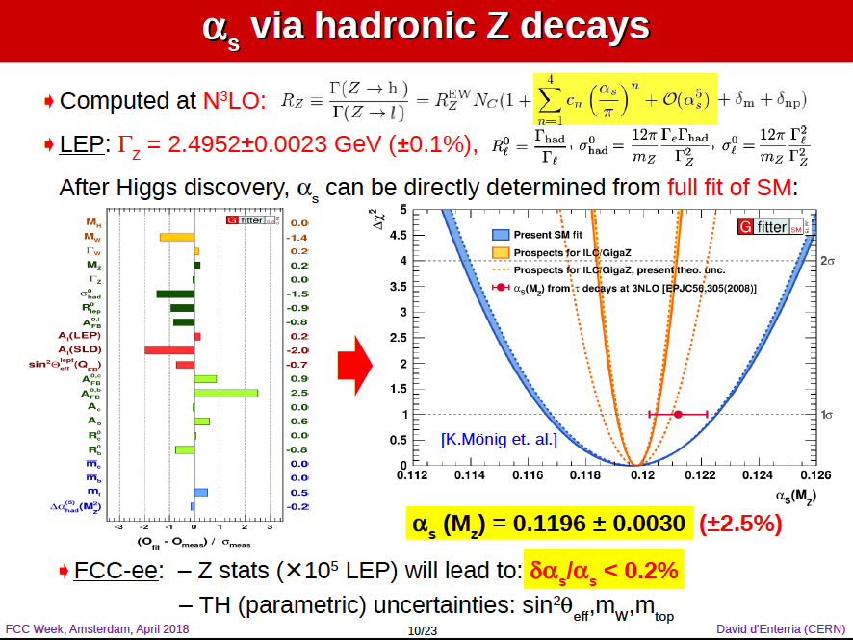
QCD

Slide 20
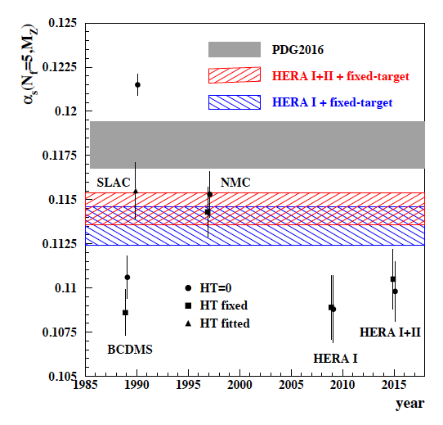

α_{s}(μ) in Deep Inelastic Scattering
H1 inclusive (1998) NLO
hep-ph/0012053 – highest cited H1 only
H1 only jets (2017) NNLO jets!
H1 inclusive and jets (2017) NNLO
It is well possible that α_{s} is smaller
than hitherto assumed. Current practice
to exclude ABM is questionable. Like in the
lattice case, one constructs, for perhaps
respectable reasons, a norm, which
gives the impression of higher accuracy
than a critical evaluation would lead to.
ABMP 2017
DIS: Fixed target: higher twist corrections 1/Q²,
nuclear corrections, small lever arm, gluon?
Current strong coupling precision at best 1-2%: FCC ee and eh want 1-2 per mille

Slide 21
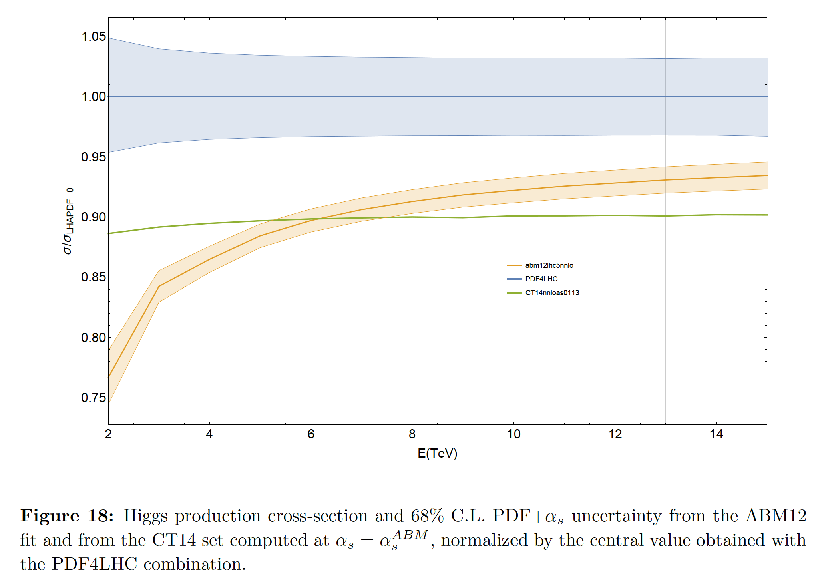
Higgs Cross Section (LHC)
← LHeC
1305.2090
True PDF errors?
[LHeC/FCCeh at
per-mille level,
mass and xsection]
PDFs to N³LO →
DIS to N³LO
[10 years program]
σ ~ (α_{s} xg)²
High precision pp
Higgs physics requires
high precision
for PDFs and α_{s}
C Anastasiou et al, arXiv:1602.00695

Slide 22
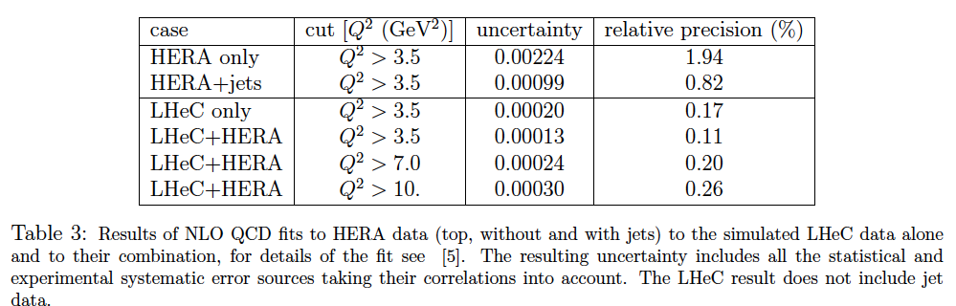
α_{s}(μ) at LHeC/FCCeh
CDR 2012
LHeC/FCCeh lead to 0.1% uncertainty (stat+syst), free of previous DIS deficiencies (HT,nc)
Joint determination with parton distributions (maybe simplified as H1 published in 2001)
Needs clarity about low x behaviour as this uses DGLAP.
Requires to control heavy flavour (theory) at new level (measure s, c, b, t also)
Very high precision of NC (y and Z) and CC and extension to x near 1 will drastically
reduce the PDF parameterisation uncertainties
Scale uncertainties require that N³LO formalism be applied (the bizarre 1/2 .. 2 rule.??)
The attempt to measure the strong coupling in DIS to permille accuracy requires
nothing less than a renaissance of experimental and theoretical DIS (ep) physics

Slide 23
Parton Distribution Functions

Slide 24
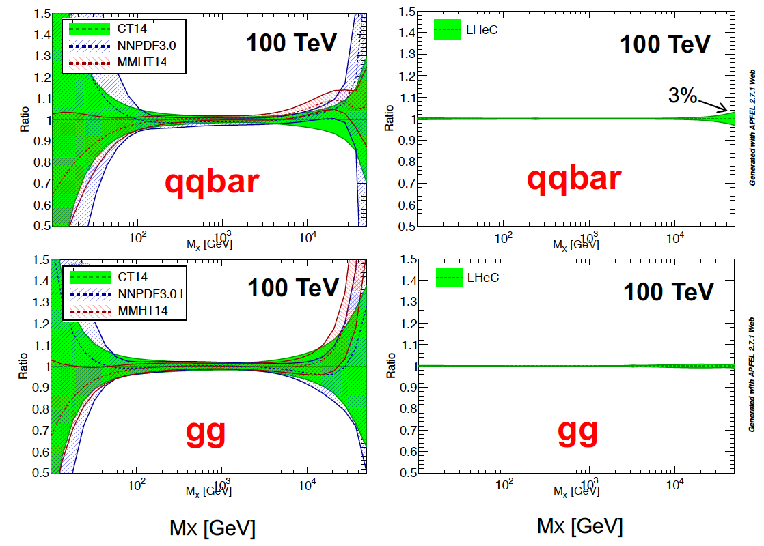
The LHeC PDF Programme
Resolve parton structure of the proton completely: u_{v},d_{v},s_{v}?,u,d,s,c,b,t and xg
Unprecedented range, sub% precision, free of parameterisation assumptions,
Resolve p structure, solve non linear and saturation issues, test QCD, N³LO…
20 GeV
40 TeV

Slide 25
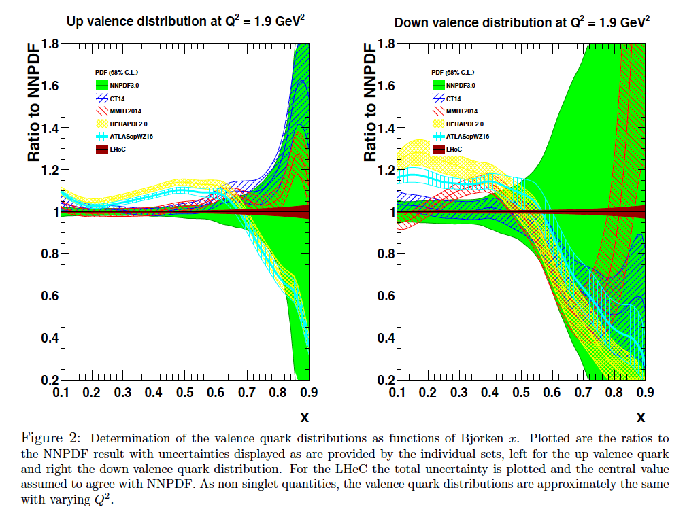
C Gwenlan, MK

Slide 26
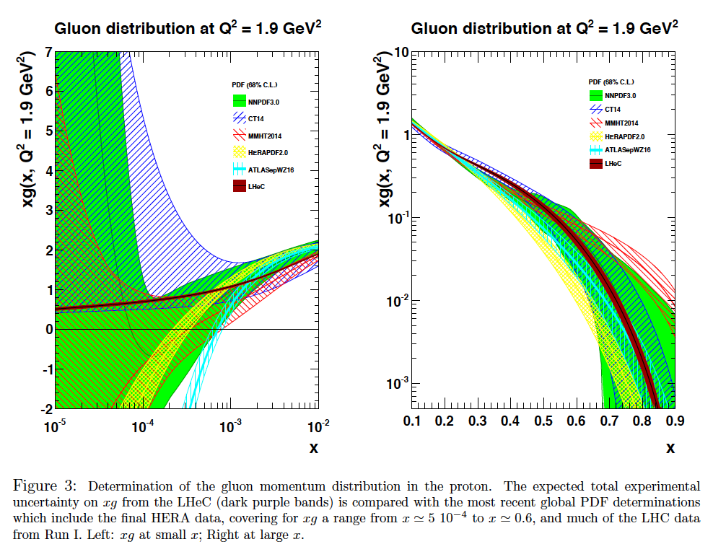
C Gwenlan, MK

Slide 27
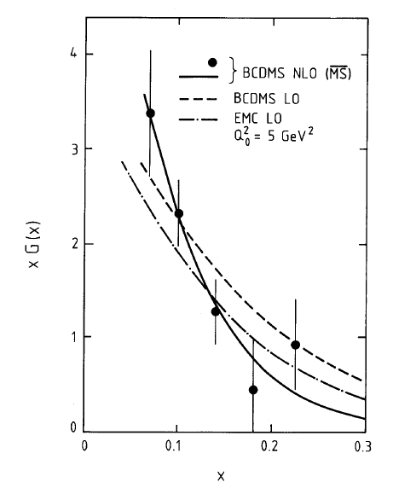
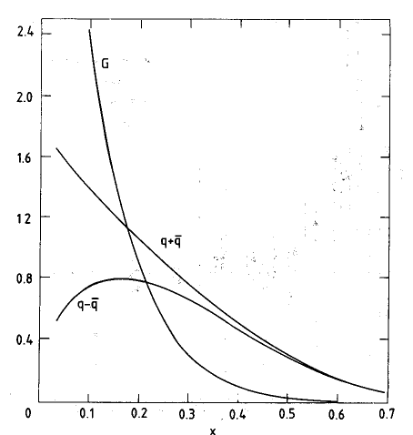


PDFs before HERA - Gluon - xg(x,Q²)
BCDMS
CDHS

Slide 28

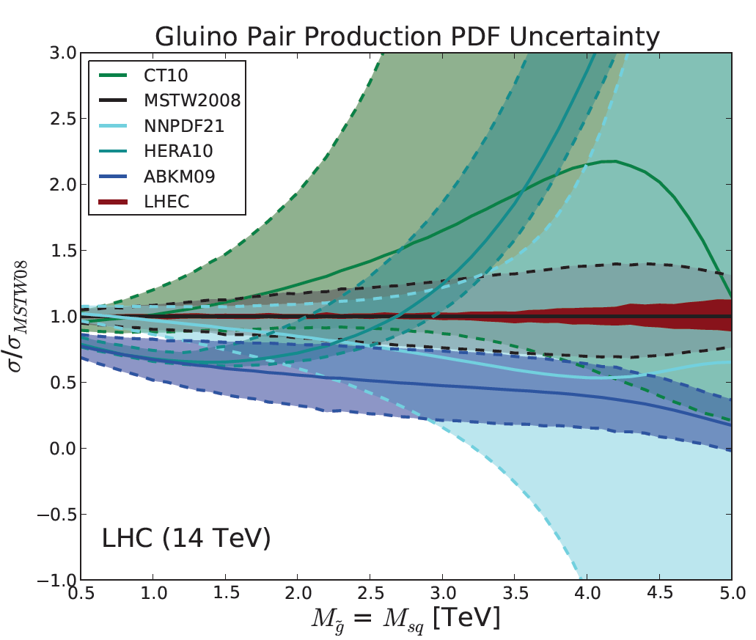
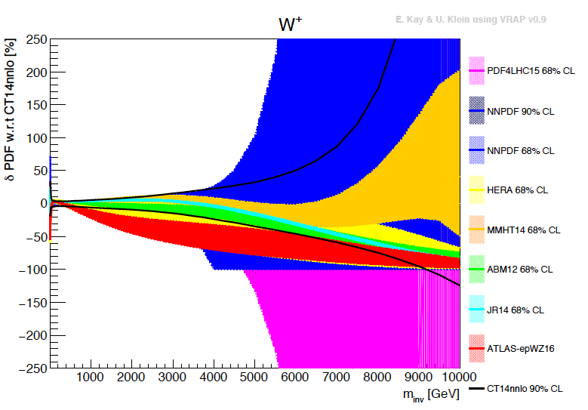
Empowering pp Discoveries
External, reliable input (PDFs, factorisation..) is crucial for range extension + CI interpretation
GLUON
QUARKS
SUSY, RPC, RPV, LQS..
Exotic+ Extra boson searches at high mass
ATLAS
today

Slide 29
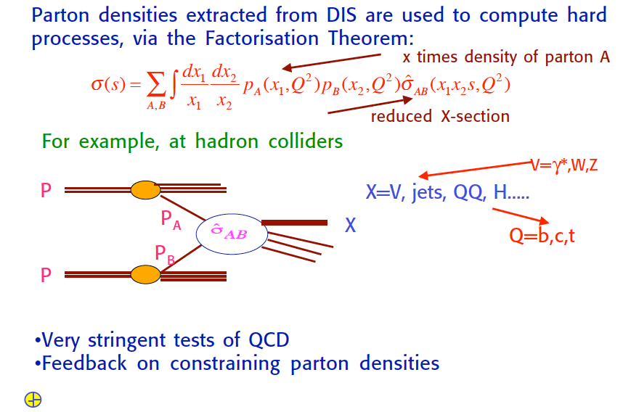
QCD
Guido Altarelli DIS2009, Madrid

Slide 30
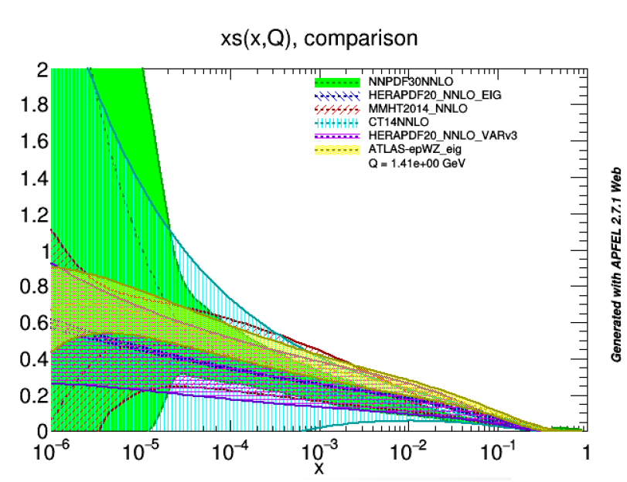
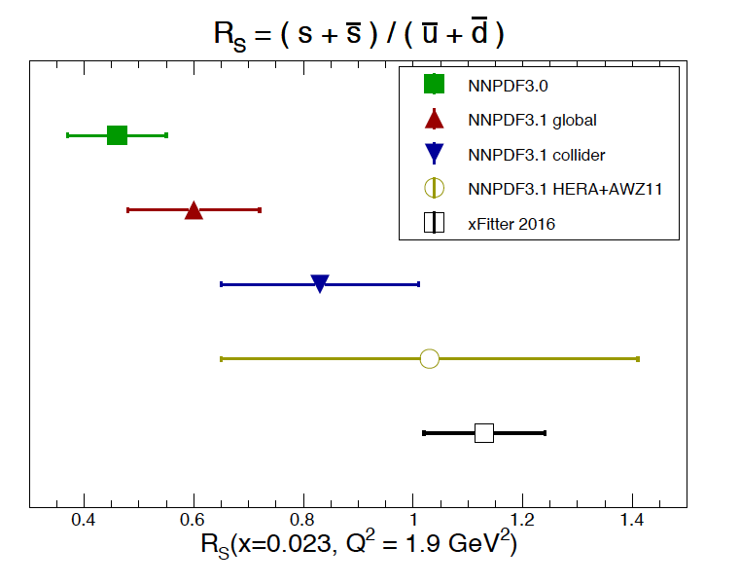
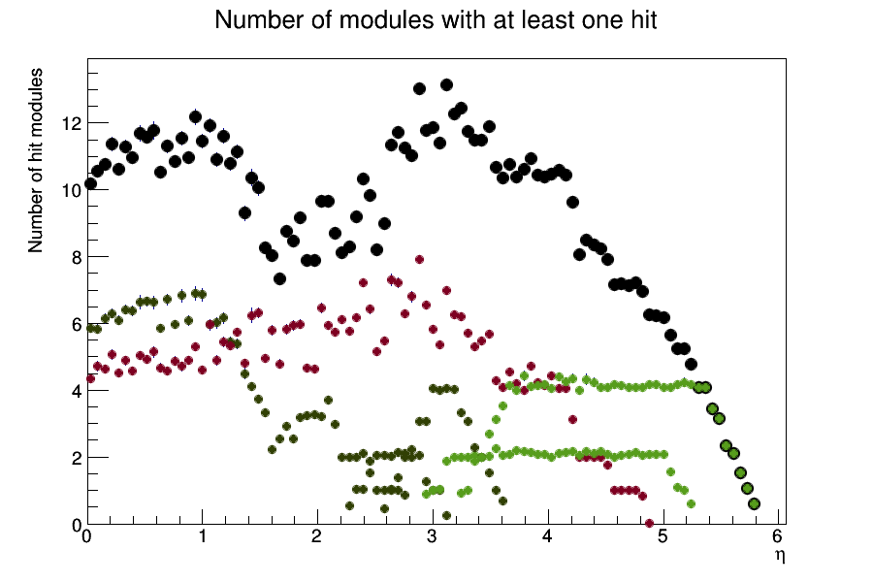
Strange Strange
Strange quark suppression [dimuons in neutrino data] vs light flavour democracy [W,Z LHC]
NNPDF3.1 arXiv:1706.00428, note:
“xFITTER16” = ATLAS: 1612.0301
Also look at MMHT and other results
A Cooper-Sarkar, DIS17
The strange quark density, after 50 years of DIS, has remained unknown. Is there a valence s?

Slide 31
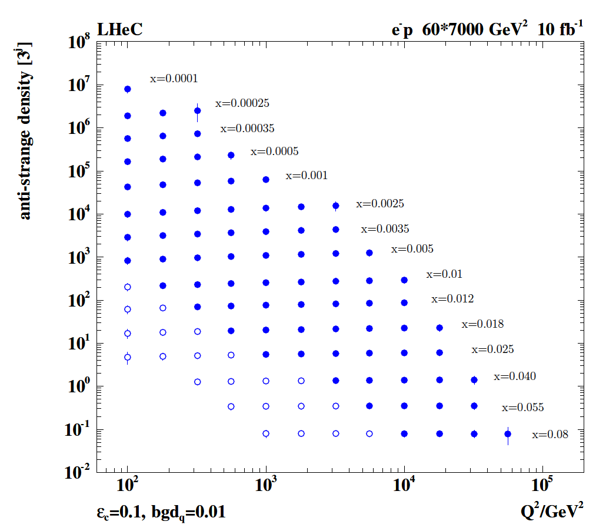
Strange Quark Distribution from LHeC
High luminosity
High Q²
Small beam spot
Modern Silicon
NO pile-up..
First (x,Q²)
measurement of
the (anti-)strange
density, HQ valence?
x = 10⁻⁴ .. 0.1
Q² = 100 – 10⁵ GeV²
Initial study (CDR): Charm tagging efficiency of 10% and 1% light quark background in impact parameter

Slide 32
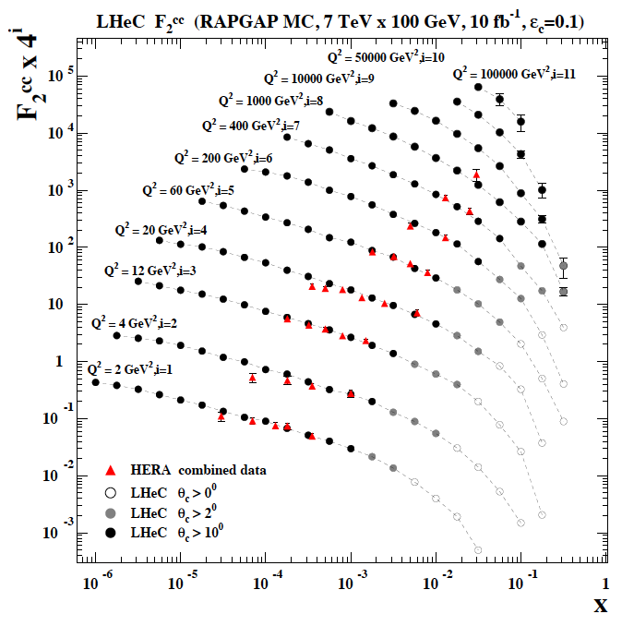
Charm: F₂^{cc} and Mass
Heavy Flavour with LHeC
Beam spot (in xy): 7μm
Impact parameter: better than 10μm
Modern Silicon detectors, no pile-up
Higher E, L, Acceptance, ε, than at HERA
→ Huge improvements predicted
 | HERA | LHeC
m_{c}(m_{c})/GeV | 1.26 | ?
δ(exp) | 0.05 | 0.003
δ(mod) | 0.03 | ~0.002
δ(par) | 0.02 | ~0.002
δ(α_{s}) | 0.02 | 0.001
LHeC CDR arXiv:1206.2913
Determination of charm mass to 3 MeV:
crucial for M_{W} in pp or H→ cc in ep
cf also NNPDF3.1 (arXiv:1706.00428) and refs
HERA 0.0005/2.5 .. 0.05/2000 GeV²
LHeC 0.00001/1 .. 0.2/200000 GeV²
ε(c) assumed 10%, 1% light background, ~3% δ(syst)

Slide 33
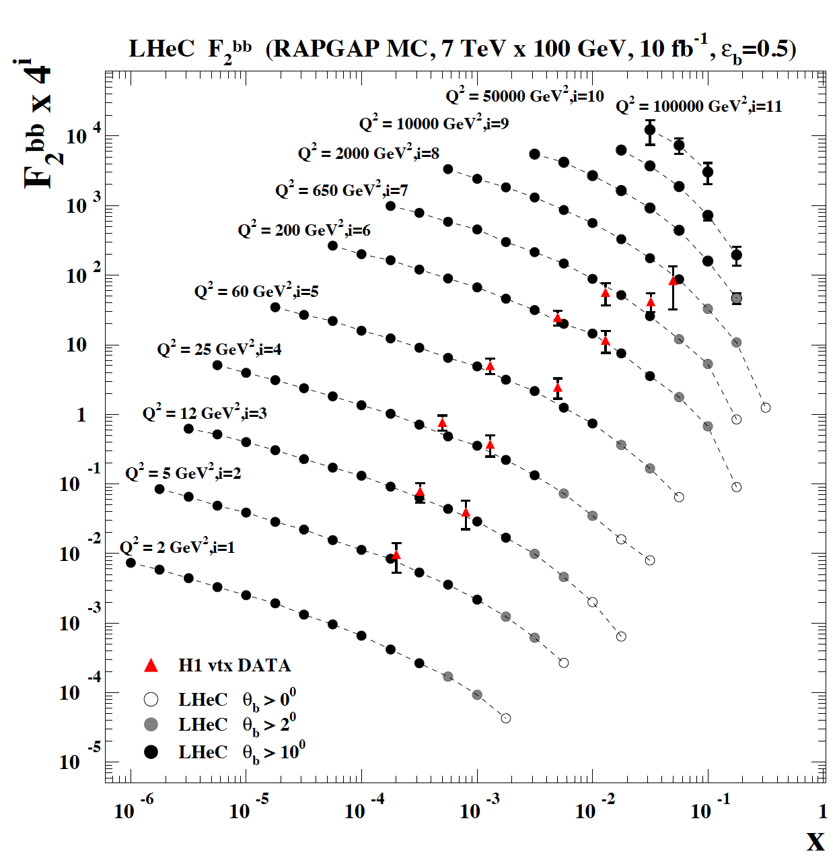
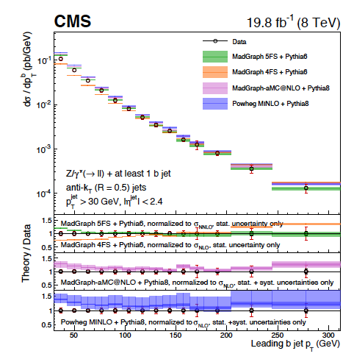
Bottom: F₂^{bb} and Mass
LHeC CDR arXiv:1206.2913
Bottom density not well known
Scheme dependence affects
LHC interpretations
In MSSM: Higgs from bb→ H not gg
(we only miss the MSSM..)
m_{b}(m_{b}) with LHeC to 10 MeV
Huge improvement vs HERA for the same reasons as for charm
New data H1+ZEUS
Early theory of HQ: J Collins, R.K Ellis: Nucl Phys B360(91)3
E Laenen, S Riemersma, J Smith, W van Neerven NP B392(93)162

Slide 34
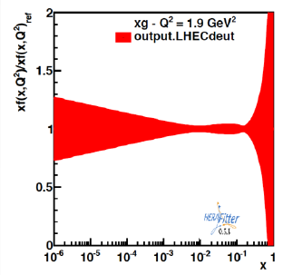
Nuclear QCD through eA at FCCeh/LHeC
Beauty in Lead
δGluon in Lead
unknown
badly
known
unknown ←
preliminary
eA: extends kinematic range in Q², 1/x by 3-4 orders of magnitude. Lumi 6 10³² (J.Jowett)
Measure nPDFs as in ep scattering and determine then the ratio R(x,Q²)=nPDF/PDF
Shadowing? A1/3 amplification? Saturation? Colour Flow? QGP initial state, collective effects
LHeC has been co-initiated and supported by NuPECC
see: Nestor Armesto FCC week 1/2018, CDR (LHeC) M.K. DOI: 10.1051/epjconf/201611203002

Slide 35
Low x Physics

Slide 36
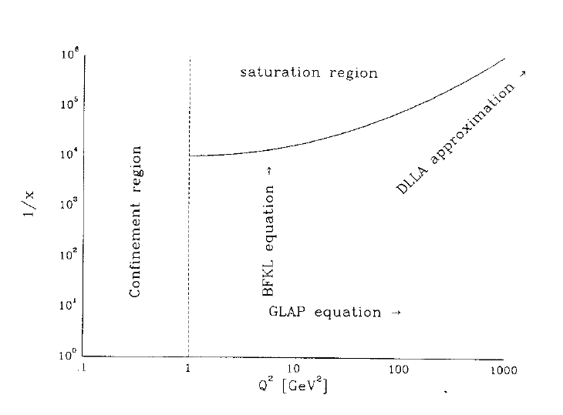
BFKL and Saturation
Gribov, Levin, Ryskin. Semihard Processes in QCD Phys Rept 100 (1983) 1-150
Rise of Gluon (and Quark) densities towards low x discovered at HERA. This
may lead to saturation – non-linear interactions and BFKL ln(1/x) effects.
Not discovered at HERA, to much surprise, despite recent ‘speculations’ ..
Change of parton distributions + evolution → to be clarified for FCC + (HE) LHC
BFKL papers: The Pomeranchuk Singularity in QCD/Gauge Theories 1978/1977

Slide 37
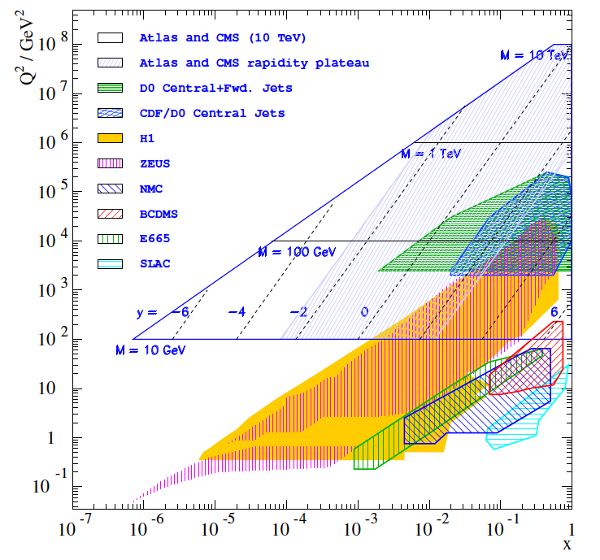
FCCpp
FCCeh
LHeC
y=0: x₀ = M/2E_{p}
Higgs at LHC:
x₀ = 0.0089
x₀ = 0.0013
Higgs physics is
and becomes
low x physics

Slide 38




Low x Partons
0911.0884
Low x > 0.01 before HERA
Note: HERA: QCD vacuum dominates p structure at small x. xg vanishes/rises at low/hi Q²

Slide 39





How to determine low x evolution + discover saturation ?
Needs cleanest DIS constraints,
proton, not ion, high E: F₂+F_{L}
High precision F_{L} from variation
of E_{e} independently of LHC/FCC
LHeC CDR: 1206.2913 J Phys G
High precision F₂(x,Q²) from few days
of nominal ep running. Needs large Q²
and low x ~ 1/s:
Impossible at EIC
MK: 1802.04317
This constrains DGLAP and rules it out (or not..). cf CDR (LHeC)

Slide 40
QCD
QCD

Slide 41
That’s it?? That may not be it..
Developments Discoveries
AdS/CFT
Instantons
Odderons
TOTEM ? CERN EP 2017-335
Non pQCD, Spin
Quark Gluon Plasma
QCD of Higgs boson
N^{k}LO, Monte Carlos..
Resummation
Saturation and BFKL
Photon, Pomeron, n PDFs
Non-conventional partons
(unintegrated, generalised)
Vector Mesons
The 3 D view on hadrons..
CP violation in QCD?
Massless quarks?? Would solve it..
Electric dipole moment of the neutron?
Axions, candidates for Dark Matter
Breaking of Factorisation [ep-pp]
Free Quarks
Unconfined Color
New kind of coloured matter
Quark substructure
New symmetry embedding QCD
C. Quigg, arXiv1308.6637
QCD has an exciting future with the FCC

Slide 42
backup

Slide 43

LHC Folklore: PDFs come from pp
LHC data constrain PDFs, BUT do not determine them:
Needs complete q_{i},g unfolding (miss variety)
at all x, as there are sumrules
- Needs strong coupling to permille precision, not in pp
Needs stronger sensitivity (miss Q² variation)
cannot come from W,Z at Q²=10⁴ GeV²
Needs clear theory (hadronisation, one scale)
Needs heavy flavour s,c,b,t measured and VFNS fixed
Needs verification of BFKL at low x (only F₂-F_{L})
Needs N³LO (as for Higgs)
Needs external input for pp to find QCD subtleties
such as factorisation, resummation…to not go wrong
- Needs external precise input for subtle BSM discoveries
Needs data which yet (W,Z) will hardly be better
Needs agreement between the PDFs and χ²+1 ..
NNPDF3.1 arXiv:1706.00428
PDFs are not derived from pp scattering. And yet we try, as there is nothing else.., sometimes
with interesting results as on the light flavour democracy at x ~ 0.01 (nonsuppressed s/dbar).
Can take low pileup runs, mitigate PDF influence .. – but can’t do what is sometimes stated.
LHeC/FCCeh vs HERA: Higher Q²: CC; higher s: small x/g saturation?; high lumi: x→ 1; s, c,b,t.

Slide 44
Final Remark
Guido Altarelli, Moriond 1983, Cited by R K Ellis, Nuovo Cim 39C (2016) 355
But: it is worth it, possible beyond all expectation in 1983

Slide 45


QCD
Wu-Ki Tung CTEQ School 2006

Slide 46
Future Nuclear PDFs with LHeC
From an eA collider one can determine nuclear PDFs in a novel, the classic way.
Currently: use some proton PDF base and fit a parameterised shadowing term R.
Then: use the NC and CC eA cross sections directly and get R(x,Q²;p) as p/N PDFs.
Gluon density uncertainty in eA
Charm density in nuclei
preliminary
1fb⁻¹ of sole eA isoscalar data fitted
Impact parameter measurement in eA

Slide 47

FCCeh
Claire Gwenlan PDFs at FCCeh – FCC Week 1/2018

Slide 48

QCD

Slide 49


QCD
arXiv:1607.01831, FCC-pp

Slide 50

FCCeh
Claire Gwenlan PDFs at FCCeh – FCC Week 1/2018

Slide 51

QCD

