Slide 1
Future Physics with pp and ep
Why going beyond the LHC?
Three remarks
FCC-pp:
Five examples for its physics
ep with pp at the LHC
FCC-eh
Remarks
Max Klein and Paul Newman,
PPAP Birmingham, 12.9.2019

Slide 2
Higgs at HL-LHC
Observations and Questions:
LHC accesses rare channels, unlike e⁺e⁻ or ep
[50 pb cross section vs 0.2 pb at these machines, 1pb FCCeh]
Most couplings in the SM will be measured to a few percent
precision (no charm), much better than initially expected
The measurements are expected to be limited by QCD.
Double Higgs production may be seen at 5 sigma, if we use
the time LHC offers.
It is, yet, for FCC-pp to study the H potential + self coupling
Very high precision needs higher energy and lepton
Colliders (ee and ep).
Are there further (charged) Higgs particles, is the
Higgs composite?

Slide 3
What is beyond the LHC reach (or still within?)
We need higher energy, higher precision and to understand the proton and its dynamics deeper: pp+ep

Slide 4
The SM looks complete, but PP is far from having answered its fundamental questions
PP is not astrophysics, it needs pp+ep and as well ee and neutrino, energy frontier and low energy experiments.
It may be justified independently of the dark astro questions. It is as before a technology driver and challenge.
There was no SM when Stanford endorsed the 2m electron linac and when CERN went for ISR and SPS.

Slide 5
Future Higgs Physics with FCC-pp
e.g. Charged Higgs Boson?
Michel Selvagi, FCC CDR presentation, March 2019, CERN

Slide 6
Composite Higgs?
Note:
HL-LHC reaches 1.2 TeV
with LHeC 2.1 TeV
e+e- colliders + LHC
lead to 3-4 TeV
CLIC here is the 3 TeV
Version.
Example for pp+ep+ee
Symbiosis.
Gian Giudice and Paris Sphicas with BSM WG, Granada, May 2019

Slide 7
Future Searches with FCC-pp
Example: Strongly interacting SUSY: Gluinos
Gian Giudice and Paris Sphicas with BSM WG, Granada, May 2019
FCC-pp unbeatable in its discovery reach, through energy and luminosity. A 40 TeV FCC-pp is in between HE-LHC and 100 TeV

Slide 8
Future Physics with pp and ep
Another example of
the complementarity
of experiments in
the search for new
physics.
Gian Giudice and Paris Sphicas with BSM WG, Granada, May 2019

Slide 9
QCD with FCC-pp
Example:
Strong coupling
sensitivity to gluinos
Jets
QCD at FCC
M.K. Presentation of CDR
March 2019, CERN

Slide 10
Future Physics with pp and ep
J De Hondt, Granada QCD Summary May 2019

Slide 11
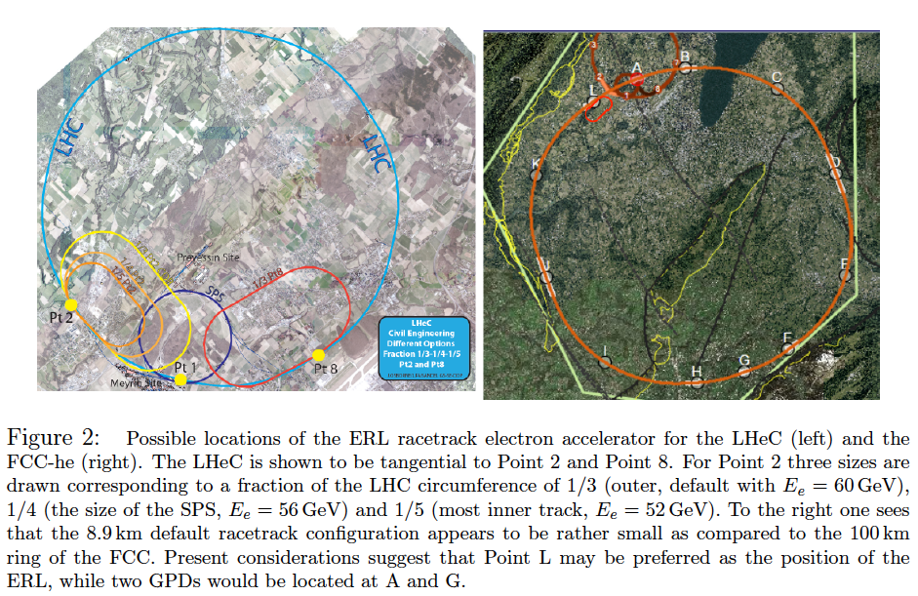
LHC (HL+HE) Footprint of ERL FCC
FCC-eh
60 GeV
9km tunnel
3 TeV cms
10³⁴ Lumi
O(2) ab⁻¹
Point L
LHeC
50 GeV
5km tunnel
1 TeV cms
10³⁴ Lumi
O(1) ab⁻¹
IP2

Slide 12
Energy Recovery today and tomorrow
FCC-ee
- Joint 802 MHz cavity development [LHeC+FCC]
- Complete Design of FCC-ee with ERL technique:
[extension to higher energy, less SR power, higher lumi > WW]
LHeC: 1 TeV ep collider with 10³⁴ luminosity: P/10! Dump at injection.
Possible injector to FCC-ee in recirculating mode [O.Bruening]
ERL: A revolutionary
technology ripe for
real applications in
HEP, low energy and
industrial areas, of
huge potential
just evolving : to be
recognised in strategy
PERLE BINP, CERN, Daresbury, Liverpool, Jlab, Orsay+. Could be 6 GeV injector to FCC-ee →
ERLs in: Berlin, BINP, Cornell, Daresbury, Darmstadt, Jlab, KEK, Mainz..
High current and E ~ 1GeV: low energy physics [1000 x L(ELI)!, lithography, photofission
Llatas
M.Klein, LHeC Ghent 12.7.19
Llatas, Litvinenko, Roser FCC Brussels

Slide 13
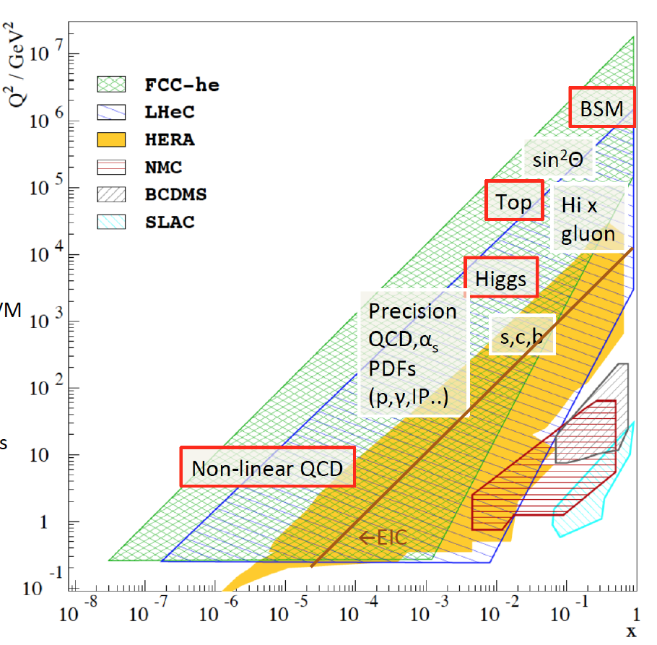
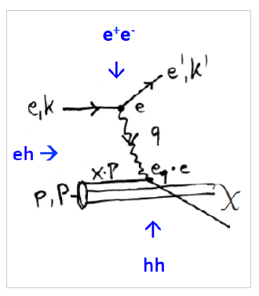
Physics with Energy Frontier DIS
Raison(s) d’etre of the LHeC
Cleanest High Resolution
Microscope: QCD Discovery
Empowering the LHC
Search Programme
Transformation of LHC into
high precision Higgs facility
Discovery (top, H, heavy ν’s..)
Beyond the Standard Model
A Unique
Nuclear Physics Facility
Deep Inelastic Scattering

Slide 14
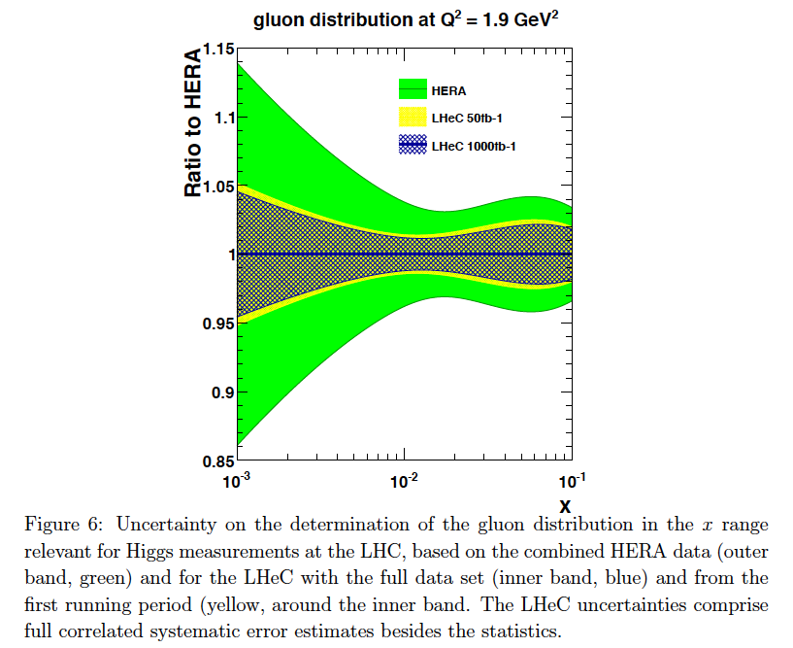
Parton Distributions
Complete unfolding of parton contents in
unprecedented kinematic range: u,d,s,c,b,t, xg
Strong coupling to permille accuracy (incl + jets):
Crucial for LHC:
- high precision eweak, Higgs measurements
- Extension of high mass search range
- Non-linear low x parton evolution; saturation?
DIS: clean theory, light cone, redundant e/h FS reconstruction, ..
For LHC to have an impact on
the search and precision physics
program at HL-LHC it is crucial
that PDF and QCD information
is available early.
PDF study with 50 vs 1000 fb⁻¹
Remove essential party of
QCD uncertainties of gg→ H
cf C. Gwenlan, talk at DIS19 and
M Cooper Sarkar yesterday at EPS
FCC-eh
← LHeC
← EIC
Note that 50fb⁻¹ is 100 times H1‘s total luminosity: Low x needs just 1fb⁻¹.
← HERA

Slide 15
Higgs in ep and pp [LHeC and HL-LHC]
Determination of SM Higgs couplings jointly from pp + ep
Results for FCC-eh at
20 TeV E_{p} x 60 GeV E_{e}
Uncertainties on kappa
Decay FCCep HL-LHC
bb 0.9 2.7
WW 0.3 1.2
gg 1.7 2.2
tau 1.5 1.6
cc 1.9 --
ZZ 0.5 1.0
yy 3.3 1.7
in percent. SM width.
1%
The combined ep+pp at LHC reaches below 1% for dominant channels
ep adds charm. Analysis in EFT framework work in progress (aTGCs in ep..)

Slide 16
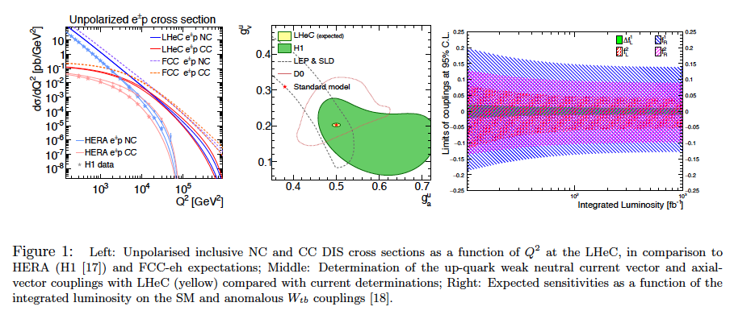
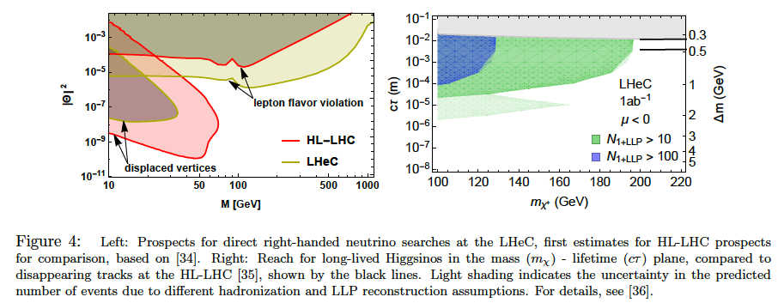
Precision
Electroweak
Physics
Anomalous
Wtb couplings
Electroweak+Top Physics
From LHeC strategy paper CERN-ACC-NOTE-2018-0084
Higgsinos
Heavy Neutrinos
BSM + Searches

Slide 17
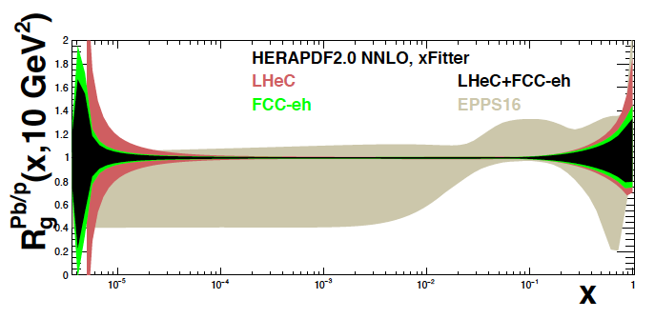
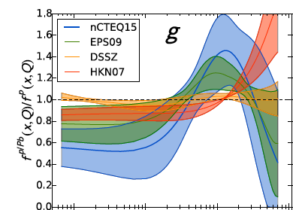

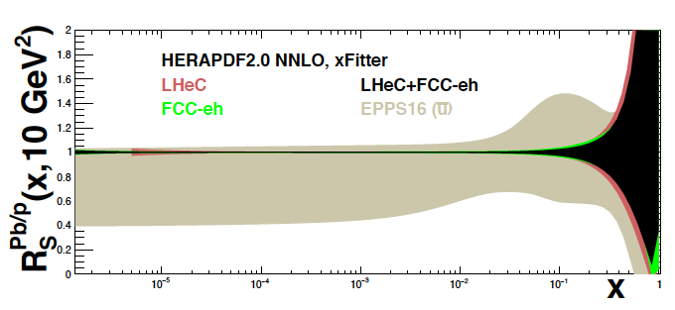
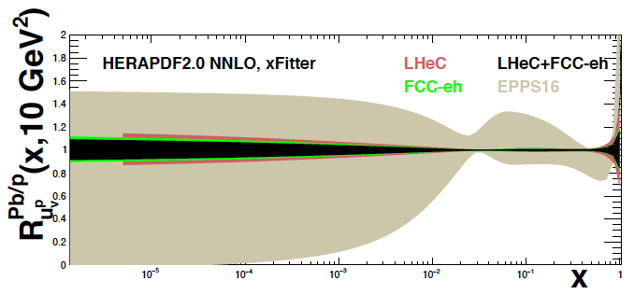
Nuclear PDFs at LHeC/FCCeh
Unique nuclear/HI physics programme
Extension of fixed target range by 10 ³⁻⁴
QCD of QGP, de-confinement, saturation..
nPDFs independent of p PDFs
1509.00792
High
luminosity
~ 10 ³³
enables
high statistics
in short
eA runs
cf J Jowett et al
present
status →
on xg
Pb/p
gluon
N Armesto, FCC Physics Week 1/2018
sea
valence
cf talk by
A Stasto today
LHeC: Full error, Δχ² =1. EPPS Δχ² =52

Slide 18
LHeC Detector
L=13.6 m [FCCeh:19.3 about CMS size]
R=4.6 m
[6.2 FCCeh]
Study of installation (sequence)
of LHeC detector in IP2 cavern
using L3 magnet support structure
[commensurate with 2 year shutdown]
A. Ghaddi et al, LHeC Workshop 2015
12/2018
Currently: increase radius of tracker, choose technology, summarise/simulate response: update this fall

Slide 19
FCC-eh in the CDR [V1 Physics and V3 hh]
Volume 1 had been the collaborative effort to present the entity of FCC physics, in ee, pp and ep, including AA and eA
Volume 3 on FCC hh contains a short summary of the main characteristics of FCC-eh and the detector concept
Some striking physics eh prospects are on searches and the high precision measurements on Higgs and proton structure:
3
Complementary prospects to
discover rh massive neutrinos
in ee, ep and pp
[mixing angle vs mass]
Unique resolution of partonic contents of
and dynamics inside the proton, providing
precise and independent parton luminosities
for interpretation and searches on FCC-hh
Prospects for high precision measurements of
Higgs couplings at FCC ee and ep. Note ee gets
the width with Z recoil. ee is mainly ZHZ, while
ep is mainly WWH: complementary also to pp

Slide 20
FCC-eh

Slide 21
Concluding Remarks
The LHC has only seen 5% of its anticipated luminosity. The total cost of ist HL upgrade is near to 2 BSF.
The exploitation of the LHC is the prime task of PP. The LHeC is the ideal complement to sustain the 30ies.
The FCC-pp collider is the only future collider which may change the paradigm of PP. Its 100 TeV version
is currently beyond financial and technology reach (Nb₃Sn high field dipoles?). It therefore is worth
to seriously consider building a 40 TeV (cms) hadron collider at CERN, with LHC magnet technology
in 2040+, especially if Asia eventually decides to build a next e+e- collider.
The physics programme of the FCC-pp builds on the LHC. If there is no further physics, even at 10 TeV
energies, it yet has a fundamental goal, which is the understanding of the Higgs potential, it cannot fail.
The addition of an ERL electron beam makes the FCC physics richer, very precise, reliable and adds to
the discovery potential in QCD and electroweak physics, potentially beyond, including nuclear structure.
Energy recovery becomes a realistic means, no less important than plasma, to revolutionise accelerator
technology (under design for ep, under consideration for FCCee, under construction for low energy
physics and applied facilities such as PERLE at Orsay, MESA at Mainz and possibly DIANA at Daresbury.

Slide 22
backup

Slide 23
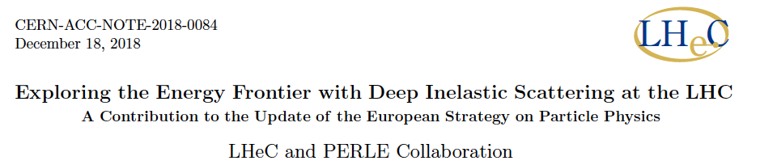
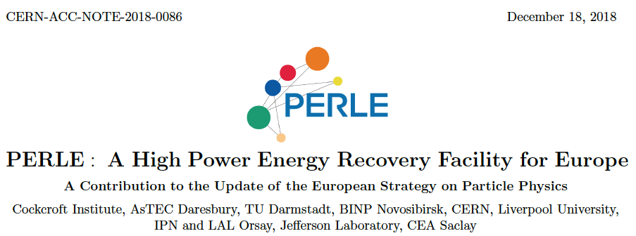
title
LHeC also described in the ES paper by A.Caldwell, A.Levy, R.Ent, P.Newman and F.Olness
Summary
Papers
submitted
to the
European
Strategy
12/2018

Slide 24
Higgs Mass and Potential

