Slide 1
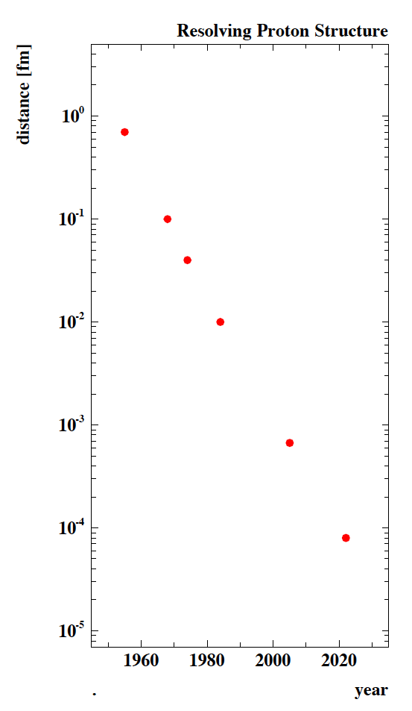
10⁻¹⁵m
Finite Proton Size
SLAC
Quarks
SLAC
FNAL
CERN
Quark-Gluon
Dynamics
DESY
HERA
?
CERN
LHeC
10⁻²⁰m

