Slide 1
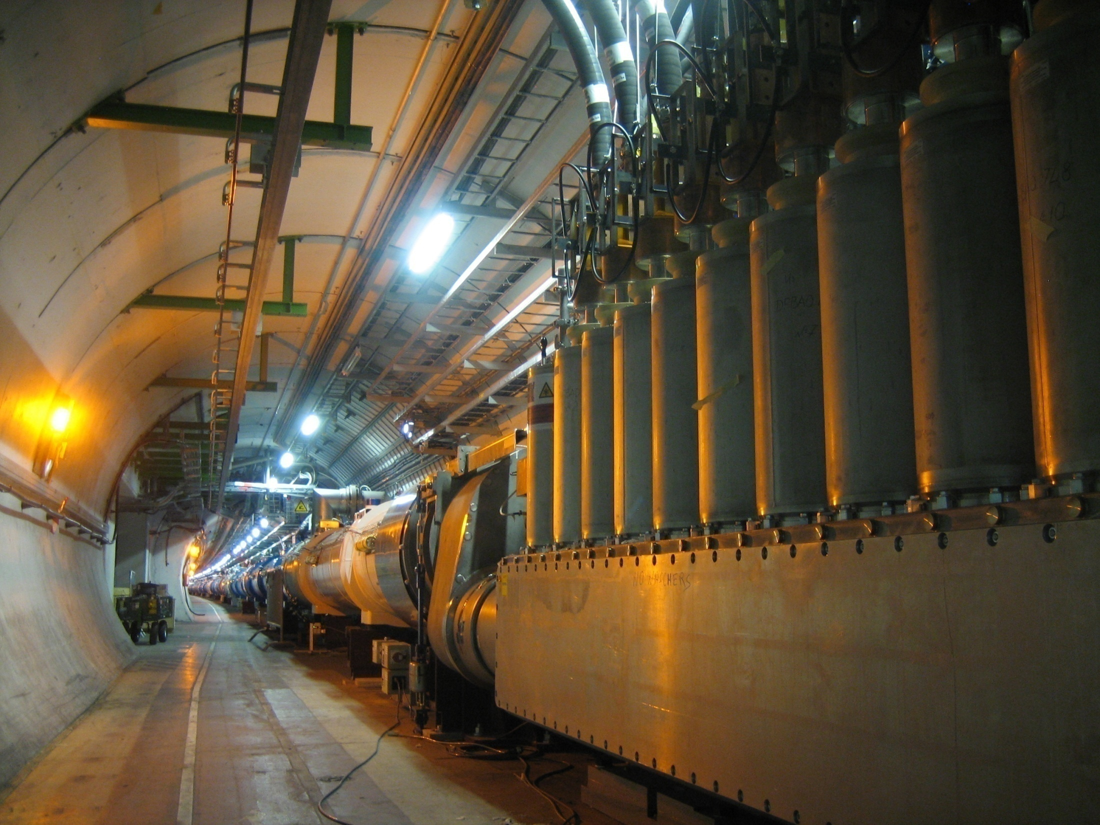
Upgrades to the LHC
Six Lessons to consider
HL-LHC: Luminosity Upgrade
LHeC: ep for the LHC
FCC: A Vision of the 100 TeV
LHC: 1984-2050
U = 27 km
10k magnets
10k monitors
.5 GJ stored E
Pileup to 300
150 tons of He
2 GPDs …
Max Klein
University of Liverpool
ATLAS, H1, LHeC,FCC,ECFA
PIZZA Speech to Liverpool Students March 21st , 2017

Slide 2
The increase of energy and luminosity often led to discoveries
Substructure discovered at Stanford
Hofstatter et al: 1957: ep →ep E_{e}=200 MeV beam: proton finite radius of 1fm
Taylor et al: 1968: ep → eX E_{e}=1-20 GeV beam (2 mile linac): partons at 0.1fm
W,Z Bosons discovered at CERN
ISR in 1970,
SPS in 1974 Ep=450 GeV (fixed target lh, hh experiments, injector for LHC)
transformed to SppS Collider L=10³⁰⁻³¹ cm⁻² s⁻¹ by van der Meer + Rubbia
UA1, UA2: first full acceptance pp detectors to catch W → lnu and MET
Partons came unexpected - despite the Quark Model
W,Z were predicted in SU_{L}(2)xU(1) electroweak theory

Slide 3
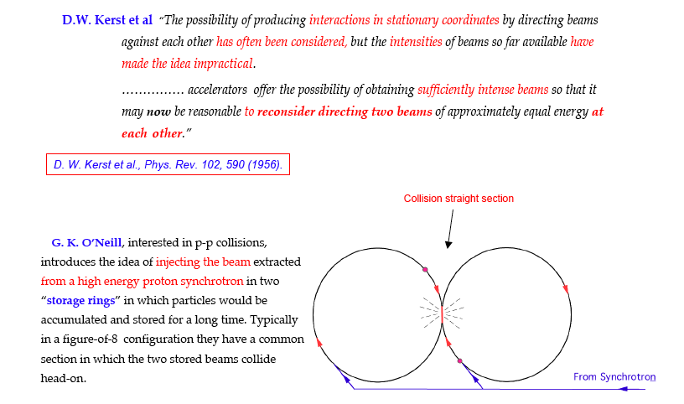
2. Storage rings to conquer high energies
Tazzari, Cern Acc School 2006
fixed target accelerator: s=2ME, collider: s=4E² : gain: 2E/M
First e⁺e⁻ storage ring ADA at Frascati: Bruno Touschek et al.

Slide 4
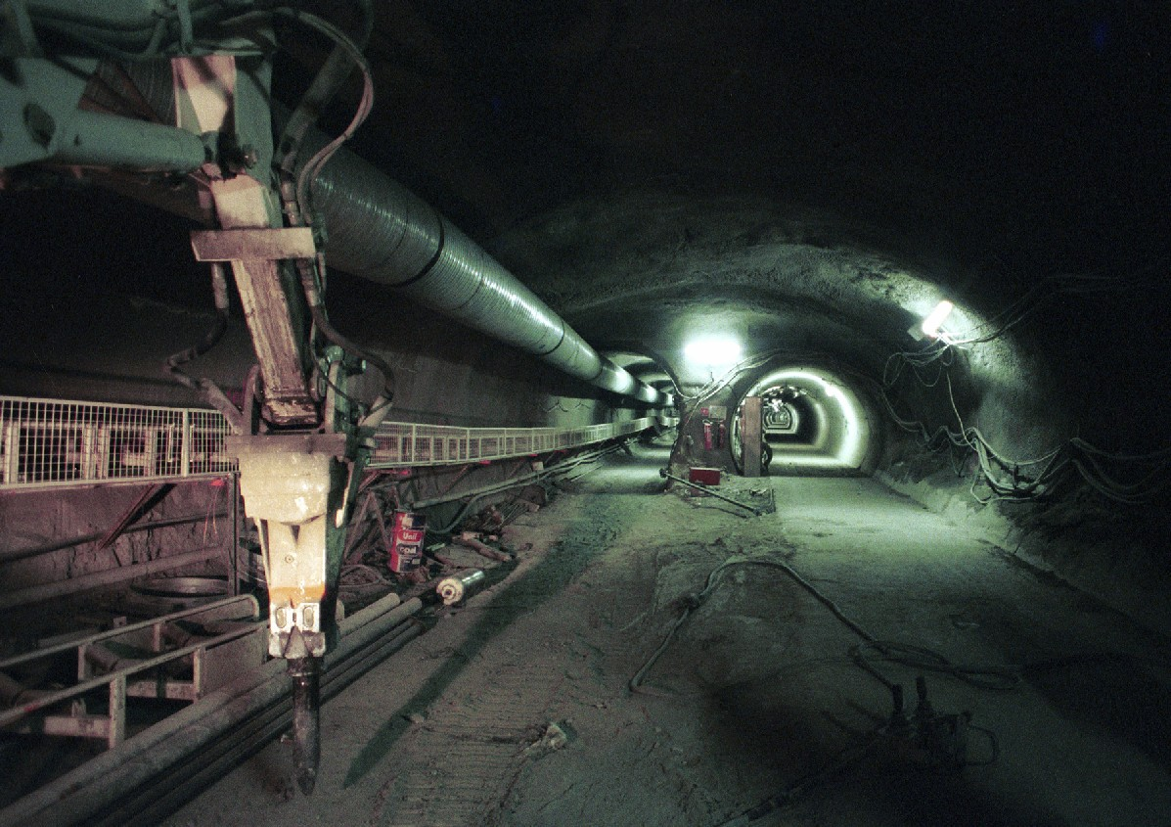
3. Colliders need time and a community
LHC tunnel 2002
10 years from here to the discovery of the Higgs boson …
First large workshop on LHC: Lausanne 1984: LEP first, then LHC, with ep
Letter of Intent of ATLAS is now 25 years old. 10k physicists and engineers are on LHC

Slide 5
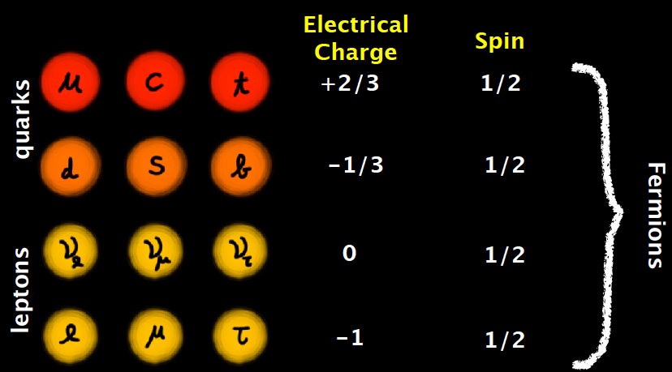
4. Decades of establishing the SM are successfully ending
Quantum Electrodynamics QED (Feynman, Schwinger, Tomonaga)
1972 “A Model of Leptons”: S. Weinberg (and independently A. Salam)
SU_{L}(2) x U(1) - t’Hooft
mixing of neutral gauge fields to obtain photon and Z, angle Θ_{W}
1973 SU_{c}(3) Gell Mann et al. QCD - colour + asymptotic freedom
1974 J/Ψ = cc: restored l-q symmetry
4 leptons and 4 quarks
1977 CP violation in 6 quark theory
predict bottom and top
bottom discovered
gauge bosons: photon, Z, W±, and 8 gluons (coloured)
1978 polarised ep→eX :the electron is a r.h. singlet (discovery through precision)
ee → qqg: gluons found in 3-jet events and running of α_{s} established
1982 W and Z
Top
2012 Higgs

Slide 6
5. Big Questions
New: We lost the SM guidance
Reminds on Kelvin, Planck ~1900
Note: 500 ATLAS papers
Do we have too many particles? 12 leptons, 36 quarks, 12 mediators, 1 Higgs = 61
Is there a further layer of structure (preons?)
How can we unify the 3 + 1 interactions (SU(5) failed in 1980 but established neutrino physics)
Why are leptons and quarks different?
Can one restore the boson-fermion symmetry (SUSY since 1972)
Why do we have 3 families?
Neutrino puzzles: Majorana, sterile neutrinos – Oscillations (98), Pontecorvo (57)
Is the proton stable?
…
And: what is “behind” dark matter.. ? Not sure that is a particle physics question?

Slide 7
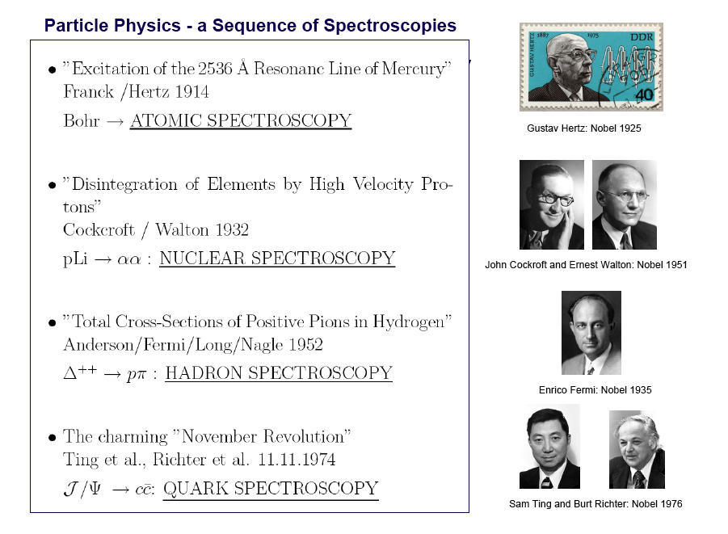
Spectroscopy
6. No new spectroscopy appeared – neither 1992 (LEP) nor 2012 (LHC),
No SUSY, neither at 100 GeV nor at 1000 GeV → a major surprise
M.K Inaugural lecture Liverpool 2007

Slide 8
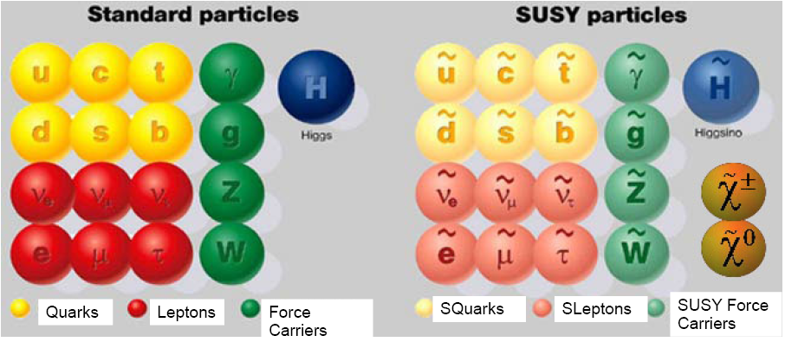
A supersymmetric picture of the elementary particle world
J=1/2 J=1 J=0 J=0 J=1/2 J=1/2
New interactions: e.g. gluino →anti-quark+squark→quark+photino, or W→selectron+sneutrino,
or stop → top and lightest susy particle (LSP) etc.
SuperGravity (SUGRA): Goldstino → Gravitino (J=3/2) partner of the Graviton (J=2)
[Gravitino mass plays role of η in SU(2)xU(1) – superHiggs mechanism]
M.Klein 28.4.2014 L14

Slide 9

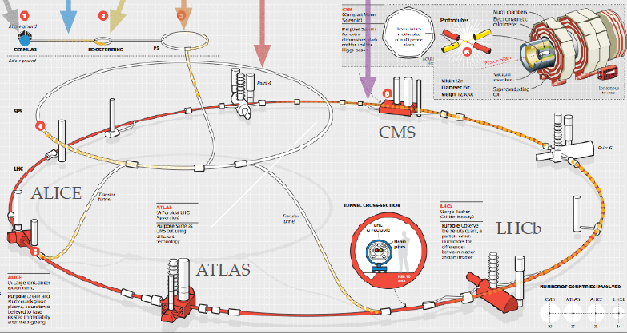
The Large Hadron Collider

Slide 10
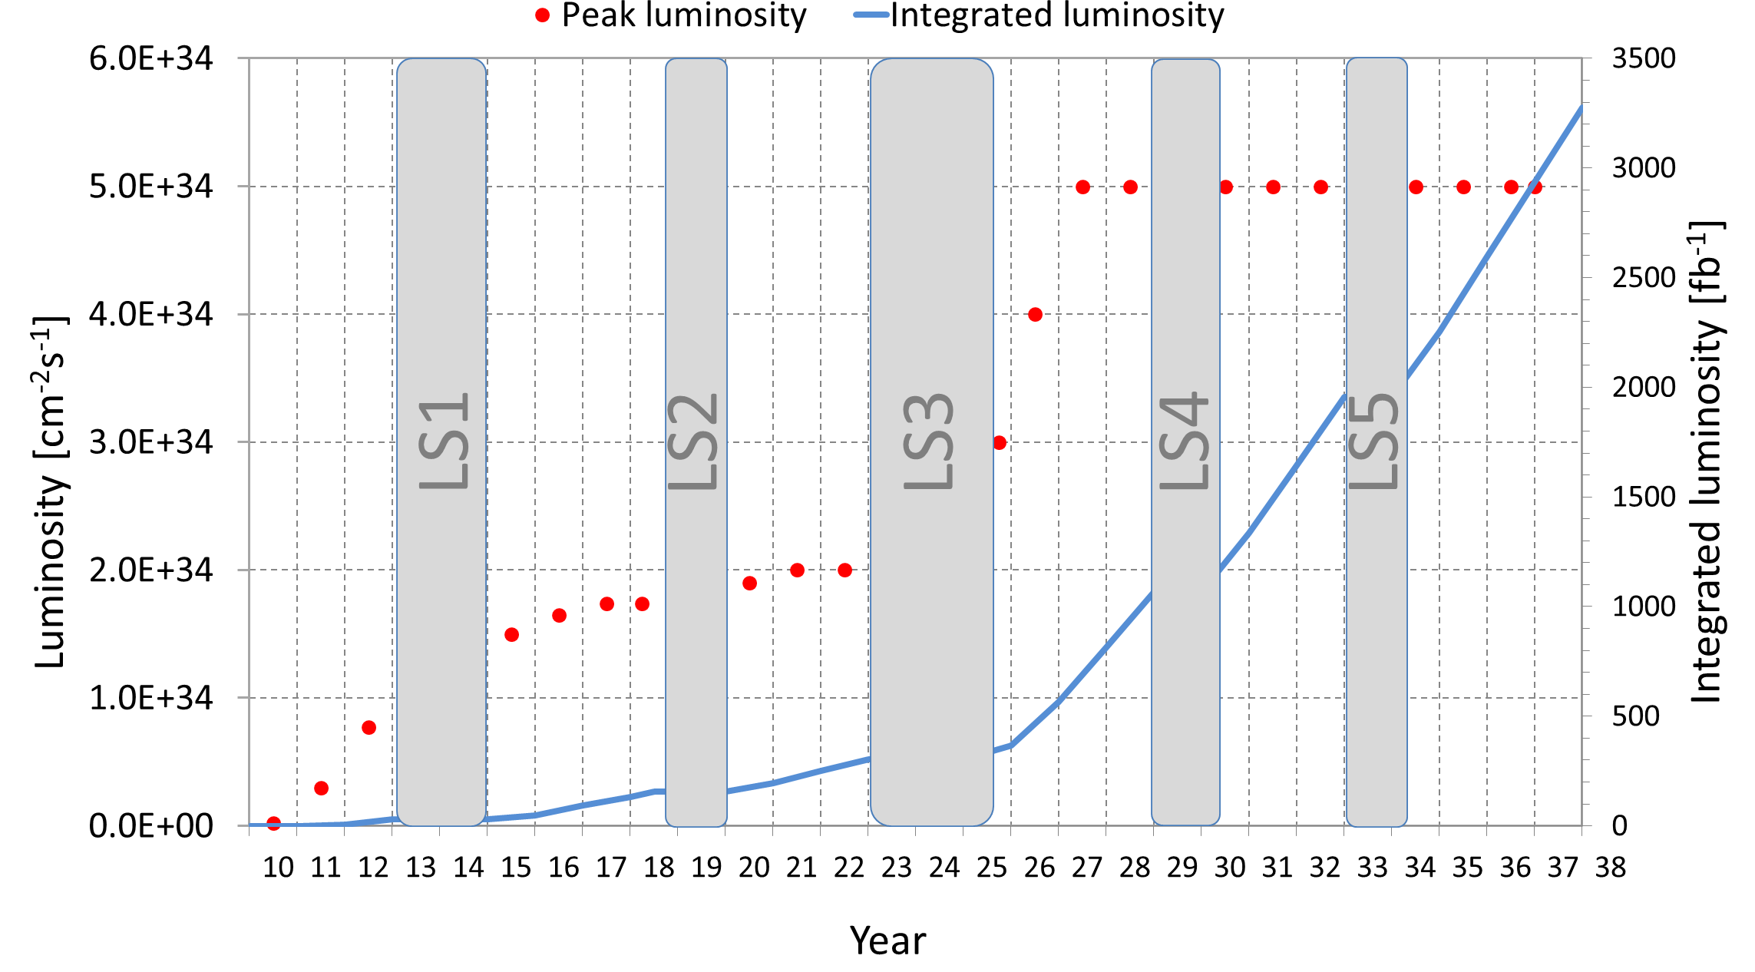
Long Term Planning of the LHC Operation
Run 1
Run 2
Run 3
300 fb⁻¹
30 fb⁻¹
F. Bordry at the FCC Workshop at Washington DC March 2015
Max Klein - Future HEP - 1.5.15 at DIS2015 Dallas, Texas

Slide 11
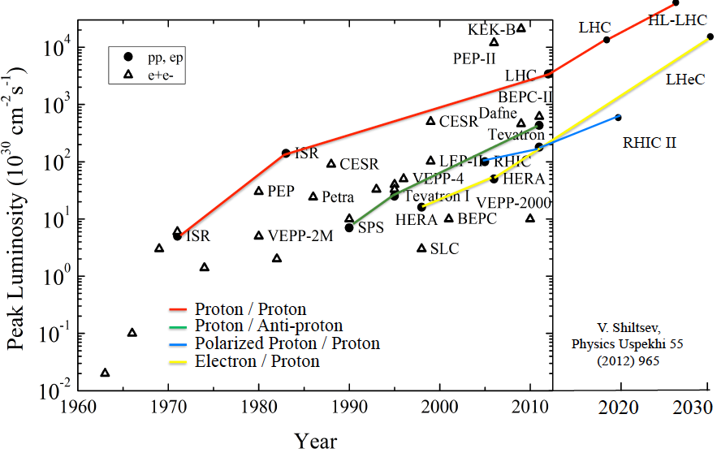
Collider Luminosities vs Year
O. Bruening 2/17

Slide 12
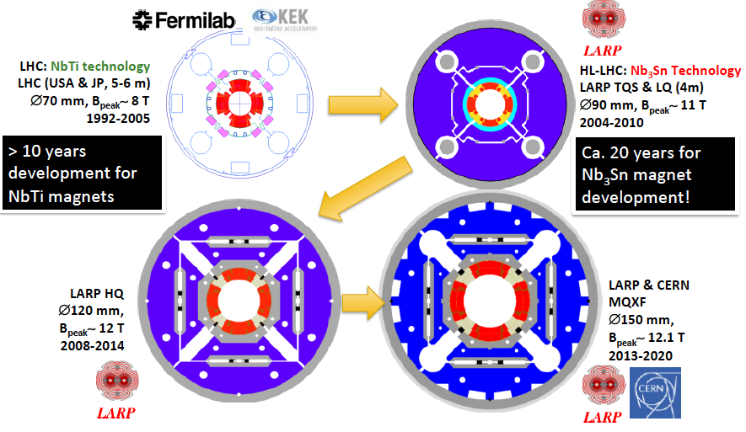
HL LHC – Replacement of Inner Quadrupoles
Inner triplet quadrupoles receive 25MGy of radiation from 300fb⁻¹ of pp at the LHC →
Larger aperture, larger field to ensure high luminosity performance: 1-2 decades of design

Slide 13
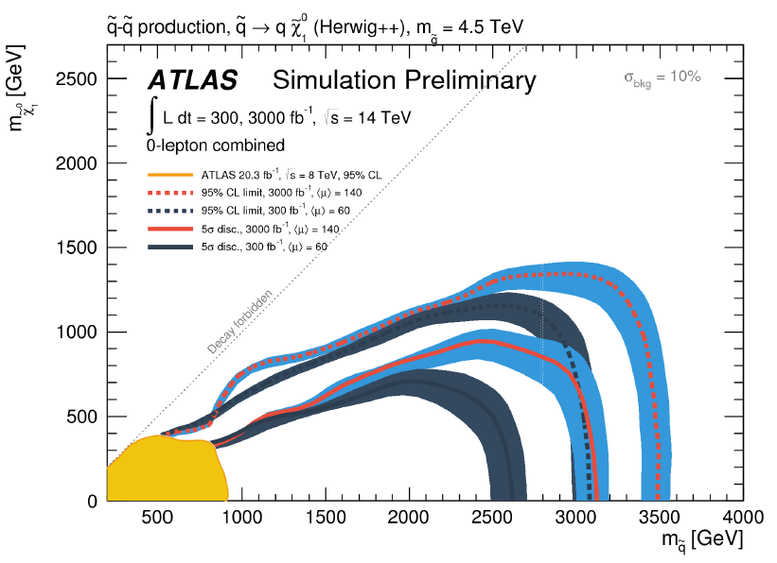
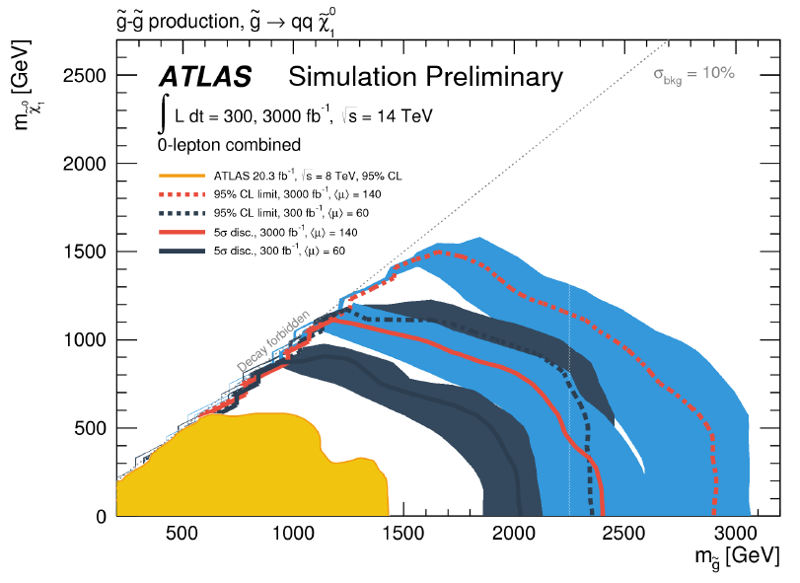
Luminosity Upgrade – SUSY?
5σ up to ~2.5TeV gluinos
@ HL-LHC
ATLAS-PUB-2014-10
5σ up to ~3TeV squarks
5σ up to ~1.2 TeV stops
5σ up to ~1.3 TeV sbottoms
@ HL-LHC
Max Klein - Future HEP - 1.5.15 at DIS2015 Dallas, Texas

Slide 14
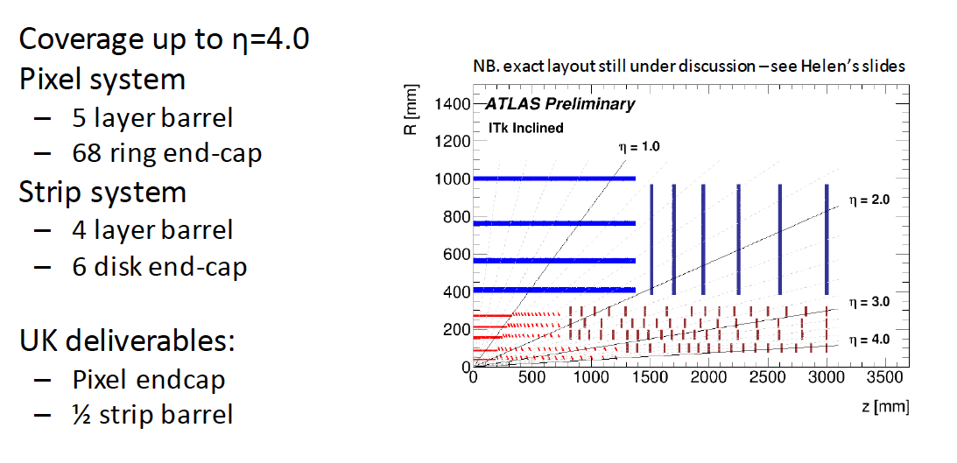
Replacement of the ATLAS Inner Tracker “ITK”
Biggest part of ATLAS detector upgrade, O(100)MSF, Installation 2024
2412 modules
Major Role: Assembly of the pixel endcap at Liverpool, ground floor

Slide 15
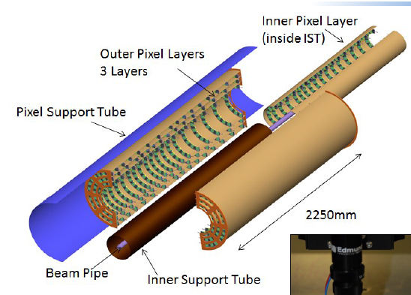
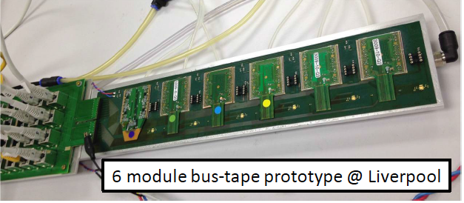
Preparations for ITK at Liverpool
Mechanics
Electronics
Si Detectors
R+D, DAQ, Software…

Slide 16
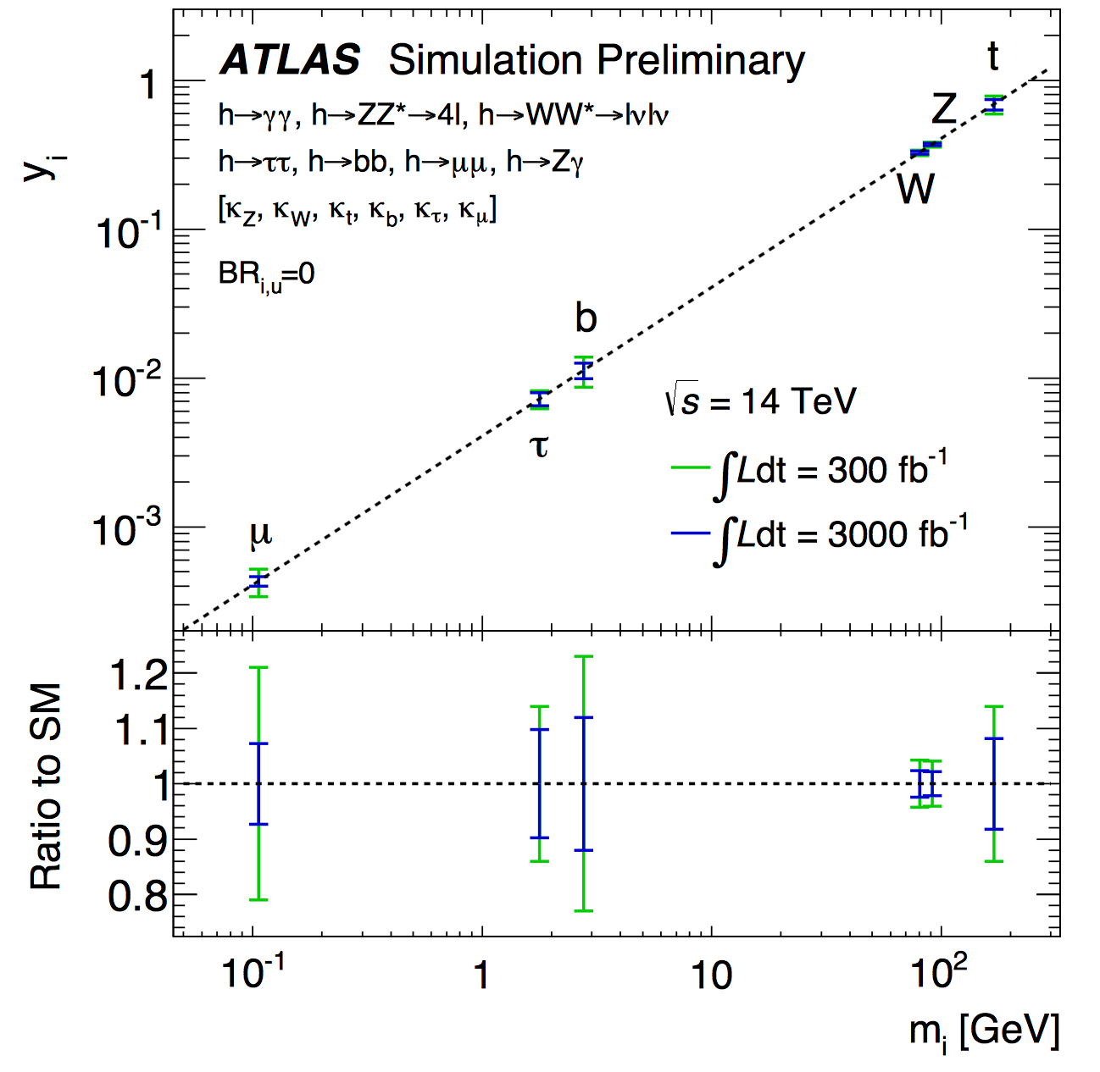
Luminosity Upgrade - Higgs
c
LHeC, 1ab⁻¹
Work in progress
Br: b 59% c 3%
May transform
LHC into high
Precision Higgs
facility
ATL-PHYS-PUB-2014-016

Slide 17
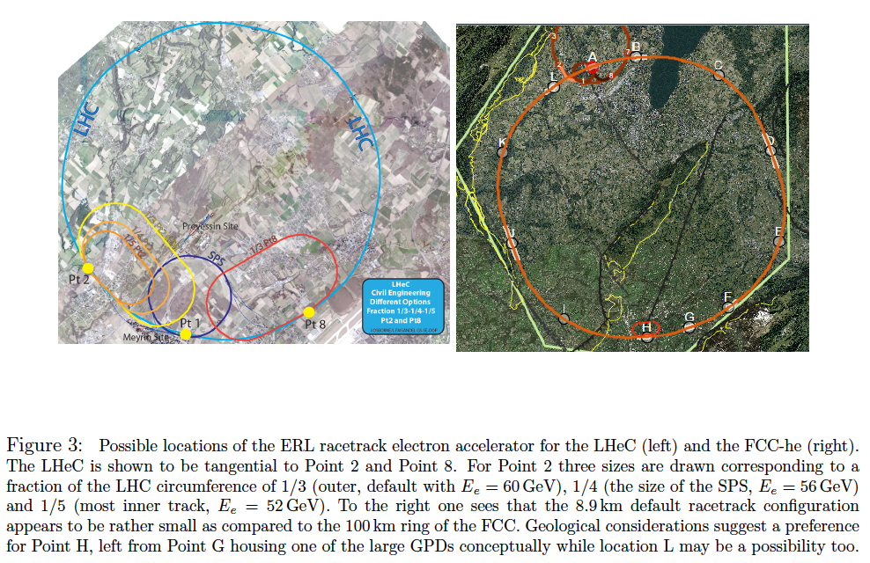
Location and E-Cost Scaling for e ERL
U(LHeC)=1/3U(LHC), 60 GeV -→ 1/5(LHC) 51 GeV at much reduced cost. SPS: 1/4(LHC)

Slide 18
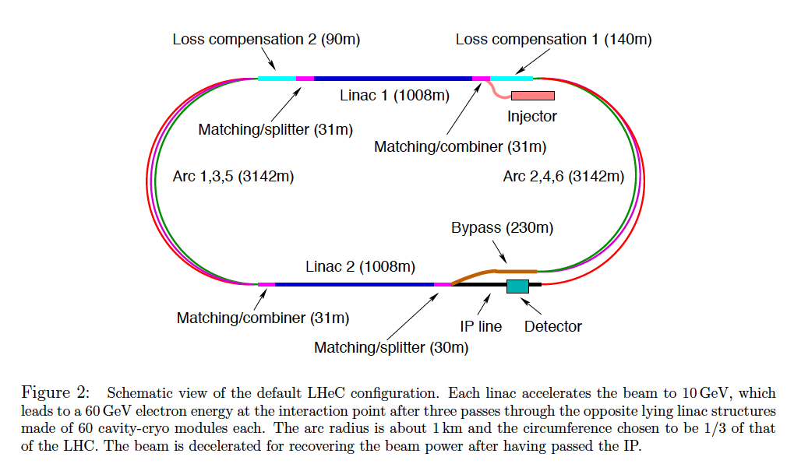
Baseline of ep at (HL+HE)-LHC and FCC-eh
.. a 3 turn, two fold, high current, 802 MHz energy recovery linac

Slide 19
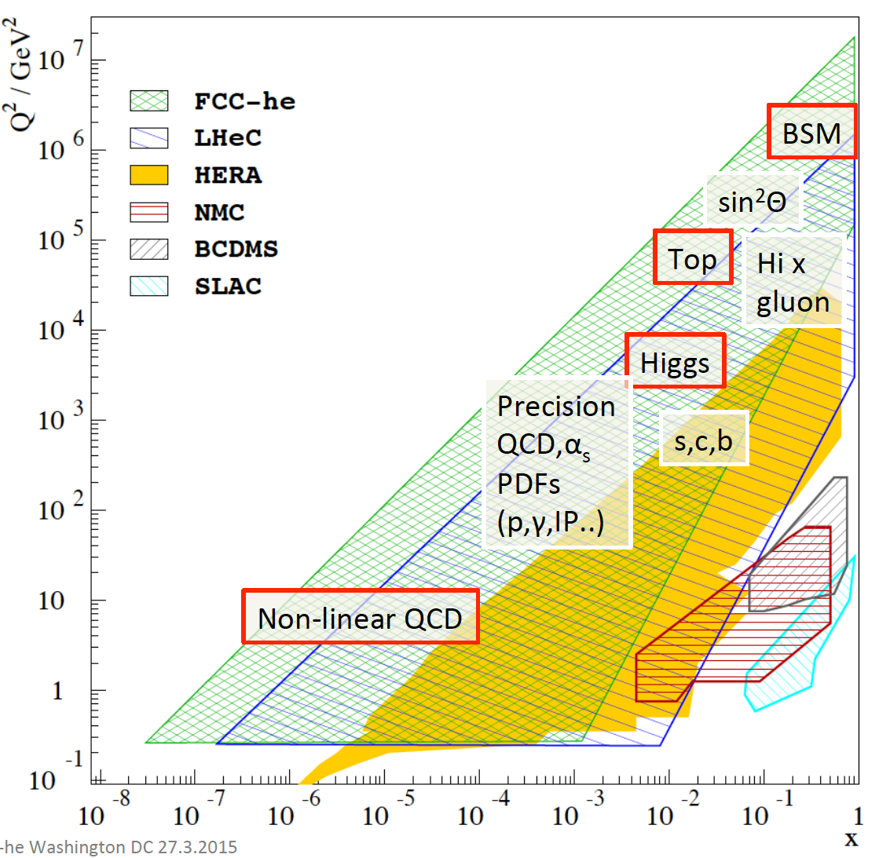
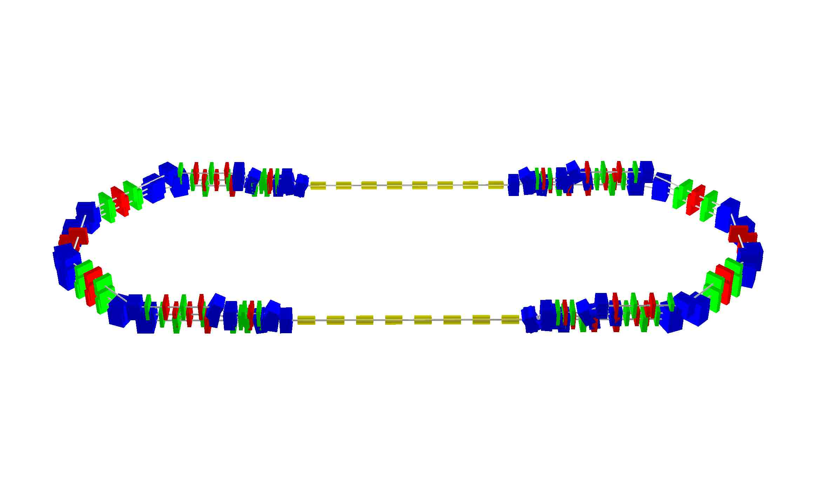
LHC Electron Beam Upgrade
LHeC
-Finest microscope of the world
-The next machine which sees H
-Transforms LHC in precision lab.
-PDFs gain O(.5)TeV search range
-Revolution of nuclear structure
ERL Facility:
Two LINACS 150 MeV, 3 passes
with energy recovery → 900MeV
Design Concept 2015
AsTEC, BINP, CERN, Jlab +
scRF, ERL, Physics, Tests
Luminosity of order 10³⁴cm⁻² s⁻¹
in concurrent ep-pp operation
Max Klein - Future HEP - 1.5.15 at DIS2015 Dallas, Texas

Slide 20
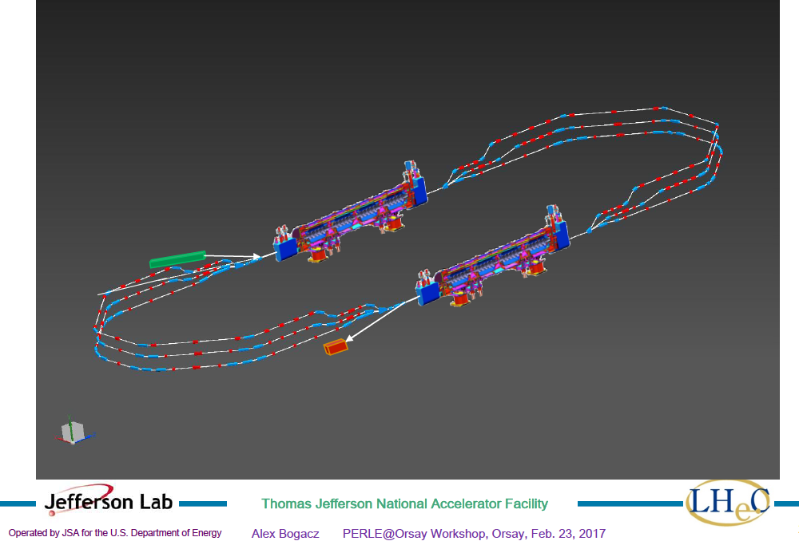
title
Powerful ERL for Experiments (ep.yp): PERLE at Orsay
PERLE at Orsay: New Collaboration: BINP, CERN, Daresbury/Liverpool, Jlab, Orsay +
CDR publication imminent.
3 turns, 2 Linacs, 15mA, 802 MHz ERL facility
-Demonstrator of LHeC
-Technology (SCRF) Development Facility
-Low E electron and photon beam physics
-High intensity: 100 x ELI
See https://indico.lal.in2p3.fr/event/3428/

Slide 21


Robert Jungk (1966)
Die grosse Maschine
-auf dem Weg in eine andere Welt
The big machine
-on the road into a new world
Max Klein - Future HEP - 1.5.15 at DIS2015 Dallas, Texas

Slide 22
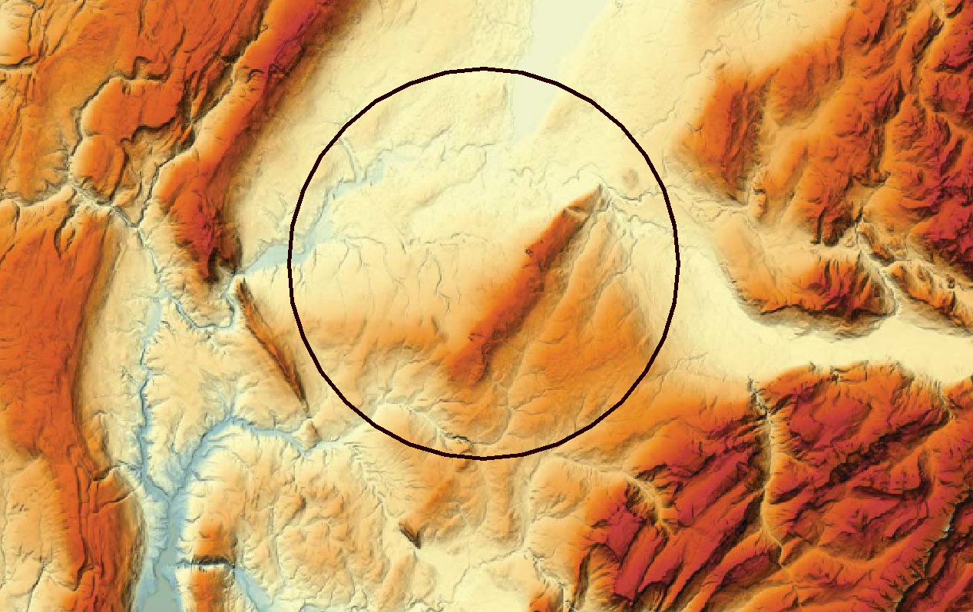
FCC
Lac Léman
300 – 372 m/mer
Massif du Jura
550 – 1720 m/mer
Plaine du genevois
350 – 550 m/mer
Pré-Alpes du Chablais
600 – 2500 m/mer
Vallée du Rhône
∼330 m/mer
Mont Salève
550 - 1380
Valée de l’Arve
400 – 600 m/mer
Plateau du Mont Sion
550 – 860 m/mer
Mont Vuache
550 - 1100
Plateau des Bornes
600 – 850 m/mer
Vallon des Usses
380 – 500 m/mer
Mandallaz
Bornes – Aravis
600 – 2500 m/mer
J.Osborne FCC Meeting Washington 3/15
Max Klein - Future HEP - 1.5.15 at DIS2015 Dallas, Texas

Slide 23
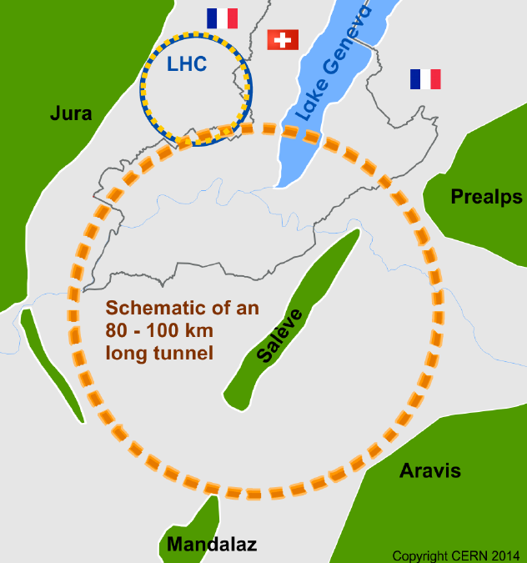

FCC
Similar plans in
China, cf
colloquium
last week at
Liverpool

Slide 24
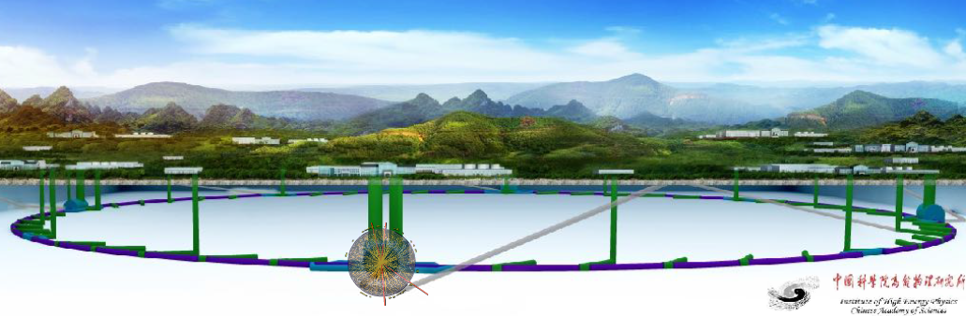
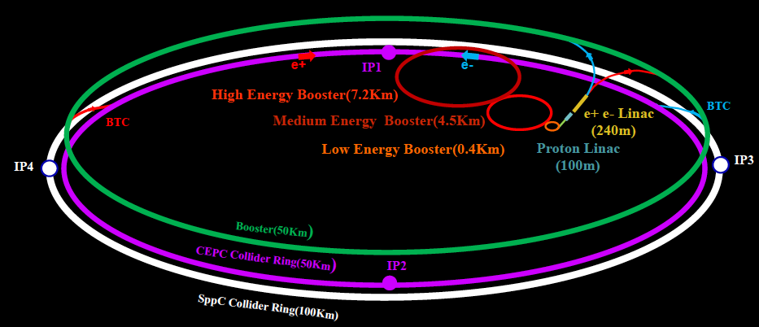
CepC and SppC in China

Slide 25
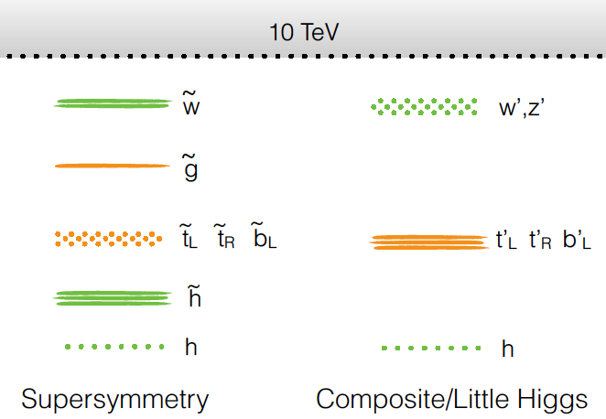
Theory to pave new ways
“Colored” Naturlness N.Craig Aspen 1/15
Max Klein - Future HEP - 1.5.15 at DIS2015 Dallas, Texas

Slide 26
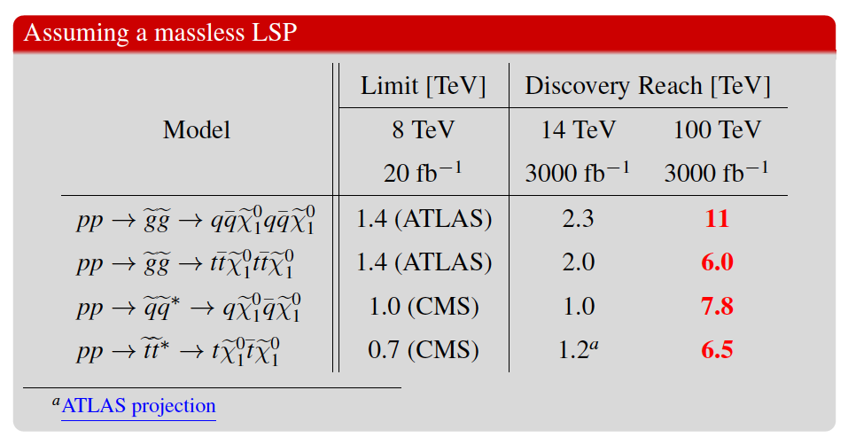
Future SUSY
M. Hance Aspen 15
SUSY is too beautiful to not exist but it is broken heavier and heavier
For the FCC to be built we need overriding reasons which the society can accept for the project to go ahead. Magnets and theory are the main challenges of the FCC.
Max Klein - Future HEP - 1.5.15 at DIS2015 Dallas, Texas

Slide 27
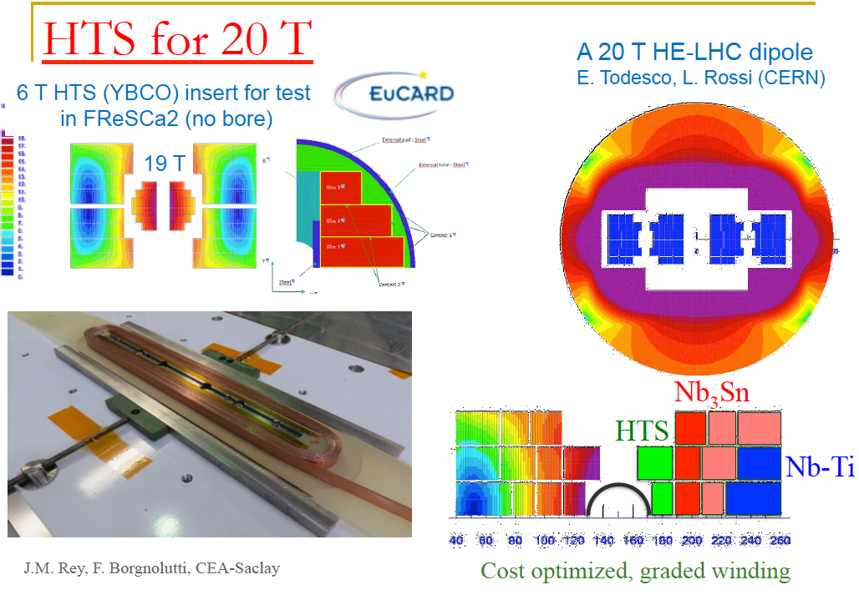
Design of High Field Dipoles
Sc wire: higher current, higher field. Reduced losses. NbTi: 15T at 10K, Nb₃Sn: 25Tat4K, HTC inserts YBCO
Cost is a major factor: today: Nb₃N is 5 times the NbTi cost and HTC is 10 times Nb3N (O.Bruening at KET 2/17)

Slide 28


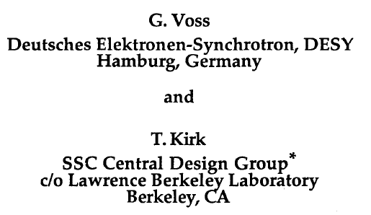
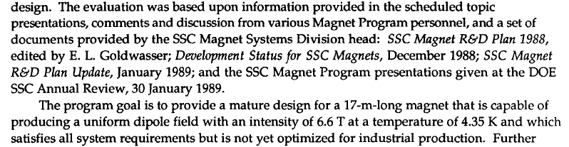
Max Klein - Future HEP - 1.5.15 at DIS2015 Dallas, Texas

Slide 29
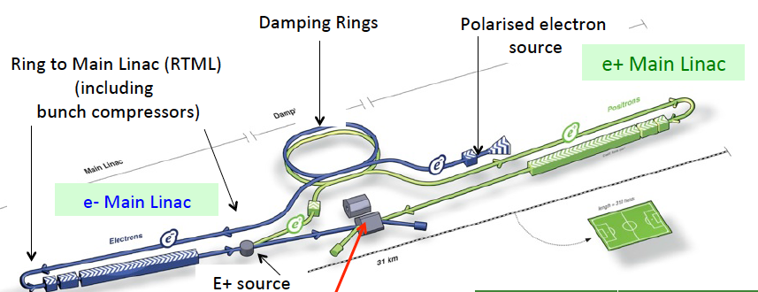
Linear electron-positron colliders
ILC in Japan
ee → ZH:
E_{e} >120 GeV
ee → tt
E_{e} > 180 GeV
CLIC at CERN
ee → sparticles
E_{e} as large as ?
max E_{e}=1.5 TeV
Low E_{e}: H+top

Slide 30
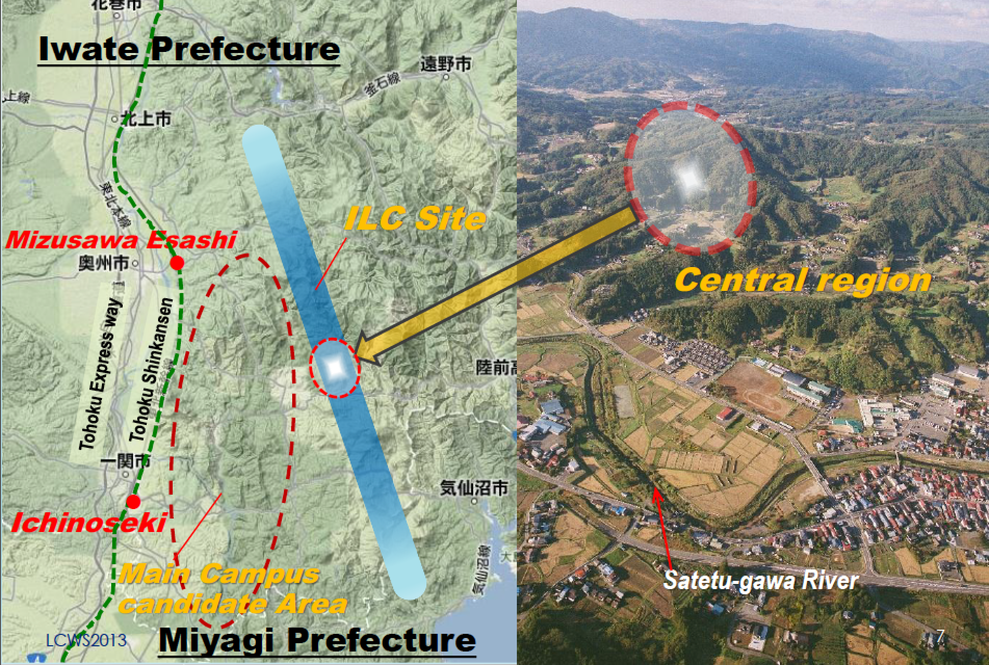
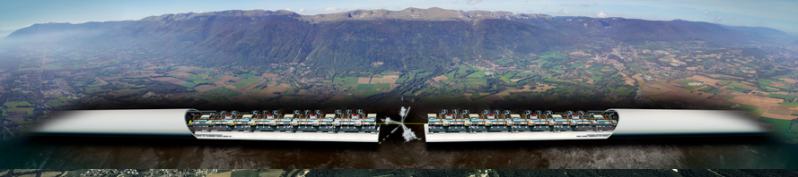
Linear electron-positron colliders
ILC
Huge enterprises
[e+, drive beams,
power, CE, length..]
New since 2016:
No BSM in their
energy range
(so far) – uncertain
Revival of circular
ee colliders – FCC-ee,
CepC – for Higgs (Z,t)
CLIC

Slide 31
The Upgrades of the LHC will endure for your
lifetime as physicists. They will change our
understanding of nature, answer some of the
“big questions” and pose new ones.
They rely on the development of technology,
theory, experimentation and cannot be pursued
if the old concepts of walls and nationalism win.
Actually CERN, also Dubna, were built in the early
50ies to overcome the division of the world. That
has been the undisputed base for its success and
its persistent attraction.

Slide 32
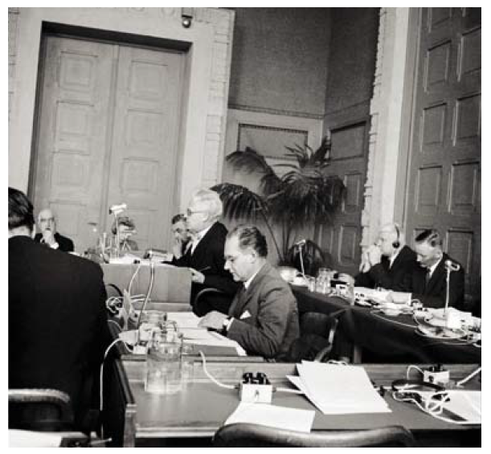
1st session of CERN Council, 15.2.1952 - Niels Bohr watching us..
Max Klein - Future HEP - 1.5.15 at DIS2015 Dallas, Texas

Slide 33
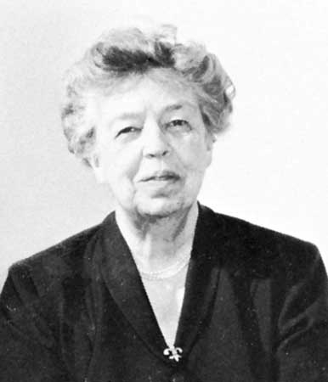
“The future belongs to those who believe in the beauty of their dreams.”
Anna Eleanor Roosevelt
(1884-1962)
Universal Declaration of Human Rights (1948)
cited by Frank Zimmermann at the FCC Meeting at Washington DC, March 2015

Slide 34
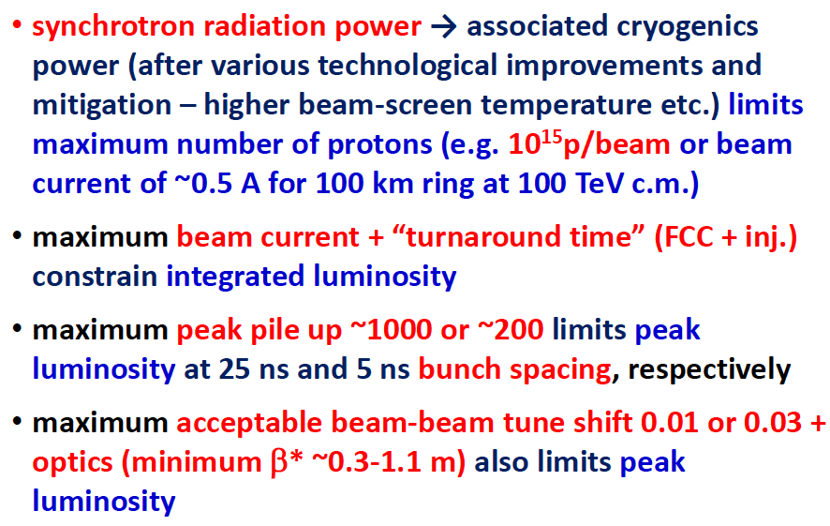
Designing the FCC-hh
F.Zimmermann 1/17

