Slide 1


EIC and LHeC side by side in the CTEQ context of unpolarised parton distribution functions PDFs
“Side by Side”
Physics Programs
Detector Choices + Kinematics
The PDF Vision of the LHeC
PDFs with the EIC
An Initial Comparative Study
Longitudinal Structure Function
PDFs in Nuclei
LHeC:
E_{e}=60 GeV
E_{p}= 7 TeV
For references,
please consult
EIC web page
EIC White Paper
arXiv:1212.1701
unpublished
Max Klein
University of Liverpool
with
Voica Radescu
CERN
Contributions to a Discussion
For references,
please consult
lhec.web.cern.ch
LHeC CDR
arXiv:1206.2913
J.Phys. G39 (2012) 075001
POETIC7 with CTEQ, Philadelphia, 17th of November 2016

Slide 2
Side by Side
In time: - The EIC and the LHeC will not be operational before 2030
[ cf B. Mueller on eRHIC Monday and LH(e)C time schedule (LS4),
HERA took 8 years to build: approval in 1984 data 1992 → 2007. XFEL ~9 years]
- They should be considered to be operational together, not sequential ^{*)}
- EIC needs decades for spin, ep and eA data, much beyond the Trump time
- LHeC will be terminated with the LHC but may reappear with HE LHC (FCC)
In their technology choice:
- currently (BNL?) both the two US EICs and the LHeC use ERLs for the e beam
- they have similar challenges (multi-turn, high current ERL)
- all luminosity goals are very ambitious and need R+D:
a common problem is a high current polarised e⁻ source (LHeC 15, BNL 50mA)
- they almost certainly will have 100 times less or no positrons, P=0
In their kinematics: Q²_{max} = s = 10⁴ GeV² (EIC) 10⁶ GeV² (LHeC), x > 1 GeV² /s in DIS
In their role: seen from the perspective of genuine deep inelastic scattering:
- EIC will “replace BCDMS/NMC (suspicious at high x) and HERMES/COMPASS”
- LHeC will “replace HERA (uncertain at high x and no CC x > 0.5)”
^{*)} Predicting is difficult, in particular if it concerns the future (V. Weisskopf)

Slide 3
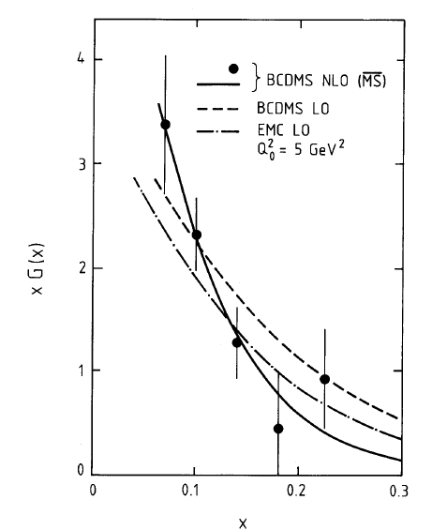
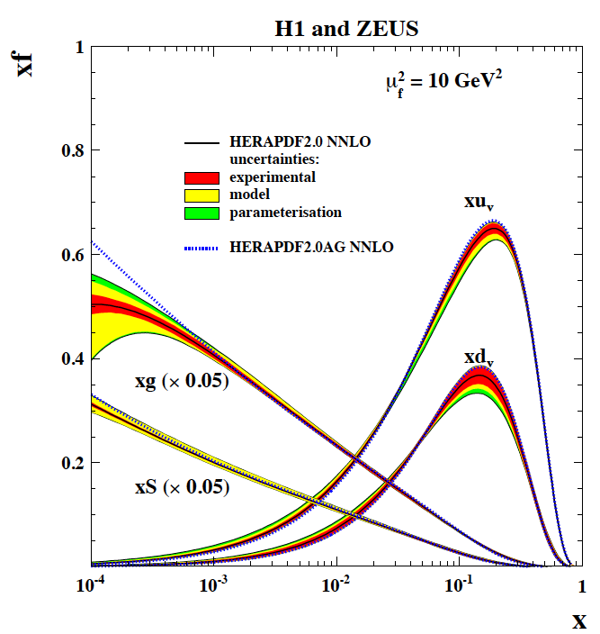

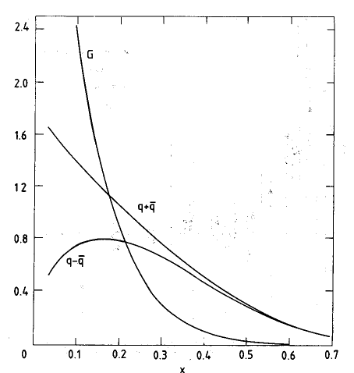

Gluons and Quarks 1989 → 2015
BCDMS
fixed target lN to ep collider →
CDHS
gg→H
(y=0)
arXiv:1506.06042
“Legacy” paper NC/CC
HERAPDF2.0 NNLO
High mass
HL-LHC
C.Gwenlan+M.Klein, ATLAS, Lecce 6.10.15

Slide 4
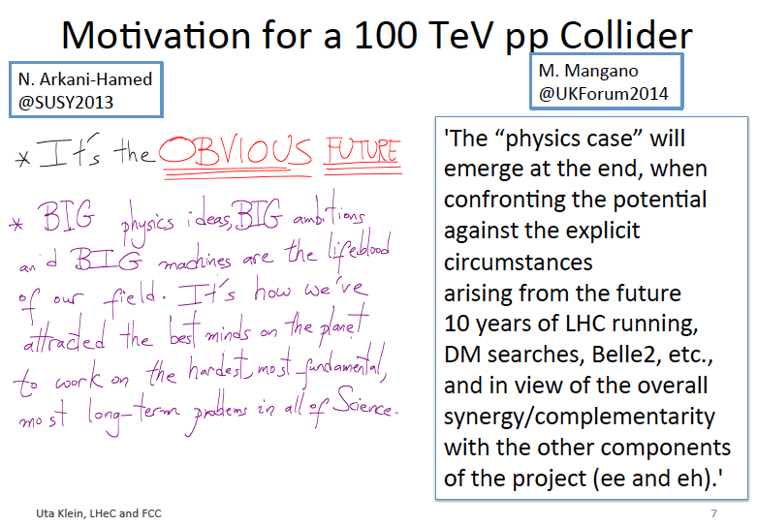
titel

Slide 5
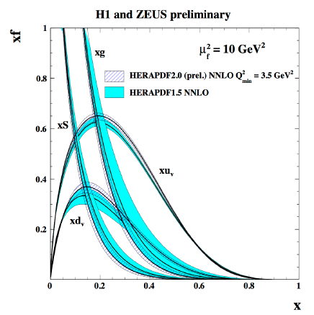
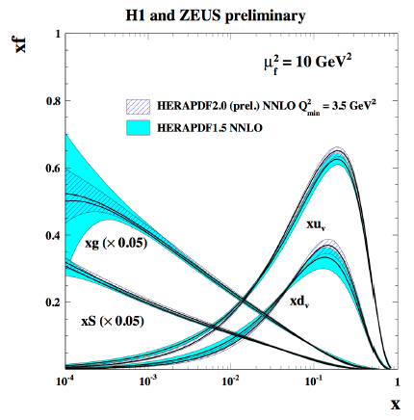
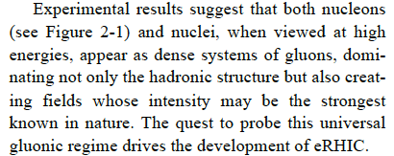

The Physics Programme of the EIC
1409.1633
How are the sea quarks and gluons and their spins distributed in space and momentum
inside the nucleon?
Where does the saturation of gluons set in?
How does the nuclear environment affect the distribution of quarks and gluons and
their interaction in nuclei?
See talks of Berndt Mueller, Rik Yoshida, Elke Aschenauer and many others at this workshop

Slide 6
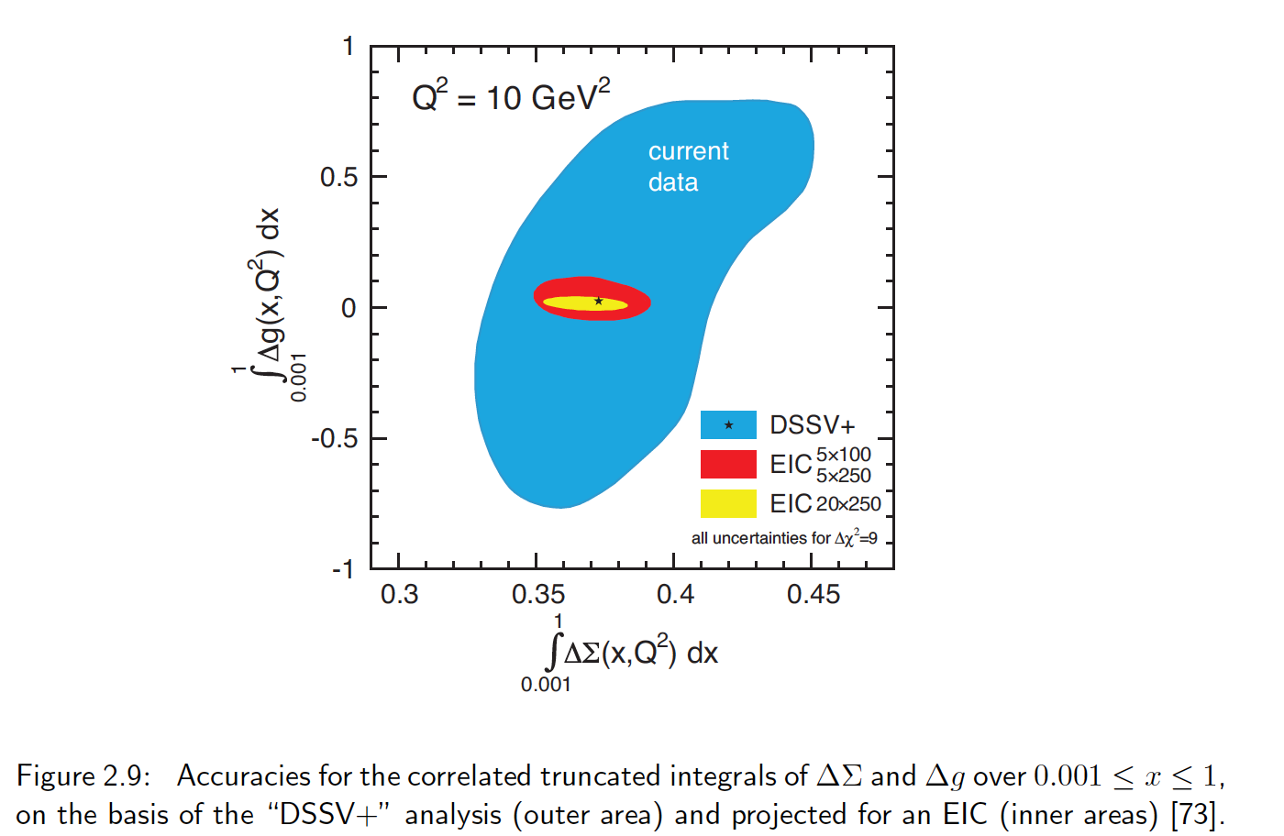
The Proton Spin - A Unique Focus of the EIC wrt LHeC
White Paper
why Δg=0?
Simulations of g₁ based on 10fb⁻¹ at different energies, in polarised-polarised state

Slide 7
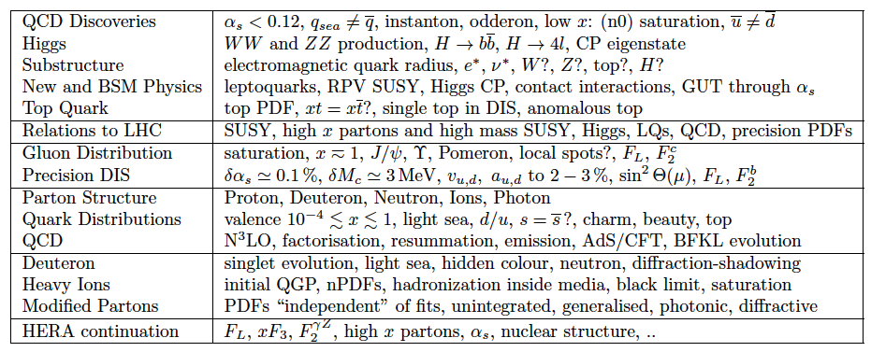
The Physics Programme of the LHeC
arXiv:1206.2913 (CDR) 1211.4831 and 5102
See introductory talk on Tuesday 15.11. and special presentations at this workshop

Slide 8
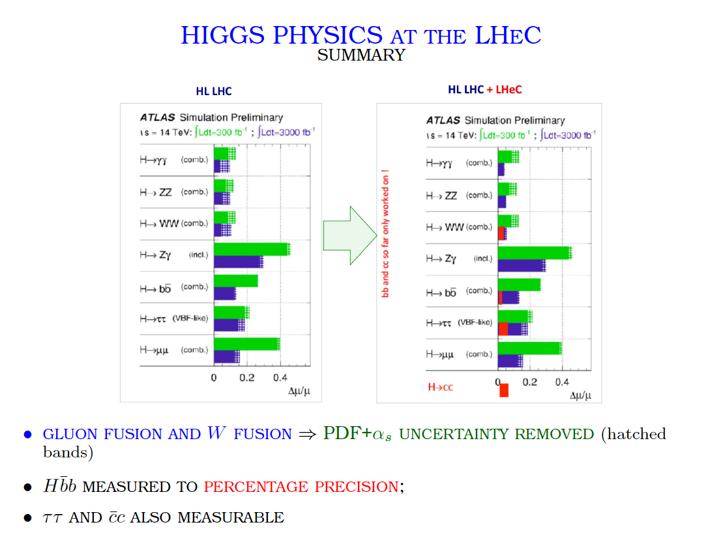
Precision Higgs – A Unique Focus of the LHeC wrt EIC + LHC
Stefano Forte ECFA 11/15
BSM Higgs physics, C Zhang at this workshop
H cross section is largest in e⁻p, P=-0.8 → predominantly operate in this configuration, O(1)ab⁻¹

Slide 9
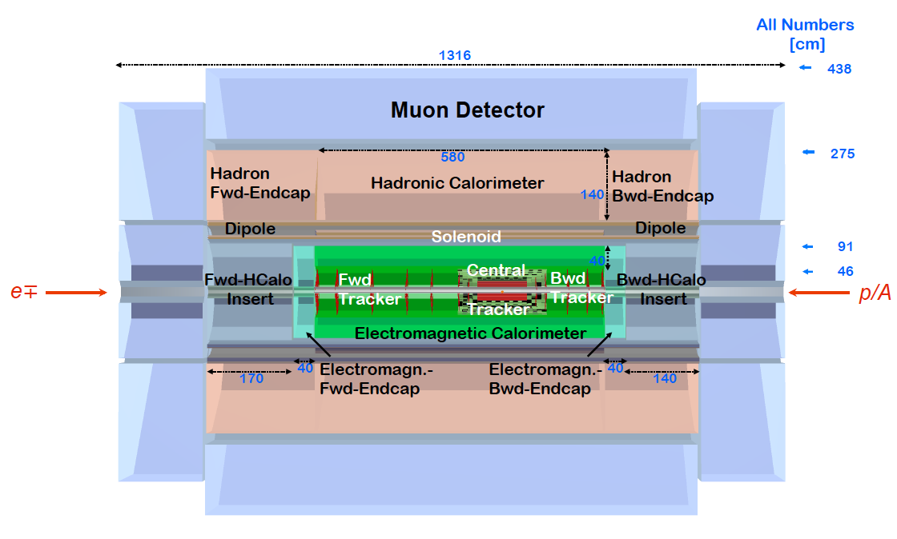
LHeC Detector
PK: Status 11/16
Forward/backward asymmetry in energy deposited and thus in geometry and technology
Present dimensions: LxD =13x9m² [CMS 21 x 15m² , ATLAS 45 x 25 m²]
Taggers at -62m (e), 100m (γ,LR), -22.4m (γ,RR), +100m (n), +420m (p)

Slide 10
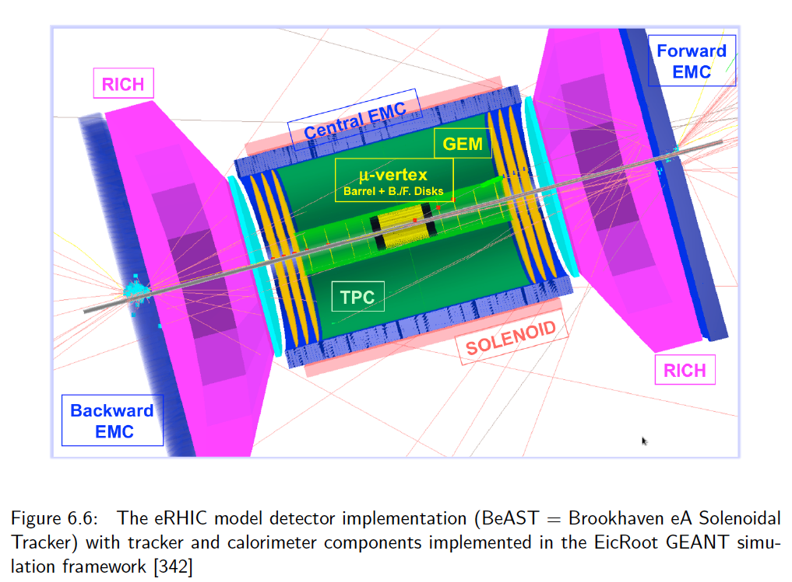
titel
From white paper

Slide 11
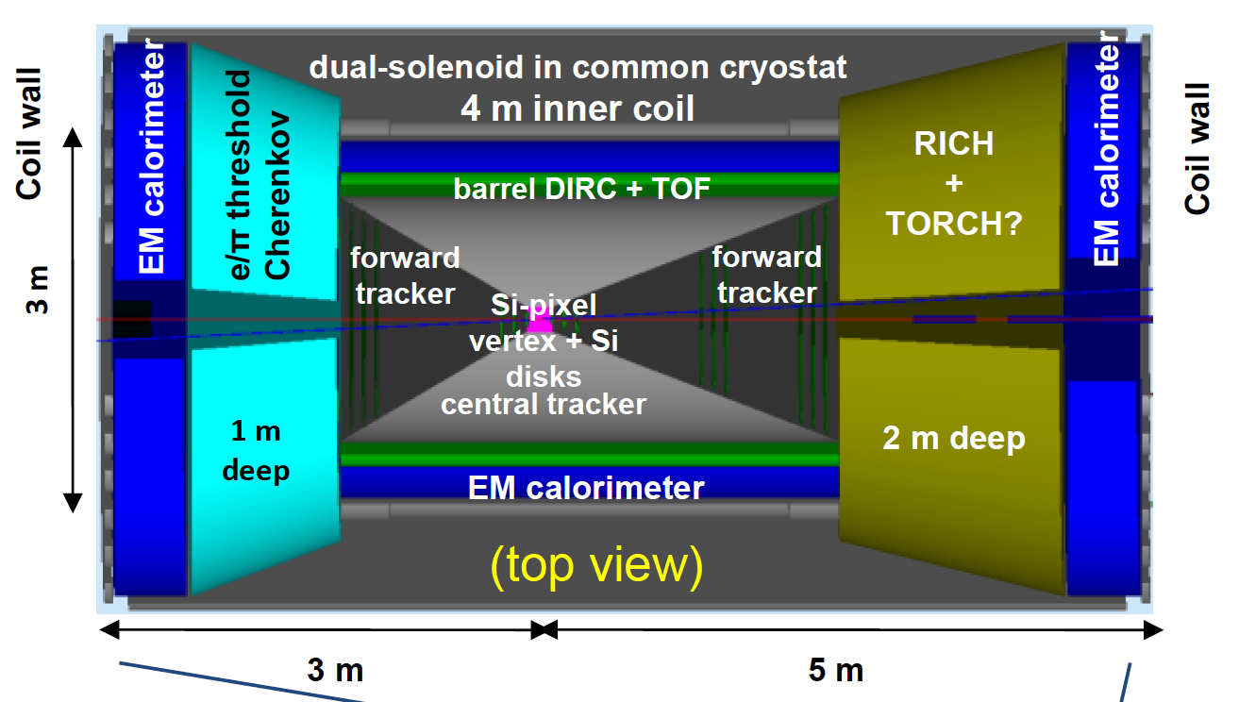
Physics Program of the
From the white paper

Slide 12
The importance of hadron calorimetry for DIS
-Coverage of low y, since the electron measurement precision diverges as 1/y_{e}
-Cross calibration of hadronic and elm energy scales (needs 0.5% on δE_{h}/E_{h} scale)
-High resolution for disentangling the final state (LHeC: H → bb as an example)
-Charged current measurement needs missing energy reconstruction (yp background)
-Momentum balance (“E-p_{z}”) required to cope with RC and background from photoprod.
LHeC thus has classic ep collider detector configuration (“H1 + ATLAS”)
innovative in technology eventually but conservative in its design concept
EIC (white paper) focus has been different: semi-inclusive DIS, particle ID
it probably is being studied how precise NC and CC may be measured then
and it would be only logical to design two complementary EIC apparatus
(simulation study presented below assumes a high precision “classic” detector)

Slide 13
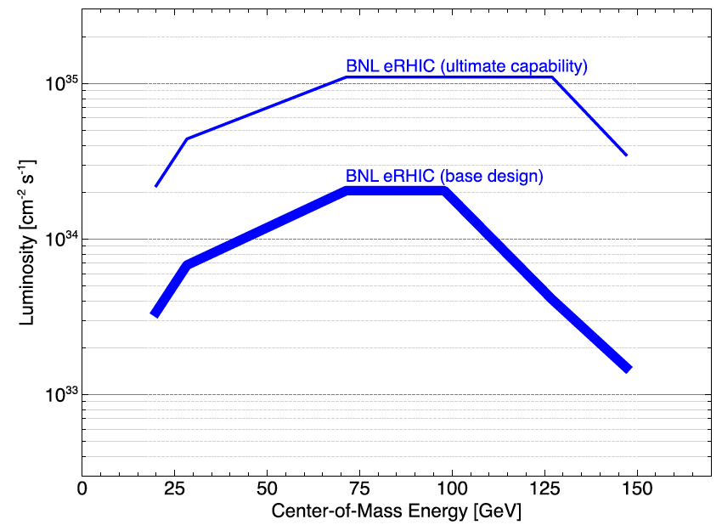
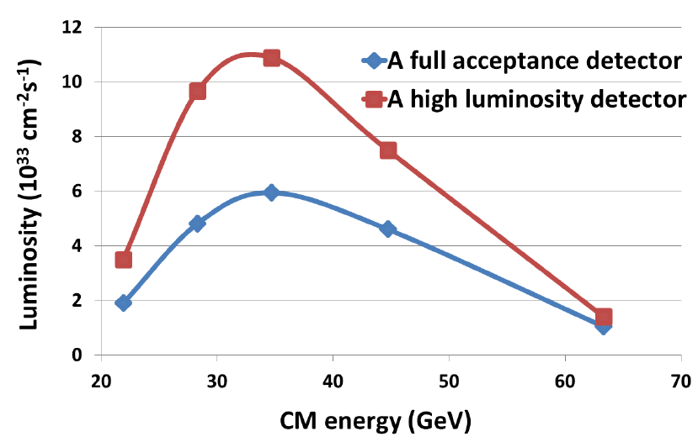
Luminosity (e⁻p) and Energy (√s=2√E_{e}E_{p})
These are projections which
depend on $, trust, R+D and time..
BNL: RR? (BM) Jlab: no PEP? (RY)
Baseline: 100 GeV cms and 10 ³⁴
Notice strong L dependence on energy
1409.1633 eRHIC design report, 2014
note logarithmic scale for luminosity
1504.07961 MEIC design report 2015
note linear scale for luminosity
Subsequently considered two energy settings: 100 GeV and 30 GeV cms energy

Slide 14
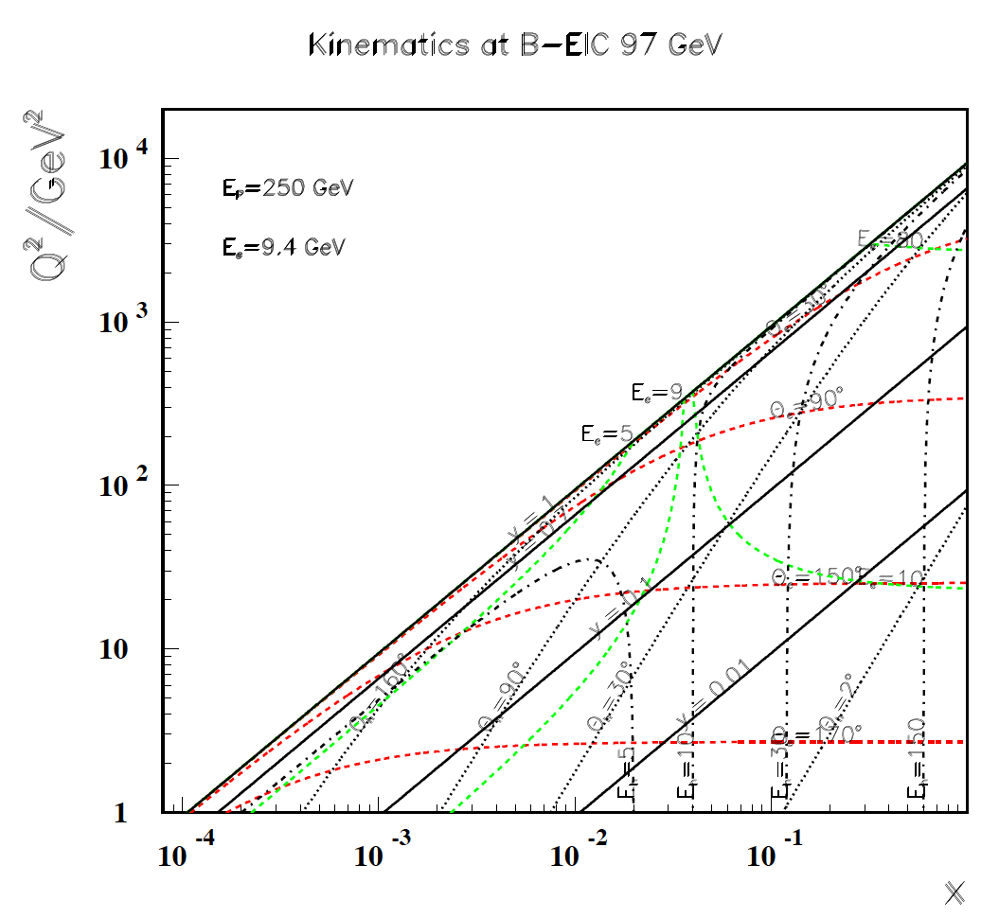
title
Kinematics at 250 x 9.4 GeV²
HERA
Observations
Good angular
coverage
High Q² to 10⁴
CC at large x > 0.01
Low Q² High x
HT area,
but reach high x
for Q² > 100 too.
High y
Very low E_{e}’
+
+
+
+
+
+
W² < 10 GeV²

Slide 15
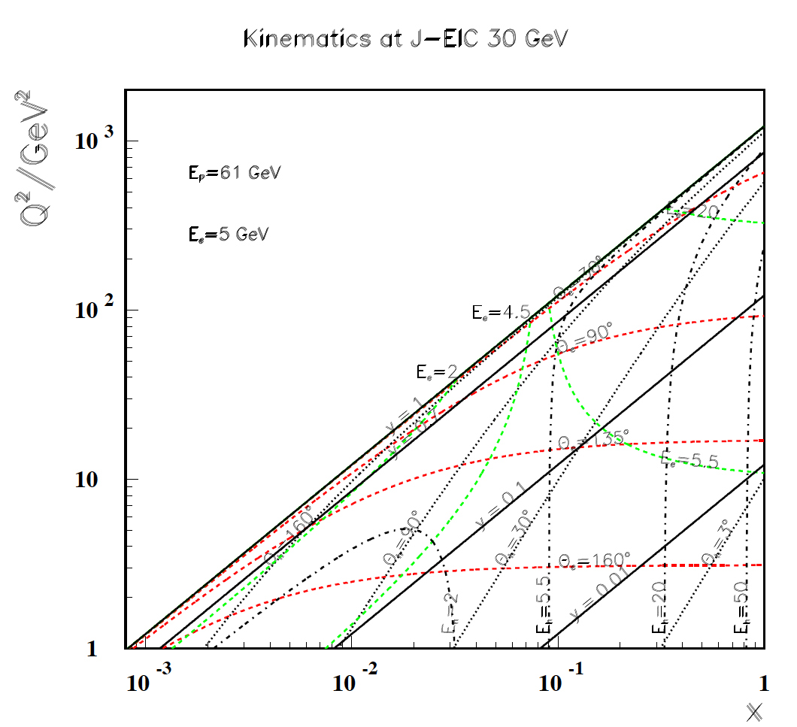
Kinematics of JEIC
Kinematics at 61 x 5 GeV²
HERA collider looks far away
Observations
Good angular
coverage
High Q² to 10³
CC at large x > 0.1
Low Q² High x
HT area,
reach high x
for Q² > 100 too
But just to 1000
High y
Really low E_{e}’
Big step wrt Jlab12
and HERMES
eAu: 18 GeV like NMC: seems there would be no gain in eA kinematic coverage but precision yes!
HERMES
Jlab
12 GeV
W² < 10 GeV²

Slide 16
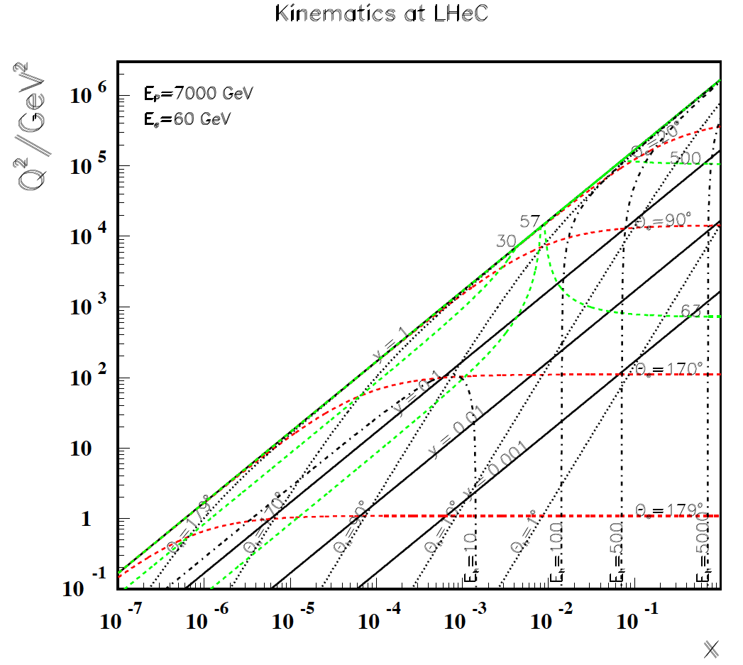
titel
Observations
Good angular
coverage but at high x
low Q2
High Q² to 10⁶
CC at large x > 0.0001
Low Q² High x
Very fwd hadrons:
High y =0.9 → 6 GeV
F_{L} “easy”

Slide 17
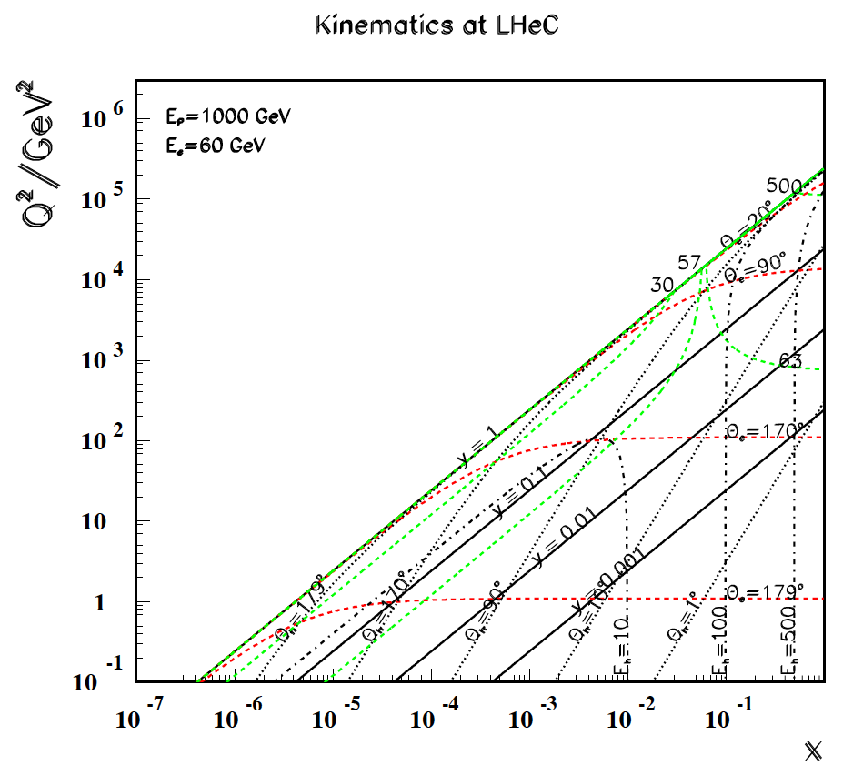
titel
← B EIC
Lower E_{p}
to access
high x at
lower Q²
Modest
Luminosity
required

Slide 18
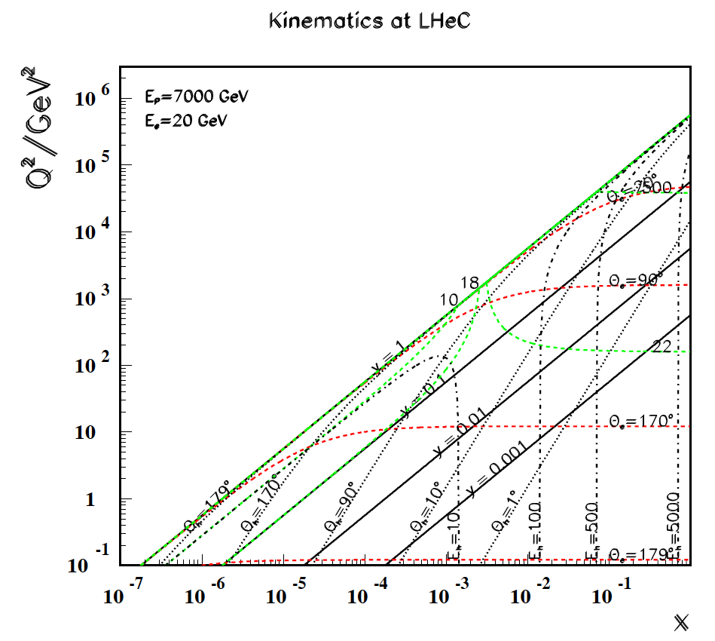
titel
E_{e} = 20 GeV
Covers
transition
hadronic
to partonic →
behaviour.
“NO” luminosity
required,
part of F_{L} run

Slide 19
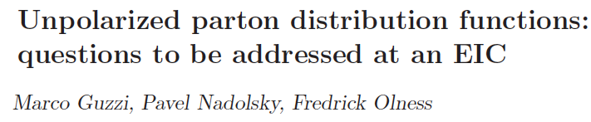
Nuclear PDFs
Better constraints on the strangeness PDF
The d/u ratio at large x
Gluon PF in the proton and charm production at large x
Inclusive charm production
Transition to the high density regime.. particularly using heavy ion beams
Perturbative-nonperturbative QCD boundary
The longitudinal structure function
Electroweak contributions to proton PDFs [photon PDF, isospin violation, weak NC+CC]
In 1108.1713
EIC Science Case

Slide 20
The LHeC PDF Programme
Input: high precision (stat+syst) data on
Neutral Current (x: 10⁻⁶-1; Q²:1-10⁶) Charged Current (10⁻⁴-1; 100-10⁶)
Tagging of Charm and Beauty with high precision and coverage. ep (eD)
Goal
Determine ALL pdfs in a coherent way + the strong coupling to 0.1% accuracy
No higher twists, no nuclear corrections, no symmetry assumptions, N³LO
→ ubar, uv, dbar, dv, s, c, b, t, xg and alpha_{s}
See talks by Mandy Cooper-Sarkar and Claire Gwenlan on ALL pdfs simulated
Note that the fit studies mostly do not use the simulated s,c,b nor t data, yet.

Slide 21
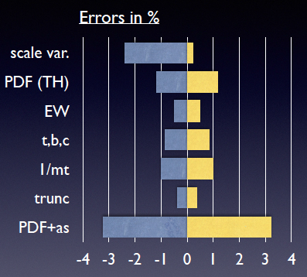
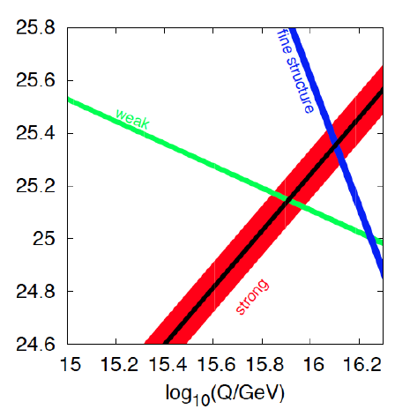
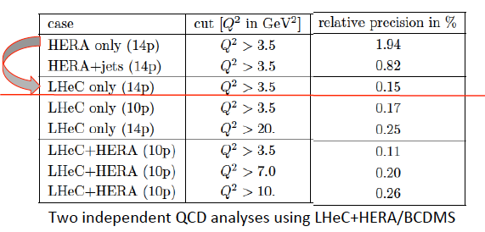
Strong Coupling Constant
- α_{s} least known of coupling constants
Grand Unification predictions need smaller δα_{s}
- Is α_{s}(DIS) lower than world average (?)
- LHeC: per mille - independent of BCDMS!
- High precision from inclusive data – α_{s}(jets)??
- Challenge lattice QCD
Uncertainty on Higgs cross section
Giulia Zanderighi, Vietnam 9/16,
from C.Anastasiou et al, 1602.00695
who also discuss the ABM alpha_s..
LHeC simulation, NC+CC inclusive, total exp error
PDG
LHeC

Slide 22
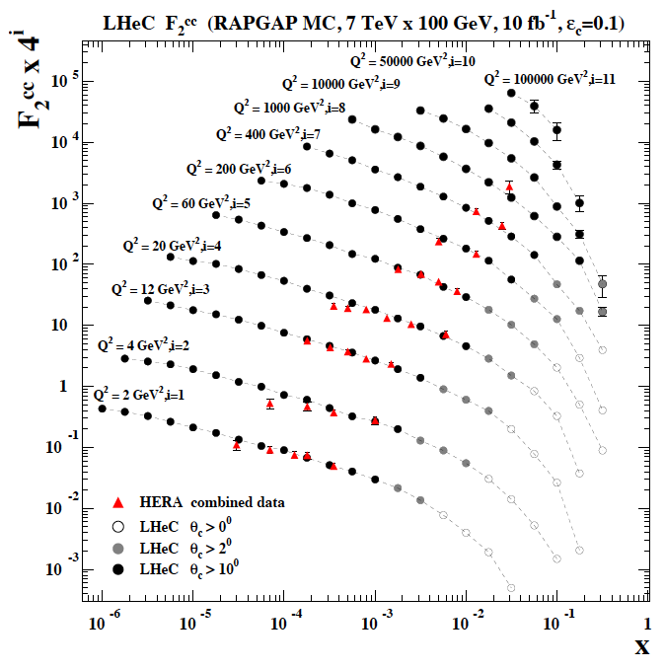
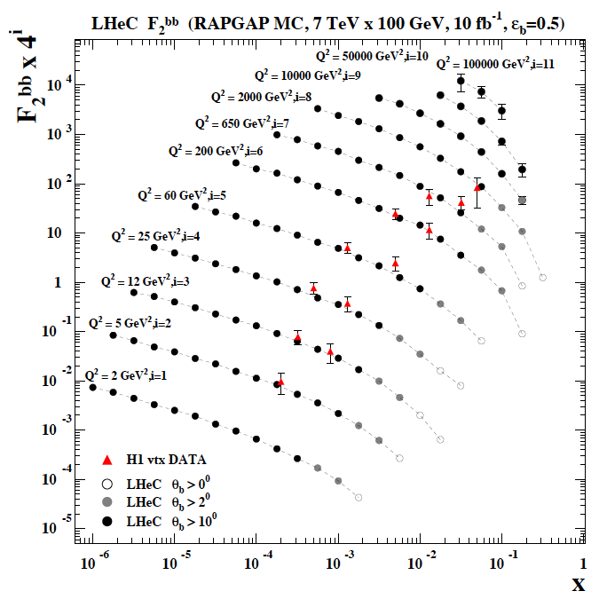
F₂^{charm} and F₂^{beauty} from LHeC
Hugely extended range and much improved precision (δM_{c}=60 HERA → 3 MeV)
will pin down heavy quark behaviour at and far away from thresholds, crucial for precision t,H..
In MSSM, Higgs is produced dominantly via bb → H (Pumplin et al) , but where is the MSSM..

Slide 23
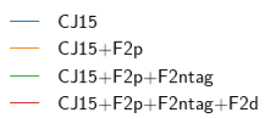
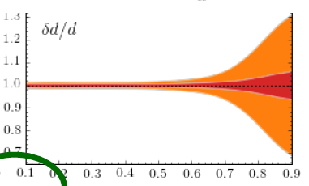
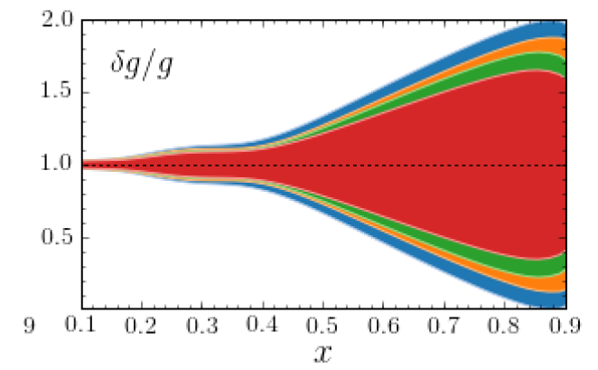
The EIC PDF Programme
Being worked out in detail (AA today) Depends on the energy chosen,
Especially: 100 GeV and 30 GeV are different: CC and low x
Presentations by Elke Aschenauer, see also Jlab High x Workshop 10/16
Alberto Accardi

Slide 24
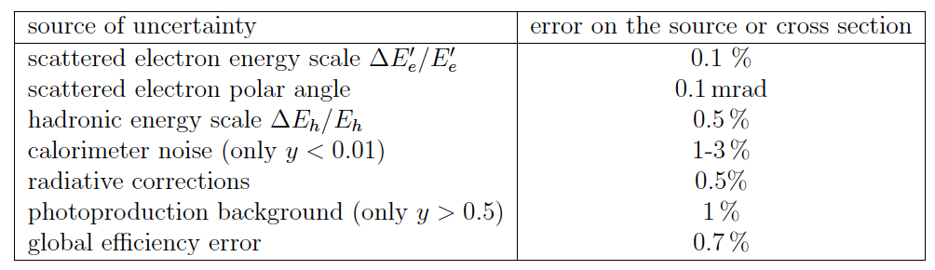
Novel Simulation Study and QCD Evaluation
Perhaps too optimistic (det, 100fb⁻¹) and surely very preliminary (days old) and not thorough (E’s fixed)
- Determination of PDFs using only inclusive NC and CC simulated data
- Numerical treatment of correlated and uncorrelated systematic and statistical errors
[based on PHE-1990-02 (J.Blümlein, M.K.), cross checked with H1 Monte Carlo]
- Here also applied to EIC for 100 GeV CM energy NO W² cut made, no thy uncertainties
[Note: this assumes high EIC detector performance at lower energies, e-h 4π calorimetry..]
- followed by QCD analysis using HERA fit framework, XFITTER, Hessian Errors
used for various sets, assumptions, targets. Here for a first comparison with EIC too
see LHeC CDR and description in: Voica Radescu, MK
Contribution to Snowmass 2013, LHeC-Note-2013-002. PDF set available on LHAPDF

Slide 25
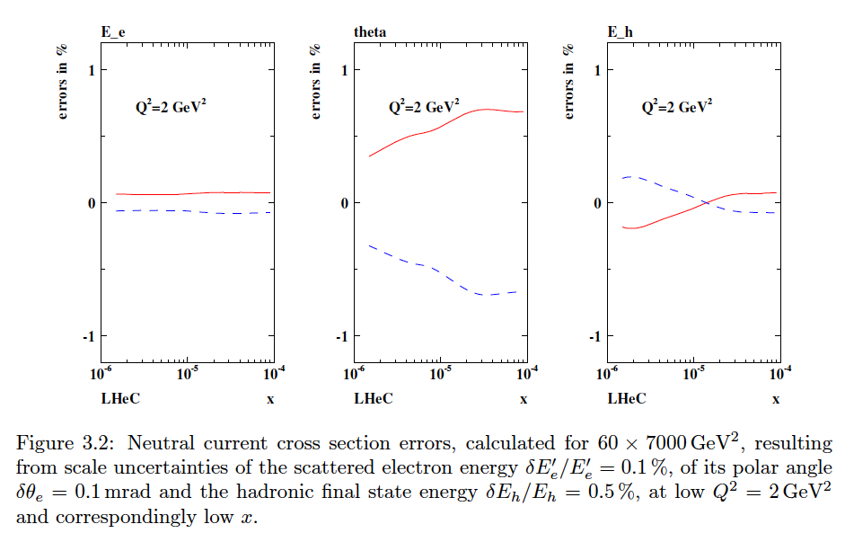
NC Cross Section Correlated Uncertainties (Q²=2 GeV²)
From LHeC CDR

Slide 26
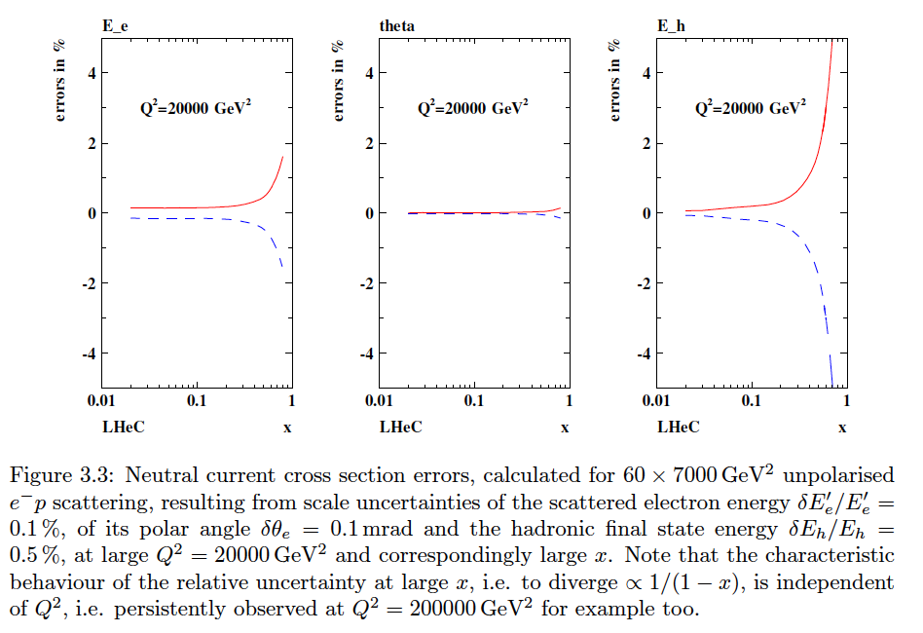
NC Cross Section Correlated Uncertainties (Q²=20000 GeV²)
From LHeC CDR

Slide 27
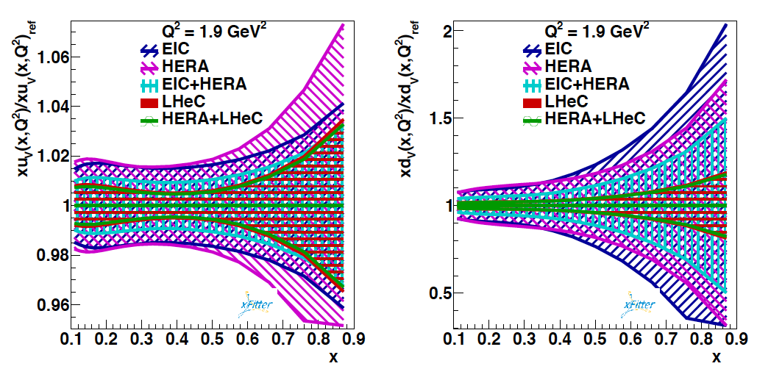
Valence Quarks
Very preliminary
d valence
u valence

Slide 28

Valence quarks
High x crucial for HL LHC searches
Related to DrellYan , W mass etc
d/u → 1 a classic question, still there
up
Need to be very careful
about error estimates
and central values also!
Study only indicative.
down

Slide 29
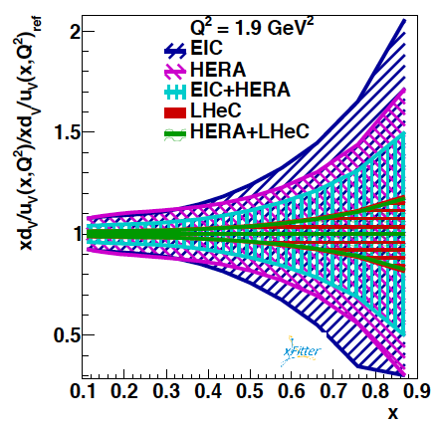
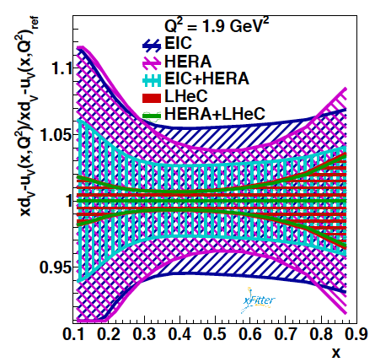
Light Quarks at Large x
Very preliminary
d_{v}/u_{v}
d_{v}-u_{v}

Slide 30
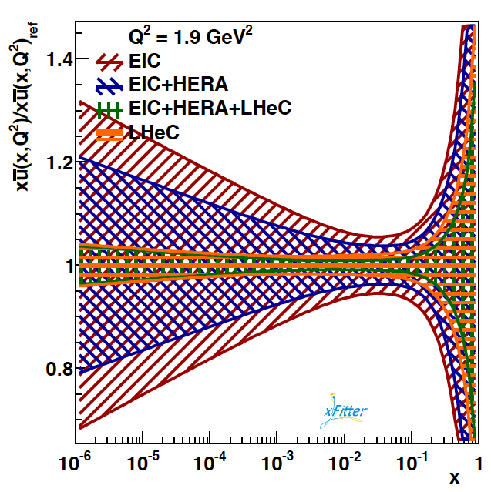
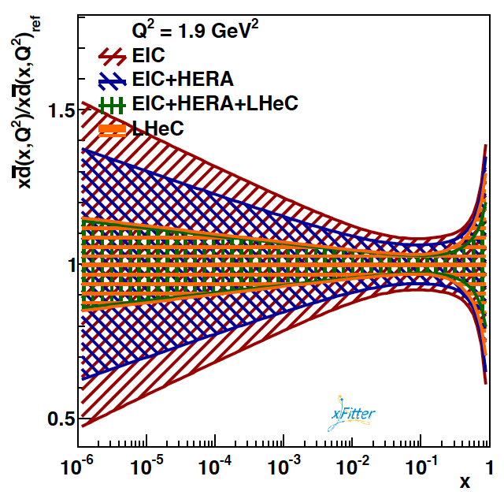
Light Sea at small x
Very preliminary
anti-up
anti-down
Kine coverage NC B-EIC

Slide 31
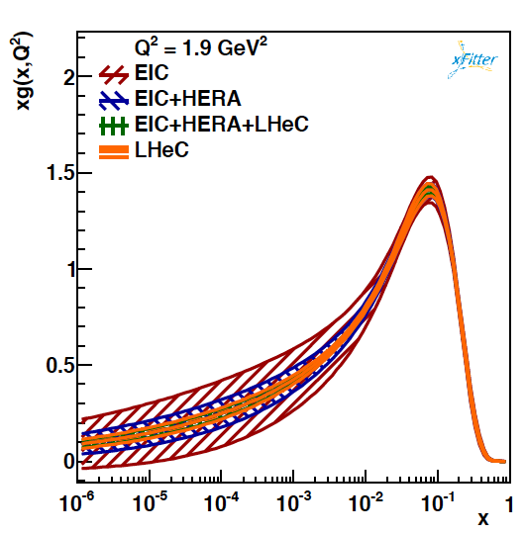
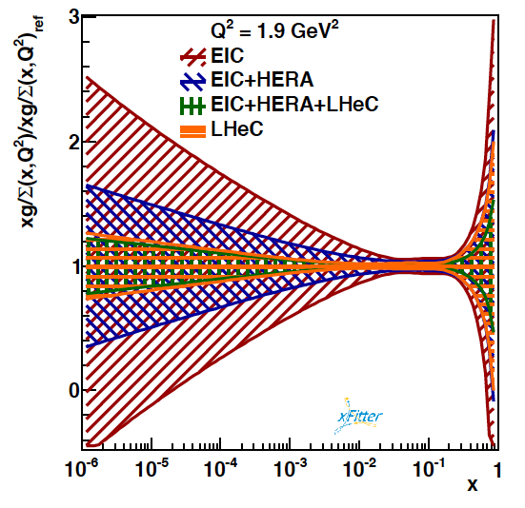
Gluon distribution
Very preliminary
Kine coverage NC B-EIC

Slide 32
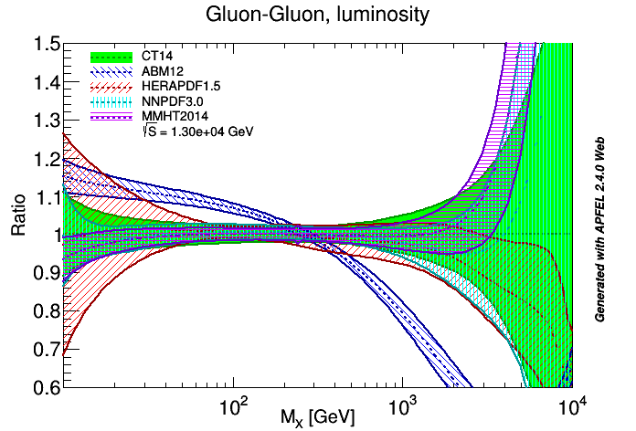
Parton-Parton “Luminosities”
0.00077
0.1
0.77
1
x
Note: ABM and HERA do not use LHC jets – is that relevant?. qq luminosity isn’t solved either

Slide 33
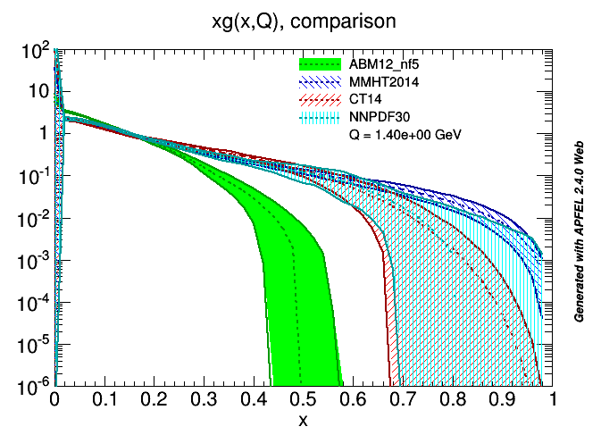
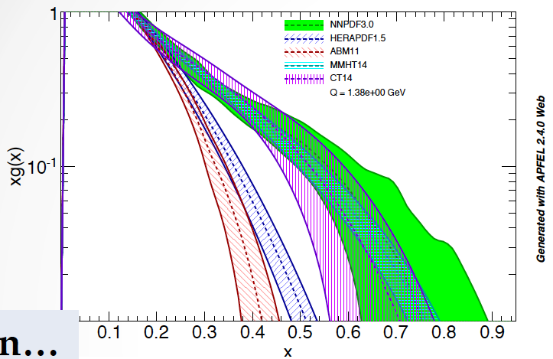
Gluon Distribution at High x
HERA and ABM gluons are much steeper at large x than those of MMHT,CT,NNPDF
Can we trust factorisation, how do we test it. Jets vs inclusive DIS
Gluon at large x becomes very small and is hugely uncertain while M_{X}²=sx₁x₂ ..
The determination of xg at large x is a severe challenge + not just for one channel

Slide 34



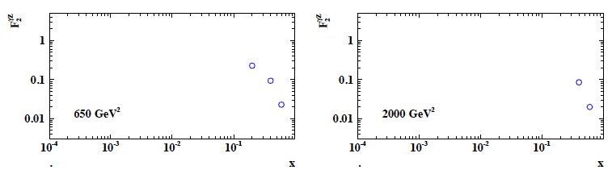
PV Structure Function F₂^{γZ}
e² 2ev
u 4/9 2/9
d 1/9 2/9
EIC 10fb⁻¹ P=+- 0.8 E_{e}=9.4, E_{p}=250 GeV
Z exchange may be seen at large x at the EIC to measure PV effects with polarisation flip

Slide 35
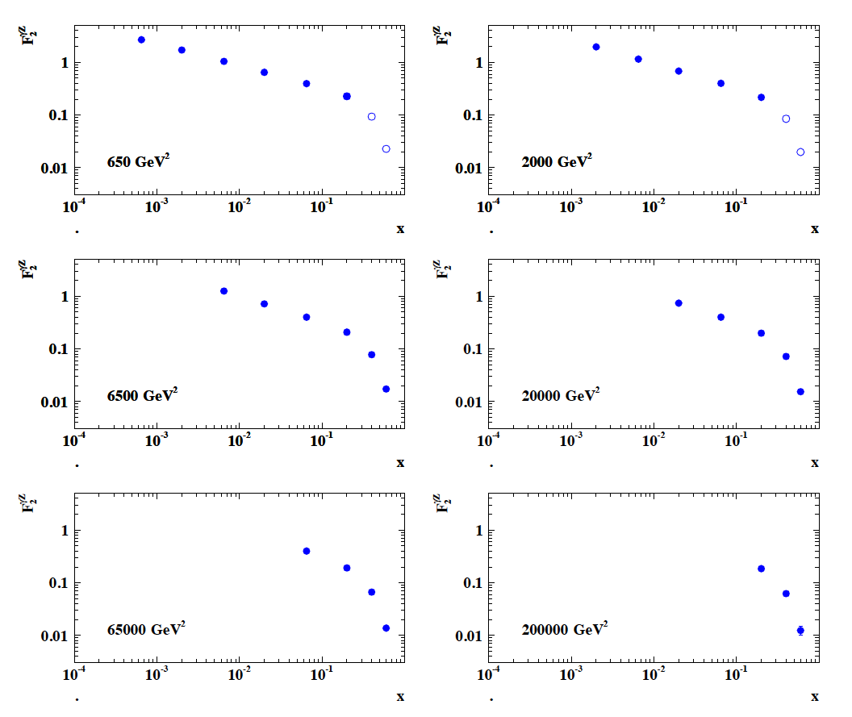
title
F₂^{γZ}
LHeC 10fb⁻¹ P=+- 0.8 E_{e}=60, E_{p}=7000 GeV o EIC 10fb⁻¹ P=+- 0.8 E_{e}=9.4, E_{p}=250 GeV

Slide 36


Remarks on Saturation
cf talk by Anna Stasto
“BFKL evolution and Saturation in DIS”
“Critical gravitational collapse”
Circles in a circle
V. Kandinsky, 1923
Philadelphia Museum of Art
5d tiny black holes and perturbative saturation
Talk by A.S.Vera at LHeC Workshop 2008

Slide 37
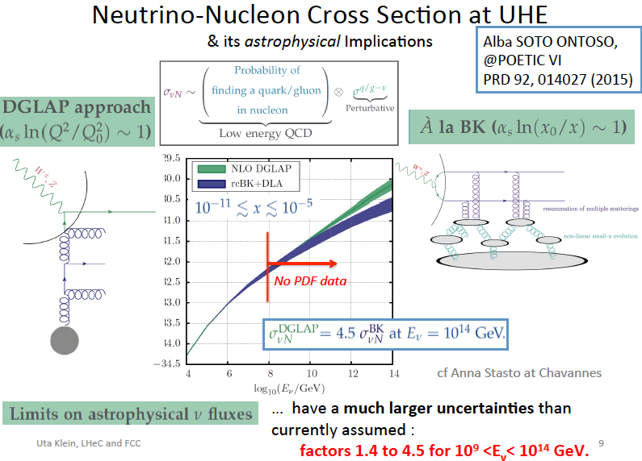
titel

Slide 38
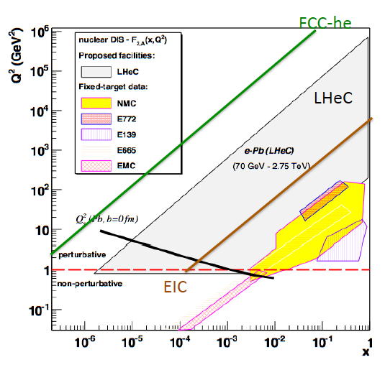
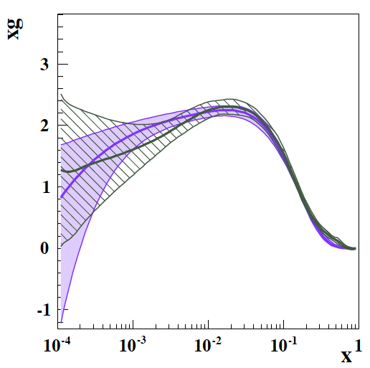
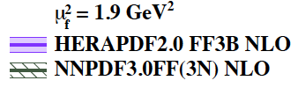
eA Kinematics and xg near the Saturation Line
To see saturation you need xg to be large, the strong coupling small, ep and eA.
To discover subtleties such as log(1/x) terms one needs high precision data of
δF₂/δlnQ² which requires to include data to Q² ~ 10 GeV² [x_{min}=10/s] and of F_{L}.
This has been demonstrated for the LHeC kinematic range in the CDR (cf MCS talk).

Slide 39
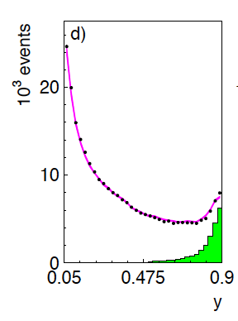
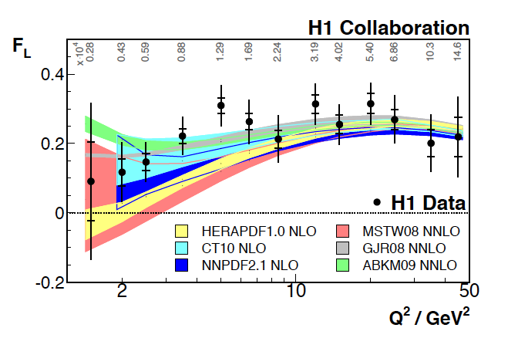

HERA - Lessons on F_{L}
Large backgrounds at high y=1-E’/E_{e}
Subtraction with opposite beam charge data, corrected for background charge asymmetry
→ Need very high luminosity at minimal three energy settings
Need some e⁺ data
Need E_{e} → E’ as large as possible (y=0.9 is E’=1 GeV for 10 GeV electron beam energy)
Need tracker in front of backward calorimeter, charge measurement [H1 BST..]
Need efficient photoproduction tagger

Slide 40

title
LHeC
H1
F_{L} LHeC
+ H1 data
Stat+syst
Errors.
See CDR
E_{e}/L[fb⁻¹] 60/1 30/0.3 20/0.1 10/0.05
Much increased range and precision vs H1. Luminosities chosen for 10³³ design. Lower E_{e}

Slide 41
F_{L} at the EIC in ep
e+p
Complementary F_{L} measurements of EIC and LHeC - will be “side by side”

Slide 42

Future Nuclear PDFs with LHeC
cf talk by Nestor Armesto at this workshop
From an eA collider one can determine nuclear PDFs in a novel, the classic way.
Currently: use some proton PDF base and fit a parameterised shadowing term R.
Then: use the NC and CC eA cross sections directly and get R(x,Q²;p) as p/N PDFs.
Gluon density uncertainty in eA
Charm density in nuclei
preliminary
1fb⁻¹ of sole eA isoscalar data fitted
Impact parameter measurement in eA

Slide 43

F₂^{c,Au}(x,Q²) with the EIC
eRHIC
Design Study
1409.1633

Slide 44
Charm Structure Function in Nuclei
0.0000085
LHeC
1fb⁻¹
ePb
60x2750 GeV²
→ √s=0.8TeV
0.00002
0.00005
0.000085
0.0002
0.0005
0.00085
0.002
0.005
0.0085
0.02
.05
.085
0.2
Also F_{L}c and b
EIC 10fb⁻¹ eAu: 5..20 x 100 GeV² → √s=89 GeV

Slide 45

Nuclear and Non-Linear Effects in F₂^{c,A}
→ LHeC Range (Q² > 2 GeV²)
Error on LHeC data
??
| | | |
10⁻⁶
10⁻⁵
10⁻⁴
The interesting quantity may be F₂^{cA}/F₂^{cp} which
should be measurable at both EIC and LHeC
Fig2.21 in eRHIC
Design Study
1409.1633

Slide 46
Remarks
Electron-hadron colliders, following HERA, are essential for the future of PP and NP.
The LHeC goes beyond HERA in the energy, luminosity and with eA. It accesses scales
sensitive to new and Higgs physics. Its QCD program has an unrivalled scope and range.
The EIC goes beyond HERA in the energy for spin physics, luminosity and with eA.
It chooses a kinematic coverage which is ideal for spin and interesting for QCD.
The EIC’s shall not be judged upon by ‘just’ their PDF abilities, because of BSM + the
unexplored richness of QCD, nucleon structure and dynamics. The US EIC yet needed a
4π detector for NC and CC and desirably ~100 GeV cms energy to be of major PDF use.
Particle and nuclear physics in former times had accelerators with even exactly
the same energy, with SLC and LEP or PETRA,PEP (and TRISTAN) as prominent examples.
In this context, the complementarity of the LHeC and an EIC is striking and we should
wish us mutually good luck. Future high precision PDFs may not fit to pp, was dann?
EIC in the NSAC context and LHeC in the LHC context are most impressive options for
future nuclear and particle physics. Both communities ought to be strong enough to
realize both. In this country the new president elect has a unique chance to build a
universally acceptable, long term legacy which unites people..

