Slide 1
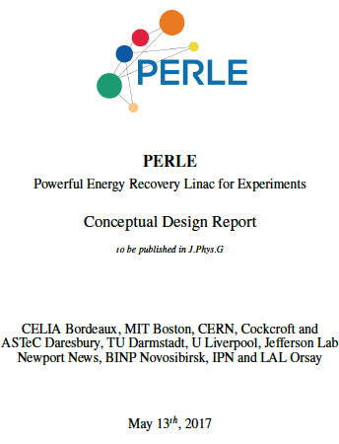


Towards a novel ERL Facility - PERLE at Orsay
Max Klein
for the PERLE Collaboration
Achille Stocchi and Walid Kaabi (Orsay)
based on the CDR [→] and the TDR kickoff
meeting held in February 2017 at Orsay
FCC Week Berlin 1.6.2017
https://indico.lal.in2p3.fr/event/3428/

Slide 2
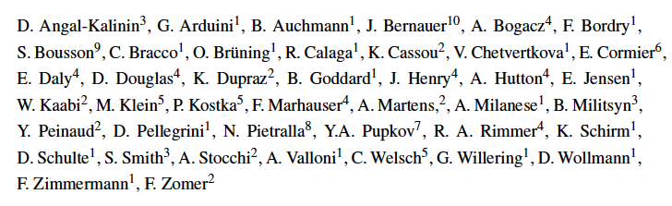
PERLE Intention
Authors of the CDR, but many further
colleagues attended the TDR kickoff
The CDR is an expression of interest in: ERL, low energy electron and photon physics,
technology development (high quality SCRF), development of the LHeC/FCC-eh etc
It is considered to be a technical facility first but has the potential to become a major
user physics and technology development facility then with unique parameters, such
as the orders of magnitude increased photon beam intensity wrt ELI now.

Slide 3
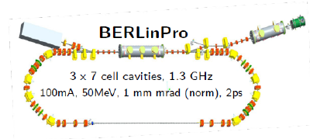
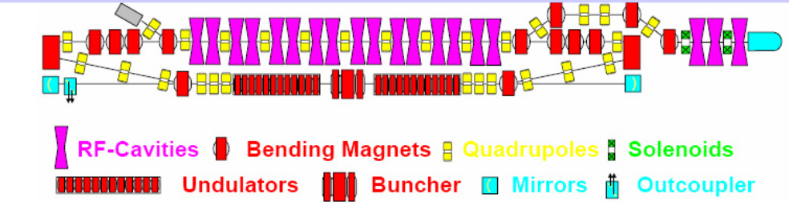
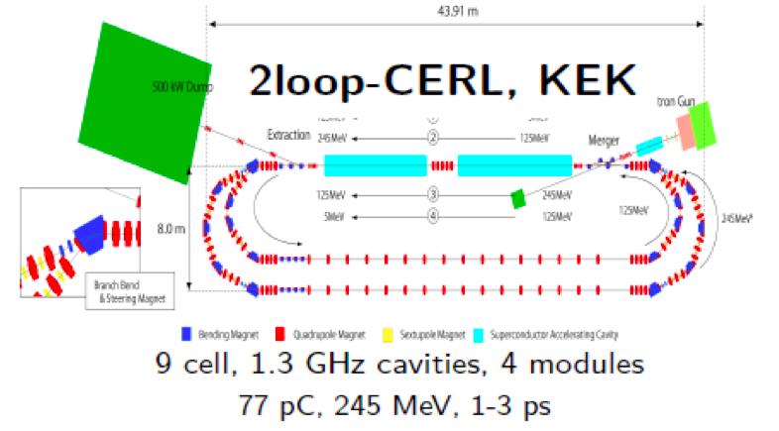
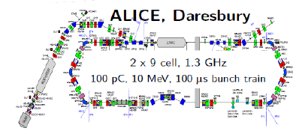
Other Facilities
Normal Conducting 180 MHz + DC Gun
30 mA, 11 MeV, 70-100 ps
BINP, Novosibirsk
+D: MESA at Mainz and S-Dalinac Darmstadt
Also: CEBAF (single pass, 5 GeV, .. CBETA (50mA, 3 pass, FFAG, 1.3GHz)
Strong possibilities for collaboration (ERL workshop 19-23.6.2017 at CERN, E Jensen et al)

Slide 4
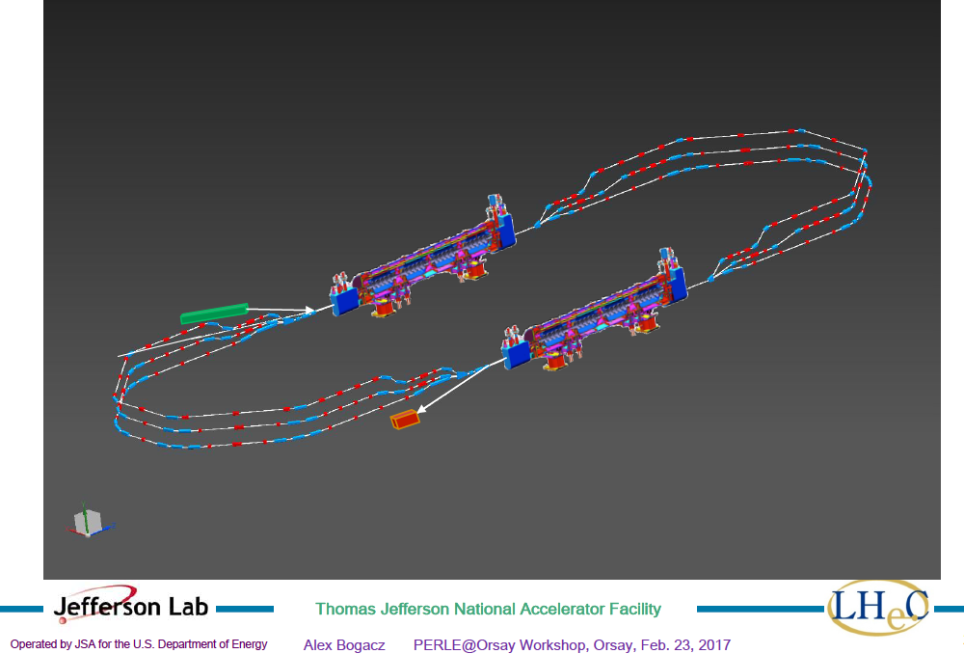
title
Powerful ERL for Experiments (ep,γp): PERLE at Orsay
PERLE at Orsay (LAL/INP) Collaboration: BINP, CERN, Daresbury/Liverpool, Jlab, Orsay +
3 turns, 2 Linacs, 400 MeV, 15mA, 802 MHz, Energy Recovery Linac facility
-Demonstrator of ERL for ep at LHC/FCC
-SCRF Beam based development facility
-Low E electron and photon beam physics
-High intensity: O(100) x ELI
5.5 x 24m²
CDR to appear in J Phys G [arXiv:1705. 08783]
See also https://indico.lal.in2p3.fr/event/3428/
A.Bogacz

Slide 5
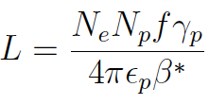
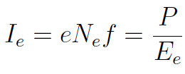
Energy Recovery – Green Accelerators
M Tigner Nuovo Cimento 1.6.1965
High luminosity needs
nearly GW of power P,
for 60 GeV energy E
This can only be achieved
with efficient energy
recovery technique
P = P₀ /(1-ε) ERL efficiency
CDR of LHeC: Goal now is 10³⁴ could NOT
pay for power and not realise high lumi w/o ERL

Slide 6
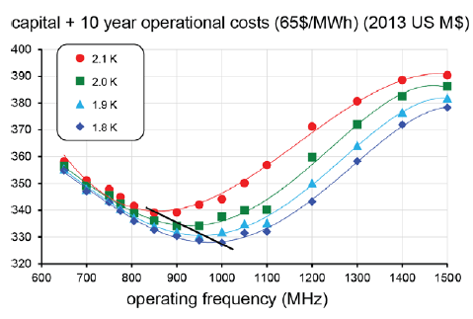
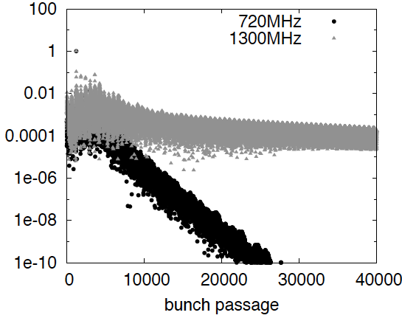
Frequency Choice
Cost, dynamic heat losses, resistance, Q₀… point to f < 1 GHz (F Marhauser, Orsay 2/17)
Beam beam interactions unstable for f > 1 GHz (D Schule, D Pellegrini March 2013)
Compatibility with LHC: Decision for 802 MHz ( E Jensen CI Workshop 1/2015, FM input)

Slide 7
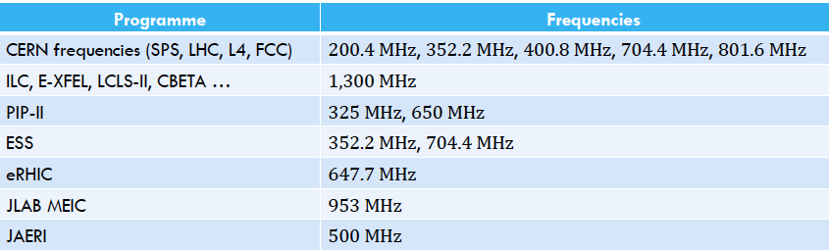
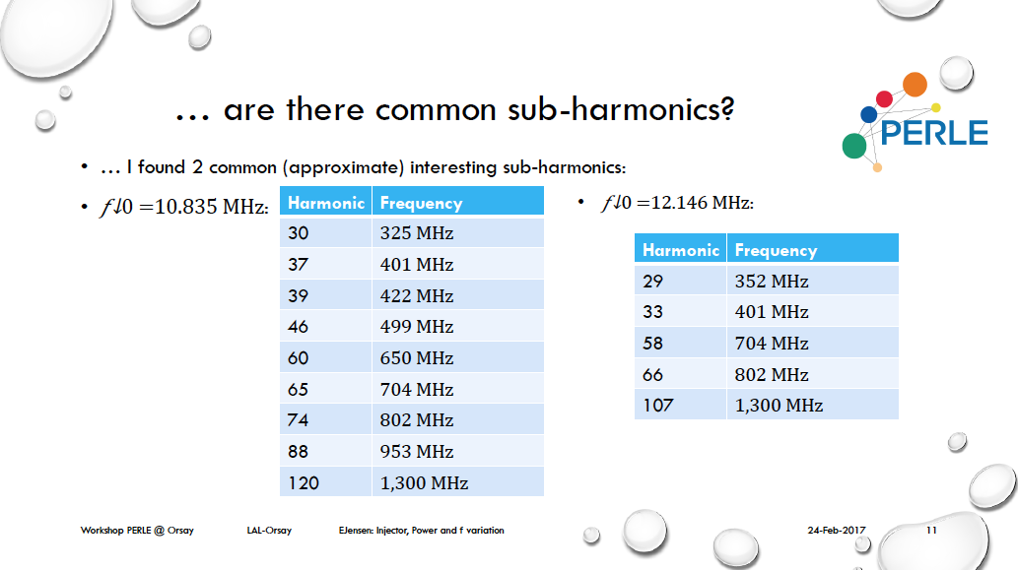
title
E Jensen: use flexibility of laser driven photocathode → sub-harmonics: test of various cavities
Many other technical applications: beam tests of quench behaviour (CDR), detector test …

Slide 8
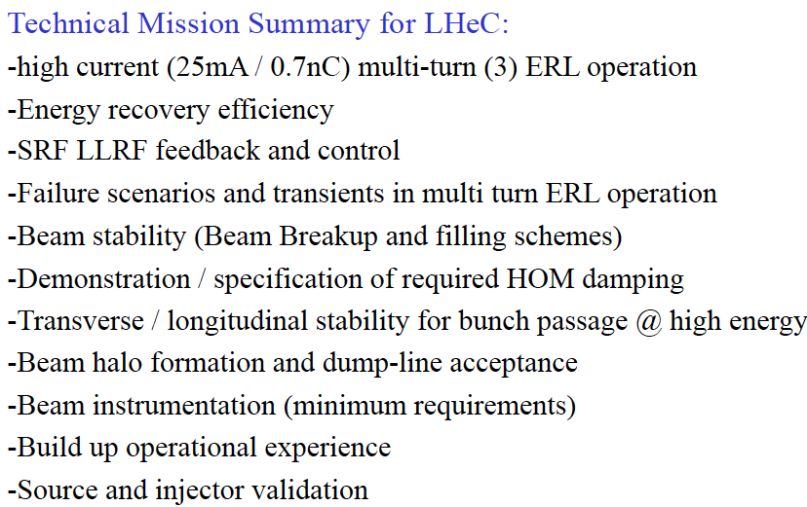
O Bruening at PERLE TDR Kickofff meeting at Orsay 2/17: Much more than a demonstration

Slide 9



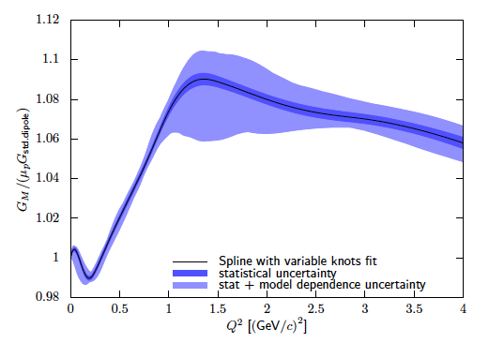
ep Physics with PERLE – proton radius
elastic ep → ep
CDR
p radius from Q² dependence of G, Q²=0
thin target (gas jet), high current
angular scan with different E_{e} < 400MeV
electric and magnetic radius
h.o. QED corrections
Jan Bernauer

Slide 10
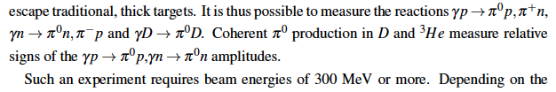
Further ep Physics with PERLE
sin²Θ_{W}
Measurement of electroweak asymmetries (charge and polarisation)
Weak neutral current quark couplings [cf MK, T Riemann PL85B(79)385]
Confinement scale QCD
Dark photons
cf CDR
Higher luminosity than DarkLight (Jlab)
Electron-proton physics: high current, polarisation, positrons, energy > 300 MeV

Slide 11
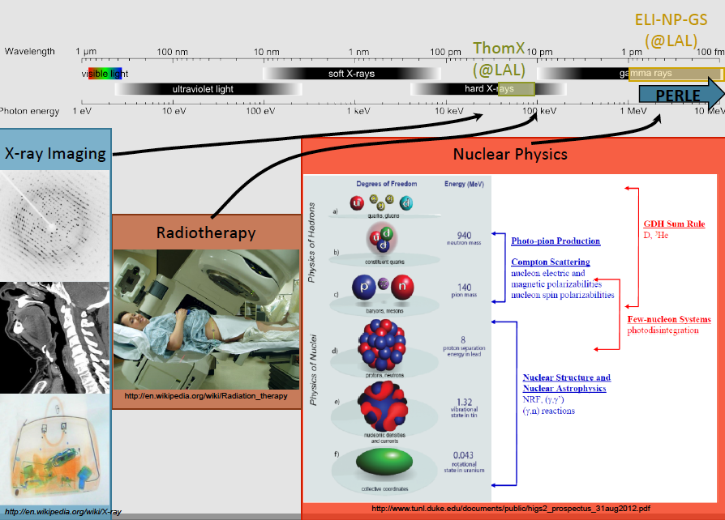
PERLE Photon Physics (Compton Backscattering)
CDR: Photonuclear reactions, Nuclear Structure, Neutrino Physics, Nuclear Astrophysics
→ High energy, high intensity (100-1000 x ELI) – next generation photon physics facility
N Pietralla (TU Darmstadt)
K Dupraz (LAL)

Slide 12
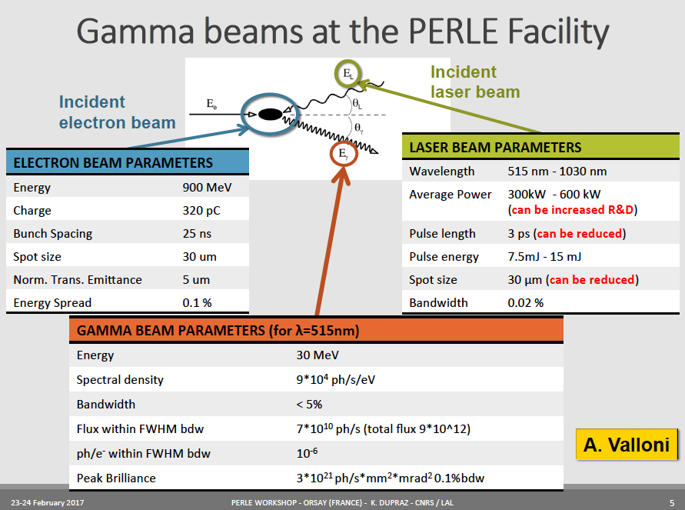
title
Work in progress as electron energy will be 400 MeV and parameters evolve

Slide 13
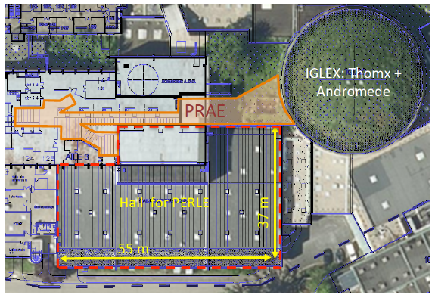
title

Slide 14
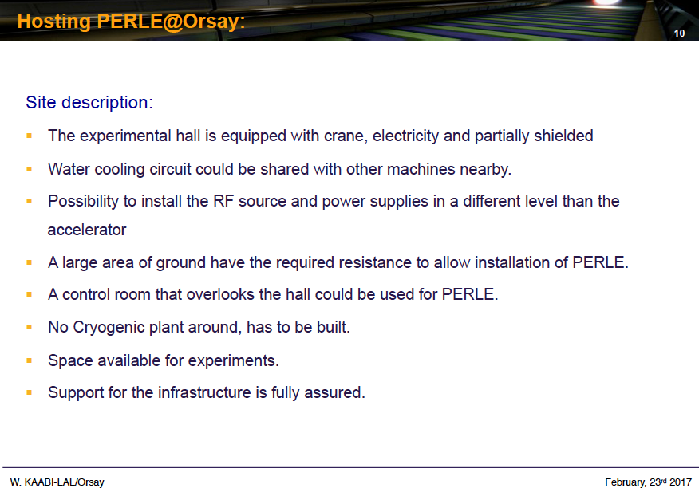
title

Slide 15
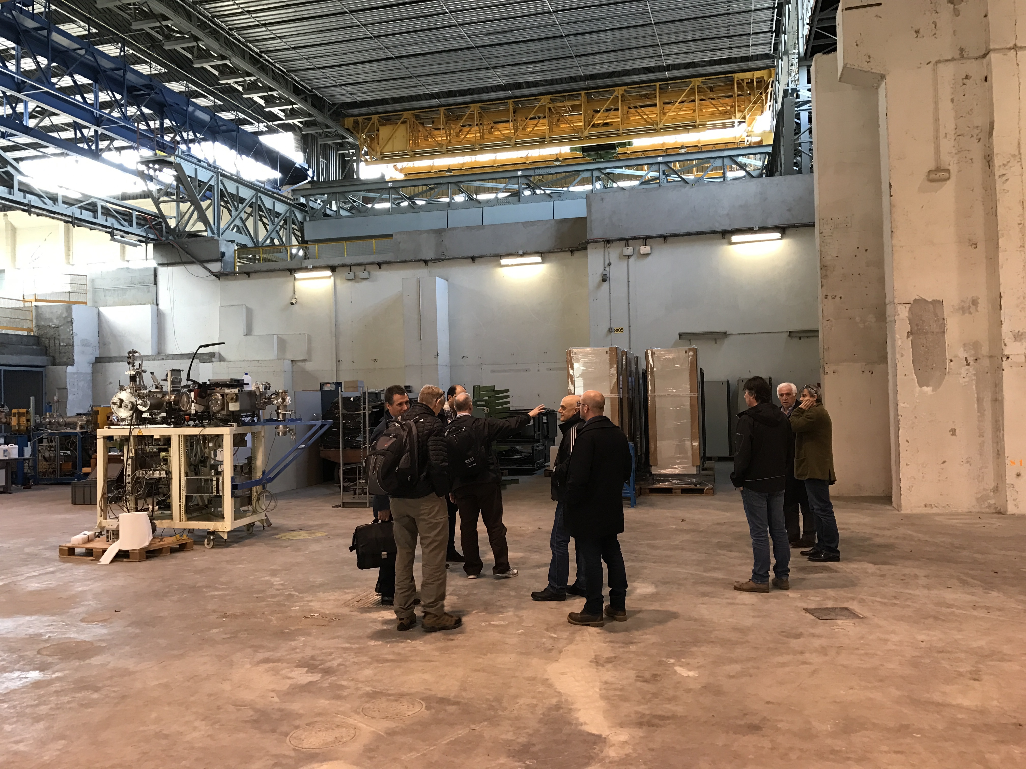
title

Slide 16
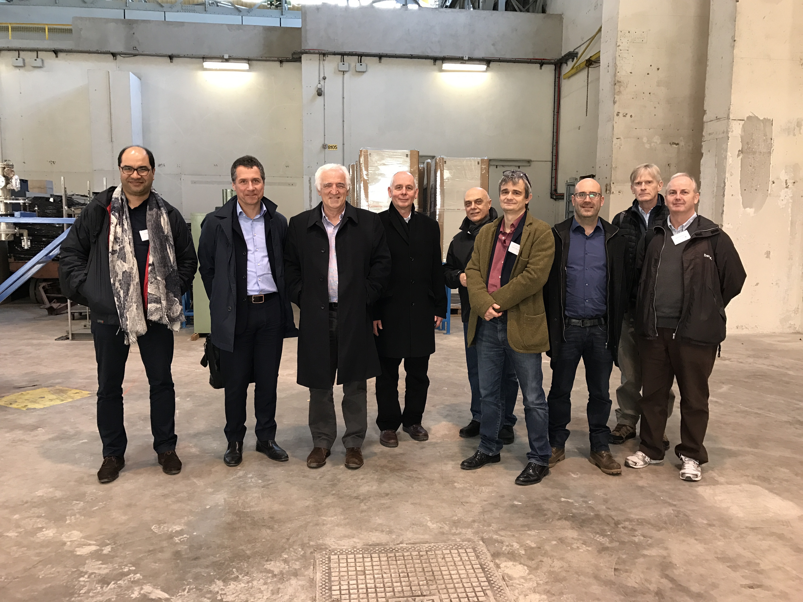
title

Slide 17
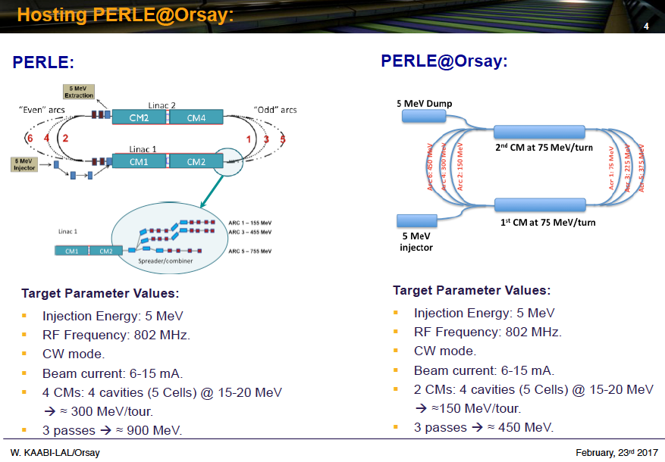
title

Slide 18
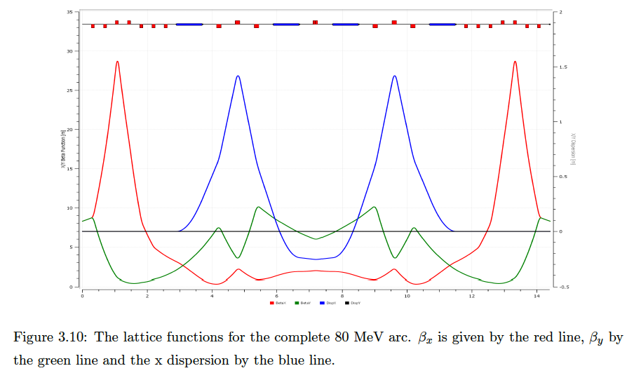
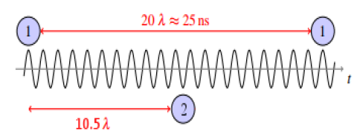
Study of First Stage (single pass)
Independent design study: 6.2 x 20.9 m²
Matched optics, momentum compaction
46 dipoles and quadrupoles
Linear Optics Study of PERLE, Ben Hounsell (Master Thesis 5/17) U Liverpool (MK and AB/AV)

Slide 19
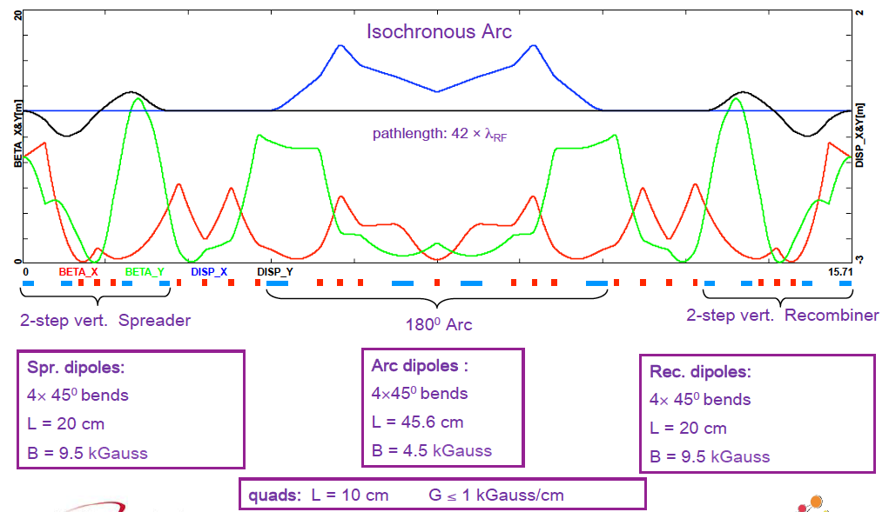
PERLE 3 turn optics (80 MeV Arc)
A Bogacz (24.5.17)
70 Dipoles and 114 Quadrupoles footprint 22 x 5.5 m2

Slide 20
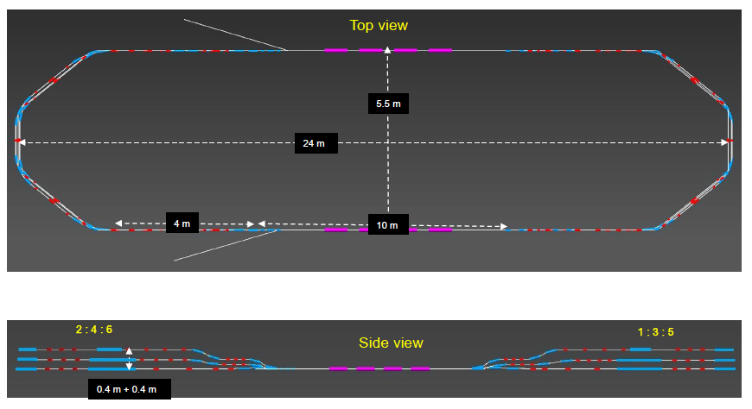
Footprint of PERLE@Orsay (tentative)
A. Bogacz (24.5.17)
5 x 2 cavities: 16.5 MeV/cavity (17.5/m) → 165 MeV per pass → 395 + 5 → E_{e}=400 MeV

Slide 21
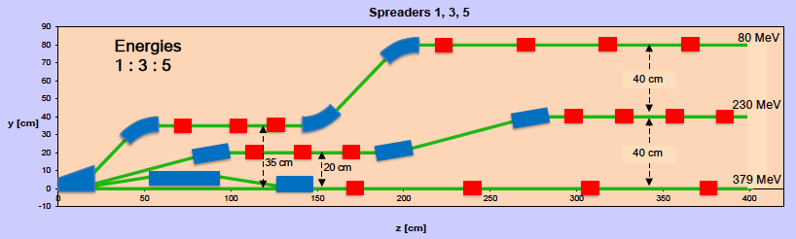
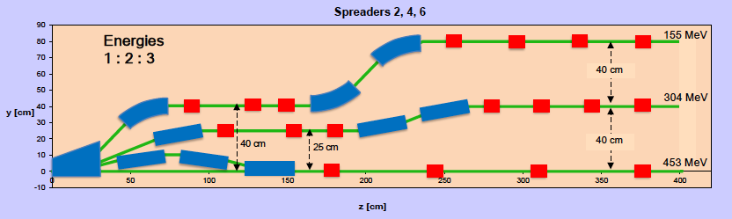
Vertical Switchyards
A Bogacz (24.5.17)

Slide 22
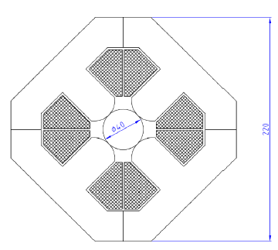
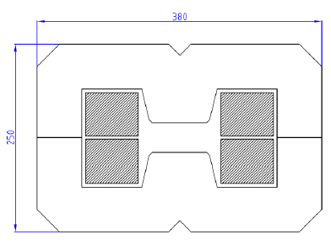
PERLE Magnets
70 dipoles 0.45-1.29 T
+- 20 mm aperture, l=200,300,400 mm
May be identical for hor+vert bend
7A/mm2 (in grey area) water cooled
DC operated
220 mm
380 mm
114 quadrupoles max 28T/m
Common aperture of 40mm all arcs
Two lengths: 100 and 150mm
DC operated
250 mm
P Thonet, A Milanese (CERN), C Vallerand (LAL), Y Pupkov (BINP)

Slide 23
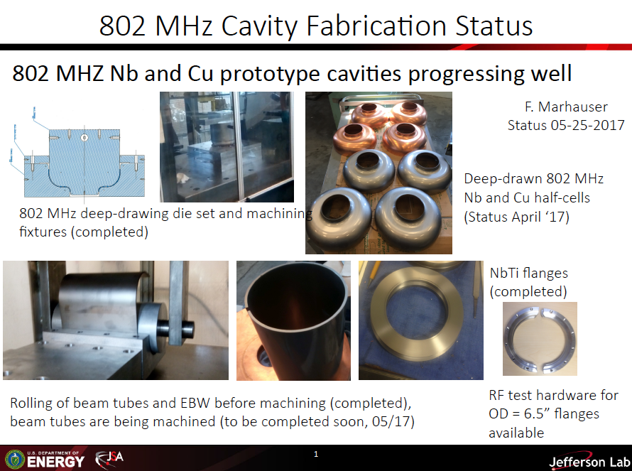
title

Slide 24
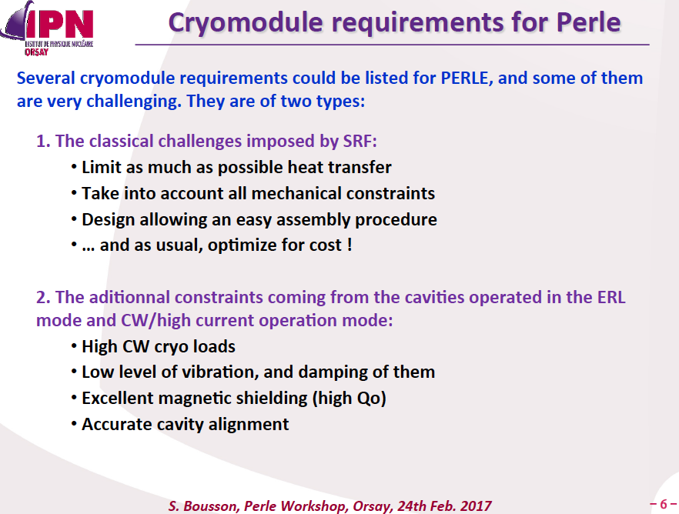
title

Slide 25
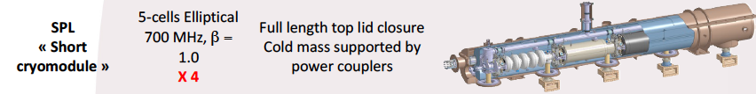
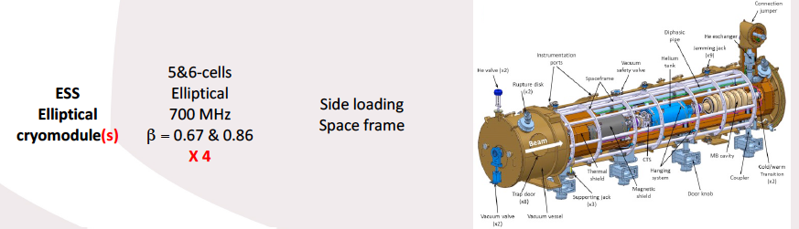

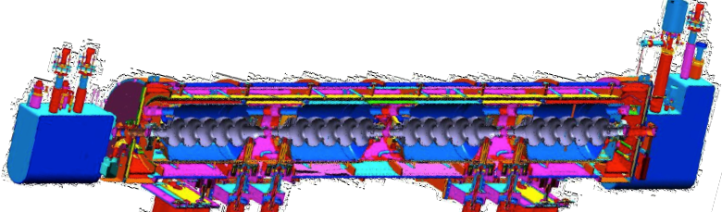

Expertise on Cryomodules
Plan for production of PERLE cryomodules (2) by IPN Orsay in collaboration with Jlab+CERN
Jlab
SNS 805 MHz cryomodule

Slide 26
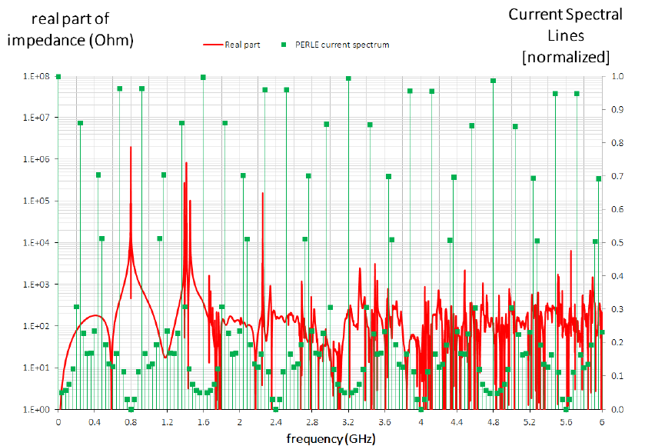
HOM Assessment
Impedance of cavities + oscillating modes (F Marhauser) ≠ Spectral content of PERLE beam (D Pellegrini)

Slide 27
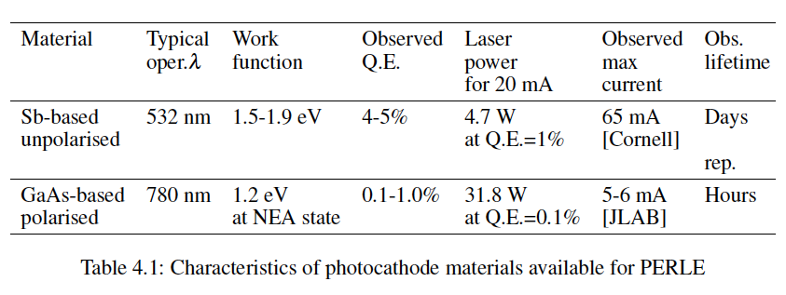
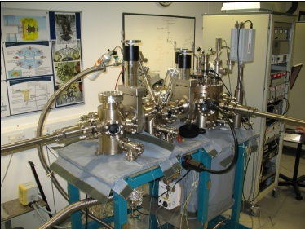

Source
← Boris Militsyn’s home

Slide 28
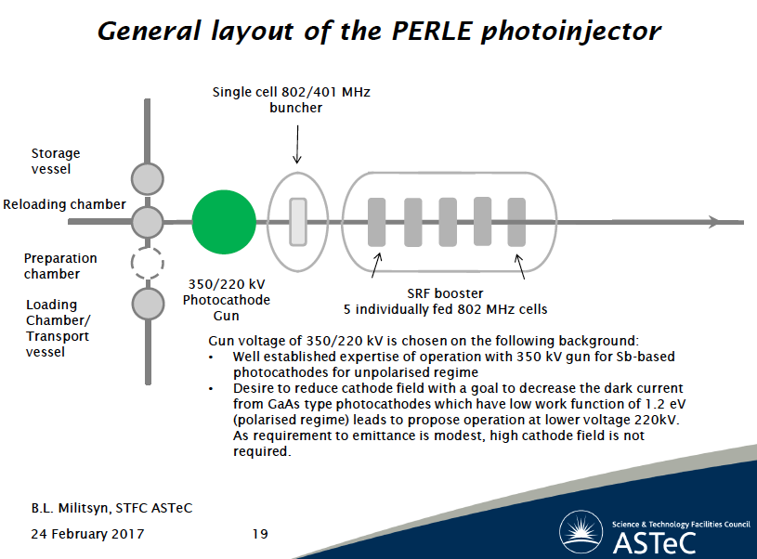
Source

Slide 29

Summary
CDR of PERLE
PERLE is a novel project and still to be established. It calls for and is open for
a wide collaboration to make it a success for accelerator, particle and nuclear physics.
For the FCC developments at large it has a strong value as a test bed for SCRF development.
Special thanks to Erk Jensen, Achille Stocchi and many more people than I can list here.

Slide 30
No backup

