Slide 1




The Large Hadron Electron Collider Project
Conceptual Design and Project Status
Deep Inelastic Scattering?
Partons (ep,en,eA)
Higgs “Factory”
Next Steps
Max Klein
Seminar at Glasgow, Scotland, June 13th, 2013
http://cern.ch/lhec

Slide 2
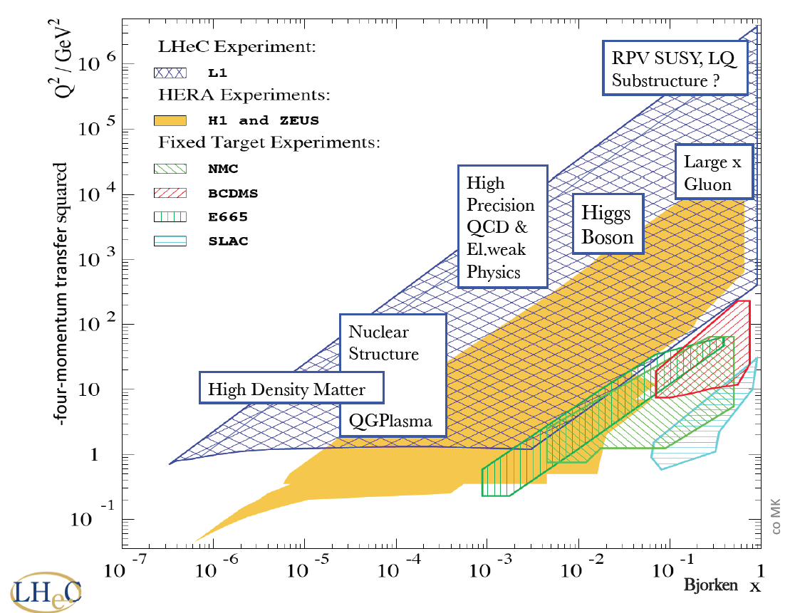
New dreieck

Slide 3
-Conceptual Design Report-
LHeC Collaboration
Default Linac-Ring Design
Physics
Detector
Time Schedule
CDR
CERN Mandate
ECFA Statement

Slide 4
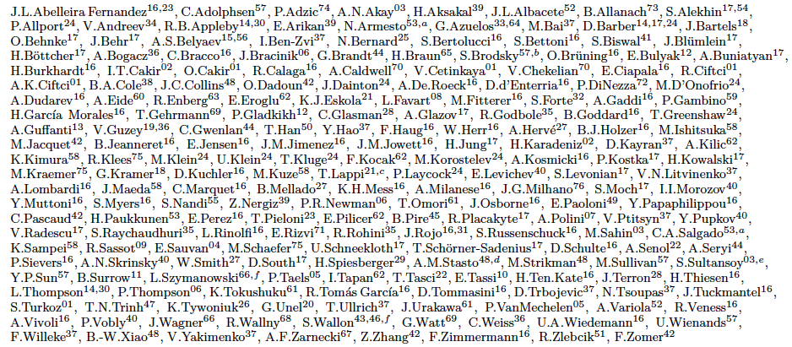
http://cern.ch/lhec
LHeC Study group and CDR authors (Dec.2012)
About 200 Experimentalists and Theorists from 76 (+3) Institutes

Slide 5
60 GeV electron beam energy, L= 10³³ cm⁻²s⁻¹, √s=1.3 TeV: Q²_{max}= 10⁶ GeV², 10⁻⁶ < x< 1
Recirculating linac (2 * 1km, 2*60 cavity cryo modules, 3 passes, energy recovery)
Ring-ring as fall back. “SAPHIRE” 4 pass 80 GeV option to do mainly: γγ→ H

Slide 6





















Accelerator Design: Participating Institutes
TOBB ETU
Source | Power [MW]
Cryogenics (linac) | 21
Linac grid power | 24
SR compensation | 23
Extra RF cryopower | 2
Injector | 6
Arc magnets | 3
Total | 78
KEK

Slide 7
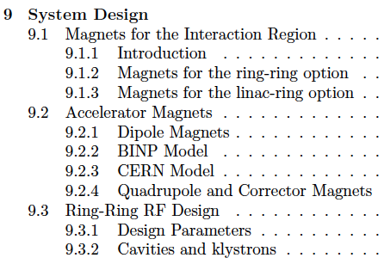
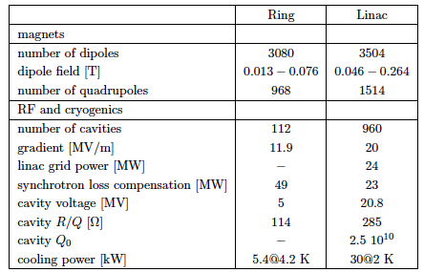
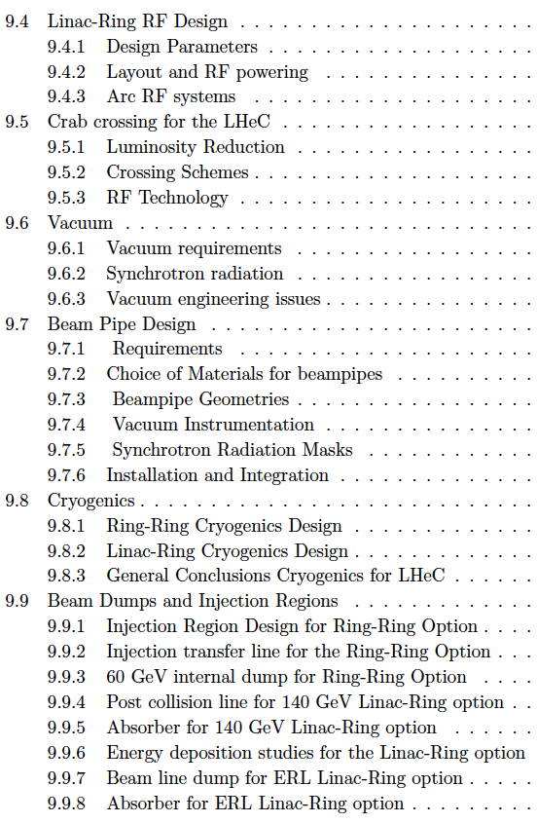
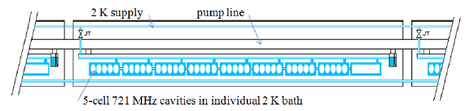

Chapter 9 of CDR
Components and Cryogenics
Jlab:
4 10¹¹
Need to develop LHeC cavity (cryo-module)
from CDR LHeC

Slide 8
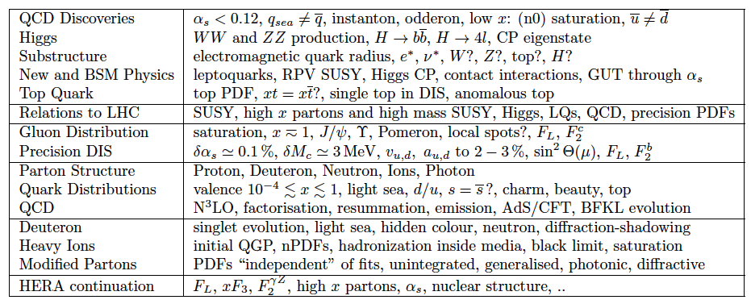
LHeC Physics Programme
CDR, arXiv:1211.4831 and 5102
http://cern.ch/lhec
Ultra high precision (detector, e-h redundancy) - new insight
Maximum luminosity and much extended range - rare, new effects
Deep relation to (HL-) LHC (precision+range) - complementarity
Summarised for the European Strategy Debate (summary 1211.4831 and link to LHC .5102)

Slide 9
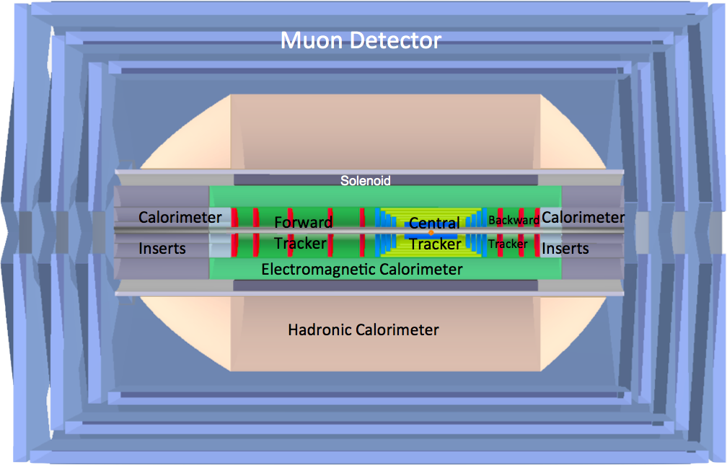
LHeC Detector Overview
LAr electromagnetic calorimeter
Tile Calorimeter
Detector option 1 for LR and full acceptance coverage
Forward/backward asymmetry in energy deposited and thus in geometry and technology
Present dimensions: LxD =14x9m² [CMS 21 x 15m² , ATLAS 45 x 25 m²]
Taggers at -62m (e),100m (γ,LR), -22.4m (γ,RR), +100m (n), +420m (p)

Slide 10
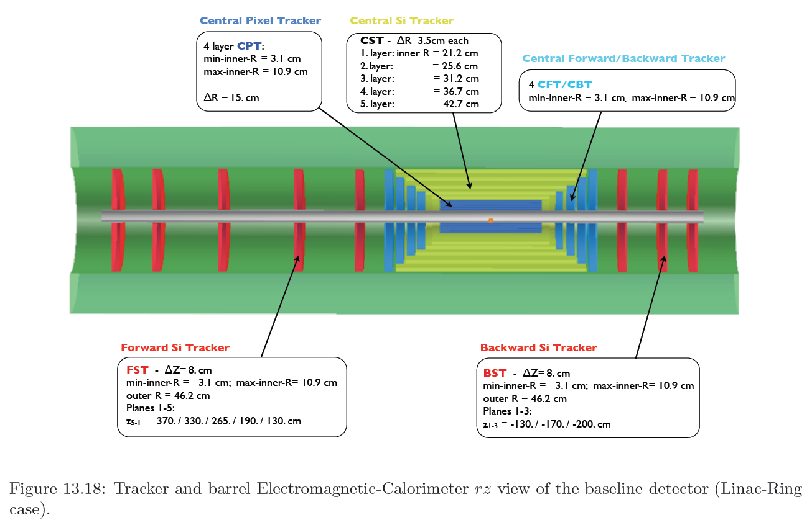

Silicon Tracker and EM Calorimeter
Transverse momentum
Δp_{t}/p²_{t} → 6 10⁻⁴ GeV⁻¹
transverse
impact parameter
→ 10μm
LHeC-LHC: no pile-up, less radiation, smaller momenta apart from forward region

Slide 11
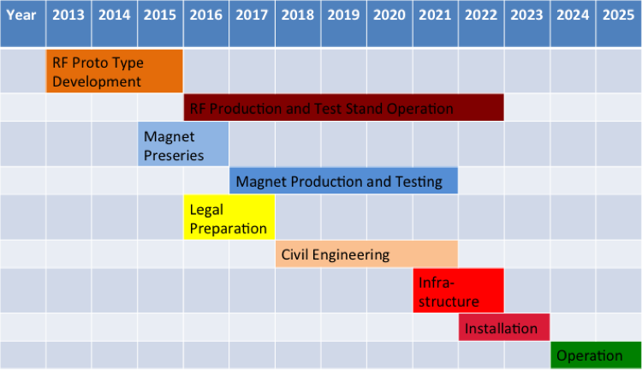
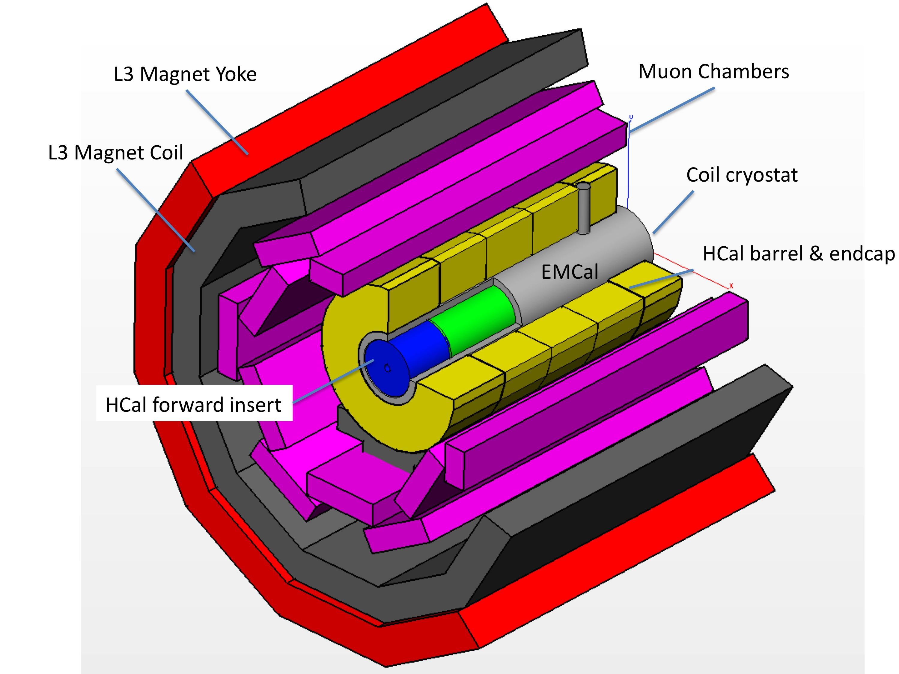
Time Schedule*⁾
Detector installation
study for IP2, reuse
of L3 magnet as
support for LHeC.
Estimated 30 months
LHeC is to operate synchronous with HL-LHC
LS3 requires 2-3 years for ATLAS+. It is the
one extended time period, which will allow
installation and connection of LHeC
*) LS3 → schedule most likely shifted by +2 years

Slide 12
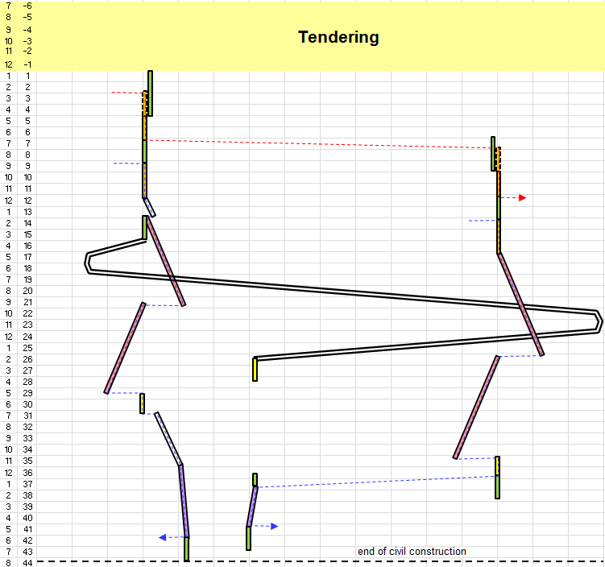
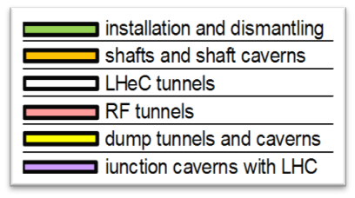
Civil Engineering
Shaft sinking installation
Roadheader 1
CDR: Evaluation of CE, analysis
of ring and linac by Amber Zurich
with detailed cost estimate
[linac CE: 249,928 kSF..] and time:
3.5 years for underground works using 2 roadheaders and 1 TBM
More studies needed for
Integration with all services
(EL,CV, transport, survey etc).
Geology
Understanding vibration risks
Environmental impact assessment
Tunnel connection in IP2
Roadheader 2
J.Osborne, Chavannes

Slide 13
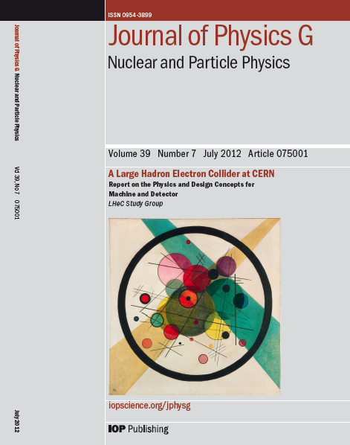
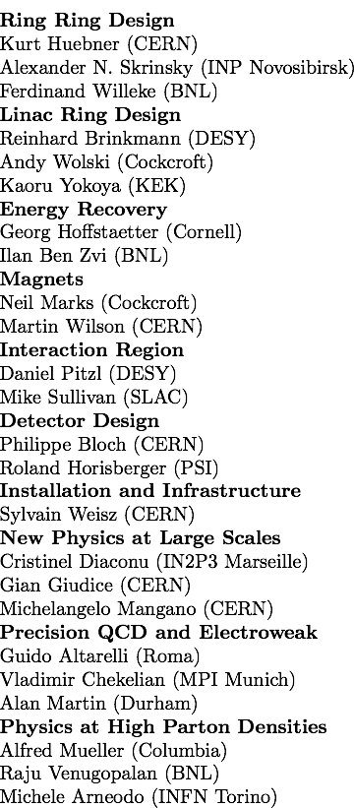
CERN Referees
arXiv:1206.2913
arXiv:1211.4831 and 5102
Published 600 pages conceptual design report (CDR) written by 150 authors from 60 Institutes.
Reviewed by ECFA, NuPECC (long range plan), Referees invited by CERN. Published June 2012.

Slide 14


“BFKL evolution and Saturation in DIS”
“Critical gravitational collapse”
Circles in a circle
V. Kandinsky, 1923
Philadelphia Museum of Art
5d tiny black holes and perturbative saturation
Talk by A.S.Vera at LHeC Workshop 2008

Slide 15
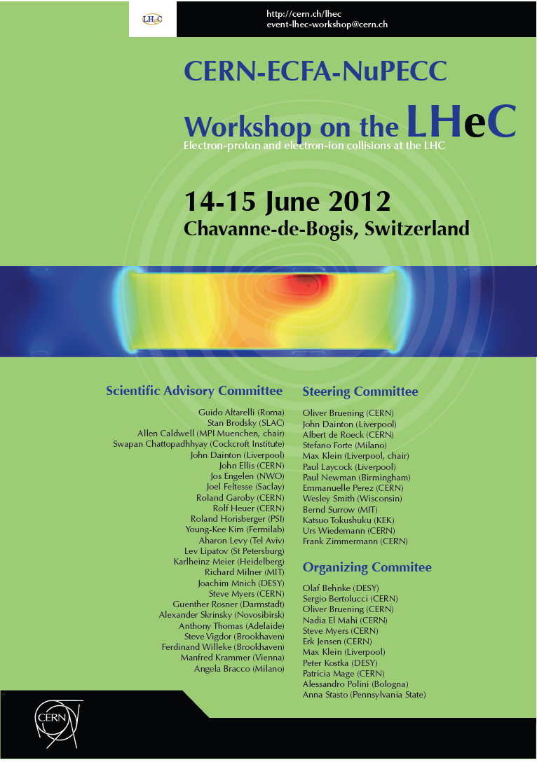
Four main results of a sunny workshop:
Higgs close to be discovered
[WW→ H re-emphasised
and LHeC physics reviewed]
Decision for Linac-Ring
[Ring-Ring as backup, doable
but challenging installation]
Confirmation of Detector Concept
[detailed reviews of tracking,
magnets, IR and calorimetry]
Mandate of CERN to proceed
[preparations of key technologies
for project decision in ~2017]

Slide 16
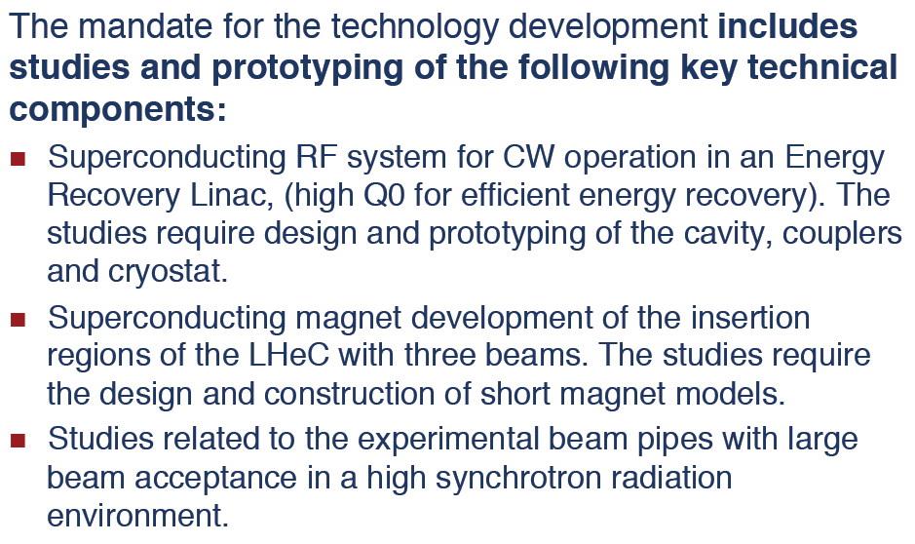
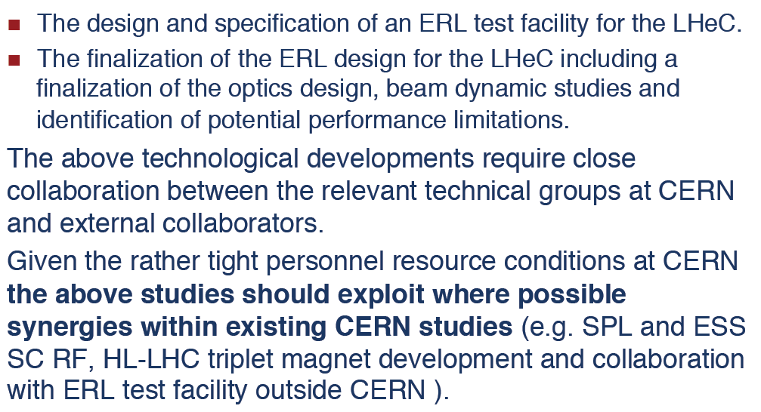
CERN Mandate – TDR by ~2015
S.Bertolucci at Chavannes workshop 6/12 based on
CERN directorate’s decision to include LHeC in the MTP

Slide 17
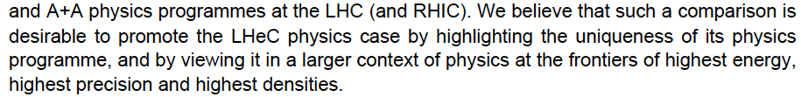
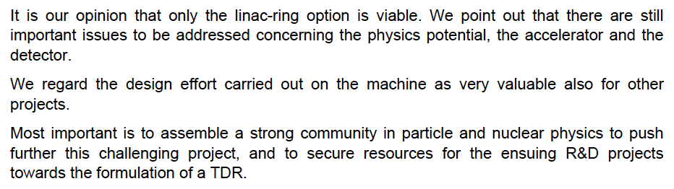
ECFA Review 2007-2012
CERN SPC, [r]ECFA Mandate given in 2007 to work out the LHeC
physics, detector and accelerator design(s) – looking back to 1994
CDR and referee process carefully evaluated by ECFA committee
…
Stressed: Link to LHC physics and operation, link to HEP, cost estimates, R&D, DIS community
ECFA Statement ECFA/12/279 December 2012

Slide 18
-the value of DIS and the LHeC-
DIS discoveries
HERA
Beyond HERA
LHeC discovery potential
High Q² and huge luminosity
Higgs discovered
HL LHC requirements
ep - pp - ee

Slide 19
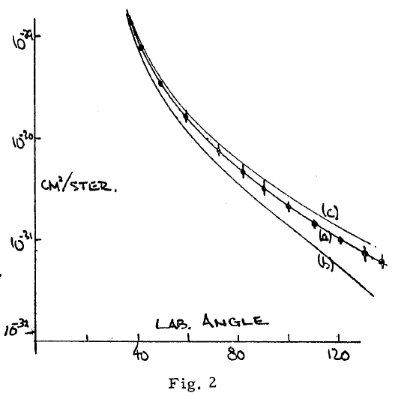
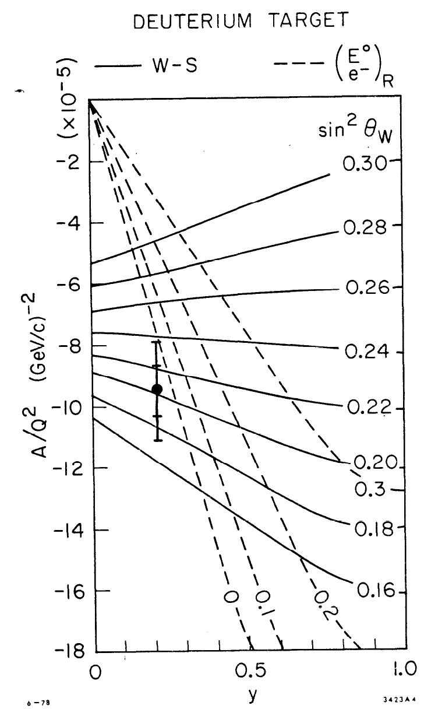
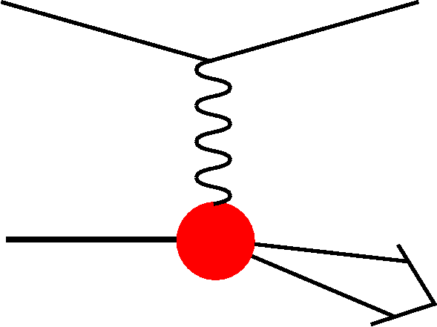
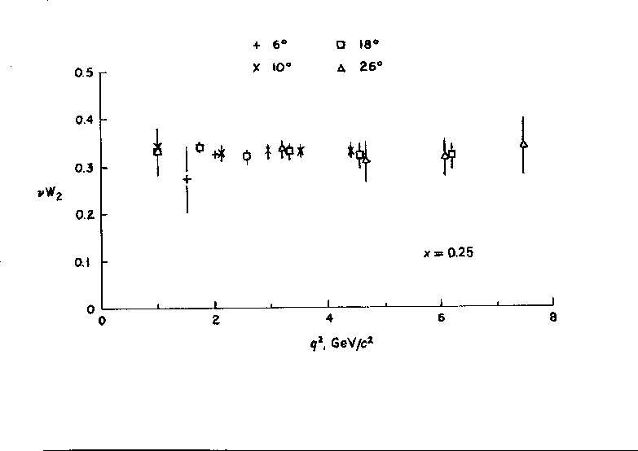


Early ep Scattering
Hofstadter et al, 1955, r_{p}=0.74±0.20fm
In DIS the
x and Q²
scales are
prescribed
by the
electron
kinematics
SLAC-MIT 1968 Bj Scaling → Partons
Prescott et al, 1978, I_{3,R}^{e}=0

Slide 20
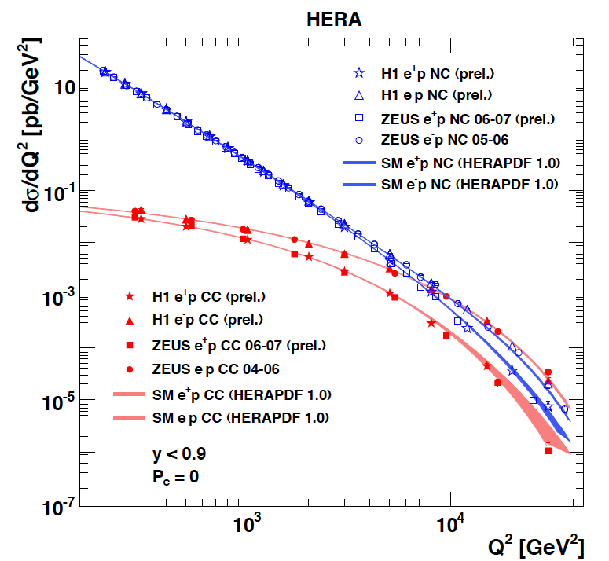
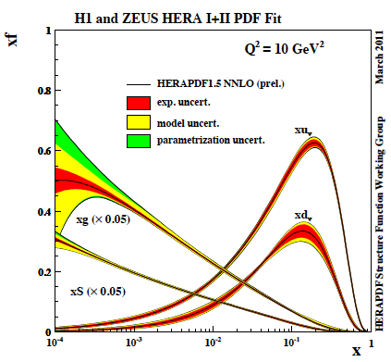
Results from HERA
The weak and electromagnetic interactions reach similar strength when Q² ≥ M²_{W,Z}
F₂ rises towards low x, and xg too.
Parton evolution - QCD to NNLO
Measurements on α_{s}, Basic tests of QCD: longitudinal structure function, jet production, γ structure
Some 10% of the cross section is diffractive (ep → eXp) : diffractive partons; c,b quark distributions
New concepts: unintegrated parton distributions (k_{T}) , generalised parton distributions (DVCS)
New limits for leptoquarks, excited electrons and neutrinos, quark substructure, RPV SUSY
Interpretation of the Tevatron measurements (high Et jet excess, M_{W}, searches..), + base for PDF fits..
M.Klein, R.Yoshida: Collider Physics at HERA Prog.Part.Nucl.Phys. 61 (2008) 343-393 and recent H1,ZEUS results
A Recent review of The Theory of Deep Inelastic Scattering: J.Bluemlein arXiv:1208.6087 ProgPartNuclPhys 69(2013)28

Slide 21
What HERA could not do or has not done
Test of the isospin symmetry (u-d) with eD - no deuterons
Investigation of the q-g dynamics in nuclei - no time for eA
Verification of saturation prediction at low x – too low s
Measurement of the strange quark distribution – too low L
Discovery of Higgs in WW fusion in CC – too low cross section
Study of top quark distribution in the proton – too low s
Precise measurement of F_{L} – too short running time left
Resolving d/u question at large Bjorken x – too low L
Determination of gluon distribution at hi/lo x – too small range
High precision measurement of α_{s} – overall not precise enough
Discovering instantons, odderons – don’t know why not
Finding RPV SUSY and/or leptoquarks – may reside higher up
…

Slide 22
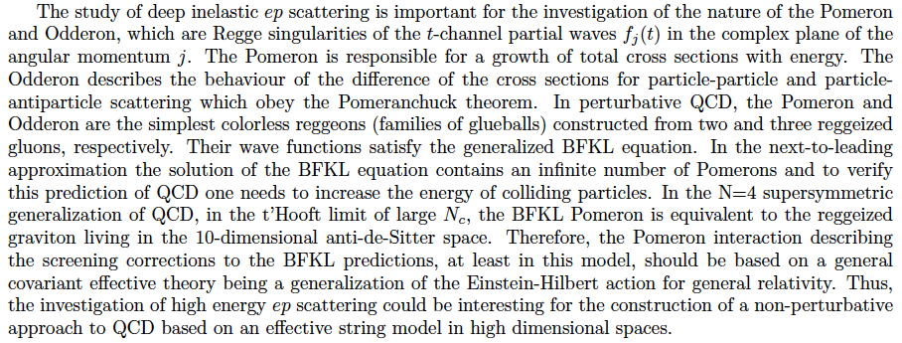
Candidates for Surprises and Discoveries
PDFs (t, s, q-q, val, xg)
Odderon
Instanton
(no) saturation, QCD
QGP initial state
Neutron structure
Factorization pp-ep
LQs, RPV SUSY
e*
Higgs CP
α_{s} indeed small (GUT)
Lev Lipatov in the CDR…
Ultra high precision (detector, e-h redundancy) - new insight
Maximum luminosity and much extended range - rare, new effects
Deep relation to (HL-) LHC (precision+range) - complementarity
→ LHeC brings a substantial enrichment of LHC physics

Slide 23
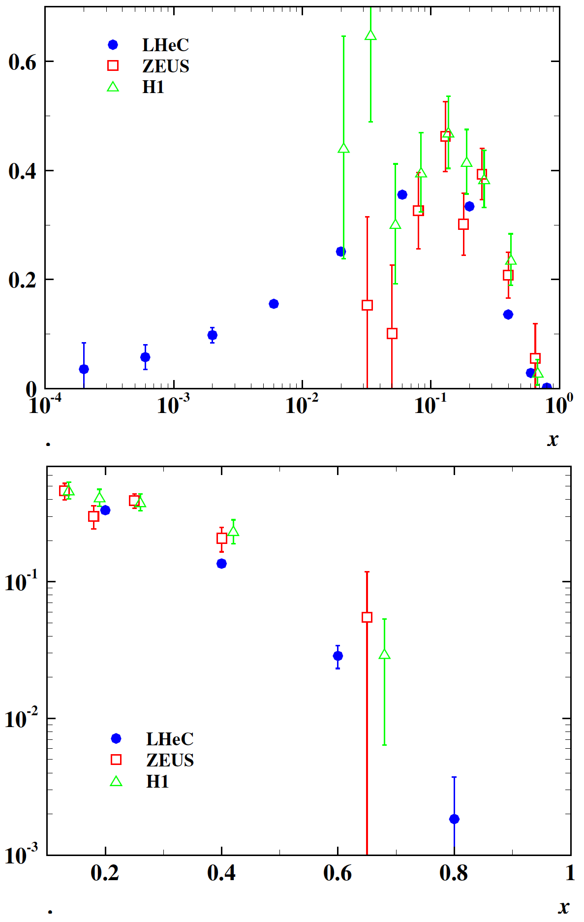
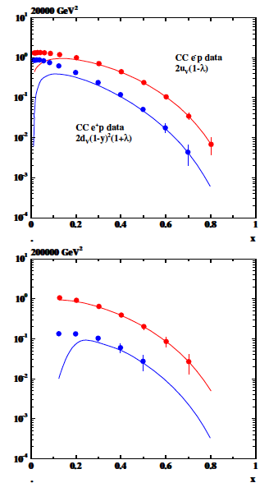
Primary measurements – simulated – high Q²
Precision CC measurements: top [10pb]
valence quarks, high x, V_{tb}, strange, ..
xF₃^{yZ}
xF₃^{yZ}
Precision electroweak measurements
PV with polarisation, F₂^{b,Z}, NC couplings..

Slide 24
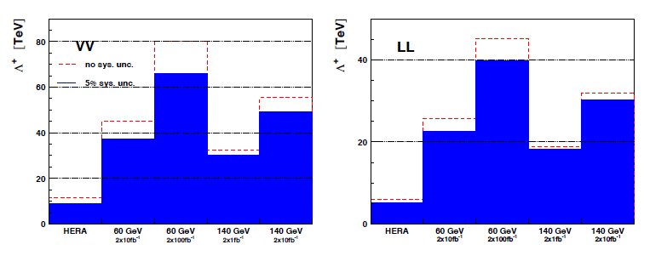

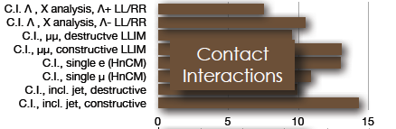
Contact interactions (eeqq)
New currents or heavy bosons may produce indirect effect via new particle exchange interfering with γ/Z fields.
Reach for Λ (CI eeqq): 25-45 TeV with 10 fb⁻¹ of data depending on the model
Similar to LHC
ATLAS and CMS constraints on
eeqq CI (expected up to 30-40
TeV at c.o.m. 14 TeV LHC)

Slide 25
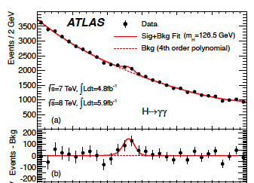
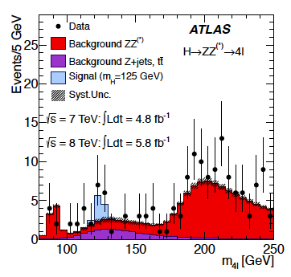
H → γγ H→ ZZ* → 4l
Discovery of H
4.7.2012 ICHEP Melbourne
arXiv:1207.7214
arXiv:1207.7214
13.12.2012 CERN Council
ATLAS CONF 2012-168
ATLAS CONF 2012-169

Slide 26
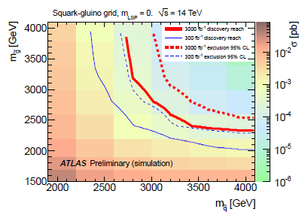
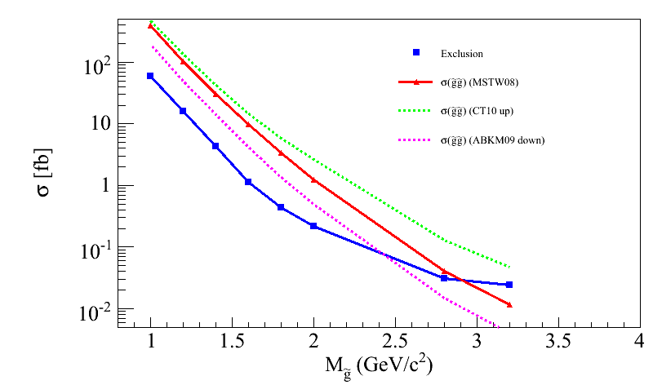
Impact on discovery/exclusion reach
PDF uncertainties impact discovery / exclusion reach:
  Total yields
  Shape variations on discriminating quantities (in progress)
Impact on discovery/exclusion contours under various PDF hypothesis in progress
LHC @ 14 TeV 3 ab-1, M(squark) > 4 TeV
CT10 up
ABKM09 down
MSTW08 equivalent to LHeC PDF
Caution: very very preliminary, mostly as illustration
(UL for gl-gl courtesy of G.Redlinger)
(TeV)
Note: impact of PDF uncertainties on SM background also not negligible
However → mitigated by usage of Control Regions and semi data-driven estimate

Slide 27

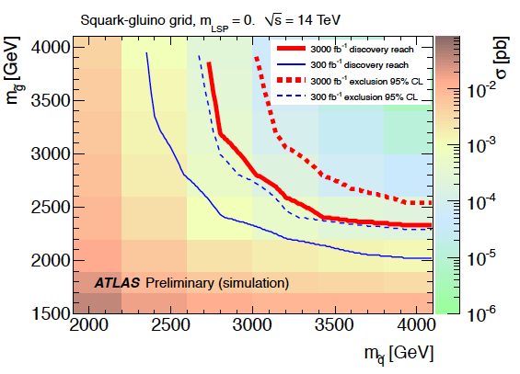
Link to HL LHC, e.g. High Mass SUSY
LHeC: arXiv:1211.5102
ATLAS October 2012 “Physics at High Luminosity”
With high energy and luminosity, the LHC search range will be extended to high masses,
up to 4-5 TeV in pair production, and PDF uncertainties come in ~ 1/(1-x), CI effects?

Slide 28
The TeV Scale [2012-2035..]
pp
W,Z,top
Higgs?
New Particles??
New Symmetries?
LHC
ep
e⁺e⁻
New Physics
ttbar
Higgs?
Spectroscopy??
High Precision QCD
High Density Matter
Higgs?
Substructure??
eq-Spectroscopy??
ILC/CLIC/Ring
LHeC

Slide 29
-some simulated results-
Weak and strong couplings [GUT]
Gluon at low and high x
Unfolding partons (NC,CC and deuterons)
Strange, Charm and Beauty
Gluon Saturation?
Nuclear PDFs
Hadronisation..

Slide 30
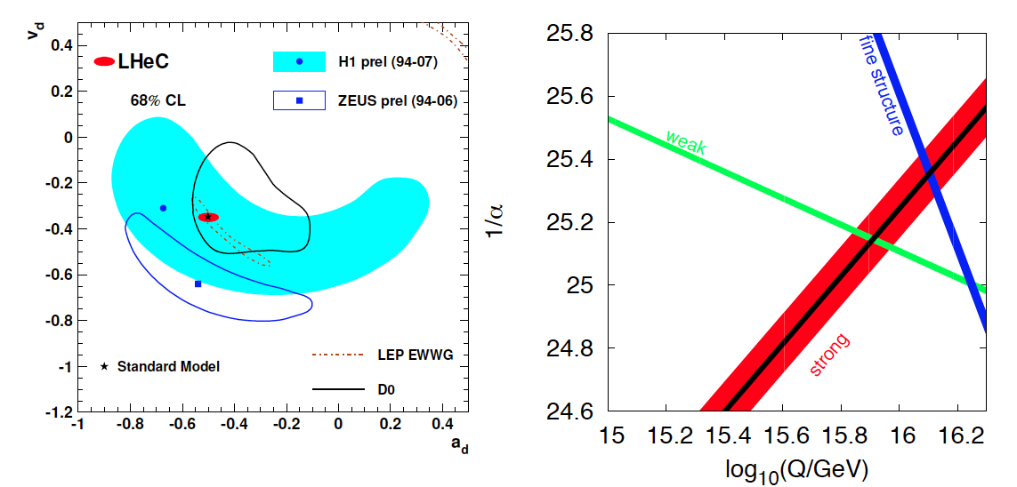
High Precision DIS
High Precision DIS
Q² >> M_{Z,W}², high luminosity, large acceptance
Unprecedented precision in NC and CC
Contact interactions probed to 50 TeV
Scale dependence of sin²θ left and right to LEP
→ A renaissance of deep inelastic scattering ←
Solving a 30 year old puzzle:
α_{s} small in DIS or high with jets?
Per mille measurement accuracy
Testing QCD lattice calculations
Constraining GUT (CMSSM40.2.5)
Charm mass to 3MeV, N³LO

Slide 31
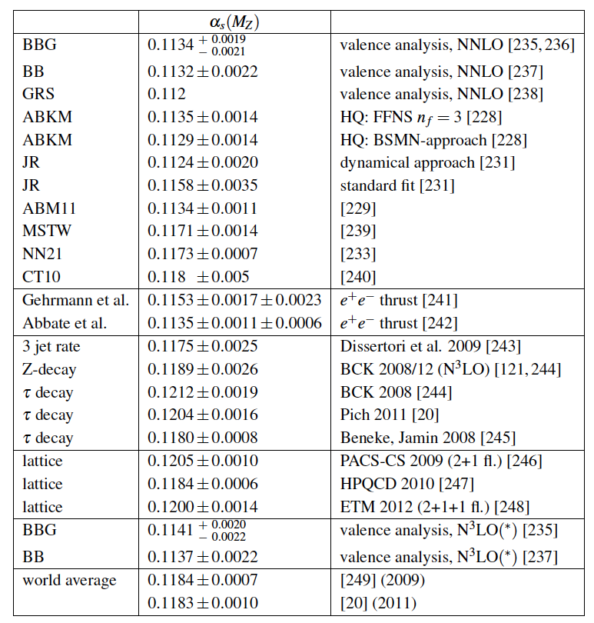
The strong coupling constant
α_{s} is the worst measured
fundamental coupling constant.
Is there grand unification?
In DIS, values (NNLO) range from
0.113 to 0.118.
τ leads to about 0.120
Lattice predictions seem to
determine the world average.
The LHeC has the potential to
measure αs to permille accuracy
(0.0002) from a consistent
data set. This leads to high
precision understanding of all
related effects (low x, δM_{c}=3MeV)
and pQCD at N³LO
J.Bluemlein, Why Precision, arXiv:1205.4991

Slide 32
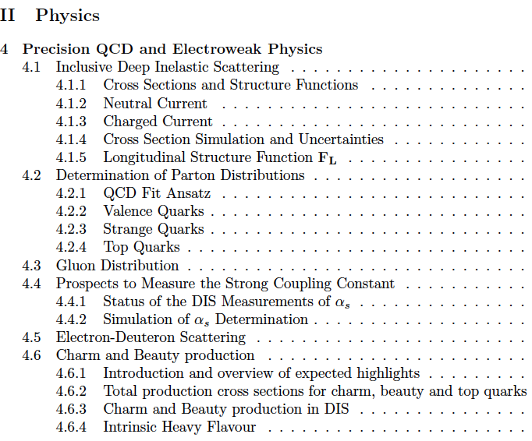
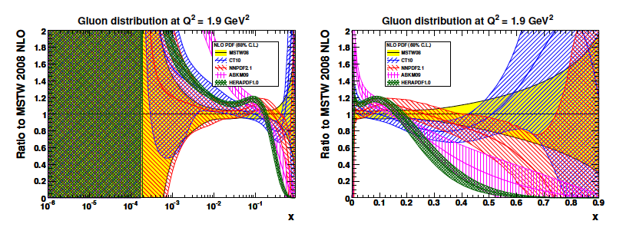
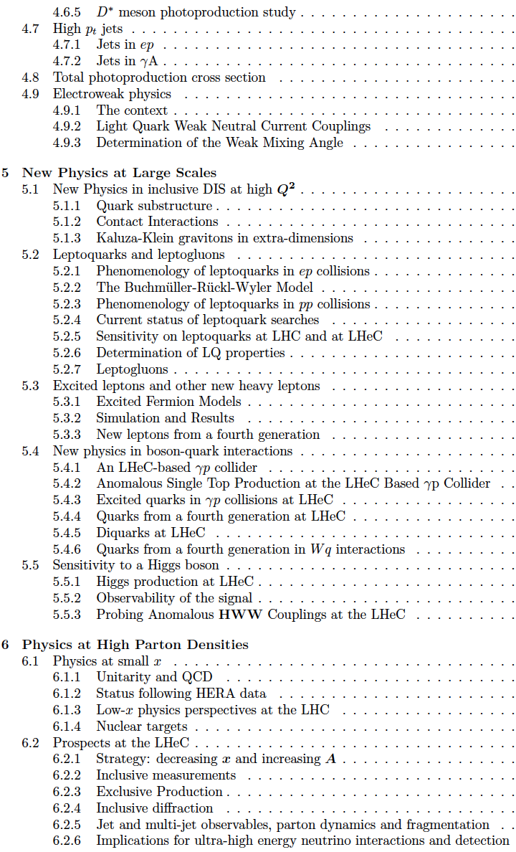
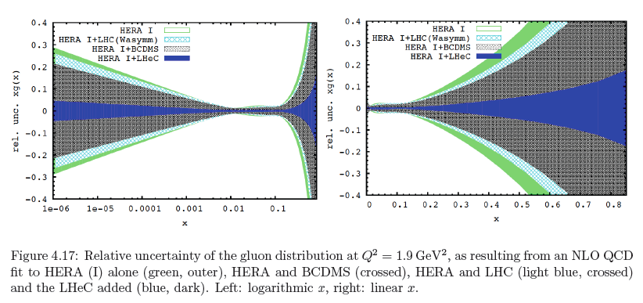
CDR
Gluon Distribution
153 pages
now
then
Precision measurement of gluon density to extreme x → α_{s}
Low x: saturation in ep? Crucial for QCD, LHC, UHE neutrinos!
High x: xg and valence quarks: resolving new high mass states!
Gluon in Pomeron, odderon, photon, nuclei.. Local spots in p?
Heavy quarks intrinsic or only gluonic?

Slide 33
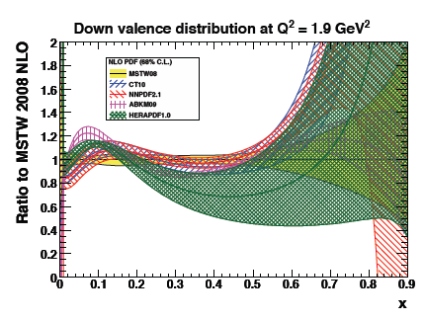
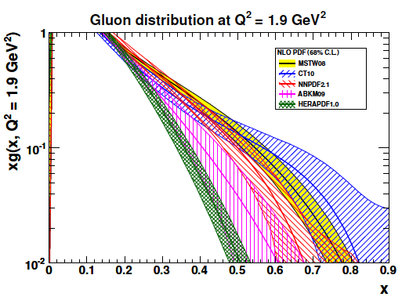
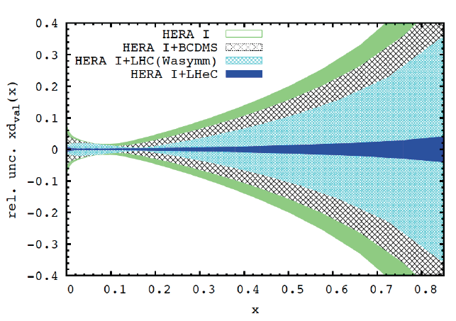
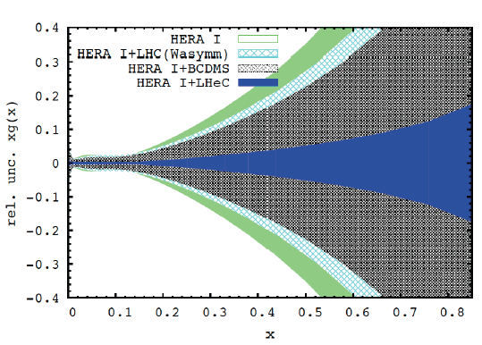
PDFs at Large x
No higher twist corrections, free of nuclear uncertainties, high precision test of factorisation

Slide 34
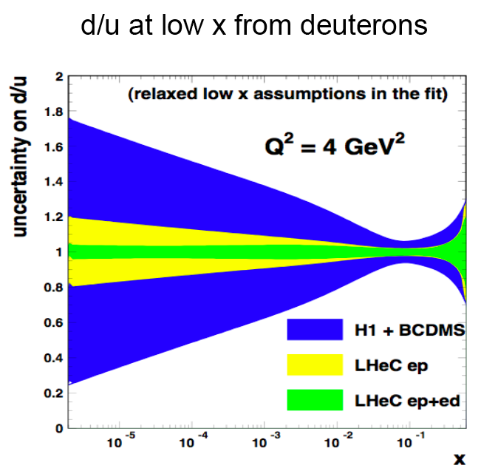
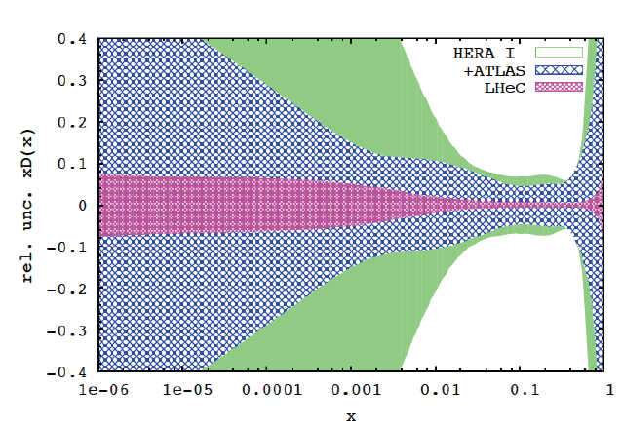

Deuterons and Light Sea Quark Asymmetry
D=“total down” from LHeC (ep) fit
with FREE d-u difference, including
simulated high precision LHC W,Z
CDR
Deuterons: Crucial for
NS-S decomposition
Neutron structure
Flavour separation
Nice: Gribov relation and spectator tagging to get rid off shadowing and Fermi motion!!

Slide 35
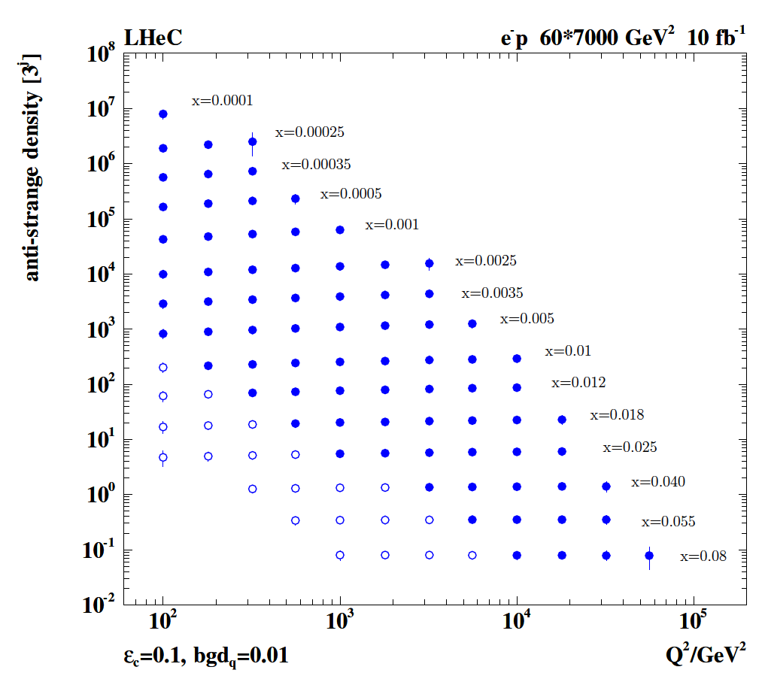
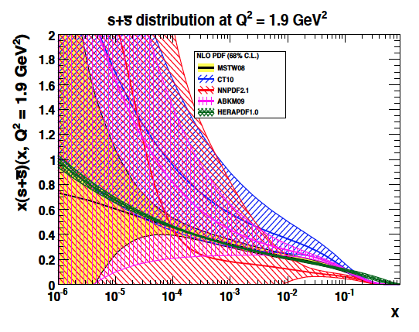
Strange Quark Distribution
High luminosity
High Q²
Small beam spot
Modern Silicon
NO pile-up..
First (x,Q²)
measurement of
the (anti-)strange
density, HQ valence?
x = 10⁻⁴ .. 0.05
Q² = 100 – 10⁵ GeV²
Initial study (CDR): Charm tagging efficiency of 10% and 1% light quark background in impact parameter

Slide 36


F₂^{charm} and F₂^{beauty} from LHeC
Hugely extended range and much improved precision (δM_{c}=60 HERA → 3 MeV)
will pin down heavy quark behaviour at and far away from thresholds, crucial for precision t,H..
In MSSM, Higgs is produced dominantly via bb → H (Pumplin et al) , but where is the MSSM..

Slide 37


Low x Physics – Gluon Saturation?
Precision Measurements of various
crucial observables (F₂, F_{L}, J/ψ, diffraction
also GPDs with polarisation, charge asymmetries..

Slide 38



Gluon at Low x
LHeC
H1
Gluon measurement down to x=10⁻⁵, Saturation or no saturation (F₂ and precise F_{L})
Non-linear evolution equations? Relations to string theory, and SUSY at ~10 TeV?
cf H.Kowalski, L.Lipatov, D.Ross, arXiv:1205.6713

Slide 39



LHeC as an electron-ion collider
up valence
gluon
3-4 orders of magnitude extension of lA kinematic range
→ LHeC has huge discovery potential for new HI physics
(bb limit, saturation, deconfinement, hadronisation,QGP..)
will put nPDFs on completely new ground
unmeasured | known?

Slide 40


In-medium Hadronisation
The study of particle production in eA (fragmentation functions and hadrochemistry)
allows the study of the space-time picture of hadronisation (the final phase of QGP).
Low energy (ν): need of
hadronization inside.
Parton propagation: pt broadening
Hadron formation: attenuation
High energy (ν): partonic
evolution altered in the
nuclear medium.
W.Brooks, Divonne09
LHeC :
+ study the transition from small to high energies in much extended range wrt. fixed target data
+ testing the energy loss mechanism crucial for understanding of the medium produced in HIC
+ detailed study of heavy quark hadronisation …
Notes:
40

Slide 41
-Higgs and ep-
Higgs production
Higgs to bbar with S/B=1
CP
LHeC as Higgs “Factory”
Rates [ → more work ..]
H in e⁺e⁻
Precision xg and gg→ H at the LHC

Slide 42


Higgs at the LHeC
Clean final state, no pile-up, low QCD bgd, uniquely WW and ZZ, small theory unc.ties
Default
U. Klein, ICHEP12, Melbourne for the LHeC
Full simulation of ep → nu H X → nu bbar X: reconstruction efficiency of 2.5%
With polarised electrons, 100fb⁻¹ - bb coupling measurement precision of 2-3%.

Slide 43






CP Higgs at the LHeC
In the SM the Higgs is a J^{PC}=0⁺⁺ state.
One needs to measure the EV if CP
is conserved, and the mixture of even
and odd states if it is not.
λ (λ’) anomalous CP (non) conserving terms
S.Biswal et al,
PhysRevLett.109.261801

Slide 44

LHeC at 10³⁴ Luminosity
LHeC Collaboration arXiv:1211:5102, see also O.Bruening and M.Klein arXiv:1305.2090

Slide 45

LHeC Higgs Rates

Slide 46

Higgs at the ILC
U.Klein, before June 12

Slide 47

Higgs with the LHeC
ZZ → H ~10 times lower rate
LPCC LHeC Workshop at CERN– April12+ 13: indico: 244768 and 244990
Unique production mechanism (WW,ZZ)
Clean experimental conditions:
No pileup, simpler final state …
LHeC at 10³⁴cm⁻²s⁻¹ : arXiv:1211:5102
Nb: Cross section and luminosity as large
as are projected for the ILC. Access to
difficult channels (ττ, cc – under study)
With its unique Higgs measurements and
precision N³LO PDFs and δα_{s} ,
ep upgrade transforms the LHC facility
into a precision Higgs factory.
[cf arXiv:1211:5102 + OB, MK: arXiv:1305:2090]
Rates for E_{e}=60 GeV, proportional to E_{e}
Initial study for CDR:
H →bbar: selection efficiency: ~2.5%
which gives 5000 events with S/B=1.
corresponding to 0.7% coupling precision.
[cf: CDR, U.Klein ICHEP12, B.Mellado LPCC]
Max Klein, Les Houches 12.6.13

Slide 48
Exp uncertainty
of LHeC Higgs
cross section is
0.25% (sys+sta),
using LHeC only.
Leads to mass
sensitivity..
Strong coupling
underlying
parameter
(0.005 – 10%).
LHeC: 0.0002
Needs N³LO
HQ treatment
important
PRECISION σ(H)
Calculated for scale of M_{H}/2
Higgs production (gg) at the LHC is
Bandurin (ICHEP12) Higgs physics at the LHC is limited by the PDF knowledge

Slide 49


Slide 50
-next steps and final remarks-
Physics studies and further LHC discoveries
Interaction region
Detector simulation (not shown)
LHeC Test Facility
Magnet designs
Theory and experiment
Future ep colliders and the energy frontier
A Summary

Slide 51


Top Quark and Leptoquarks
The LHeC is a (single) top quark production
factory, via Wb → t. Top was never observed
in DIS. With ep: top-PDF → 6 flavour VFNS,
precision M_{t} direct and from cross section,
anomalous couplings [to be studied]
Leptoquarks (-gluons) are predicted in RPV SUSY,
E6, extended technicolour theories or Pati-Salam.
The LHeC is the appropriate configuration to do their
spectroscopy, should they be discovered at the LHC.

Slide 52



LR LHeC IR layout & SC IR quadrupoles
Exit hole for electrons & non-colliding protons
Synchrotron radiation
Q2
Electron beam
Q1
Q2
Q1
Nb₃Sn (HFM46): 5700 A, 175 T/m, 4.7 T at 82% on LL (4 layers), 4.2 K | Nb₃Sn (HFM46): 8600 A, 311 T/m, at 83% LL, 4.2 K
46 mm (half) ap., 63 mm beam sep. | 23 mm ap.. 87 mm beam sep.
0.5 T, 25 T/m | 0.09 T, 9 T/m
colliding proton beam
Non-colliding proton beam
Inner triplets
Inner triplets
High-gradient SC IR quadrupoles based on Nb₃Sn for colliding proton beam with common low-field
As shown by F. Zimmermann at Chamonix12

Slide 53






Towards an LHeC ERL Test Facility at CERN
Contribution to IPAC13
Daresbury Workshop:
- Collaboration: CERN, AsTEC, CI, JeffersonLab, U Mainz, +
- LHeC Parameters (C,Q,source,I) rather conservative
- Test Facility to develop full technology, key: cavity
- RF frequency chosen
22/23.1.2013 Daresbury (UK) http://cern.ch/lhec

Slide 54



Magnets Developments
flux density in the gaps | 0.264 T 0.176 T 0.088 T
magnetic length | 4.0 m
vertical aperture | 25 mm
pole width | 85 mm
number of magnets | 584
current | 1750 A
number of turns per aperture | 1 / 2 / 3
current density | 0.7 A/mm²
conductor material | copper
resistance | 0.36 mΩ
power | 1.1 kW
total power 20 / 40 / 60 GeV | 642 kW
cooling | air
Prototypes for Ring dipoles
Fabricated and tested by
CERN (top) and Novosibirsk
LR recirculator dipoles and quadrupoles
New requirements (aperture, field)?
Combined apertures?
Combined functions (for example, dipole + quad)?
LR linac quadrupoles and correctors
New requirements (aperture, field)?
More compact magnets, maybe with at least two
families for quadrupoles?
Permanent magnets / superconducting for quads?
A.Milanese, Chavannes workshop
1/2m dipole model
Full scale prototype
Quadrupole for Linac
Magnets for ERL test stand
Collaboration of CERN, Beijing, Daresbury, Novosibirsk)

Slide 55



THEORY
M.Froissart ICHEP (“Rochester”) 1966
H.Murayama – ICFA11
→ Quarks in 1969
→ ?in 2015+?
We like to see particle physics as driven by experiment … Burt Richter

Slide 56

Energy frontier deep inelastic scattering - following HERA with the LHC
LHeC: A new laboratory for particle physics, a 5th large LHC experiment

Slide 57
Summary
1. The LHeC is the natural (and the only possible) successor of the energy frontier exploration of deep inelastic
scattering with fixed target experiments and HERA at 10, 100 and then 1000 GeV of cms energy.
2. Its physics programme has key topics (WW→ H, RPV SUSY, α_{s} , gluon mapping, PDFs, saturation, eA…)
which ALL are closely linked to the LHC (Higgs, searches for LQ and at high masses, QGP ..). With the
upgrade of the LHC by adding an electron beam, the LHC can be transformed to a high precision
energy frontier facility, which is crucial for understanding new+”old” physics and its sustainability.
3. The LHeC will deliver vital information to future QCD developments (N³LO, resummation, factorisation,
non-standard partons, neutron and nuclear structure, AdS/CFT, non-pQCD, SUSY..) and as a gigantic
next step into DIS physics it promises to find new phenomena (no saturation, instantons, substructure
of heavy elementary particles ??).
4. The default LHeC configuration is a novel ERL (with < 100MW power demand) in racetrack shape which
is built inside the LHC ring and tangential to IP2. This delivers multi-100fb⁻¹ (> 100 * HERA) and a factor of
larger than 10³ increased kinematic range in lN DIS, accessing the range of saturation at small α_{s} in ep+eA.
5. The LHeC is designed for synchronous operation with the LHC (3 beams) and has to be operational for
the final decade of its lifetime. This gives 10-12 years for its realisation, as for HERA or CMS.
6. A detector concept is described in the CDR suitable for the Linac-Ring IR and to obtain full coverage and
ultimate precision. This can be realised with a collaboration of 500 physicist.
7. Half of the LHeC is operational. The other half requires next: an ERL test facility at CERN, IR related proto-
typing (Q1, pipe), to develop the LHC-LHeC physics links, to simulate and preparing for building the detector.

Slide 58
-backup-

Slide 59


Kinematics - LHeC and HERA
Access to “saturation” (?) region
in DIS (Q² > 1 GeV²) and ep
Extending beyond the Fermi scale with
precision Z and W exchange data →
high x, top PDF, flavour & new physics,

Slide 60


PDF constraints from LHC - Di-Lepton Production
Precision
Drell-Yan
(W,Z) data
constrain
PDFs
PRD D85 (2012) 072004
according to the ATLAS data and
HERA+ATLAS QCD analysis: s = d !
PRL 109(2012)012001
ATLAS-CONF-2012-159
Very high precision required
for any constraint on PDFs
Change of strange affects sea - UHE ν

Slide 61



PDF constraints from LHC – Jets
ATLAS-CONF-2012-128
S.Moch 6th Terascale Workshop (Hamburg, 3.12.12)
μ=3GeV
First constraints on gluon distribution from
jets: cross sections and ratios 2.7/7 TeV
Will improve, but depends on energy scales,
jet definition, non-perturbative effects ..
Similar results from CMS (W±, DY, top..)

Slide 62

CP Properties
B.Mellado at LPCC 3/13

Slide 63
BSM Summary and outlook
LHeC provides complementarities to the LHC SUSY search program in the twenties
  Ideal to search and study properties of new bosons with couplings to electron-quark
  Direct searches for CI, excited fermions, leptoquark, RPV SUSY, RPC SUSY in specific scenarios such as compressed, non-degeneracy for squarks
  Interplay with HL-LHC to constraints on PDF crucial for model testing in case of observed deviations → an independent precision measurement of PDFs will be important for an efficient use of the high luminosity for setting reliable high mass limits

Slide 64


α_{s}
Per mille precision
NNNLO PDFs
Heavy quarks →
Full set of PDFs
Full exp. error
From LHeC CDR

Slide 65



Parameters and Design
257 pages of technical design
in the CDR arXiv:1206:2913, e.g.
“Q1” SC 3-beam IR magnet
Update of parameter table in view of H - arXiv:1211:5102
Designed for synchronous ep and pp operation
1→3 beam spreader design

Slide 66

60 GeV Electron Accelerator
Two 1km long LINACs
connected at CERN territory
Arcs of 1km radius: ~9km tunnel
3 passages with energy recovery
John Osborne (June LHeC Workshop)

Slide 67


Linac Characteristics
Multibunch wakefields - ok
Emittance growth - ok
[ILC 10nm, LHeC 10μm]
36σ separation at 3.5m - ok
Fast ion instability - probably ok
with clearing gap (1/3)
U_{LHeC}=U_{LHC}/3 : 1.5 x HERA
Tunneling: 150m per week – 60 weeks
Two 1km linacs with 59 cryomodules
of 8 cavities each → 1000 cavities

Slide 68



Interaction Region Developments
Beam pipe: in CDR 6m, Be, ANSYS calculations
Composite material R+D, prototype, support..
→ Essential for tracking, acceptance and Higgs
Have optics compatible with LHC and β*=0.1m
Head-on collisions mandatory →
High synchrotron radiation load, dipole in detector
Specification of Q1 – NbTi prototype ( with KEK?)
Revisiting SR (direct and backscattered),
Masks+collimators
Beam-beam dynamics and 3 beam operation studies
Optimisation: HL-LHC uses IR2 quads to squeeze IR1
(“ATS” achromatic telescopic squeeze) Start in IR3 – 10cm ok.

Slide 69



Liquid Argon Electromagnetic Calorimeter
Inside Coil
H1, ATLAS
experience.
Barrel: Pb, 20 X₀ , 11m³
fwd/bwd inserts:
FEC: Si -W, 30 X₀ ,0.3m³
BEC: Si -Pb, 25 X₀,0.3m³
GEANT4 Simulation

Slide 70




Hadronic Tile Calorimeter
Outside Coil: flux return
Modular. ATLAS experience.
R=2.6m
+5.9m
-3.6m
Combined GEANT4 Calorimeter Simulation

Slide 71
Project Development
2007: Invitation by SPC to ECFA and by (r)ECFA to work out a design concept
2008: First CERN-ECFA Workshop in Divonne (1.-3.9.08)
2009: 2nd CERN-ECFA-NuPECC Workshop at Divonne (1.-3.9.09)
2010: Report to CERN SPC (June)
3rd CERN-ECFA-NuPECC Workshop at Chavannes-de-Bogis (12.-13.11.10)
NuPECC: LHeC on Longe Range Plan for Nuclear Physics (12/10)
2011: Draft CDR (530 pages on Physics, Detector and Accelerator) (5.8.11)
refereed and being updated
2012: Discussion of LHeC at LHC Machine Workshop (Chamonix)
Publication of CDR + 2 Contributions to European Strategy [arXiv]
Chavannes workshop (June14-15, 2012) – CERN: Linac+TDR Mandate
ECFA final endorsement of CDR
2013: EU Strategy places lower priority to the LHeC.
Workshop in early fall. Testfacility at CERN.
http://cern.ch/lhec

Slide 72

The first F₂ from HERA
Not too steep, not flat (Regge)
in accord with 1974 expectation
hidden in pioneering pQCD paper
H1 Collaboration, Nucl. Phys. B407 (1993) 515
ZEUS Collaboration, Phys. Lett. B316( 1993) 412

Slide 73

Industry of PDF Determinations
V.Radescu
The determination of the partonic contents of the proton is a subtle, complex task.
It often involves data which are barely compatible as is tolerated with χ² innovations..
Future high precision needs a new, complete PDF data basis and precision h.o. theory.
(cf arXiv:1310.1073,jb)

Slide 74


High Mass Drell Yan
Towards high mass the PDF uncertainties
rise, strongly towards the edge (√s) x → 1…
CMS Di-Jets arXiv:1212:6660
For HL-LHC:
Need to study limits
and interferences (ED?)
in context with energy
calibrations, and thy
uncertainties, + PDFs
vs BSM expectations
14 TeV, VRAP L.Dixon et al, U.Klein

Slide 75



Strong Coupling Constant
α_{s} least known of coupling constants
Grand Unification predictions suffer from δα_{s}
DIS tends to be lower than world average (?)
LHeC: per mille - independent of BCDMS.
Challenge to experiment and to h.o. QCD →
A genuine DIS research programme rather than
one outstanding measurement only.
1/α
fine structure
weak
strong
Two independent QCD analyses using LHeC+HERA/BCDMS

Slide 76




60 GeV Energy Recovery Linac
CERN 1
CERN 2
Jlab
BNL
Two 10 GeV energy recovery Linacs, 3 returns, 720 MHz cavities

Slide 77

Collaboration on ERL
Budker Institute

Slide 78

Large Hadron Electron Collider - LHeC
Information on http://cern.ch/lhec
ep/A synchronous to pp/AA
- LHC is the only place for TeV energy DIS
- ~60 GeV electron beam upgrade to the LHC
- DIS at TeV energies: Q²_{max}10⁶, x > 10⁻⁶
- A new Higgs facility – new detector
Noteable:
Unprecedent precision (α_{s} to per mille)
Complete unfolding of PDFs (1st time)
Precision electroweak measurements
Novel precision input for LHC physics
BSM (RPV SUSY, e*, CI, lq resonances?)
Quark Gluon Plasma – initial formation
QCD
Discovery/disproval of saturation at low x
Less conventional partons (kt, diff., GPDs)
Nuclear structure in huge kinematic range
Top with 10pb cross section in DIS, tPDF
Max Klein, Les Houches 12.6.13
The LHeC is a new laboratory for energy frontier particle physics of unique character.
Ref’s: CDR arXiv:1205:2913, summary: arXiv:1211.4831, relation to LHC: arXiv:1211:5102

Slide 79

Measurement Simulations
Full simulation of NC and CC inclusive cross section measurements including
statistics, uncorrelated and correlated uncertainties – checked against H1 MC

Slide 80
L vs E_{e}
Storage Ring
Energy Recovery Linac

Slide 81


Detector Magnets
Dipole (for head on LR) and
solenoid in common cryostat,
perhaps with electromagnetic LAr
3.5T field at ~1m radius to house
a Silicon tracker
Based on ATLAS+CMS experience

Slide 82
Energy frontier deep inelastic scattering - following HERA with the LHC
LHeC: A new laboratory for particle physics, a 5th large LHC experiment

