Slide 1
Lecture 7 – Detectors - I
Early Techniques
Collider Detectors
Solenoidal Field
Tracking
Drift Chamber
Silicon Detector
Introduction to Particle Physics - Max Klein – Lecture 7 - Liverpool University 17.3.14
M.Klein 17.3.2014 L7

Slide 2
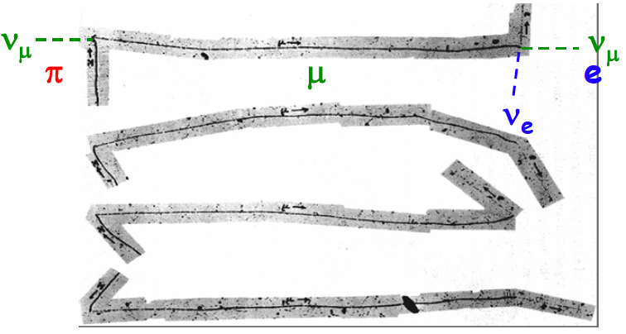
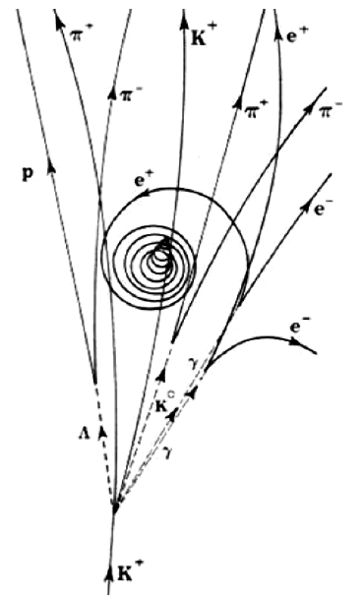
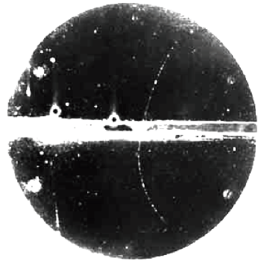
Early Techniques
Emulsion: silver halide crystals in gelatine (π±,K±, ..)
Bubble chamber:
ionisation in
superheated
liquid (Σ⁰,Ξ⁰..)
The Study of Elementary Particles by the Photographic Method
C.Powell, P.Fowler, D.Perkins, Pergamon, London 1959
photographic techniques
not triggerable
small active volumes
small event rates
M, p, Q from ionisation and
curvature in magnetic field
Cloud chamber: ionisation in cloud (e⁺, μ±, K⁰,..)
A.Bettini, Introduction to Elementary Particle Physics, Cambridge, 2008
M.Klein 17.3.2014 L7

Slide 3
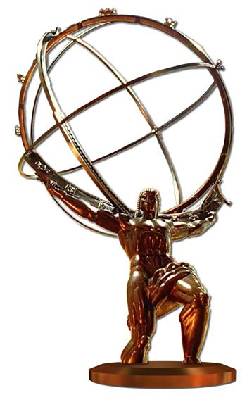
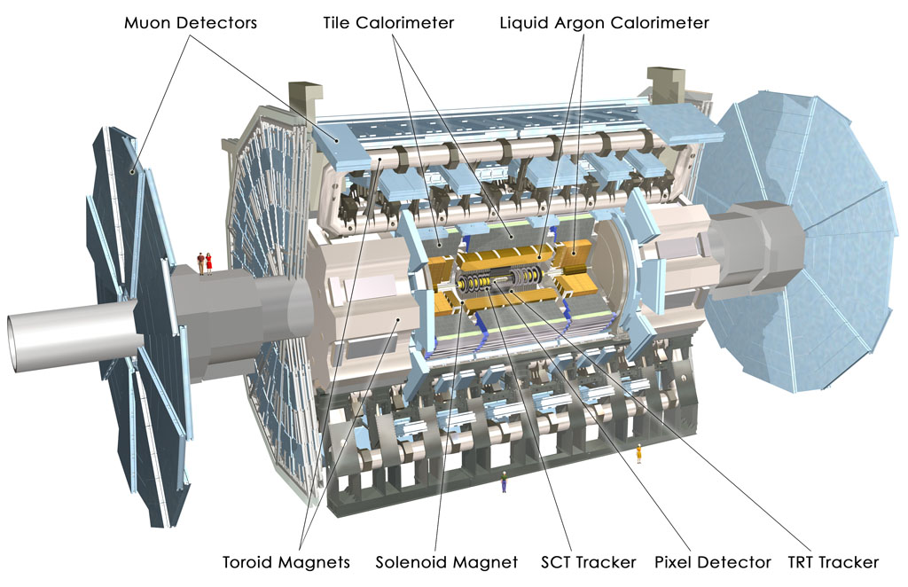
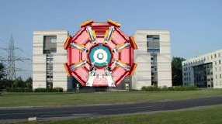
A now famous detector: ATLAS
Design 92-97
R&D 94-02
Construction 99-08
Operation 08-33(?)
High energies are nowadays
achieved with colliders.
Full (4π) acceptance is crucial
for searches for new particles.
This determines the by now
classic detector structure,
at LEP, HERA, Tevatron, now
the LHC as for future colliders.
ATLAS: global collaboration of ~ 200 institutes
and ~3300 physicists and engineers to explore
the physics at the accelerator energy frontier.
Detector: housed 100m underground in cavern
25m x 45m D x Z, 7000t, 10⁸ channels, 3000 cables
M.Klein 17.3.2014 L7

Slide 4
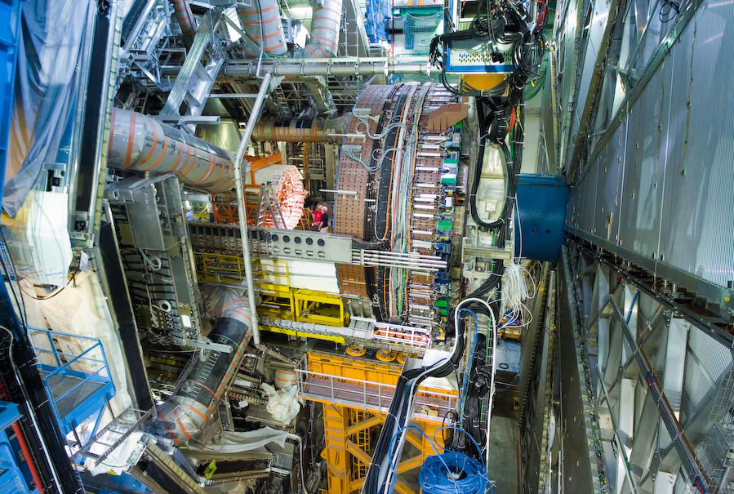
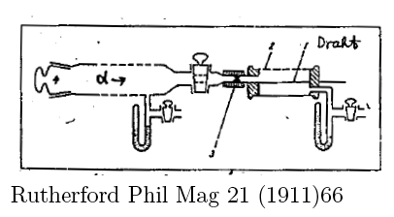
Atlas photo
A gigantic evolution of instrumentation, electronics and computing over 100 years

Slide 5
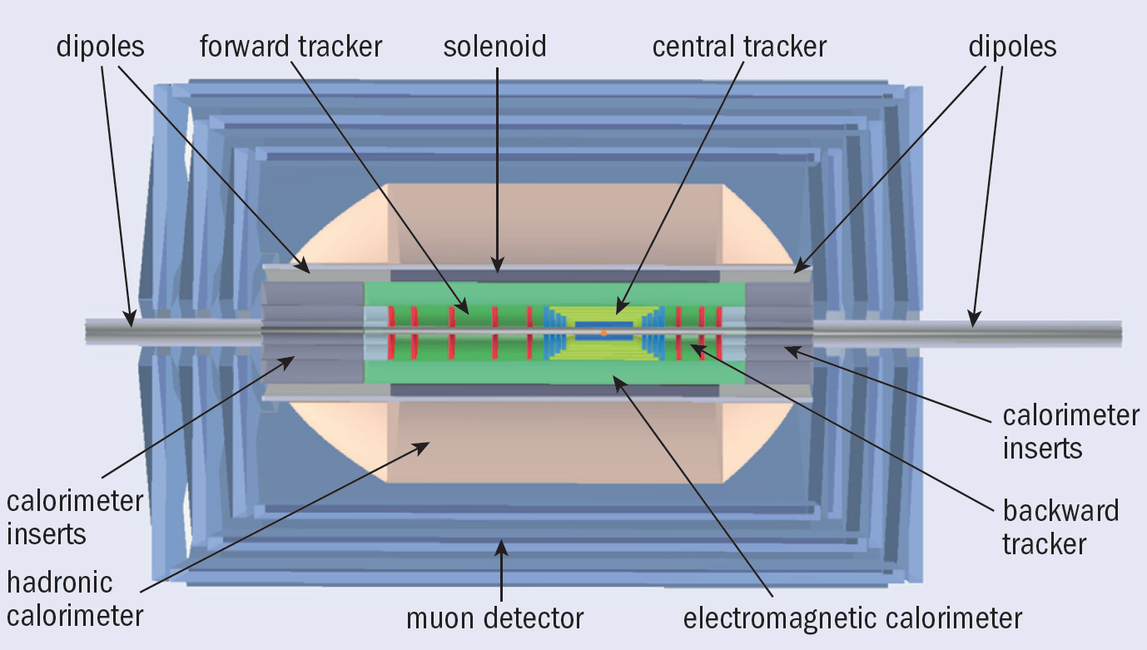
A detector under design
Muon detector: ID with few detector planes, no momentum measurement – unlike ATLAS
Detector dimensions: 9m diameter,12m length
M.Klein 17.3.2014 L7

Slide 6
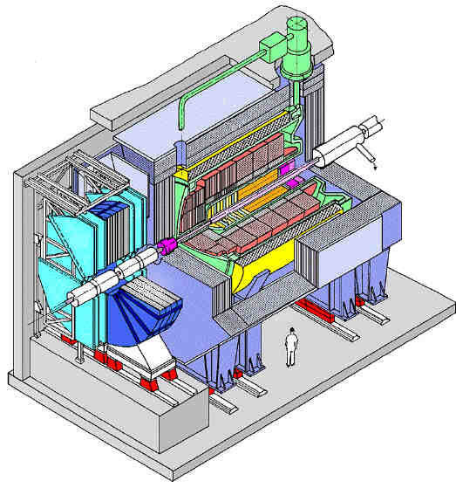
H1 Detector at HERA
electronic techniques
triggerable
large active volumes
huge event rates
Design 83-85
R&D 84-87
Construction 87-92
Operation 92-07
Data Analysis -2014
Tracker
Lar Calorimeter
Coil
Return Iron/ μ Detector
350 Physicists
100 PhD students/year
100 Engineers
40 Institutes
130 Publications
beam
line
Forward muon detector
M.Klein 17.3.2014 L7

Slide 7
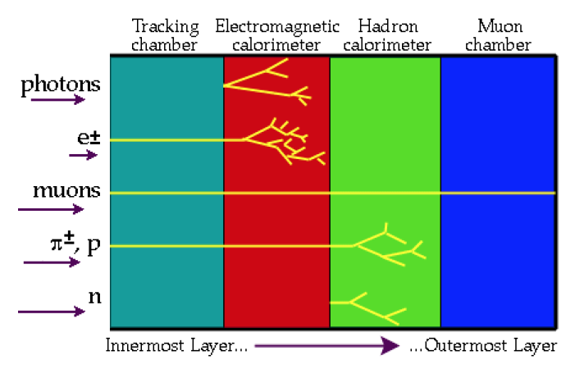
Particle Identification
ν neutrino carries energy away (“missing E”) -- Hermetic Detector!
M.Klein 17.3.2014 L7

Slide 8
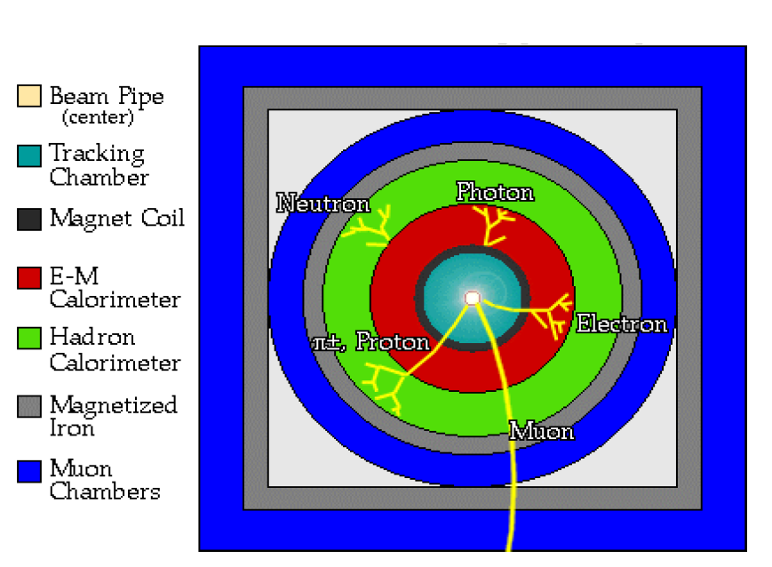
Particle Identification
M.Klein 17.3.2014 L7

Slide 9
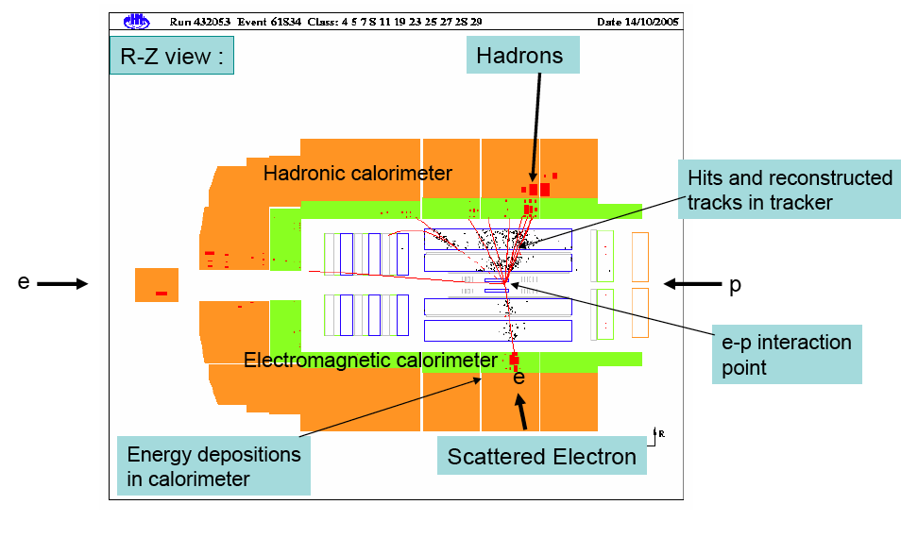
Deep inelastic scattering event in H1
ep → e’X
1m
M.Klein 17.3.2014 L7

Slide 10
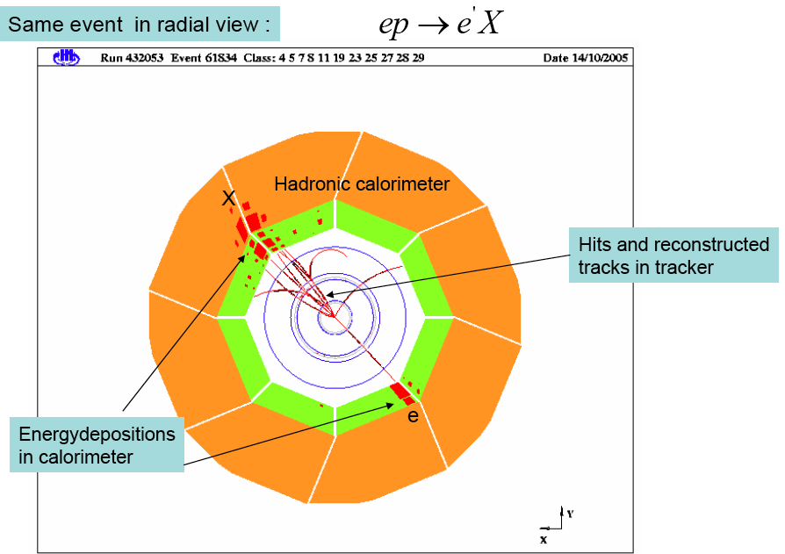
The same event in xy view
soleniodal
magnetic field
bends charged
particle tracks.
transverse
momentum
conservation:
e-h back to back
Electron
deposits full
energy in
elem. Calorimeter
hadrons deposite
all energy in elem
and subsequent
hadronic
calorimeter
[cf detectors – II]
Electromagnetic calorimeter
1m
M.Klein 17.3.2014 L7

Slide 11
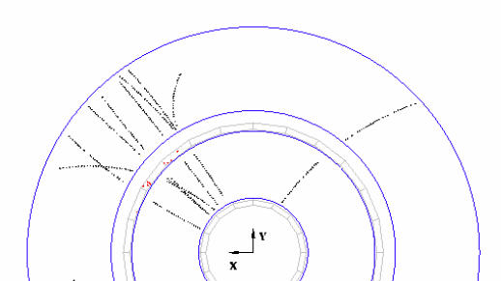
Momentum Measurement
Lorentz force
Tracks in the central
drift chamber of H1
In solenoidal field:
transverse motion
perpendicular to B:
centrifugal force
Charged particles ionize gas of a tracking chamber: the ionisation is detected on wires and the track is reconstructed using the drift time information. Hits
are found to be on a curved track - in the plane
transverse to the beam, i.e. the solenoidal field. The
curvature is the larger the smaller the transverse
momentum, p_{t} , of the track is.
[GeV] [T] [m]
M.Klein 17.3.2014 L7

Slide 12
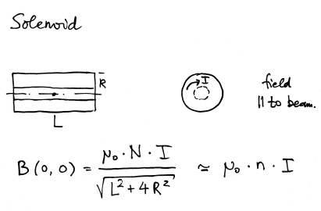
Solenoid - Magnet
Magnetic field parallel to the beam axis
Stored energy
Keep dimensions
small to keep cost
down.
Try to arrange the
magnet to contain
the calorimeter
H1: L=5.7m, R=3m, I=6kA,W=1238, B=1.13T, E=100MJ
M.Klein 17.3.2014 L7

Slide 13
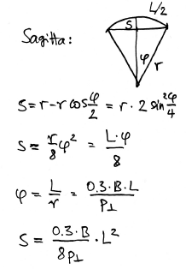
Tracking
“triple sagitta”
2
1 3
s = sagitta
R.Glueckstern, NIM 24(1963)381
→ small Δ, high field B, large L (+ ‘no’ material)
[note clash in notation: r is the radius of
curvature, L is the track length, which in
a solenoidal field determined the radial
extension of the tracking detector ..]
Given the desired momentum resolution, the field,
the point resolution and the number of layers, the
radial extension of the tracker is fixed to be ~0.5m
M.Klein 17.3.2014 L7

Slide 14
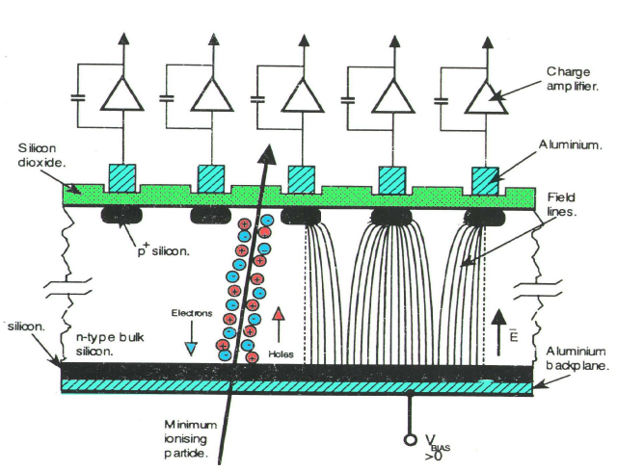
Silicon Detectors
“p in n”
Planar sensor from pure Si wafer
segmented with implants (pn)
Strip pitch p~50μm,δ≈p/√12
Resolution worsens with inclination
Bulk Si ‘depleted’ by reverse bias V
Ionisation creates e-h pairs
e (h) drift time 10 (25) ns
Charge amplified for strip
Pedestal defined by random noise
…
Visit ground floor at “Oliver Lodge”
D.Pitzl
Modern semiconductor detectors use charge deposited by minimum ionising particle
for high precision measurement of charged particle tracks to ~10μm hit reconstruction precision.
Signal: ~20ke in 250μm Si, Noise: interstrip C~ 1k, leakage current 0.1k, bias resistors 0.2k [BST H1]
M.Klein 17.3.2014 L7

Slide 15
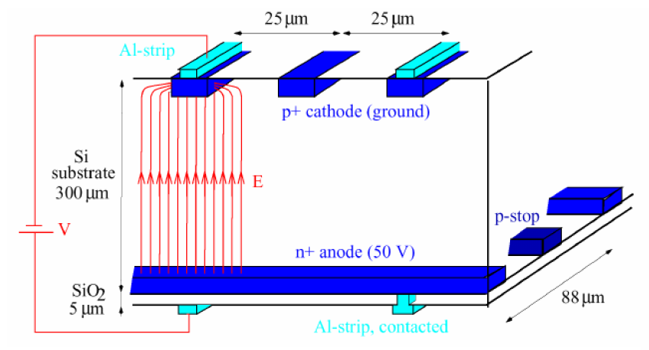
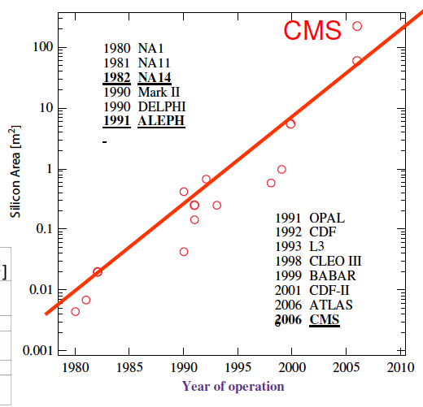
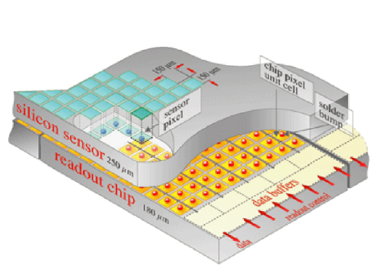
Segmentation and History
Two dimensional strip readout
(often preferred back-to-back single sided r/o)
CMS
CMS pixel detector
1997+ H1,ZEUS
Silicon detectors have dominated tracking detectors and major efforts are
devoted to high resolution, radiation hardness, fast and integrated readout..
M.Klein 17.3.2014 L7

Slide 16
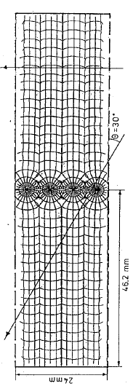
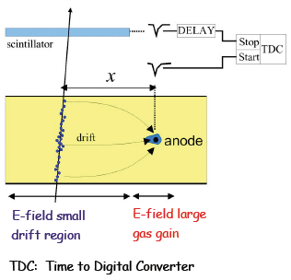
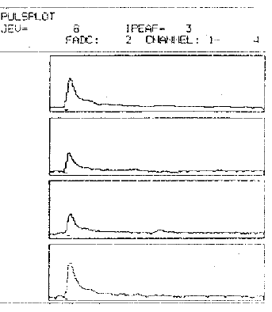
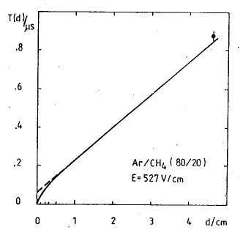
Drift Chambers
Example: COZ of H1 (PHE 88-02, Zeuthen)
Electric field lines and drift time isochrones in a drift cell
Calculation of time-distance
relation and measurement of
maximum drift time to determine
the drift velocity v_{D}=56μm/ns
amplitude
C.Niebuhr
Large sensitive volume
Point resolution of order 200μm
Typical: 1m radius, 10⁴ wires positioned
to 20μm precision, strung parallel to beam
or circular around (“z chambers”).
Sensitive to ageing, gas impurities,
wire and wire-feedthrough mechanics..
time - channel number
Analog pulses to determine the
spatial resolution using different
pulse shape analyses.
Second coordinate from readout
at both ends (charge division)
M.Klein 17.3.2014 L7

Slide 17
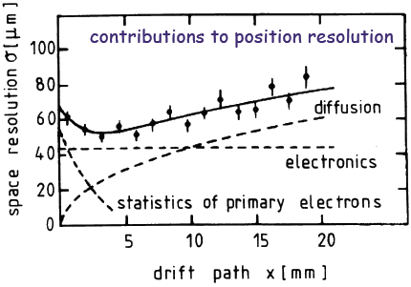
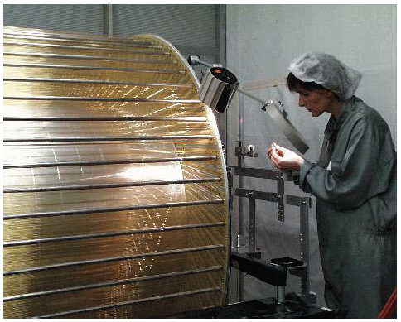
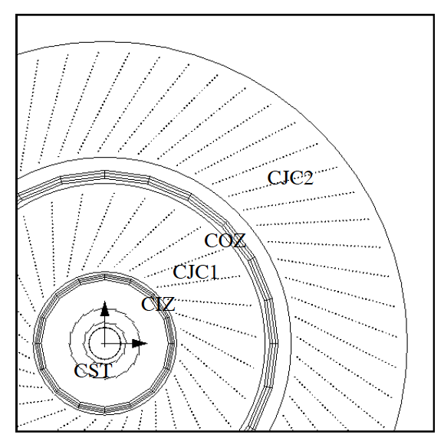
Drift Chambers
spatial resolution vs drift length
Outer H1 central jet chamber (CJC2)
15 000 wires,, 6 tons on endflange, separating CJC from forward tracker
Radial view of H1 central tracker
M.Klein 17.3.2014 L7

Slide 18
coz
COZ
H1 drift
chamber
built at
Zeuthen
1986-91

