Slide 1
Structure Functions at HERA
DIS
HERA
H1 and ZEUS
New Data (F₂, CC, NC)
QCD analyses
γZ and H1+ZEUS
F_{L}
Future DIS
Focus on inclusive + yet unpublished
DIS measurements
Recent full account of HERA physics:
M.K. and Rik Yoshida,
Collider Physics at HERA
arXiv 0805.3334 [hep-ex]
Prog. Part. Nucl. Phys. 61,343 (2008)
Max Klein
(H1 and ATLAS)
Seminar at SLAC, 8.4.2009, Stanford

Slide 2
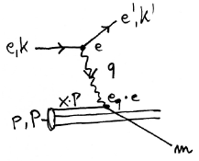
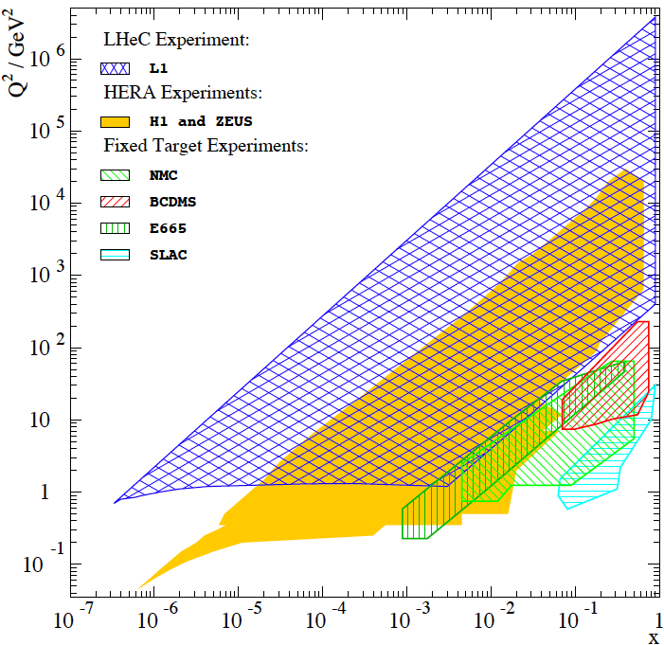
Deep Inelastic e/μp Scattering

Slide 3
Neutral (NC) and Charged Current (CC) DIS Cross Sections
Sensitive to sum or difference of q and anti-q
Electroweak effects appear O(10⁻⁴Q²/GeV²).
Charge and polarisation asymmetry effects.
CC on protons are charge dependent
Flavour separation but of sums of up
and down quarks. Propto (1 ± P_{e}).

Slide 4
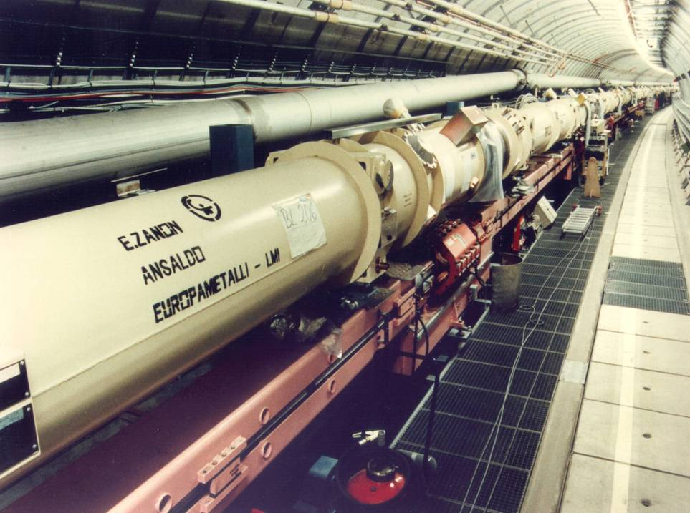
HERA: construction 1985-1991
6.2 km ring accelerator(s)
Superconducting p: E_{p} =460-920 GeV
Warm e: E_{e} =27.5 GeV, |P_{e}|=0.3..0.5
Data delivery (0.6fb⁻¹): 1992-2007

Slide 5
In 2001 the DESY directorate decided
to rebuild PETRA as a 3rd generation
synchrotron light source considering
the HERA programme to be exploited
by 2006 and TESLA to be the next
accelerator project of the laboratory.

Slide 6
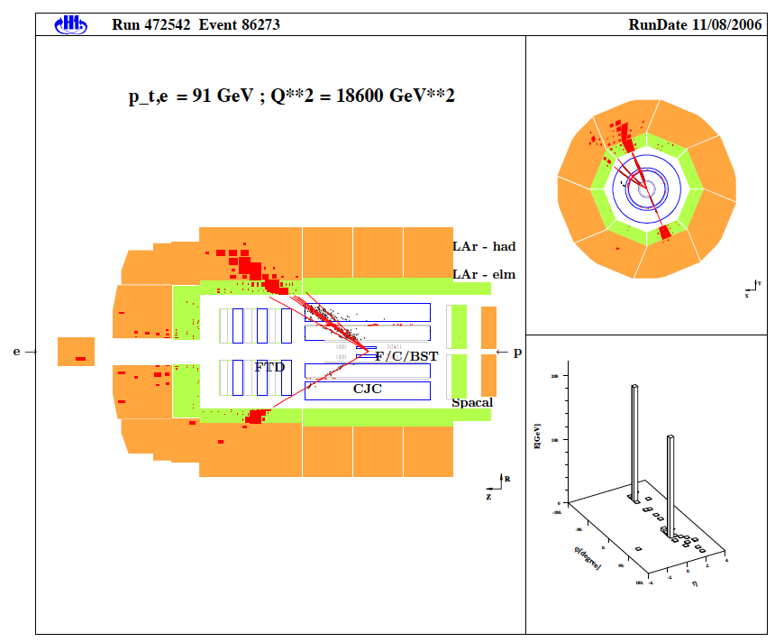
H1
LAr (Pb –elm, SS –hadr) σ_{had} =50%/√E
SpaCal (elm+hadr) σ_{elm} =12%/√E
B/C/FST
CIP
Driftchamber (CJC) …
Trigger: LAr, CIP, FTT, BST
Alignment (trackers, Comptons)
Calibration (kinem. peak, DA)
Luminosity: ep →epγ (1%)
MC simulation GEANT3 + physics
Redundant reconstruction of the
kinematics from e and h(X) FS
A neutral current DIS event in the H1 detector

Slide 7
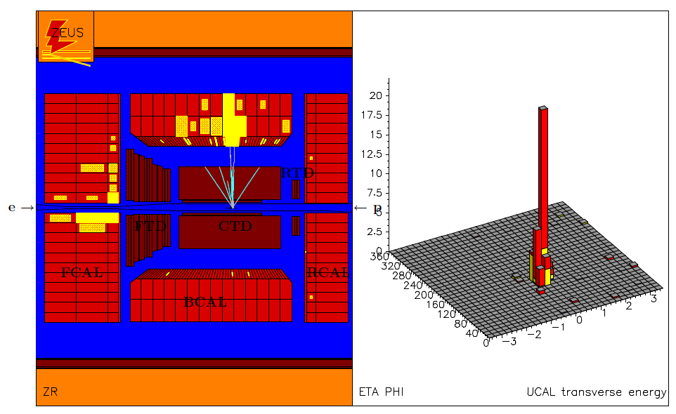
ZEUS
Uranium/Sc –elm and hadronic
σ_{elm} =18%/√E, σ_{had} =35%/√E
MVD (fwd, central)
Driftchamber (CTD) …
Trigger: Calorimeter
A charged current DIS event in the ZEUS detector
Calibration and alignment methods
and L measurement similar as for H1. Kinematic reconstruction different,
which is at the origin of the systematic
error compensation in the combination
of the H1 and ZEUS cross section data.

Slide 8
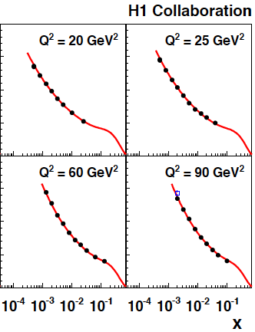
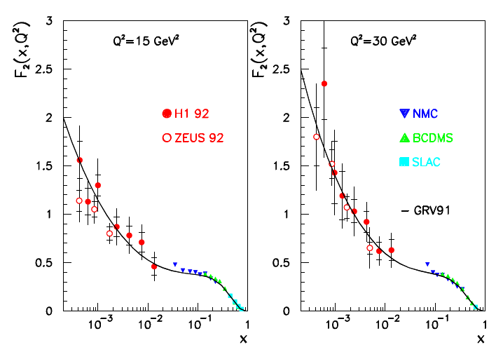
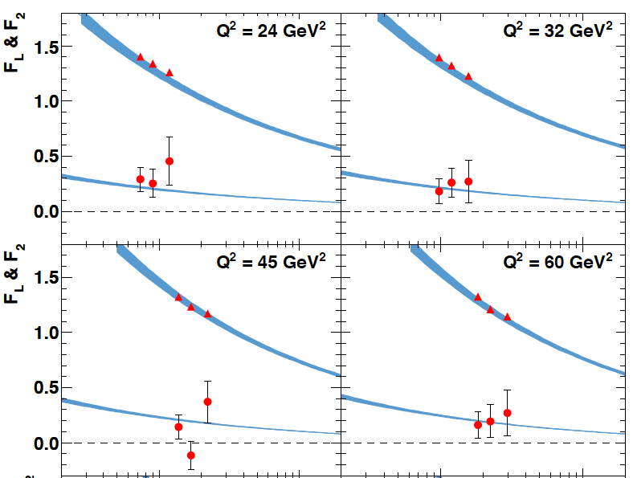
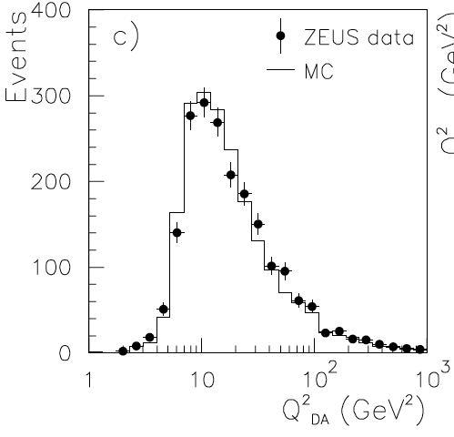
F₂=νW₂
Most recent
F₂ from 00
L=22 pb⁻¹
H1: e and Σ
First F₂ data
taken in 1992
L=0.03 pb⁻¹
H1: e and h
ZEUS: DA
Most recent
F_{2,L} from 07
14+7+44 pb⁻¹
ZEUS: e

Slide 9
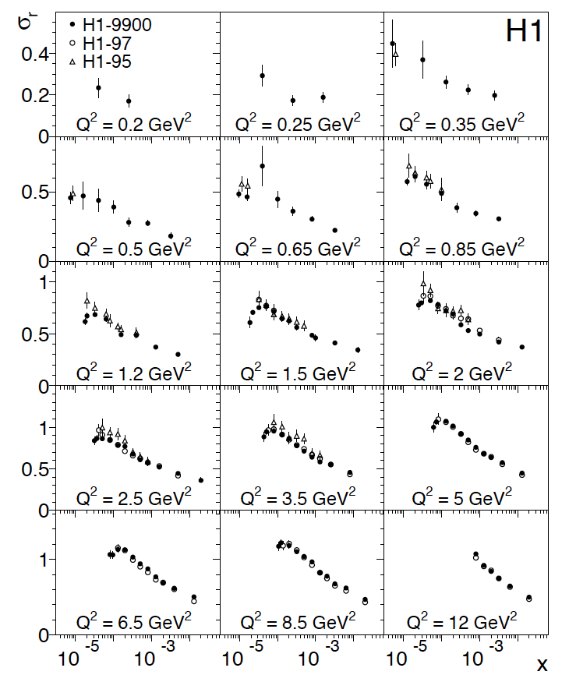
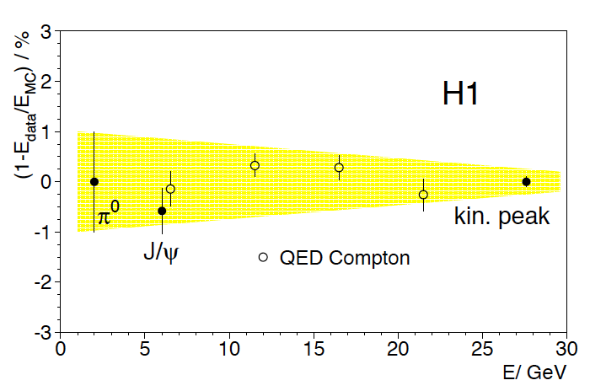
The lowest Q²,x measurement of σ_{r} by H1
H1: DESY 08-171 to appear
Detailed account of methods.
Lowest Q² accessed by shifting vertex,
and using low edge of BDC + BST
Reanalysis of 97 data, +3% (lumi)
Novel combination method to combine
different measurements (S.Glazov, DIS05)
based on χ² minimisation with adjustment
of systematic errors.
0.2% energy scale uncertainty in kinematic
peak (E’ = E_{e}), lower scales from π⁰, J/ψ
and QED Compton events.
Lowest Q² better covered by ZEUS BPT data.

Slide 10
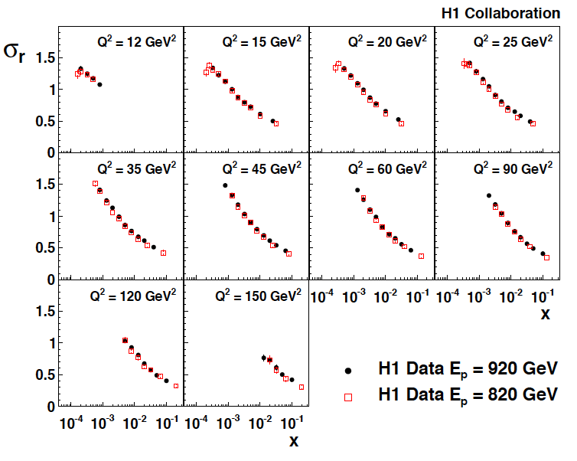
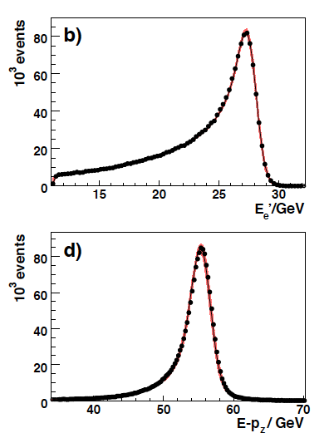
The most precise F₂ measurement, H1
H1: DESY 09-005 to appear
Based on methods detailed in 08-171,
medium Q² accessed with maximum
precision [1.3-2%]
Reanalysis of 97 (820 GeV) data,
+0.5% (lumi) and small change of Q²
dependence due to reweighting error.
Both data sets combined to one.
Electron scattered into SpaCal (“backwards”). Track with BDC
cross checked with CJC and BST. 920 data taken in 2000,
just before break for the luminosity upgrade of HERA..

Slide 11
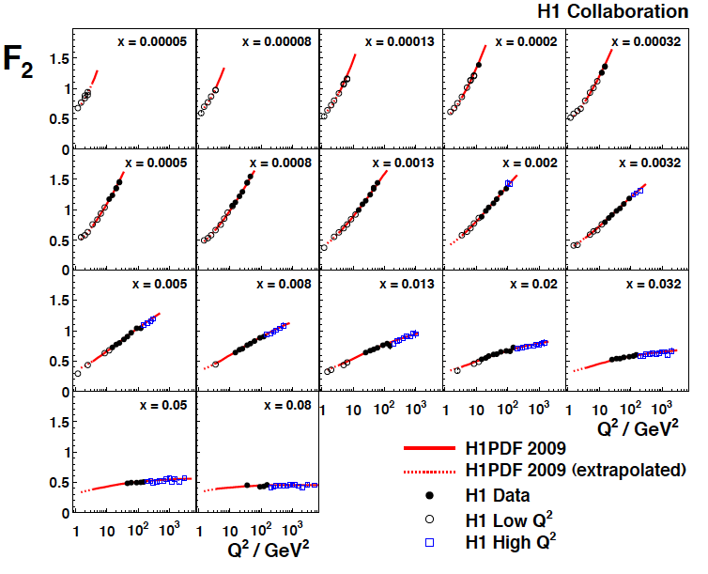
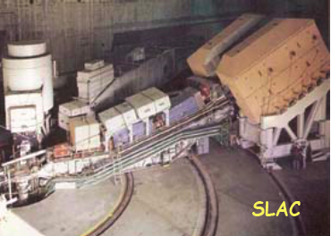
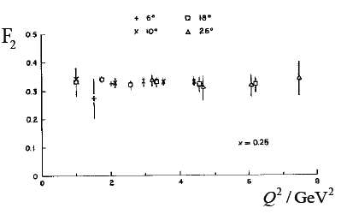
Low x - Violations of Bjorken Scaling
DESY 09-005 to appear

Slide 12
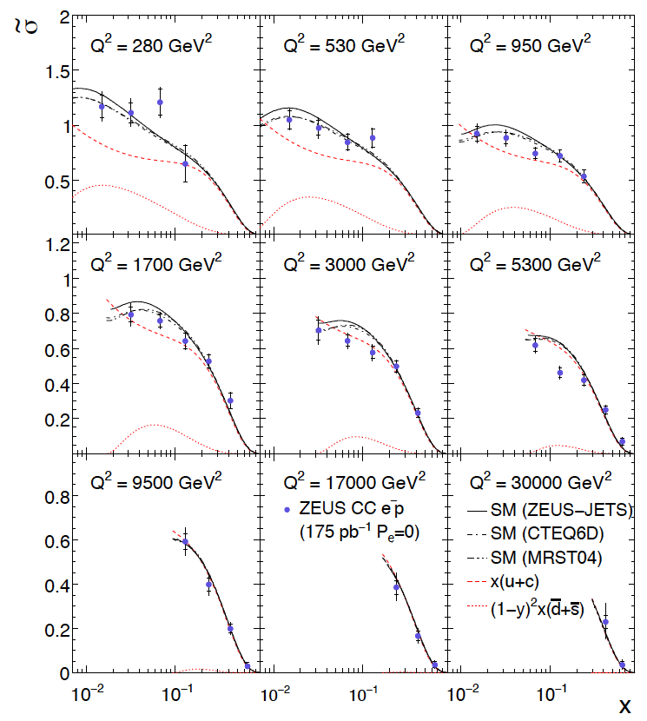
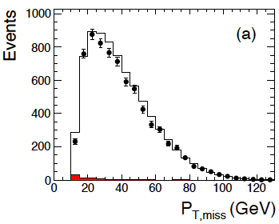
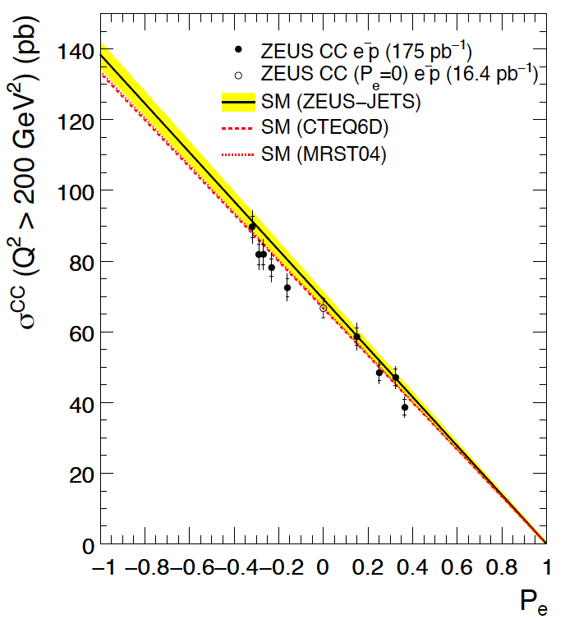
The new high Q² CC (e⁻p→νX) measurement by ZEUS
DESY 08-177, submitted
HERA II, 175 pb⁻¹
CC depends linearly on P

Slide 13
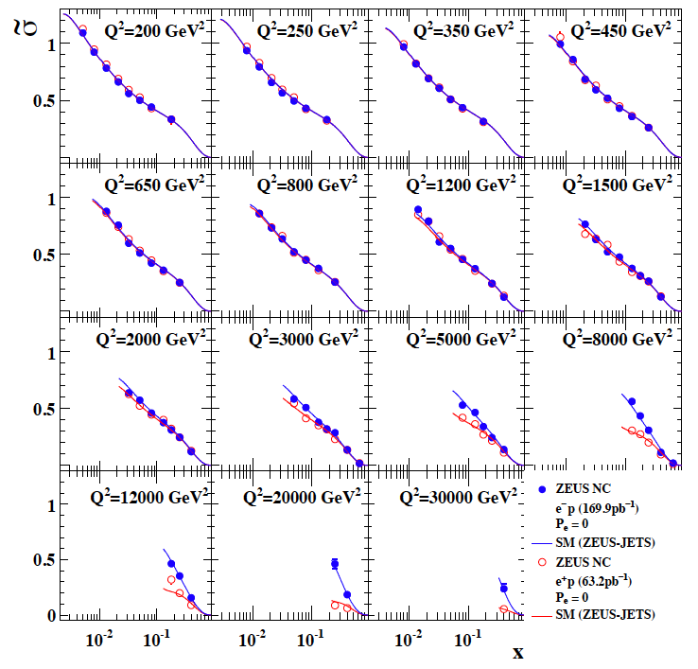
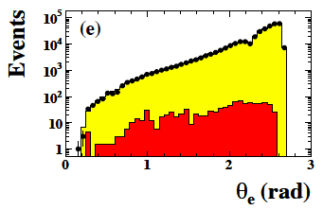
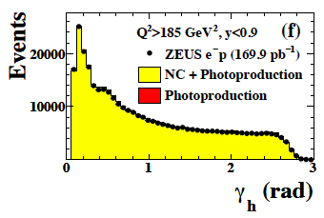
The new high Q² NC (e⁻p→e⁻X) measurement by ZEUS
DESY 08-202, submitted
HERA II, 169 pb⁻¹
polarised e⁻ beam
Double angle method:

Slide 14
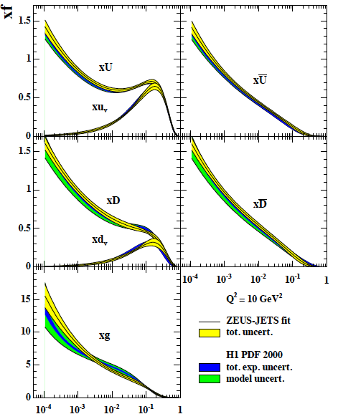
QCD Fits of HERA Structure Function Data
With NC and CC measure combinations of 4 parton
distribution functions, U, anti-U, D and anti-D, where
U=u+c, D=s+d. The valence quark distributions there
follow, assuming that sea=anti-quarks ( is s = anti-s??).
Thus HERA NC and CC data alone allow a determination
of a pdf set, free of HT, nuclear corrections and data
inconsistencies, apart our own
At an initial scale Q₀² the pdf’s are parameterised
and h.o pQCD evolution is used to obtain predictions
for all x,Q² and y.
A χ² function is minimised allowing the data to move,
constrained by penalty terms for error sources.
Usually α_{s} is fixed, but a dedicated fit of H1+BCDMS
was published in 01 and gave 0.151 +- 0.017 +- 0.019.
The pdf’s have an experimental uncertainty, a model
uncertainty and nowadays a parameterisation
uncertainty. The latter two are arbitrary to some extent.
These fits can be compared with global data fits,
by CTEQ, MRST/MSTW, Alekhin or the NNgroup .
HERA has further data to allow consistency checks:
F₂^{charm}, F₂^{beauty}, electroweak, F_{L}
previous generation fits

Slide 15
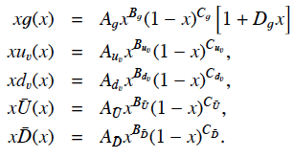
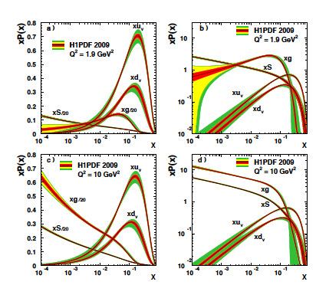
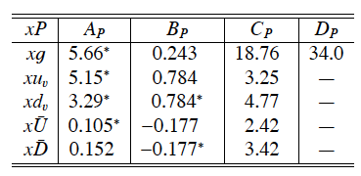
The most recent NLO fit (H1PDF2009)
H1: DESY 09-005, to appear
^{χ2}_{dof}=587/644, Q₀²=1.9
Sea at low x fixed by F₂ (if d=u!)
Gluon at low Q²,x uncertain, expressed
via Q₀² variation; at high x too, expressed
as parameterisation choice variation. Get
astonishingly easy a high sea at large x..
“p is glue for x < 0.1!”
for Q² > few GeV² (DIS)

Slide 16
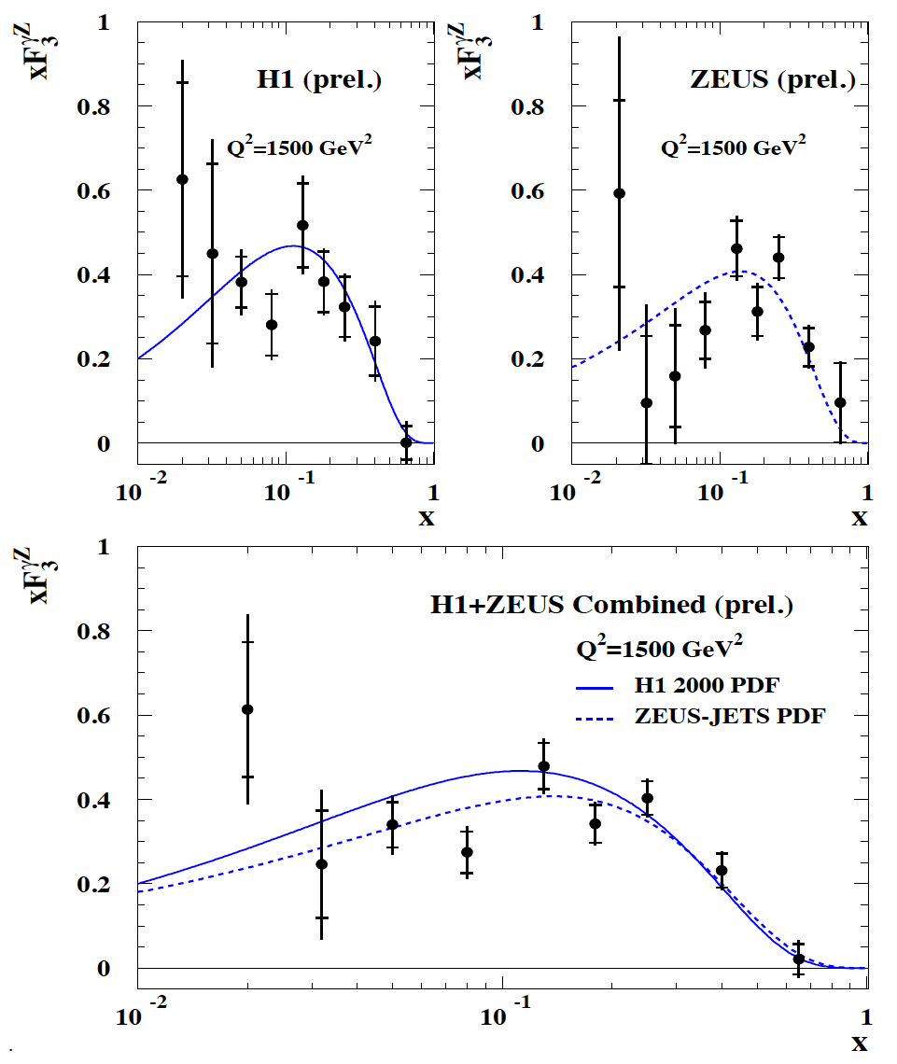
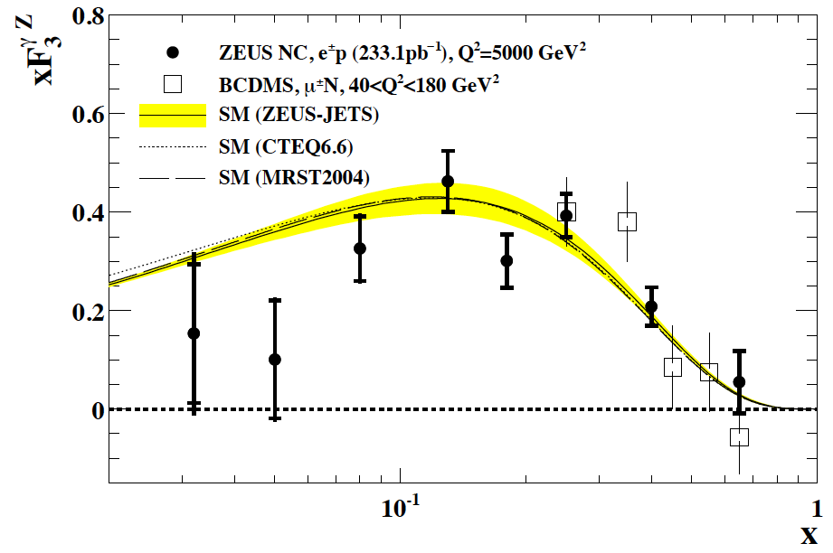
Combination of H1 and ZEUS inclusive Data – xF₃
Measurement of valence quarks [2u_{v}+d_{v}]/3
down to low x, unless q_{sea} ≠ anti-q
Difficult to measure at HERA, needs high Q²
and contributes only at high y as Y₋=1-(1-y)²
Update of xF₃ by ZEUS, DESY 08-202
ICHEP06, H1prel. 06-142, ZEUSprel. 06-022

Slide 17
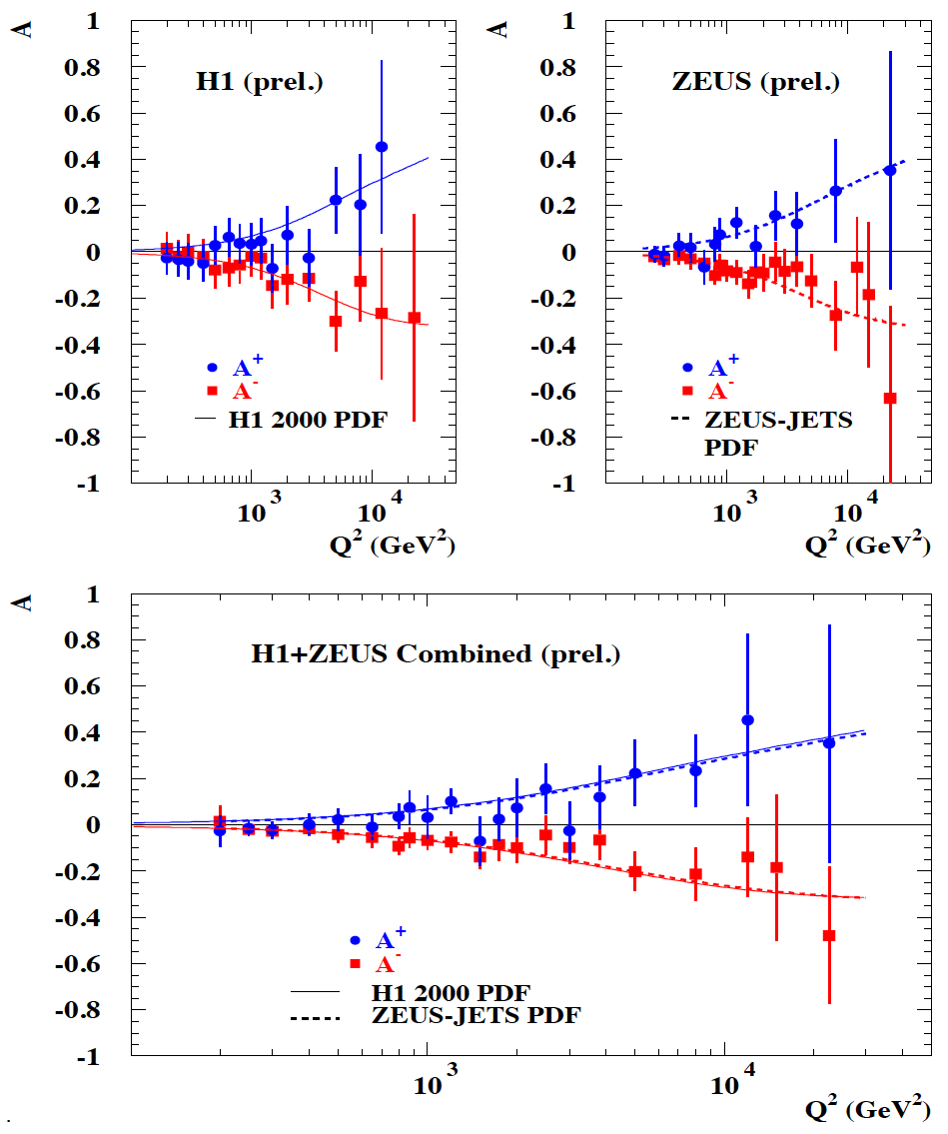
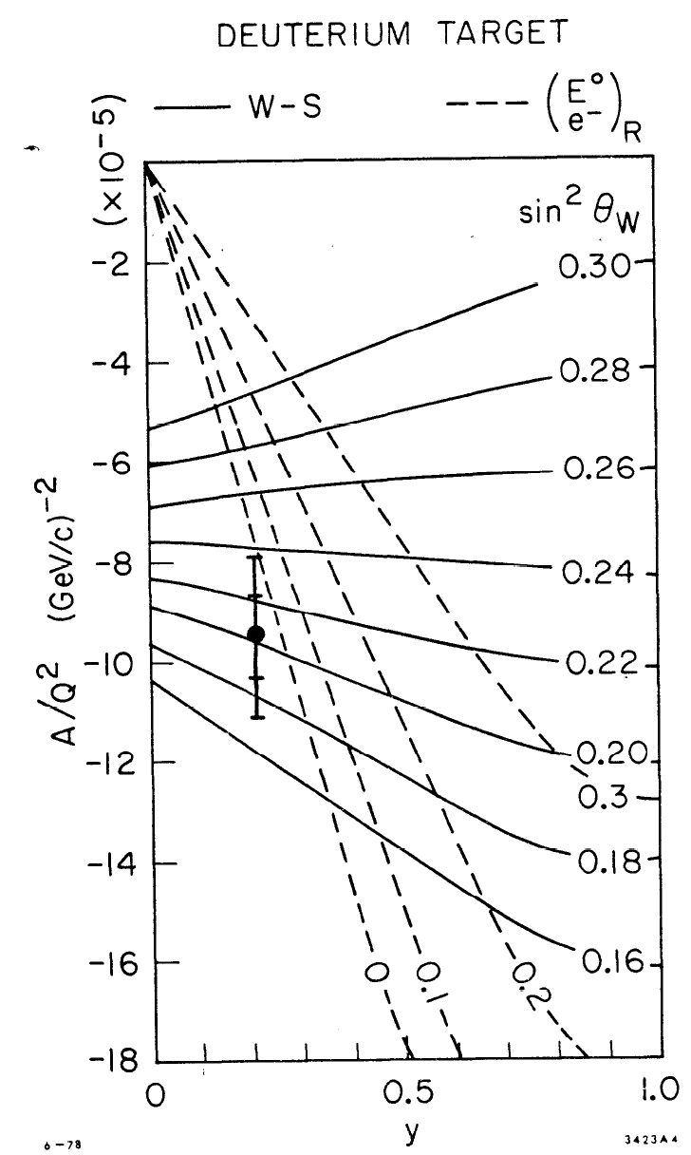
Combination of H1 and ZEUS inclusive Data – A±
Q² =1..2 GeV²
ICHEP06, H1prel. 06-142, ZEUSprel. 06-022

Slide 18
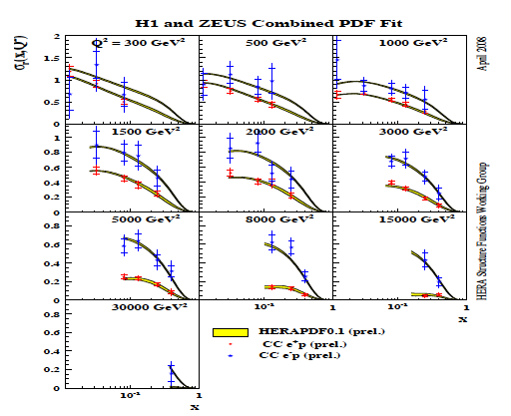
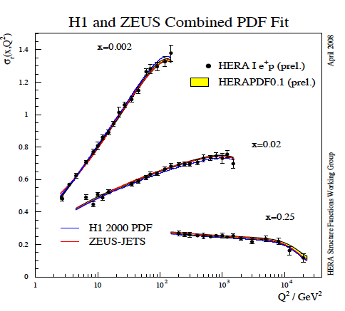
Combination of H1+ZEUS Data
Minimisation for more than one data set with possible systematic error correlations among the
sets (>100 sources in H1/ZEUS). Being used for
data combination and QCD fit (as in H1 F₂ papers)
Combinations: 06/07 high Q² mainly
DIS08: attempt for full systematic analysis
including joint QCD fit to combined data.
DIS09: Madrid, end of April: new preliminary:
adapt to modified χ², include new
H1 data (see above which are 1.3-2% accurate
in the bulk region). Fit close to H1pdf09:
VFNS, Q₀²,parameterisation and uncertainties

Slide 19
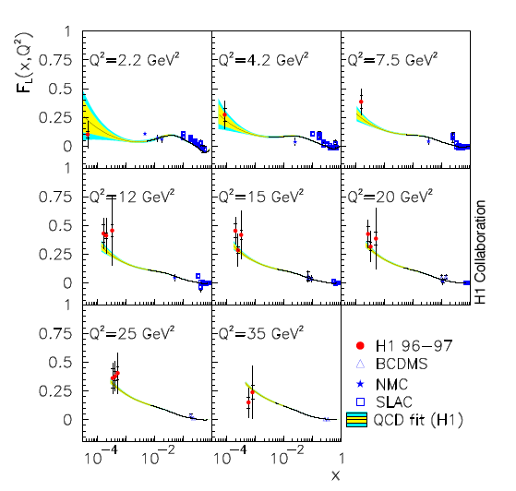
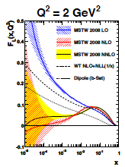
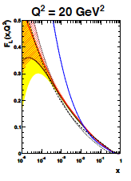
Expectations on F_{L}
Experiment
Theory (pQCD)
F_{L} prediction related to the gluon density,
the size and the uncertainties on xg -
constraints require max accuracy and range
Theory developed to NNLO
[W.van Neerven, J.Vermaseren, et al.]
A measurement of F_{L} tests QCD at h.o. at low x
Fixed target: F_{L} is small at large x (spin 1/2 quarks)
indications for increase towards low x
H1: hints to large F_{L} when F₂ is assumed to be known
Eur.Phys.J.C21:33-61,2001
MSTW09 arXiv0901.0002

Slide 20
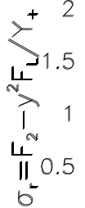
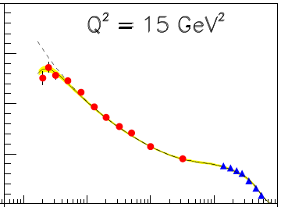
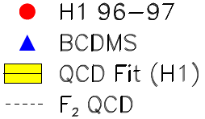
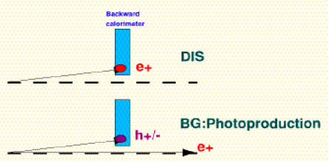
F_{L} - an experimental challenge
Need to vary s, keep x,Q² fixed.
Measure cross sections at high y
Trigger on energy down to a few GeV
Subtract photoproduction background to extract genuine DIS.
Part of γp events is tagged in downstream taggers.
Important to measure charge of e candidate [done in H1]
Measure cross section as accurate as possible
cannot measure F_{L} at large x (low y) at HERA
2% at y=0.7 gives
~0.06 error on F_{L}

Slide 21
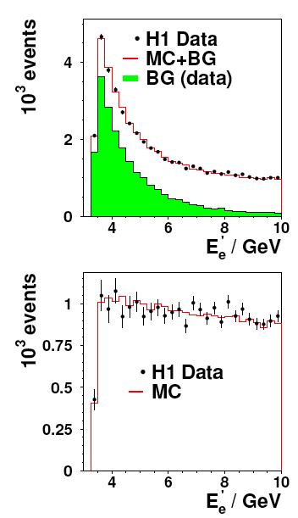
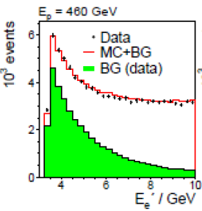
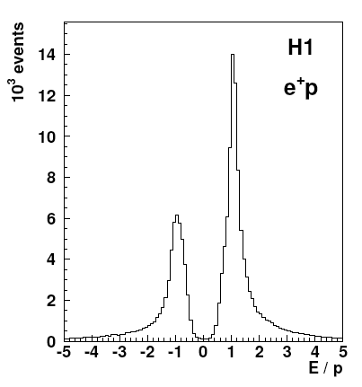
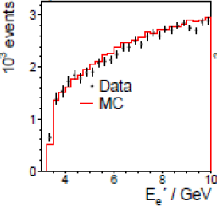
Background Subtraction - H1
At small energies DIS signal
is superimposed by γp events.
Those are charge symmetric,
apart from small effect due to
anti-protons vs protons, which
is measured using e⁺ and e⁻
data, and corrected for. H1, in
full range of Q² , has momentum
measurement of e candidate.
Scattered e energy distributions at medium and low Q²
SpaCal and CJC (2008) Spacal + BST (2009 – today)
E_{SPaCal} / p_{CTD}

Slide 22
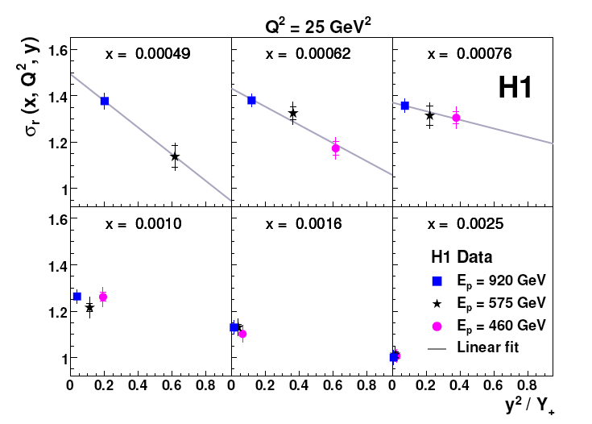
How to extract F_{L} ?
Separate structure functions at given x and Q² using straight line fit and error compensation.
Intermediate energy for measurement control. Energy value chosen to interpolate in y²/Y₊
At low y, fixed x,Q² cross sections need to coincide: Renormalisation, used by H1 and by ZEUS.
Note ZEUS in a recent paper is using a joint fit to all data instead of the method sketched here.

Slide 23
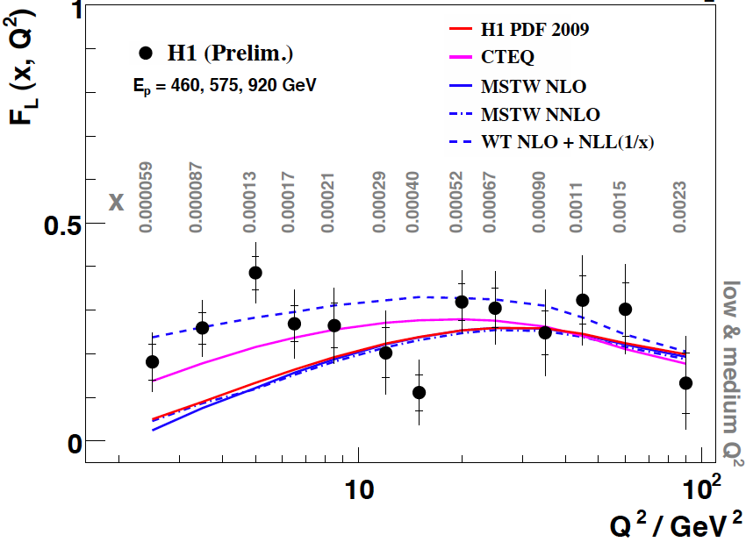
The Longitudinal Structure Function F_{L} - H1
E_{e}’ > 3 GeV
eID with max. p_{T}
BST/CJC track and
charge determination
to remove γp bgd
Values extracted point
by point assuming
uncorrelated errors
at this stage.
Results at medium Q²
are consistent with ZEUS
but error treatment differs.
At low x,Q² begin to
obtain new constraint
to pQCD and models.
Improvement over
first F_{L} publication:
F.D. Aaron et al.,
Phys. Lett. B 665, 139 (2008)
.
BST → CJC →
SpaCal → SpaCa+LAr →
To be submitted to DIS09

Slide 24
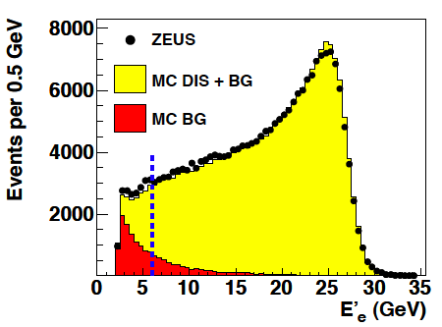
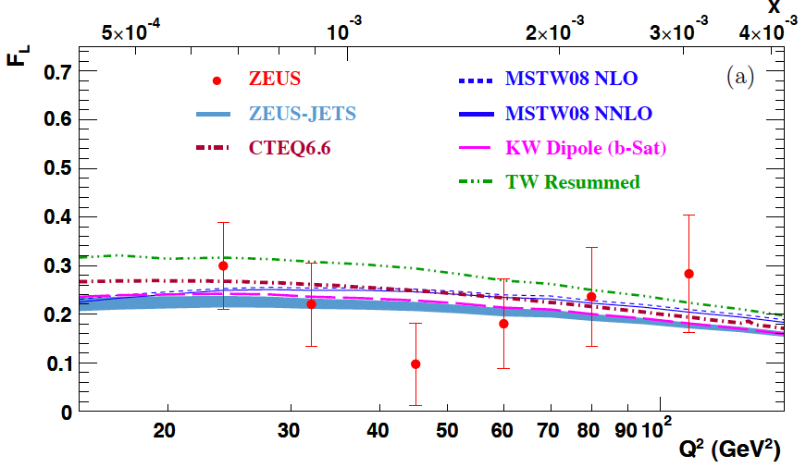
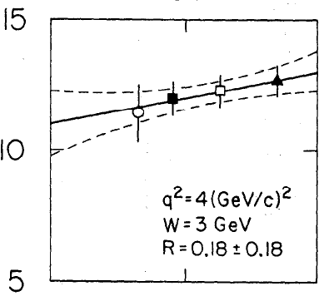
The Longitudinal Structure Function - ZEUS
E_{e}’ > 6 GeV.
eID with NN based on shower shape,
some hit requirement (MVD, CTD)
outside track reconstruction acc.
Monte Carlo used for background subtraction
DESY 09-046, to appear
Errors from joint fit allowing changes of systematics.
Publish both F_{L} and F₂
R=0.18+0.07-0.05
remember R=0.18+-0.10 from SLAC]

Slide 25
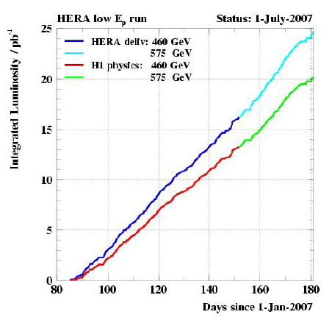
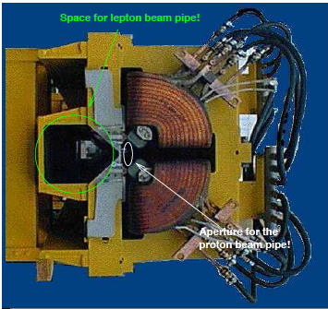
Measuring F_{L} in e⁺p HERA
Matched e and p beams: p beam wider
Less focussing of e beam: better lifetime:
went back to 60º phase advance optics.
New optics for both e and p beams. Kept
magnet positions despite narrow apertures.
E_{p}=460 GeV
~13 pb⁻¹
575 GeV
~6 pb⁻¹
Luminosity over 4 months at lower E_{p}
End of 2nd GM half quadrupole at ~-18m
/4
- Set up time of few days only
- Luminosity prompt and as calculated
- Polarisation increased (HERMES)
Time given for intermediate E_{p} run
The culmination of HERA upgrade
Specific luminosity over first 2 weeks

Slide 26
Summary
The results on inclusive DIS from HERA have been most impressive,
based on a reliable accelerator (team), efficient detectors for 15 years
and genuine innovations in measurement techniques, often based
on the redundancy from e and h kinematics determinations.
In DIS at low x the proton is gluon dominated and the sea rises.
pQCD works over many orders of magnitude in x and Q² but the
highest accuracy data may still shed a different light to x ≤ 10⁻⁴.
A full set of pdf’s has been determined and one is able to describe
the heavy quark structure functions, and the Tevatron jet data
to about 20% accuracy (not shown here)
The HERA data thus represent a solid base for predicting TeV scale
pp interactions as is required for the initial phase of the LHC.
More publications are imminent in 2009/10. These regard F_{L}, combined
HERA-I cross sections, HERA-II high Q² and high y, further QCD studies..

Slide 27
The Fermi Scale [1985-2010]
pp
b quark
top quark
M_{W}
Tevatron
ep
e⁺e⁻
The Standard
Model Triumph
M_{Z} , sin² Θ
3 neutrinos
h.o. el.weak (t,H?)
gluon
h.o. strong i.a.
c,b distributions
high parton densities
LEP/SLC
HERA
CKM - B factories

Slide 28
Beyond HERA’s structure functions?
Low x: the kinematic range is too small to establish the expected saturation of xg;
there is no information on the flavour dependence of the sea
Large x: the CC data are practically limited to x < 0.5:
The HERA based predictions at large x are rather uncertain (d/u?, xg?, sea-valence?)
The heavy quark distributions: not measured s, anti-s, just measured b, “no” Wb → top
Most of the pdf information is obtained using pQCD fits, with serious deficiencies + ambiguities.
The partonic contents of the proton is yet to be fully unfolded and QCD to be challenged.
Understanding LHC observations, at high masses or related to xg, b (cf Higgs and SUSY Higgs),
may require ep data in the appropriate kinematic range (see below for an example)
The partonic structure of nuclei at lower x or higher Q² is a terra incognita beyond the fixed
target range, yet we embark on quark-gluon plasma and CGC discoveries with ALICE (AA,pA).
We have missed to explore neutron’s structure in runs with deuterons (shadowing – diffraction, Gribov).
Perhaps quarks have substructure below 10⁻¹⁹m, perhaps leptons and quarks are one type of matter..
We work on a CDR for the LHeC by 2010 – Ring and LINAC (5 times 2 mile for 50 000 times SLAC’s Q²)
http://www.lhec.org.uk

Slide 29
Structure Functions with the LHeC
high Lumi,
high precision,
new detector,
full range:
α_{s} to 0.0001
thy challenge
T.Kluge, MK - DIS08
CC e⁻
High precision electroweak structure functions.
Flavour separation to highest x
CC e⁺
F₂ and F_{L}: the ultimate challenge to saturation
(Foreshaw et al, NNPDF group)
MK. Divonne LHeC workshop 9/2008 and DIS07/08

Slide 30
pdf’s and New Physics at the LHC
Factorisation is violated in production
of high p_{T} particles (IS and FS i.a.s).
Important, perhaps crucial, to measure
pdf’s in the kinematic range of the LHC.
cf also ED limits vs pdf’s.
E.Perez, Divonne
NP may be accommodated by HERA/BCDMS
DGLAP fit. It can not by the fit to also LHeC.
(recall high E_{T} excess at the Tevatron which
disappeared when xg became modified)

Slide 31
The TeV Scale [2010-2035..]
pp
W,Z,top
Higgs??
New Particles??
New Symmetries?
LHC
ep
e⁺e⁻
New Physics*
High Precision QCD
High Density Matter
Substructure??
eq-Spectroscopy??
ttbar
Higgs??
Spectroscopy??
LHeC
ILC/CLIC
* and the ‘completion’ of the old one

Slide 32
DIS has been most exciting for decades there can be a future to DIS, a tribute to
Bjoern Wiik
Willy van Neerven
Pief Panofsky
Wu-Ki Tung

Slide 33
Thank you
cf recent DIS workshops and the one coming
arXiv – F_{L} (ZEUS), F₂’s of H1 ..appearing
the H1 and ZEUS web pages and
for LHeC: http://www.lhec.org.uk

Slide 34
The 10-100 GeV Energy Scale [1968-1986]
(--)
pp
Drell Yan
Charm
W,Z
Jets
lh
e⁺e⁻
SU(2)_{L} x U(1)
QCD
Quarks
Neutral currents
Singlet e_{R}
Asymptotic Freedom
Charm
3 colours
Gluon Jets

