Slide 1
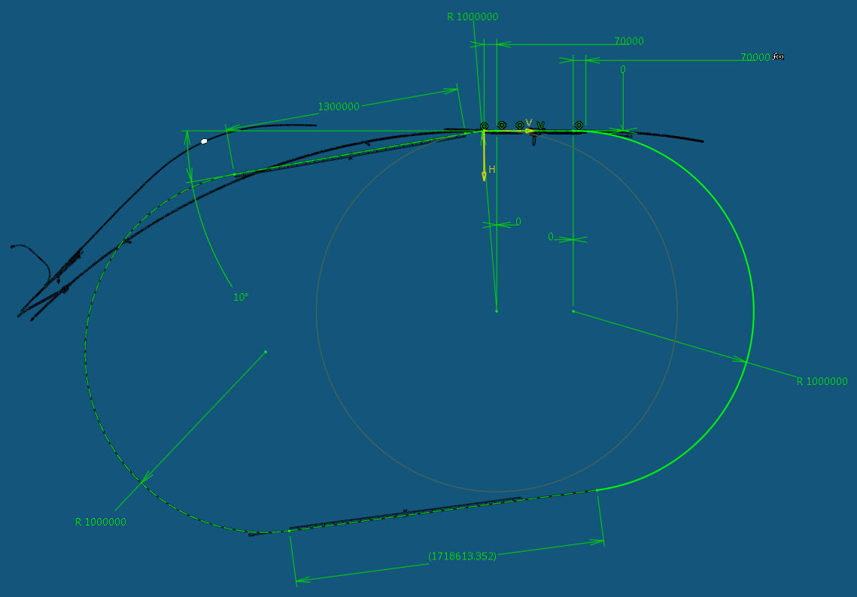
The LHeC
Project Overview
Physics Programme
Accelerator
Detector
Max Klein, University of Liverpool - University of Geneva, 5.12.2012

Slide 2
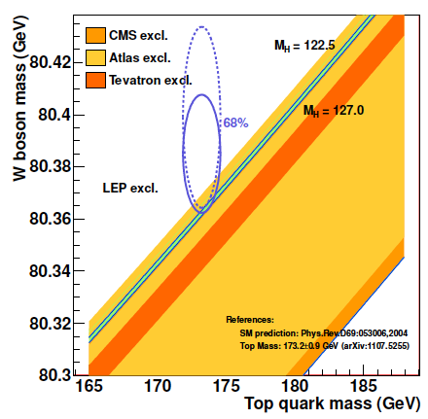
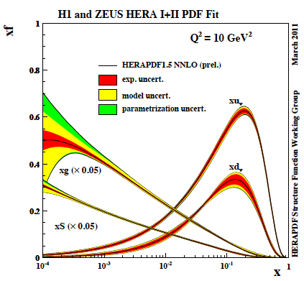
Colliders explored the Fermi Energy Scale
Tevatron to find SUSY and BSM; LEP/SLC to find SUSY and the Higgs; HERA to find Lepto-Quarks
probable legacy plots/numbers
NNLO!
R.Lopes de Sa (Moriond 11.3.12)
M_{Z}=91.1876±0.0021 GeV (PDG2010)
Practical end of HERA xg sensitivity

Slide 3
What HERA could not do or has not done
Test of the isospin symmetry (u-d) with eD - no deuterons
Investigation of the q-g dynamics in nuclei - no time for eA
Verification of saturation prediction at low x – too low s
Measurement of the strange quark distribution – too low L
Discovery of Higgs in WW fusion in CC – too low cross section
Study of top quark distribution in the proton – too low s
Precise measurement of F_{L} – too short running time left
Resolving d/u question at large Bjorken x – too low L
Determination of gluon distribution at hi/lo x – too small range
High precision measurement of α_{s} – overall not precise enough
Discovering instantons, odderons – don’t know why not
Finding RPV SUSY and/or leptoquarks – may reside higher up
…
The H1 and ZEUS apparatus were basically well suited
The machine had too low luminosity and running time
HEP needs a TeV energy scale machine with 100 times
higher luminosity than HERA to develop DIS physics
further and to complement the physics at the LHC. The
Large Hadron Collider p and A beams offer a unique
opportunity to build a second ep and first eA collider
at the energy frontier [discussed at DIS since Madison 2005]
HERA in one box
the first ep collider
E_{p}*E_{e}=
920*27.6GeV²
√s=2√E_{e}E_{p}=320 GeV
L=1..4 10³¹cm⁻²s⁻¹
→ ΣL=0.5fb⁻¹
1992-2000 & 2003-2007
Q²= [0.1 -- 3 * 10⁴ ] GeV²
-4-momentum transfer²
x=Q²/(sy) ≅10⁻⁴ .. 0.7
Bjorken x
y≅0.005 .. 0.9
inelasticity

Slide 4
60 GeV electron beam energy, L= 10³³ cm⁻²s⁻¹, √s=1.3 TeV: Q²_{max} 10⁶ GeV², 10⁻⁶ < x< 1
Recirculating linac (2 * 1km, 2*60 cavity cryo modules, 3 passes, P < 100 MW, ERL)

Slide 5

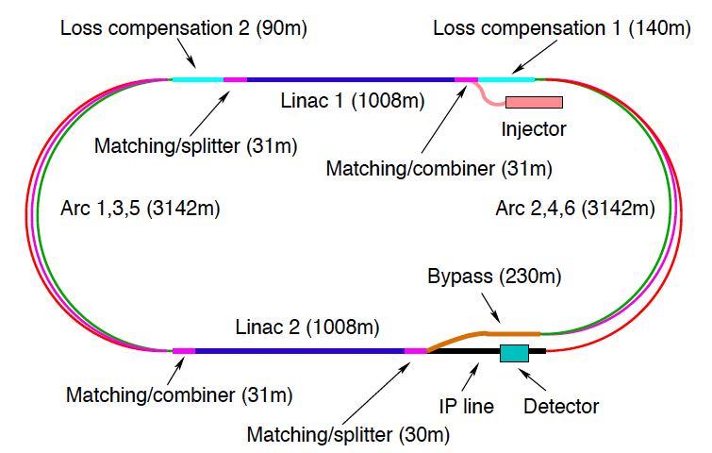
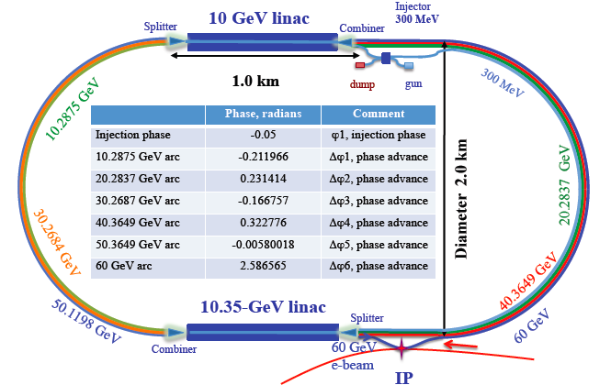
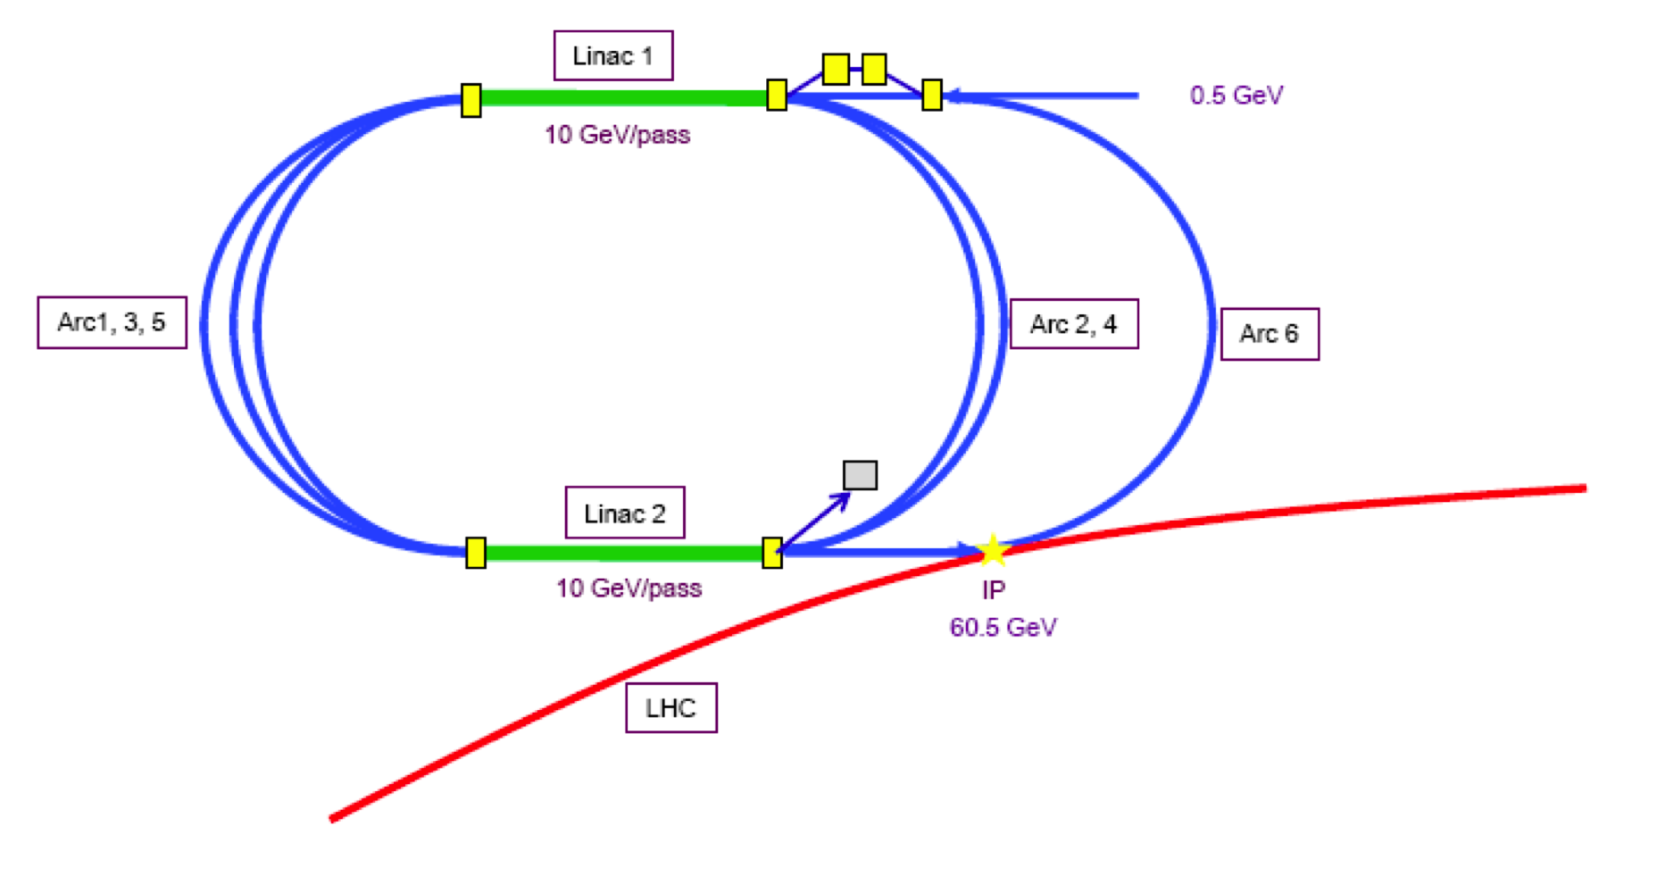
60 GeV Energy Recovery Linac
CERN 1
CERN 2
Jlab
BNL
Two 10 GeV energy recovery Linacs, 3 returns, 720 MHz cavities

Slide 6
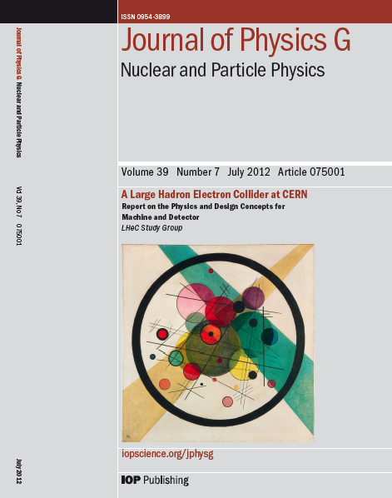
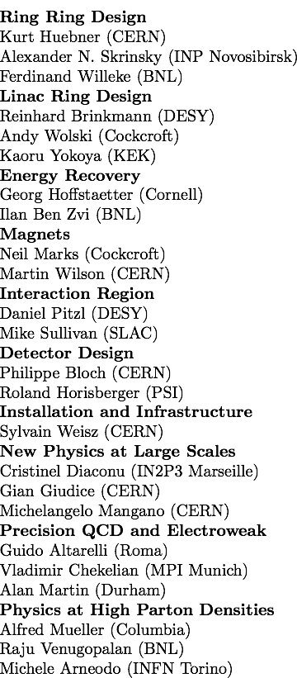
CERN Referees
Published 600 pages conceptual design report (CDR) written by 200 authors from 60 Institutes and
refereed by 24 world experts on physics, accelerator and detector, which CERN had invited.

Slide 7
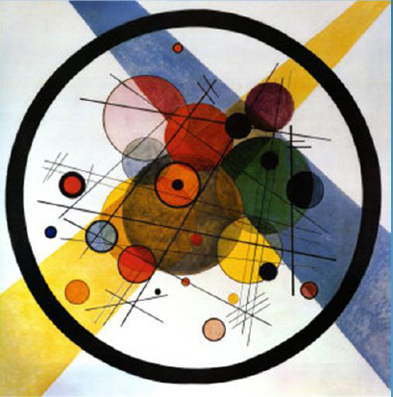


“BFKL evolution and Saturation in DIS”
“Critical gravitational collapse”
Circles in a circle
V. Kandinsky, 1923
Philadelphia Museum of Art
5d tiny black holes and perturbative saturation
Talk by A.S.Vera at LHeC Workshop 2008

Slide 8
Project Development
2007: Invitation by SPC to ECFA and by (r)ECFA to work out a design concept
2008: First CERN-ECFA Workshop in Divonne (1.-3.9.08)
2009: 2nd CERN-ECFA-NuPECC Workshop at Divonne (1.-3.9.09)
2010: Report to CERN SPC (June)
3rd CERN-ECFA-NuPECC Workshop at Chavannes-de-Bogis (12.-13.11.10)
NuPECC: LHeC on Longe Range Plan for Nuclear Physics (12/10)
2011: Draft CDR (530 pages on Physics, Detector and Accelerator) (5.8.11)
refereed and being updated
2012: Discussion of LHeC at LHC Machine Workshop (Chamonix)
Publication of CDR + 2 Contributions to European Strategy [arXiv]
Chavannes workshop (June14-15, 2012) – CERN: Linac+TDR Mandate
ECFA final endorsement of CDR
http://cern.ch/lhec

Slide 9
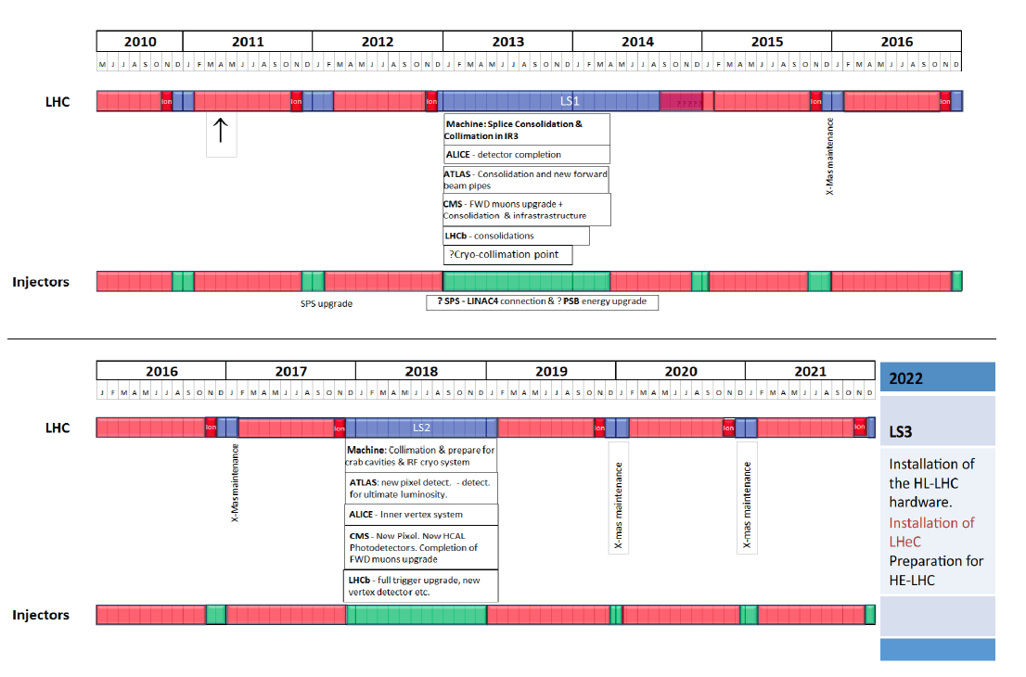
LHC Schedule for the coming decade
as shown by S. Myers at EPS 2011 Grenoble - Principal guidance of CDR [+N years..]

Slide 10
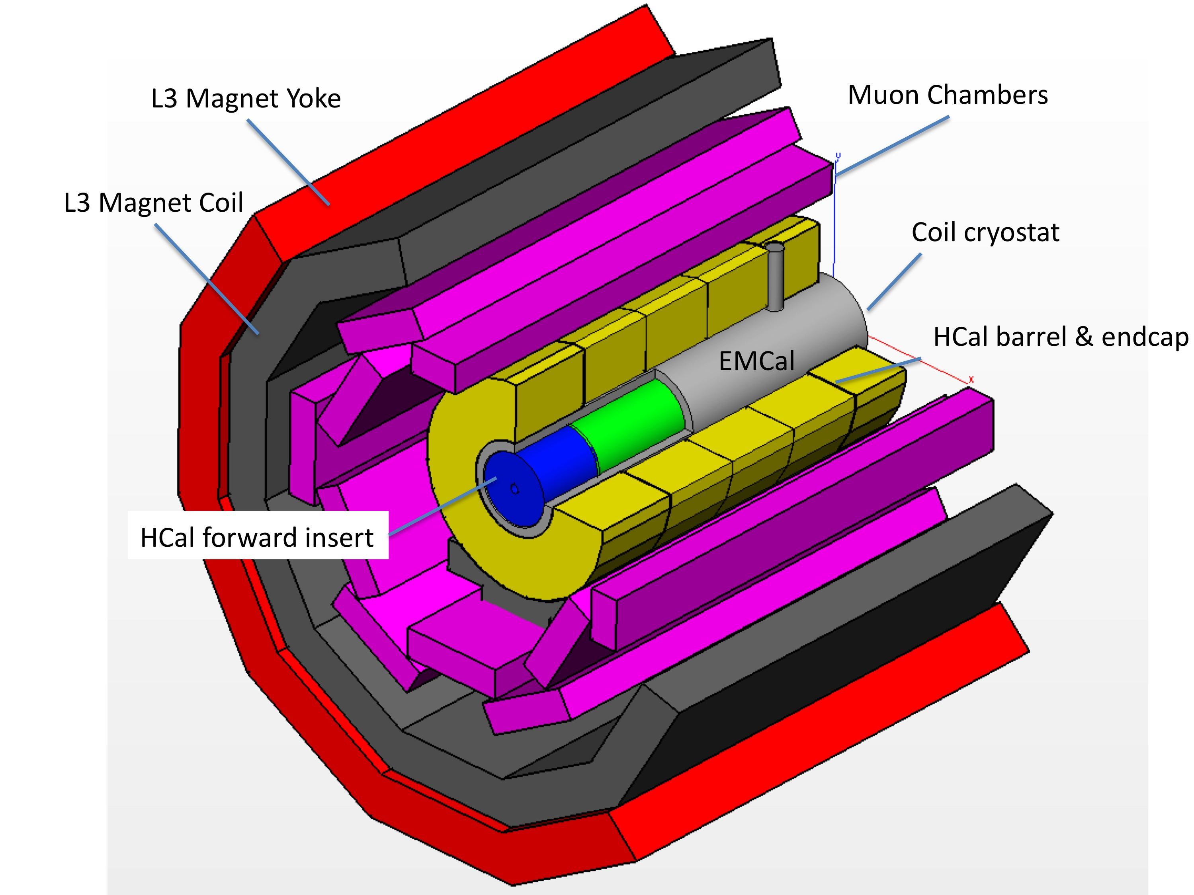
Detector supported by L3 Magnet
Installation study in CDR (Herve, Ghaddi): 30 months for removal and installation
which is compatible with LHC shutdown for HL-LHC (“LS3”)

Slide 11
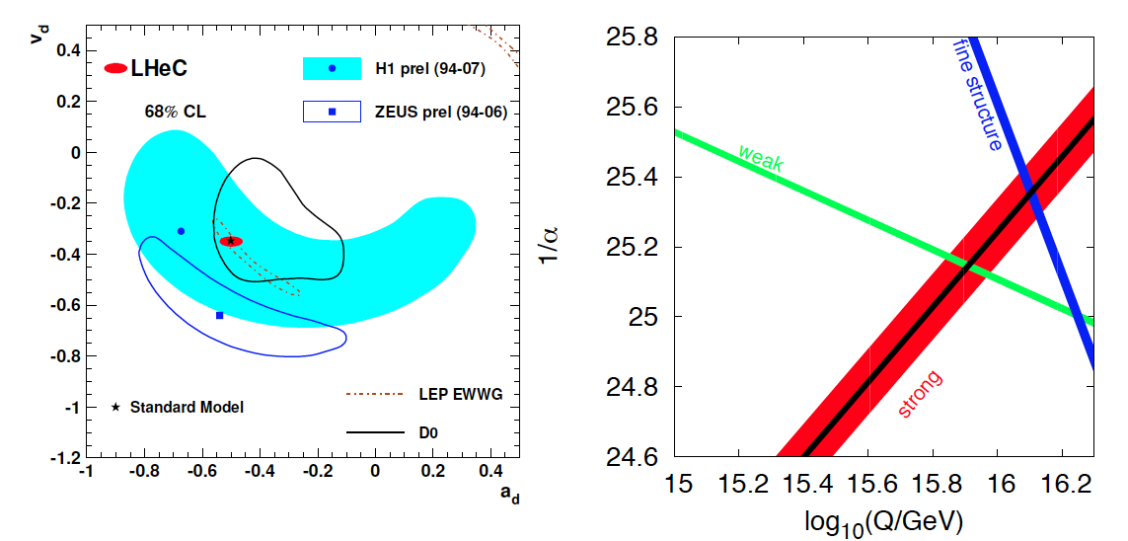
High Precision DIS
High Precision DIS
Q² >> M_{Z,W}², hi luminosity, large acceptance
Unprecedented precision in NC and CC
Contact interactions probed to 50 TeV
Scale dependence of sin²θ left and right to LEP
→ A renaissance of deep inelastic scattering ←
Solving a 40 year puzzle:
α_{s} small in DIS or high with jets?
Per mille measurement accuracy
Testing QCD lattice calculations
Constraining GUT (CMSSM40.2.5)
Charm mass to 3MeV, N³LO

Slide 12
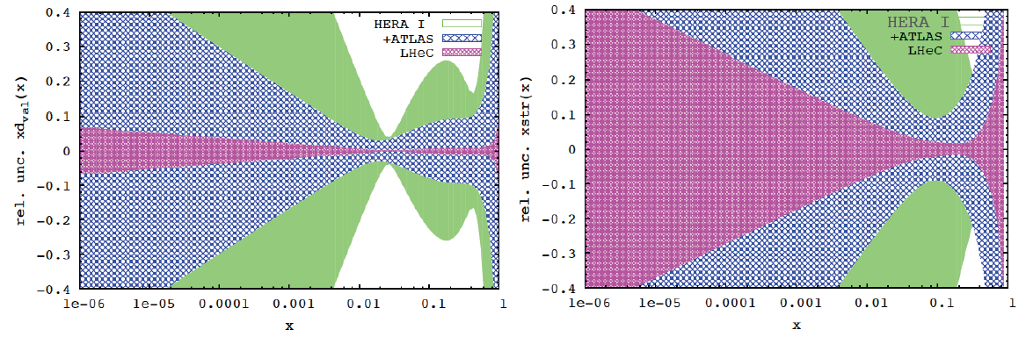
PDFs from HERA+LHC and LHeC
d valence
strange
QCD fit with free
u,d,s, HERA plus ultimate ATLAS and
full systematic error simulation on LHeC
DIS is the appropriate process to determine PDFs (just compare HERA – Tevatron PDF constraints)
LHeC: first time ever to fully determine PDFs, free of symmetry and ad hoc assumptions
in huge and unexplored kinematic range
LHC: precision Drell-Yan data provide constraints
(cf for example the ATLAS determination of s/d)
Yet, high precision (<1%) only achievable at W,Z
scale (miss the evolution) and large eweak-QCD theory uncertainties complicate interpretation
Direct strange measurement from charged current
Ws→c in ep → νcX [high lumi, large range, small spot ~7μm²]

Slide 13

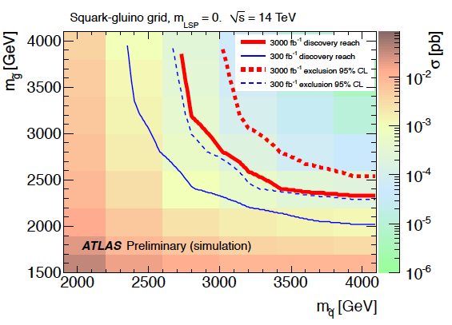
LHeC and the HL-LHC (SUSY searches)
With high energy and luminosity, the LHC search range will be extended to high masses,
up to 5 TeV in pair production. At correspondingly high x (> 0.5) the PDFs are unknown to
a considerable extent [cf gg luminosity → ğğ and gluon density from LHeC (10% at x=0.6)]
The HL-LHC (search) programme requires a much more precise understanding of QCD,
which the LHeC provides (strong coupling, gluon, valence, factorisation, saturation, diffraction..)

Slide 14
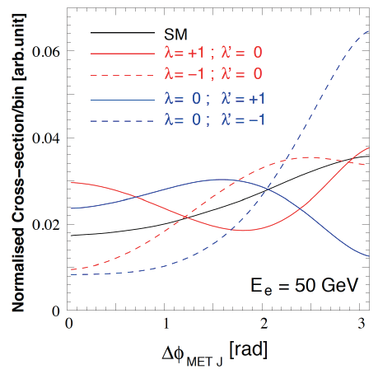
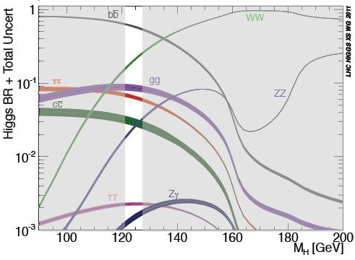
Higgs and LHeC
Precision measurements of couplings in WW and ZZ production (so far: bb in CC to 4%)
Measurement of CP properties (J^{PC}=0⁺⁺ in SM; MSSM has 2 CP-even and 1 CP-odd states)
Reduction of theoretical uncertainties for pp measurements
Initial study of WW → H → bb
PGS for detector, cut based analysis,
S/N =1, 500 H-bb events for 100fb⁻¹
ICHEP12: J Campbell: ultimate limitation of
Higgs measurements from LHC by PDFs/QCD
With high luminosity the LHeC has a huge potential for precision Higgs physics, which is being further evaluated.

Slide 15
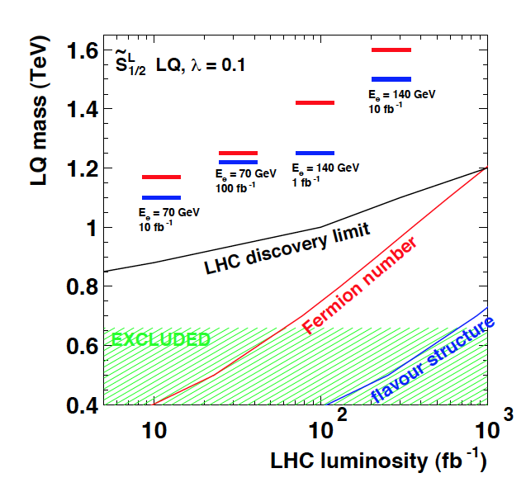
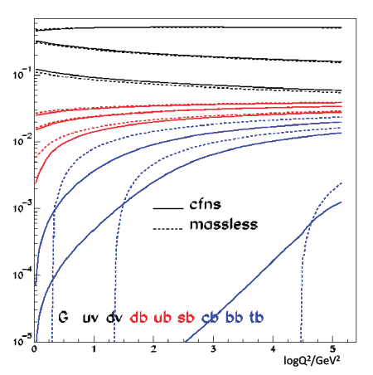
Top Quark and Leptoquarks
The LHeC is a (single) top quark production
factory, via Wb → t. Top was never observed
in DIS. With ep: top-PDF → 6 flavour VFNS,
precision M_{t} direct and from cross section,
anomalous couplings
Leptoquarks (-gluons) are predicted in RPV SUSY,
E6, extended technicolour theories or Pati-Salam.
The LHeC is the appropriate configuration to do their
spectroscopy, should they be discovered at the LHC.

Slide 16
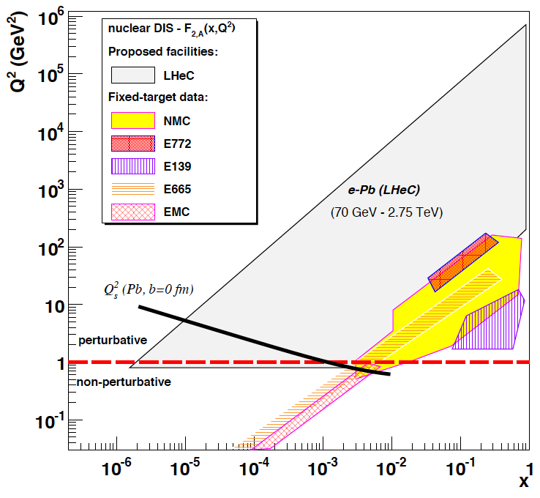
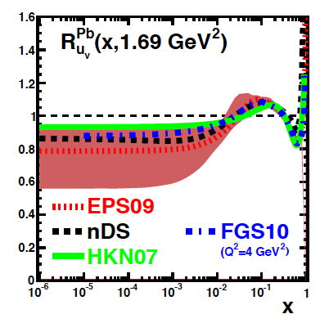
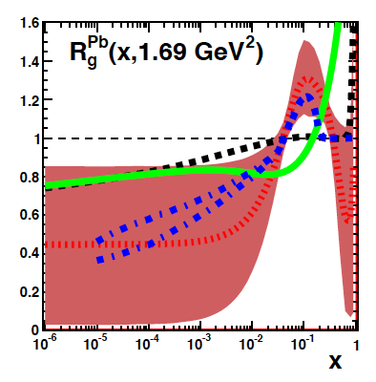
Heavy Ion Physics
up valence
gluon
eA physics is essentially not done yet (no eA at HERA)
LHeC has huge discovery potential for new HI physics
(bb limit, saturation, deconfinement, hadronisation..)
It will put nPDFs on completely new ground and
constrain the initial conditions of the Quark-Gluon Plasma
unmeasured | known?

Slide 17
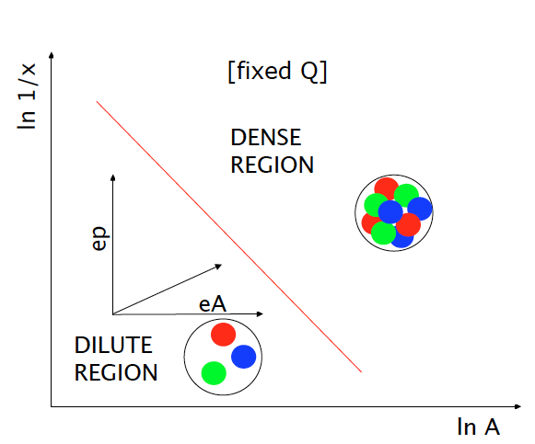
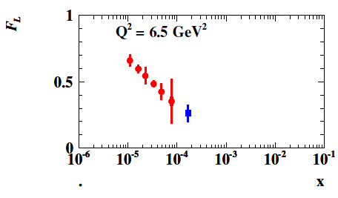
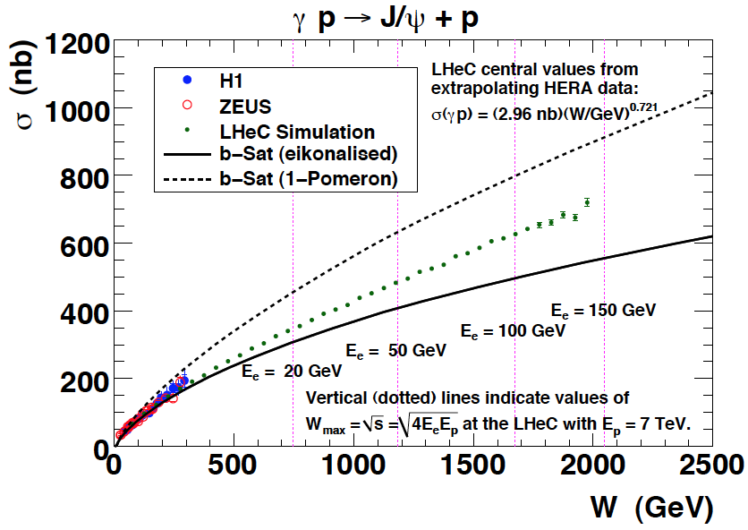
Saturation – Low x Physics
Precision Measurements of
crucial observables (F₂, F_{L}, J/ψ..
New phase of matter: small coupling but
non-linear parton-parton interactions:
End of DGLAP ? BFKL?
Access to 10 TeV scale SUSY via BFKL (“DP”) arXiv:1205.6713 Kowalski, Lipatov, Ross
Restauration of unitarity?
Relevant for UHE neutrino scattering

Slide 18
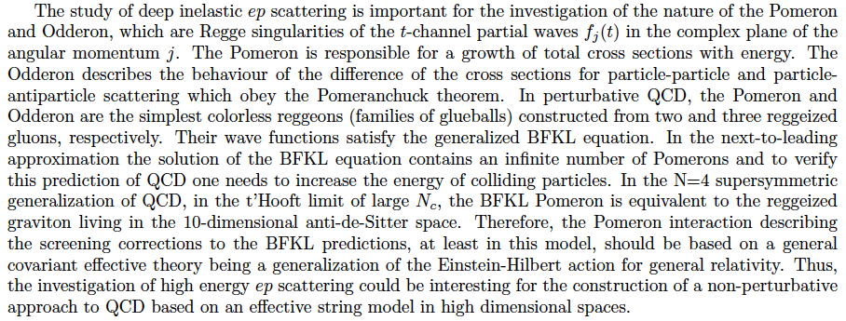
Candidates for Surprises and Discoveries
PDFs (t, s, q-q, val, xg)
Odderon
Instanton
(no) saturation, QCD
QGP initial state
Factorization pp-ep
LQs, RPV SUSY
e*
Higgs CP
α_{s} indeed small (GUT)
Lev Lipatov in the CDR…
Ultra high precision (detector, e-h redundancy) - new insight
Maximum luminosity and much extended range - rare, new effects
Deep relation to (HL-) LHC (precision+range) - complementarity
→ LHeC brings a substantial enrichment of LHC physics

Slide 19
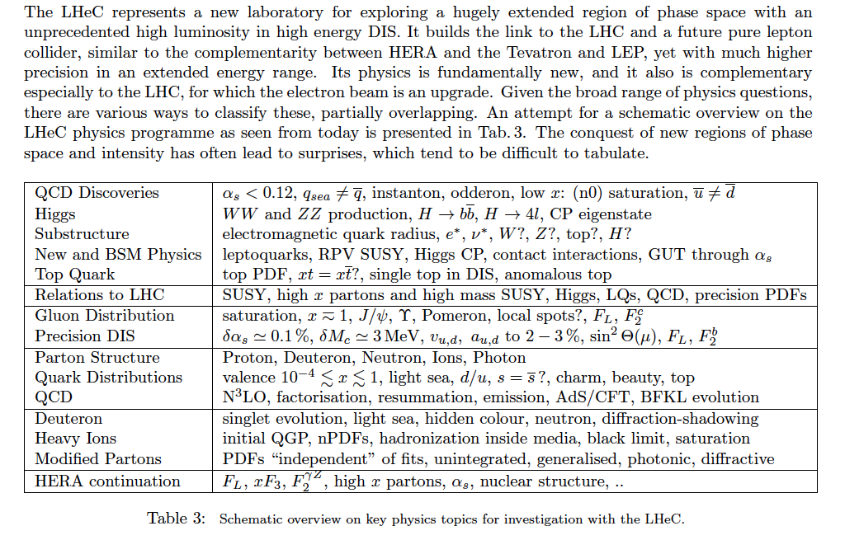
Summary of LHeC Physics [arXiv:1211:4831+5102]

Slide 20





















Accelerator Design: Participating Institutes
TOBB ETU
KEK

Slide 21
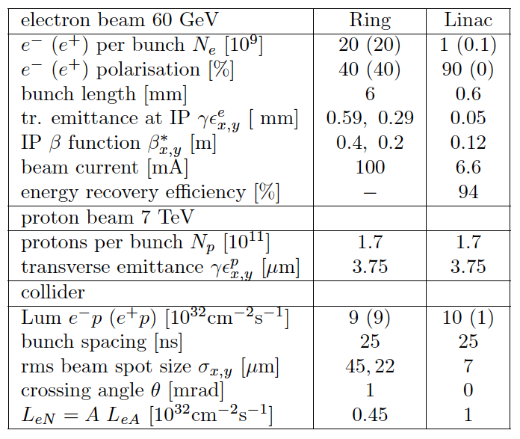
LHeC Parameters
Source | Power [MW]
Cryogenics (linac) | 21
Linac grid power | 24
SR compensation | 23
Extra RF cryopower | 2
Injector | 6
Arc magnets | 3
Total | 78
CDR: Two options for electron beam: Ring or (Racetrack) Linac with E-recovery for L > 10³³cm⁻²s⁻¹
Synchronous operation of pp and ep in HL-LHC phase. e Ring required bypassing pp experiments

Slide 22
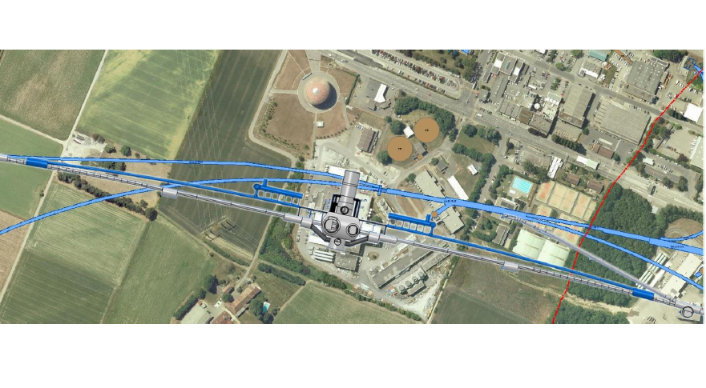
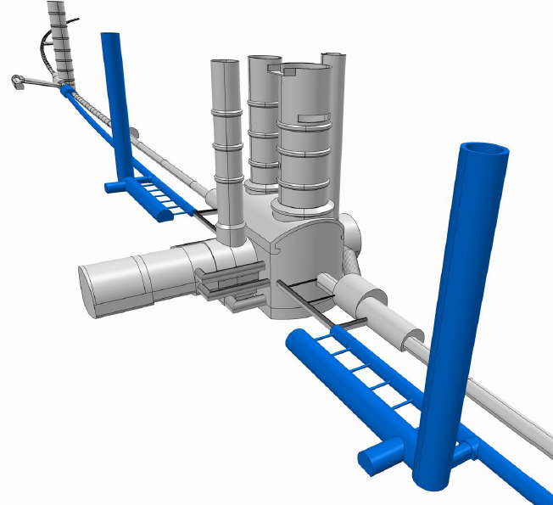
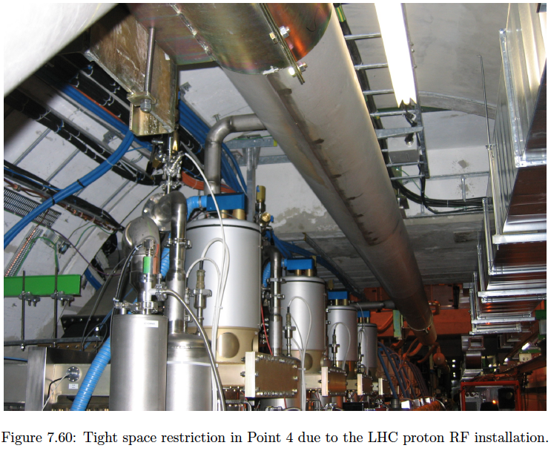
Ring-Ring
Civil engineering studied and reviewed by CH company Amber, both for ring and for linac options. Bypass in
ring option used to house rf. ~4years of installation
Quite some interference with LHC: cryo jumpers (asymmetric FODO), connection of bypasses, access to
LHC, proton dump area (point 3), RF (point 4), .. Cf CDR
June workshop, after CDR: RR not preferred, design LR

Slide 23
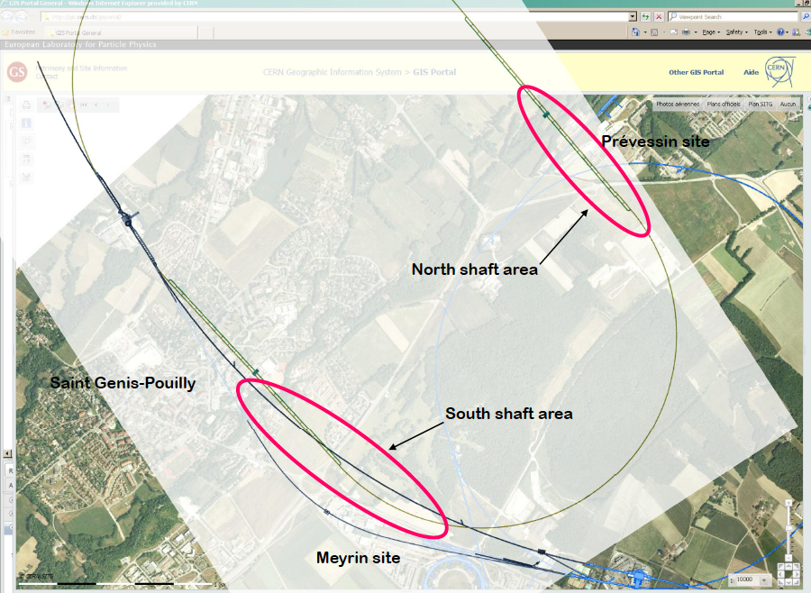
60 GeV Electron Accelerator
Two 1km long LINACs
connected at CERN territory
Arcs of 1km radius: ~9km tunnel
3 passages with energy recovery
John Osborne (June LHeC Workshop)

Slide 24
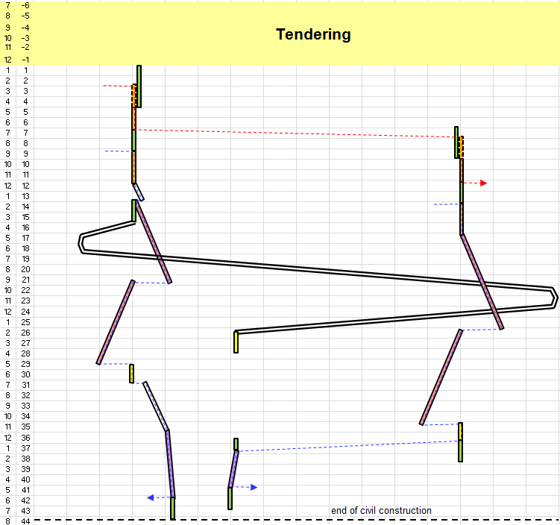
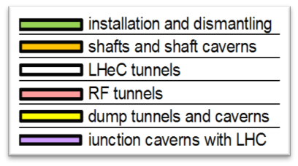
Civil Engineering until 2015
Shaft sinking installation
Roadheader 1
CDR: Evaluation of CE, analysis
of ring and linac by Amber Zurich
with detailed cost estimate
[linac CE: 249,928 kSF..] and time:
3.5 years for underground works using 2 roadheaders and 1 TBM
More studies needed for
Integration with all services
(EL,CV, transport, survey etc).
Geology
Understanding vibration risks
Environmental impact assessment
Tunnel connection in IP2
Roadheader 2
J.Osborne, Chavannes

Slide 25
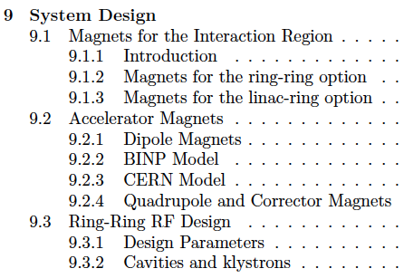
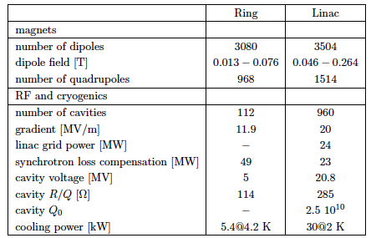
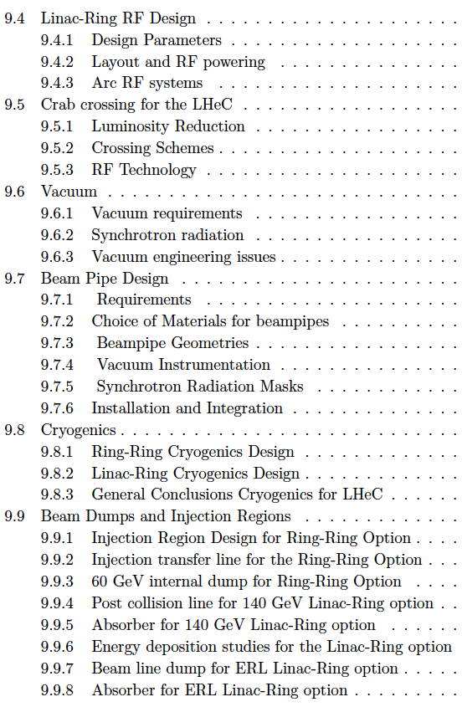
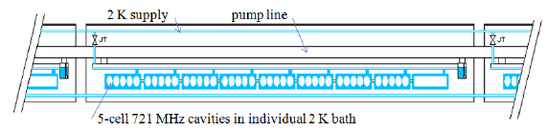

Chapter 9 of CDR
Components and Cryogenics
Jlab:
4 10¹¹
Need to develop LHeC cavity (cryo-module)
from CDR LHeC

Slide 26
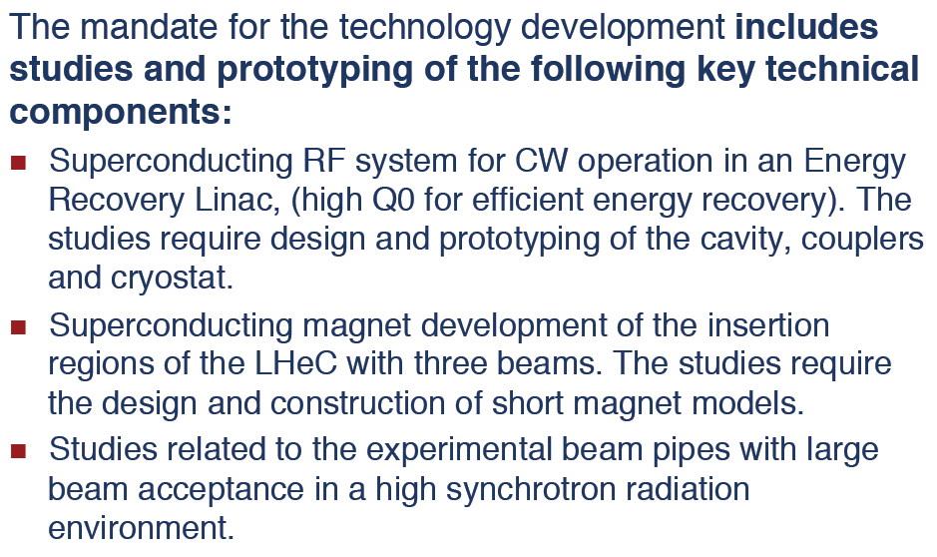
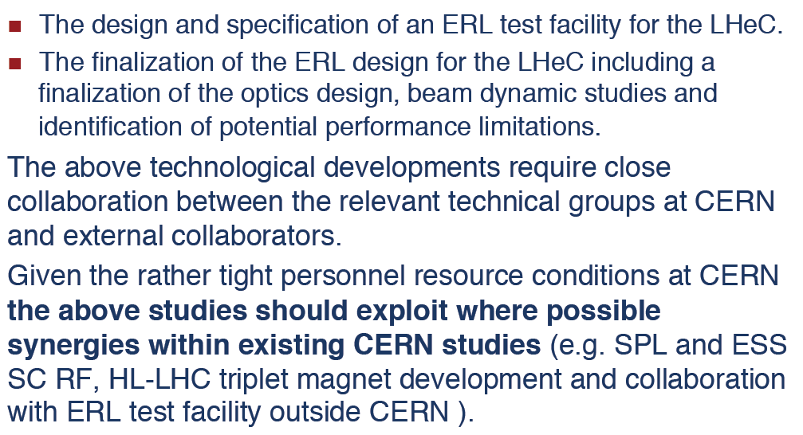
CERN Mandate – TDR by ~2015
S.Bertolucci at Chavannes workshop 6/12 based on
CERN directorate’s decision to include LHeC in the MTP

Slide 27
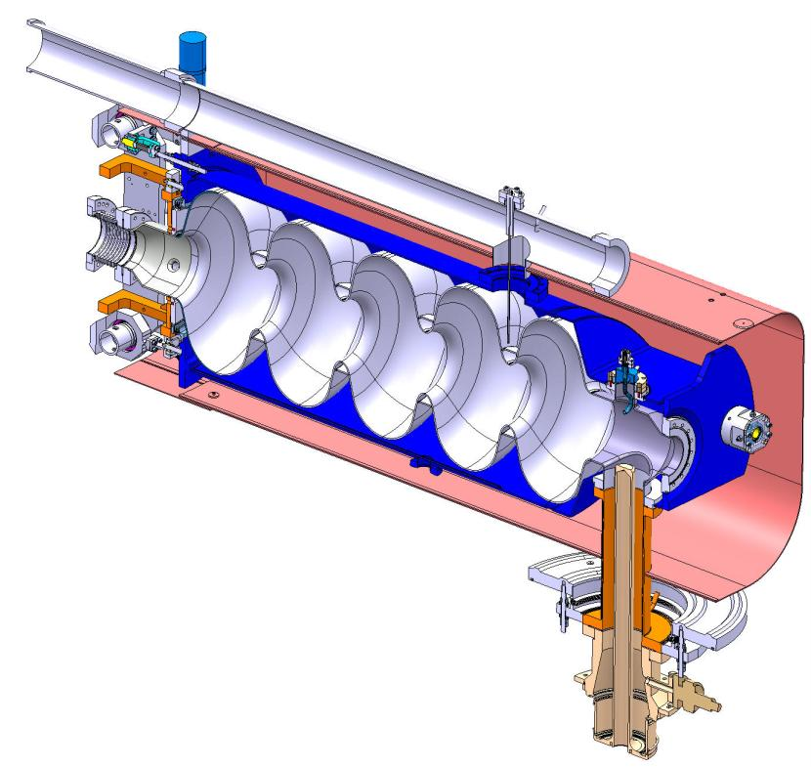
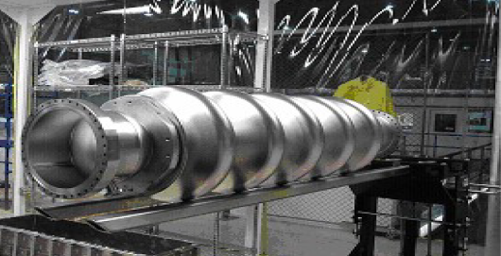
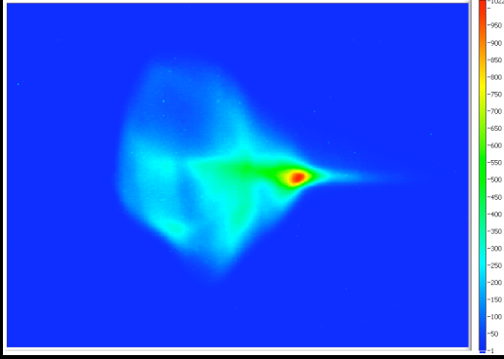
RF Development
Frequency choice: n * 120.237 MHz
N=6: 721 MHz, n=11: 1.3GHz (XFEL)
Detailed comparison (threshold current, cryo power,
Rf power, size, cost, collaboration, synergy..)
ALICE 1.3 GHz, not CW – only EU ERL facility operational
Daresbury develops cryomodule for ESS (700 MHz)
CERN: in house collaboration with SPL, and eRHIC/BNL
SPL cryomodule 704 MHz
Accelerator physics motivation:
  ERL demonstration, FEL, γ-ray source, e-cooling demo!
  Ultra-short electron bunches
One of the 1st low-frequency, multi-pass SC-ERL
  synergy with SPL/ESS and BNL activities
High energies (200 … 400 MeV) & CW
Multi-cavity cryomodule layout – validation and gymnastics
Two-Linac layout (similar to LHeC)
MW class power coupler tests in non-ER mode
Complete HOM characterization and instability studies!
Cryogenics & instrumentation test bed … E.Jensen
BNL 704 MHz cavity (20 MV/m with
high Q0 demonstrated)
Steps: Design of LHeC ERL TF, cavity-cryo module (hi Q),
lattice, optics, magnets, source, ….
Watch out for surprises as humming bird:
Building international collaboration
(CERN,Daresbury, Jlab, others?)
beam structure at ALICE with 230-kV DC gun voltage

Slide 28
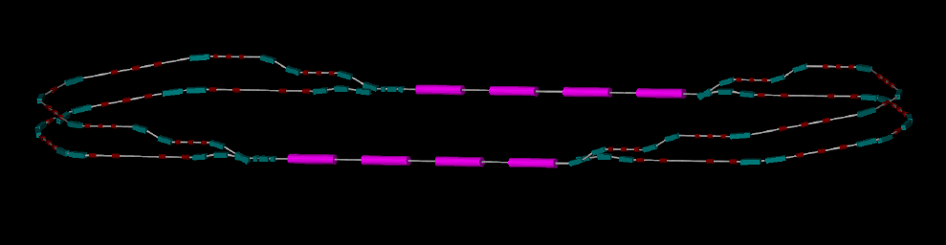
LHeC - ERL-TF
Arc 3 - 230 MeV optics
10
2
Tentative study of multipass optics and lattice
BETA_X&Y[m]
DISP_X&Y[m]
0
0
BETA_X
BETA_Y
DISP_X
DISP_Y
7.07065
-2
5 MeV
ΔE = 75 MeV
ΔE = 75 MeV
ΔC = λ/2
5 MeV
Development of LHeC Testfacility at CERN in international collaboration (ASTeC, Jlab, +)

Slide 29
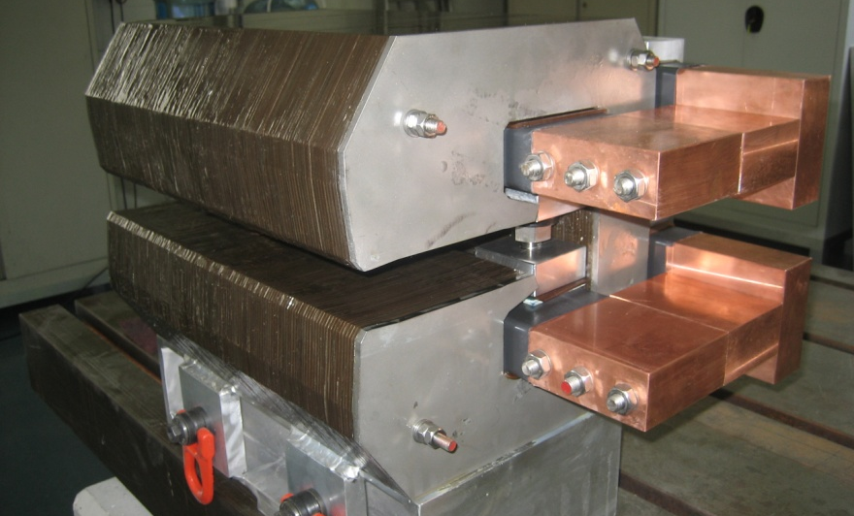
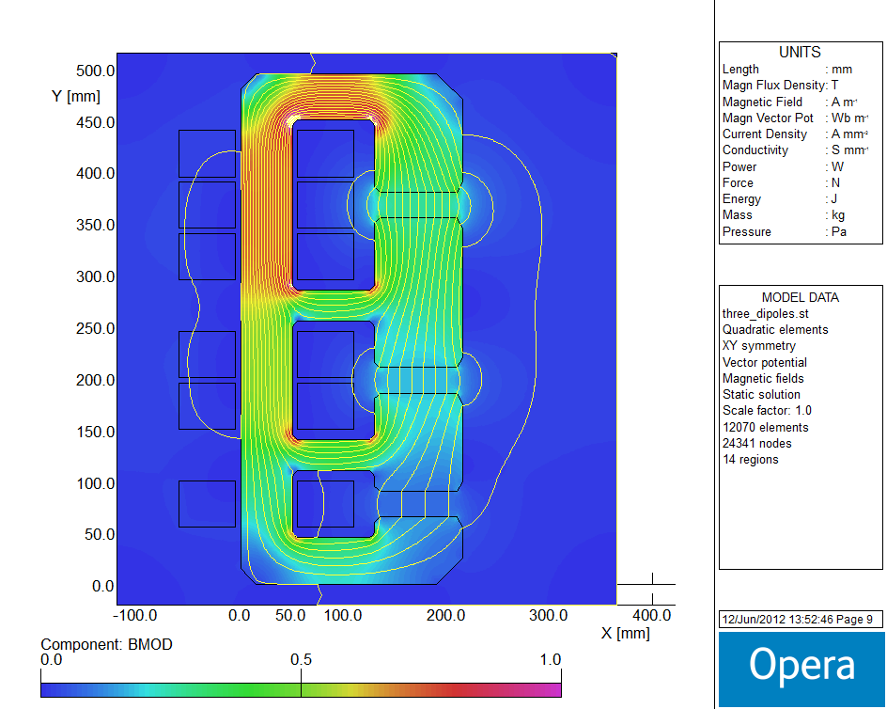
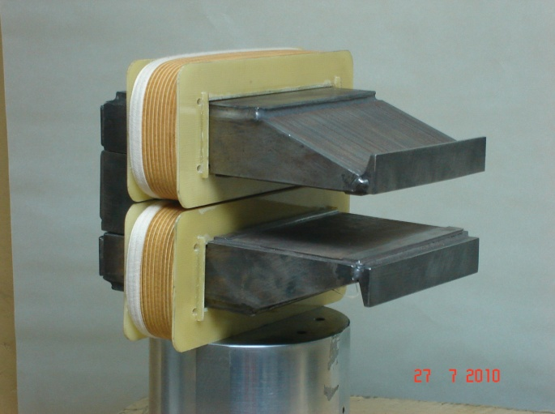
Magnets Developments
flux density in the gaps | 0.264 T 0.176 T 0.088 T
magnetic length | 4.0 m
vertical aperture | 25 mm
pole width | 85 mm
number of magnets | 584
current | 1750 A
number of turns per aperture | 1 / 2 / 3
current density | 0.7 A/mm²
conductor material | copper
resistance | 0.36 mΩ
power | 1.1 kW
total power 20 / 40 / 60 GeV | 642 kW
cooling | air
Prototypes for Ring dipoles
Fabricated and tested by
CERN (top) and Novosibirsk
LR recirculator dipoles and quadrupoles
New requirements (aperture, field)?
Combined apertures?
Combined functions (for example, dipole + quad)?
LR linac quadrupoles and correctors
New requirements (aperture, field)?
More compact magnets, maybe with at least two
families for quadrupoles?
Permanent magnets / superconducting for quads?
A.Milanese, Chavannes workshop
1/2m dipole model
Full scale prototype
Quadrupole for Linac
Magnets for ERL test stand
Collaboration of CERN, Daresbury and Budker (Novosibirsk)

Slide 30
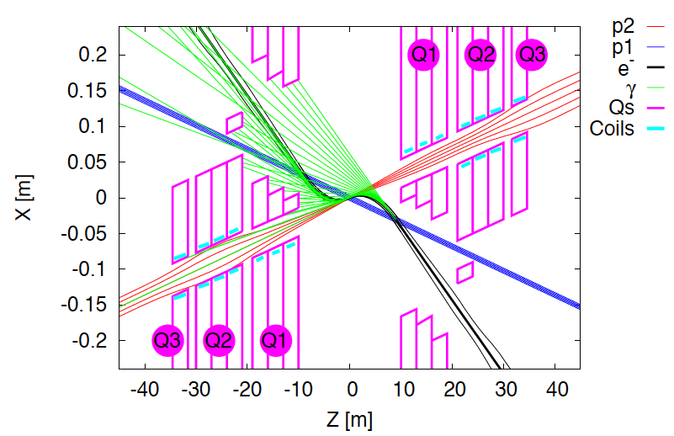
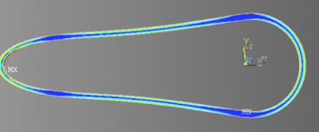
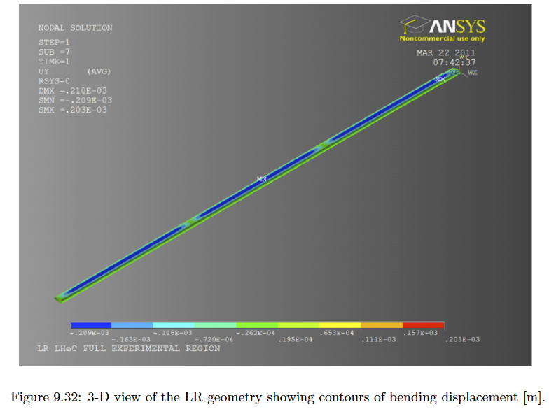
Interaction Region Developments
Beam pipe: in CDR 6m, Be, ANSYS calculations
Composite material R+D, prototype, support..
→ Essential for tracking, acceptance and Higgs
Have optics compatible with LHC and β*=0.1m
Head-on collisions mandatory →
High synchrotron radiation load, dipole in detector
Specification of Q1 – NbTi prototype ( with KEK?)
Revisit SR (direct and backscattered),
Masks+collimators
Beam-beam dynamics and 3 beam operation studies
Optimisation: HL-LHC uses IR2 quads to squeeze IR1
(“ATS” achromatic telescopic squeeze) Start in IR3.? R.Tomas et al.

Slide 31
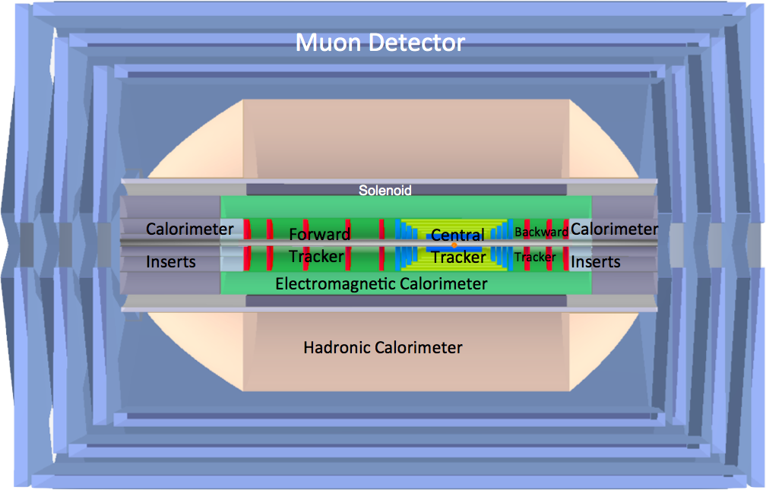
LHeC Detector Overview
LAr electromagnetic calorimeter
Tile Calorimeter
Detector option 1 for LR and full acceptance coverage
Forward/backward asymmetry in energy deposited and thus in geometry and technology
Present dimensions: LxD =14x9m² [CMS 21 x 15m² , ATLAS 45 x 25 m²]
Taggers at -62m (e),100m (γ,LR), -22.4m (γ,RR), +100m (n), +420m (p)

Slide 32


Detector Magnets
Dipole (for head on LR) and
solenoid in common cryostat,
perhaps with electromagnetic LAr
3.5T field at ~1m radius to house
a Silicon tracker
Based on ATLAS+CMS experience

Slide 33


Silicon Tracker and EM Calorimeter
Transverse momentum
Δp_{t}/p²_{t} → 6 10⁻⁴ GeV⁻¹
transverse
impact parameter
→ 10μm
LHeC-LHC: no pile-up, less radiation, smaller momenta apart from forward region

Slide 34



Liquid Argon Electromagnetic Calorimeter
Inside Coil
H1, ATLAS
experience.
Barrel: Pb, 20 X₀ , 11m³
fwd/bwd inserts:
FEC: Si -W, 30 X₀ ,0.3m³
BEC: Si -Pb, 25 X₀,0.3m³
GEANT4 Simulation

Slide 35




Hadronic Tile Calorimeter
Outside Coil: flux return
Modular. ATLAS experience.
R=2.6m
+5.9m
-3.6m
Combined GEANT4 Calorimeter Simulation

Slide 36


Slide 37

The LHeC is an upgrade of the LHC, to operate with it, and not the next world project

Slide 38

Summary
The LHeC has a unique physics programme (QCD, Higgs, BSM, HI).
It has a rich synergy with the LHC, SPL,ESS.. and links NP and PP.
The now published design report moved the dream of a TeV scale
electron-hadron collider to the “real axis” (SB). It can be done. The
LHeC is the only new collider for CERN which can live with the LHC.
Many thanks to CERN, NuPECC, ECFA and to the expanding LHeC Group
“Energy frontier,
Precision,
QCD,
QGP”
Tatsuya Nakada
Cracow 9/12 ESG

Slide 39
Backup slides

Slide 40


ATLAS Higgs projections
Updated in October 2012

Slide 41

Precision Measurements

Slide 42

linac e⁺ source options
recycle e+ together with energy, multiple use,
  damping ring in SPS tunnel w τ⊥~2 ms
Compton ring, Compton ERL, coherent pair production, or undulator for high-energy beam
3-ring transformer & cooling scheme
(D. Schulte)
(Y. Papaphilippou)
(H. Braun,
E. Bulyak,
T. Omori,
V. Yakimenko)
extraction ring (N turns)
fast cooling ring (N turns)
accumulator ring (N turns)
(E. Bulyak)

Slide 43
ERL Test Facilities
IHEP ERL-TF | HZB BERLinPro | BINP | Peking FEL | BNL ERL-TF | KEK cERL | Daresbury ALICE | JAERI | CERN ERL-TF
35 MeV | 100 MeV | 11-40 MeV | 30 MeV | 20 MeV | 245 MeV | 10 MeV | 17 MeV | 300 MeV
1.3 GHz 9 cell | 1.3 GHz | 180 MHz | 1.3 GHz 9-cell | 704 MHz 5-cell | 1.3 GHz 9-cell | 1.3 GHz 9-cell | 500 MHz | 721 MHz 2x4x5 cell
10 mA | 100 mA | 30 mA | 50 mA | 50-500 mA | 10-100 mA | 13 µA | 5-40 mA | 2-6 mA
60 pC | 10-77 pC | 0.9-2.2 nC | 60 pC | 0.5-5 nC | 77 pC | 80 pC | 400 pC | 500 pC
1 pass | 1-2 pass | 4 passes | 1 pass | 1 pass | 2 passes | 1 pass | 1 pass | 2 passes
under construction | planned / construction | operating |  | under construction | under construction | operating | operating | first ideas
BNL 704 MHz cavity (20 MV/m with
high Q0 demonstrated)
E.Jensen

Slide 44

CDR - Time Schedule*⁾
Detector installation
study for IP2, reuse
of L3 magnet as
support for LHeC.
Estimated 30 months
LHeC is to operate synchronous with HL-LHC
LS3 requires 2-3 years for ATLAS+. It is the
one extended time period, which will allow
installation and connection of LHeC
*) LS3 → schedule most likely shifted by +2 years

Slide 45


In-medium Hadronisation
The study of particle production in eA (fragmentation functions and hadrochemistry)
allows the study of the space-time picture of hadronisation (the final phase of QGP).
Low energy (ν): need of
hadronization inside.
Parton propagation: pt broadening
Hadron formation: attenuation
High energy (ν): partonic
evolution altered in the
nuclear medium.
W.Brooks, Divonne09
LHeC :
+ study the transition from small to high energies in much extended range wrt. fixed target data
+ testing the energy loss mechanism crucial for understanding of the medium produced in HIC
+ detailed study of heavy quark hadronisation …
Notes:
45

Slide 46



LR LHeC IR layout & SC IR quadrupoles
Exit hole for electrons & non-colliding protons
Synchrotron radiation
Q2
Electron beam
Q1
Q2
Q1
Nb₃Sn (HFM46): 5700 A, 175 T/m, 4.7 T at 82% on LL (4 layers), 4.2 K | Nb₃Sn (HFM46): 8600 A, 311 T/m, at 83% LL, 4.2 K
46 mm (half) ap., 63 mm beam sep. | 23 mm ap.. 87 mm beam sep.
0.5 T, 25 T/m | 0.09 T, 9 T/m
colliding proton beam
Non-colliding proton beam
Inner triplets
Inner triplets
High-gradient SC IR quadrupoles based on Nb₃Sn for colliding proton beam with common low-field
As shown by F. Zimmermann at Chamonix12

Slide 47

http://cern.ch/lhec
About 180 Experimentalists and Theorists from 60 Institutes
Tentative list of those who contributed to the CDR
Supported by
CERN, ECFA, NuPECC

Slide 48
UK Accelerator Engagement
Deepa Angal-Kalinin¹, Robert Appleby⁵, Ian Bailey³, Steve Buckley¹, Graeme Burt³, Neil Bliss², Swapan Chattopadhyay^{3,4,5}, Jim Clarke¹, Peter Corlett¹, Philippe Goudket¹, Andy Goulden¹, Joe Herbert¹, Kai Hock⁴, Frank Jackson¹, Steve Jamison¹, James Jones¹, Lee Jones¹, Alexander Kalinin¹, Oleg Malyshev¹, Neil Marks¹, Peter McIntosh¹, Julian McKenzie¹, Keith Middleman¹, Boris Militsyn¹, Andy Moss¹, Bruno Muratori¹, David Newton⁴, Tim Noakes¹, Shrikant Pattalwar¹, Yuri Saveliev¹, Ben Shepherd¹, Susan Smith¹, Rob Smith¹, Trina Thakker¹, Luke Thompson⁵, Reza Valizadeh¹, Carsten Welsch⁴, Alan Wheelhouse¹, Peter Williams¹, Andy Wolski⁴
¹ASTeC/STFC, ²TD/STFC, ³University of Lancaster, ⁴University of Liverpool, ⁵University of Manchester
Topics of joint interest and priority
Meeting ASTEC/CI 5.9.12 at CERN
Electron source for TF
Design of IR, Optics for p beams, synrad tracking
Test facility design (OPAC fellow)
Sc cavity design, coupler, HOM damper, tuner..
Instrumentation for TF…
With only somewhat reduced priority: beam dynamics,
positron source, magnets ..
Preparation of MoU, with view also to other partners
The LHeC represents a unique opportunity
for the Daresbury Campus (ASTEC and CI),
but also for the wider UK accelerator
community (A.Seryi co-author of CDR) to be
at the forefront of accelerator developments,
building on their unique expertise, a very
welcome strong expression of interest, and its
strong links to Universities, CERN and industry.

Slide 49

ATLAS and LHeC Silicon Trackers
Tentative designs as of 2012
← New ATLAS Si tracker
LHeC forward (LHCb link!) and backward telescopes and central Si
LHeC: no pile-up, less radiation, smaller momenta apart from forward region

