Slide 1
Lecture 8 – Detectors - II
Calorimetry
Considerations for designing a collider detector -- with LHeC as an example
Introduction to Particle Physics - Max Klein – Lecture 8 - Liverpool University 17.3.14
M.Klein 17.3.2014 L8

Slide 2
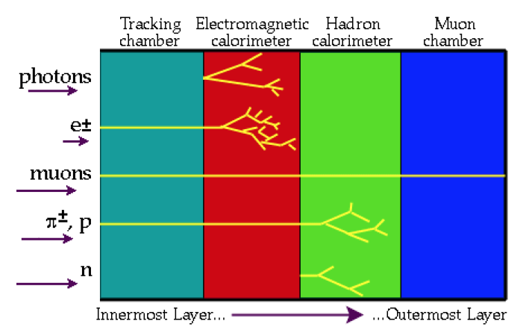
Particle Identification
ν neutrino carries energy away (“missing E”) -- Hermetic Detector!
M.Klein 17.3.2014 L8

Slide 3
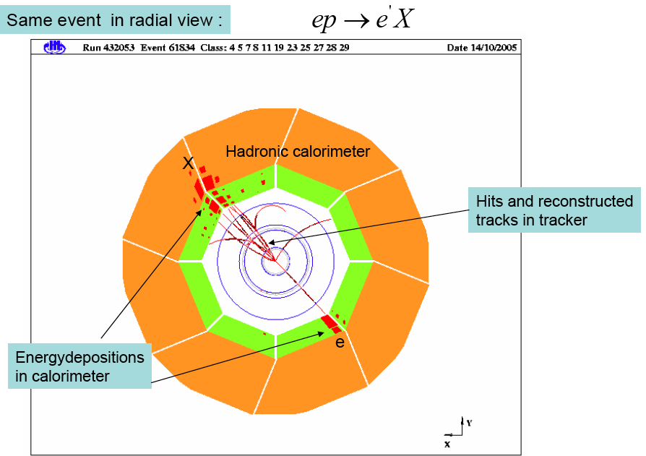
H1 DIS event in xy view
Electromagnetic calorimeter
1m
M.Klein 17.3.2014 L8

Slide 4
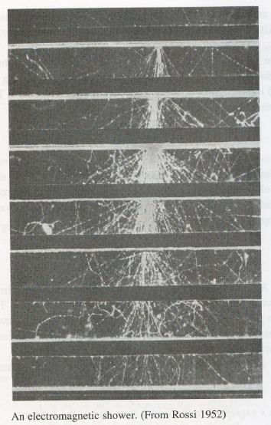
Calorimeters
γ
Sensitive to charged and neutral particles
Cascade (showers of particles) N ~ E: σ/E~1/√E
Longitudinal dimension scales ~ lnE
Segmentation: spatial and angular information
Different response to e, h, μ: particle ID
Hermetic coverage to detect neutrinos (“missing E”)
Fast time response: high rates, time measurement
Calorimeters are “sampling calorimeters”:
Several layers of active medium/absorber for
optimum energy deposition and measurement
M.Klein 17.3.2014 L8

Slide 5
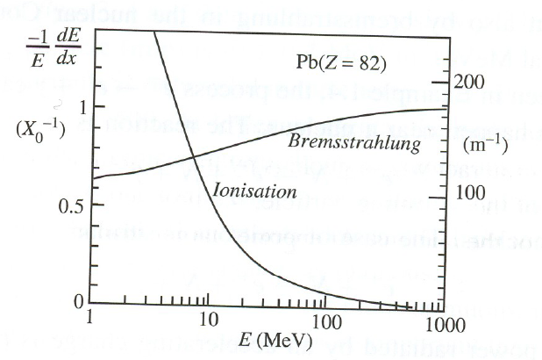
Electromagnetic energy loss - electrons
E_{c}
r_{e}² ~ m_{e}⁻²: muon deposits
2 10⁻⁵ times less energy
than electron by the
bremsstrahlung process.
Bremsstrahlung
Ionisation
critical energy
Bremsstrahlung dominates rather uniform
energy loss: high resolution of elm calorimeters
M.Klein 17.3.2014 L8

Slide 6
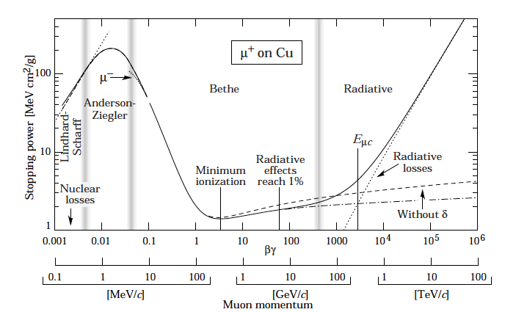
Muon Energy Loss
Critical energy for
muons very large.
E_{c} = 200 GeV in Pb
(~10 MeV for electron)
Muon energy
losses for precision
measurements and
high momenta have
to be controlled too
Taken from PDG2010
M.Klein 17.3.2014 L8

Slide 7
Radiation Length
X₀ distance over which 1/e of E₀ is lost in bremsstrahlung
also = 7/9 of mean free path of a photon [γZ → Ze⁺e⁻]
Energy loss is additive:
For example: Air: f(N)=0.77, f(O₂)=0.22, f(Ar)=0.01, X₀ =0.3km
Absorbers for electromagnetic calorimeters:
Pb: X₀ =0.56 cm, Fe: X₀ = 1.6 cm
Y.T. Tsai Rev.Mod.Phys 46(1974)815
M.Klein 17.3.2014 L8

Slide 8
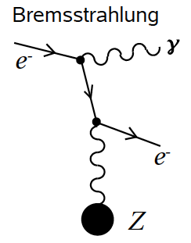
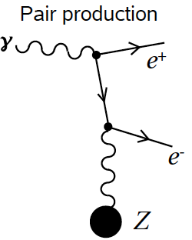
Electromagnetic Calorimeter
Radiation length
Lateral extension
Shower extends perpendicularly to
incident direction due to bremsstrahlung
(ϑ~E/m) and multiple scattering
95% of shower is contained in cone
of one Molière radius (1.8cm in lead)
Pb: X₀ =0.56 cm, Fe: X₀ = 1.6 cm
Electromagnetic calorimeters are rather compact. They are placed in between the tracker and the hadronic calorimeter. They thus represent the first stage of the hadronic energy measurement. If space and cost permit, the magnet coil is outside the calorimeters – not possible for LHeC:
20 layers 0.56cm plus LAr gaps: ~40cm
Electron and photon energy loss very similar: σ_{γ}=7/9σ_{e}
M.Klein 17.3.2014 L8

Slide 9
Hadronic Calorimeter
Hadronic energy loss
Particle production (strong interaction)
n ~ 20 ln(E/GeV) -18 secondaries
Nuclear collisions and excitations
Electromagnetic interactions (π⁰ → γγ)
Ionization, muons, neutrinos
Stronger fluctuation of energy loss
than for electromagnetic interactions.
Thus the resolution is worse.
Interaction or absorption length
Fe: λρ=132 g/cm² λ=17 cm =10 X₀
The hadronic calorimeters are placed
behind electromagnetic ones and used
as “tail catchers” of the elm. shower
95% of secondaries are confined in 1 λ
A shower is absorbed fully after 7 λ
ATLAS
Scintillator tile – Fe Calorimeter (7λ=1.1m)
M.Klein 17.3.2014 L8

Slide 10
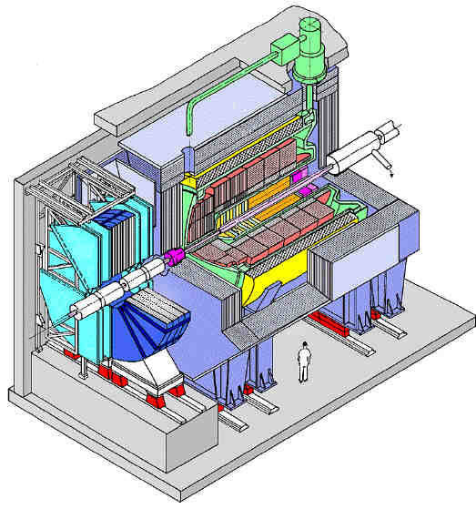
H1 Detector
Tracker
Liquid Argon Calorimeter
Coil
Return Iron/ μ Detector
beam
line
Forward muon detector
M.Klein 17.3.2014 L8

Slide 11
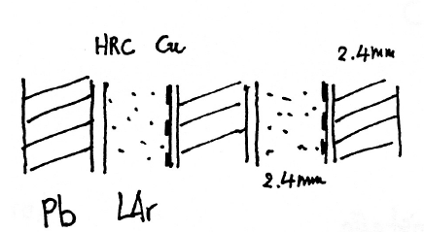
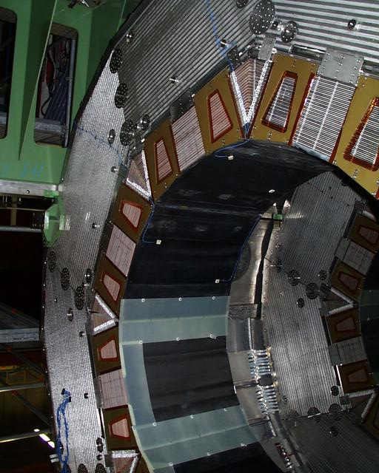
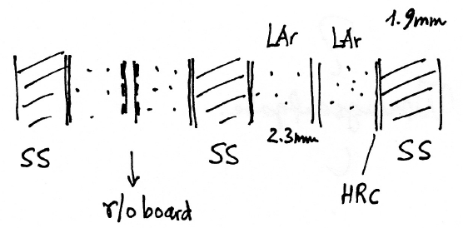
H1 Liquid Argon (LAr) Calorimeter
elm.
25X₀
12%/√E
Hadr.
7λ
50%/√E
Pb: G10|Lead\G10, SS: stainless steel
HRC: high resistive coating (10MΩ/area)
Photograph after deassembly, October 2007
M.Klein 17.3.2014 L8

Slide 12
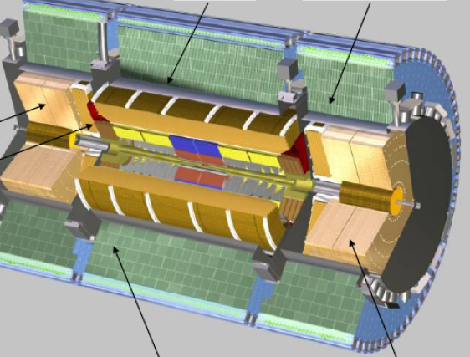
ATLAS Calorimeters
Tile barrel and extended barrel
LAr
hadronic
electromagn.
endcaps
Central barrel electromagnetic Forward calorimeter
M.Klein 17.3.2014 L8

Slide 13
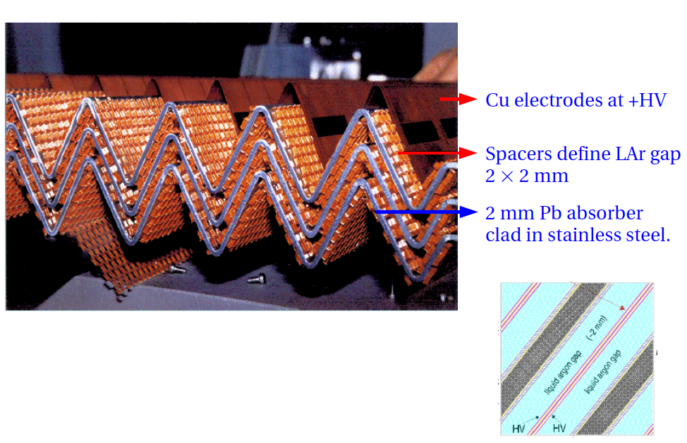
ATLAS LAr Electromagnetic Calorimeter
D.Pitzl
M.Klein 17.3.2014 L8

Slide 14
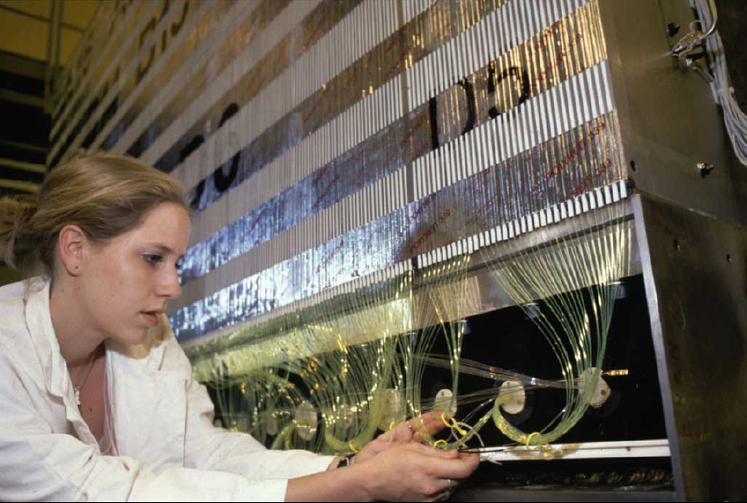
ATLAS Scintillator Tile Hadronic Calorimeter
Scintillator and Fe absorber, read out perpendicular to beam axis
M.Klein 17.3.2014 L8

Slide 15
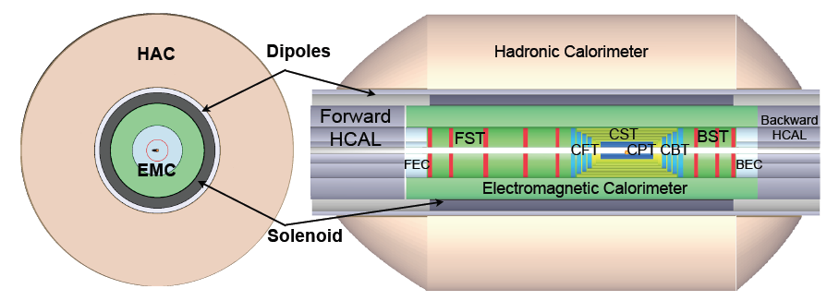
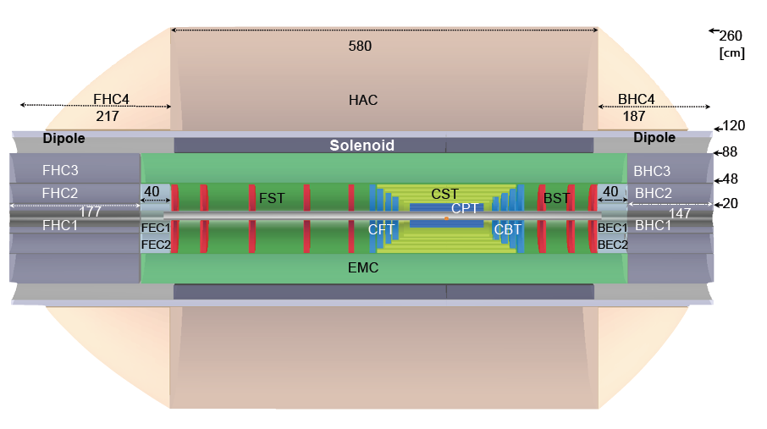
LHeC Detector^{*)}
Central silicon tracker: 48cm, EMC: D=40cm, Solenoid: R=1m, HAC: D=140cm
^{*)} from LHeC design report 2012
M.Klein 17.3.2014 L8

Slide 16
Dimensions of the LHeC Detector
Tracker: Silicon only, compact, D=50cm
Locate solenoid between EMC and HAC:
Cost [and joins dipole for beam bending]
The LHeC detector is surrounded by a
muon detector system, conceptionally for
muon identification only. There are forward
and backward detectors as part of the
central detector, and there are further apart
detectors for tagging p,n in p beam direction
and e,γ in e beam direction (“backwards”)
EMC: LAr-Pb: D=40cm
HAC: Sc-Fe: D=140cm
M.Klein 17.3.2014 L8

Slide 17
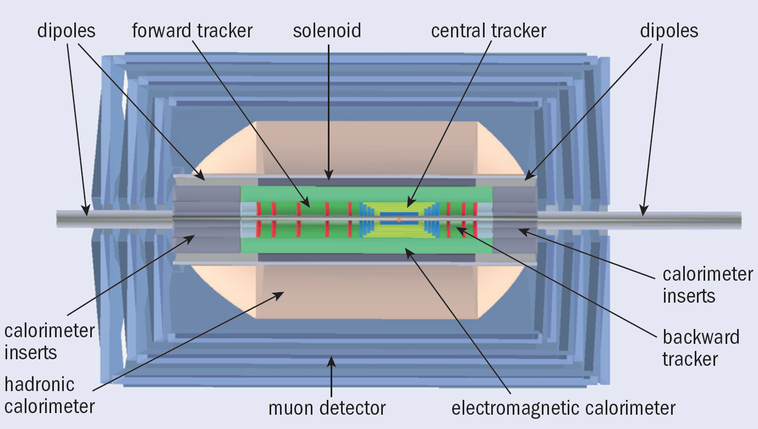
LHeC Detector Design Concept
Muon detector: ID with few detector planes, no momentum measurement – unlike ATLAS
M.Klein 17.3.2014 L8

Slide 18
Detector - Summary
The requirement to select often rare events (“trigger”) has replaced the photographic methods.
The physics of heavy quarks has boosted the development of Silicon track detectors.
Energies are measured in “sampling calorimeters” – in multilayers of absorber and active material.
Modern collider detectors have a common structure: tracker, ecal., hcal., solenoid, muon detector.
The (xy) dimension of a tracker is determined by the required momentum resolution (B,Δ,L).
An electromagnetic calorimeter absorbs 95% of the shower energy in 20 radiation lengths (X₀).
The em. energy loss mechanism is primarily bremsstrahlung and the energy resolution ~10%/√E.
A hadronic calorimeter absorbs a hadron shower completely after 7 absorption lengths (λ).
Due to the more stochastic nature of hadron interactions and the complexity of the hadron energy
loss processes, the energy resolution is ~40%/√E. The “HCAL” catches the elm. shower tail.
10. Calorimetry has to be hermetic (4π) acceptance in order to reconstuct the energy balance (ν’s MET).
11. Muons penetrate the whole calorimeter and can thus be identified and their momentum reconstructed.
Detectors have to fulfill further demands as from trigger complexity, readout speed and data volume…
M.Klein 17.3.2014 L8

