Slide 1
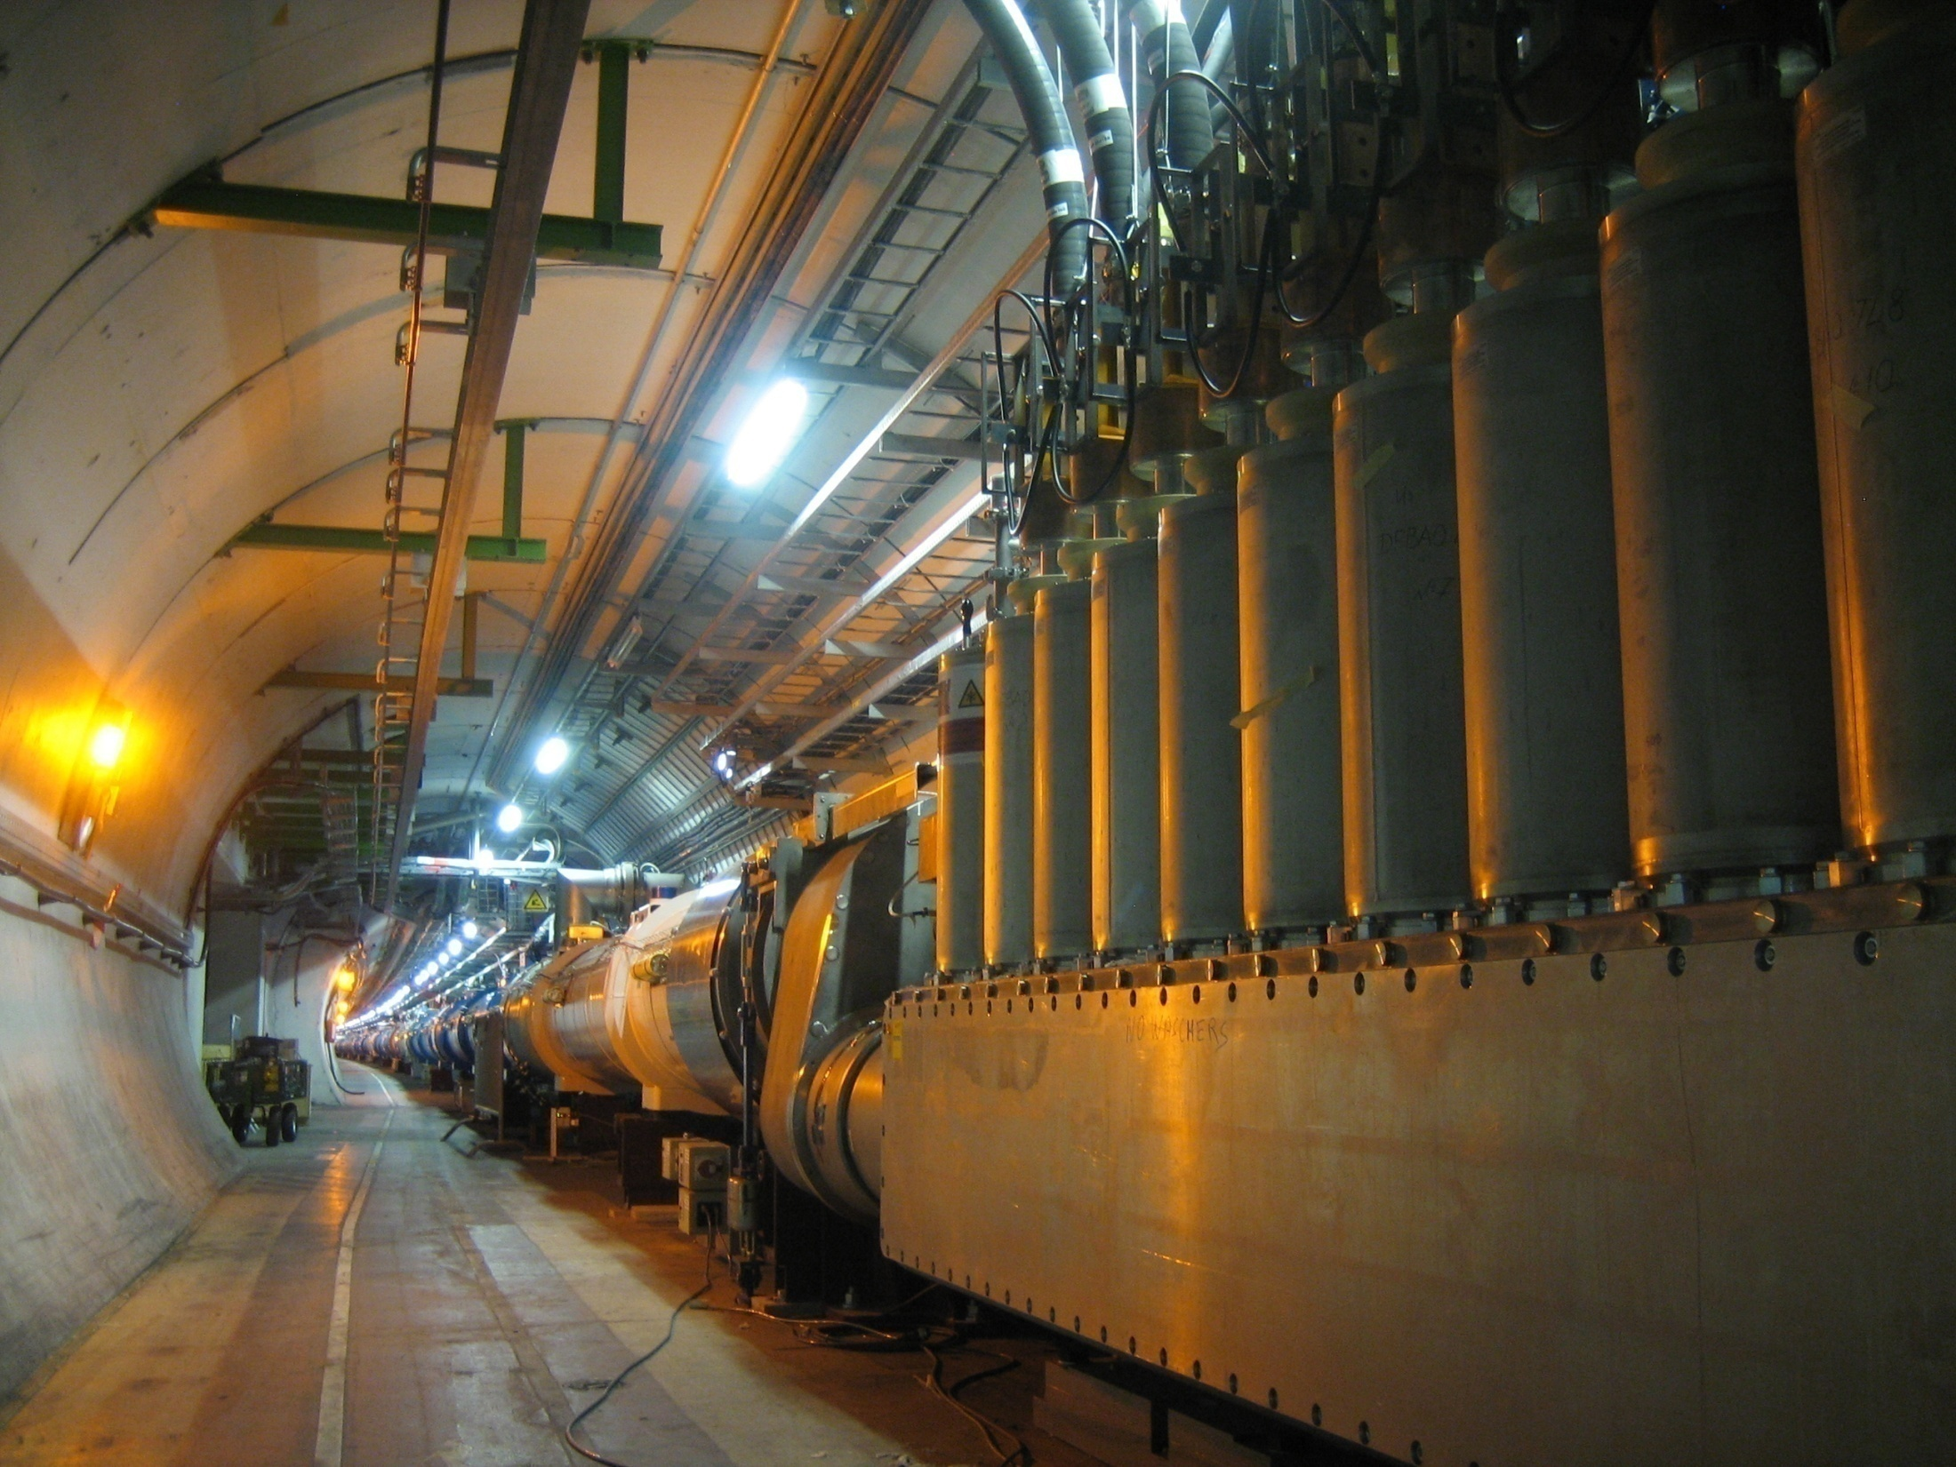
Lecture 11 – Accelerators
Principles
Examples
Introduction to Particle Physics - Max Klein – Lecture 11 - Liverpool University 31.3.14
M.Klein 31.3.2014 L11

Slide 2
References
M. Conte & W. MacKay, “An introduction to the physics of particle accelerators”, World Scientific, Singapore, 1991.
H. Wiedemann, “Particle accelerator physics, 1 : basic principles and linear beam dynamics”- 2nd ed. , Springer, Berlin 1999.
A. Sessler & E. Wilson, “Engines of Discovery : A Century of Particle Accelerators,” World Scientific, Singapore, 2007.
S.Y. Lee, “Accelerator Physics” - 2nd ed. / Lee, World Scientific, Singapore, 2004.
J.B. Rosenzweig, “Fundamentals of Beam Physics,” Oxford Univ. Press, 2003.
A.W. Chao, M. Tigner, “Handbook of accelerator physics and engineering”, World Scientific, Singapore,1999
From F. Zimmermann

Slide 3
Course Overview
24.2. Introduction and Basics
3.3. Quantum Numbers and Quarks, Gluons
10.3. Leptons,Photons, QED and Neutrinos,Weak Interactions
17.3. Detectors, Tracking and Calorimeters [here already due to travel]
24.3. Quark Mixing and Densities and Heavy Quarks
31.3. Accelerators and Recollection
Easter Break
28.4. Higgs and HEP Outlook
Tutorials: 7.3., 20.3., next 3.4., + one more
M.Klein 31.3.2014 L11

Slide 4

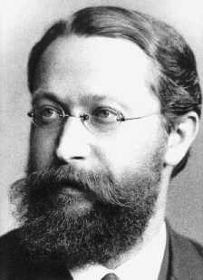
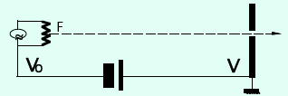
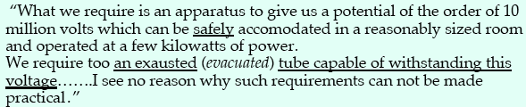
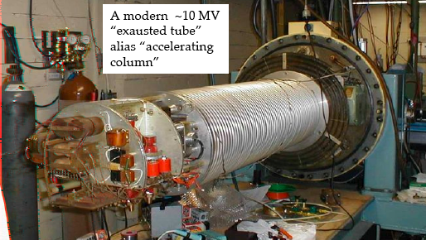
Electrostatic Accelerator
Braun cathode ray tube (1897)
Karl Ferdinand Braun
Rutherford 1930
Momentum of particle of charge
q and mass m after passage of
a voltage difference. Limited by V.
Van de Graaf
Cockcroft Walton
Tandem
Oscillographs, CRT TV sets..
Tazzari, Cern Acc School 2006
M.Klein 31.3.2014 L11

Slide 5
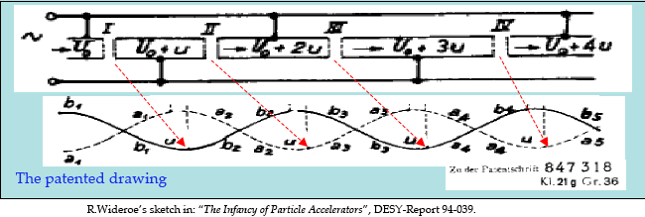
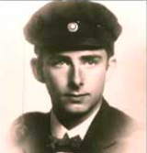

High Frequency Linear Accelerator
Passage through N times
a voltage difference V
Multiple acceleration
cf Laurence Nobel lecture:
1920
[note: V=u for RW!]
Resonance condition:
Frequency = velocity/2L
at each gap. As frequency
is constant, length has to
grow like √k.
For large v=cβ, frequency has
to be very high to keep L small
Rolf Wideroe, 1902-1996
1927 (PhD)
[2 sections, 25kV, 50Hz]
M.Klein 31.3.2014 L11

Slide 6
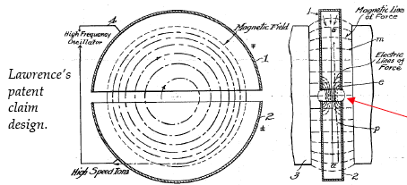
Cyclotron [B=const, f=const, r varies]
Lawrence invents the cyclotron 1931 based on Wideroes linac. Strong magnetic field to bend particles on a circle.
Alternating electric field (potential between two halves):
Each turn an energy qV is gained. The time per turn is independent of the radius as r and v increase like √k with
the frequency resonance condition analogous to Wideroe’s.
V
Large radius and high mag field to achieve large energy. Needs constant mass, i.e. non relativistic
conditions (Bethe E_{p} < 20 MeV..?)
M.Klein 31.3.2014 L11

Slide 7
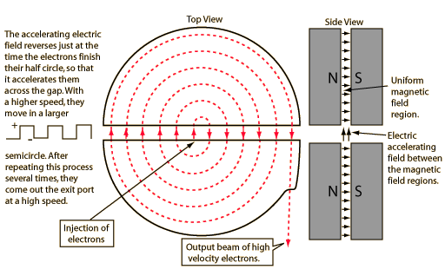
Cyclotron [B=const, f=const, r varies]
Lawrence invents the cyclotron 1931 based on Wideroes linac. Strong magnetic field to bend particles on a circle.
Alternating electric field (potential between two halves):
Each turn an energy qV is gained. The time per turn is independent of the radius as r and v increase like √k with
the frequency resonance condition analogous to Wideroe’s.
Large radius and high mag field to achieve large energy. Needs constant mass, i.e. non relativistic
conditions (Bethe E_{p} < 20 MeV..?)
M.Klein 31.3.2014 L11

Slide 8
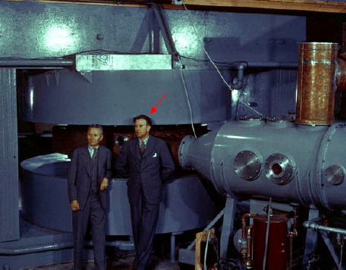
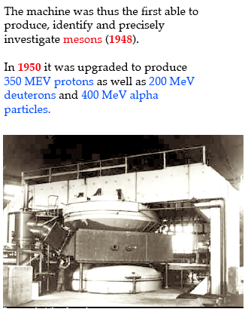
Cyclotron
184”
4’’
11’’, 27’’ (1932)
60” - 8 MeV p - 220t magnet – 1938
[isotopes, plutonium during WWII..]
Phase stability: McMillan, Veksler 1945
“Fast: early arrival: less push
slow: late arrival: more push” (Koeth)
Tazzari, Cern Acc School 2006
M.Klein 31.3.2014 L11

Slide 9
Betatron [B varies, f=const, r=const]
Cyclotron: radius increases during acceleration ~√k
Betatron: radius constant but magnetic field increases with time [Kerst]
Variable magnetic field induces
electric field. This causes an
accelerator voltage V. Particles
are accelerated without an extra
external voltage applied. The
accelerator voltage V is proportional
to the radius of the accelerator
squared and the mean field.
The generated momentum p is
given as the product of r and B.
Stability requires that the mean field
divided by 2 is equal to the field at
r₀ (Wideroe stability criterion).
M.Klein 31.3.2014 L11

Slide 10
Synchrotron
[B varies, f varies, r=const]
The synchrotron cures deficits of cyclotron
and betatron by adjusting the magnetic field to
compensate for the relativistic rise of mass
and the frequency to keep the radius constant.
high field, large radius
k - accelerator elements * turns
Cyclotron: radius changes with v,
frequency is constant (for small β)
and B is constant. Must fail in
relativistic velocity range.
Betatron: keep radius constant
and vary B field, but again fails in
relativistic region.
Orbit stabilisation required
“phase stability” Veksler, McMillan (1945)
Bunched beam:
only particles at right moment are accelerated.
CERN: SPS: 400GeV, 4600 bunches, revolution
frequency is 200 MHz from 2MW rf. 10⁵ turns in 2s
M.Klein 31.3.2014 L11

Slide 11
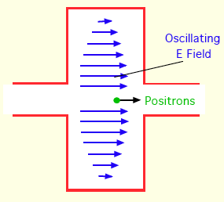
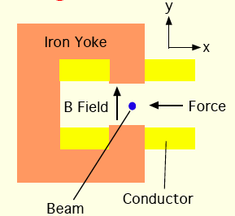
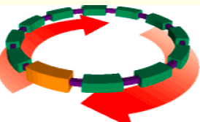
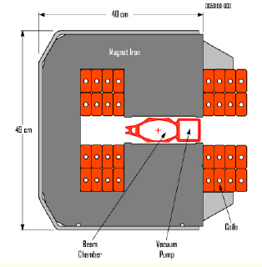
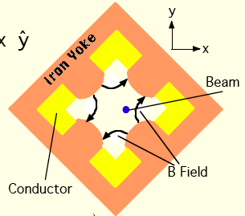
Accelerator Elements
Dipole: keep beam on orbit
Cavity: rf structure to develop large oscillating field. up to tens of MV/m.
“ride on crest of a wave”
Quadrupole: focus/defocus
beam alternating in x/y plane
“strong focussing” principle
FODO lattice concept
[Christofilos 1950; Courant, Snyder 1952]
M.Billing, Cornell 07
M.Klein 31.3.2014 L11

Slide 12
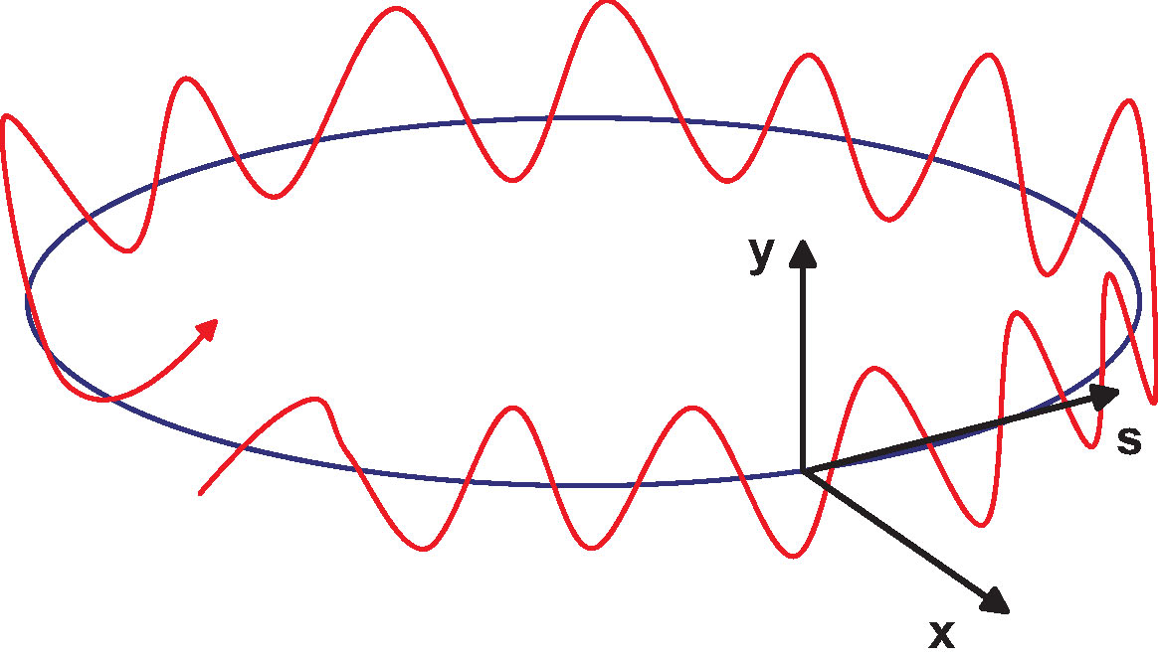
Beam Optics
Linear optics described by Hills equation
Solution expressed in terms of “beta-function”
Tune: number of oscillations per turn
C = circumference
F.Zimmermann
M.Klein 31.3.2014 L11

Slide 13
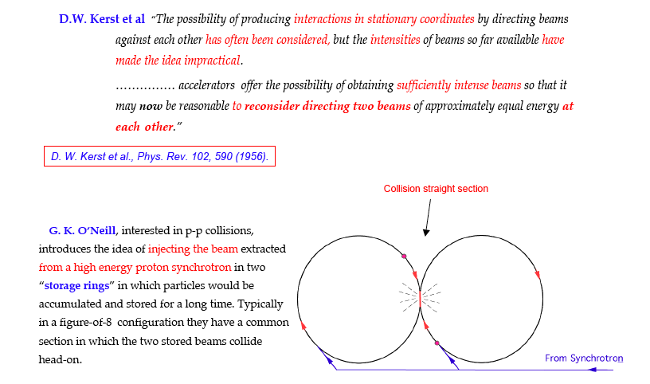
Storage Rings
Tazzari, Cern Acc School 2006
fixed target accelerator: s=2ME, collider: s=4E² : gain: 2E/M
First e⁺e⁻ storage ring ADA at Frascati: Bruno Touschek et al.
M.Klein 31.3.2014 L11

Slide 14
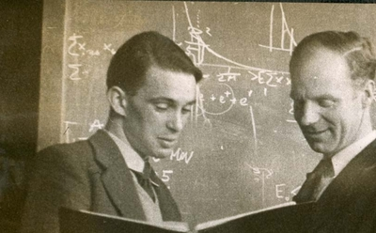
Bruno Touschek (1921-1978) Sam Currant (1912-1988)
M.Klein 31.3.2014 L11

Slide 15
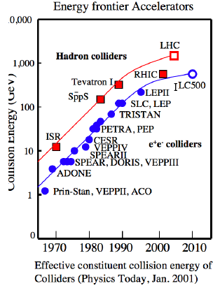
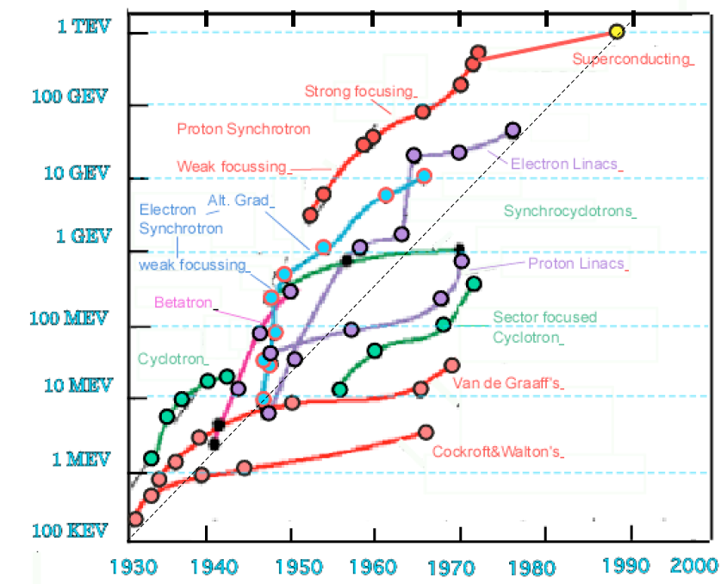
Accelerator Development
Development up to 1990
LHeC
?
HERA
pp, ep, e⁺e⁻
M.Klein 31.3.2014 L11

Slide 16
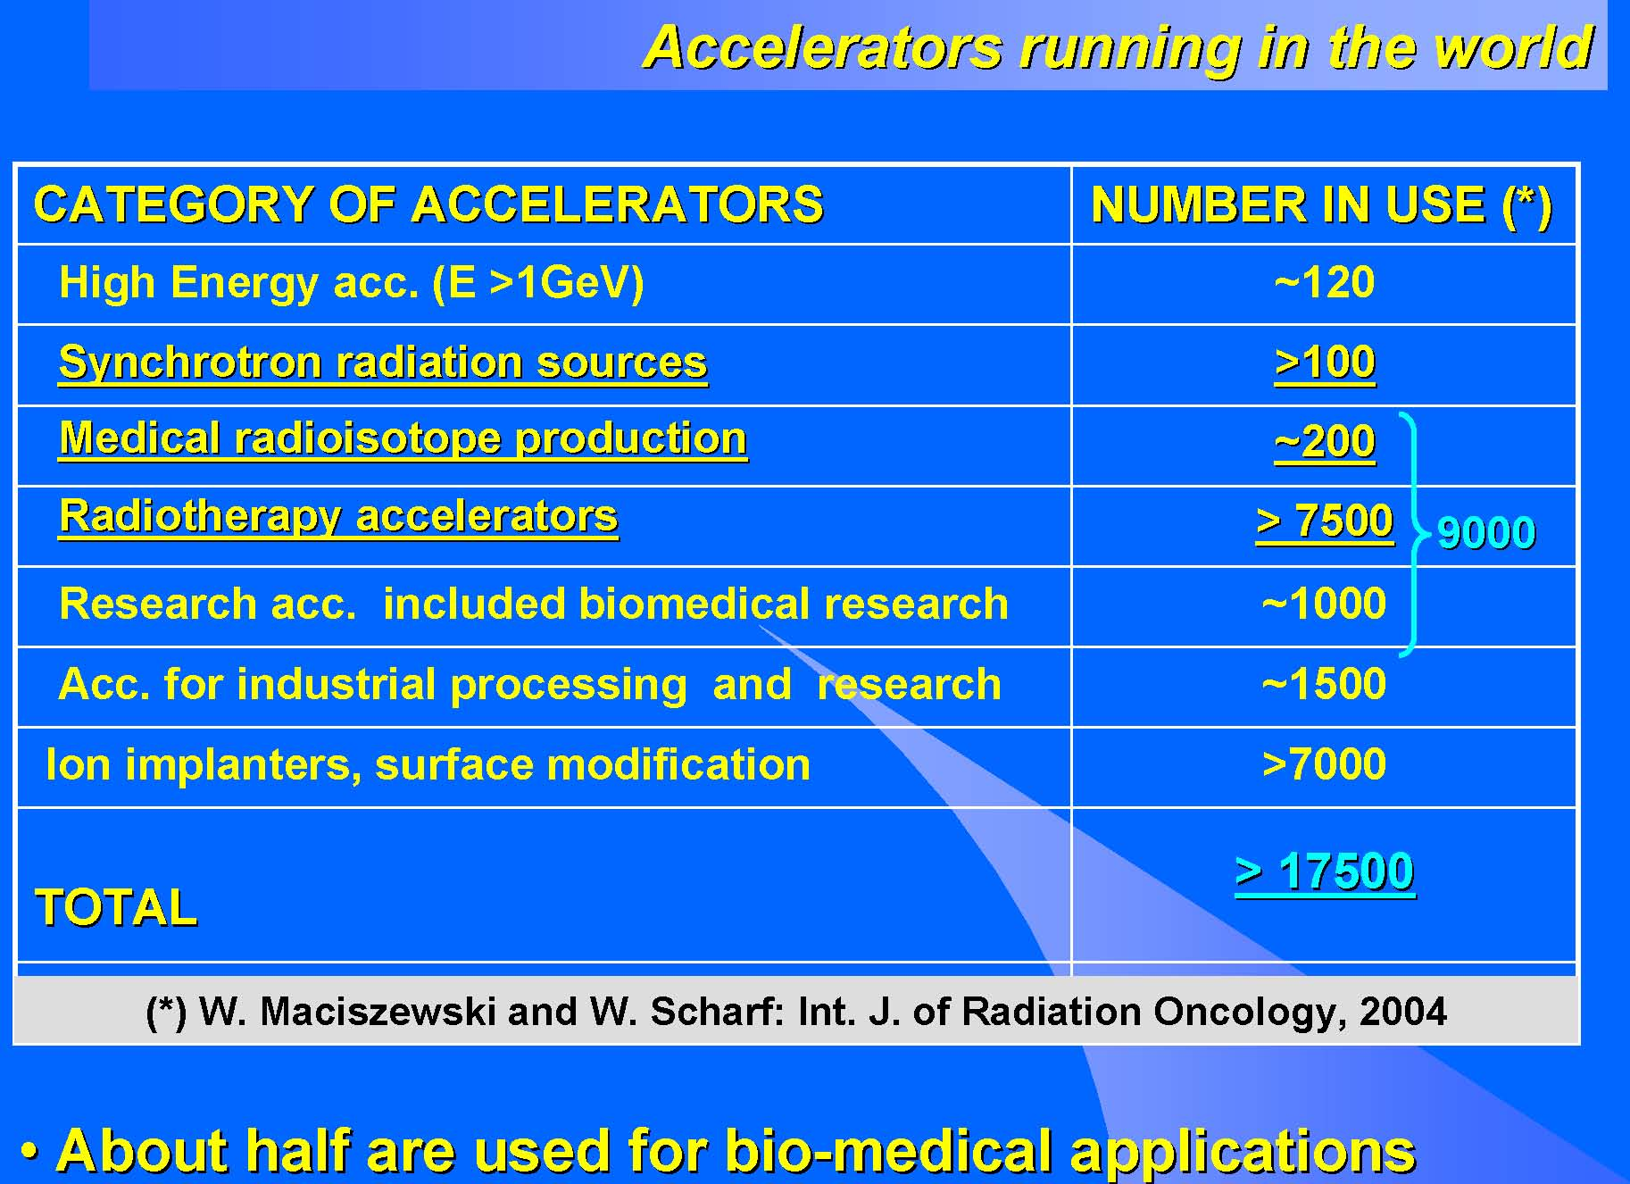
World Accelerators
The demands of particle physics for high energies and intensities have had a major impact on modern society
Table taken from W. Scarf & W. Wiesczycka, Proc. EPAC2000
M.Klein 31.3.2014 L11

Slide 17
Recent colliding ring machines
to explore energy frontier physics
M.Klein 31.3.2014 L11

Slide 18
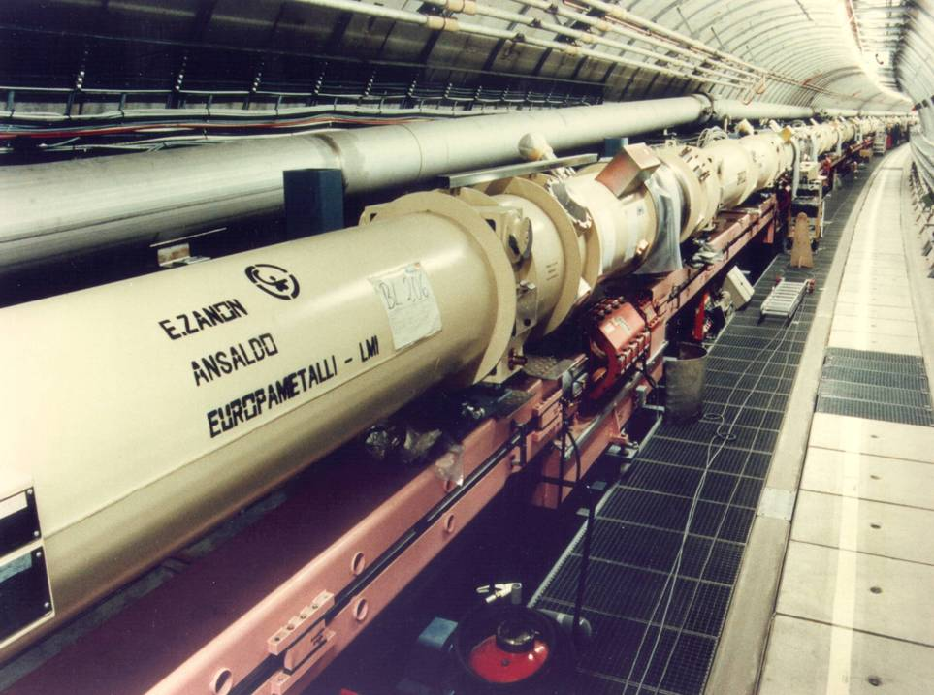
HERA ep: built 1985-1991
6.2 km ring accelerator(s)
Superconducting p ring
Warm magnet e ring
Data delivery: 1992-2007

Slide 19
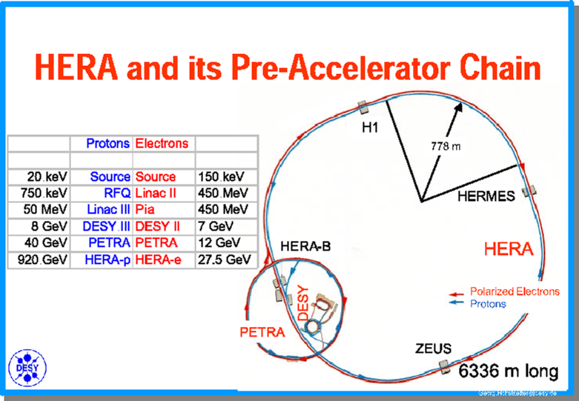
hera

Slide 20
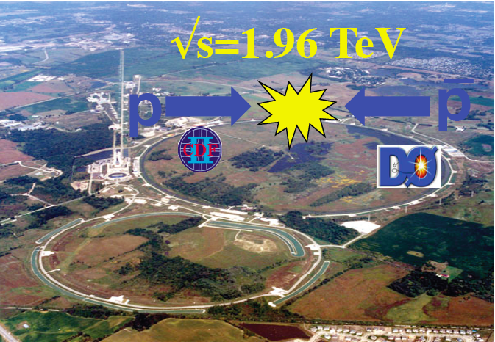
Tevatron
Fermilab
1985-2011

Slide 21
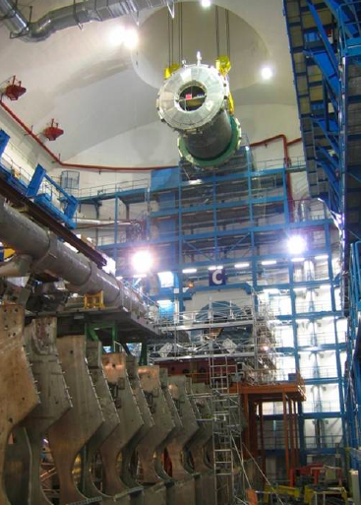
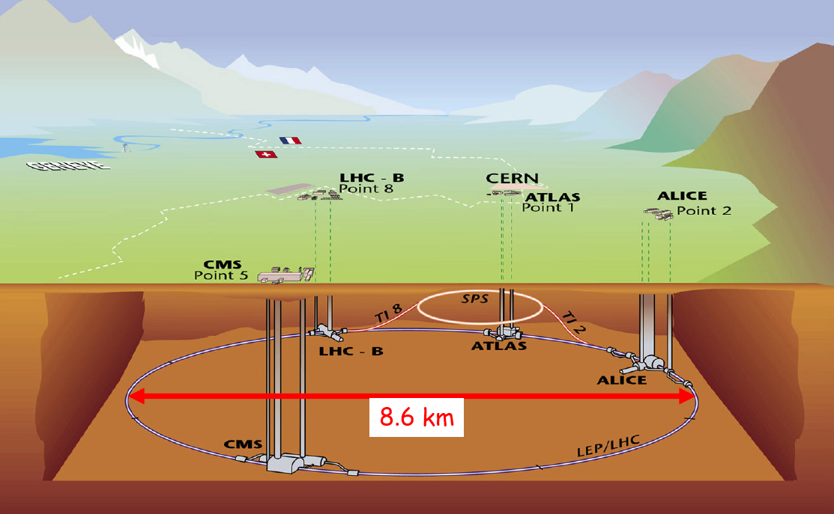
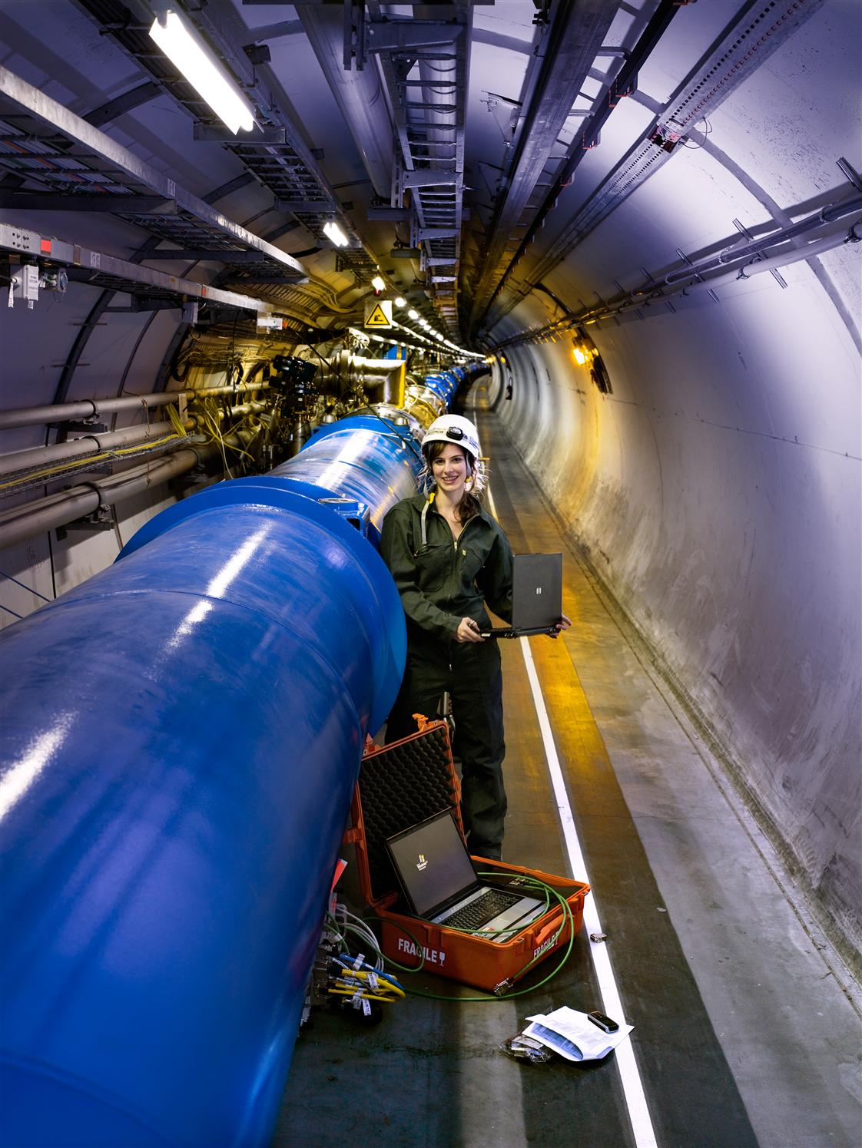
The Large Hadron Collider
LHC: 7000 * 7000 GeV² pp [AA] from 2009 onwards
ATLAS
University of Liverpool engaged.
LEP e⁺e⁻ 89-00
LHC pp 09-35
LHeC ep … 35+ ?

Slide 22
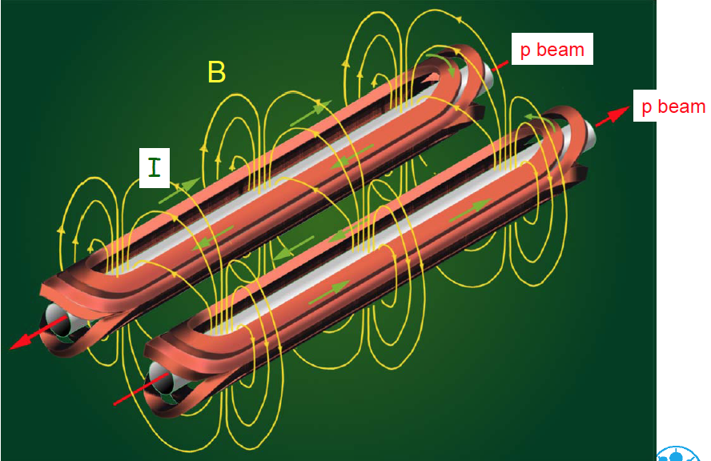
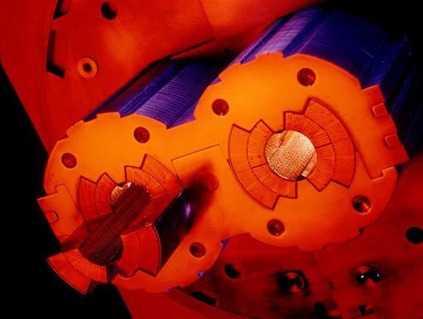
LHC 2-in-1 Dipole

Slide 23
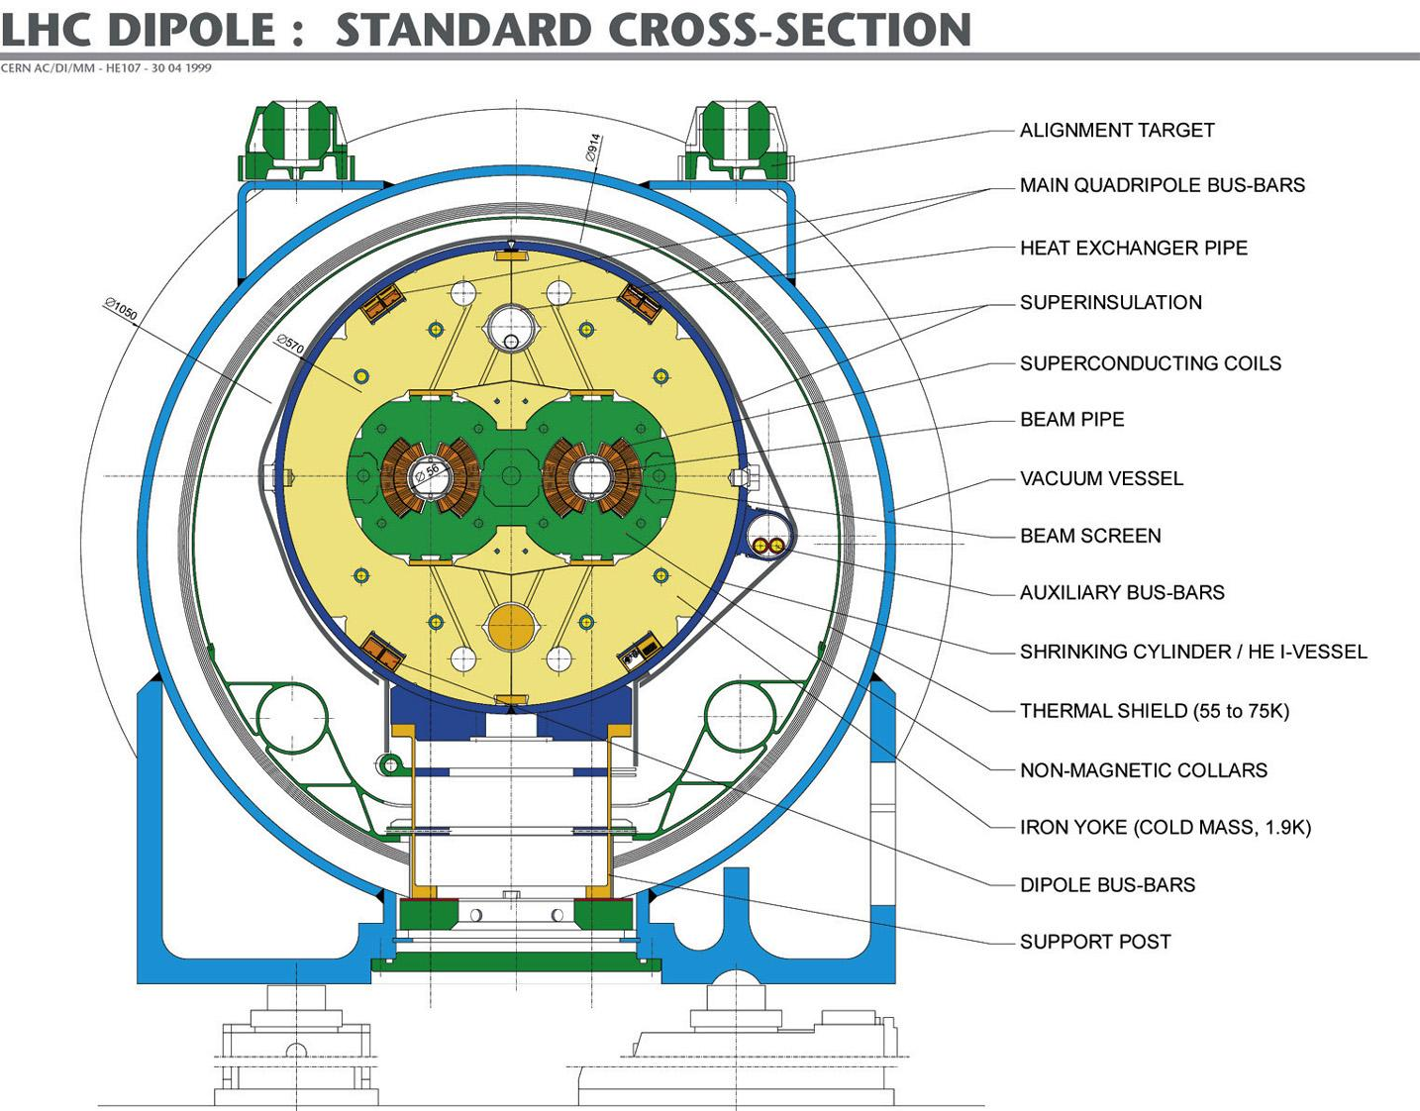

Slide 25

Plans and projects for next energy frontier colliders
Latest Development:
FCC design study at
CERN 2014-2018
E_{p} = 50 TeV
E_{e}= 120 GeV
→ pp/ee/ep
e⁺e⁻: ILC, CLIC, CPEC; ep: LHeC …
M.Klein 31.3.2014 L11

Slide 26
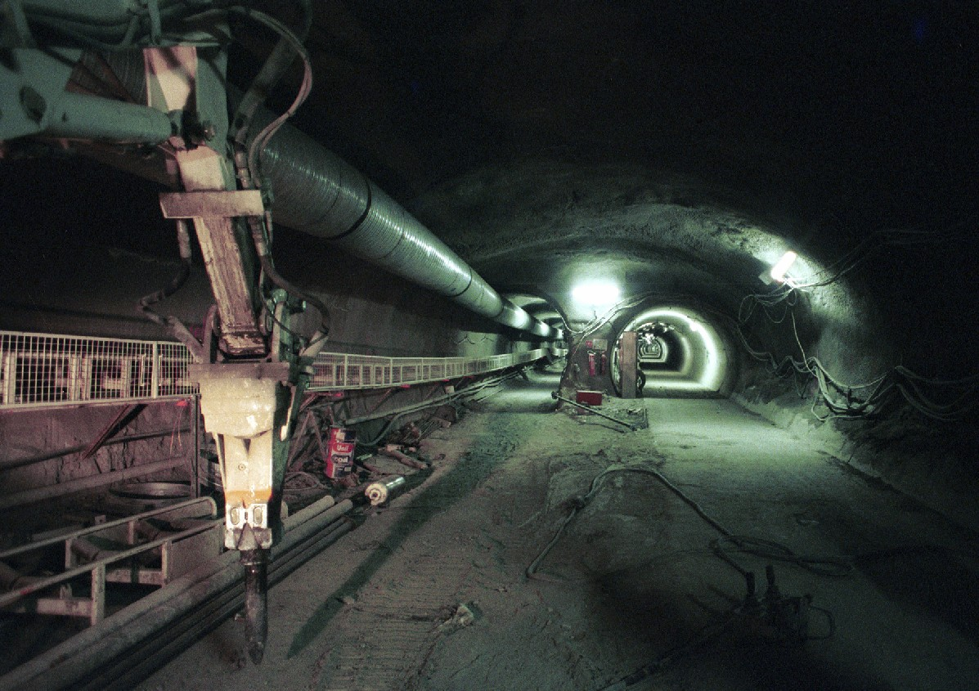
LHC tunnel 2002
10 years from here to the Higgs boson …
M.Klein 31.3.2014 L11

