Slide 1




The Quark-Gluon Structure of the Proton
Introduction
HERA
LHC and the LHeC
Max Klein
Talk at the DPG Particle Physics, Dresden, March 8th, 2013
On the occasion of the receipt of the Max-Born-Price by the DPG and the IoP

Slide 2
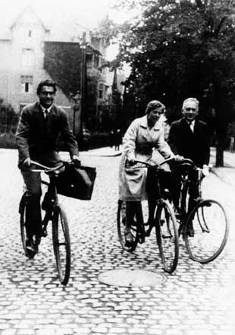
Max Born
Victor Weisskopf (1908-2002) Maria Goeppert (1906-1972) Max Born (1882-1970)

Slide 3
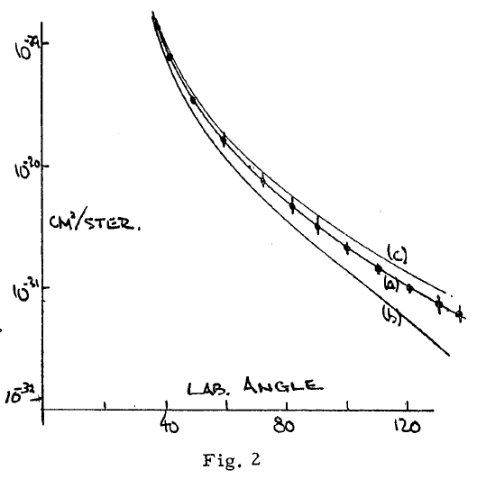
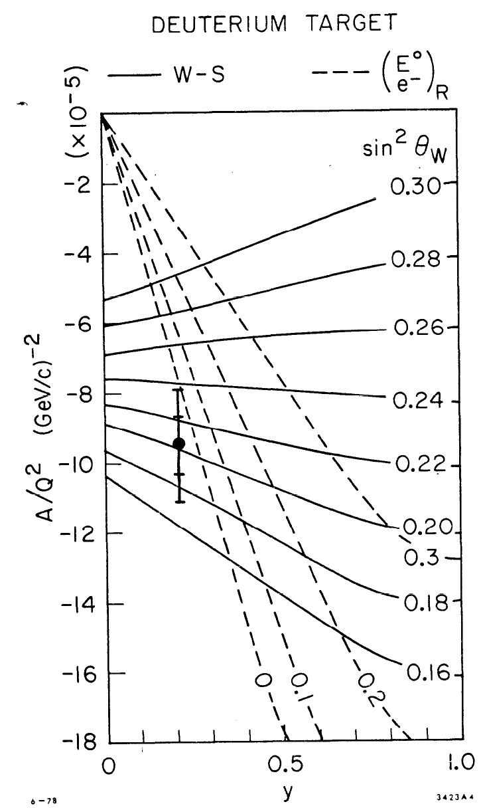
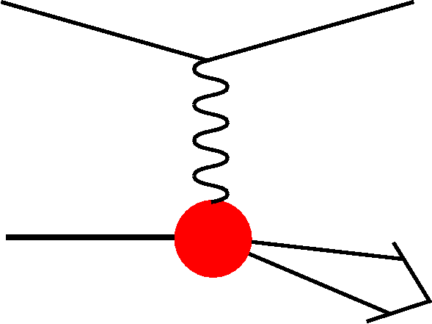
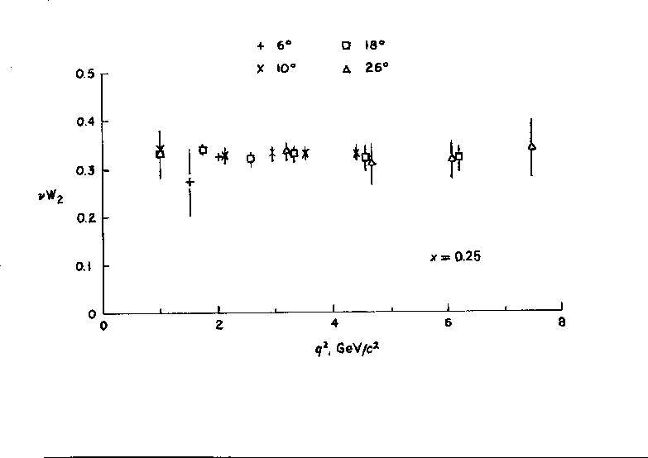


Quarks early ep scattering
Hofstadter et al, 1955, r_{p}=0.74±0.20fm
In DIS the
x and Q²
scales are
prescribed
by the
electron!
SLAC-MIT 1968 Bj Scaling → Partons
Prescott et al, 1978, I_{3,R}^{e}=0

Slide 4
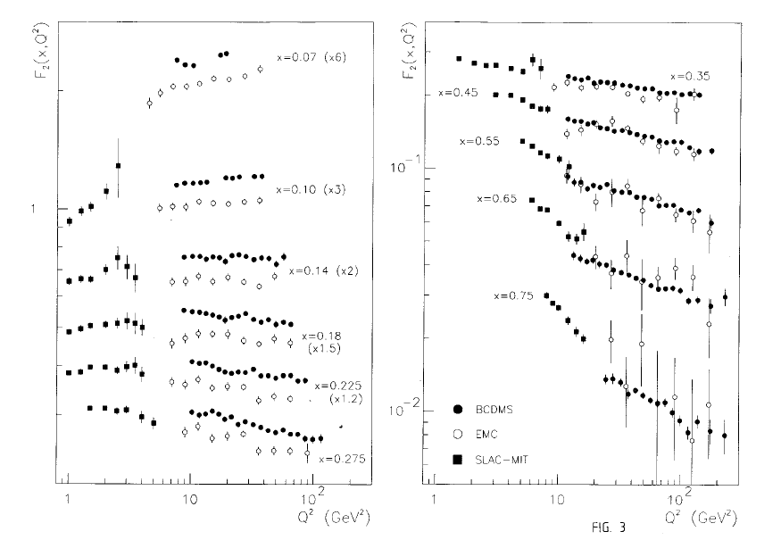

F₂(x,Q²) 1969-1989
Low x?
Q²=sxy
High x, low y?
δF₂/F₂ ~ 1/(1-x)
Regge limits
Phys.Lett. B223 (1989) 485
lN : SLAC, FNAL, BCDMS, EMC??, NMC, COMPASS..
νN: GGM, BEBC, HPWF, CDHSW, CHARM, NuTEV..

Slide 5
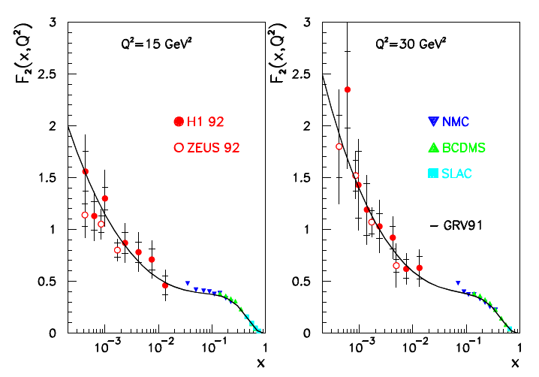
The first F₂ from HERA
Not too steep, not flat (Regge)
in accord with 1974 expectation
hidden in pioneering pQCD paper
H1 Collaboration, Nucl. Phys. B407 (1993) 515
ZEUS Collaboration, Phys. Lett. B316( 1993) 412

Slide 6
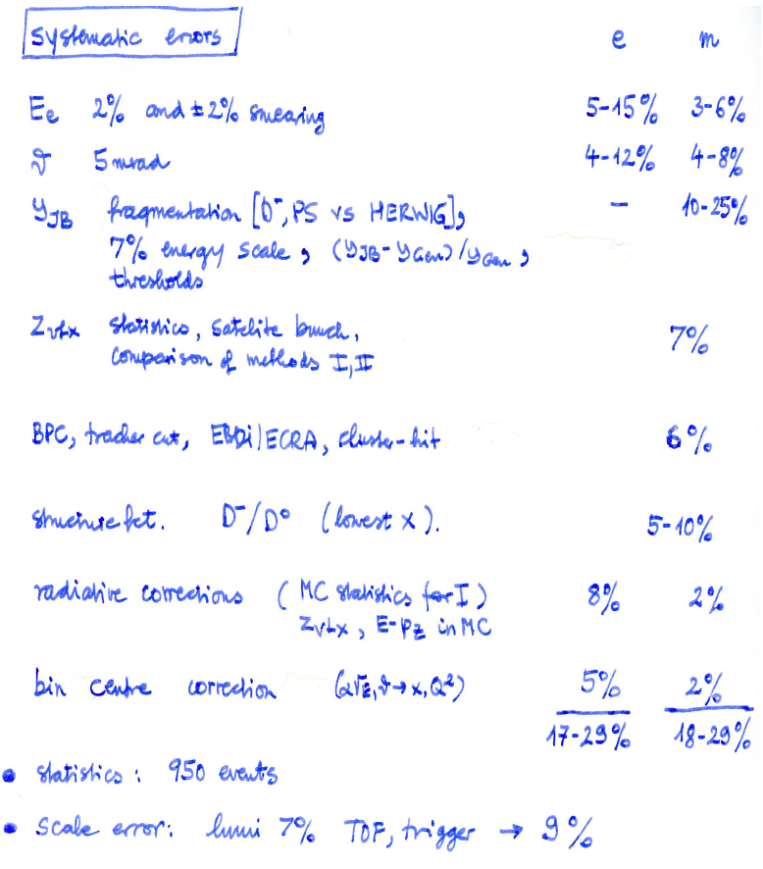
The first F₂ from H1
e = electron method
Q²=Q²_{e}, y=y_{e}, δσ/σ ~ 1/y_{e}
m = mixed method
Q²=Q²_{e}, y=y_{h}, δσ/σ ~ 1/(1-y_{h})
Access to small y (large x) by
using electron AND hadron
kinematics.
Much reduced rad. corrections
but uncertainty of hadronic FS
Collider:
Much extended range (52TeV)
redundant kine. reconstruction

Slide 7

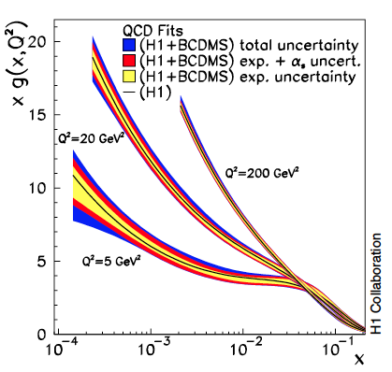
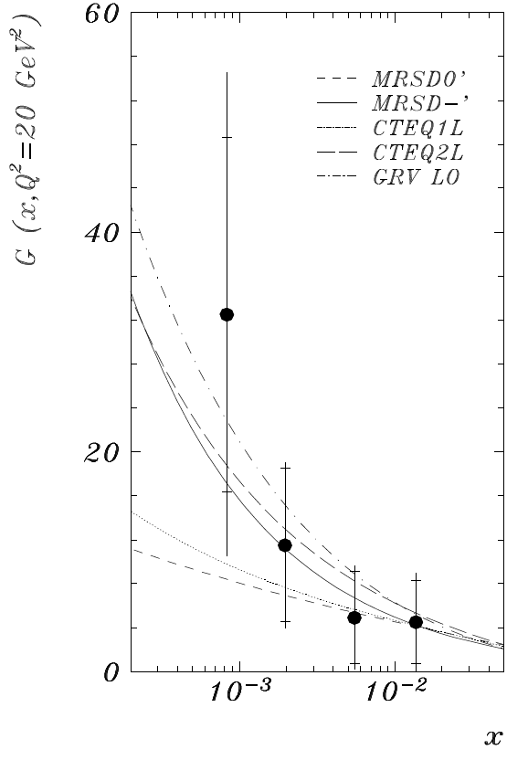

The most cited H1 paper
and the first low x gluon
Deep inelastic inclusive ep scattering at low x
and a determination of α_{s} - EPJ C21 (2001)33
Data from 1996/97. This followed the 1994 data
paper which was the first accurate measurement
of the low Q², x DIS cross section of H1
Phys.Lett. B321(1994)161

Slide 8
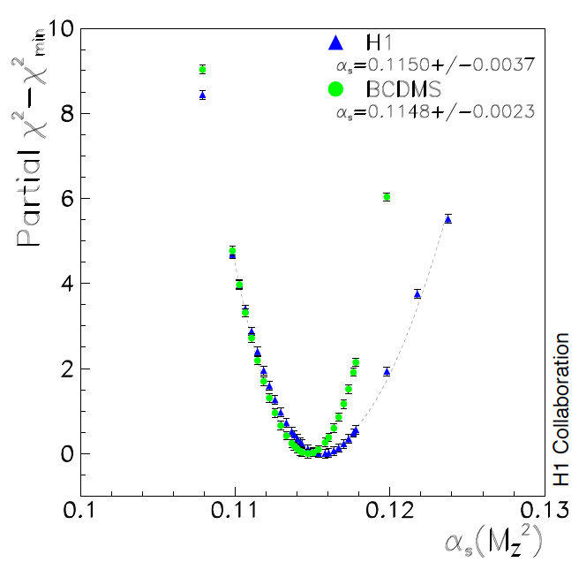
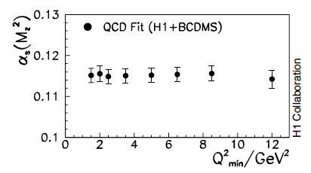
Measurement of α_{s}
Deep inelastic inclusive ep scattering at low x and a determination of α_{s} - EPJ C21 (2001)33
Low x and charm mass dominated model
uncertainty – both need substantially
improved understanding (LHeC..)!
Large renormalisation scale effect (0.005)
NNLO:
Vermaseren, Moch and Vogt papers 04/05
Joint H1+BCDMS – detailed systematic
uncertainty study of BCDMS (y > 0.03).
Strong but resolvable correlation of the
gluon distribution and the strong coupling

Slide 9
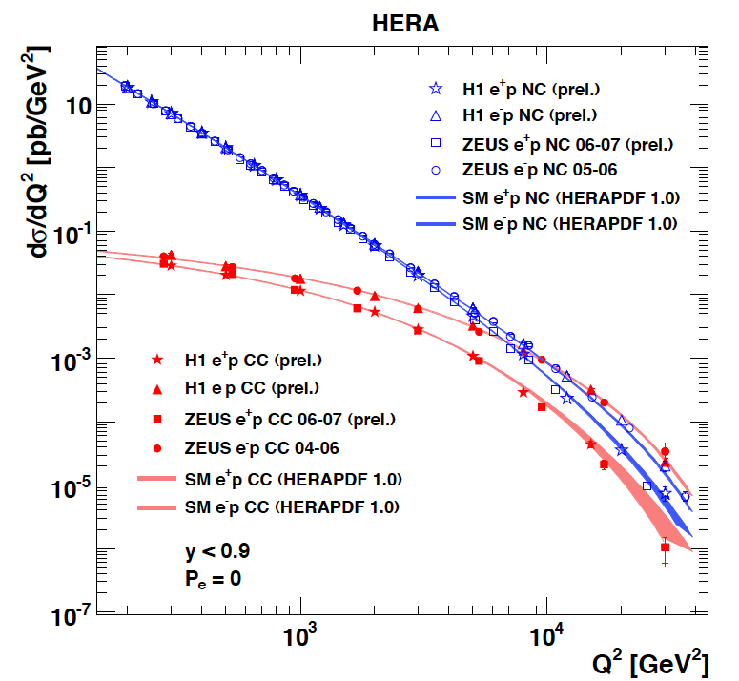
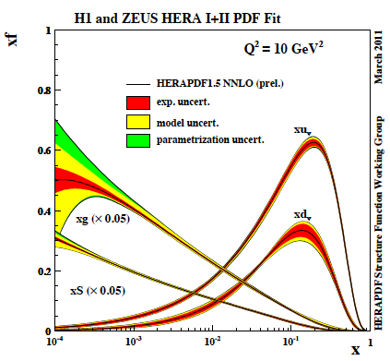
Results from HERA
The weak and electromagnetic interactions reach similar strength when Q² ≥ M²_{W,Z}
F₂ rises towards low x, and xg too.
Parton evolution - QCD to NNLO
Measurements on α_{s}, Basic tests of QCD: longitudinal structure function, jet production, γ structure
Some 10% of the cross section is diffractive (ep → eXp) : diffractive partons; c,b quark distributions
New concepts: unintegrated parton distributions (k_{T}) , generalised parton distributions (DVCS)
New limits for leptoquarks, excited electrons and neutrinos, quark substructure, RPV SUSY
Interpretation of the Tevatron measurements (high Et jet excess, M_{W}, searches..), + base for PDF fits..
M.Klein, R.Yoshida: Collider Physics at HERA Prog.Part.Nucl.Phys. 61 (2008) 343-393 and recent H1,ZEUS results

Slide 10
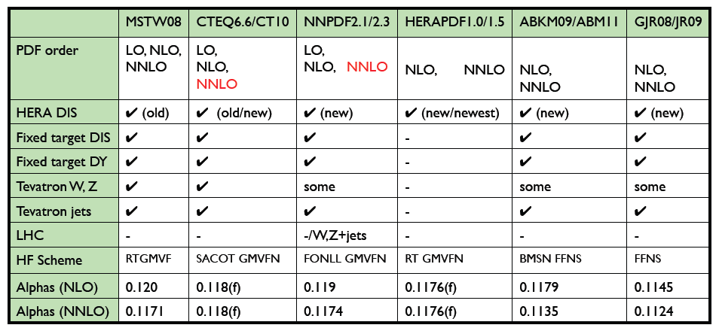
Industry of PDF Determinations
V.Radescu
The determination of the partonic contents of the proton is a subtle, complex task.
It often involves data which are barely compatible as is tolerated with χ² innovations..
Future high precision needs a new, complete PDF data basis and precision h.o. theory.
(cf arXiv:1310.1073,jb)

Slide 11
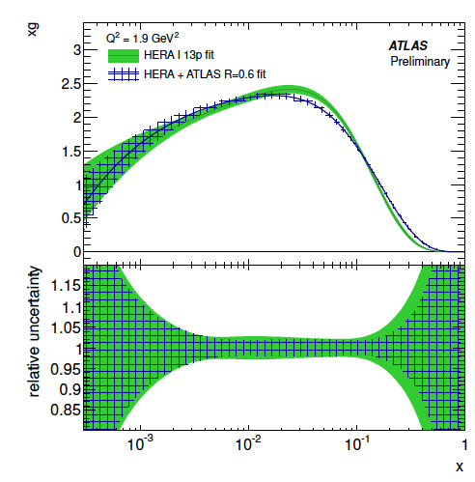
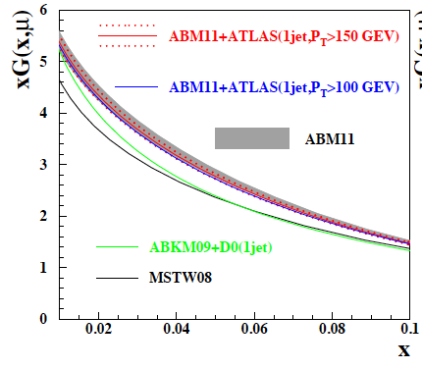
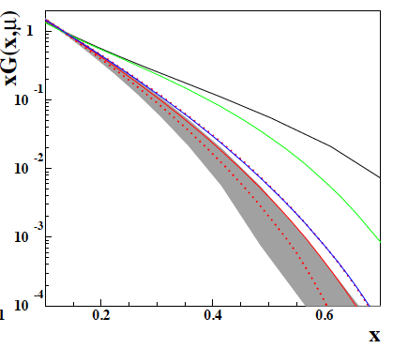
PDF constraints from LHC – Jets
ATLAS-CONF-2012-128
S.Moch 6th Terascale Workshop (Hamburg, 3.12.12)
μ=3GeV
First constraints on gluon distribution from
jets: cross sections and ratios 2.7/7 TeV
Will improve, but depends on energy scales,
jet definition, non-perturbative effects ..
Similar results from CMS (W±, DY, top..)

Slide 12
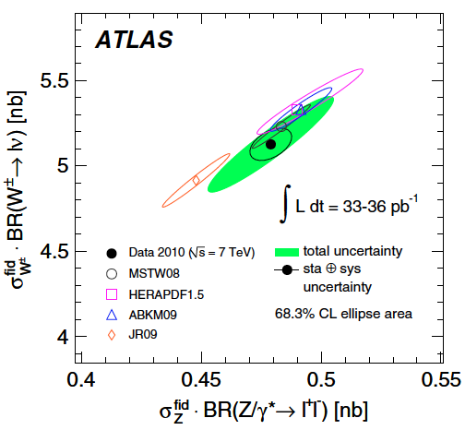
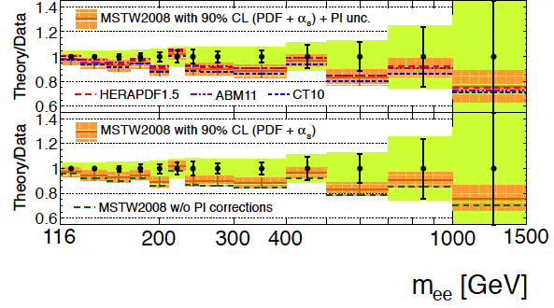
PDF constraints from LHC - Di-Lepton Production
Precision
Drell-Yan
(W,Z) data
constrain
PDFs
PRD D85 (2012) 072004
according to the ATLAS data and
HERA+ATLAS QCD analysis: s = d !
PRL 109(2012)012001
ATLAS-CONF-2012-159
Very high precision required
for any constraint on PDFs
Change of strange affects sea - UHE ν

Slide 13
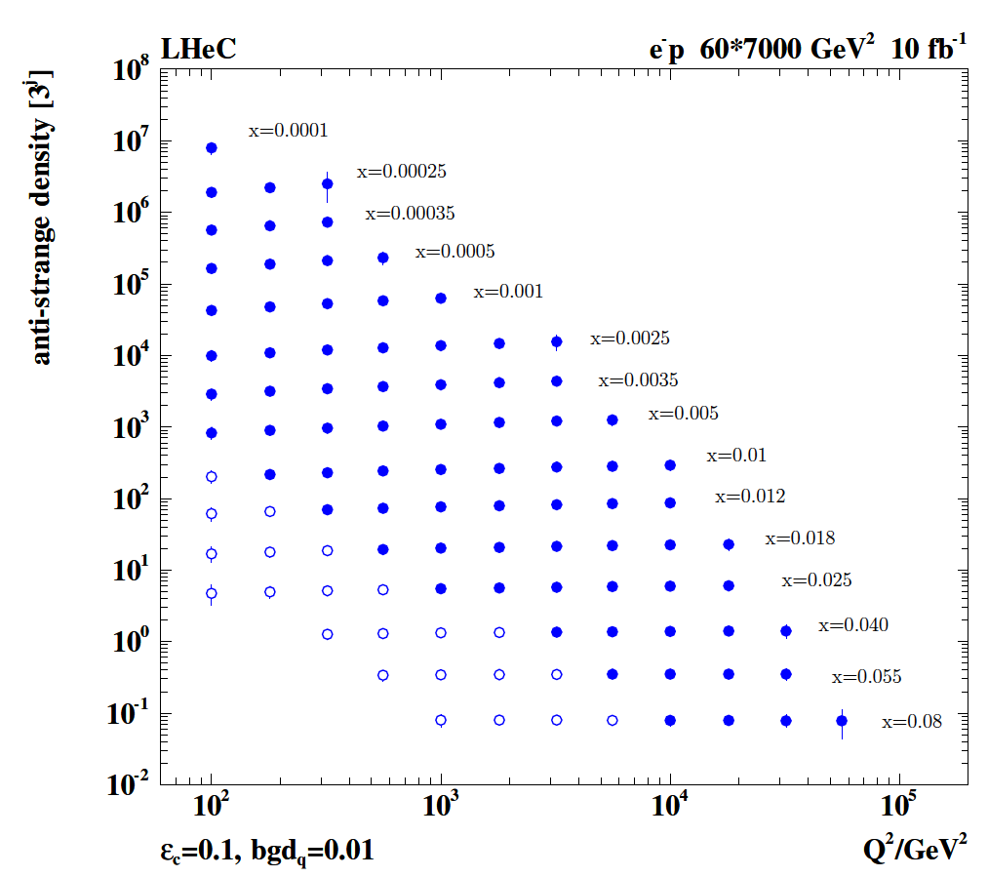
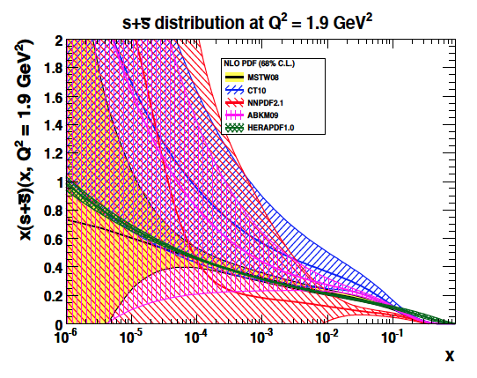
Strange Quark Distribution
High luminosity
High Q²
Small beam spot
Modern Silicon
NO pile-up..
First (x,Q²)
measurement of
the (anti-)strange
Density, HQ valence?
x = 10⁻⁴ .. 0.05
Q² = 100 – 10⁵ GeV²
Initial study (CDR): Charm tagging efficiency of 10% and 1% light quark background in impact parameter

Slide 14
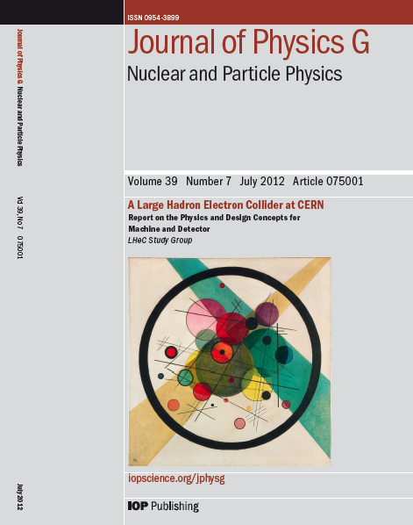
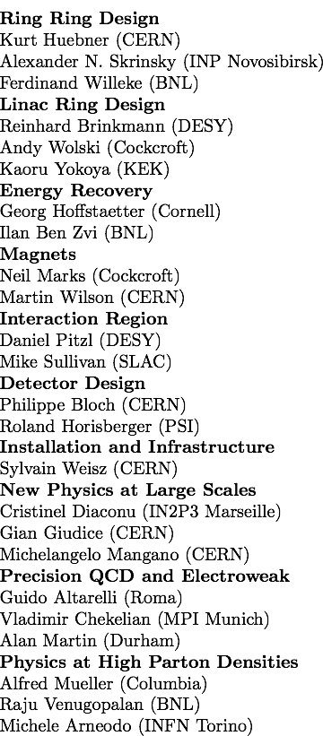
CERN Referees
arXiv:1206.2913
arXiv:1211.4831 and 5102
Published 600 pages conceptual design report (CDR) written by 150 authors from 60 Institutes.
Reviewed by ECFA, NuPECC (long range plan), Referees invited by CERN. Published June 2012.

Slide 15
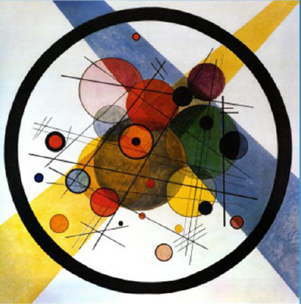

“BFKL evolution and Saturation in DIS”
“Critical gravitational collapse”
Circles in a circle
V. Kandinsky, 1923
Philadelphia Museum of Art
5d tiny black holes and perturbative saturation
Talk by A.S.Vera at LHeC Workshop 2008

Slide 16
60 GeV electron beam energy, L= 10³³ cm⁻²s⁻¹, √s=1.3 TeV: Q²_{max}= 10⁶ GeV², 10⁻⁶ < x< 1
Recirculating linac (2 * 1km, 2*60 cavity cryo modules, 3 passes, energy recovery)
Ring-ring as fall back. New dipole magnets. “SAPHIRE” 4 pass 80 GeV option: γγ→ H

Slide 17





















Accelerator Design: Participating Institutes
TOBB ETU
Source | Power [MW]
Cryogenics (linac) | 21
Linac grid power | 24
SR compensation | 23
Extra RF cryopower | 2
Injector | 6
Arc magnets | 3
Total | 78
KEK

Slide 18
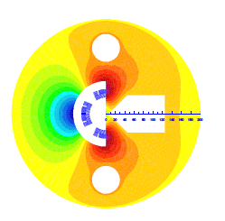
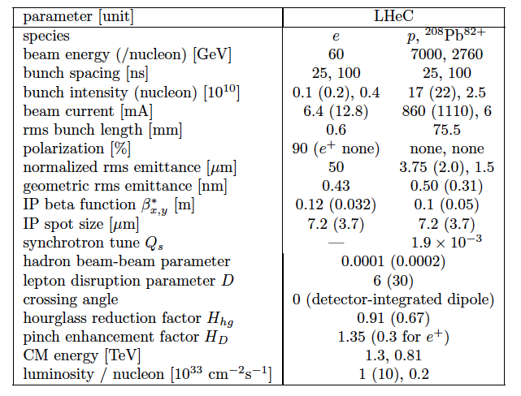
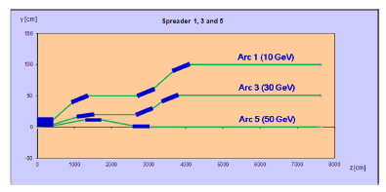
Parameters and Design
257 pages of technical design
in the CDR arXiv:1206:2913, e.g.
“Q1” SC 3-beam IR magnet
Update of parameter table in view of H - arXiv:1211:5102
Designed for synchronous ep and pp operation
1→3 beam spreader design

Slide 19
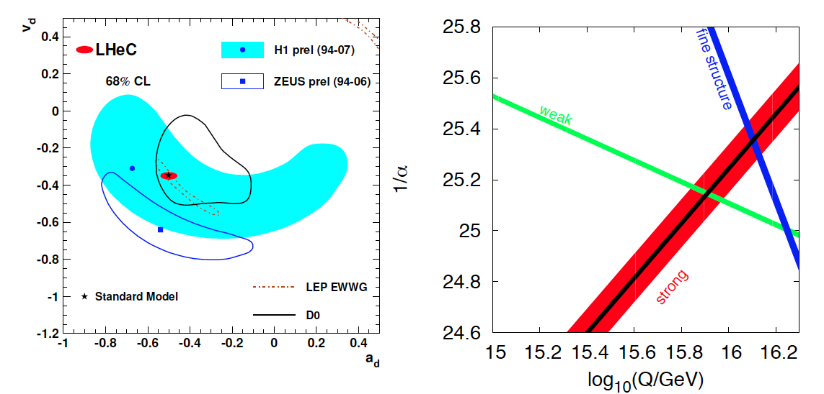
High Precision DIS
High Precision DIS
Q² >> M_{Z,W}², high luminosity, large acceptance
Unprecedented precision in NC and CC
Contact interactions probed to 50 TeV
Scale dependence of sin²θ left and right to LEP
→ A renaissance of deep inelastic scattering ←
Solving a 30 year old puzzle:
α_{s} small in DIS or high with jets?
Per mille measurement accuracy
Testing QCD lattice calculations
Constraining GUT (CMSSM40.2.5)
Charm mass to 3MeV, N³LO

Slide 20
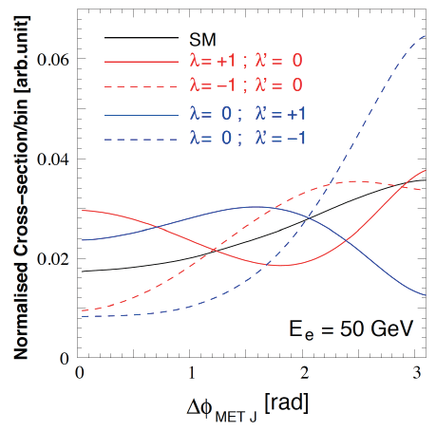
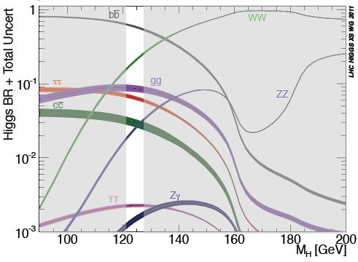
Higgs and LHeC
Precision measurements of couplings in WW and ZZ production (CDR: bb study in CC)
Measurement of CP properties (J^{PC}=0⁺⁺ in SM; MSSM has 2 CP-even and 1 CP-odd states)
First LHeC Higgs study: WW → H → bb
PGS for detector, cut based analysis,
S/B =1, 500 H-bb events for 100fb⁻¹
2-3% H-bb coupling precision
thy corrections small:
J.Blümlein et al, NP B395(1993)35
ICHEP12: J Campbell: ultimate limitation of
Higgs measurements from LHC by PDFs/QCD
→
With high luminosity the LHeC has a huge potential for precision Higgs physics, which is being further evaluated.

Slide 21
Exp uncertainty
of LHeC Higgs
cross section is
0.25% (sys+sta),
using LHeC only.
Leads to mass
sensitivity..
Strong coupling
underlying
parameter
(0.005 – 10%).
LHeC: 0.0002
Needs N³LO
HQ treatment
important
PRECISION σ(H)
Calculated for scale of M_{H}/2
Higgs production (gg) at the LHC is

Slide 22

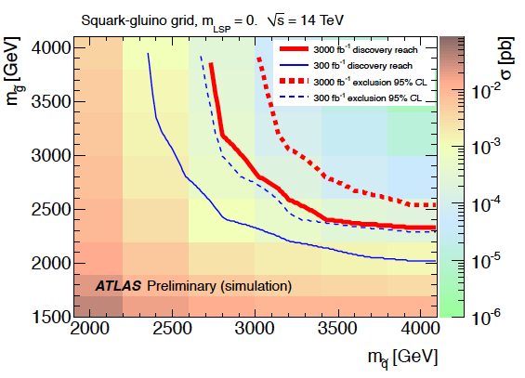
Searching for High Mass SUSY
ATLAS October 2012 “Physics at High Luminosity”
LHeC: arXiv:1211.5102
With high energy and luminosity, the LHC search range will be extended to high masses,
up to 4-5 TeV in pair production, and PDF uncertainties come in ~ 1/(1-x).

Slide 23
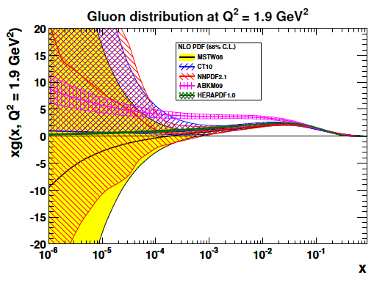
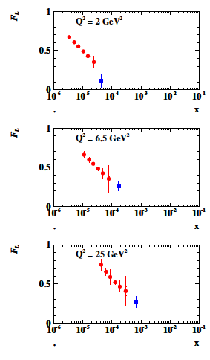
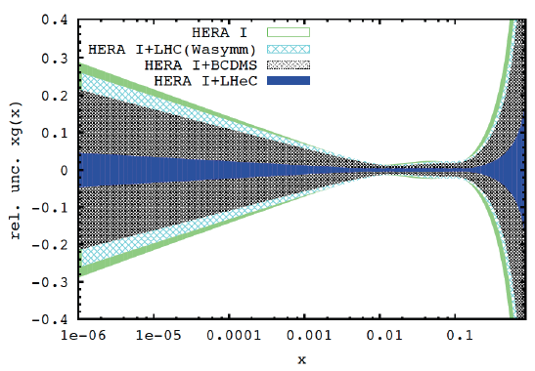
Gluon Saturation at Low x?
LHeC
H1
Gluon measurement down to x=10⁻⁵, Saturation or no saturation (F₂ and precise F_{L})
Non-linear evolution equations? Relations to string theory, and SUSY at ~10 TeV?
cf H.Kowalski, L.Lipatov, D.Ross, arXiv:1205.6713

Slide 24
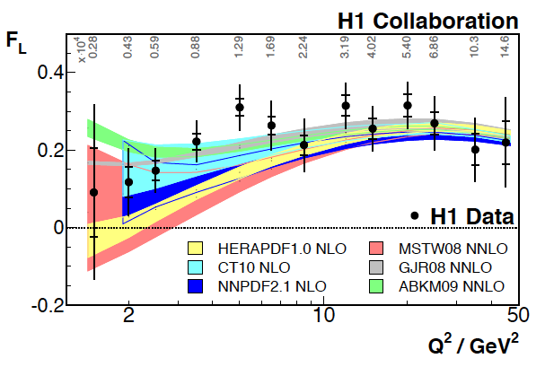
Longitudinal Structure Function
F_{L} provides
independent
test of QCD
Two F_{L} papers of H1: PLB665(2008)139 and EPJ C71(2011)1579
Data taken in 2007 before termination of HERA.
Low Q² accessed with Backward Silicon Tracker (1992-2007), 20 years on F_{L} …
H.Lippold, A.Meissner, W.Lange, U.Harder, H.Henschel + I. Tsurin et al. Thanks to DESY+H1

Slide 25
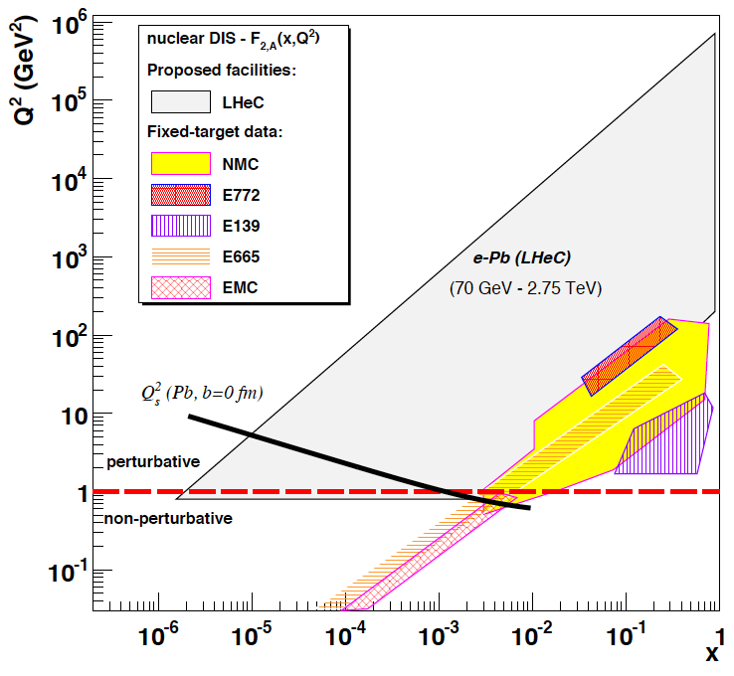
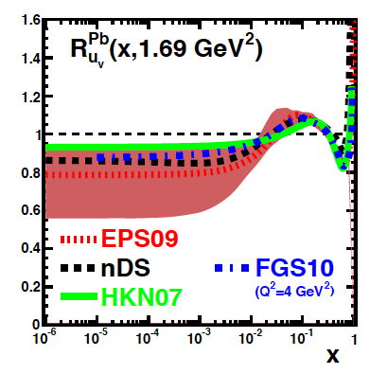
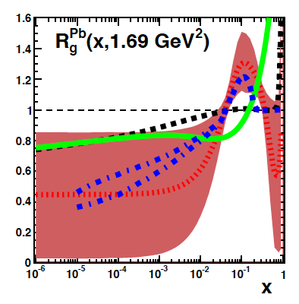
LHeC as an electron-ion collider
up valence
gluon
3-4 orders of magnitude extension of lA kinematic range
→ LHeC has huge discovery potential for new HI physics
(bb limit, saturation, deconfinement, hadronisation,QGP..)
will put nPDFs on completely new ground - Deuterons
unmeasured | known?

Slide 26
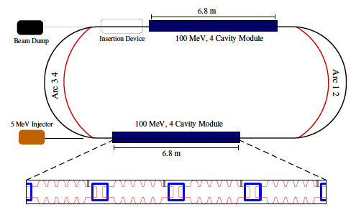
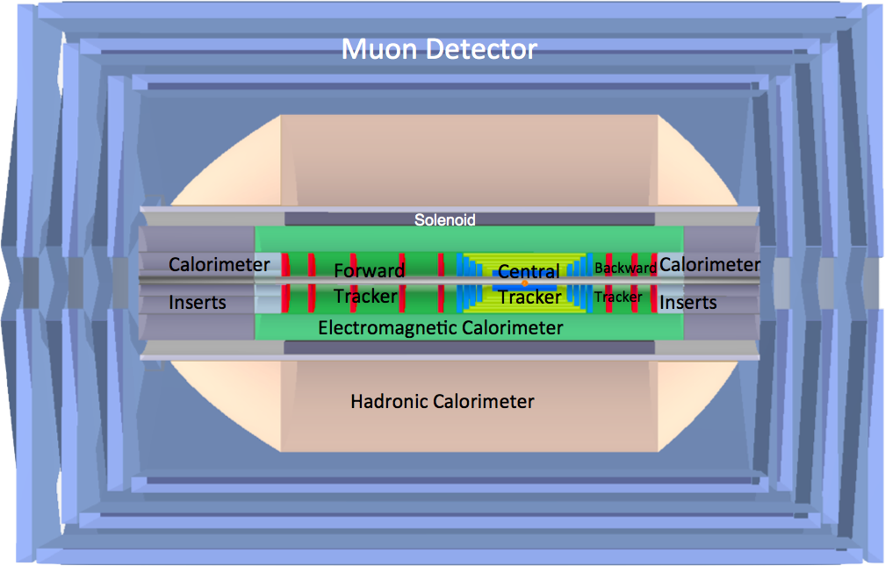
Key developments for the LHeC
LHeC ERL Test Facility at CERN
Physics studies in view of LHC results
(LPCC day on LHeC 18.4.2013).
Higgs and high luminosity, top, …
R.Calaga, E.Ciapala, E.Jensen, LHeC-Note-2012-005 ACC
Collaboration with AsTEC, Jlab, Mainz, BNL, Novosibirsk..
High Q cavity,
Prototype of Q1
Beam Dynamics (ATS, HL-LHC..)
Interaction Region …
Further development of ep/eA detector
(forward tracking, GEANT5 simulation..)
..Decision on the LHeC realization in a few years, after 2015 (13 TeV pp data)..

Slide 27
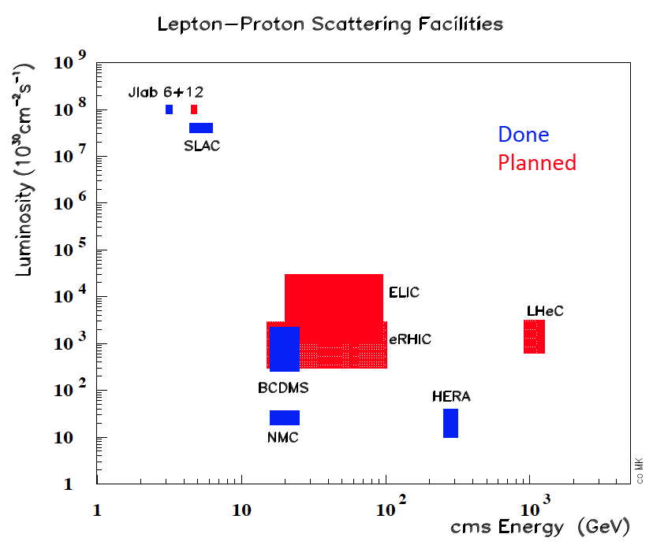
The LHeC provides the only, single opportunity to develop DIS as part of HEP for decades, enriching the LHC physics… “it would be a waste not to use it” (G.Altarelli, 2008)

Slide 28
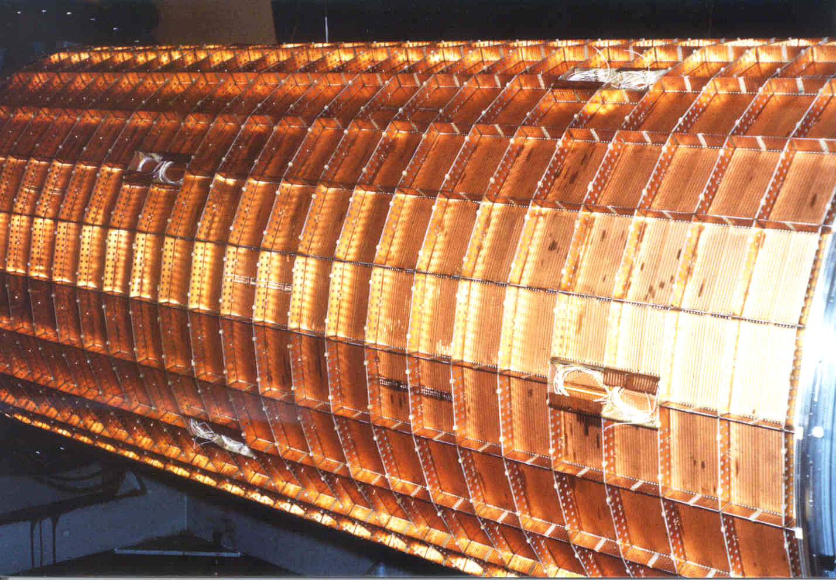
coz
PhD Students
Uta Stoesslein – first F₂ and xg
Sasha Glazov – first precise F₂
Rainer Wallny – alphas
Doris Eckstein – BST momentum
Tomas Lastovicka – self similarity
Ilya Tsurin – BST electronics
Jan Kretzschmar – most precise F₂ …
Zeuthen H1
Hartmut Baerwolff
Johannes Blümlein
Ulrich Gensch
Helmut Kaufmann
Peter Kostka
Thomas Naumann ..
BCDMS
Dima Bardin
Alberto Benvenuti
Ticiano Camporesi
Igor Golutvin
Francesco Navarria
Jim Pilcher
Tord Riemann
Igor Savin ..
L3: Hans Hofer, Rudolph Leiste
Martin Pohl, Bolek Wieslouch..
H1
Alexey Babaev
Vladimir Chekelyan
Jochen Bürger
John Dainton
Franz Eisele
Joel Feltesse
Karsten Gadow
Tim Greenshaw
Carsten Niebuhr
Daniel Pitzl
Emmanuelle Perez
Natasa Raicevic..
ATLAS
Phil Allport
Max Bellomo
Monica D’Onofrio
Fabiola Gianotti
Sasha Glazov
Karl Jakobs
Peter Jenni
Uta Klein
Jan Kretzschmar
Leandro Nisati
Jim Pilcher
The Liverpool ATLAS Group
LHeC
Guido Altarelli
Nestor Armesto
Olaf Behnke
Sergio Bertolucci
Stan Brodsky
Oliver Brüning
Rama Calaga,
John Dainton
Stefano Forte
Rolf Heuer
Uta Klein
Peter Kostka
Paul Laycock
Lev Lipatov
Erk Jensen
John Jowett
Steve Myers
Paul Newman
John Osborne
Emmanuelle Perez
Alessandro Polini
Voica Radescu
Daniel Schulte
Sasha Skrinsky
Anna Stasto
Ferdinand Willeke
Frank Zimmermann ..
COZ
H1 drift
chamber
built at
Zeuthen
1986-91
Thanks to Zeuthen, Dubna, Zürich, Hamburg, Liverpool and Meyrin, …. to IoP and DPG

Slide 29
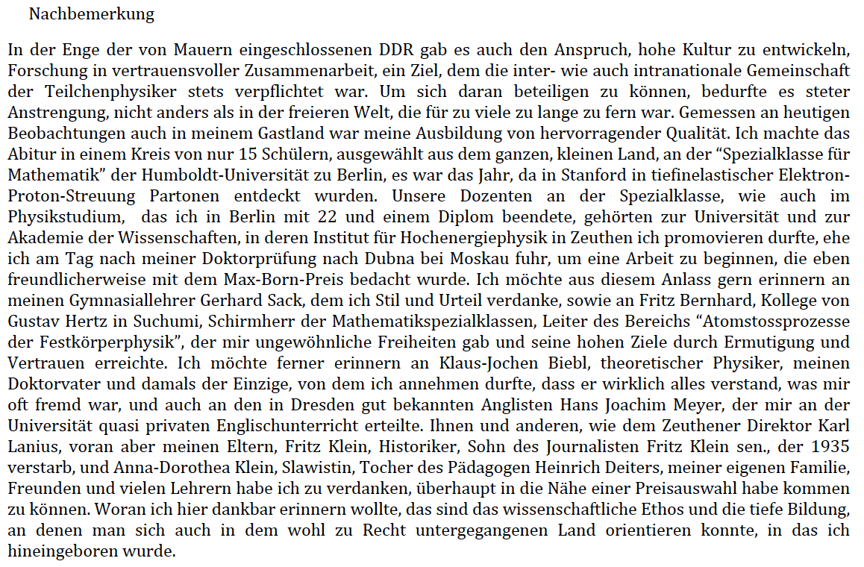

Slide 30
Thanks

Slide 31
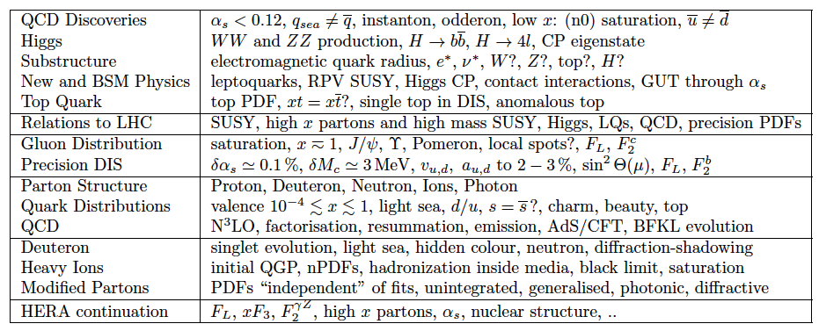
Candidates for Surprises and Discoveries:
PDFs (t, s, q-q, val, xg)
Odderon
Instanton
(no) saturation, QCD
QGP initial state
Factorization pp-ep
LQs, RPV SUSY
e*
Higgs CP
α_{s} indeed small (GUT)
LHeC Physics Programme: CDR, arXiv:1211.4831 and 5102
Ultra high precision (detector, e-h redundancy) - new insight
Maximum luminosity and much extended range - rare, new effects
Deep relation to (HL-) LHC (precision+range) - complementarity
→ LHeC brings a substantial enrichment of LHC physics

Slide 32
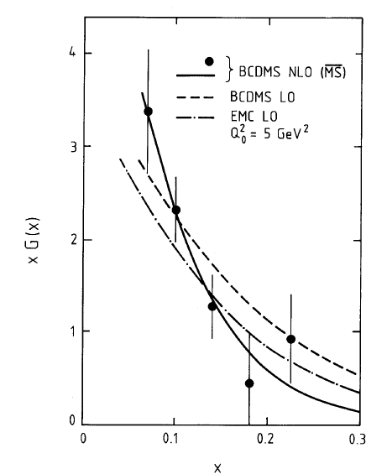
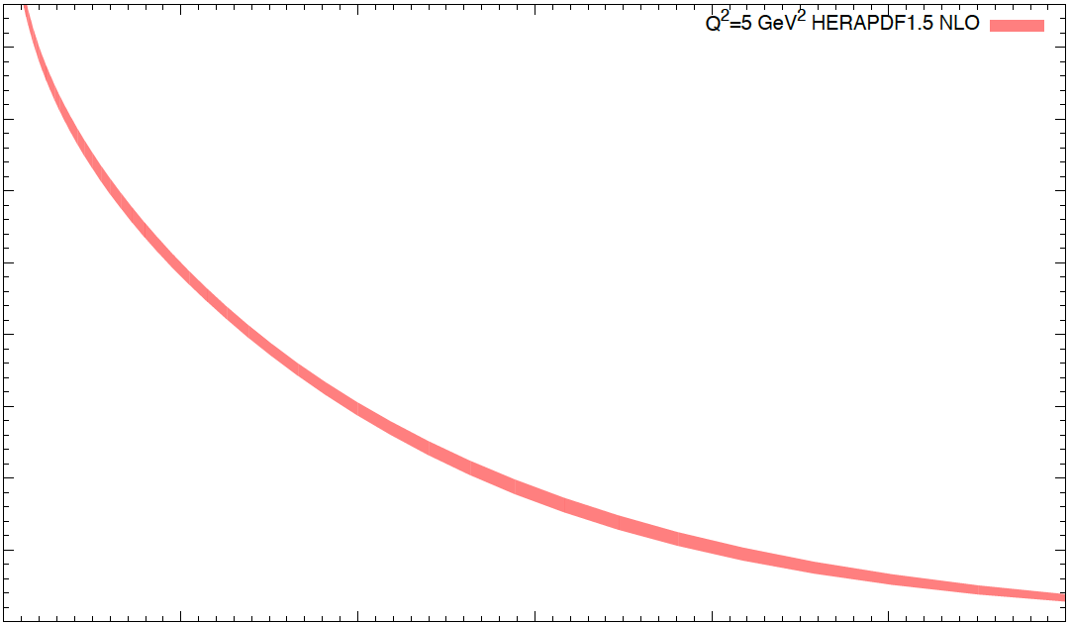
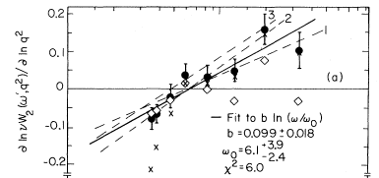

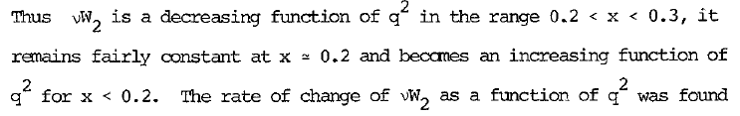
Gluons early μN scattering
Scaling violations, FNAL 74, ω=1/x
Phys.Lett. B223 (1989) 490
Pattern of scaling violation implied by field theories
Wu-Ki Tung Phys.Rev.D12 (1975) 3613
a friend not forgotten
…DGLAP equations, NLO.
3-jet events at PETRA “the gluon is found” (Abdus Salam at Rochester Conference, Madison 1980)

Slide 33
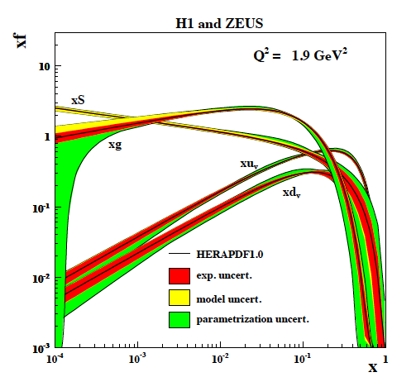
Precision input
EPJ C64(2009)561
and novel data
combination method
lead to
HERAPDF1.0
Later added
charm, jets,
NNLO in different
versions.
High x not well
measured at HERA
mainly due to lowish
luminosity. HERA 2
under way
Low x:
no xg information
below x = 2 10⁻⁴
H1+ZEUS EPJ C64(2009)561

Slide 34


Constraints on Strange Quark Distribution - LHC
- Large non-perturbative effects to control
- Ratios (W+c/W+j)
- Use charges to access valence strange
Scale
Q² = M²_{W,Z}
CMS:
PAS-EWK-11-03
W.Stirling, E.Vryonidou, Phys.Rev.Lett. 109 (2012) 082002

Slide 35


Top Quark and Leptoquarks
The LHeC is a (single) top quark production
factory, via Wb → t. Top was never observed
in DIS. With ep: top-PDF → 6 flavour VFNS,
precision M_{t} direct and from cross section,
anomalous couplings [to be studied]
Leptoquarks (-gluons) are predicted in RPV SUSY,
E6, extended technicolour theories or Pati-Salam.
The LHeC is the appropriate configuration to do their
spectroscopy, should they be discovered at the LHC.

Slide 36


High Mass Drell Yan
Towards high mass the PDF uncertainties
rise, strongly towards the edge (√s) x → 1…
CMS Di-Jets arXiv:1212:6660
For HL-LHC:
Need to study limits
and interferences (ED?)
in context with energy
calibrations, and thy
uncertainties, + PDFs
vs BSM expectations
14 TeV, VRAP L.Dixon et al, U.Klein

Slide 37




PDFs at Large x
No higher twist corrections, free of nuclear uncertainties, high precision test of factorisation

Slide 38
What HERA could not do or has not done
Test of the isospin symmetry (u-d) with eD - no deuterons
Investigation of the q-g dynamics in nuclei - no time for eA
Verification of saturation prediction at low x – too low s
Measurement of the strange quark distribution – too low L
Discovery of Higgs in WW fusion in CC – too low cross section
Study of top quark distribution in the proton – too low s
Precise measurement of F_{L} – too short running time left
Resolving d/u question at large Bjorken x – too low L
Determination of gluon distribution at hi/lo x – too small range
High precision measurement of α_{s} – overall not precise enough
Discovering instantons, odderons – don’t know why not
Finding RPV SUSY and/or leptoquarks – may reside higher up
…
The H1 and ZEUS apparatus were basically well suited
The machine had too low luminosity and running time
HEP needs a TeV energy scale machine with 100 times
higher luminosity than HERA to develop DIS physics
further and to complement the physics at the LHC. The
Large Hadron Collider p and A beams offer a unique
opportunity to build a second ep and first eA collider
at the energy frontier.
HERA in one box
the first ep collider
E_{p}*E_{e}=
920*27.6GeV²
√s=2√E_{e}E_{p}=320 GeV
L=1..4 10³¹cm⁻²s⁻¹
→ ΣL=0.5fb⁻¹
1992-2000 & 2003-2007
Q²= [0.1 -- 3 * 10⁴ ] GeV²
-4-momentum transfer²
x=Q²/(sy) ≅10⁻⁴ .. 0.7
Bjorken x
y≅0.005 .. 0.9
inelasticity

Slide 39
LHeC Detector Overview
LAr electromagnetic calorimeter
Tile Calorimeter
Detector option 1 for LR and full acceptance coverage
Forward/backward asymmetry in energy deposited and thus in geometry and technology
Present dimensions: LxD =14x9m² [CMS 21 x 15m² , ATLAS 45 x 25 m²]
Taggers at -62m (e),100m (γ,LR), -22.4m (γ,RR), +100m (n), +420m (p)

