Slide 1
Some slides for Michel please take what you like
Max Klein (klein@ifh.de)

Slide 2
The 10-100 GeV Energy Scale [1968-1988]
(--)
pp
Drell Yan
Charm
W,Z
Jets
lh
e⁺e⁻
SU(2)_{L} x U(1)
QCD
Quarks
Neutral currents
Singlet e_{R}
Asymptotic Freedom
Charm
3 colours
Gluon Jets

Slide 3
The Fermi Scale [1985-2012]
pp
b quark
top quark
M_{W} (H?)
Tevatron
ep
e⁺e⁻
The Standard
Model Triumph
M_{Z} , sin² Θ
3 neutrinos
h.o. el.weak (t,H?)
gluon
h.o. strong
c,b distributions
high parton densities
LEP/SLC
HERA
CKM - B factories

Slide 4
The TeV Scale [2010-2035..]
pp
W,Z,top
Higgs??
New Particles??
New Symmetries?
LHC
ep
e⁺e⁻
New Physics
ttbar
Higgs??
Spectroscopy??
High Precision QCD
High Density Matter
Substructure??
eq-Spectroscopy??
ILC/CLIC
LHeC
CKM - superB

Slide 5
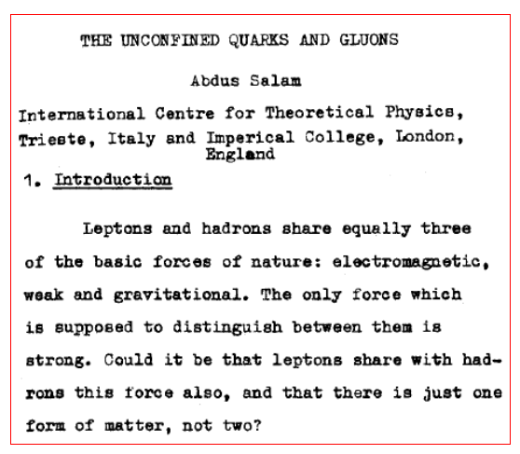
Leptons and Quarks
A. Salam ICHEP Tbilissi 1976

Slide 6
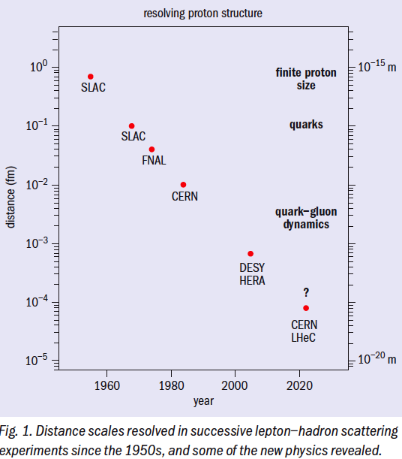
History of DIS
You notice this points to ~2020
to stay on a steady path in history…
From M.Klein, P.Newman
CERN Courier 4/09
http://cerncourier.com/cws/article/cern/38298

Slide 7
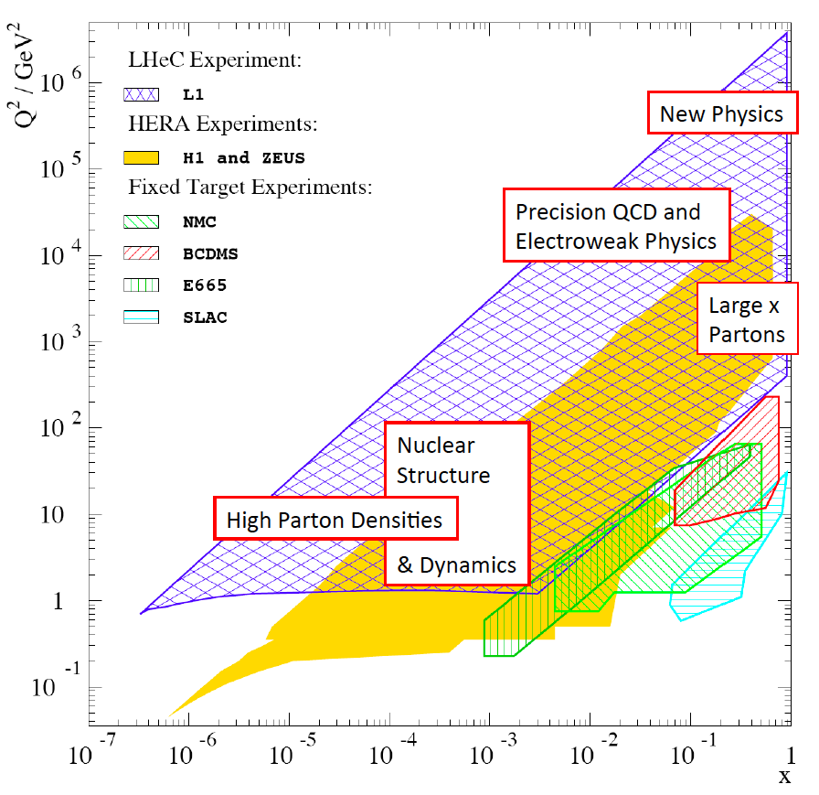
Q²-x

Slide 8
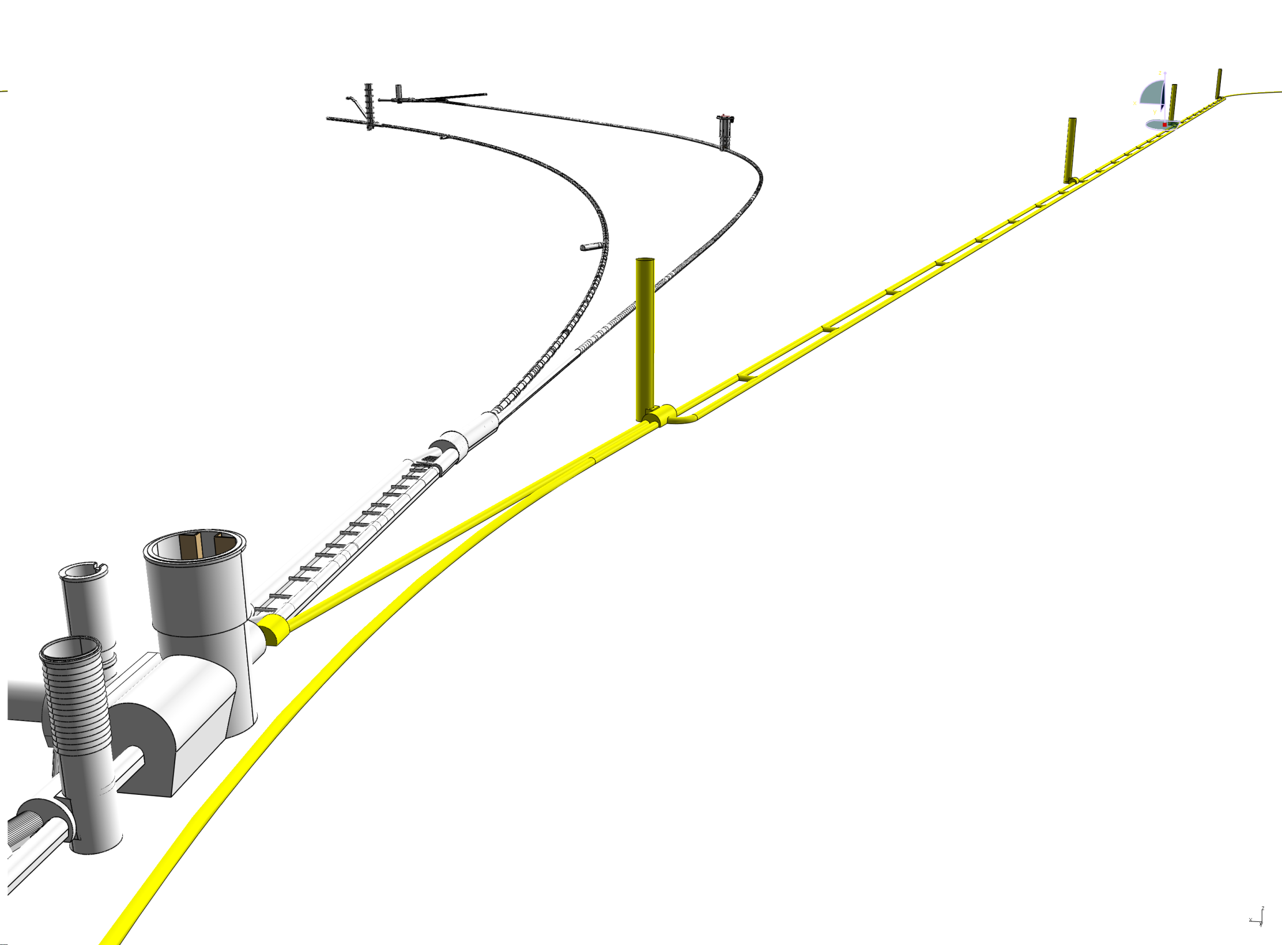
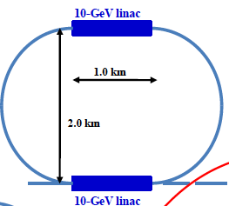
Linac-Ring configuration
Note: CLIC x LHC ~10³⁰
due to different time
structure (0.5 vs 50ns)
Baseline: Energy Recovery Linac
60 GeV Power=100MW 10³³cm⁻²s⁻¹
Tentative sketch

