Slide 1
Report on ATLAS 2011
Max Klein
for the Liverpool ATLAS Group
LHC and H
Operation/Collaboration
Liverpool Group
Highlights
Outlook*⁾
a light weighted summary, as
invited by the new leader -TB
*⁾ Upgrade see talk of Phil Allport
Christmas Meeting of the Liverpool HEP Group 15th of December 2011

Slide 2
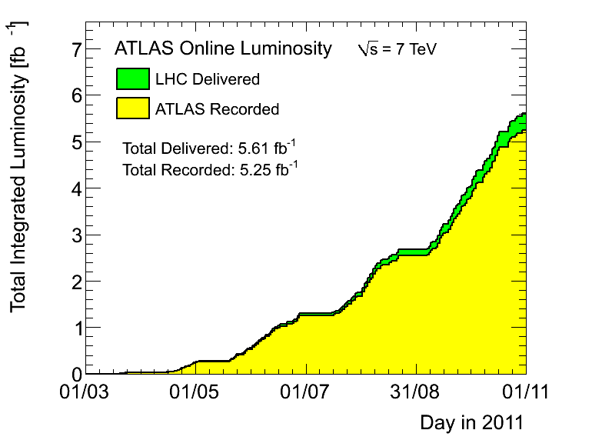
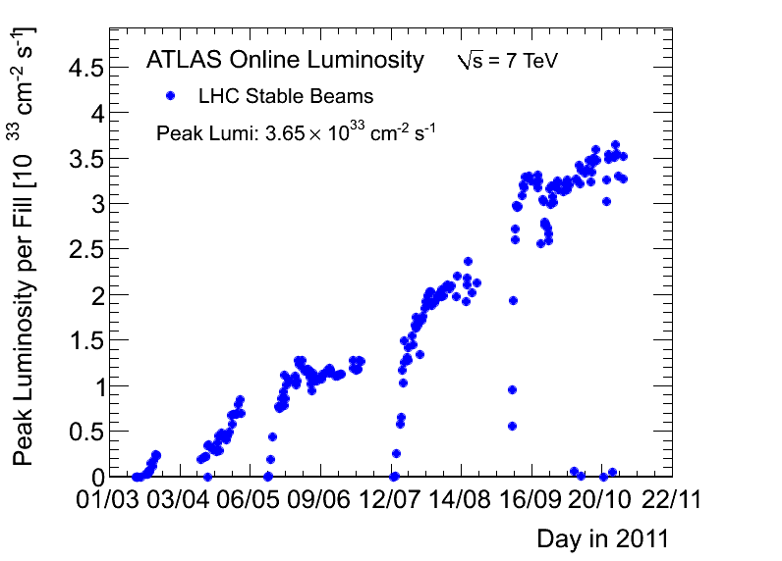
LHC in 2011
The main reason for the steady increase in
integrated luminosity was the rise of the
specific luminosity to 3.5 10³³ cm⁻²s⁻¹. At 50ns
bunch crossing this causes a mean pileup of 15.
In 2015 we expect 10³⁴ (S.Myers, 22.11. at ATLAS),
from β*=0.5m and E_{p}=6.5 TeV get ~30fb⁻¹ with,
at 50ns, a mean pileup of 50 ( horizon for Grant..).
A year ago I had predicted 10fb⁻¹ at 8 TeV...
The 8 TeV was not supported at Chamonix11.
The official DG goal of 1fb⁻¹ yet was already
achieved end of June, which points to the
difficulty of expectation management. We
recorded 5fb⁻¹ in 2012 – the basis of all the
~70 papers published in 2011 and ~700 talks.

Slide 3
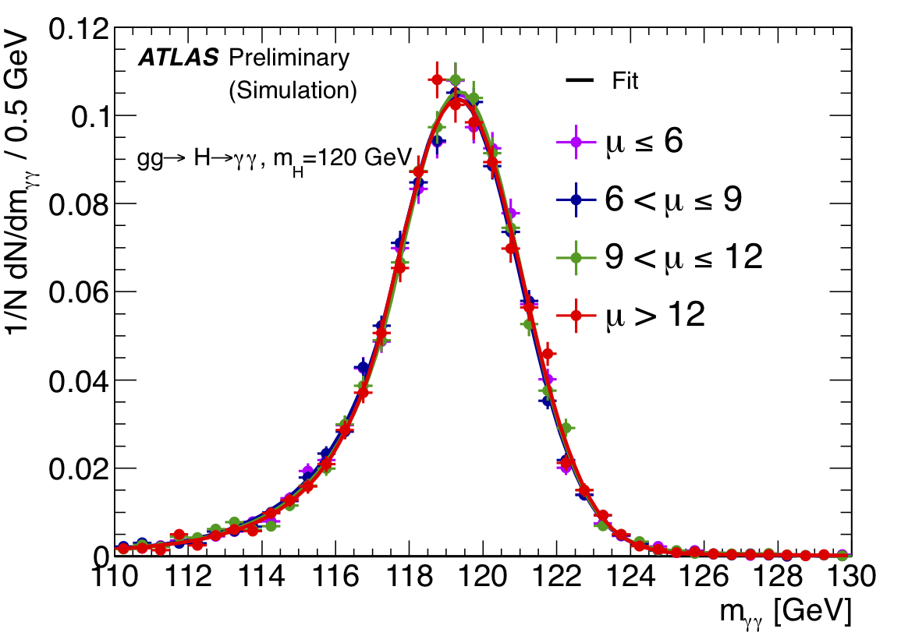
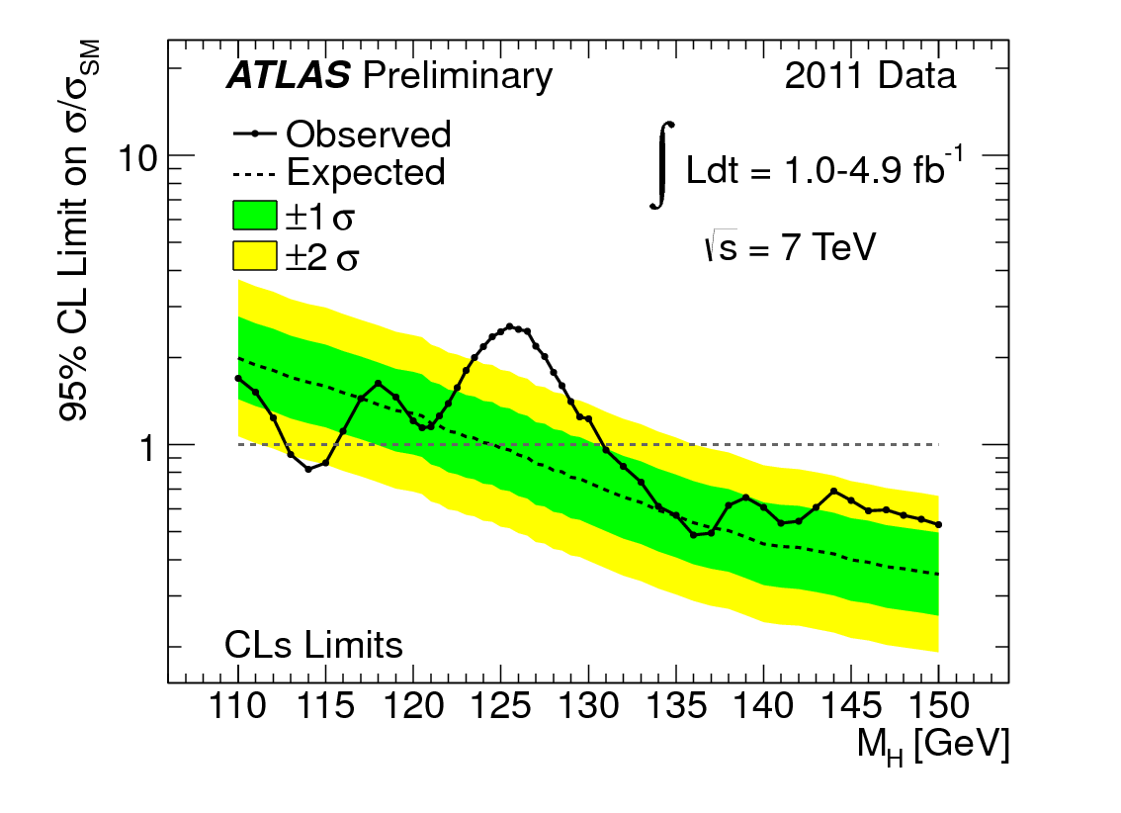
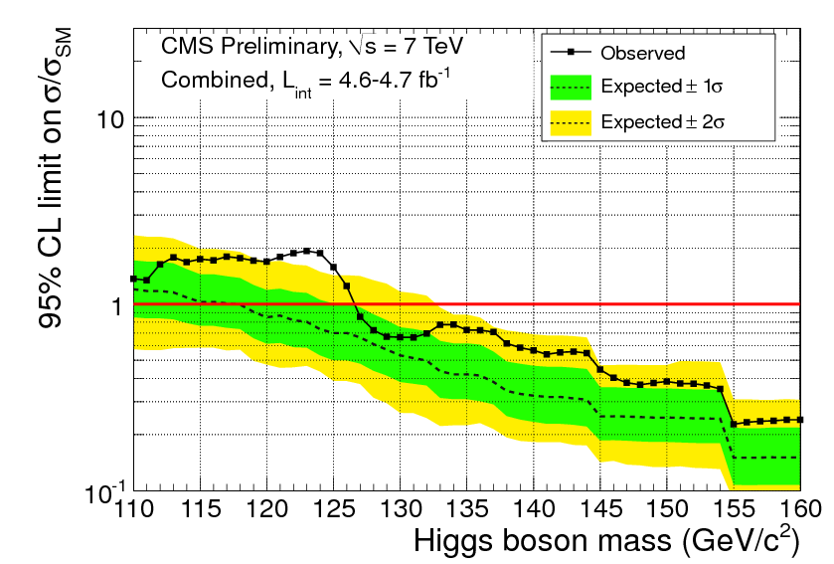
Higgs on December 13th
simulated SM Higgs → γγ in ATLAS
The “excesses” are about 2 GeV
apart, probably just compatible
The Higgs is NOT god’s particle
and may (not) exist. I don’t think
it is more important than the
proton, the up/down quark,
the gluon, ν or the W… BUT sth is
missing and the H exciting for sure.

Slide 4
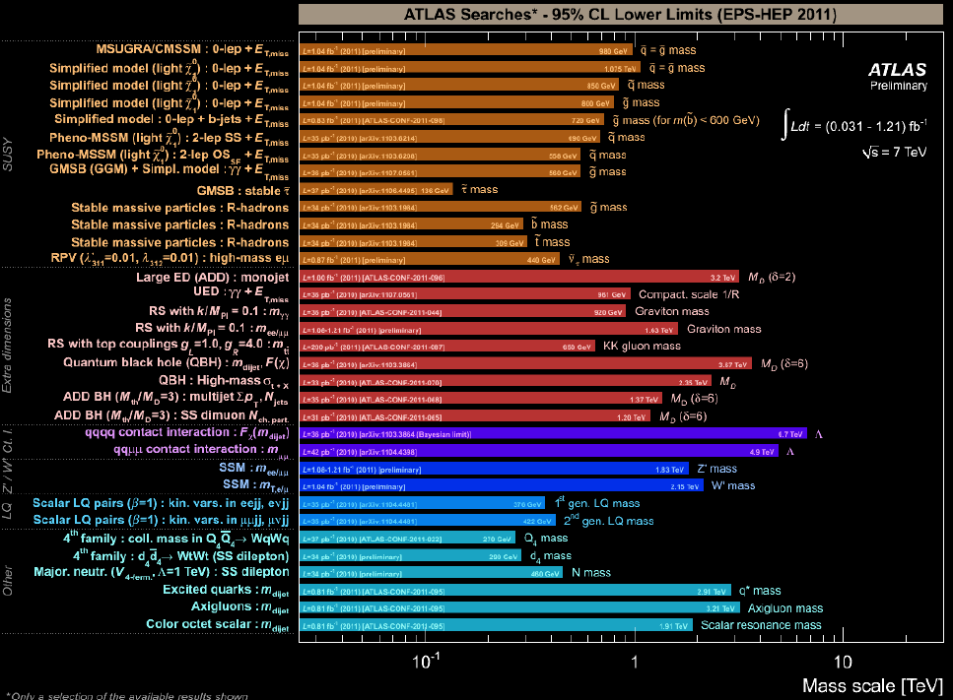
To early for despair, enough for depression (G.Altarelli at EPS11 Grenoble)

Slide 5
The Liverpool ATLAS Group Tasks
These tasks can only be
fulfilled by an intimately
cooperating group which
is aware of the sharing
of its responsibilities as of
the fun parts too. Cannot
do justice in 20 minutes..
SCT
Shifts
Teaching
Operation
Service
Upgrade
Editorial boards
Committees
Discoveries
Calibration
Outreach
Precision Measurements
Computing
Publications
Searches for New Physics
Education of Students
Conferences
Participation in 15.000 EVO meetings in 2011 and 50 daily at CERN
Liverpool is 1% of ATLAS &
the largest of 14 groups in
the kingdom..
Challenging to bridge between
the CERN + Liverpool realities
Group’s travel budget too small
to realise LTA’s with families.
Currently 5 + 5 on LTA at CERN

Slide 6
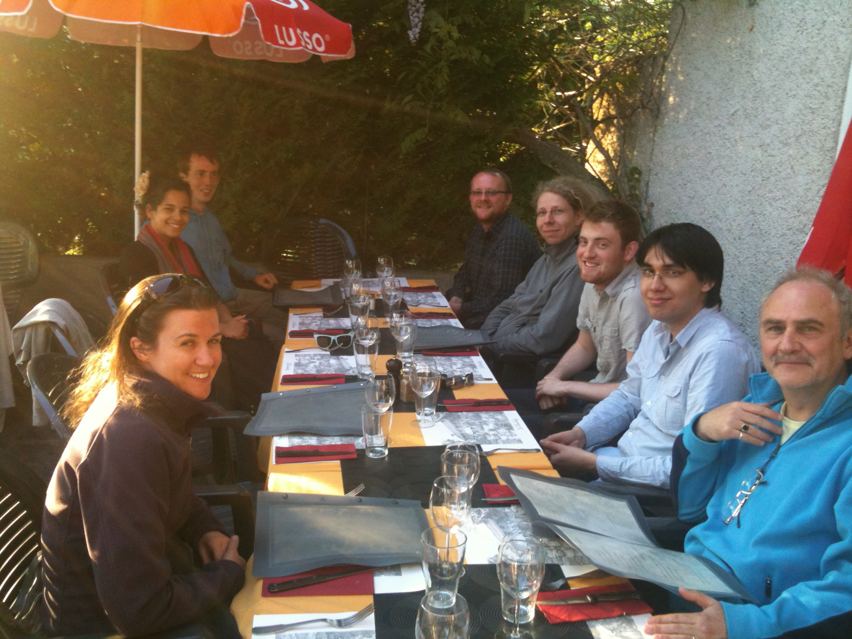
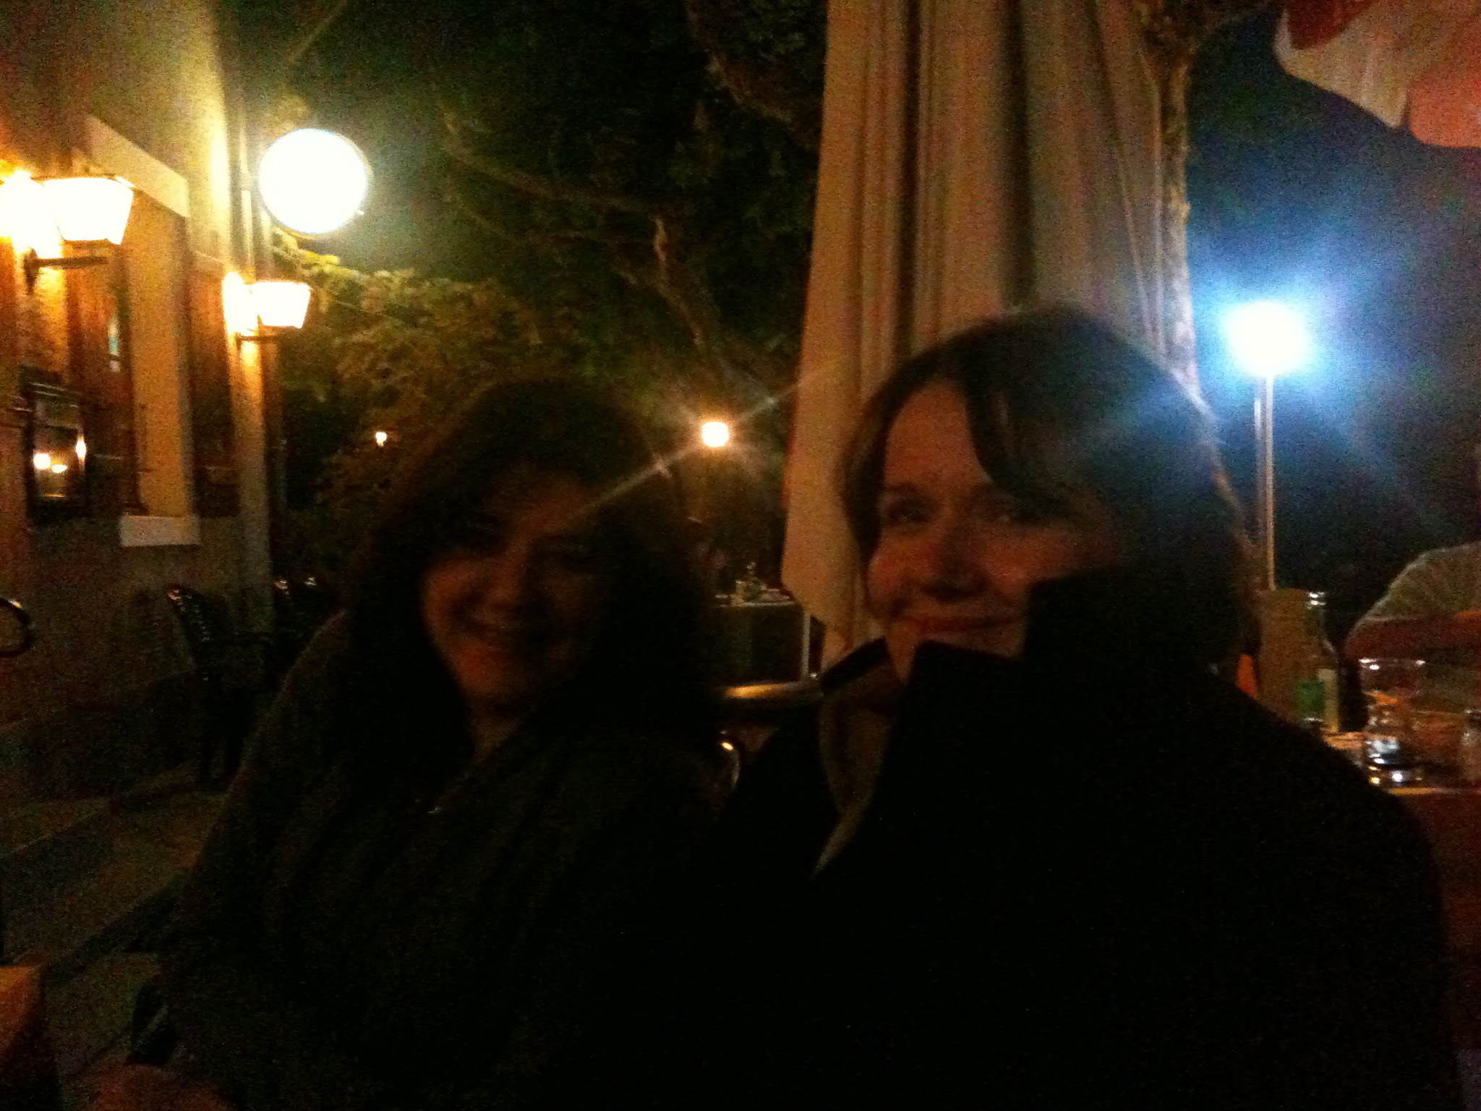
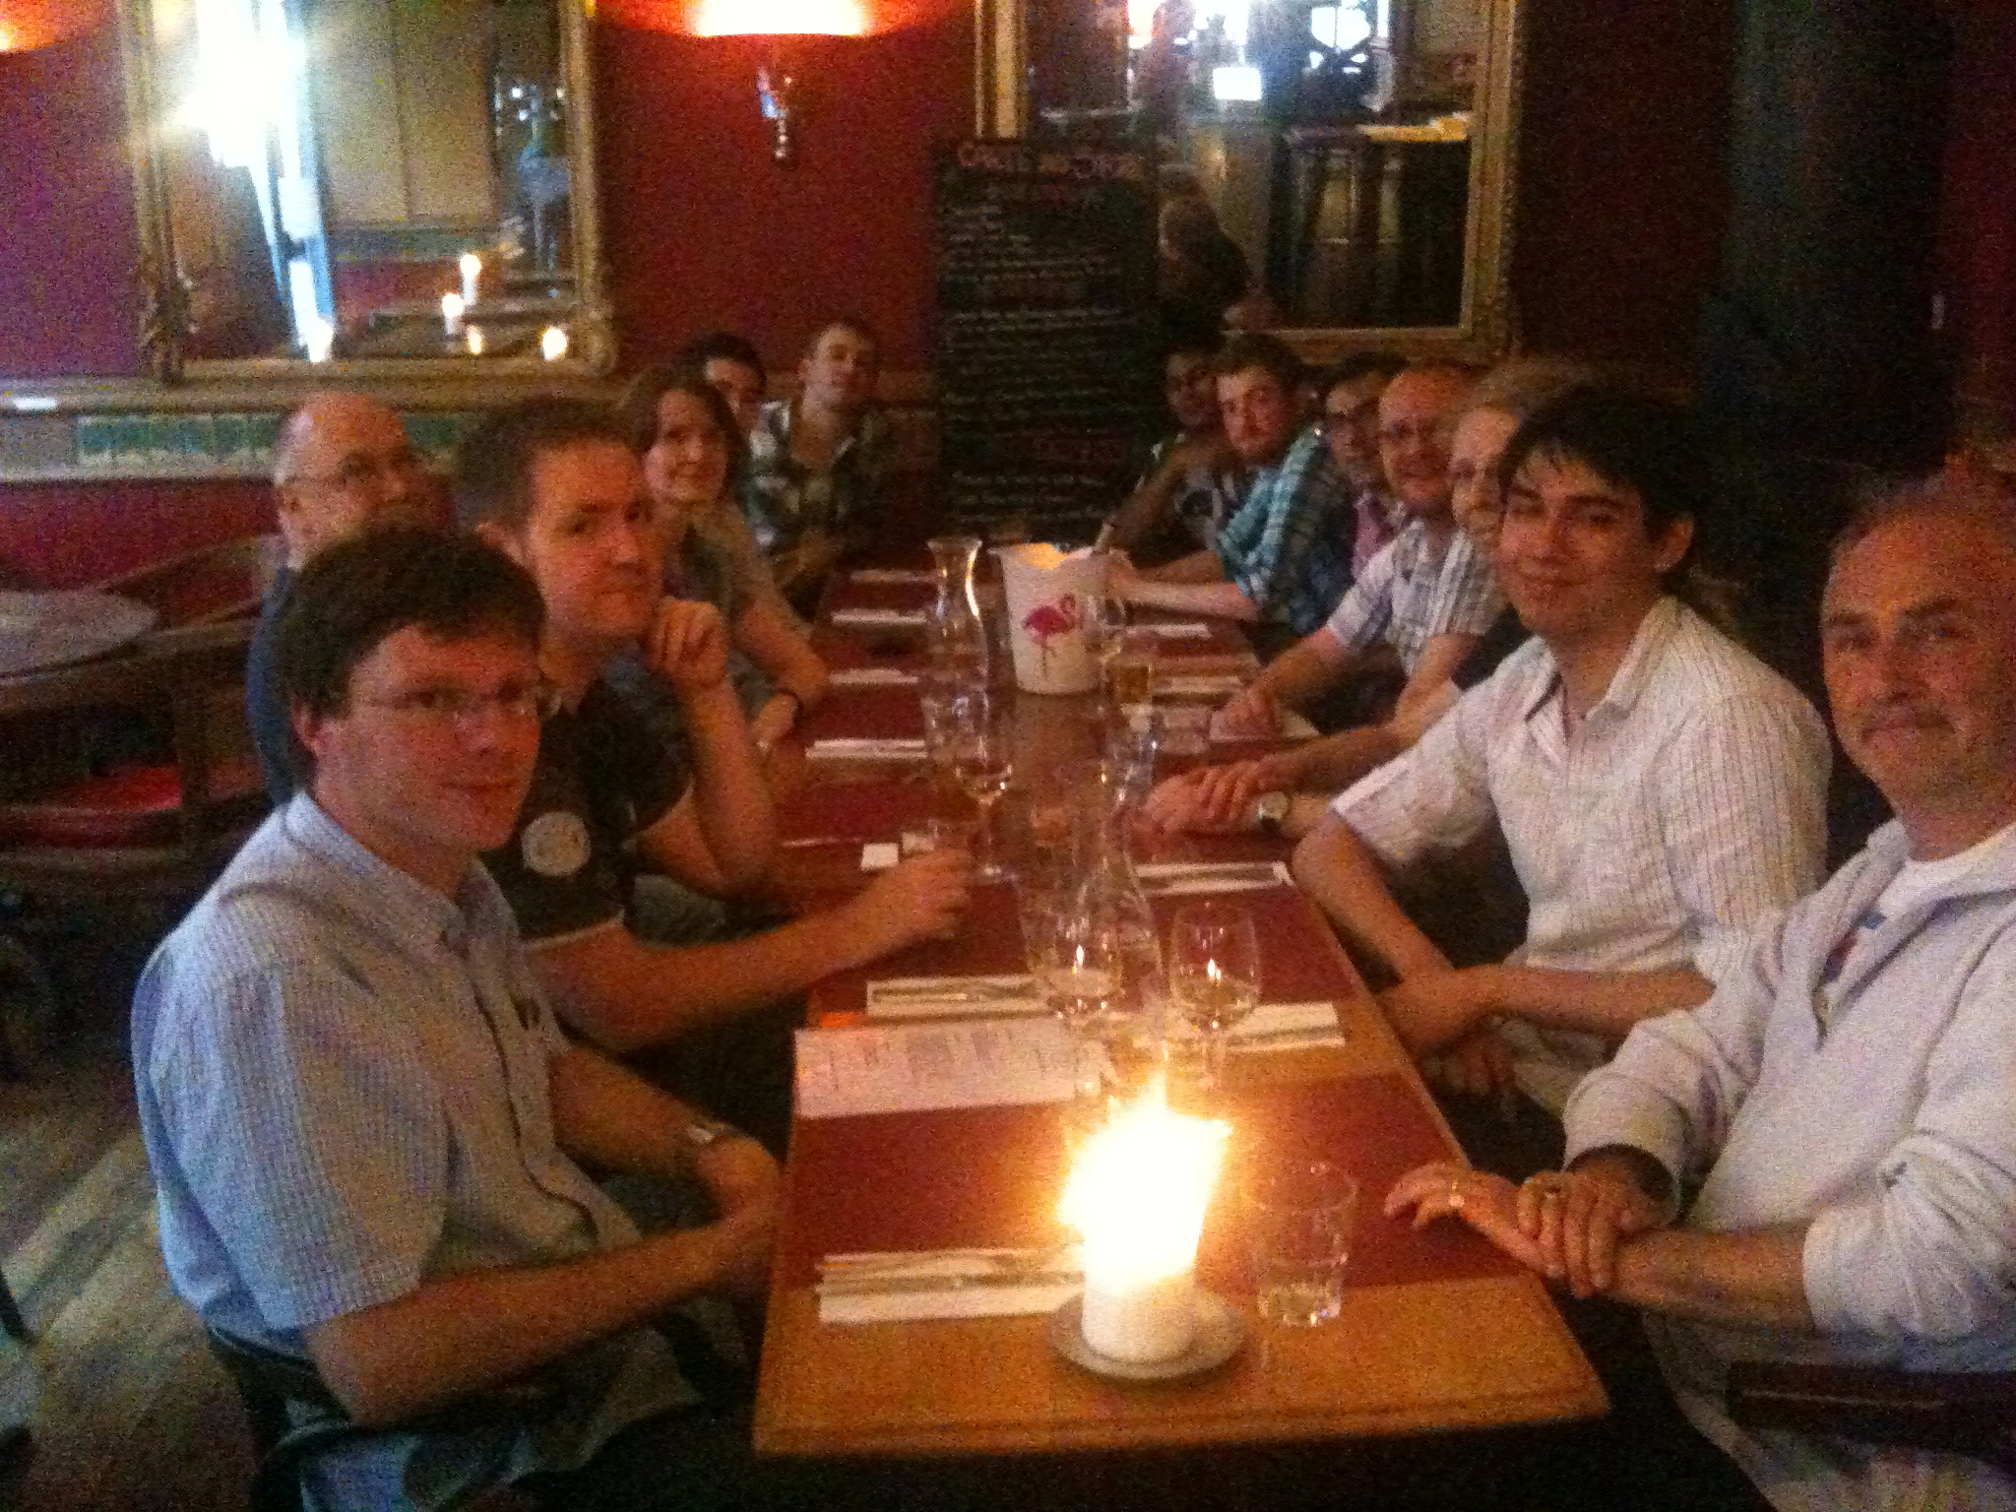
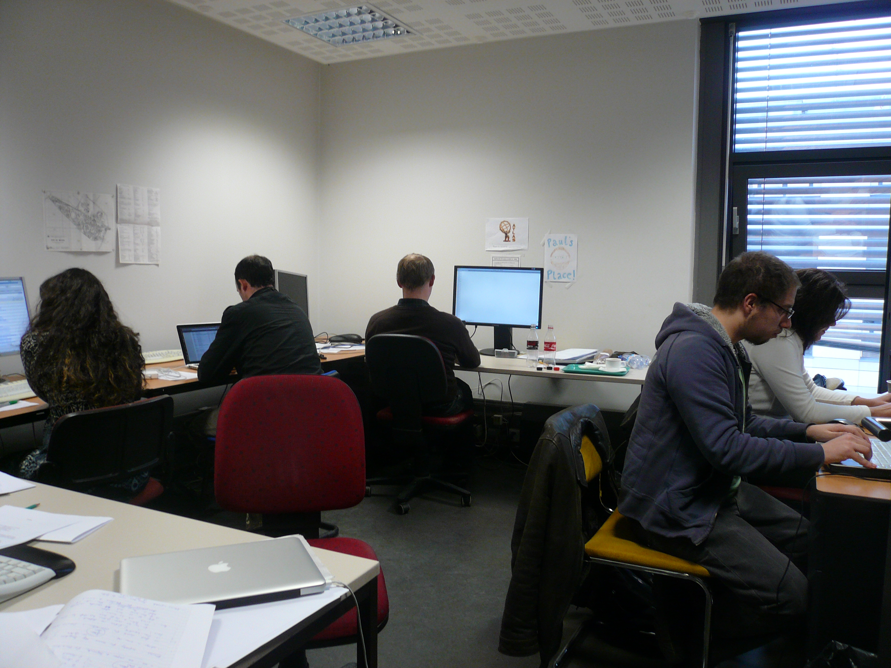
Liverpool ATLAS Group

Slide 7
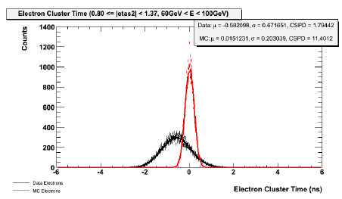
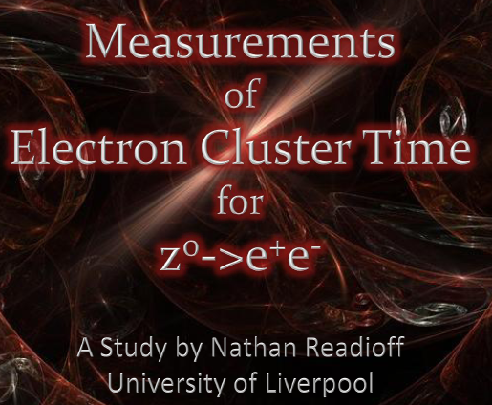
Students
11 PhD students involved in ATLAS data analysis, see yesterday’s summary talks. It is
VERY challenging to them to contribute to ATLAS publications given the first year
course and project phase, the second year authorship qualification demands and
the strong time pressure of ATLAS and competition of ~800 PhD students + postdocs.
High motivation, full dedication and strong collaboration are mandatory for success.
At CERN, Paul runs regular PhD student forum for practice and group communication.
For the 2nd time we have organised a summer placement of 3rd year students at CERN.
Electrons arrive earlier than predicted
which lead to 0.5ns timing correction

Slide 8
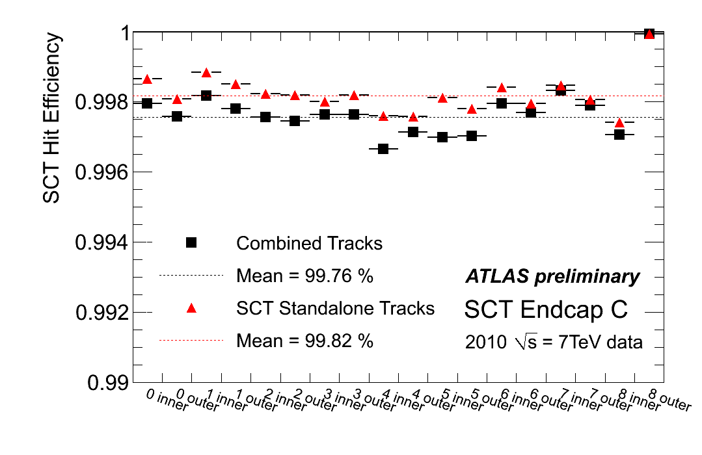
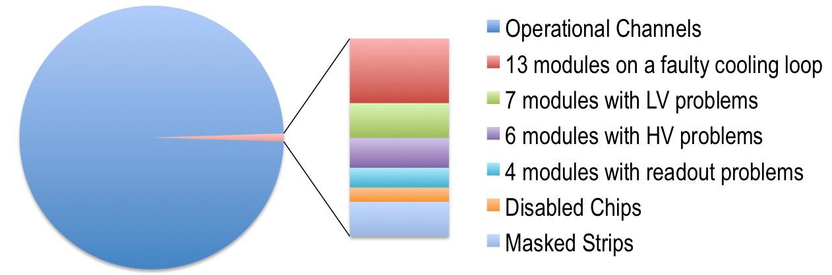
SCT
EndCap C – built by Liverpool
Major Liverpool contributions to SCT in 2011:
Burdin, Dervan, Greenall, Hayward, Sellars, Vossebeld [UK coordinator]
SCT Data Quality: tool & web-display development, on-call expert + control room shifts and coordination
Module Environmental monitoring
Radiation damage monitoring and
modelling, module irradiation and tests

Slide 9
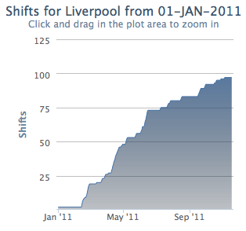
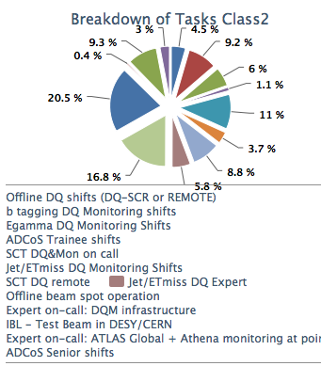
Shifts
 | Shifts in 2010 |  |  | Shifts in 2011
 | Taken | Quota | Fraction | Taken | Quota | Fraction
Cat 1 | 72 | 184 | 39% | 106 | 111 | 95%
Cat 2 | 325 | 473 | 69% | 468 | 442 | 106%
Cat 1 shifts: control room shifts
Cat 2: on call and remote shifts
gently organised by Helen

Slide 10
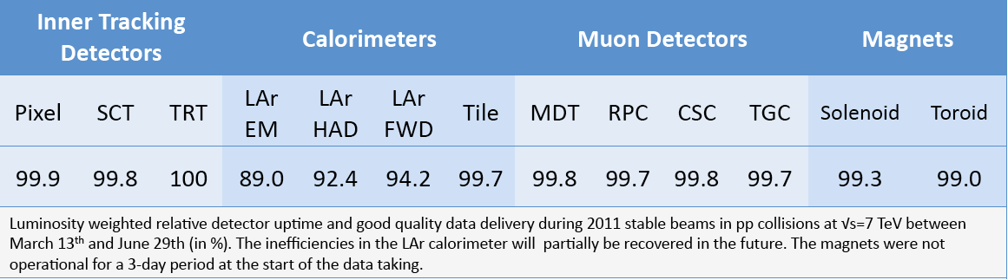
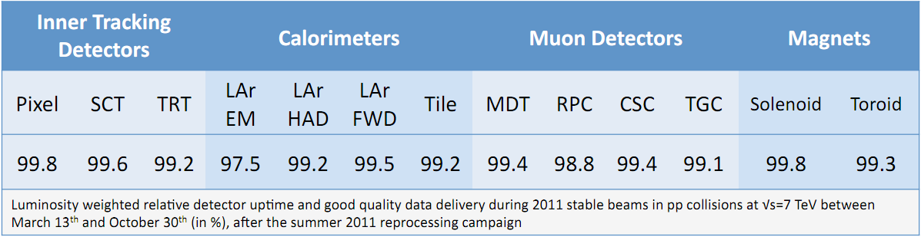
Data Quality ≥ 99%
Reprocessing to gain LAr efficiency
Relatively to ATLAS ready (w/o warmstarts/stops and unstable beams)
strictly co-coordinated for ATLAS by Helen on LTA
defect data base (Peter) tag data base (Paul) beam spot (Carl)

Slide 11
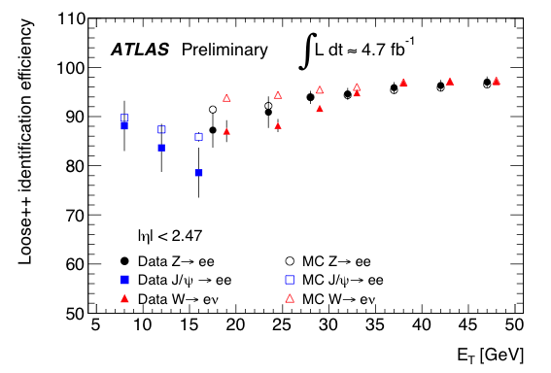
Electromagnetic Energy Calibration
Jan: co-convener of electron efficiency group [trigger, reconstruction and identification]
Part of Higgs analysis release 2 days ago. Moriond: <1% for high statistics analyses.

Slide 12
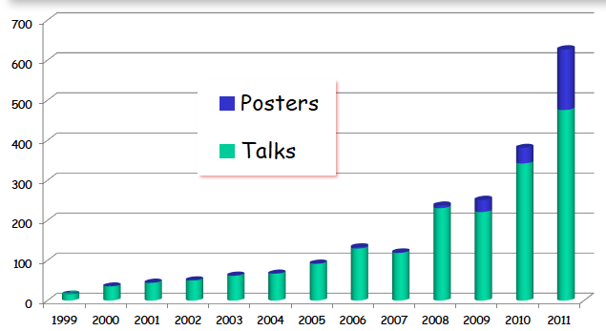
ATLAS Talks at Annual Conferences
Uta: Newly elected member of speaker’s committee
In 2011 had 11 talks at bigger Conferences (EPS and others) and big seminars (MdO CERN)

Slide 13
Data Analysis
Agreed aims as of 2-3 years ago [“Strategy”]
Precision Drell-Yan W,Z Measurements
Searches for SUSY (with beauty production and GMSB)
Searches for Higgs (at higher masses)
Academic freedom to: search for something else
5. Contributions to past (H1, ZEUS, D0, CDF) and future (LHeC) projects
The group has become a leading centre for cutting edge analyses in ATLAS:
lead authors and editors on W/Z, pdf’s, Z+b, Higgs, sbottom, stop, monopoles, GMSB..
main or leading contributions to 16 papers and ~20 so-called CONF notes [preliminaries]
~28 chairs or members of Editorial boards on further papers
- convenors of crucial analyses/analysis groups
….

Slide 14
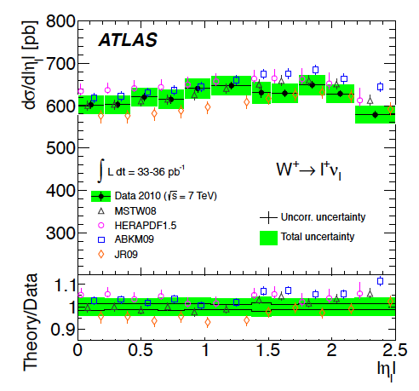
1. W± + Z Inclusive - PDFs
1% precision measurement
of W⁺, W⁻ and Z cross sections
in combined e+μ channels,
apart from 3.4% luminosity
Jan, Uta, Max
NNLO QCD calculation in
fiducial region, differential
(FEWZ and DYNNLO to 0.5%)
never done before.
ALL Liverpool desktops/CPUs
linked to ensure statistical
precision –thanks John, Rob!
Sensitivity to PDFs evident
Uta: now co-convenor
of new ATLAS PDF forum. pt_{Z,W}
QCD analysis imminent
Also: W⁻, Z, ratios, correlations [stronger than A] e-μ universality: PRD to appear (55 pages)

Slide 15
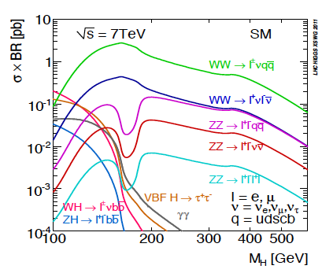
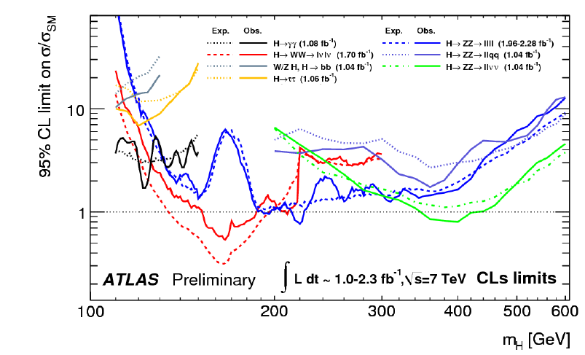
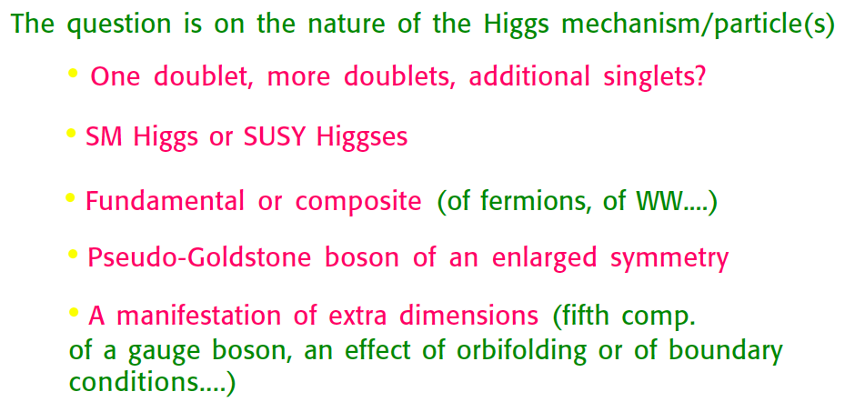
2. Search for the Higgs
Andy, Carl, Joost + Joe, Matthew
H → ZZ at high masses [best limit in llνν]
Associated HW and HZ, with H→bb decay
(with Birmingham)
G.Altarelli 18.12.10 (Paris)
Status September 2011

Slide 16
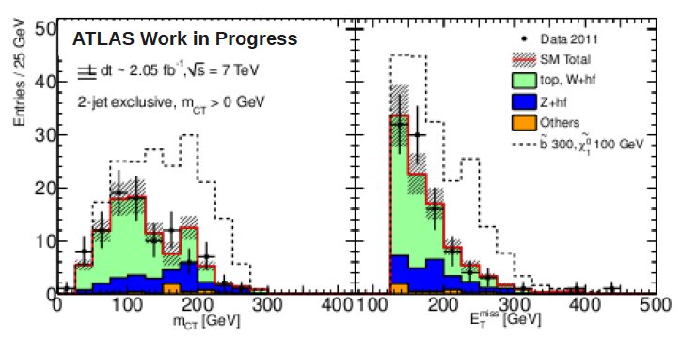
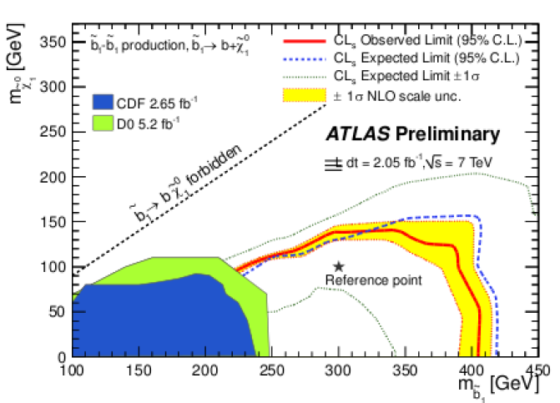
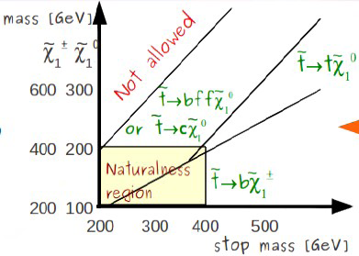
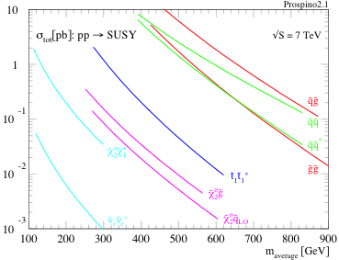
3. SUSY
From sbottom pair production to stop
Monica + Sara, Ben, Paul
M: subgroup convenor for stop
We did not say it will be easy (D.Gross) ??

Slide 17
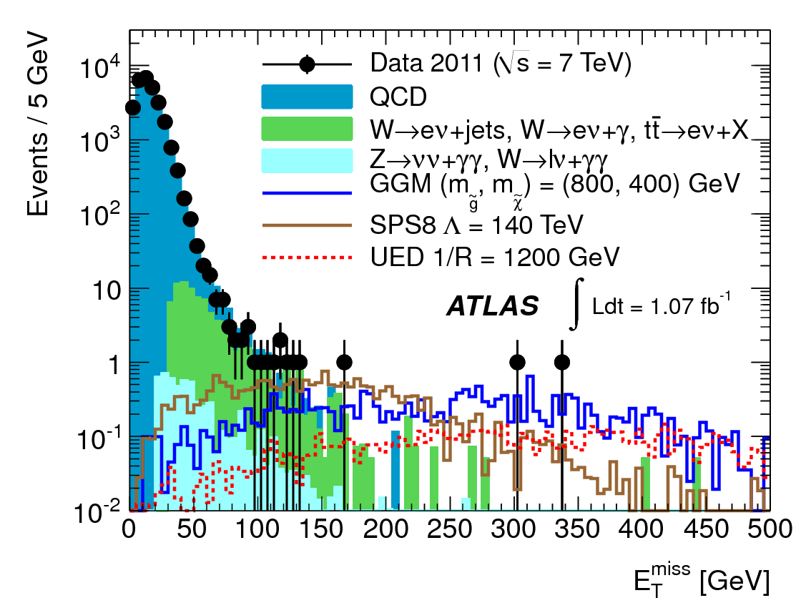
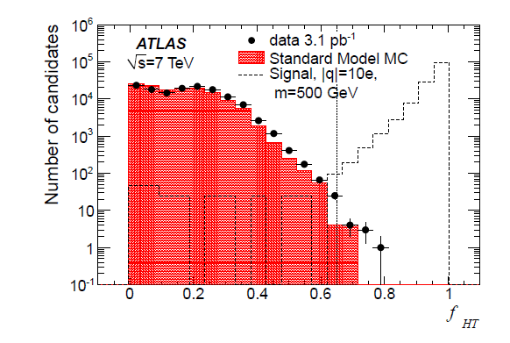
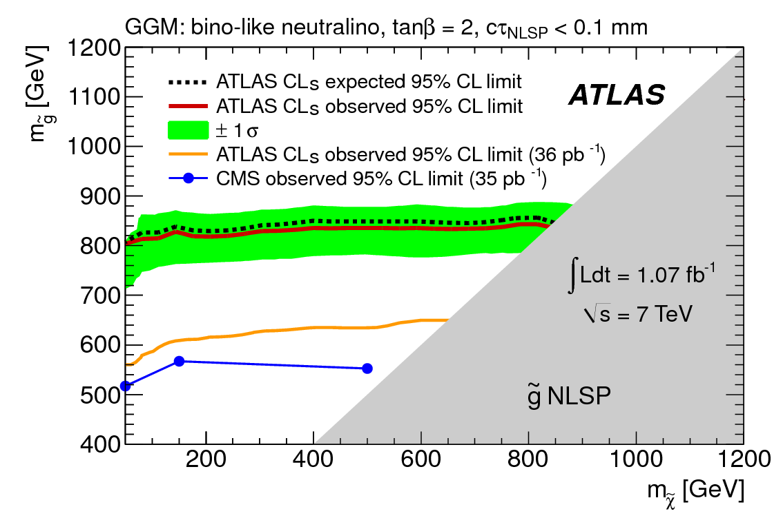
4. GMSB - Searches - Highly Ionizing Particles
Limits on the production cross section
for electric charges 6e ≤ |q| ≤ 17e and
masses 200 GeV ≤ m ≤ 1000 GeV
Sergey. Phys.Lett.B698:353-370,2011
Helen
Sergey
Steve
Peter
Alan

Slide 18
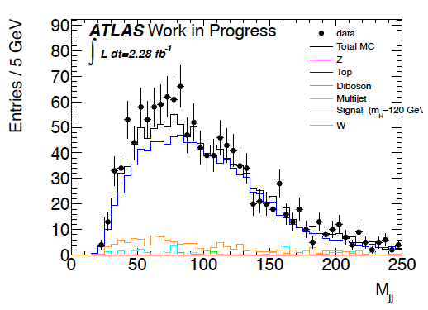
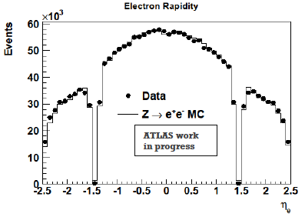
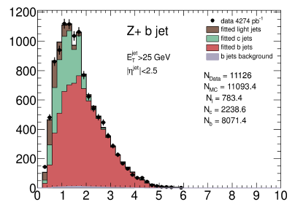
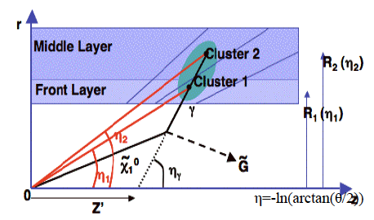
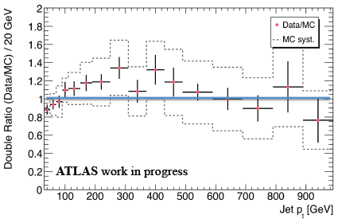
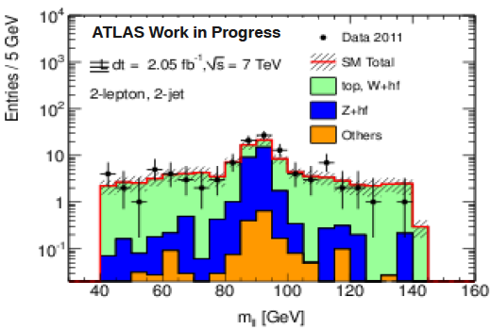
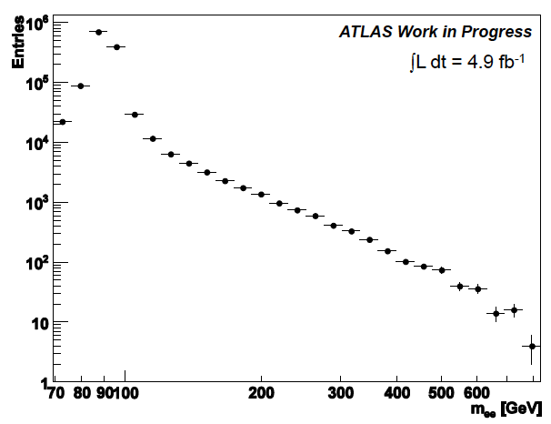
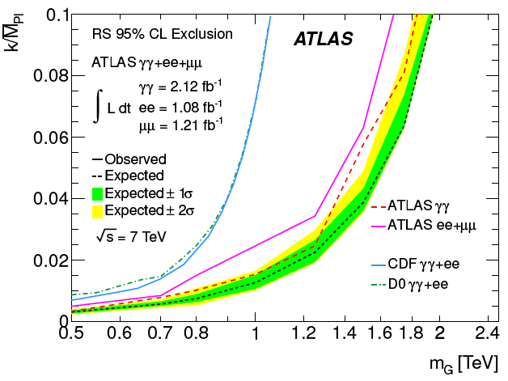
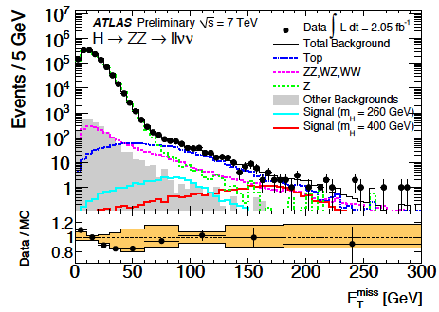
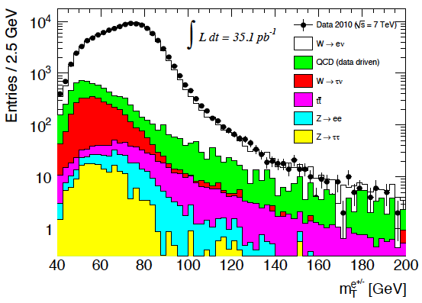
PhD Students
Z
cf talks of 14.12.11
H
Z+b
GMSB
sbottom
sbottom
Z’
ED
H
stop
W

Slide 19
Summary
2011 has been an extremely fruitful year for ATLAS.
This relies [totally] on the LHC delivering and ATLAS registering collisions.
The group has moved to a central position in data analysis.
This requires ingenuity, extremely hard work and presence at CERN too.
Much work and dedication is needed to analyse the 5 fb⁻¹ at 7 TeV.
In 2012 we are promised 16 fb⁻¹ at 8 TeV, which will be a data set to
decide on the existence of the SM Higgs, to reinforce searches and to
develop the SM further.
The current main lines of our analysis strategy thus can be expected
to be appropriate for 2012/13 as well as the expectations are high.

Slide 20

Thanks to all members of the ATLAS group Liverpool.
Thanks to all floors for supporting our challenging work.

Slide 21
backup

Slide 22
Agenda
[made two large review
meetings at CERN]
9.30- 9.50 Opening Remarks Max
9.50-10.10 Z' Project Yan-Jie
10.10-10.30 SUSY Project Ben
10.30-11.00 DQ Helen
11.00-11.30 Coffee
11.30-12.00 WZ inclusive Jan
12.00-12.30 WZ pt and prospects Uta
12.30-13.30 Lunch
13.30-14.00 Higgs Andy
14.00-14.30 SUSY Monica
14.30-15.00 Z+Bjets Paul
15.00-15.30 Coffee
15.30-16.00 Upgrade Barry
16.00-16.30 Exotics Sergey
Wednesday 20.4.2011
Liverpool Group Meeting at CERN

Slide 23
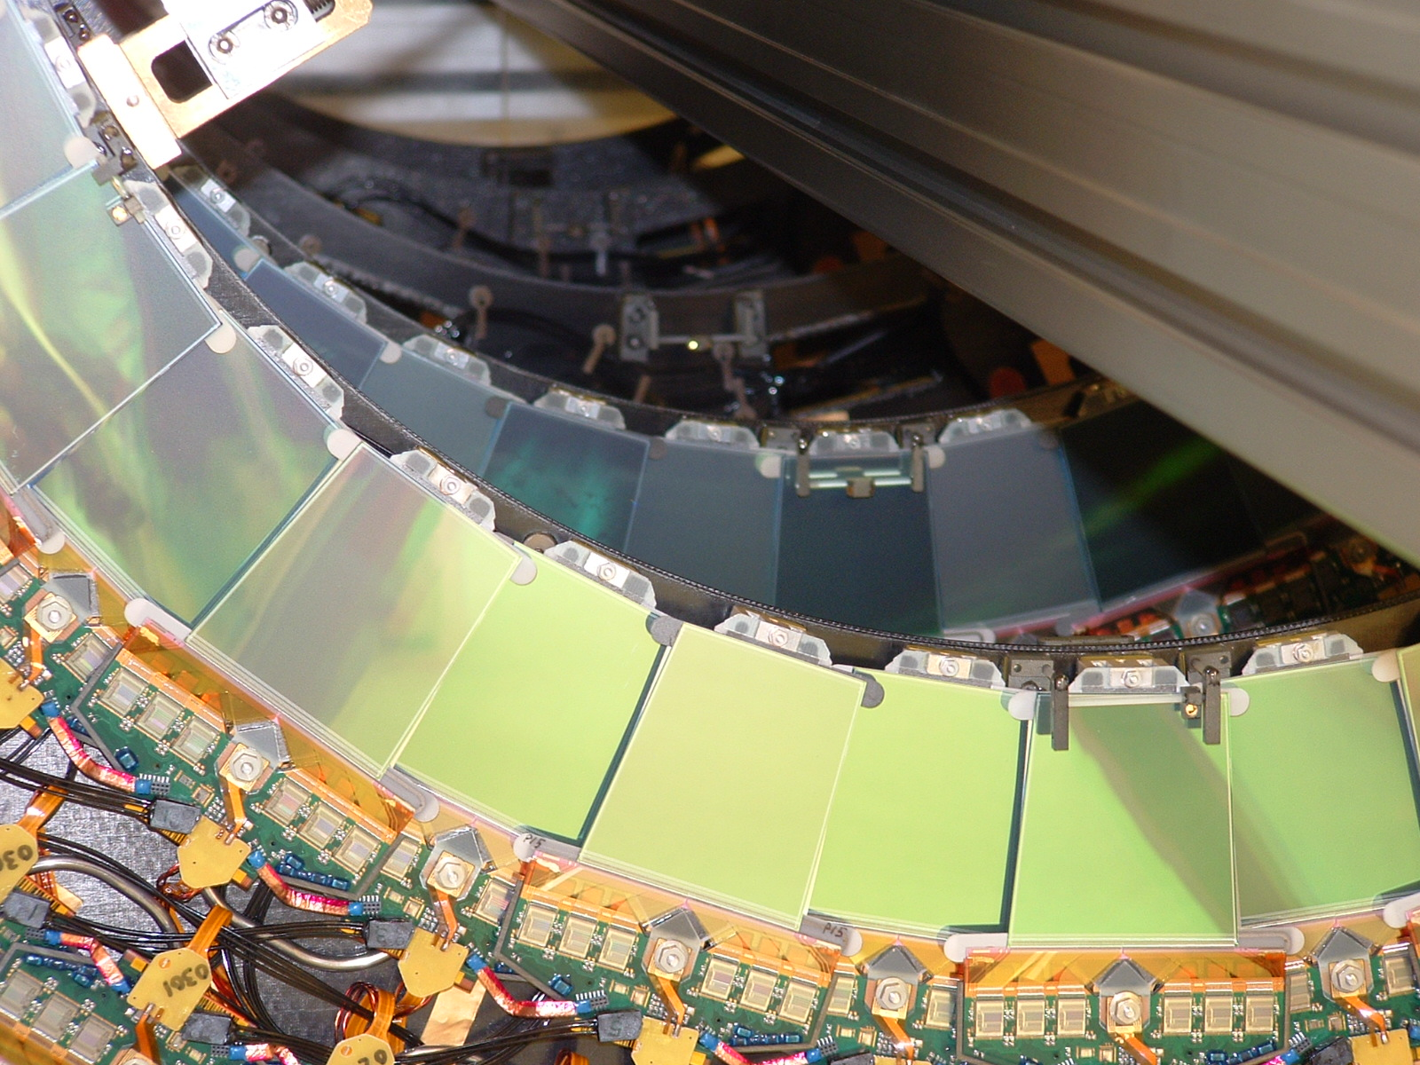
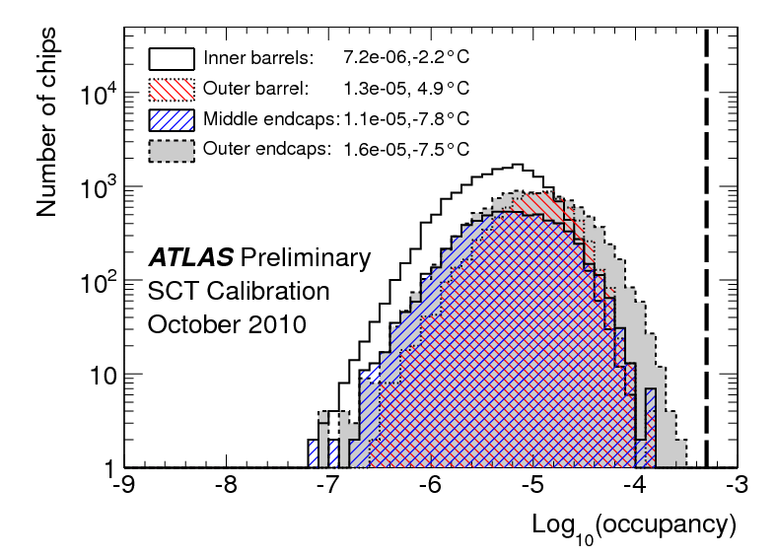
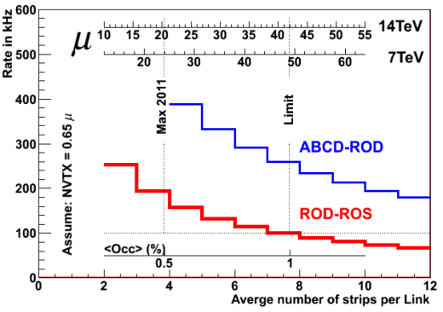
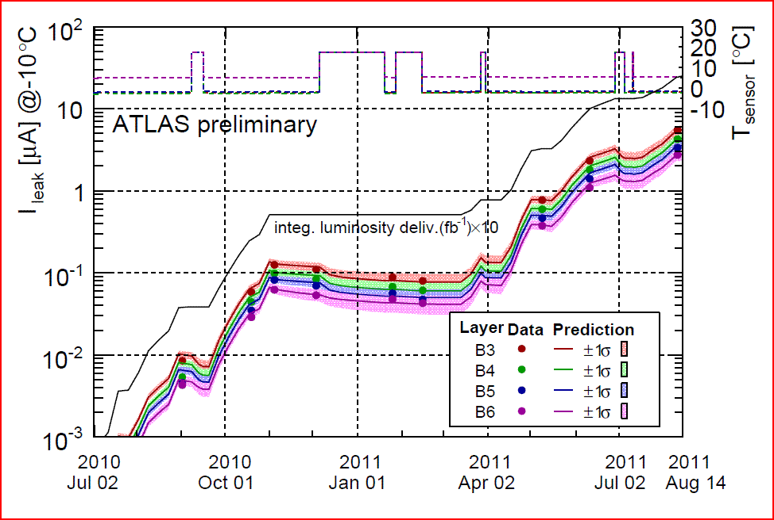
SCT Status
Successful operation 201
99.2% of modules functional
99.8% hit-on-track efficiency
Noise occupancy ~10⁻⁵
Coping well with high occupancies/rates
Major Liverpool contributions to SCT in 2011:
SCT Data Quality: tool & web-display development, on-call expert shifts and coordination
(Hayward, Burdin, Sellars)
SCT DAQ/DCS control room shifts
(Dervan, Burdin, Vossebeld)
Module Environmental monitoring (Dervan)
Radiation damage monitoring and
modelling, module irradiation and tests
(Greenall, Dervan, Vossebeld, Burdin)

Slide 24
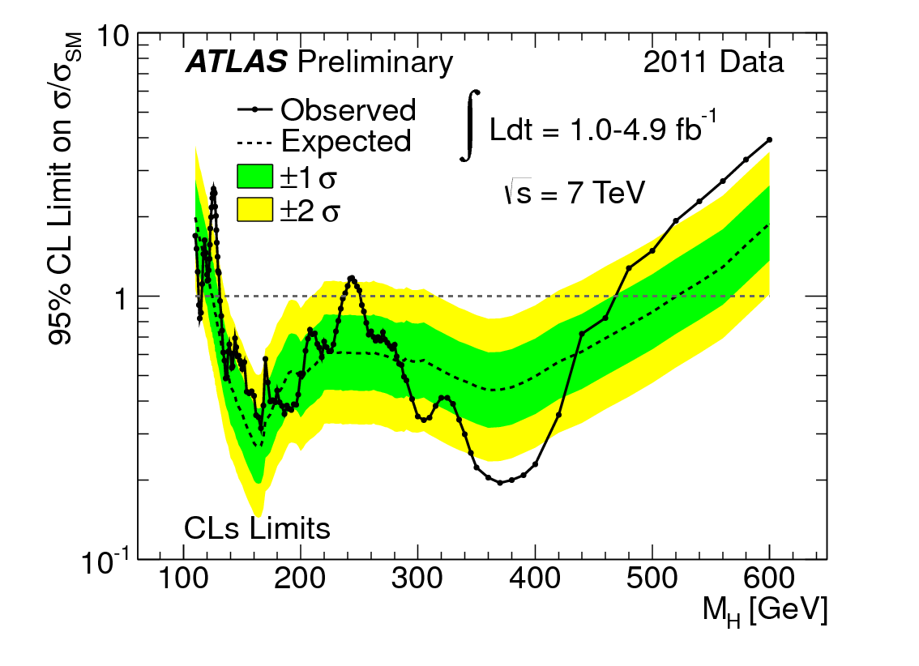
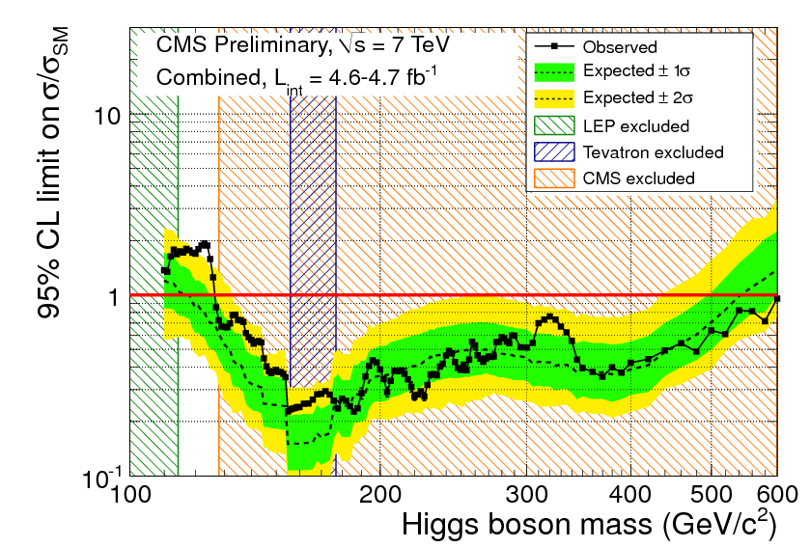
Higgs on December 13th

Slide 25
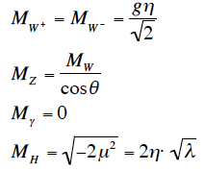
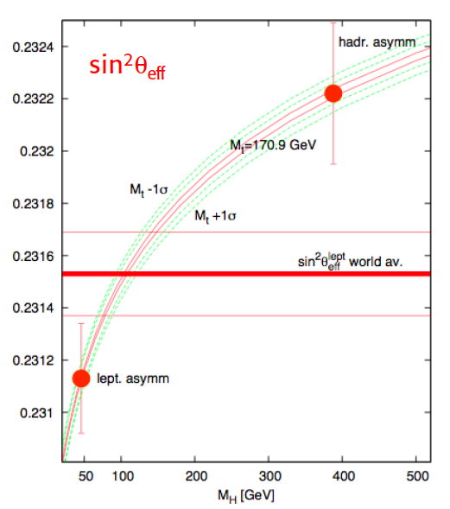
Problem 1 – “There is no Higgs” (Veltman)
P.Gambino
ρ=1, no ‘light’ H?
Masses to W,Z
Rise of σ(WW)
Liverpool
(Andy Mehta, Joost Vossebeld, Carl Gwilliam +)
Search for H also at higher masses
Work on e,μ,τ,γ,ν
Be prepared for a much longer road
G.Altarelli 18.12.10 (Paris)

