Slide 1
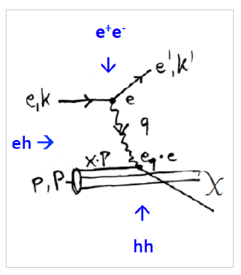
Physics and Prospects with LHeC
Large Hadron Electron Collider: add 60 GeV electron accelerator to LHC in the 30ies
Transform the HL and HE LHC to Twin pp+ep (AA+eA) Colliders, and FCC later as well
W Kandinsky, Circles in a Circle,
1923, Philadelphia Art Museum
Note that LHeC has had a 600 pages CDR on physics, accelerator, detector arXiv:1206.2913
Max Klein, for the LHeC/FCCeh/PERLE Collaborations. Shanghai, TDLI 2.7.2018

Slide 2
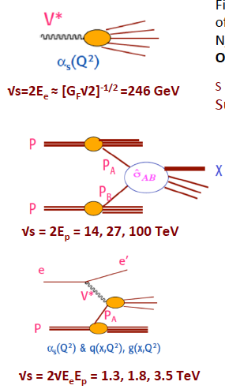
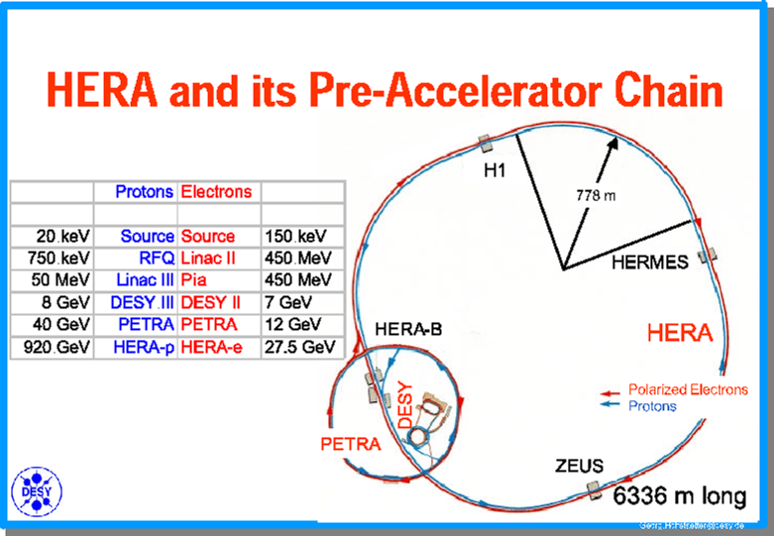
Electron-Hadron, or Deep Inelastic Scattering
HERA: first ep collider: E_{e}=27.6 GeV, E_{p}=920 GeV, L=3 10³¹
Parton Structure, Electroweak Unification, Diffractive DIS
No Leptoquarks, no SUSY up to 300 GeV. Crucial for LHC
HERA operated in parallel with Tevatron and LEP
Unification of ee-ep-pp also recognised in FCC study
ee, pp, ep belong together

Slide 3
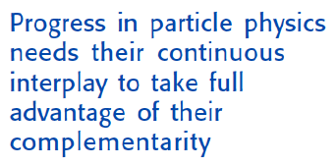
Towards a strategy for European Particle Physics
“Two Problems” of HEP
1980: Leon Lederman at ICHEP in Madison:
“Shortage of Money and Overconfidence of Theorists” [SU(5)/SUSY ahead times..]
Today:
Shortage of Money and Missing Confidence of Theory [EFT/ SUSY passed times?]
Reminiscent of the situation as experienced 50 years ago:
before the SM and discovery of partons in ep at Stanford
→
In 2014 CERN decided
to set up a new LHeC
organisation and an IAC
to “assist building the
international case of an
ep/A collider” at CERN
IAC: Two main tasks:
Update CDR + Testfacility
Time for high precision,
high energy,
high luminosity
collider experiments
ee, pp and ep:
→
Guido Altarelli, DIS 2009, Madrid

Slide 4
Organisation^{*)}
Working Groups
International Advisory Committee
Mandate by CERN to define
“..Direction for ep/A both at LHC+FCC”
PDFs, QCD
Fred Olness,
Claire Gwenlan
Higgs
Uta Klein,
Masahiro Kuze
BSM
Georges Azuelos,
Monica D’Onofrio
Oliver Fischer
Top
Olaf Behnke,
Christian Schwanenberger
eA Physics
Nestor Armesto
Small x
Paul Newman,
Anna Stasto
Detector
Alessandro Polini
Peter Kostka
Coordination Group
Accelerator+Detector+Physics
Sergio Bertolucci (CERN/Bologna)
Nichola Bianchi (Frascati)
Frederick Bordry (CERN)
Stan Brodsky (SLAC)
Hesheng Chen (IHEP Beijing)
Eckhard Elsen (CERN)
Stefano Forte (Milano)
Andrew Hutton (Jefferson Lab)
Young-Kee Kim (Chicago)
Victor A Matveev (JINR Dubna)
Shin-Ichi Kurokawa (Tsukuba)
Leandro Nisati (Rome)
Leonid Rivkin (Lausanne)
Herwig Schopper (CERN) – Chair
Jurgen Schukraft (CERN)
Achille Stocchi (LAL Orsay)
John Womersley (ESS)
Gianluigi Arduini
Nestor Armesto
Oliver Brüning – Co-Chair
Andrea Gaddi
Erk Jensen
Walid Kaabi
Max Klein – Co-Chair
Peter Kostka
Bruce Mellado
Paul Newman
Daniel Schulte
Frank Zimmermann
5(12) are members of the
FCC coordination team
OB+MK: co-coordinate FCCeh
We miss Guido Altarelli.
*) April 2018

Slide 5
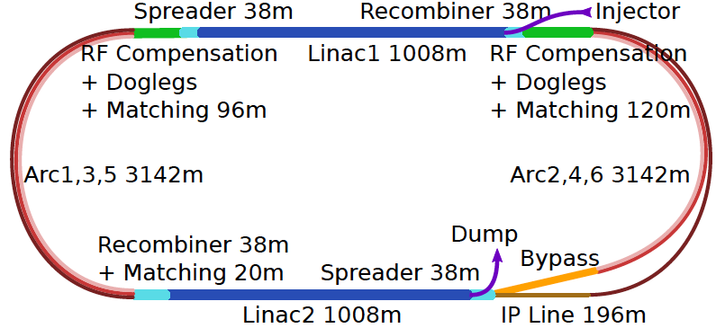
60 GeV Electron ERL added to LHC
U(ERL) = 1/3 U(LHC)
Concurrent operation to pp, LHC/FCC become 3 beam facilities. Power limit: 100 MW
10³⁴ cm⁻² s⁻¹ luminosity and factor of 15/120 (LHC/FCCeh) extension of Q², 1/x reach
1000 times HERA luminosity. It therefore extends up to x~1.
Four orders of magnitude extension in deep inelastic lepton-nucleus (ion) scattering.

Slide 6
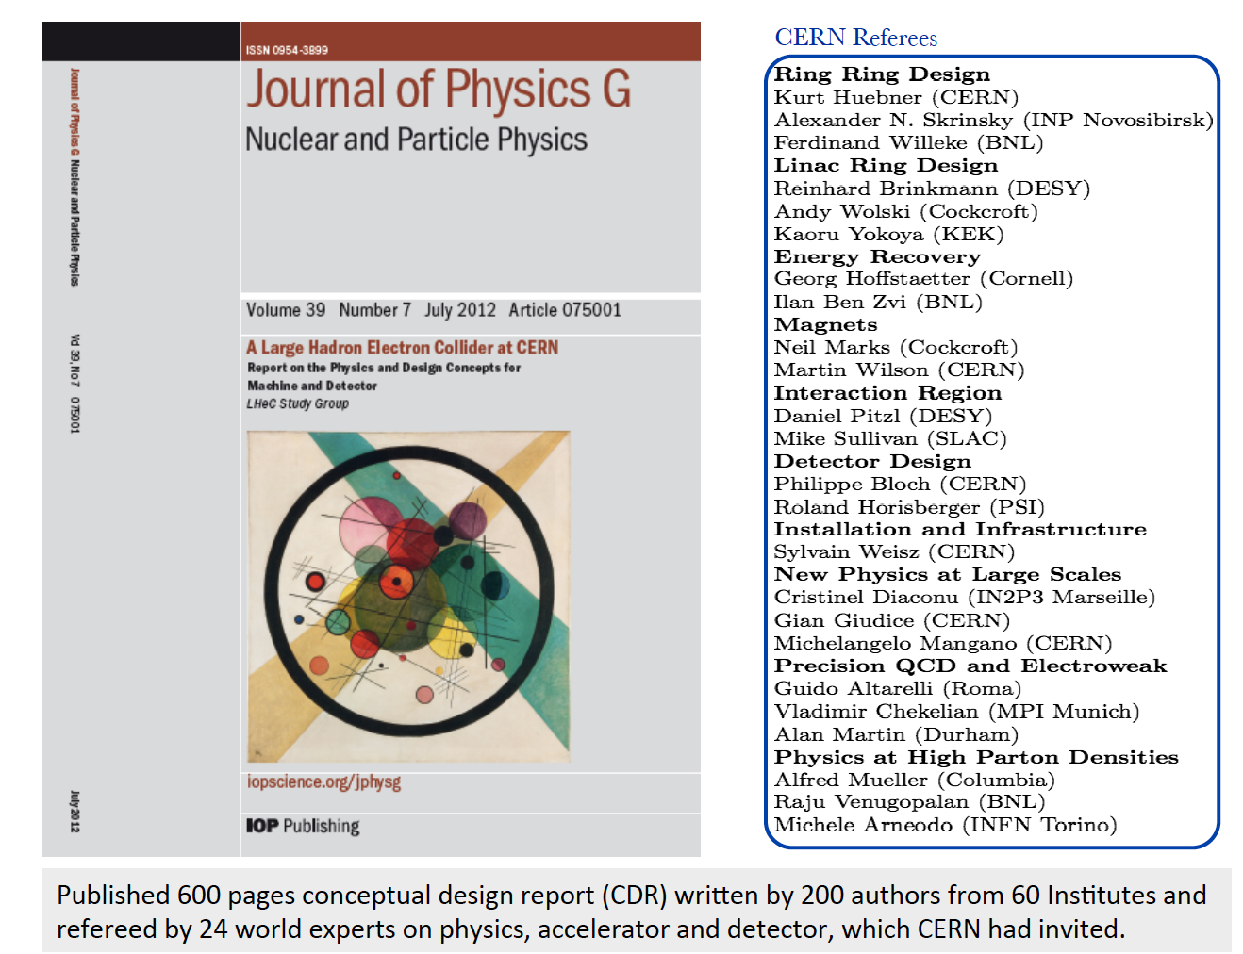
title
arXiv:1206.2913

Slide 7
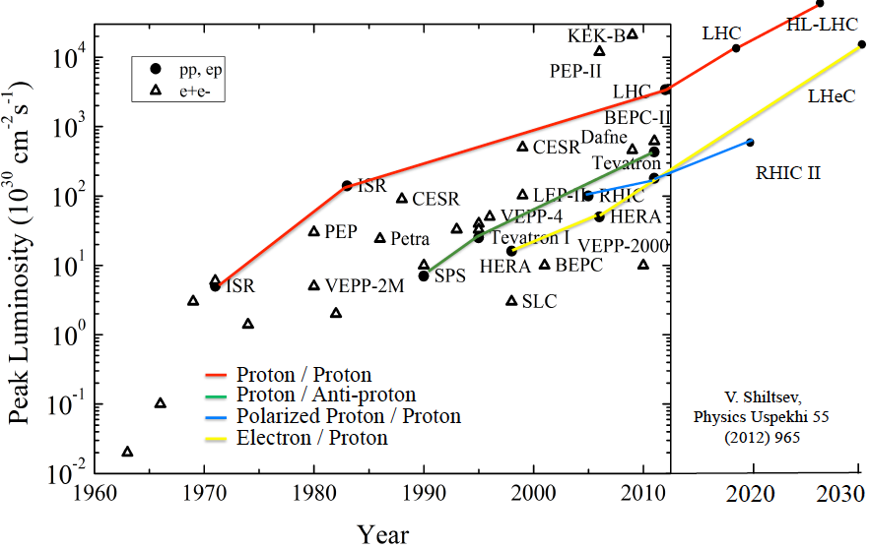
Collider Luminosities vs Year (pp and ep)
O. Bruening 2/17

Slide 8
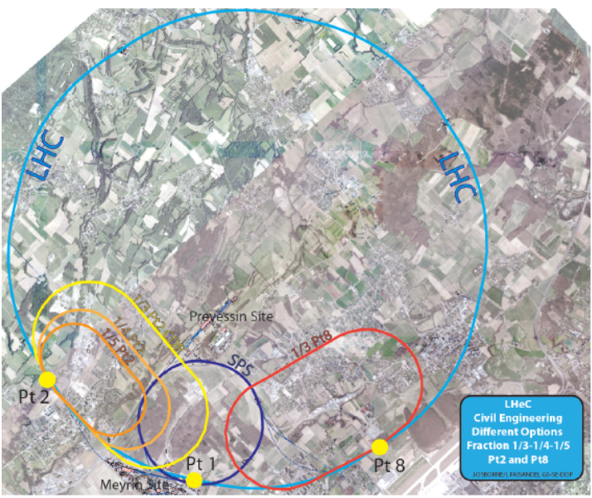
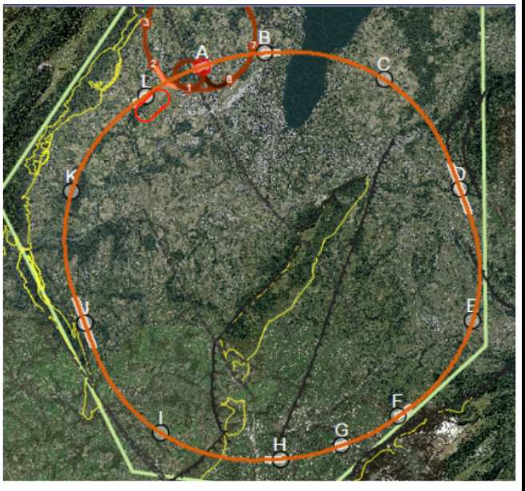
Location, Footprint, Use of the Electron Racetrack
e beam external to LHC. Location suitable for both HL and HE LHC.
- U(ERL) = 1/n U(LHC): 60 GeV: 1/3
BSM, top, Higgs, Low x all want maximum E_{e}
- Cost goes almost linearly down with E_{e}
For FCC can realise ep/A collisions
With IR at point L, not far from CERN
U(ERL) = 1/11 U(FCC)
Energy – Cost – Physics – Footprint are being reinvestigated for EU strategy

Slide 9
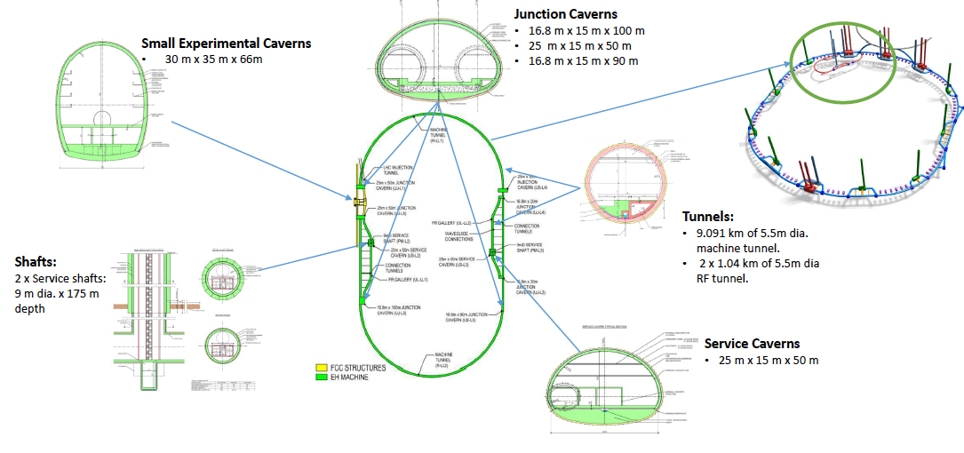
Civil Engineering for ERL
For LHC: re-use IP2. For FCC: deeper shafts, new IP cavern
Refinement of CE study, see J Osborne Amsterdam FCC week
and see Matt Stuart at LHeC Workshop, last week

Slide 10
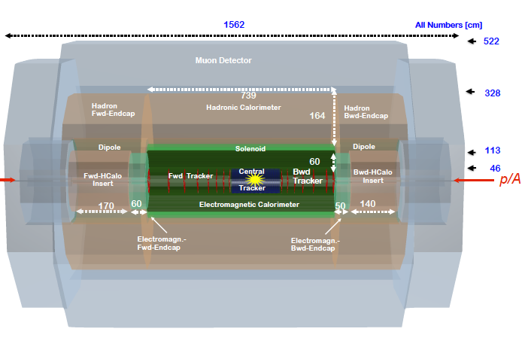
title
LHeC Detector for the HL/HE LHC
e
P.Kostka et al
Length x Diameter: LHeC (13.3 x 9 m²) HE-LHC (15.6 x 10.4) FCCeh (19 x 12)
ATLAS (45 x 25) CMS (21 x 15): [LHeC < CMS, FCC-eh ~ CMS size]
If CERN decides that the HE LHC comes, the LHeC detector should anticipate that
Forward taggers for p,n, d?. Backward for photons and electrons (Lumi and low Q²)

Slide 11
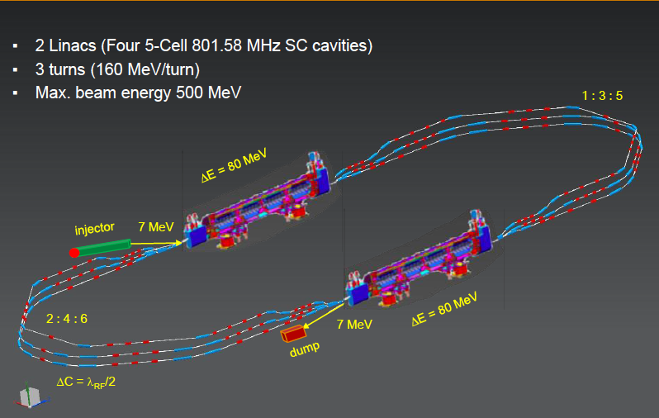

Powerful ERL for Experiments at Orsay
at 20mA → 10 MW
5.5 x 24m²
cf Walid Kaabi at Amsterdam FCC
New SCRF, High Intensity (100 x ELI) ERL Development Facility with unique low E Physics
Max Klein Kobe 17.4.18

Slide 12
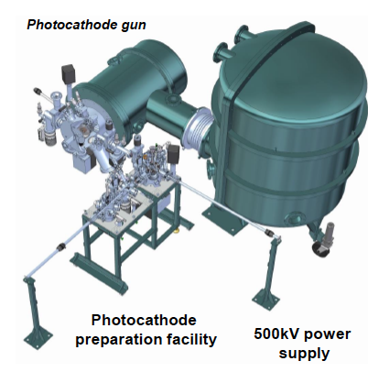
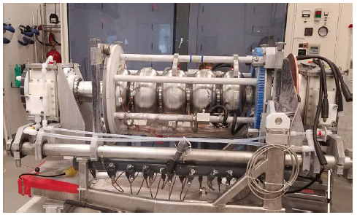
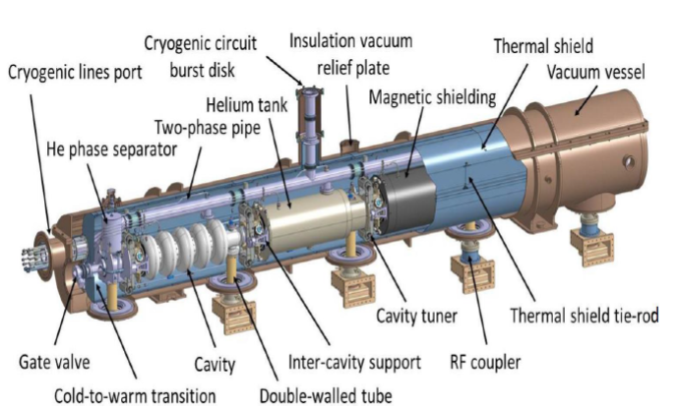
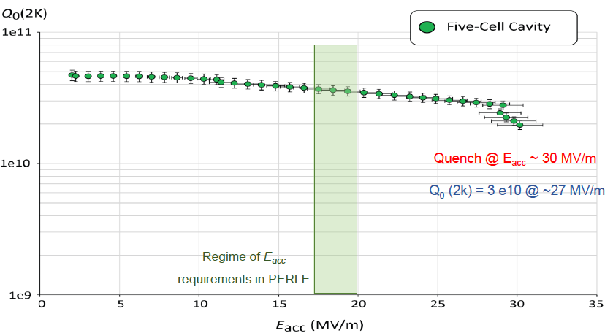
Towards PERLE: 802 MHz cavity, Source, Cryomodule, Magnets
First 802 MHz cavity successfully built (Jlab)
BINP, CERN, Daresbury/Liverpool, Jlab, Orsay, +
CDR 1705.08783 [J.Phys G] → TDR in 2019
Max Klein Kobe 17.4.18

Slide 13
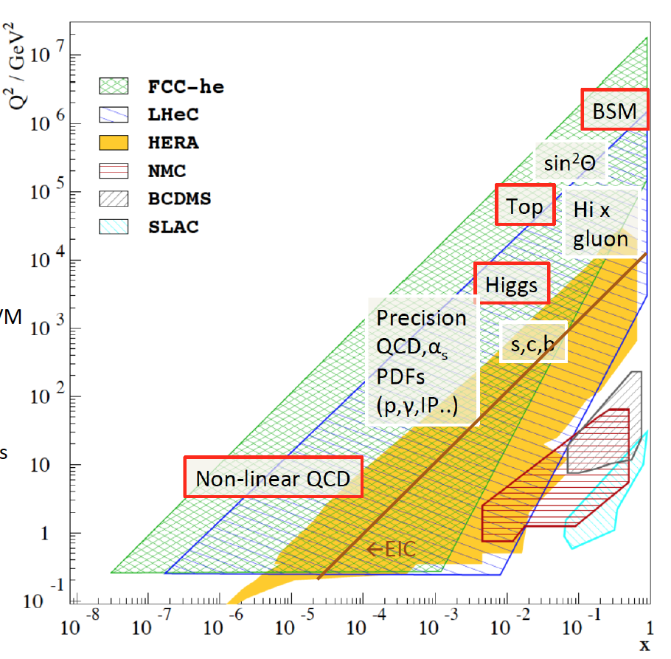
Physics with Energy Frontier DIS
Raison(s) d’etre of the LHeC
Cleanest High Resolution
Microscope: QCD Discovery
Empowering the LHC
Search Programme
Transformation of LHC into
high precision Higgs facility
Discovery (top, H, heavy ν’s..)
Beyond the Standard Model
A Unique
Nuclear Physics Facility

Slide 14
Huge increase in energy and luminosity enables unique development of particle + DIS physics
The Classic DIS Programme with the LHeC: 0 < Q² < 10⁶ GeV², 1 > x > 10⁻⁶
besides collinear PDFs and strong coupling
Generalised Parton Distributions [DVCS] – “proton in 3D - tomography”
Unintegrated Parton Distributions [Final State] – DGLAP/BFKL?
Diffractive Parton Distributions [Diffraction] – pomeron, confinement??
Photon Parton Distribution [Photoproduction Dijets,QQ; F_{2,L}] - fashionable..
Neutron Parton Distributions [Tagged en (eD) Scattering] – ignored at HERA
see the CDR 1206.2913 + updates

Slide 15
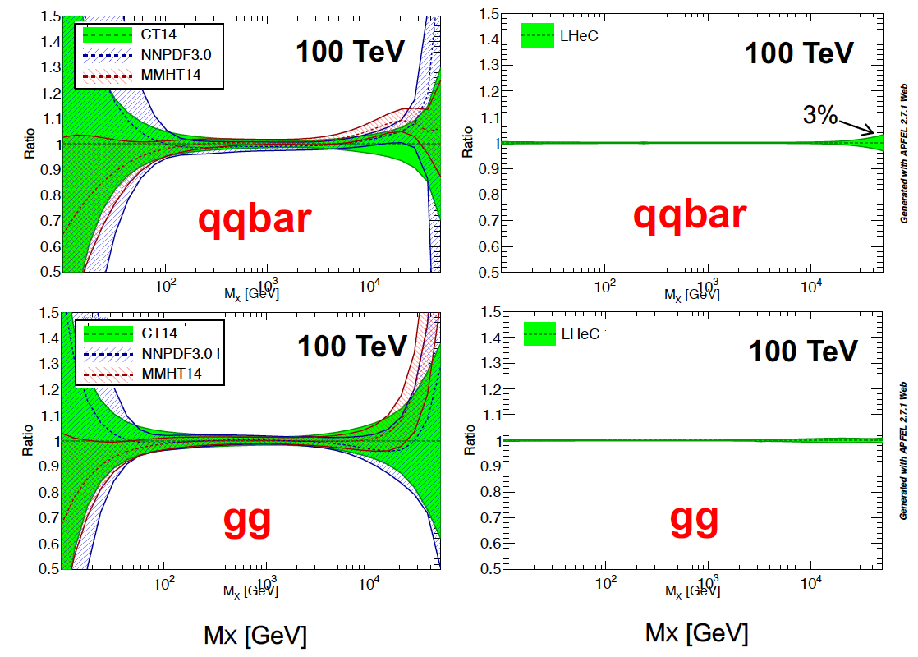
The LHeC collinear proton (and nuclear) PDF Programme
Resolve parton structure of the proton completely: u_{v},d_{v},s_{v}?,u,d,s,c,b,t and xg
Unprecedented range, sub% precision, free of parameterisation assumptions,
Resolve p structure, solve non-linear and saturation issues, test QCD, N³LO…
No
higher twist
No
Nuclear
Corrections
No
Jet or pp data
→ Test QCD
NP?
Alpha_s
to
0.1-0.2%
total
uncertainty
SUSY?
H
20 GeV
40 TeV
Empowers the LHC H, BSM + SM Physics

Slide 16
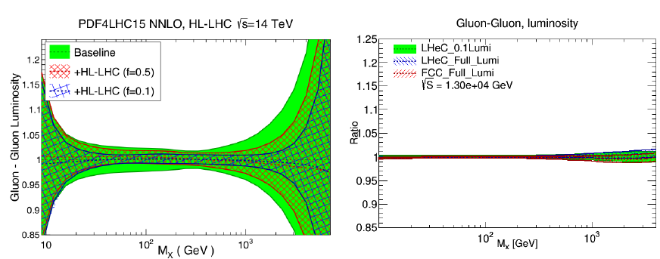
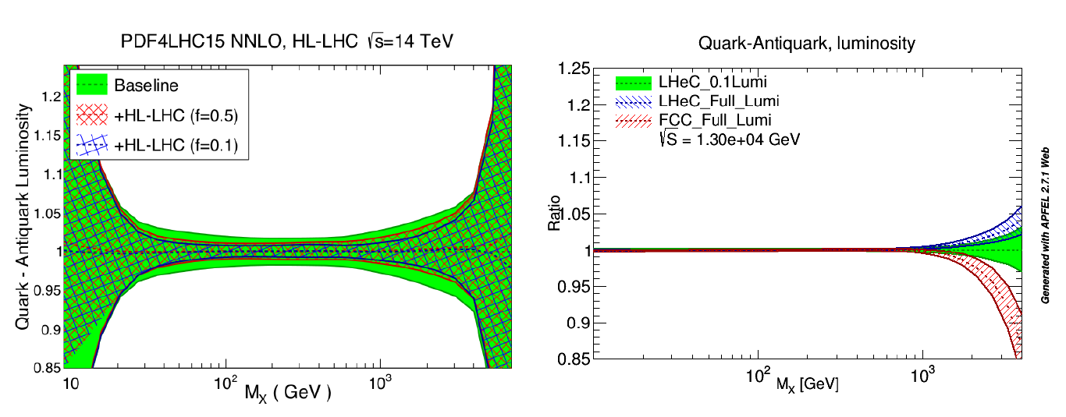
Parton Distributions from pp and ep
all preliminary
L_{gg}
New/First Analysis of Full HL LHC Potential New, Consistent Study of LHeC PDFs (NC,CC)
L_{qqb}
L Harlang, presented at HL LHC WS, last week
Gavin Pownall, Claire Gwenlan, MK, LHeC WS last week

Slide 17
QCD is far from fully developed and it will evolve and may break:
Developments Discoveries
AdS/CFT
Instantons
Odderons
TOTEM ? CERN EP 2017-335
Non pQCD, Spin
Quark Gluon Plasma
QCD of Higgs boson
N^{k}LO, Monte Carlos..
Resummation
Saturation and BFKL
Photon, Pomeron, n PDFs
Non-conventional partons
(unintegrated, generalised)
Vector Mesons
The 3 D view on hadrons..
CP violation in QCD?
Massless quarks?? Would solve it..
Electric dipole moment of the neutron?
Axions, candidates for Dark Matter
Breaking of Factorisation [ep-pp]
Free Quarks
Unconfined Color
New kind of coloured matter
Quark substructure
New symmetry embedding QCD
C. Quigg, arXiv1308.6637

Slide 18

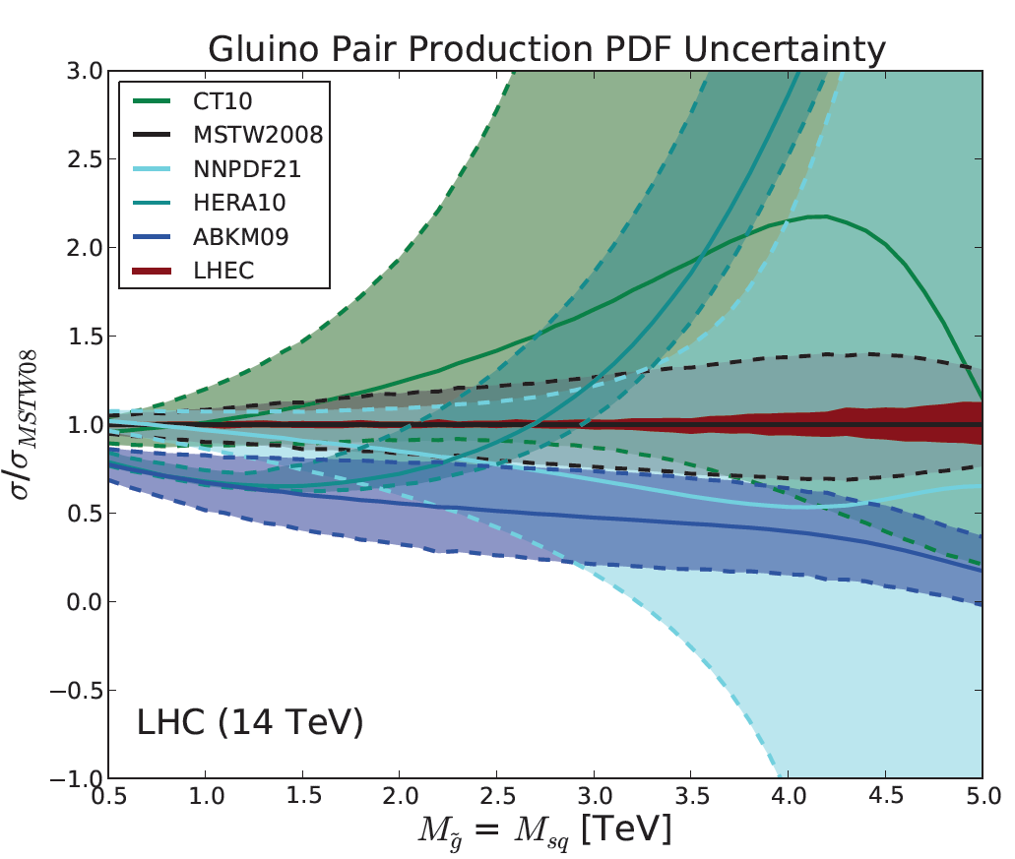
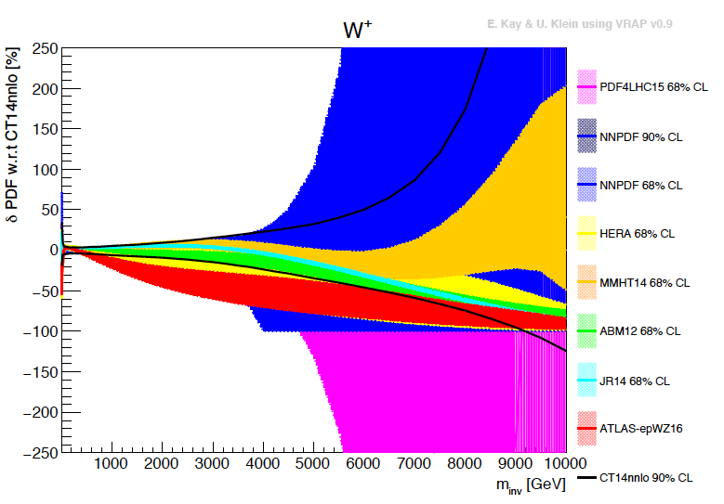
Empowering pp Discoveries
External, reliable input (PDFs, factorisation..) is crucial for range extension + CI interpretation
GLUON
QUARKS
SUSY, RPC, RPV, LQS..
Exotic+ Extra boson searches at high mass
ATLAS
today

Slide 19
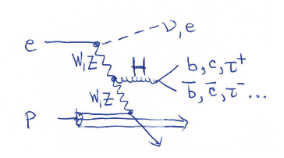
Higgs - Signal Strengths and Couplings in ep
k=1: CC: WW, σ_{tot}SM ≈ 200 fb
k=2: NC: ZZ, σ_{tot}SM ≈ 25 fb
So far we considered 7 most abundant
SM Higgs decay channels, i=1..7
bb, WW, gg, ττ, cc, ZZ, γγ
ttH will be added. (ep: 1.3 TeV cms!)
→ Nine measurements of κ_{W} and κ_{Z}
Two simultaneous measurements
of the other couplings (in CC and NC)
Note: FCCeh: CC: σ_{tot}SM ≈ 1 pb. L=2ab⁻¹
Jorge de Blas,
M+U.Klein 4/18
Reconstruct the full cross section as Σ_{j}
In e⁺e⁻ use Z recoil for the total width.
In ep, the kinematics constrained also
(under study, needs x..)

Slide 20
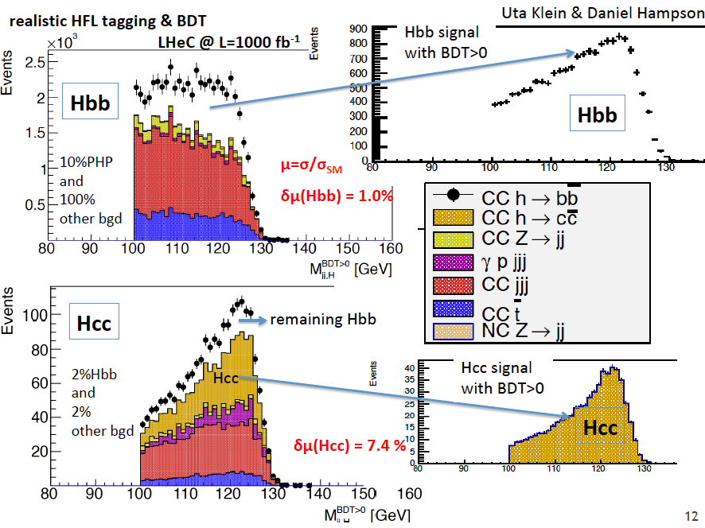
title

Slide 21
Signal Strength of SM Higgs Decays in ep [LHeC and FCCeh]
δμ/μ [%]
preliminary
M+U.Klein, 6.3.18
Charged Currents: ep → νHX
Neutral Currents: ep → eHX
Σ br_{i}=0.99±0.01 precise reconstruction of full width from 7 most frequent decays
(2% at LHeC, and 1% at LHeC+LHC). Charged currents only
Used: E_{e} = 60 GeV LHeC E_{p} = 7 TeV L=1ab⁻¹ HE-LHC E_{p} = 14 TeV L=2ab⁻¹ FCC: E_{p} = 50 TeV L=2ab⁻¹

Slide 22
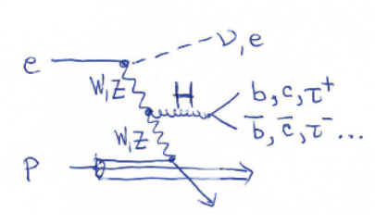
Transformation of the LHC into a High Precision Higgs Facility
δκ/κ [%]
preliminary
J. De Blas, M.+U. Klein, 16.4.2018
ttH at LHeC to 15%
LHC: ATLAS prospects PUB Note 2014-016
The addition of ep to pp (LHeC to LHC (HL,HE) and FCC-eh to FCC-pp) transforms these
machines into precision Higgs facilities. Vital complementarity with e⁺e⁻ (JdB Amsterdam)
Note that the HL LHC prospects are being updated (HL/HE LHC Physics workshop).

Slide 23
Comparison of LHeC and CLIC Prospects
δκ/κ [%]
preliminary
M+U Klein 3.4.18
LHeC: 60 GeV x 7 TeV. CLIC: 350 GeV [arXiv:1608.07538, “model dependent fit”, 0.5ab⁻¹]
Ultimate: Combine pp-ee-ee to test the Higgs Sector as stringent as possible, SM, HH, BSM
Note: Demanding level of precision, width from Z recoil, rare channels in pp, low cost ep

Slide 24
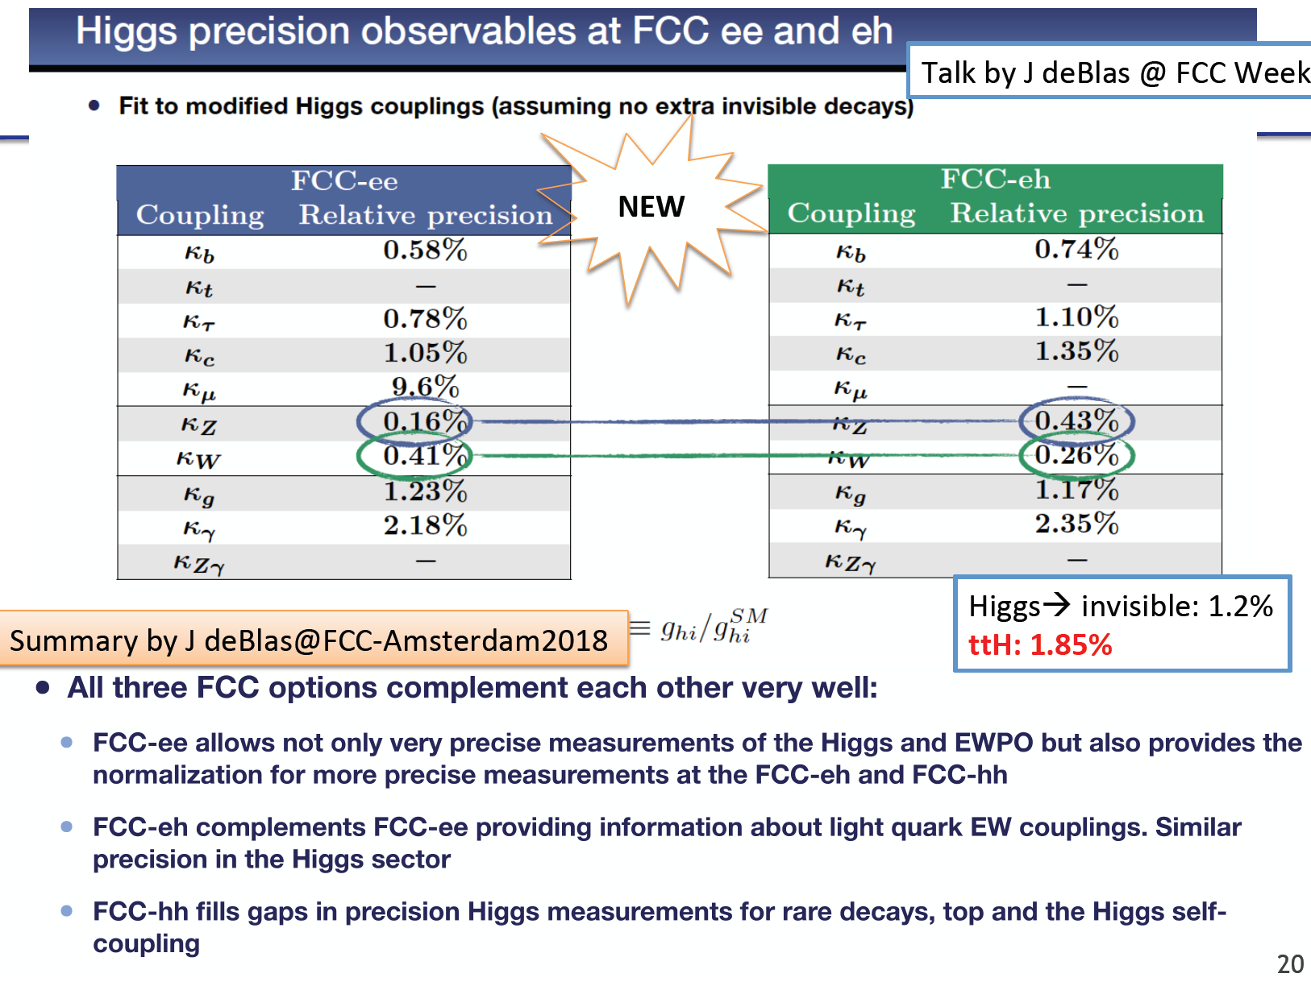
Comparison of κ Results with CLIC
Jorge de Blas, FCC Amsterdam 4/18 + Uta Klein, LHeC/FCCeh/PERLE WS 28.6.

Slide 25
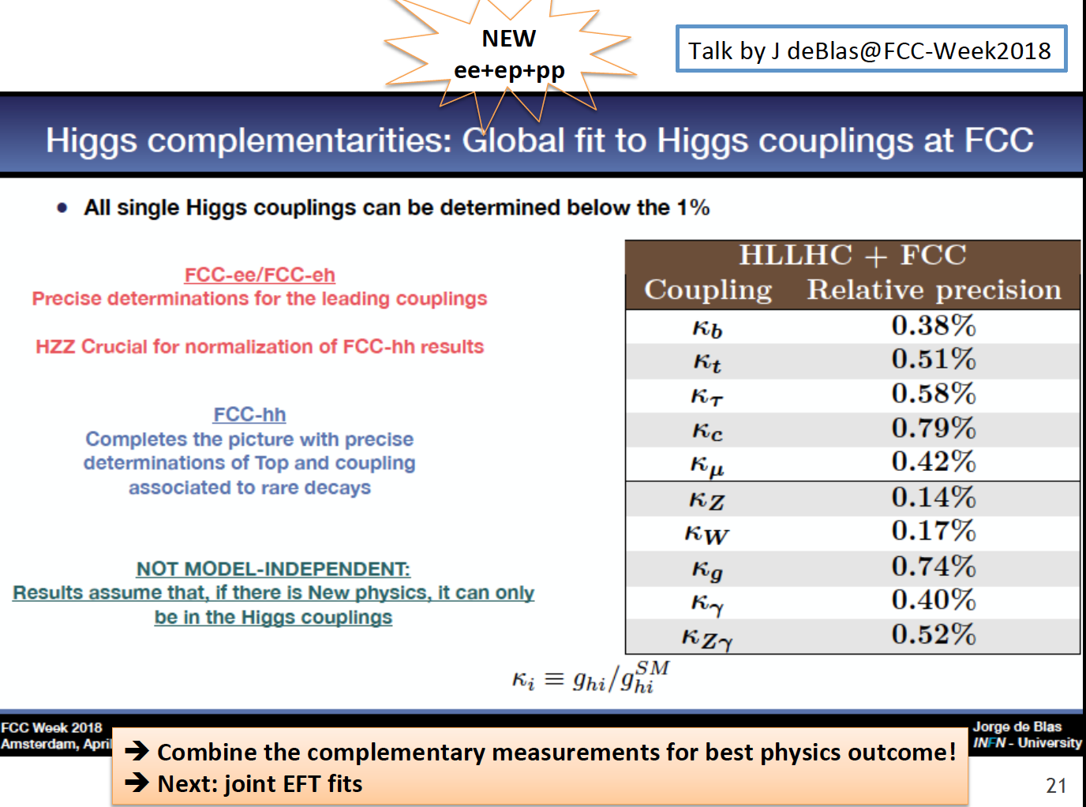
shanghai

Slide 26
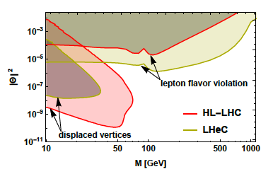
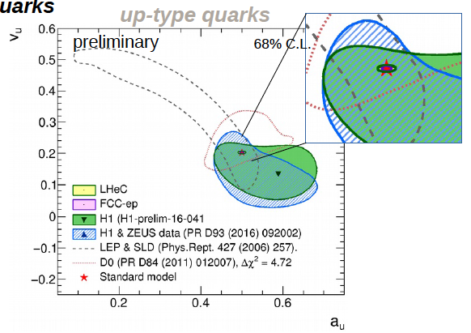
New Physics through High Precision (LHC: ep& pp)
Masses:
Charm HERA 40 MeV LHeC 3 MeV
W LHC 19→ 10 MeV LHeC 15 MeV
and prediction to ±2.8 MeV for pp
Top: to be studied
Proton: gluon we are made of…
Higgs: Cross section to 0.3%: Mass
dependent. OB, MK 1305.2090
Neutrinos: Heavy “sterile” Neutrinos
CKM, electroweak, alpha_s, …
V_{tb}: to 0.01
V_{cs}: to 0.02 [LHC+LHeC, like ATLAS+HERA]
α_{s} to 0.2% [0.1% with HERA] – GUT?
sin²θ_{W} (μ)
LHC: better than LEP with LHeC PDFs
LHeC: scale dependence from
0.4 GeV (PERLE) to 1 TeV (LHeC)
NC couplings
Antusch, Cazzato, Fischer – work still in progress
Britzger, MK, Spiessberger, Zhang – work still in progress

Slide 27
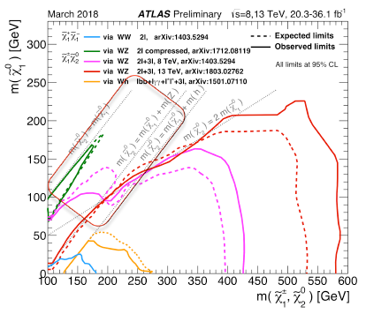
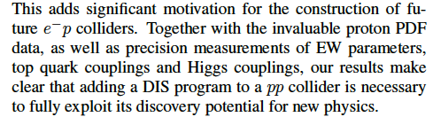
Beyond the Standard Model
Higgs into Dark Matter
Higgs into Neutralinos (RPV SUSY)
Higgs into Scalars → 4b
H±± in Vector Boson Scattering
H± in Vector Boson Scattering
H⁺ in 2HDM
Triple Gauge Couplings
Top FCNC
Contact Interactions
Empower LHC Discoveries
Higgsinos: mass degenerate
Wino/bino compressed
Prompt decays or long lifetimes
SUSY ewk sector most
challenging for pp colliders
cf U Klein + M Donofrio at Amsterdam FCC
D Curtin et al
arXiv:1712.07135

Slide 28
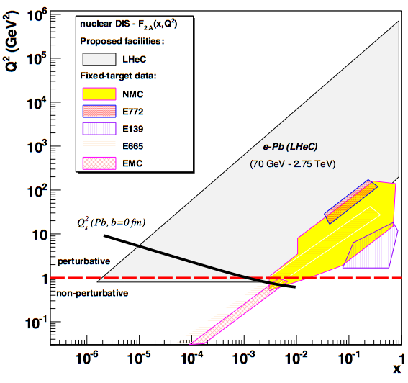
LHeC as Electron Ion Collider
FCC-he
Extension of kinematic range in lA
by 4-5 orders of magnitude will
change QCD view on nuclear
structure and parton dynamics
May lead to genuine surprises…
No saturation of xg (x,Q²) ?
[discover saturation in ep
THEN analyse eA –separate
nonlinear g from nuclear effects]
Small fraction of diffraction ?
Broken isospin invariance ?
Flavour dependent (anti)shadowing ?
Safely can expect
nuclear PDFs like at HERA
→ R(x,Q²) flavour dependent
LHeC
EIC
Precision QCD study of parton dynamics in nuclei
Investigation of high density matter and QGP
DGLAP to BFKL – vital for LHC and FCCpp physics
Note Change of Paradigm: pPb shows collective
behaviour. Ridge – correlations.. Discovery with eA
L_{eN} = 6 10³² cm⁻² s⁻¹

Slide 29

Large Hadron Electron Collider on one page
E_{e} = 10-60 GeV, E_{p} =1-7 TeV: √s = 200 – 1300 GeV. Kinematics: 0 < Q² < s, 1 > x ≥ 10⁻⁶ (DIS)
Electron Polarisation P=±80%. Positrons: significantly lower intensity, unpolarised
Luminosity: O(10³⁴) cm⁻² s⁻¹. integrated O(1) ab⁻¹ for HL LHC and 2 ab⁻¹ for HE LHC/FCCeh
e-ions 6 10³² cm⁻² s⁻¹ O(10)fb⁻¹ in ePb . O(1)fb⁻¹ for ep F_{L} measurements
Physics: QCD: develop+break? The worlds best microscope. BSM (H, top, ν, SUSY..)
Transformations: Searches at LHC, LHC as Higgs Precision Facility, QCD of Nuclear Dynamics
The LHeC has a deep, unique QCD, H and BSM precision and discovery physics programme.
Time: Determined by the Large Hadron Collider (HL LHC needs till ~2040 for 3 ab⁻¹ )
LHeC: Detector Installation in 2 years, earliest in LS4 (2030/31).
HE LHC: re-use ERL. In between HL-HE, 10 years time of ERL Physics (laser, γγ..)
Very long term: FCC-eh
Challenges: Demonstration of ERL Technology (high electron current, multi-turn)
Design 3-beam IR for concurrent ep+pp operation, New Detector with Taggers - in 10 years.
The LHeC is a great opportunity to sustain deep inelastic physics within future HEP.
The cost of an ep Higgs event is O(1/10) of that at any of the 4 e⁺e⁻ machines under consideration
It can be done: the Linac is shorter than 2 miles and the time we have longer than HERA had.
CERN and world HEP: Vital to make the High Luminosity LHC programme a success.
1802.04317
http://lhec.web.cern.ch
Max Klein Kobe 17.4.18

Slide 30
LHeC Prospects
The ep interaction does not disturb pp, i.e. the LHC may become a twin collider,
ep and pp operate concurrently and no luminosity loss is planned for pp. This
requires a premounted eh detector which may then be inserted in 2 years.
At LS4 (~2030) the heavy ion LHC operation ends and one may propose a
different use of IP2 which currently houses ALICE.
The electron beam energy (> 50 GeV) and luminosity (O(10³⁴) cm⁻² s⁻¹) goals are
derived from Higgs, top and BSM physics, also DIS itself (F_{L}, low x~1/s).
The cost of the O(1) TeV ep collider is a small fraction of any other big project
currently under discussion. The LHC determines the time frame. This may extend
considerably if CERN moves to HE LHC in the fourties.
The ERL technology is being developed worldwide (Darmstadt, Cornell, Berlin,
Novosibirsk, Jefferson Lab). PERLE would be a multi-turn 802 MHZ ERL technology
development and test facility which would timely accompany the LHeC progress.
We celebrate this year the 50th anniversary of the discovery of quarks. This was
not planned and achieved by a step in energy with a linac SHORTER than LHeC’s
- There is a very long term future for eh as part of hh in the FCC vision

Slide 31
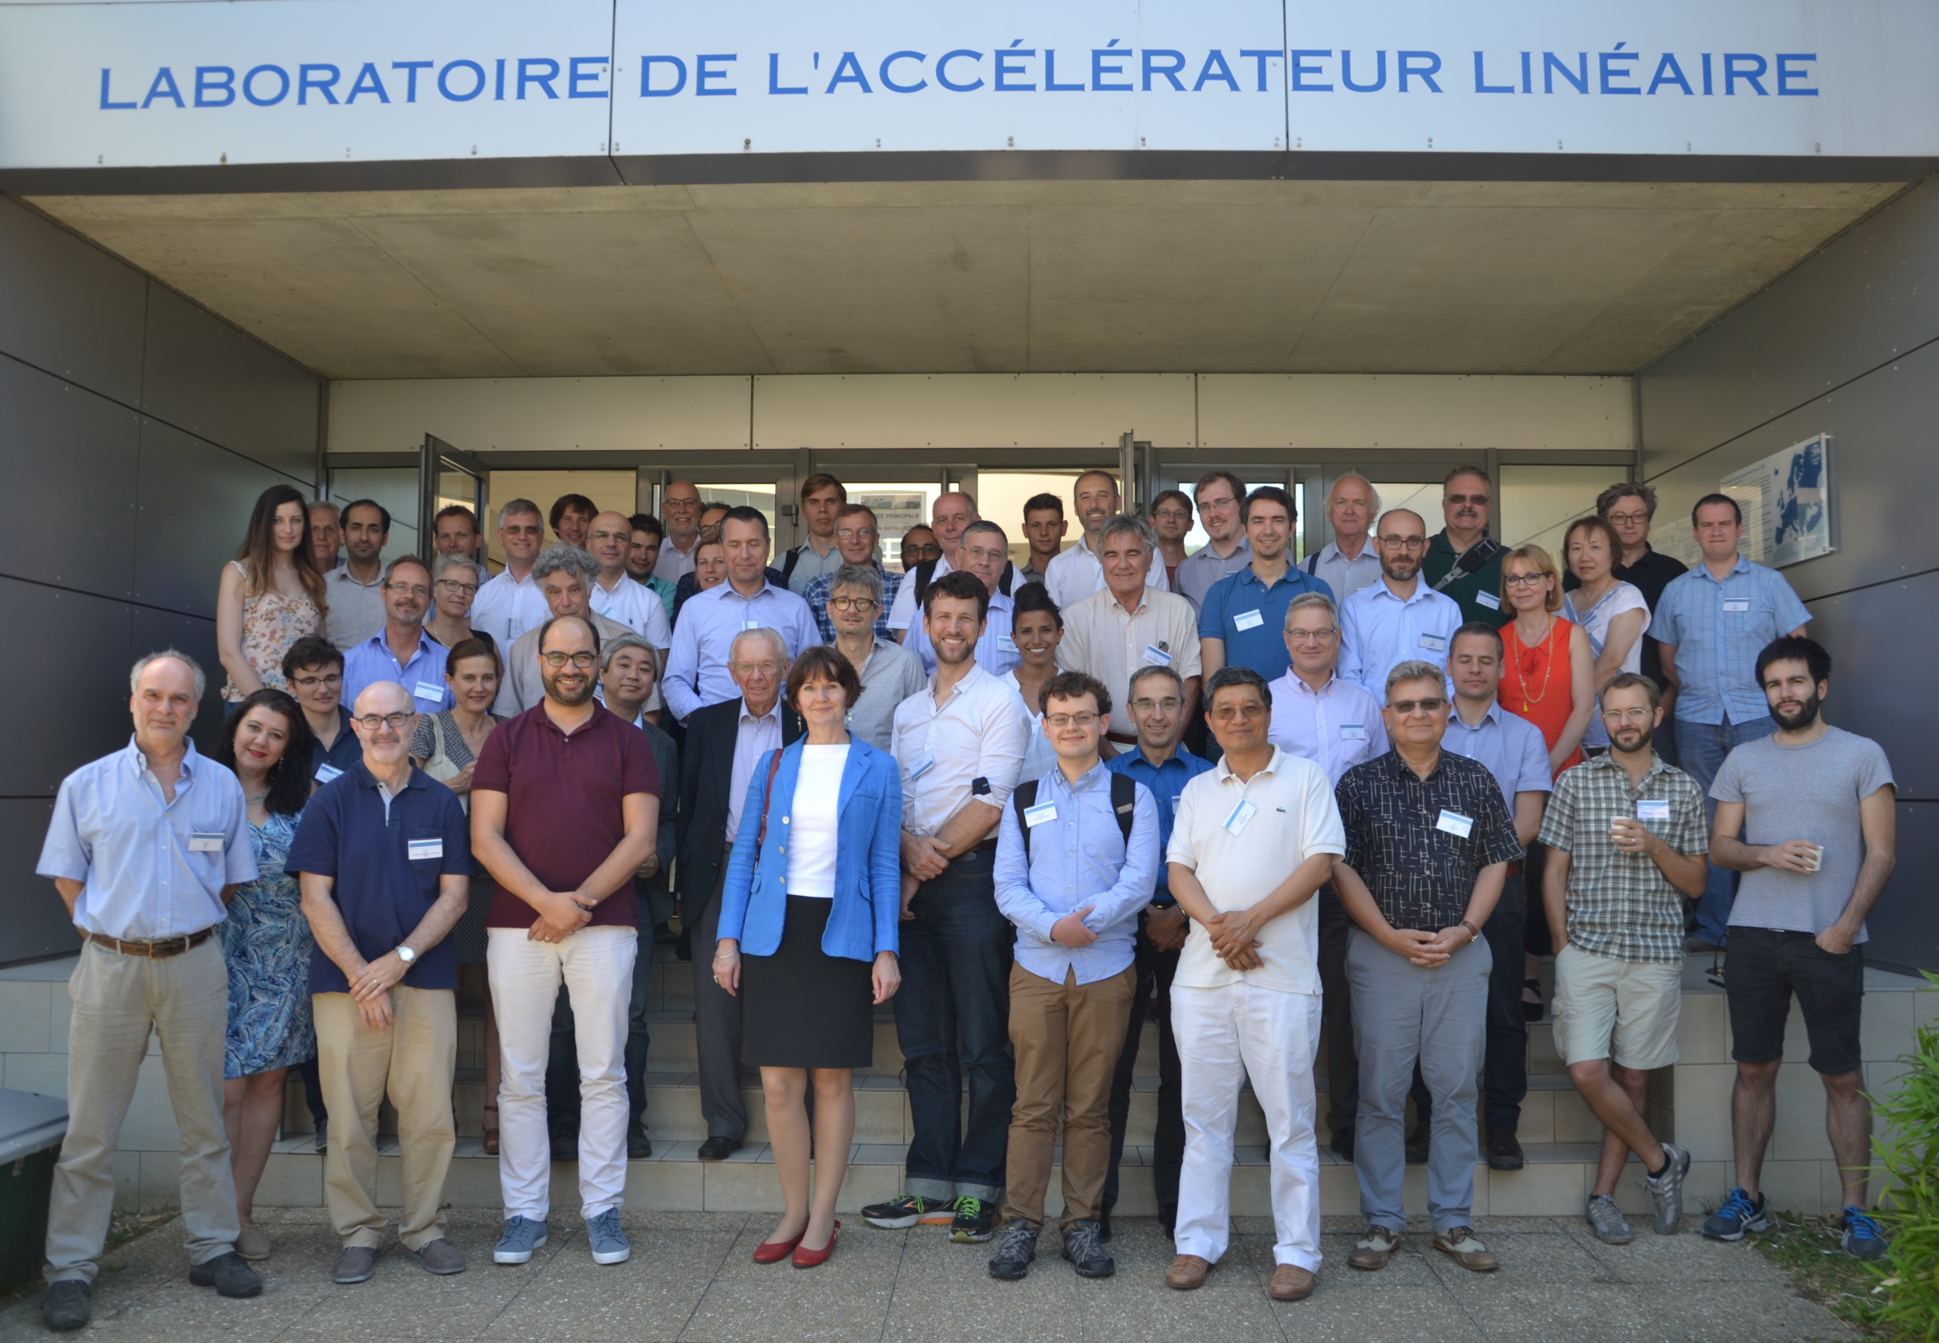
Most up-to-date Information: https://indico.cern.ch/event/698368/
Workshop: LHeC/FCCeh and PERLE
Last week at Orsay near Paris
New and Updates on
Physics: PDFs, QCD, H, t, BSM, eA + Relation eh-hh..
Accelerator: IR, Optics, Lattice, Cost-Energy, CE..
Detector: the GPD and its fwd and bwd detectors
PERLE: Source, Injector, Cavity, Cryomodule,.. Physics
Project Development towards the ES2020:
LHeC + FCCeh+ PERLE input 12/18. PERLE TDR in 2019.
http://lhec.web.cern.ch

Slide 32
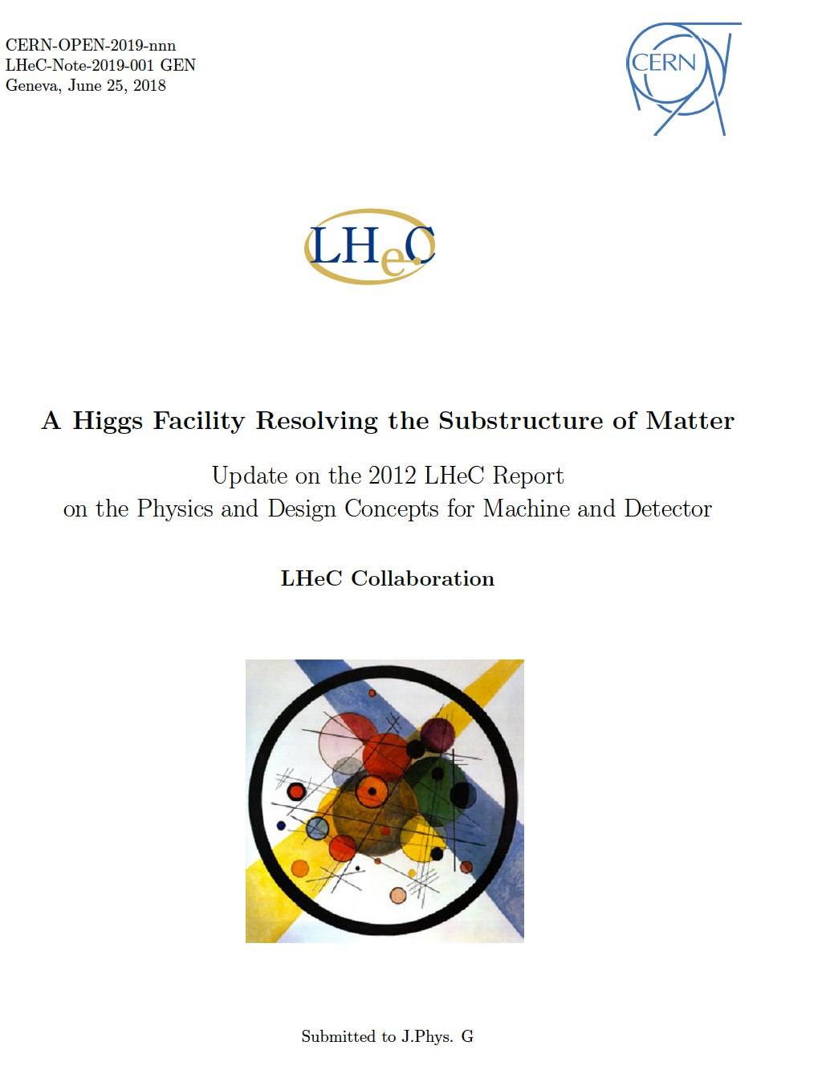
← “Implementation Plan” or
“Expression of Interest” …
will be written in early 2019
Submissions of Papers to the
European Strategy 12/18:
- PERLE Acc/ERL Development
- LHeC for HL and HE LHC
- FCCeh as part of FCC
- Generic DIS 10 page Paper

Slide 33

Time comes to unite pp with ep and ee at TeV scale
LHC
?
Jo Ruderman, modified
By adding ep to HL and HE LHC and building one new e⁺e⁻ collider, a realistic program
emerges for exploring the SM deeper and leading beyond, for the next 40 years ahead.

Slide 34
Shanghai backup

Slide 35
Physics and Prospects with LHeC
Raison(s) d’etre of the LHeC
Cleanest High Resolution
Microscope: QCD Discovery
Empowering the LHC
Search Programme
Transformation of LHC into
high precision Higgs facility
Discovery (top, H, heavy ν’s..)
Beyond the Standard Model
A Unique Nuclear Physics Facility
Project Design and Developments
Accelerator: ERL: 10-60 GeV Ee
Luminosity O(1000) HERA
ERL Technology Development: PERLE
Detector and its Installation
Project Features + Prospects
Outlook to HE LHC and FCCeh pp and ee
Towards the European Strategy
Note that LHeC has had a 600 pages CDR on physics, accelerator, detector arXiv:1206.2913
Max Klein, for the LHeC/FCCeh/PERLE Collabrations. Shanghai, TDLI 2.7.2018

Slide 36
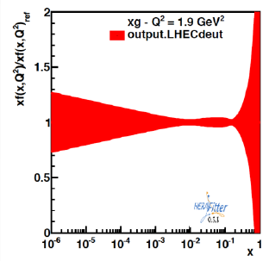
Nuclear QCD through eA at FCCeh/LHeC
Beauty in Lead
δGluon in Lead
unknown
badly
known
unknown ←
preliminary
eA: extends kinematic range in Q², 1/x by 3-4 orders of magnitude. Lumi 6 10³² (J.Jowett)
Measure nPDFs as in ep scattering and determine then the ratio R(x,Q²)=nPDF/PDF
Shadowing? A1/3 amplification? Saturation? Colour Flow? QGP initial state, collective effects
LHeC has been co-initiated and supported by NuPECC
see: Nestor Armesto FCC week 1/2018, CDR (LHeC) M.K. DOI: 10.1051/epjconf/201611203002

Slide 37
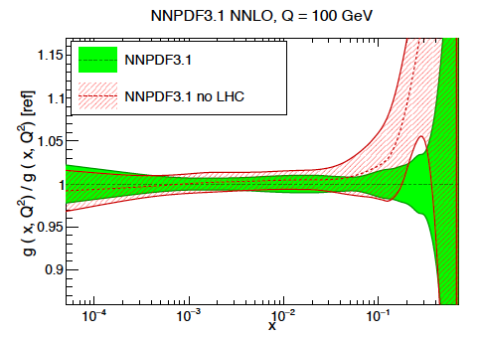
LHC Folklore: PDFs come from pp
LHC data constrain PDFs, BUT do not determine them:
Needs complete q_{i},g unfolding (miss variety)
at all x, as there are sum-rules
- Needs strong coupling to per mille precision, not in pp
Needs stronger effects (miss Q² variation)
cannot come from W,Z at Q²=10⁴ GeV²
Needs clear theory (hadronisation, one scale)
Needs heavy flavour s,c,b,t measured and VFNS fixed
Needs verification of BFKL at low x (only F₂-F_{L})
Needs N³LO (as for Higgs)
Needs external input to find QCD subtleties
such as factorisation, resummation…to not go wrong
- Needs external precise input for subtle discoveries
Needs data which yet (W,Z) will hardly be better
Needs agreement between the PDfs and χ²+1 ..
NNPDF3.1 arXiv:1706.00428
PDFs are not derived from pp scattering. And yet we try, as there is nothing else.., sometimes
with interesting results as on the light flavour democracy at x ~ 0.01 (nonsuppressed s/dbar).
Can take low pileup runs, mitigate PDF influence .. – but can’t do what is sometimes stated.
LHeC vs HERA: Higher Q²: CC; higher s: small x/g saturation?; high lumi: x→ 1; s, c,b,t. …

Slide 38
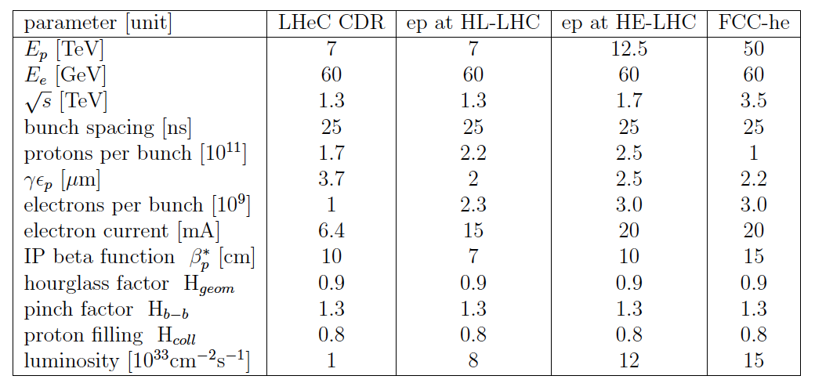

Luminosity for LHeC, HE-LHeC and FCC-ep
Contains update on eA:
6 10³² in e-Pb for LHeC.

Slide 39


Powerful Energy Recovery Linac for Experiments
15mA and 60 GeV correspond to 900 MW power
This can only be realised using energy recovery.
New: high current, high energy, multi-pass: study!
BINP, CERN, Daresbury, Jefferson Laboratory, U Liverpool, Orsay (LAL+INP), + Collaboration

Slide 40
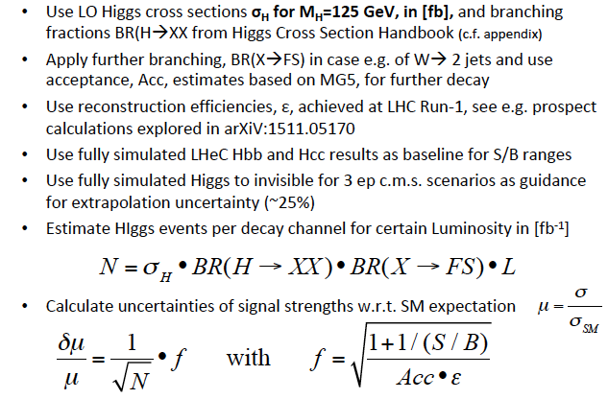
Extended H Decay Channel Prospect Study
Presented by Uta Klein to FCC and DIS workshops in 2018 - preliminary

Slide 41
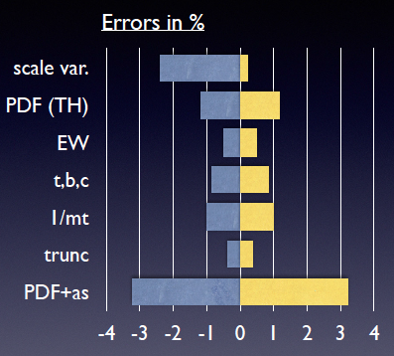
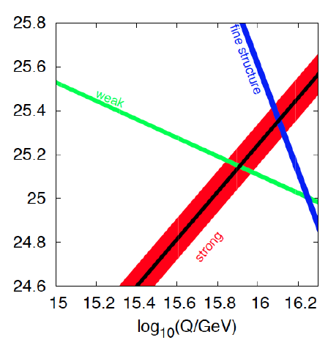
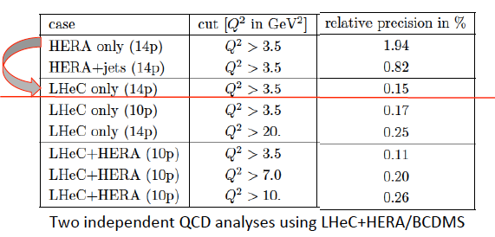
Strong Coupling Constant
- α_{s} least known of coupling constants
Grand Unification predictions need smaller δα_{s}
- Is α_{s}(DIS) lower than world average (?)
- LHeC: per mille - independent of BCDMS!
- High precision from inclusive data – α_{s}(jets)??
- Challenge lattice QCD
Uncertainty on Higgs cross section
Giulia Zanderighi, Vietnam 9/16,
from C.Anastasiou et al, 1602.00695
who also discuss the ABM alpha_s..
LHeC simulation, NC+CC inclusive, total exp error
PDG
LHeC

Slide 42
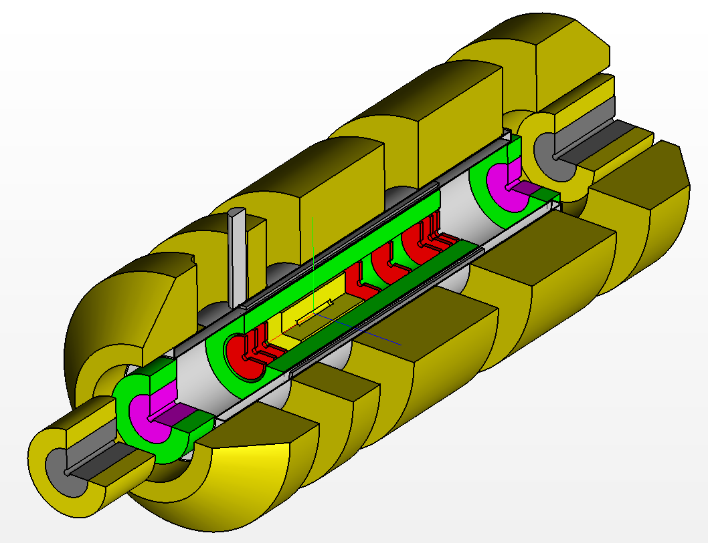
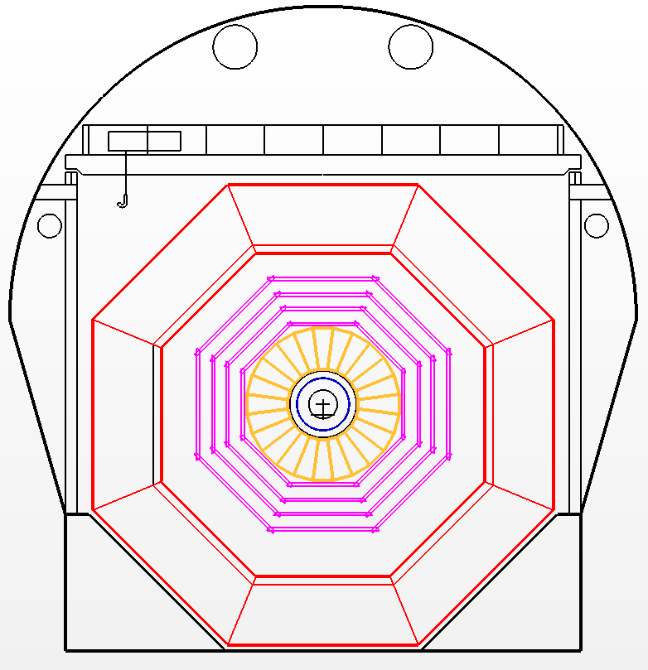
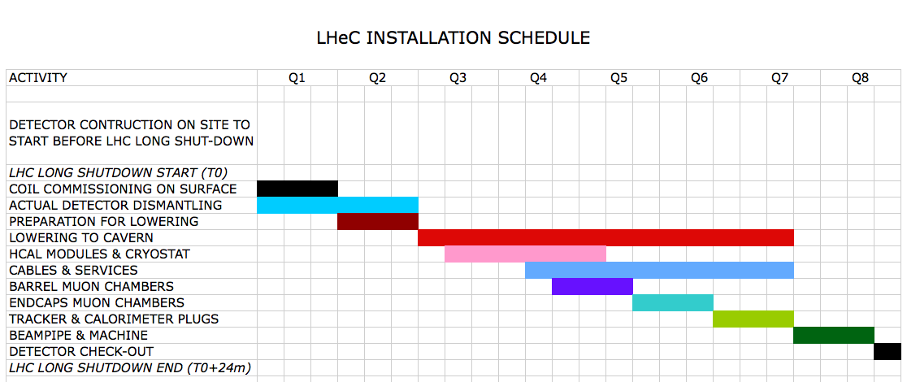
Installation
Study to fit into LHC shutdown needs, directed to IP2
Andrea Gaddi et al
Detector fits in L3 magnet support
Modular structure

