Slide 1
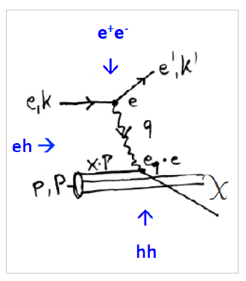
LHeC: Slides for Ian - PPAP
W Kandinsky, Circles in a Circle,
1923, Philadelphia Art Museum
Max Klein for LHeC UK, update 14.7.18

Slide 2
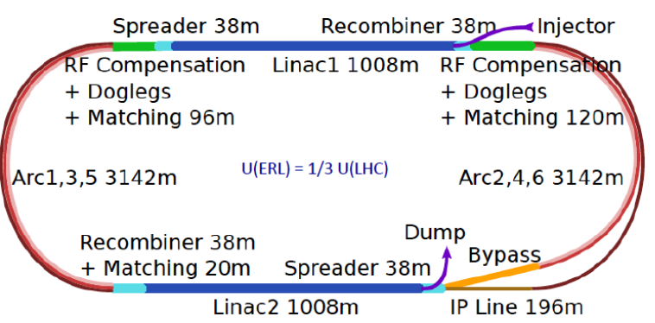
Three Raisons d’etre of the LHeC
Physics
- Microscope: World’s Cleanest High Resolution
- Empowerment of the LHC Physics Programme
- Creation of a high precision, novel Higgs facility
- Discovery Beyond the Standard Model
- Revolution of Nuclear Particle Physics
Sustainability and Cost
LHC:
- see: SM, Higgs and no BSM
- use: Investment of O(5) BSF
- run: HL LHC until ~2040
LHeC [1206.2913, update 2/19]
- 1.2 TeV ep/A for O(1)BSF
→ Establish novel ep+pp
Twin Collider Facility at CERN:
sustains HL LHC and bridges to
CERN’s long term future
For installation during LS4 (2030+)
and long term use (HE LHC, FCCeh)
Technology
Accelerator: Novel SRF ERL, green power facility
Detector: Novel high tech (CMOS..) apparatus
Keep accelerator and detector base uptodate
while preparing for colliders that cost O(10)BSF

Slide 3
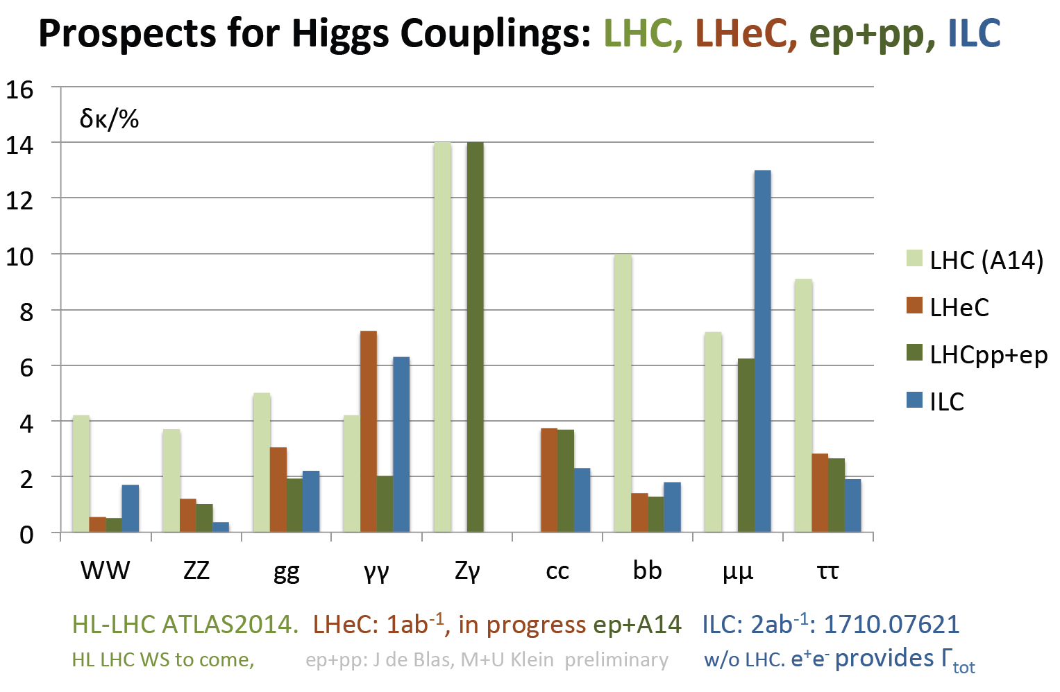
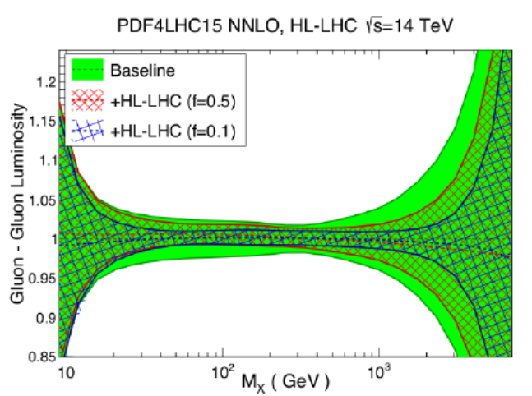
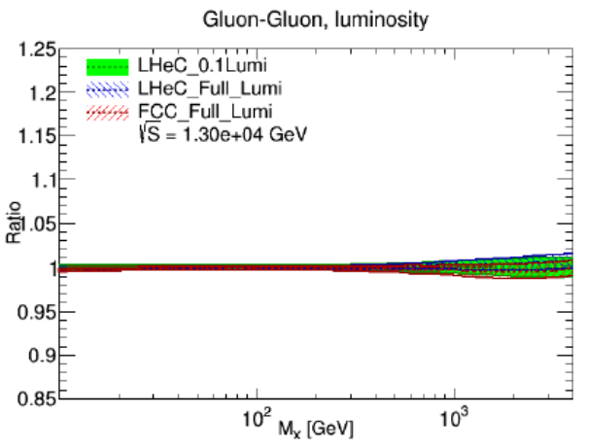
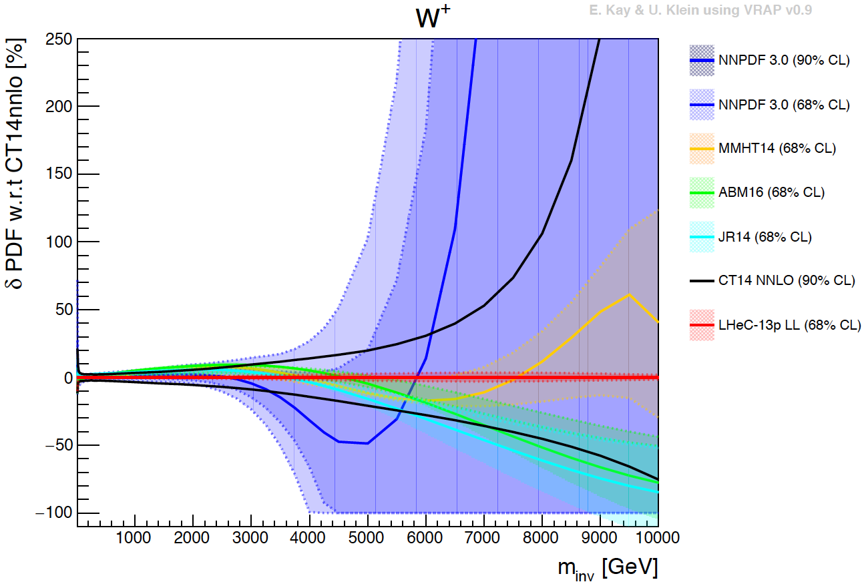
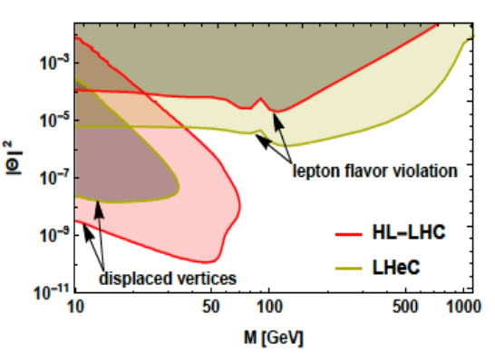
Physics
HL LHC
LHeC
H
L(gg)
High
Mass
Searches
1802.04317
Search for Heavy Neutrinos
α_{s} to 0.1%
V_{tb} to 1%...
sin²θ_{W} better than LEP
M_{W} [pp+ep]: 0.007%
…
HIGH precision leads
to Discovery BSM
now←

Slide 4
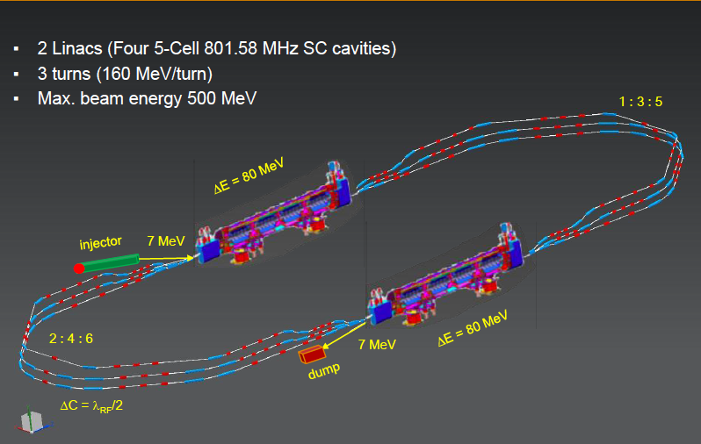
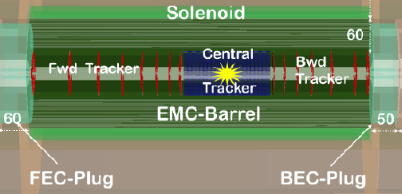
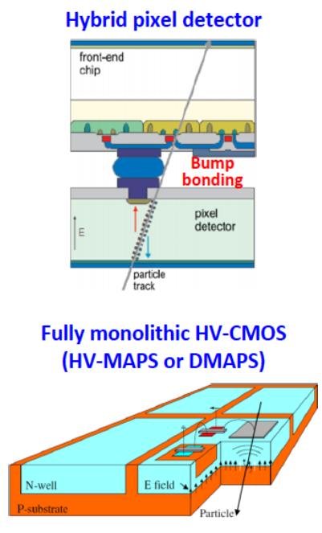
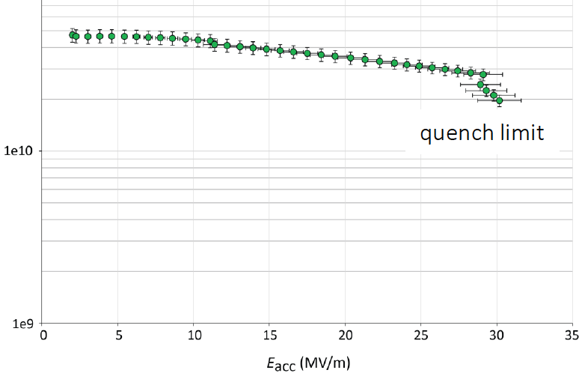
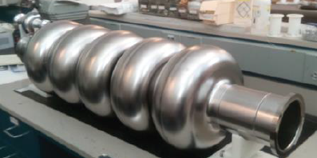
Acc & Det Technology
PERLE at Orsay
1705.08783
AsTEC, BINP, CERN, Jlab ,Liverpool, Orsay, +
Zoom LHeC detector [15.6 x 10.4m² HE LHC]
Challenge: demonstrate multi-turn ERL (cbeta, 2019)
Develop 802 MHz, LHeC Technology (PERLE > 2022)
UK Institutes
Accelerator
AsTEC, Cockcroft (Lancaster,
Manchester, Liverpool,
Srathclyde), JAI (Oxford)
Detector+Physics
Birmingham, Liverpool,
Manchester, Oxford, QMW
HERA+LHC have also
Bristol, Glasgow, Imperial,
Lancaster, RAL, UCL.
Q₀
PERLE/LHeC first 802 MHz cavity
CERN-Jlab. Q₀ > 3 10¹⁰, 2K. freedom
to choose operation point ~ 20MV/m
Detector: a new task post HL LHC design
Challenge for Acc+Det: 3 beam-IR design

Slide 5
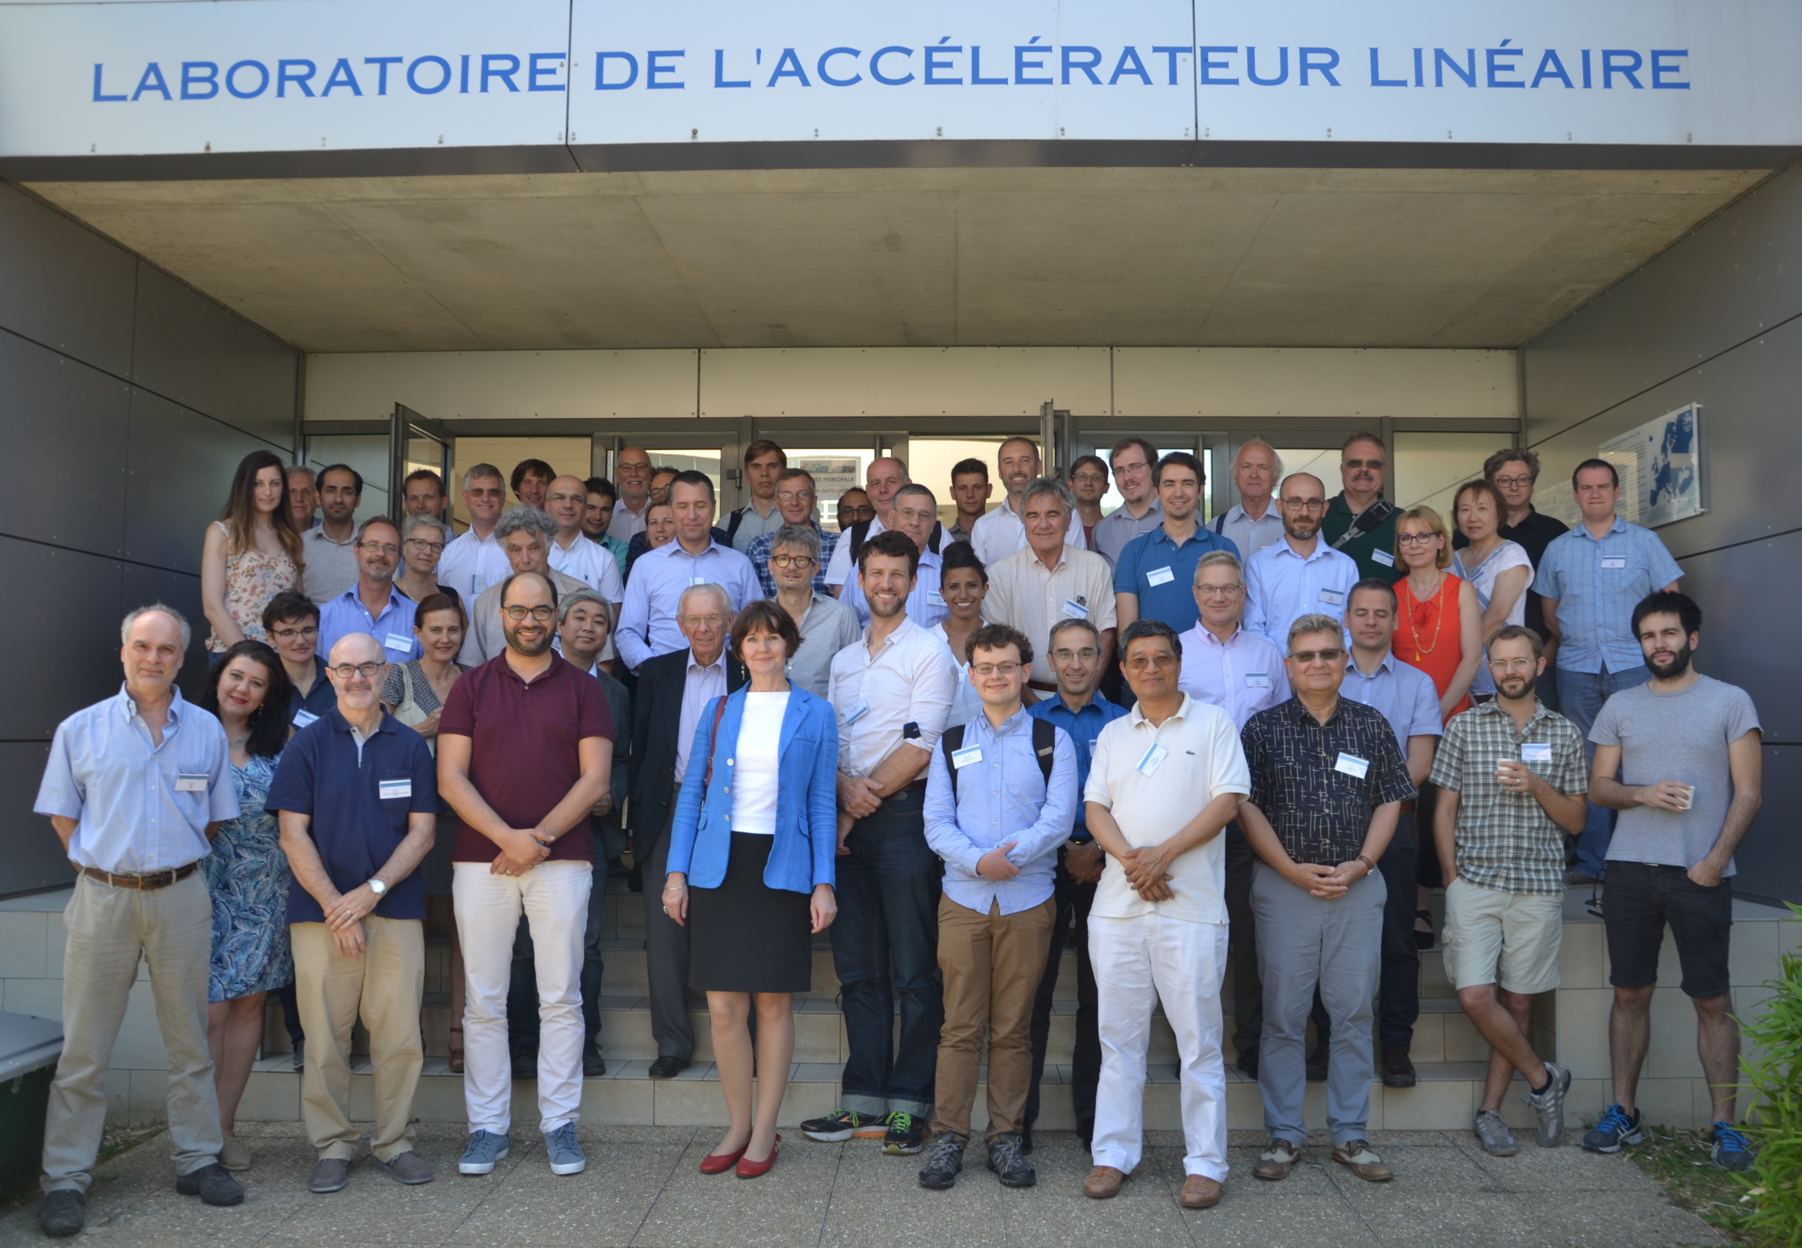
Most up-to-date Information: https://indico.cern.ch/event/698368/
Workshop: LHeC/FCCeh and PERLE
Last week at Orsay near Paris
New and Updates on
Physics: PDFs, QCD, H, t, BSM, eA + Relation eh-hh..
Accelerator: IR, Optics, Lattice, Cost-Energy, CE..
Detector: the GPD and its fwd and bwd detectors
PERLE: Source, Injector, Cavity, Cryomodule,.. Physics
Project Development towards the ES2020:
LHeC + FCCeh+ PERLE input 12/18. PERLE TDR in 2019.
http://lhec.web.cern.ch

