Slide 1
LHeC: Status and Prospects
Overview
Physics
ERL
Machine
PERLE
Next Steps
Large Hadron Electron Collider:
e:10-60 GeV, p: 1-7 TeV (LHC)
FCC-eh: Few TeV cms eh collider
e:10-60 GeV, p: 20 .. 50 TeV
Max Klein
University of Liverpool, ATLAS, H1
For the LHeC and PERLE Collaborations
EPS Conference, Ghent, 12.7.2019
further LHeC/FCC-eh talks at this conference:
D Britzger [eweak], M Cooper Sarkar [QCD/PDFs], U Klein [Higgs], C Schwanenberger [top/BSM], A Stasto [low x/eA]
For FCC-eh see FCC books 1 (physics) and 3 (FCC-hh with eh integrated)
See also the CDR presentation in March 2019: https://indico.cern.ch/event/789349/
with talks on FCC-eh machine (OB), Higgs in eh (UK) and QCD (MK).
FCC Week at Brussels: Parallel Session [IR, cost, PERLE], summary by O Bruening

Slide 2
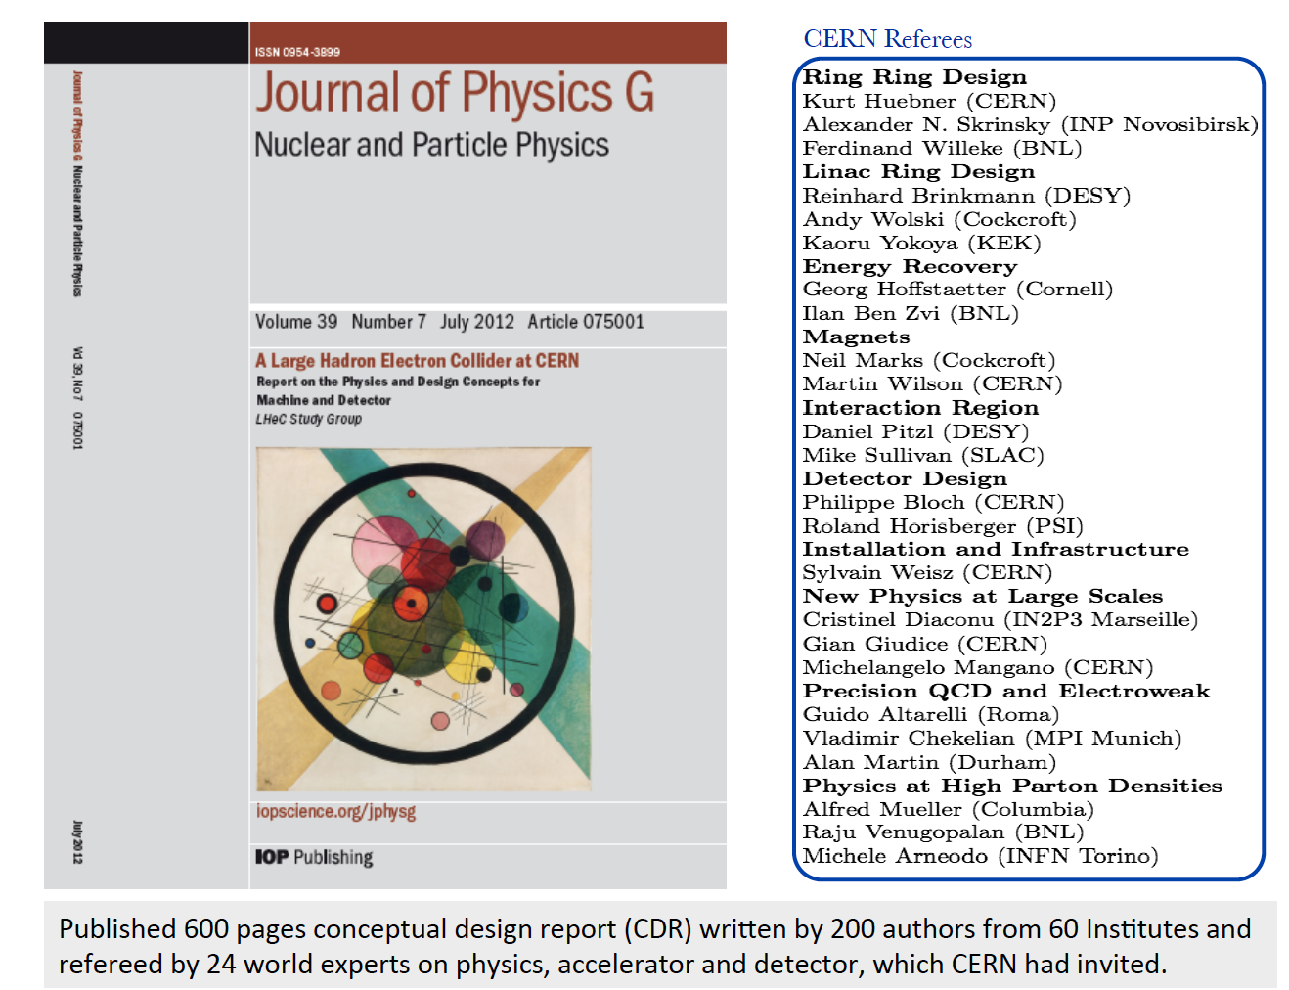
title
Conceptual Design Report
ep/eA with the LHC
[r]ECFA + CERN Mandate
← Result of a four year study
and one year referee process.
Next generation ep [and
first generation eA] collider
following HERA (1992-2007)
for extension of DIS
energy frontier
60 GeV on 7 TeV [2.7 TeV Pb]
Lower energy: EICs, spin, 3D..
Then came Higgs, no SUSY ...
from LHC, which worked
admirably, and the decision
for extending LHC to 2040
Choice for Linac Ring, new
physics, tenfold higher Lumi..
→ New Mandate by CERN
arXiv:1206.2913
W Kandinski
„Circles in
A circle“ 1912
... Gluon
selfsimilarity

Slide 3
Organisation
Working Groups
International Advisory Committee
Mandate by CERN (2014+17) to define
“..Direction for ep/A both at LHC+FCC”
PDFs, QCD
Fred Olness,
Claire Gwenlan
Higgs
Uta Klein,
Masahiro Kuze
BSM
Georges Azuelos,
Monica D’Onofrio
Oliver Fischer
Top
Olaf Behnke,
Christian Schwanenberger
eA Physics
Nestor Armesto
Small x
Paul Newman,
Anna Stasto
Detector
Alessandro Polini
Peter Kostka
Coordination Group
Accelerator+Detector+Physics
Sergio Bertolucci (CERN/Bologna)
Nichola Bianchi (Frascati)
Frederick Bordry (CERN)
Stan Brodsky (SLAC)
Hesheng Chen (IHEP Beijing)
Eckhard Elsen (CERN)
Stefano Forte (Milano)
Andrew Hutton (Jefferson Lab)
Young-Kee Kim (Chicago)
Victor A Matveev (JINR Dubna)
Shin-Ichi Kurokawa (Tsukuba)
Leandro Nisati (Rome)
Leonid Rivkin (Lausanne)
Herwig Schopper (CERN) – Chair
Juergen Schukraft (CERN)
Achille Stocchi (LAL Orsay)
John Womersley (ESS)
Gianluigi Arduini
Nestor Armesto
Oliver Brüning – Co-Chair
Andrea Gaddi
Erk Jensen
Walid Kaabi
Max Klein – Co-Chair
Peter Kostka
Bruce Mellado
Paul Newman
Daniel Schulte
Frank Zimmermann
5(12) are members of the
FCC coordination team
OB+MK: co-coordinate FCCeh
We miss Guido Altarelli.

Slide 4
LHeC Configuration (for two electron beam energies) [CERN, BNL, Jlab for CDR]
Energy recovery linac(s)
20mA I_{e}
Concurrent ep + pp
operation with LHC
Integrated luminosity
in e⁻p up to O(1) ab⁻¹
U(ep) = 1/n U(LHC)
Likely n=3 (CDR) → n=4
gains 20-30% cost. E< 60
H, BSM, top, low x..
require E > 50 GeV
Frequency set to 802 MHz,
commensurate with LHC
and 401/802 at CERN+FCC.
also beam-beam stability
3-turn energy recovery racetrack configuration. Modular for LHeC/FCC-eh

Slide 5
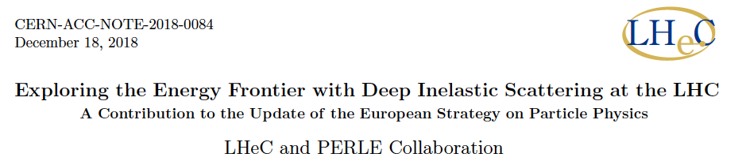
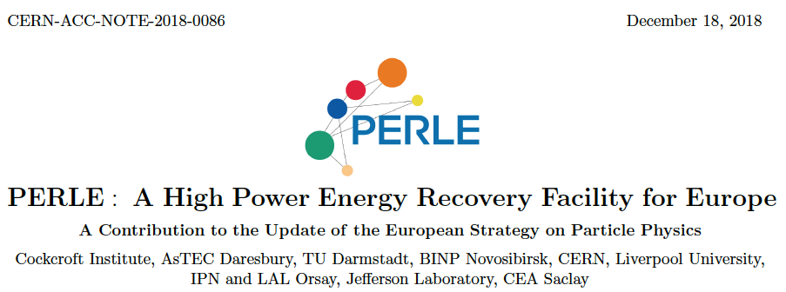
title
LHeC also described in the ES paper by A.Caldwell, A.Levy, R.Ent, P.Newman and F.Olness
Summary
Papers
submitted
to the
European
Strategy
12/2018

Slide 6
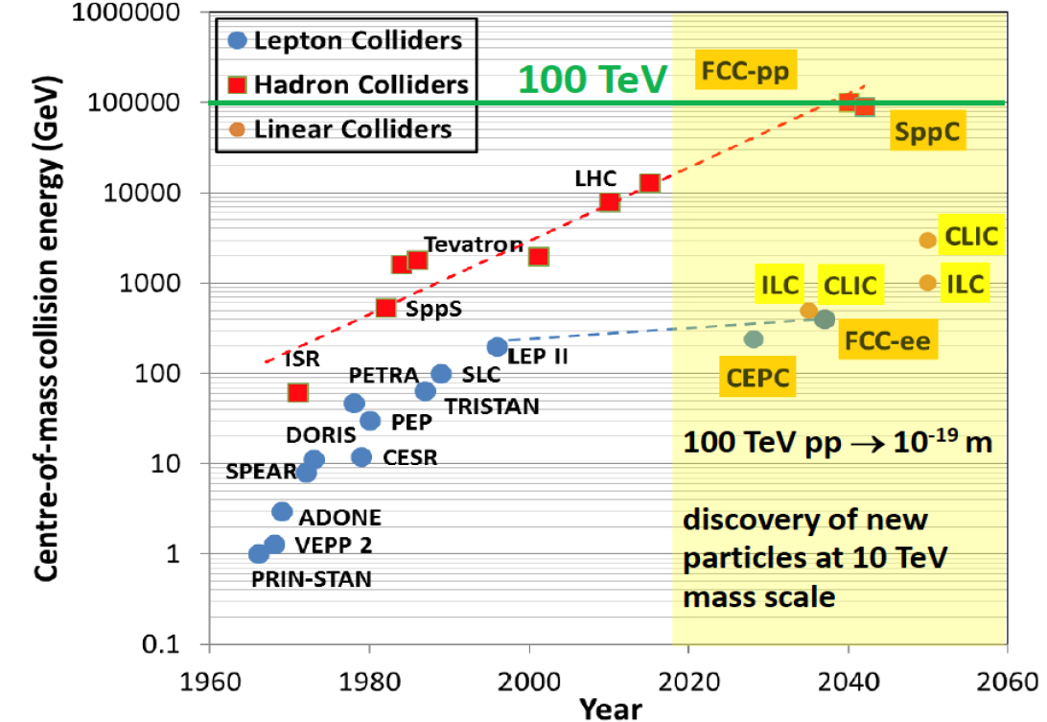

title
Hundred
Years of
HEP
Colliders
FCC-pp
40 TeV
FCC-eh
LHeC
HERA
EIC
ep/A
Parameters:
MK EPS 7/19. adapted from M Benedikt (3/19)

Slide 7
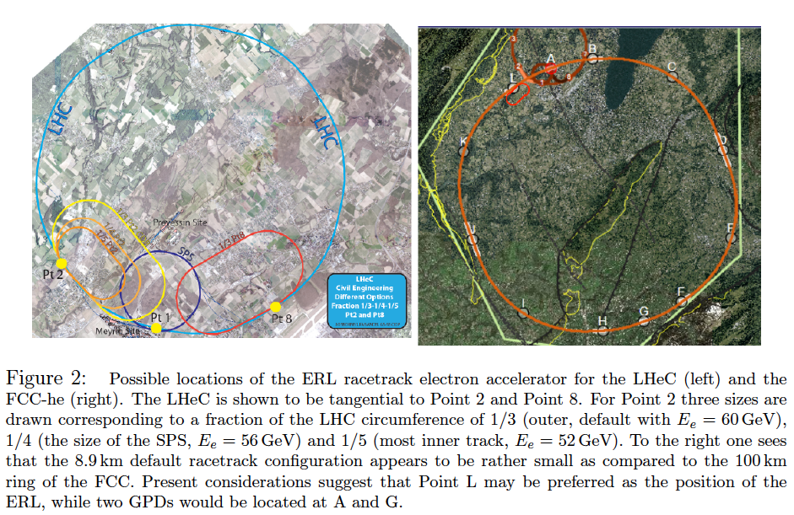
LHC (HL+HE) Footprint of ERL FCC

Slide 8
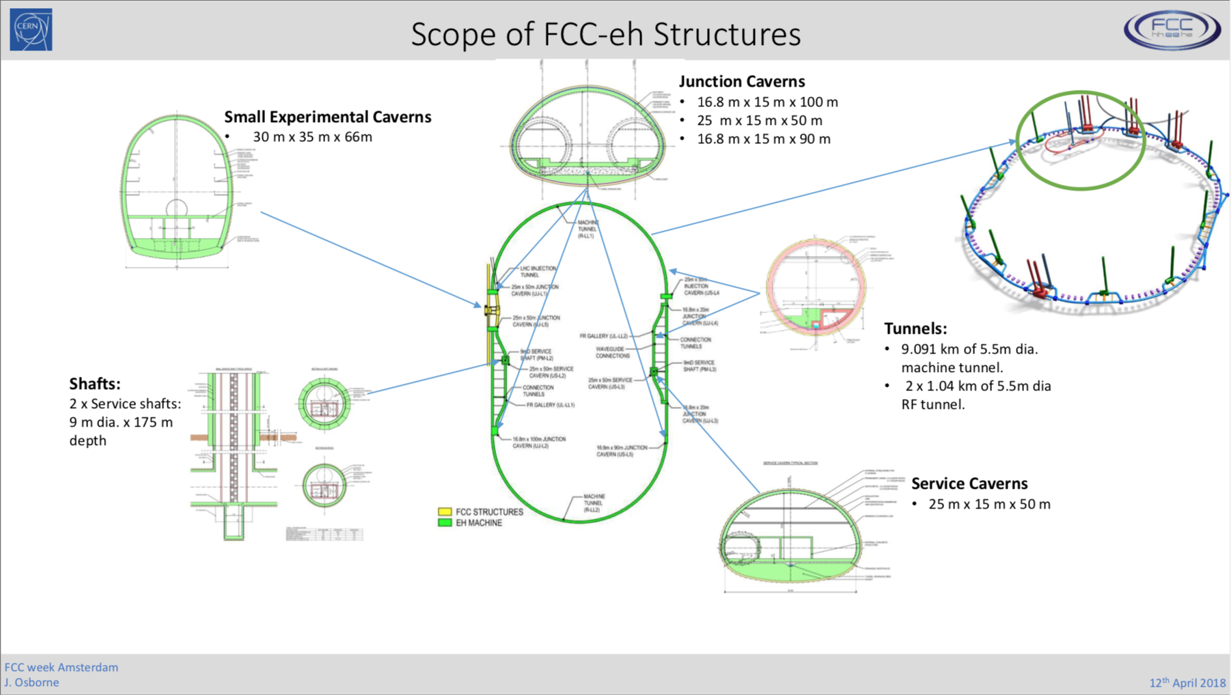

Slide 9
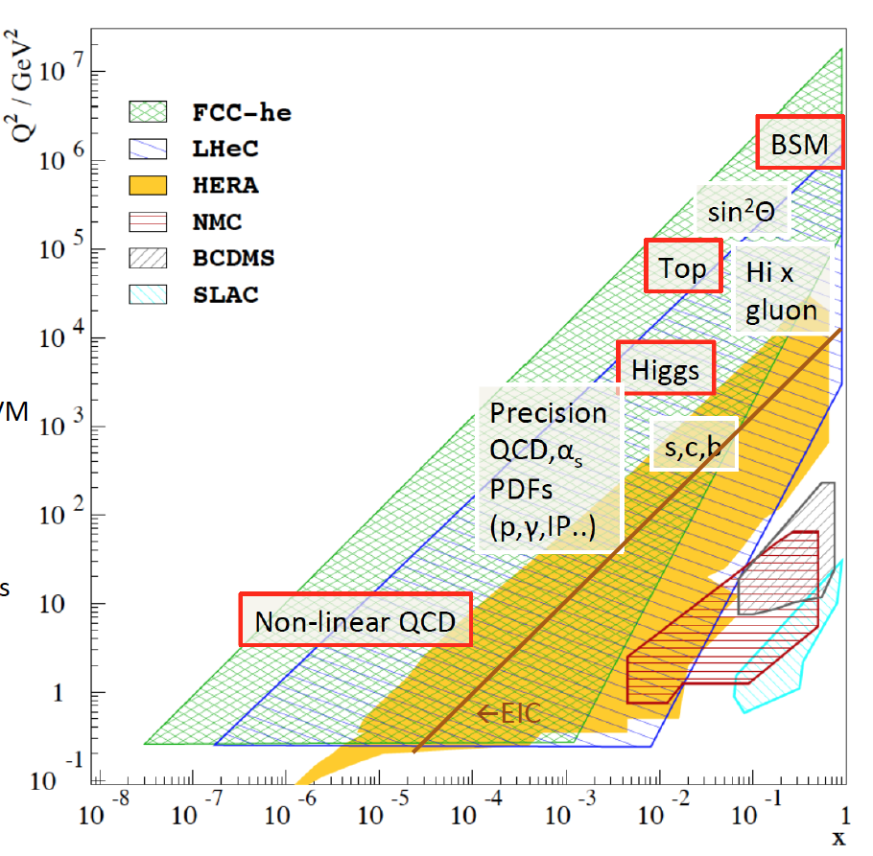
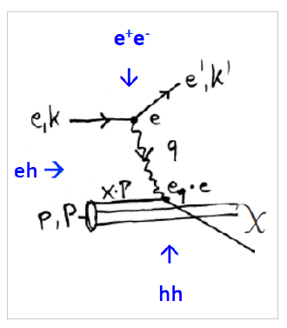
Physics with Energy Frontier DIS
Raison(s) d’etre of the LHeC
Cleanest High Resolution
Microscope: QCD Discovery
Empowering the LHC
Search Programme
Transformation of LHC into
high precision Higgs facility
Discovery (top, H, heavy ν’s..)
Beyond the Standard Model
A Unique
Nuclear Physics Facility
Deep Inelastic Scattering

Slide 10
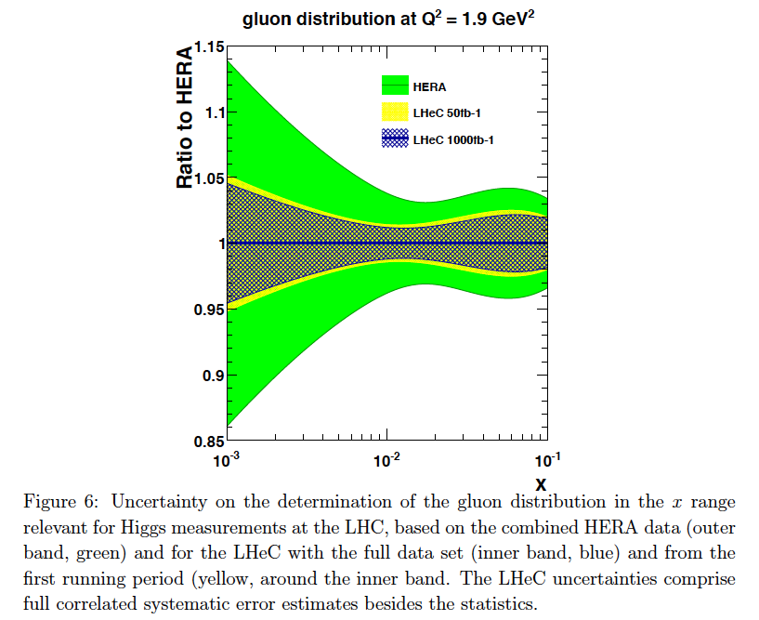
Parton Distributions
Complete unfolding of parton contents in
unprecedented kinematic range: u,d,s,c,b,t, xg
Strong coupling to permille accuracy (incl + jets):
Crucial for LHC:
- high precision eweak, Higgs measurements
- Extension of high mass search range
- Non-linear low x parton evolution; saturation?
DIS: clean theory, light cone, redundant e/h FS reconstruction, ..
For LHC to have an impact on
the search and precision physics
program at HL-LHC it is crucial
that PDF and QCD information
is available early.
PDF study with 50 vs 1000 fb⁻¹
Remove essential party of
QCD uncertainties of gg→ H
cf C. Gwenlan, talk at DIS19 and
M Cooper Sarkar yesterday at EPS
FCC-eh
← LHeC
← EIC
Note that 50fb⁻¹ is 100 times H1‘s total luminosity: Low x needs 1fb⁻¹.
← HERA

Slide 11
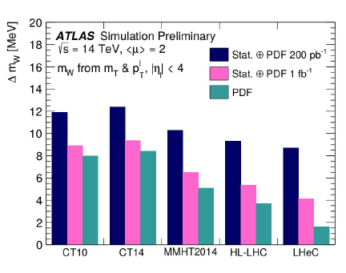
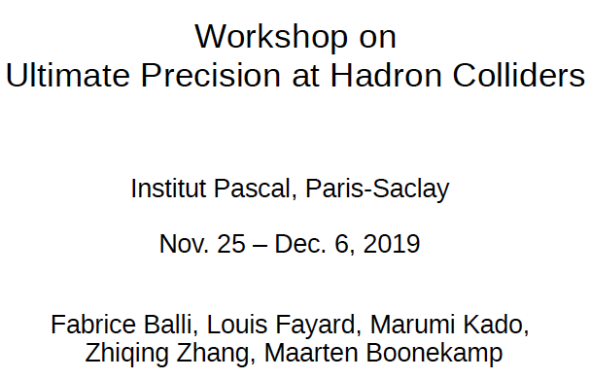
High Precision Electroweak Physics with HL-LHC and LHeC
ATLAS: Studies of HL-LHC+LHeC prospects
W Boson Mass: +-4 MeV (exp) +- 2 MeV (PDF)
Weak mixing angle, PUB-2018-037: HL-LHC + LHeC
0.23153 +- 0.00008 [LEP+SLD: +- …16]

Slide 12
Higgs in ep
Charged Currents
To be published
Prospects for signal strength measurements of Higgs decays
Neutral Currents
LHeC: 1ab⁻¹, 7 TeV E_{p}
HE LHeC: 2ab⁻¹, 13 TeV E_{p}
FCC-eh: 2ab⁻¹, 50 TeV E_{p}
cf talk by U. Klein today at EPS

Slide 13
Higgs in ep and pp [LHeC and HL-LHC]
Determination of SM Higgs couplings jointly from pp + ep
Results for FCC-eh at
20 TeV E_{p} x 60 GeV E_{e}
Uncertainties on kappa
Decay FCCep HL-LHC
bb 0.9 2.7
WW 0.3 1.2
gg 1.7 2.2
tau 1.5 1.6
cc 1.9 --
ZZ 0.5 1.0
yy 3.3 1.7
in percent. SM width.
1%
The combined ep+pp at LHC reaches below 1% for dominant channels
ep adds charm. Analysis in EFT framework work in progress (aTGCs in ep..)

Slide 14
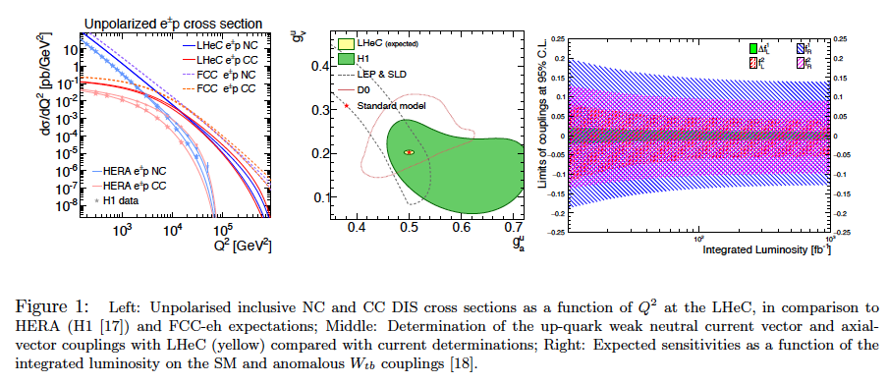
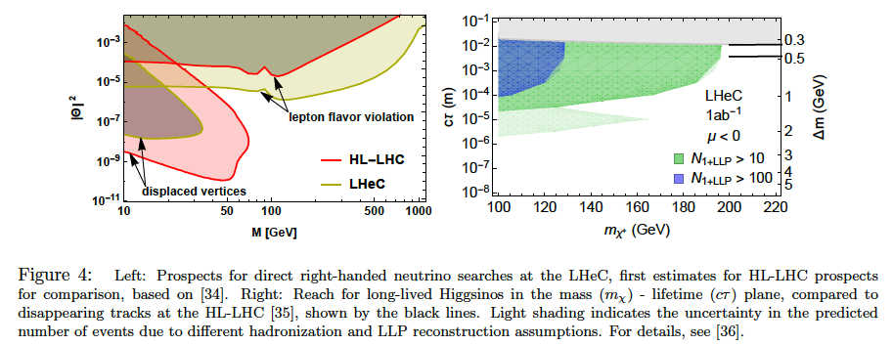
Precision
Electroweak
Physics
Anomalous
Wtb couplings
Electroweak+Top Physics
From LHeC strategy paper CERN-ACC-NOTE-2018-0084
cf today talks by
D Britzger and
C Schwanenberger
Higgsinos
Heavy Neutrinos
BSM + Searches

Slide 15
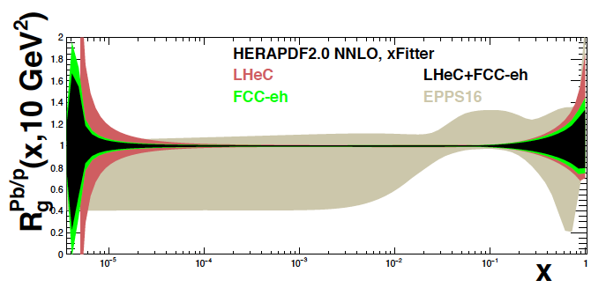
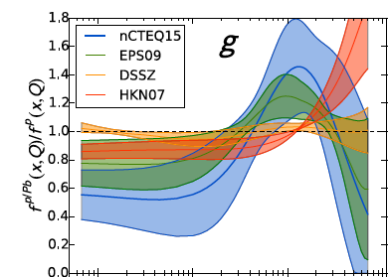

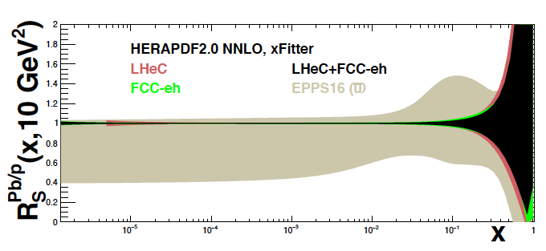
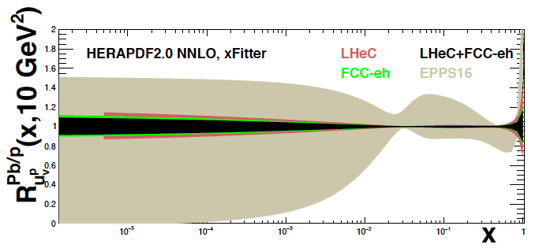
Nuclear PDFs at LHeC/FCCeh
Unique nuclear/HI physics programme
Extension of fixed target range by 10 ³⁻⁴
QCD of QGP, de-confinement, saturation..
nPDFs independent of p PDFs
1509.00792
High
luminosity
~ 10 ³³
enables
high statistics
in short
eA runs
cf J Jowett et al
present
status →
on xg
Pb/p
gluon
N Armesto, FCC Physics Week 1/2018
sea
valence
cf talk by
A Stasto today
LHeC: Full error, Δχ² =1. EPPS Δχ² =52

Slide 16
Energy Recovery today and tomorrow
FCC-ee
- Joint 802 MHz cavity development [LHeC+FCC]
- New: Design of FCC-ee with ERL technique:
[extension to higher energy, less SR power, higher lumi > WW]
LHeC: 1 TeV ep collider with 10³⁴ luminosity: P/10! Dump at injection.
Possible injector to FCC-ee in recirculating mode [O.Bruening]
ERL: A revolutionary
technology ripe for
real applications in
HEP, low energy and
industrial areas, of
huge potential
just evolving : to be
recognised in strategy
PERLE BINP, CERN, Daresbury, Liverpool, Jlab, Orsay+. Could be 6 GeV injector to FCC-ee →
ERLs in: Berlin, BINP, Cornell, Daresbury, Darmstadt, Jlab, KEK, Mainz..
High current and E ~ 1GeV: low energy physics [1000 x L(ELI)!, lithography, photofission..
Llatas
M.Klein, LHeC Ghent 12.7.19
Llatas, Litvinenko, Roser: FCC Brussels. tentative

Slide 17
Recent ERL achievements
Q₀
Parameter | Unit | CRN5
E_{acc} at quench | MV/m | 30.1
E_{pk} at quench | MV/m | 68.1
B_{pk} at quench | mT | 126.3
FE onset field | MV/m | ~25
FE-induced radiation(max) | mR/hr. | 0.06
Max. Q₀-value | /1e10 | 4.72
Q₀-value at 25 MV/m | /1e10 | 3.12
Lorentz Force Detuning | Hz/(MV/m)² | -1.5
ER
without ER
Gradient MV/m
F Marhauser et al.
Jlab, CERN
First 5 cell Niobium
Cavity, 802 MHz
High Q₀, high stability
Demonstration of energy recovery in
new cBETA facility at Cornell, with BNL
G Hoffstaetter et al 19.6.2019

Slide 18
FCC-eh
Walid Kaabi (Orsay)

Slide 19
Recent PERLE Progress
Field homogeneity 8 10⁻²
Transfer of ALICE (Daresbury) gun + equipment to LAL (5/19)
Hiring of personell at Orsay
Design of source/booster/injector at Daresbury/Liverpool
Encouraging radiation protection survey at Orsay
...
arrival of the
ALICE gun in
the PERLE hall
10.5.19
LAL/IPNO and BINP-Novosibirsk applied for the H2020 European program (CRIMLINplus) and ask for fund for dipole design & prototyping and for a post-doc position.
cf Walid Kaabi
27.6. in FCCeh

Slide 20
Magnet and RF Components of LHeC ERL at 50 GeV, from full lattice simulation study [A.Bogacz]
Cost estimate for 60 / 50 / 30 [phase 1 of 50] GeV E_{e}: 1.7 / 1.3/ 1.0 BSF. O Bruening: CERN-ACC-Note (2108).
Conservative: in doubt took the conservative value. Resulting estimated for ILC 30% higher than default.
802 MHz four 5-cell cavity cryomodule: 112/linac: industrialisation will determine eventual cost. CE offer: 265 MSF

Slide 21
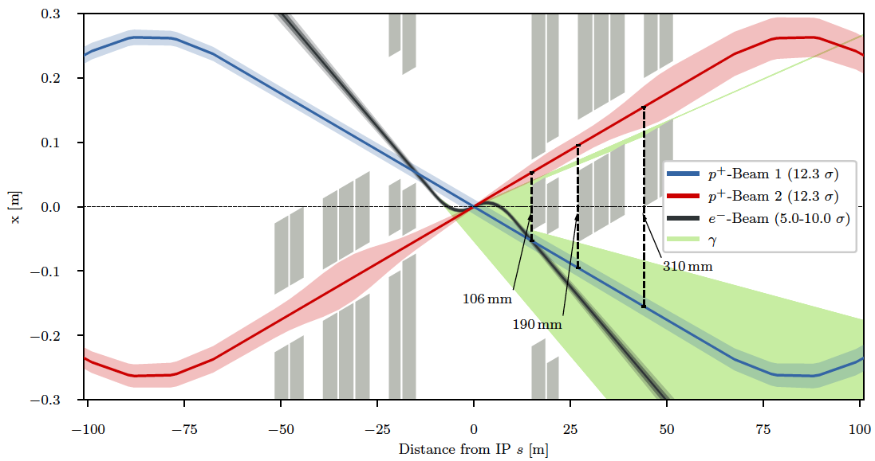
Interaction Region
Recent updates presented
at FCC week in Brussels
Emilia Cruz, Kevin Andre
tentative:
LHeC HERA
E _{crit} keV 270 150
Synrad
Power kW 30 28
3 beams, needs head-on
collisions. Design of Q1
ongoing and crucial for
aperture and load
Roman Martin
Study for LHeC and FCC-eh; reduction of synchrotron load with magnet alterations and 50 GeV
K Andre, E Cruz, B Holzer, R Martin, R Tomas, with B Parker, S Russenschuck. Work in progress

Slide 22
LHeC Detector
L=13.6 m [FCCeh:19.3 about CMS size]
R=4.6 m
[6.2 FCCeh]
Study of installation (sequence)
of LHeC detector in IP2 cavern
using L3 magnet support structure
[commensurate with 2 year shutdown]
A. Ghaddi et al, LHeC Workshop 2015
12/2018
Currently: increase radius of tracker, choose technology, summarise/simulate response: update this fall

Slide 23
Remarks on Next Steps
CDR is 7 years old. New: Higgs, LHC physics
and performance, technology, PERLE, FCC..
CDR on FCC-eh and Update on HL-LHeC
Comprehensive paper to appear end of 19
Workshop 24/25.10.2019 at Chavannes [http://lhec.web.cern.ch]
Beyond:
- Evolution of Physics, with LHC, theory..
- Design of the Interaction region
- Development of ERL technology
- PERLE at Orsay ..
Future depends on strategy decisions and global HEP evolution
The physics and technology case of the LHeC is compelling
The cost is O(1) billion SF, not ten
The CERN hadron colliders are the only means for TeV scale DIS
Adding an ERL electron beam, transforms pp/AA physics
The future of particle physics requires a maximum of diversity
If you want to discover a great taste, you will have to sample several: J de Hondt, slide 93 opening session

Slide 24
FCC-eh

Slide 25
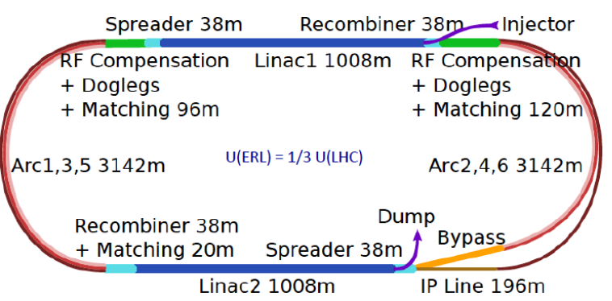
Three Raisons d’etre of the LHeC
With many thanks to
all collaborators
from exp, acc + thy
CERN Directors
Advisory Committee
and its Chair,
H Schopper, em DG
Our home institutions
and colleagues for
supporting this
engagement for the
future
The LHeC/FCC
coordinating groups
and convenors
..
Physics
- Microscope: World’s Cleanest High Resolution
- Empowerment of the LHC Physics Programme
- Creation of a high precision, novel Higgs facility
- Discovery Beyond the Standard Model
- Revolution of Nuclear Particle Physics
Sustainability and Cost
LHC:
- see: SM, Higgs and no BSM
- use: Investment of O(5) BSF
- run: HL LHC until ~2040
LHeC [1206.2913]
- 1.2 TeV ep/A for O(1)BSF
→ Establish novel ep+pp
Twin Collider Facility at CERN:
sustains HL LHC and bridges to
CERN’s long term future
For installation during LS4 (2030+)
and long term use (HE LHC, FCCeh)
Technology
Accelerator: Novel SRF ERL, green power facility
Detector: Novel high tech (CMOS..) apparatus
Keep accelerator and detector base uptodate
while preparing for colliders that cost O(10)BSF

Slide 26
backup

Slide 27
FCC-eh in the CDR [V1 Physics and V3 hh]
Volume 1 had been the collaborative effort to present the entity of FCC physics, in ee, pp and ep, including AA and eA
Volume 3 on FCC hh contains a short summary of the main characteristics of FCC-eh and the detector concept
Some striking physics eh prospects are on searches and the high precision measurements on Higgs and proton structure:
3
Complementary prospects to
discover rh massive neutrinos
in ee, ep and pp
[mixing angle vs mass]
Unique resolution of partonic contents of
and dynamics inside the proton, providing
precise and independent parton luminosities
for interpretation and searches on FCC-hh
Prospects for high precision measurements of
Higgs couplings at FCC ee and ep. Note ee gets
the width with Z recoil. ee is mainly ZHZ, while
ep is mainly WWH: complementary also to pp

Slide 28
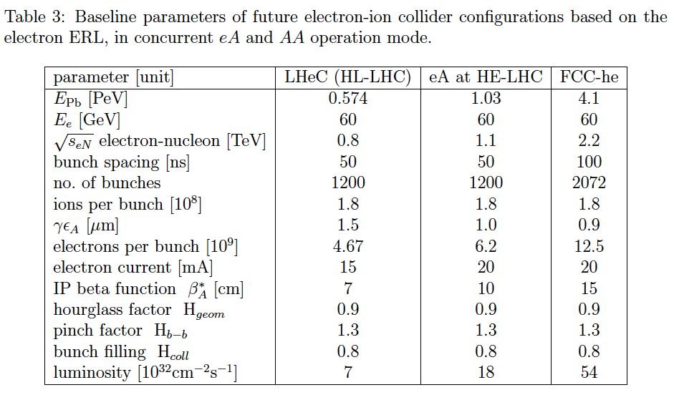
Energy and Luminosity ePb Prospects
2017

Slide 29
title
Beate Heinemann

Slide 30
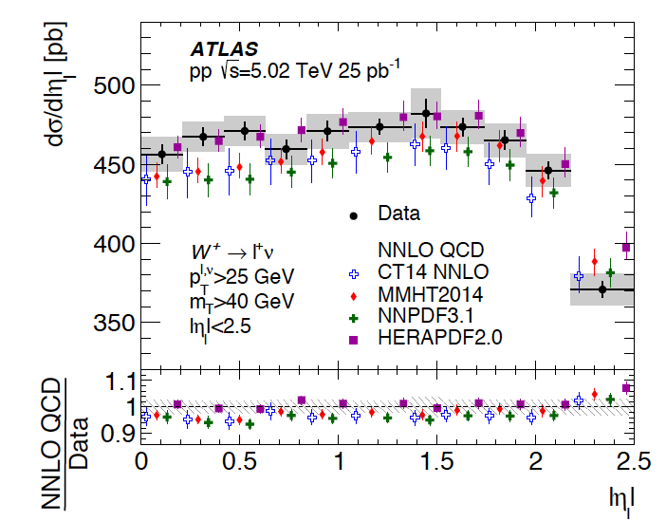
W and Z
ATLAS
5 TeV W,Z data
1810.08424
HERAPDF2.0 is best and very good while CT14 is worst, as are others.
Ideal concept: import PDFs from ep and confront them with LHC data.
This tests QCD, avoids PDFs from pp and enables searches for BSM.

Slide 31
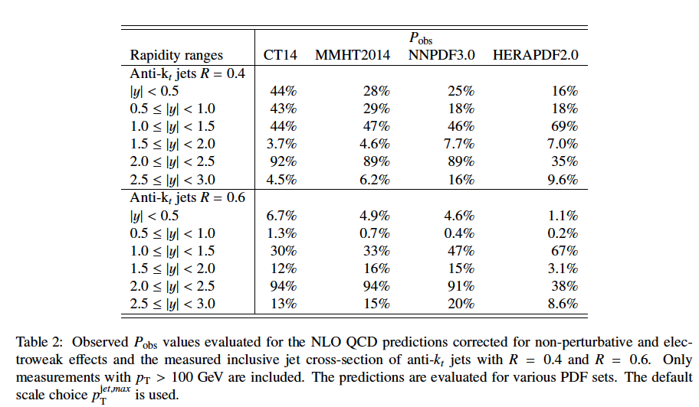
Jets
NNPDF
1706.00428
Impossible to
achieve a good
description of all
rapidity bins with
correlations
included…
Used only central bin
ATLAS: 1706.03192 8 TeV jet data
“Tensions between the data and the theory predictions are observed”
CT14 best, but not good, and HERAPDF2.0 worst, as opposed to W paper
Very extensive studies on data correlations, including also 7 + 13 TeV
There is no simple
pattern on how PDF
sets describe LHC data.
Using their projections
as HL-LHC PDFs is
indeed questionable.

Slide 32
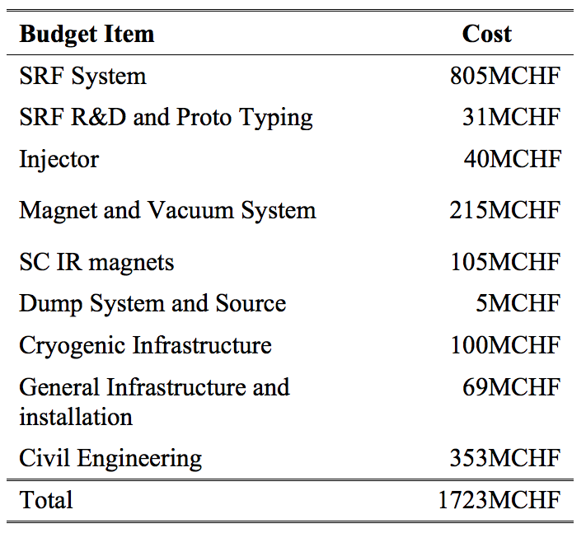
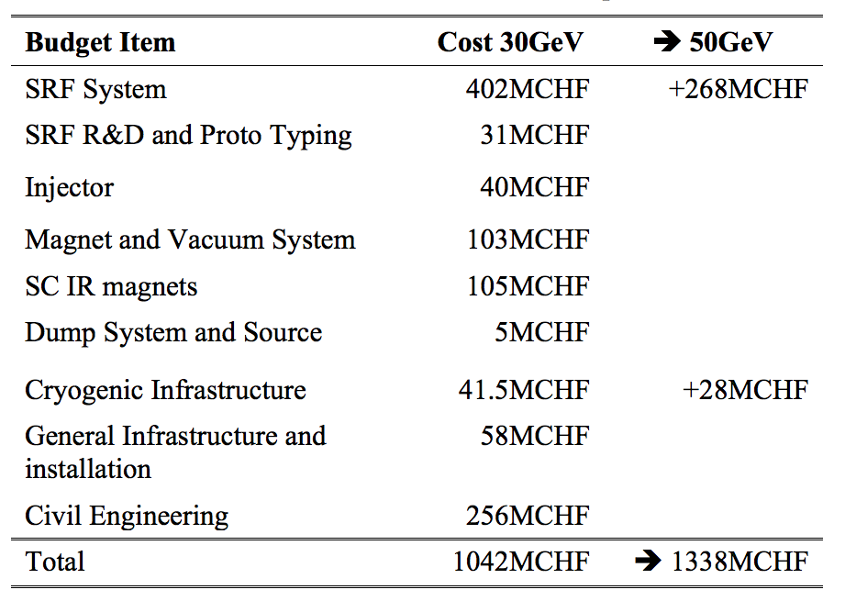
Cost estimate of ERL for LHeC and FCC-eh
Nominal 60 GeV Configuration:
30GeV to 50GeV Variation:
➔ The scaled ERL circumference corresponds to 1/5th of the LHC circumference: 5.4km
ACC Note by Oliver Bruening:

