Slide 1
The Large Hadron Electron Collider Project
Scientific Advisory Committee
Guido Altarelli (Rome)
Sergio Bertolucci (CERN)
Stan Brodsky (SLAC)
Allen Caldwell -chair (MPI Munich)
Swapan Chattopadhyay (Cockcroft)
John Dainton (Liverpool)
John Ellis (CERN)
Jos Engelen (CERN)
Joel Feltesse (Saclay)
Lev Lipatov (St.Petersburg)
Roland Garoby (CERN)
Roland Horisberger (PSI)
Young-Kee Kim (Fermilab)
Aharon Levy (Tel Aviv)
Karlheinz Meier (Heidelberg, ECFA)
Richard Milner (Bates)
Joachim Mnich (DESY)
Steven Myers, (CERN)
Guenter Rosner (Glasgow, NuPECC)
Alexander Skrinsky (Novosibirsk)
Anthony Thomas (Jlab)
Steven Vigdor (BNL)
Frank Wilczek (MIT)
Ferdinand Willeke (BNL)
Working Group Convenors
Accelerator Design [RR and LR]
Oliver Bruening (CERN),
John Dainton (CI/Liverpool)
Interaction Region and Fwd/Bwd
Bernhard Holzer (DESY),
Uwe Schneeekloth (DESY),
Pierre van Mechelen (Antwerpen)
Detector Design
Peter Kostka (DESY),
Rainer Wallny (UCLA),
Alessandro Polini (Bologna)
New Physics at Large Scales
Emmanuelle Perez (CERN),
Georg Weiglein (Durham)
Precision QCD and Electroweak
Olaf Behnke (DESY),
Paolo Gambino (Torino),
Thomas Gehrmann (Zuerich)
Claire Gwenlan (Oxford)
Physics at High Parton Densities
Nestor Armesto (CERN),
Brian Cole (Columbia),
Paul Newman (Birmingham),
Anna Stasto (MSU)
Max Klein, University of Liverpool
Future of DIS. Panel. Madrid 30.4.2009 -DIS09
2005: LHeC: * DIS, Madison
2006: 10³³cm⁻²s⁻¹: 2006 JINST 1 10001
2007 CERN Council and [r]ECFA
2008 Divonne I, NuPECC, ICFA,ECFA
2009 Divonne II (1.-3.9.), ECFA 11/09
→ 2010: Conceptual Design Report
http://www.lhec.org.uk
Steering Committee
Oliver Bruening (CERN)
John Dainton (Cockcroft)
Albert DeRoeck (CERN)
Stefano Forte (Milano)
Max Klein - chair (Liverpool)
Paul Newman (Birmingham)
Emmanuelle Perez (CERN)
Wesley Smith (Wisconsin)
Bernd Surrow (MIT)
Katsuo Tokushuku (KEK)
Urs Wiedemann (CERN))
LEP*LHC (1990), Thera (2001), QCD explorer (2003)
Tentative, preliminary, often incomplete results based on many people’s work.
cf DIS07,08, EPAC08 and for DIS09 see premeeting and summary talks of
B.Holzer, A.Stasto, U.Klein, O.Behnke, A.Polini, and J.Rojo

Slide 2
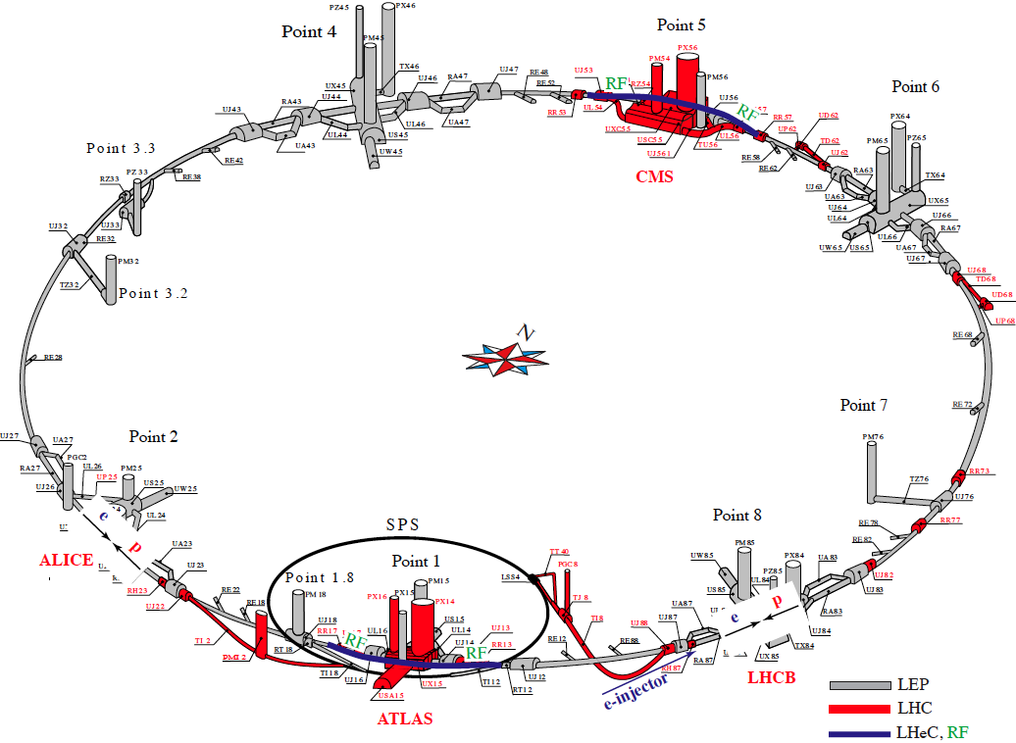
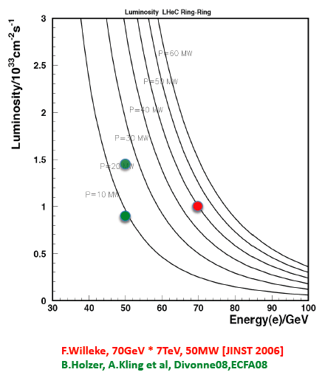
Ring – Ring Design tentative
SPL
Subject to LHC, power, tuneshifts etc. – 100 times HERA luminosity

Slide 3
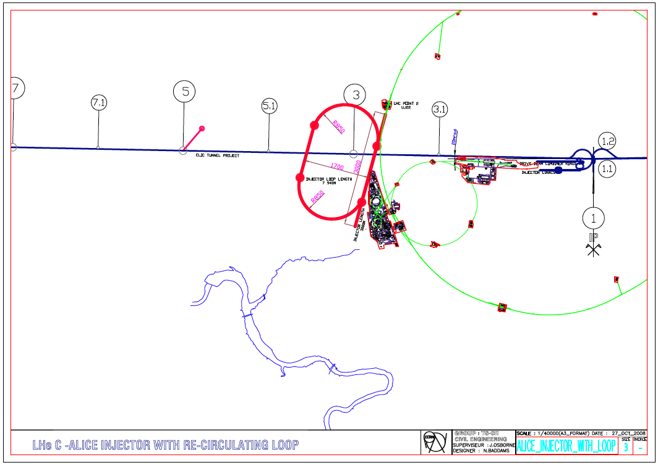
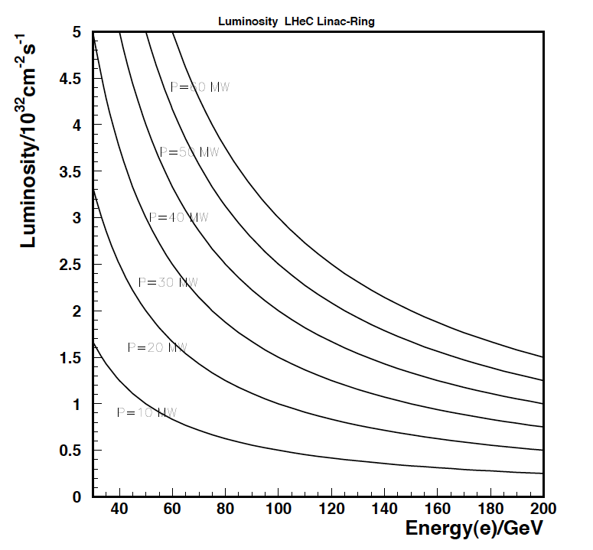
LHeC
LINAC-Ring Design - tentative
Based on sLHC. e⁺ ? , w/o energy recovery
F. Zimmermann ECFA11/08

Slide 4
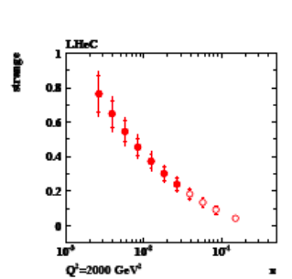
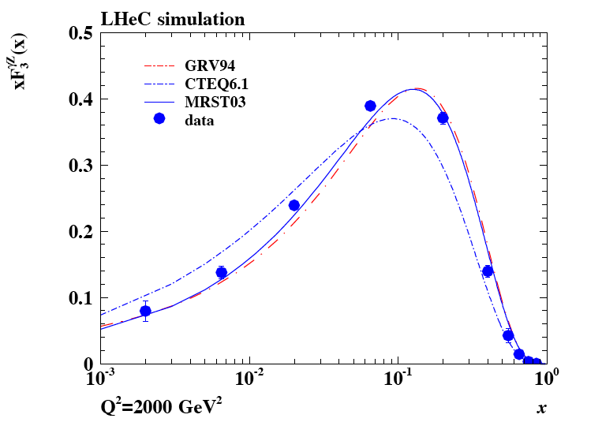
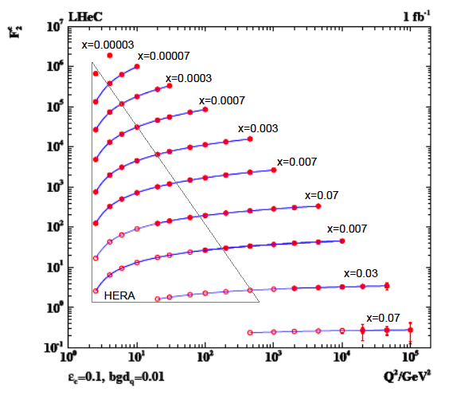
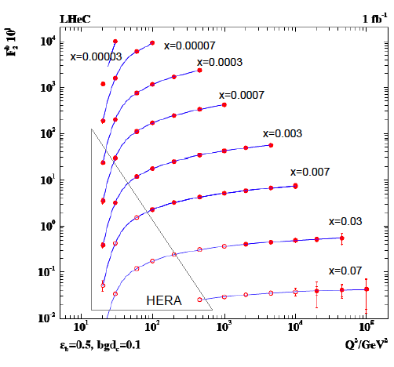
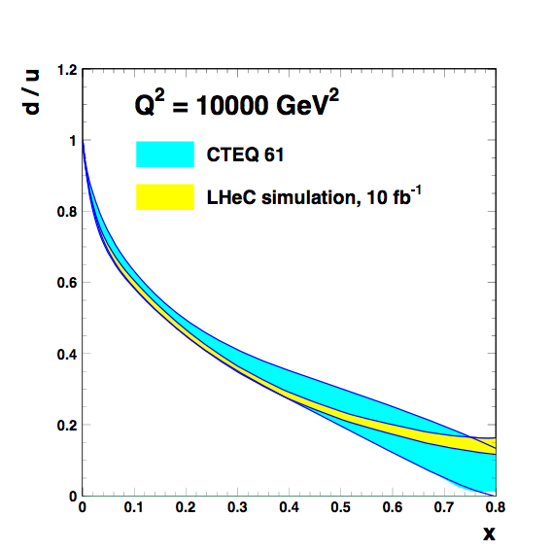
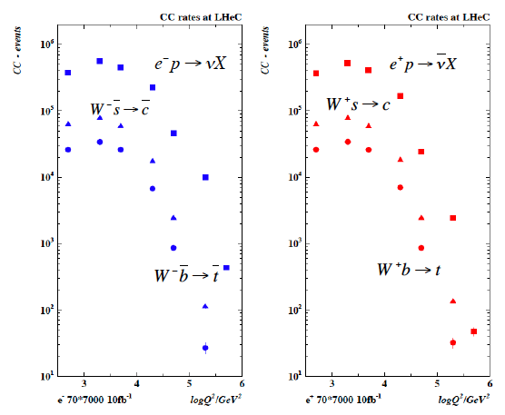
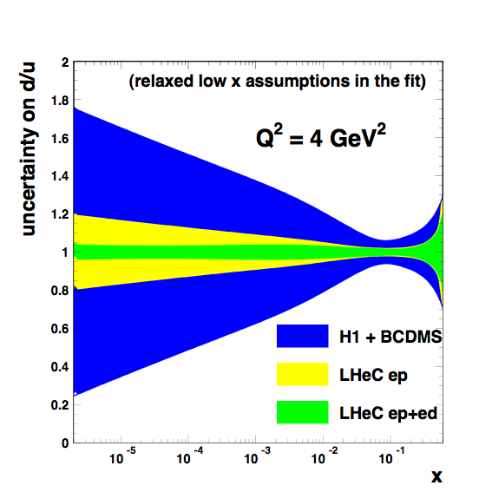
1. Unfolding Proton Structure – DIS, complete for the first time
2u_{v}+d_{v}
c
s
sbar
b
+
parton dynamics
photon structure
neutron structure
..
Instantons
Odderons
Multiquark exotica
Intrinsic heavy flavour
Single t, tbar factory O(10)pb

Slide 5
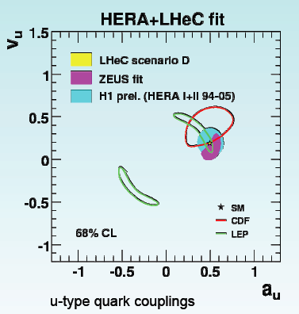
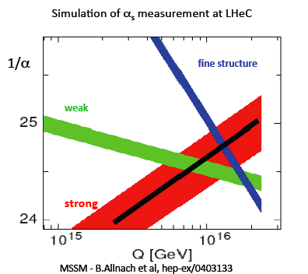
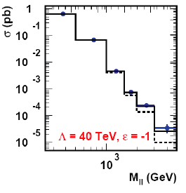
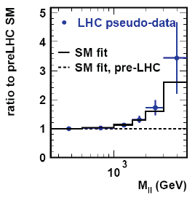
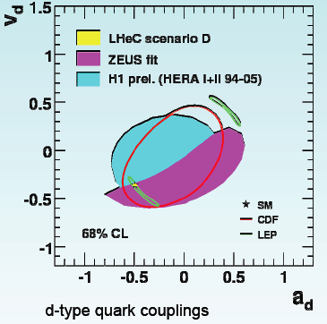
2. Exploration of High (“swerch”) Scales – High Precision in ep
GUT/SUSY unification?
effective couplings?
resolving CI type
observations at the LHC
… access to much higher
scales with precision DIS
challenge to N^{k}LO QCD
LHeC freezes the pdfs to allow new
physics to be revealed. HERA+BCDMS
reshuffle the sea… ED similar study

Slide 6
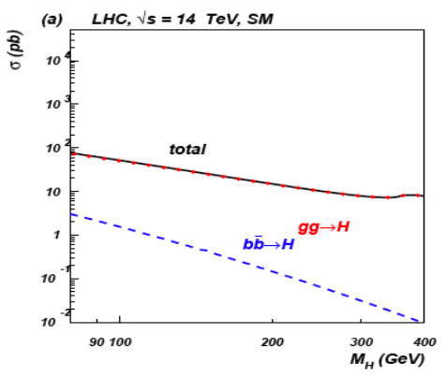
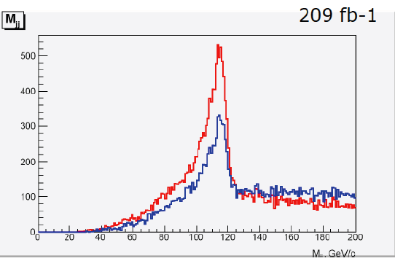
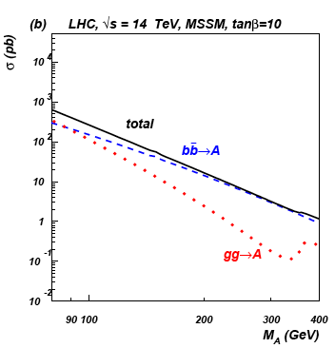
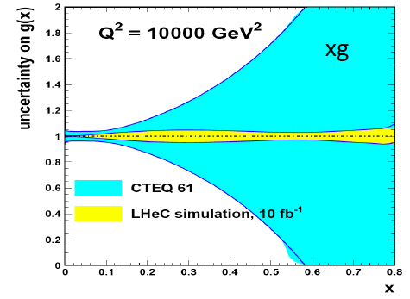
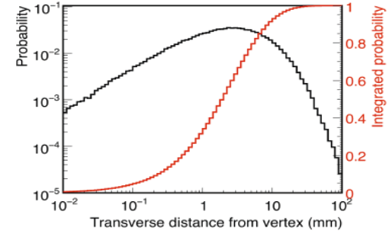
3. Complementing the LHC – Higgs and gluon (for example)
SM Higgs
WW→H→bbar
MSSM Higgs
Bgd study ongoing, B tagging promising
clean(er) environment
huge range in Q²
access to large x,
high mass region
B tagging mandatory.
confirmed at DIS09 within
factor 2 for error treatment

Slide 7
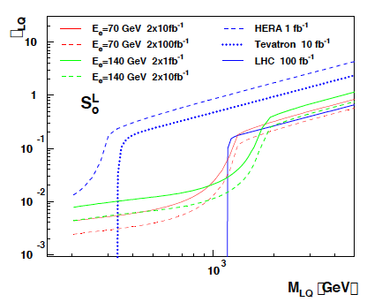
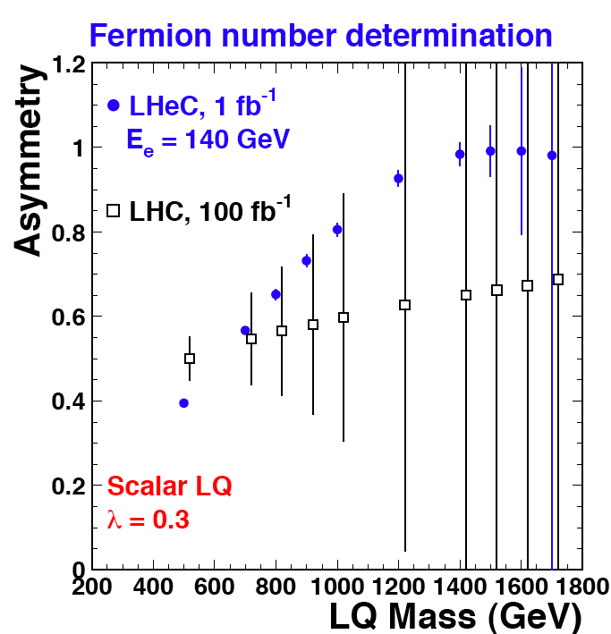
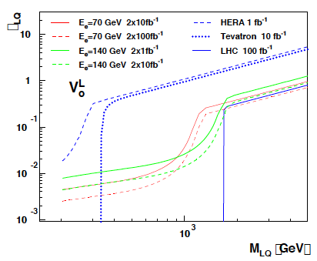
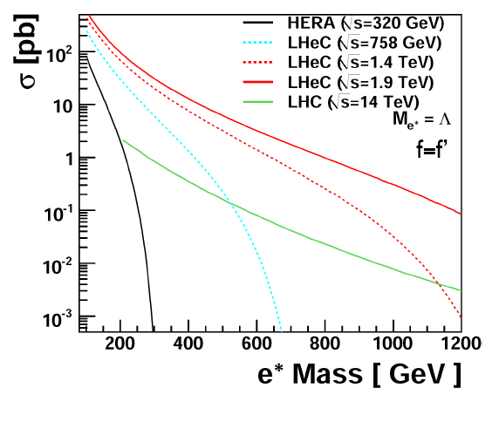
4. New Physics in the eq Sector – unique eq as compared to qq
?LQ, RPV SUSY
Spectroscopy
?Excited fermions
SUSY studies to come

Slide 8
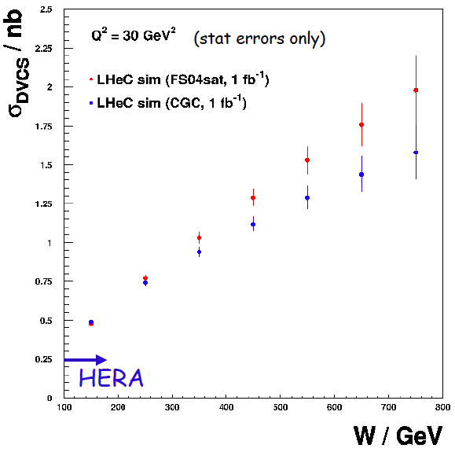
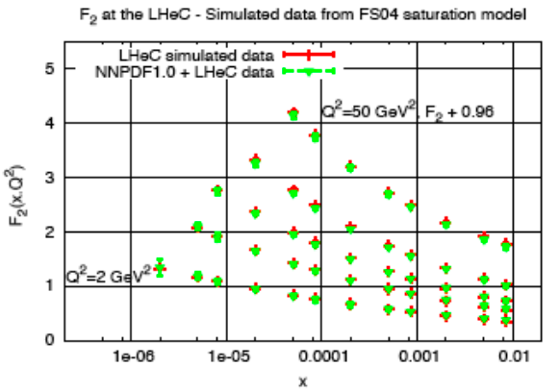
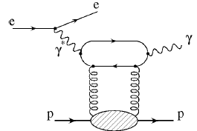
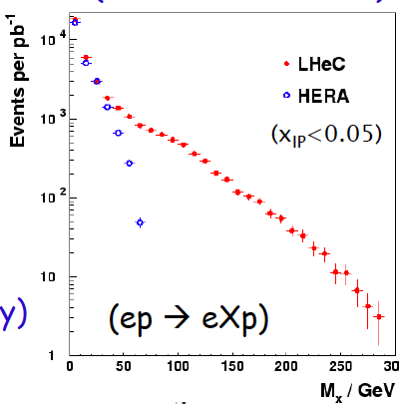
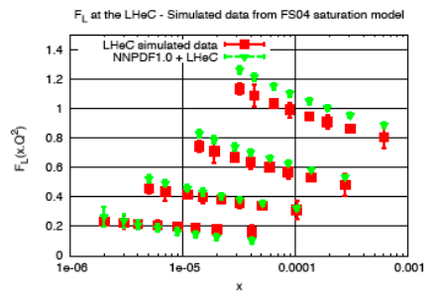
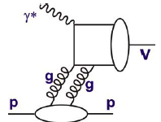
5. Parton Saturation – low x beyond the unitarity limit in DIS ep
Diffractive
B,W,Z,H?
Forward jets, VMs..
Saturation from precision F₂ and F_{L}

Slide 9
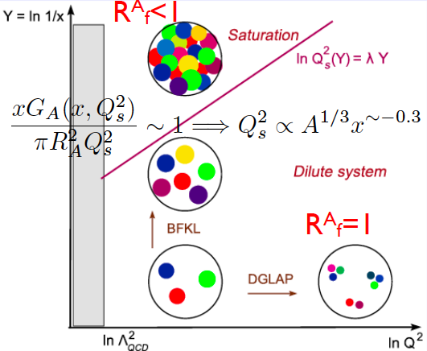
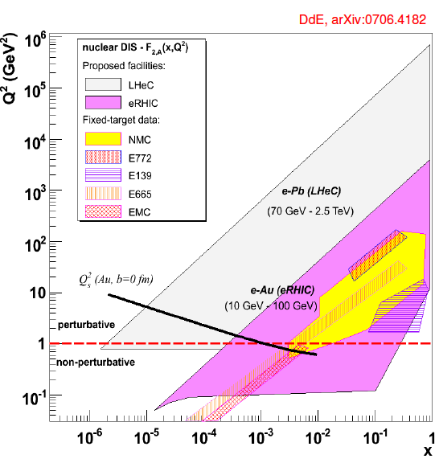
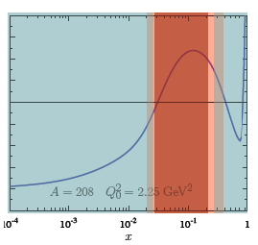
6. Partonic Structure of Nuclei – a new phase of matter
Nuclear parton distributions
xg ~ A^{1/3}
black disc limit (F₂~ln(1/x))
50% diffraction..
A must to understand AA
Gluon “a desaster” (NA)

Slide 10
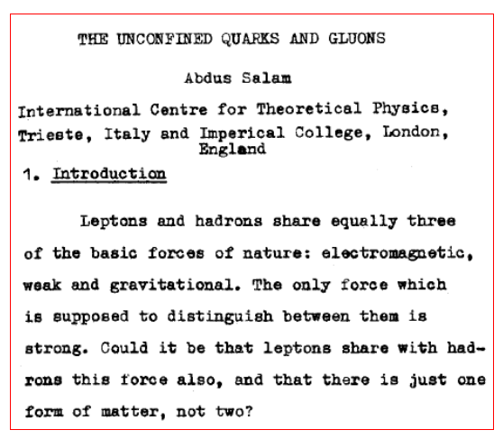
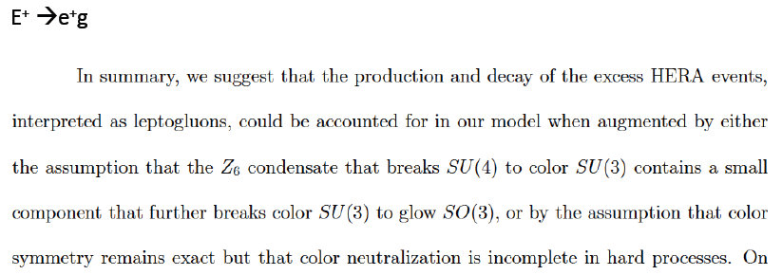
Surprises and Theory
Things may evolve differently
than we think, but one can
rely on the ingenuity of our
theory colleagues to deal with
the unexpected.
Design a maximum energy, high
luminosity, affordable collider
Tbilissi 76
S.Adler, arXiv:hep-th/9610104

Slide 11
CDR

Slide 12
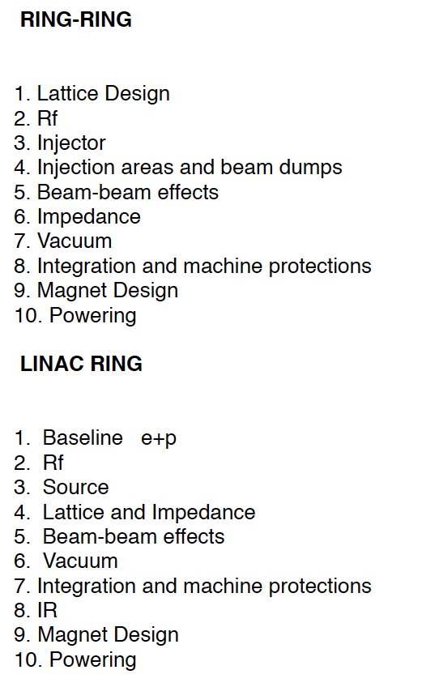
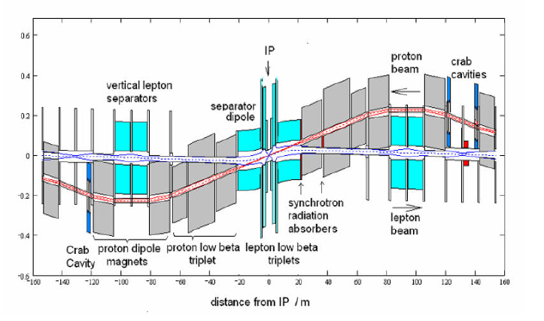
Organisation Accelerator Design Concepts
IR for simultaneous pp and ep operation
Bypass around ATLAS+CMS
Contact persons for workpackages [BE-ABP, RF, BT, VAC, PO]
O.Bruening, B.Holzer, E.Chiapola, H.Burkhardt,B.Goddard, W.Herr, F.Zimmermann
M.Jimmenez, KH.Mess, D.Tommasini, F.Bordry,G.Hofstatter, L.Rinolfi, D.Schulte.
Collaboration: Novosibirsk, EPFL Lausanne + [tbd]: SLAC , CI, DESY, BNL, Cornell

Slide 13
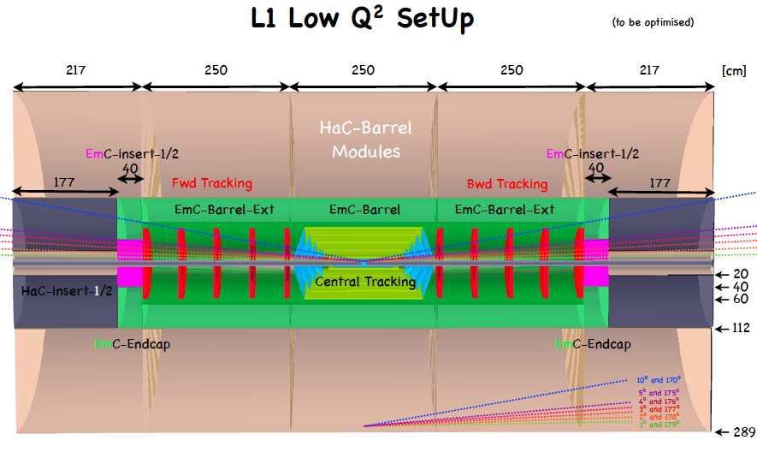
L1
P.Kostka, A.Polini, R.Wallny
Tentative design: full coverage, high precision, no material…
- modular for installation (CMS), dimensions determined by beam pipe-IR-synchr. rad. : to be simulated
- focusing magnets nearer to IR for high Q², high luminosity (instrumented?)
variation of beam energies to access low Q² and large x at “medium” Q² ~ 20000 GeV²
- contacts to ILC (4th concept: coil? ALIROOT) and ATLAS/CMS detector developments

Slide 14
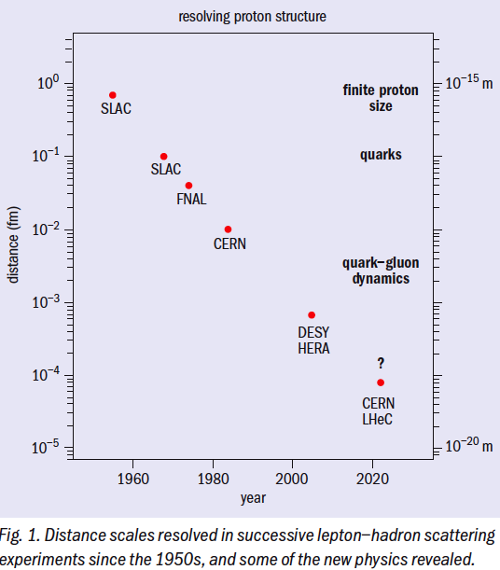
Deep Inelastic Scattering
SLAC 69: 2m LINAC: a “bold extrapolation
of existing technology” to “collect
data which may be of future use…”
Many thanks to very many
gifted and enthusiastic
colleagues in thy, exp and acc,
to ECFA, CERN and NuPECC.
50 000 times Q² possibly with
5 times the accelerator length..
In one year we hope to know how to
build the ep/eA collider complement
of the LHC, and we will start to look
into the TeV scale physics with pp.
The CDR should help shaping our future.
www.lhec.org.uk, EPAC08, .. also for
proper referencing of work presented above.

