Slide 1
Quark^{*)} Distributions with the LHeC
Project
Scenarios
Statistics
Systematics
Light Quarks
Heavy Quarks
Max Klein
DESY, 7.4.2010
Meeting on QCD at the LHeC
^{*)} For the gluon see
previous talks by
E. Perez at DIS07
C. Gwenlan at DIS09
Some plots old,
some plots new.
All is preliminary
and here shown
for discussion.

Slide 2
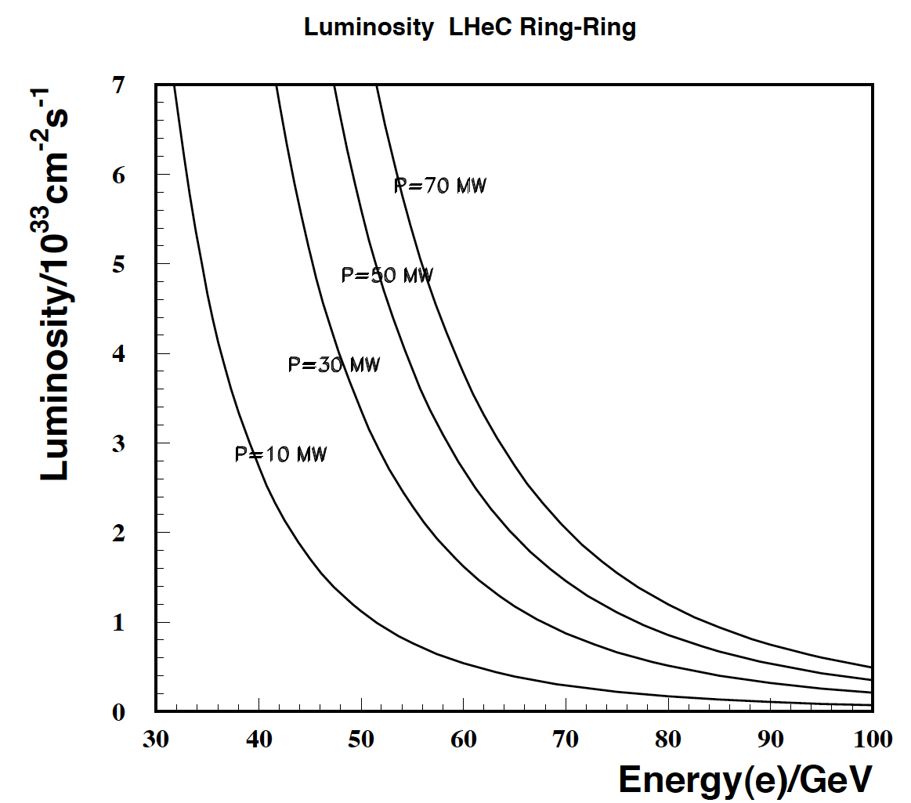
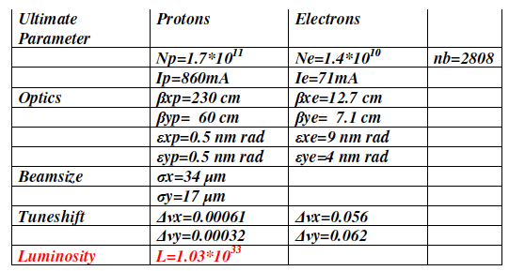
Ring-Ring Parameters
Luminosity for e±p safely above 10³³cm⁻²s⁻¹
Used “ultimate” LHC beam parameters
Energy limited by injection and syn.rad losses
Power limit set to 100 MW
Small p tuneshift: simultaneous pp and ep

Slide 3
LINAC-Ring Parameters
Configuration | 60 GeV, pulsed | 60 GeV CW ERL | 140 GeV pulsed
N_{e}/bunch/ 10⁹/50ns | 4 | 1.9 | 2
gradient MV/m | 32 | 13 | 32
normalised ε/ μm | 50 | 50 | 100
cryo power/MW | 3 | 20 | 6
effective beam power/MW | 50 | 40/(1-η_{ERL}) | 50
Luminosity for ultimate beam
The LR combination yet requires a still
better p beam or/and E_{e} recovery to
come to luminosity beyond 10³²cm⁻²s⁻¹

Slide 4
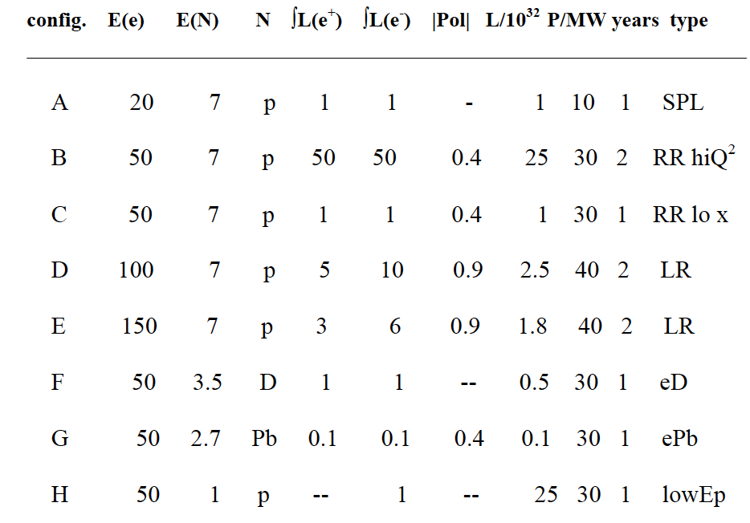
Simulated Default Scenarios, April 2009
http://hep.ph.liv.ac.uk/~mklein/simdis09/lhecsim.Dmp.CC, readfirst

Slide 5
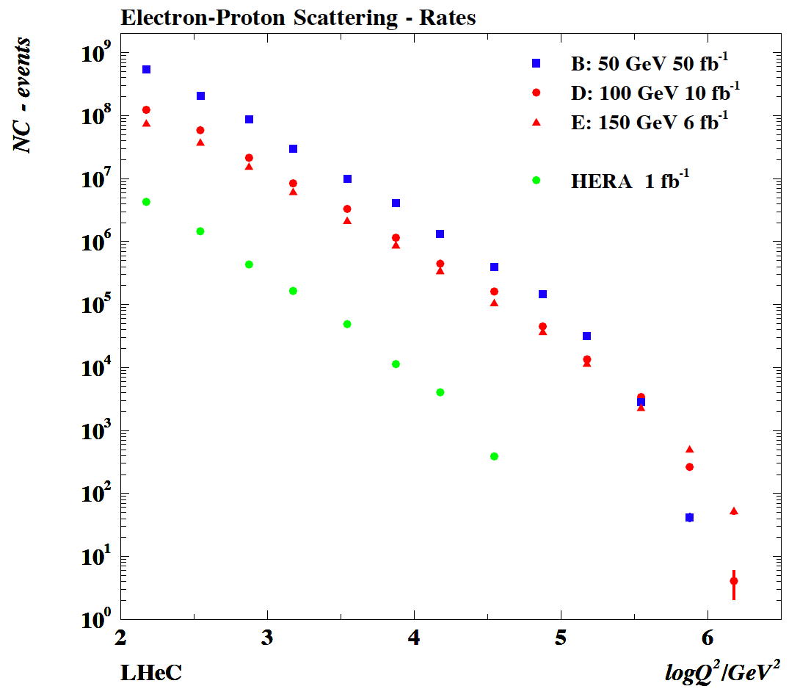
Kinematics
Largest energy
is crucial for low x
and high masses
and high Q². The
LHC may set the
scale for everything,
perhaps.

Slide 6
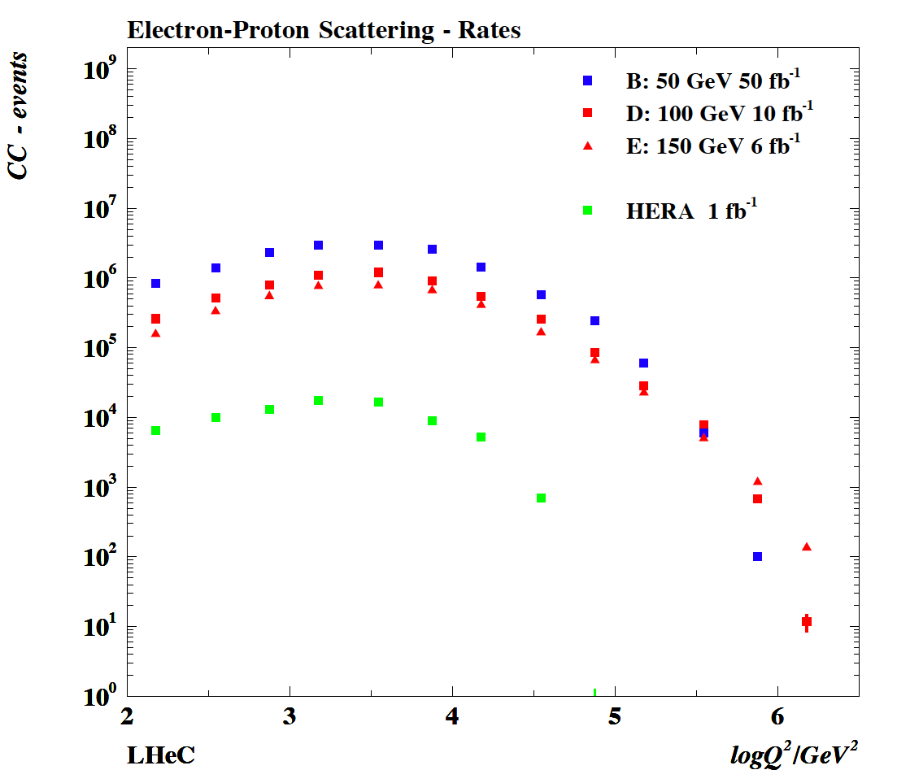
Rates
The HERA CC
data are restricted
to x < 0.5. There follow
substantial pdf
uncertainties in the
(new) HERA pdf QCD
fits. High integrated
luminosity is thus
necessary to
unfold partons
and study dynamics
at large x and high
masses. LHeC also
prrovides larger s:
win-win for CC

Slide 7
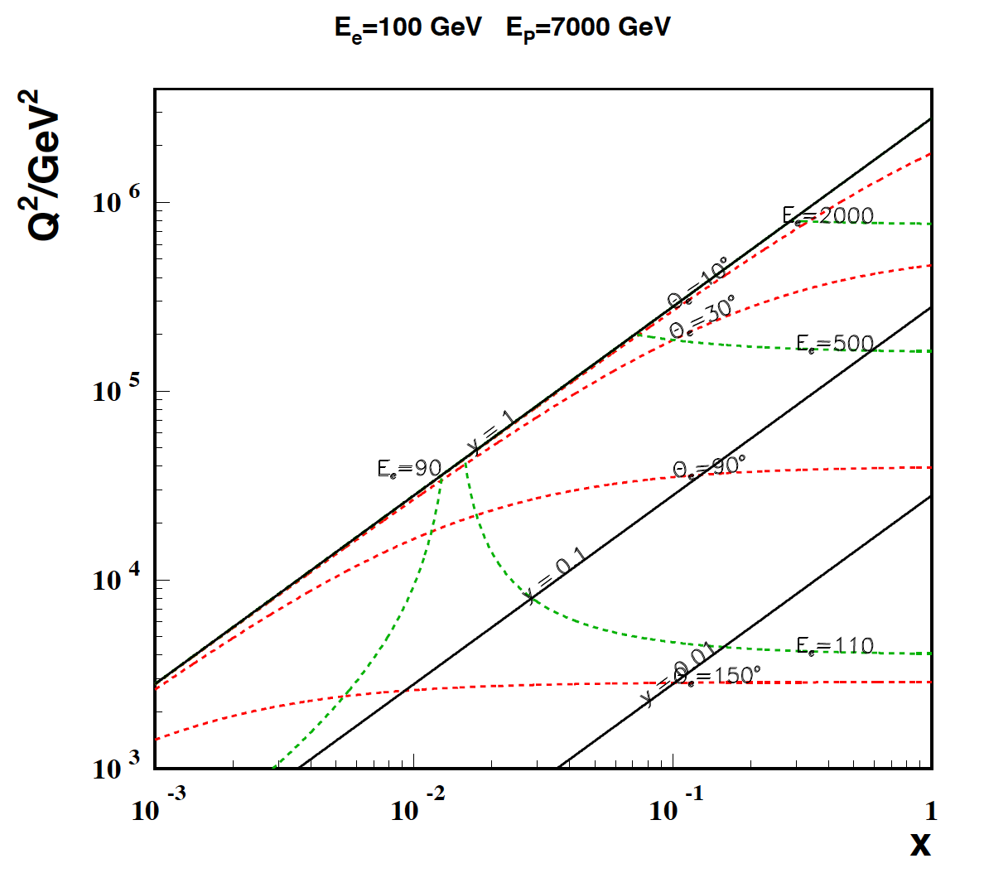
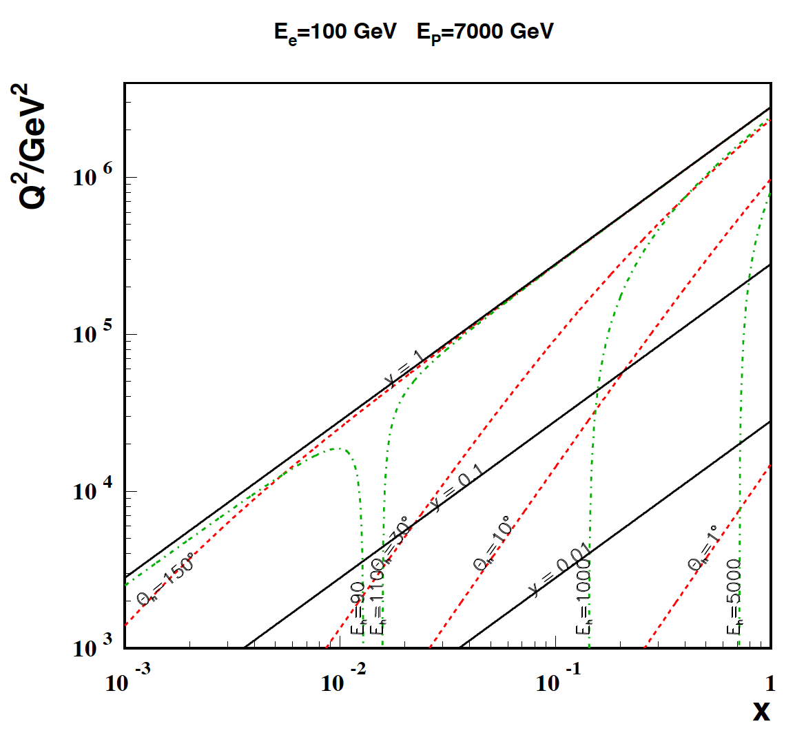
Kinematics – high Q²
The electron kinematics at high Q²
Is no big problem, apart from extreme
backscattering at very high Q² of electrons
of a few TeV energy.
Need forward elm. calorimeter of few TeV
energy range down to 10º and below
with reasonable calibration accuracy.
High x and high Q²: few TeV HFS scattered forward:
Need forward had. calorimeter of few TeV
energy range down to 10º and below.
Mandatory for charged currents. Strong
variations of cross section at high x demand
hadronic energy calibration as good as 1%

Slide 8
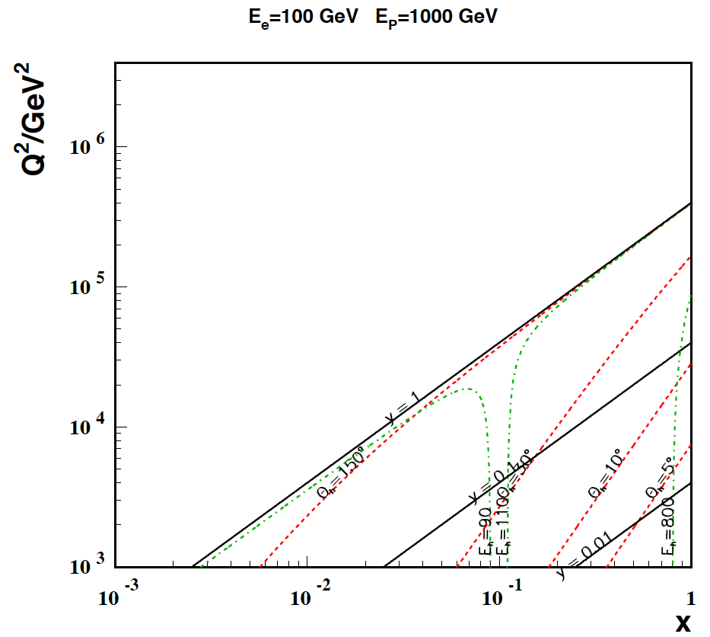
Kinematics – large x
Low proton beam energy: access large x.
Needs high luminosity: L ~ 1/E_{p}²
Nominal proton beam energy: need very fwd.
angle acceptance for accessing large x
⇧
x=E_{e}/E_{p}

Slide 9
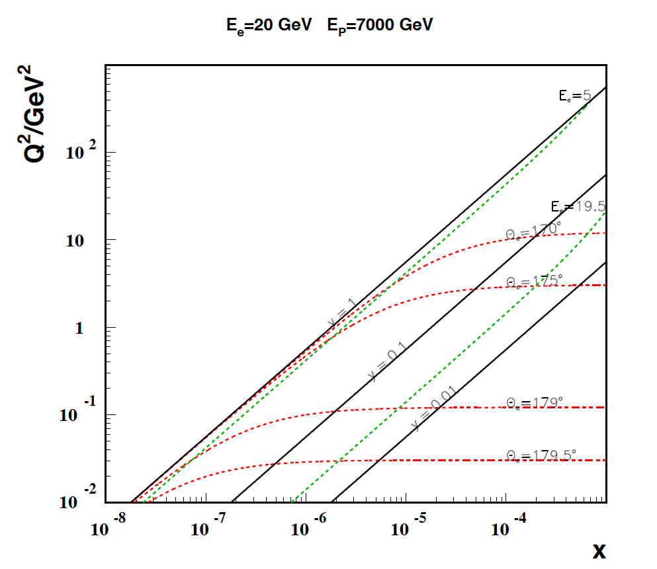
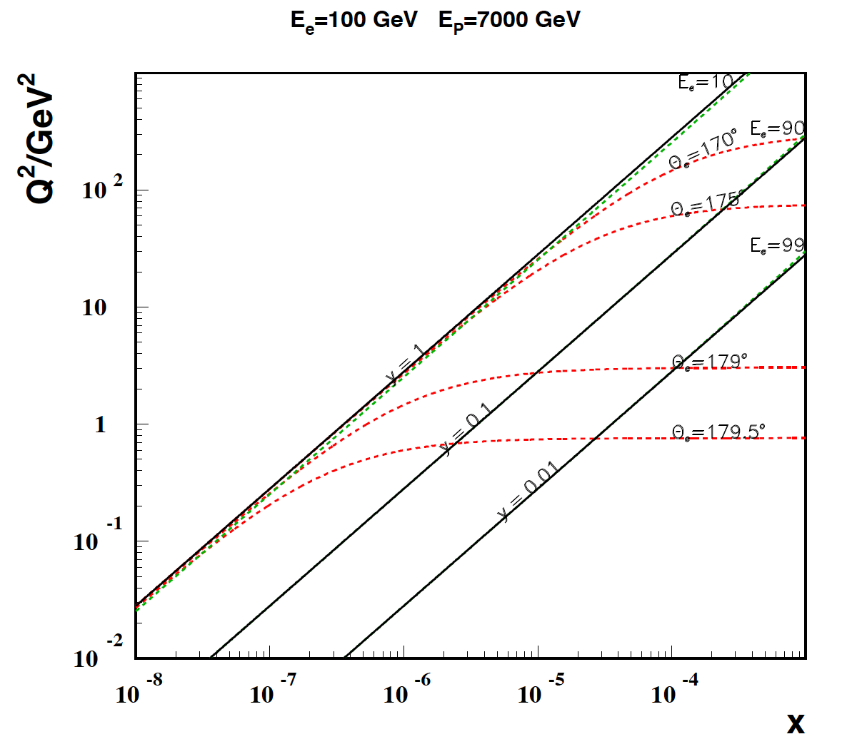
Kinematics – low Q²,x
Low electron beam energy: access low x.
Needs only small luminosity. SPL for low
Q² physics, however, lowest x require max s.
Nominal proton beam energy: need very bwd
angle acceptance for accessing low x and Q²

Slide 10
Detector requirements
High luminosity to reach high Q² and large x
10³³ - 10³⁴ 1-5 10³¹
Largest possible acceptance
1-179º 7-177º
High resolution tracking
0.1 mrad 0.2-1 mrad
Precision electromagnetic calorimetry
0.1% 0.2-0.5%
Precision hadronic calorimetry
0.5% 1%
High precision luminosity measurement
0.5% 1%
The LHeC detector
has to be at least
2 times better than the good old H1
Detector parameters
were put in simulation of
NC and CC (LO) cross
sections with analytic
calculation of systematic uncertainties.
NLO QCD fits to these
‘data’ were performed,
on pdfs by Emmanuelle
Perez, on alphas by
Thomas Kluge and on
electroweak couplings
(and pdfs) by
Claire Gwenlan
LHeC HERA

Slide 11
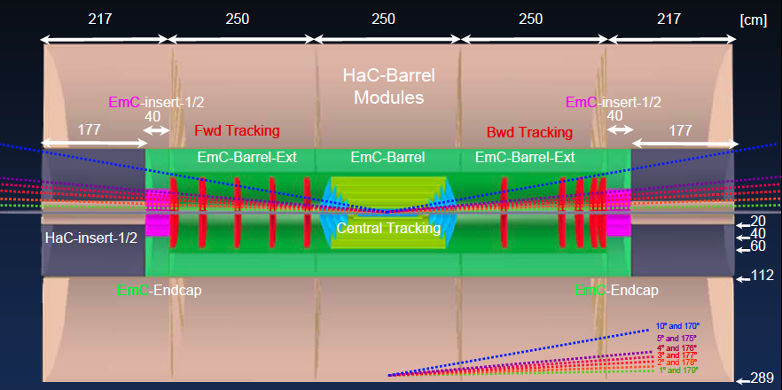
Detector under Design (low x, high Q², eA)
P.Kostka, A.Pollini, R.Wallny et al, 9/09
high precision, large acceptance, LHC/ILC/HERA related, Forward tagging of p, n, d

Slide 12
Valence Quarks

Slide 13
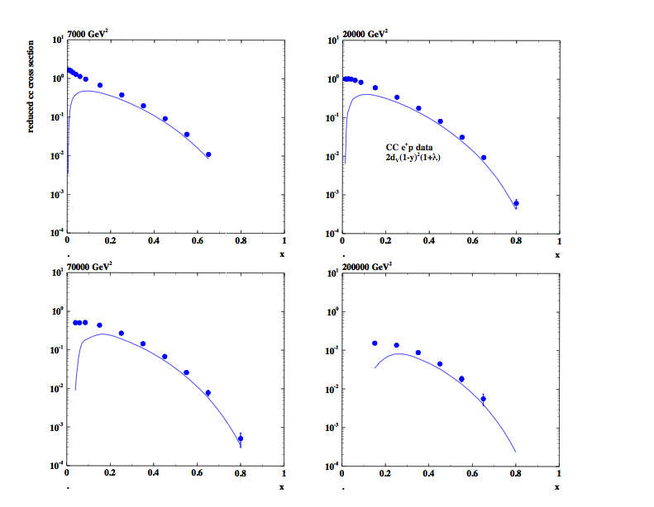
Charged currents (e+)

Slide 14
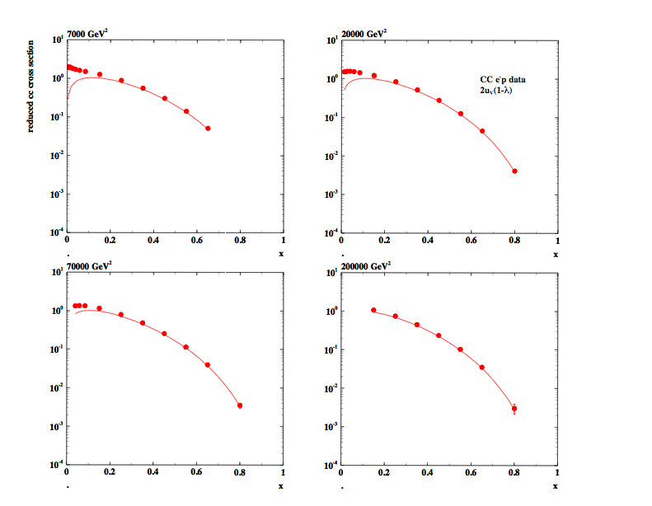
Charged currents (e-)

Slide 15
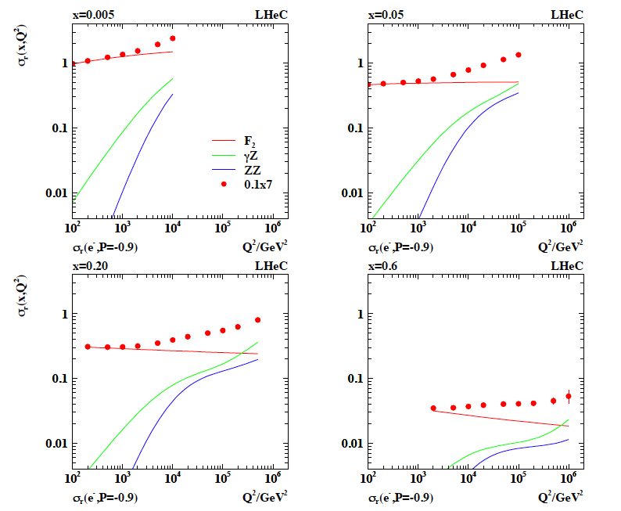
Electroweak NC Cross Section Measurements

Slide 16
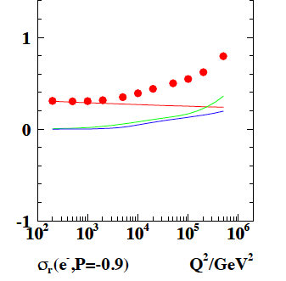
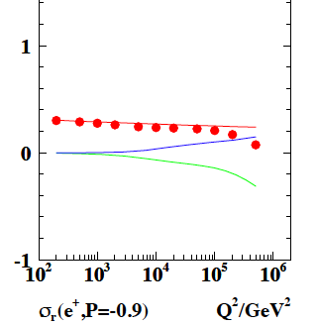
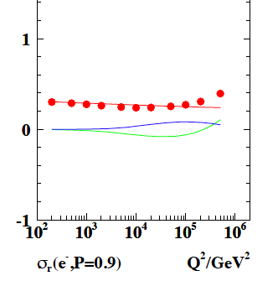
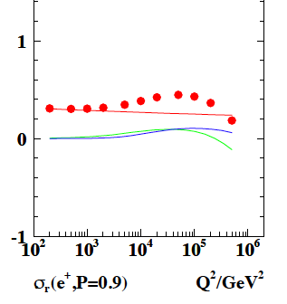
Electroweak NC Cross Section Measurements
D, x=0.2
2 charges and
2 polarisations
very desirable
for electroweak
physics and the
new spectroscopy
should that appear.
Z effects depend
on charge and
polarisation.

Slide 17
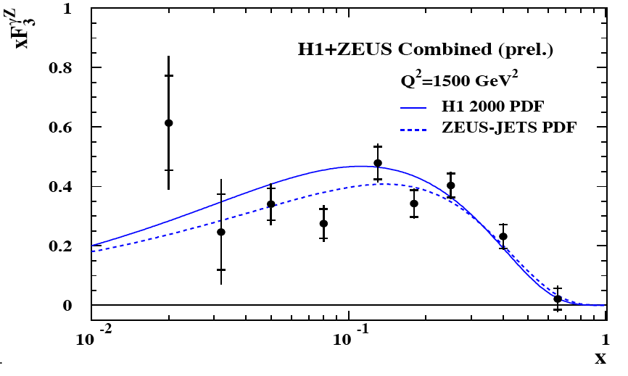
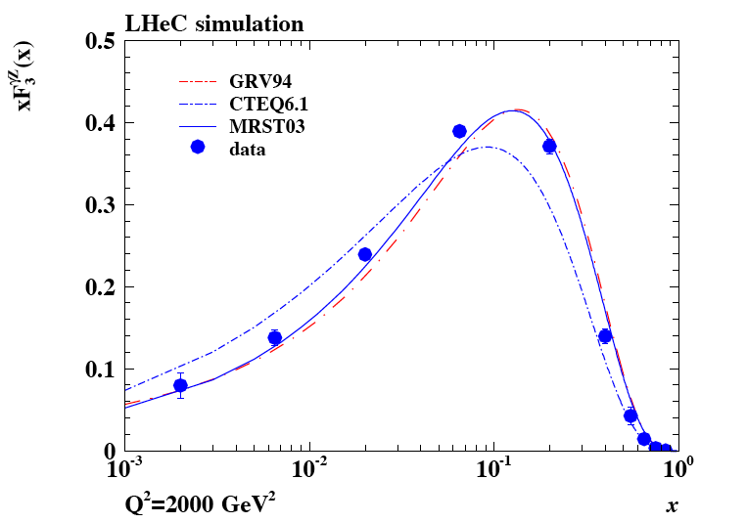
xF₃^{γZ}
HERA I
Valence quarks at low x
or/and unexpected sea
asymmetries
from yZ interference

Slide 18
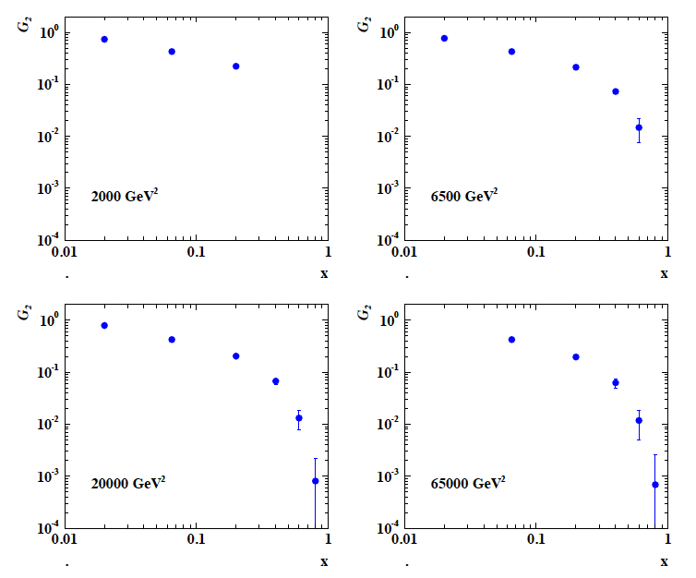
G₂ =F₂^{γZ}=2xΣv_{q}e_{q}(q+qbar)
Huge PV effects in
polarisation
asymmetry
Scenario C:
50*7000 GeV²
e⁻ (P=±0.4)
1fb⁻¹
CC and NC
provide accurate
determination and
separation of valence
quark distributions

Slide 19
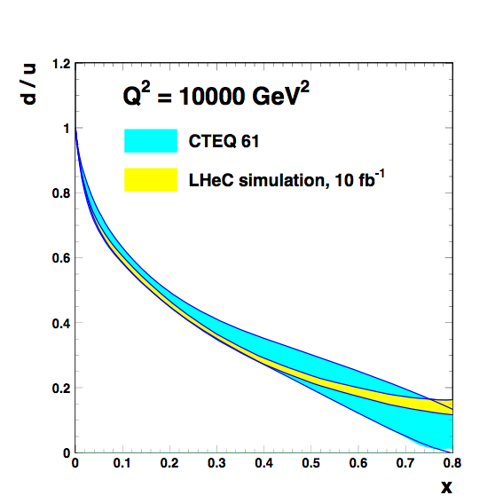
d/u at large x
E.Perez

Slide 20
Constraints at Low x

Slide 21
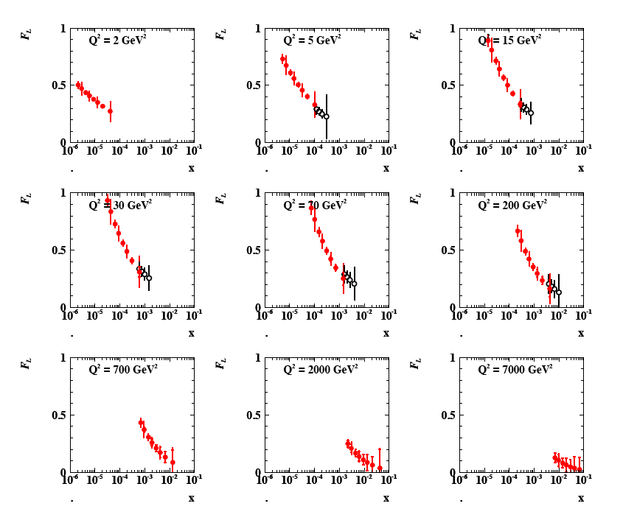
Simulated F_{L} Measurement at the LHeC
F_{L} takes long
(1986-2010)…
LHeC
HERA
Simul.
F_{L} and F₂ provide crucial information at low x → strong constraint on gluon

Slide 22
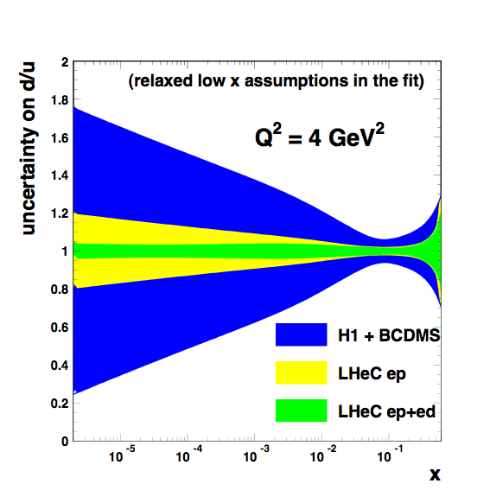
d/u at low x from deuterons
Note
all QCD fits
assume
u=d
at low x
No constraint
from HERA,
Just
[some constraint
from LHC (W,Z)
but at 10⁴ GeV²]
Control shadowing
with diffraction!
Tag spectator
protons in eD=en
collisions!
E.Perez

Slide 23
Heavy Quarks
b-c-t-s

Slide 24
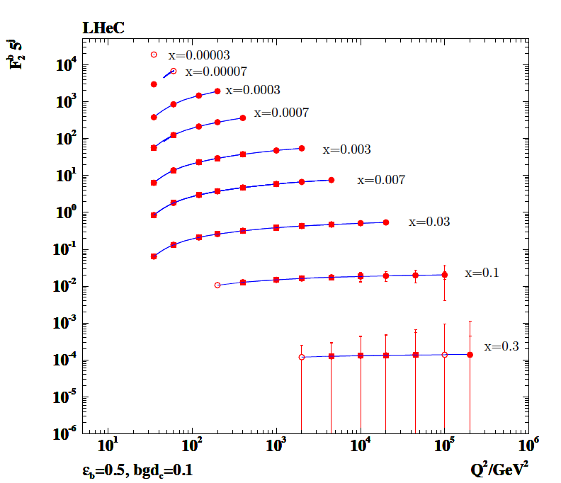
Beauty
Systematic error
dominates (so far 5%)
Precise measurement
near threshold and
up to 10⁵ GeV²
Beauty may become
crucial if MSSM Higgs
is found
open: 1^{O}
closed: 10º
box: 1 TeV
xF₃, F₂^{bb,γZ}?

Slide 25
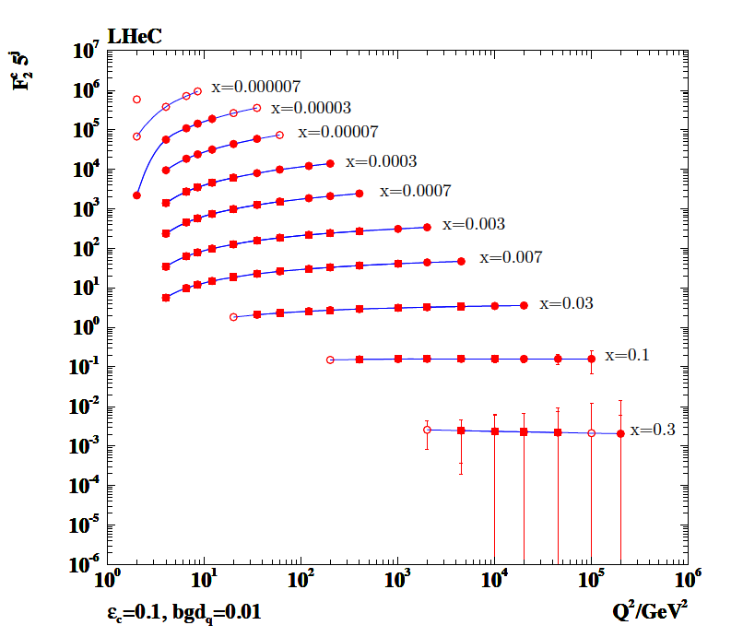
Charm
Systematic error
dominates (so far 3%)
Precise measurement
near threshold and
up to 10⁵ GeV²
F₂^{cc} will become precision
testing ground for QCD
and proton structure
open: 1^{O}
closed: 10º
box: 1 TeV
xF₃, F₂^{cc,γZ}? → charm NC couplings

Slide 26
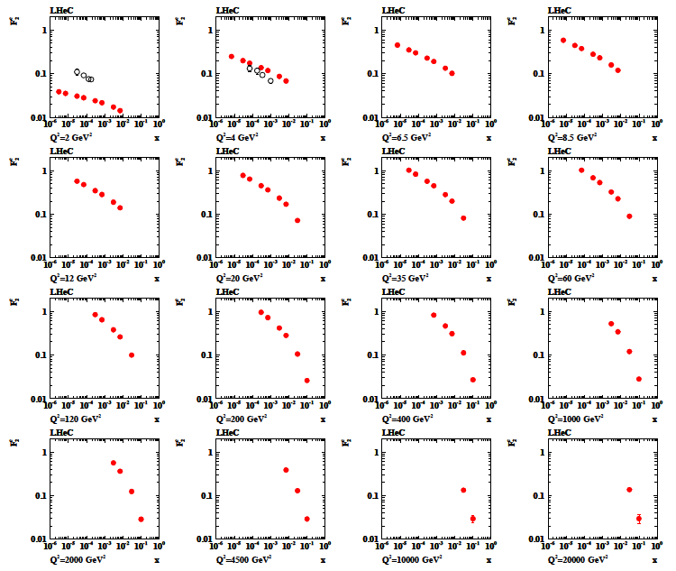
Charm

Slide 27
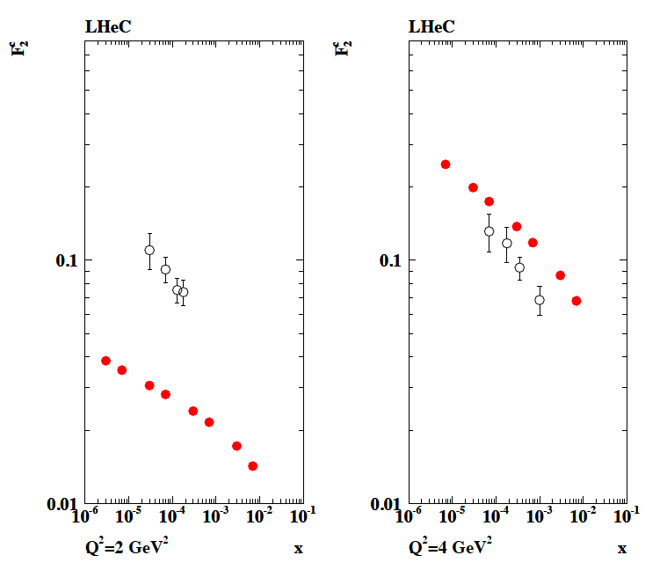
Charm
open: H1 ZEUS 2010
closed: LHeC
using H1pdf09 LO
for illustration
Have to make good
i.e. better and complete
plots to demonstrate
potential of LHeC
vs HERA and vs THY

Slide 28
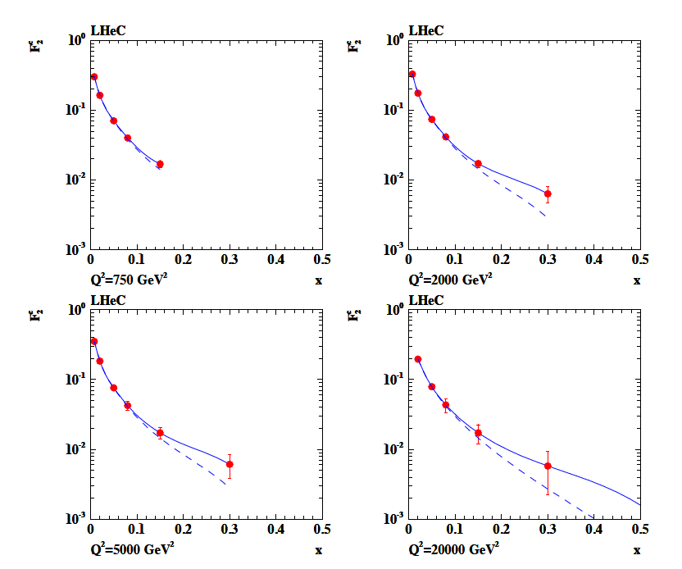
Intrinsic Charm ??
CTEQ6 with (solid)
and w/o (dashed)
intrinsic charm
To access the high x
region one needs
to tag charm in fwd
direction and lower
the proton beam
energy and get
high luminosity.
Worth a remark in
the CDR
Cf D0
PRL 102, 192002 (2009)
Thanks to Stan.

Slide 29
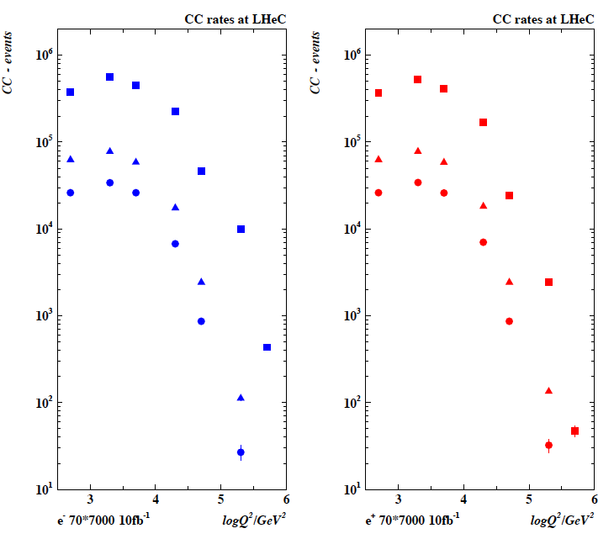
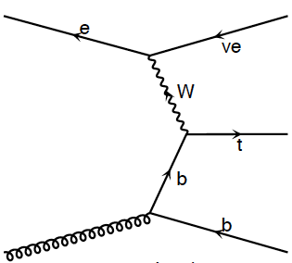
Top and Top Production at the LHeC (CC)
LHeC is a single top and
anti-top quark factory
with a CC cross section
of O(10)pb
Top at HERA essentially
impossible to study. Single
top at Tevatron barely seen
and at LHC very challenging

Slide 30
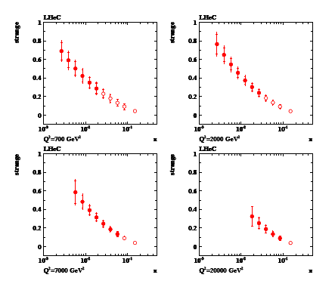
Strange Quark

Slide 31
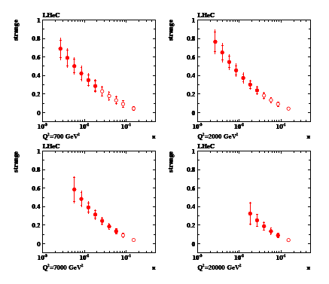
Anti-Strange Quark

Slide 32
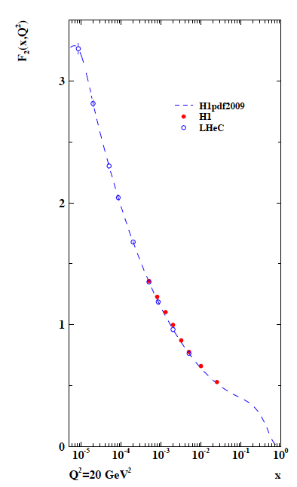
Summary
The LHeC is the first DIS machine with the potential
to completely unfold the partonic structure of the
proton. This should remove the assumptions inherent
to QCD fits on the behaviour of the sea quarks
(strange, anti-strange, up, down) and provide precision
information on the charm and beauty quarks around
and much beyond threshold. The valence quarks
follow from NC and CC measurements and may
be accessed most accurately for x between 10⁻³ up
to nearly 1.
The detector must cover a maximum range of
polar angles, which is much helped by lower
energy runs, electron for large θ_{e} and protons
for small θ_{h}. For such runs (as for the F_{L} run
at HERA) the luminosity of the machine must be high.
For the CDR a coherent set of plots is required
on the structure function measurements
(HERA + LHeC) and the parton distributions.

