Slide 1


Deep Inelastic Scattering with the LHC*
Overview
Ring
LINAC
Physics
Detector
Status
Max Klein
ATLAS and H1
An Introduction to the
Seminar at NIKHEF, Amsterdam, 1.4.11
http://cern.ch/lhec
*All tentative - work in progress - prior to CDR publication..

Slide 2
The 10-100 GeV Energy Scale [1968-1986]
(--)
pp
Drell Yan
Charm
W,Z
Jets
lh
e⁺e⁻
SU(2)_{L} x U(1)
QCD
Quarks
Neutral currents
Singlet e_{R}
Asymptotic Freedom
Charm
3 colours
Gluon Jets

Slide 3
The Fermi Scale [1985-2010]
pp
b quark
top quark
M_{W}, H?
Tevatron
ep
e⁺e⁻
The Standard
Model Triumph
M_{Z} , sin² Θ
3 neutrinos
h.o. el.weak (t,H?)
gluon
h.o. strong
c,b distributions
high parton densities
LEP/SLC
HERA
CKM - B factories

Slide 4
The TeV Scale [2010-2035..]
pp
W,Z,top
Higgs??
New Particles??
New Symmetries?
LHC
ep
e⁺e⁻
New Physics
ttbar
Higgs??
Spectroscopy??
High Precision QCD
High Density Matter
Substructure??
eq-Spectroscopy??
ILC/CLIC
LHeC
CKM - superB

Slide 5
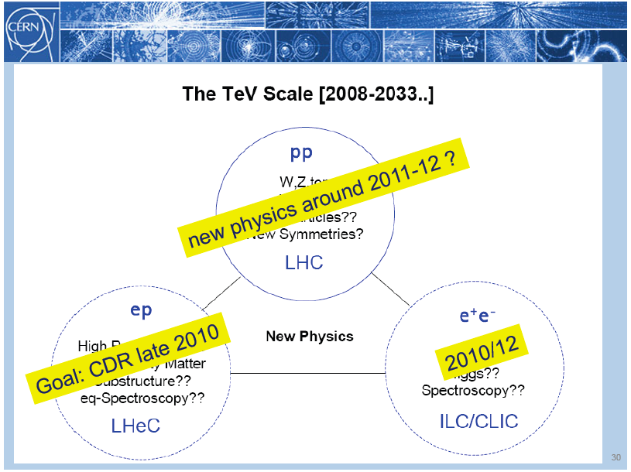
title
Rolf Heuer: 3/4. 12. 09 at CERN: From the Proton Synchroton to the Large Hadron Collider
50 Years of Nobel Memories in High-Energy Physics

Slide 6
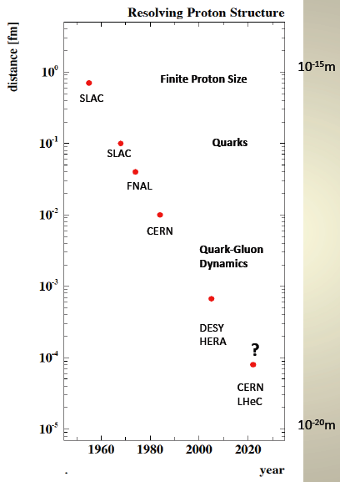
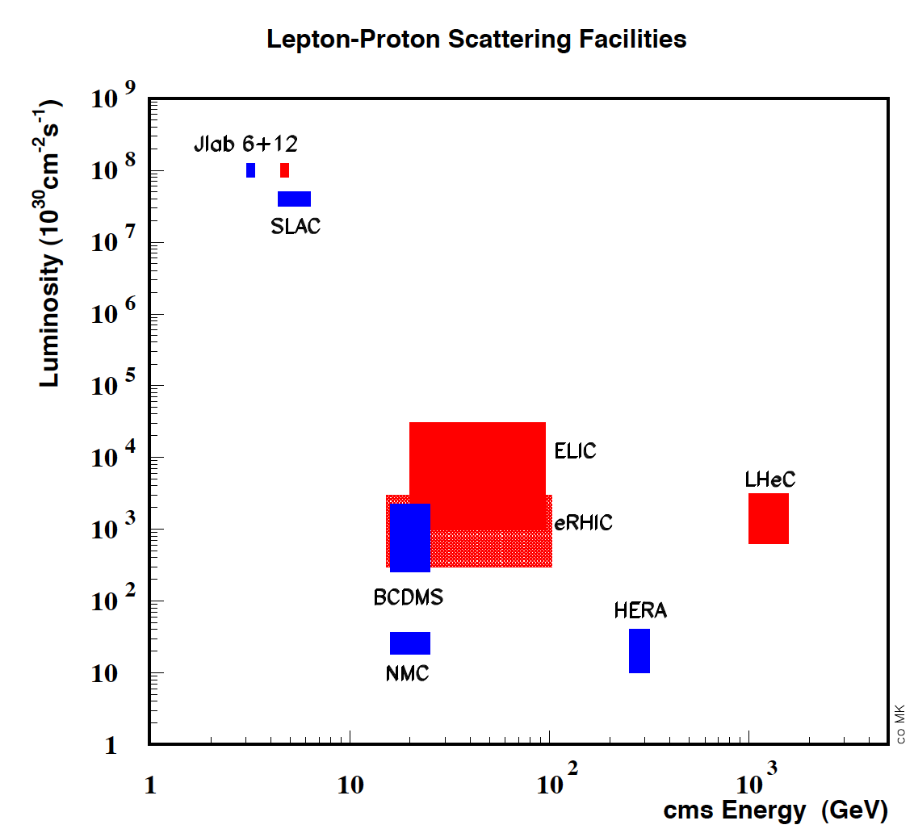
Deep Inelastic Scattering - History and Prospects
History of Deep Inelastic Scattering
Stanford
Stanford

Slide 7
LHeC Physics -1
Grand unification? α_{s} to per mille accuracy: jets vs inclusive
ultraprecision DIS programme: N^{k}LO, charm, beauty, ep/eD,..
A new phase of hadronic matter: high densities, small α_{s}
saturation of the gluon density? BFKL-Planck scale
superhigh-energy neutrino physics (p-N)
Partons in nuclei (4 orders of magnitude extension)
saturation in eA (A^{1/3}?), nuclear parton distributions
black body limit of F₂, colour transparency, …
Novel QCD phenomena
instantons, odderons, hidden colour, sea=antiquarks (strange)
Complementarity to new physics at the LHC
LQ spectroscopy, eeqq CI, Higgs, e*
Complete unfolding of partonic content of the proton,
direct and in QCD

Slide 8
LHeC Physics - 2
Neutron structure free of Fermi motion
Diffraction – Shadowing (Glauber). Antishadowing
Vector Mesons to probe strong interactions
Diffractive scattering “in extreme domains” (Brodsky)
Single top and anti-top ‘factory’ (CC)
Gluon density over 6 orders of magnitude in x
GPDs via DVCS
Unintegrated parton distributions
Partonic structure of the photon
Electroweak Couplings to per cent accuracy
….
For numeric studies and plots see recent talks at DIS10, ICHEP10, EIC and LHeC Workshops [ cern.ch/lhec]
Every major step in energy can lead to new unexpected results, ep: SLAC, HERA
Requires: High energy, e±, p, d, A, high luminosity, 4π acceptance, high precision (e/h)
TeV scale physics, electroweak, top, Higgs, low x unitarity

Slide 9
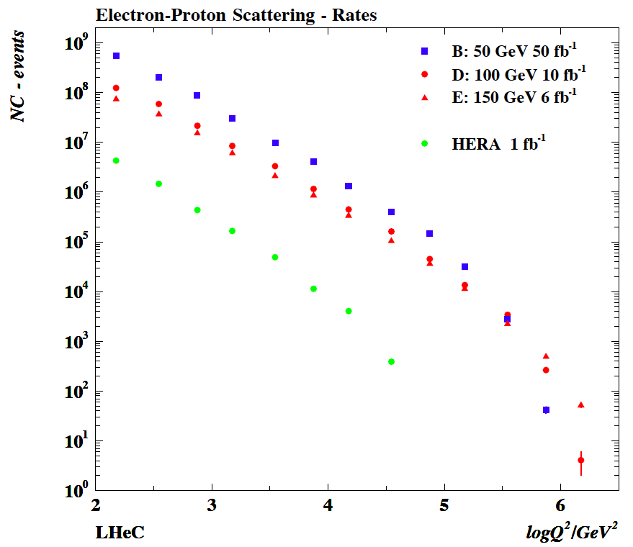
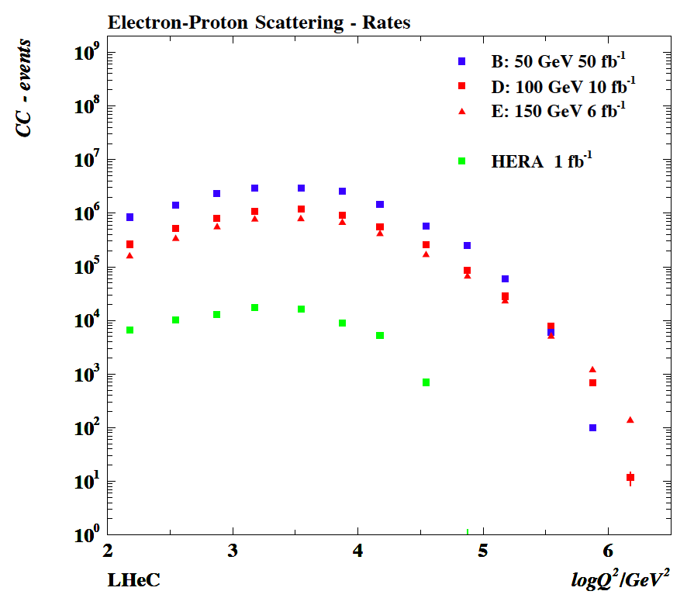
Statistics and Range
NC
CC
Need much higher luminosity than HERA to cover largest Q². Huge rates in electroweak region.

Slide 10
Two Options
Ring-Ring
Power Limit of 100 MW wall plug
“ultimate” LHC proton beam
60 GeV e± beam
L = 2 10³³ cm⁻²s⁻¹ → O(100) fb⁻¹
LINAC Ring
Pulsed, 60 GeV: ~10³²
High luminosity:
Energy recovery: P=P₀/(1-η)
β*=0.1m
[5 times smaller than LHC by
reduced l*, only one p squeezed
and IR quads as for HL-LHC]
L = 10³³ cm⁻²s⁻¹ → O(100) fb⁻¹
Synchronous ep and pp operation (small ep tuneshifts)
The LHC p beams provide 100 times HERA’s luminosity

Slide 11



















LHeC Accelerator: Participating Institutes
TOBB ETU
KEK

Slide 12
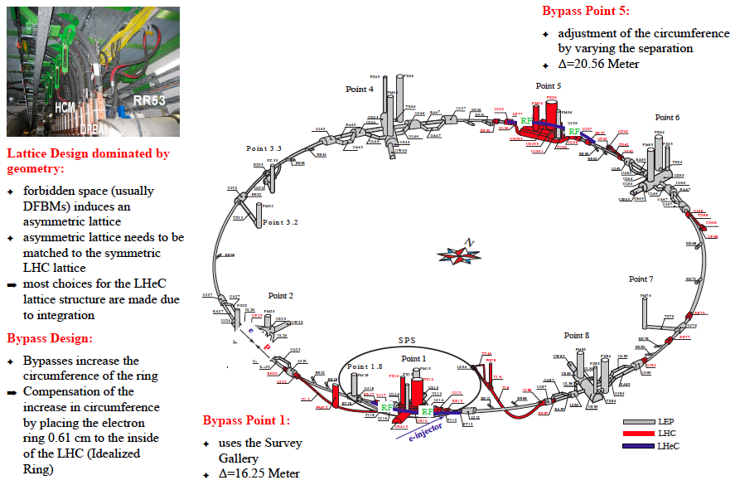
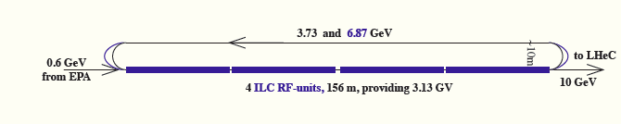
A 60 GeV Ring with 10 GeV LINAC Injector
5min filling time

Slide 13
Ring-Ring Option
Luminosity 10³³cm⁻²s⁻¹ rather ‘easy’ to achieve
Electrons and Positrons
Energy limited by synchrotron radiation
Polarisation perhaps 40%
Magnets, Cryosystem no major R+D, just D
Injector using ILC type cavities
Interference with the proton machine
Bypasses for LHC experiments (~3km tunnel)
Fully on CERN territory
Cost will be estimated
…

Slide 14
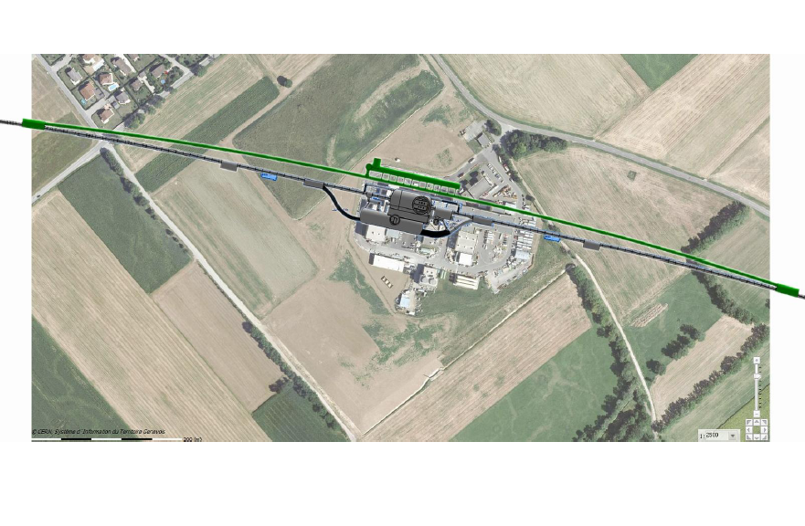
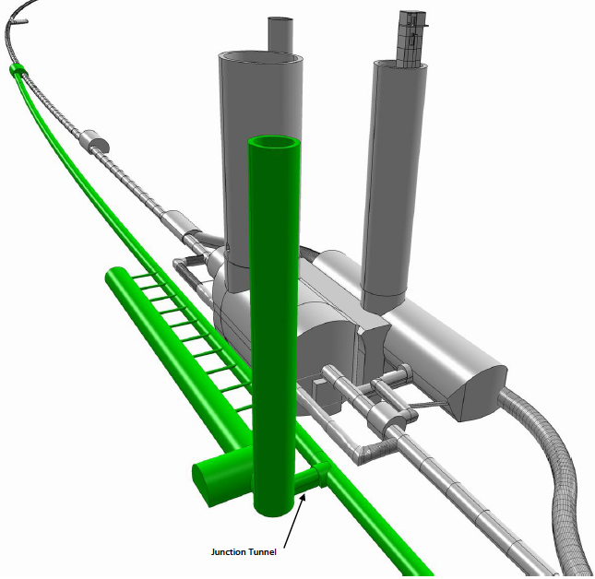
Bypassing CMS

Slide 15
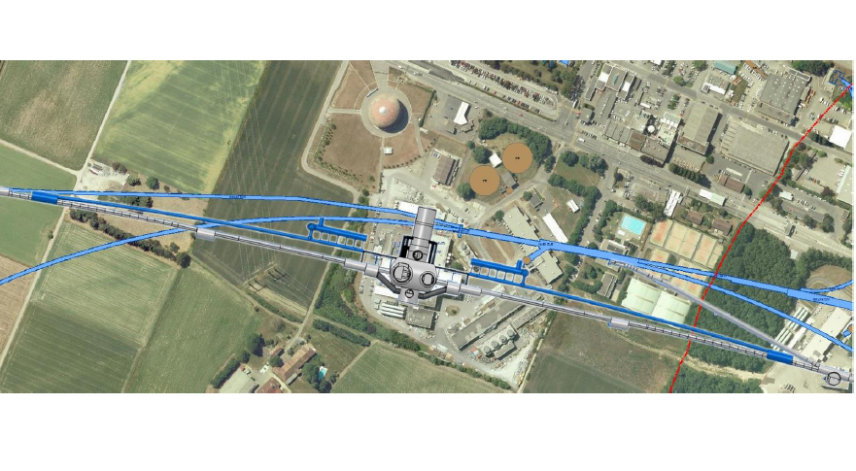
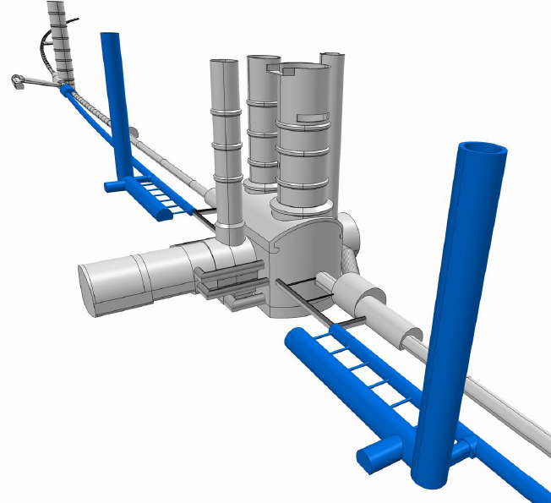
Bypassing ATLAS
For the CDR the bypass concepts
were decided to be confined to
ATLAS and CMS which is no
statement about LHCB or ALICE

Slide 16
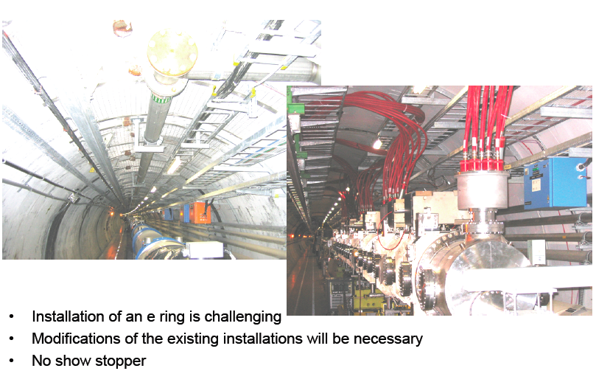
Ring Installation Study
This is the big question for the ring option (interference, activation,..)

Slide 17
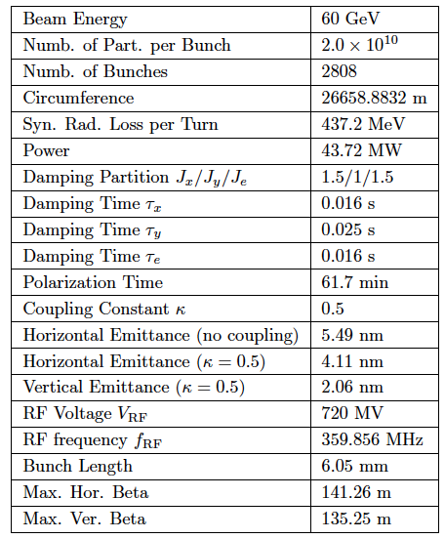

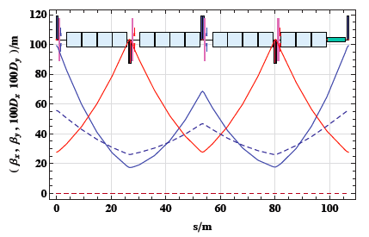
Ring - Optics
Half the LHC FODO size for emittance
Asymmetric FODO cell to account for
regular cryo jumpers of LHC
Put maximum number of dipole magnets
to keep synchrotron radiation small
Also designed: Dispersion suppressor (8 quads),
Bypass optics, Matched IR optics

Slide 18
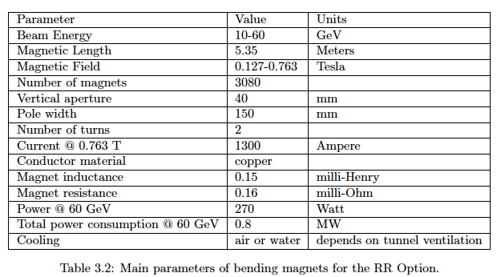
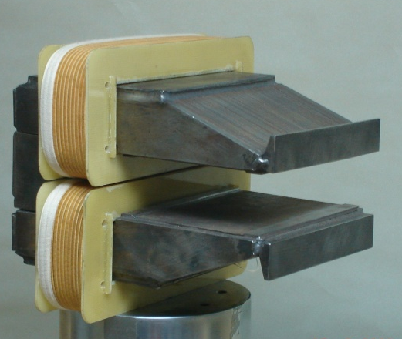
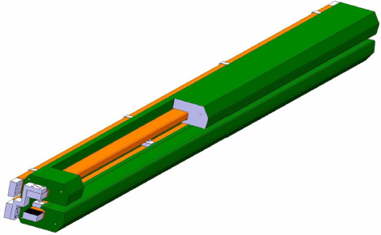
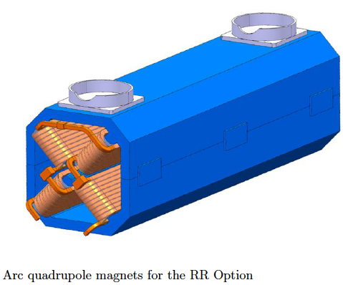
Ring Dipole + Quadrupol Magnets
BINP &
CERN
prototypes
5m long
(35 cm)²
slim + light
for installation
736 magnets
1.2 m long

Slide 19
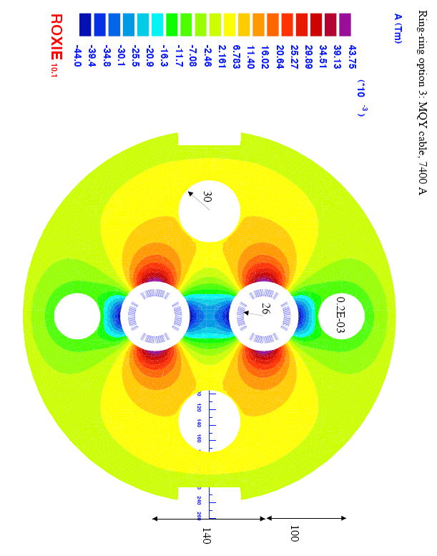
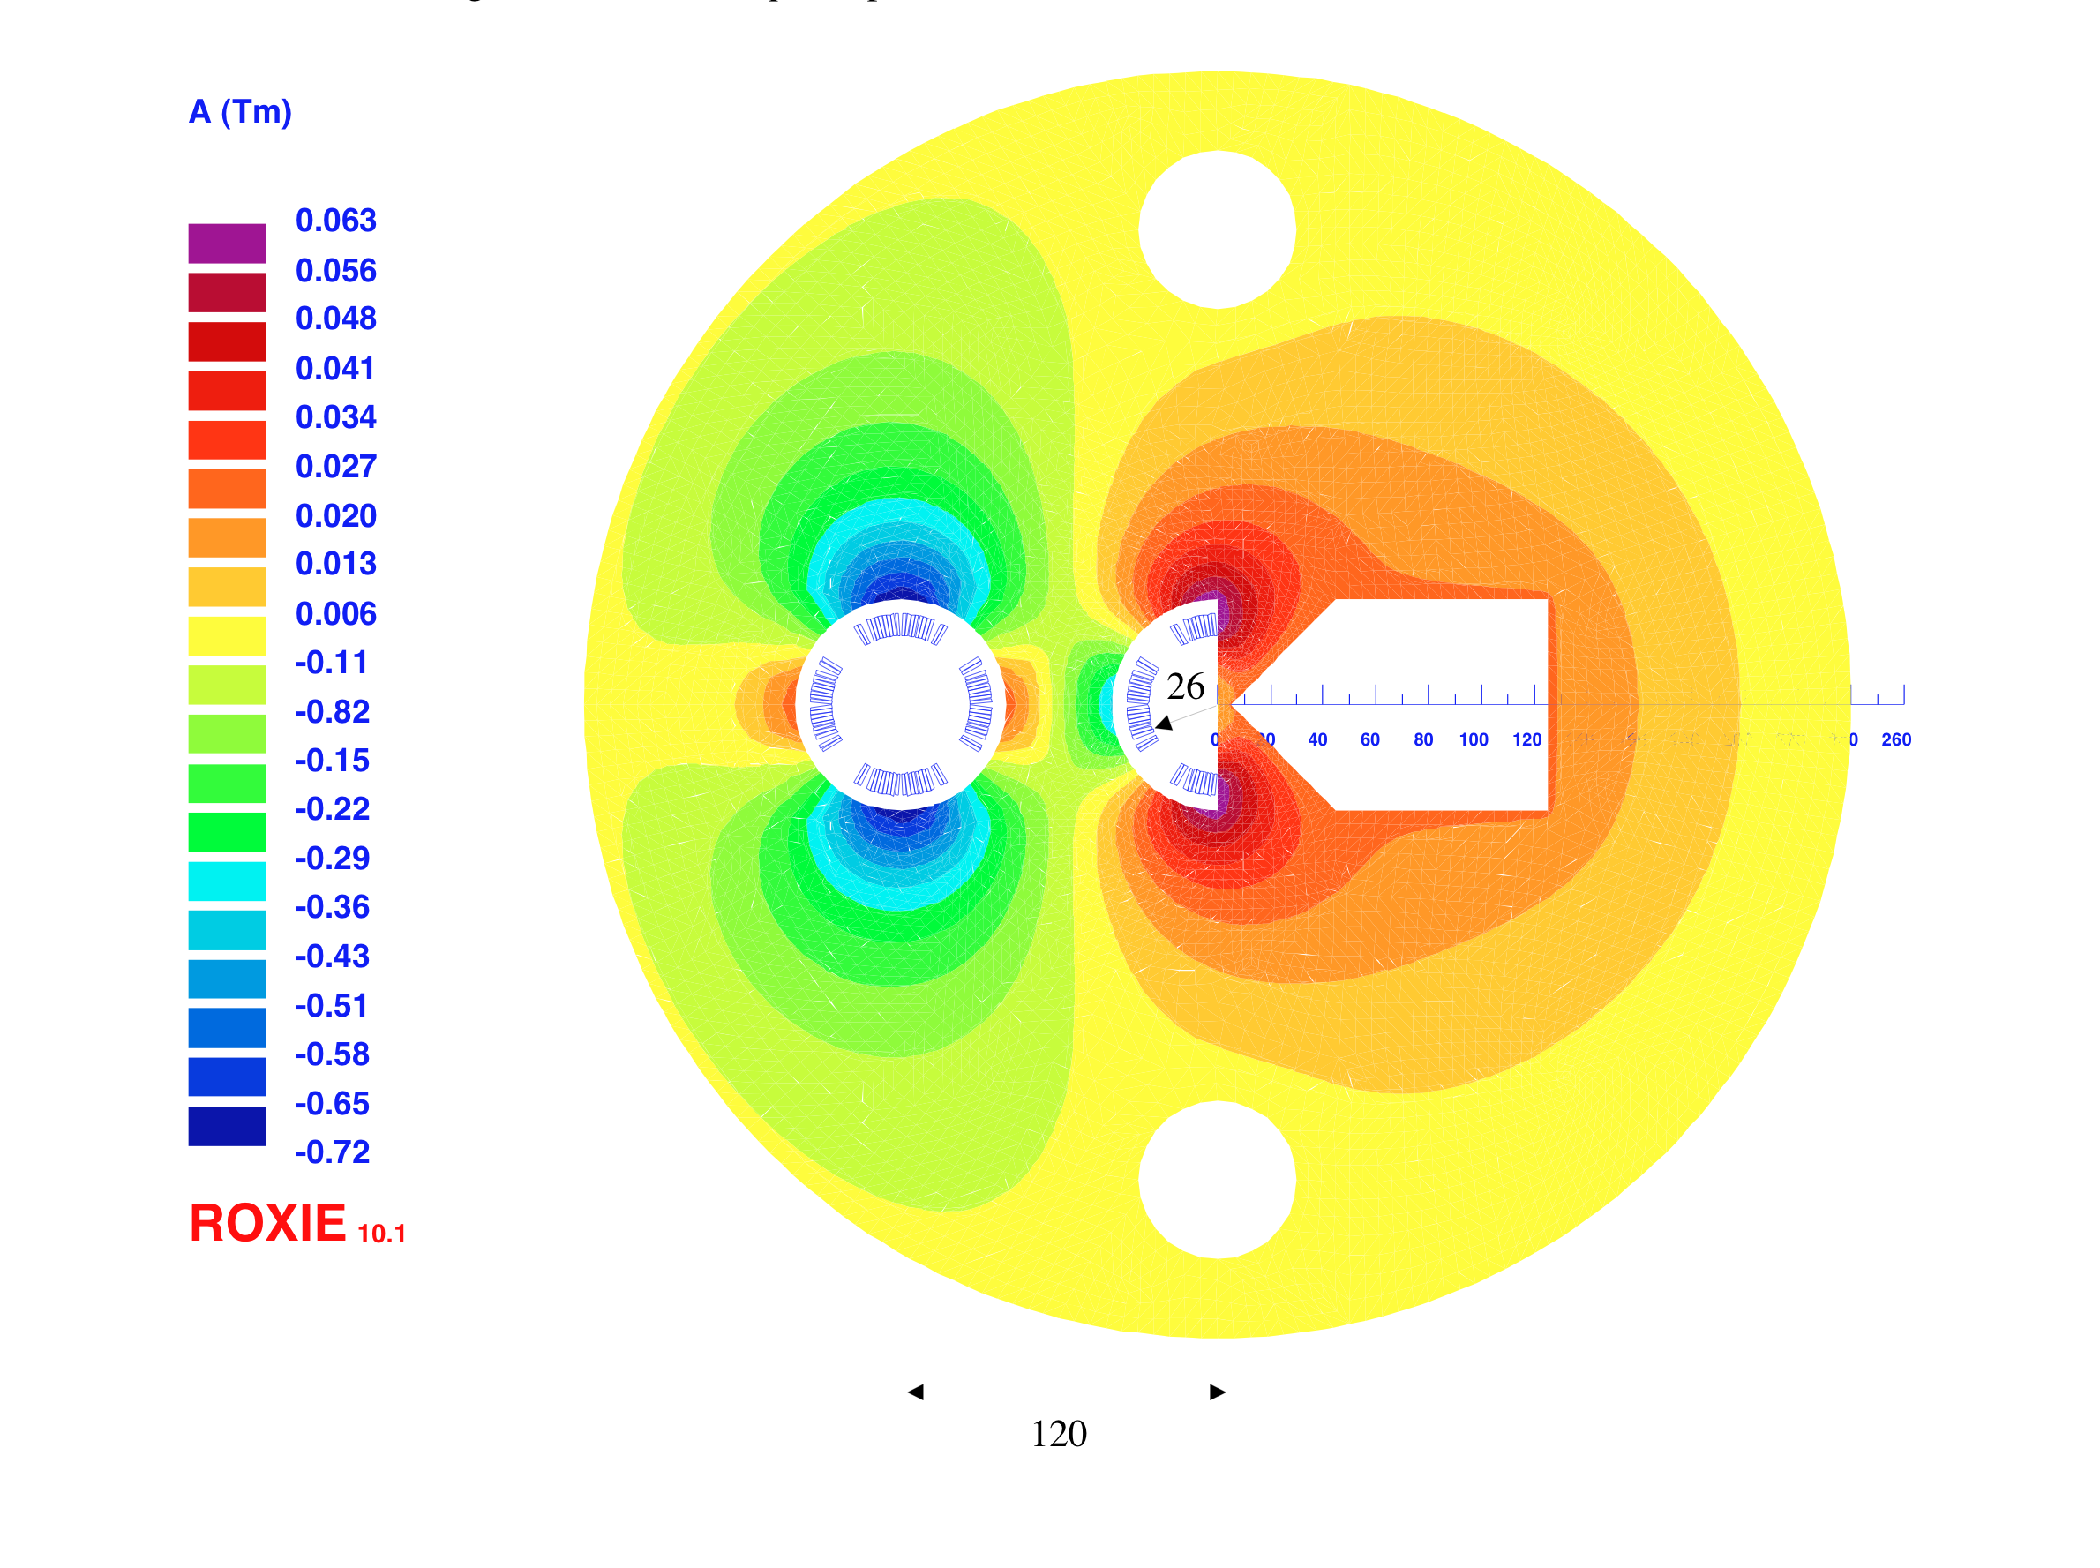
Interaction Region(s)
RR -Small crossing angle ~1mrad (25ns) to avoid first parasitic crossing (L x 0.77)
LR – Head on collisions, dipole in detector to separate beams
Synchrotron radiation –direct and back, absorption simulated (GEANT4) ..
[July 2010]
1st sc half quad (focus and deflect)
separation 5cm, g=127T/m, MQY cables, 4600 A
2nd quad: 3 beams in horizontal plane
separation 8.5cm, MQY cables, 7600 A

Slide 20

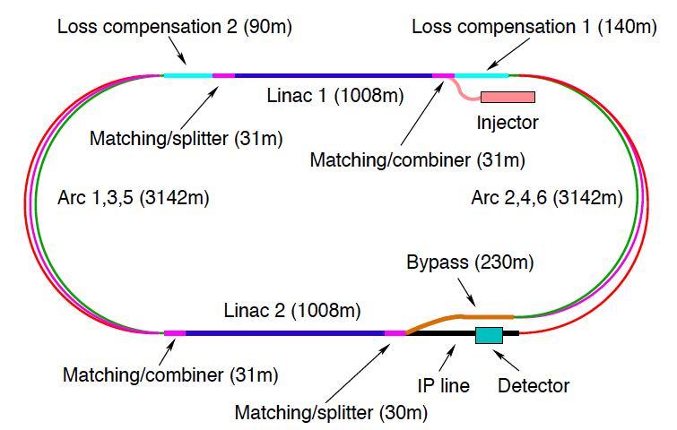
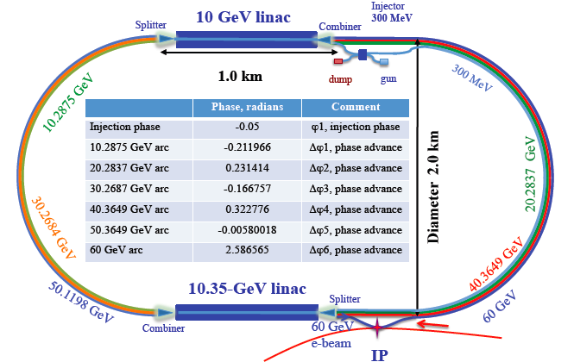
LINACs
CERN 1
CERN 2
Jlab
BNL
Two 10 GeV Linacs, 3 returns, ERL, 720 MHz cavities, rf, cryo, magnets, injectors, sources, dumps…

Slide 21
LINAC-Ring Option
Luminosity 10³³cm⁻²s⁻¹ possible to achieve for e⁻
Positrons require E recovery AND recycling, L+ < L-
Energy limited by synchrotron radiation in racetrack mode
Two beam recovery for high energy LINAC may be a long term option
Polarisation ‘easy’ for e⁻ ~90%, rather 0 for e⁺
Cavities: Synergy with SPL, ESS, XFEL, ILC
Cryo: fraction of LHC cryo system
Energy Recovery (CI, Cornell, BINP, ..) to be developed for LHeC
Small interference with the proton machine
Bypass of own IP
Extended dipole at ~1m radius in detector
Outside CERN territory (~9km tunnel below St Genis for IP2)
Cost will be estimated
…

Slide 22
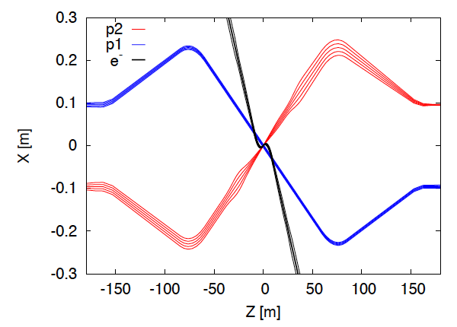
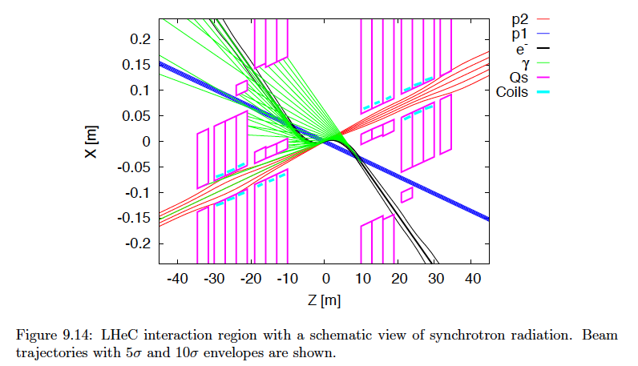
LR Interaction Region
3 beams, head-on collisions
p and e optics done

Slide 23
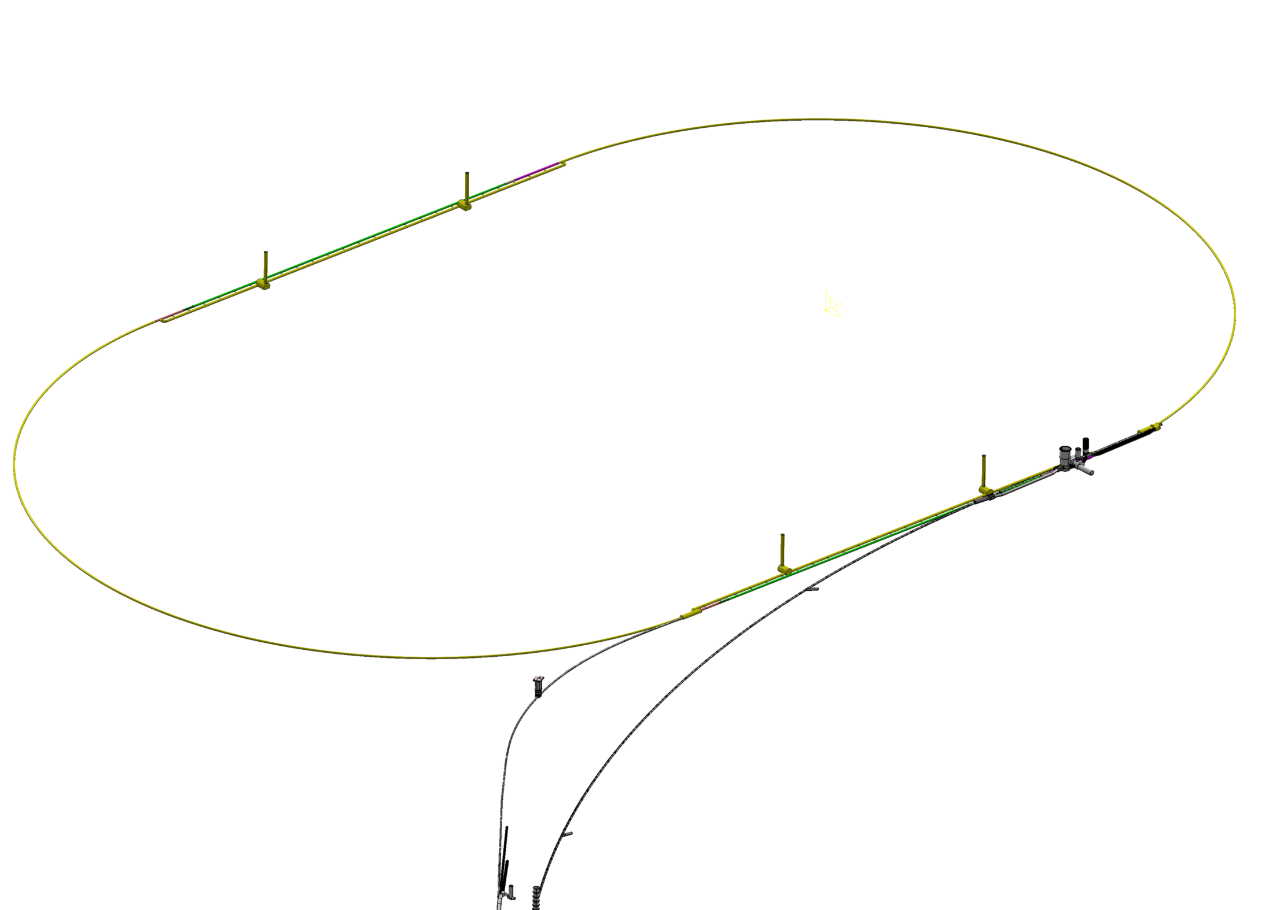
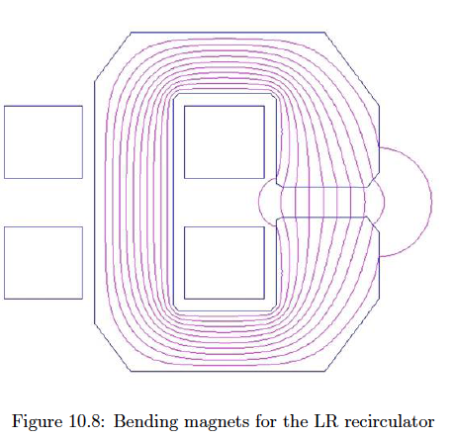
60 GeV Energy Recovery Linac
U=1/3 U(LHC)
1056 cavities
66 cryo modules per linac
721 MHz
19MV/m CW
21 MW rf,
total 88 MW
Cryo 29 MW for 37W/m heat load
Multibunch wakefields - ok
Emittance growth - ok
[ILC 10nm, LHeC 10μm]
36σ separation at 3.5m - ok
Fast ion instability - probably ok
with clearing gap (1/3)
Q – probably ok (between ILC/BNL)
600 4m dipoles/arc
240 1.2m quadrupoles/arc
LAYOUT TENTATIVE

Slide 24
Design Parameters
electron beam | RR | LR | LR
e- energy at IP[GeV] | 60 | 60 | 140
luminosity [10³² cm⁻²s⁻¹] | 17 | 10 | 0.44
polarization [%] | 40 | 90 | 90
bunch population [10⁹] | 26 | 2.0 | 1.6
e- bunch length [mm] | 10 | 0.3 | 0.3
bunch interval [ns] | 25 | 50 | 50
transv. emit. γε_{x,y} [mm] | 0.58, 0.29 | 0.05 | 0.1
rms IP beam size σ_{x,y} [μm] | 30, 16 | 7 | 7
e- IP beta funct. β*_{x,y} [m] | 0.18, 0.10 | 0.12 | 0.14
full crossing angle [mrad] | 0.93 | 0 | 0
geometric reduction H_{hg} | 0.77 | 0.91 | 0.94
repetition rate [Hz] | N/A | N/A | 10
beam pulse length [ms] | N/A | N/A | 5
ER efficiency | N/A | 94% | N/A
average current [mA] | 131 | 6.6 | 5.4
tot. wall plug power[MW] | 100 | 100 | 100
proton beam | RR | LR
bunch pop. [10¹¹] | 1.7 | 1.7
tr.emit.γε_{x,y} [μm] | 3.75 | 3.75
spot size σ_{x,y} [μm] | 30, 16 | 7
β*_{x,y} [m] | 1.8,0.5 | 0.1
bunch spacing [ns] | 25 | 25
“ultimate p beam”
1.7 probably conservative
Design also for deuterons
(new) and lead (exists)
RR= Ring – Ring
LR =Linac –Ring
Parameters from 8.7.2010
New: Ring: use 1º as baseline : L/2
Linac: clearing gap: L*2/3

Slide 25
4. Physics

Slide 26
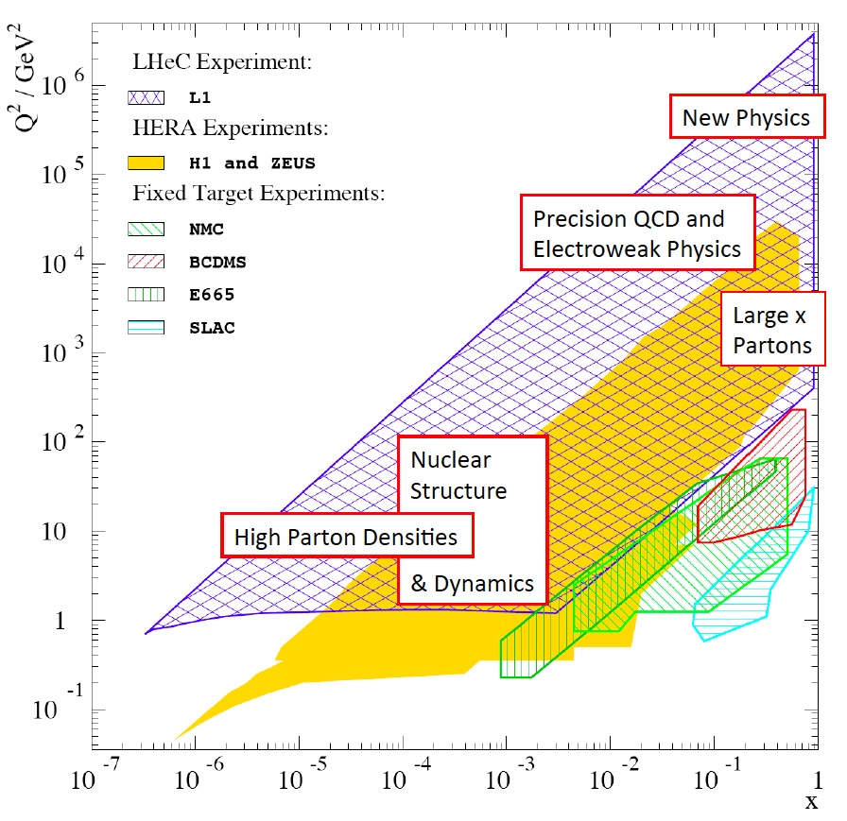
Deep Inelastic e/μ p Scattering

Slide 27
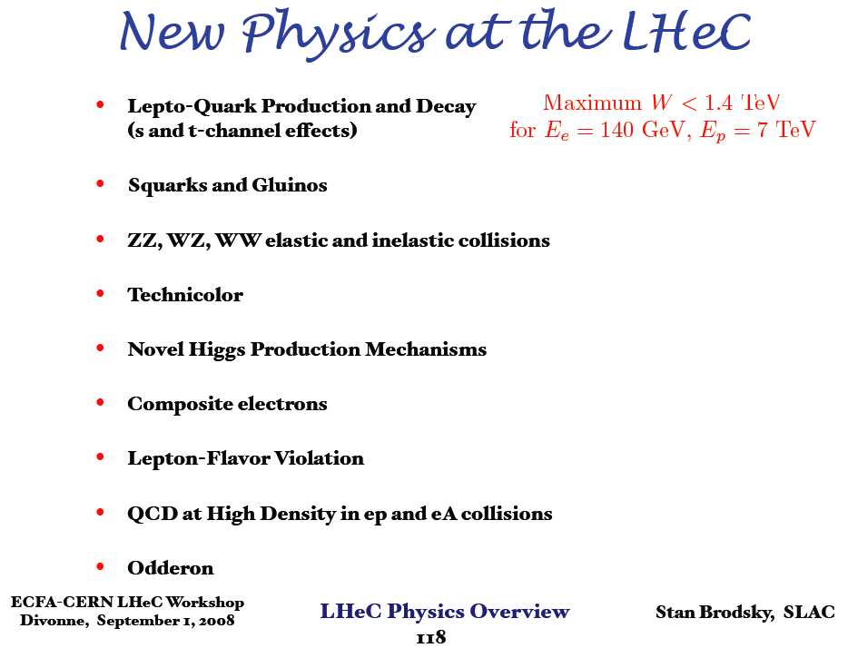
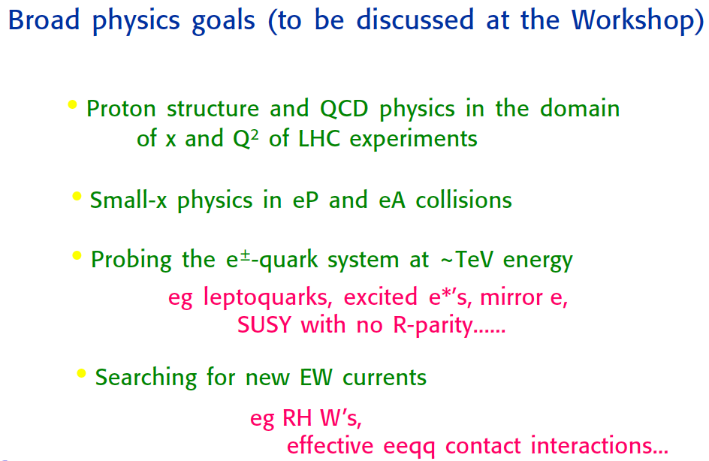
Questions on a TeV ep Collider
Divonne 08
G. Altarelli
J.Bartels: Theory on low x

Slide 28
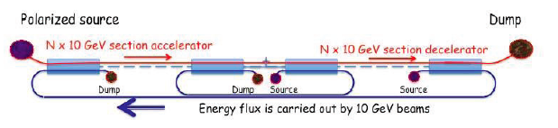
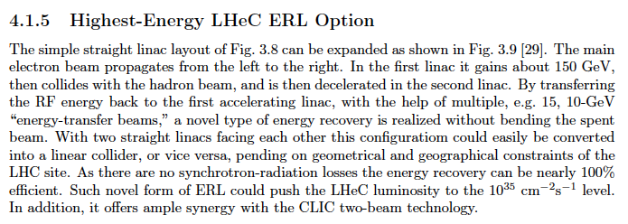
Towards Higher E_{e} and Luminosity
The LINAC concept has a possible evolution to say 150 GeV colliding with 16 TeV in the HE LHC, > 2030
This is 10⁶ times the Q² reach of the SLAC experiment which discovered quarks using a 2 mile LINAC.
From CDR draft, courtesy V. Litvinenko, Divonne 2008

Slide 29
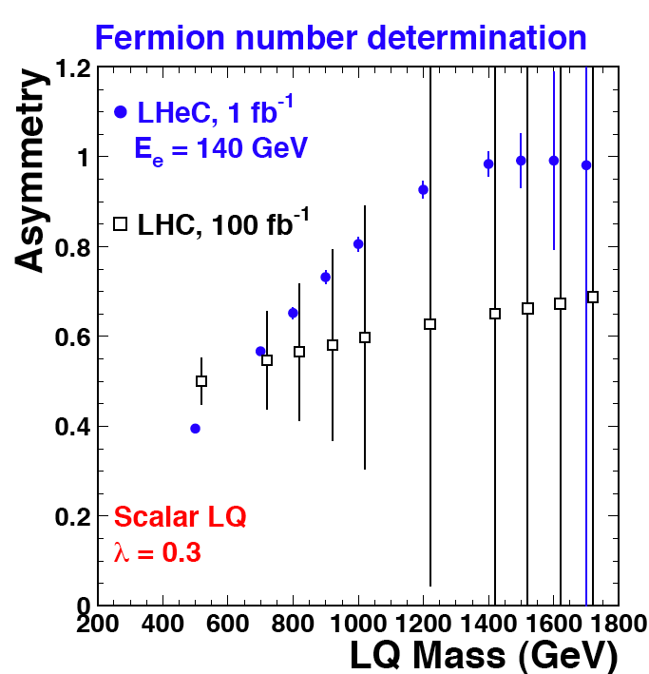
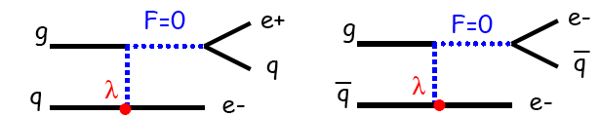
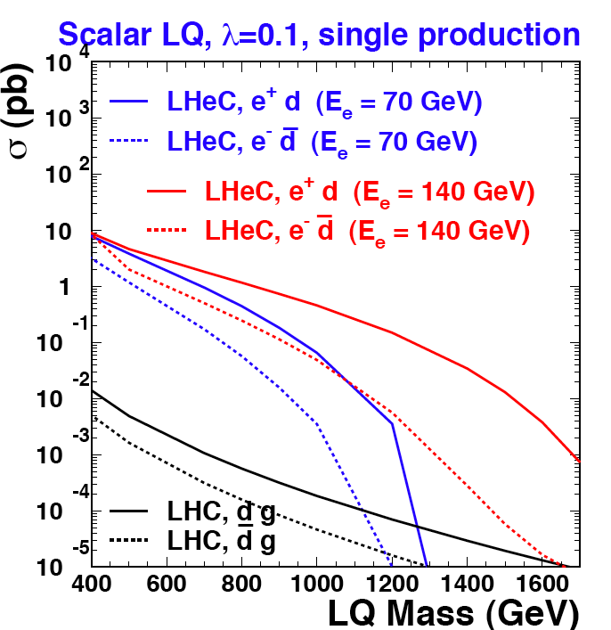
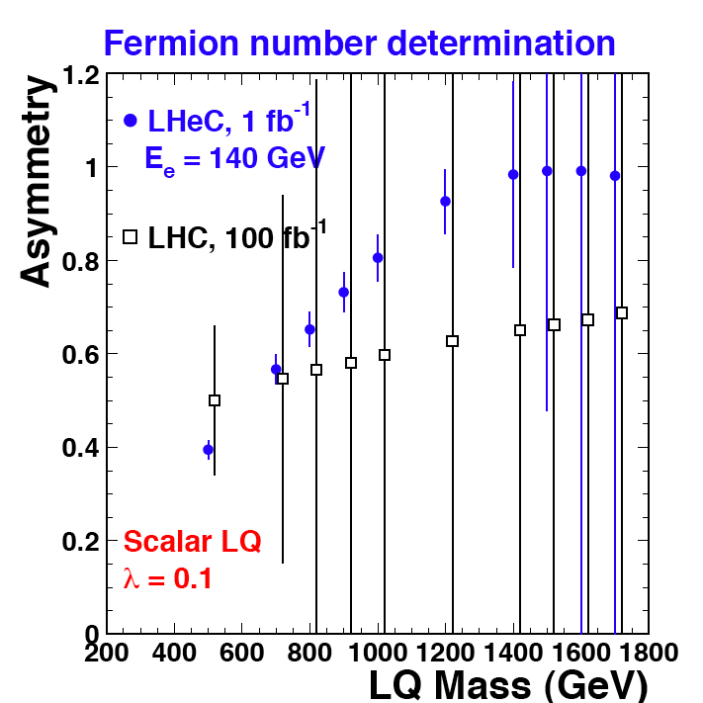
LQ Quantum Numbers
Charge asymmetry much cleaner in ep [in] than in pp [out].
Similar for simultaneous determination of coupling
and quark flavour. Polarisation for spectroscopy
JINST 1 2006 P10001

Slide 30
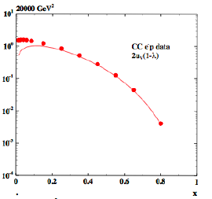
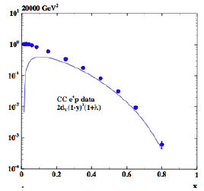
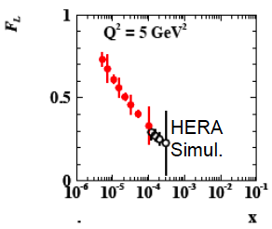
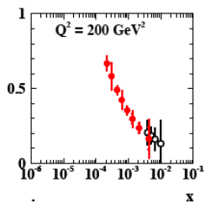
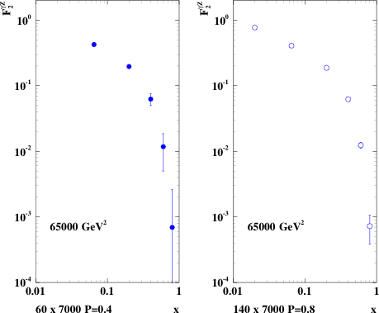
Structure Functions – Examples:
F₂^{γZ}
CC e⁻
CC e⁺
F_{L}

Slide 31
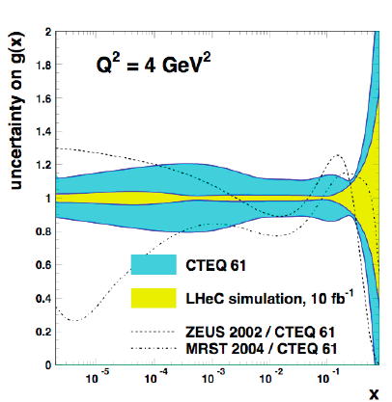
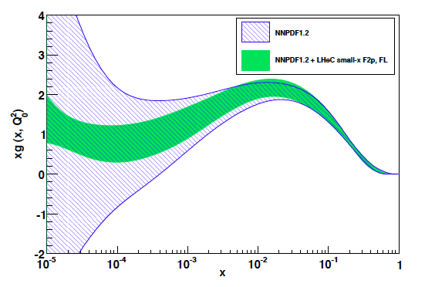
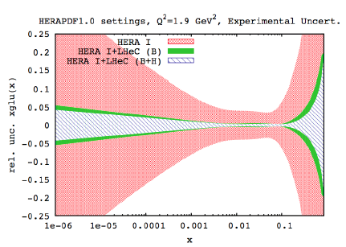
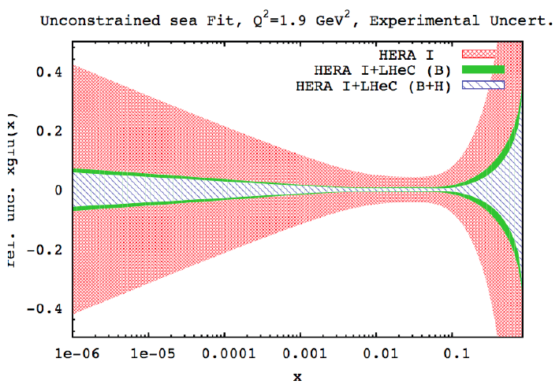
Gluon Distribution
From F₂ and F_{L} simulation - NNPDF
NLO QCD “Fits” of LHeC simulated data

Slide 32
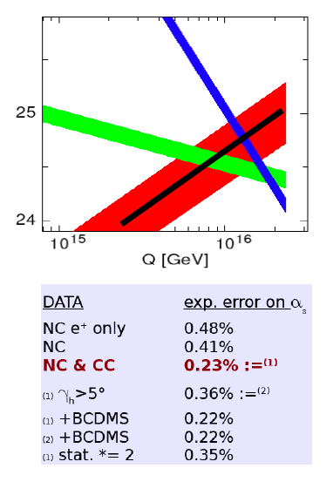
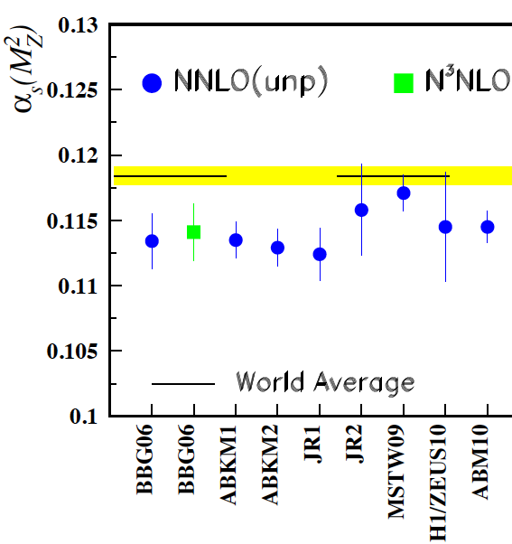
Strong Coupling Constant
Simulation of α_{s} measurement at LHeC
α_{s} least known of coupling constants
Grand Unification predictions suffer from δα_{s}
DIS tends to be lower than world average
LHeC: per mille accuracy indep. of BCDMS.
Challenge to experiment and to h.o. QCD
1/α
fine structure
weak
strong
MSSM - B.Allnach et al, hep-ex/0403133
?
+pol
J.Bluemlein and H. Boettcher, arXiv 1005.3013 (2010)

Slide 33
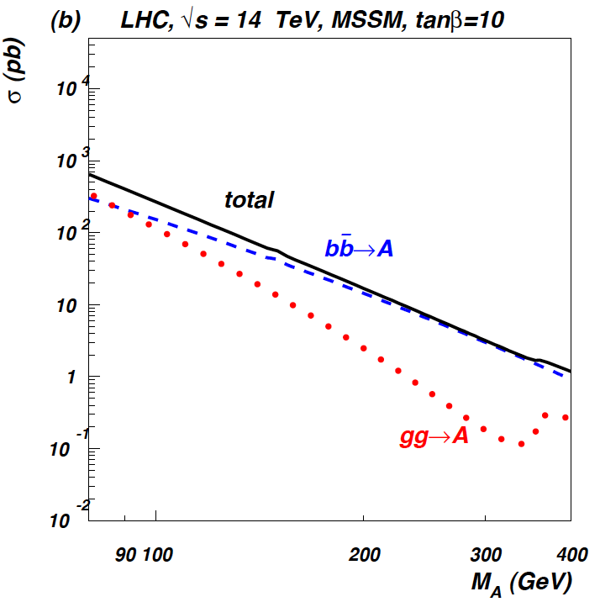
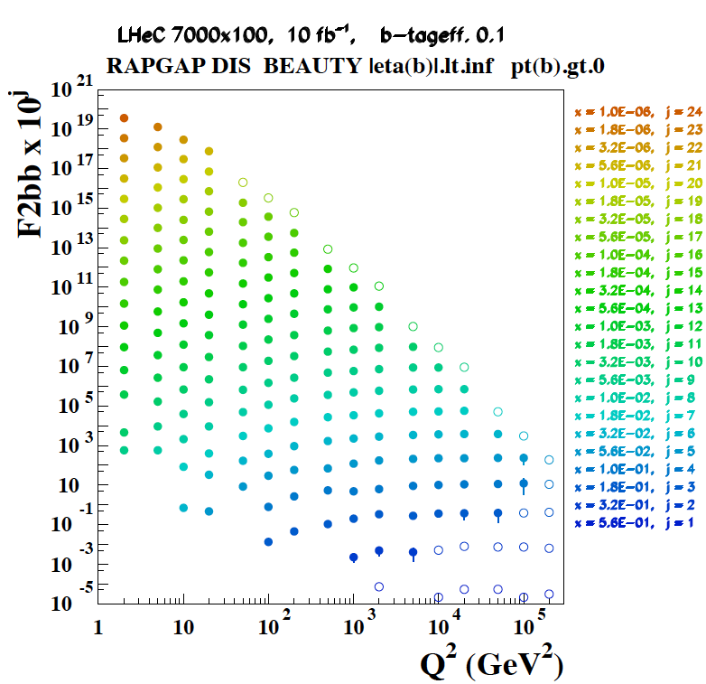
Beauty - MSSM Higgs
CTEQ Belyayev et al. JHEP 0601:069,2006
In MSSM Higgs production is b dominated
HERA: First measurements of b to ~20%
LHeC: precision measurement of b-df
LHeC: higher fraction of b, larger range,
smaller beam spot, better Si detectors

Slide 34
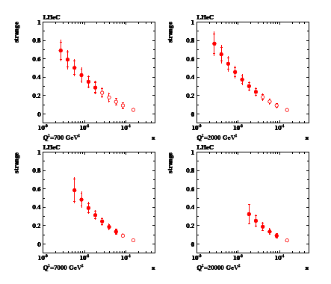
Strange (=? anti-strange) Quark
Some dimuon and K data
never properly measured

Slide 35
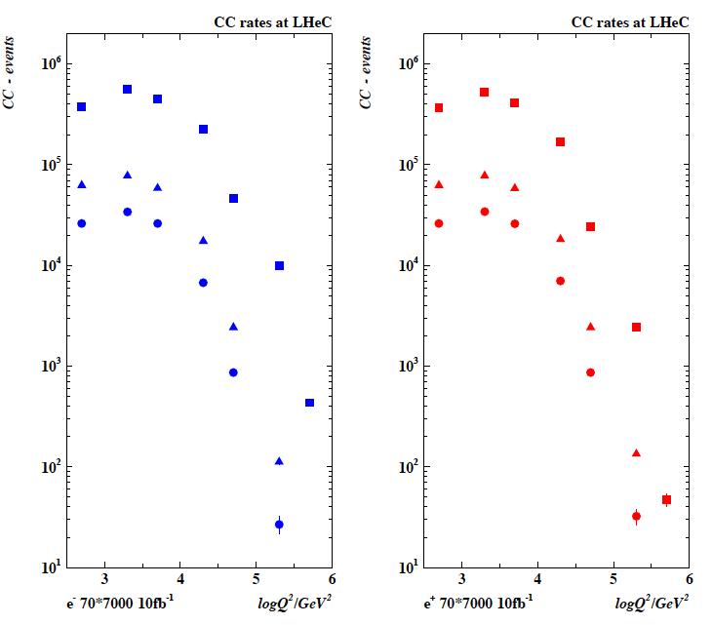

Top and Top Production in Charged Currents
LHeC is a single top and
anti-top quark factory
with a CC cross section
of O(10)pb
Study Q² evolution of
top quark onset –
6 quark CFNS

Slide 36




Valence Quarks
u_{v}
d_{v}

Slide 37


Weak NC Couplings of Light Quarks
ZEUS
Per cent accuracy of NC couplings
sin²Θ still to be estimated
For H1, CDF, LEP cf Z.Zhang DIS10

Slide 38





Neutron Structure (ed → eX)
crucial constraint on evolution (S-NS), improved α_{s}

Slide 39


Saturation of Gluon Density
HERA: Quark and gluon densities
in p rise towards low Bjorken x.
Gluon dominant but no clear
proof of nonlinear effects – range
Limited for access of dF₂ /dlnQ²
T.Lastovicka, M.Klein, DIS06
Expect saturation of rise at Q²_{s} ≈ xg α_{s} ≈ c x^{-λ}A^{1/3}
Saturation of cross sections amplified with A^{1/}
The LHeC is bound to discover saturation in DIS
both in ep and in eA in a region where α_{s} is small
V.Radescu Moriond 3/2011
Colour Glass Condensate - perturbatively calculable via non-linear evolution equations

Slide 40


Electron-Ion Scattering: eA → eX
Qualitative change of behaviour
- Bb limit of F₂
Saturation of cross sections amplified
with A^{1/3} (A wider than p)
Rise of diffraction to 50%
hot spots of gluons or BDL?
Extension of kinematic range by 3-4 orders of
magnitude into saturation region (with p and A)
Like LHeC ep without HERA.. (e.g. heavy quarks in A)

Slide 41



Nuclear Parton Distributions
Study using eA LHeC pseudodata
R=q^{Pb}/q^{p}
A complete determination of nPDFs in grossly extended range, into nonlinear regime
certainly more diverse than in V,S,G terms and cleaner than pA at the LHC
K.Eskola, H.Paukkunen, C.Salgado, Divonne09

Slide 42


In-medium Hadronisation
The study of particle production in eA (fragmentation functions and hadrochemistry)
allows the study of the space-time picture of hadronisation (the final phase of QGP).
Low energy (ν): need of
hadronization inside.
Parton propagation: pt broadening
Hadron formation: attenuation
High energy (ν): partonic
evolution altered in the
nuclear medium.
W.Brooks, Divonne09
LHeC :
+ study the transition from small to high energies in much extended range wrt. fixed target data
+ testing the energy loss mechanism crucial for understanding of the medium produced in HIC
+ detailed study of heavy quark hadronisation …
Notes:
42

Slide 43
NuPECC – Roadmap 2010: New Large-Scale Facilities
 |  |  | 2010 |  |  |  |  | 2015 |  |  |  |  | 2020 |  |  |  |  | 2025
FAIR | PANDA | R&D Construction Commissioning |  |  |  |  |  |  |  |  | Exploitation
 | CBM | R&D Construction Commissioning |  |  |  |  |  |  |  |  | Exploitation |  |  | SIS300
 | NuSTAR | R&D Construction Commissioning |  |  |  |  |  |  |  |  | Exploit. |  | NESR FLAIR
 | PAX/ENC | Design Study R&D Tests Construction/Commissioning |  |  |  |  |  |  |  |  |  |  |  |  |  | Collider
SPIRAL2 |  | R&D Constr./Commission. |  |  |  |  | Exploitation |  |  |  |  |  |  | 150 MeV/u Post-accelerator
HIE-ISOLDE |  |  | Constr./Commission. |  |  |  | Exploitation |  |  |  |  |  |  |  | Injector Upgrade
SPES |  |  |  | Constr./Commission. |  |  |  | Exploitation
EURISOL |  | Design Study R&D Preparatory Phase / Site Decision Engineering Study Construction
LHeC |  | Design Study R&D Engineering Study Construction/Commissioning
G. Rosner, NuPECC Chair, Madrid 5/10

Slide 44
5. Detector

Slide 45
Acceptance and Calibration
High luminosity to reach high Q² and large x
10³³ 1-5 10³¹
Largest possible acceptance
1-179º 7-177º
High resolution tracking
0.1 mrad 0.2-1 mrad
Precision electromagnetic calorimetry
0.1% 0.2-0.5%
Precision hadronic calorimetry
0.5% 1%
High precision luminosity measurement
0.5% 1%
Acceptance
Modern Si
DA, kin peak,
High statistics
may be possible
track+calo, e/h
Lumi will be hard
LHeC H1

Slide 46

LHeC Detector Overview
LAr electromagnetic calorimeter
Tile Calorimeter
Fwd/Bwd asymmetry in energy deposited and thus in geometry and technology [W/Si vs Pb/Sc..]
Present dimensions: LxD =13x9m² [CMS 21 x 15m² , ATLAS 45 x 25 m²]
Taggers at -62m (e),100m (γ,LR), -22.4m (γ,RR), +100m (n), +420m (p)
Tentative 21.3.11

Slide 47

LHeC Detector Overview
Fwd/Bwd asymmetry in energy deposited and thus in geometry and technology [W/Si vs Pb/Sc..]
Present dimensions: LxD =13x9m² [CMS 21 x 15m² , ATLAS 45 x 25 m²]
Taggers at -62m (e),100m (γ,LR), -22.4m (γ,RR), +100m (n), +420m (p)
Tentative 21.3.11

Slide 48


Detector Performance (HCAL)
A charged pion in the LHeC HCAL
Performance simulated for tile cal only

Slide 49

Track Detector Concept

Slide 50


Beam Pipe
Beam pipe design – work in progress
LR more challenging than RR due to
extended synchrotron radiation fan
R. Veness et al CERN
Tentative 21.3.11

Slide 51


Detector Performance (Tracker)
transverse momentum
Δp_{t}/p²_{t} → 6 10⁻⁴ GeV⁻¹
transverse
impact parameter
→ 10μm

Slide 52
6. Final Remarks

Slide 53



LHC 2010-2012
B. Murray Chamonix 1/2011
If m_{squark}=m_{gluino}
exclude < 700 GeV
No SUSY in 0,1,2
lepton searches
so far..
M.D’Onofrio ATLAS
CERN seminar 8.3.11

Slide 54


LHC 2010-2012
Leptoquarks
Brown-Englert-Higgs-Kibble..
Can expect to settle the
SM Higgs question by latest
2012 – no major decision
will be taken before
G.Rolandi Paris 12/2010

Slide 55
LHeC DRAFT Timeline
Based on LHC constraints, ep/A programme, series production, civil engineering etc
Year | 2012 | 2013 | 2014 | 2015 | 2016 | 2017 | 2018 | 2019 | 2020 | 2021 | 2022
 | Prototyping- testing
 |  |  |  | Production main components
 |  |  | Civil engineering
 |  |  |  |  |  |  |  | Installation
 |  |  |  |  |  |  |  |  |  | Operation
Variations on timeline:
production of main components can overlap with civil engineering
Installation can overlap with civil engineering
Additional constraints from LHC operation not considered here
in any variation, a start by 2020 requires launch of prototyping of
key components by 2012
[shown to ECFA 11/2010: mandate to 2012]

Slide 56

Organisation + Status for the CDR
Accelerator Design [RR and LR]
Oliver Bruening (CERN),
John Dainton (CI/Liverpool)
Interaction Region and Fwd/Bwd
Bernhard Holzer (DESY),
Uwe Schneeekloth (DESY),
Pierre van Mechelen (Antwerpen)
Detector Design
Peter Kostka (DESY),
Rainer Wallny (U Zurich),
Alessandro Polini (Bologna)
New Physics at Large Scales
George Azuelos (Montreal)
Emmanuelle Perez (CERN),
Georg Weiglein (Durham)
Precision QCD and Electroweak
Olaf Behnke (DESY),
Paolo Gambino (Torino),
Thomas Gehrmann (Zuerich)
Claire Gwenlan (Oxford)
Physics at High Parton Densities
Nestor Armesto (Santiago),
Brian Cole (Columbia),
Paul Newman (Birmingham),
Anna Stasto (MSU)
Today: writing … for the
Referees of CERN
Scientific Advisory Committee
Guido Altarelli (Rome)
Sergio Bertolucci (CERN)
Stan Brodsky (SLAC)
Allen Caldwell -chair (MPI Munich)
Swapan Chattopadhyay (Cockcroft)
John Dainton (Liverpool)
John Ellis (CERN)
Jos Engelen (CERN)
Joel Feltesse (Saclay)
Lev Lipatov (St.Petersburg)
Roland Garoby (CERN)
Roland Horisberger (PSI)
Young-Kee Kim (Fermilab)
Aharon Levy (Tel Aviv)
Karlheinz Meier (Heidelberg)
Richard Milner (Bates)
Joachim Mnich (DESY)
Steven Myers, (CERN)
Tatsuya Nakada (Lausanne, ECFA)
Guenther Rosner (Glasgow, NuPECC)
Alexander Skrinsky (Novosibirsk)
Anthony Thomas (Jlab)
Steven Vigdor (BNL)
Frank Wilczek (MIT)
Ferdinand Willeke (BNL)
Steering Committee
Oliver Bruening (CERN)
John Dainton (Cockcroft)
Albert DeRoeck (CERN)
Stefano Forte (Milano)
Max Klein - chair (Liverpool)
Paul Laycock (secretary) (L’pool)
Paul Newman (Birmingham)
Emmanuelle Perez (CERN)
Wesley Smith (Wisconsin)
Bernd Surrow (MIT)
Katsuo Tokushuku (KEK)
Urs Wiedemann (CERN))
Frank Zimmermann (CERN)
Expect CDR in spring 2011
Working Group Convenors

Slide 57
Summary
The LHeC has the potential to become an exciting 5th big experiment at the LHC
It needs a new polarised electron/positron beam, and two options are under
consideration, a ‘Linac’ and a ring, with a ‘linear’ injector.., both promising to
deliver O(50) fb⁻¹ thus reaching Q² = 1 TeV², high x = 0.8 and x=10⁻⁶ in DIS..
The LHeC physics programme is broad, unique and complementary to the LHC
Steps in 2010: DIS11, CDR, EPS, Accelerator Workshop to decide(?) LR-R
…. Adapt organisation for international accelerator project and for LHeC Collaboration
in order to arrive in time for an exploitation for 10 years, about, assuming the LHC
lives until ~2030.
Very much depends on the findings in the 2011/2012 LHC run and on us.
Envisage update on LHeC physics programme by spring 2012 (DIS12 ??)
THANKS to the whole study group on LHeC : http://cern.ch/lhec

Slide 58
backup

Slide 59


ERL Electrical Site Power

Slide 60
Three Pass ERL RF system at 721 MHz
Energy = 3 * 20 GeV, 2 x 10 GeV Linacs, 6.6 mA. 721 MHz, allow for 25 ns bunches
Take SPL type cavity @18 MV/m (Close to BNL design for eRHIC)
1.06 m/cavity => 19.1 MV/cav => 1056 cavities total (=132 x 8)
Take 8 cavities in a 14 m cryomodule (cf SPL) => 66 cryo modules/linac
Total length = 924 m/linac + margin ~10%
Power loss in arcs = 9.5 MW, 9 kW/cavity, Take P_{rf} = 20 kW/cavity with overhead for feedbacks, total installed RF 21 MW.
No challenge for power couplers, power sources – could be solid state
However, still need adjacent gallery to house RF equipment (high gradient = radiation !) 4-5 m diameter sufficient
Synchrotron radiation losses in arcs: need re-accelerating ‘mini’-linacs

Slide 61



Charm – α_{s}
F₂^{cc}
LHeC
HERA
LHeC: higher fraction of c, larger range,
smaller beam spot, better Si detectors

Slide 62


J/ψ – golden channel
cf also:
A.Caldwell, H.Kowalski
PR C81:025203,2010
Investigation of nuclear
matter with J/Psi

Slide 63




Quark-Gluon Dynamics - Diffraction and HFS (fwd jets)
Understand multi-jet emission (unintegr. pdf’s), tune MC’s
Production of high mass 1⁻ states
At HERA resolved γ effects mimic non-kt ordered emission

Slide 64

LINAC – near the IR

Slide 65

LINAC – injector side
18.1.11 -All civil engineering drawings tentative!

Slide 66

Calorimeter - Resolutions and Scales

Slide 67

Momentum Resolution

Slide 68


Linac-Ring Cryogenics
Cryo supply
ERL
Sector 250 m
Picture not to scale
1 km
string of cryomodules
CW operation, 18 MV/m
2 K thermal load: 37 W/m (for active length)
2 K total therma l load: 42 kW @ 2 K
Electric power: 30 MW
(with a COP of 700)
2 Cryoplant units
Compressor s
On surface
Cooling requirements dominated by dynamic losses at 2 K
(other loads neglected here for simplicity)
Split cold boxes (see LEP2, LHC)
Lay-out is based on LHC cryogenic principles with split cold boxes (surface cold box and underground cold box with cold compressors).
Refrigerator units of approx. 5 kW @ 2 K assumed. To be designed. Technology and experience: LHC, CEBAF (JLAB).
Underground cavern
Distribution
Cryo supply

Slide 69

Heavy Flavours at the LHeC

Slide 70
HERA - ‘an unfinished business’
Low x: DGLAP holds although ln1/x is large
Saturation not proven
High x: would have required much higher luminosity
[u/d ?, xg ?]
Neutron structure not explored
Nuclear structure not explored
New concepts introduced, investigation just started:
-parton amplitudes (GPD’s, proton hologram)
-diffractive partons
-unintegrated partons
-heavy quarks
Instantons not observed
Odderons not found
…
Lepton-quark states not observed

Slide 71

Intrinsic Charm ??
CTEQ6 with (solid)
and w/o (dashed)
intrinsic charm
To access the high x
region one needs
to tag charm in fwd
direction and lower
the proton beam
energy and get
high luminosity.

Slide 72

LR Parameters

Slide 73
6. Final Remarks

