Slide 1
Strong Interaction, Quarks + Gluons
Quark Model
Partons
Gluons + QCD
Introduction to Particle Physics - Max Klein – Lecture 4 - Liverpool University 4.3.13
M.Klein 4.3.2013 L4

Slide 2
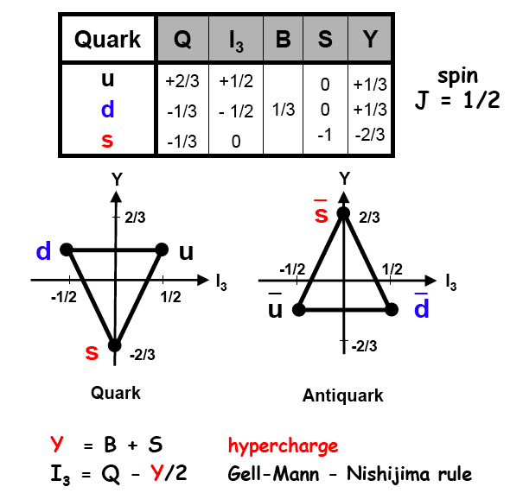
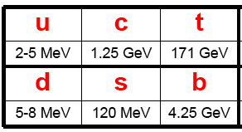
Light Quarks
Light quarks are u,d,s, with
masses much smaller than M_{p}
M.Klein 4.3.2013 L4

Slide 3
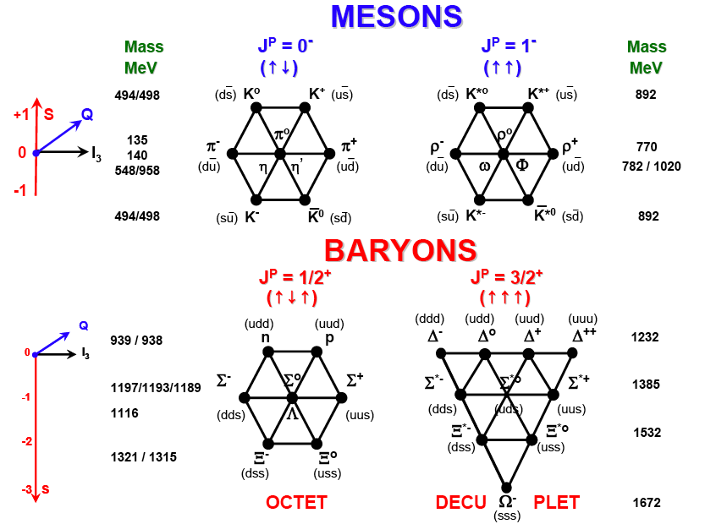
Quark Model
T.Naumann
M.Klein 4.3.2013 L4

Slide 4
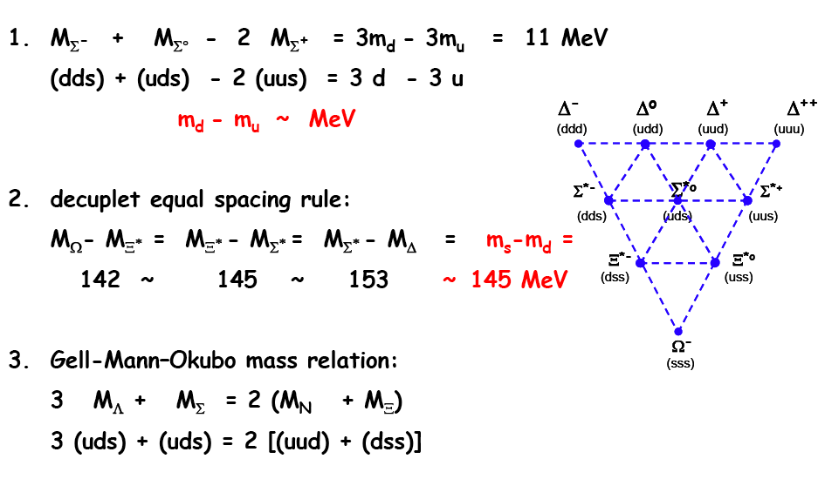
Light Quark Masses
M.Klein 4.3.2013 L4

Slide 5
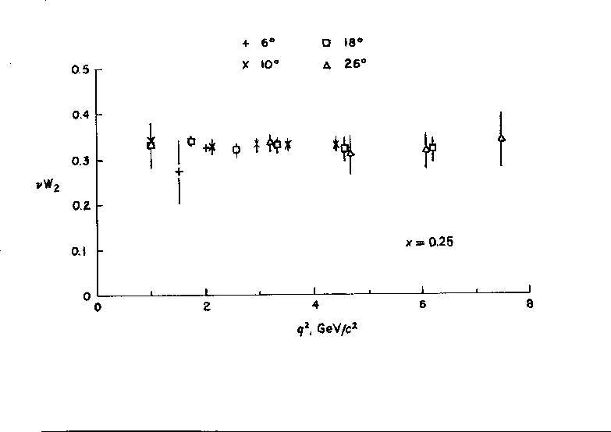
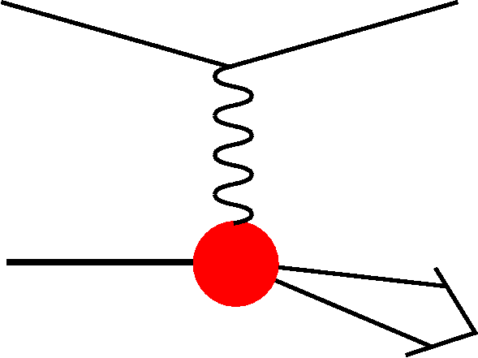
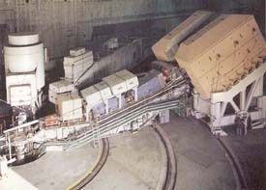
The discovery of partons in deep inelastic ep scattering in1969
pointlike scattering centers inside proton
x = momentum fraction carried by quarks
Q² negative 4 momentum transfer squared
ν=E-E’: energy transfer = energy of the photon
spatial resolution: d =1/√Q²=10⁻¹⁶m
SLAC
Friedman, Kendall, Taylor
M.Klein 4.3.2013 L4

Slide 6
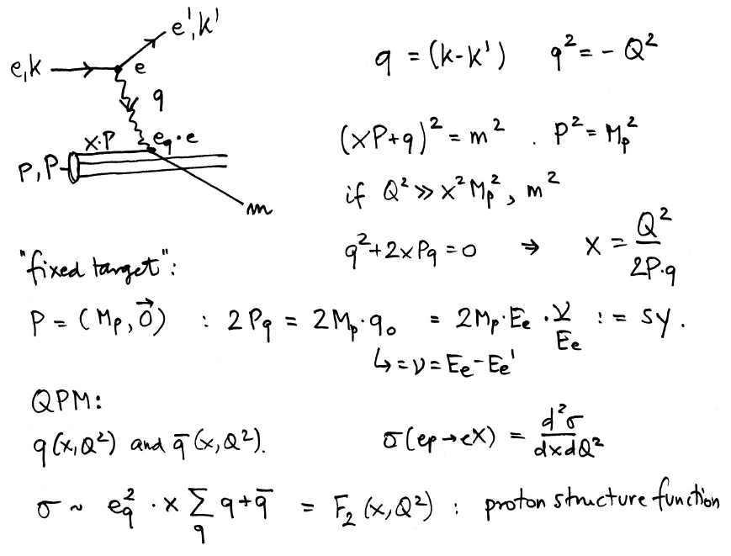
Deep Inelastic Scattering - F₂
In DIS the inclusive
cross section depends
on two variables, the
negative 4-momentum
transfer squared (Q² ),
which determines the
resolving power of the
exchanged particle in
terms of p substructure,
and the variable
Bjorken x, which Feynman
could relate to the fraction
of momentum of the proton
carried by a parton [in
what he called the
‘infinite momentum frame’
in which the transverse
momenta are neglected].
Feynman’s partons were
readily linked to Gell-Mann
and Zweig’s quarks.
“fixed target”:
- ep collider
M.Klein 4.3.2013 L4

Slide 7
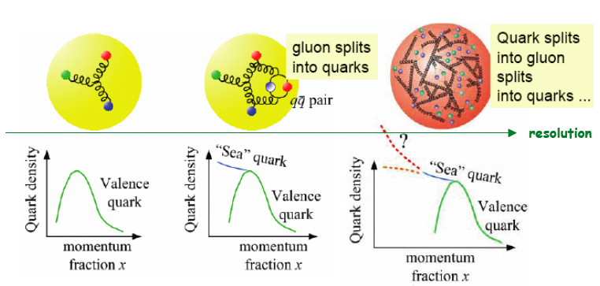
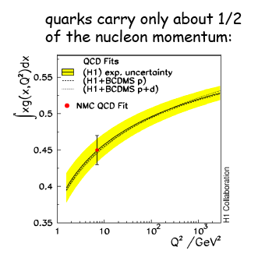
The “dynamic” structure of the proton
Early on the measured
integrated density of
quarks was observed
to not add up to 1. This
implied that half of proton’s
momentum is carried by
gluons. A strong support
for the existence of gluons.
The view on proton’s structure is dynamic. It
is determined by the resolving power of the
process, as in ordinary microscopes. However,
with a lepton beam emitting a photon or Z,W
boson for resolving the proton structure, one
reaches MUCH smaller dimensions. The best
limit for the point-like structure of quarks is now
r_{q} < 10⁻²⁰ m (LHC)
M.Klein 4.3.2013 L4

Slide 8
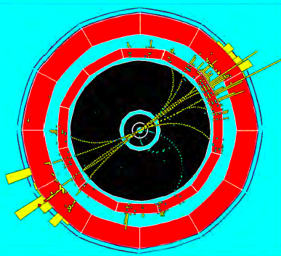
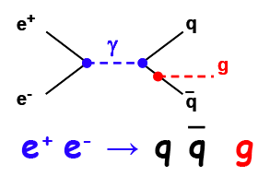
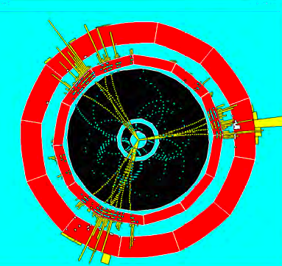
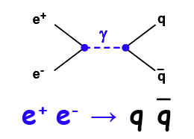
The Gluon and its ‘Bremsstrahlung’
3 jets discovered at DESY in 1979
The lowest order reaction leads to two bundles (“jets”) of particles which are back-to-back in azimuth, “balanced” in transverse momentum. The observation
of jet production was a major success
of the Quark Parton Model approach.
At the LHC observe a significant number of multi jet events.
Jet production is an important means to understand the
dynamics of quark-gluon interactions in the underlying
field theory: Quantum Chromo-Dynamics [QCD]
M.Klein 4.3.2013 L4

Slide 9
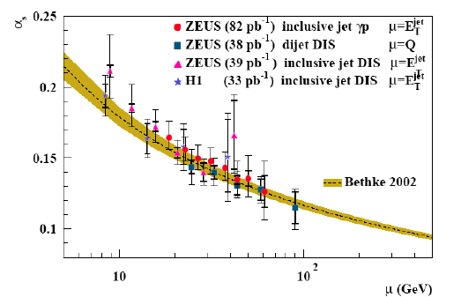

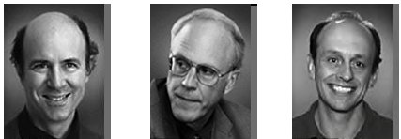
Quantum Chromodynamics
QED: one photon, QCD: 8 gluons
At high energies the effective charge
is small; the coupling approaches
an asymptotic value. In this regime
the coupling constant is so small
that the quarks can be considered
free. The strong interaction gets
weakened and perturbative calculations
become meaningful in the theory of
strong interactions, a major surprise!
QCD is asymptotically free
The story of asymptotic freedom is around a minus sign and who got it first, back in 1974...
F.Wilzcek D.Gross H.Politzer
M.Klein 4.3.2013 L4

Slide 10
Adapting to new, hypothetical theories?
“… when I reported these things here in Göttingen, they laughed at me that I should take such fantasies seriously”
R.Courant to N.Bohr, 1922, December, 8
Fermi’s “A Tentative Theory of ß Decay” refused to publish in Nature
cited by Pontecorvo
1962: Gell Mann predicts the Omega minus (sss state)
“ The paper looks crazy, but if I accept it and it is nonsense, everyone will blame Gell-Mann and not Physics Letters. If I reject it and it turns out to be right, I will be ridiculed.”
cited by Lipkin
“ …we know that … mesons and baryons are mostly, if not entirely, made up out of one another. The probability that a meson consists of a real quark pair rather than two mesons… must be quite small” Gell-Mann XIII ICHEP Berkeley, 1967
Zweig, who invented the Quark Model with Gell Mann in 1964, could not get a paper published describing his quark theory until the mid 70ies.
cited by H.Kendall
“The correct theory will not be found within the next 100 years”
F.Dyson 1960
M.Klein 4.3.2013 L4

Slide 11
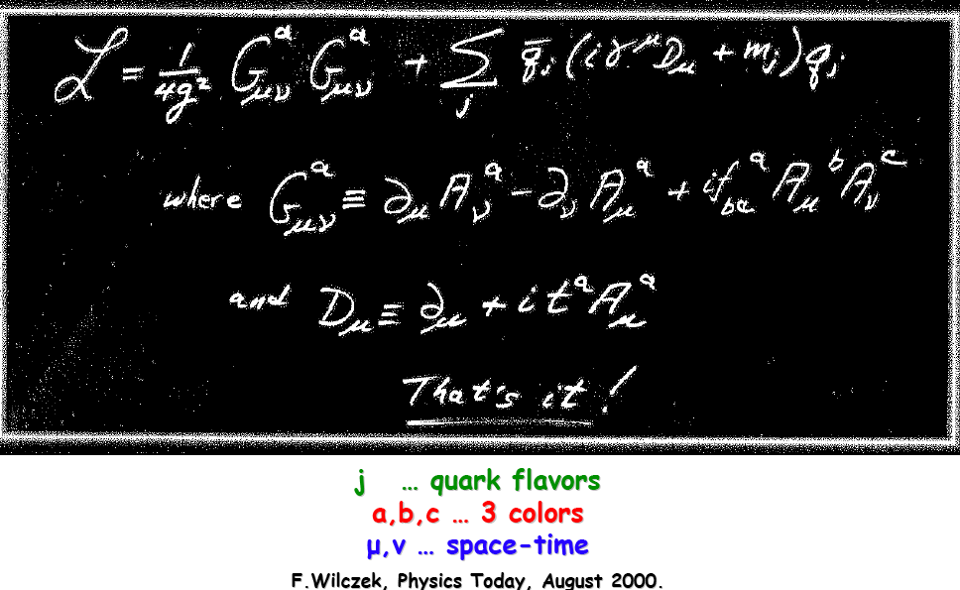
The Lagrangian of QCD
quark mass
gluon
q propagation and q-g interaction
selfinteraction
of gluon field
M.Klein 4.3.2013 L4

Slide 12
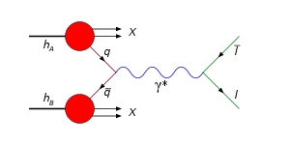
Drell-Yan Scattering and Jets
P₁
p₁
q,l
g,γ
q,l
p₂
P₂
Drell-Yan process is THE tool for studying the partonic
structure of the proton and for searching for new physics
at the LHC. Few TeV mass range being explored.
M.Klein 4.3.2013 L4

Slide 13
Multijets on ATLAS
Transverse
view of a
multi-jet event
from SUSY
searches
on ATLAS
r,z view
Multiple,
large (missing)
energy
depositions
in angular
space.
The event has
multiple vertices
“pile-up”
because of the
large pp
cross section,
high luminosity
and acceptance
N=σLA
M.Klein 4.3.2013 L4

Slide 14
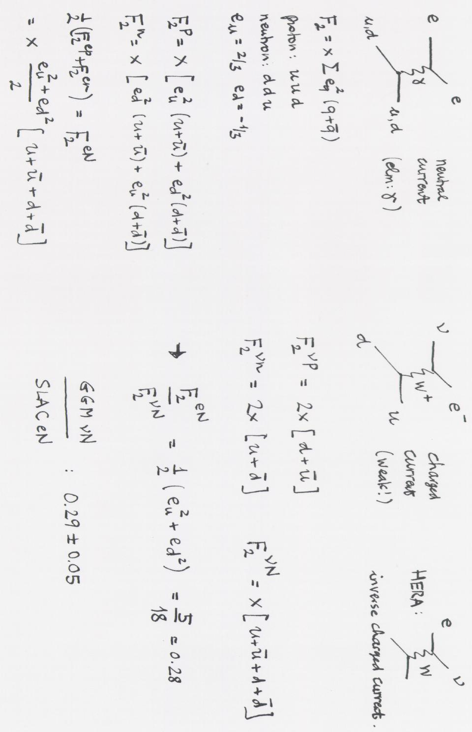
Fractional Charges in Deep Inelastic Scattering
M.Klein 4.3.2013 L4

