Slide 1
Parton Distribution Functions
DRAFT 4.10.2015, 7pm
PDF Status
QCD Fits
Data Comparisons
PDF Relevance
Claire Gwenlan (Oxford) and Max Klein (Liverpool+CERN)
For the ATLAS PDF Forum
See Marjorie for PDFs in MCs – links to PMG group
See Claire at Sibiu for a complementary summary
ATLAS Collaboration Week Lecce (Italy) 6th October, 2015

Slide 2
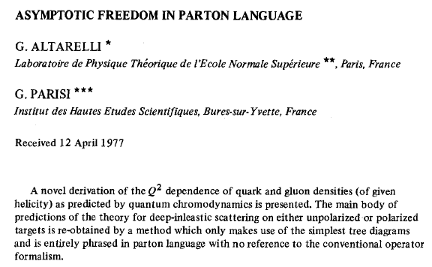
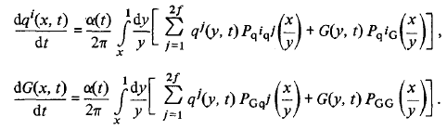


PDFs
(1941-2015)

Slide 3
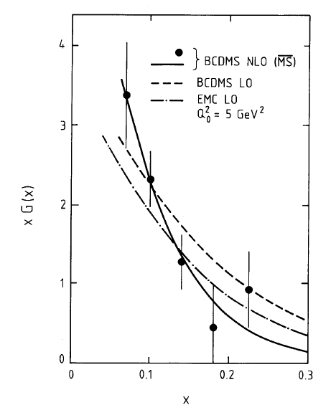
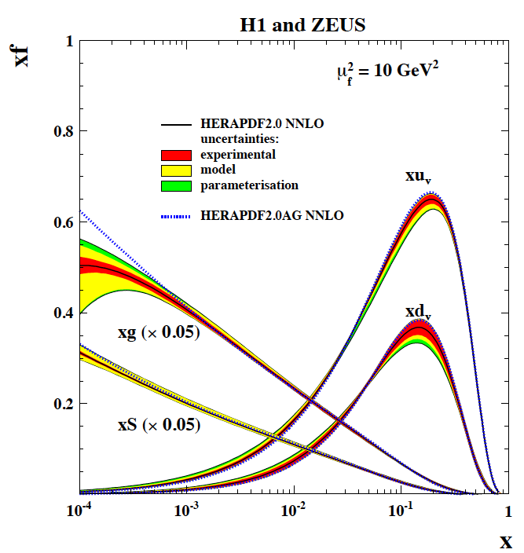

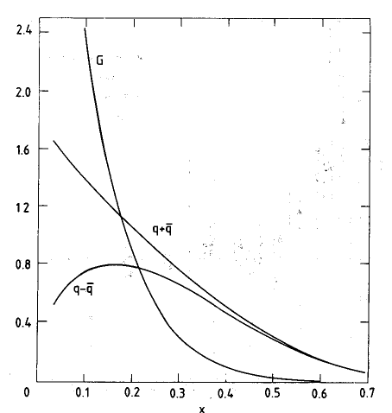

Gluons and Quarks 1989 → 2015
BCDMS
fixed target lN to ep collider →
CDHS
gg→H
(y=0)
arXiv:1506.06042
“Legacy” paper NC/CC
HERAPDF2.0 NNLO
High mass
HL-LHC
C.Gwenlan+M.Klein, ATLAS, Lecce 6.10.15

Slide 4
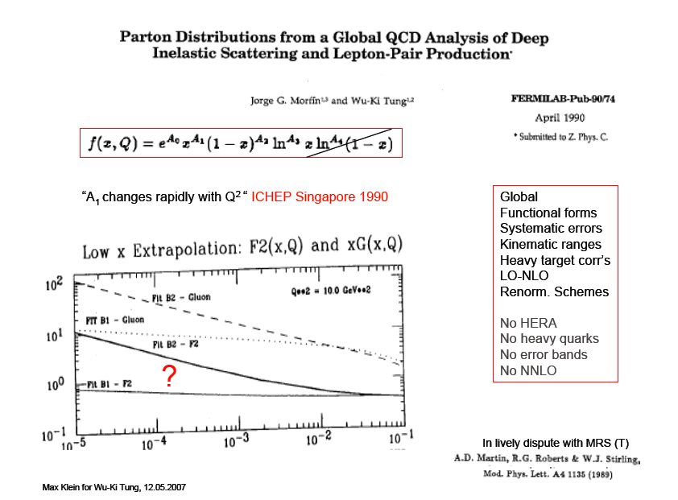

Slide 5
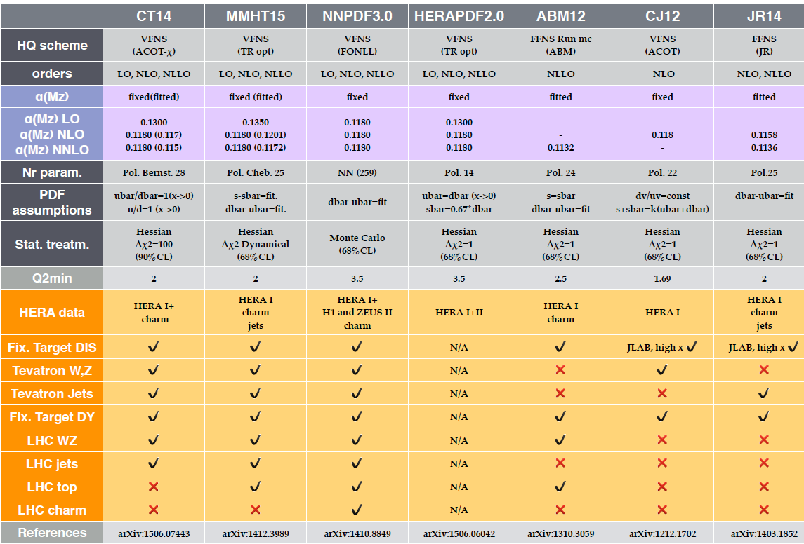
PDF sets and their assumptions
V.Radescu 10/15

Slide 6
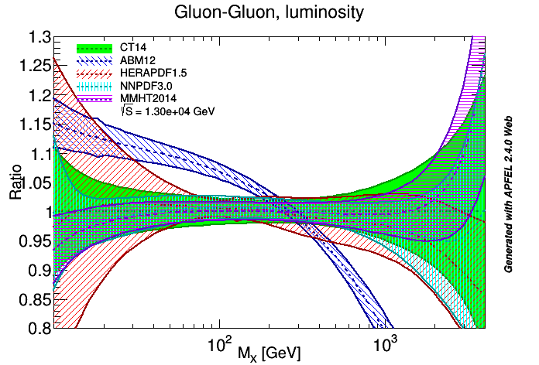
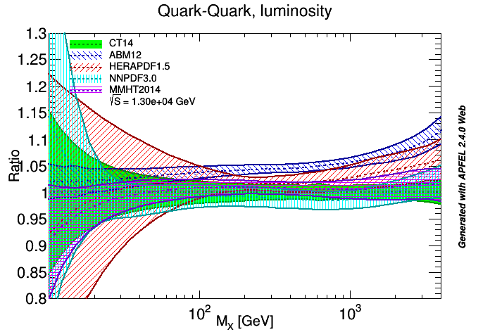
Parton-Parton “Luminosities”
C.Gwenlan+M.Klein, ATLAS, Lecce 6.10.15

Slide 7
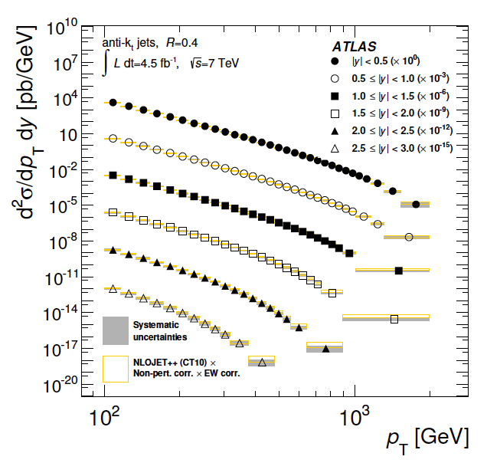
Inclusive jets
JHEP 02(2015)15
p_{T} – y cross section
Drops by ~5 orders
of magnitude for
p_{T} increase 0.1-1 TeV
Sensitive to q and xg
Also published di-jets (JHEP05(14)059 and tri-jets (EPJ C75(15)228)
C.Gwenlan+M.Klein, ATLAS, Lecce 6.10.15

Slide 8
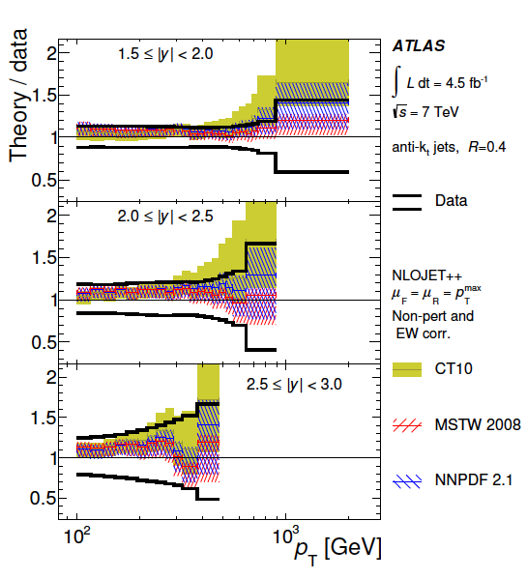
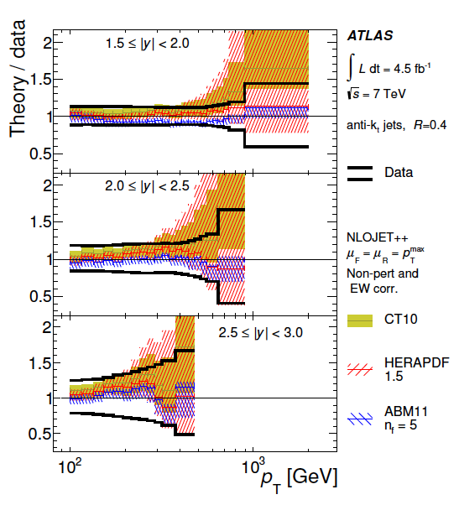
Inclusive jets - forward
JHEP 02(2015)15
C.Gwenlan+M.Klein, ATLAS, Lecce 6.10.15
Jet energy scale and large x PDF uncertainties dominant

Slide 9
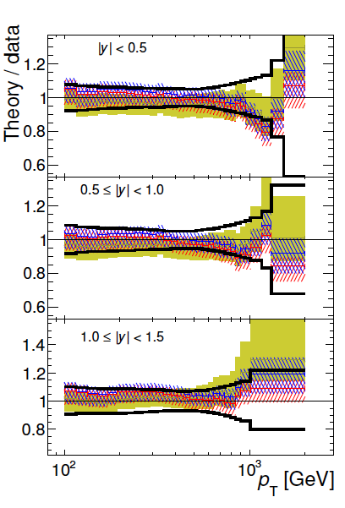
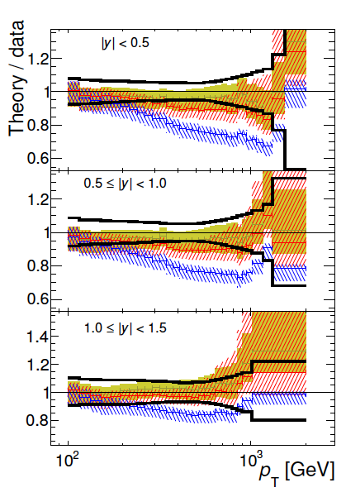
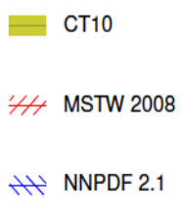
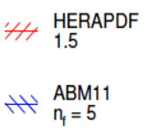
Inclusive jets - central
JHEP 02(2015)15
A major success of pQCD
Not bad, neither
ABM nor HERA fit
LHC jet data !
C.Gwenlan+M.Klein, ATLAS, Lecce 6.10.15

Slide 10
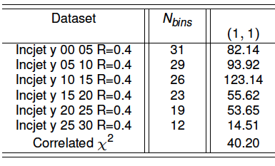
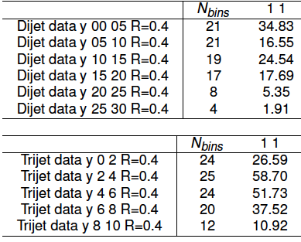
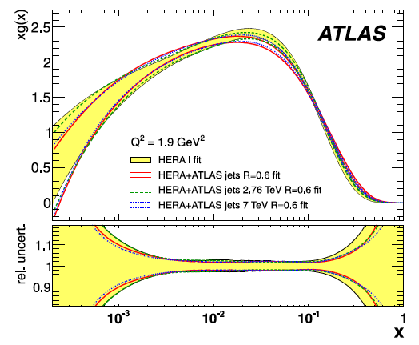
Fitting inclusive n-Jets
An attempt to fit the 7 TeV 1,2,3 jet data
together with HERA for a study of xg
reveals that we have been unable to
obtain respectable Χ² values, especially
for the central region of the inclusive jets
which has been difficult also for the
comparison with ABM and HERA1.5
Study ongoing on why that is, as one hardly can use a bad fit to change xg – variation of: jet radius,
scales-jets,h.o., hadronisation and UE (PERUGIA, AUET2B, HERWIG), data correlations, order NLO ?
Also looking at + HERA jet and the 8 TeV data
C.Gwenlan+M.Klein, ATLAS, Lecce 6.10.15
Initial study showed some sensitivity to xg

Slide 11
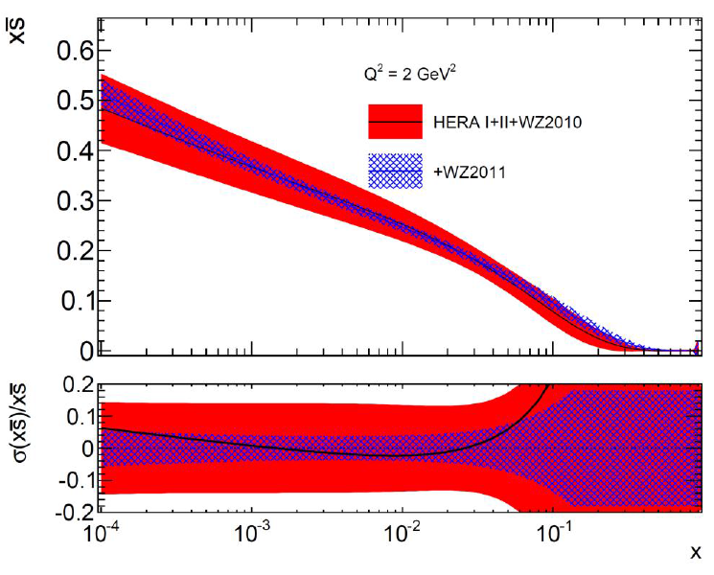
Determination of the Strange Sea Fraction
Published W,Z 2010
+ QCD analysis – 2 papers
found s/d ≈1 ± 0.2 (exp)
Note the u,d sea changes
then substantially also
HERA I+II and WZ2010
add WZ2011 (imminent..)
now s/d ≈1 ± 0.06 (exp)
extra errors delicate to
estimate..
Revived area of “global”
activity.
A. CooperSarkar
and V. Radescu
PDF forum 2.10.
WZ meeting 27.9..
(parameterisation leads to outside x range covered..)
HERA measures (down+strange) in F₂ and, for Q² limited range and luminosity, cannot separate the two.
Neutrino di-lepton data suggest(ed) suppression of s/d. Is the strange a ‘heavy quark’? No – WK. Tung
Nuclear Corr’s in νN! HERMES obtained a very different x shape in an LO analysis of K multiplicities.
C.Gwenlan+M.Klein, ATLAS, Lecce 6.10.15

Slide 12
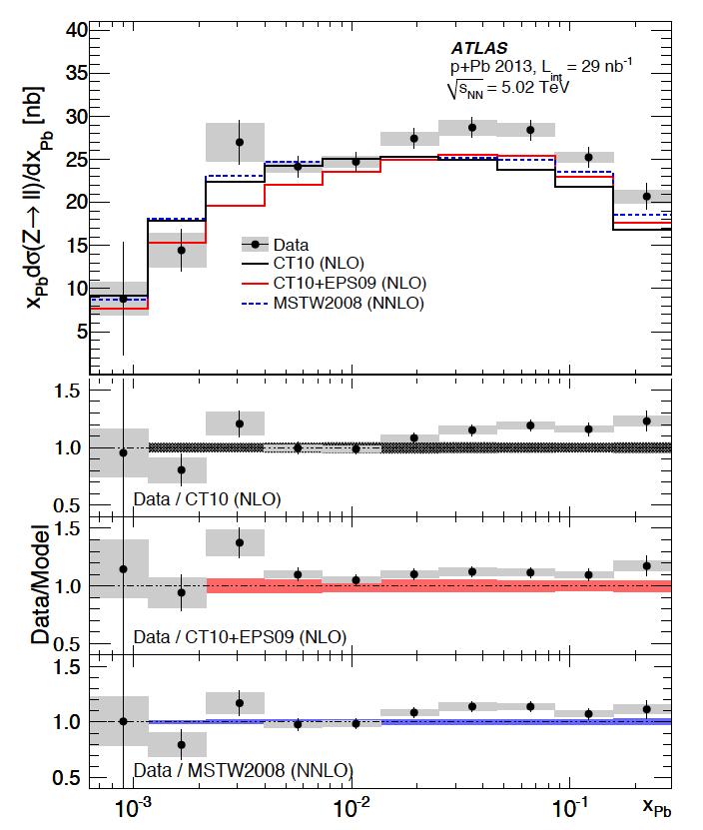


Nuclear PDFs
Z into di-leptons in pPb
Not affected by QGP
Sensitive to nPDFs and
to nuclear corrections
Consistent with pQCD
and binding effects as
implemented in EPS09
Difficult to constrain
PDFs with W,Z because
at Q² = M_{W,Z}² the Q²
evolution has washed out
initial differences in x shape
requires <1% precision..
C.Gwenlan+M.Klein, ATLAS, Lecce 6.10.15

Slide 13
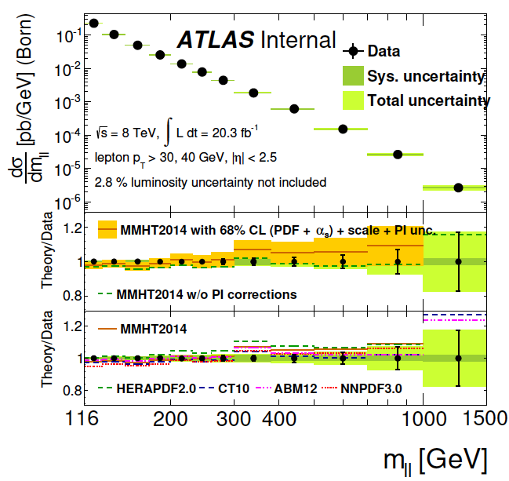
Recent comparisons – High Mass Drell Yan 8 TeV
ATL-COM-PHYS-2014-376
High mass Drell-Yan (e and mu), 8 TeV. Notice success of ABM12 (all basically d’accord)
C.Gwenlan+M.Klein, ATLAS, Lecce 6.10.15

Slide 14
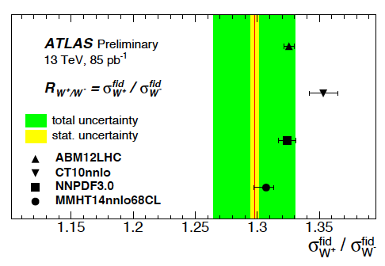
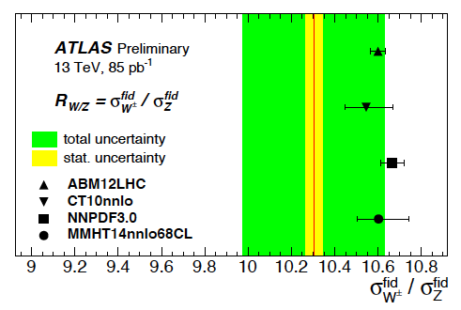
Recent comparisons – W,Z - 13 TeV
W+/W-
First tests of cross sections measured
for W,Z with 0.1fb⁻¹ of 13 TeV data
against modern PDF sets.
W/Z
18.8.2015
C.Gwenlan+M.Klein, ATLAS, Lecce 6.10.15

Slide 15
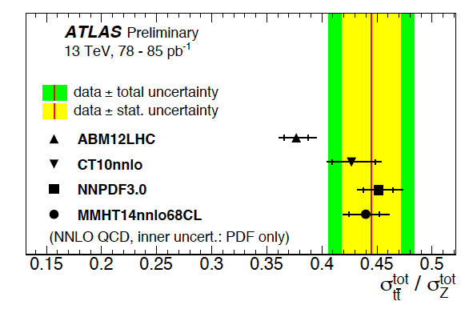
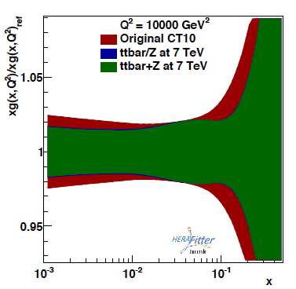

Recent comparisons – tt/Z - 13 TeV
“profiling”: use PDFset (here CT10) to
represent “the world” and add ATLAS
(simulated) data to estimate sensitivity
With ttbar+Z can improve on the gluon
and, correlated also the low x sea.
tt/Z
14.9.2015
C.Gwenlan+M.Klein, ATLAS, Lecce 6.10.15
A.Glazov
indico.cern.ch/event/395434/

Slide 16
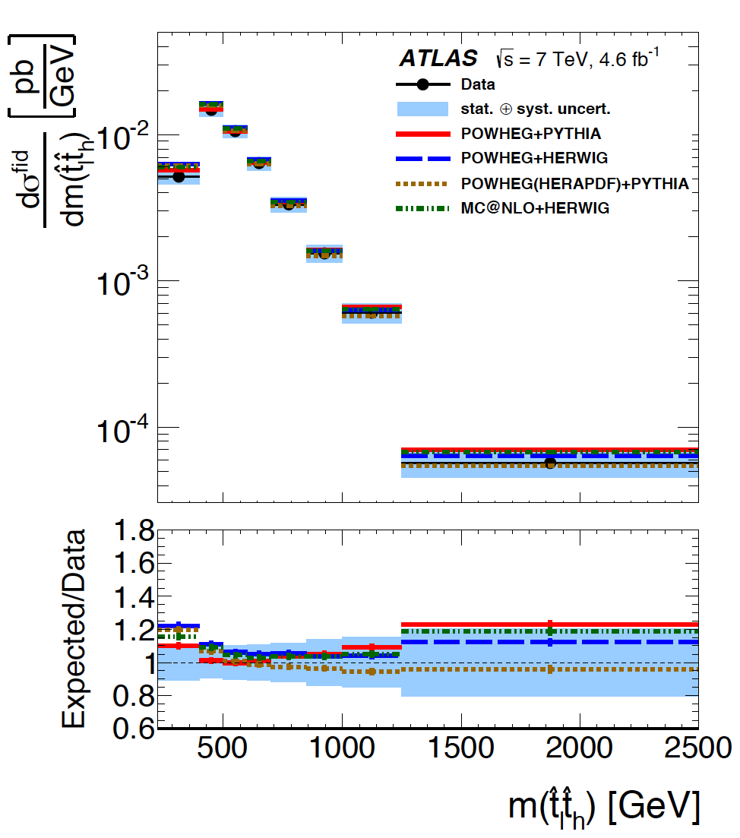

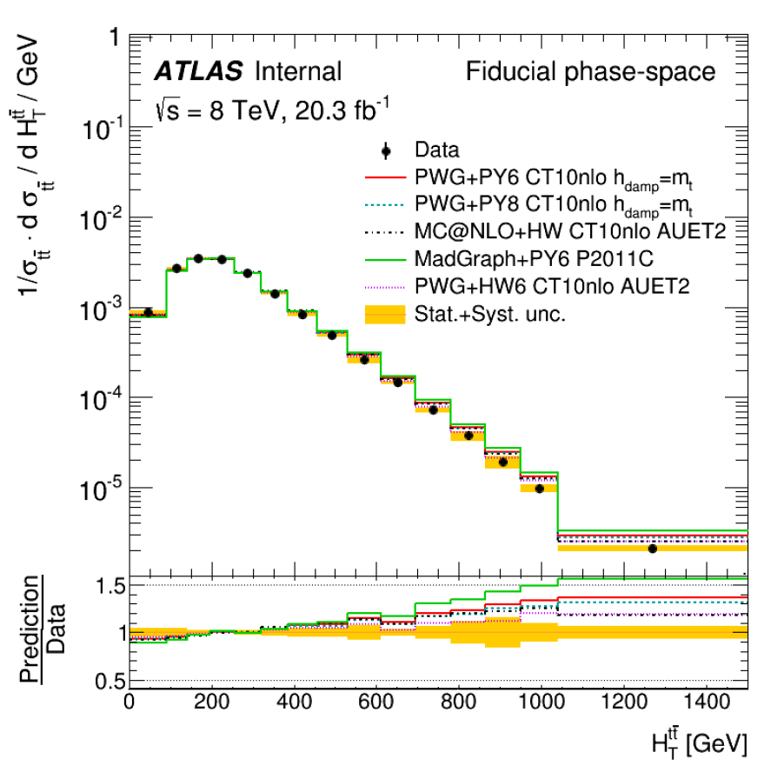

top-top
____
Sensitive to generators, tunes, IFSR
PDF sets, perturbative series and
electroweak corrections
Draft conclusion of 8 TeV paper draft

Slide 17

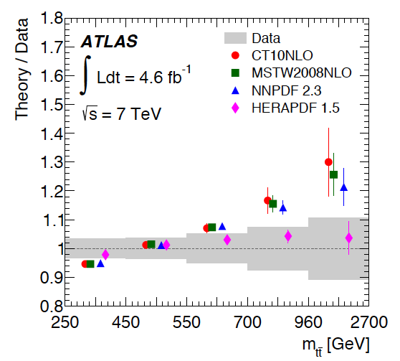
top-top
____
Sensitive to generators, tunes, IFSR
PDF sets, perturbative series and
electroweak corrections
7 TeV
8 TeV
see also
Draft conclusion of 8 TeV paper draft
C.Gwenlan+M.Klein, ATLAS, Lecce 6.10.15

Slide 18
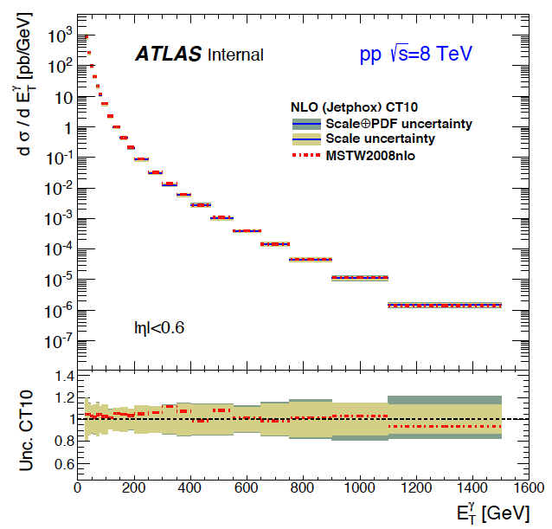
Prompt Photons
Work in progress, 8 TeV
STDM-2014-09
Amazing agreement with
theory (JetPhox, NLO, CT10)
over 10 orders of magnitude
10-20% uncertainties from
CT10, coupling, scales
Sensitive to gluon distribution
(renewal ? as photons had
been abondened from QCD
fits for kt effecs in fixed target
data description, long ago..)
cf eg Aurenche et al, PRD39(89)3275

Slide 19
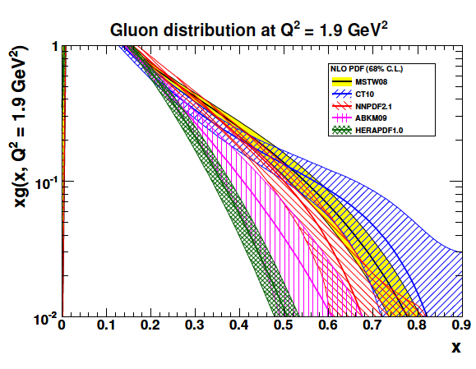
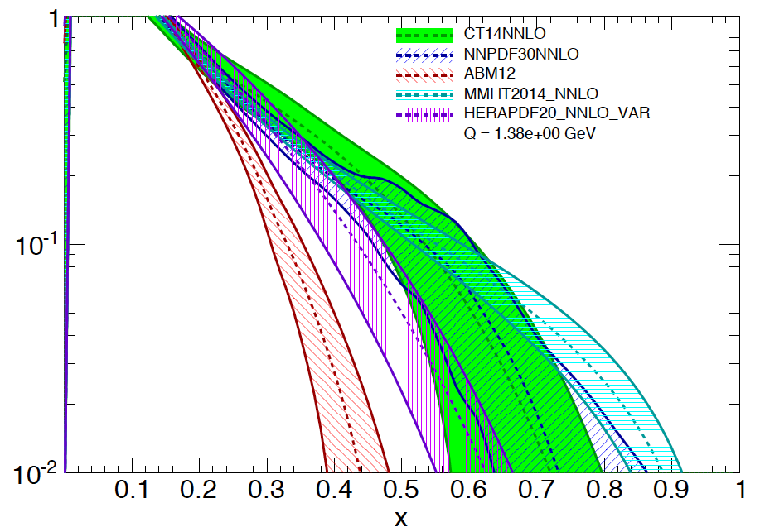
Gluon at High x ?
A QCD problem by itself and a key question for searches as luminosity increases …
Gluon prior to LHC data (2011)
Gluon with (first) LHC data (2015)
used by CT14,NNPDF,MMHT
Related to quark distributions, low x, α_{s} , heavy flavour treatment, to resummation
C.Gwenlan+M.Klein, ATLAS, Lecce 6.10.15

Slide 20

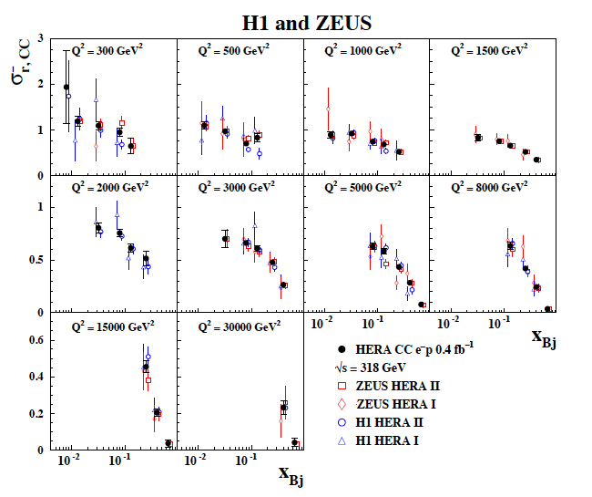
Large Bjorken x
CC at HERA reached at best x=0.5.
The luminosity was 3 10³¹ while > 10³³ is required as xq ~ (1-x)^{k} for x → 1
Fixed target DIS data suffer from
TMC, HT, nuclear corrections and
inconsistencies
There is no reliable prediction at large x which is the high mass region we are interested in HL LHC
Final HERA data on charged currents
C.Gwenlan+M.Klein, ATLAS, Lecce 6.10.15

Slide 21
Valence quarks
up
down
C.Gwenlan+M.Klein, ATLAS, Lecce 6.10.15

Slide 22
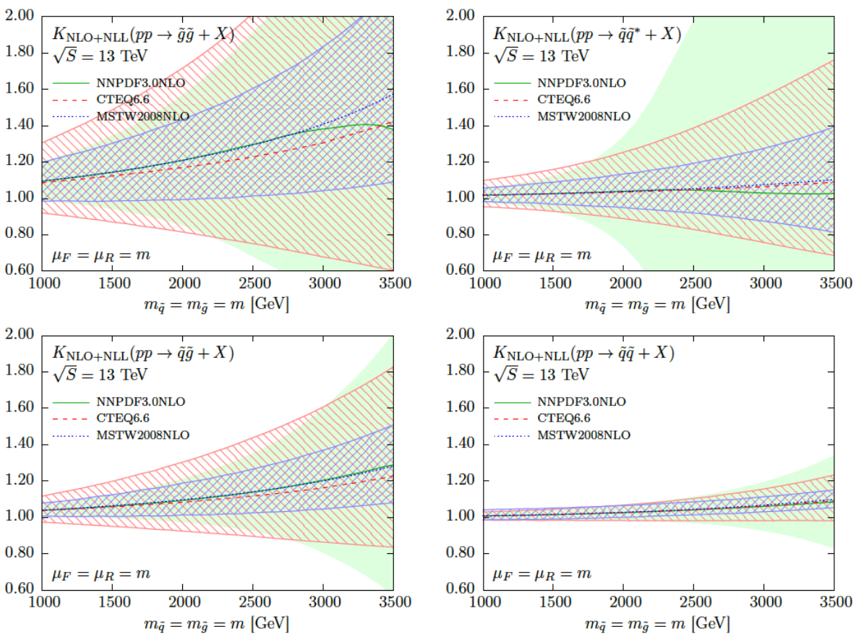
Rising PDF uncertainties at high x → mass SUSY
Juan Rojo
PDF forum
2.10.15
C.Gwenlan+M.Klein, ATLAS, Lecce 6.10.15

Slide 23
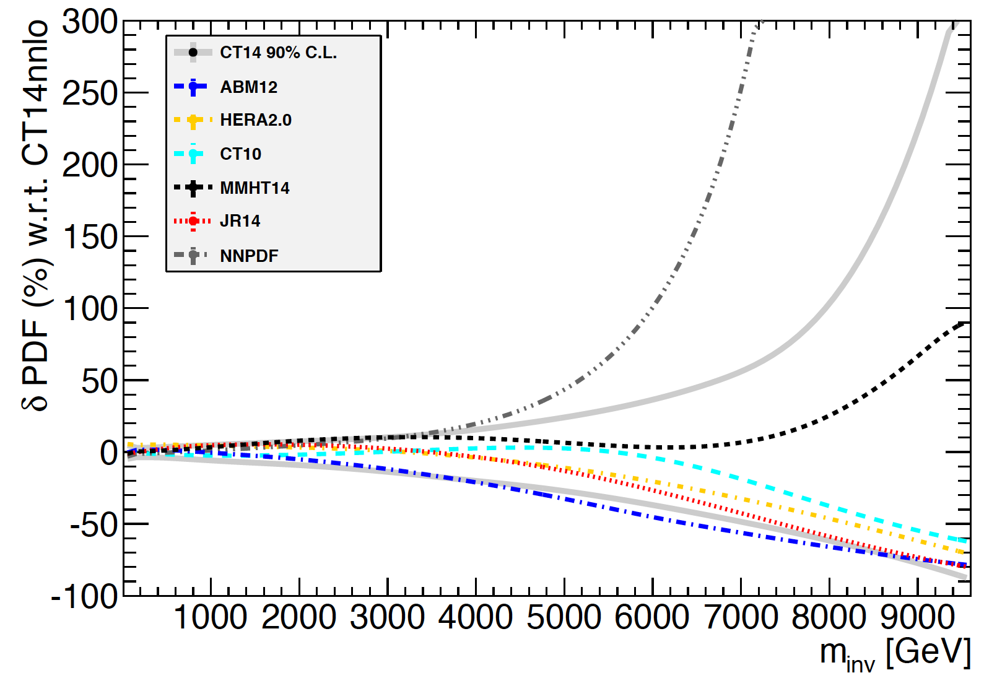
Very High Mass Dell Yan 13 TeV - σ(PDF)/σ(CT14)
NNPDF3 →
← MMHT14
JR14
HERA2.0
CT10
ABM12 →
VRAP calculation, U.Klein
C.Gwenlan+M.Klein, ATLAS, Lecce 6.10.15

Slide 24
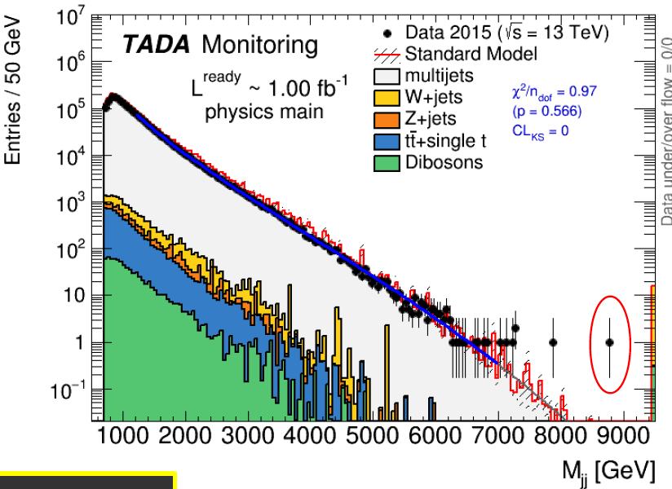
Approaching 10 TeV
From Dave Charlton 5.10.2015
C.Gwenlan+M.Klein, ATLAS, Lecce 6.10.15

Slide 25
Final Remarks
pQCD has a major success in broadly describing our measurements
Higher precision is required to interprete the measurements in terms
of PDFs, to derive constraints on the PDFs. Important areas are the
constraints on the strange quark (W,Z, W+c) and the gluon (jets, tt).
Higgs, M_{W}, .. measurements demand even higher precision.
The Forum, with the analysis groups, provides a professional base for
treating these as appropriate as possible. Besides the data, we face
many calculational challenges on which impressive work is being done
as a collborative effort, with also theorists such as: statistical treatment,
h.o. QCD and linked electroweak corrections, QCD fit techniques, …
There is a close collaboration with the PDF4LHC forum (new paper today)
We need to very seriously think of how we master the high x challenge
where new phenomena are expected which may not be confused with PDFs.
C.Gwenlan+M.Klein, ATLAS, Lecce 6.10.15

Slide 26
backup

Slide 27
Recent comparisons – W,Z,tt 13 TeV
W:+/-
First tests of cross sections measured
for W,Z,tt with 0.1fb⁻¹ of 13 TeV data
against modern PDF sets.
Working machinery for NNLO
tt/Z
W/Z
18.8.2015
14.9.2015

Slide 28
high x PDFs: link to LHC
large uncertainties in high x PDFs limit searches for new physics at high scales
many interesting processes at LHC are gluon-gluon initiated: top, Higgs, … and BSM processes, such as gluino pair production
arXiv:1407.2410
LHeC PDF
current BSM search in dilepton final state; uncertainties on high-x (anti)quarks dominate
arXiv:1211.5102

Slide 29
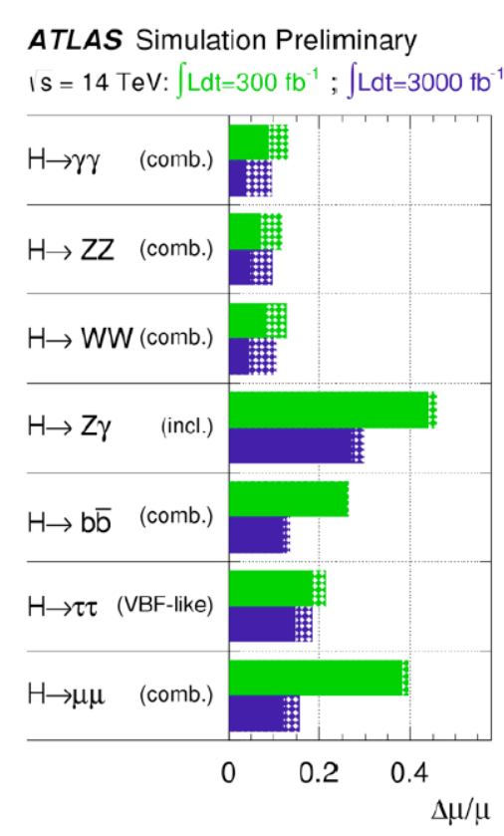
Higgs and M_{W} Theory Uncertainties

Slide 30
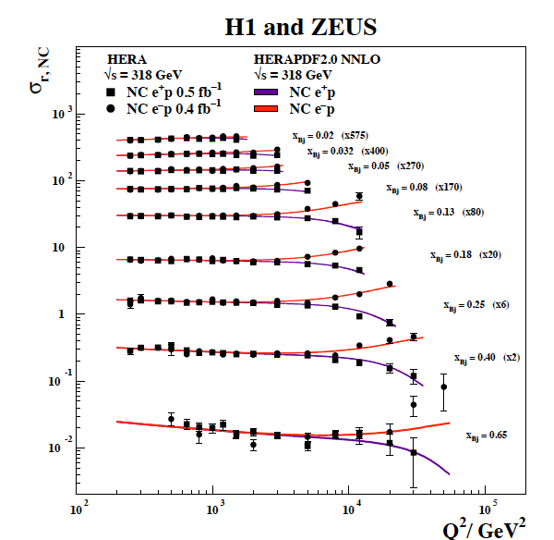
more on PDFs …
High x HERA
Neutral Current

Slide 31
ATLAS Data-PDF Comparisons
Should perhaps have a list of recent (2014-15) PDF relevant papers, but survive without

