Slide 1
Kinematics
Reactions and Phase Space
Units and Dimensions
4-Vectors
Kinematics of 2-2 Reaction
3-Body Decay
Deep Inelastic ep Scattering
Drell-Yan pp Scattering
Proton Structure
Feynman Rules
Calculation of a Scattering Cross Section
Max Klein, Lectures for Postgraduates at the University of Liverpool
November 4+10, 2020

Slide 2
Phase Space

Slide 3
Units

Slide 4

Units and Dimensions
Dimension Counting. Example: ey → ey Thompson Scattering
-1
( )
→ $σ=? barn$
R_{e} = Compton wavelength of the electron

Slide 5
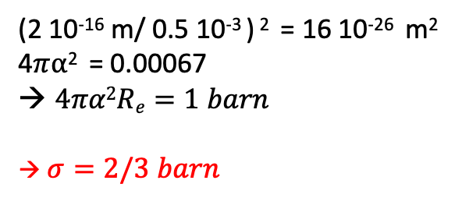
Units and Dimensions
Dimension Counting. Example: ey → ey Thompson Scattering
-1
(2 10⁻¹⁶ m/ 0.5 10⁻³ ) ² = 16 10⁻²⁶ m²
4$π$⍺² = 0.00067
$4πα2Re=1 barn$
→ $σ=2/3 barn$
R_{e} = Compton wavelength of the electron [often h/mc: 2.4 10⁻¹² m]

Slide 6
Kinematics

Slide 7
Lifetime

Slide 8
Lifetime
?

Slide 9
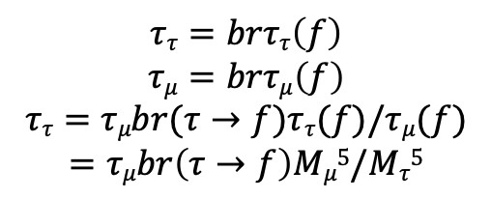
Lifetime
$$ττ=brττ\left(f\right)$$
$$τμ=brτμ\left(f\right)$$
$$ττ=τμbr(τ→f)ττ(f)/τμ(f)$$
$$=τμbr\left(τ→f\right)Mμ5/Mτ5$$

Slide 10
Four-Vectors, Energy and Momentum Conservation
Three-Momentum and Energy
Space and Time

Slide 11
Decay

Slide 12
Decay

Slide 13
Mandelstam Variables
=
f(m_{e},m_{p})=?
?

Slide 14
Mandelstam Variables
=

Slide 15
Two-body Decay

Slide 16
Example: Calculation of Elastic ep Scattering Kinematics
E = E(e)
M= M(p)
Application:
Search for Dark Matter
as WIMPs
generate recoils

Slide 17
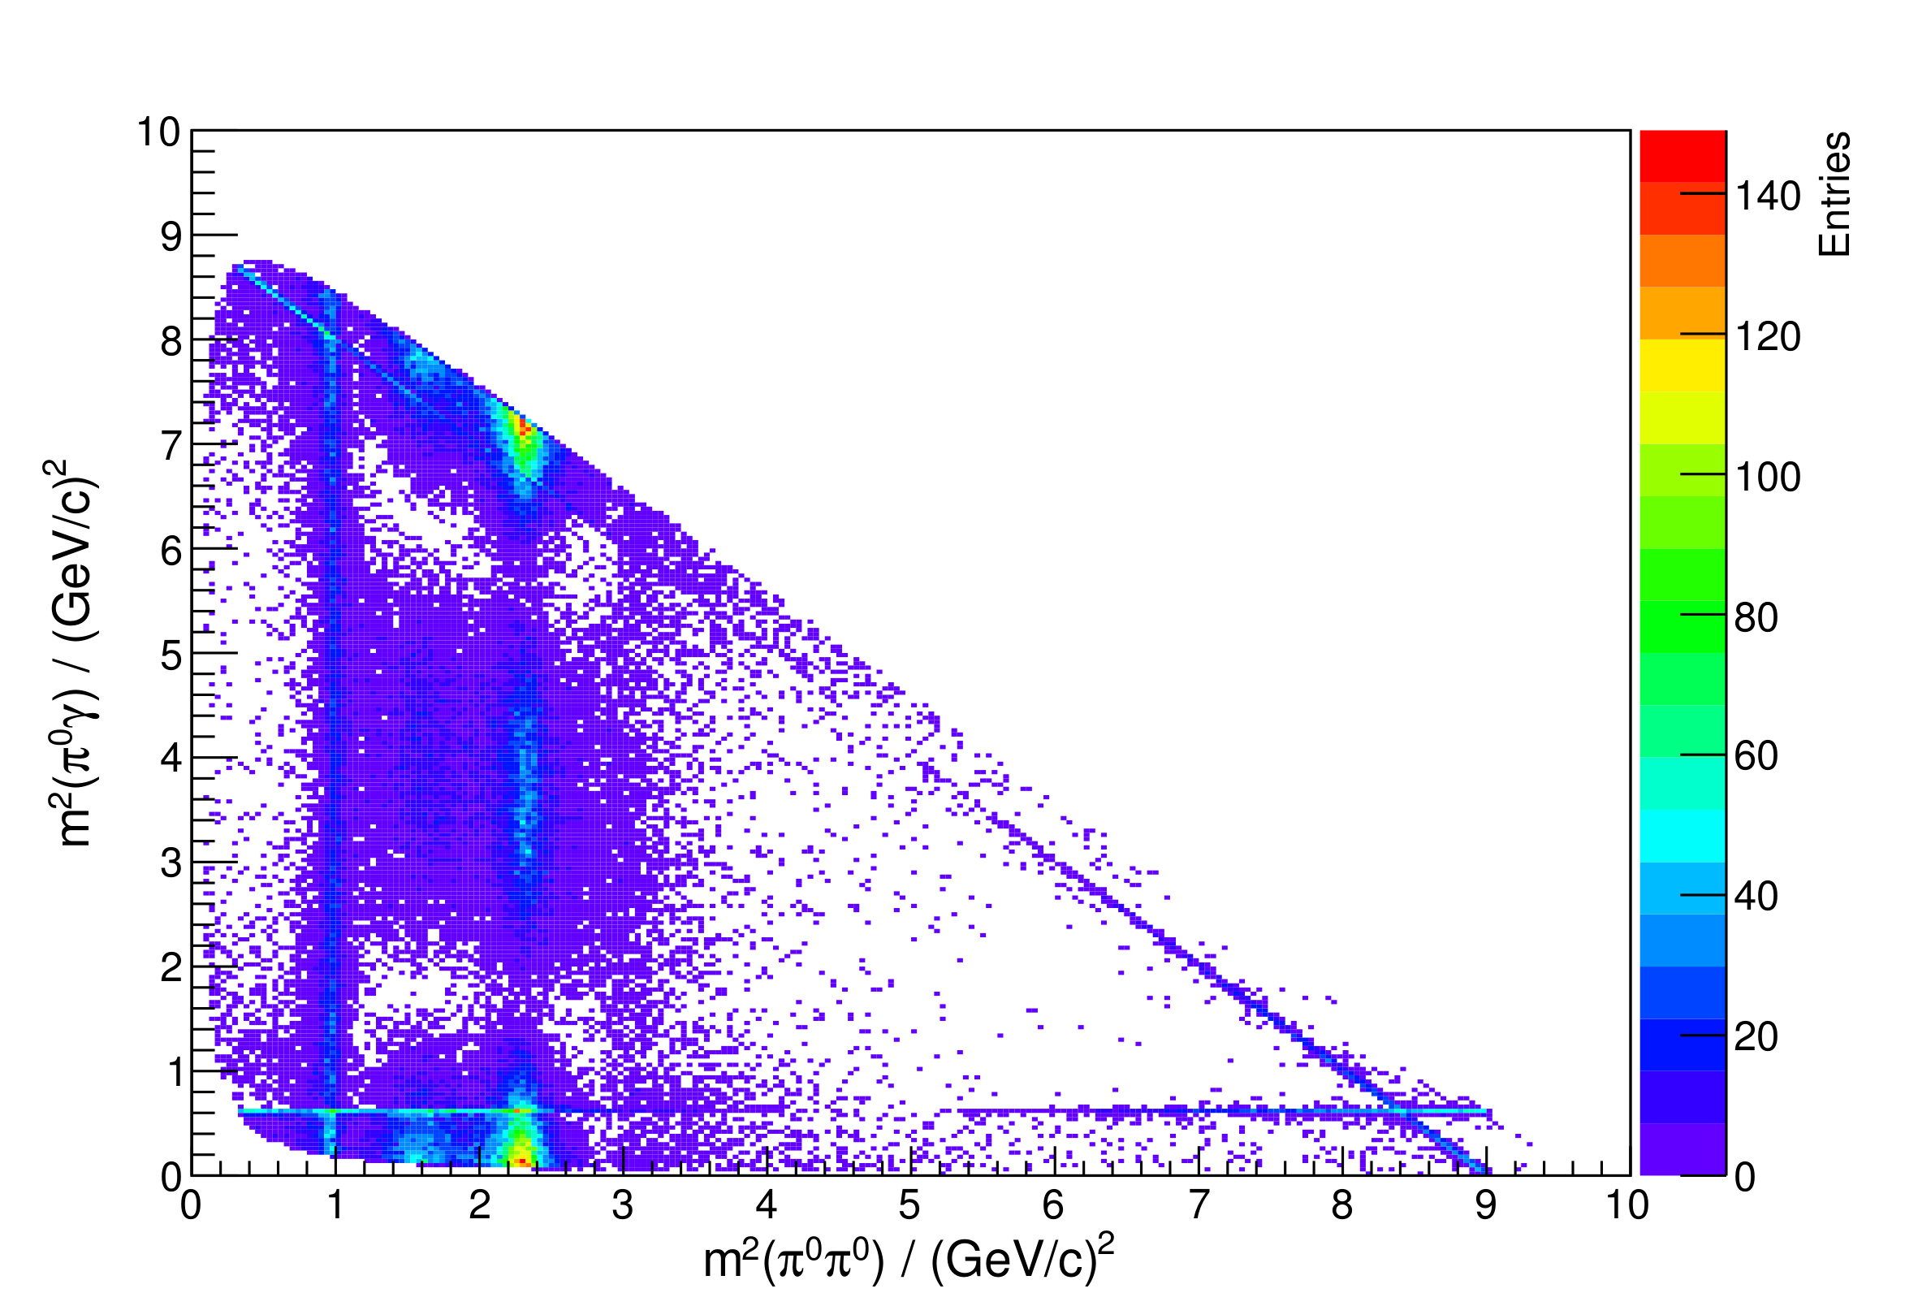

Dalitz Plot (kinematics of 3-body decay)
J/$ψ → π0π0γ$
Richard Henry Dalitz (1925-2006)
Cambridge
Bristol
Birmingham
Cornell
Chicago
Oxford

Slide 18
Dalitz Plot
s₁ = m₂₃²
Restframe of Parent
2
Restframe of 2+3
to find min(s₁)

Slide 19
Dalitz Plot
This formula provides the
maximum (minimum) of s₂
in the s₂-s₁ plane.
Similar for s₁-s₃ plane which
is illustrated left

Slide 20
Kinematics Part 2
6.11.2019

Slide 21
Deep Inelastic ep Scattering
Proton at rest
Energy transfer
y=relative E transfer
= inelasticity
cms energy squared
4-momentum transfer
Conservation of 4-momentum
Deep inelastic scattering
Bjorken x
Calculate the cms energy squared for a
head-on ep collider of beam energies E_{e}, E_{p}

Slide 22
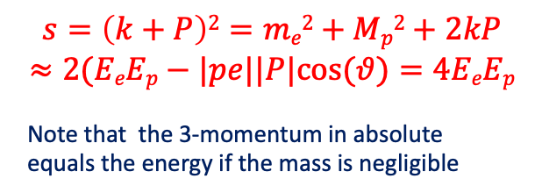
Deep Inelastic ep Scattering
Proton at rest
Energy transfer
y=relative E transfer
= inelasticity
cms energy squared
4-momentum transfer
Conservation of 4-momentum
Deep inelastic scattering
Bjorken x
$$s=\left(k+P\right)2=me2+Mp2+2kP$$
$$≈2(EeEp−|pe||P|cos⁡(θ)=4EeEp$$
Note that the 3-momentum in absolute
equals the energy if the mass is negligible
Example: LHeC: s=4x60x7000 GeV² → an equivalent fixed target electron beam would need to have 900 TeV
Quarks were discovered with a 2mile LINAC of 20 GeV. The LHeC equivalent would be 90 000 miles long.

Slide 23
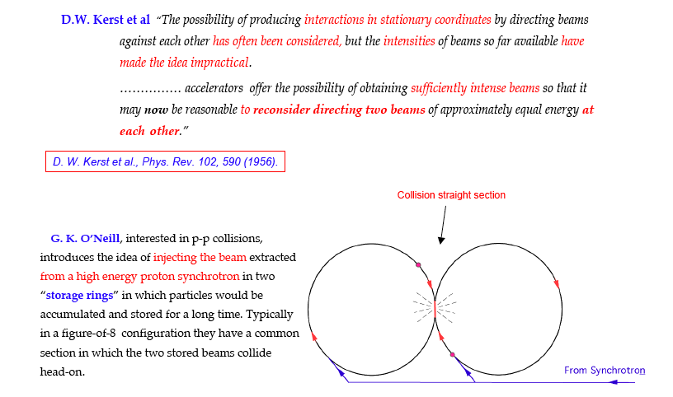
Storage Rings
Tazzari, Cern Acc School 2006
fixed target accelerator: s=2ME, collider: s=4E² : gain: 2E/M
First e⁺e⁻ storage ring ADA at Frascati: Bruno Touschek et al.

Slide 24
Inelastic ep Scattering in the QPM
Elastic ep Scattering Cross Section

Slide 25
Verification of the Quark-Parton Model - Fractional Electric Charges

Slide 26
Drell-Yan Scattering

Slide 27
Rapidity

Slide 28
Drell Yan
ATLAS Internal Note 2010

Slide 29
Drell Yan

Slide 30
Drell Yan
2 electrons, simulated 2010
4 leptons, 2019

Slide 31
An Exercise

Slide 32
An Exercise

Slide 33
Calculation of a Cross Section (Born)

Slide 34
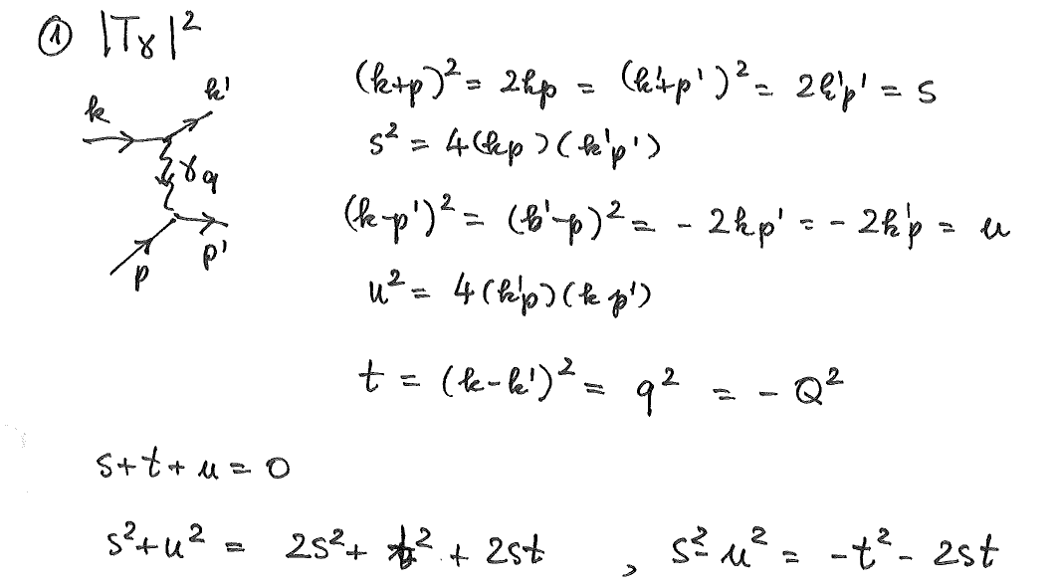
4-momenta of scattering diagram kinematics
Neglect masses

Slide 35
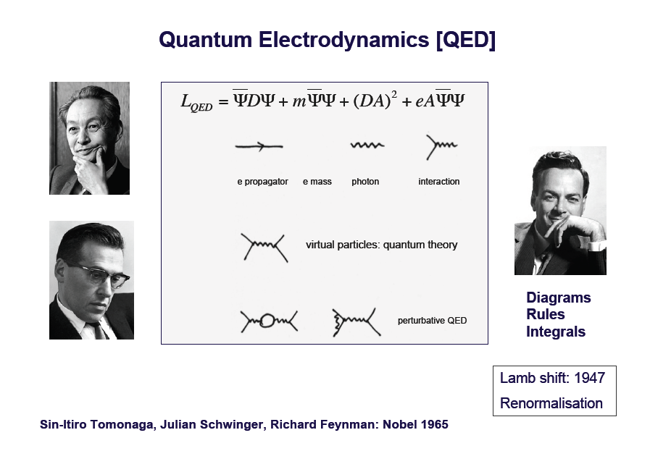
QED
“QED and the men who made it”, by S.Schweber, Princeton 1994
Classical mechanics: Equations of motion from Lagrange equations L=T-V
QED – a Lagrangian, renormalisable gauge field theory

Slide 36
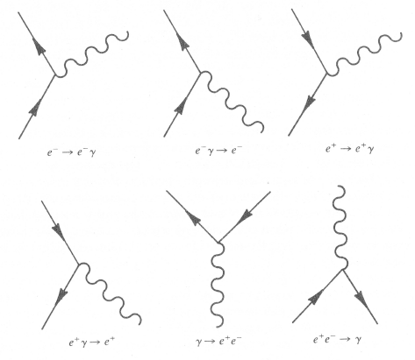

Feynman Diagrams
cf Feynman lectures
(video tapes, New Zealand)
An introduction to QED by
the master, you can listen to
time
Electron is a line, incoming/outgoing
Photon is a wiggly line
Emission of photon determines a vertex.
Conservation of charge and energy-momentum at the vertex
(yields δ-functions for the sum of 4-momenta)
Probability of this emission is proportional to charge e=√(4πα)
In QED, as in other quantum field theories,
we can use the little pictures invented by
my colleague Richard Feynman, which are
supposed to give the illusion of understanding
what is going on in quantum field theory.
M.Gell-Mann
cited in “Particles and Nuclei”, B.Povh et al.

Slide 37
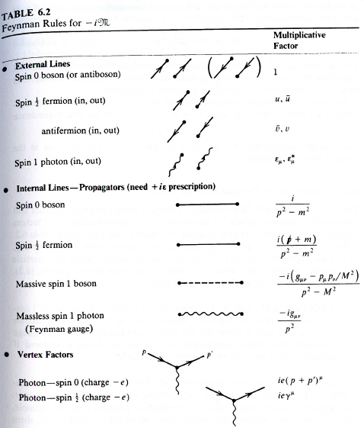
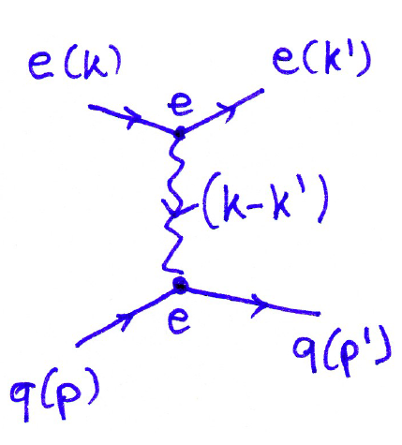
Feynman Rules
Feynman diagrams lead to straightforward
calculation of scattering amplitudes. This
requires also to sum over incoming and
average over final state spin states. The
cross section is obtained from the square
of the (complex) amplitude (TT*)
taking into account phase space factors.

Slide 38
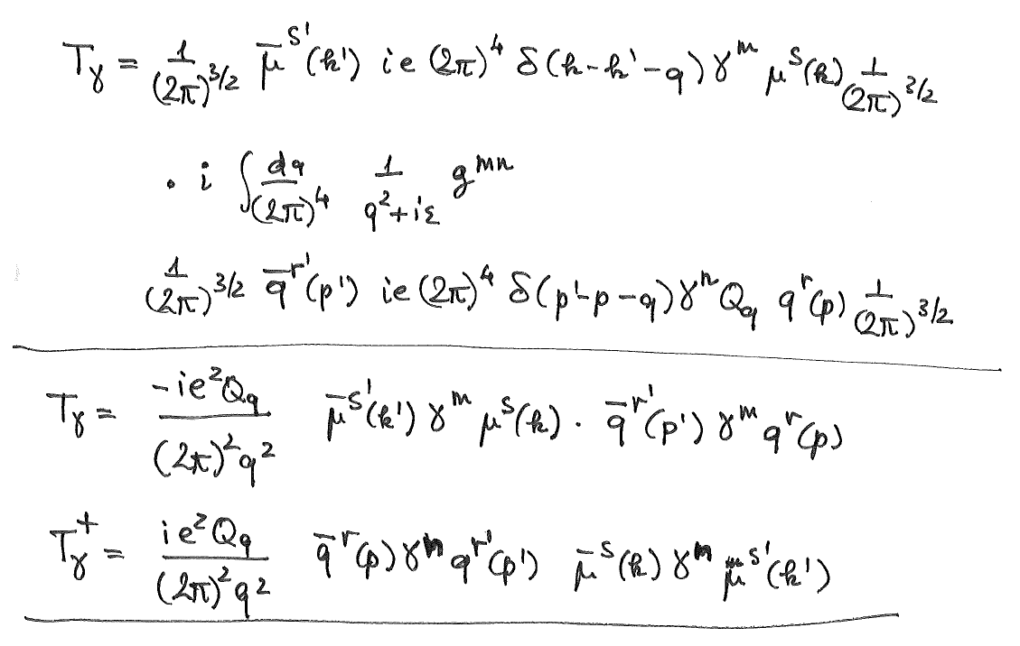
Amplitudes
Feynman Rules: Bogoljubov,Shirkov: Quantum Field Theory

Slide 39
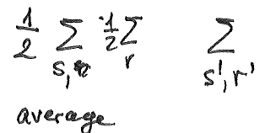
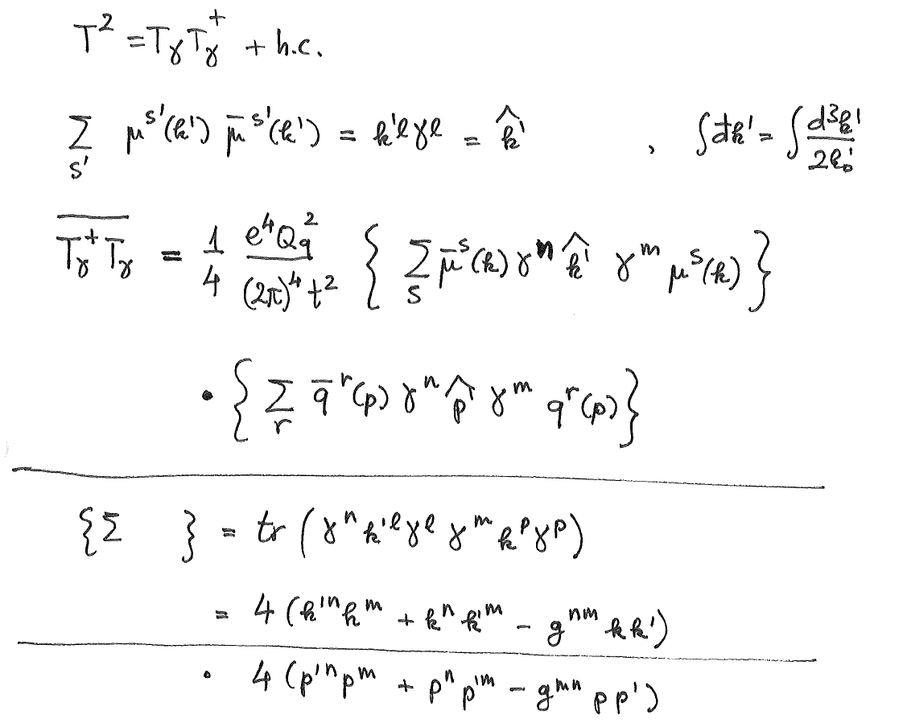
Amplitude Product
Average over incoming spins
Sum over outgoing spins
Trace of y matrices

Slide 40
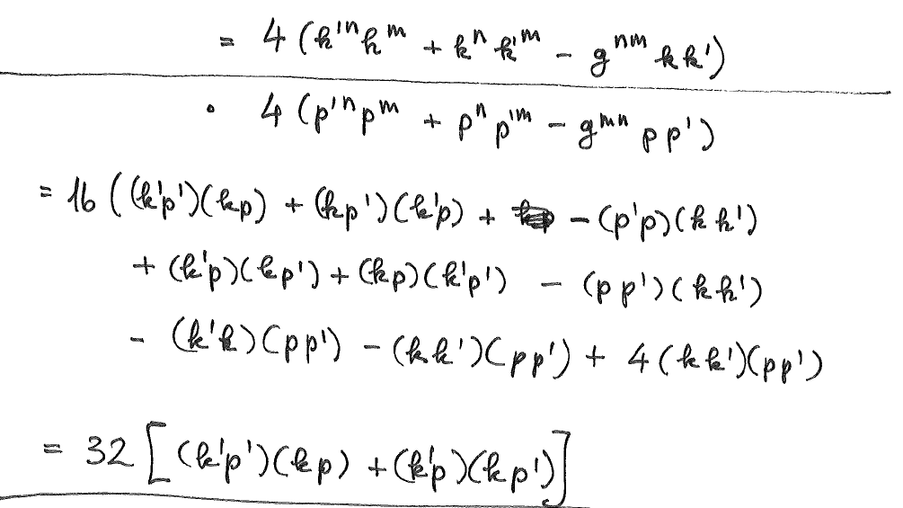
4-Vector Algebra

Slide 41
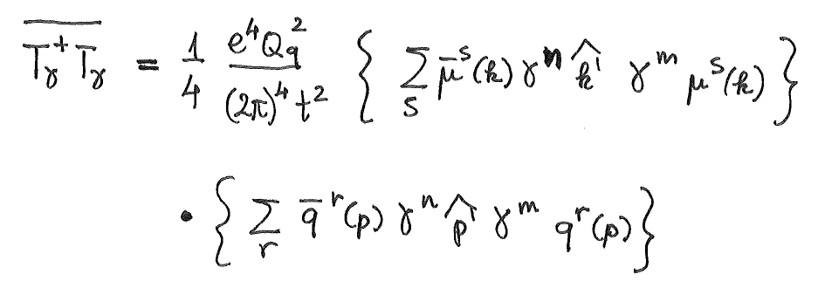
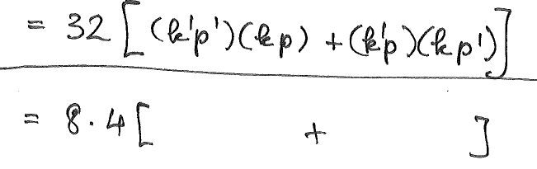
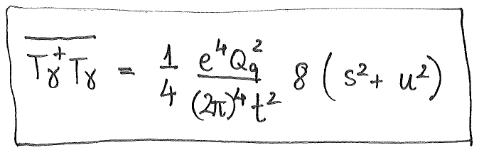
Product of Amplitudes
cf above

Slide 42
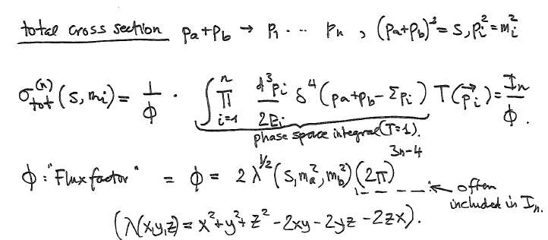
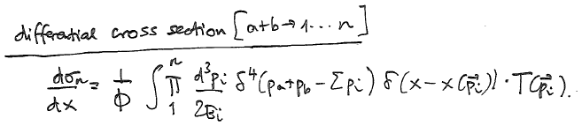
Cross Section Kajantie Byckling

Slide 43
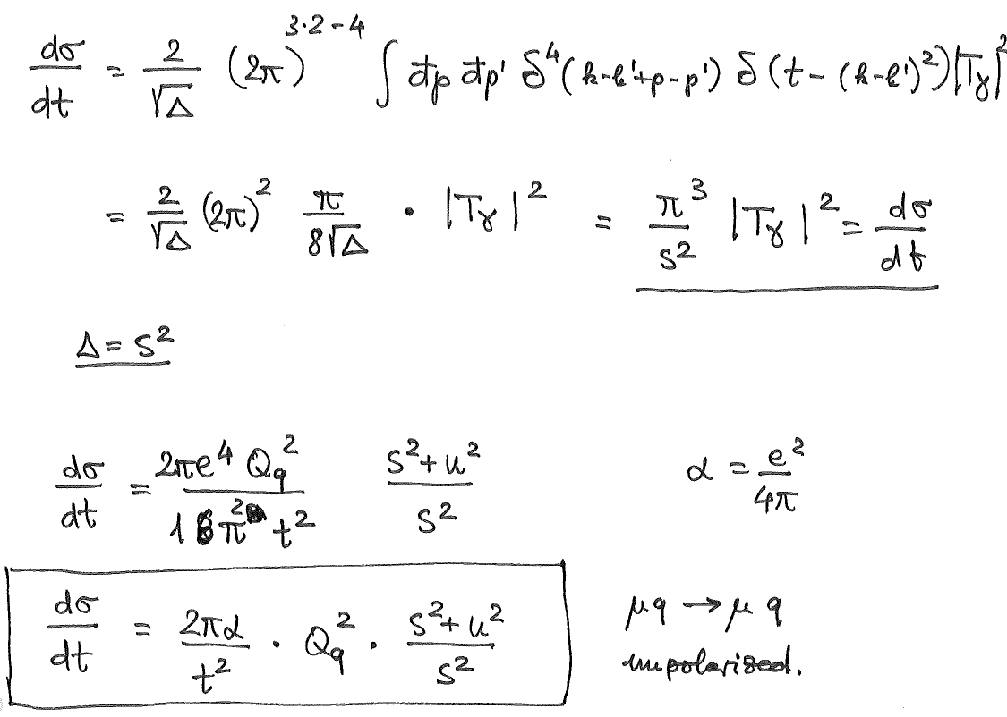

Elastic lp Scattering Cross Section

Slide 44
Inelastic ep Scattering in the QPM
Elastic ep Scattering Cross Section

Slide 45
Verification of the Quark-Parton Model - Fractional Electric Charges

Slide 46
Kinematics
Good luck to your further research, PhDs and beyond. Thanks.

