Slide 1
From Quarks 1968 to Future DIS at CERN
Bits of History
The Case for the LHeC
Updating the CDR for the European Strategy 2020
Max Klein
Introduction to the LHeC/FCCeh/PERLE Workshop at Orsay, 27.6.2018

Slide 2
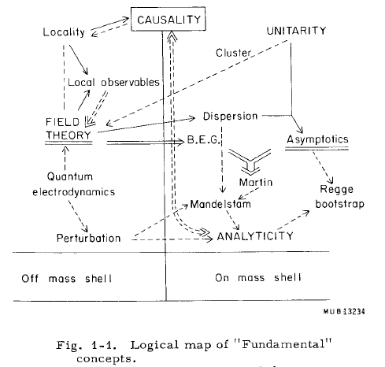
Rapporteur Talk at ICHEP 1966

Slide 3
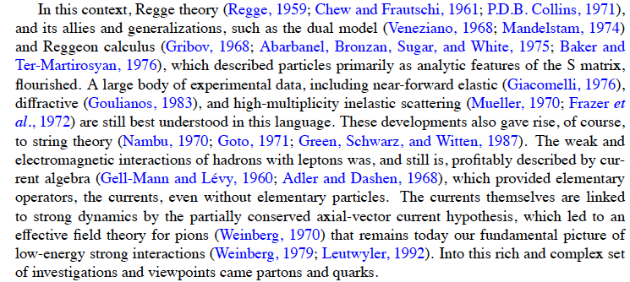
QCD evolved from a Lagrangian with the property of asymptotic freedom to a sophisticated tool for the calculation of high energy processes. R.K. Ellis Nuovo Cimento 39C(2016)355

Slide 4
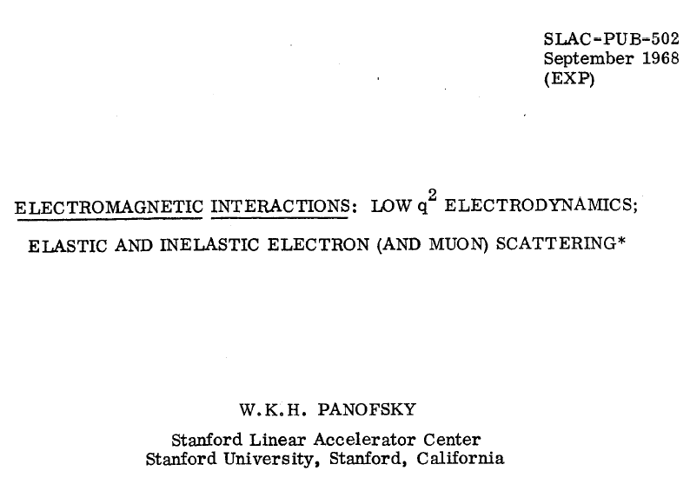

Slide 5
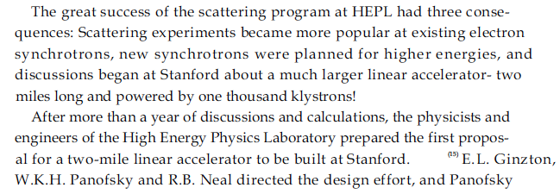
2mile Linac

Slide 6
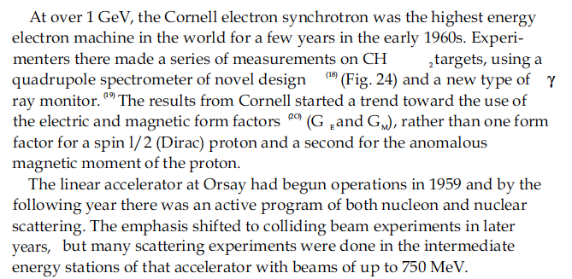
Cornell and Orsay
…Further from R Taylor (1929-2018)
Nobel Prize Lecture

Slide 7
title

Slide 8
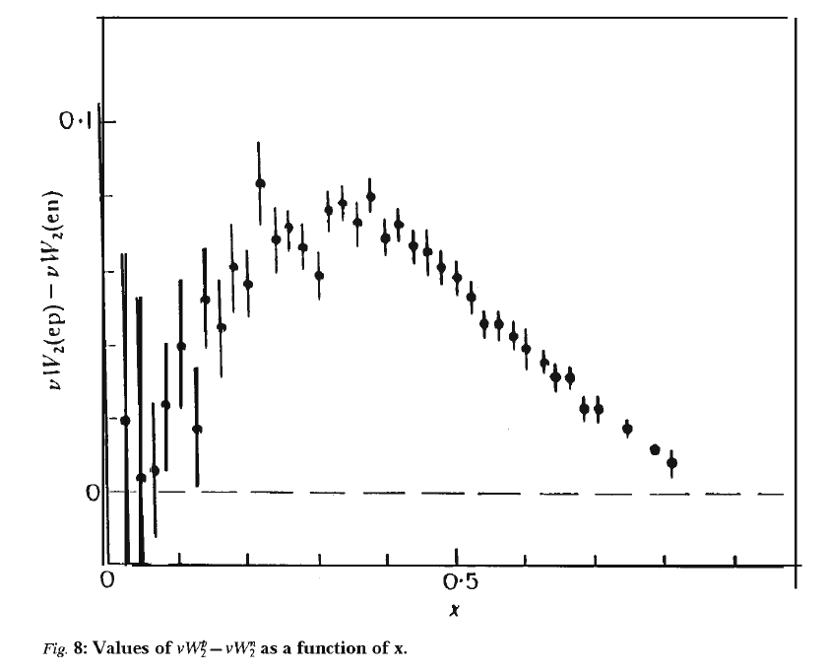
The Quark Parton Model
F₂(ep)= x [e_{u}² (u+ubar) + e_{d}² (d+dbar)]
F₂(ep)= x [e_{u}² (u+ubar) + e_{d}² (d+dbar)]
q=q_{v}+q_{s} (Kuti Weisskopf)
If u_{s}=ubar=d_{s}=dbar
F₂(ep)-F₂(en) = x [e_{u}² u_{v} - e_{d}² d_{v}]
e_{u}=2/3, e_{d}=-1/3
till today u_{v} is better known than d_{v}
F₂(eN)/F₂(νN) =1/2 (e_{u}²+e_{d}²)
SLAC/GGM: 0.29 +- 0.05 (1974)
J Friedman, Nobel prize lecture

Slide 9
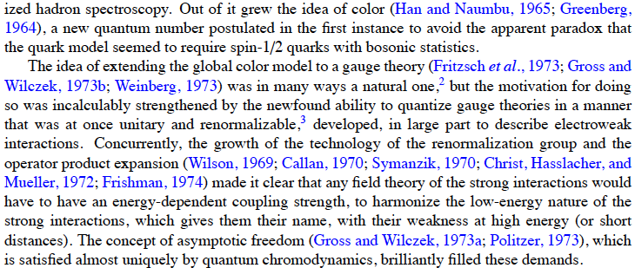
That may not be it..
H
Handbook of perturbative QCD, CTEQ

Slide 10
Guido Altarelli DIS2009, Madrid

Slide 11
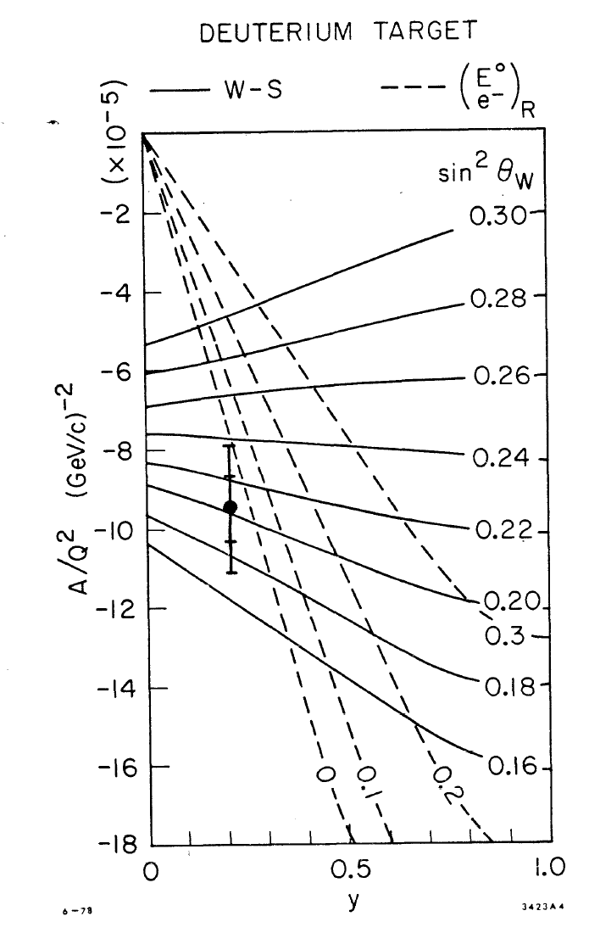
Polarised eD Scattering
20 GeV polarised electrons, P=0.37, Q² ~ 2 GeV²
C.Prescott … W.Jentschke
→ SU_{L}(2) x U(1), electron r.h. singlet: GWS eweak theory

Slide 12
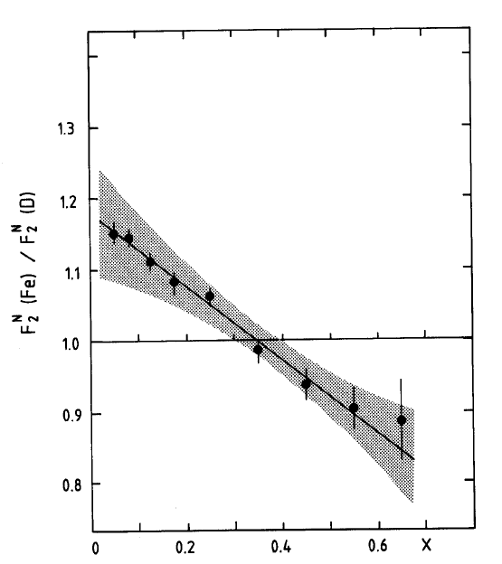
The EMC Effect
DIS on Nuclei,
Unresolved till today
EIC + LHeC
well complementary
QGP, Deconfinement
Saturation at small x

Slide 13
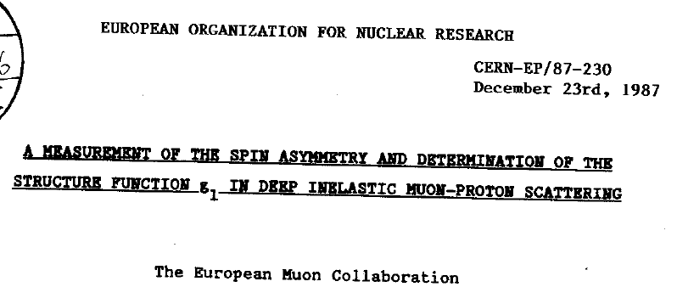
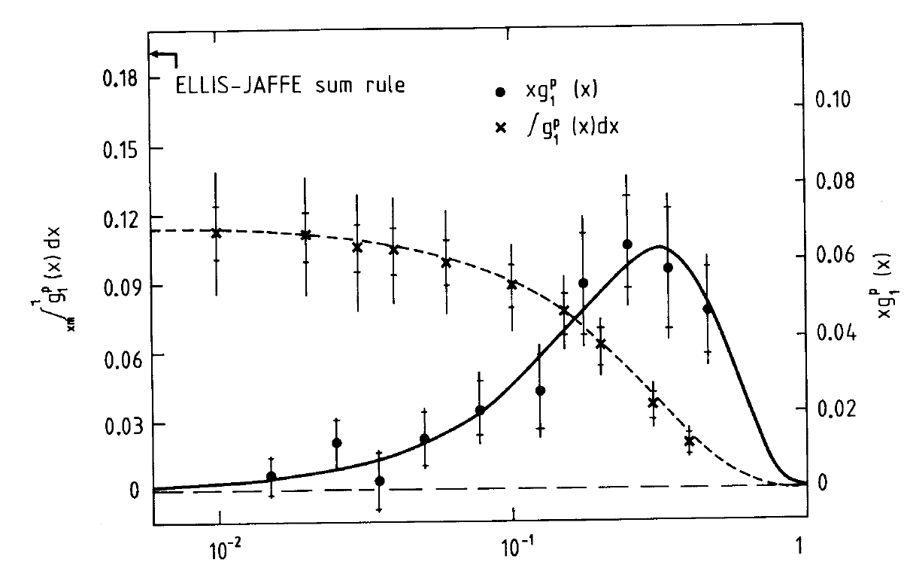
title
The 87 discovery
of the spin deficit
..EMC, HERMES,
COMPASS to EIC

Slide 14
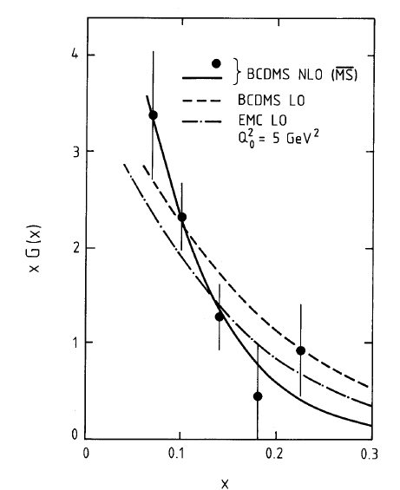
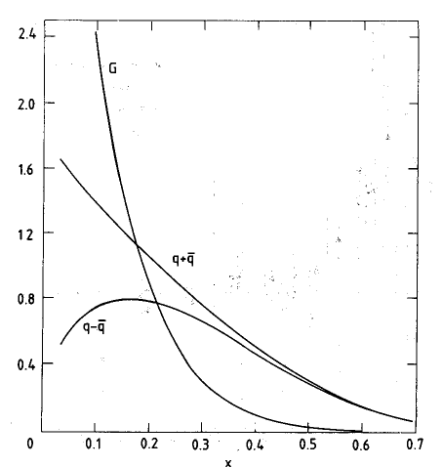
PDFs before HERA - Gluon - xg(x,Q²)
BCDMS
CDHS
9 Nov 89: R Taylor at Paris

Slide 15
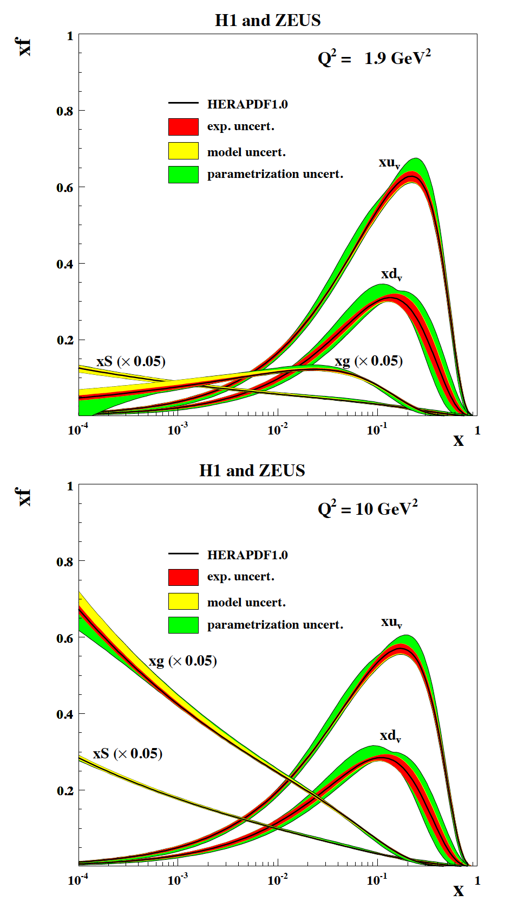
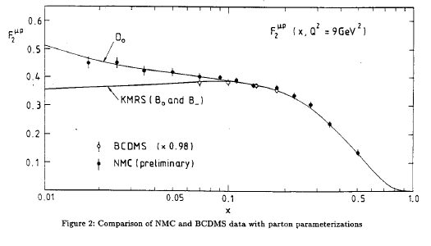
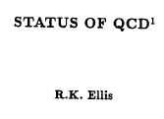
Low x + Partons - HERA
0911.0884
Low x > 0.01 before HERA
Note: HERA: QCD vacuum dominates p structure at small x. xg vanishes/rises at low/hi Q²

Slide 16
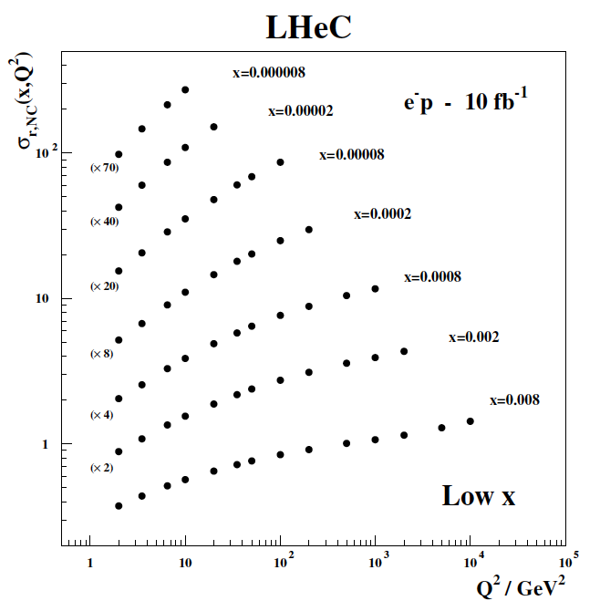
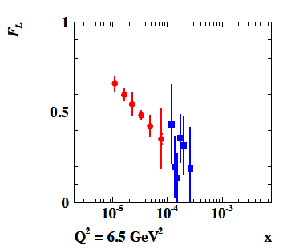
How to determine low x evolution + discover saturation ?
Needs cleanest DIS constraints,
proton, not ion, high E: F₂+F_{L}
High precision F_{L} from variation
of E_{e} independently of LHC/FCC
LHeC CDR: 1206.2913 J Phys G
High precision F₂(x,Q²) from few days
of nominal ep running. Needs large Q²
and low x ~ 1/s:
Impossible at EIC
MK: 1802.04317
This constrains DGLAP and rules it out (or not..). cf CDR (LHeC)

Slide 17
The Case for the LHeC

Slide 18
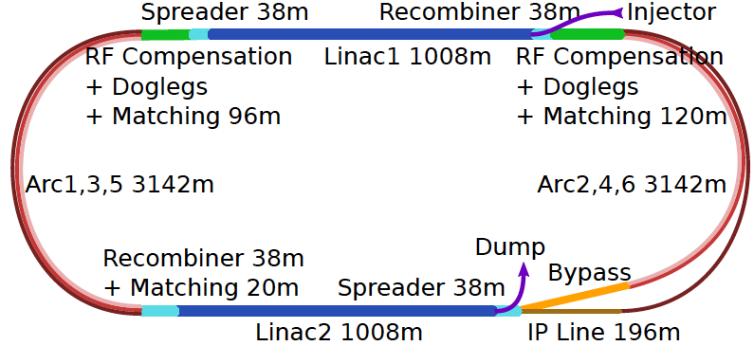
60 GeV Electron ERL added to LHC
U(ERL) = 1/3 U(LHC)
Concurrent operation to pp, LHC/FCC become 3 beam facilities. Power limit: 100 MW
10³⁴ cm⁻² s⁻¹ luminosity and factor of 15/120 (LHC/FCCeh) extension of Q², 1/x reach
1000 times HERA luminosity. It therefore extends up to x~1.
Four orders of magnitude extension in deep inelastic lepton-nucleus (ion) scattering.
Max Klein Kobe 17.4.18

Slide 19
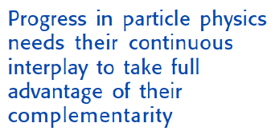
Towards a strategy for European Particle Physics “Two Problems” of HEP
1980: Leon Lederman at ICHEP in Madison:
“Shortage of Money and Overconfidence of Theorists” [SU(5)/SUSY ahead times..]
Today:
Shortage of Money and Missing Confidence of Theory [EFT/ SUSY passed times?]
Reminiscent of the situation as experienced 50 years ago:
before the SM and discovery of partons in ep at Stanford
→
In 2014 CERN decided
to set up a new LHeC
organisation and an IAC
to “assist building the
international case of an
ep/A collider” at CERN
IAC: Two main tasks:
Update CDR + Testfacility
Time for high precision,
high energy,
high luminosity
collider experiments
ee, pp and ep:
→
Guido Altarelli, DIS 2009, Madrid
Max Klein Kobe 17.4.18

Slide 20
Organisation^{*)}
Working Groups
International Advisory Committee
Mandate by CERN to define
“..Direction for ep/A both at LHC+FCC”
PDFs, QCD
Fred Olness,
Claire Gwenlan
Higgs
Uta Klein,
Masahiro Kuze
BSM
Georges Azuelos,
Monica D’Onofrio
Oliver Fischer
Top
Olaf Behnke,
Christian Schwanenberger
eA Physics
Nestor Armesto
Small x
Paul Newman,
Anna Stasto
Detector
Alessandro Polini
Peter Kostka
Coordination Group
Accelerator+Detector+Physics
Sergio Bertolucci (CERN/Bologna)
Nichola Bianchi (Frascati)
Frederick Bordry (CERN)
Stan Brodsky (SLAC)
Hesheng Chen (IHEP Beijing)
Eckhard Elsen (CERN)
Stefano Forte (Milano)
Andrew Hutton (Jefferson Lab)
Young-Kee Kim (Chicago)
Victor A Matveev (JINR Dubna)
Shin-Ichi Kurokawa (Tsukuba)
Leandro Nisati (Rome)
Leonid Rivkin (Lausanne)
Herwig Schopper (CERN) – Chair
Jurgen Schukraft (CERN)
Achille Stocchi (LAL Orsay)
John Womersley (ESS)
Gianluigi Arduini
Nestor Armesto
Oliver Brüning – Co-Chair
Andrea Gaddi
Erk Jensen
Walid Kaabi
Max Klein – Co-Chair
Peter Kostka
Bruce Mellado
Paul Newman
Daniel Schulte
Frank Zimmermann
5(12) are members of the
FCC coordination team
OB+MK: co-coordinate FCCeh
We miss Guido Altarelli.
Max Klein Kobe 17.4.18
*) April 2018

Slide 21
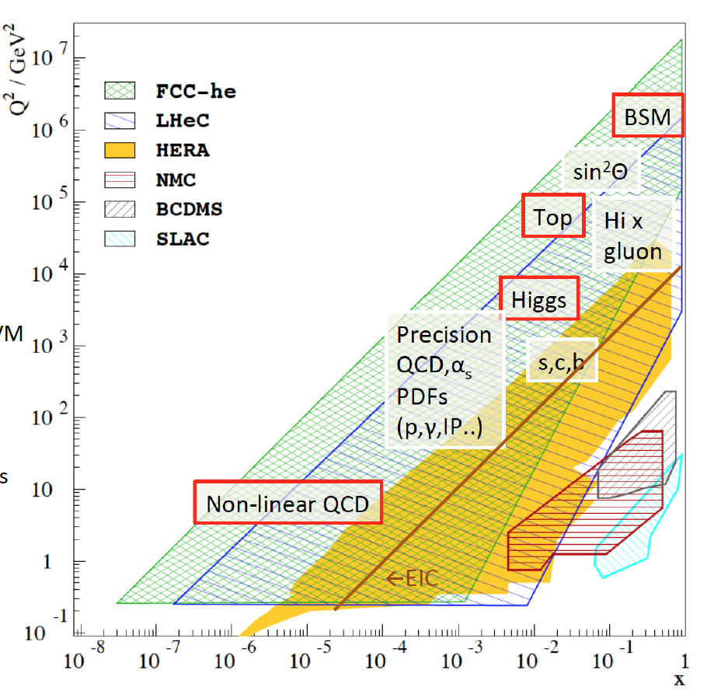
Physics with Energy Frontier DIS
Raison(s) d’etre of the LHeC
Cleanest High Resolution
Microscope: QCD Discovery
Empowering the LHC
Search Programme
Transformation of LHC into
high precision Higgs facility
Discovery (top, H, heavy ν’s..)
Beyond the Standard Model
A Unique
Nuclear Physics Facility
Max Klein Kobe 17.4.18

Slide 22
Huge increase in energy and luminosity enables unique development of particle physics
The Classic DIS Programme with the LHeC: 0 < Q² < 10⁶ GeV2, 1 < x < 10⁻⁶
Generalised Parton Distributions [DVCS] – “proton in 3D - tomography”
Unintegrated Parton Distributions [Final State] – DGLAP/BFKL?
Diffractive Parton Distributions [Diffraction] – pomeron, confinement??
Photon Parton Distribution [Photoproduction Dijets,QQ; F_{2,L}] - fashionable..
Neutron Parton Distributions [Tagged en (eD) Scattering] – ignored at HERA
see the CDR 1206.2913 + updates
Max Klein Kobe 17.4.18

Slide 23
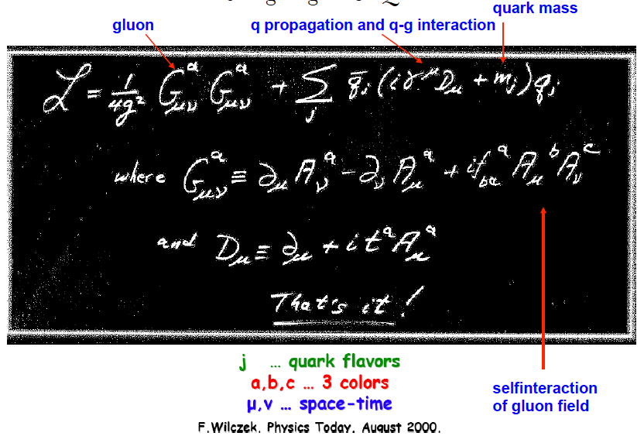
QCD
QCD

Slide 24
That’s it?? That may not be it..
Developments Discoveries
AdS/CFT
Instantons
Odderons
TOTEM ? CERN EP 2017-335
Non pQCD, Spin
Quark Gluon Plasma
QCD of Higgs boson
N^{k}LO, Monte Carlos..
Resummation
Saturation and BFKL
Photon, Pomeron, n PDFs
Non-conventional partons
(unintegrated, generalised)
Vector Mesons
The 3 D view on hadrons..
CP violation in QCD?
Massless quarks?? Would solve it..
Electric dipole moment of the neutron?
Axions, candidates for Dark Matter
Breaking of Factorisation [ep-pp]
Free Quarks
Unconfined Color
New kind of coloured matter
Quark substructure
New symmetry embedding QCD
C. Quigg, arXiv1308.6637
QCD has an exciting future with the FCC

Slide 25
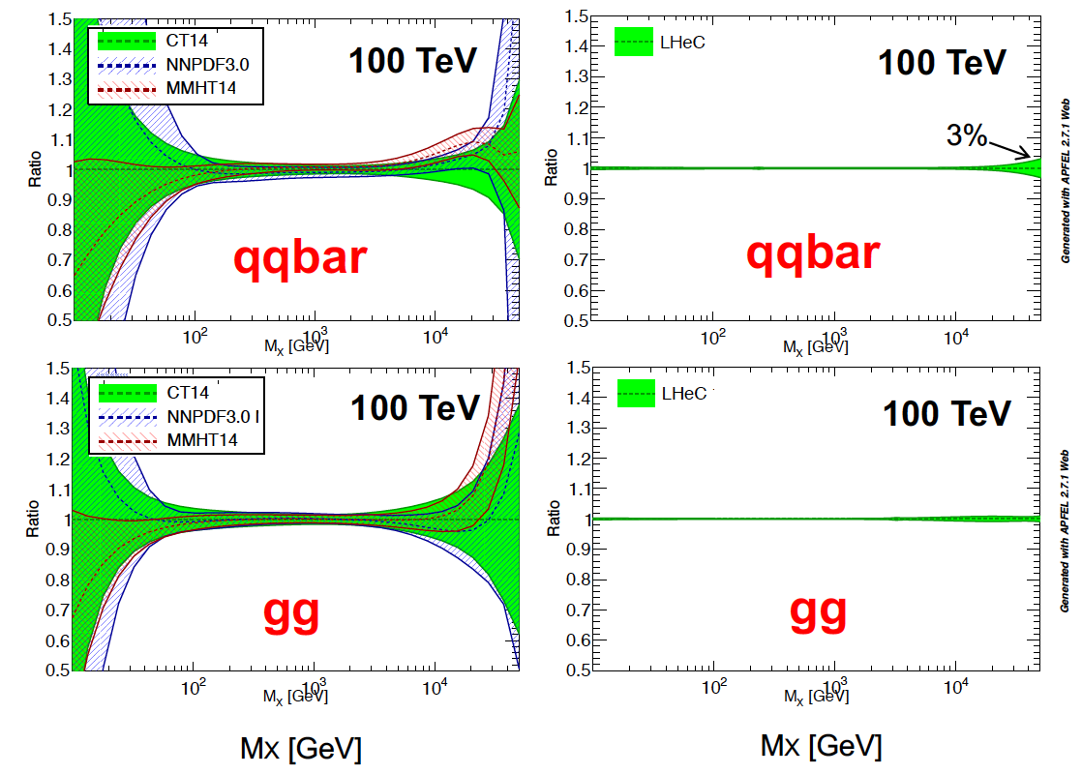
The LHeC collinear proton (and nuclear) PDF Programme
Resolve parton structure of the proton completely: u_{v},d_{v},s_{v}?,u,d,s,c,b,t and xg
Unprecedented range, sub% precision, free of parameterisation assumptions,
Resolve p structure, solve non linear and saturation issues, test QCD, N³LO…
NP?
PDFs
are NOT
determined
in pp
but in ep
cf backup
SUSY?
H
20 GeV
40 TeV
Max Klein Kobe 17.4.18
Empowers the LHC H, BSM + SM Physics

Slide 26
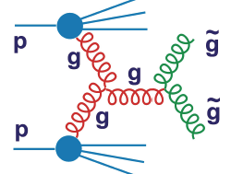
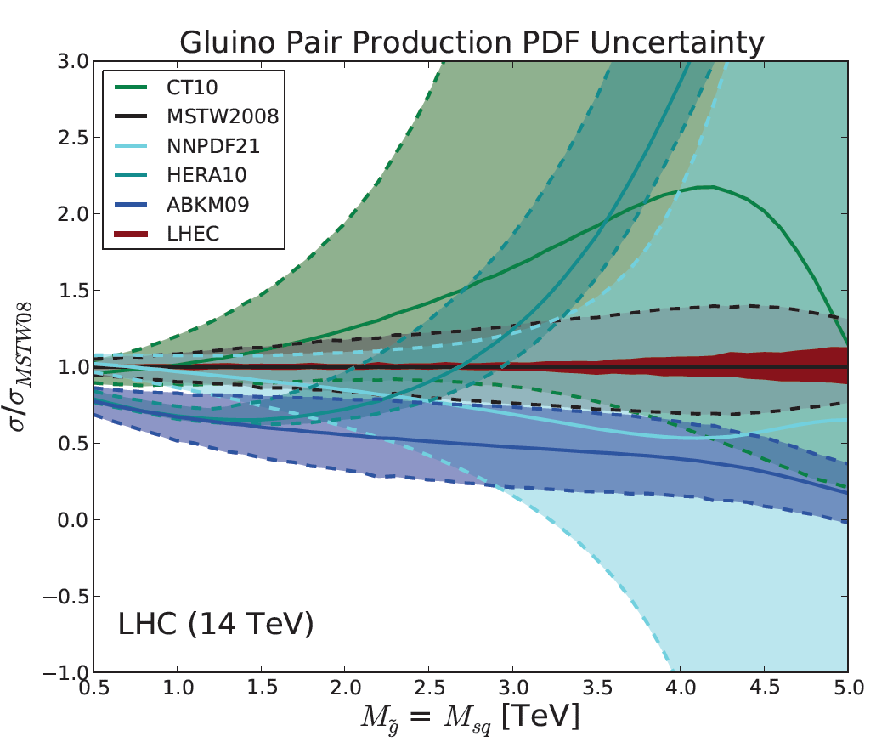
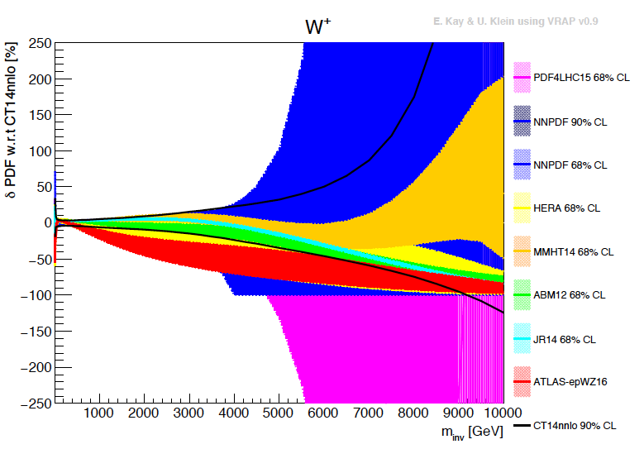
Empowering pp Discoveries
External, reliable input (PDFs, factorisation..) is crucial for range extension + CI interpretation
GLUON
QUARKS
SUSY, RPC, RPV, LQS..
Exotic+ Extra boson searches at high mass
ATLAS
today
Max Klein Kobe 17.4.18

Slide 27
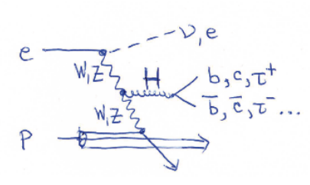
Determination of SM Higgs Couplings, HL-LHC and LHeC → LHC
δκ/κ [%]
preliminary
J. De Blas, M.+U. Klein, 16.4.2018
ttH at LHeC to 15%
LHC: ATLAS prospects PUB Note 2014-016
The addition of ep to pp (LHeC to LHC (HL,HE) and FCC-eh to FCC-pp) transforms these
machines into precision Higgs facilities. Vital complementarity with e⁺e⁻ (JdB Amsterdam)
Note that the HL LHC prospects are being updated (HL/HE LHC Physics workshop).
Max Klein Kobe 17.4.18

Slide 28
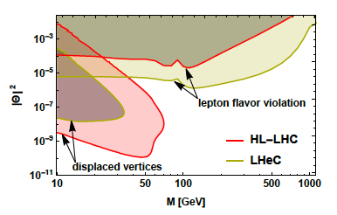
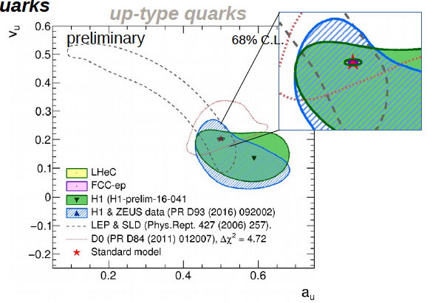
New Physics through High Precision
Masses:
Charm HERA 40 MeV LHeC 3 MeV
W LHC 19→ 10 MeV LHeC 15 MeV
and prediction to ±2.8 MeV for pp
Top: to be studied
Proton: gluon we are made of…
Higgs: Cross section to 0.3%: Mass
dependent. OB, MK 1305.2090
Neutrinos: Heavy “sterile” Neutrinos
CKM, electroweak, alpha_s, …
V_{tb}: to 0.01
V_{cs}: to 0.02 [LHC+LHeC, like ATLAS+HERA]
α_{s} to 0.2% [0.1% with HERA] – GUT?
sin²θ_{W} (μ)
LHC: better than LEP with LHeC PDFs
LHeC: scale dependence from
0.4 GeV (PERLE) to 1 TeV (LHeC)
NC couplings
Antusch, Cazzato, Fischer – work still in progress
Max Klein Kobe 17.4.18
Britzger, MK, Spiessberger, Zhang – work still in progress

Slide 29
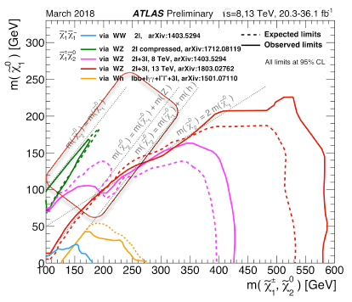
Beyond the Standard Model
Higgs into Dark Matter
Higgs into Neutralinos (RPV SUSY)
Higgs into Scalars → 4b
H±± in Vector Boson Scattering
H± in Vector Boson Scattering
H⁺ in 2HDM
Triple Gauge Couplings
Top FCNC
Contact Interactions
Empower LHC Discoveries
Higgsinos: mass degenerate
Wino/bino compressed
Prompt decays or long lifetimes
SUSY ewk sector most
challenging for pp colliders
cf U Klein + M Donofrio at Amsterdam FCC
D Curtin et al
arXiv:1712.07135
Max Klein Kobe 17.4.18

Slide 30
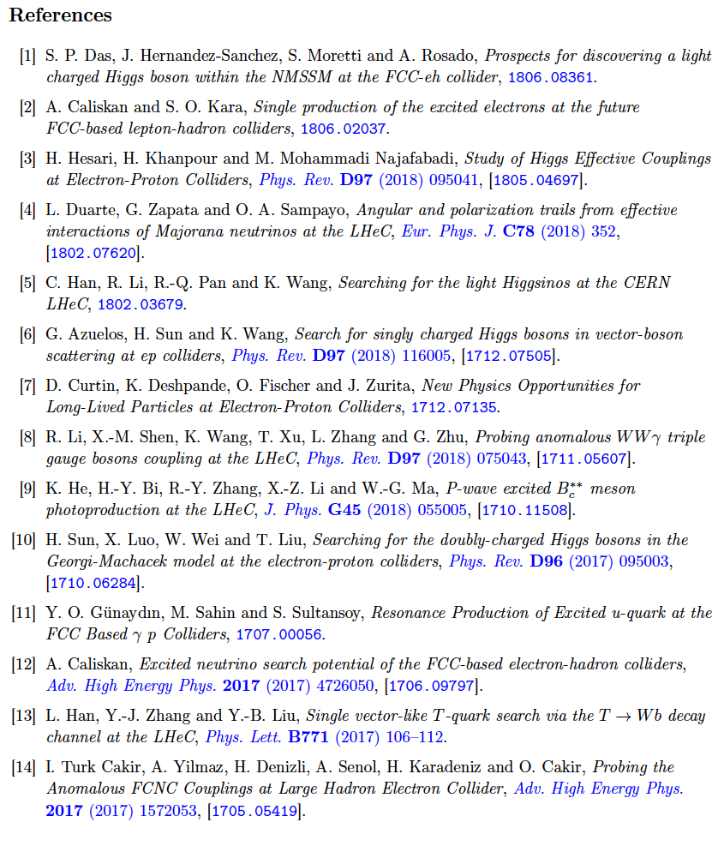
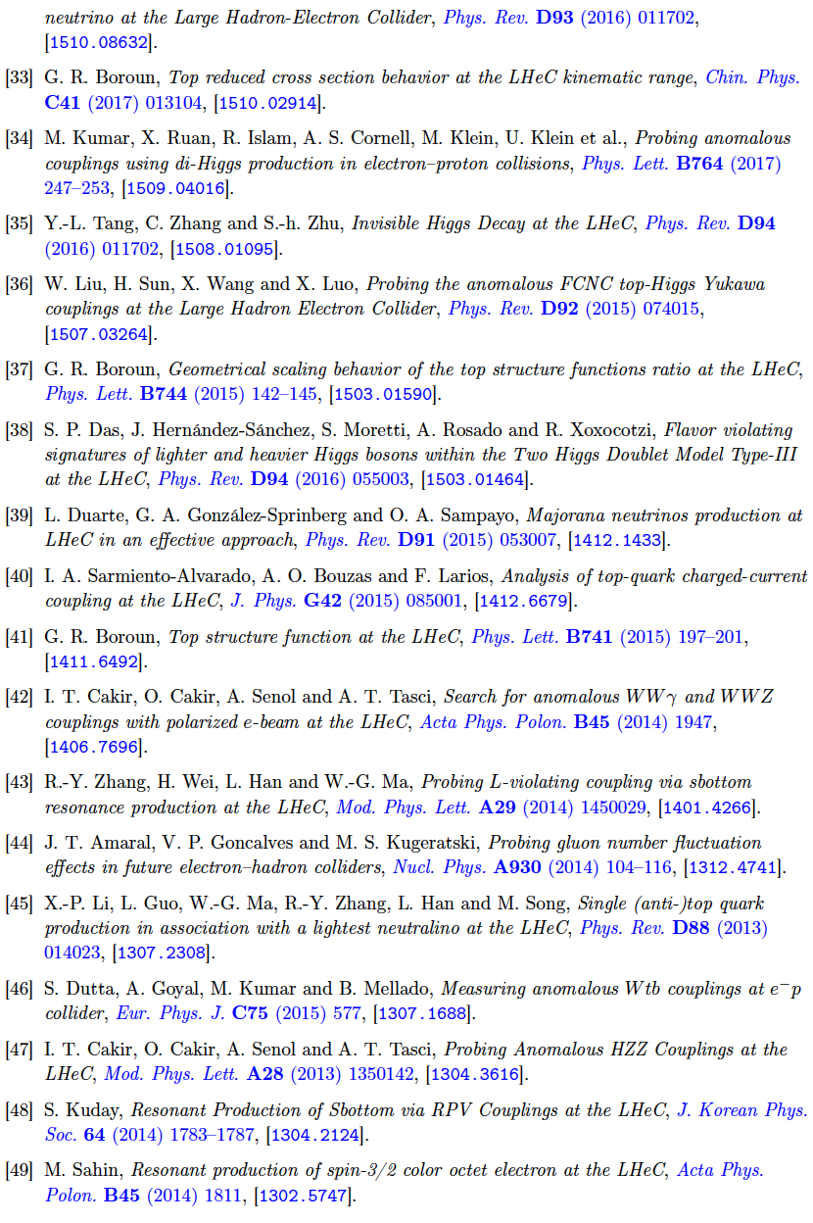
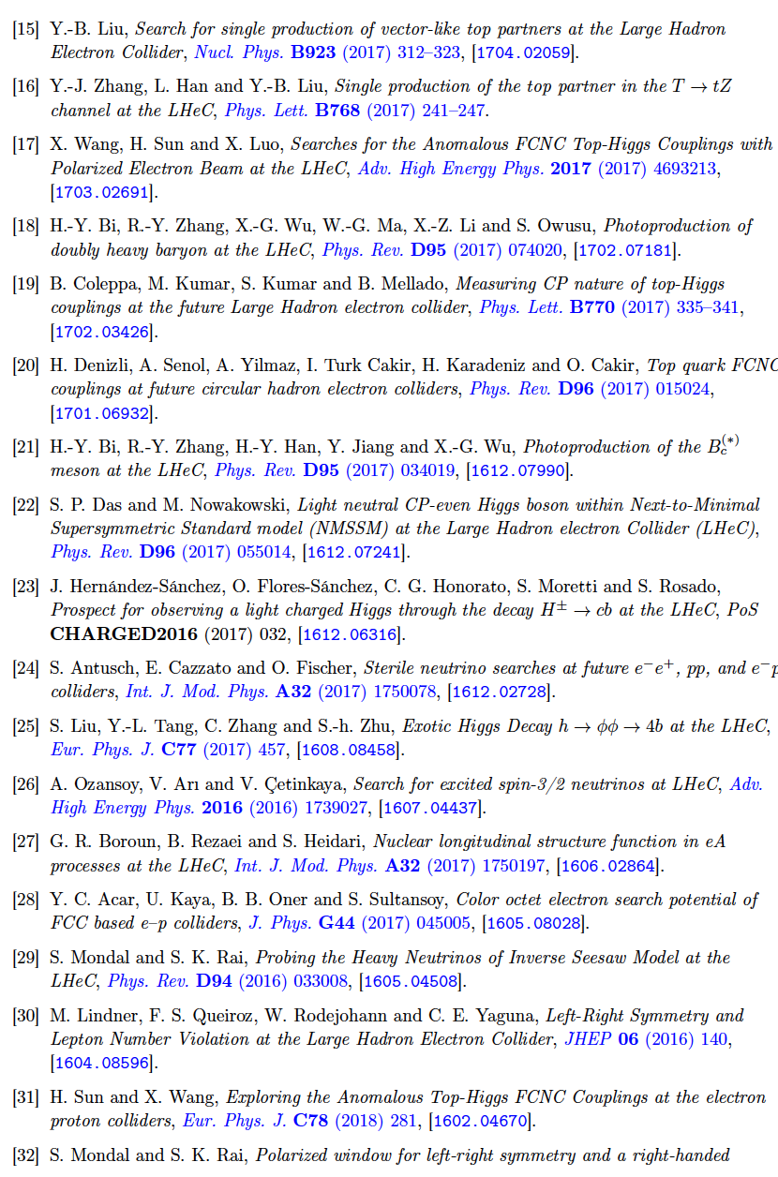
Thanks to Hao Sun
50 journal papers on NP with LHeC in recent years

Slide 31
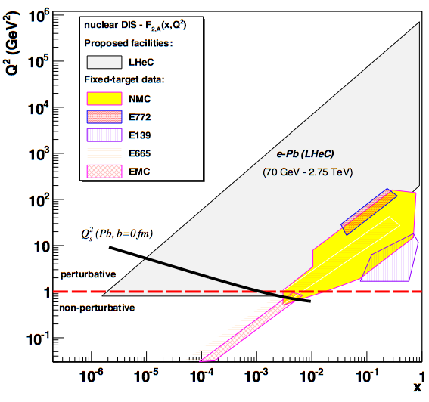
LHeC as Electron Ion Collider
FCC-he
Extension of kinematic range in lA
by 4-5 orders of magnitude will
change QCD view on nuclear
structure and parton dynamics
May lead to genuine surprises…
No saturation of xg (x,Q²) ?
[discover saturation in ep
THEN analyse eA –separate
nonlinear g from nuclear effects]
Small fraction of diffraction ?
Broken isospin invariance ?
Flavour dependent shadowing ?
Safe: nuclear PDFs like at HERA
→ R(x,Q²) flavour dependent
LHeC
EIC
Precision QCD study of parton dynamics in nuclei
Investigation of high density matter and QGP
DGLAP to BFKL – vital for LHC and FCCpp physics
L_{eN} = 6 10³² cm⁻² s⁻¹
Max Klein Kobe 17.4.18

Slide 32
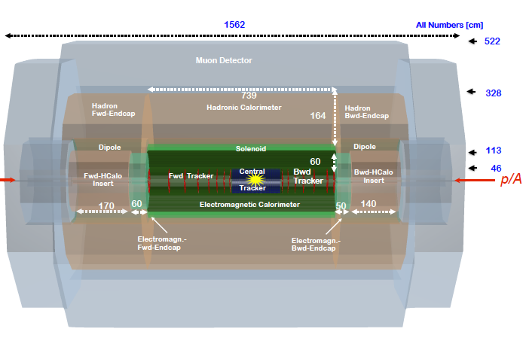
title
LHeC Detector for the HL/HE LHC
e
P.Kostka et al
Length x Diameter: LHeC (13.3 x 9 m²) HE-LHC (15.6 x 10.4) FCCeh (19 x 12)
ATLAS (45 x 25) CMS (21 x 15): [LHeC < CMS, FCC-eh ~ CMS size]
If CERN decides that the HE LHC comes, the LHeC detector should anticipate that
Max Klein Kobe 17.4.18

Slide 33
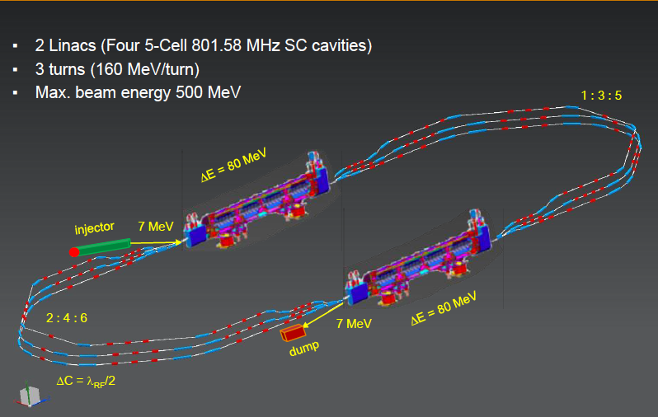
Powerful ERL for Experiments at Orsay
at 20mA → 10 MW
5.5 x 24m²
cf Walid Kaabi at Amsterdam FCC
New SCRF, High Intensity (100 x ELI) ERL Development Facility with unique low E Physics
Max Klein Kobe 17.4.18

Slide 34
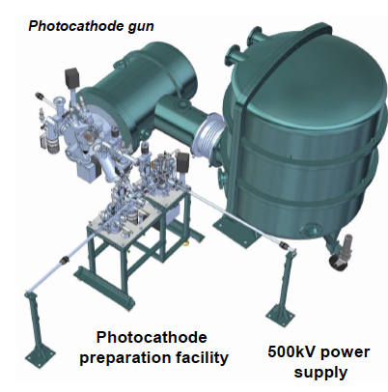
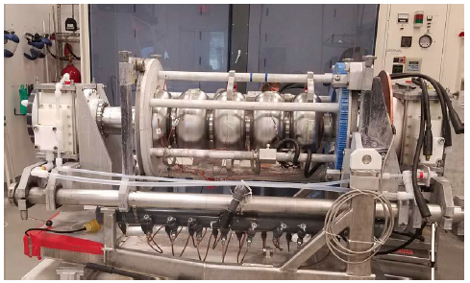
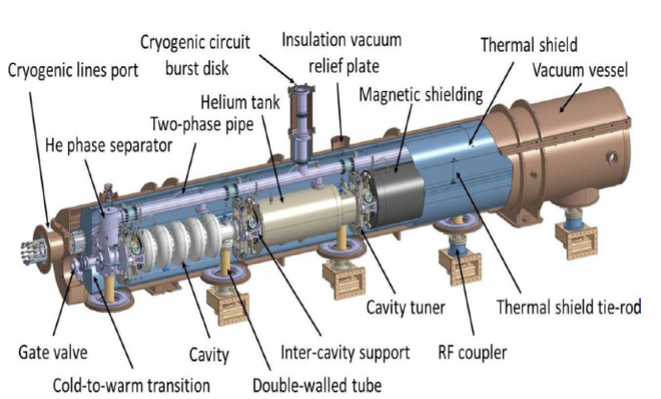
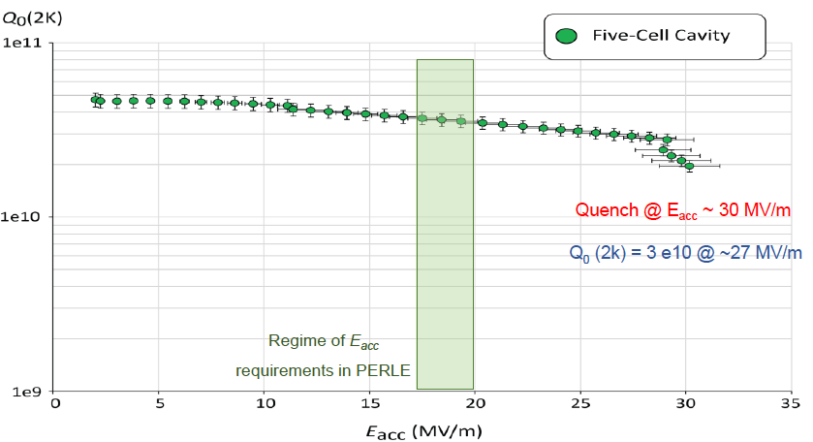
Towards PERLE: 802 MHz cavity, Source, Cryomodule, Magnets
First 802 MHz cavity successfully built (Jlab)
BINP, CERN, Daresbury/Liverpool, Jlab, Orsay, +
CDR 1705.08783 [J.Phys G] → TDR in 2019
Max Klein Kobe 17.4.18

Slide 35
Recent Presentations on LHeC and FCCeh
http://lhec.web.cern.ch
FCC Week Amsterdam 9-13.4.18
Theory
Jo Rudermann, Jorge de Blas
Overviews
Bruce Mellado, Uta Klein
QCD Max Klein
Top Christian Schwanenberger
and Orhan Cakir
Higgs Uta Klein
BSM Monica D’Onofrio
Detector Peter Kostka
Machine Oliver Bruening
Civil Engineering John Osborne
Cavity Frank Marhauser
IR Roman Martin
PERLE Walid Kaabi
DIS Workshop Kobe 16.4.-18.4.
Machine+PERLE Gianluigi Arduini
PDFs Claire Gwenlan
Low x+Diffraction Paul Newman
Nuclear PDFs Nestor Armesto
Higgs Uta Klein
Top Hao Sun
Electroweak Max Klein
New and BSM Jose Zurita
Project Max Klein
Structure of the Proton Uta Klein
FCC David D’Enterria
Max Klein Kobe 17.4.18

Slide 36
Towards the European Strategy in Particle Physics
15/15.11. ECFA Symposium at CERN about Future Colliders
December 2018: Submission of a 10 page LHeC (HL/HE LHC) Document
‘eh’ also part of the separate FCC submission
[Book1 on Physics, Book2 on FCChh +eh, …]
February 2019: Update of the CDR to appear [Main Topic of this Workshop]
May 13, 2019: Symposium in Spain
January 2020: Council + Secretariat Meeting in Bad Honnef (D)
Spring 2020: Update of the 2013 Paper.

Slide 37
Large Hadron Electron Collider on one page
E_{e} = 10-60 GeV, E_{p} =1-7 TeV: √s = 200 – 1300 GeV. Kinematics: 0 < Q² < s, 1 > x ≥ 10⁻⁶ (DIS)
Electron Polarisation P=±80%. Positrons: significantly lower intensity, unpolarised
Luminosity: O(10³⁴) cm⁻² s⁻¹. integrated O(1) ab⁻¹ for HL LHC and 2 ab⁻¹ for HE LHC/FCCeh
e-ions 6 10³² cm⁻² s⁻¹ O(10)fb⁻¹ in ePb . O(1)fb⁻¹ for ep F_{L} measurements
Physics: QCD: develop+break? The worlds best microscope. BSM (H, top, ν, SUSY..)
Transformations: Searches at LHC, LHC as Higgs Precision Facility, QCD of Nuclear Dynamics
The LHeC has a deep, unique QCD, H and BSM precision and discovery physics programme.
Time: Determined by the Large Hadron Collider (HL LHC needs till ~2040 for 3 ab⁻¹ )
LHeC: Detector Installation in 2 years, earliest in LS4 (2030/31).
HE LHC: re-use ERL. In between HL-HE, 10 years time of ERL Physics (laser, γγ..)
Very long term: FCC-eh
Challenges: Demonstration of ERL Technology (high electron current, multi-turn)
Design 3-beam IR for concurrent ep+pp operation, New Detector with Taggers - in 10 years.
The LHeC is a great opportunity to sustain deep inelastic physics within future HEP.
The cost of an ep Higgs event is O(1/10) of that at any of the 4 e⁺e⁻ machines under consideration
It can be done: the Linac is shorter than 2 miles and the time we have longer than HERA had.
CERN and world HEP: Vital to make the High Luminosity LHC programme a success.
1802.04317
http://lhec.web.cern.ch
Max Klein Kobe 17.4.18

Slide 38
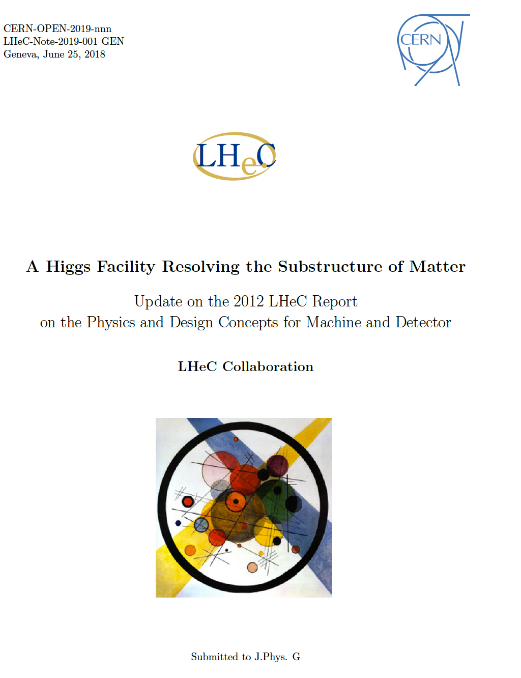

Slide 39
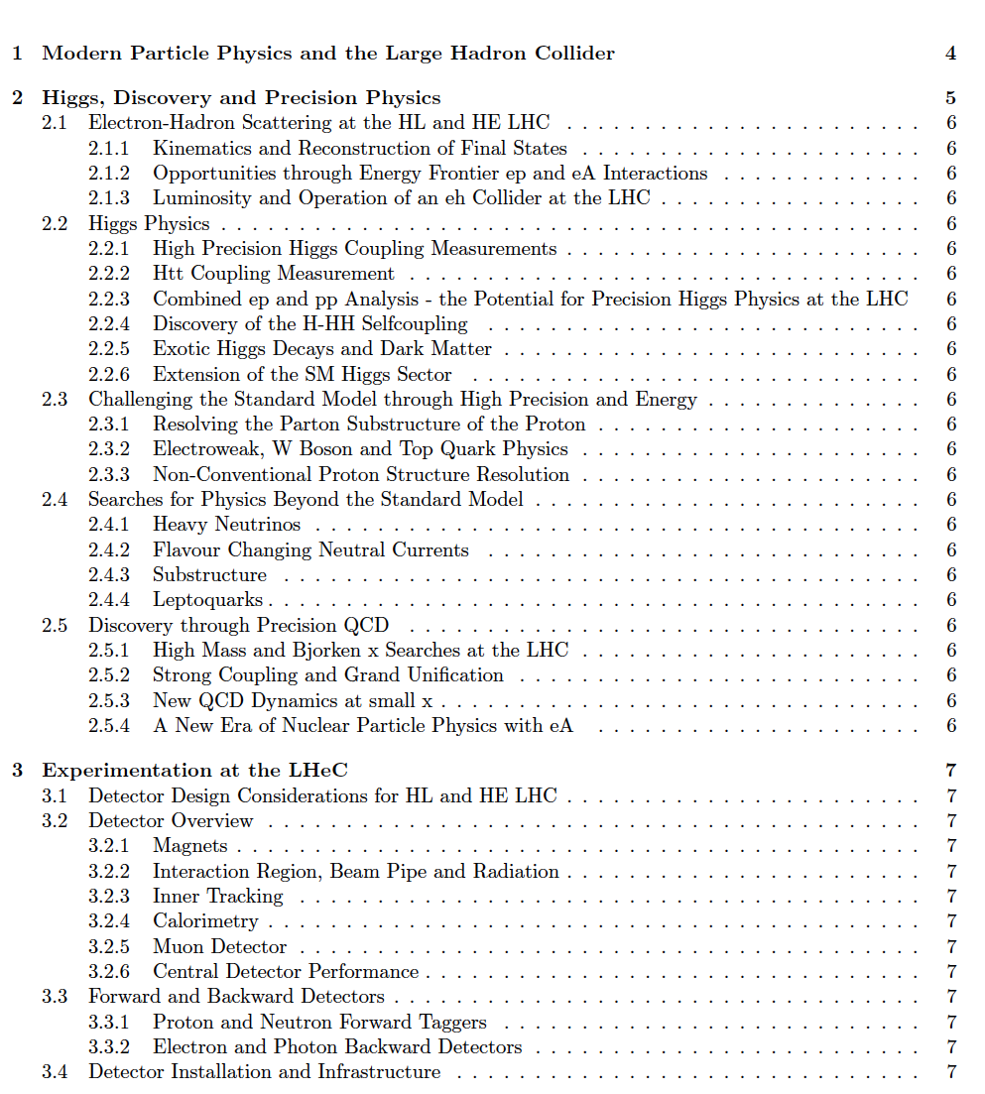

Slide 40
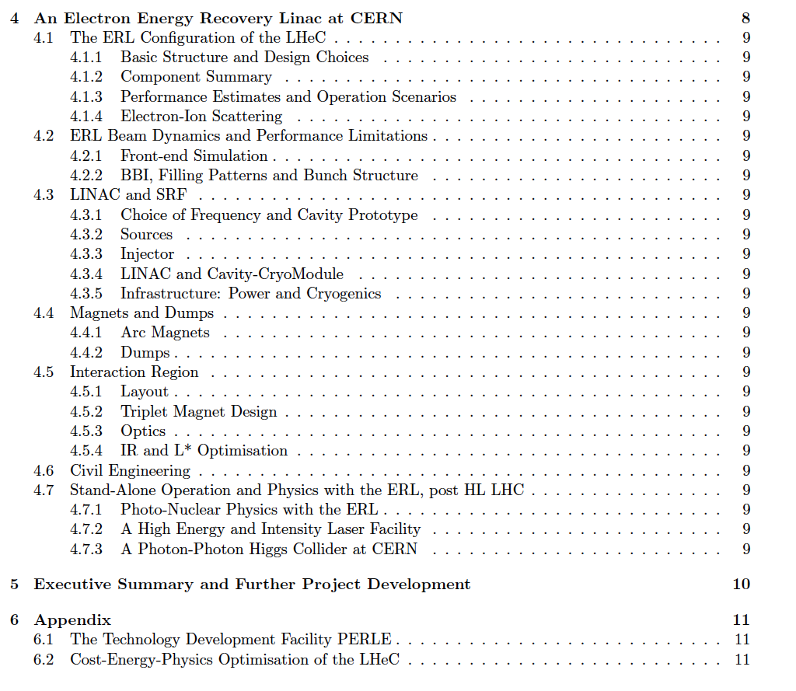

Slide 41
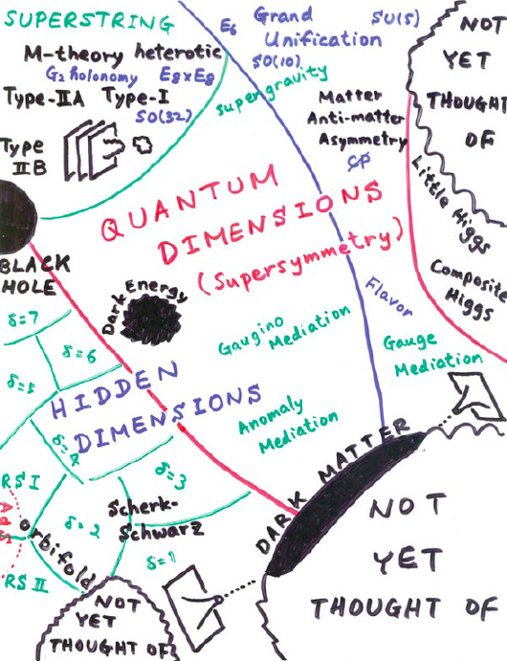
backup
The SM looks complete, some people believe in the new dark aether, need precision+diversity

Slide 42
Time comes to unite pp with ep and ee at TeV scale
LHC
?
Jo Ruderman, modified
A currently best bet is HL/HE LHC, ep with both, and CepC: a realistic program
for exploring the SM deeper and leading beyond, for the next 40 years ahead.

Slide 43
backup
It needs
Welcome
on behalf of the
Coordination
Group.

Slide 44
backup

Slide 45
pQCD Theory
Substantial and remarkable theoretical progress in pQCD calculations to N^{k}LO, e.g.
1803.09973, 2 weeks ago
G Heinrich 1710.04998

Slide 46
title
Mk Lecture in 2005

Slide 47
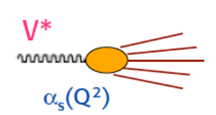
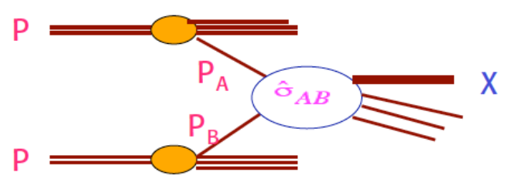
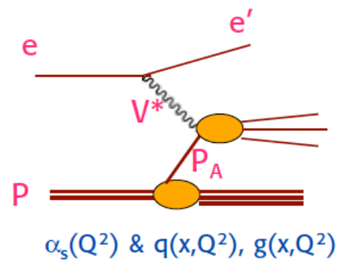
QCD with ee pp ep
Final state arises completely from short distance interaction
of virtual boson with quarks: NO PDFs, but jets, α_{s}
Njets +0, energy, angles. Unique association of q,g with jets
Observation of 3-jet events at PETRA to discover the gluon
√s=2E_{e} ≈ [G_{F}√2]^{-1/2} =246 GeV
S Ellis and D Soper, hep-ph/9306280
Successive combination jet algorithm for hadron collisions
Many initial partons but only two interact.
“rest” is the underlying event of soft i.a.’s
Dynamical coupling of all components. MPIs
N jets at large pT +X, pseudorapidity + azimuth
Ledermann-Drell-Yan scattering, jets
Scattering depends on parton distributions
The “Altarelli cocktail” to save the SM (1984, Bern)
√s = 2E_{p} = 14, 27, 100 TeV
“Route royale” to the structure and dynamics
of parton interactions inside the proton (nucleon)
Universal partons evolving with resolution scale
x BJ fixed through electron kinematics. PDFs + α_{s}
Redundant e and h final state reconstruction.
Discovery of partons and the QPM … DGLAP
√s = 2√E_{e}E_{p} = 1.3, 1.8, 3.5 TeV
ep - “option” which ought to be a real part. Seguil tuo corso, e lascia dir el genti (Dante, KM)

Slide 48
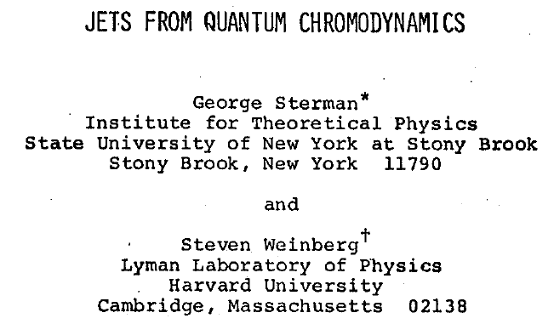
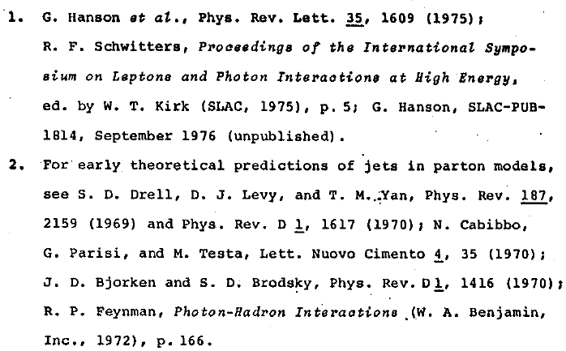
Jets
=
Jets in e⁺e⁻ at > 5 GeV at SPEAR at Stanford

Slide 49
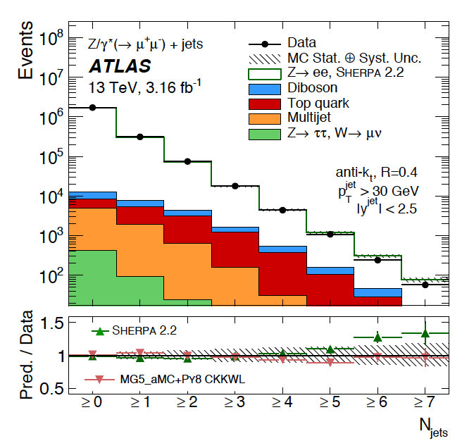
QCD at work at the LHC
1702.05725 Z + n jets ATLAS 3fb⁻¹ 13 TeV
1609.05331 inclusive jets, 26fb⁻¹ 8 TeV
100 events with ≥ 7 jets
10 orders of magnitude in cross section
LHC is the trick to attract a few 1000 physicists to work on QCD: T Sjoestrand, 2007, after we saw ATLAS

Slide 50
BFKL and Saturation
Gribov, Levin, Ryskin. Semihard Processes in QCD Phys Rept 100 (1983) 1-150
Rise of Gluon (and Quark) densities towards low x discovered at HERA. This
may lead to saturation – non-linear interactions and BFKL ln(1/x) effects.
Not discovered at HERA, to much surprise, despite recent ‘speculations’ ..
Change of parton distributions + evolution → to be clarified for FCC + (HE) LHC
BFKL papers: The Pomeranchuk Singularity in QCD/Gauge Theories 1978/1977

Slide 51
α_{s}(μ) in Deep Inelastic Scattering
H1 inclusive (1998) NLO
hep-ph/0012053 – highest cited H1 only
H1 only jets (2017) NNLO jets!
H1 inclusive and jets (2017) NNLO
It is well possible that α_{s} is smaller
than hitherto assumed. Current practice
to exclude ABM is questionable. Like in the
lattice case, one constructs, for perhaps
respectable reasons, a norm, which
gives the impression of higher accuracy
than a critical evaluation would lead to.
ABMP 2017
DIS: Fixed target: higher twist corrections 1/Q²,
nuclear corrections, small lever arm, gluon?
Current strong coupling precision at best 1-2%: FCC ee and eh want 1-2 per mille

Slide 52
α_{s}(μ) at LHeC/FCCeh
CDR 2012
LHeC/FCCeh lead to 0.1% uncertainty (stat+syst), free of previous DIS deficiencies (HT,nc)
Joint determination with parton distributions (maybe simplified as H1 published in 2001)
Needs clarity about low x behaviour as this uses DGLAP.
Requires to control heavy flavour (theory) at new level (measure s, c, b, t also)
Very high precision of NC (y and Z) and CC and extension to x near 1 will drastically
reduce the PDF parameterisation uncertainties
Scale uncertainties require that N³LO formalism be applied (the bizarre 1/2 .. 2 rule.??)
The attempt to measure the strong coupling in DIS to permille accuracy requires
nothing less than a renaissance of experimental and theoretical DIS (ep) physics

Slide 53
The Case for the LHeC From the CDR 2012 to the time ahead 2018+
Particle Physics
Physics Case
Preparations
Max Klein
Contribution to a Panel on Future DIS, 17.4.2018, Kobe, for the LHeC/FCCeh Study Group
Max Klein Kobe 17.4.18
http://lhec.web.cern.ch

