Slide 1
Introduction and Synergies
Max Klein (U Liverpool) with Oliver Bruening (CERN)
For the LHeC/PERLE/FCC-eh Collaboration (global)
Overview
Physics
Prospects
Developments
Synergies
Parallel Session on FCC-eh, on-line FCC Workshop, 12.11.2020

Slide 2
LHeC, PERLE and FCC-eh
Powerful ERL for Experiments @ Orsay
CDR: 1705.08783 J.Phys.G
CERN-ACC-Note-2018-0086 (ESSP)
Operation: 2025+, Cost: O(20) MEuro
LHeC ERL Parameters and Configuration
I_{e}=20mA, 802 MHz SRF, 3 turns →
E_{e}=500 MeV → first 10 MW ERL facility
BINP, CERN, Daresbury, Jlab, Liverpool, Orsay (IJC), +
50 x 7000 GeV²: 1.2 TeV ep collider
Operation: 2035+, Cost: O(1) BCHF
CDR: 1206.2913 J.Phys.G (550 citations)
Upgrade to 10³⁴ cm⁻²s⁻¹, for Higgs, BSM
CERN-ACC-Note-2018-0084 (ESSP)
arXiv:2007.14491, subm J.Phys.G
60 x 50000 GeV²: 3.5 TeV ep collider
Operation: 2050+, Cost (of ep) O(1-2) BCHF
Concurrent Operation with FCC-hh
FCC CDR:
Eur.Phys.J.ST 228 (2019) 6, 474 Physics
Eur.Phys.J.ST 228 (2019) 4, 755 FCC-hh/eh
Future CERN Colliders: 1810.13022 Bordry+

Slide 3
Published in 2020
arXiv:2007:14491 (400 pages, 300 authors)
5 page summary: ECFA Newsletter Nr 5., August 20
https://cds.cern.ch/record/2729018/files/ECFA-Newsletter-5-Summer2020.pdf
156 Institutions involved

Slide 4
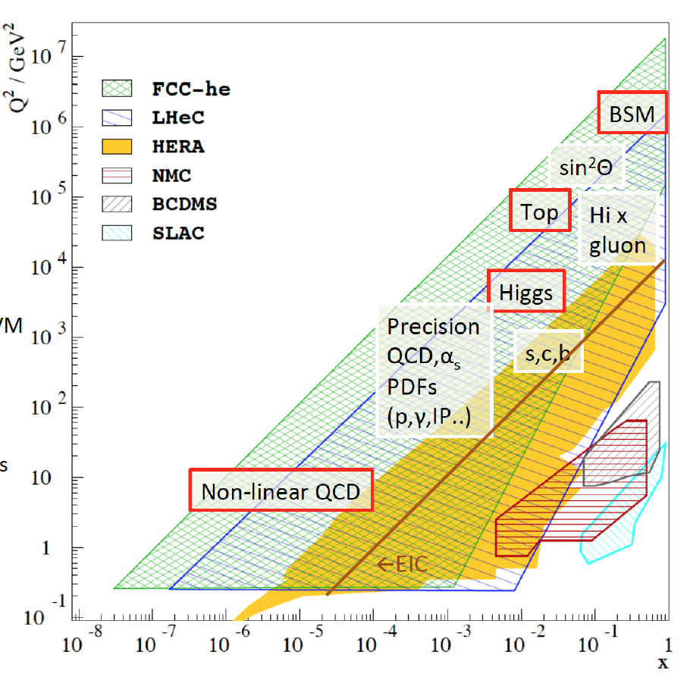
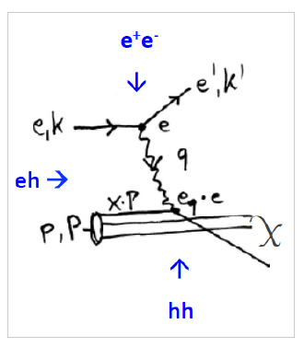
Physics with Energy Frontier DIS
Deep Inelastic Scattering
Raison(s) d’etre of ep/eA
at the energy frontier
Cleanest High Resolution
Microscope: QCD Discovery
Empowering the LHC/FCC
Search Programme
Transformation of LHC/FCChh into
high precision Higgs facility
Discovery (top, H, heavy ν’s..)
Beyond the Standard Model
A Unique
Nuclear Physics Facility
Talks at this workshop:
C Schwanenberger eh+hh+ee
M Bonvini Low x Physics
D Britzger electroweak physics

Slide 5
Higgs in ep and pp [LHC and FCC]
LH(e)C

Slide 6
Machine Parameters and Operation - ep
arXiv:2007.14401
No pileup
For comparison, HERA I operated at 10³¹cm⁻²s⁻¹, and was upgraded by a factor of up to 4 for HERA II
The total luminosity delivered was 1 fb⁻¹ over a running period of 15 years, including shutdowns.
LHeC may operate at 20 x 1000 GeV² and ”repeat” all of HERA in a short running period.
The updated CDR considers a Ring-Ring ep collider as a back-up solution. May be revived for HE-LHC.

Slide 7
Machine Parameters - eA
arXiv:2007.14401
The LHeC and FCC-eh are the highest energy, most powerful electron-ion colliders the world may build.

Slide 8
Welcome
14

Slide 9
Three Messages from the 2m LINAC at Stanford
-- you do NOT need to promise to discover dark matter or know what new to expect
when you increase the energy range (we yet may have to readjust our perception
about nature, its richness and as well our ability to predict and understand it.
‘we like to see the field to be driven by experiment’ – Burt Richter 2009)
-- you can build a 2 mile electron linac in 3 years time, if you really want it
we surely could build LHeC and FCC-eh in short time when decided to do so
-- electron-proton scattering is the best means to explore the substructure of matter
a crucial complement to the LHC/FCC and moreover, now a unique Higgs facility
50 years since the discovery of quarks by the SLAC-MIT ep scattering experiment
Vienna 8/1968

Slide 10
Lessons/Scenarios/Prospect
A personal remark
The discussion of the past years has shown that the time is not ripe for any decision about the next big machines.
We enter a novel phase of physics (exp+thy), detector, accelerator and CE R+D “to evaluate their feasibility” (HA).
Strategy is difficult to make, just take FCC and LHC: Highest priority is for two decades the exploitation of the LHC. What
may or may not happen, we do not know now, and projects are related in reality. Consider for example:
FCC-ee asap: reduces the exploitation of the LHC (cf UB’s schedule where FCC-ee operates together with LHC)
FCC-ee later: challenged by the developments of CEPC and ILC, moves FCC-hh to beyond 2070 (Lausanne was 84, 25 years to LHC, not 50)
FCC-hh following LHC: opens window for a bridge project (LHeC) and full exploitation of HL-LHC
No FCC: possible revival of HE-LHC
No FCC, No HE-LHC: muon collider by 2050ish?, CLIC?
- No big project [“soon”]? Extend HL-LHC beyond 2040 with updated programme (H-HH with 5ab⁻¹, ..)
Physics is not only telling us that we shall study the Higgs boson, it tells us that we do not know now how to reach beyond
the Standard Model. This calls for a desirably parallel rather than sequential, development of particle physics, triples of
hh, eh and ee machines, as was crucial for the formation of the SM. HEP is a global science, with Meyrin as one key place.
The LHeC/PERLE/FCC-eh group sees many physics, cost and technology reasons to proceed. It is crucial to maintain the culture
of energy frontier DIS, develop its novel technology and prepare exploiting its potential for the future of high energy physics.
In the example scenarios listed above there appear various possibilities where LHeC and/or FCC-eh may indeed be realised.

Slide 11
next
J de Hondt (5.10.20 to Snowmass)

Slide 12
The ERL in more Detail
←
- LHeC Configuration reduced from 60 to 50 GeV.
- LINAC: 112 cryomodules with 4 cavities each
→ Total number of cavities: 896 [ILC: O(10⁴)]
- Configuration may be staged with less RF
- Tunnel is small part of cost and better not
reduced further, synchrotron loss, upgrades..
- ERL reduces power to << GW and dumps at < GeV
→ novel, “green” accelerator technology
Positrons: 500pC is 3 10⁹e⁻/bunch → 20mA and 1.2 10¹⁷ e⁻/s
LHeC programme needs e⁻p predominantly (Higgs) and only
smaller e⁺p sample, ~fb⁻¹ → O(10¹⁵) e⁺/s, still demanding!

Slide 13
Developments +Partners
Cf recent meeting: https://indico.cern.ch/event/923021/
High Current Source (e⁻, P, e⁺)
SCRF: High Q₀, complete Cryomodule
PERLE will
begin with
5mA ALICE
source, which
has been
transferred
from Daresbury
to Orsay while
UK was in EU..
B Militsyn et al
Jointly with FCC-ee
BINP, BNL/Cornell (cBETA), Daresbury, IJC, Jlab, +
Interaction Region Design and Q₁ Prototype:
B Holzer, B Parker, S Russenschuck et al
PERLE/LHeC
F Marhauser et al
Next: dressed cavity (HOMs), 20mA
Adapt SPL Cryomodule for PERLE
CERN, Jlab, Orsay +
BNL, CERN, +

Slide 14
Energy Recovery and Synergies
Technical Synergies of LHeC with other applications
SAPPHIRE: a yy collider : Higgs, eweak and QCD machine
F. Zimmermann et al, arXiv:1208.2827
ERL as an injector into FCC-ee [direct into Z]
O. Bruening, Y. Papaphilippou
LHeC-FEL
F. Zimmermann et al, work in progress
Injector into FCC-hh
R. Calaga
Proposal of ERL Version of FCC-ee for high Lumi at high E_{e}
V Litvinenko, T Roser, M Chamizo-Llatas arXiv: 1909.04437
802 MHz technology: PERLE, FCC-ee, eSPS
F Marhauser, B Rimmer et al
704 MHz SPL Cryomodule (CERN) modified for PERLE
F Gerigk, E Jensen et al.
ALICE (Daresbury) Gun delivered to Orsay for PERLE
D Angal-Kalinin, B Militsyn et al
JLEIC Booster (Jlab) likely to be used in PERLE
F Hannon, B Rimmer et al
Forward Calorimetry: FCC-hh and ee colliders / CALICE..
Inner Tracker/CMOS: ee colliders, new HI detector at IP2
- ….
LHeC/FCC-eh: high luminosity, high energy
High ERL power facility P=I_{e} E_{e}
This is a programme for high quality SRF (Q₀ > 10¹⁰),
high current sources, and multiturn to reach high E_{e}
Future/current ERL developments: distribution of emphasis
- CBETA: high current, single turn - for e cooler (EIC)
- MESA: polarised beam - for new PV asymmetry exp.
- CEBAF: few GeV energy - for study of syn. radiation
- PERLE: high current, multiturn - for exp’s and future
Plans: Daresbury, Darmstadt, Berlin. Revival of KEK ERL
normal conducting ERL machine at BINP
Coordination: Lab Director Group (A Stocchi IJClab for ERL)
European Accelerator R+D Roadmap: CERN council 9/21
ERL Network. ERL workshop series

Slide 15
Applications/
Synergy - examples
LHeC-FEL
Work in progress, F Zimmermann et al. [in between LHeC and FCC-hh potentially]
Presented by O Bruening, March 2019 [being rediscussed. Note PSI FEL concept]
Energy recovery configuration of FCC-ee
Presented by R Calaga, 2017 [worth reconsidering]
V Litvinenko, T Roser, M Chamizo-Llatas arXiv: 1909.04437, [ongoing study]

Slide 16
Tasks for 2021-2025
Under study
Could we
unify the
idea for
a “slim” new
AA detector
with the one
for LHeC?
For FCC:
Could one
integrate an
AA programme
into GPDs (for
High scales) and
eh for low pt?
to resolve the
issue of just
four IRs?
ECFA
Newsletter 5
8/2020
O Bruening
M Klein

Slide 17
title
P. Kostka – work in progress

Slide 18
Statement of the IAC to DG, published in 2007.14491
There follows a programme for the coming years which is being established and for us to shape.

Slide 19
from a UK Document 23.10.20
There is a programme for the coming years which is being established: you are cordially invited to join.
Today: B. Holzer: Interaction Region, Y. Yamazaki: Detector, W. Kaabi: PERLE – a large eh workshop to come.

