Slide 1
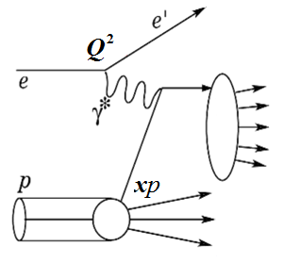
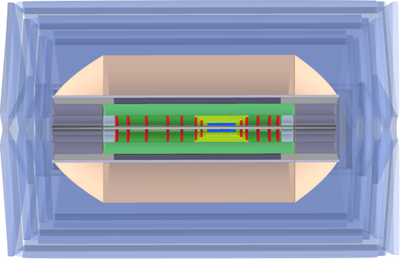
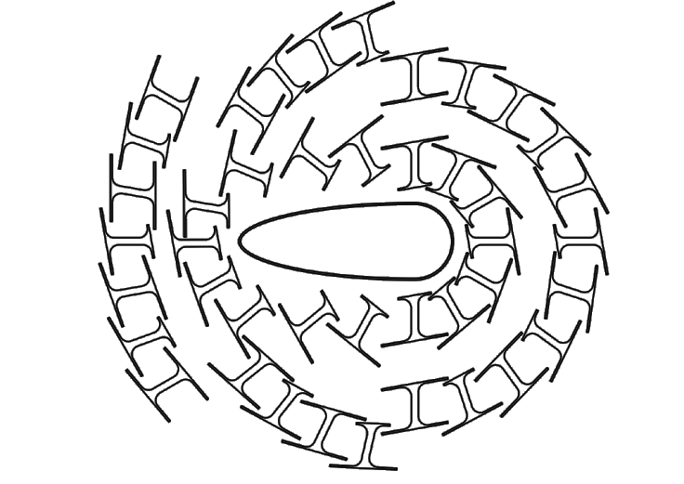
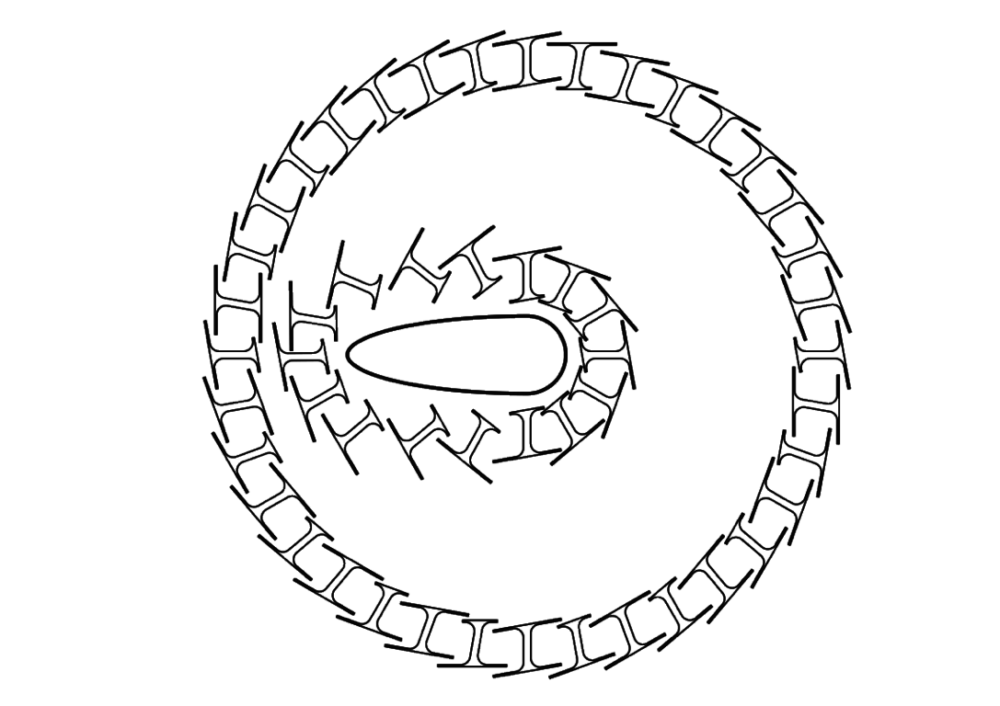
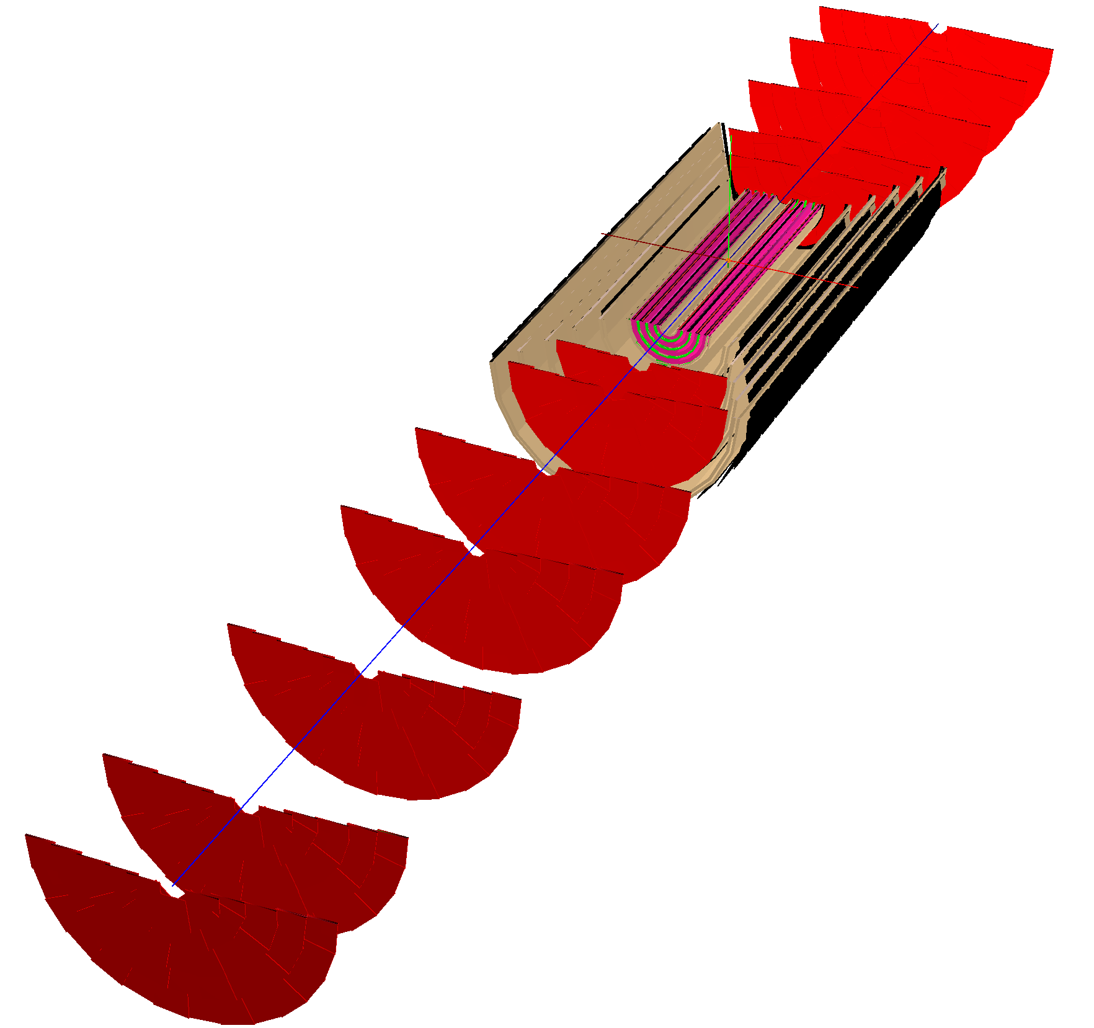
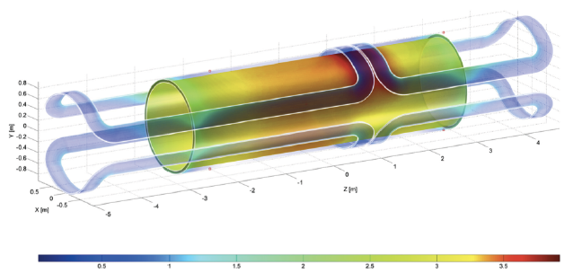
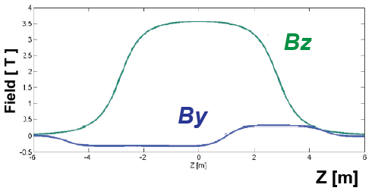
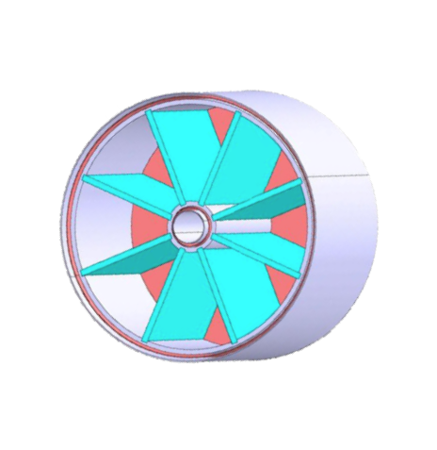
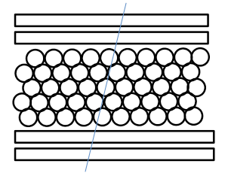
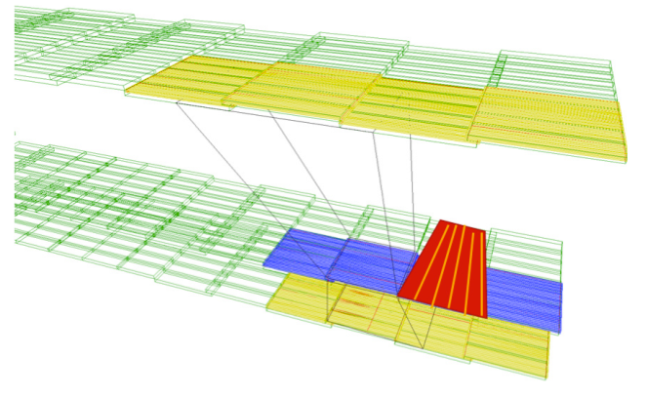
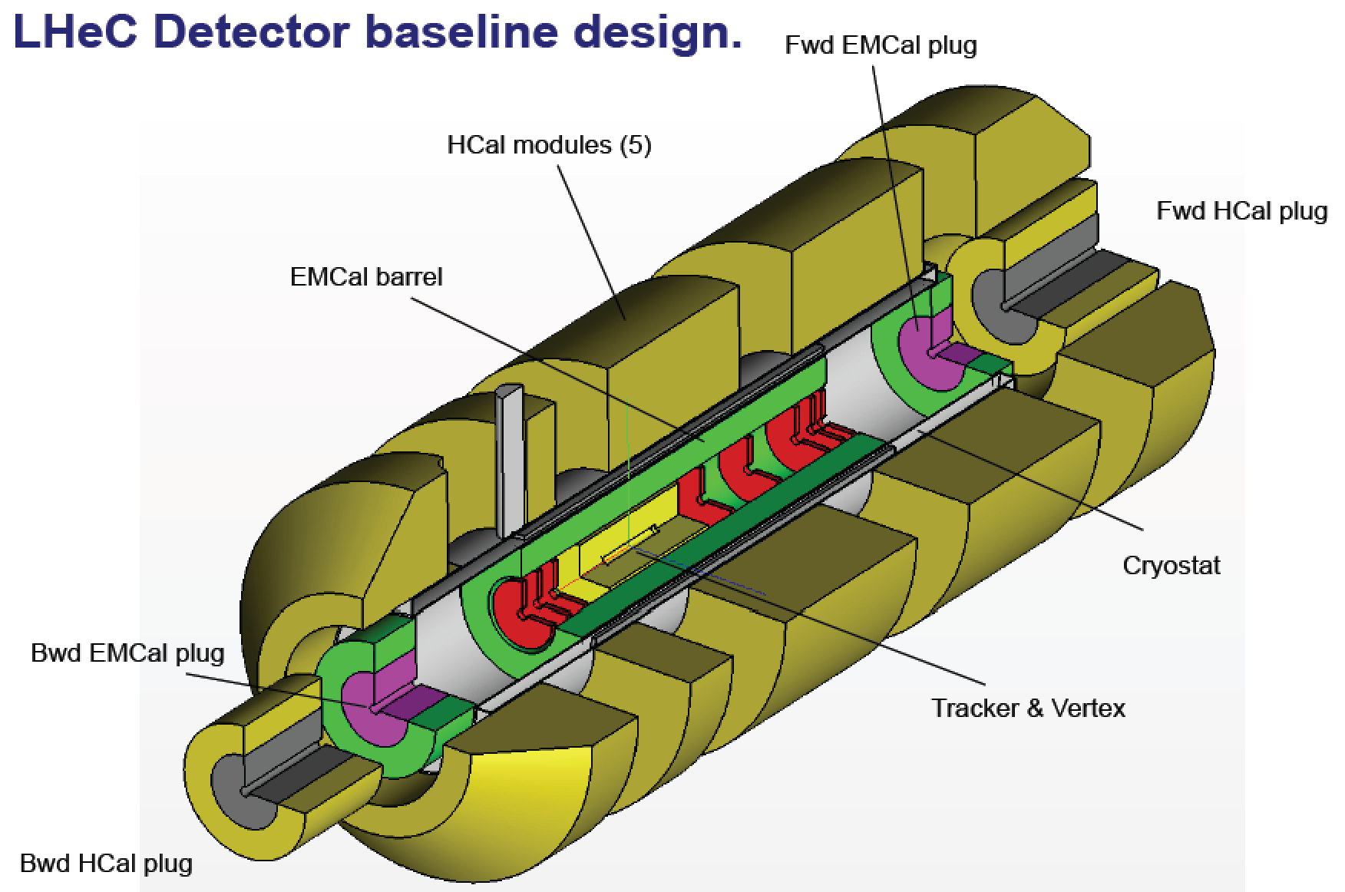
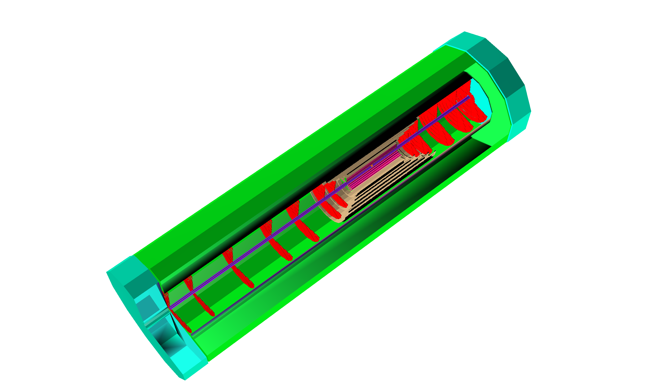
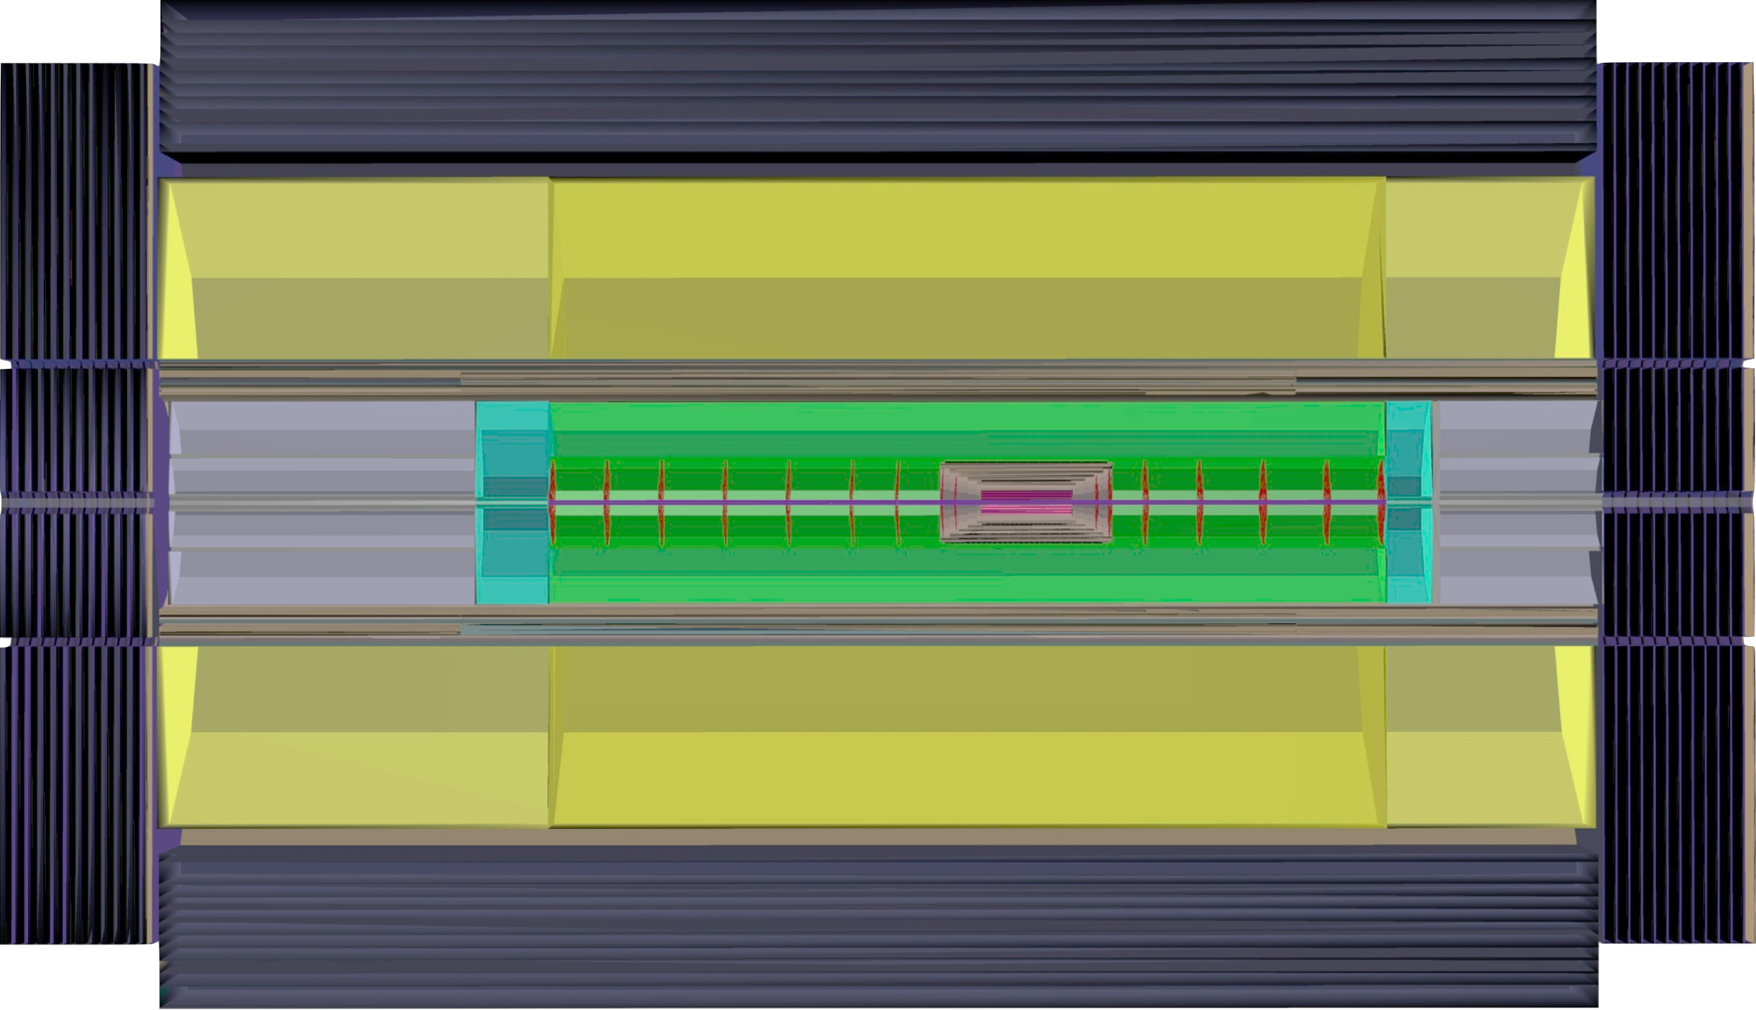
Design of a New Detector for ep/eA Collisions
M. Klein (U. Liverpool and CERN), P. Kostka (U.Liverpool), A.Polini (INFN Bologna) on behalf of the LHeC Collaboration
The Large Hadron electron Collider is a project for future ep and eA collisions from a new energy recovery linac of ~60 GeV energy and the LHC, and later the FCC. It needs a multi-purpose detector for pursuing a unique physics programme of deep inelastic scattering (DIS) with high precision over a hugely extended kinematic range wrt. HERA. This contribution summarises the current design concepts for a new detector of large polar angle coverage. For there is no pile-up and a more tolerant radiation environment, the LHeC detector may be based on currently available tracking and calorimeter technology, with special demands posed by the forward region. The experiment is designed for synchronous ep and pp operation and the interaction region therefore is for three beams, two of which are colliding. With a luminosity close to 10³⁴ cm⁻² s⁻¹, the LHeC, besides its genuine DIS program, also becomes a facility for precision Higgs physics and at the FCC-he a Higgs factory. The cms energy of the LHeC is ~1 TeV extended to ~4 TeV when a ~50 TeV proton beam becomes available for ep.
Physics Program CDR, arXiv: 1211.4831 and 1211.5102 / http://lhec.web.cern.ch
LHeC x-Q² DIS Kinematic Plane
Resolving Proton Structure
Kinematics at High Q² at the FCC-he
Finite p Radius
Stanford
Q^{2/}GeV²
FCC-he
Ee : 175 GeV
60 GeV
SLAC
Quarks
FNAL
CERN
Quark Gluon Dynamics
LHeC
100 Years of lp scattering
5 orders of magnitude
deeper into matter
HERA-LHeC-FCC-eh:
finest microscopes
with resolution
increasing as 1/√Q²
ϑh=1⁰
HERA
LHeC
Gluon
BSM
H
?
HERA
FCC-­‐he
Bjorken x
LHeC - Detector Layout
The LHeC Experiment (Energy Recovery Linac+LHC) is designed to run simultaneously with the LHC, requiring a three beam IR and compatible optics configuration
Head-on collisions: synchrotron radiation fan from e± beam, dipoles around the beam-pipe (±9m) for avoiding a finite crossing angle to obtain maximum luminosity
Muon Detector
Beampipe:
CDR: 6m length, Beryllium 2.5-3mm thickness
Inner dimensions: circular(x)=2.2cm, elliptical(-x)=10cm & (y)=2.2cm
composites also investigated
Silicon Track Detector Layout:
Very compact design, contained within the EMC
Large coverage in the proton direction: dense forward jet production (down to 1º in θ)
Services and Infrastructure demand careful design as the main contributors to the Material Budget
Calorimetry:
Hermetic EMC and HAC calorimetry surrounding the silicon tracking with appropriate thicknesses (X₀ and λ_{i})
Technology baseline in the Conceptual Design (CDR):
EMC: Liquid Argon Technology
HAC: Barrel Scintillator Tiles/Iron
Fwd-Bwd Inserts (Silicon/Tungsten-Silicon/Copper)
HCAL
Fwd
Calorimeter
Inserts
Solenoid
Dipole
Dipole
e∓
Tracker
Bwd
Calorimeter
Inserts
p/A
EMC
Tracking Layout
Fwd/bwd asymmetry reflecting beam energies; central detector 14m x 9m
Conclusions
Magnet System
Muons
Muon system with 2-3 super-layers surrounding the central detector. Baseline: muon tagging, no independent momentum measurement and use of technologies as at LHC (and elsewhere). Extensions possible: Independent momentum measurement: → larger solenoid or dual coil system with all of calorimeter within inner coil; in forward region: toroid (air core design)
A high resolution, large acceptance detector is being designed for precision DIS physics in a kinematic range extending over six orders of magnitude in Q² and 1/x. With no pile-up and much less radiation compared to pp operation, the LHeC detector can be based on existing technology. Current work focusses on the software description of the design to support more refined studies as on the Higgs or top physics. This design may be scaled to the FCC-he kinematics, roughly by extending the forward dimensions by a factor of ln(50/7)~2 while keeping the backward region as it is determined by the electron beam energy. The rare H→μμ decay is an example of new processes, accessible at the FCC-he, leading to new detector considerations such as on the muon momentum measurement.
A superconducting coil between the barrel EMC and HCAL provides a field of 3.5 T. The solenoid and dipoles (~0.3T, required for steering of the electron beam) are placed within the same cold vacuum vessel.
On–site Installation
Detector Description - DD4hep
Full detector description; geometry, materials, visualisation, readout, alignment, calibration etc.
Full experiment life cycle
Single source of detector information, simulation, reconstruction, analysis
LHeC and FCC-he same software; but different geometry, materials etc.
e∓p/e∓A simulation
The LHeC/FCC-he detectors are being described using DD4hep
Installation study: Modularity and pre-mounting on the surface to be compliant with LHC shutdown durations.
http://aidasoft.web.cern.ch/DD4hep
DD4hep sketch of the FCC-he detector design
Central detector dimensions: ~ 21m x 12m

