Slide 1
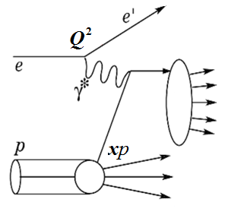
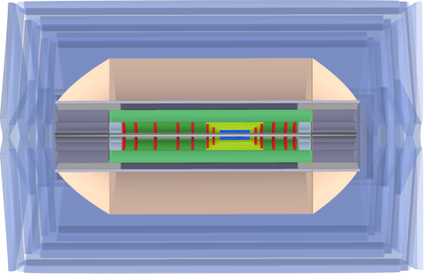
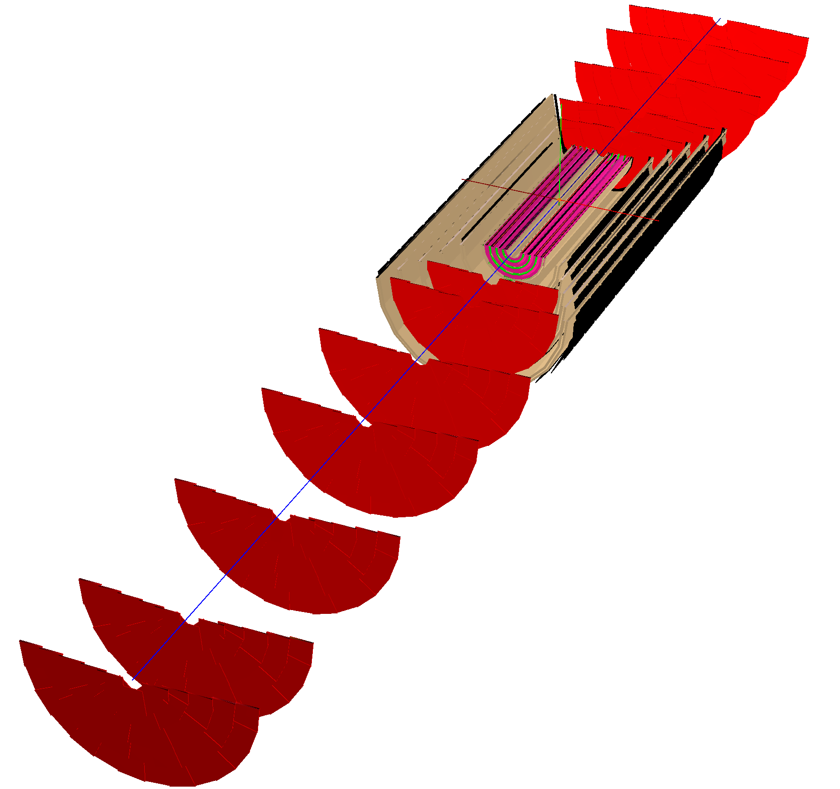
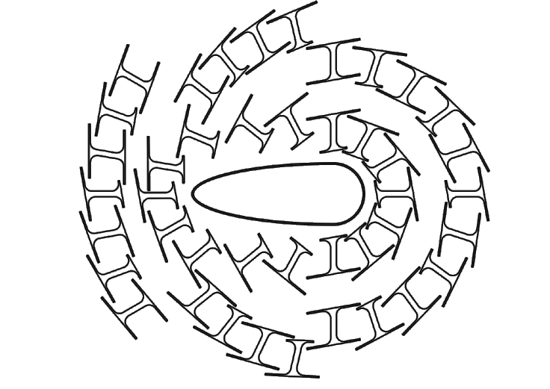
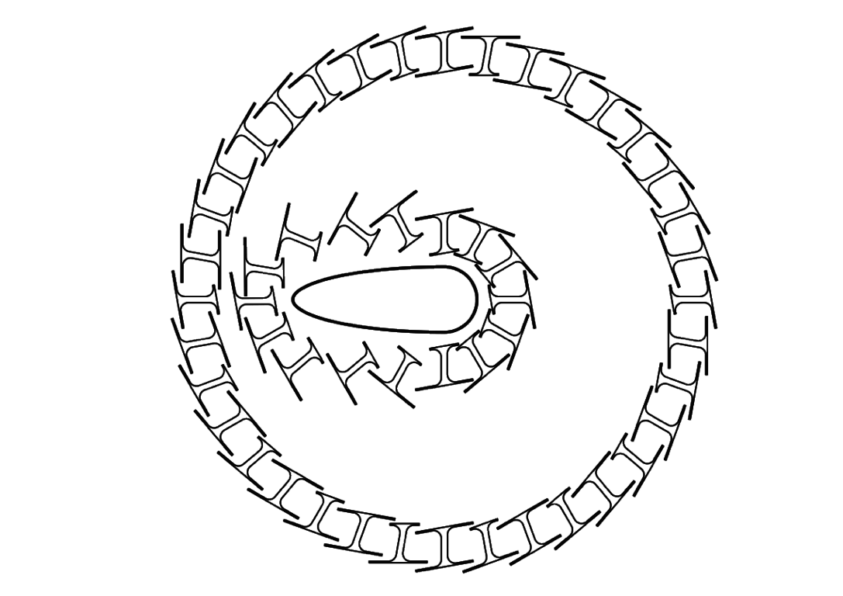
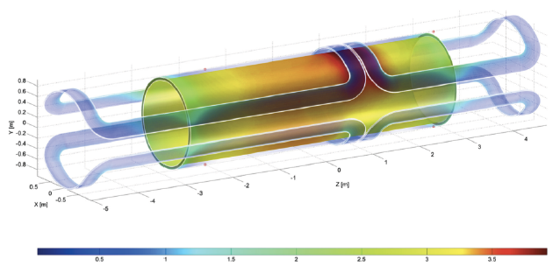
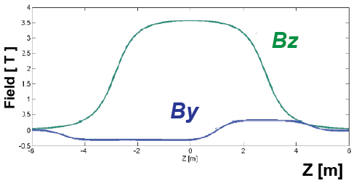
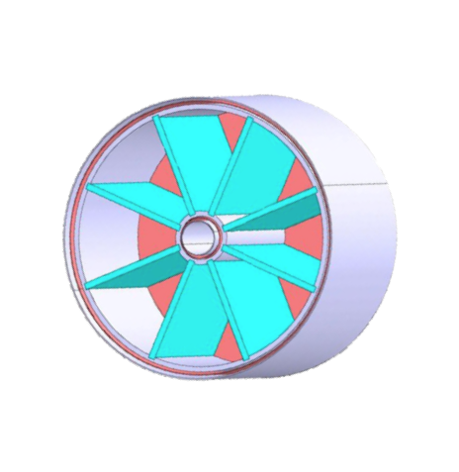
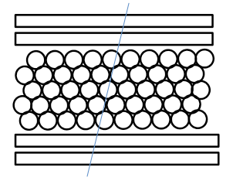
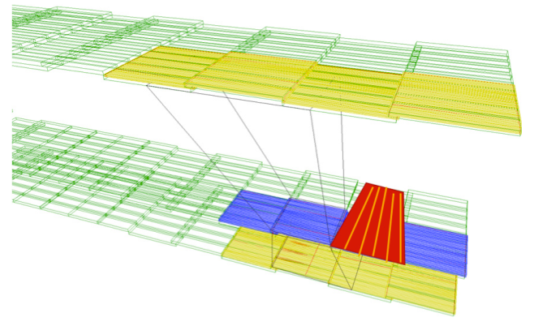
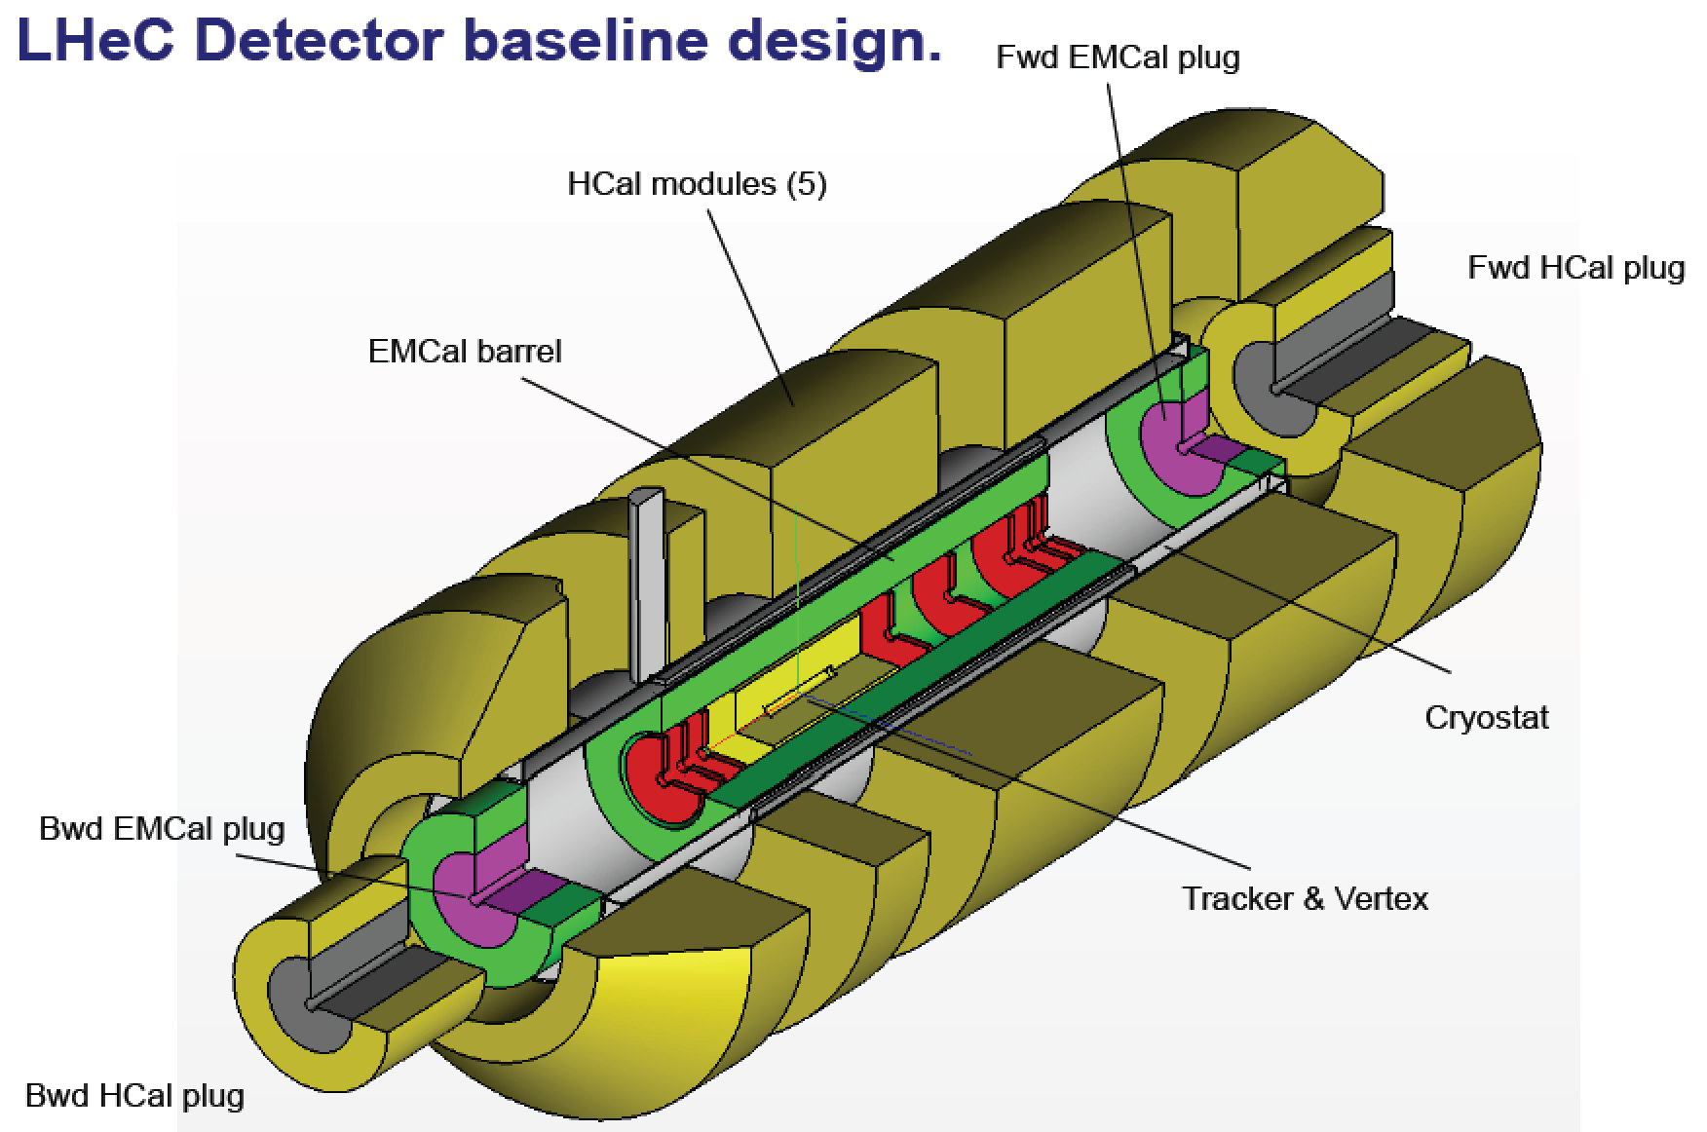
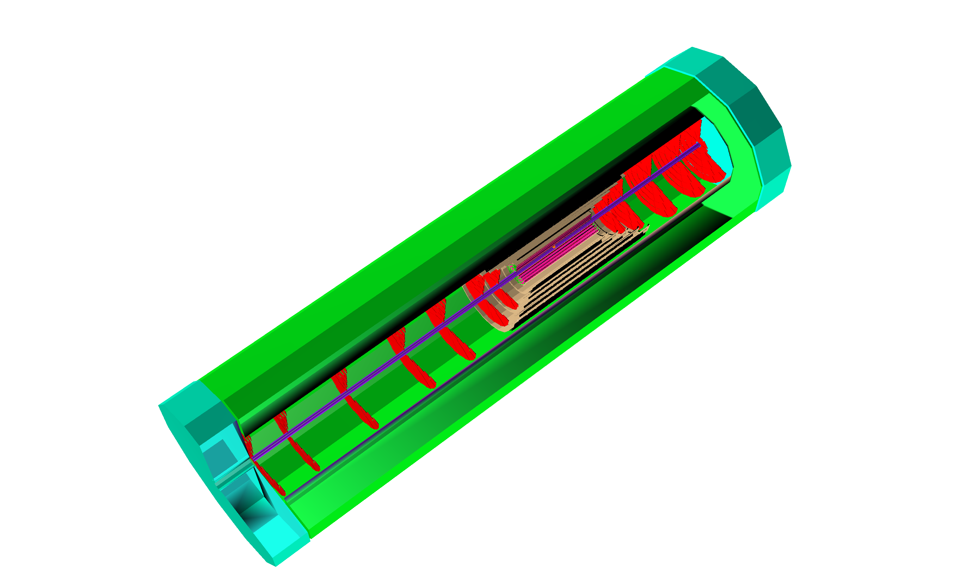
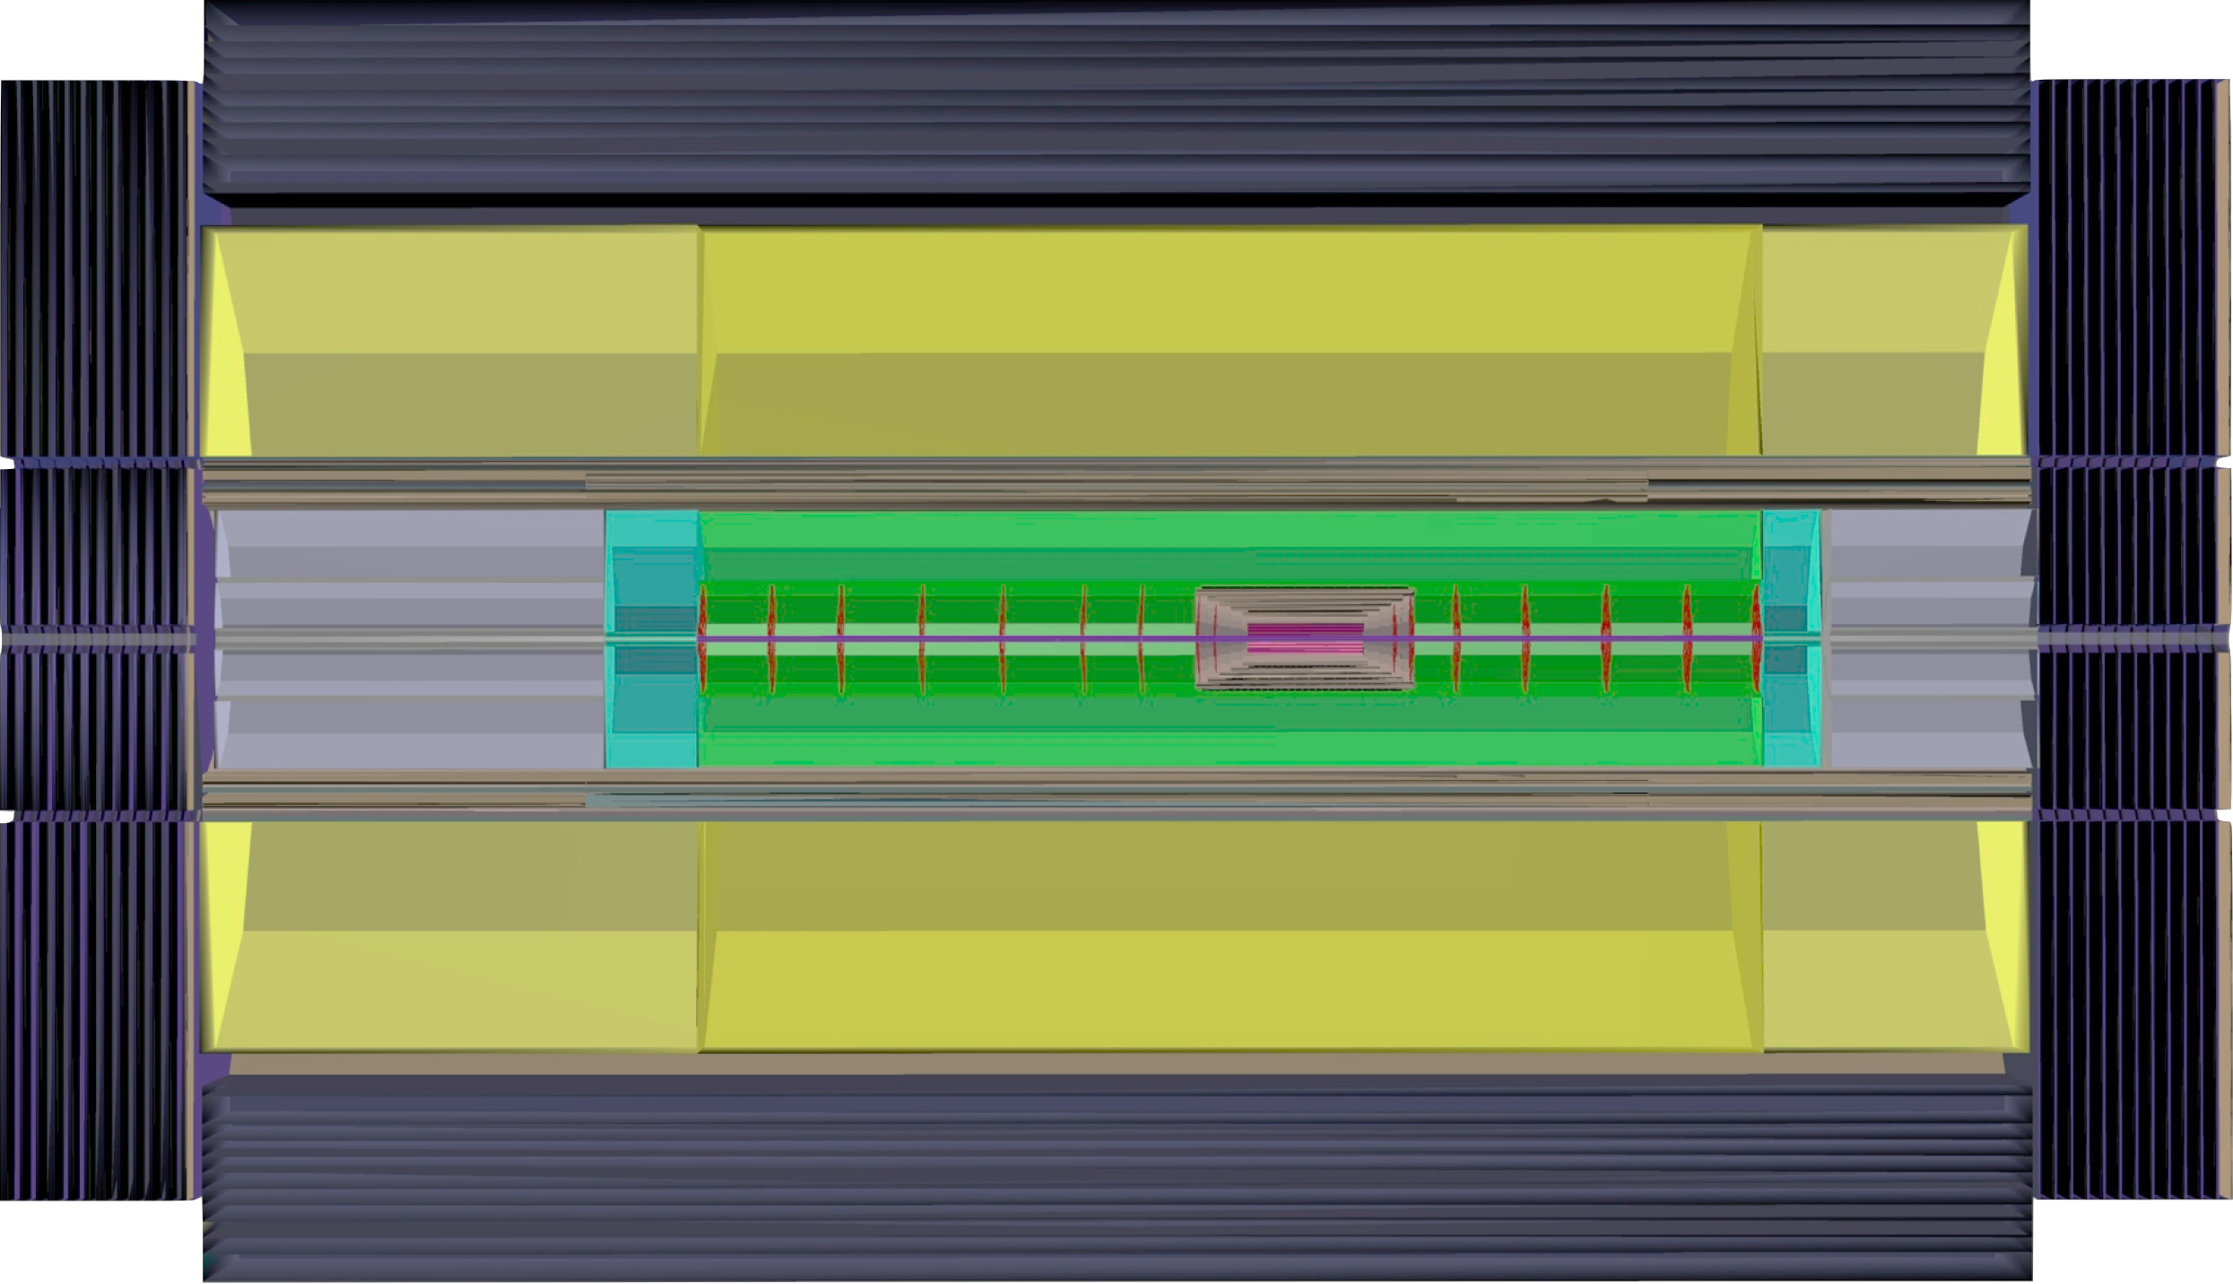
Design of a New Detector for ep/eA Collisions
P.Kostka (Univ.Liverpool), A.Polini (INFN Bologna) on behalf of the LHeC Collaboration
Abstract The Large Hadron electron Collider, with a multi-purpose detector, has a unique physics programme of deep inelastic scattering (DIS), which can be pursued with unprecedented precision over a hugely extended kinematic range. This contribution summarises the design concepts for a new detector, which combine the demands of very high precision with those of large acceptance into a novel device for electron-proton and electron-ion physics at TeV energies. The physics and technical requirements, choices of detector techniques and the integration of the detector with the 3 beam interaction region including its magnet designs are presented. With increasing luminosity the LHeC becomes a precision Higgs research facility and at FCC-he a Higgs factory. The cms energy of the LHeC is ~1 TeV extended to ~4 TeV when an about 50 TeV proton beam becomes available for ep.
Physics Program CDR, arXiv: 1211.4831 and 1211.5102 / http://lhec.web.cern.ch
LHeC x-Q² DIS kinematic plane
Resolving the Proton Structure
Q^{2/}GeV²
Kinematics at High Q² at the FCC-he
Finite p Radius
Stanford
FCC-he
Ee : 175 GeV
60 GeV
SLAC
Quarks
FNAL
CERN
Quark Gluon Dynamics
LHeC
100 Years of lp scattering
5 orders of magnitude
deeper into matter
HERA-LHeC-FCC-eh:
finest microscopes
with resolution
varying like 1/√Q²
ϑh=1⁰
HERA
LHeC
?
HERA
FCC-­‐he
Bjorken x
LHeC - Detector Layout
The LHeC Experiment (Energy Recovery Linac+LHC) is designed to run simultaneously with the LHC, requiring a three beam IR and compatible optics configuration
Head-on collisions: synchrotron radiation fan from e± beam, dipoles along the whole beam-pipe (±9m) for avoiding a crossing angle to obtain maximum luminosity
Muon Detector
Beampipe:
CDR: 6m length, Beryllium 2.5-3mm thickness,
Inner dimensions: circular(x)=2.2cm, elliptical(-x)=10cm & (y)=2.2cm
composites also investigated
Silicon Track Detector Layout:
Very compact design, contained within the EMC
Large coverage in the proton direction: dense forward jet production (down to 1o in θ)
Services and Infrastructure demand careful design as the main contributors to the Material Budget
Calorimetry:
Hermetic EMC and HAC calorimetry surrounding the silicon tracking with appropriate thicknesses (X₀ and λ_{i})
Technology baseline in the Conceptual Design (CDR):
EMC: Liquid Argon Technology
HAC: Barrel Scintillator Tiles/Iron
Fwd-Bwd Inserts (Silicon/Tungsten-Silicon/Copper)
Beampipe Design
HCAL
Fwd
Calorimeter
Inserts
Solenoid
Dipole
Dipole
e∓
Tracker
Bwd
Calorimeter
Inserts
p/A
EMC
Fwd/bwd asymmetry reflecting beam energies; central detector 14m x 9m
Tracking Layout
Magnet System
Muons
Conclusions
Muon system with 2-3 super-layers surrounding the central detector. Baseline: muon tagging, no independent momentum measurement and use of technologies as at LHC (and elsewhere). Extensions possible: Independent momentum measurement: → larger solenoid or dual coil system with all of calorimeter within inner coil; in forward region: toroid (air core design)
A high resolution, large acceptance detector is being designed for precision DIS physics in a kinematic range extending over six orders of magnitude in Q² and 1/x. With no pile-up and much less radiation than affects the pp operation, the LHeC detector can be based on existing technology. Current work focusses on the software description of the design to support more refined studies as on the Higgs or top physics. The
design has been scaled to the FCC-he kinematics, roughly by scaling the forward dimensions by a factor of ln(50/7)~2 and keeping the backward region which is determined by the electron beam energy. The rare H→μμ decay is an example of new processes accessible at the FCC-he leading to new detector considerations such as on the muon momentum measurement.
3.5 T field magnet around the EMC part within the HCAL. Super conducting solenoid and dipoles (~0.3T) are placed within the same cold vacuum vessel.
On–site Installation
Detector Description - DD4hep
Premounting of detector and
commissioning of the coil system on surface, lowering and commissioning of the detector underground. At IP2
mount detector inside L3
magnet support structure.
Time for field map of solenoid and beam-pipe bake out & vacuum pumping.
Estimated total time is
about compliant with LHC shutdown durations.
Full detector description; geometry, materials, visualisation, readout, alignment, calibration etc.
Full experiment life cycle
Single source of detector information, simulation, reconstruction, analysis
LHeC and FCC-he same software; but different geometry, materials etc.
e∓p/e∓A simulation
The LHeC/FCC-he detectors are being described using DD4hep
http://aidasoft.web.cern.ch/DD4hep

