Slide 1




Future Deep Inelastic Scattering at High Energies
High Energies
Default Electron Accelerator Design
Demonstration of ERL
Realisations
Detectors
Key Physics Subjects
Prospects
Max Klein
University of Liverpool
for the LHeC Collaboration
For all references,
please consult
lhec.web.cern.ch
Dedicated to Isabelle Irene Poncette (11.7.1988-24.7.2016)
ICHEP Conference, Chicago, USA, 5th of August 2016

Slide 2
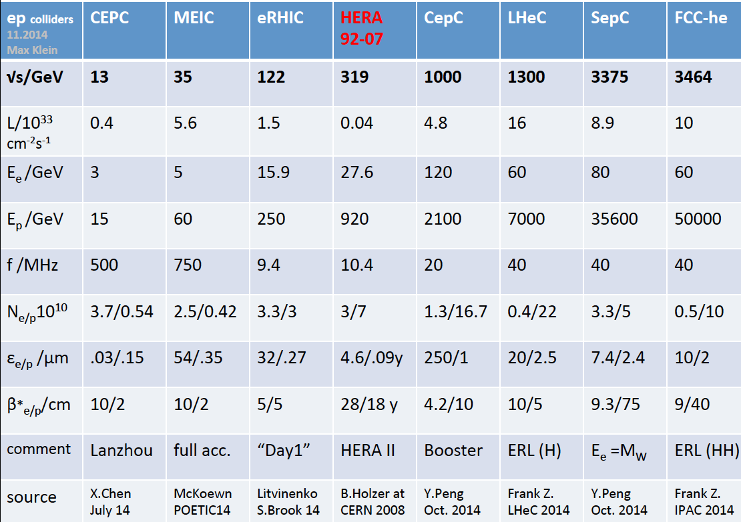
title
A Revival of electron-proton (ion) colliders following HERA

Slide 3
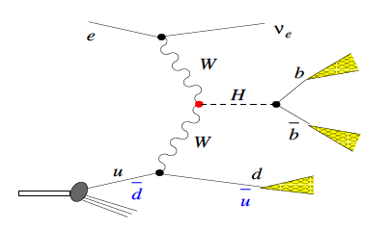
High Energy and Luminosity ep Scattering
/e
/Z
CC/NC
DIS ep
/Z
CDR 2012
In reach L=10³⁴:
-p-brightness * 1.7
-e-current * 2
-IR focus / 2
e power limit set
P=I*E=P₀/(1-η) → ERL
E_{p}=7 – 14 – 50 TeV (HL,HE LHC, FCC)
the energy frontier is at CERN
E_{e}= 60 GeV, lower: cost, higher: H,BSM
Current working point for LHeC
- 60 GeV: 200fb = σ(WW→ H) in e⁻p
- 10³⁴ → 1ab⁻¹ [all of L(HERA) in days]
s=4E_{e}E_{p} → Q²_{max} =s=10⁶ GeV² (10⁷ at FCC)
x_{Bj} ~ 1/s : down to 10⁻⁶ ⁽⁻⁷⁾ for Q² =1 GeV²
High luminosity enables to access x → 1

Slide 4
Default Electron Accelerator Configuration
Conceptual Design Report arXiv:1206.2913
Non default: An expensive generalisation to achieve E_{e}= 500 GeV or more

Slide 5
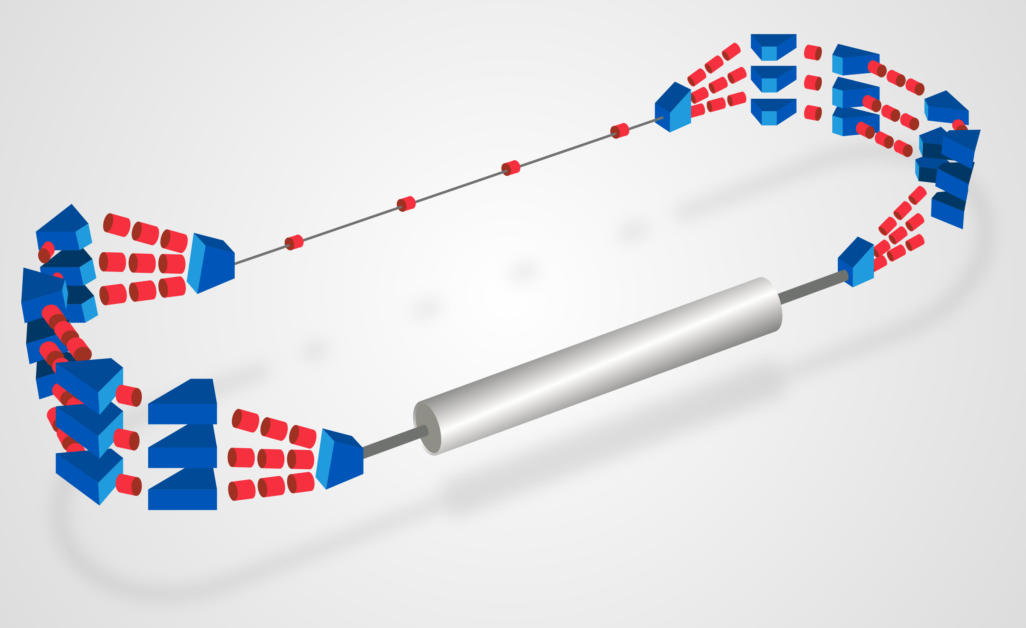
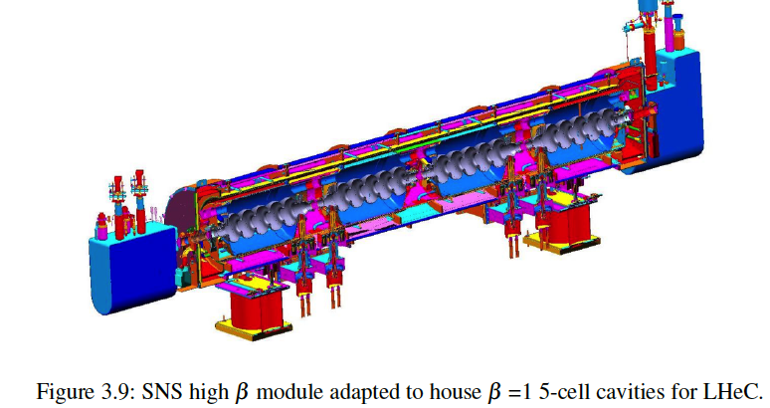
LHeC Demonstrator
Demonstration of high current
(10mA), multi(3)turn ERL
Test and development of 802MHz
SCRF technology
E_{e} = 200 (400) MeV with 1(2) module
Footprint:14x4m²
Parameter | Value
Dipoles per arc Dipole length Max B Field | 3/4 50 cm 1.1 T
Quadrupoles per arc Quadrupoles in straight lines | 5 4
Dipoles in Spreader/Combiner Quads in Spreader/Combiner | 1-3 3
Dipoles for Injection-Extraction | 6
BINP, CERN, Daresbury, Jlab,
Liverpool, Orsay (LAL/INP),+
Collaboration being established
802 MHz cavity soon produced
PERLE CDR to be published, ICFA Beam Newsletter 68 (2016)

Slide 6
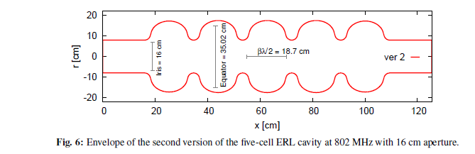

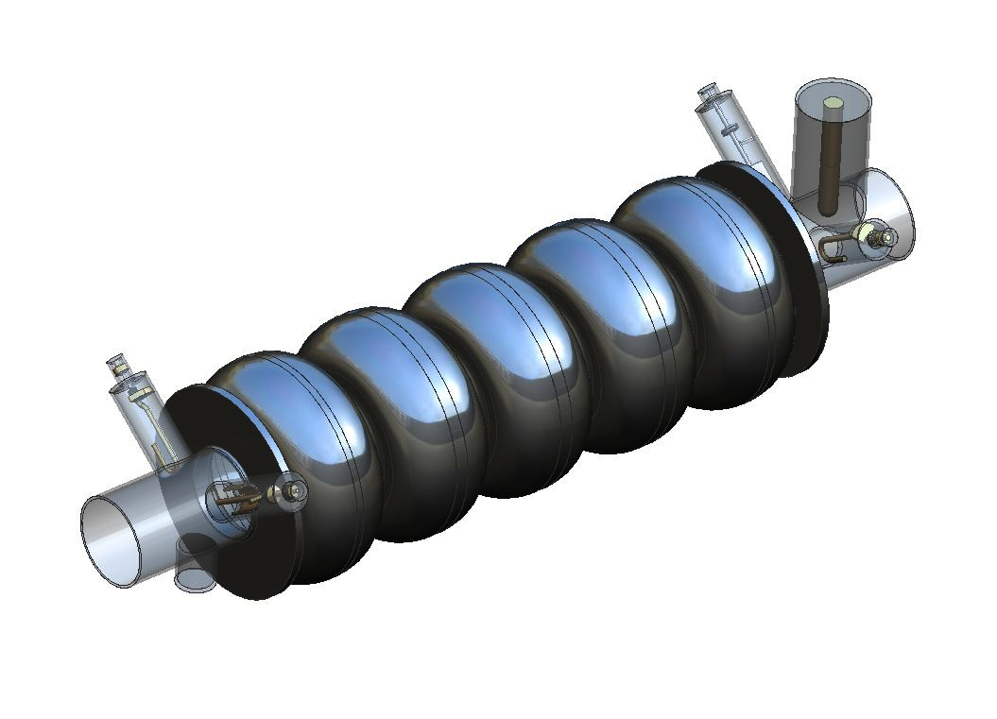
802 MHz Cavity Parameters design to also test FCC-ee
Parameter | Unit | Value | Value | Value |  | Value | Value
cavity type |  | LHeC prototype (2016) | LHeC study (2015) | LHeC study (2015) |  | LHeC Ver. 1 | LHeC Ver. 2
frequency | MHz | 801.58 | 802 | 802 |  | 801.58 | 801.58
number of cells |  | 5 | 5 | 5 |  | 5 | 5
L_{active} | mm | 917.91 | 922.31 | 922.14 |  | 935 | 935
R/Q = V_{eff}²/(ω*W) | Ω | 523.7 | 580.1 | 583.4 |  | 430 | 393
R/Q/cell | Ω | 104.7 | 116.0 | 116.7 |  | 86.0 | 78.6
G | Ω | 274.6 | 273.2 | 273.2 |  | 276 | 283
R/Q∙G/cell |  | 28765 | 31702 | 31877 |  | 23736 | 22244
Eq. Diameter | mm | 327.95 | 323.12 | 323.12 |  | 350.2 | 350.2
Iris Diameter | mm | 130 | 115 | 115 |  | 150 | 160
Tube Diameter | mm | 130 | 140 | 115 |  | 150 | 160
Eq./Iris ratio |  | 2.52 | 2.81 | 2.81 |  | 2.19 | 2.19
Wall angle (mid-cell) | deg | 0 | 0 | 0 |  | 12.5 | 12.5
E_{peak}/E_{acc} (mid-cell) |  | 2.26 | 2.07 | 2.07 |  | 2.26 | 2.40
B_{peak}/E_{acc} (mid-cell) | mT/(MV/m) | 4.20 | 4.00 | 4.00 |  | 4.77 | 4.92
k_{cc} | % | 3.22 | 2.14 | 2.14 |  | 4.47 | 5.75
N²/k_{cc} |  | 7.78 | 11.71 | 11.71 |  | 5.59 | 4.35
cutoff TE₁₁ | GHz | 1.35 | 1.26 | 1.53 |  | 1.17 | 1.10
cutoff TM₀₁ | GHz | 1.77 | 1.64 | 2.00 |  | 1.53 | 1.43
Detail end group + flange locations → build
F.Marhauser, B.Rimmer, J.Henry (Jlab) + R.Calaga, E.Jensen, K. Schirm et al (CERN) [4.8.16]
Notes:
Red Interior Page Design 1

Slide 7
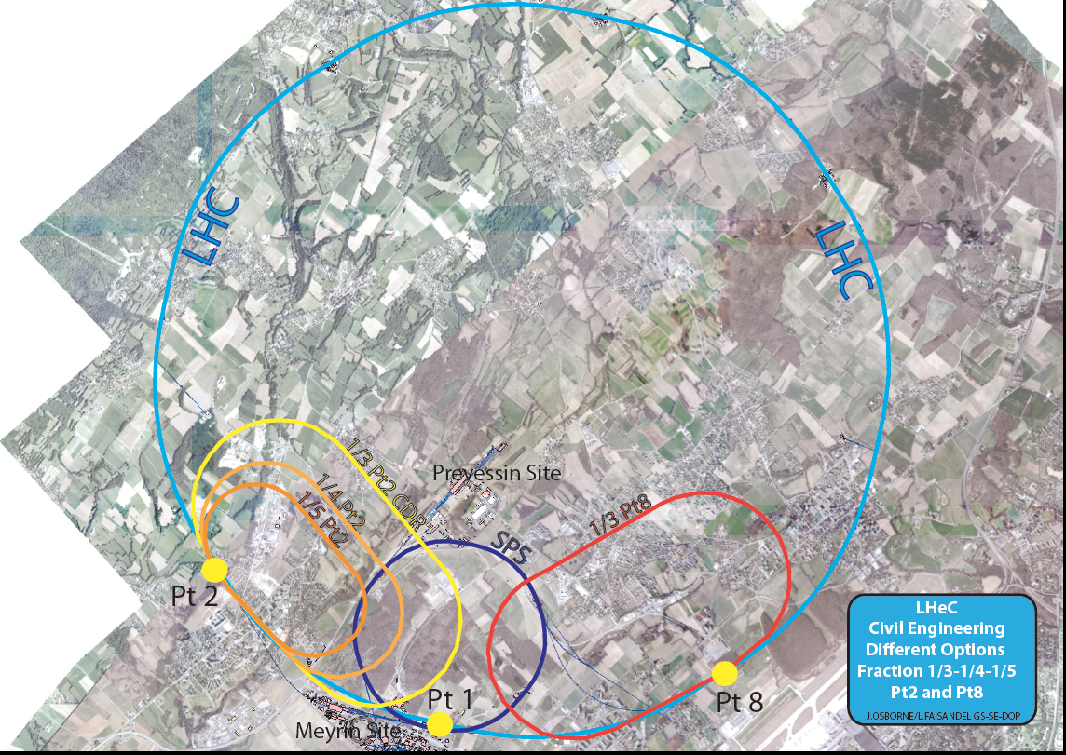
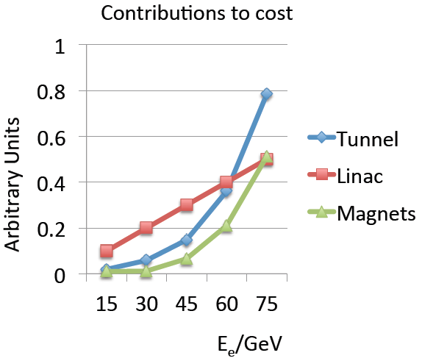
backup
Realisation of
the LHeC
~4 years of CE
Physics and cost will
determine footprint
MK 6/14

Slide 8
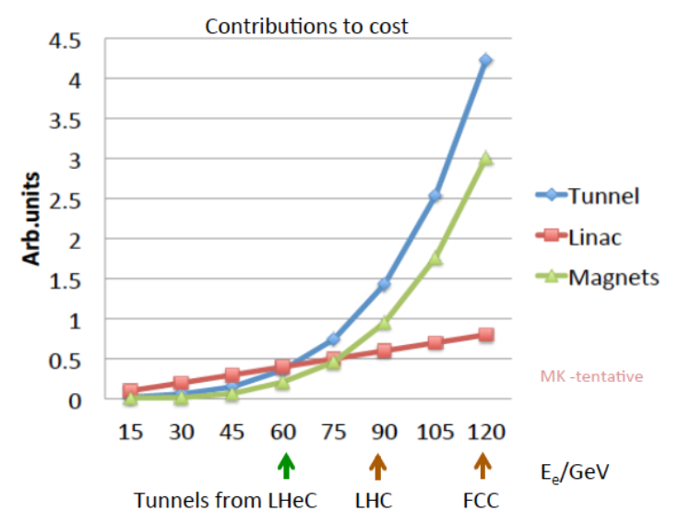
Choice of FCC_eh Baseline Configuration = f(cost,E_{e},s)
Cost strongly rising with tunnel circumference. Presently stick to LHeC default.
Maximise independence of ring installation, design for synchronous ep and pp OP

Slide 9
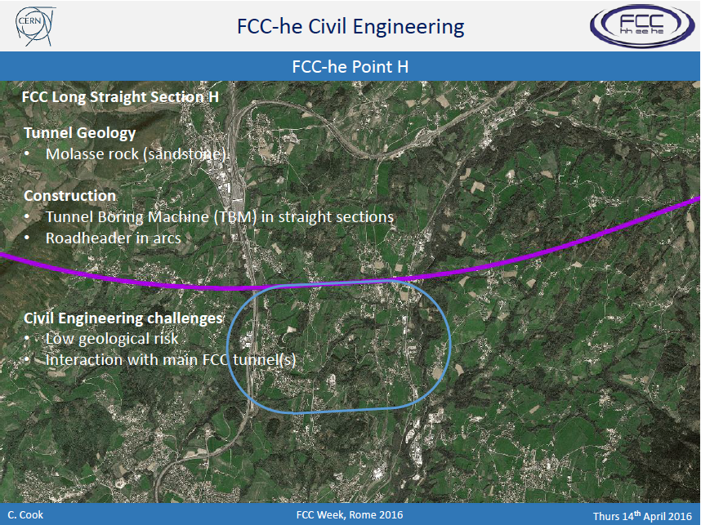
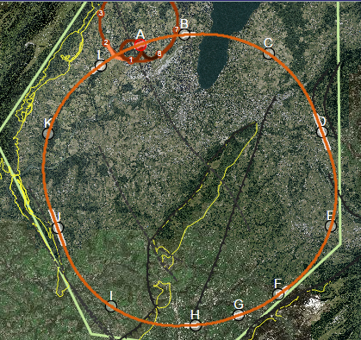
CE: favoured eh
site is point H

Slide 10
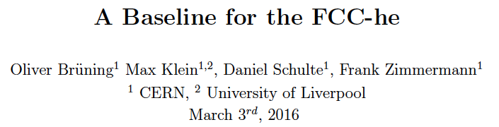
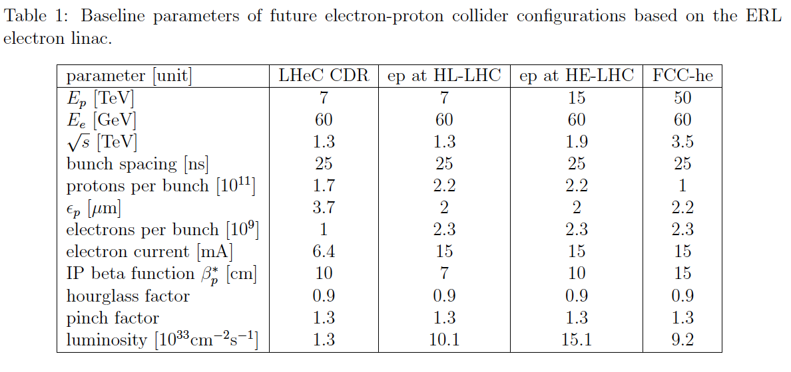
work in progress (also eA)

Slide 11
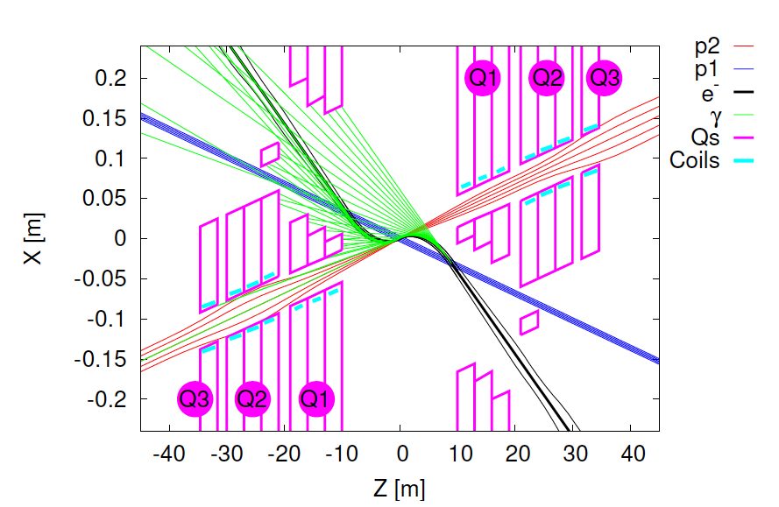
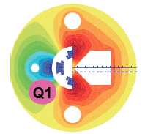
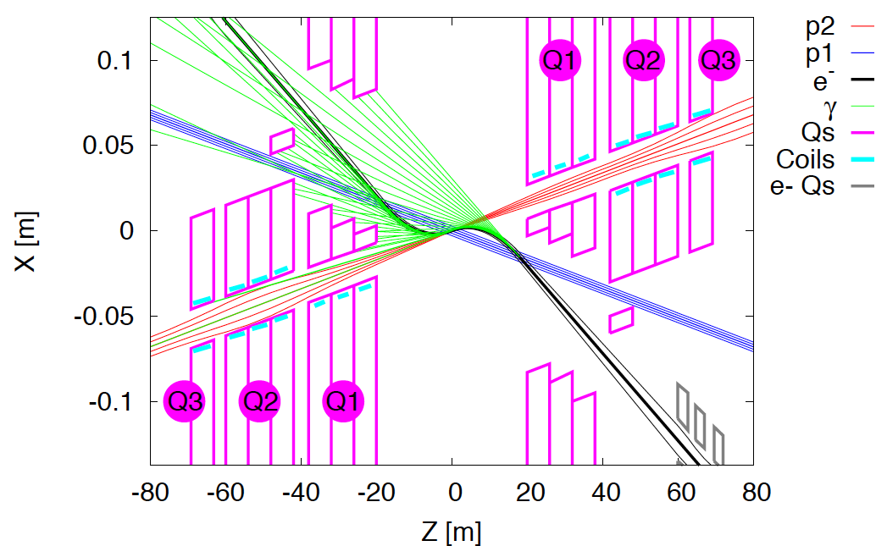
Interaction Regions for ep with Synchronous pp Operation
LHeC (CDR)
60 GeV * 7 TeV
Still work in progress:
may not need half
quad if L*(e) < L*(p)
Non colliding p beam
FCC-he (ERL)
60 GeV * 50 TeV
Tentative: ε_{p}=2μm, β*=20cm → σ_{p}=3μm ≈σ_{e} matched! ε_{e}=5μm ..
Rogelio Tomas et al

Slide 12
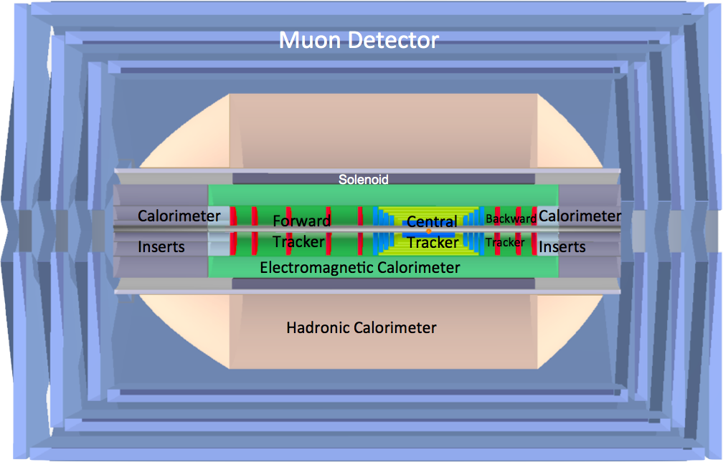
LHeC Detector Overview
LAr electromagnetic calorimeter
Tile Calorimeter
Detector option 1 for LR and full acceptance coverage
Forward/backward asymmetry in energy deposited and thus in geometry and technology
Present dimensions: LxD =14x9m² [CMS 21 x 15m² , ATLAS 45 x 25 m²]
Taggers at -62m (e), 100m (γ,LR), -22.4m (γ,RR), +100m (n), +420m (p)

Slide 13
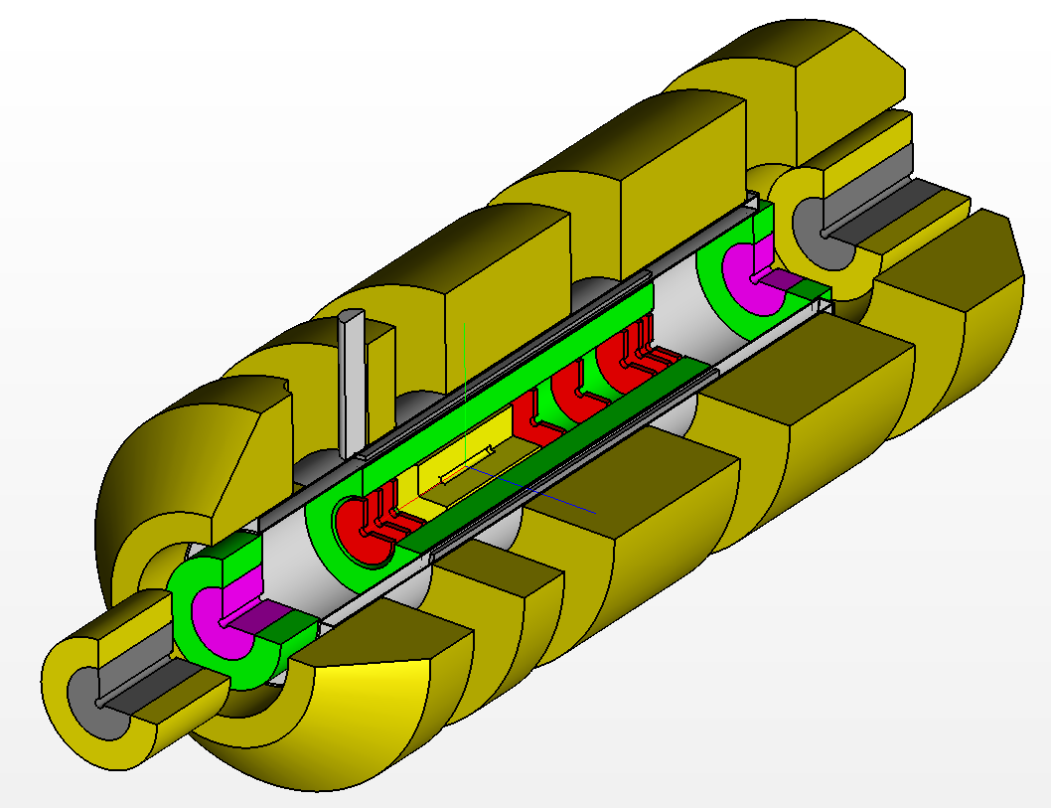
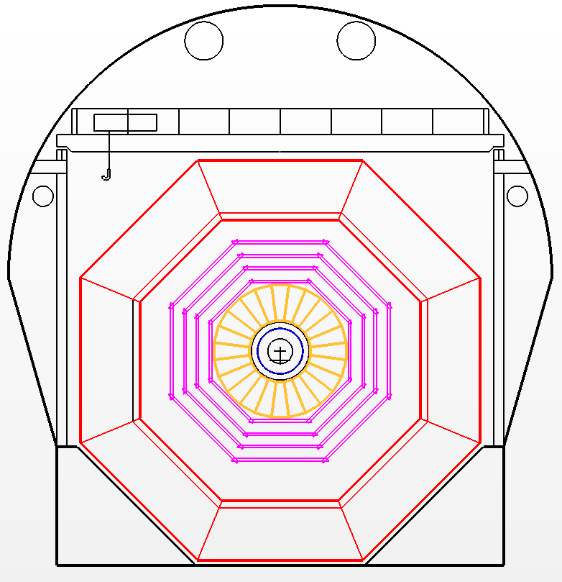
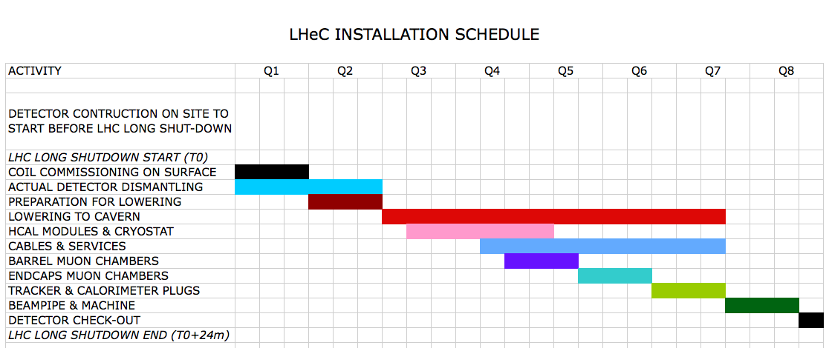
Installation
Study
Detector fits in L3 magnet support
Modular structure

Slide 14
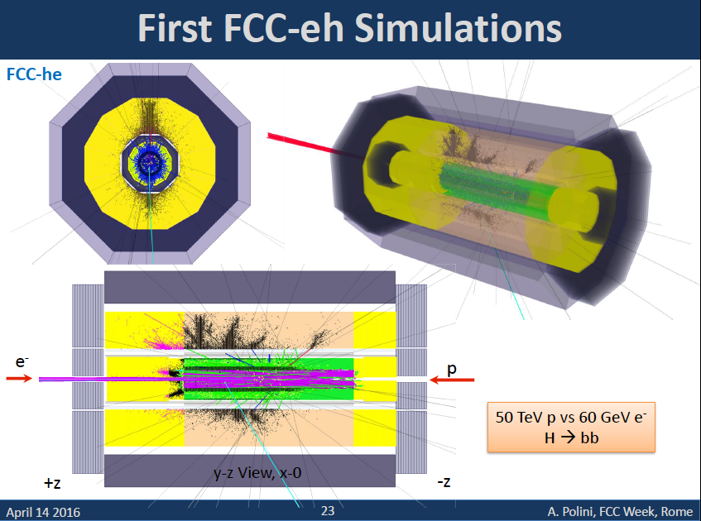
title

Slide 15
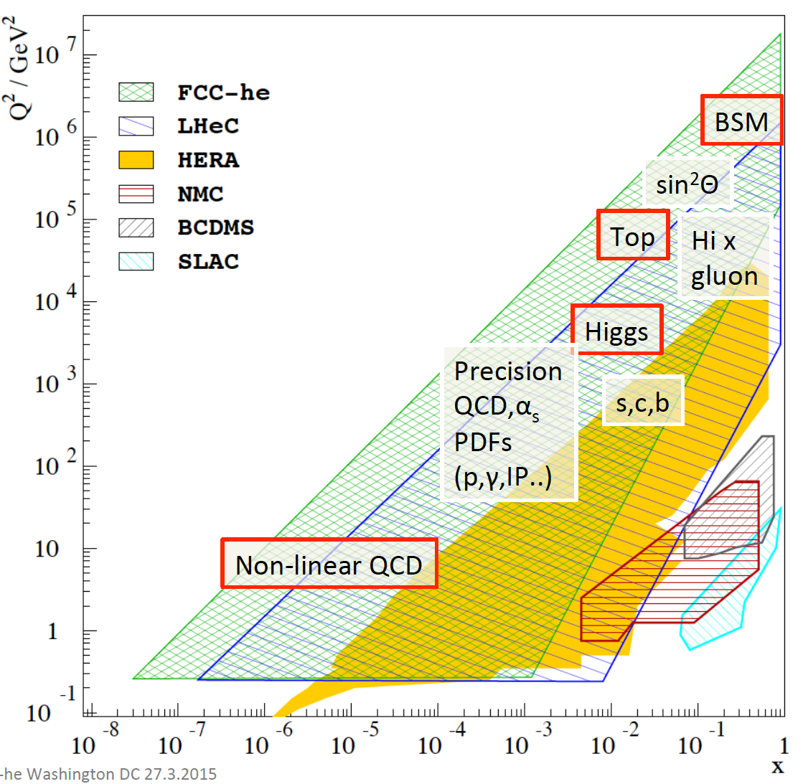
Summary of ep Physics
At this conference
B Mellado: Higgs
A Stasto: eA+low x
C Schwanenberger
Top, elweak + BSM
Poster on QCD
←EIC

Slide 16
title
Current status of gluon-gluon sub-cross section uncertainty at FCC (hh) vs mass produced

Slide 17
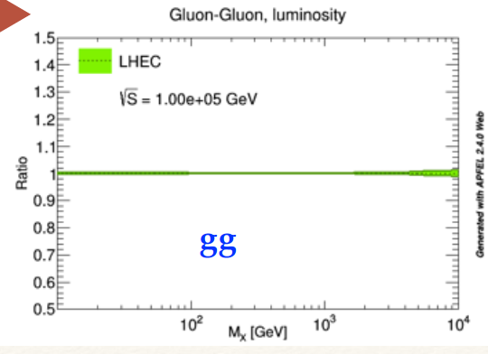
The unique value of PDFs from ep DIS: Complete set of quark and gluons:
Unprecedented precision, independence of symmetry assumptions, N³LO
→ clean prediction for substructure, QCD, Higgs and searches in pp
Needs extension
of grid beyond
Q²=10⁸ GeV² ..
V.Radescu
Expected gluon-gluon sub-cross section uncertainty at FCC (eh) vs mass produced

Slide 18
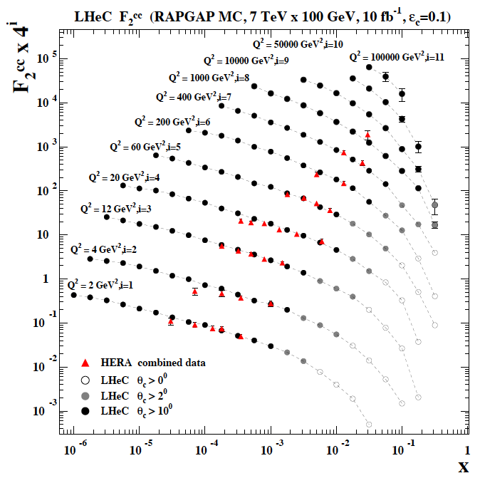
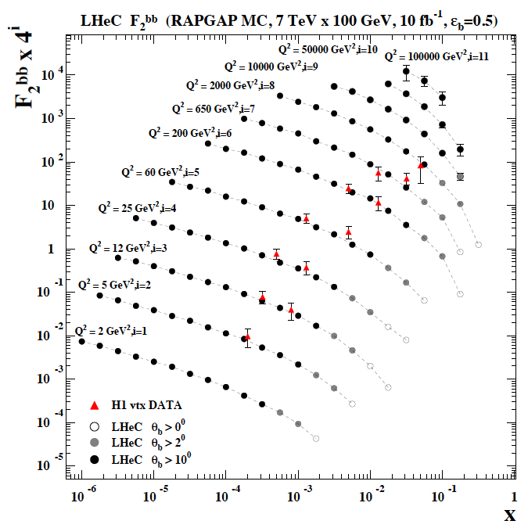
F₂^{charm} and F₂^{beauty} from LHeC
Hugely extended range and much improved precision (δM_{c}=60 HERA → 3 MeV)
will pin down heavy quark behaviour at and far away from thresholds, crucial for precision t,H..
In MSSM, Higgs is produced dominantly via bb → H (Pumplin et al) , but where is the MSSM..

Slide 19
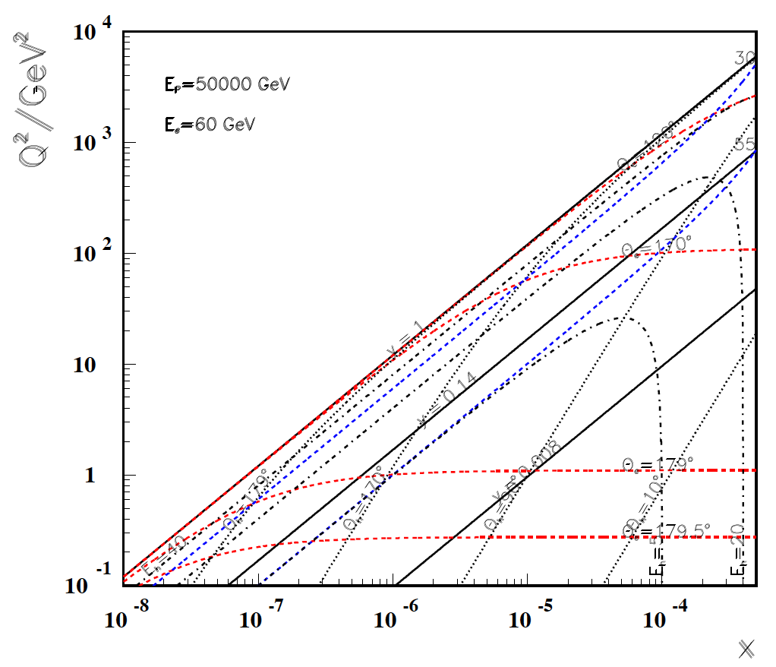
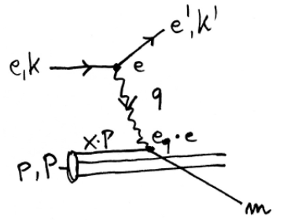
Acceptance of a 750 GeV Ghost S
FCC-he
60 GeV
LHeC
← y >0.047
(=0.33 LHeC)
S
-----------
179º
@ 180 GeV
.. very low x
requires not
the maximum
of E_{e}
3 C’s
Cross section?
Couplings?
Confirmation!
HERA
G Azuelos
U,M.Klein
x
For x < 10⁻³ no (average) energy deposition exceeding the electron beam energy

Slide 20
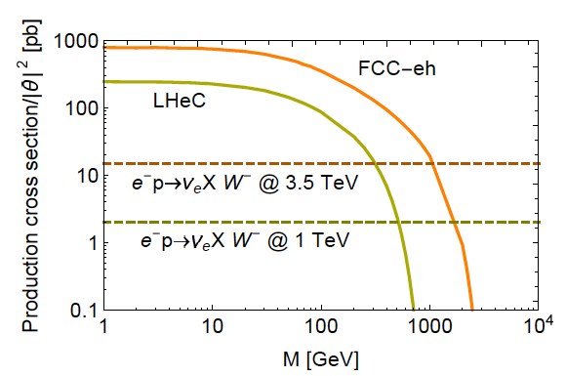
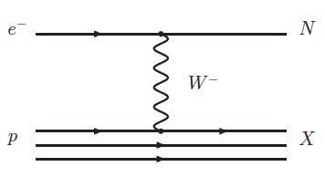
Heavy Neutrino Search at FCC (ee,hh,eh)
Oliver Fischer
Rome Talk
Sterile Neutrinos

Slide 21
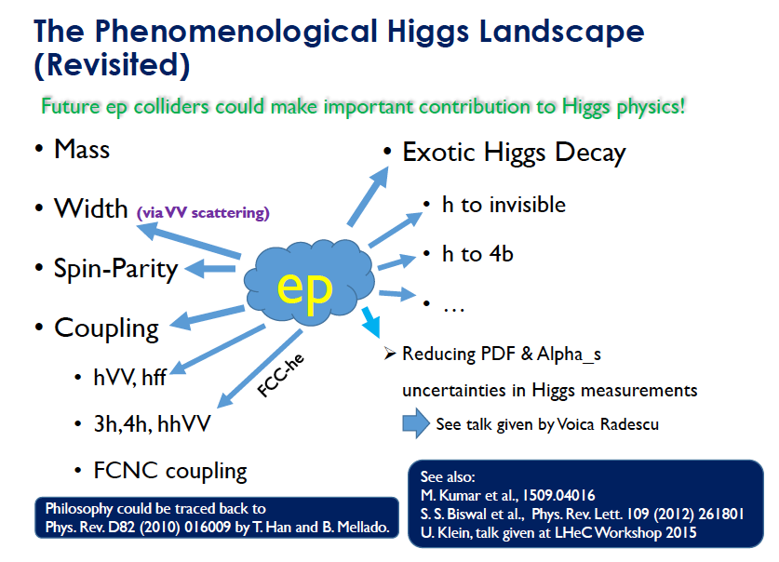
Chen Zhan 12.4.16

Slide 22
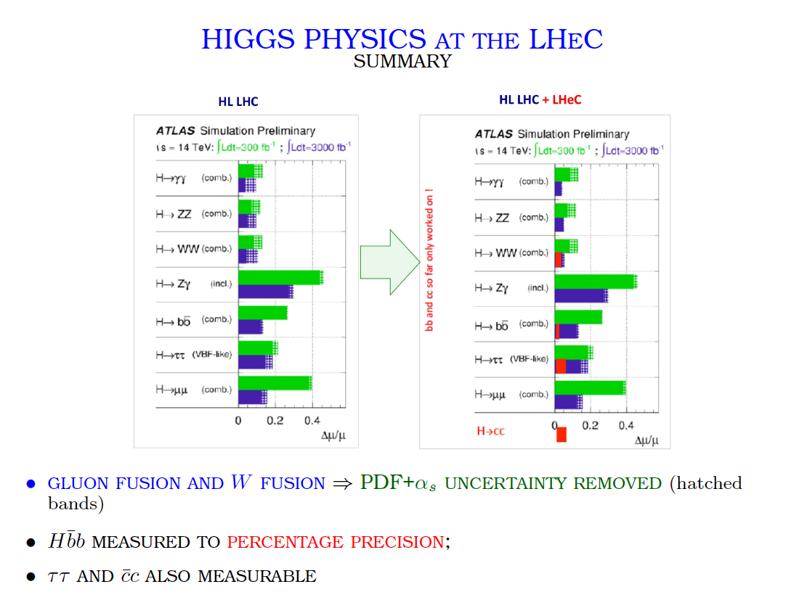
Meeting with Eckhard Elsen
S.Forte ECFA 11/15

Slide 23
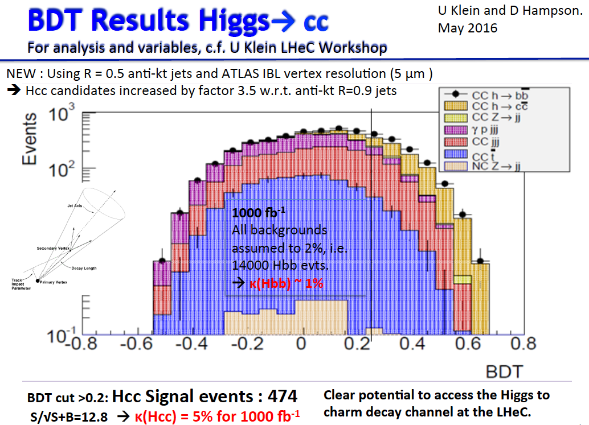
backup

Slide 24
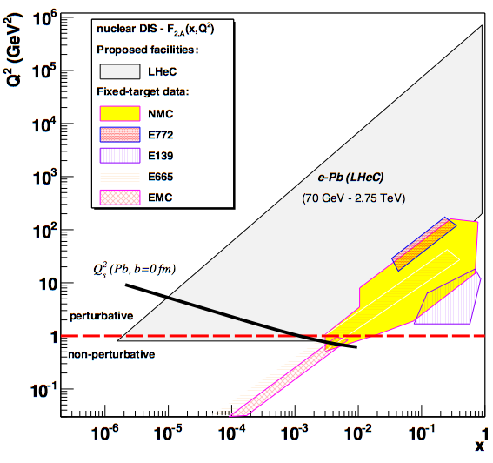
LHeC-FCC-he as Electron Ion Collider(s)
FCC-he
LHeC is part of NuPECCs
long range plan since 2010
L_{eN} ~ 10³² cm⁻² s⁻¹
LHeC
Extension of kinematic range in lA
by 4-5 orders of magnitude will
change QCD view on nuclear
structure and parton dynamics
May lead to genuine surprises…
No saturation of xg (x,Q²) ?
Small fraction of diffraction ?
Broken isospin invariance ?
Flavour dependent shadowing ?
EIC (US)
Some expect g-saturation at
Q²_{s} ≈ xg α_{s} ≈ c x^{-λ}A^{1/3}
Note that the gluon is valence like at low Q²
Precision QCD study of parton dynamics in nuclei
Investigation of high density matter and QGP
Gluon saturation at low x, in DIS region.

Slide 25
Remarks on the Project Status
LHeC: CDR in 2012 (300 authors, 600 pages). 2014+16: CERN Mandate to continue the study:
Mandate to the International Advisory Committee 2014-2017
Advice to the LHeC Coordination Group and the CERN directorate by following the
development of options of an ep/eA collider at the LHC and at FCC, especially with:
Provision of scientific and technical direction for the physics potential of the ep/eA
collider, both at LHC and at FCC, as a function of the machine parameters and of a
realistic detector design, as well as for the design and possible approval of an ERL
test facility at CERN.
Assistance in building the international case for the accelerator and detector
developments as well as guidance to the resource, infrastructure and science
policy aspects of the ep/eA collider.
Chair: Herwig Schopper
Two major next goals:
-Design and build an LHeC ERL demonstrator (10mA, 3 turn, 802 MHz)
-Update of the CDR by 2018: LHC physics, 10³⁴ lumi, detector and accelerator updates
FCC-eh: Utilize the LHeC design study to describe baseline ep/A option.
Emphasis: 3 TeV physics, IR and Detector: synchronous ep-pp operation.
Open to other configurations and new physics developments (750..)

Slide 26
Organisation^{*)}
Working Groups
International Advisory Committee
“..Direction for ep/A both at LHC+FCC”
PDFs, QCD
Fred Olness,
Voica Radescu
Higgs
Uta Klein,
Masahiro Kuze
BSM
Georges Azuelos,
Monica D’Onofrio
Top
Olaf Behnke,
Christian Schwanenberger
eA Physics
Nestor Armesto
Small x
Paul Newman,
Anna Stasto
Detector
Alessandro Polini
Peter Kostka
Coordination Group
Accelerator+Detector+Physics
Sergio Bertolucci (CERN/Bologna)
Nichola Bianchi (Frascati)
Frederick Bordry (CERN)
Stan Brodsky (SLAC)
Hesheng Chen (IHEP Beijing)
Andrew Hutton (Jefferson Lab)
Young-Kee Kim (Chicago)
Victor A Matveev (JINR Dubna)
Shin-Ichi Kurokawa (Tsukuba)
Leandro Nisati (Rome)
Leonid Rivkin (Lausanne)
Herwig Schopper (CERN) – Chair
Jurgen Schukraft (CERN)
Achille Stocchi (LAL Orsay)
John Womersley (STFC)
Nestor Armesto
Oliver Brüning – Co-Chair
Stefano Forte
Andrea Gaddi
Erk Jensen
Max Klein – Co-Chair
Peter Kostka
Bruce Mellado
Paul Newman
Daniel Schulte
Frank Zimmermann
5(11) are members of the
FCC coordination team
OB+MK: FCC-eh responsibles
MDO: physics co-convenor
IAC being renewed by new DG
We lost Guido Altarelli.
*)August 2016

Slide 27
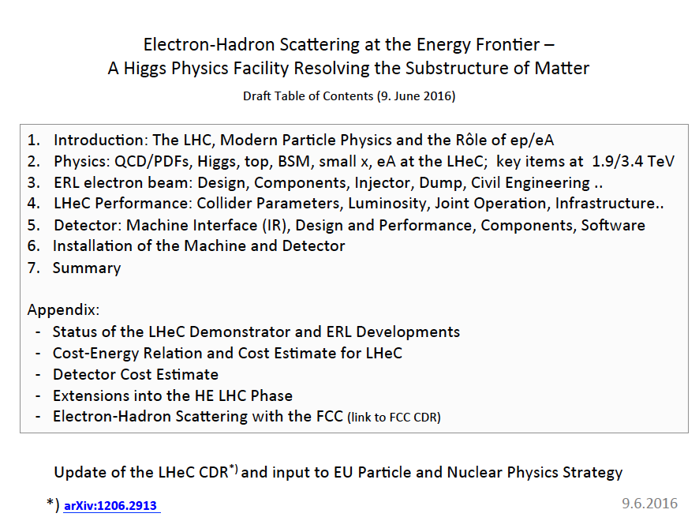
backup
LHeC CDR update because:
- Lumi * 10
- LHC results
- Technology progress
Open for any participation

Slide 28
Summary
The CERN hadron beams (LHC and later HE LHC and/or FCC) enable (few) TeV cms
energy collider experiments - at 1000 times the HERA luminosity.
The current default e beam is a 60 GeV, 3 turn ERL racetrack of 1/3 of U(LHC).
A demonstrator is under evaluation to study 802 MHz, 3 turn, 10mA ERL, i.e. the basic
LHeC technology, in synergy with FCC and with low energy e/y physics community.
This electron-hadron machine has a unique QCD, eweak, Higgs, BSM programme. In short,
CERN has the realistic option of building the world’s cleanest microscope with which
the LHC facility can be turned into a precision Higgs factory, operating with HL LHC.
The electron-ion physics potential is huge as the energy and luminosity are so high.
A new GPD detector, smaller than CMS, larger than H1, may be built to enable that physics.
An initial installation study demonstrates it could be installed in times commensurate with LSi
The next two important goals, approached with the support of the CERN directorate(s),
are to develop the base technology and to update the 2012 CDR for the new luminosity
goal, set by the Higgs discovery, the LHC results of Run 2 and technology progress.
2017: FCC physics week (Jan), LHeC Workshop (Feb), FCC Week (May), ERL Workshop (Jun)
at CERN Orsay Berlin CERN

Slide 29
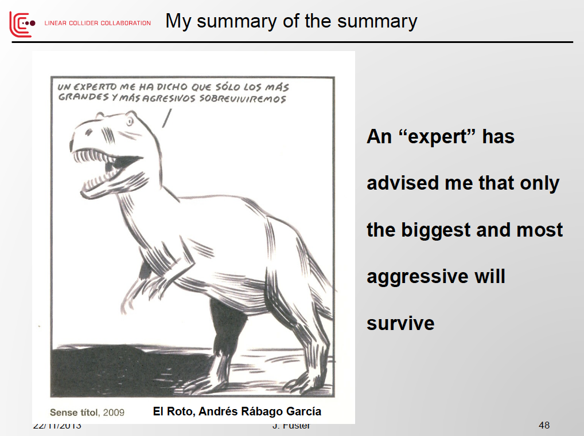
Plenary ECFA talk by Juan Fuster, November 2013 at CERN, on the Linear Collider

Slide 30

I hope DT has not seen Juan’s picture and that the less aggressive ones are given a future too.

Slide 31
The electron beam upgrade has a place in between the recently
endorsed luminosity and the not unlikely energy upgrade of the LHC. It
builds on the biggest investment particle physics ever enjoyed and
helps sustaining its future with a seminal physics programme.
It provides a new, independent energy and intensity frontier collider
configuration which fits to the needs of HEP - physics and community.
That may be realised, with the required courage and realism, bridging
well to future, expensive ee and pp machines which it complements too.
Thank you.
Many thanks to CERN’s directors, the IAC, the FCC team and the ep/h community engaged

Slide 32
backup

Slide 33
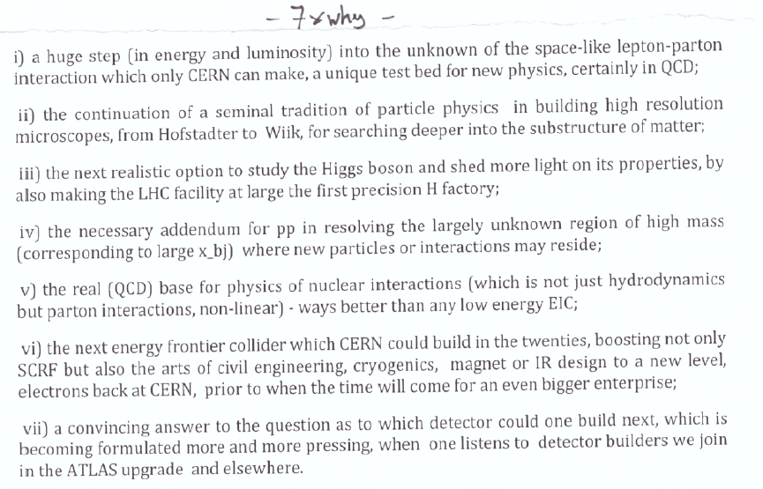
dis

Slide 34
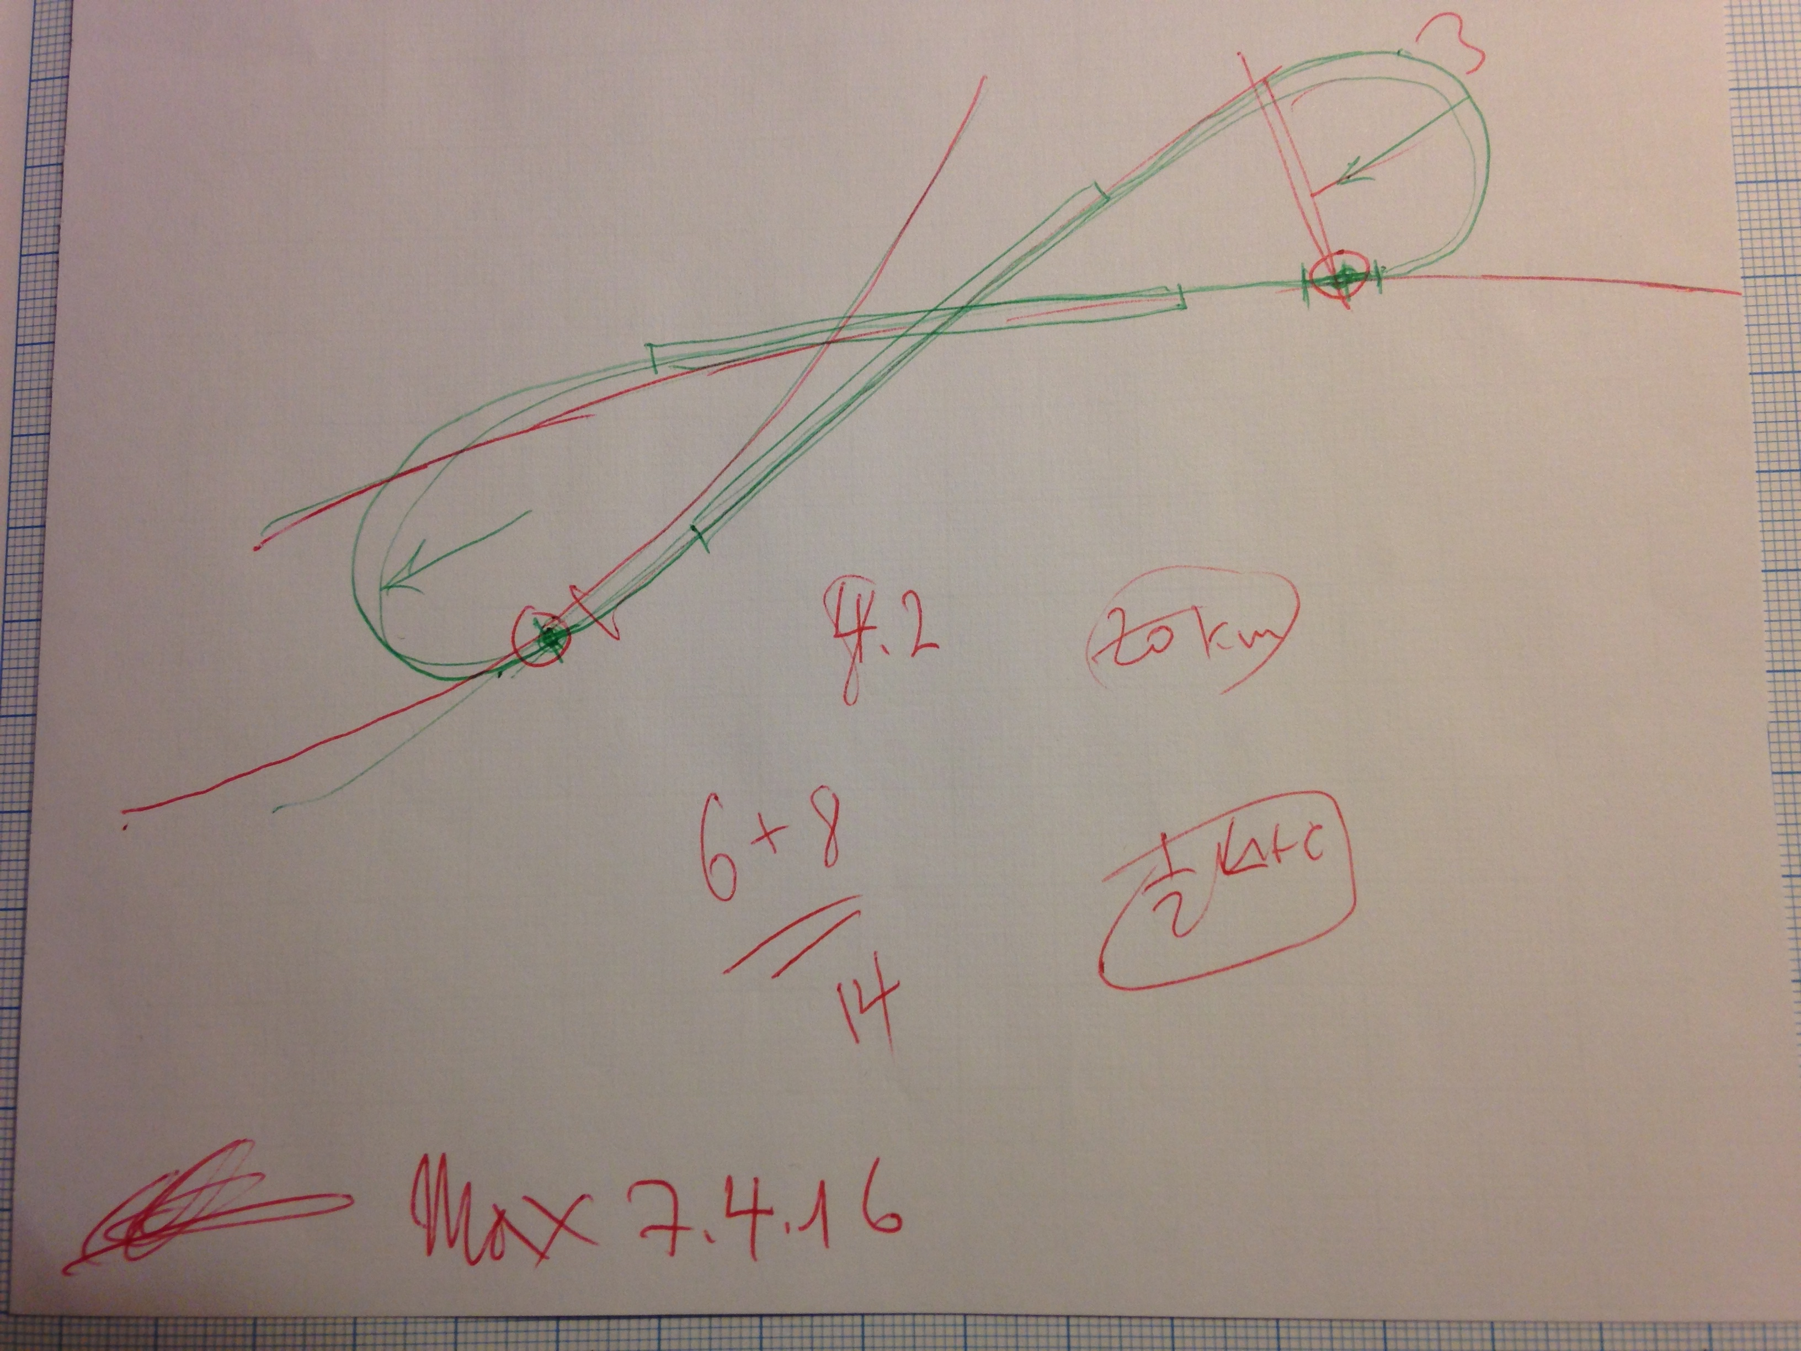
title
An attempt to serve
LHC and the FCC
without relocation.

Slide 35


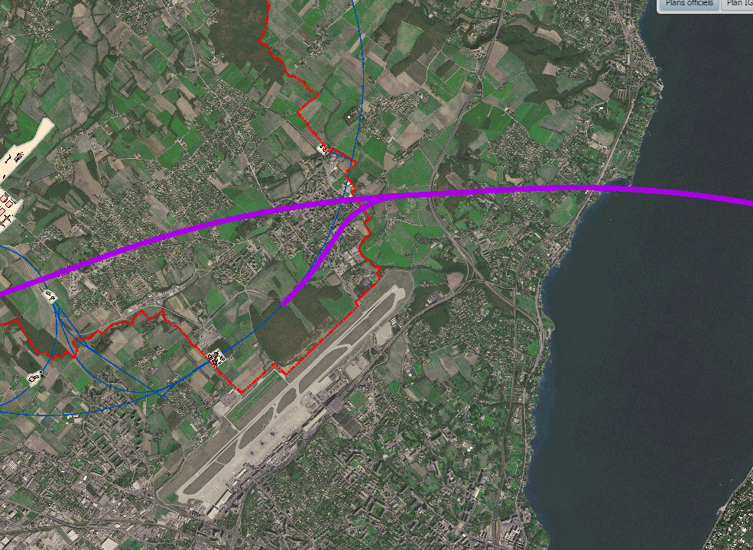
FCC-he Civil Engineering
LHeC/FCC-he Civil Engineering
LHC Point 8 & FCC Long Straight Section L
Further Study
TO BE STUDIED
8 fold way .. for
serving LHC+FCC
C. Cook
FCC Week, Rome 2016
Thurs 14th April 2016

Slide 36
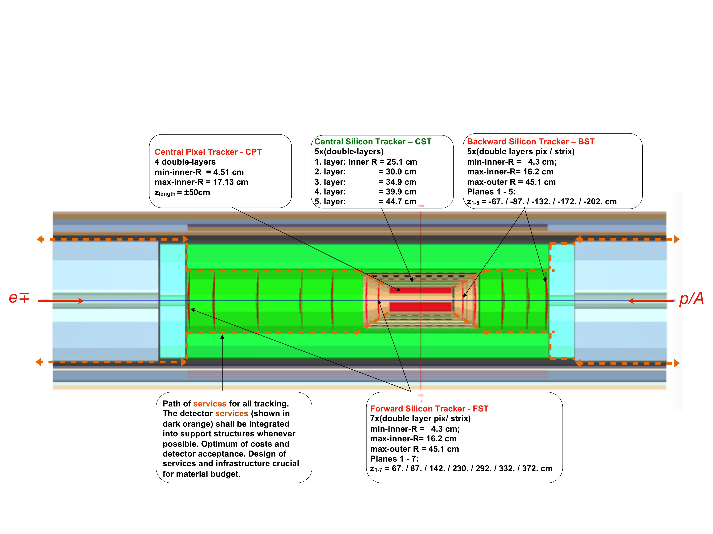
Detector design: Inner Silicon Tracker (status 3/16)
More detailed designs for other components too. DD4HEP software developments..
An opportunity for R+D and building a novel, challenging 4π detector in the twenties.

Slide 37
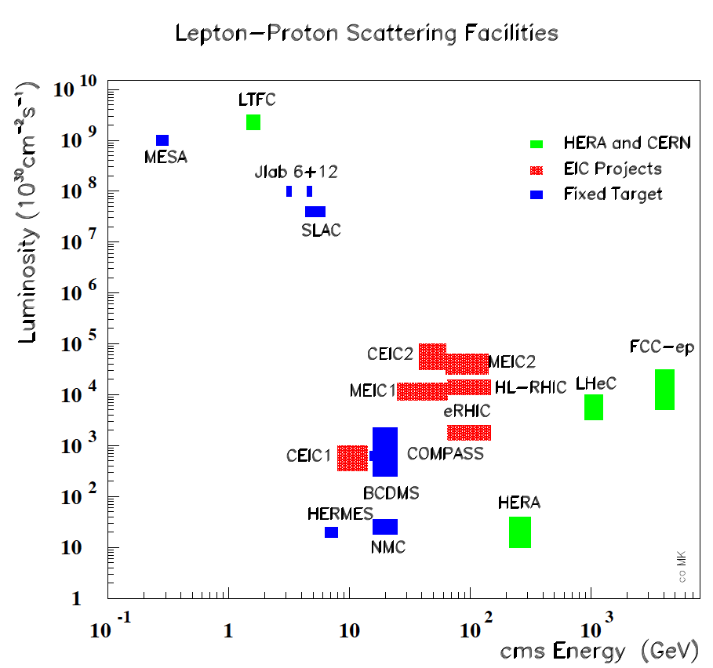
Intensity and Energy Frontier of Future DIS
From CERN Courier
MK, H.Schopper
June 2014
With input from
A.Hutton, R.Ent,
F.Maas, T.Rosner

Slide 38

Valence quarks
It will be crucial for the LHC to resolve
the high x and Q² uncertainties, for its
sustainable future. This requires hi L+s!
up
down
Related to DY , W mass etc
Recall xq_{v} ~ (1-x)³
d/u → 1 a classic question

Slide 39
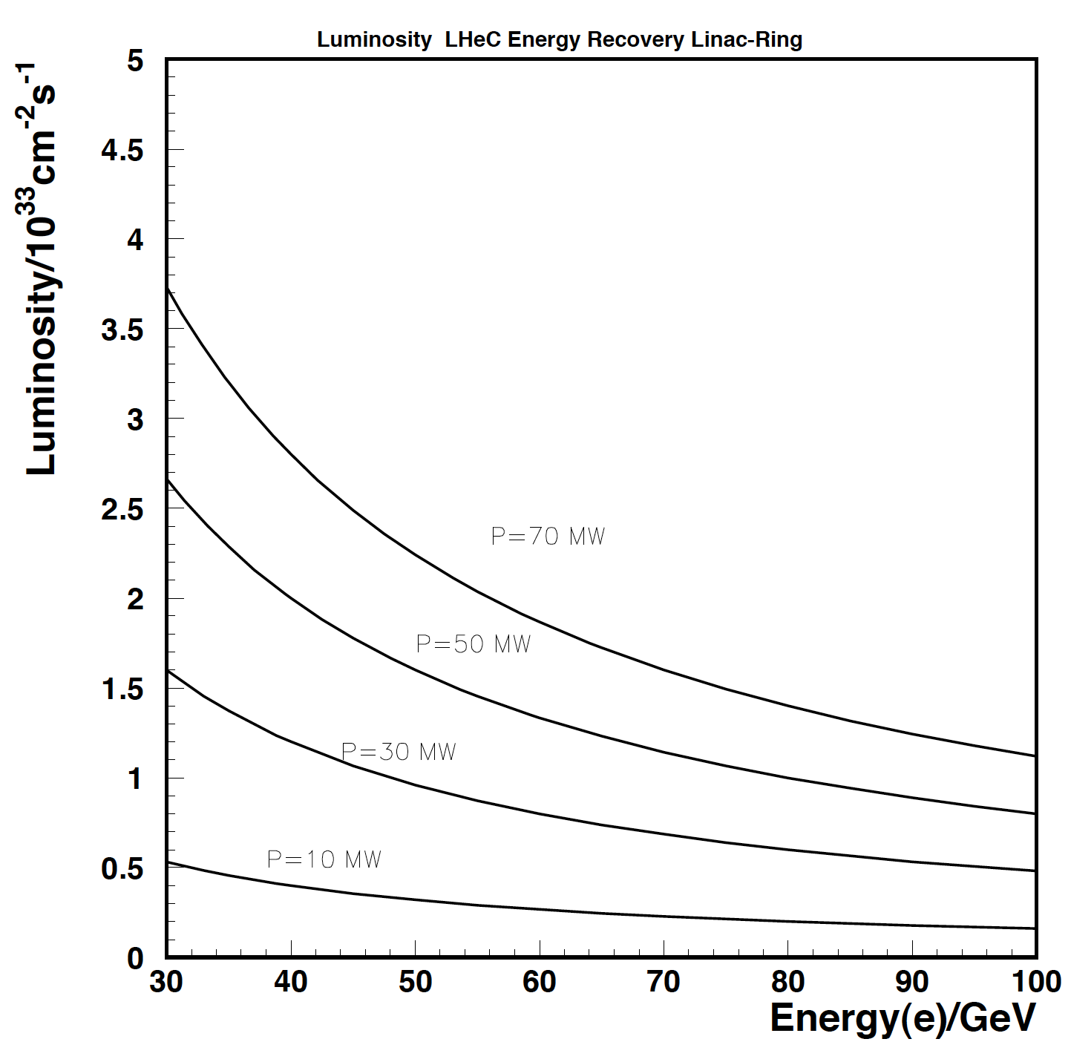
Luminosity
October 2012
The CDR Luminosity
Higgs in ep sets
scale for luminosity!
… so do searches,
high x and special
conditions such as
positron, deuteron,
eA or low energy..
CDR
after the Higgs arXiv:1211.5102
2.5 * brightness, 2 * I_{e} , 0.5 * β*
LHeC Luminosity → 10³⁴ cm⁻² s⁻¹
L(E,P) subject of
current study:
beam-beam, ion
gap stability…
H*pinch(e⁻)*gap-loss ~ 1

Slide 40
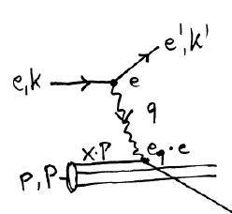
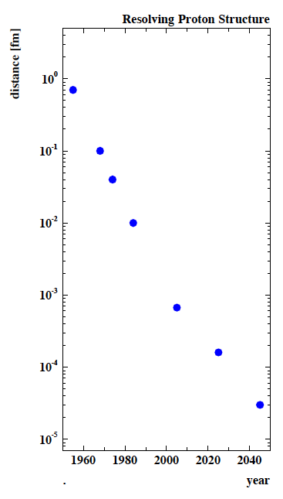
The high energy DIS future is here+near
e⁺e⁻
→
eh →
X
Finite p Radius
Stanford
→
Quarks
SLAC
hh
FNAL
Quark
Gluon
Dynamics
-Parton momentum fixed by electron kinematics
-Incl. NC (γ,Z) and CC (W±) independent of hadronisation
-Rigorous theory: Operator expansion (lightcone)
-Collider- as at HERA: y_{h}=y_{e} : Redundant kinematics
DIS is an ideal laboratory for the development of
particle physics into the multi TeV energy scale era.
The CERN hadron beams are the unique base for
building the world’s cleanest microscopes exploring the inner structure and pursue novel measurements leading
to discovery. In this quest, hh, eh and ee are an entity.
CERN
100 years of lp scattering
→ 5 orders of magnitude
deeper into matter
HERA
LHeC
?
FCC-he

Slide 41
Cavity Parameters
Parameter | Unit | Value | Value | Value | Value | Value | Value
cavity type |  | LHeC study | LHeC study | CEBAF HC | LCLS-II (TESLA) | CEBAF OC | CEBAF LL
frequency | MHz | 802 | 802 | 748.5 | 1300 | 1497 | 1497
number of cells |  | 5 | 5 | 5 | 9 | 5 | 7
L_{active} | mm | 922.31 | 922.14 | 1000 | 1036.02 | 500 | 700
R/Q = V_{eff}²/(ω*W) | Ω | 580.1 | 583.4 | 518.8 | 1036.0 | 482.5 | 868.9
R/Q/cell | Ω | 116.0 | 116.7 | 103.8 | 115.1 | 96.5 | 124.1
G | Ω | 273.2 | 273.2 | 278.3 | 270.0 | 274.0 | 280.3
R/Q∙G/cell |  | 31702 | 31877 | 28876 | 31080 | 26441 | 34793
Eq. Diameter | mm | 323.12 | 323.12 | 352.73 | 206.60 | 187.03 | 173.99
Iris Diameter | mm | 115 | 115 | 140 | 70 | 70 | 53
Tube Diameter | mm | 140 | 115 | 140 | 78 | 70 | 70
Eq./Iris ratio |  | 2.81 | 2.81 | 2.52 | 2.95 | 2.67 | 3.28
Wall angle (mid-cell) | deg | 0 | 0 | 0 | 13.31 |  | 8.10
E_{peak}/E_{acc} (mid-cell) |  | 2.07 | 2.07 | 2.44 | 1.98 | 2.56 | 2.17
B_{peak}/E_{acc} (mid-cell) | mT/(MV/m) | 4.00 | 4.00 | 4.24 | 4.17 | 4.56 | 3.74
k_{cc} | % | 2.14 | 2.14 | 3.12 | 1.89 | 3.15 | 1.49
N²/k_{cc} |  | 11.71 | 11.71 | 8.01 | 42.97 | 7.94 | 32.89
cutoff TE₁₁ | GHz | 1.26 | 1.53 | 1.25 | 2.25 | 2.51 | 2.51
cutoff TM₀₁ | GHz | 1.64 | 2.00 | 1.64 | 2.94 | 3.28 | 3.28
Ranking
1
2
3
4
5
Notes:
Red Interior Page Design 1

Slide 42
802 MHz Cavity Parameters design to also test FCC-ee
Parameter | Unit | Value | Value | Value |  | Value | Value
cavity type |  | LHeC prototype (2016) | LHeC study (2015) | LHeC study (2015) |  | LHeC Ver. 1 | LHeC Ver. 2
frequency | MHz | 801.58 | 802 | 802 |  | 801.58 | 801.58
number of cells |  | 5 | 5 | 5 |  | 5 | 5
L_{active} | mm | 917.91 | 922.31 | 922.14 |  | 935 | 935
R/Q = V_{eff}²/(ω*W) | Ω | 523.7 | 580.1 | 583.4 |  | 430 | 393
R/Q/cell | Ω | 104.7 | 116.0 | 116.7 |  | 86.0 | 78.6
G | Ω | 274.6 | 273.2 | 273.2 |  | 276 | 283
R/Q∙G/cell |  | 28765 | 31702 | 31877 |  | 23736 | 22244
Eq. Diameter | mm | 327.95 | 323.12 | 323.12 |  | 350.2 | 350.2
Iris Diameter | mm | 130 | 115 | 115 |  | 150 | 160
Tube Diameter | mm | 130 | 140 | 115 |  | 150 | 160
Eq./Iris ratio |  | 2.52 | 2.81 | 2.81 |  | 2.19 | 2.19
Wall angle (mid-cell) | deg | 0 | 0 | 0 |  | 12.5 | 12.5
E_{peak}/E_{acc} (mid-cell) |  | 2.26 | 2.07 | 2.07 |  | 2.26 | 2.40
B_{peak}/E_{acc} (mid-cell) | mT/(MV/m) | 4.20 | 4.00 | 4.00 |  | 4.77 | 4.92
k_{cc} | % | 3.22 | 2.14 | 2.14 |  | 4.47 | 5.75
N²/k_{cc} |  | 7.78 | 11.71 | 11.71 |  | 5.59 | 4.35
cutoff TE₁₁ | GHz | 1.35 | 1.26 | 1.53 |  | 1.17 | 1.10
cutoff TM₀₁ | GHz | 1.77 | 1.64 | 2.00 |  | 1.53 | 1.43
F.Marhauser, B.Rimmer, J.Henry (Jlab) + R.Calaga, E.Jensen, K. Schirm et al (CERN) [4.8.16]
Notes:
Red Interior Page Design 1

Slide 43
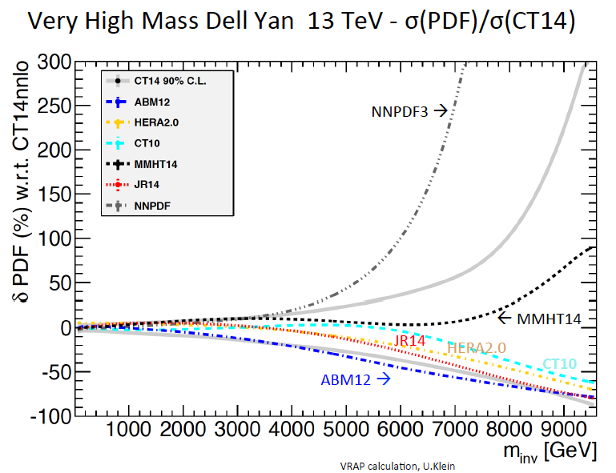
Understanding the High x = Large Mass region

Slide 44
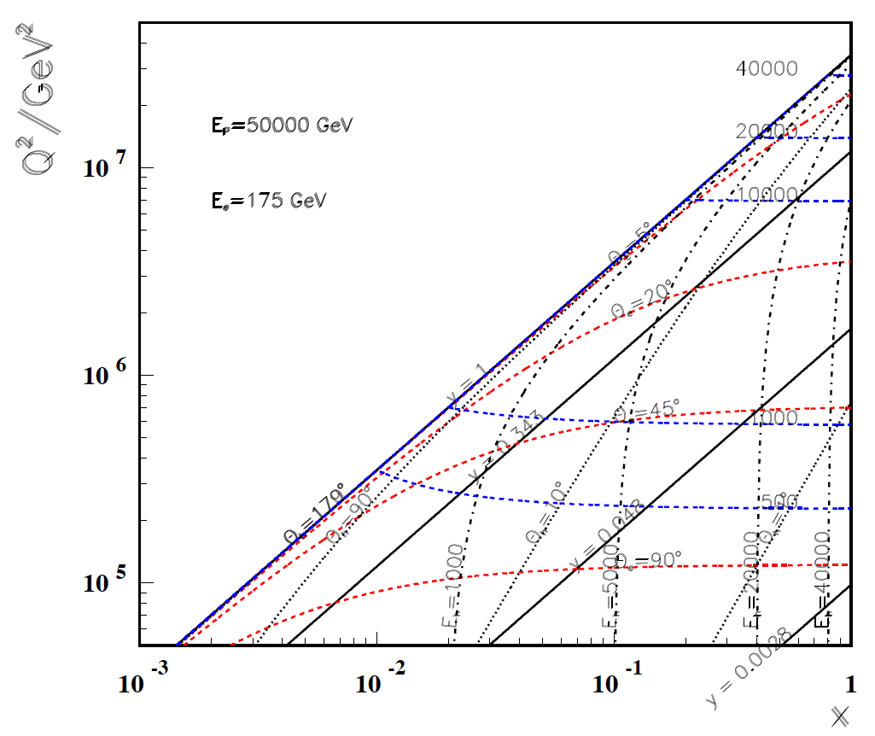
High Q²
Rutherford backscattering
of dozens of TeV e- energy
FCC-he
175 GeV
60 GeV
LHeC
← ϑ_{h}=1º
Large imabalance
of e and p energies
is surprisingly
tolerable for the
high Q², x kinematics,
LHeC to bridge
from HERA to FCC
← HERA

Slide 45
Low x
FCC-he
60 GeV
LHeC
Backward
region, low x
is governed
solely by E_{e}!
-----------
179º
@ 180 GeV
.. very low x
requires not
the maximum
of E_{e}
Very low x
reaches
direct
range of
UHE
neutrino
physics →
HERA
x
For x < 10⁻³ no (average) energy deposition exceeding the electron beam energy

