Slide 1
The Structure of the Proton and HERA
Proton structure and what have we learnt from HERA
1989 – before HERA
The first years
Some of today’s results
Summary
Max Klein
(H1 and ATLAS)

Slide 2
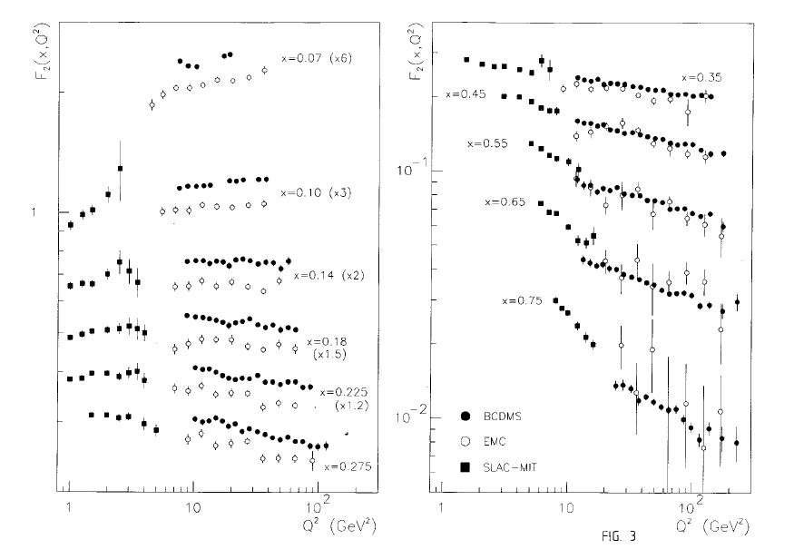
1989 – BCDMS (μp) – F₂
x=0.07-0.75
Q²=9-230 GeV²
EMC?
High x – low y?
~2% accurate
p and d data

Slide 3
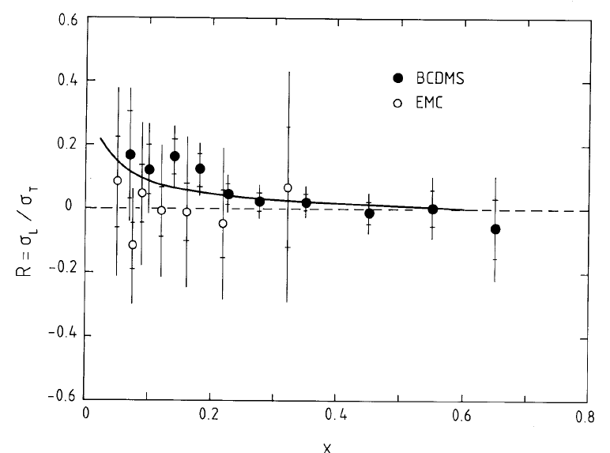
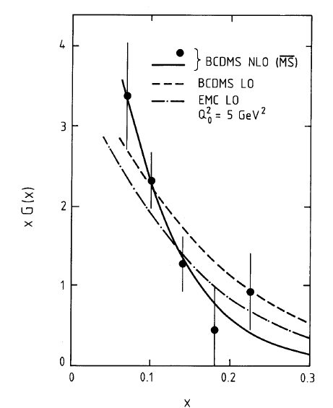
1989 – BCDMS (μp) – R and xg
NLO QCD: y > 0.14
Non-singlet: x>0.275 (xg=0)
Singlet+non-singlet (xg ~(1-x)^{c})
Λ = 220 ± 15 (st)± 50(sy) MeV
Curve: NLO QCD with

Slide 4
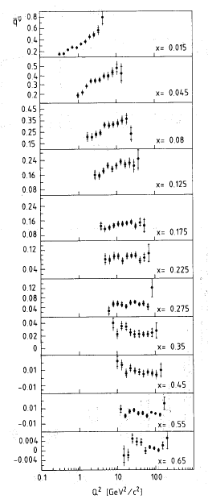
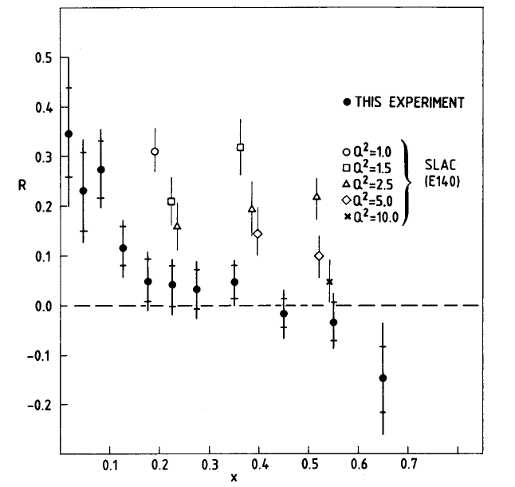
1989 – CDHS (νFe) – structure functions
CDHS
F₂, xF₃ , F_{L}
x=0.015-0.65
Q²=0.8-210 GeV²
Iron target
Confirm BCDMS over EMC
Large scaling viol’s at low x
F_{L} from y dependence

Slide 5
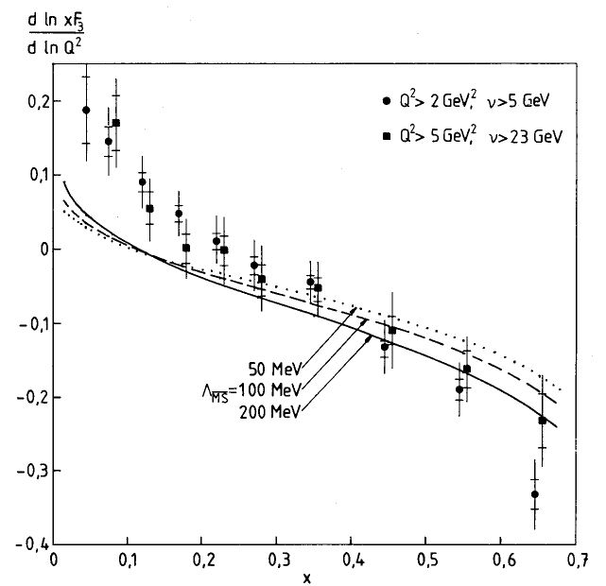
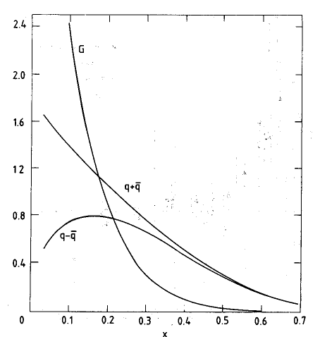
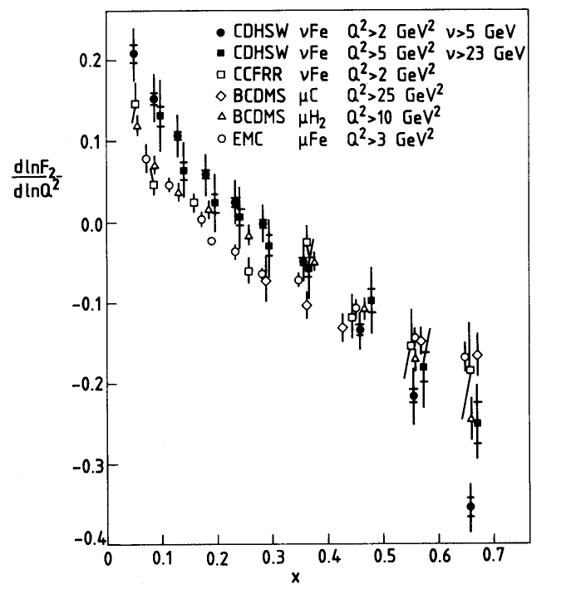
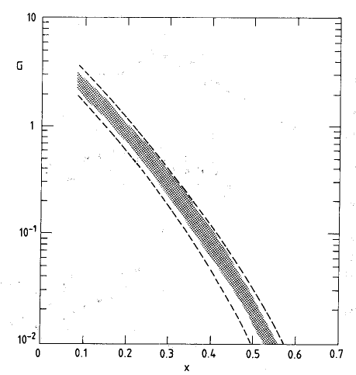
CDHS (νFe) NLO - QCD
xg ~ (1-x)^{c}
with error band
q=x(u+d+s+c)
q-qbar=x(u_{v}+d_{v})
c=0
derivative – QCD??

Slide 7
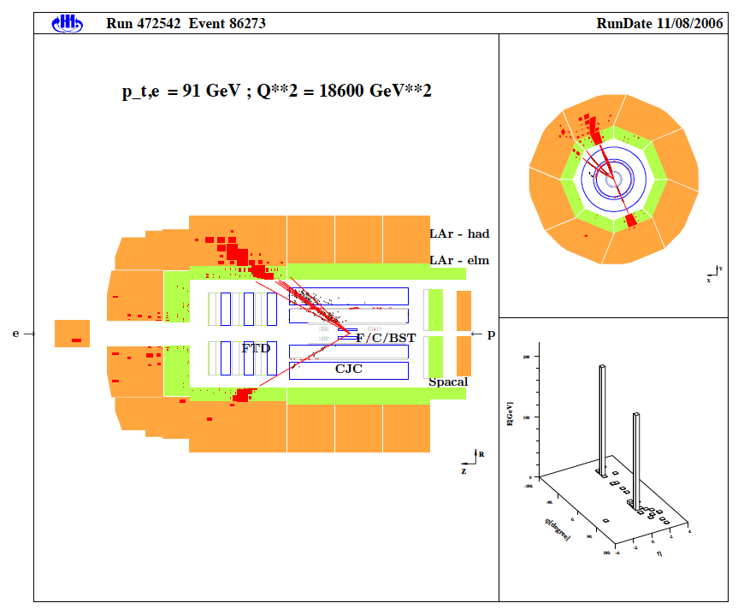
H1
LAr (Pb –elm, SS –hadr) σ_{had} =50%/√E
SpaCal (elm+hadr) σ_{elm} =12%/√E
B/C/FST
CIP
Driftchamber (CJC) …
Trigger: LAr, CIP, FTT, BST
Alignment (trackers, Comptons)
Calibration (kinem. peak, DA)
Luminosity: ep →epγ (1%)
MC simulation GEANT3 + physics
Redundant reconstruction of the
kinematics from e and h final state.
‘Removal’ of Radiative Corrections.
A neutral current DIS event in the H1 detector

Slide 8
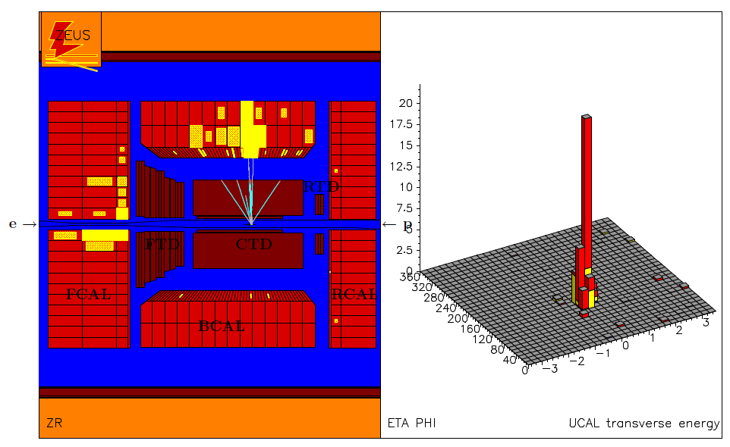
ZEUS
Uranium/Sc –elm and hadronic
σ_{elm} =18%/√E, σ_{had} =35%/√E
MVD (fwd, central)
Driftchamber (CTD) …
Trigger: Calorimeter
A charged current DIS event in the ZEUS detector
Calibration and alignment methods
and L measurement similar as for H1. Kinematic reconstruction different,
which is at the origin of a systematic
error compensation in the combination
of the H1 and ZEUS cross section data.
Inverse neutrino and anti-neutrino scattering off p’s

Slide 9
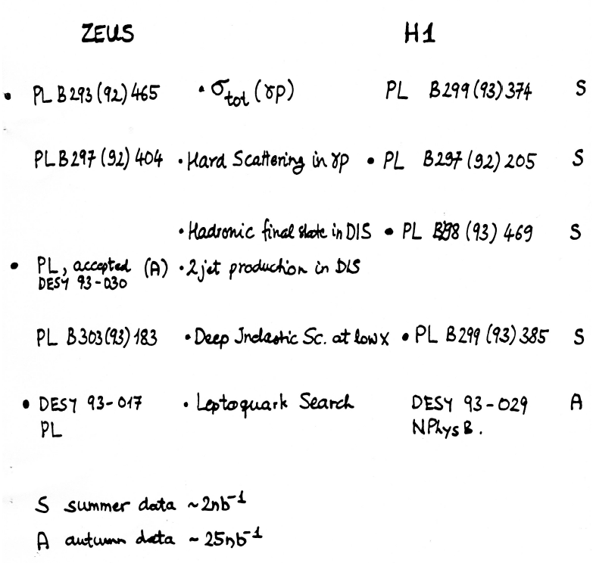
The first papers

Slide 10
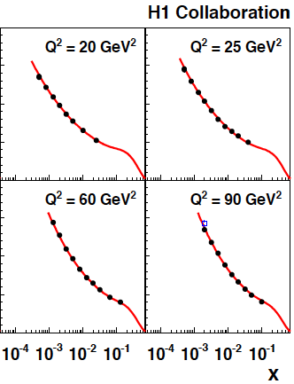
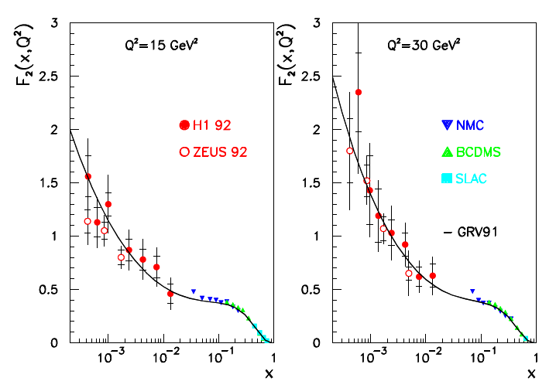
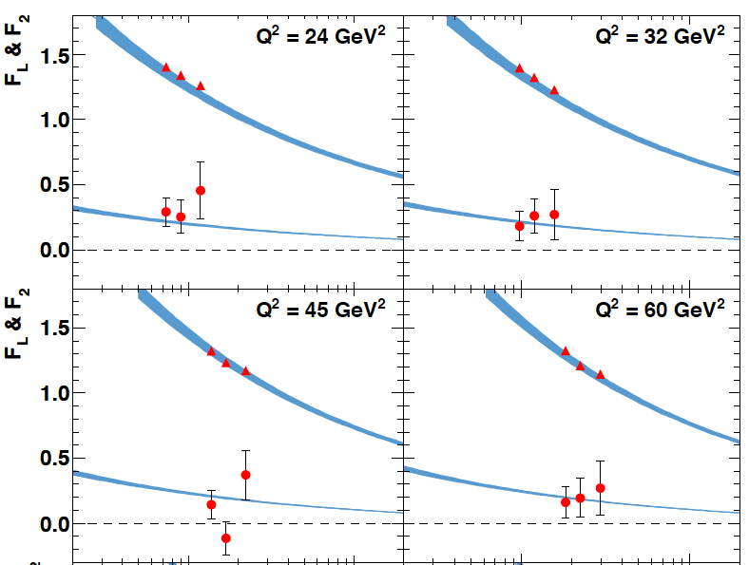
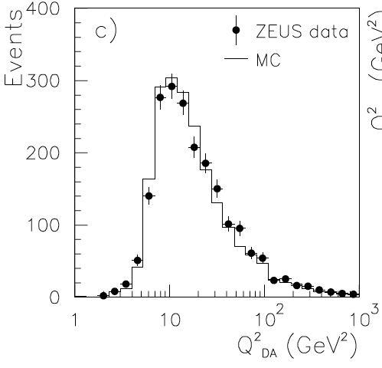
F₂=νW₂
2009
Most recent
F₂ from 00
L=22 pb⁻¹
H1: e and Σ
First F₂ data
taken in 1992
L=0.03 pb⁻¹
H1: e and h
ZEUS: DA
Most recent
F_{2,L} from 07
14+7+44 pb⁻¹
ZEUS: e

Slide 11
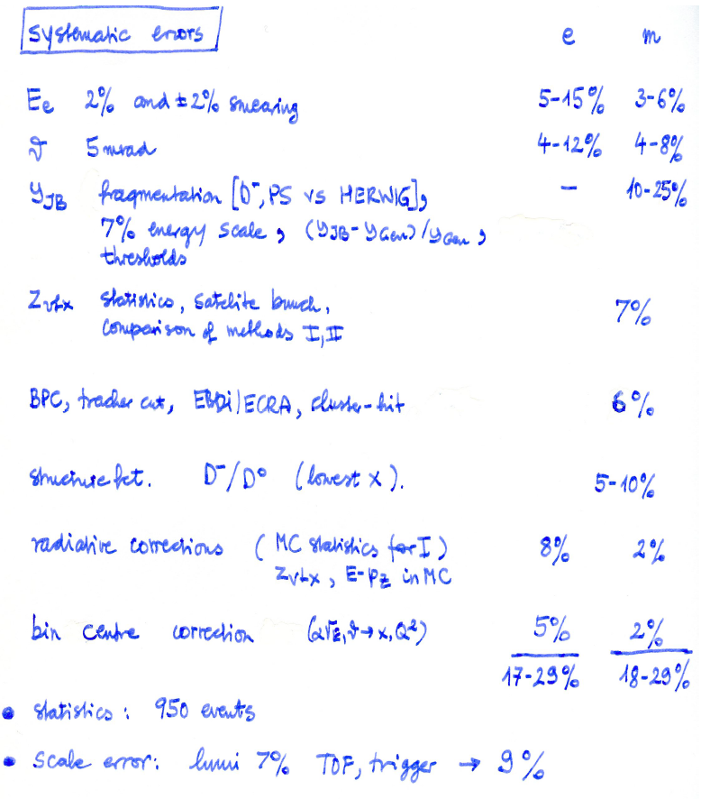
σ_{r} Errors in 2009
Spacal
Double angle calibration: 0.2%
BST /CJC/ BDC 0.2mrad
Noise at low y 3% at 0.01
z vertex 0.3%
eID: max 1%
BDC 0.5%
Iteration --
RC to alpha in MC 0.3%
Negligible
------------------------------------------
1.3-3%
~10⁶
+ Lumi 1.2% trigger --
H1 April 2009
H1 July 1993

Slide 12
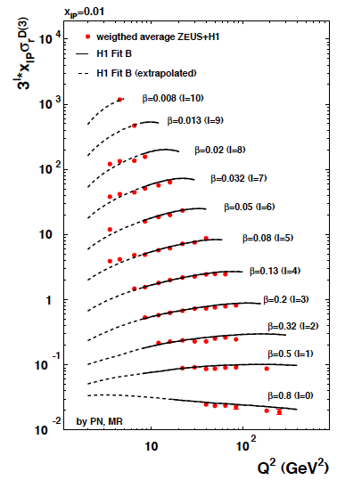
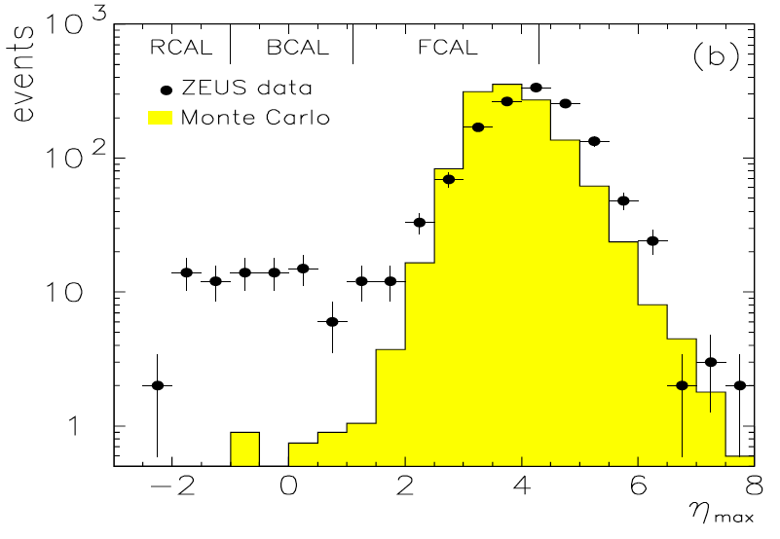
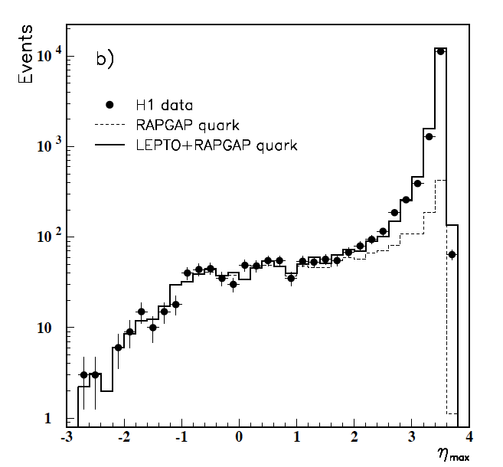
Rapidity Gaps → F₂^{D}
M.Ruspa DIS09
ZEUS DESY 93-093
Normalisations, LRG vs L/FPS
Regge + QCD. Dijets to fix xg at large β. Cf P.Newman
H1 DESY 94-133

Slide 13
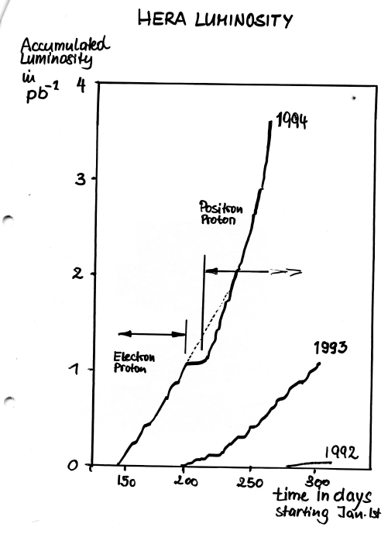
Meeting on the Future of HERA [24.9.1994]
F.Sciulli: ep with high luminosity
M.K. First measurement of F_{L}
R.Brinkmann: HERA – e
F. Willeke: HERA – p
also HERMES and HERA-B talks
Foundation of luminosity
upgrade programme
F.Willeke [ε_{HERA}= 5 (93)—10 (94)—20 (9/94)%]

Slide 14
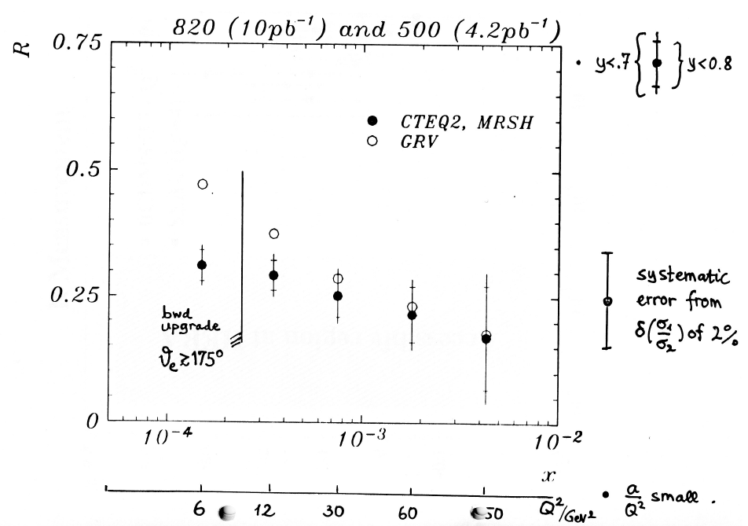
Simulated R in 1994..
MK future of HERA meeting

Slide 15
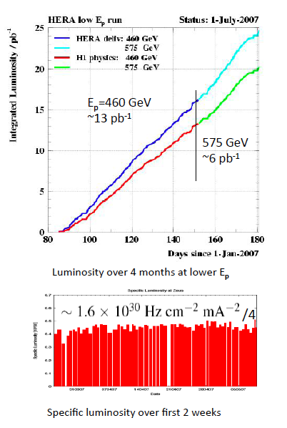
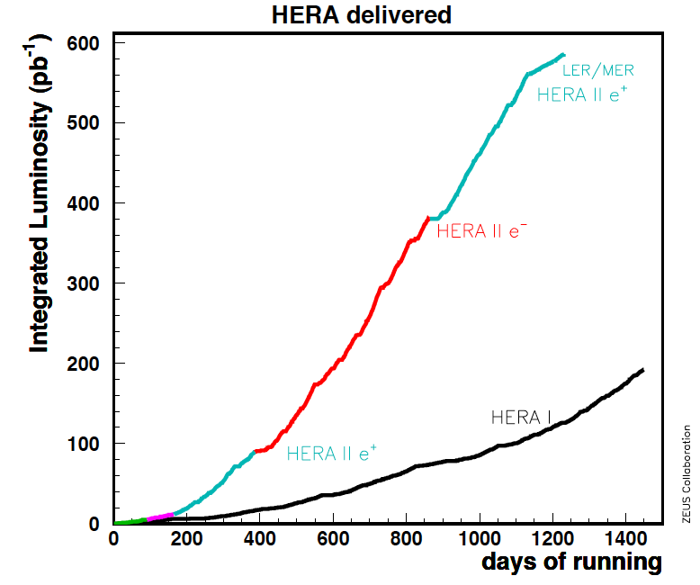
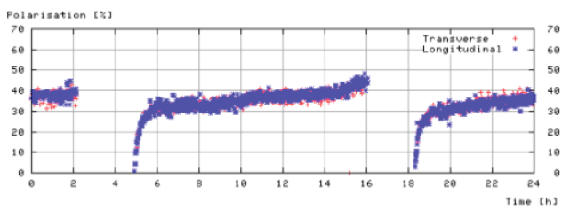
HERA 1992-2007
Lepton Beam Polarisation

Slide 16
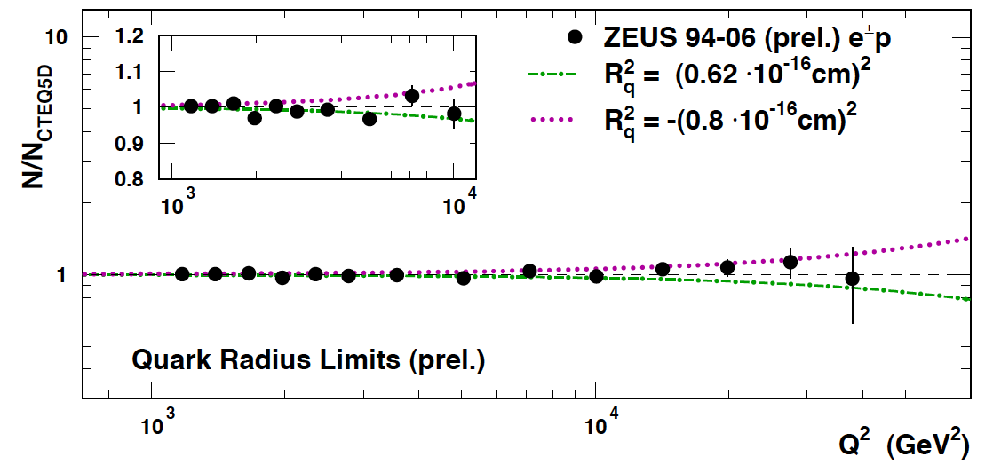
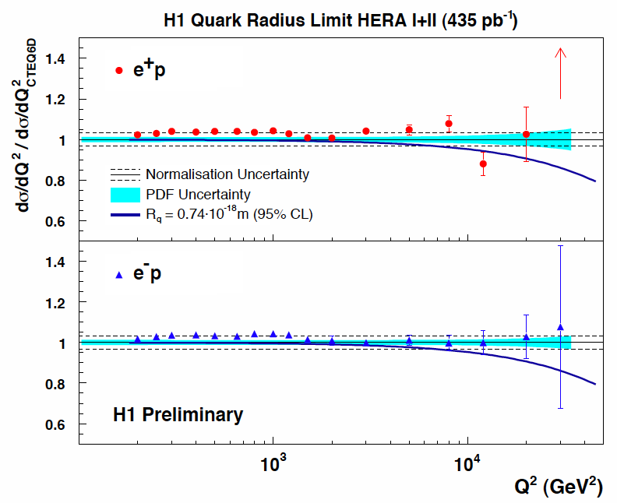
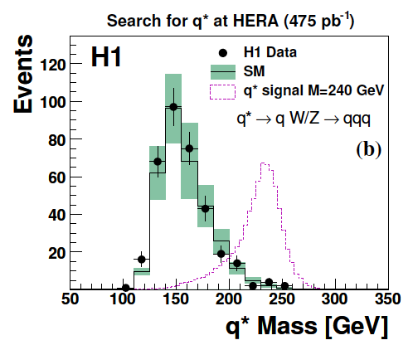
Quark Substructure?
Preliminary results based on
full HERA statistics:
no substructure of quarks, no q*,
corresponding limits on CI, ED,..
DESY 09-040

Slide 17
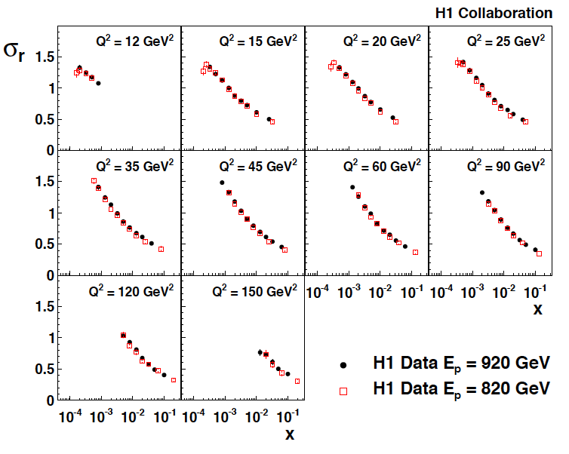
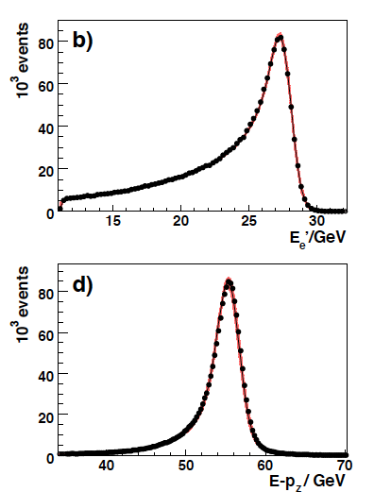
The most precise F₂ measurement, H1
H1: DESY 09-005
Based on methods detailed in 08-171,
medium Q² accessed with maximum
precision [1.3-2%]
Reanalysis of 97 (820 GeV) data,
+0.5% (lumi) and small change of Q²
dependence due to reweighting error.
Both data sets combined to one.
Electron scattered into SpaCal (“backwards”). Track with BDC
cross checked with CJC and BST. 920 data taken in 2000,
just before break for the luminosity upgrade of HERA..

Slide 18
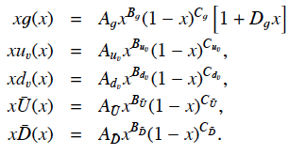
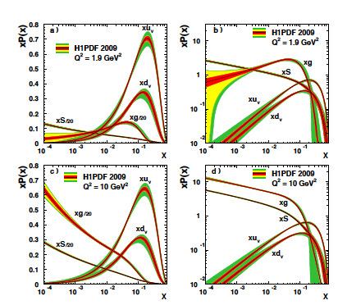
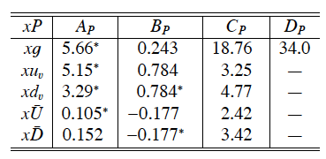
H1PDF2009
H1: DESY 09-005
^{χ2}_{dof}=587/644, Q₀²=1.9
Sea at low x fixed by F₂ (if d=u!)
Gluon at low Q²,x uncertain, expressed
via Q₀² variation; at high x too, expressed
as parameterisation choice variation. Get
astonishingly easy a high sea at large x..
Large uncertainties at high x (masses)
“p is glue for x < 0.1!”
for Q² > few GeV² (DIS)

Slide 19
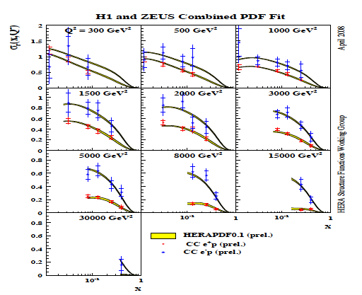
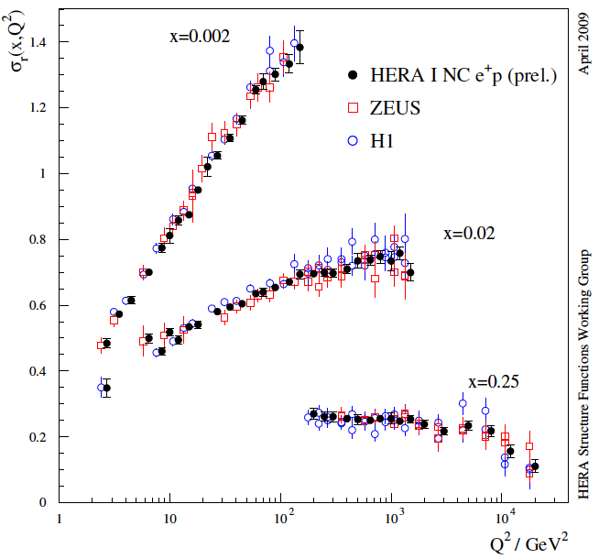
Combination of H1+ZEUS Data
Minimisation for more than one data set with possible systematic error correlations among the
sets (>100 sources in H1/ZEUS). Being used for
data combination and QCD fit (as in H1 F₂ papers)
Combinations: 06/07 high Q² mainly
DIS08: attempt for full systematic analysis
including joint QCD fit to combined data.
DIS09: Madrid, end of April: new preliminary:
adapt to modified χ², include new
H1 data (which are 1.3-2% accurate
in the bulk region). Fit close to H1pdf09:
VFNS, Q₀²,parameterisation and uncertainties

Slide 20
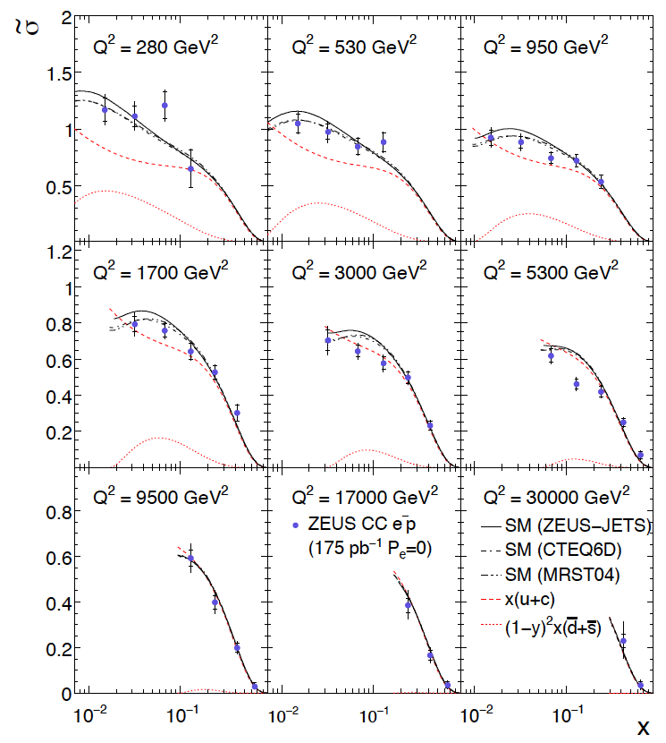
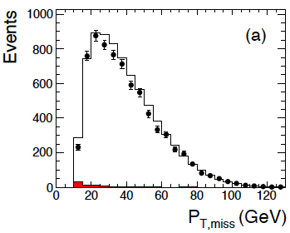
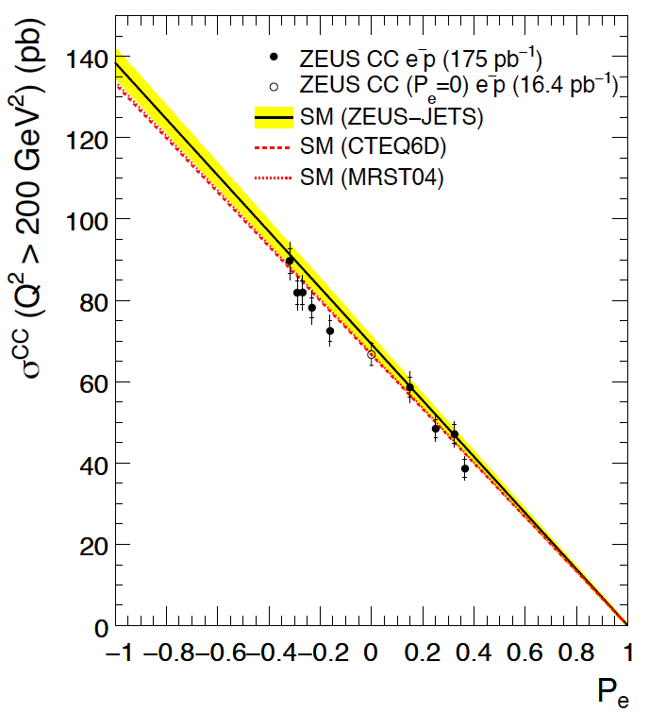
The new high Q² CC (e⁻p→νX) measurement by ZEUS
DESY 08-177, submitted
HERA II, 175 pb⁻¹
CC depends linearly on P

Slide 21
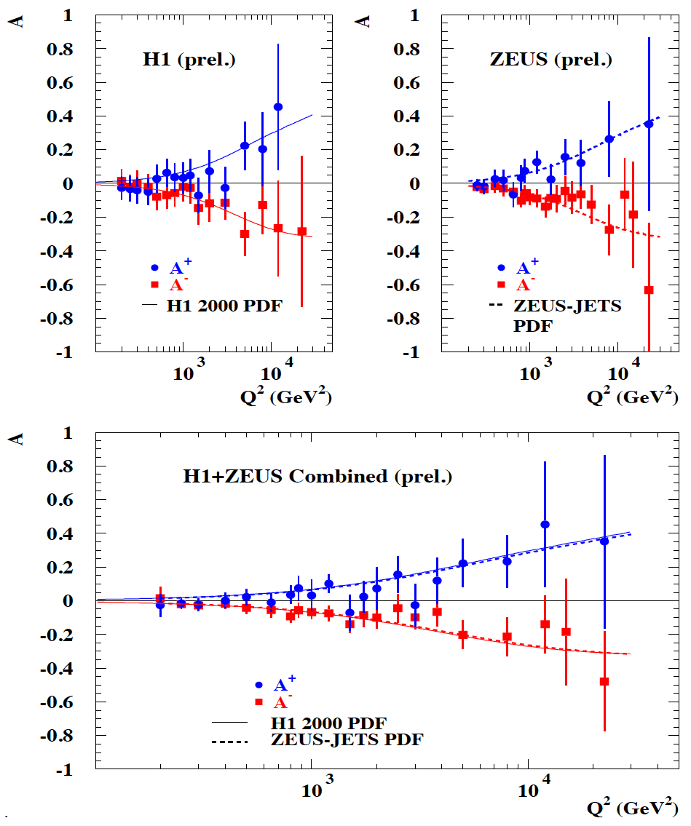
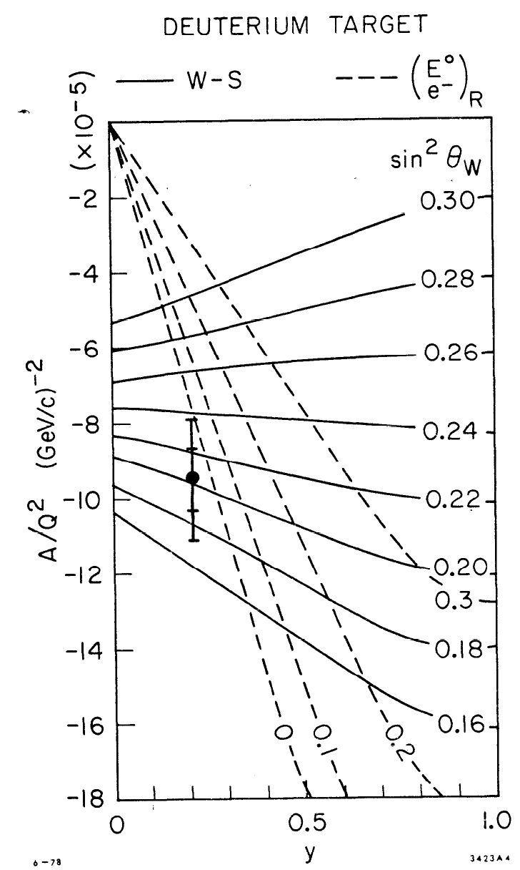
u/d at large x - parity violation A±
Q² =1..2 GeV²
ICHEP06, H1prel. 06-142, ZEUSprel. 06-022
Cf L.Stanco

Slide 22
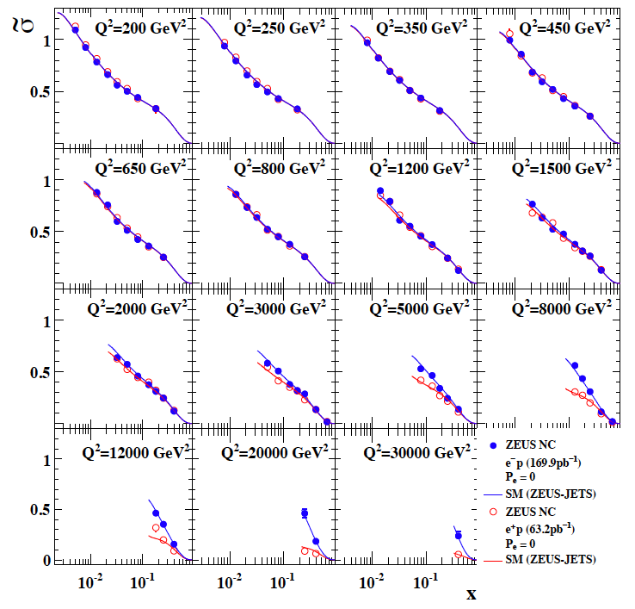
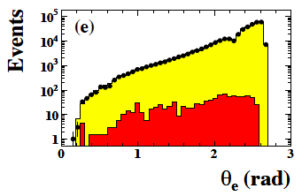
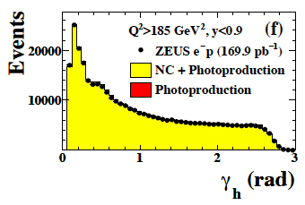
The new high Q² NC (e⁻p→e⁻X) measurement by ZEUS
DESY 08-202, submitted
HERA II, 169 pb⁻¹
polarised e⁻ beam
Double angle method:

Slide 23
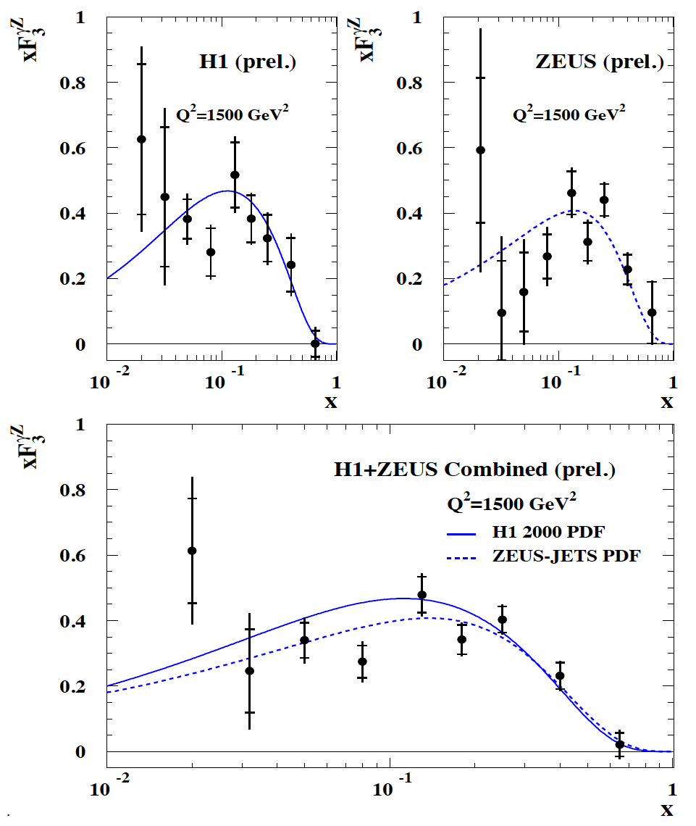
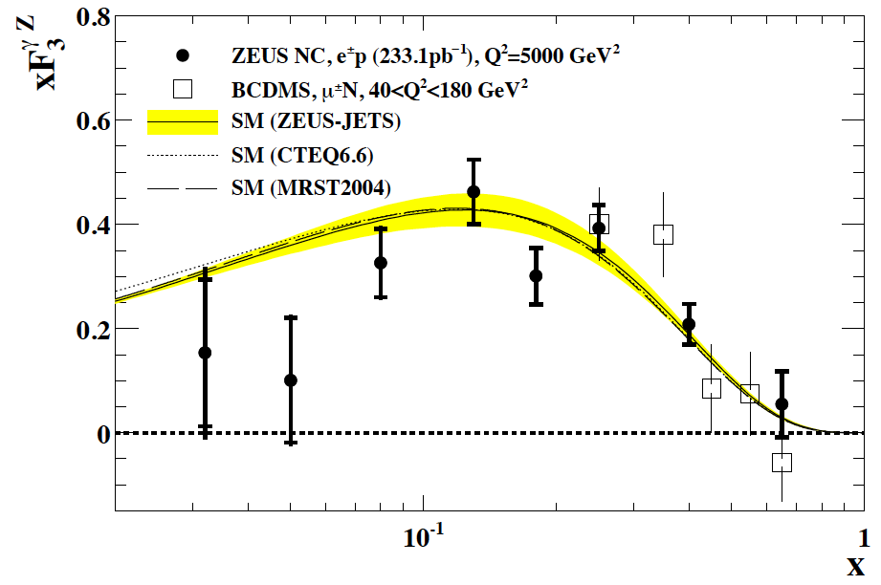
Valence Quarks – xF₃
Measurement of valence quarks [2u_{v}+d_{v}]/3
down to low x, unless q_{sea} ≠ anti-q
Difficult to measure at HERA, needs high Q²
and contributes only at high y as Y₋=1-(1-y)²
Update of xF₃ by ZEUS, DESY 08-202
ICHEP06, H1prel. 06-142, ZEUSprel. 06-022

Slide 24
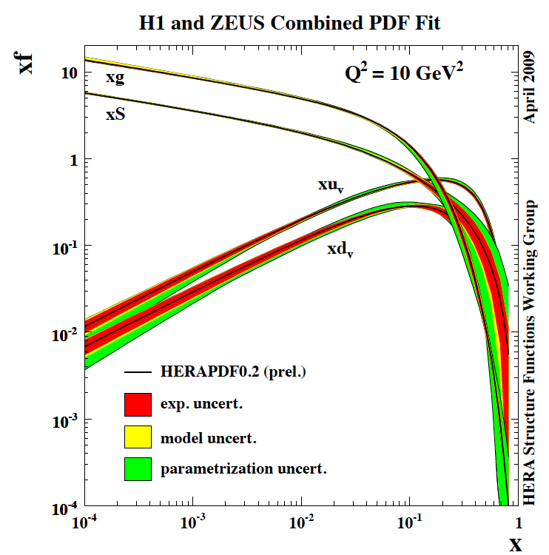
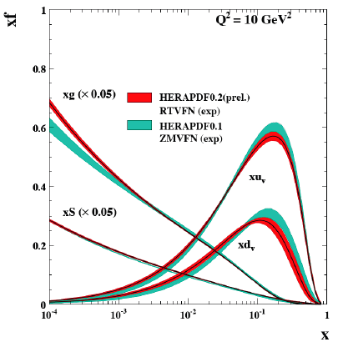
HERAPDF0.2
New precision H1 data in.
Variable flavour scheme
Pdf uncertainties
9 parameters (Q₀²=1.9GeV²)
Based on HERA I alone.
Publication this year.
Assumptions on: strange, u/d at low x
Dynamic generation of c,b. uncertainties
at large x:. parameterisation, input data, xg
V.Radescu DIS09

Slide 25
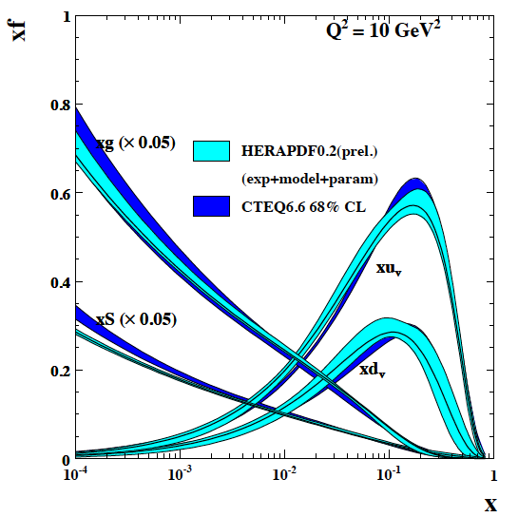
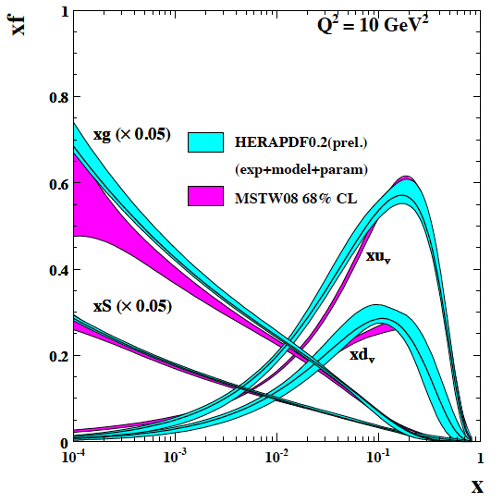
HERApdf vs GLOBALs

Slide 26
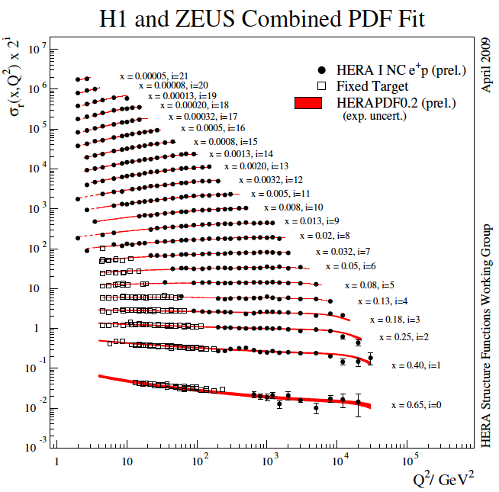
hera
BCDMS not
part of the fit.
α_{s} to NNLO
for the final analysis.

Slide 27
Comparison with Tevatron
CDF not
part of the fit.
E.Perez

Slide 28
charm and beauty
In recent fits c and b are dynamically generated,
i.e. the predictions are absolute [VFNS]
Remember c=0, 20 years ago (EMC)
cf G.Grindhammer

Slide 29
The Longitudinal Structure Function - ZEUS
E_{e}’ > 6 GeV.
eID with NN based on shower shape,
some hit requirement (MVD, CTD)
outside track reconstruction acc.
Monte Carlo used for background subtraction
DESY 09-046.
Errors from joint fit allowing changes of systematics.
Published both F_{L} and F₂
R=0.18+0.07-0.05
remember R=0.18+-0.10 from SLAC]
J.Grebeniuk, DIS09

Slide 30
The Longitudinal Structure Function F_{L} - H1
E_{e}’ > 3 GeV
eID with max. p_{T}
BST/CJC track and
charge determination
to remove γp bgd
Values extracted point
by point assuming
uncorrelated errors
at this stage.
Results at medium Q²
are consistent with ZEUS
but error treatment differs.
Improvement over
first F_{L} publication:
F.D. Aaron et al.,
Phys. Lett. B 665, 139 (2008)
.
Backward Silicon Central Jet Chamber
A.Glazov, DIS09

Slide 31
F_{L} at low x – some puzzles
NNLO: MSTW(NLO)=MSTW(NLO)
but CTEQ moves down…
Need best possible measurement at low x,Q²
To help understanding h.o. QCD
Dipole models work.
MSTW =H109 (NLO)
CTEQ6.6 higher
Use CTEQ prescription to calculate F_{L}:
MSTW moves up !
P.Nadolsky, R.Thorne, E.Perez

Slide 32
σ_{r} = F₂^{D}-f(y)F_{L}^{D}
DIS09

Slide 33
Summary
Below x=0.1 the proton structure in the DIS region is gluon dominated.
Quarks are pointlike down to 0.7 10⁻¹⁸ m – HERA was the best microscope of mankind
Broadly, the observations (here F₂(inclusive, charm, beauty, diffractive)
and F_{L}(inclusive, diffractive) can be understood by NLO QCD
-A great development in the understanding of qg dynamics
with new concepts as parton amplitudes, unintegrated distributions
and the new area of high parton densities
The HERA data and inclusive QCD fits are able to describe fixed target
and Tevatron jet data, and yield predictions for the LHC (W,Z,Higgs)
Next steps:
completion of data analysis (high Q², y, F_{L},…)
Studies of QCD at low x, Q² (stability of α_{s}, F_{L})
Coupling constant and pdf’s at NNLO ..
HERA was a remarkable success
and so have been the collaborations: H1-ZEUS, HERA, Theory.
A review: M.K. and Rik Yoshida, Collider Physics at HERA, Prog. Part. Nucl. Phys. 61,343 (2008)

Slide 34
1989/90

