Slide 1
Precision Measurement of F₂ with H1
Towards today
The Measurement
Results
QCD Analysis
Max Klein
for the H1 Collaboration

Slide 2
As F₂ developed..
1992 [data] – discovery of the rise
1994 – the last BEMC result 3%
1993 – a first measurement
1996/7 –first accurate SPACAL 2%
BCDMS: final publication 15 years after the experiment proposal 1974

Slide 3
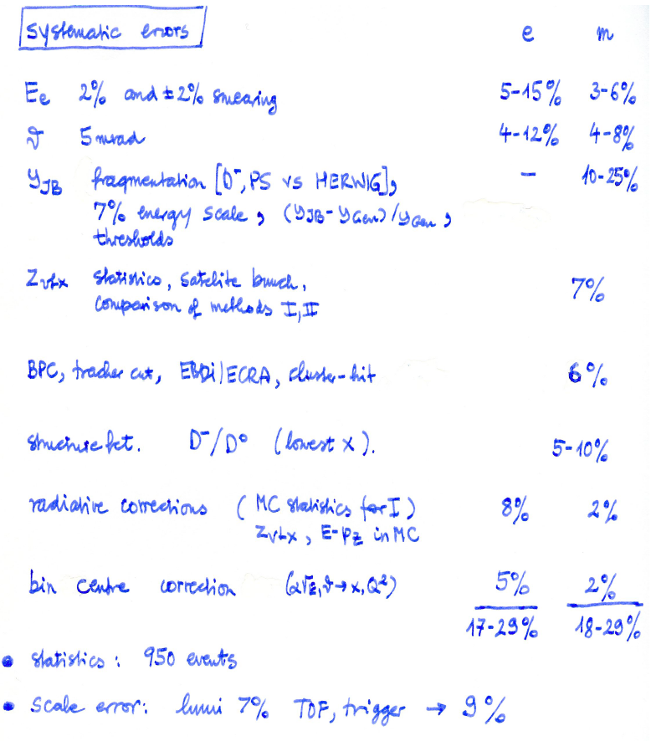
σ_{r} Errors in 2009
Spacal
Double angle calibration: 0.2%
up to 1% at 2 GeV
BST /CJC/ BDC 0.2mrad
Low y E_{h}: 2% at 0.01
LAr: 15% of its noise
z vertex 0.3%
eID: max 1%
BDC 0.5%
Iteration --
RC to alpha in MC 0.3%
Negligible
------------------------------------------
1.3-3%
~10⁶
+ Lumi 1.2% trigger --
H1 April 2009
H1 July 1993

Slide 4
The present measurement
2000 and 1996/97 – accurate to up to 1%
R taken from own
QCD fit. Very small
effect as y < 0.6
Important input to the
combined H1/ZEUS
data. At Q² ~ 30 GeV²
the accuracy further
reduced (1.3 → 1.1%)
and the amount of
systematic uncertainties
from 75 to 55%.

Slide 5
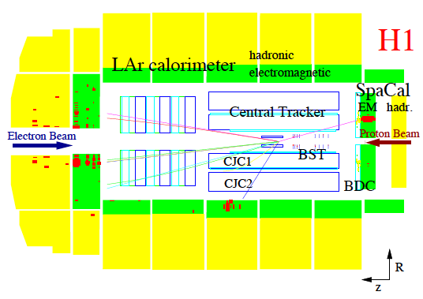
DIS Event in the H1 Detector

Slide 6
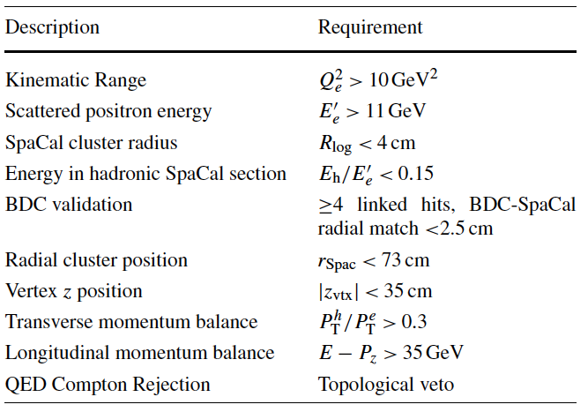
Event Selection
Low Q² – next talk
F_{L} a separate task
3 electron ID and
validation cuts
DIS: vertex and e/h
pt balance
h.o. QED radiation
anti-cuts

Slide 7
Control Plots

Slide 8
Control Plots ( e and Σ)

Slide 9
Comparison of 820 (96/97) and 920 (2000) Data
Discovered small MC reweighting problem in 820 GeV data
Both data sets were combined to obtain one set of H1 data

Slide 10
x Dependence
Not excluded
that “the rise” is a
“two-dimensional
phenomenon”, i.e.
for F₂ ~ x^{-λ},
λ=λ(x,Q²)
H1 previously:
Phys.Lett.B520:183,2001

Slide 11
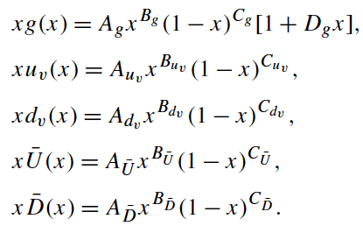
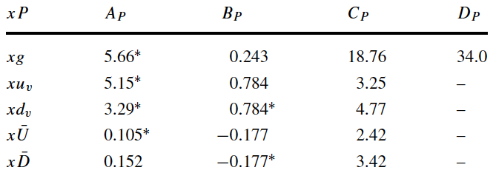
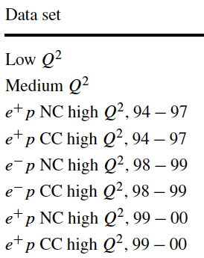
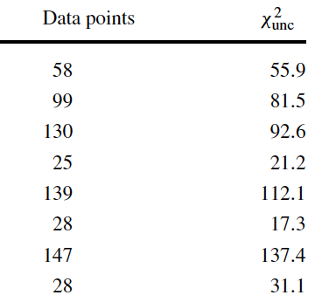
H1pdf2009
Parameterisations
Fit results
Parameter assumptions
Quark counting and
Momentum sum rules
Q₀²=1.9 GeV²
NLO, QCDNUM, VFNS

Slide 12
Q² Dependence – F₂
Data are
consistent
with other
H1 data at
lower and
at larger Q²
cf S.Glazov: Low Q² Talk

Slide 13
Q² Dependence – dF₂/dlnQ²
Q² dependence
well described
by NLO QCD
fit to the
H1 data and its
extrapolation

Slide 14
Partons at the Initial Scale
Red: experimental
Yellow: exp+model:
-m_{c}, m_{b}, f_{s}
Q²_{min}=2.25 – 5 GeV²
Q²₀ = 1.9 -1.5 GeV²
Green: +parameterisation
P(x)=Ax^{B}(1-x)^{C}[1+Ex+Dx²..]
For error bands require:
- D, E if χ² < χ²₀ + 3
- F₂ and F_{L} > 0
allow for non-canonical
(νN) valence/sea quark
ratios at large x
.. A first attempt to quantify
parameterisation uncertainty.

Slide 15
Partons at the Initial Scale
Large uncertainty of
gluon at low x
-further reduced
with low energy and
F_{L} data (cf Talks of
J.Grebenyuk and V.Radescu)
-Q²₀ variation mimics
parameterisation
uncertainty
(yellow ~ green)
Large uncertainty of
gluon also at large x
Note that this fit describes
the Tevatron jet data well.

Slide 16
Evolution drives Gluon and Sea to large values at low x
Valence quarks remain rather unaffected as
non-singlet quantities.
Some constraints on
valence quarks at low x
may be expected from
W± asymmetry data
at the LHC. At high x
d_{v} remains uncertain.

Slide 17
Summary
Recent data have been presented on the reduced cross section at y<0.6, 12 ≤Q²≤150 GeV²
These represent the most accurate data on the proton structure function F₂ obtained so far.
The evolution of the measurements of F₂ over the past almost 20 years has been consistent
and lead to a reduction of the uncertainties from initially ~20% to nearly 1% now.
The data have been used in the combination with the ZEUS data and while dominating the
combination in the here covered region of phase space they are still improved by the average.
The partial derivative of F₂(x,Q²) wrt. ln(x) is about constant at low x in the DIS region of Q².
A refined NLO QCD fit was made with a minimum number of parameters on the chosen
initial parton distributions, xg, xu_{v}, xd_{v}, and the total up and down anti-quark distributions.
The lnQ² derivative is described by NLO QCD and in accord with a rising gluon density at low x.
The fit method attempts to quantify the uncertainty due to the parameterisations of the pdf’s in a way, which has been adopted in the HERAPDF1.0 subsequent fit.
Overall there is very good agreement with NLO QCD, yet much is still to be learned on the structure of the proton and its inherent parton dynamics [cf further talks and the future..].

Slide 18
Backup

Slide 19
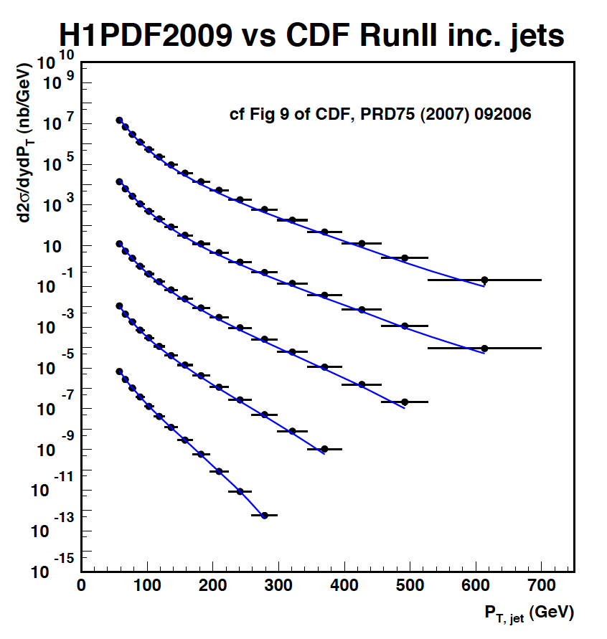
|y| < 0.1
0.1 < |y| < 0.7
0.7 < |y| < 1.1
1.1 < |y| < 1.6
1.6 < |y| < 2.1

Slide 20
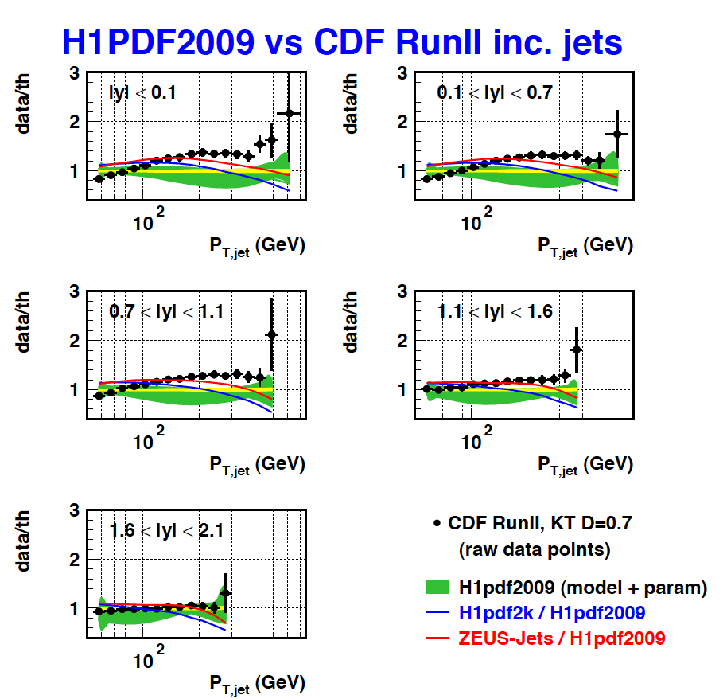
Backup

Slide 21
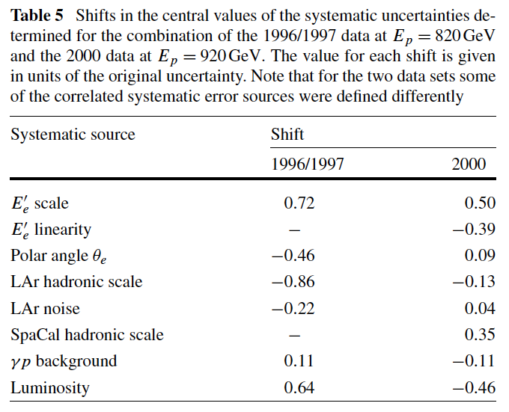
Consistency of 96/97 and 2000 data

