Slide 1
Detector(s) for Energy-Frontier eh Scattering
A.Gaddi, P.Kostka, P.Laycock, E.Pilicer, A.Polini
on behalf of the LHeC Study Group
presented by M.Klein
http://www.lhec.cern.ch [next workshop 24-26.6.2015]
CDR: “A Large Hadron Electron Collider at CERN” LHeC Study Group, [arXiv:1206.2913] J. Phys. G: Nucl. Part. Phys. 39 (2012) 075001
“On the Relation of the LHeC and the LHC” [arXiv:1211.5102]

Slide 2
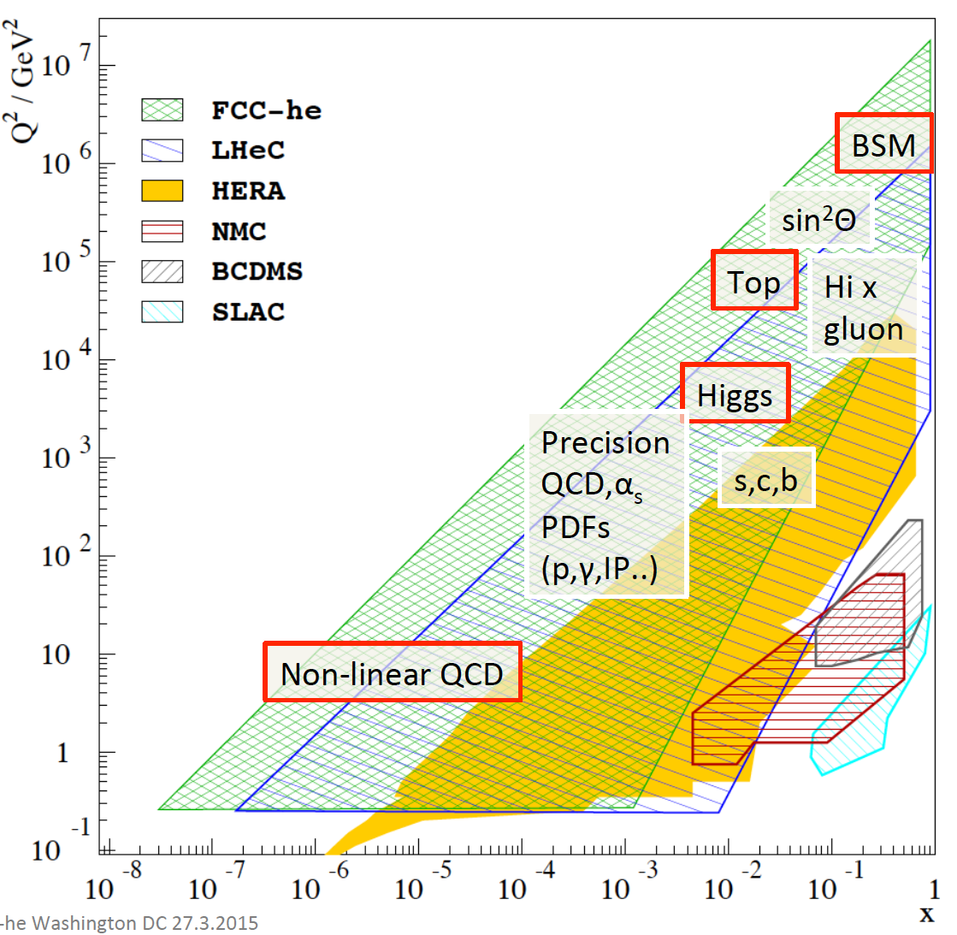
Q²-x Range and Physics
60 GeV
ERL added to
FCC 50 TeV
at 10³⁴cm⁻² s⁻¹
→ FCC-he
60 GeV
ERL added to
LHC 7 TeV
at 10³⁴cm⁻² s⁻¹
→ LHeC

Slide 3
Status in Brief
LHeC Detector has been designed for 1-179º coverage [CDR 2012]
New:
- Higgs discovery: LHeC 10³⁴ and max (fwd) rapidity crucial
- FCC study: “joint” hh-he-ee software development
- Conceptual design of FCC-eh detector
- Upgrades of LHC detectors
Of special interest:
- new generation of Si trackers (all 4 LHC detectors)
- very forward tracking and calorimetry
Differences of ep vs pp
- Radiation level down by few orders of magnitude
- No pile-up in ep
- Electron and hadron detection for very high precision
→ This presentation:
Brief progress report on the design of the LHeC detector
and conceptual ideas on an FCC-he detector and IR

Slide 4
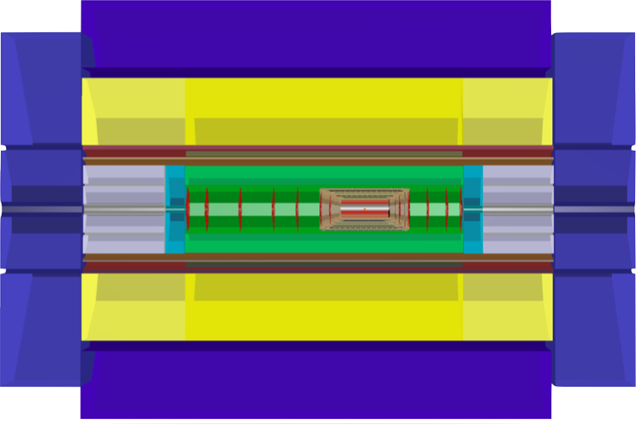
LHeC ep/A Detector
All Numbers [cm]
1316
438
Muon Detector
Hadronic
Fwd-Endcap
580
Hadronic
Bwd-Endcap
275
Hadronic Calorimeter
200
Dipole
Solenoid
Dipole
40
91
e∓
Fwd-Calorimeter
Inserts
Forward
Tracker
Central
Tracker
Backward
Tracker
Bwd-Calorimeter
Inserts
46
p/A
Electromagnetic Calorimeter
170
40
40
147
3 beams: e∓ + proton1 + proton2 (also heavy ions A) Detector has been costed as 106MSF (core)
Dipole magnets to guide the e-beam in and out, for making electrons to collide head-on with p-beam1; 0.3 T transverse field along 2 x 9 m (internal shown only)
￼

Slide 5
Installation
￼

Slide 6
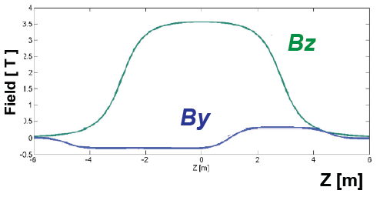
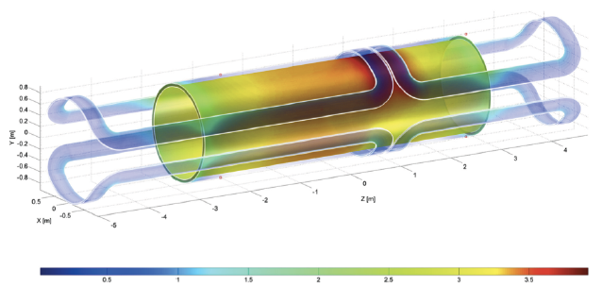
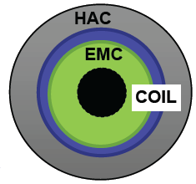
Detector Magnets: Solenoid and Dipoles
courtesy Herman ten Kate and Alexey Dudarev
Baseline: Solenoid (3.5 T) + dual dipole 0.3 T (Linac-Ring Option)
Large coils (double solenoid): Containing full calorimeter, precise muon measurement, large return flux
Small coil: Cheaper, less iron for return flux, solenoid and dipoles conveniently within the same cold vacuum vessel, but no muon measurement
Solenoid field
2-dipoles field

Slide 7
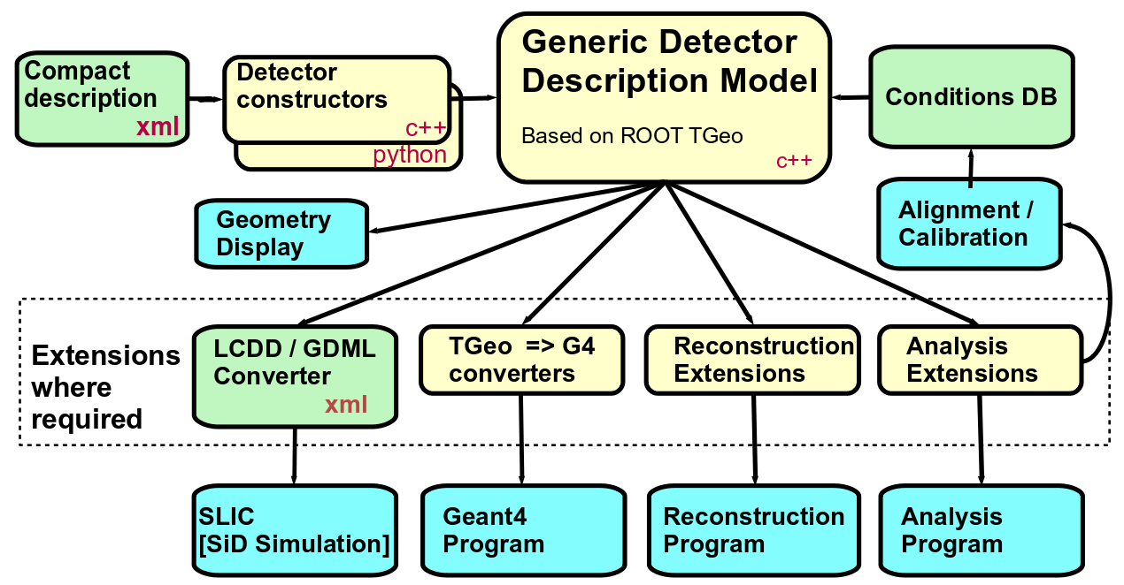
Detector Design/Sim/Rec - DD4Hep
i.e. Kalman Filter; Pandora PF
http://http://aidasoft.web.cern.ch/DD4hep software: svn co https://svnsrv.desy.de/public/aidasoft/DD4hep/trunk
￼

Slide 8
LHeC Detector / DD4Hep Layout
All Numbers [cm]
1316
438
Muon Detector
Hadronic
Fwd-Endcap
580
Hadronic
Bwd-Endcap
275
Hadronic Calorimeter
140
Dipole
Solenoid
Dipole
40
91
e∓
Fwd-Calorimeter
Inserts
Forward
Tracker
Central
Tracker
Backward
Tracker
Bwd-Calorimeter
Inserts
46
p/A
Electromagnetic Calorimeter
170
40
40
147
DD4Hep/DDG4 Detector Design / Simulation / Reconstruction Environment
linked to and working with ROOT-5.34.26 (ROOT-6 being implemented) and GEANT4-10.01 (fast simulation being worked on)
Identical software for LHeC and FCC detector - DD4hep xml-description different only
￼

Slide 9
Interaction Region Design
LHeC-HL-LHC lattice layout - MAD-X
courtesy H.Burkhardt, BE-ABP CERN ( layout x,y scaled ! )
Incorporated the HL-LHC optics and geometry (cf also Emilia Cruz’s talk)
Interface MAD-X-to-detector: design tools to develop (presently ‘by hand’)
Placement of SR - masks / absorbers (in CDR a HERA like initial design)
Combined machine and detector treatment to design the interaction region
￼

Slide 10
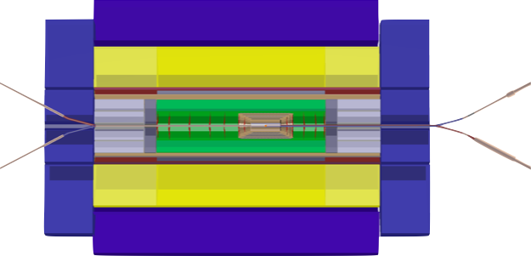
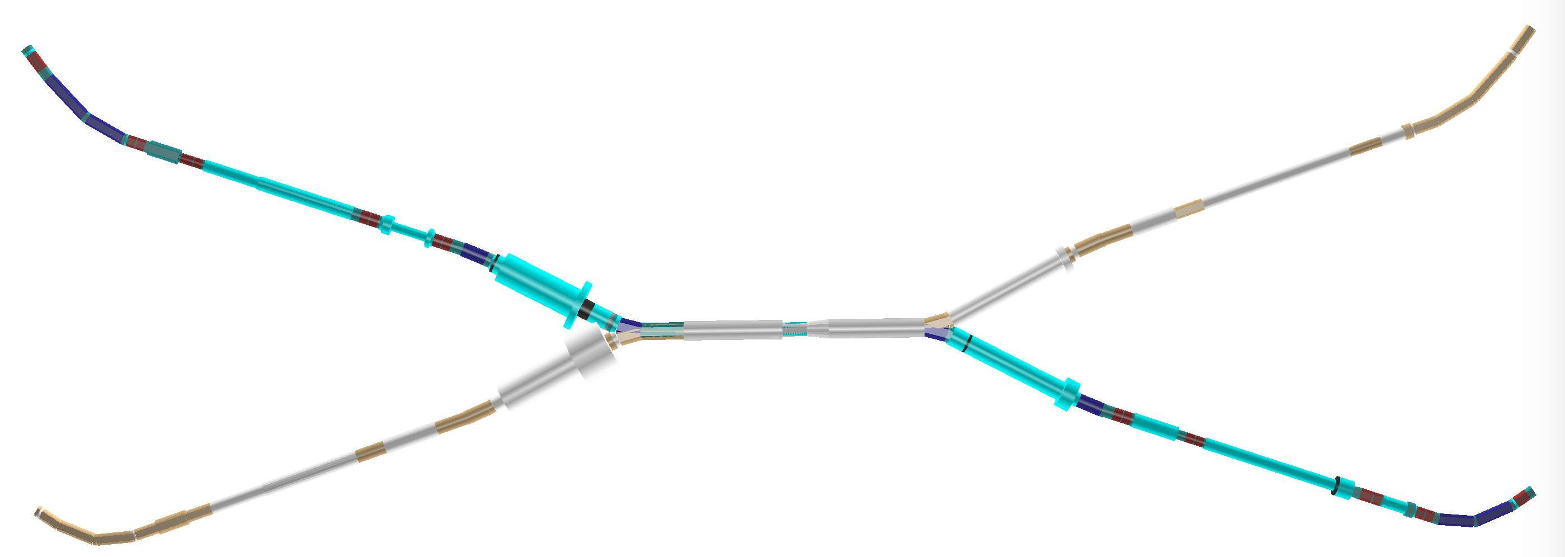
Interaction Region Design
Beam Pipe -
low X0, λI material, stable, capable for very fwd/bwd tracks !
allowing low pT particle measurement
SR - masks / absorber placements - critical issue for ep-detector machine lattice combined with detector magnet setup (inner dipole & solenoid)
←
LHeC accelerator lattice
courtesy H.Burkhardt; (scaled !! )
￼

Slide 11
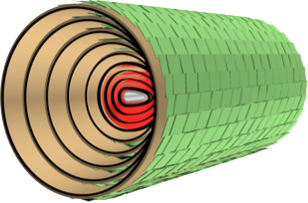
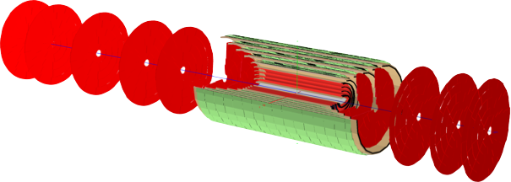
Tracker Design
p/A
e∓
p/A
Interaction region design - Impact of Synchrotron Radiation
Elliptical Beam Pipe and Vertex Pixel Detector placement around
1st version describes sensitive / passive elements
(sensors / support structure / I-O elements)
Many details to be solved
LHeC/FCC-he design differ in fwd/bwd wheels placement only (currently)
Also:
cf talk by Tim Jones
at LHeC WS 2014
MUCH smaller than
new ATLAS or CMS
Trackers for HL LHC
No pileup, e-h asy..
￼

Slide 12
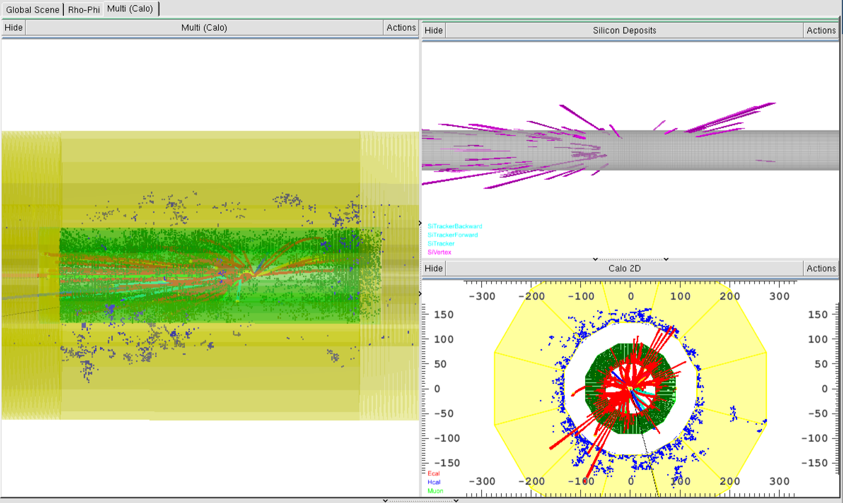
Pythia-event → LHeC-Higgs-bƀ→ DDG4 →LHeC-DDEve
^{courtesy U.Klein}
Event displays - now managed to illustrate hits, tracks, energy depositions
￼

Slide 13
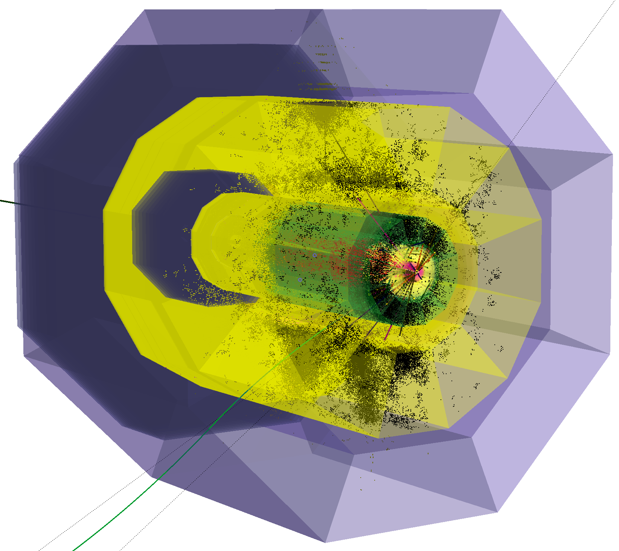
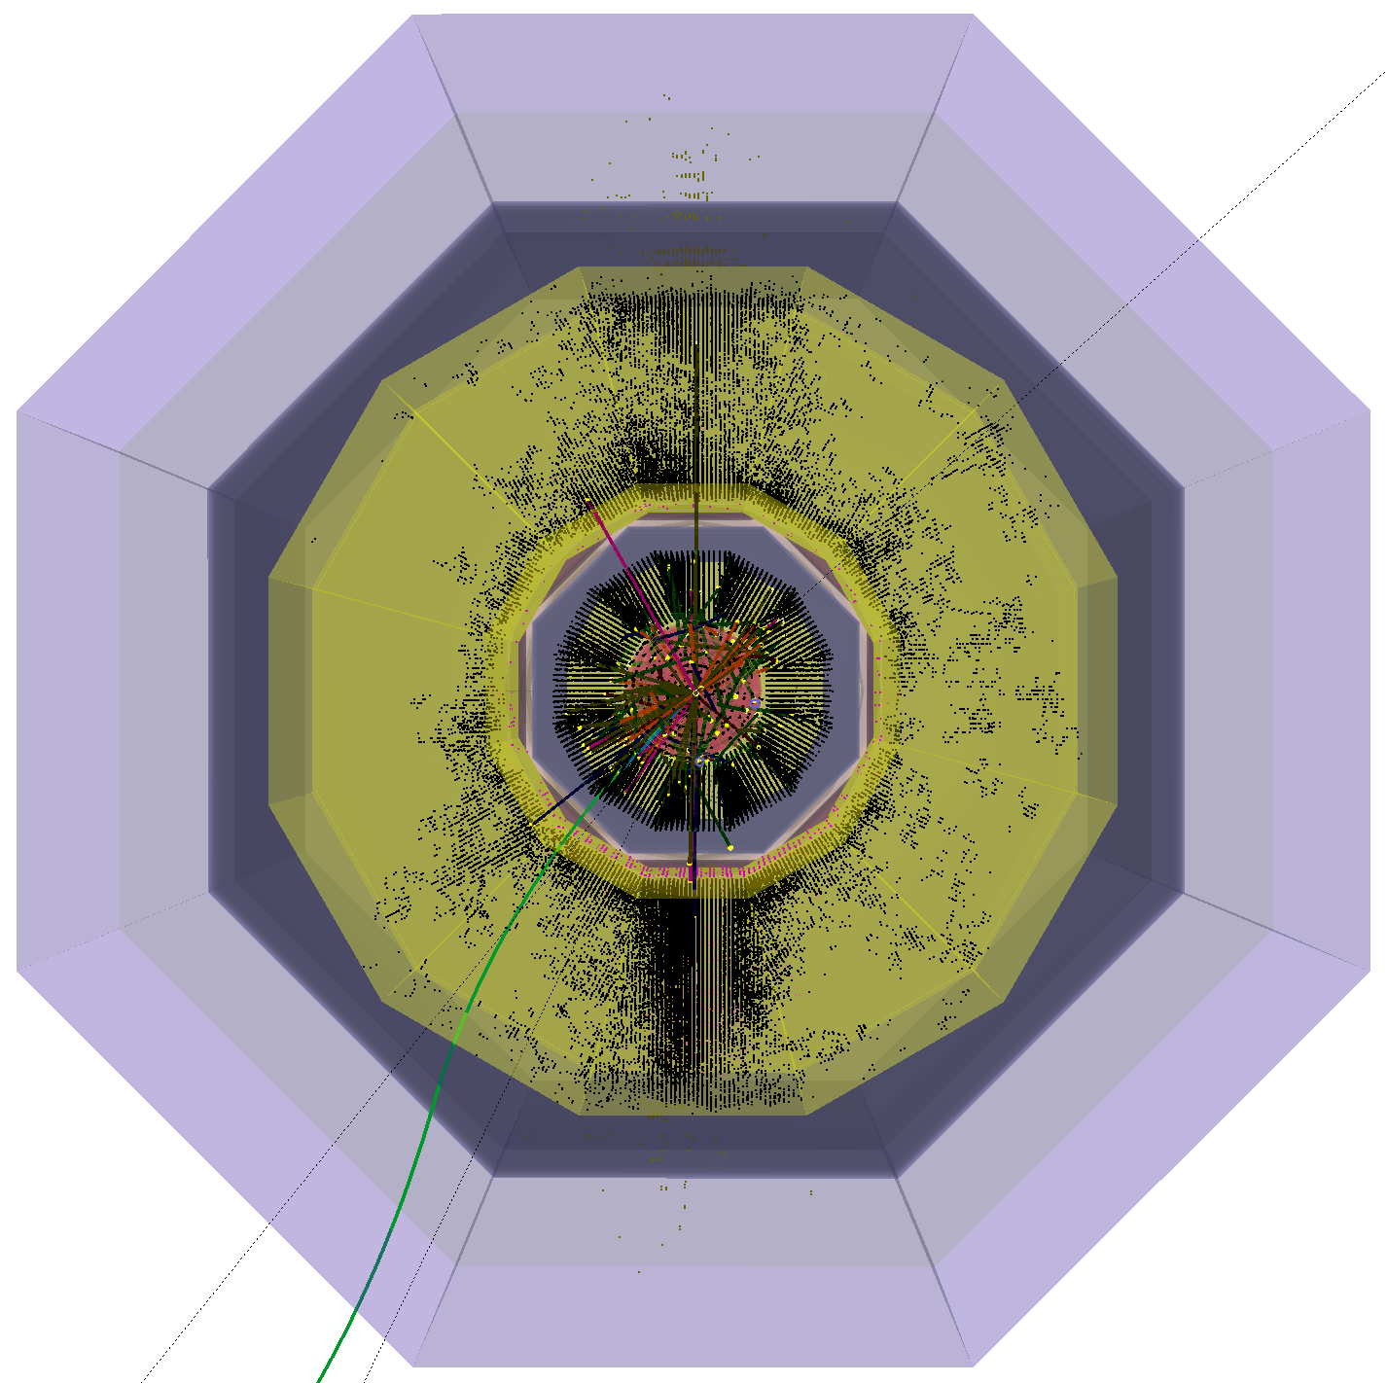
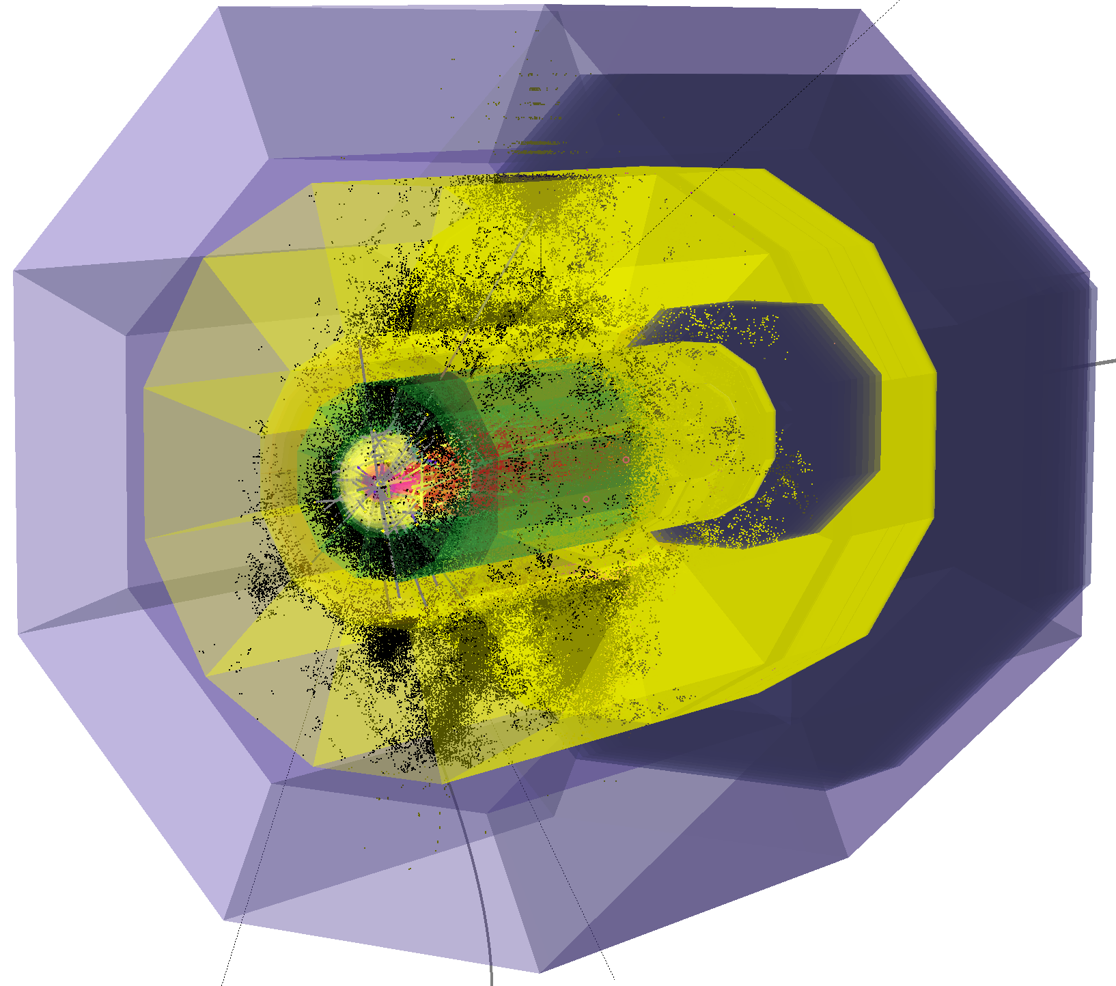
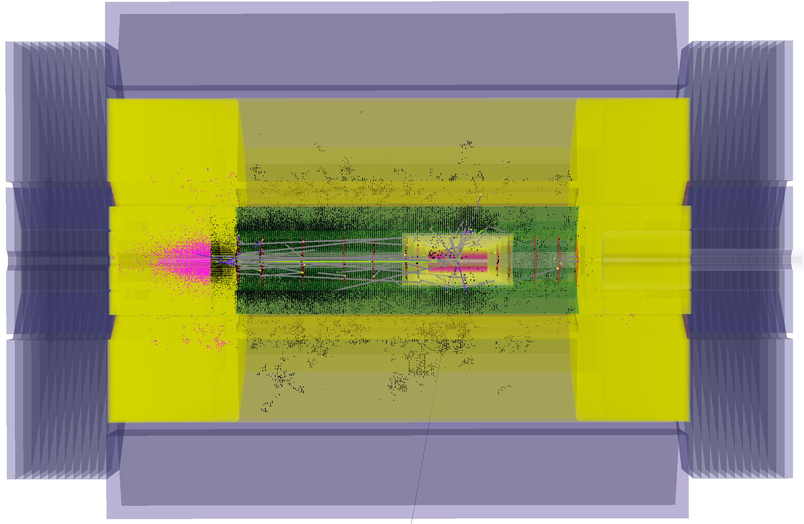
Pythia-event → LHeC-Higgs-bƀ→ DDG4 →LHeC-DDEve
^{courtesy U.Klein}
All z=0 views
into proton direction
@ z=0
@ z=0
@ z=0
e∓
p/A
y-z View, x-0

Slide 14
DD4hep/DDG4 Development
DD4hep/DDG4 - driven by ILC/CLIC based developers - pre-release software
LCIO event data model (EDM)
LCIO - connecting all modules in DD4hep/DDG4, being worked on to cope with future requirements
Generator data import into the framework - root, stdhep- and hepmc2-file formats
Python, C++ int./ext.
LHeC/FCC detector geometry (being optimised), material description, R/O description as needed, segmentations and surfaces - ingredients for reconstruction
DDEve - event display tool for quality judgment and control …
Thanks to DD4hep developers for a very fruitful collaboration!

Slide 15
^{ep/eA Detector Simulation}
Extensions needed – mainly various generators also for ep/A
besides ROOT and GEANT4 - FLUKA to be incorporated
Standard generators - e.g. PYTHIA8, HERWIG, SHERPA - currently do not describe ep and even less eA processes sufficiently
FLUKA is handling nuclear evaporation/fragmentation
For eA we need a handle on radiative corrections, bigger than in ep see Néstor Armesto: eA at the LHeC: detector requirements and simulations: http://indico.cern.ch/getFile.py/access?contribId=8&sessionId=1&resId=0&materialId=slides&confId=281921
FLUKA - drawback: licensed software
dedicated manpower needed!

Slide 16
Guidelines
Use of software tools as available
Follow the main developments & build a detector model answering physics questions (reuse of experience and implementations)
Collaboration inside the FCC-Software effort at CERN
recent documents: http://indico.cern.ch/event/337673/session/5/contribution/22
Hardware optimisation according to latest R&D (HL-LHC …)

Slide 17
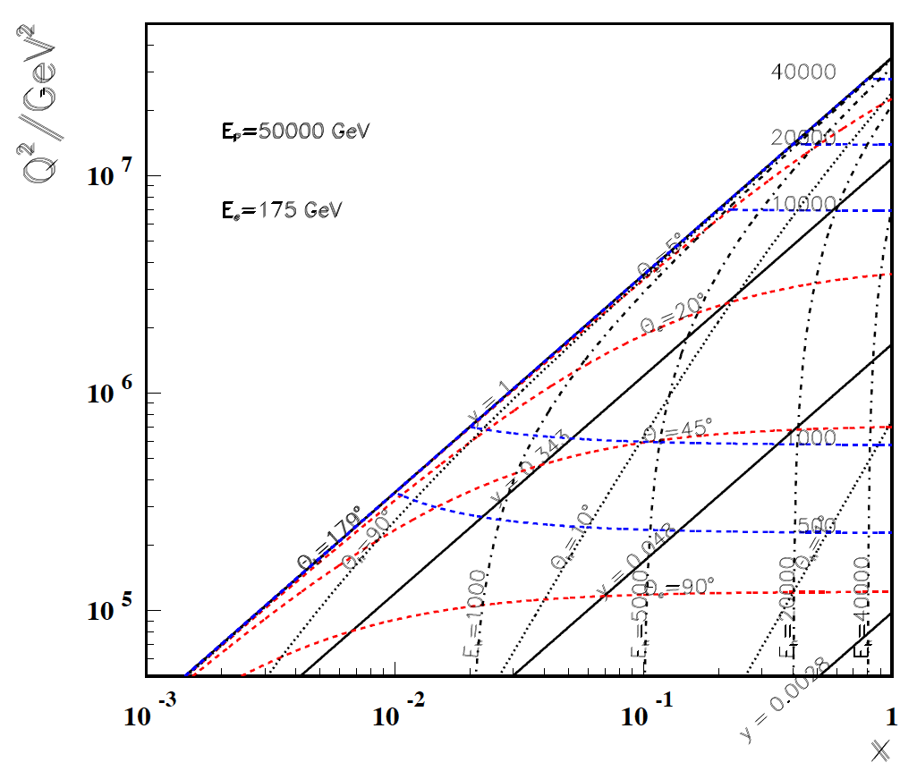
High Q²
FCC-he
LHeC
← ϑ_{h}=1º
← HERA

Slide 18
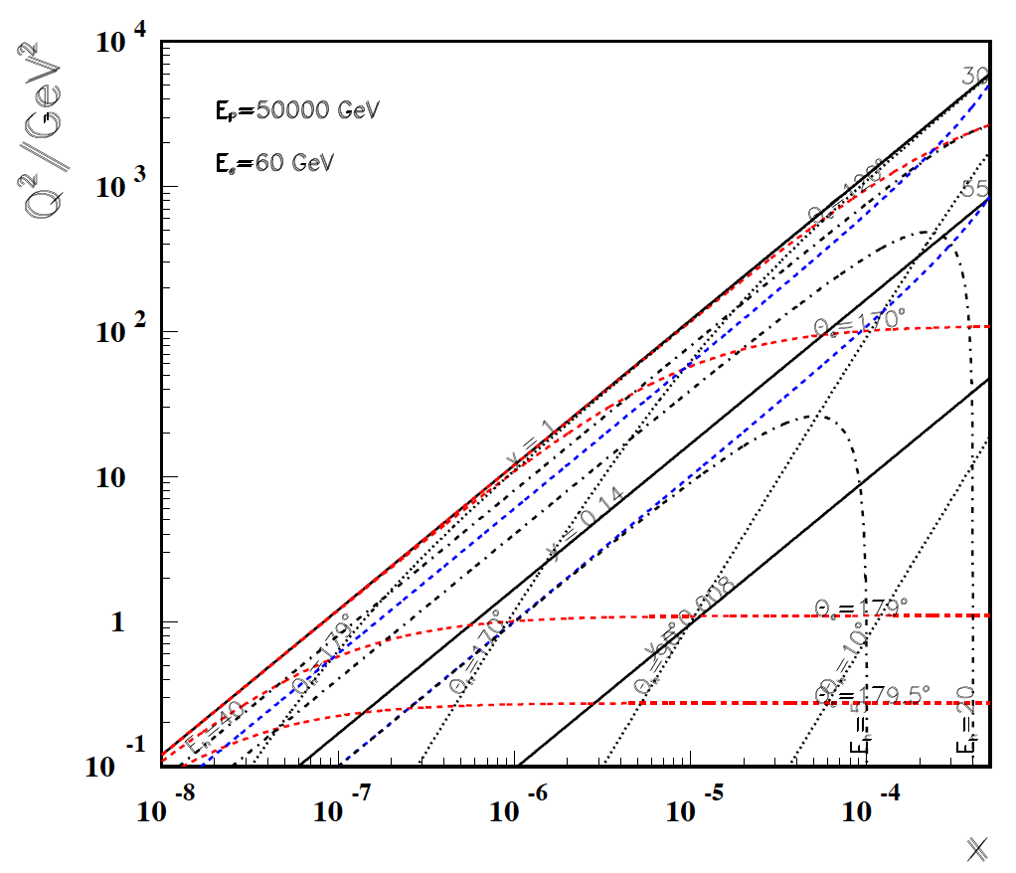
Low x
FHeC
LHeC
-----------
179º
@ 180 GeV
.. very low x
requires not
the maximum
of E_{e}
Very low x
reaches
direct
range of
UHE
neutrino
physics →
HERA
x

Slide 19
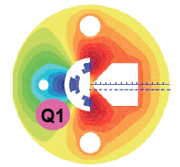
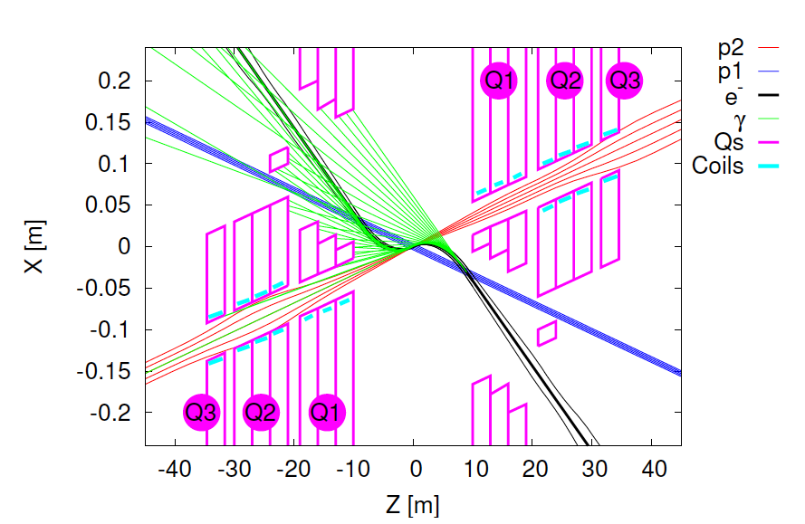
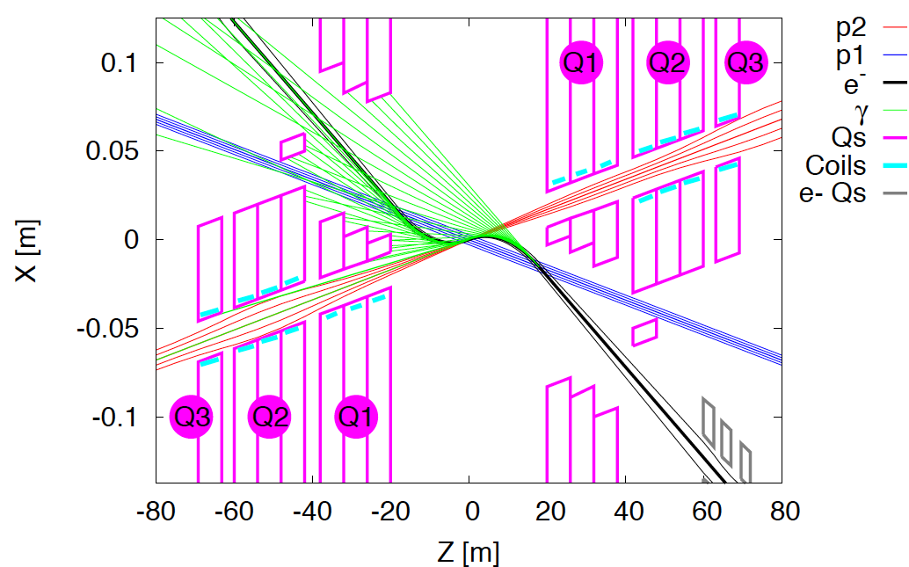
Interaction Regions for ep with Synchronous pp Operation
LHeC (CDR)
60 GeV * 7 TeV
Likely one IR.
Matching e and p beams
Limit synchrotron radiation
Design of inner magnets
Beam-beam effects ….
Non colliding p beam
Rogelio Tomas, Max Klein, ICHEP14
FCC-he (ERL)
60 GeV * 50 TeV
Tentative: ε_{p}=2μm, β*=20cm → σ_{p}=3μm ≈σ_{e} matched! ε_{e}=5μm ..

Slide 20
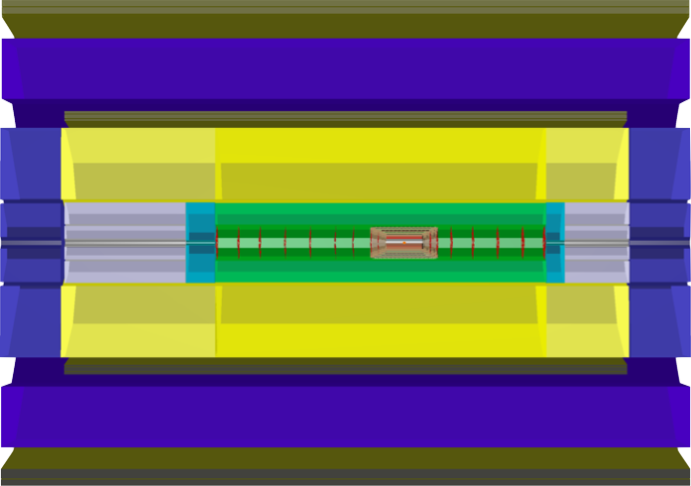
FCC-he Detector / YZ-View
All Numbers [cm]
1920
Solenoid_2
675
Muon Detector
Solenoid
1048
320
Hadronic
Fwd-Endcap
Hadronic Calorimeter
Hadronic
Bwd-Endcap
200
350
180
Forward
Tracker
60
111
e∓
Fwd-Calorimeter
Inserts
Central
Tracker
Backward
Tracker
Bwd-Calorimeter
Inserts
46
p/A
Electromagnetic Calorimeter
80
50
Based on the LHeC design; figure shows the version using a twin solenoid system; Solenoid_2 outside of Muon-Det.: independent momentum measurement - hadrons, min. interacting leptons. Single solenoid version also considered.
￼

Slide 21
FCC-he Tracker / Calorimeter Summary
Naturally that is work in progress (for a very long time..)

Slide 22
Summary
The LHeC detector has been conceptually designed. This design is being modified and updated for the Higgs measurements (fwd detection/c,b tags and high resolution hadronic calorimetry) and in view of the new technologies being applied at the LHC detector upgrades (low material, high resolution Silicon tracking and forward detection).
There is also on-going work on the IR design and the integration of the machine lattice (Hl-LHC) into the detector concept. Both are crucial items for the ep/A collider.
Strong software efforts are on-going, jointly with hh and ee FCC detectors, and profiting from ILC/CLIC developments. DD4hep/DDG4 - main detector design toolset currently. Much of the LHeC (and FCC-he) detector has been programmed and events (hits, tracks, energies) can be displayed. The toolbox of the ep/A detector is growing and relies on the most up-to-date program versions such as G4.10-01 while ROOT6 is being implemented.
A common suitable Event Data Model for hh, he, ee communities is desirable. Detailed as well as fast simulations are at hand; an interface to Delphes being prepared.
Reconstruction - implementation of existing modules (Kalman, Pandora …) – and analysis software are to be developed.
For physics simulations it has been important to stress that many of the modern (pp) and old (ep) generators need to be adapted to the LHeC (and FCC-he) needs.
Based on the LHeC, first conceptual designs of an FCC-he detector and IR have been provided. The FCC has a strong H-HH potential and access to rarer H decay channels. This suggests to improve the muon momentum measurement, for example. The FCC-he forward region is extended by a factor of ln(50/7)=2 while the backward region is much determined by the electron beam energy and basically stays as is.
The goal of the LHeC detector design is to provide a realistic detector which may be built in 10 years.
The goal of the FCC-he detector design is to provide a design concept and integrated IR for ep hence.

Slide 23
^{BACKUP}

Slide 24
Outline
Software framework DD4hep/DDG4 for design & evaluation
Peculiarities of an LHeC ep/A detector
Layout / LHeC → FCC-he
Interaction Region - Machine-detector interface
Consequences for tracking
DDEve - Event Display - illustration of simulations
DD4hep/DDG4 Development
Extensions for ep/eA Detector Simulation
Guidelines for further steps
Bright Prospectives
Summary

Slide 25
The Toolbox
A detector model mimic/simulate the response on physics, on reconstruction schemes, on analysis chains
The toolbox covers
full detector description: geometry, materials, visualisation, readout, alignment, calibration…
single source of detector information for simulation, reconstruction, analysis
support of all phases of the experiment life cycle: detector concept development, detector optimization, construction, operation

Slide 26
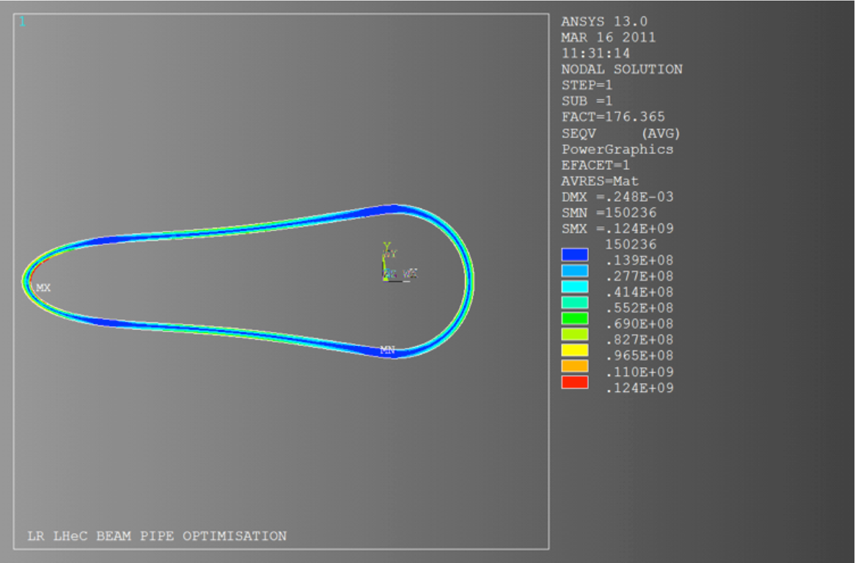
Beam Pipe Considerations
^{courtesy Paul Cruikshank, CERN}
https://indico.cern.ch/event/183282/session/12/contribution/54/material/slides/1.pdf
https://indico.cern.ch/event/278903/session/13/contribution/56/material/slides/1.pdf
Circular-Elliptical beam-pipe design
Beryllium 2.5-3.0 mm wall thickness
Central beam pipe ~ 6 meters
TiZrV NEG coated
Wall protected from primary SR (upstream masks)
Minimised end flanges, minimised supports
optimisation needed - R&D

Slide 27
Bright Prospectives
The ep configuration uniquely selects the WW-H and ZZ-H vertices for production
ep → νH(bb)X: O(1)% precision on H-bb couplings with matching theoretical uncertainty
FCC-he reaches the H→μμ decay, with O(1000) events
μ measurement essential - magnet placement
Very demanding and to be studied in detail e.g.:
ep → νHHX ep produces the Higgs from WW → double Higgs
FCC-he will be a Higgs factory and the consequences are to be studied
desire to measure also rare decays,
maximum coverage for all kinds of decays → detector design
Extrapolation from LHeC: the FCC-he detector is feasible using technologies available, detector design will benefit from coming technology progress (sensors, magnets, low power consumption, cooling, mechanical systems, electronics …)

Slide 28
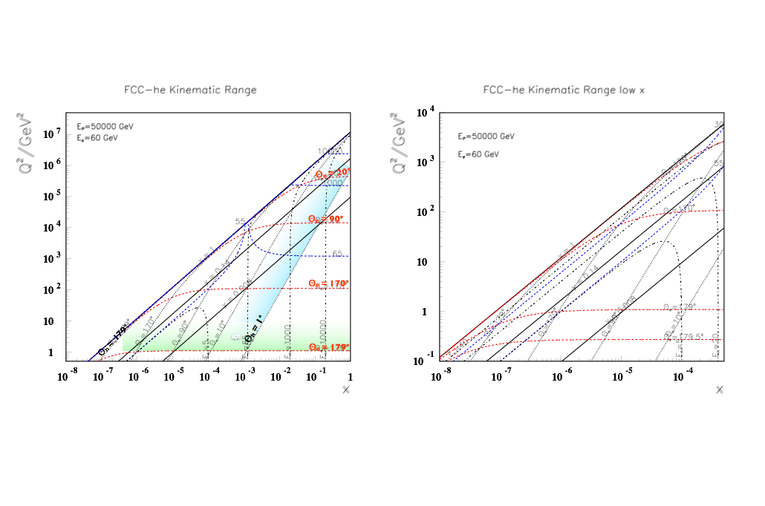
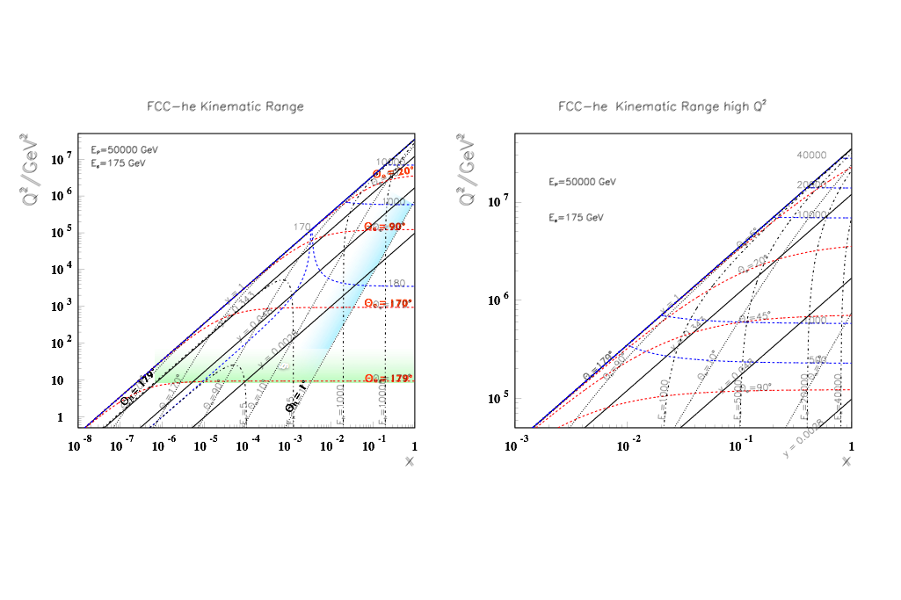
FCC-he - Machine Options
Forward calorimeter containment up to few 10thTeV down to 1⁰ →
~doubling the calorimeter depth compared to LHeC
Kinematic coverage can also be achieved by lowering Ee (goes squared to lower Q²) and lowering Ep (accesses larger x) e/A interactions - splash of particles produced - to be measured
Eh = 10000
Linac-Ring: LHeC ERL e∓ at 60 GeV on p/A at 50 TeV (i.e. Pb at 20TeV (=50 x 82/207)
Eh = 40000
Ring-Ring: max e∓ at 175 GeV on p/A at 50 TeV

Slide 29
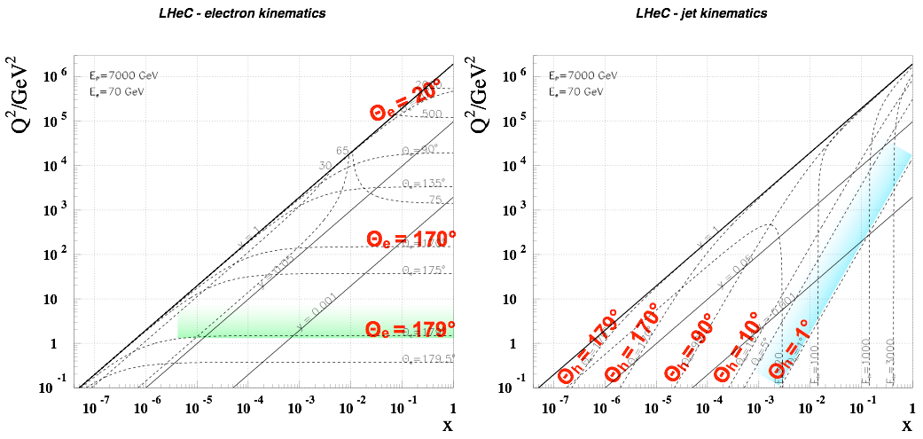
LHeC Kinematics
Eh = 3000
High x and high Q²: few TeV HFS scattered forward:
→ Need forward calorimeter of few TeV energy range down to 1⁰
Mandatory for charged currents where the outgoing electron is missing
Scattered electron: → Need very bwd angle acceptance for accessing the low Q² and high y region

Slide 30
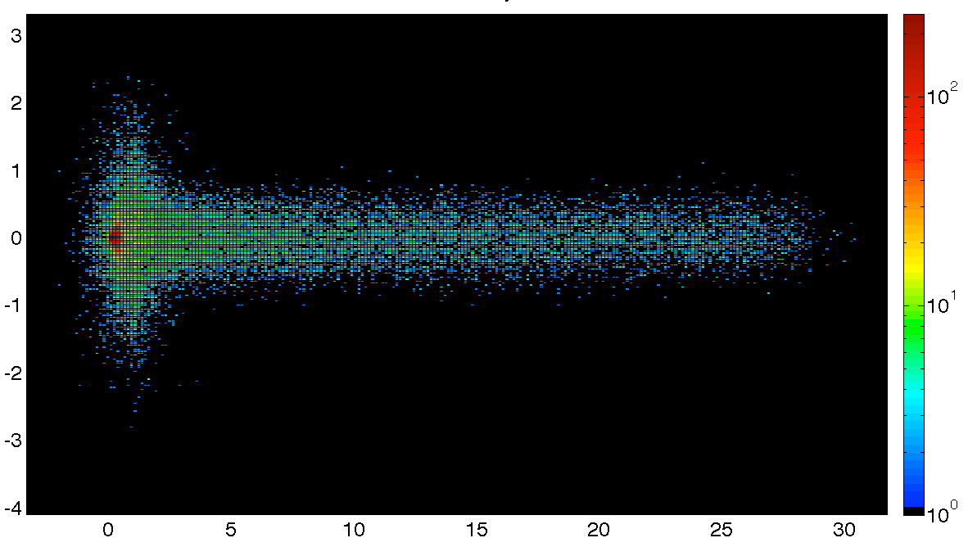
The Interaction Region
Q1
3 beam interaction region
Optics compatible with LHC running and β*=0.1m
Head-on collisions achieved via long dipole across interaction region
→ High synchrotron radiation load
→ Dipole in main detector
Q2
Photon Number Density at the IP
y [mm]
Q1
Q2
x [mm]

Slide 31
Summary
DD4hep/DDG4 - main detector design toolset currently
A common suitable Event Data Model for hh, he, ee communities desirable
Detailed / fast simulations at hand; an interface to Delphes being prepared
Reconstruction - implementation of existing modules (Kalman, Pandora …)
Forward / Backward regions being optimised
Machine-Detector unified design approach of importance for ep/A - interface to machine lattice desired

